Slide 1


Events leading up to the ejection of the corona in a microquasar
Dave Russell
Center for Astrophysics and Space Science (CASS)
New York University Abu Dhabi
dave.russell@nyu.edu
Mariano Méndez, Yuexin Zhang, M. Cristina Baglio, Tom Russell, Kevin Alabarta, Sandeep Rout, Payaswini Saikia, Divya Rawat,
Ruican Ma, Federico García, and others..
MQW XI – Microquasar Workshop, Cefalù, 18th Sept 2025

Slide 2
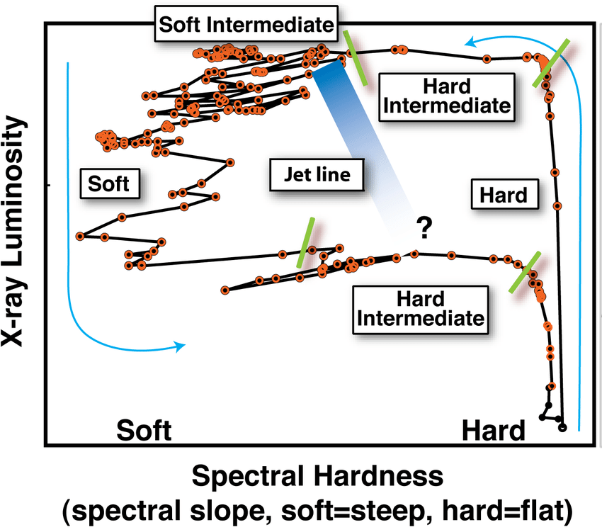
Hard to soft transition: X-rays
The classical hysteresis during a black hole XRB outburst
What is happening here?
Inner disc moves towards ISCO Evolution in corona geometry?
The jet is also evolving
What causes the discrete ejection, and the suppression of the corona and the steady jet?
Fender, Belloni & Gallo 2004
Fender, Homan & Belloni 2009
Belloni 2010

Slide 3
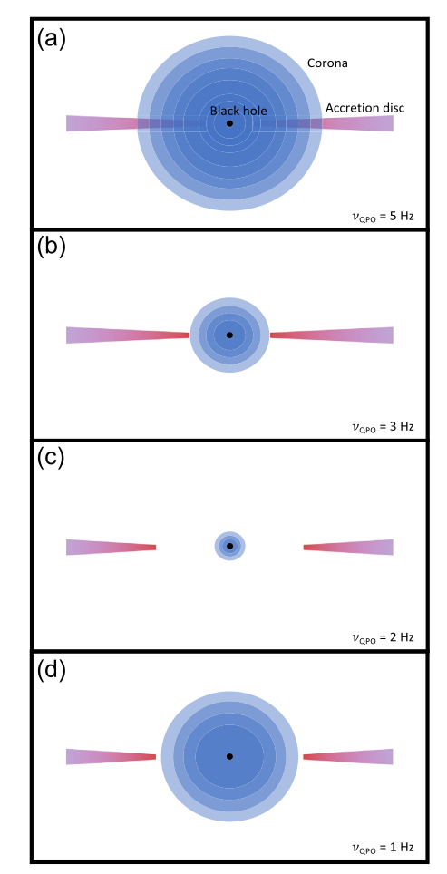
Links between the Corona and the Jet
Karpouzas et al. 2021
Some recent Comptonization models and reverberation mapping / lags have inferred:
A change in the size of the corona, or a 2-component corona (e.g. Karpouzas et al. 2021; Garcia et al. 2021; Zdziarski et al. 2021; Bellavita et al. 2022; Rout et al. 2023; Ma et al. 2023; Lucchini et al. 2023; Bollemeijer et al. 2024)

Slide 4
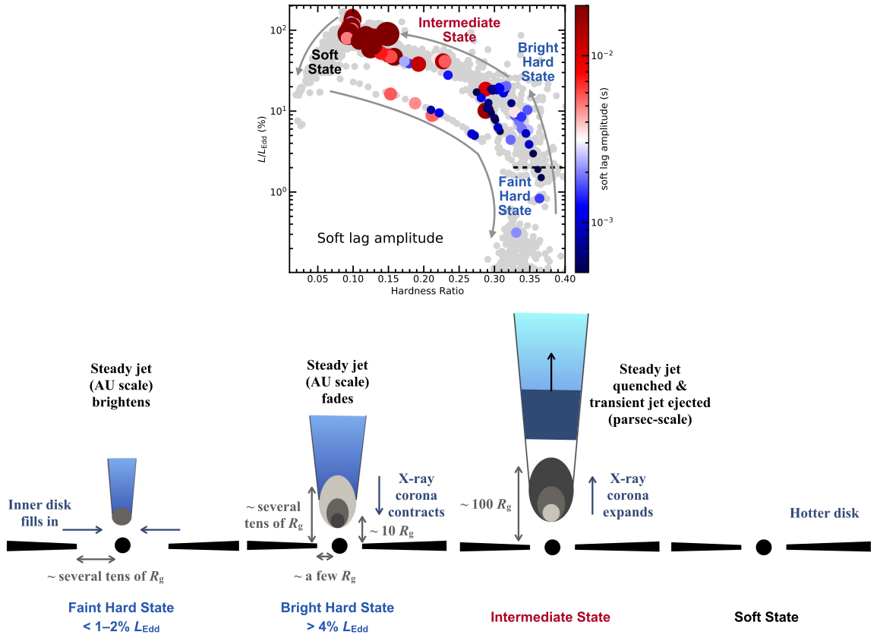
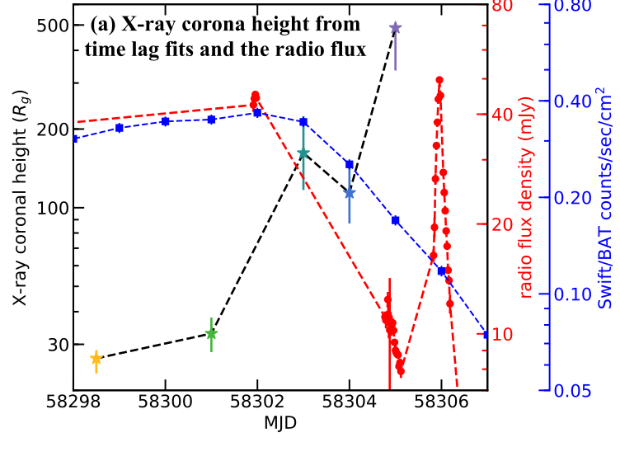
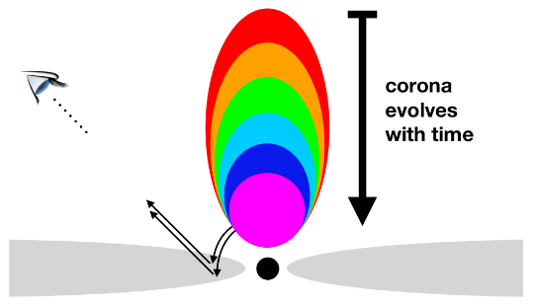
Links between the Corona and the Jet
Some recent Comptonization models and reverberation mapping / lags have inferred:
A change in vertical height of the corona (e.g. Kara et al. 2019, Wang et al. 2021, 2022; Lucchini et al. 2023)
Wang et al. 2021, 2022
Kara et al. 2019

Slide 5
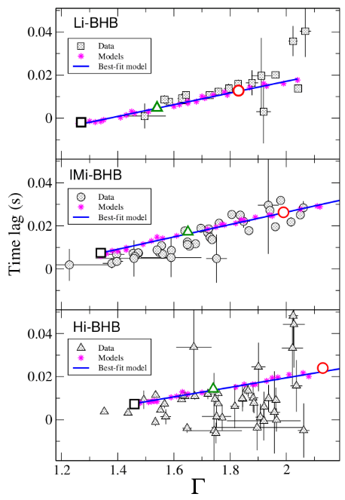
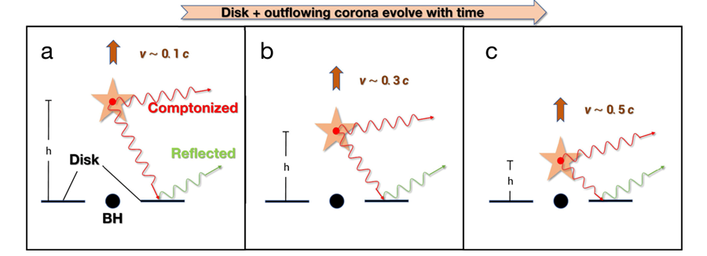
Links between the Corona and the Jet
Some recent Comptonization models and reverberation mapping / lags have inferred:
An outflowing Comptonizing region (e.g. Beloborodov 1999; Reig et al. 2003; 2018; Kylafis & Giannios 2003; Kylafis et al. 2008; 2012; Reig & Kylafis 2015; 2019; 2021; You et al. 2021)
Reig & Kylafis 2019
You et al. 2021

Slide 6
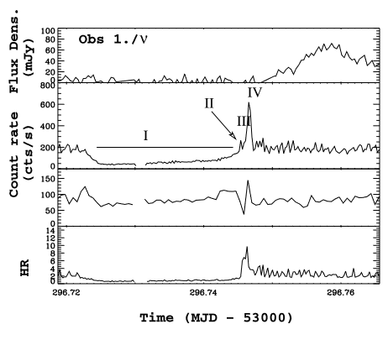
Links between the Corona and the Jet
The optically thin radio flare could signify the ejection of the corona (e.g. Fender et al. 2004, Rodriguez et al. 2008, Méndez et al. 2022)
Alternative: the inner disc is blown away, not the corona
Rodriguez et al. 2008

Slide 7
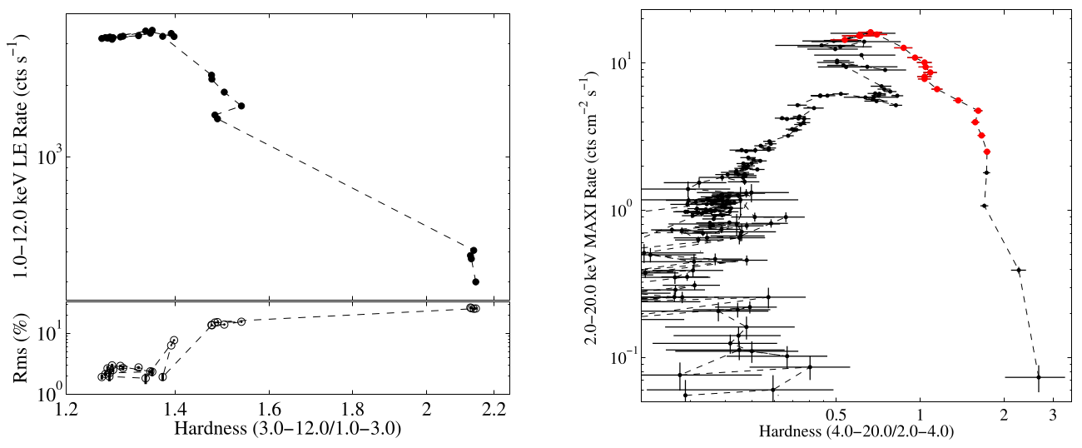
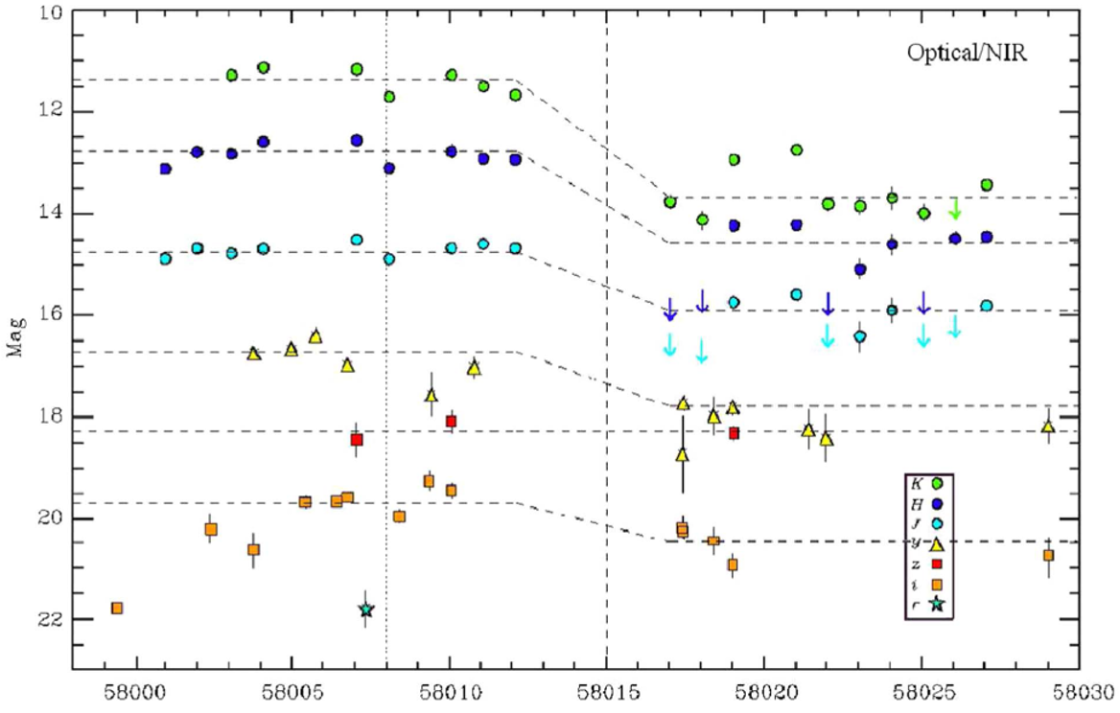
MAXI J1535−571: BH transient discovered in 2017
Huang et al. 2018
Baglio et al. 2018
Large near-IR and mid-IR flux drop over the hard to soft transition

Slide 8
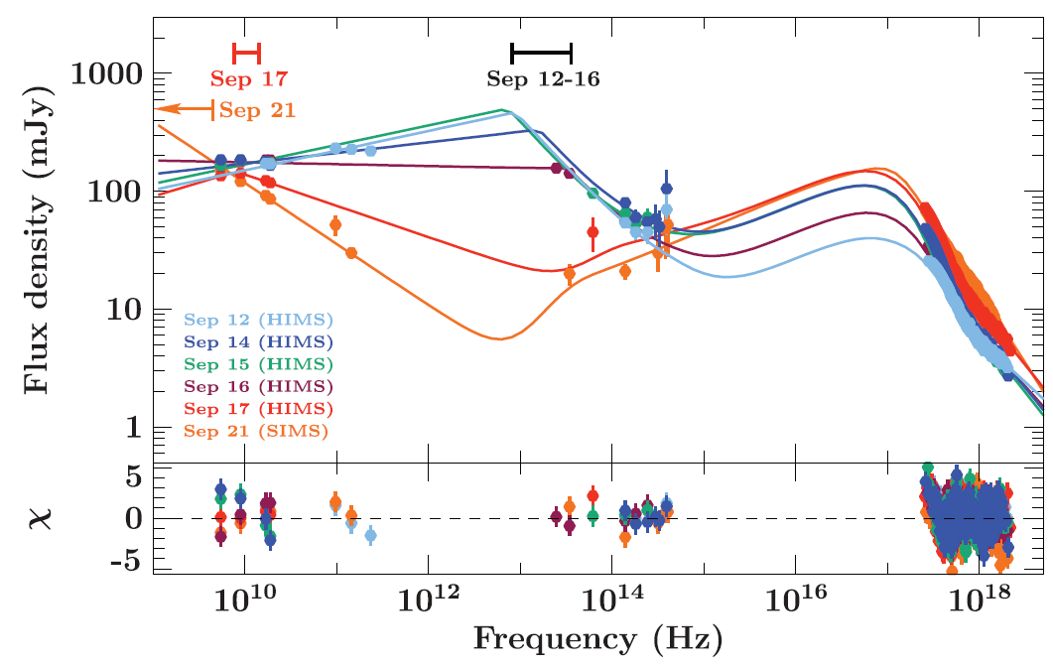
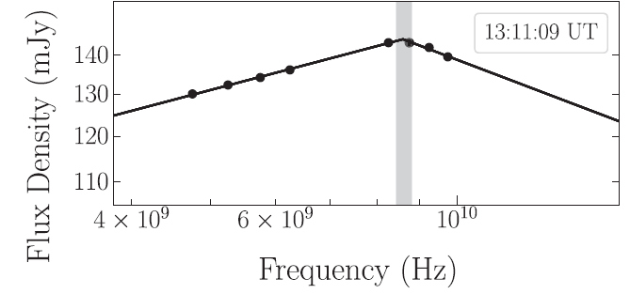
MAXI J1535−571: BH transient discovered in 2017
T. Russell et al. 2019, 2020
Broadband modelling
Jet spectrum evolves:
Jet break shifts from IR to radio
Jet luminosity decreases dramatically, before ejection

Slide 9
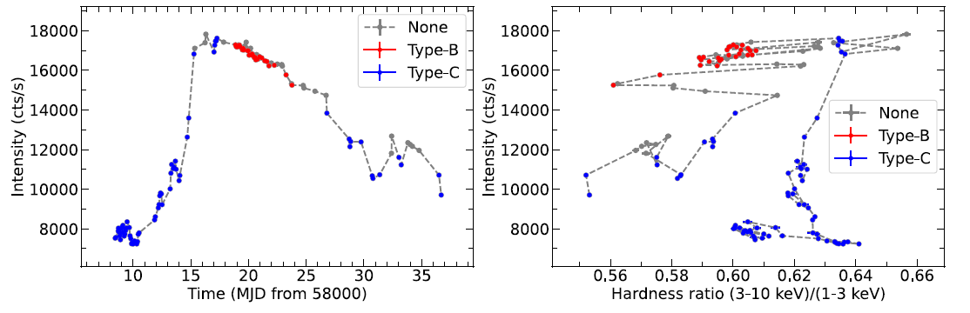
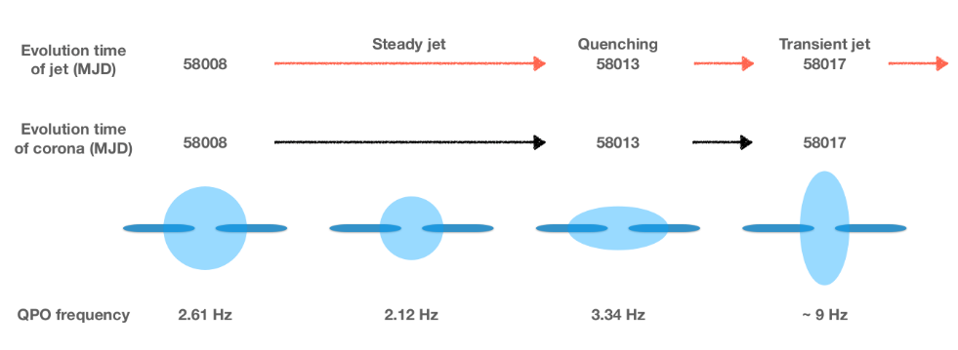
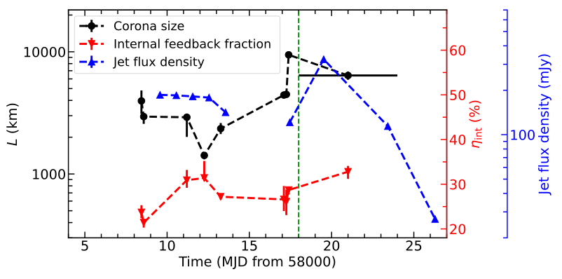
What’s happening in the corona?
Zhang et al. 2022, 2023
Time-dependent Comptonization model vKompth (Karpouzas et al. 2020, Bellavita et al. 2022) Can explain the rms and phase lags of QPOs and infers the corona geometry
See also Rawat et al. 2023, Ma et al. 2024
Intrinsic feedback fraction = the fraction of flux from the corona Comptonized photons that are illuminating the disc = the efficiency of hard photons that feedback onto the disc

Slide 10
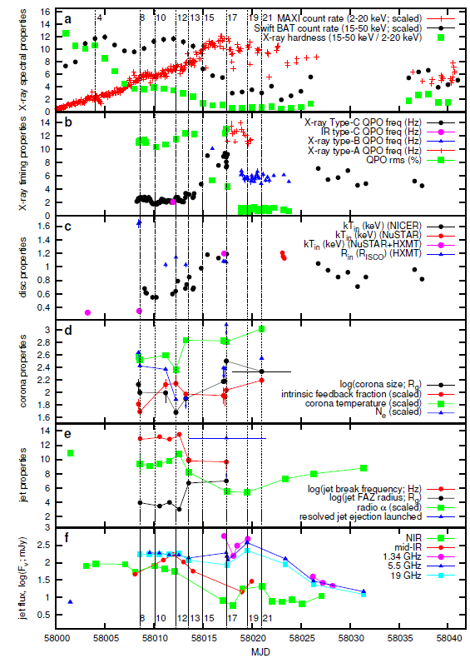
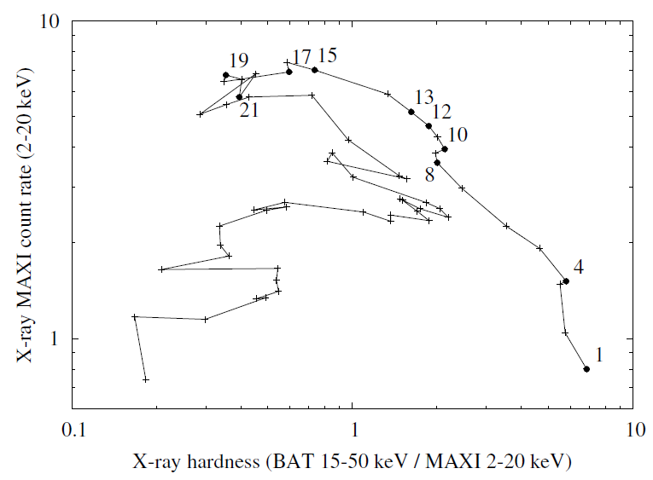
MAXI J1535 transition
We put everything together
This could be the most detailed multi-wavelength data set of the full transition

Slide 11
MAXI J1535 transition
We put everything together
This could be the most detailed multi-wavelength data set of the full transition
Data from 16 telescopes: 7 X-ray, 1 optical, 3 IR, 1 mm, 4 radio
Rawat + 2023, Vincentelli + 2021, Zhang + 2022, 2023, Bhargava + 2019, Huang + 2018, Dong + 2022, Ma + 2024, Baglio + 2018, T. Russell + 2019, 2020, Chauhan + 2019, 2021
corona size, temperature and intrinsic feedback fraction using Comptonization model vKompth
(Zhang + 2023)

Slide 12
MAXI J1535 transition
We put everything together
This could be the most detailed multi-wavelength data set of the full transition
Data from 16 telescopes: 7 X-ray, 1 optical, 3 IR, 1 mm, 4 radio
Jet data and spectral break constraints from T. Russell et al. 2020, 2021
Jet break frequency
Radio spectral index
Jet R_{FAZ}*
* The first acceleration zone in the jet

Slide 13
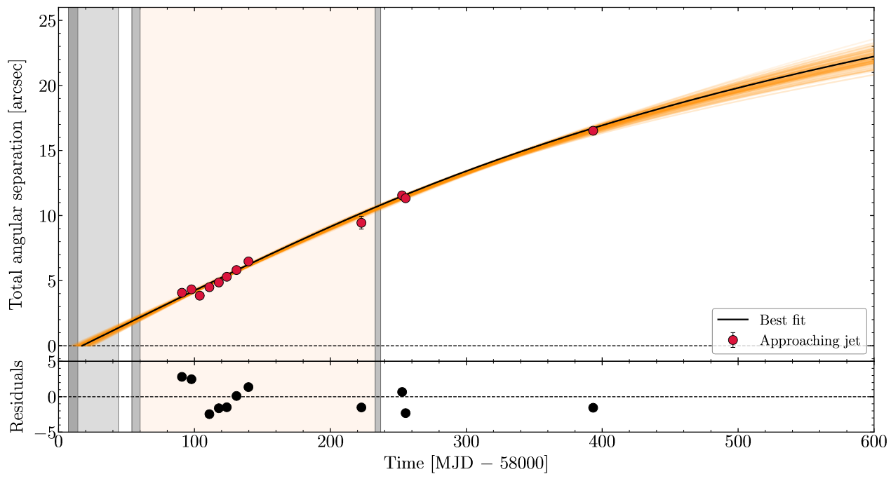
MAXI J1535 transition
We put everything together
This could be the most detailed multi-wavelength data set of the full transition
Data from 16 telescopes: 7 X-ray, 1 optical, 3 IR, 1 mm, 4 radio
Time of jet ejection (Carotenuto et al. 2024, Cooper et al. 2025)

Slide 14
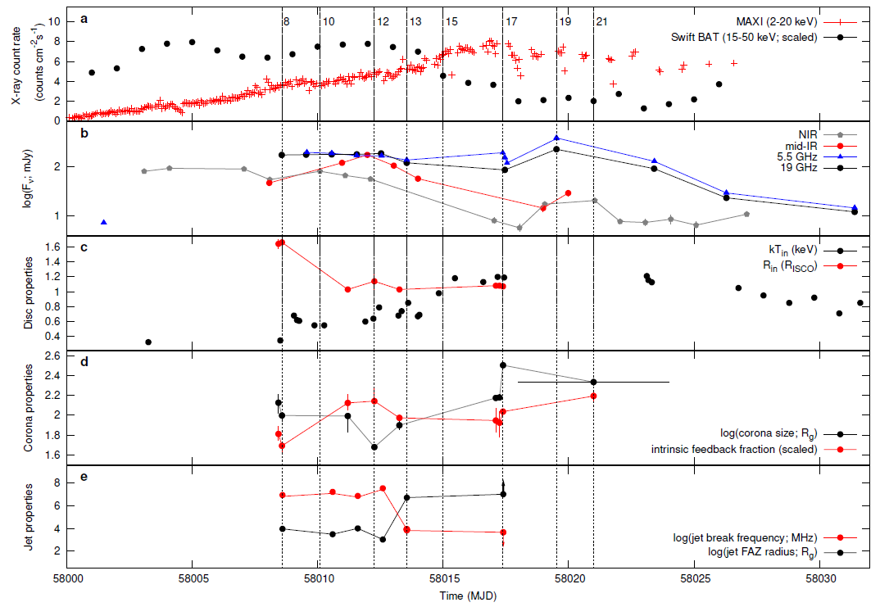
First 10 days:
Hard state rise then softening, hard to HIMS transition
Compact jet brightens then becomes steady
Day 9 to 12:
Inner disc decreases towards ISCO
Compact jet quenching starts (NIR fade starts)
Corona shrinks, feedback fraction increases
→ Corona is horizontally extended (Zhang et al. 2023)

Slide 15
Day 12-14:
Core jet quenching (mid-IR fade starts, then radio)
jet power reducing, FAZ moves out (jet break shifts from IR to radio)
Corona starts growing, feedback fraction decreases
Day 15:
Timing transition: type-C QPO jumps from 2-3 to 7-9 Hz
Corona growing, low compact jet power

Slide 16
Day 17:
Peak in soft X-ray flux
Maximum corona size, feedback fraction low
→ Corona is vertically extended (Zhang et al. 2023)
Compact jet quenched, first optically thin radio flare
Day 19-20:
Brightest radio flare, corona shrinks, feedback fraction increases → Corona becomes horizontally extended
QPO then settles at ~6 Hz (type-B), radio fades

Slide 17
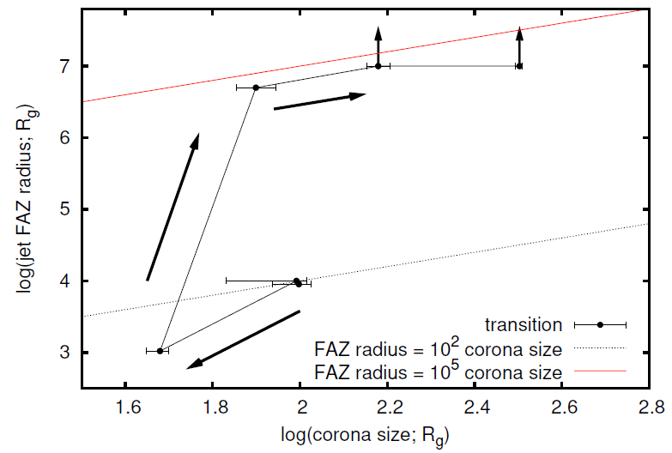
Corona and jet base evolution
The radius of the jet FAZ (~jet base) correlates monotonically with the vertical size of the corona, and not with the disc properties
The corona and the jet base first contract, then grow to their largest size together, which can be explained if corona particles feed the steady jet
The corona is largest just as the discrete, relativistic ejection is launched
Jet FAZ moves so far out it is probably disconnected

Slide 18
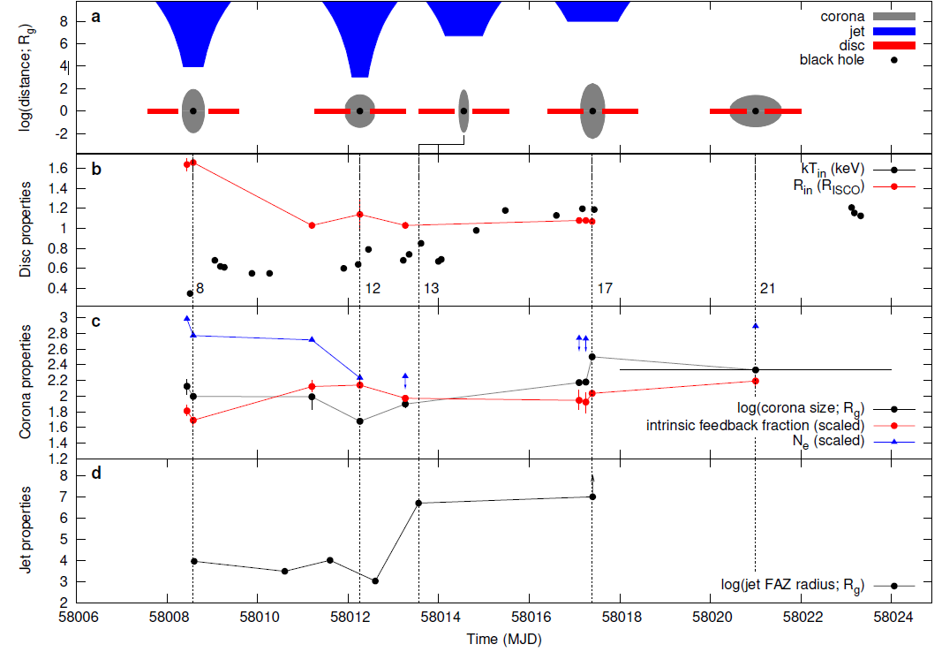
Interpretation
The inner disc first approaches the black hole - this quenches the corona (shrinking)
The initially contracting corona feeds less particles (N_{e} decreases) into the steady jet, which naturally explains the reduced jet power
This results in the inflowing particles remaining in the corona (ṁ_{disc} is high), causing it to gradually grow in size, then escape as the relativistic ejection
Probably the best observational evidence yet that the jet ejection is the corona itself being ejected at relativistic speeds

Slide 19


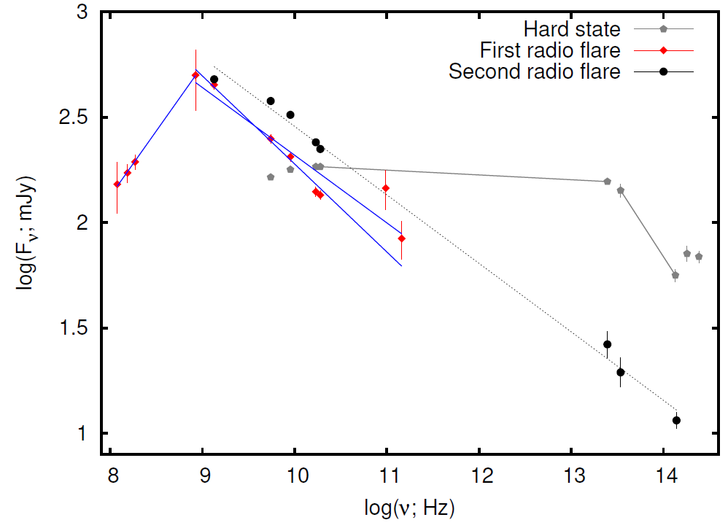
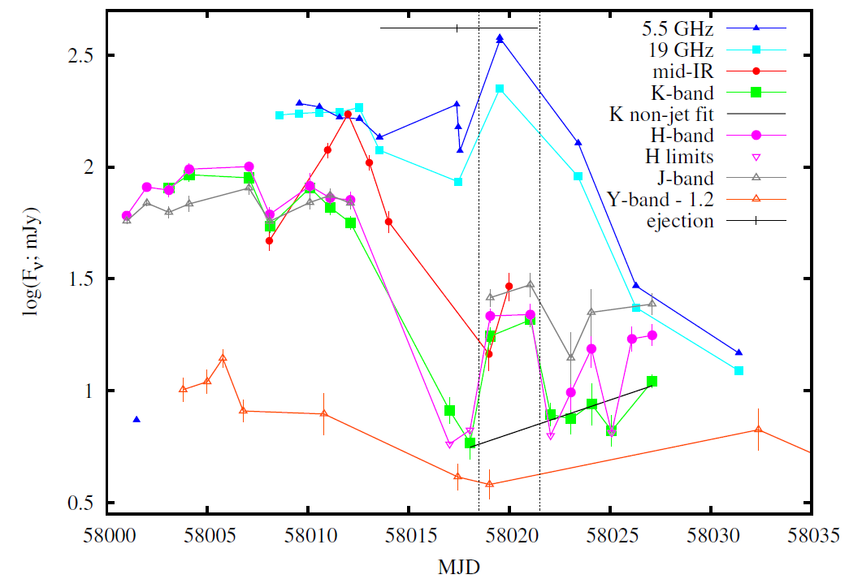
Broadband jet flare spectra
There were 2 optically thin jet flares
First: turnover between 250 and 500 MHz due to synchrotron self-absorption (Chauhan et al. 2021). Shallow optically thin slope:
Second: Coincident with IR flare. Also shallow optically thin slope:
Electron energy distribution: p ~ 1.7
Data from MWA, UTMOST, ASCAP, ATCA, ALMA, VLT-VISIR, REM, LCO
Best sampled broadband spectrum of an optically thin radio flare, including self-absorption break, and likely the first IR detections

Slide 20
Summary
MAXI J1535-571 has very densely sampled multi-wavelength observations over the state transition
The inner disc first approaches the ISCO, choking the corona and the jet
The corona grows vertically because the steady jet loses power, implying particles entering the corona from the disc are no longer launched into the jet
The compact jet disappears, then the discrete jet is launched (best sampled broadband spectrum, MHz to IR)
The jet ejection commonly seen over state transitions is the corona itself being ejected at relativistic speeds (as suggested previously by e.g. Rodriguez et al. 2008)
This explanation of the cause of the state transition, ejection of the corona, and the quenching of the steady jet, has implications for
accretion physics in both X-ray binaries and AGN, and could explain how quasars reach their bright, disc dominated state
Corona size vs jet FAZ radius

