Slide 1
Web-based approach to Data Management
My first 25 years of data handling via RDBMS and web-oriented systems
Luciano Nicastro, INAF – OAS Bologna

Slide 2
Why web-based tools?
Kwds: Collaborative data-driven science – Bringing analysis to data – Accessibility – Science for all
A browser can be seen as a VM
No (user) code maintenance required
Client-server architecture (e.g. Node.JS)
Advanced graphics (e.g. WebGL)
Can handle large data sets residing on the server / cloud
Co-existence of relational and No-SQL DBs (e.g. MongoDB)
Code implemented in various languages (not just Python)
User friendly ⟹ not just for professional astronomers
Real-time or batch processing
Archives and Data management Systems. LN @ INAF – OAS Bologna

Slide 3
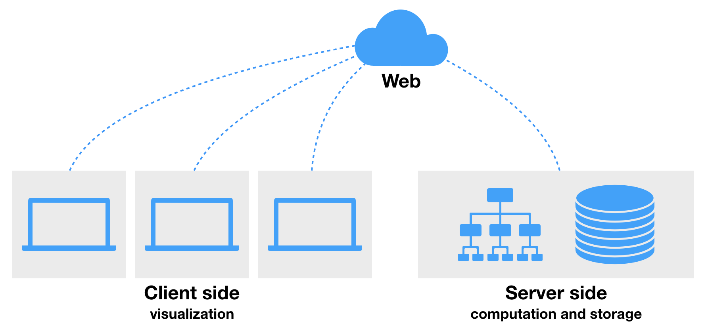
CARTA as a reference case
Cube Analysis and Rendering Tool for Astronomy
https://carta.readthedocs.io/en/4.1/
Image visualization and analysis tool designed for ALMA, VLA, MeerKAT and ASKAP as well as SKA
CARTA uses a client-server architecture suitable for visualizing images with large file sizes (GB to TB)
CARTA is mainly built in C++, TypeScript, and JavaScript and various third-party libraries
NodeJS – µWebSocket
Note:
CARTA is fundamentally a web application
with three main components:
carta_backend
carta_frontend
carta-controller
JavaScript – WebGL
c++ – MongoDB
The source code of CARTA is available on GitHub.
Archives and Data management Systems. LN @ INAF – OAS Bologna

Slide 4
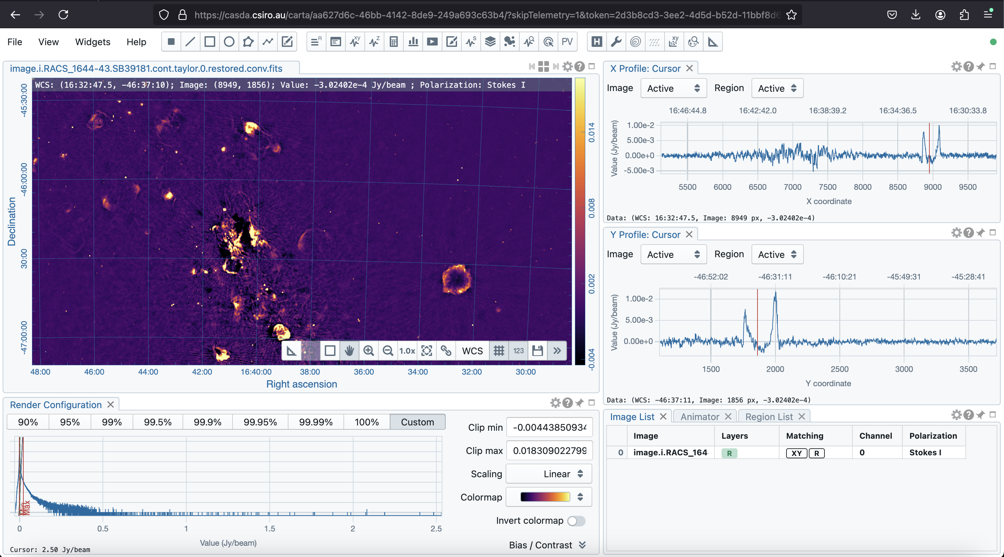
CARTA web
https://casda.csiro.au/carta/...your_image_code...
Archives and Data management Systems. LN @ INAF – OAS Bologna

Slide 5
Web-based data management tools
Project / Observatory specific tools (e.g.)
CASDA: data.csiro.au/domain/casda (CARTA viewer)
XMM-Newton: nxsa.esac.esa.int/nxsa-web/#search
SciServer: www.sciserver.org
SDSS: skyserver.sdss.org/dr18
Multi-mission / generic tools (e.g.)
ESASky: sky.esa.int/esasky
ESO science portal: archive.eso.org/scienceportal
MAST: archive.stsci.edu
CADC: www.cadc-ccda.hia-iha.nrc-cnrc.gc.ca/en
SIMBAD/VizieR: simbad.cds.unistra.fr − vizier.cds.unistra.fr
Archives and Data management Systems. LN @ INAF – OAS Bologna

Slide 6
REMIR/ROS2 images handling flow
Bologna
ROS2 PC
$ Camera_ROSS Img.fits
La Silla
MCS Mainsrv/DB
Insert/update transfer log
Receive Img.fits.bz2 – bunzip2
Define ownership via PI kwd
Log Images to DB (pub. + priv.)
Astrometry.net
Log astrometry footprint
Produce image preview
Copy Img.fits.gz etc. to repo folder based on DATE-OBS
MCS Producer/DB PC
Read Img.fits header
Log subset kwds to DB
Compress – bzip2
Notify Mainsrv (BO)
Receive OK
Send to BO (status flag)
REMIR PC
$ Camera_REMIR Img.fits
0
1
2
5
8
$ myimgslog [options] Img.fits
t (s)
Camera
Producer
…transfer…
Mainsrv
Defaults from conf. file
Archives and Data management Systems. LN @ INAF – OAS Bologna

Slide 7
REMIR/ROS2 images handling Main ingredients
rem.oas.inaf.it/DB
Custom
MCS: github.com/gcalderone/MCS
DIF / SID: github.com/lnicastro/DIF − github.com/lnicastro/SID
MyRO: github.com/lnicastro/MyRO
Catalogues: catsweb.oas.inaf.it
Public
DB server ⇒ MySQL ( MariaDB )
Web server ⇒ Apache
Languages ⇒ C++, PHP, HTML5, CSS3, JavaScript
+ G. Calderone - OATS
Main JS packages: JQuery, Aladin Lite, JS9, amCharts
DB course: astrordbms.oas.inaf.it
Archives and Data management Systems. LN @ INAF – OAS Bologna

Slide 8
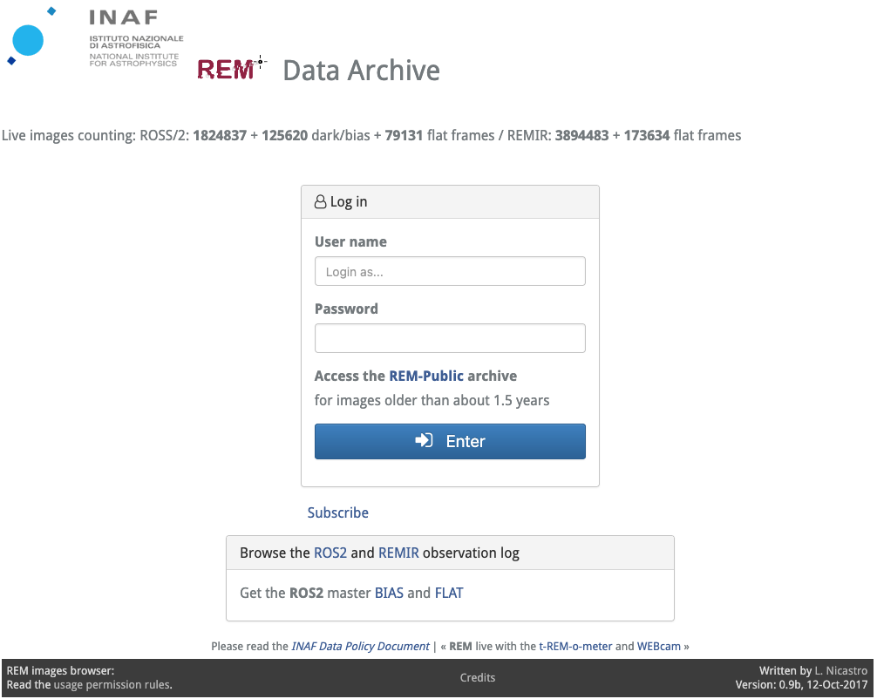
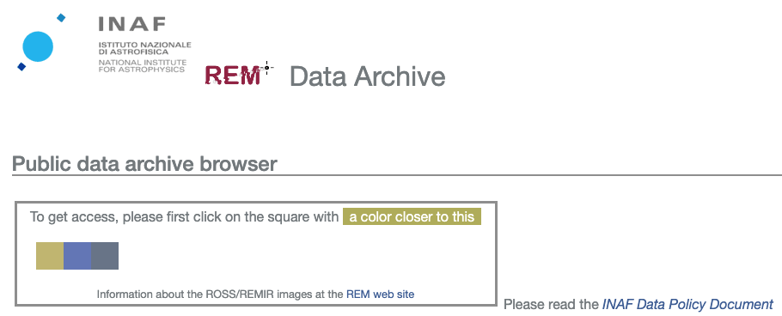
Images browsing
rem.oas.inaf.it/DB
Archives and Data management Systems. LN @ INAF – OAS Bologna

Slide 9
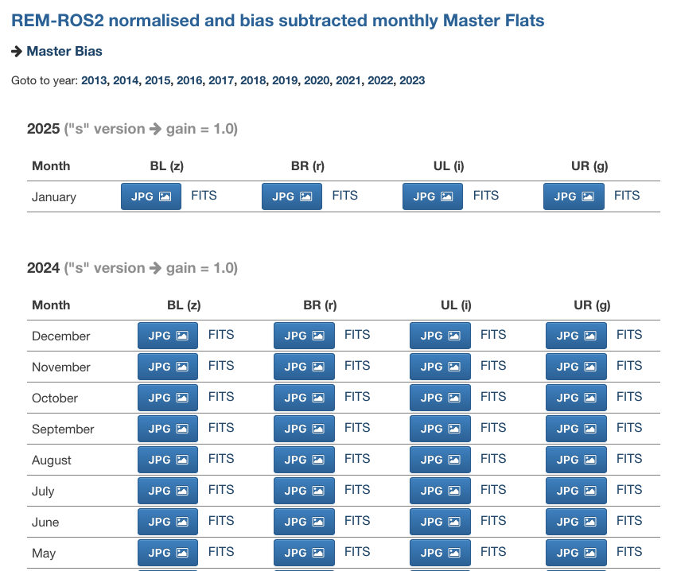
Images browsing
rem.oas.inaf.it/DB
Archives and Data management Systems. LN @ INAF – OAS Bologna

Slide 10
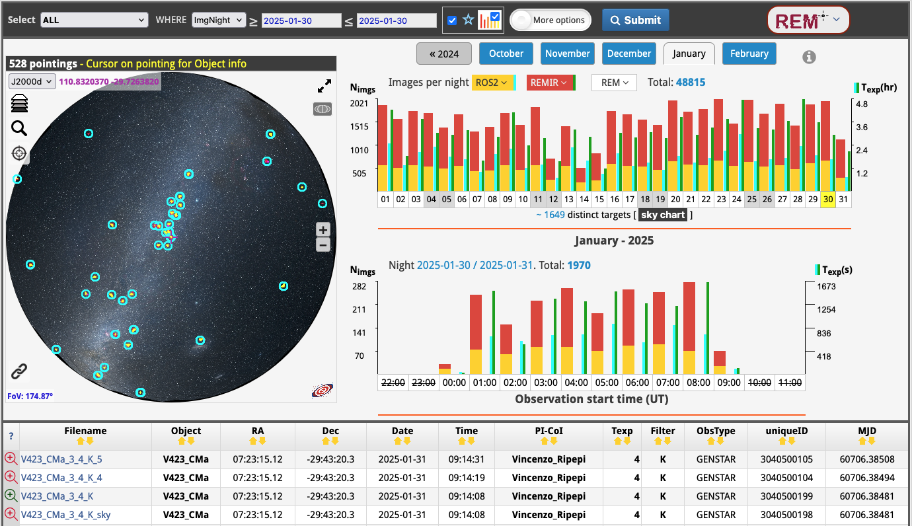
Images browsing – month/day + Aladin Lite
Archives and Data management Systems. LN @ INAF – OAS Bologna

Slide 11
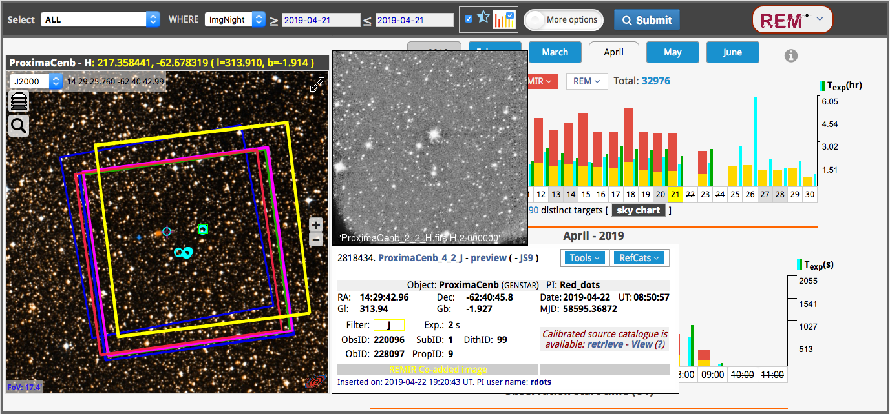
Images browsing – preview and details
Archives and Data management Systems. LN @ INAF – OAS Bologna

Slide 12
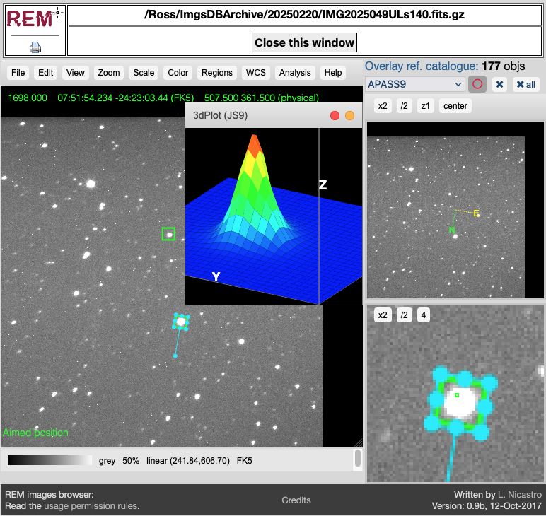
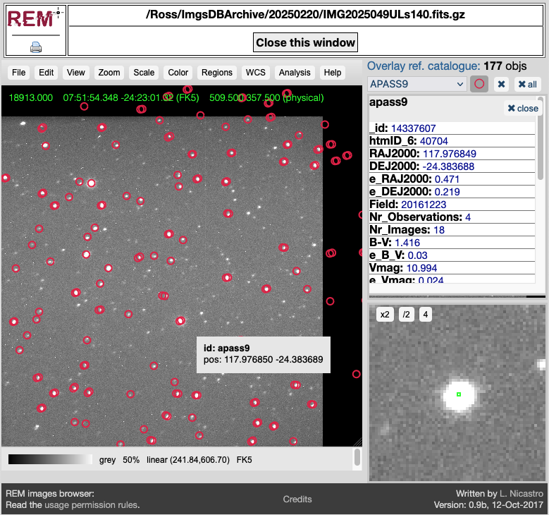
Images browsing – JS9 + TOCats
Archives and Data management Systems. LN @ INAF – OAS Bologna

Slide 13
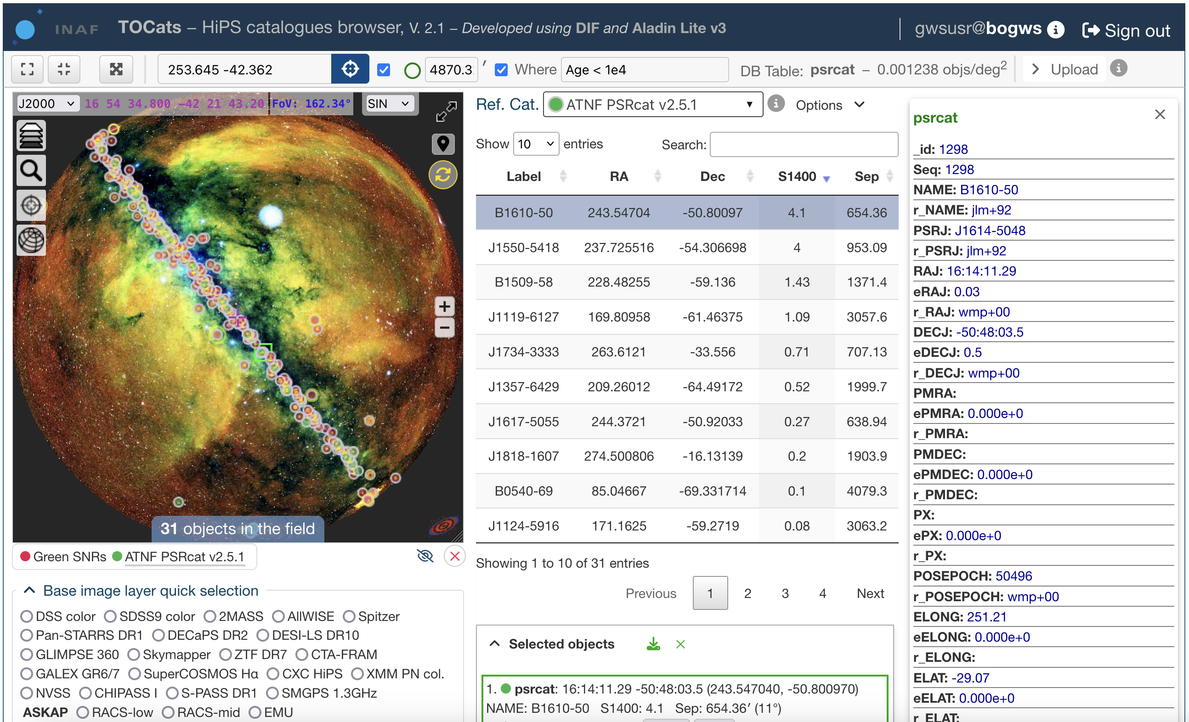
TOCats & TOCatsweb
A tool for fast access to astronomical surveys and object catalogues by using hierarchical scheme techniques to split the celestial sphere, in particular the HEALPix scheme.
catsweb.oas.inaf.it
TOCats three main components
A relational DBMS, with hierarchically structured tables containing various types of catalogues and associated metadata
A web service that makes images and catalogues easily queryable and accessible from a browser or a script
A repository of Hierarchical Progressive Surveys (HiPS) with images and object density maps
Archives and Data management Systems. LN @ INAF – OAS Bologna

Slide 14
TOCats & TOCatsweb – main components
Built on
MySQL: dev.mysql.com
DIF: github.com/lnicastro/DIF
Aladin Lite: aladin.cds.unistra.fr/AladinLite/doc
Hipsgen: aladin.cds.unistra.fr/hips
DataTables: datatables.net
amCharts: www.amcharts.com
… and
Web server ⇒ Apache
Languages ⇒ C++, PHP, HTML5, CSS3, JavaScript, Python
+ JS packages ⇒ JQuery, JS9, custom code
∼ 110 public catalogues (Opt/IR/NIR/Radio/UV/X-𝛾)
∼ 100 private catalogues
∼ 20 TB (raid 1)
10 projects
Archives and Data management Systems. LN @ INAF – OAS Bologna

Slide 15
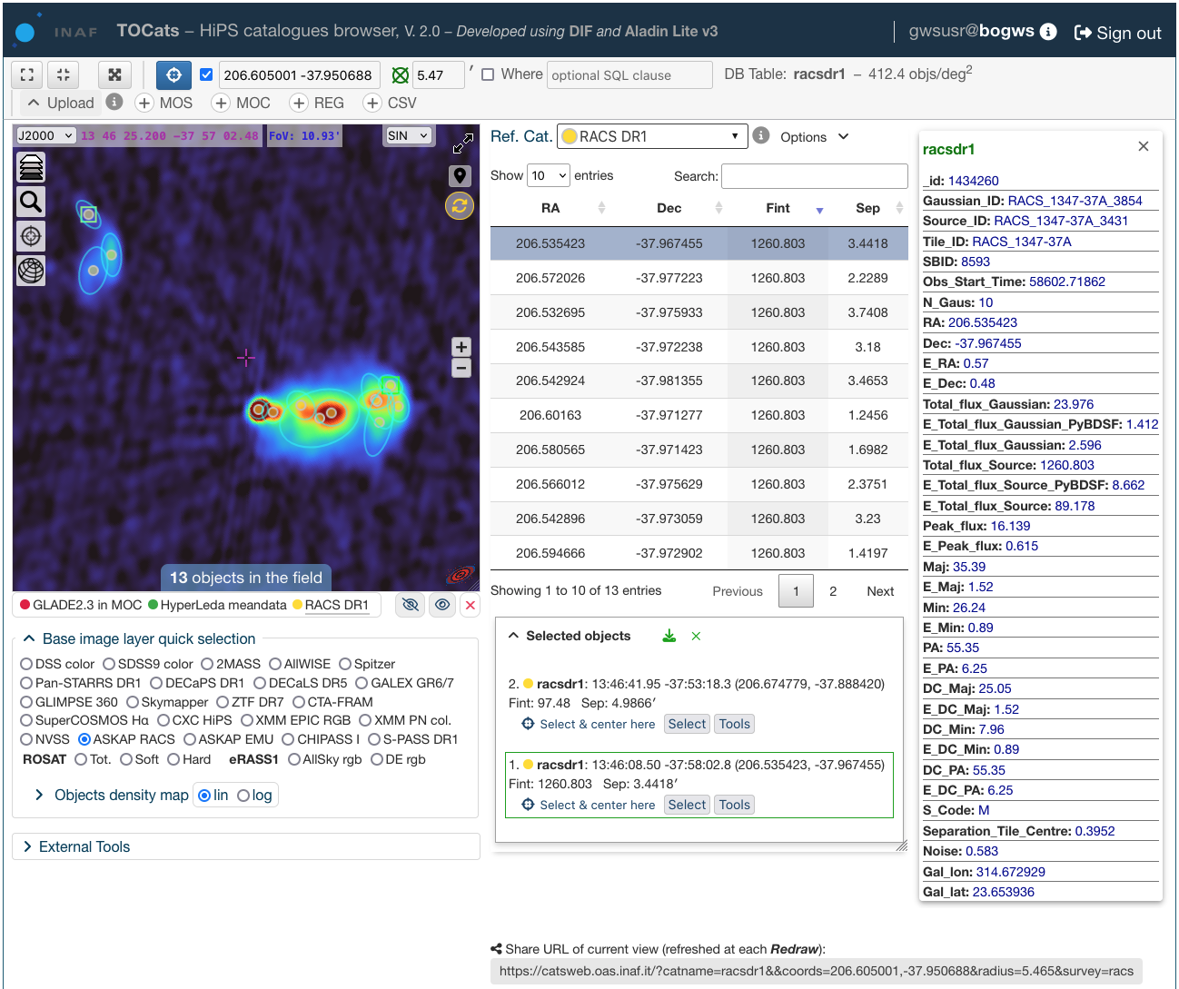
TOCats & TOCatsweb – capabilities
Combine DIF managed catalogues with HiPS public and private surveys and
Handle extended sources / footprint
Retrieve the catalogue’s data in multiple formats from the interface or a script (API)
Accessible from VO tools (e.g. TOPCAT)
One click external tools access
Add your project and implement your plug-in tools to handle any type of data
Take advantage of all the Aladin Lite v.3 capabilities:
Multi-surveys view (jpg, png, fits)
FITS files (etc.) drop-in
HIPS2FITS tool
Etc.
Note:
Aladin Lite is being upgraded continuously
Click & share
Archives and Data management Systems. LN @ INAF – OAS Bologna

Slide 16
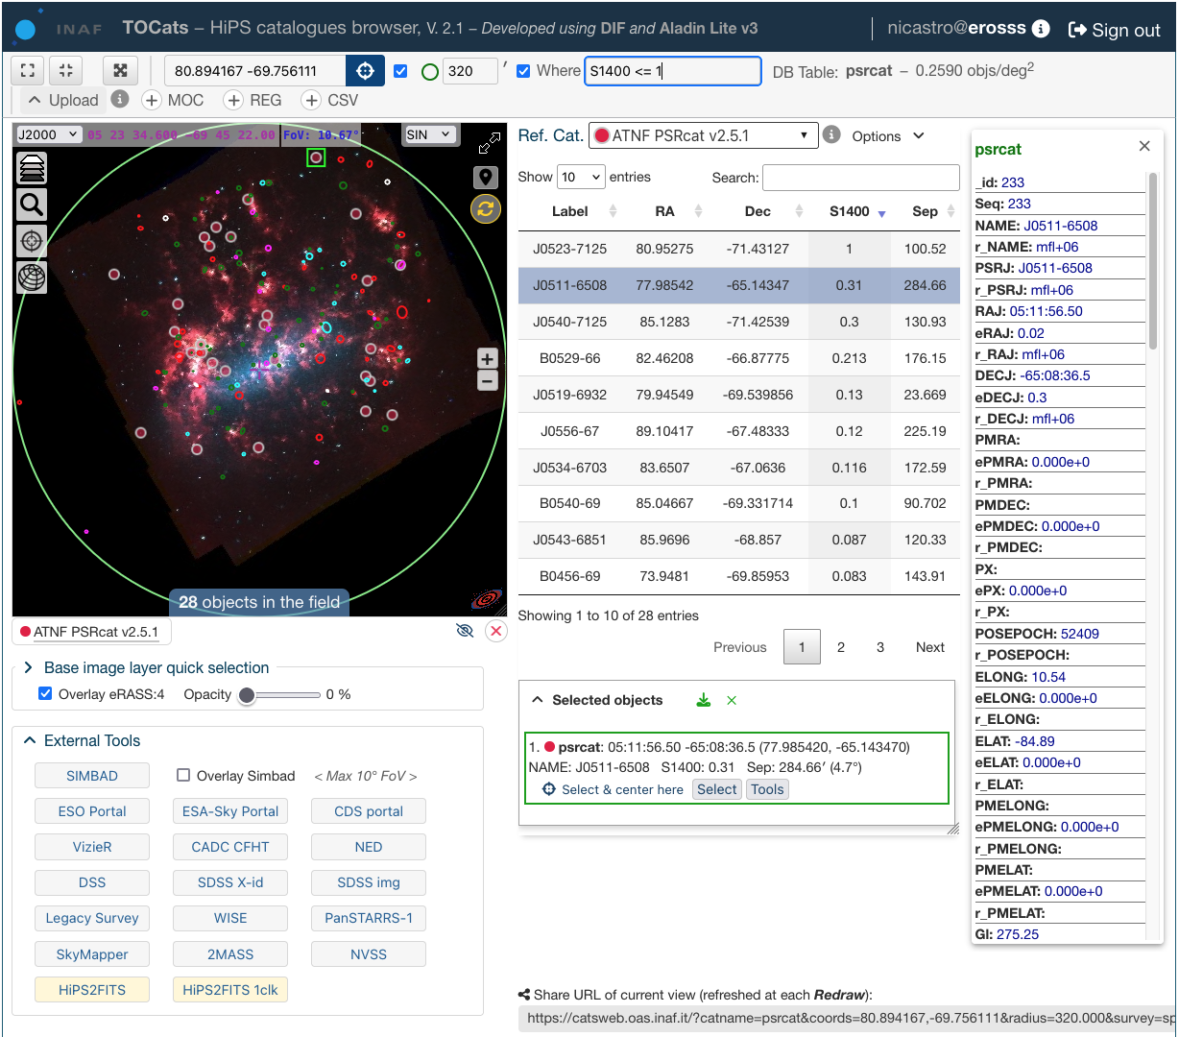
TOCats & TOCatsweb – use cases
Import local MOC, REG and CSV files
LMC
ds9 REGion file
ellipse(71.11583,-67.97030, 0.022,0.015,80) #text={J0444-6758} tag={candidate} color=red
ellipse(71.80072,-69.32124, 0.032,0.05,320) #text={J0447-6918} tag={MCSNR} color=cyan
circle(72.10489,-67.00686, 0.045) #text={J0448-6700} tag={MCSNR} color=green
ellipse(72.391666,-69.05944, 0.031,0.029,0) #text={J0449-6903} tag={MCSNR} color=cyan
circle (72.330,-69.33889, 0.027) #text={J0449-6920} tag={MCSNR} color=green
ellipse(72.55166,-68.30133, 0.126,0.10,105) #text={J0450-6818} tag={candidate} color=red
circle (72.6125,-70.8375, 0.053) #text={J0450-7050} tag={MCSNR} color=green
ellipse(72.94051,-67.29002, 0.081,0.047,60) #text={J0451-6717} tag={candidate} color=magenta
… … …
External tools
Archives and Data management Systems. LN @ INAF – OAS Bologna

Slide 17
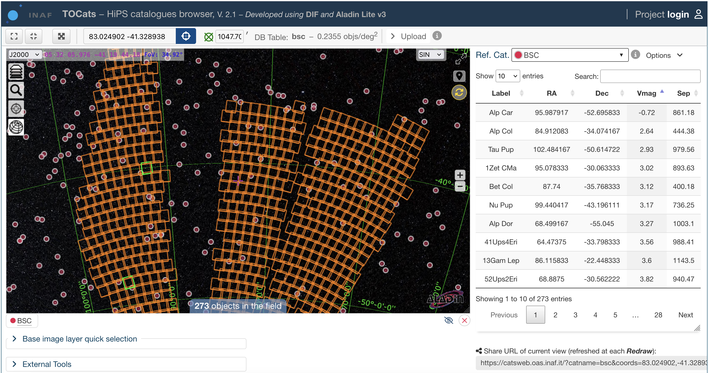
TOCats & TOCatsweb – use cases
Euclid-NISP J footprint
Archives and Data management Systems. LN @ INAF – OAS Bologna

Slide 18
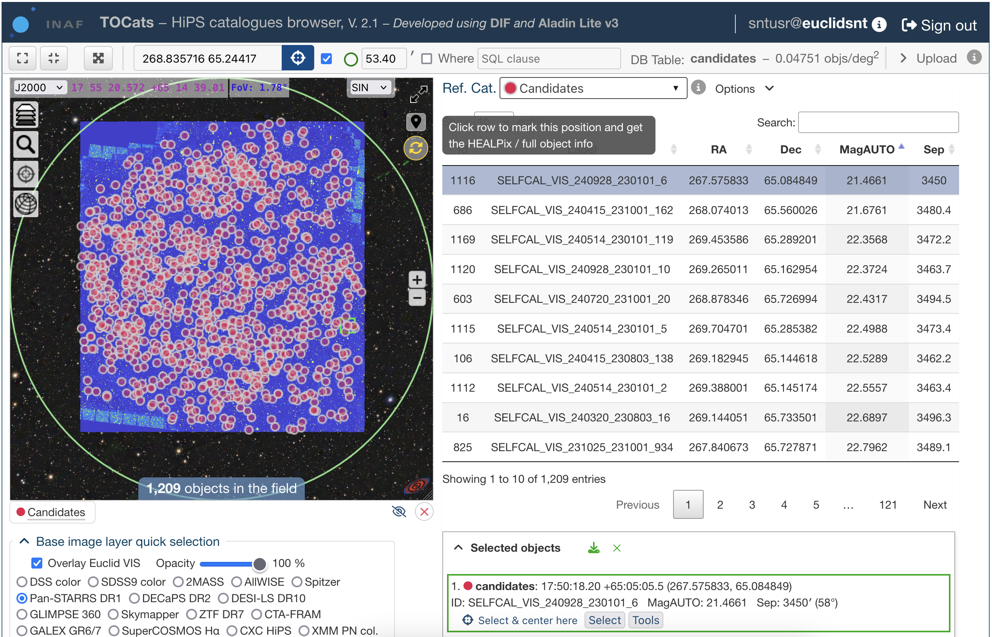
TOCats & TOCatsweb – use cases
Transient sources in the Euclid SelfCal field
VIS
SelfCal
Archives and Data management Systems. LN @ INAF – OAS Bologna

Slide 19
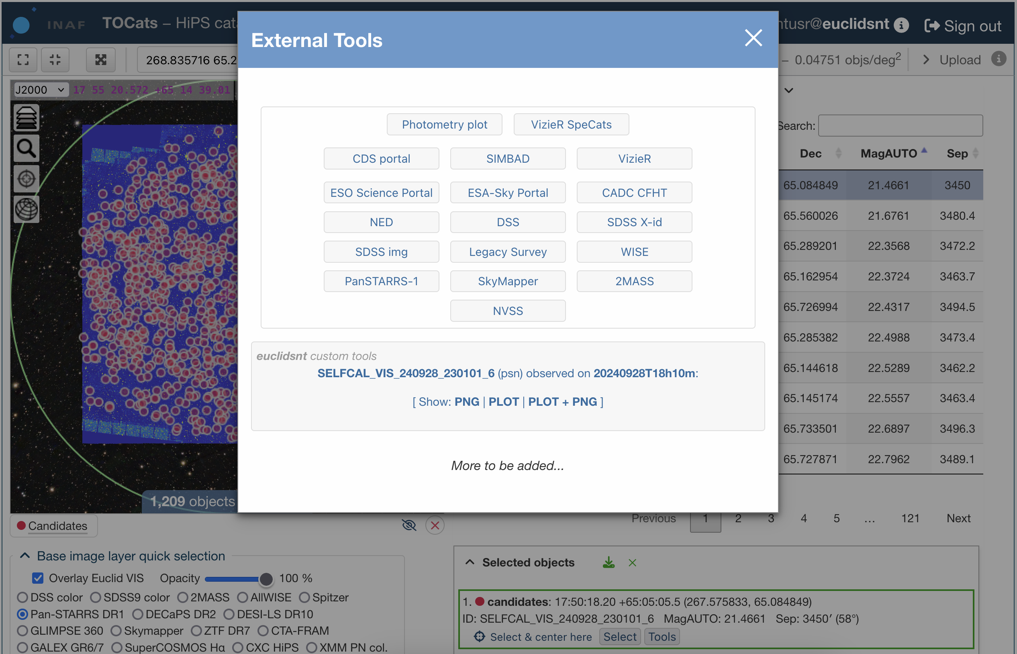
TOCats & TOCatsweb – use cases
Transient sources in the Euclid SelfCal field
VIS
SelfCal
User’s plug-ins
Archives and Data management Systems. LN @ INAF – OAS Bologna

Slide 20
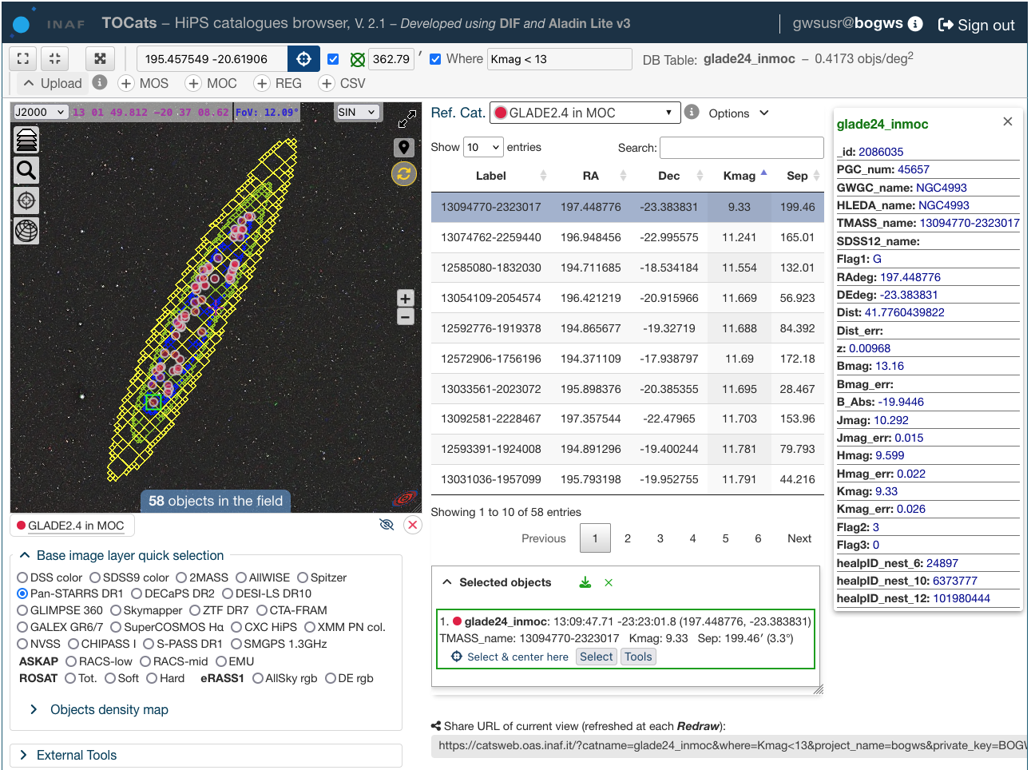
TOCats & TOCatsweb – use cases
Import GW event Multi-Order Skymap (MOS), either local of giving its URL
Identify NED-LVS and GLADE 2.4 sources in a given probability region
Archives and Data management Systems. LN @ INAF – OAS Bologna

Slide 21
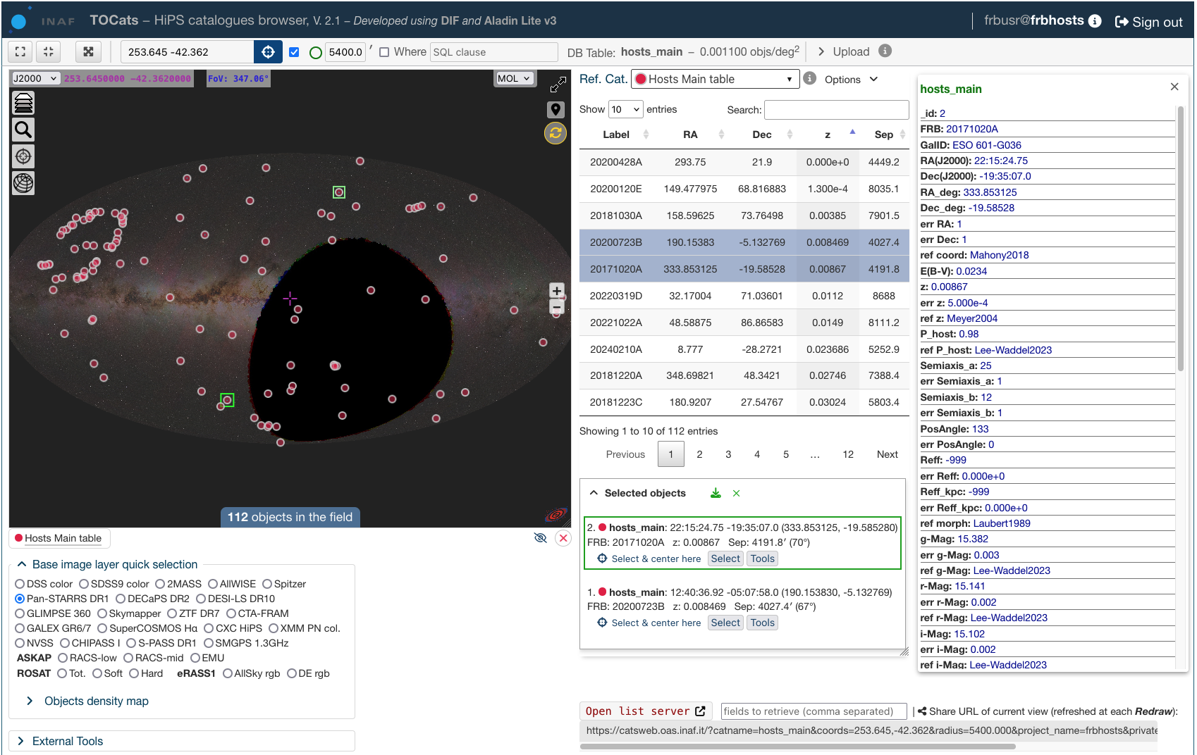
TOCats & TOCatsweb – use cases
FRBs and their host galaxies
Archives and Data management Systems. LN @ INAF – OAS Bologna

Slide 22
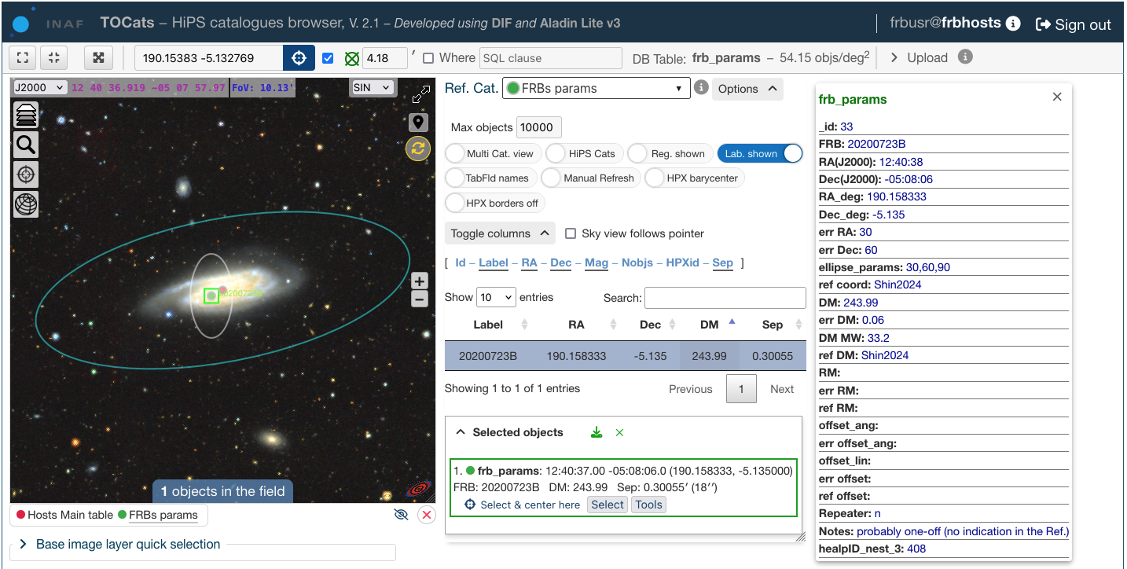
TOCats & TOCatsweb – use cases
FRB 20200723B
Archives and Data management Systems. LN @ INAF – OAS Bologna

Slide 23
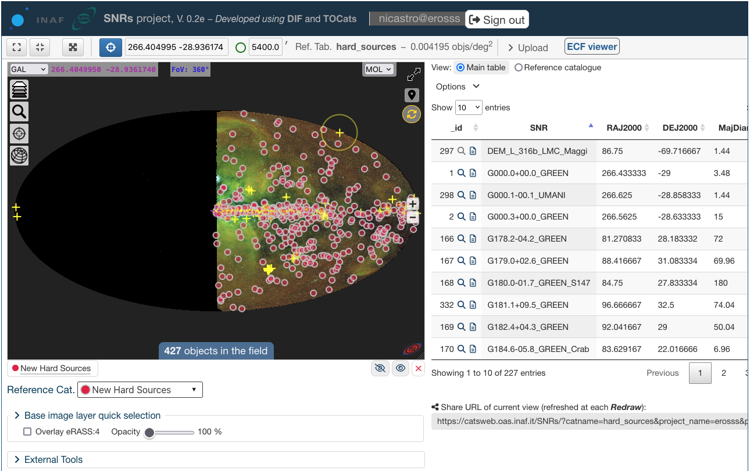
TOCats & TOCatsweb – use cases
eROSITA SNRs
Archives and Data management Systems. LN @ INAF – OAS Bologna

Slide 24
VSTbrowse
grawita.inaf.it/VSTbrowse/
A tool for investigating ESO-VST multi-epoch visits of GW sky regions and search for transients
Preliminary tasks
Hipsgen the collected VST sky survey
DB insert extracted source catalogues
DB insert identified variable objects (transient source candidates)
Web tool
Browse sky: compare with existing surveys and catalogues
Extract and inspects FITS stamps (JS9)
Plot transients LC
Mark and annotate candidates
Archives and Data management Systems. LN @ INAF – OAS Bologna

Slide 25
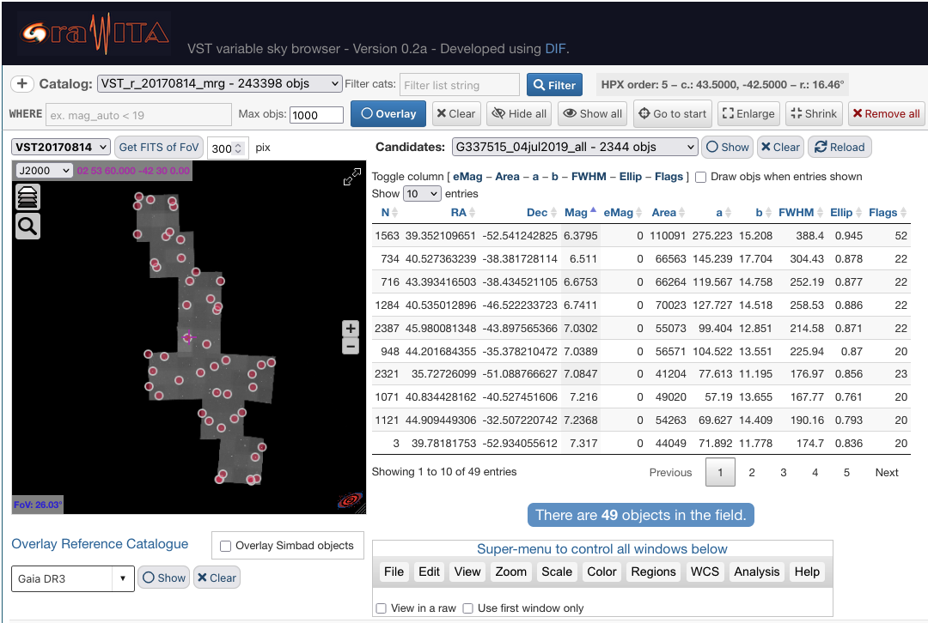
GRAWITA: VSTbrowse – GW170814
grawita.inaf.it/VSTbrowse/GW170814/
JS9
TOCats
Archives and Data management Systems. LN @ INAF – OAS Bologna

Slide 26
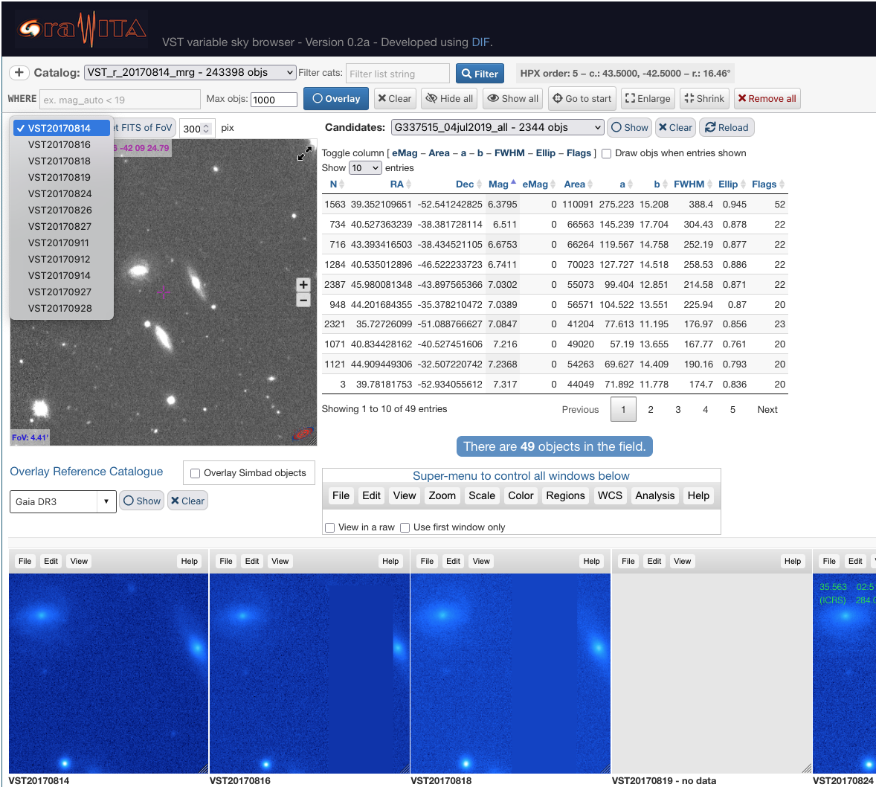
GRAWITA: VSTbrowse – GW170814
grawita.inaf.it/VSTbrowse/GW170814/
JS9
Archives and Data management Systems. LN @ INAF – OAS Bologna

Slide 27
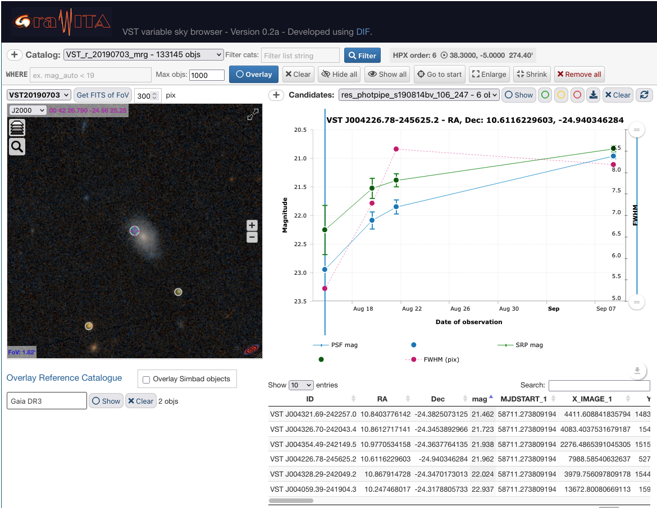
GRAWITA: VSTbrowse – G337515
grawita.inaf.it/VSTbrowse/G337515/
amCharts
TOCats
Archives and Data management Systems. LN @ INAF – OAS Bologna

Slide 28
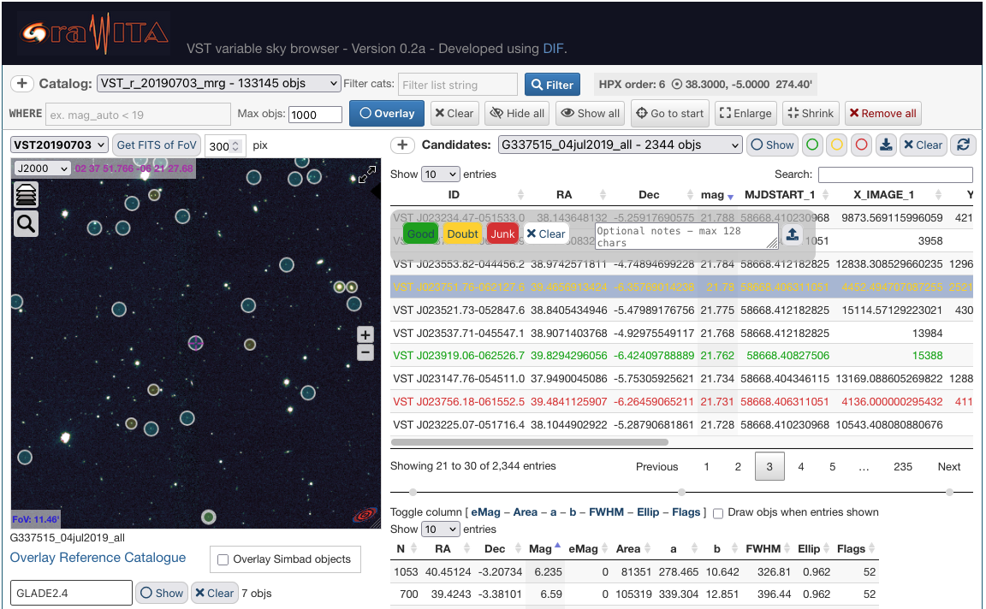
GRAWITA: VSTbrowse – G337515
grawita.inaf.it/VSTbrowse/G337515/
Archives and Data management Systems. LN @ INAF – OAS Bologna

Slide 29
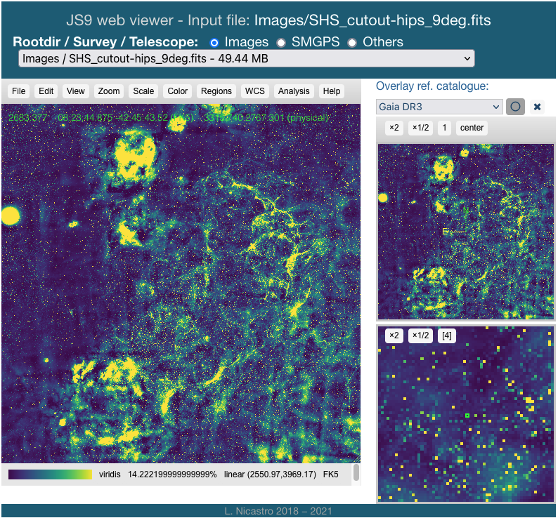
JS9 – web-based DS9
js9.si.edu
A custom implementation
cats.oas.inaf.it/js9/
Direct server image link
cats.oas.inaf.it/js9/?file=Images/SHS_cutout-hips_9deg.fits
Archives and Data management Systems. LN @ INAF – OAS Bologna

Slide 30
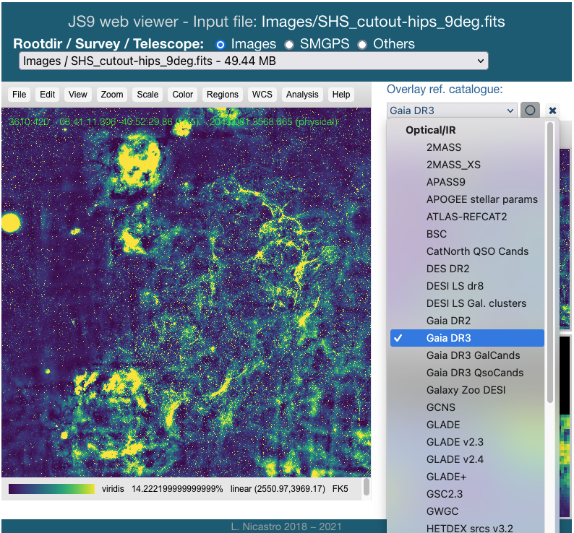
JS9 – web-based DS9
js9.si.edu
A custom implementation
cats.oas.inaf.it/js9/
Direct server image link
cats.oas.inaf.it/js9/?file=Images/SHS_cutout-hips_9deg.fits
Archives and Data management Systems. LN @ INAF – OAS Bologna

Slide 31
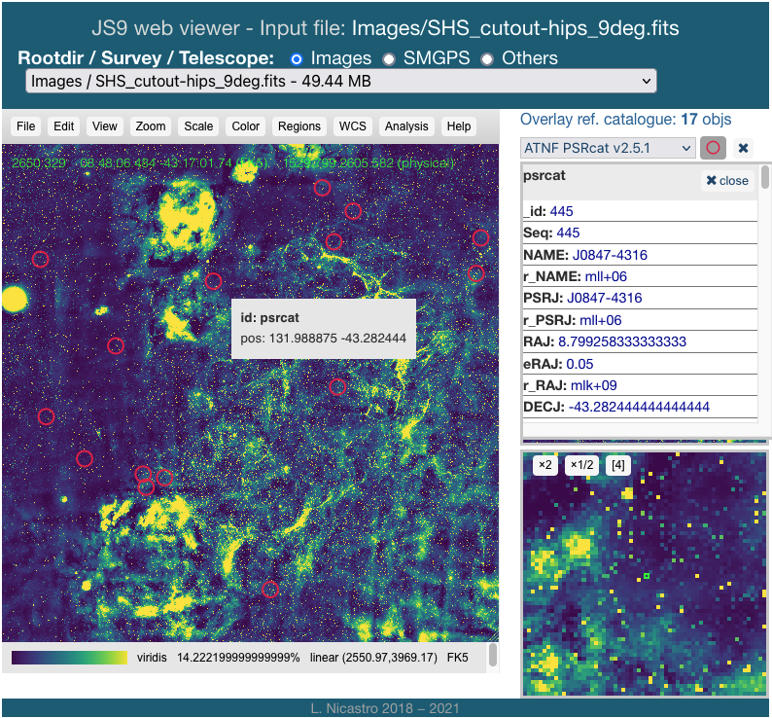
JS9 – web-based DS9
js9.si.edu
A custom implementation
cats.oas.inaf.it/js9/
Direct server image link
cats.oas.inaf.it/js9/?file=Images/SHS_cutout-hips_9deg.fits
Archives and Data management Systems. LN @ INAF – OAS Bologna

Slide 32
Discussion items for this meeting (part.)
Development of web tools (JS libs, node.js, WebGL, …)
Development of Instrument agnostic libraries / pipelines
Co-existence of relational and No-SQL DBs
Move the code, not the data (products ok)
Is it Python good for all? It is the present, and the future?
Semantic queries ⟹ AI for astronomy?
Projects and Facilities drive (custom) SW development strategies, but:
Does (or shall) INAF have the resources / capabilities to invest in SW development / homogenization?
Is INAF attractive for SW engineers?
Archives and Data management Systems. LN @ INAF – OAS Bologna

Slide 33
rem.oas.inaf.it/DB
catsweb.oas.inaf.it
cats.oas.inaf.it/js9
Archives and Data management Systems. LN @ INAF – OAS Bologna

