Slide 1
Data Lake Spoke3 and IDL
G. Coran, M. Costantini
INAF - OATs
Archives and Data Management Systems, Bologna Feb 26-27, 2025
ICSC Italian Research Center on High-Performance Computing, Big Data and Quantum Computing
Missione 4 • Istruzione e Ricerca
Notes:
Cover

Slide 2
Spoke 3 project
Spoke 3 is a project supported by European funds for the Fondazione ICSC for astrophysics and cosmological observations;
The main objectives of the Spoke 3 are the exploitation of cutting-edge solutions in HPC and Big Data processing and analysis for problems of interest in various astrophysical areas;
It also undertakes a specific outreach and training program to boost the use of high performance and high throughput, cloud solutions in research centres, academia and private companies;
Within this project we participate in the Work Package 4, which starts from already implemented best practices and frameworks to manage data and software with FAIR and Open Science principles to develop innovative frameworks able to satisfy the Big Data Challenge.
ICSC Italian Research Center on High-Performance Computing, Big Data and Quantum Computing
Missione 4 • Istruzione e Ricerca
Notes:
Template e guide lines

Slide 3
IDL project
The IDL project is one of the projects funded by the ICSC Foundation with industrial leadership, co-participated by Spoke 2 and Spoke 3;
The project involves the construction of an Interoperable Data Lake, hence the name, that is, an archiving system capable of satisfying both industrial needs and the interoperability paradigms supported by the scientific field;
At the moment the project is divided into two sections, an industrial-led section that deals with archiving data on space debris provided by TASI and our scientific section led by INAF for which we are testing the archiving also in this case of both observational and simulation data.
ICSC Italian Research Center on High-Performance Computing, Big Data and Quantum Computing
Missione 4 • Istruzione e Ricerca
Notes:
Template e guide lines

Slide 4
Spoke 3 Data Lake
For the Spoke 3 project we are focusing our work on the development of a shared archive able to support the products of the other WPs' work and to provide an effective and rapid archiving of the data collected in relational databases according to the international standards dictated by IVOA and recovery services for such data both according to common channels such as IVOA clients, with the association of a clear TAP service to the archive, and with a customized portal specifically for this project;
For the duration of the project, we have focused on a couple of observational use cases, which, we will show you shortly, are already well underway, and we are trying to repeat ourselves for another couple of simulation cases;
Spoke 3 WP4 works integrated with a dedicated Rucio instance within an infrastructure provided by INFN.
ICSC Italian Research Center on High-Performance Computing, Big Data and Quantum Computing
Missione 4 • Istruzione e Ricerca
Notes:
Template e guide lines

Slide 5
IDL Data Lake
For the IDL project we are expanding the ingestion solutions to be able to handle numerous different data files formats and metadata structures and to be integrated with a custom Rucio implementation;
As scientific data we are using a dataset of Birales data provided by colleagues Germano Bianchi and Pierluigi Di Lizia, data from the Fermi satellite and a dataset of public pulsar data present in the IRA web archive;
The data lake is provided as infrastructure by machines managed by INFN, supports a decentralization based on the blockchain system, also managed by INFN, and relies on a private DBMS, AyraDB, developed by CherryData, a start-up from Milan.
ICSC Italian Research Center on High-Performance Computing, Big Data and Quantum Computing
Missione 4 • Istruzione e Ricerca
Notes:
Template e guide lines

Slide 6
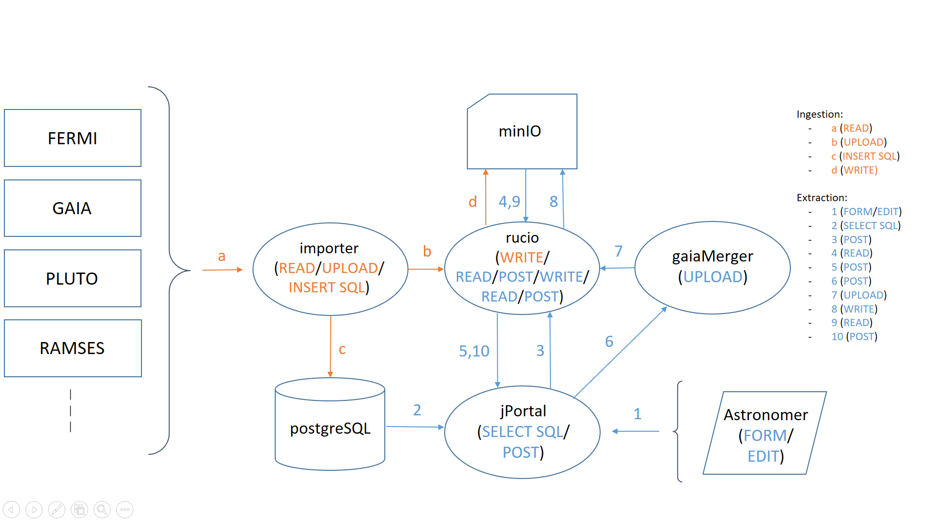
Ingestion and Retrieval in the Spoke 3 Archive Infrastructure
ICSC Italian Research Center on High-Performance Computing, Big Data and Quantum Computing
Missione 4 • Istruzione e Ricerca
Notes:
Template e guide lines

Slide 7
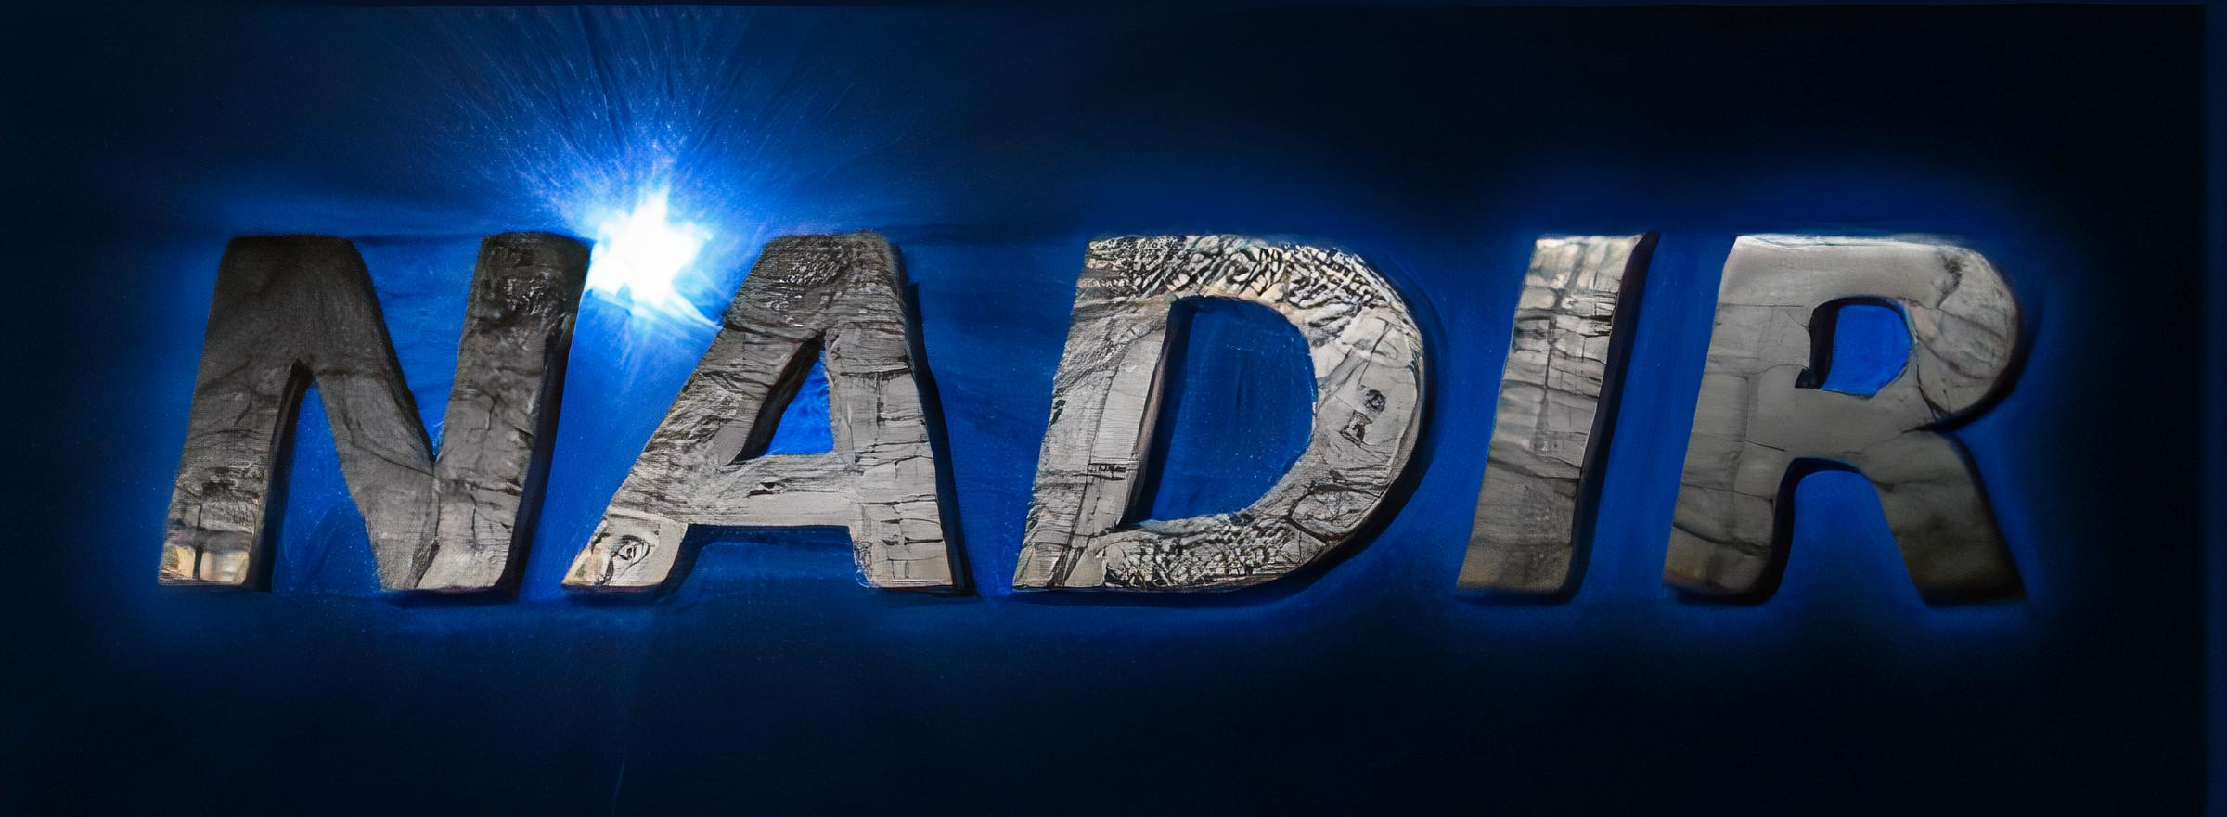
Ingestion Basis
The ingestion system is based on NADIR, the solid IA2 infrastructure that allows the ingestion and transfer of data to the archive in Trieste in a fast and efficient way; the system is used for various Italian data catalogues and is the basis of the archiving system of structures such as TNG, LBT and the Asiago Observatory;
An updated version of the NADIR software ported in Python has been developed in the last year and a half and is already active in Asiago and is being initialized for LBT.
ICSC Italian Research Center on High-Performance Computing, Big Data and Quantum Computing
Missione 4 • Istruzione e Ricerca
Notes:
Template e guide lines

Slide 8
Data and Metadata Ingestion
For the Spoke 3 project we are testing the infrastructure with data from the Fermi and Gaia space telescopes as observational use cases, for which the tests carried out are already meeting the targets initially defined in WP4, while we are managing data from Pluto and Ramses as simulation use cases.
ICSC Italian Research Center on High-Performance Computing, Big Data and Quantum Computing
Missione 4 • Istruzione e Ricerca
Notes:
Template e guide lines

Slide 9
Data and Metadata Ingestion
The ingestion process begins with the extraction of metadata by the "Importer", a software implemented as a device in the TANGO Controls distributed control system, with which it is also possible to monitor it.
ICSC Italian Research Center on High-Performance Computing, Big Data and Quantum Computing
Missione 4 • Istruzione e Ricerca
Notes:
Template e guide lines

Slide 10
Data and Metadata Ingestion
The initialized "Importer" instance retrieves the data descriptive model from a local database, in our case MariaDB, and through the use of mapping tables retrieves the key-value pairs with extraction functions developed specifically for the various types of formats used by our use cases.
ICSC Italian Research Center on High-Performance Computing, Big Data and Quantum Computing
Missione 4 • Istruzione e Ricerca
Notes:
Template e guide lines

Slide 11
Data and Metadata Ingestion
The metadata thus extracted is written to a PostgreSQL database on a dedicated machine while the data is passed to a specially prepared Rucio infrastructure that manages data storage and replication in an S3 object storage managed via MinIO.
ICSC Italian Research Center on High-Performance Computing, Big Data and Quantum Computing
Missione 4 • Istruzione e Ricerca
Notes:
Template e guide lines

Slide 12
Data and Metadata Retrieval
As for data recovery, we have created a dedicated portal that can interface with the underlying database and communicate with Rucio for file recovery;
Communication between the portal and the database therefore passes through a service that has been specifically developed, but which also acts as a TAP service, responding in a standard manner to calls received from commonly used clients that comply with the IVOA directives.
ICSC Italian Research Center on High-Performance Computing, Big Data and Quantum Computing
Missione 4 • Istruzione e Ricerca
Notes:
Template e guide lines

Slide 13
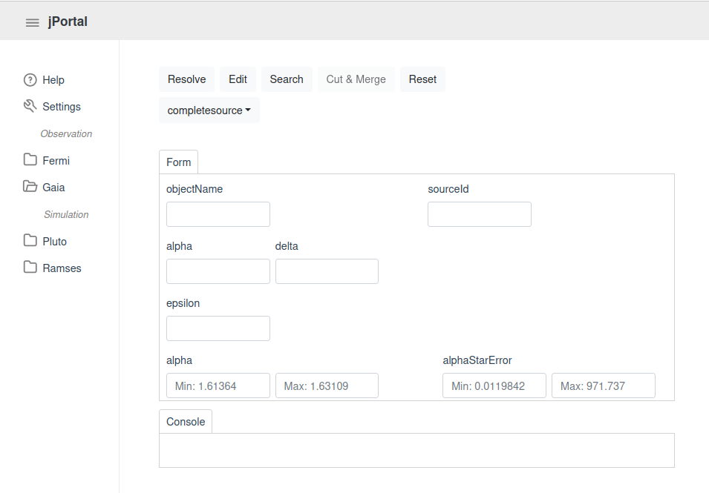
JPortal Retrieval
The astronomer can create a query by selecting an objectName, a sourceId, or any other available metadata;
ICSC Italian Research Center on High-Performance Computing, Big Data and Quantum Computing
Missione 4 • Istruzione e Ricerca
Notes:
Template e guide lines

Slide 14
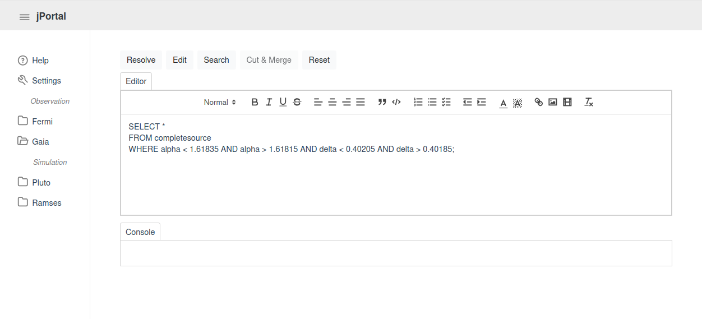
JPortal Retrieval
The astronomer can create a query by selecting an objectName, a sourceId, or any other available metadata;
An editor also allows for creating or simply copying/pasting more specific queries;
ICSC Italian Research Center on High-Performance Computing, Big Data and Quantum Computing
Missione 4 • Istruzione e Ricerca
Notes:
Template e guide lines

Slide 15
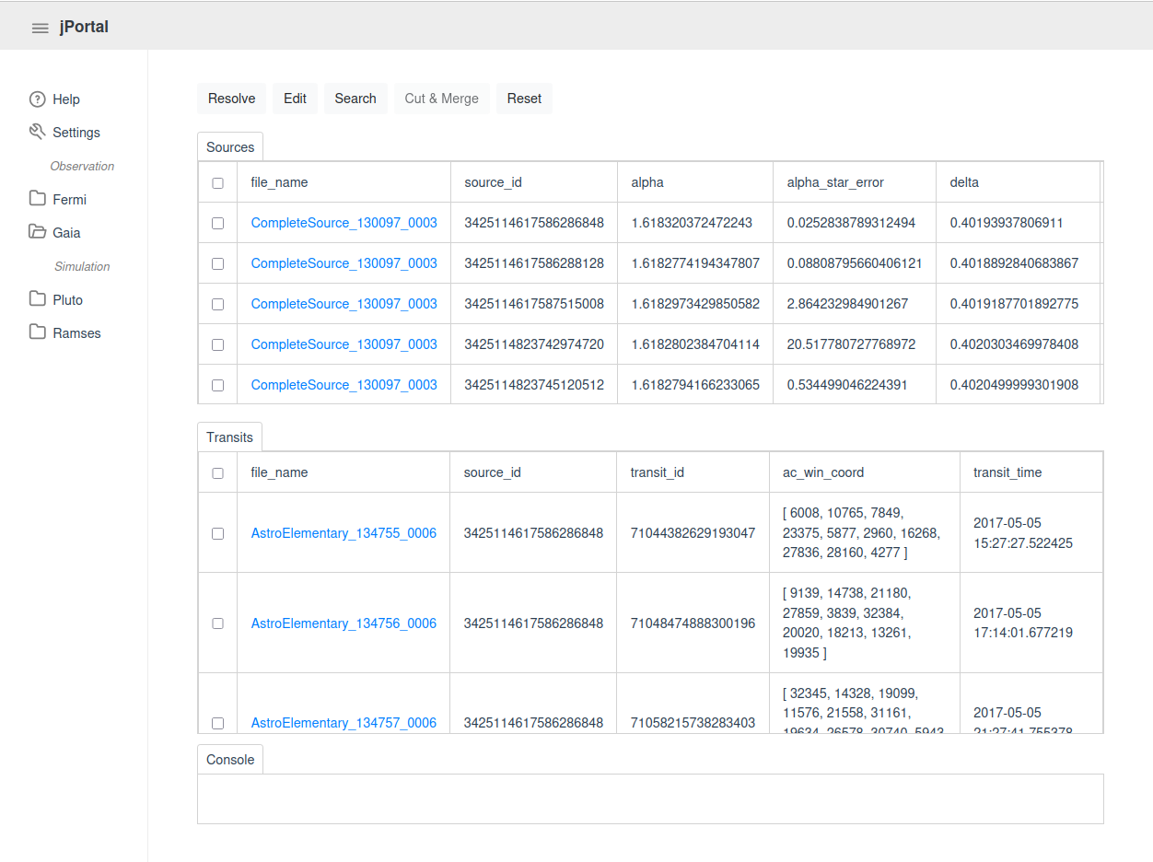
JPortal Retrieval
The astronomer can create a query by selecting an objectName, a sourceId, or any other available metadata;
An editor also allows for creating or simply copying/pasting more specific queries;
The result is a pair of tables that represent not only the metadata retrieved from PostgreSQL but also the corresponding files obtained from Rucio and downloadable from MinIO.
ICSC Italian Research Center on High-Performance Computing, Big Data and Quantum Computing
Missione 4 • Istruzione e Ricerca
Notes:
Template e guide lines

Slide 16
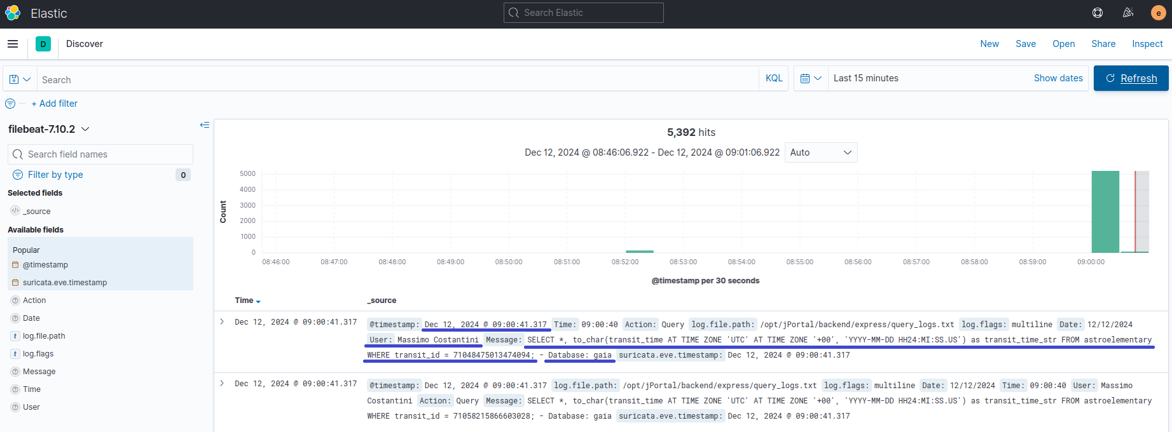
Elasticsearch / Kibana
All queries and downloads are logged using Elasticsearch and visualized via Kibana, including details such as timestamps, users and executed queries.
ICSC Italian Research Center on High-Performance Computing, Big Data and Quantum Computing
Missione 4 • Istruzione e Ricerca
Notes:
Template e guide lines

Slide 17
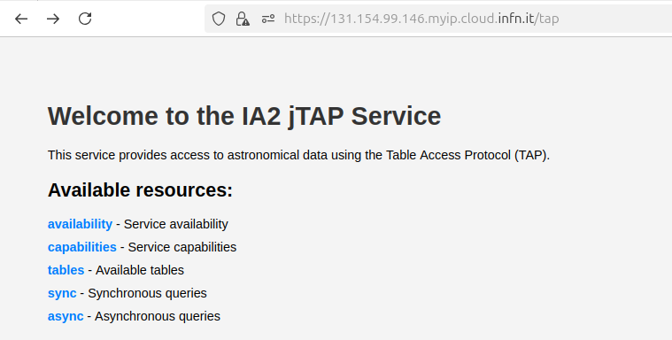
TAP Service Retrieval
Adding a /tap endpoint to the URL, you access a 'jTAP,' the Table Access Protocol service that, as specified by the IVOA standard, provides a series of additional endpoints;
ICSC Italian Research Center on High-Performance Computing, Big Data and Quantum Computing
Missione 4 • Istruzione e Ricerca
Notes:
Template e guide lines

Slide 18
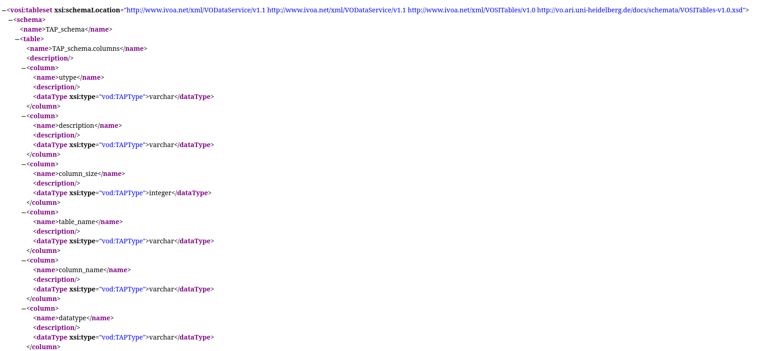
TAP Service Retrieval
Adding a /tap endpoint to the URL, you access a 'jTAP,' the Table Access Protocol service that, as specified by the IVOA standard, provides a series of additional endpoints;
For example, clicking on 'tables', you get a VOTable containing all the metadata in the standard XML format;
ICSC Italian Research Center on High-Performance Computing, Big Data and Quantum Computing
Missione 4 • Istruzione e Ricerca
Notes:
Template e guide lines

Slide 19
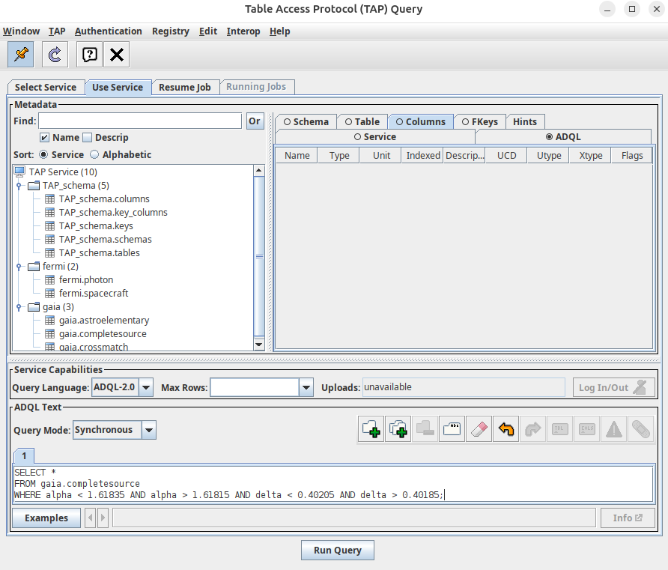
TAP Service Retrieval
Adding a /tap endpoint to the URL, you access a 'jTAP,' the Table Access Protocol service that, as specified by the IVOA standard, provides a series of additional endpoints;
For example, clicking on 'tables', you get a VOTable containing all the metadata in the standard XML format;
This also means that it is now possible to execute the same queries from a client other than jPortal, such as TOPCAT…
ICSC Italian Research Center on High-Performance Computing, Big Data and Quantum Computing
Missione 4 • Istruzione e Ricerca
Notes:
Template e guide lines

Slide 20
TAP Service Retrieval
Adding a /tap endpoint to the URL, you access a 'jTAP,' the Table Access Protocol service that, as specified by the IVOA standard, provides a series of additional endpoints;
For example, clicking on 'tables', you get a VOTable containing all the metadata in the standard XML format;
This also means that it is now possible to execute the same queries from a client other than jPortal, such as TOPCAT…
…obtaining the same metadata.
ICSC Italian Research Center on High-Performance Computing, Big Data and Quantum Computing
Missione 4 • Istruzione e Ricerca
Notes:
Template e guide lines

Slide 21
Additional Services
We are also working to integrate additional services to the archive, among these the GaiaMerger service is already available, which allows you to perform a Cut&Merge of Gaia files to generate a much lighter and easier to manipulate output than those present in the archive.
ICSC Italian Research Center on High-Performance Computing, Big Data and Quantum Computing
Missione 4 • Istruzione e Ricerca
Notes:
Template e guide lines

Slide 22
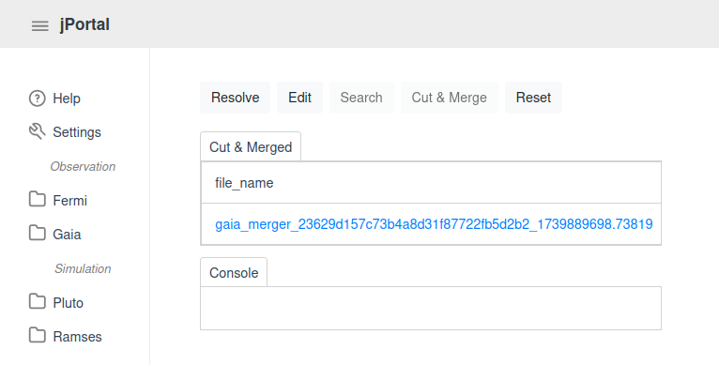
Additional Services
The GaiaMerger service is currently available only from jPortal;
The file is immediately downloadable and is preserved only for a limited time;
We are also working to integrate services such as DataLink that will allow standardized calls to this type of services as well.
ICSC Italian Research Center on High-Performance Computing, Big Data and Quantum Computing
Missione 4 • Istruzione e Ricerca
Notes:
Template e guide lines

Slide 23
Conclusions and Next Steps
Conclusions:
As you can see, it is possible to build a data lake that meets scientific standards;
NADIR's modularity has been improved, allowing code variations to be minimized when the format and structure of the input files vary;
The main challenges encountered are the obsolescence of software and libraries, the high demand for storage resources and most importantly the complexity in communication among stakeholders;
Next Steps:
We are working to structure simulated data in a coherent and, most importantly, standardized manner to ensure correct integration into the Spoke 3 database;
As mentioned, we are developing the necessary standard services for proper integration with IVOA clients, as for the DataLink;
We aim to integrate analysis services such as FermiTools for Fermi data, making them accessible both from JPortal and standard clients.
ICSC Italian Research Center on High-Performance Computing, Big Data and Quantum Computing
Missione 4 • Istruzione e Ricerca
Notes:
Template e guide lines

Slide 24
Thank you for your attention!
Questions are welcome.
Archives and Data Management Systems, Bologna Feb 26-27, 2025
ICSC Italian Research Center on High-Performance Computing, Big Data and Quantum Computing
Missione 4 • Istruzione e Ricerca
Notes:
Cover

