Slide 1
Towards a data platform providing a holistic support to AtLAST operations
This work is supported by project I+D+i PID2022-138621NB-I00 funded by MCIN/AEI/10.13039/ 5011000110033
Francisco Montenegro
Universidad Complutense de Madrid (Spain)
Archives and Data Management Systems in the Big Data Era. CNR Bologna, 2025 Feb 26-28

Slide 2
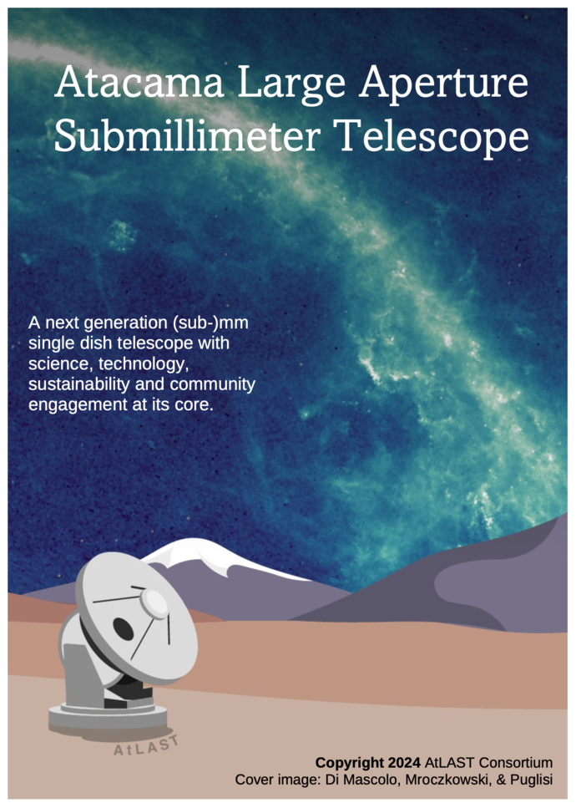
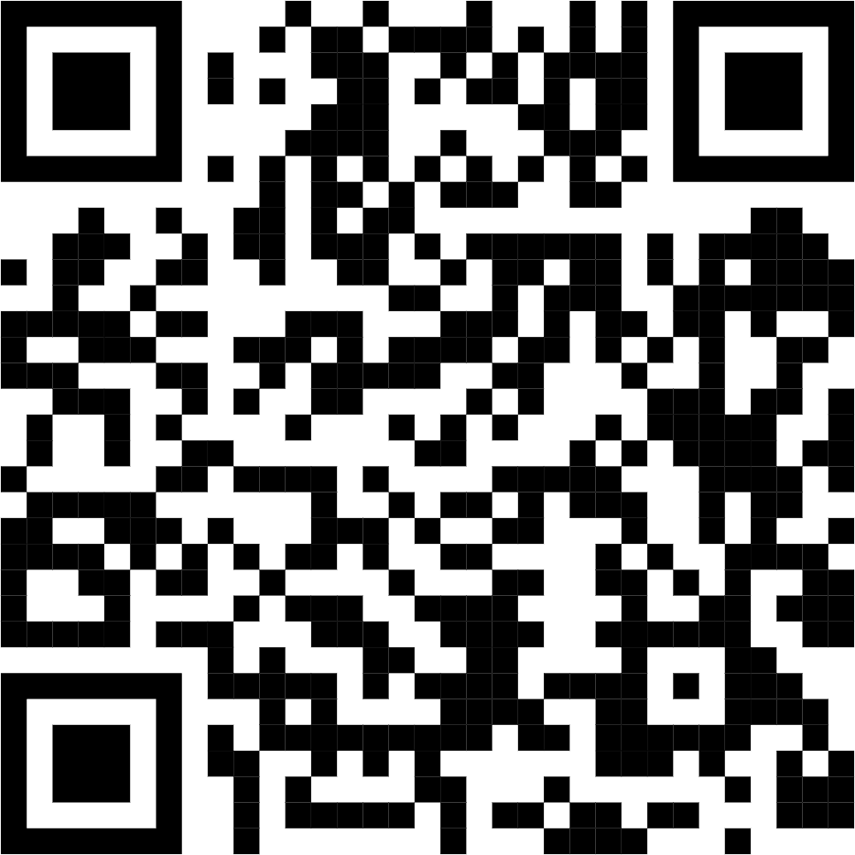
AtLAST in poche parole
Future next-generation 50-m class single-dish sub-mm astronomical observatory, run as a facility telescope by an international partnership and powered by renewable energy.
Transformational science
Sensitivity to study the typical populations of astronomical sources
Mapping the barion cycle on multiple spatial scales
Open the window to the time-varying (sub-)mm sky
Innovative design, powerful capabilities, excellent site
Unprecedent field-of-view (1-2 degrees)
Several large multi-beam instruments
Accesible to sub-mm wavelengths (up to 350 micron)
Sustainability, community engagement
Reduced carbon footprint in the long run
Dialogue with local communities
Sustainable operations for 30+ years
https://www.atlast-telescope.org

Slide 3
AtLAST project (2021-2024)
Towards an Atacama Large Aperture Submillimeter Telescope
EU Grant agreement ID: 951815
Coordination. PI. Claudia Cicone
Main deliverables:
Solid science case (community)
Telescope design
Site selection study
Operations plan
Energy studies

Slide 4
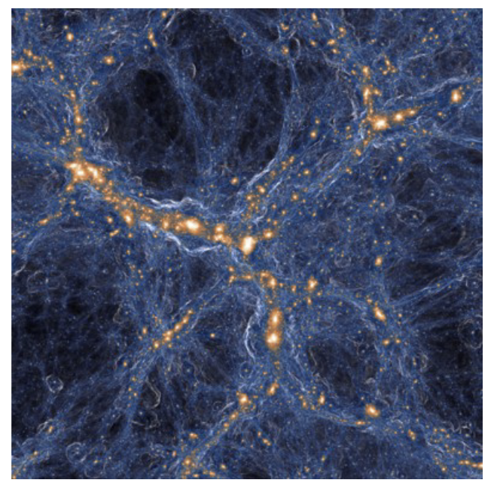
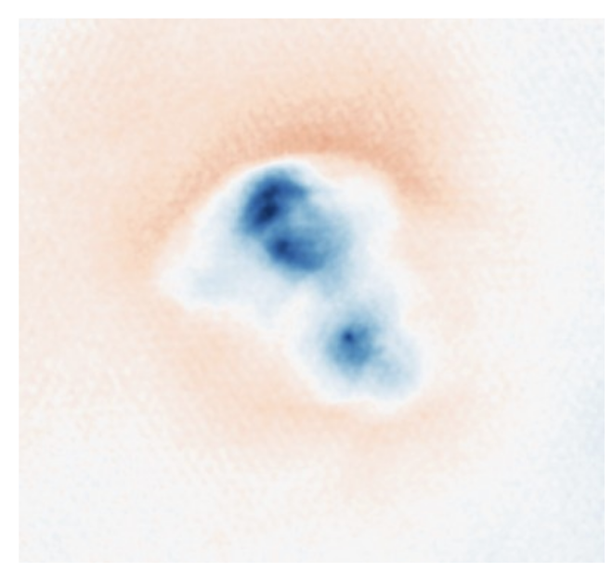
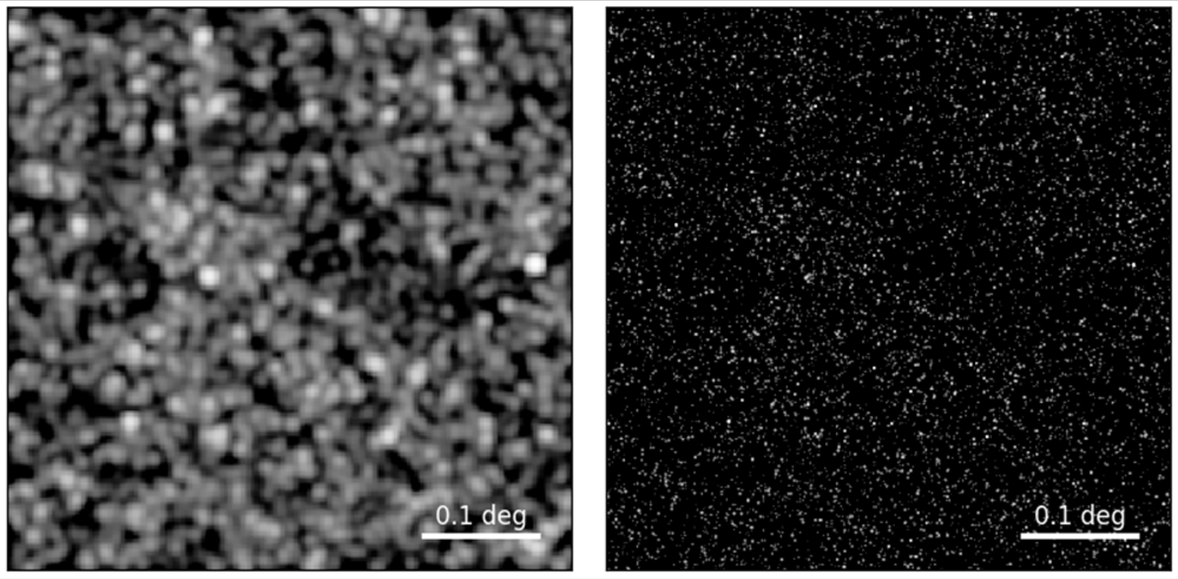
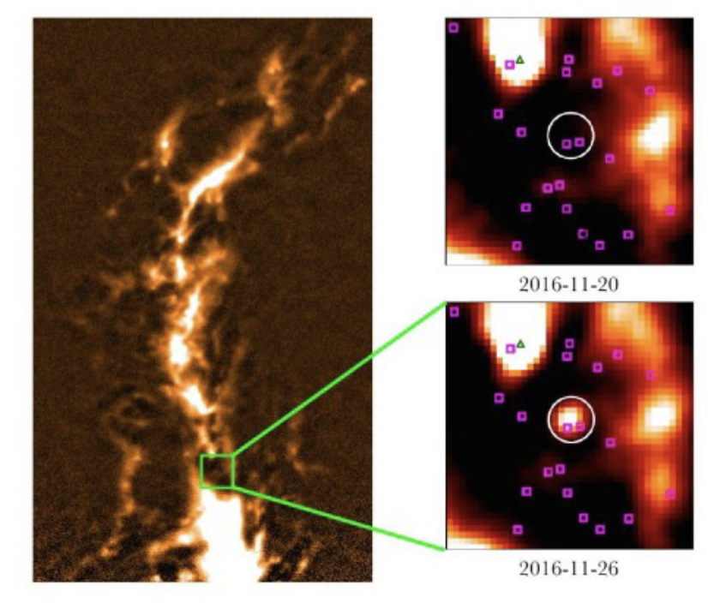
AtLAST project (2021-2024)
Towards an Atacama Large Aperture Submillimeter Telescope
EU Grant agreement ID: 951815
Main deliverables:
ACT
AtLAST
Solid science case (community)
Telescope design
Site selection study
Operations plan
AtLAST Science cases collection (8 papers). Open Research Europe.
M. Booth, P. Klaasen, C. Cicone, et al. (2024) AtLAST Science Overview Report Deliverable 6.7 and on arXiv:2407.01413
A. Schimek et al. (2024a). High resolution modelling of [CII], [CI], [OIII] and CO line emission from the ISM and CGM of a star forming galaxy at z ~ 6.5. A&A, 682, A98
A. Schimek et al. (2024b). Constraining the physical properties of gas in high-z galaxies with far-infrared and submillimetre line ratios. A&A, 687, L10
Energy studies

Slide 5
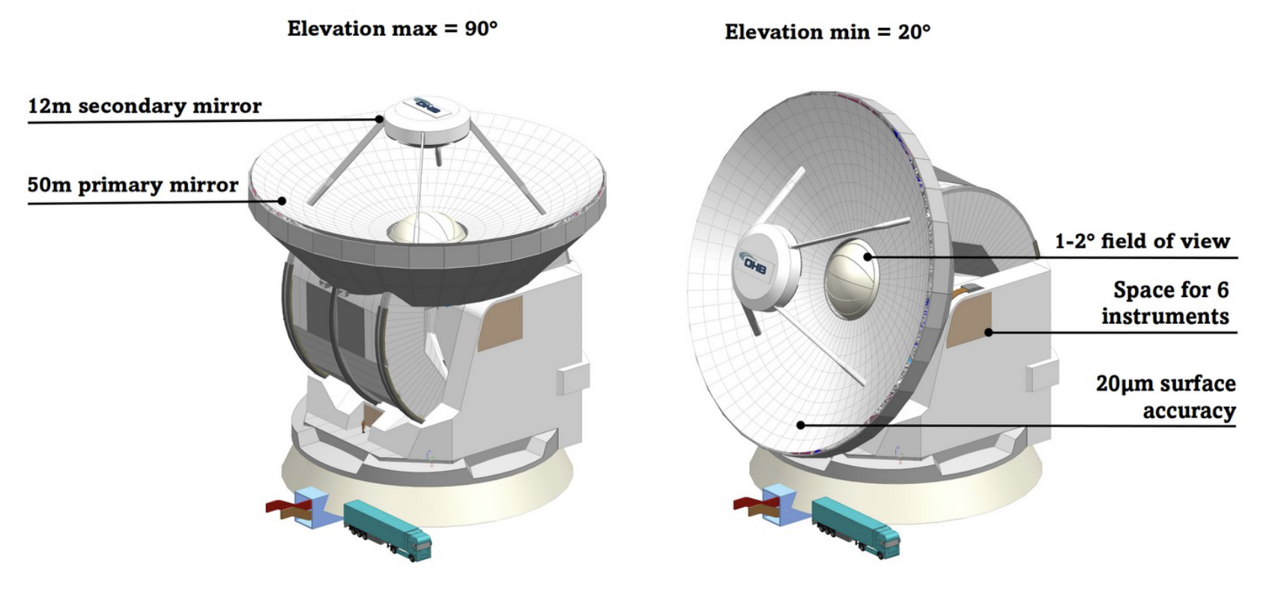
AtLAST project (2021-2024)
Towards an Atacama Large Aperture Submillimeter Telescope
EU Grant agreement ID: 951815
Main deliverables:
Solid science case (community)
Telescope design
Site selection study
Operations plan
Tony Mroczkowski+, A&A, 694, A142 (2025). On arXiv:2402.18645
A. Kiselev+ 2024, Proc of SPIE, Vol 13094, id. 130940E 9 pp. On arXiv:2404.17311
P. A. Gallardo+, 2024, Proc of SPIE, Vol 13094, id. 1309428 11 pp. On arXiv:2406.11502
R. Puddu+, 2024, Proc. of SPIE, id 13094, id. 130944S 22 pp. On arXiv:2406.16602
Energy studies

Slide 6
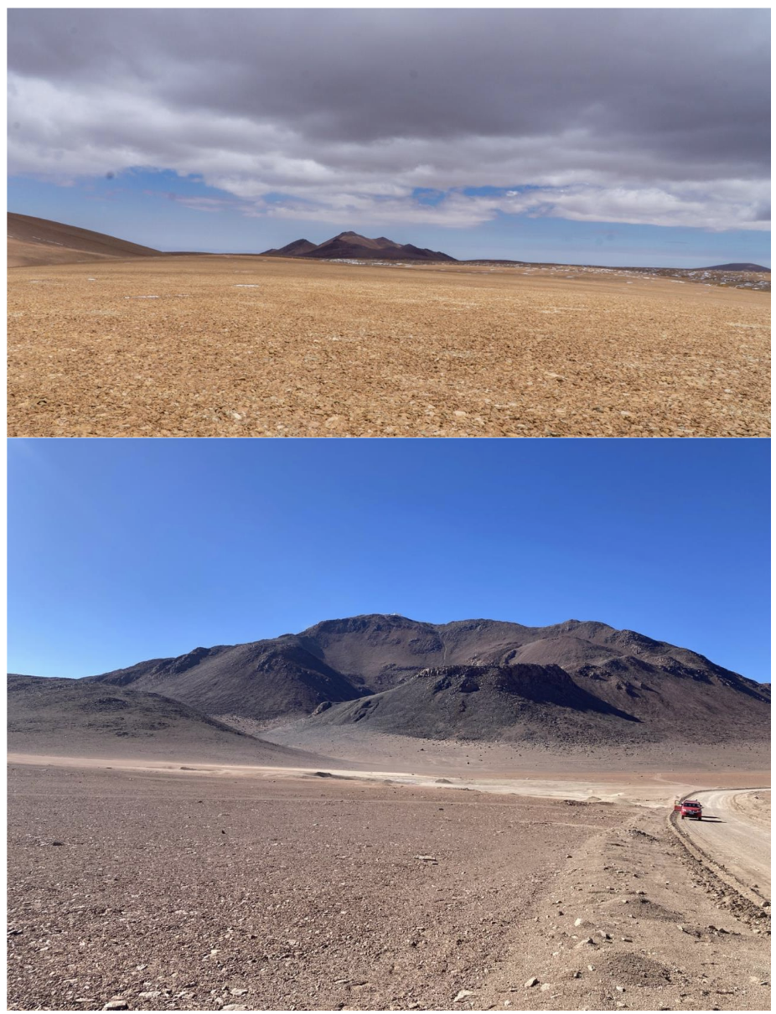
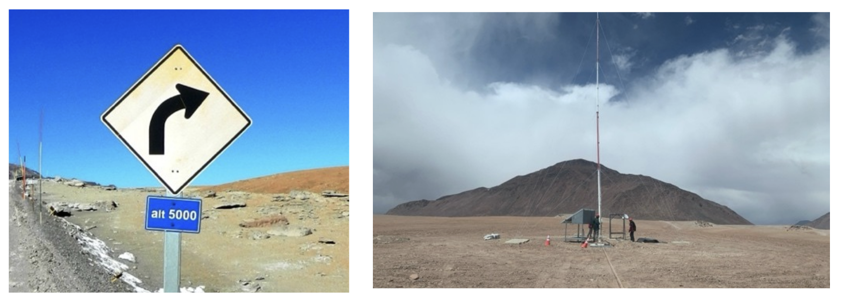
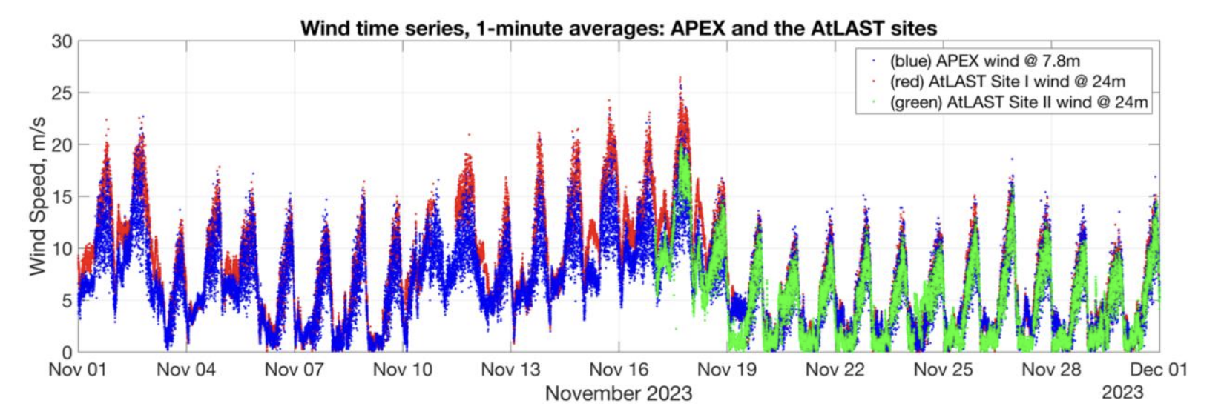
AtLAST project (2021-2024)
Site I
Towards an Atacama Large Aperture Submillimeter Telescope
EU Grant agreement ID: 951815
Site II
Main deliverables:
Solid science case (community)
Telescope design
Site selection study
Operations plan
Energy studies
C. De Breuck, A. Otárola, J.P. Pérez-Beaupuits et al. (2022) Deliverable 3.1 “Site selection criteria”
C. De Breuck, A. Otárola, J.P. Pérez-Beaupuits, et al. (2024) Deliverable 3.2. “Site selection report”

Slide 7
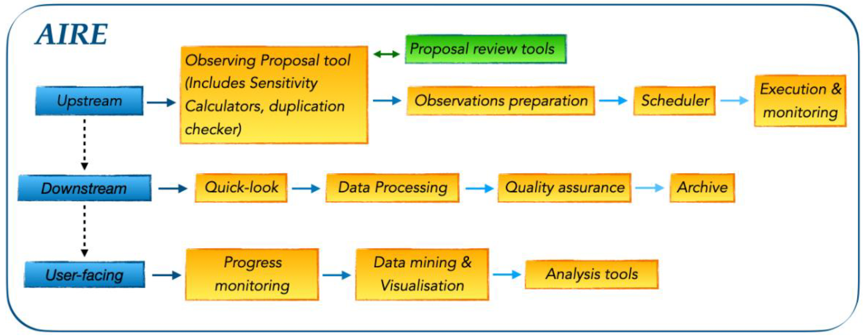
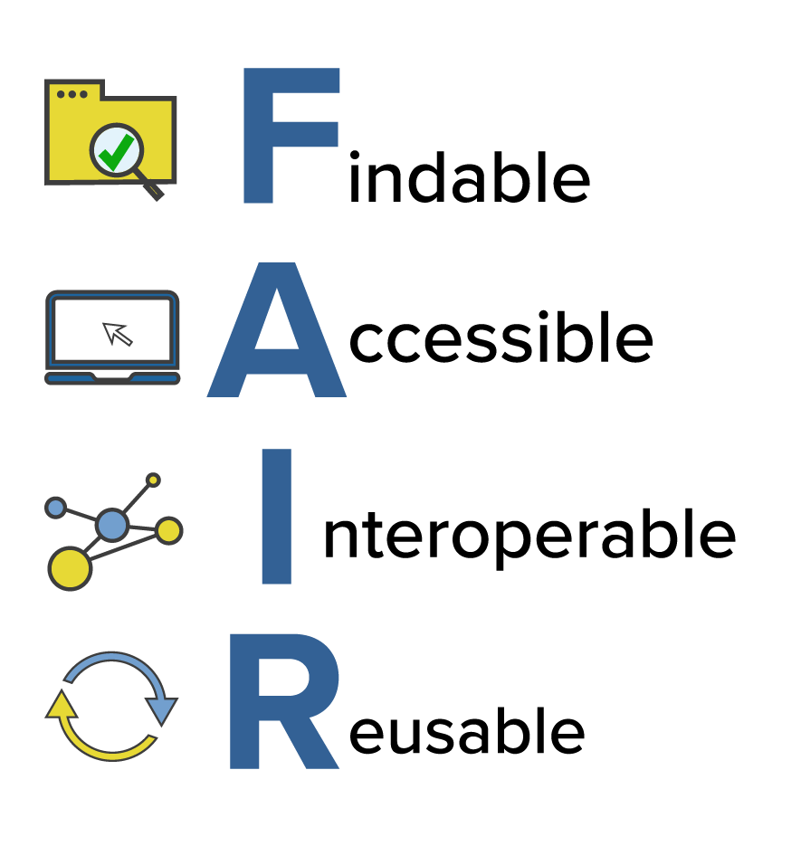
AtLAST project (2021-2024)
Towards an Atacama Large Aperture Submillimeter Telescope
EU Grant agreement ID: 951815
Lessons learned from APEX, ALMA
Main deliverables:
Solid science case (community)
Telescope design
Site selection study
Operations plan
E. Hatziminaoglou, F.M. Montenegro-Montes (2024) Deliverable 4.1. “AtLAST Operations plan”
F. M. Montenegro-Montes, E. Hatziminaoglou, C. De Breuck (2024) Deliverable 4.2 ”On the Use of existing infrastructures”
Energy studies

Slide 8
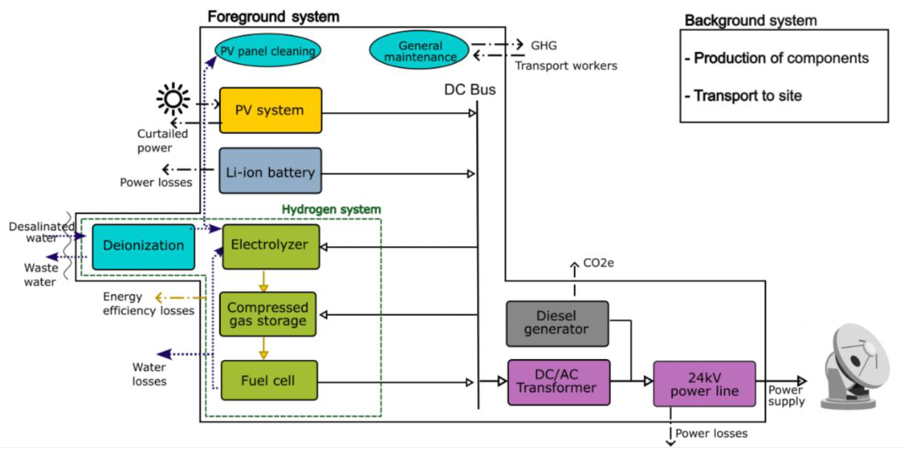
AtLAST project (2021-2024)
Towards an Atacama Large Aperture Submillimeter Telescope
EU Grant agreement ID: 951815
Main deliverables:
Solid science case (community)
Telescope design
Site selection study
I. Viole+ 2024a, “Sustainable astronomy: A comparative life cycle assessment of off-grid hybrid energy systems to supply large telescopes.” Int. J. Life Cycle Assess, 29, 1706-1726
I. Viole+ 2024b, “Integrated life cycle in off-grid energy system design – uncovering low hanging fruit for climate mitigation” Applied Energy Vol. 367, 123334
I. Viole+ 2023 “A renewable power system for an off-grid sustainable telescope fuelled by solar power, batteries and green hydrogen. Elsevier Energy, 2023, 128570.
G. Valenzuela-Venegas+, 2024, “A renewable and socially accepted energy system for astronomical telescopes”. Nature Sustainability (2024), doi:10.1038/s41893-024-01442-3
Operations plan
Energy studies

Slide 9
AtLAST-2 (2025-2028)
Coordination. PI. Claudia Cicone
Consolidating plans for the Atacama Large Aperture Submillimeter Telescope
Project
14 participants
Grant agreement ID: 101188037
Funded with 4 M€
Objectives
Consolidate the AtLAST concept
Prototype and test technology solutions
Perform a full lifecycle assessment of the facility
Expand our user community
Increase TRL of crucial components
Be ready for the implementation phase
+ 5 partners

Slide 10
Key operations concepts
24h observing (service mode) interrupted by maintenance periods
Combination of survey projects and PI science
Remote operation (world-wide) supported by local operation
Dynamic AI-assisted scheduling
Adequate monitoring of telescope systems and environment
High-quality data to enable the best science
Data (raw and reduced) to be archived and become publicly available after a 1-year propietary period
Effective Interaction channels between PIs and observatory
Adequate data accessibility and long-term preservation (legacy value)
Sharing of and synergies with existing infrastructures (transfer, HPC, storage, preservation)

Slide 11
AtLAST data
Data categories
Aspects to consider
Scientific data
Level 0 (raw)
Level 1 (calibrated)
Level 2 (science-ready)
Level 3 (special products)
Data model and documentation (metadata)
Software and tools
Planning tools
Operational
Data analysis
Enormous data rates and volumes
Data location (remote operation)
Simulated science data
Data sharing, interoperability
Engineering/technical data
Reproducibility
Weather data
Antenna and instruments
Power, cooling, computing
Processes, timing
Long term preservation
Local weather station
WV Radiometer
Atmospheric model
Forecasts
Re-use of existing data and infrastructures

Slide 12
AtLAST data will be
Findable
Datasets Uniquely identified. Described with accurate and rich metadata. Follow IVOA standards
Accessible
AtLAST portal + astronomical data portals. Open Access after limited proprietary period.
Interoperable
Interactive and programmatic access. Alert system for transient sources.
Clear data provenance. Calibration files and pipelines accessible and version controlled
Reusable

Slide 13
AtLAST Interface for Remote Exploration (AIRE)
Technical and scientific documentation
Proposal preparation tools
Proposal review tools
Phase 2 preparation
A I R E
Observations follow up
Interaction channel during observing run
Access to Archive
Simulation, reduction and analysis tools, notebooks
Support centre
Scientists
Proposal reviewers
Archive users
General public
Archives and Data Management Systems (CNR Bologna, 2025 Feb 26-28)
13

Slide 14
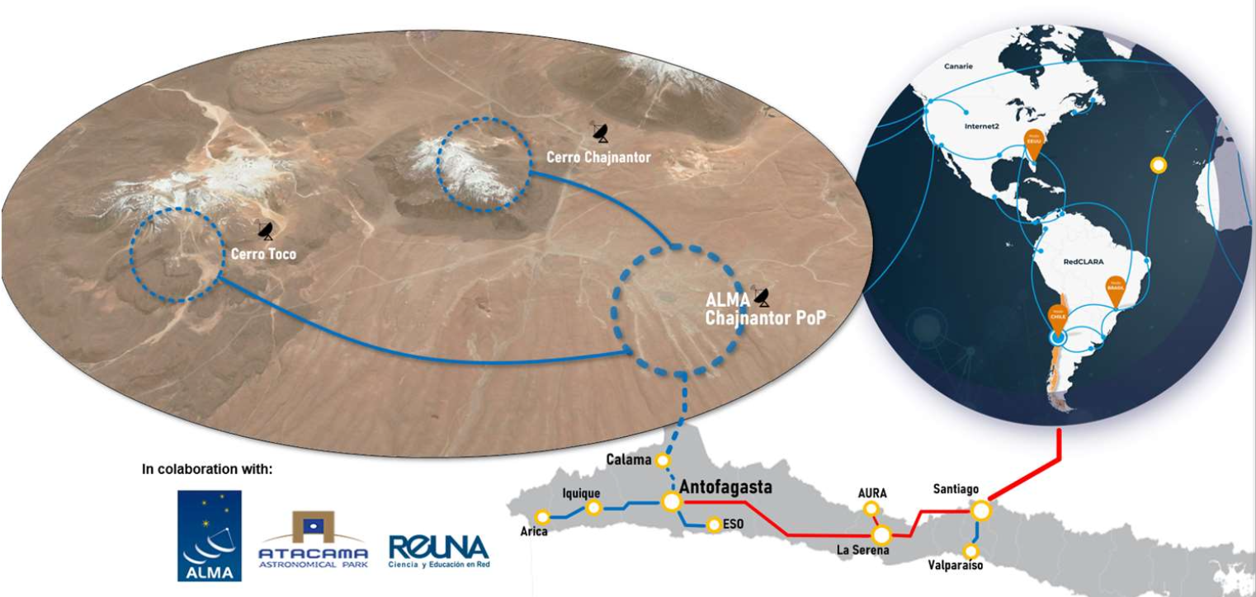
Existing infrastructures
Improved infrastructure is being developed rapidly on the Chajnantor plaeau. AtLAST will need rapid and efficient data transfer capabilities, which is essential for the kind of operations model we are considering.
REUNA (National research and education network in Chile) coordinated with ESO and ALMA to improve connectivity to Chajnantor plateau
Individual observatories to be responsible for the last part of the connection to the main system.
Connection to Cerro Toco / SO complete
Current target for overall 100 Gbps capacity
Very large data volumes are a common features of most new facilities; new solutions need to be developed for long term storage, access, availability.
On-site data reduction strategies?
Synergies advantageous for joint science analysis
Archives and Data Management Systems (CNR Bologna, 2025 Feb 26-28)
14

Slide 15
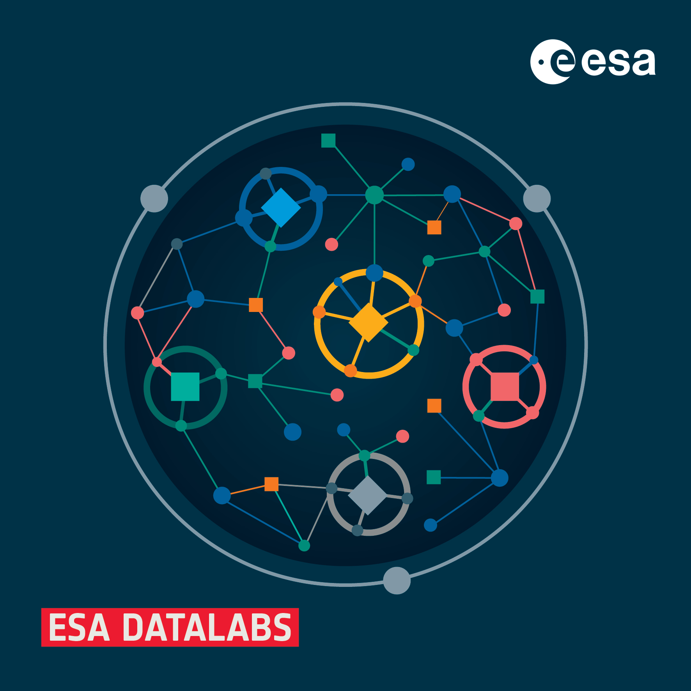
Inspiring existing efforts
Agile and Cognitive Cloud-edge Continuum management
Ongoing EU project. Grant Agreement 101093129
One use case is to demonstrate an efficient distributed processing of astronomical data cubes (100s of TB)
Use of microservices
Encapsulation of tools within containers
Container orchestration platforms
Compression, binning techniques for memory management
Software optimization
Scalability of software
V. Navarro, S. Del Río, M. A. Diego, et al. (2024), ESA Datalabs: Digital Innovation in Space Science.
https://doi.org/10.1007/978-981-97-0041-7_1
Archives and Data Management Systems (CNR Bologna, 2025 Feb 26-28)
15

Slide 16
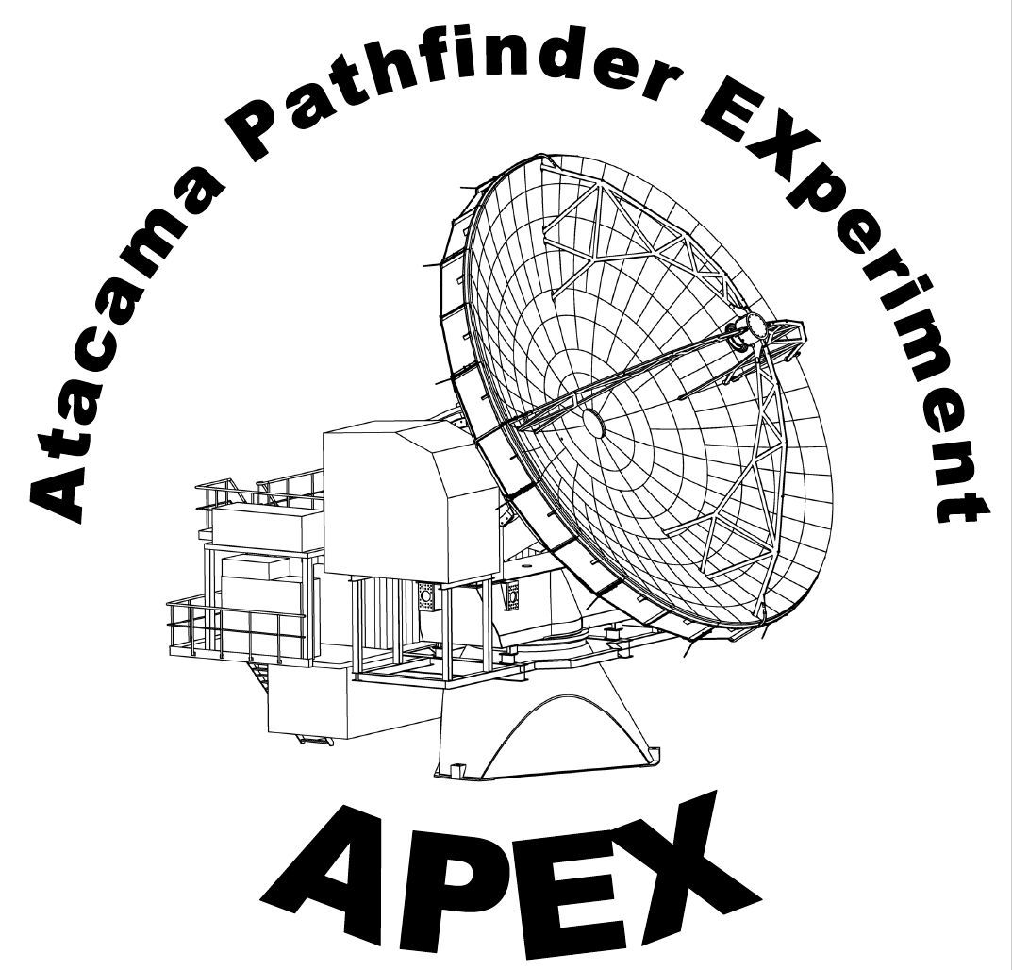
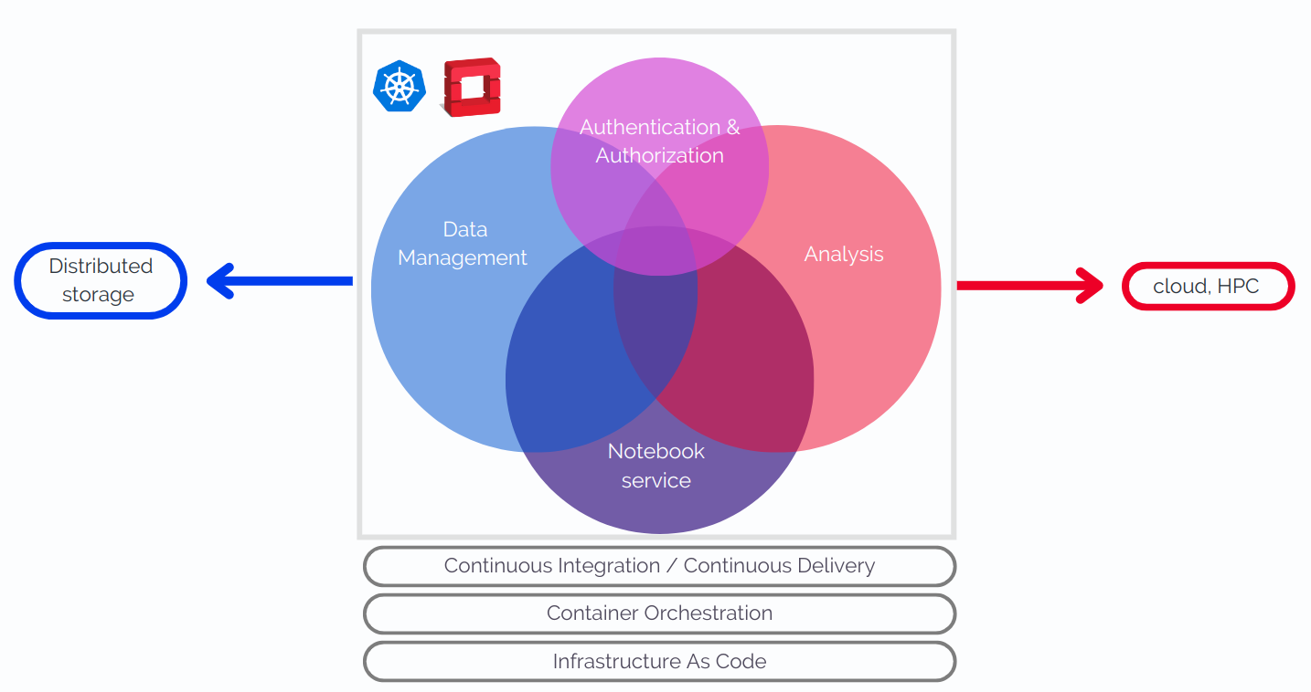
More sources of inspiration
VRE at CERN
This workshop!

