Slide 1

Science with the SKA Observatory
Dr Anna Bonaldi, Senior Scientist
SKA Cosmology SWG meeting 4/11/24

Slide 2
Commissioning Timeline
AA0.5
  Basic imaging and Tied-Array Beams
  Off-line reduction
  Limited BW/N_{Chan}
AA1
  Plus multiple beams/sub-stations
AA2
  Plus pipeline reduction, more BW/ N_{Chan}
  Science verification!
AA*
  Full BW, N_{CHan}, zooms
  Shared Risk Cycle 0
  PI (and KSP) Proposals!
Concept Credit: Mark Sargent

Slide 3
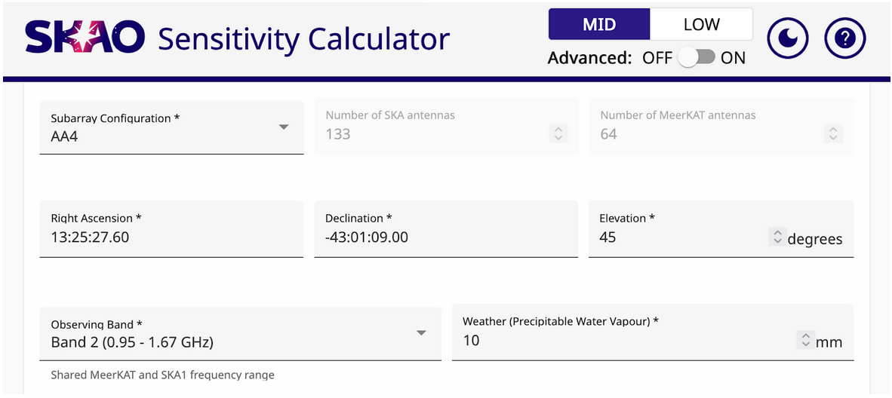
SKA Mid sensitivity calculator

Slide 4
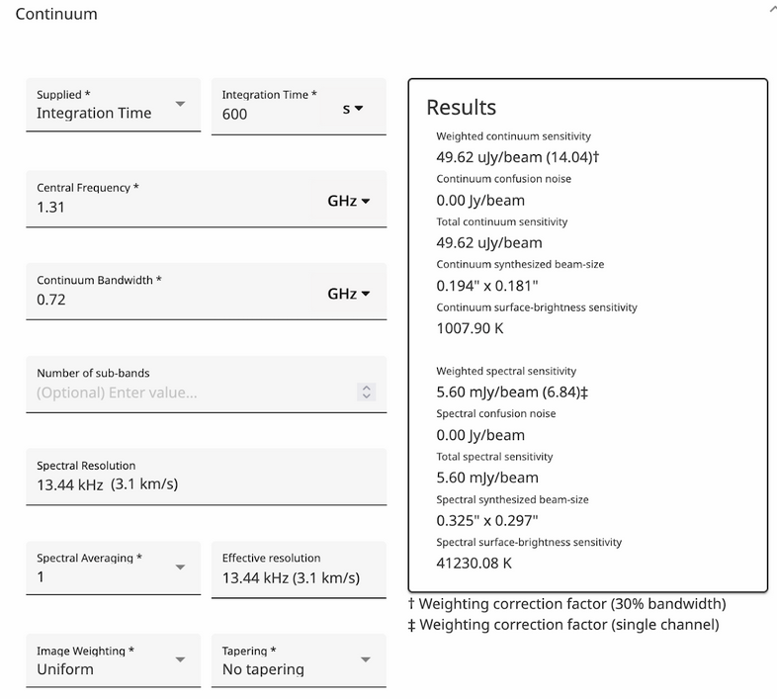
SKA Mid sensitivity calculator

Slide 5
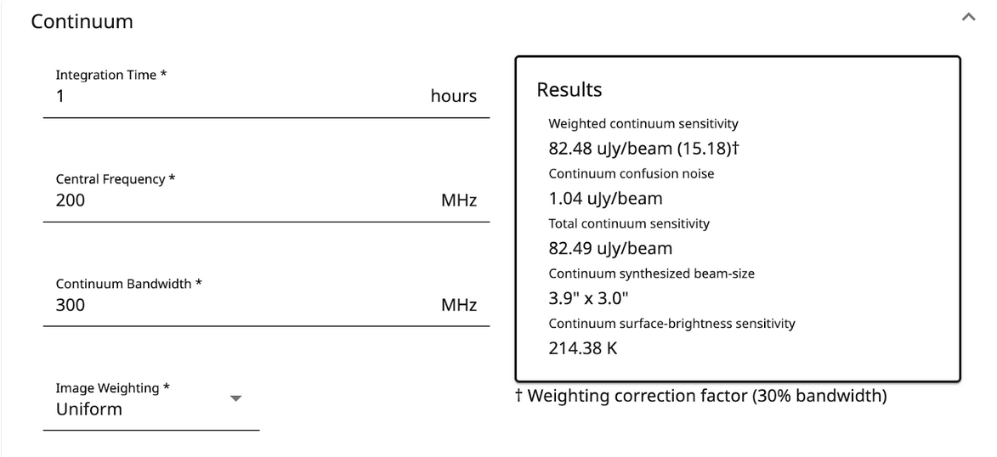
SKA Low sensitivity calculator

Slide 6
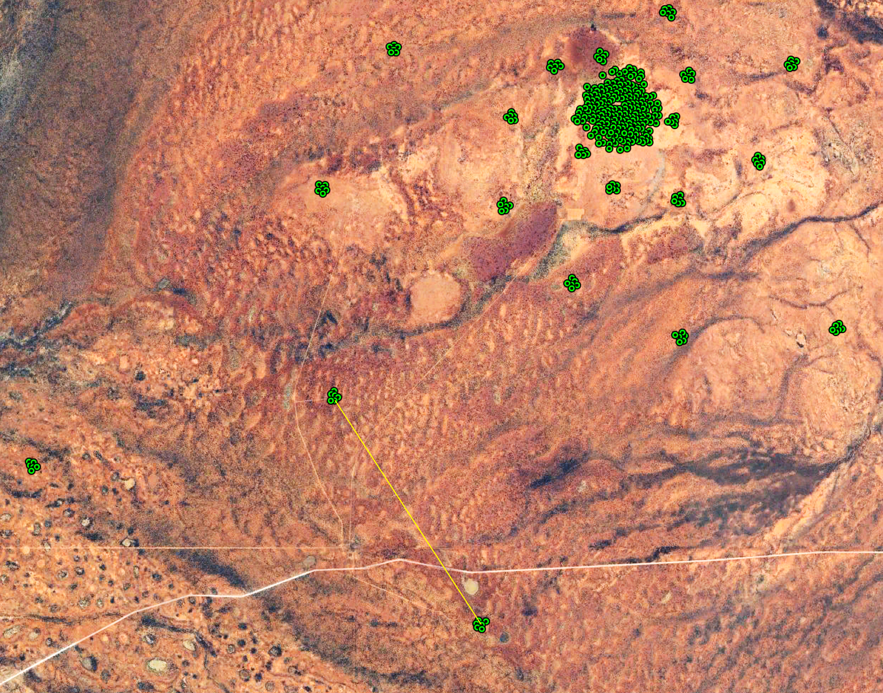
SKA-Low Construction update
All 4 AA0.5 stations!
2 AA1 stations
S8
3.2 km
S10
testing
S9
deployment
Handover to AIV

Slide 7
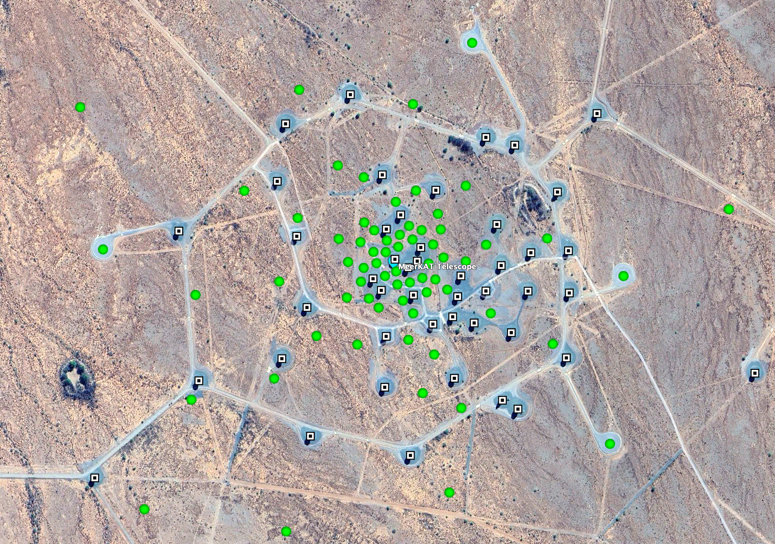
SKA-Mid construction update
SKA036
SKA063
1.36 km
SKA001
Preparing for delivery of MID Correlator Beam Former (AA0.5) and maser later this year and early next year
Band 5 feed and Band 4/5 Receiver procurements closing end of month
SKA100
delivery
deployment
Handover to AIV

Slide 8
Construction Update: Software
Status of AA0.5 Software:
  AA0.5 control system delivered
  AA0.5 Observatory Science Operations tools delivered
  Station pointing and tracking for multi station interferometry - due end of PI24 (Dec 2024)
  Enabled Pointing calibration and Holography modes but not implemented -due end of Q1 2025.
  Data product sub-systems for AA0.5 are largely ready
Status of AA1, AA2+Software:
  AA1 subsystems functionality uplifts underway
  Anticipated hardware limitations for AA2+ delivery at scale
  PSS and PST are lower risk but have not been reviewed yet.
  OSO tools at various stages of maturity for the different Array Assemblies

Slide 9
2025 Science Meeting: overview
Name: Advancing Astrophysics II: Preparing for Science with the SKAO
Dates: 16th-20nd June 2025
Location: Görlitz, soon to be the home of the brand new German Center for Astrophysics (Deutsches Zentrum für Astrophysik, DZA)
Numbers: In person: ~300 (Virtual attendance to be supported for all sessions)
Themes:
  Noting the transition from SKAO commissioning to science verification and observing
  The science meeting will feature presentations from authors of the new SKA Science Book. While the book will provide an up-to-date coverage of the science questions that will be addressed by AA4 (and beyond), at this meeting we will hear about the opportunities for early SKA science: presentations will focus on AA* capabilities
Plenary sessions
    Organised by broad Science theme, following book section themes
    Plus “Observing with SKAO” special plenary session
Parallel sessions
    In order to facilitate SWG interaction and collaborations, organise into SWGs
      Will also enable Operations to be able to tailor talks for different technical requirements
    1.5 days dedicated to parallel sessions
  Posters (with lightning talks)

Slide 10

Science Book: overview
“Advancing Astrophysics II: Preparing for Science with the SKAO”
This will be an updated version of the existing SKAO Science Book
Some chapters may not have changed much; some will have evolved; some brand-new chapters based on new science cases
Aim is two-fold:
  Facilitate SWG-coordinated chapters (both new and updated)
  Opportunity for researchers to connect with and join the SWGs
The new book will provide an up-to-date coverage of the science questions that will be addressed by the full design baseline (and beyond).

Slide 11
Science Book content
Goal of individual chapters
Self-contained description of a science application including background and motivation
  Main focus of a chapter:
    Demonstrate the science outcomes that are enabled by the capabilities of a particular component of the SKA design baseline, Array Assembly 4 (AA4)
  Supplementary focus:
    Document the extent to which scientific outcomes might be achieved by the end of staged delivery (AA*)
    Document the types of enhancements to the design baseline that could further support the science goals
  Also consider:
    Highlight synergies with other instruments
    Guidance on SKAO commensal observing to be provided to chapter authors

Slide 12
Science Book structure
Science book editorial board
SKAO Science Team and SWG chairs
Book sections
SKAO introduction
A set of SWG introduction chapters
  A high-level overview of the activities of each SWG
  Describing how the various science chapters fit into the work of the SWG
  Also looking at the technical aspects of the group’s work, particularly for the more technically-themed SWGs
  Page length TBD
  The introductory chapters will be written once all science chapters are available

Slide 13
Science Book structure: science sections
broad categories confirmed; lay questions will be added to/modified according to chapter submissions
Section title
Lay “big questions”
(Related SWGs)
Planetary systems
How do planets form? Are we alone?
(All relevant SWGs)
Sun and Stars
How do galaxies turn gas into stars? How do stars behave at the centres of galaxies?
(All relevant SWGs)
Galaxies
How do normal galaxies form and grow? What resides in the space between galaxies? Why do galaxies have huge black holes at their centres? Why do only some quasars produce powerful jets?
(All relevant SWGs)
The Cosmos
How and when did the first stars and galaxies form? What is the large-scale structure of the Universe? What are dark matter and dark energy? What is the role of magnetism?
(All relevant SWGs)
The Extreme Universe
Was Einstein right about gravity? How does matter behave at extreme densities? What are cosmic rays? What new physics will particle cascades unveil? What are Fast Radio Bursts? How do supermassive black holes collide?
(All relevant SWGs)

Slide 14
A flexible, two-phase approach
Phase 1: Call for chapter abstracts, deadline September 30th
Phase 2: Authors invited to prepare advanced drafts of chapter manuscripts, deadline February 28th
Flexible approach:
  Recognising that work on chapter updates has been ongoing in some SWGs since early 2024 or before, some authors might be invited to begin preparing draft manuscripts prior to the Phase 1 deadline
  Remaining authors might be invited after the September 30th deadline

Slide 15
Current status (Science Book):
Updates from SKAO
External Expressions of Interest call closed end September
  216 Submissions collated and shared with SWG chairs via google sheet
Second google sheet to collate all chapter titles (internal to SWGs and external in one place
Instructions for Authors and LateX template shared
Suggest a further meeting of SWG chairs, facilitated by SKAO, end Oct, to take a look together at the collated list of abstracts and identify gaps and crossover (noting that the number of working groups has grown since 2015)

Slide 16
Coordination of book chapters
(see Coordination of chapter submissions)
Chapter Call Phase 2:
SWG chairs will compile a list of chapter titles based on abstracts received (both internally and externally) and on internally-identified updates, evaluating for overlaps, duplication and any gaps.
  Coordination between SWG chairs on overlaps
    SWG only
    Oxford Abstracts (many submissions indicated multiple SWGs)
    All submissions
Chairs to invite authors to prepare draft chapter manuscripts.
We encourage all viable science ideas to be submitted as chapters for the book; note that we are not bound at this stage by a maximum number of submissions.
At this stage we will request advanced drafts for submission
Full instructions for authors and a LaTeX template will be provided
Submissions to be made by draft authors to online submissions platform
Deadline date for advanced drafts: February 28th

Slide 17
Coordination of book chapters
(see Coordination of chapter submissions)
Talk/poster selection in March 2025:
The 2025 Science Meeting Scientific Organising Committee will select a set of draft chapters for presentation at the meeting.
Authors invited to focus presentations on the early science opportunities from the first few years of Operations (AA*)
Presentations to be given in the form of plenary talks, splinter session talks, and posters (accompanied by ‘lightning’ talks).

Slide 18
Science Book: final submissions and publishing
Chapter reviewing will take place after the meeting
SWG chairs to suggest reviewers for individual chapters
Editing by SWG chairs and SKAO Science Team
Publish online versions with some hard copy
  Hard copy versions: could be printed as individual sections
  Mindful of the environmental impact and cost of physical books
  Online version: facility to update over time (as is possible on ArXiv, for example)
  Looking at either Proceedings of Science https://pos.sissa.it/ or SKAO hosting

Slide 19
Timeline
June 2024 Save the Date announcement
July 2024 Chapter abstracts sought
September 30th 2024 Chapter abstract deadline
October 1st 2024 Submission platform open for advanced drafts of chapters
November 2024 Conference poster launch
Mid December 2024 Launch website
February 28th 2025 Submission period ends
Mid/late Jan 2025 Registration open
Feb to mid-March 2025 Talk/poster selection
Mid March 2025 Speaker notification
March 2025 Early bird registration close
May 2025 Registration close
June 16th 2025 Meeting begins
Second half of 2025 Final book chapter reviews and publication

