Slide 1
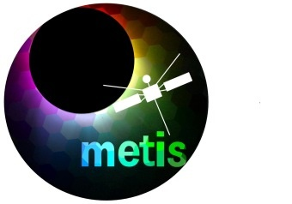

Synergies in high-resolution observations of the solar atmosphere to investigate small- to intermediate-scale energy release events
2nd Metis Science Meeting
January 27-29, 2025
Capodimonte Astronomical Observatory, Naples
Salvo L. Guglielmino¹,
I. Ermolli², M. Murabito², F. Ferrente¹, V. Andretta³, D. Spadaro¹, P. Romano¹
¹INAF – Osservatorio Astrofisico di Catania, Italy
²INAF – Osservatorio Astronomico di Roma, Italy
³INAF – Osservatorio Astronomico di Capodimonte, Italy

Slide 2

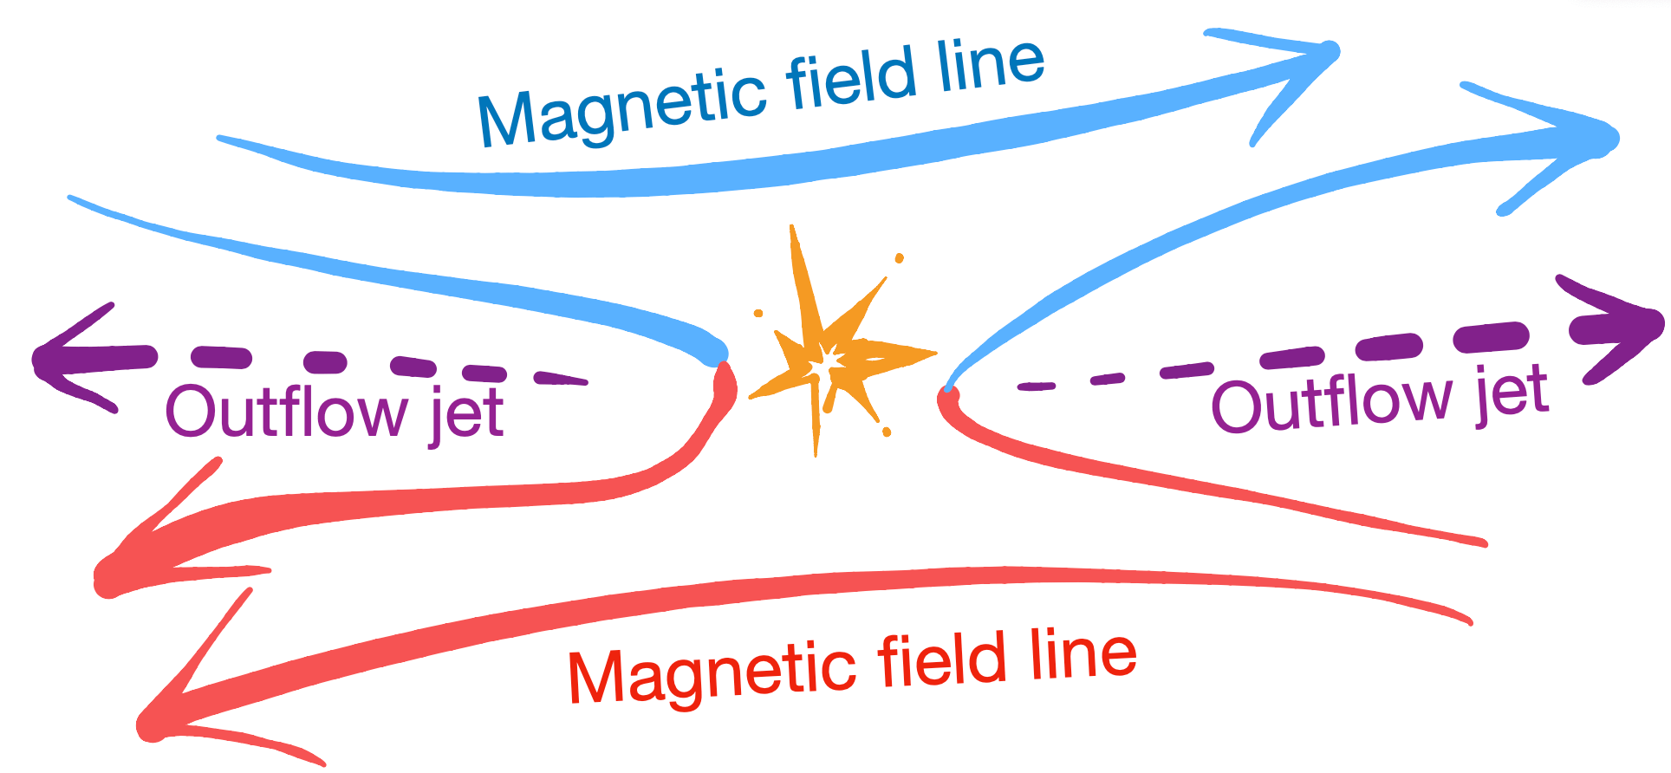
Scientific context
The impact of emerging flux regions (EFRs) on the upper atmosphere is “hot” topic in Solar Physics
Energy release may occur as a result of the interaction of new magnetic flux with the pre-existing magnetic environment
    brightening, ejections
    coronal heating
    flaring events, CMEs
The main responsible is magnetic reconnection
All these transient enhancements exhibit opposite magnetic polarities that meet
at the photospheric level

Slide 3
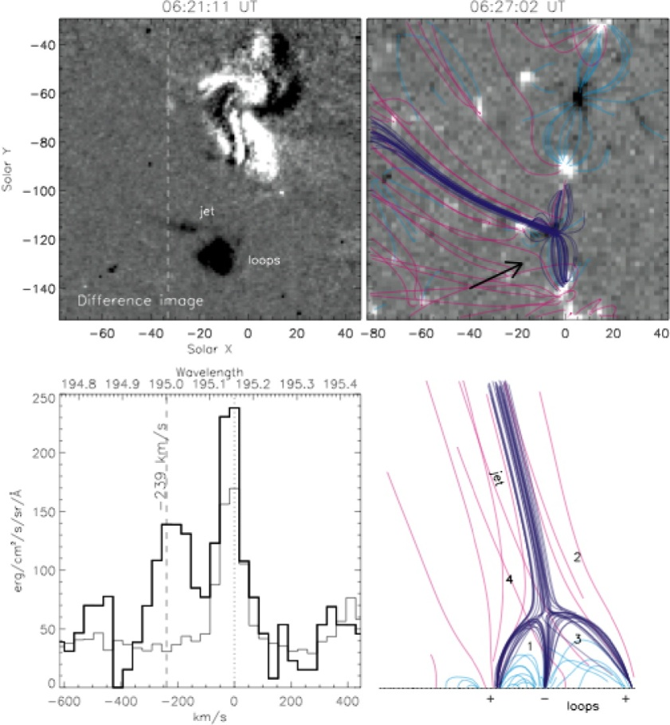
Interactions between new and pre-existing flux
Large Scale (≈100 Mm)
Hot jets in Hinode observations during flux emergence in coronal holes (Moreno-Insertis+ 2008)
Not-confined flux emergence as CMEs source (e.g., Romano+ 2014)
Small Scale (<10 Mm)
Regions characterized by transient enhancements and jet-like ejections all exhibit the presence of opposite magnetic polarities that come into contact with and/or cancel each other in the photosphere
Observations of small-scale EFRs and of their chromospheric and coronal response, reported a similar scenario with increasing spatial resolution
e.g. Vargas Domínguez+ (2012, 2014); Ortiz+ (2014, 2016, 2020); Centeno+ (2017), Toriumi+ (2017), Huang+ (2018, 2019), Berghmans+ (2021, 2023)

Slide 4
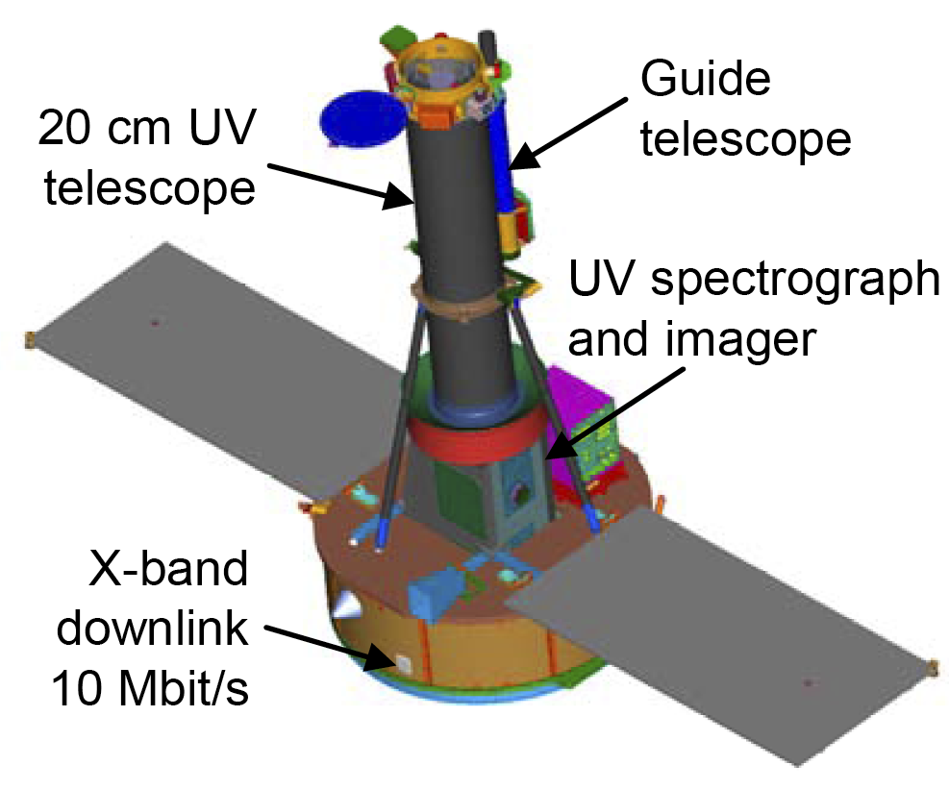
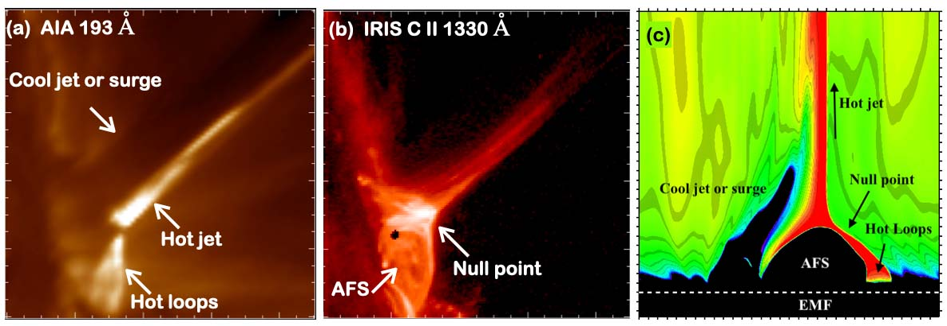
Small-scale phenomena in multi-wavelength observations
Ideal target for joint spectro-polarimetry and imaging campaigns,
combining UV/X-ray data with high-resolution observations
IRIS satellite observed the upper atmospheric response to EFRs, allowing the detection of surges, jets and UV bursts (Young+ 2018)
Similarly, SolO/EUI “campfires” were observed (Berghmans+ 2021)
Joshi+ (2020)

Slide 5
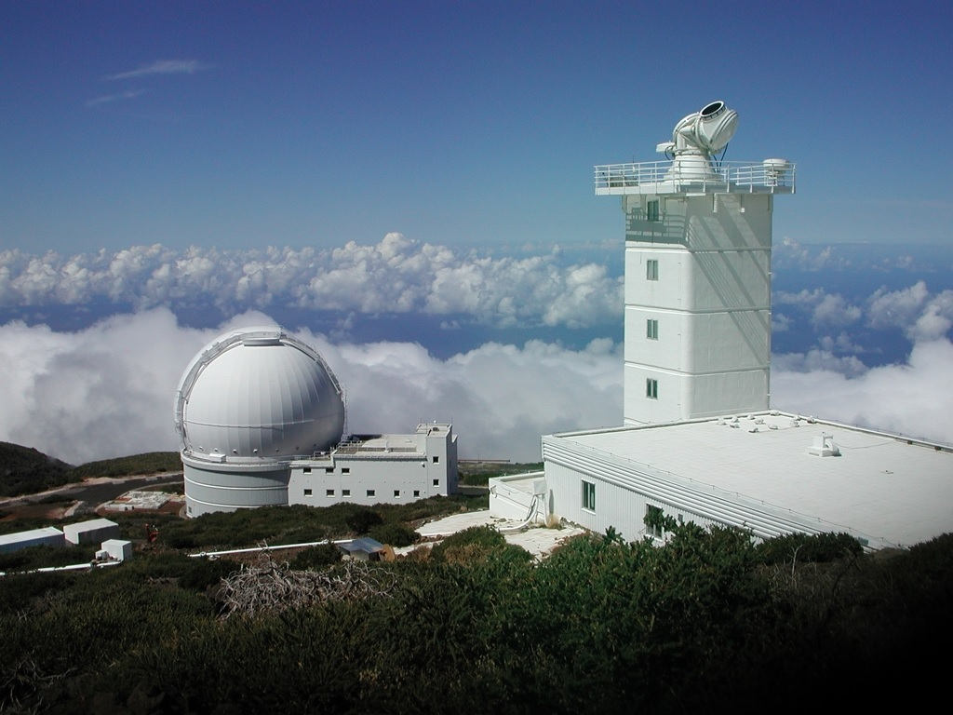
IRIS and SST observations of reconnection events
Active Region NOAA 12585 – SEPTEMBER 2016

Slide 6
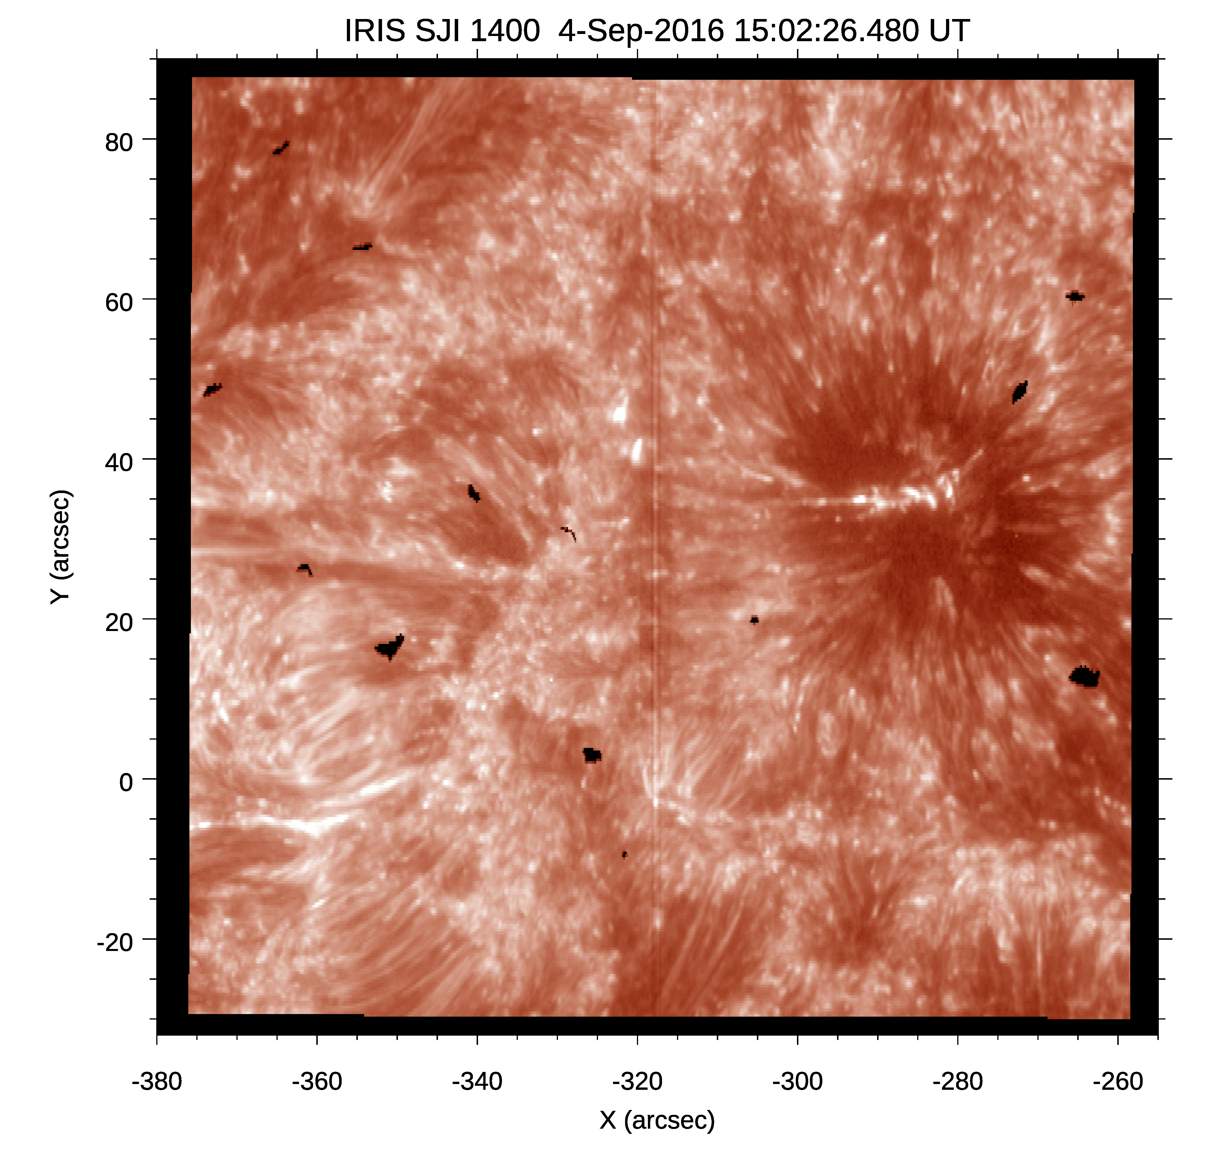
IRIS dataset and context
  Active region NOAA 12585 was observed during decay phase
        Several small-scale magnetic patches
        in the moat around the leading spot
  IRIS acquired a sequence during AR evolution
        It consists of 4 very large dense 128-step rasters, with simultaneous slit-jaw images (SJIs) in the 1400 and 2796 Å passbands
        The scan sequence has a 0".35 step size, a 16.5 s step cadence, and a 15 s exposure time, with a raster cadence of about 35 min
        Acquired between 14:09 UT and 16:39 UT on 2016 September 4

Slide 7
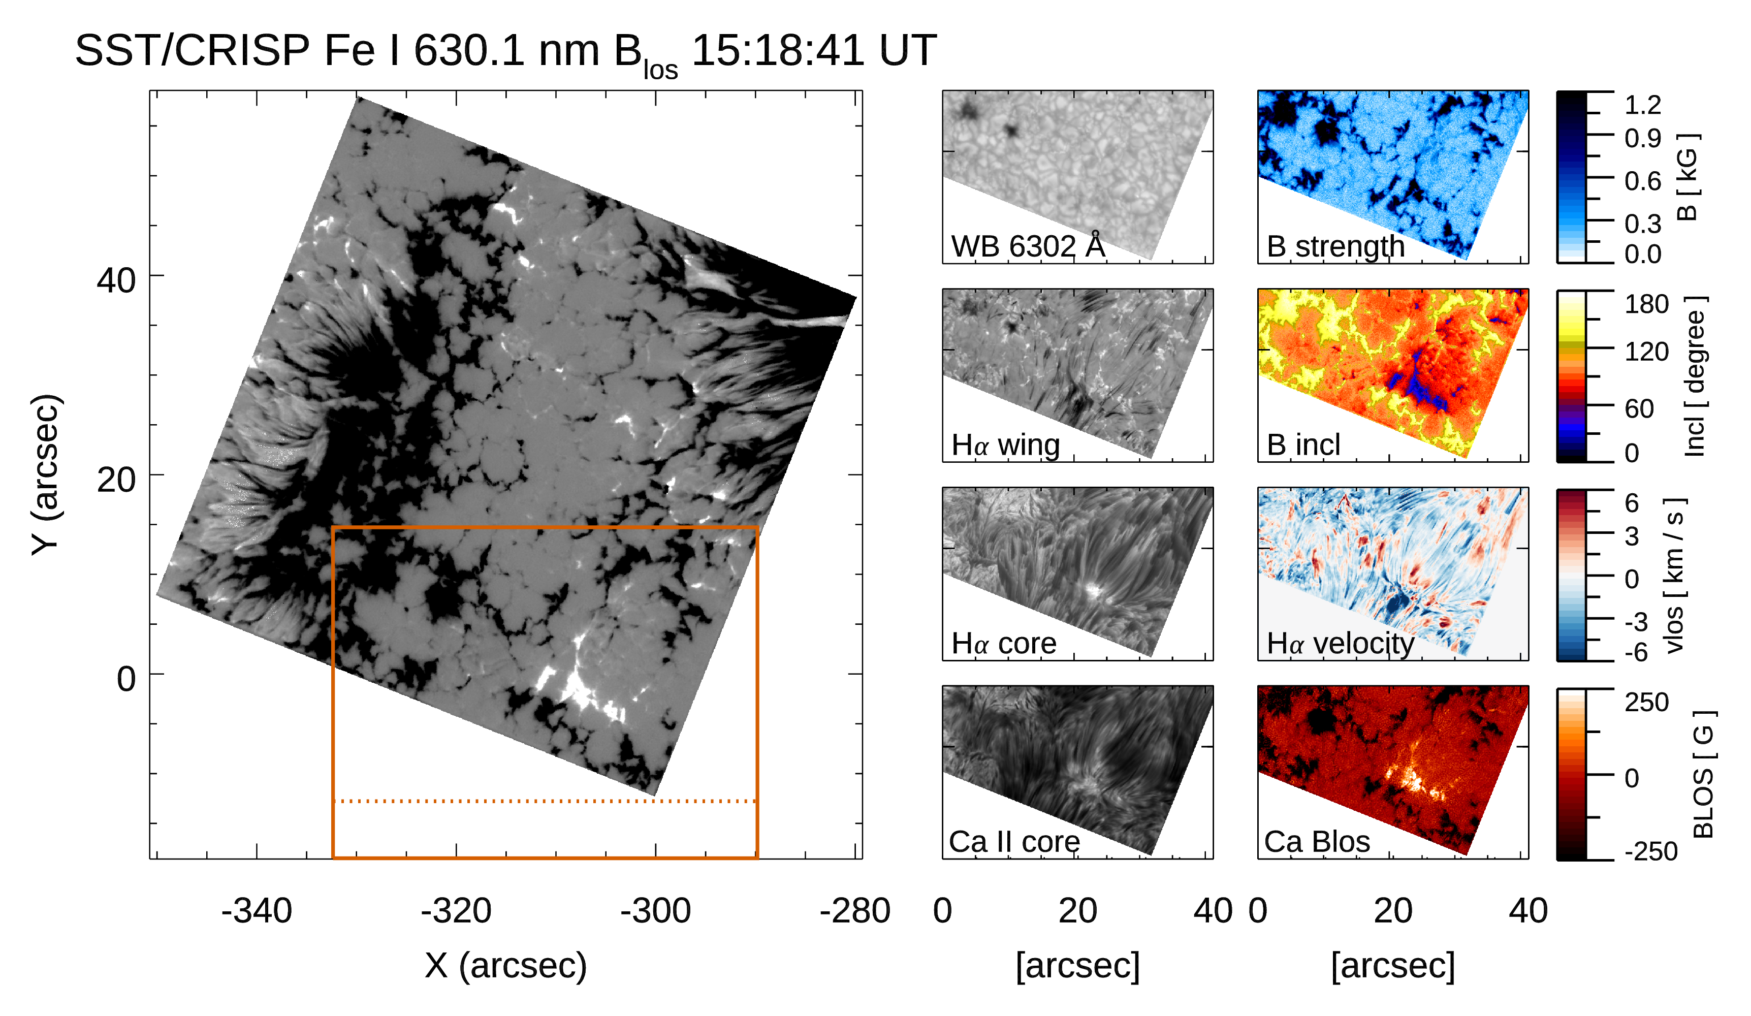
SST high-resolution dataset
  High-resolution spectroscopic and spectropolarimetric data provided by SST (single frame)
  courtesy of L. Ruppe Van der Voort and D. Nóbrega-Siverio
Spectropolarimetric measurements carried out by CRISP
  Fe I 630.2 nm line pair
  Ca II at 854.2 nm line
  Hα line at 656.3 nm (only spectroimaging)
Spectroscopic analysis to derive velocities
Use of Milne-Eddington inversion to derive photospheric parameters
Weak-field Approximation applied
to Ca II 854.2 data

Slide 8
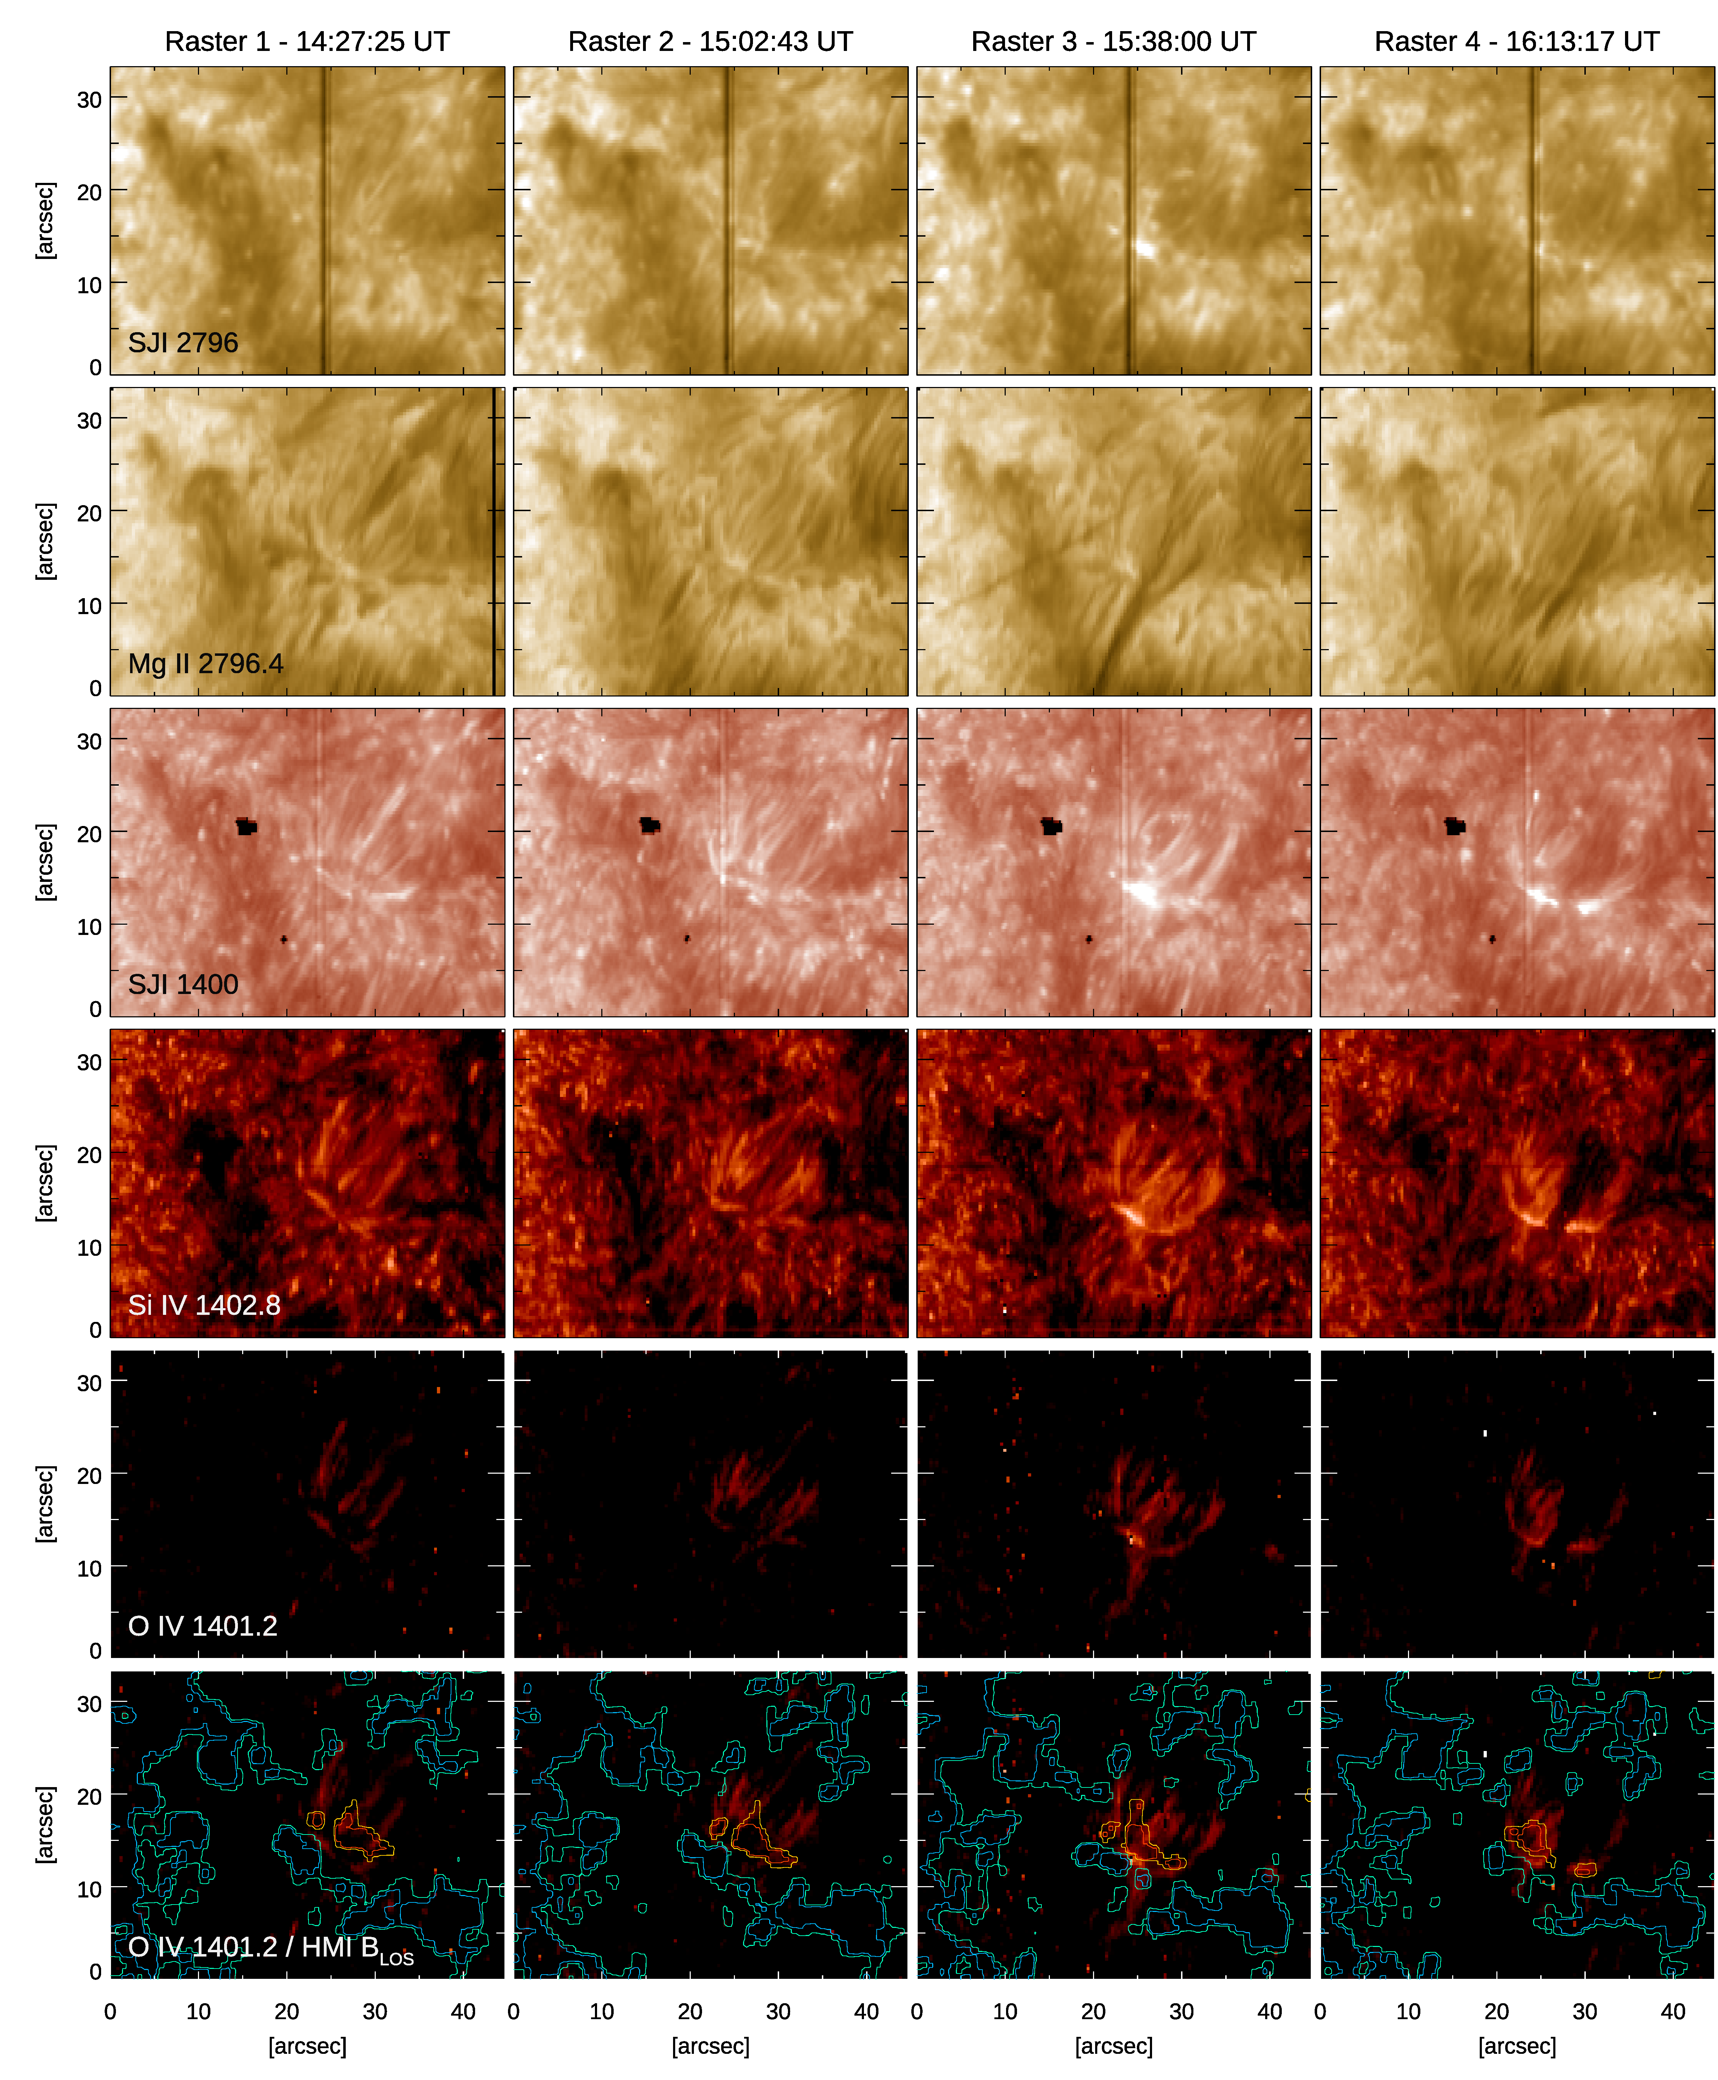
Reconnection in the arch filament system
Co-temporal observations by IRIS indicate energy release events in the arch filament system (AFS) area
Occurring at the base of one footpoint of the AFS observed in the chromosphere
    The event begins when one AFS leg meets the opposite ambient diffuse field: brightening at the polarity inversion line (PIL)
Long duration, with a peak: UV burst
The O IV line emission can be used as a tracer for plasma heating, revealing an unexpected complex configuration

Slide 9
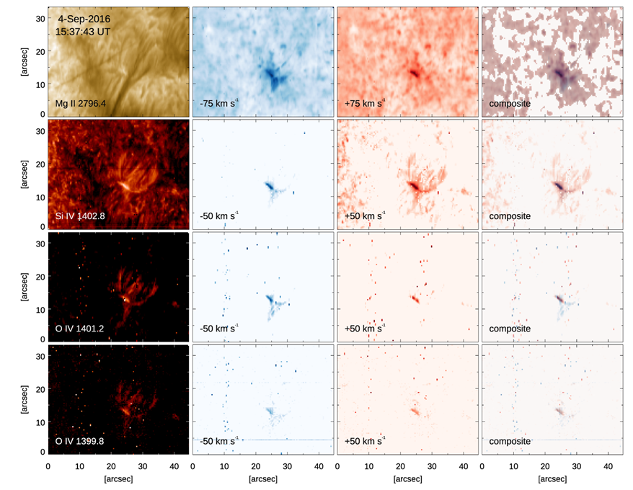
Multi-wavelength imaging spectroscopy
A multi-wavelength approach reveals the complex behavior during reconnection
Indication for jet/surge activity is clearly detected in the line wings, both red and blue
Still, the geometry of the reconnection event is puzzling
To be compared with
information obtained from
SST Hα and Ca II data

Slide 10
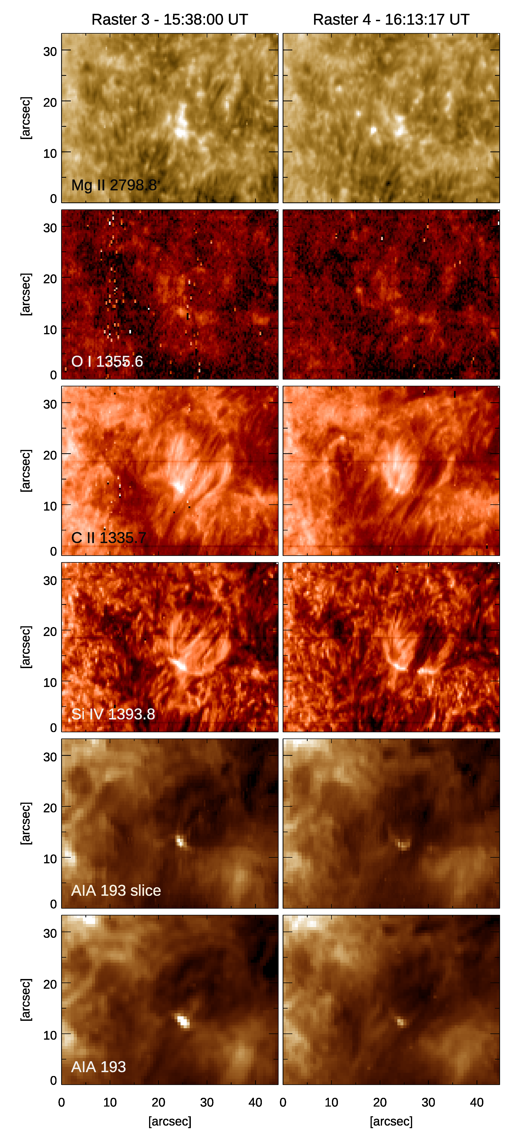
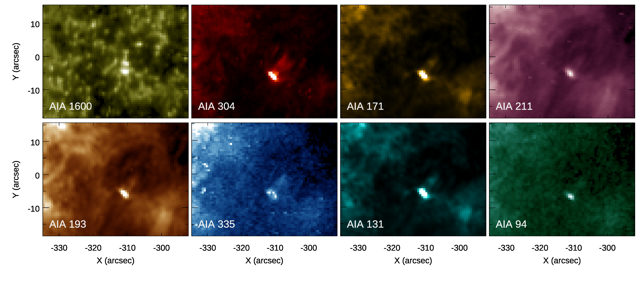
Multi-wavelength imaging in UV and EUV
Emission in Mg II triplet and O I is observed
in bright kernels at chromospheric level
  Complementary information for C II and Si IV
SDO/AIA data indicate a counterpart, both in slice-reconstructed and instantaneous images
Indeed, all SDO/AIA channels show a brightening cospatial to the UV burst

Slide 11
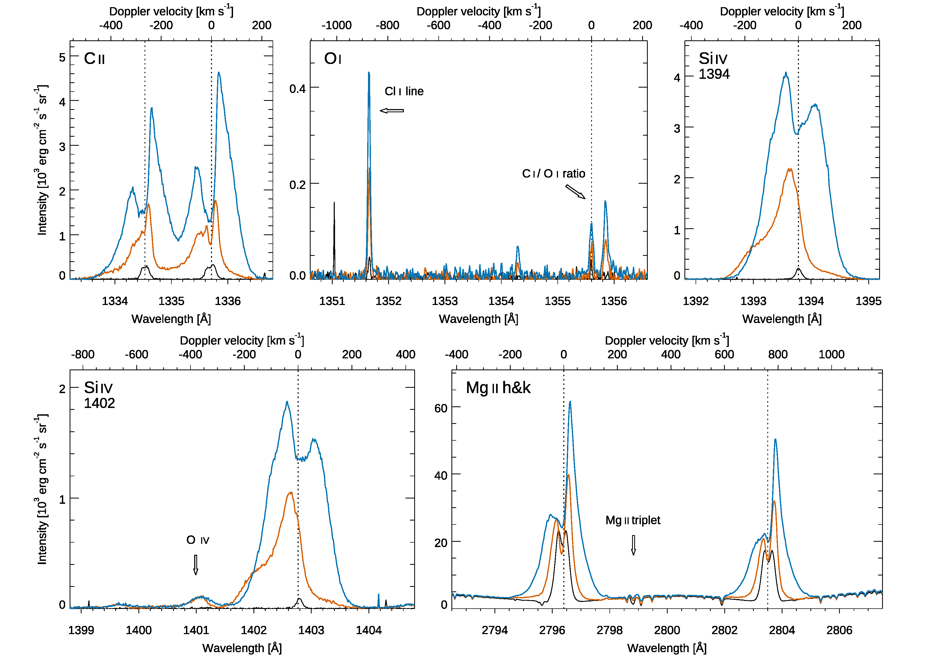
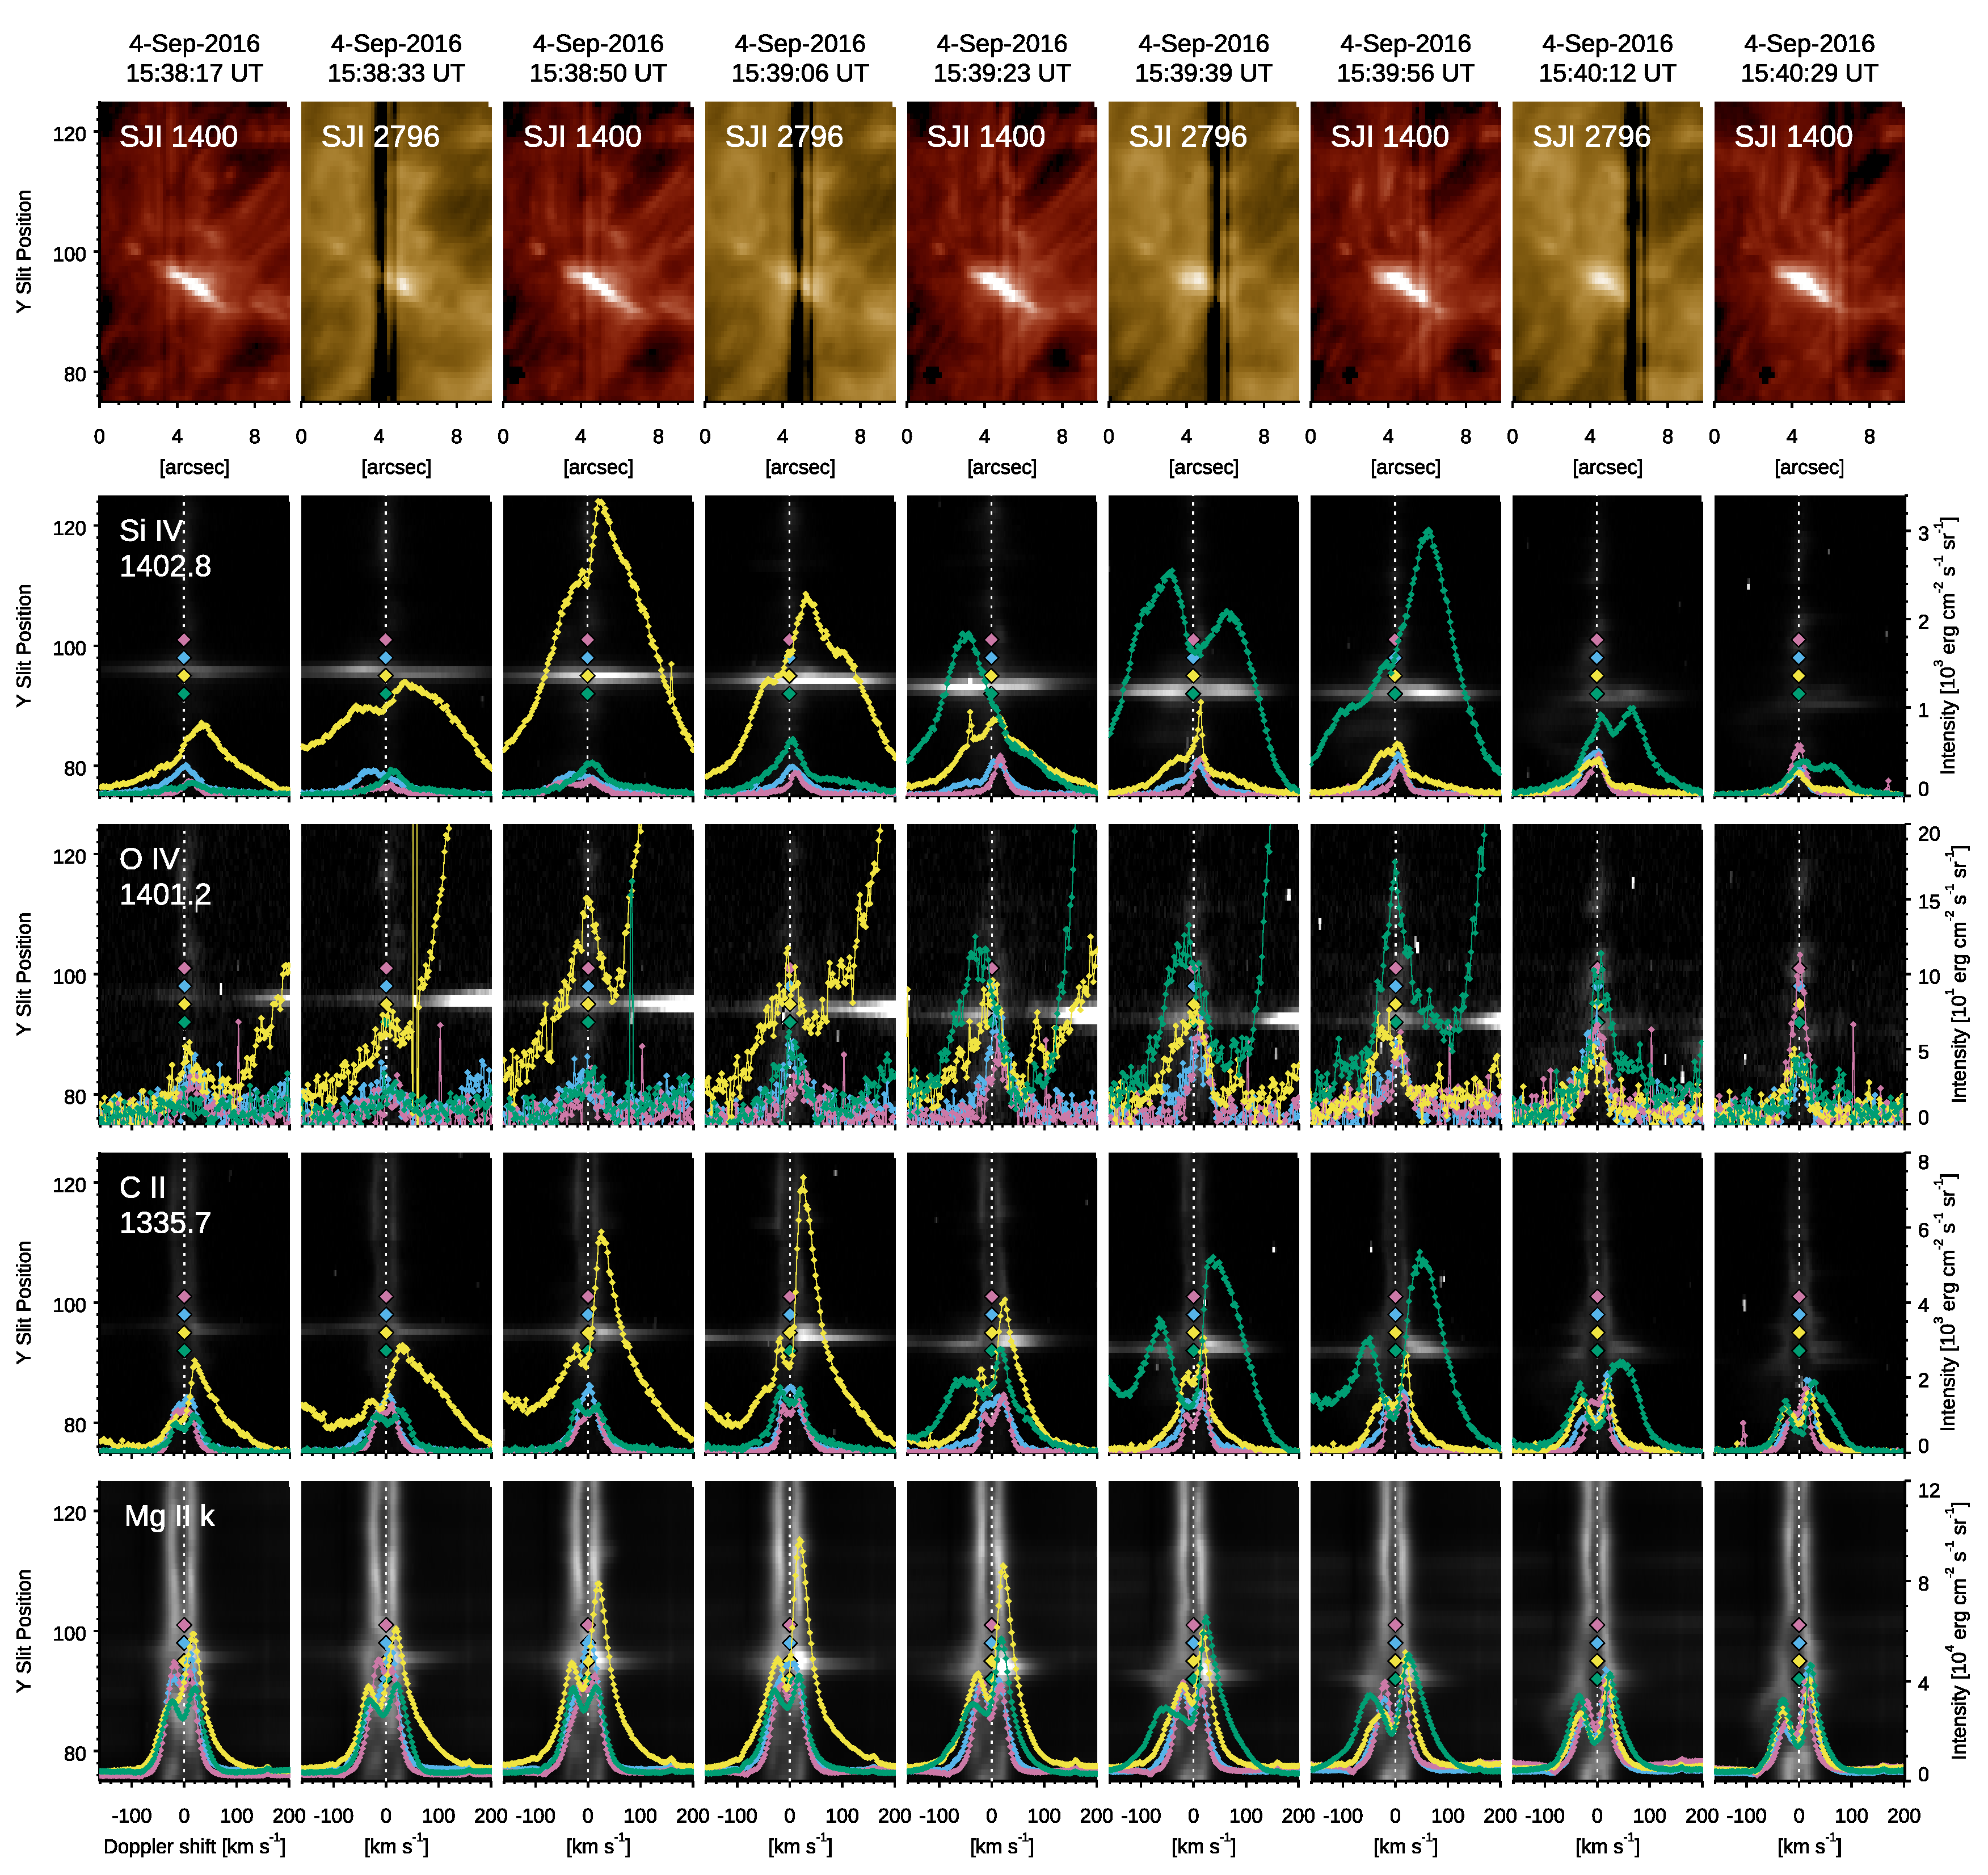
UV spectra and their evolution in the AFS
Localized bi-directional flows, up to +150 km s⁻¹
O IV line at any location
C II strongly asymmetric
Asymmetry is also found at the chromosphere

Slide 12
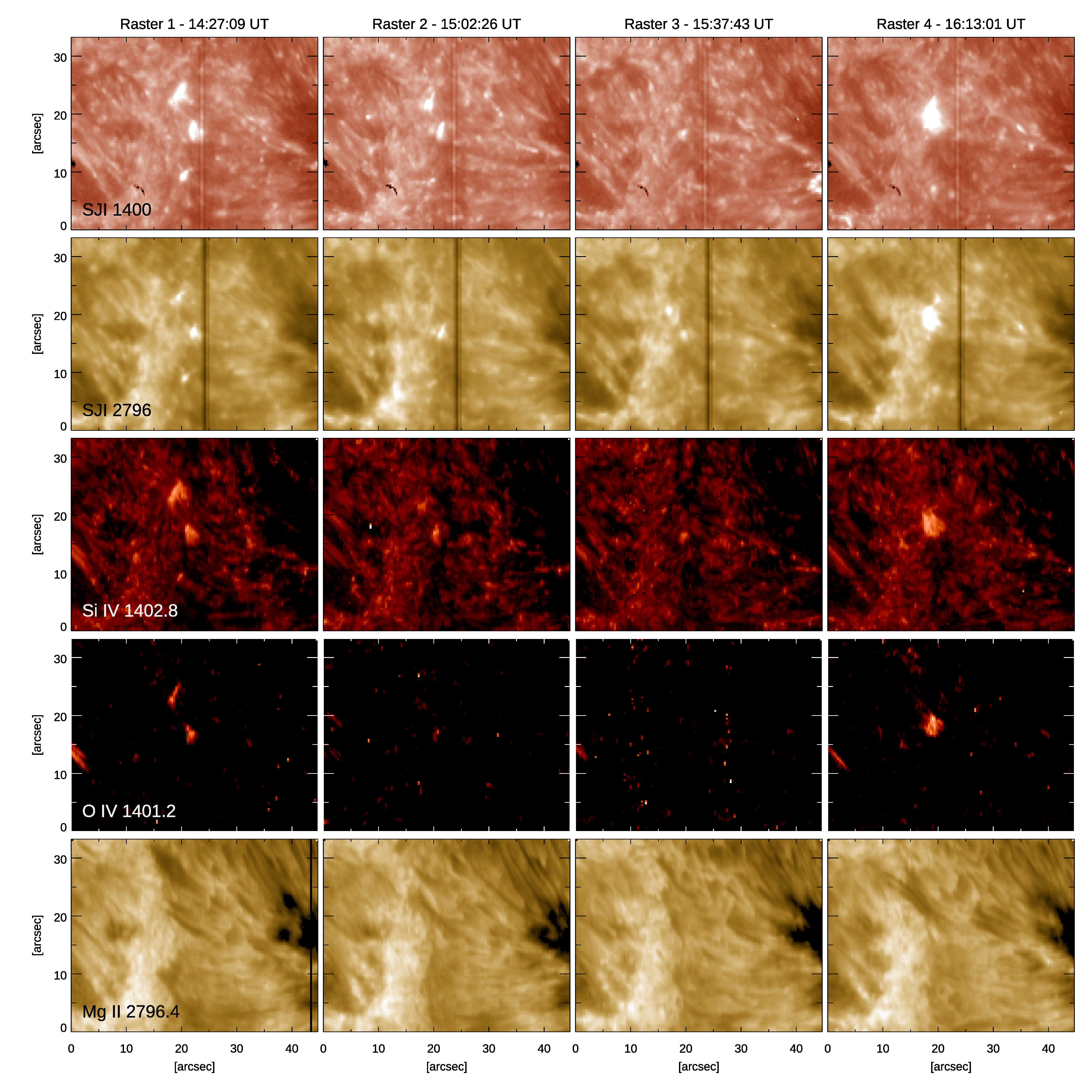
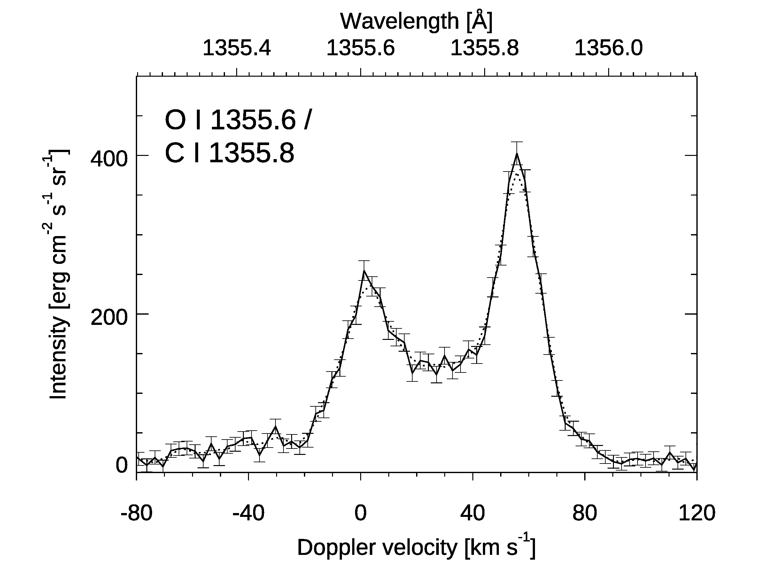
Preliminary analysis for a UV burst
Occurring between a MMF streaming from the spot and a magnetic patch with opposite polarity
Clearly observed in SDO/AIA
Inverted C I / O I ratio, like in flares

Slide 13
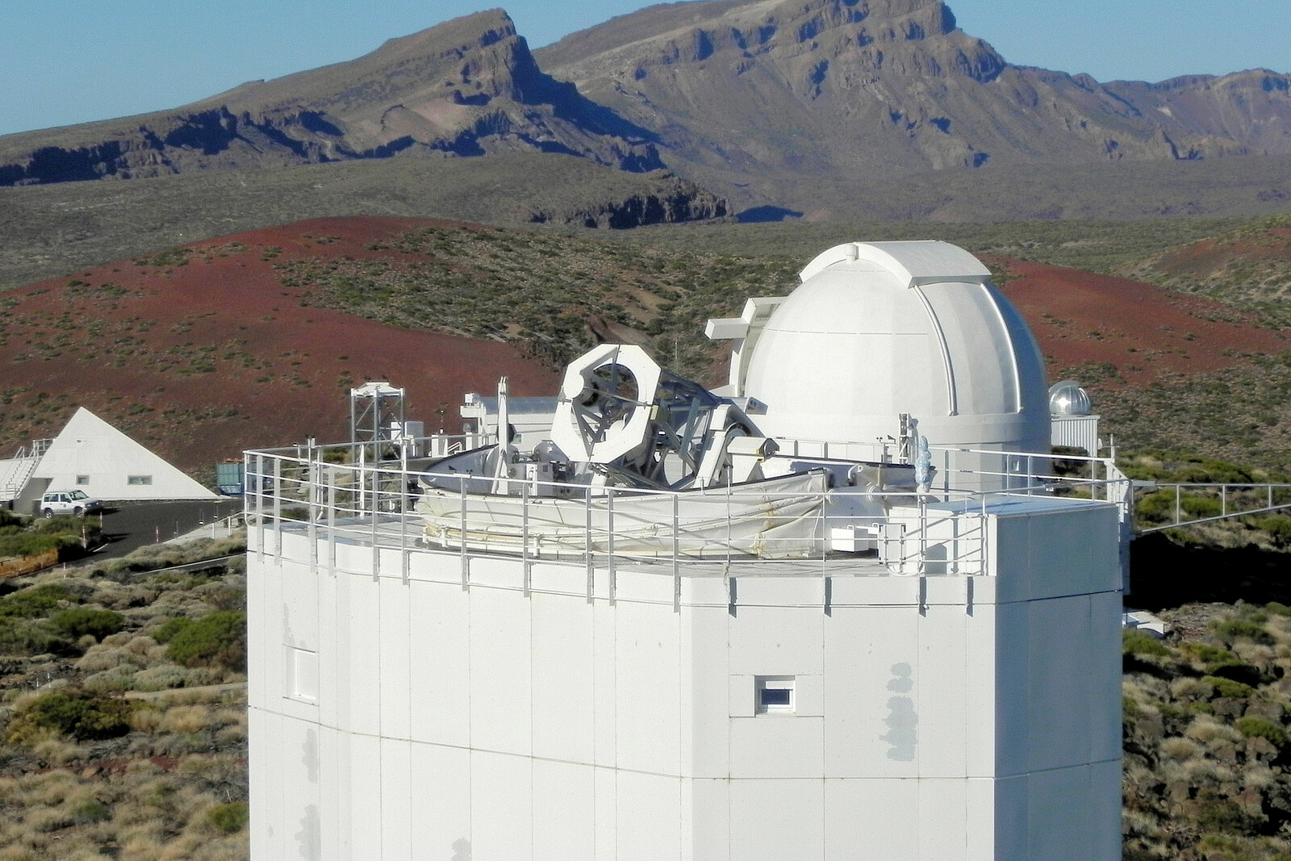
IRIS and GREGOR observations of small-scale energy release phenomena
Active Region NOAA 13392 – AUGUST 2023

Slide 14
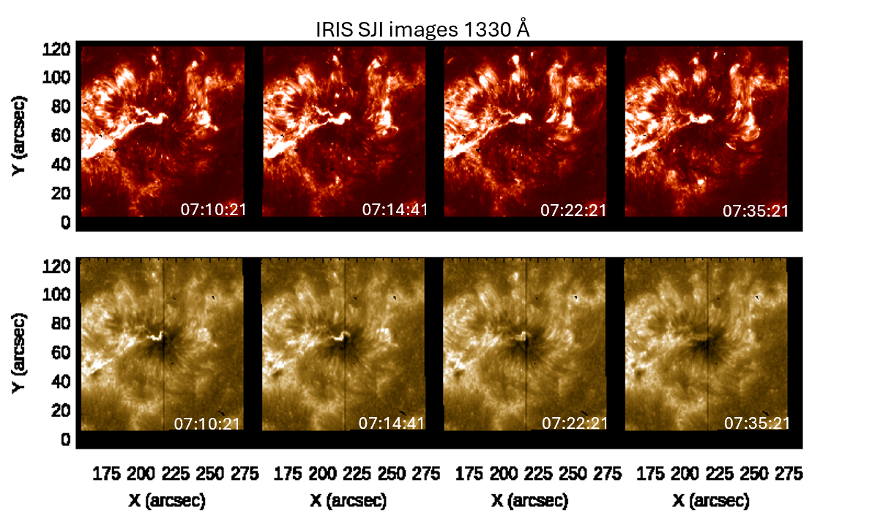
Coordinated observations
10-day observing campaign conducted in August 2023 at GREGOR telescope (1.5 m diameter, Tenerife island), using the High-resolution Fast Imager (HiFI+) and GREGOR Infrared Spectrograph (GRIS)
Coordination with Hinode and IRIS
On August 5, IRIS captured a footpoint of a C-class flare within the leading sunspot of the active region.
On August 6, IRIS detected a small-scale reconnection event
GREGOR HiFI+ – Hα at 656.3 nm narrow-band

Slide 15
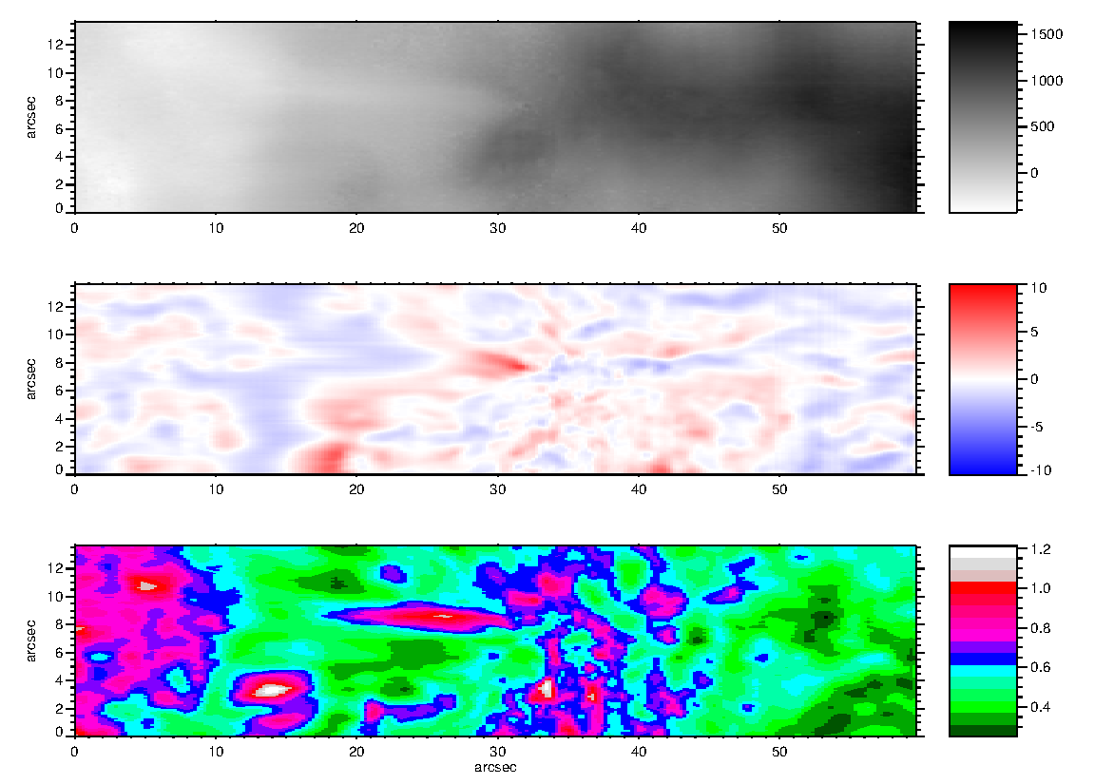
GREGOR observations: GRIS
GRIS observation
Si I 1082.7 nm (continuum)
HAZEL inversion
Longitudinal magnetic field (B_{z})
He I 1083.0 nm (blue wing)
Doppler velocity (v_{LOS})
He I 1083.0 nm (red wing)
Optical depth (τ)

Slide 16
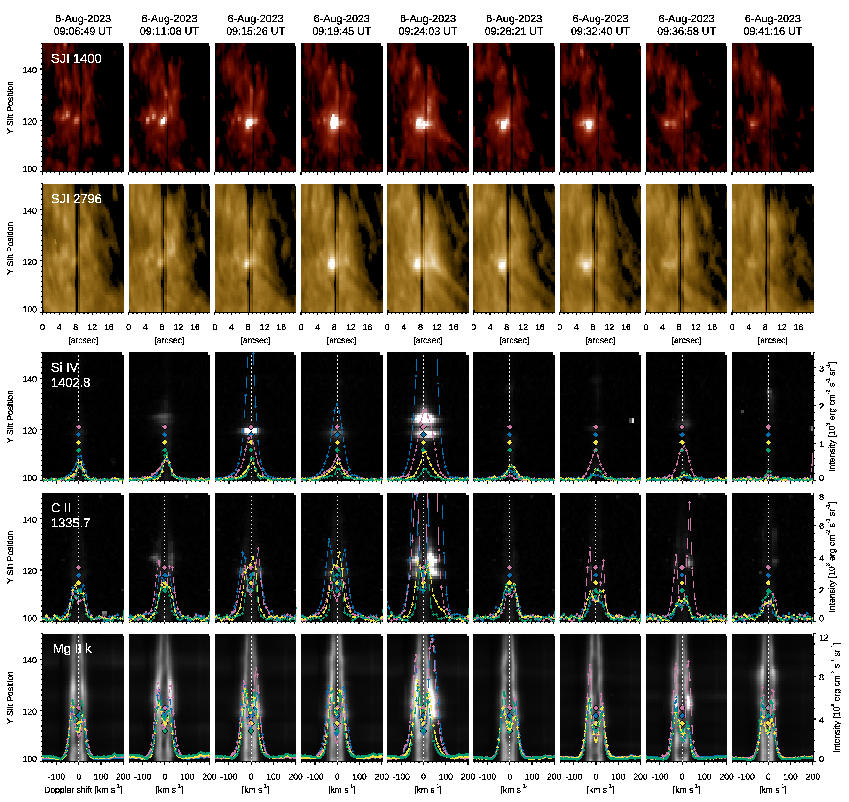
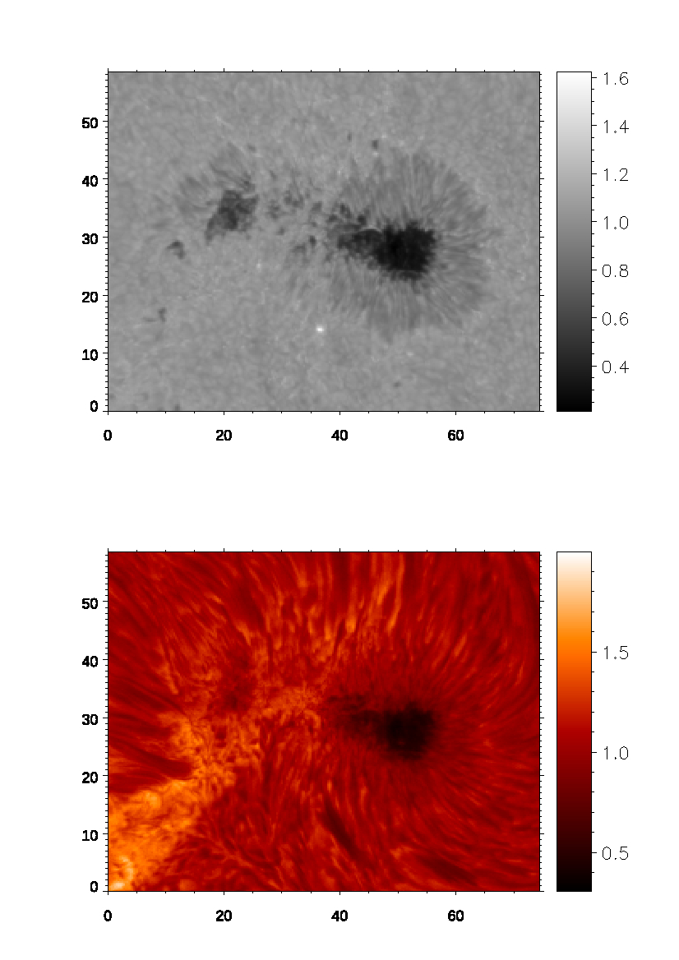
IRIS UV burst
UV burst and co-spatial surge ejection, within the moat region surrounding the leading sunspot
Observations from GREGOR HiFI+ exhibit analogous events within the same area
HiFI+ – Hα broad-band HiFI+ – Hα narrow-band

Slide 17
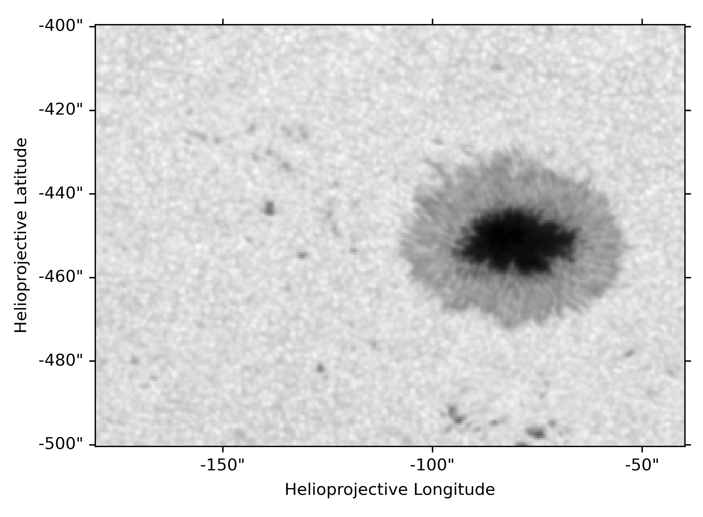
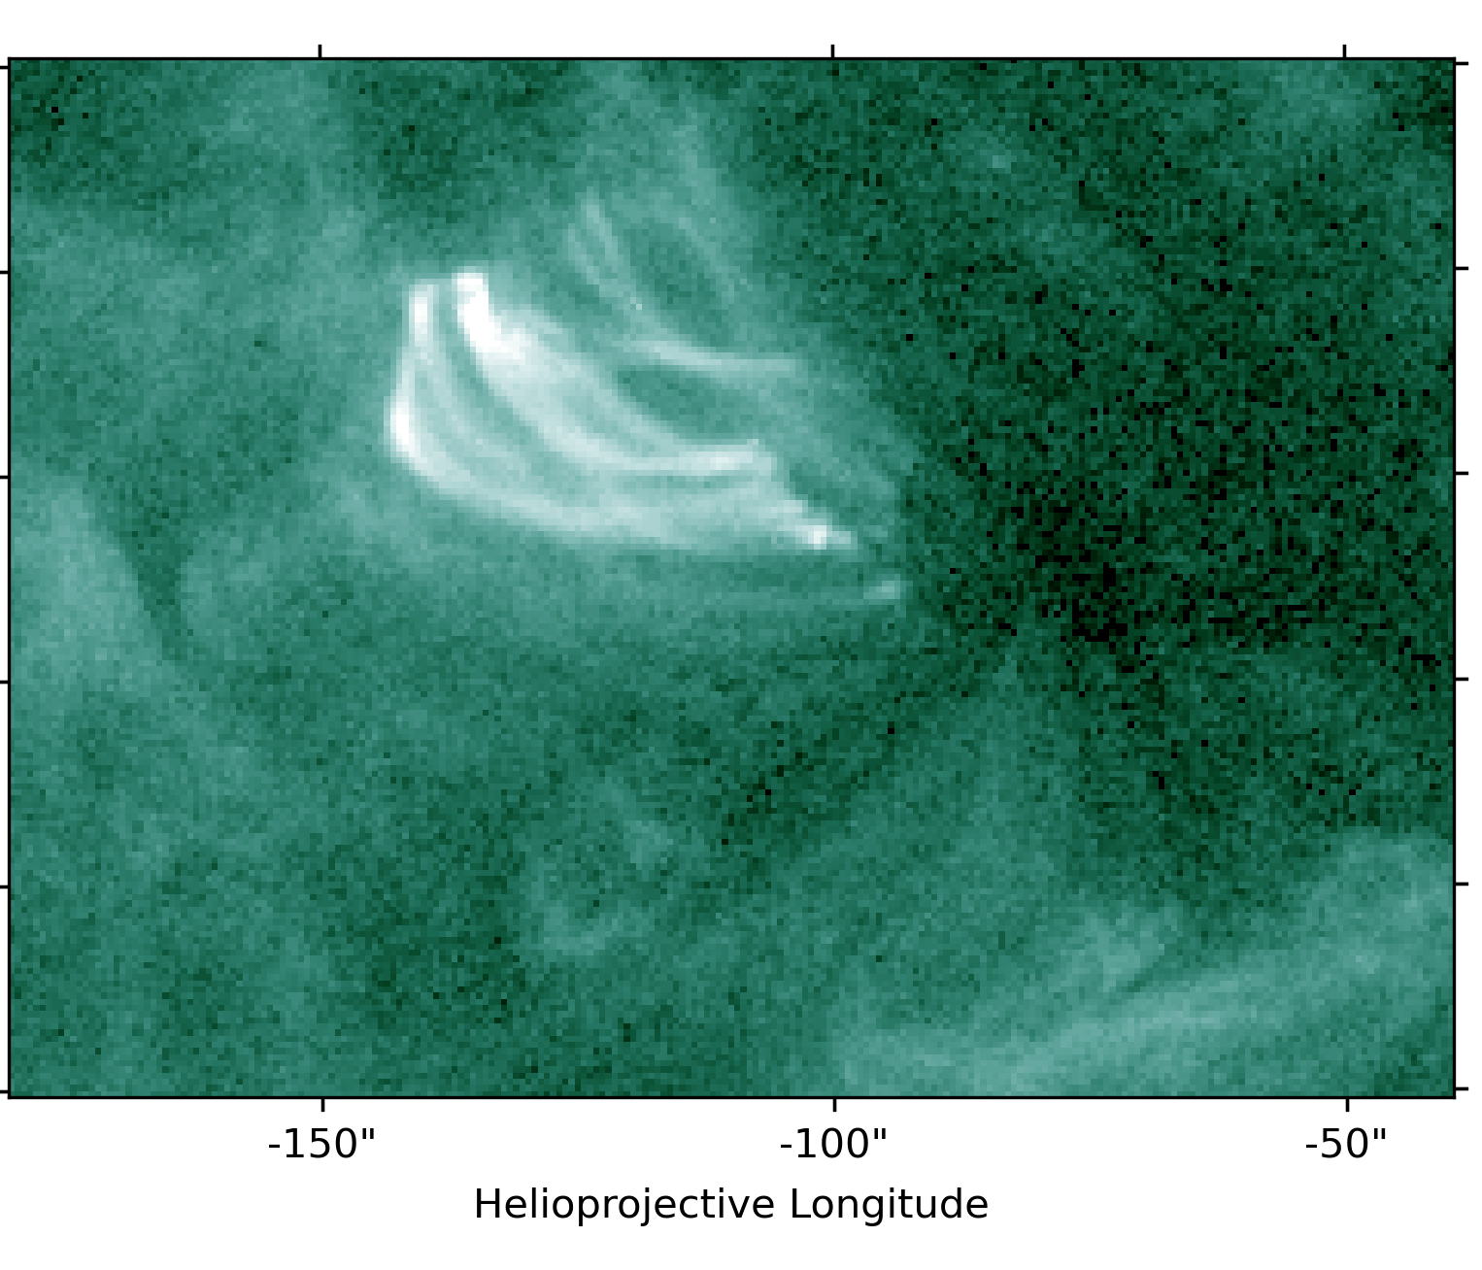
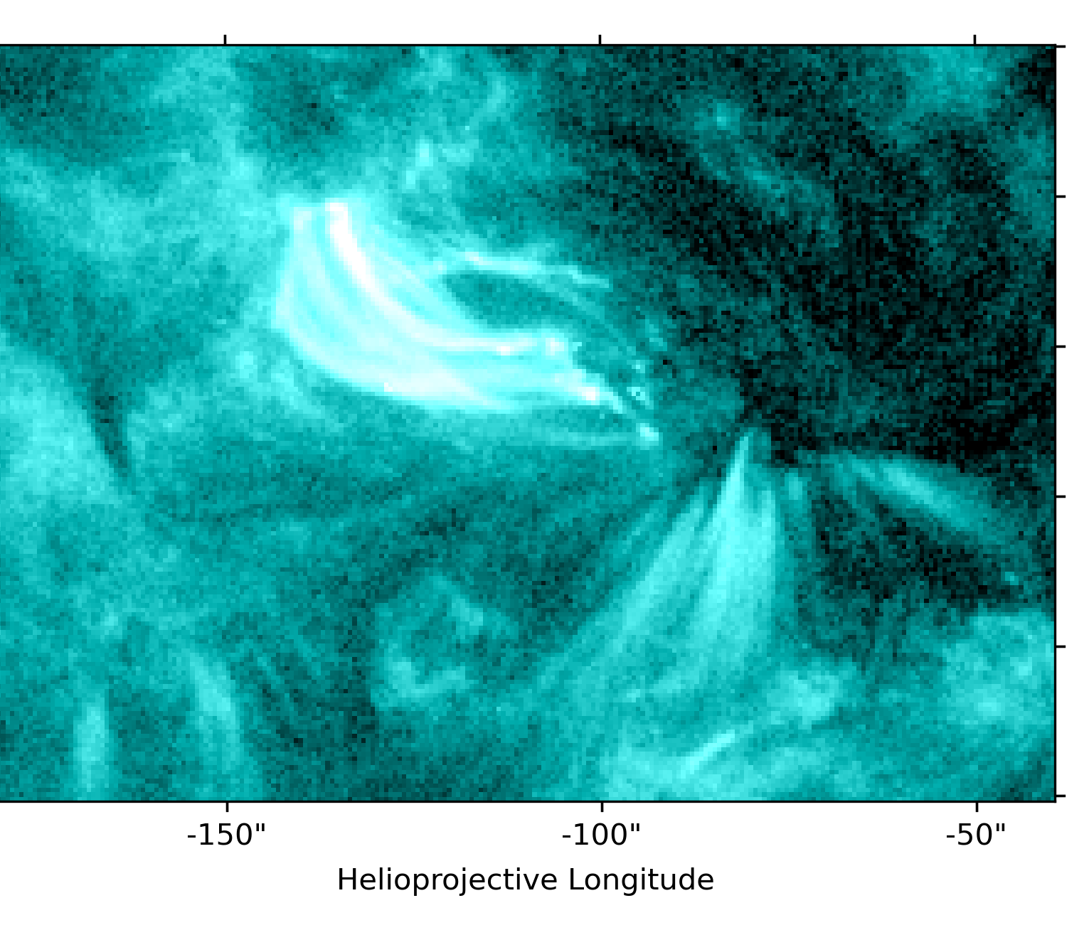
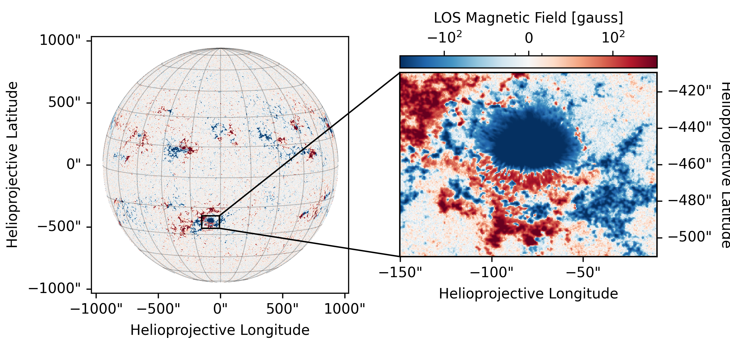
Brightening occurred in the AR NOAA 13394
HMI continuum
AIA 94
AIA 131
Active region NOAA 13394 was also observed during the coordinated GREGOR/IRIS campaign in August 2023
A brightening event was detected on August 8,
near the upper-eastern edge of the sunspot
This phenomenon is also visible in AIA/SDO filtergrams at 94 Å and 131 Å

Slide 18
Brightening occurred in the AR NOAA 13394
The brightening is observed in the narrowband channel of the Hα HiFi+ camera and in IRIS SJI images at 1330 Å and 2796 Å
  spectro-polarimetric inversions of GREGOR/GRIS data in the He I spectral region to derive atmospheric parameters of the region
  analysis of IRIS spectra, as the slit captures part
  of the brightening evolution
Blue continuum at 450.6 nm
Hα narrow band

Slide 19
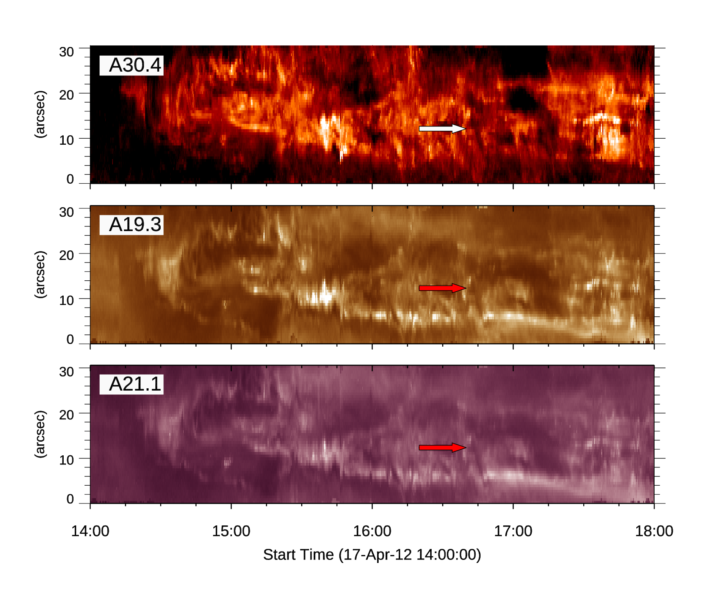
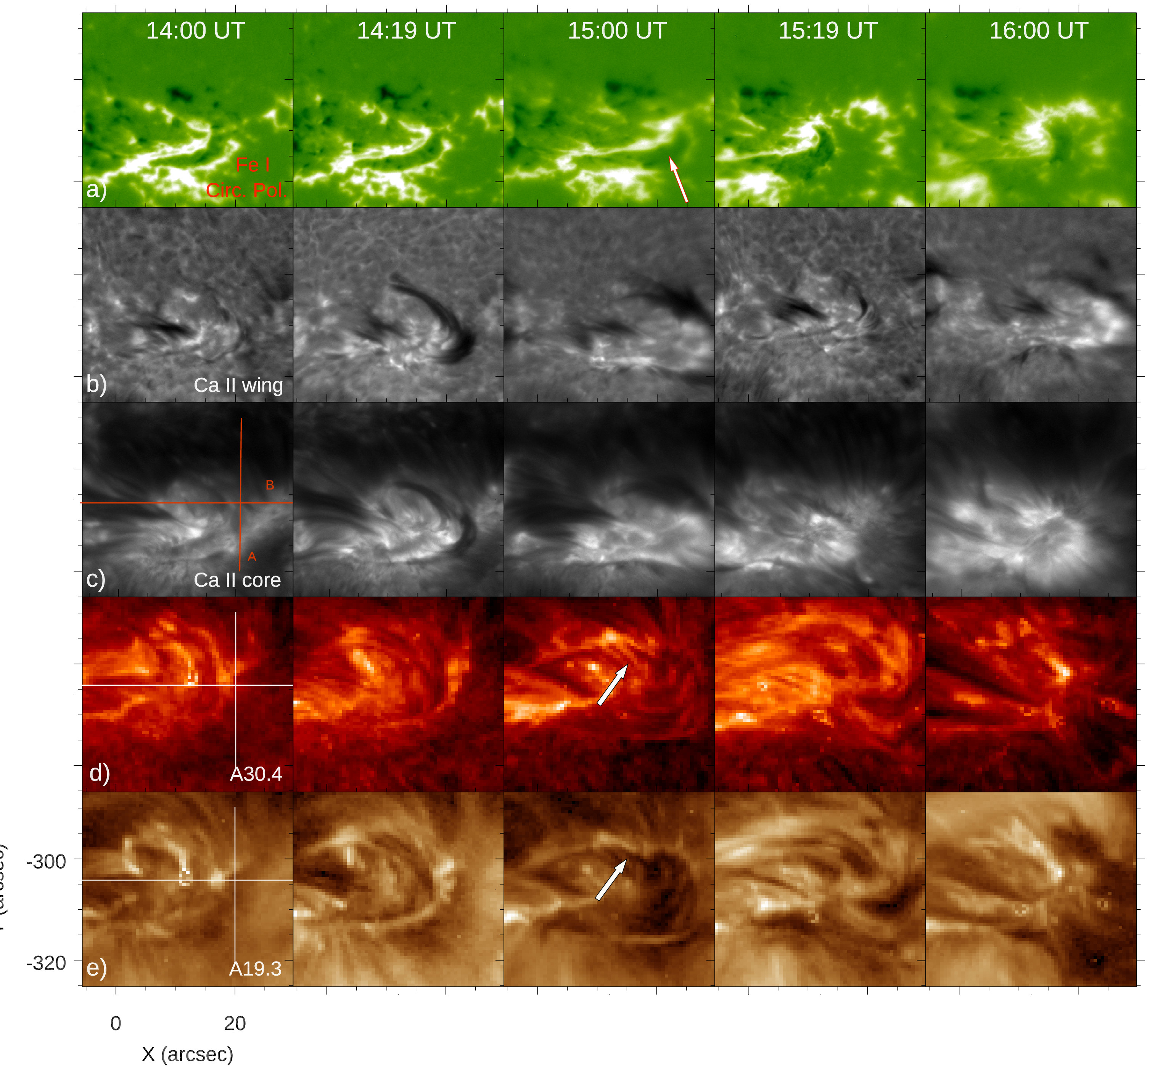
DST/IBIS and SDO/AIA during pore formation
Murabito, Ermolli, Guglielmino, Giorgi & Romano (2025, submitted)

Slide 20
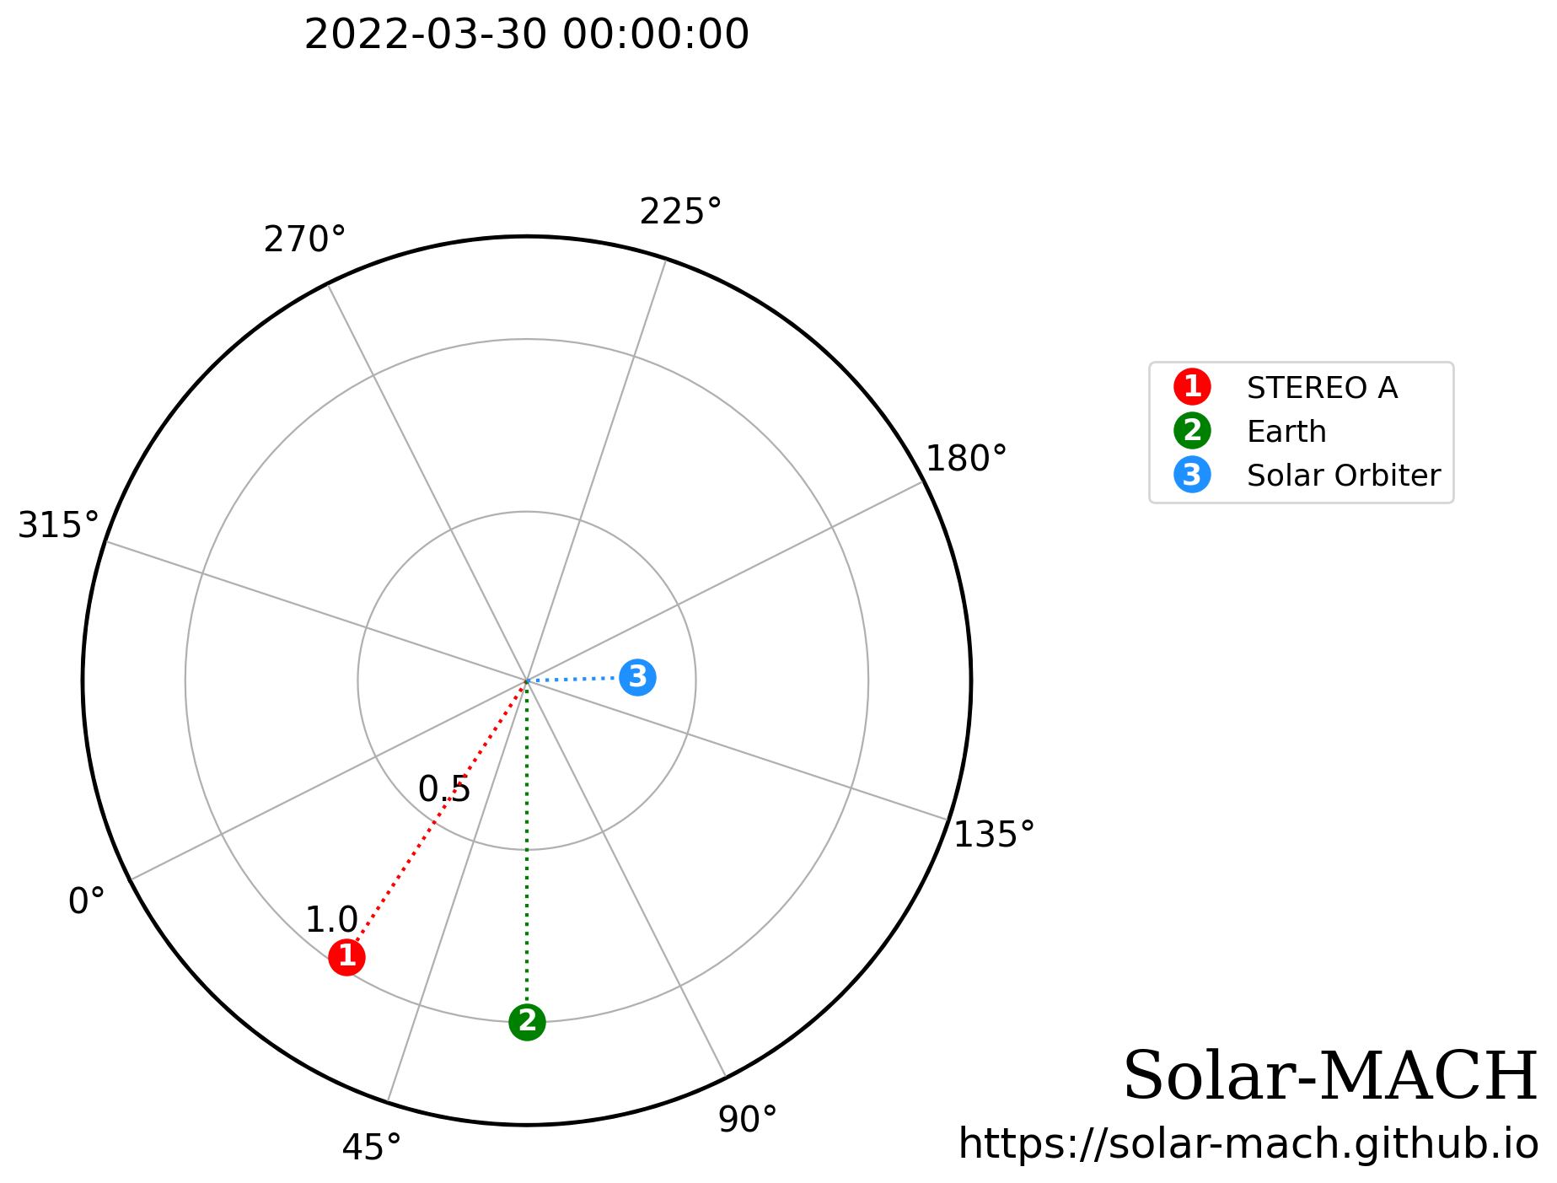
Solar Orbiter quadrature

Slide 21
Solar Orbiter quadrature
PHI
METIS
EUI
e.g. Ventura+ (2023)
PHI
SPICE
Earth – LOS

Slide 22
Concluding remarks
Our analysis suggests that the interplay between emerging flux and other flux systems triggers small- to intermediate scale energetic events through magnetic reconnection
IRIS observations indicate that these energy release events, associated to EFRs detected at high resolution with spectropolarimetric measurements, are visible in UV with a clear coronal counterpart
Specific spectral signatures, like the C I / O I lines ratio and H₂ emission lines, help us to analyse different triggering mechanisms
  O IV emission can represent a tracer for plasma heating
  Complex configuration in some reconnection events is revealed
Possible joint investigations with Solar Orbiter in quadrature positions may shed light on the eruption of plasma blobs up to the extended corona
In future, we will need a synergistic approach, planning coordinated observational efforts with ground- and space-based observatories:
IBIS2.0 instrument and EST telescope, as well as the Solar-C and MUSE satellites

Slide 23
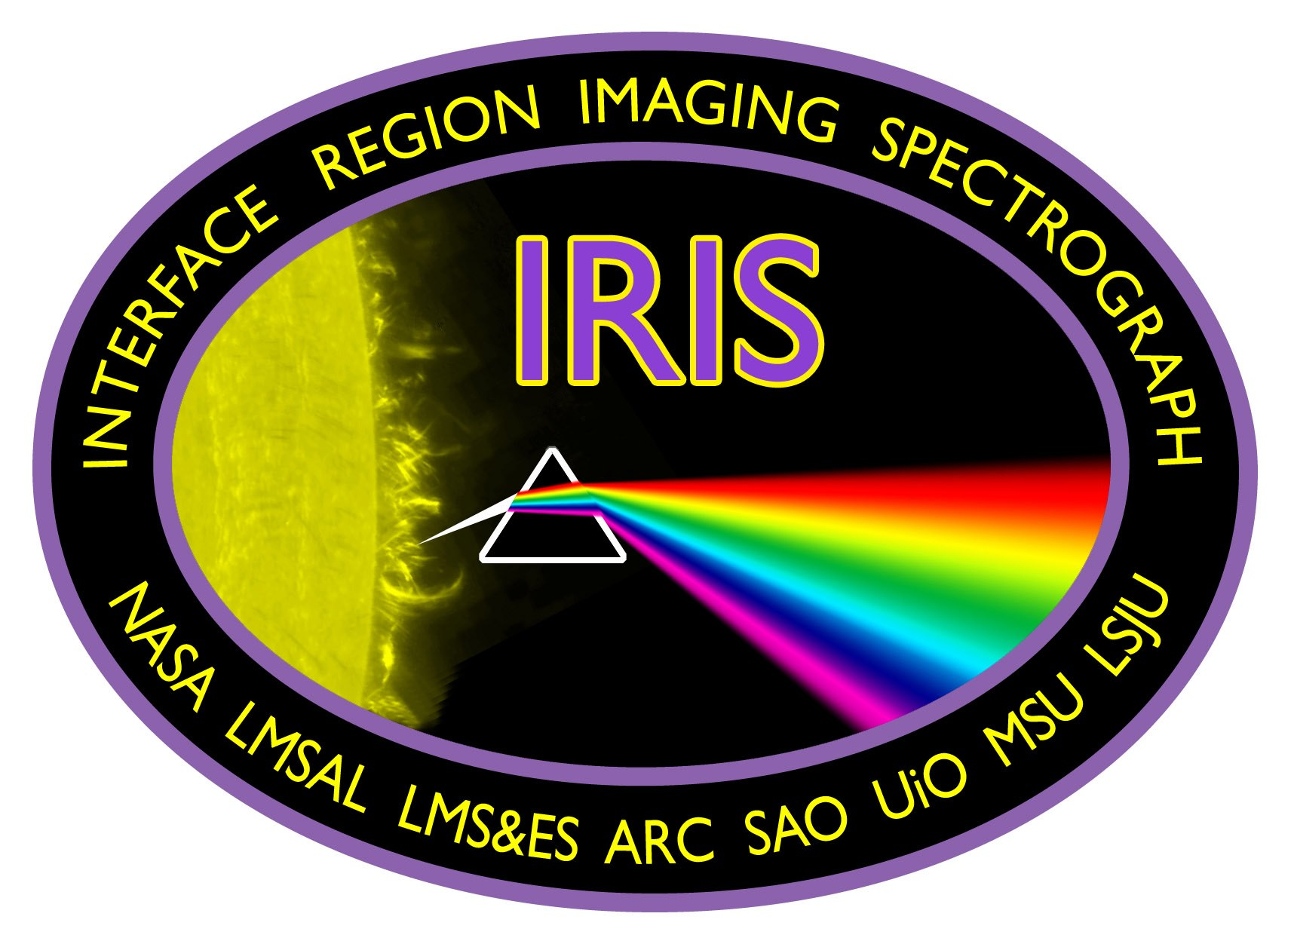






THANK YOU!

