Slide 1

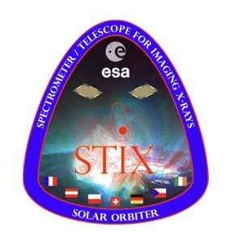


machine learning and artificial intelligence applied to solar and heliospheric physics
michele piana
MIDA, dipartimento di matematica, università di genova
osservatorio astrofisico di torino, istituto nazionale di astrofisica
II metis science meeting, january 27-29, osservatorio astronomico di capodimonte

Slide 2

MIDA in a nutshell
anna maria massone
federico benvenuto
cristina campi, sara garbarino
HELCOMP
M3
LISCOMP
MIDA
methods for image
and data analysis
federico benvenuto
centro eliofisico
altec, OATo, POLITO
LISCOMPTECH
gaslini
andrea tacchino

Slide 3
the active sun: some open issues
what is the intimate nature of the physical mechanisms at the base of particle acceleration in the active sun? →more specifically: how effective is the sun as a particle accelerator?
what is the origin of the thermal structure of the plasma in the outer regions of the sun?
→more specifically: why is the corona hotter than the chromosphere?
do we have enough data and of good enough quality to predict the chain of events that from active regions on the solar surface leads to geomagnetic storms on earth?
→ more specifically: are flare forecasting and then space weather forecasting feasible?

Slide 4
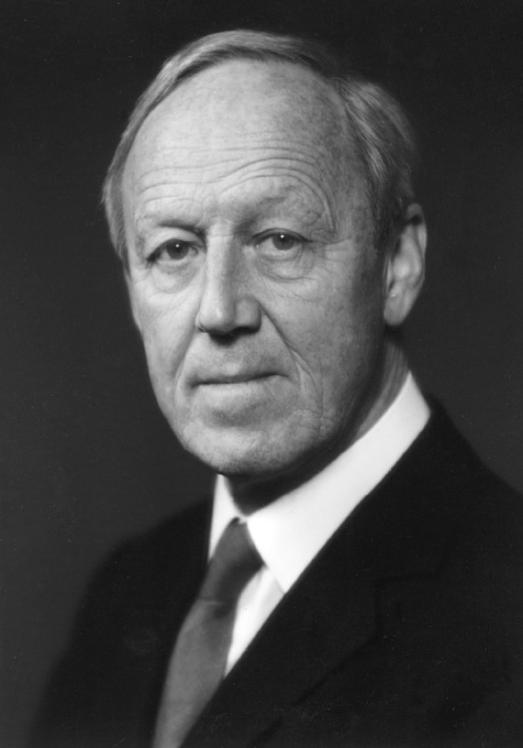
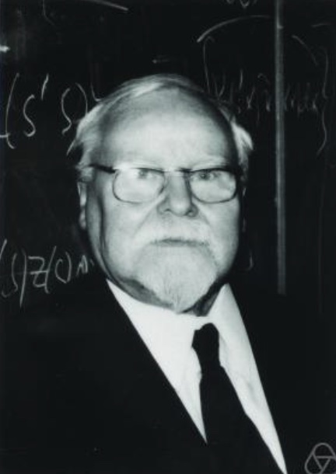




deterministic vs data-driven approaches
warning: from now on AI means
whatever can be addressed
in the framework of regularization theory

Slide 5
the active sun: open issues
what is the intimate nature of the physical mechanisms at the base of particle acceleration in the active sun? →more specifically: how effective is the sun as a particle accelerator?
what is the origin of the thermal structure of the plasma in the outer regions of the sun?
→more specifically: why is the corona hotter than the chromosphere?
do we have enough data and of good enough quality to predict the chain of events that from active regions on the solar chromosphere leads to geomagnetic storms on earth?
→ more specifically: are flare forecasting and then space weather forecasting feasible?

Slide 6
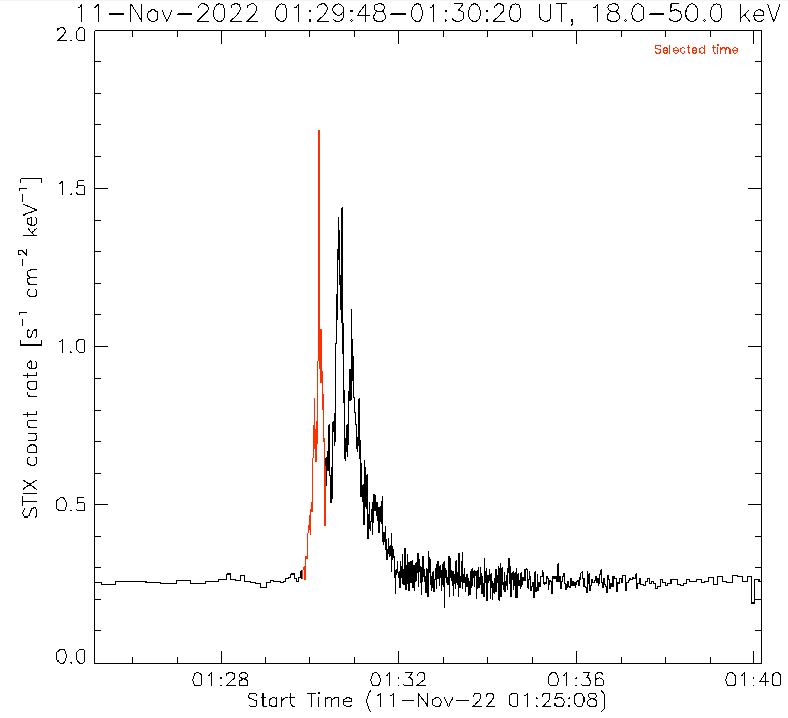
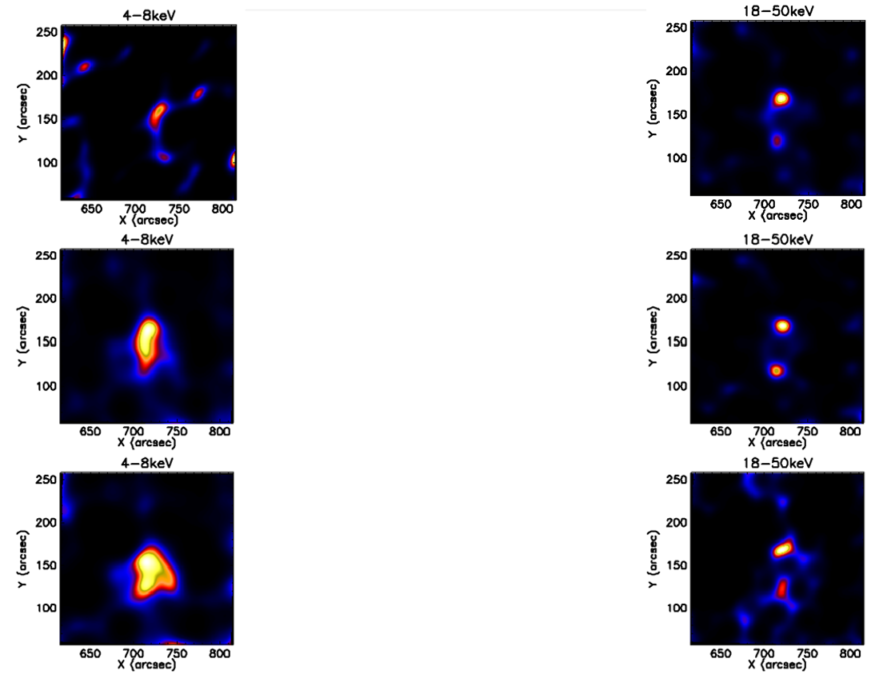
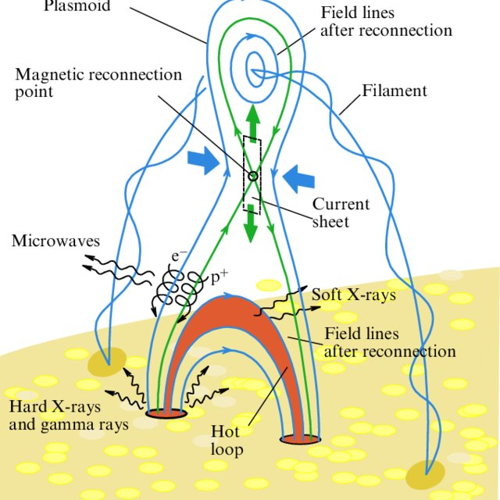
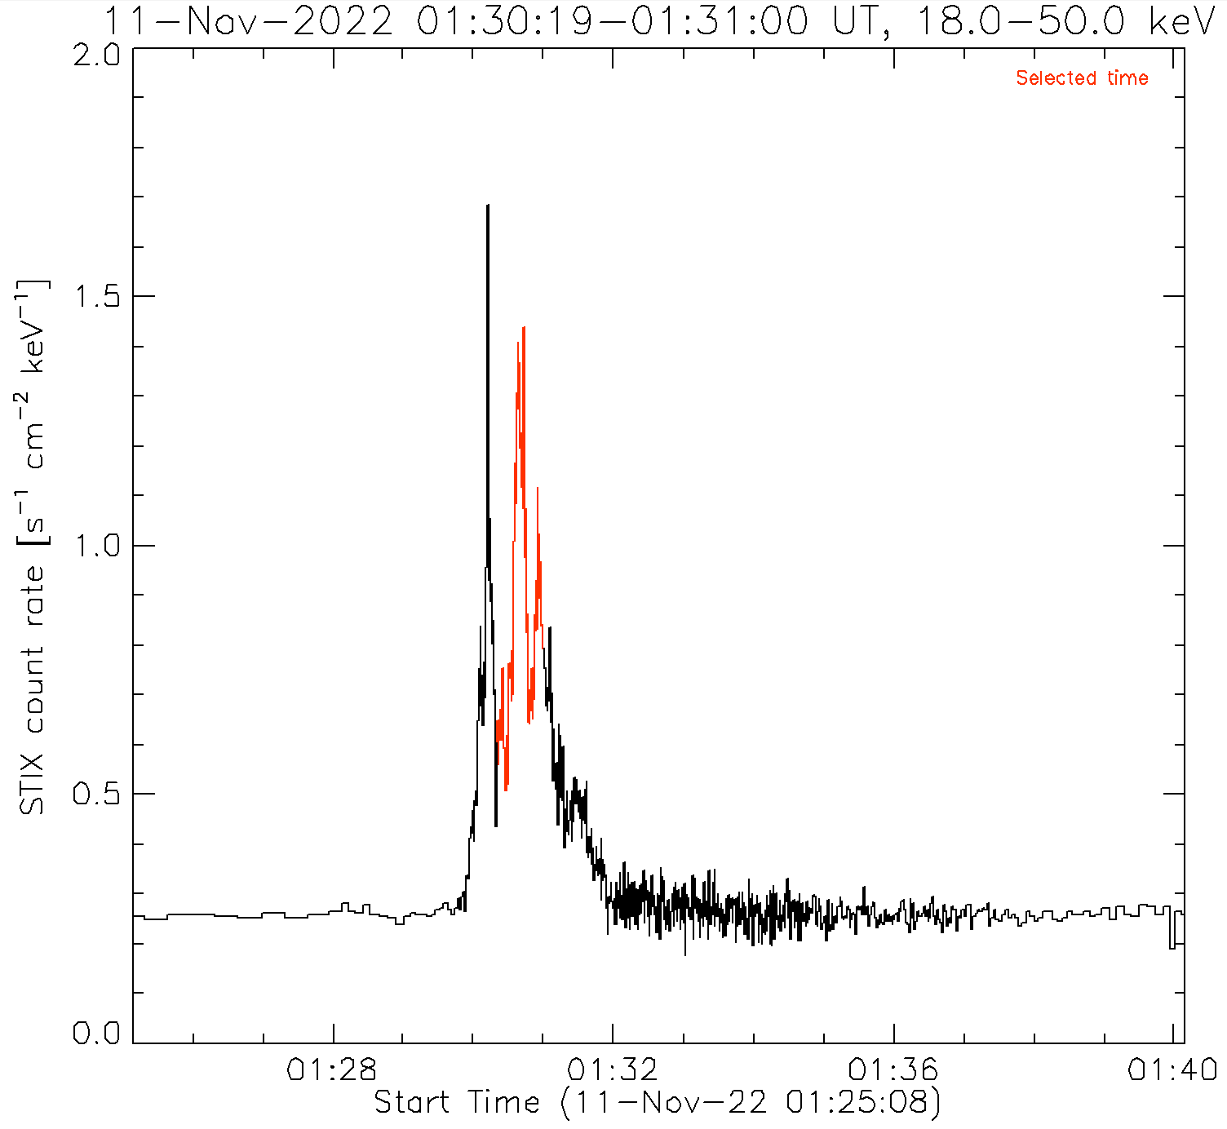
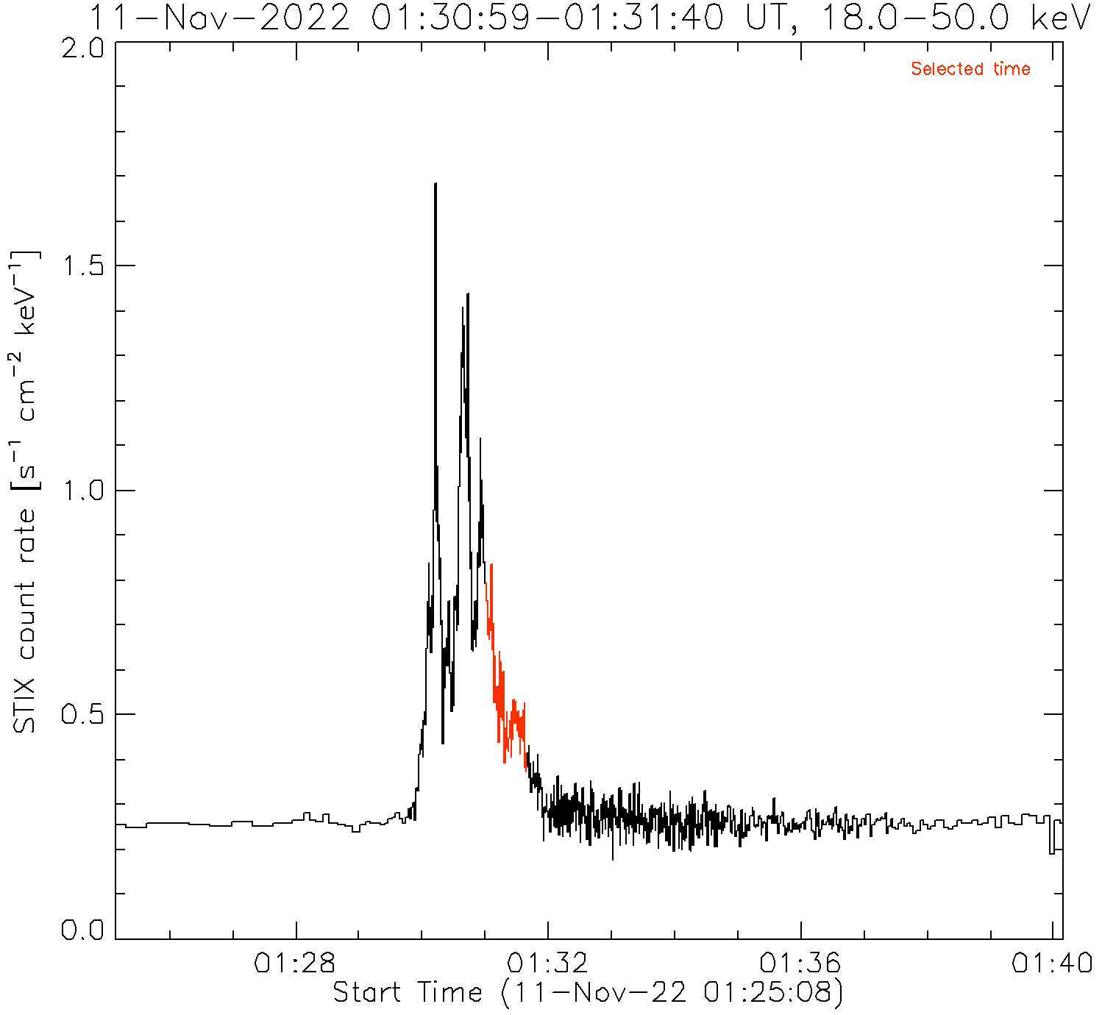
the flare standard model
event: 11 November 2022
energy
time

Slide 7
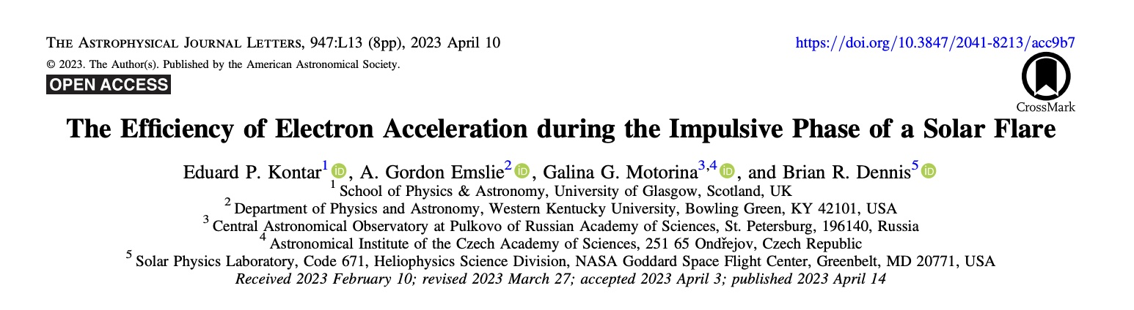
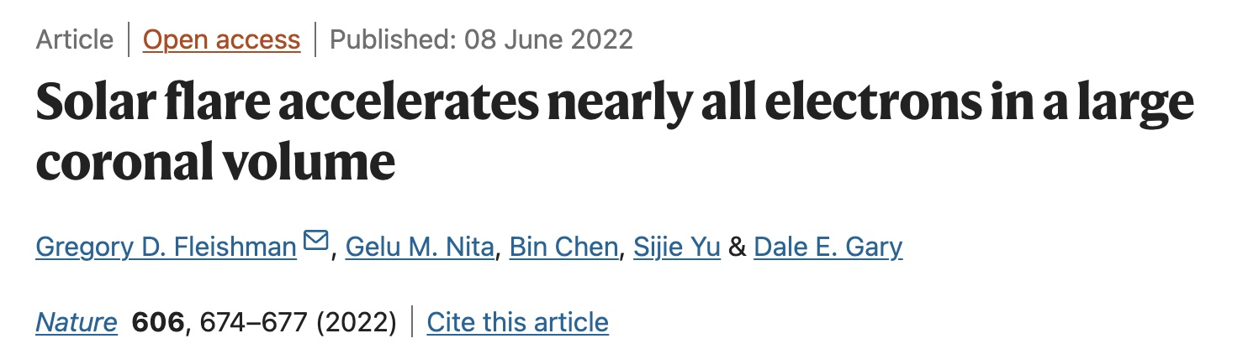
two controversial results
methodology:
microwave observations (EOVSA)
distribution of thermal and non-thermal electrons
conclusion: please read the title
methodology:
hard X-ray and EUV observations (RHESSI + AIA)
spatially integrated and spatially resolved spectra
conclusion: less than 1% of the electrons in the region were accelerated

Slide 8
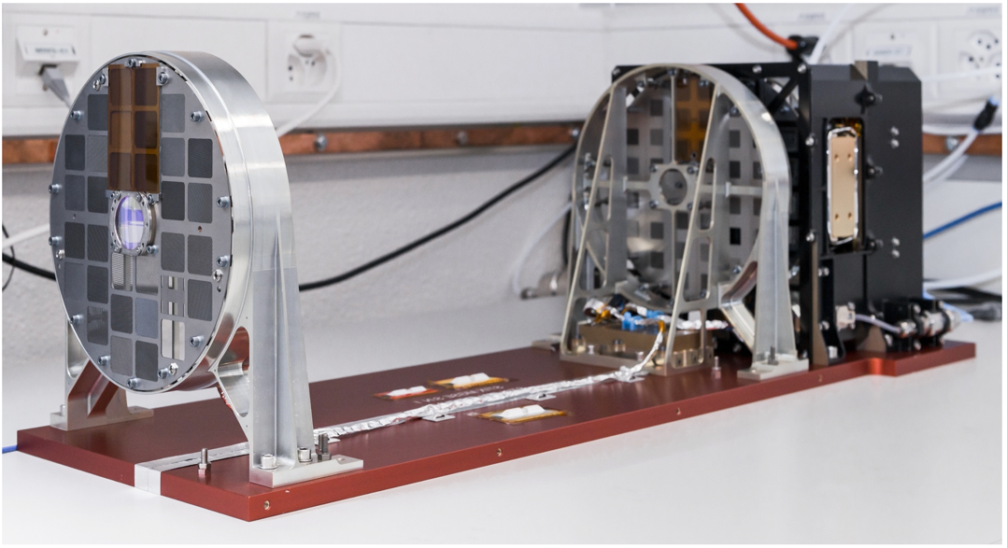
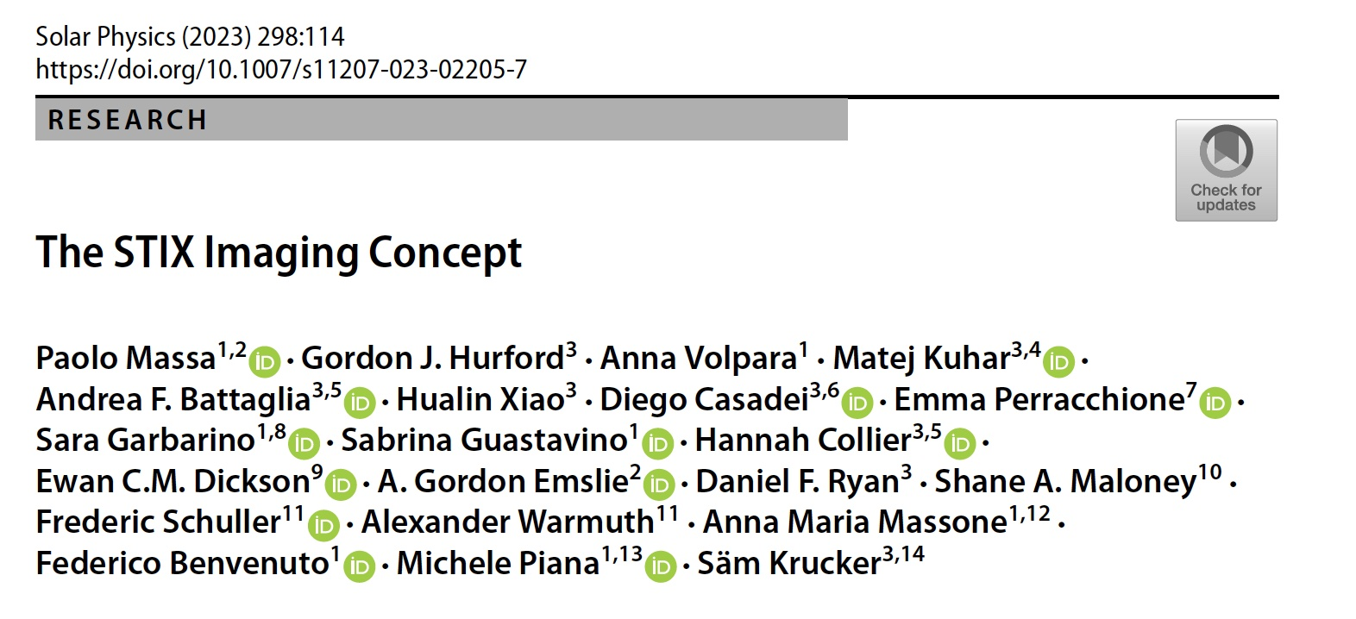
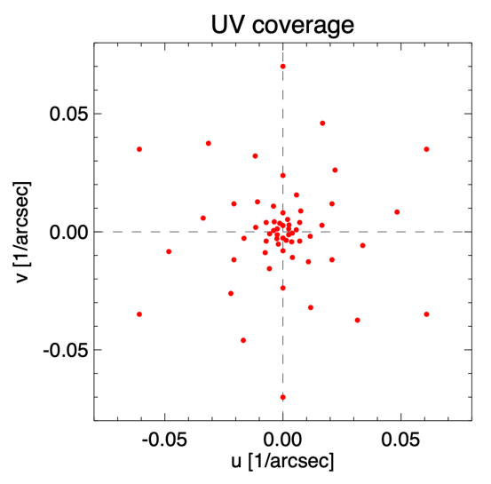
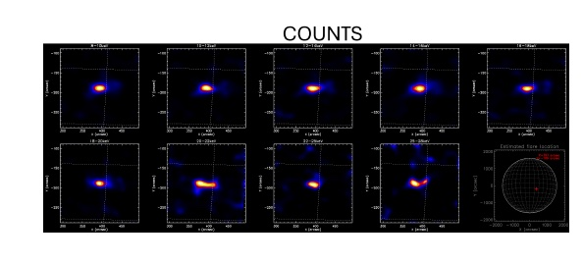
our approach: STIX data
event selection:
loop-shaped events
more than 3 × 10³ counts at energies higher than 25 keV.
when possible: events visible form 1 𝐴𝑈, in order to leverage AIA morphological information

Slide 9
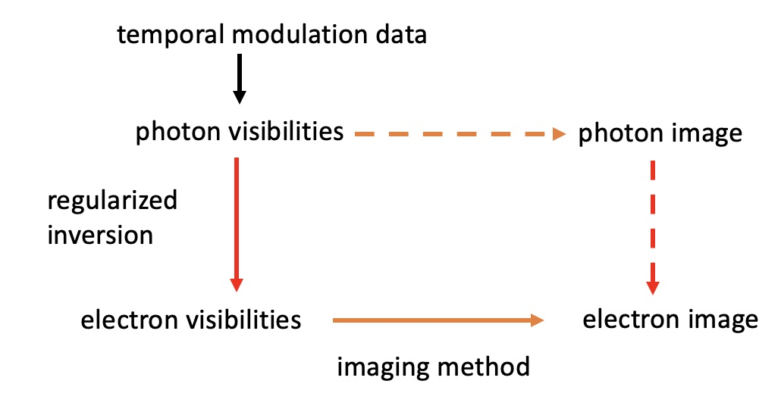
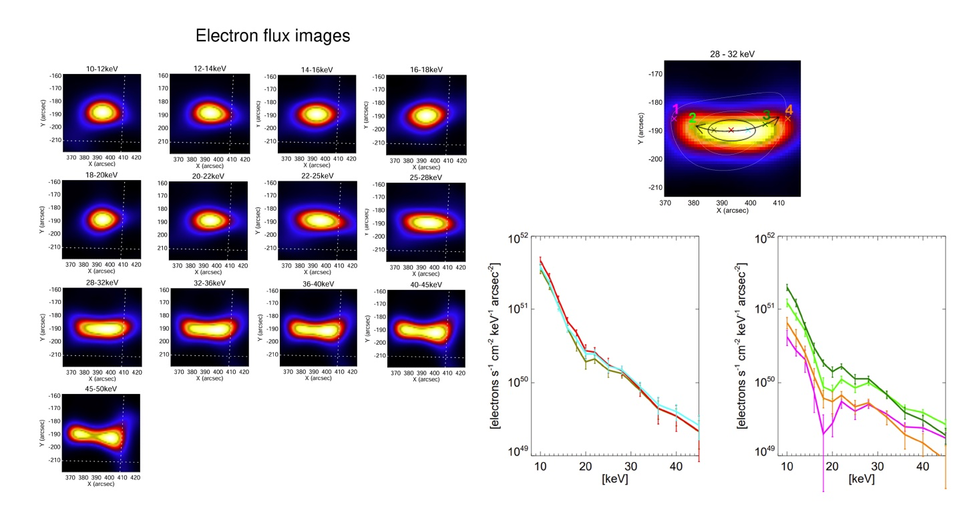
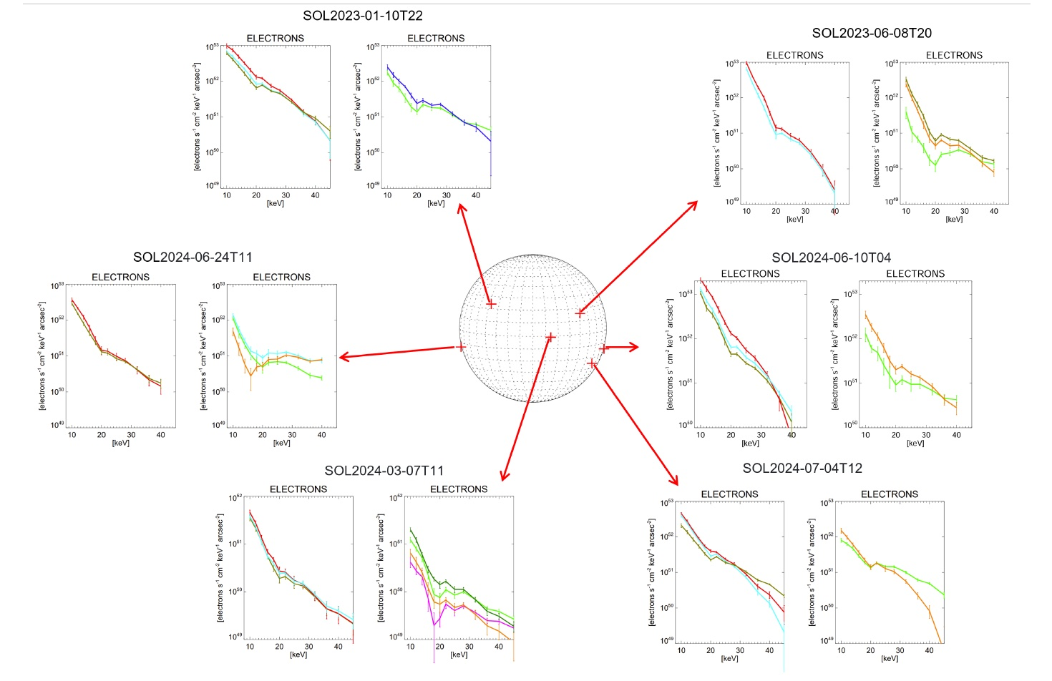
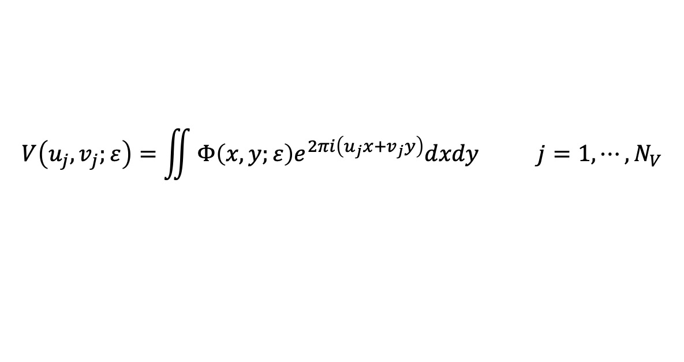
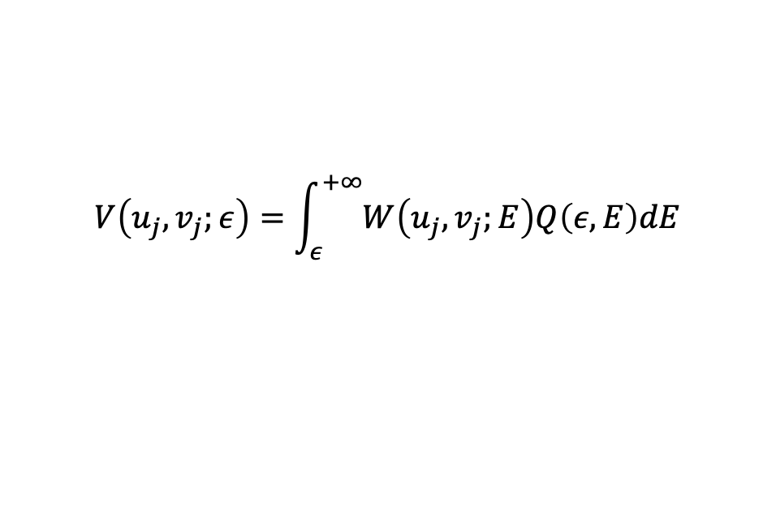
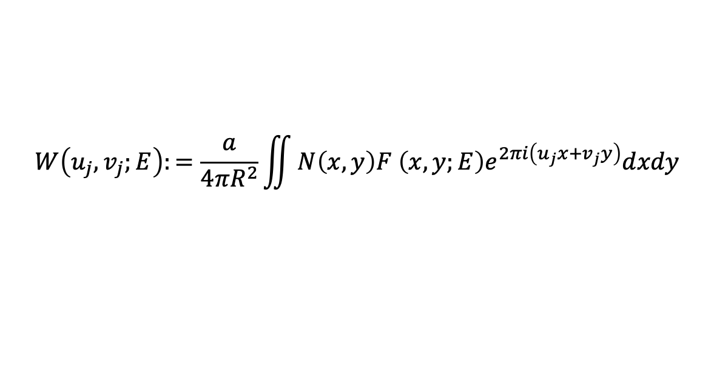
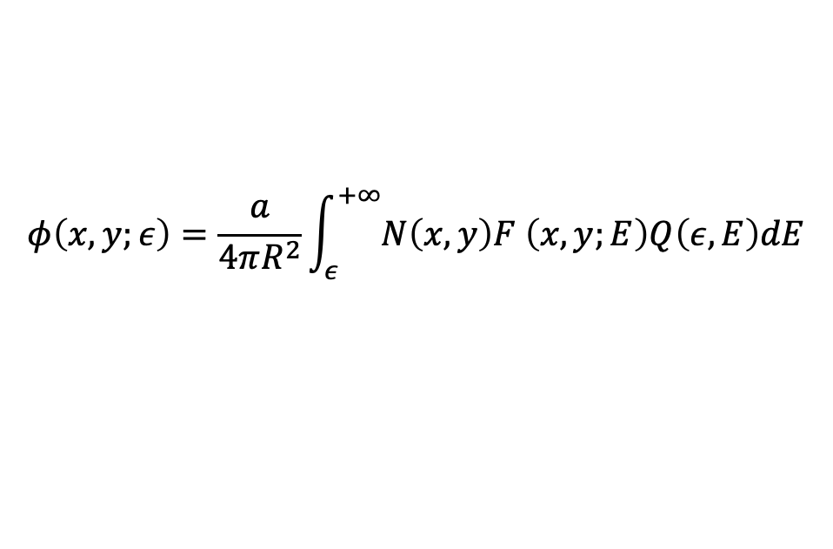
our approach: electron maps
$$φ\left(x,y;ε\right)=\frac{a}{4πR^{2}}\int_{ε}^{+∞}{N\left(x,y\right)F \left(x,y;E\right)Q\left(ε,E\right)dE}$$
$$V\left(u_{j},v_{j};ε\right)=\iint{Φ\left(x,y;ε\right)e^{2πi\left(u_{j}x+v_{j}y\right)}dxdy j=1,⋯,N_{V}}$$
$$W\left(u_{j},v_{j};E\right):=\frac{a}{4πR^{2}}\iint{N\left(x,y\right)F \left(x,y;E\right)e^{2πi\left(u_{j}x+v_{j}y\right)}dxdy}$$
$$V\left(u_{j},v_{j};ε\right)=\int_{ε}^{+∞}{W\left(u_{j},v_{j};E\right)Q\left(ε,E\right)dE}$$

Slide 10


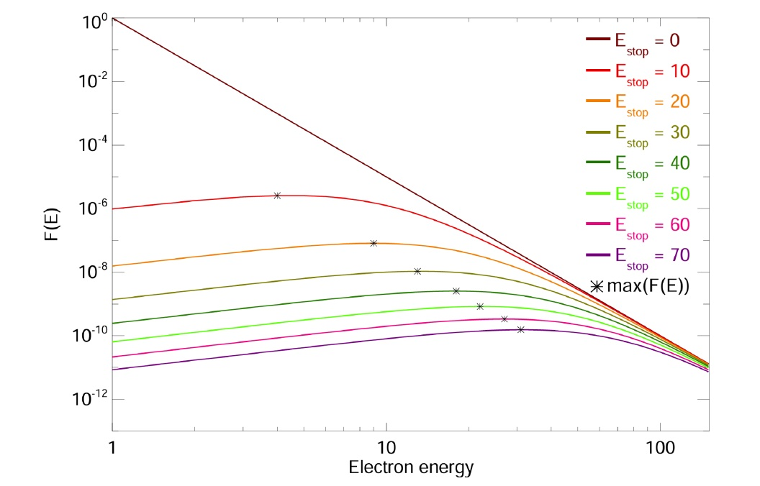



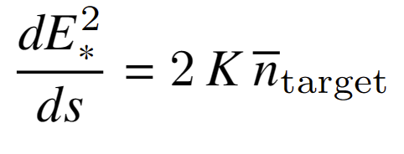
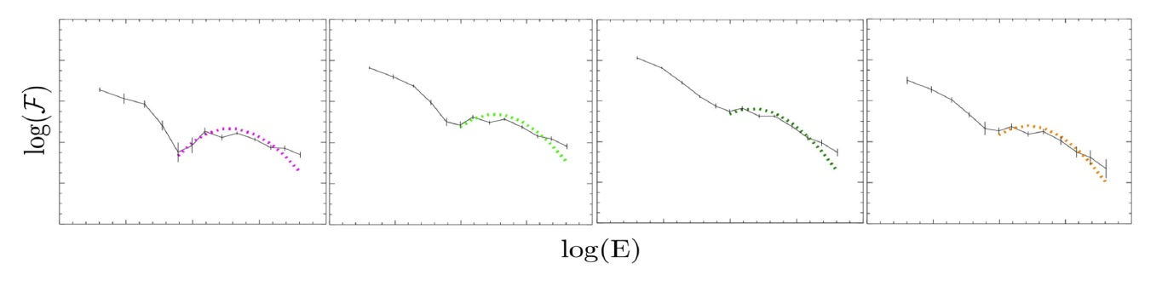
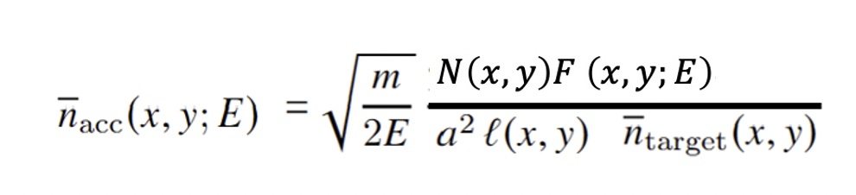
our approach: model equations
=

Slide 11
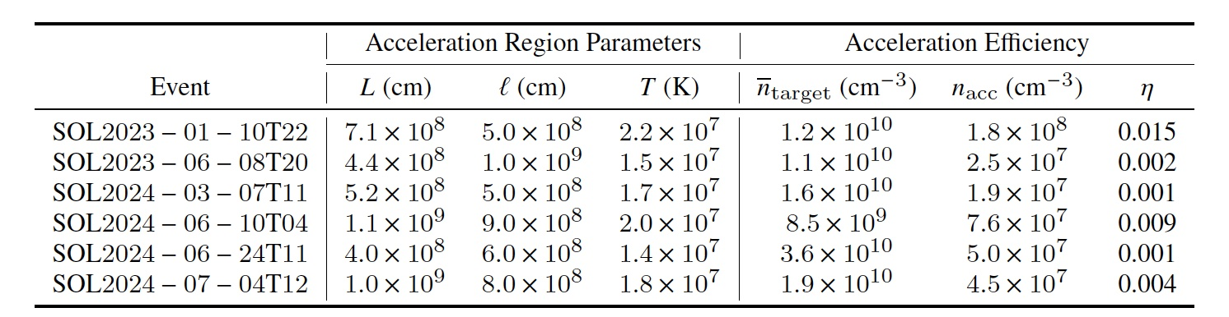
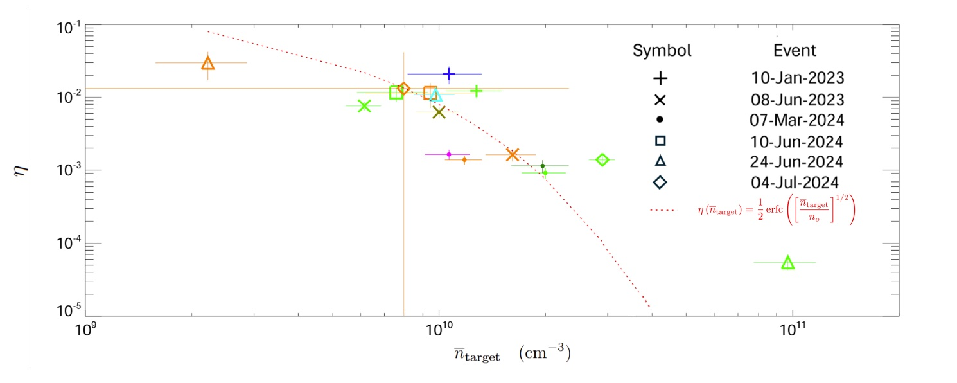

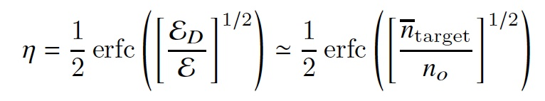
the accerelation rate never exceeds few percent

Slide 12
the active sun: open issues
what is the intimate nature of the physical mechanisms at the base of particle acceleration in the active sun? →more specifically: how effective is the sun as a particle accelerator?
what is the origin of the thermal structure of the plasma in the outer regions of the sun?
→more specifically: why is the corona hotter than the chromosphere?
do we have enough data and of good enough quality to predict the chain of events that from active regions on the solar chromosphere leads to geomagnetic storms on earth?
→ more specifically: are flare forecasting and then space weather forecasting feasible?

Slide 13
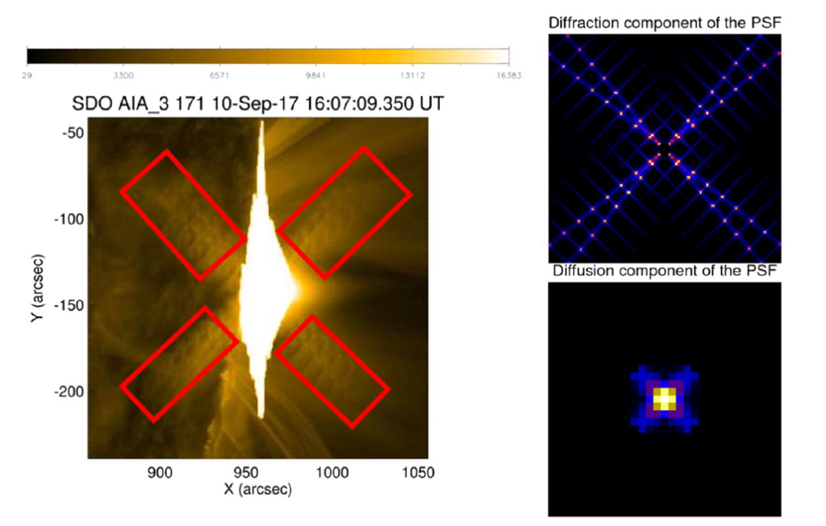
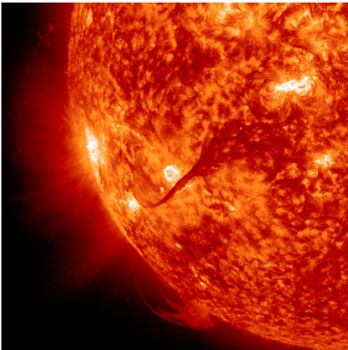
EUV maps: SDO/AIA
primary saturation: the signal generated by the incoming photon flux exceeds the capacity of the CCD pixels (16383 DN pixel⁻¹)
blooming: exceeding charge spreads along the north-south direction
the core PSF induces diffusion effects
the diffraction PSF replicates at periphery the interaction between radiation and filters support
all information lost due to primary saturation is
in the peripheral diffraction pattern
this information can be restored by solving an inverse diffraction problem
four telescopes
seven EUV wavelengths
1.5’’ spatial resolution
12 s time cadence
from SDO/AIA data it is possible
to infer temperature maps of the sun
from the photosphere to the corona
with unprecedented spatial resolution

Slide 14
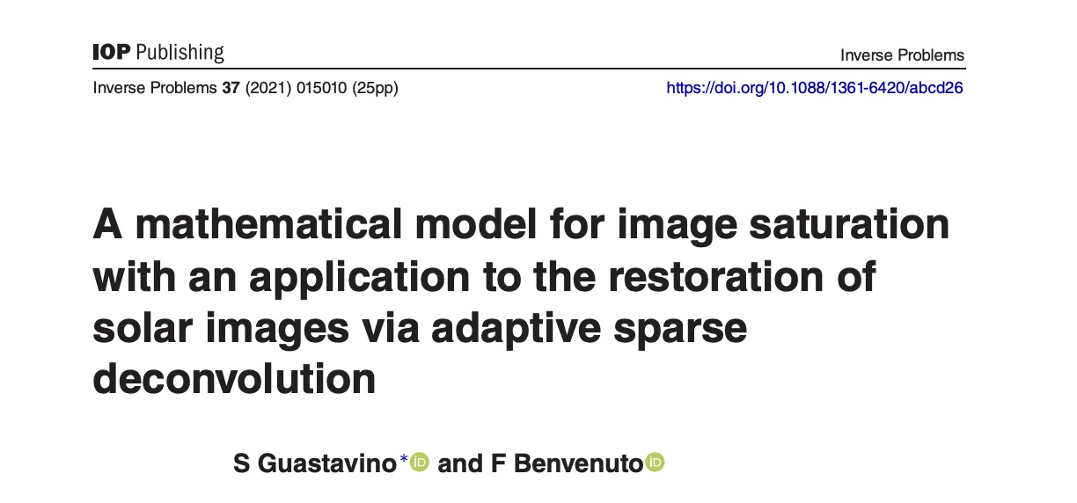
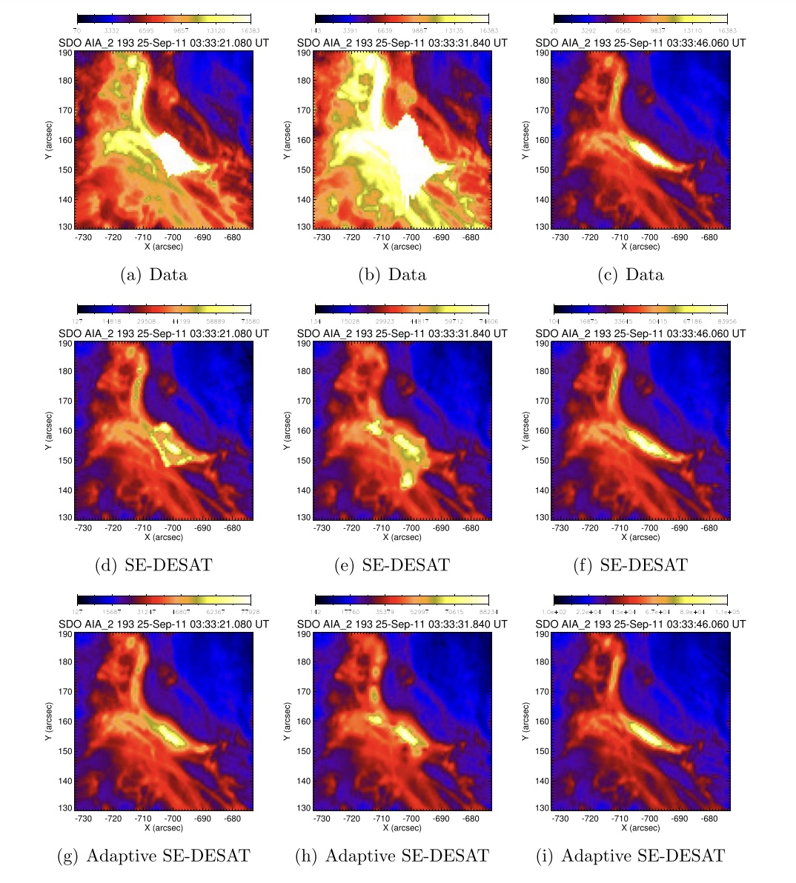

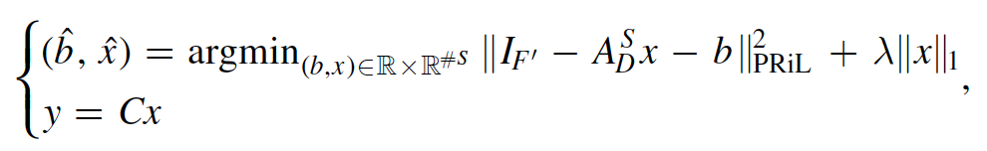
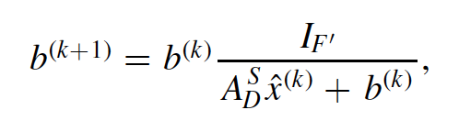
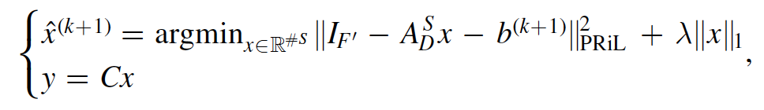
flares morphology - desaturation
the only significant correlation between the saturation region and the diffraction fringes is for pixels related to primary saturation: sparsity-enhancing constraint needed
unsaturated pixels contain photon-induced counts: the noise affecting the diffraction data is poisson

Slide 15
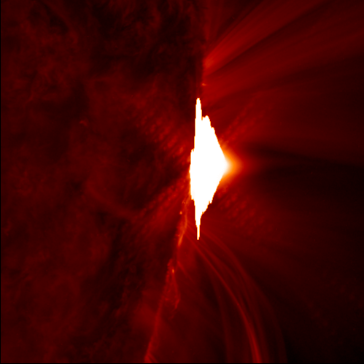
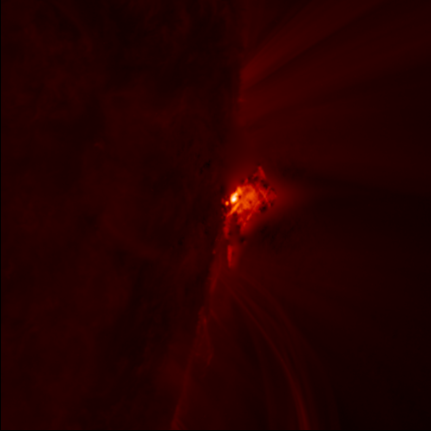
desaturation in action

Slide 16
the active sun: open issues
what is the intimate nature of the physical mechanisms at the base of particle acceleration in the active sun? →more specifically: how effective is the sun as a particle accelerator?
what is the origin of the thermal structure of the plasma in the outer regions of the sun?
→more specifically: why is the corona hotter than the chromosphere?
do we have enough data and of good enough quality to predict the chain of events that from active regions on the solar chromosphere leads to geomagnetic storms on earth?
→ more specifically: are flare forecasting and then space weather forecasting feasible?

Slide 17
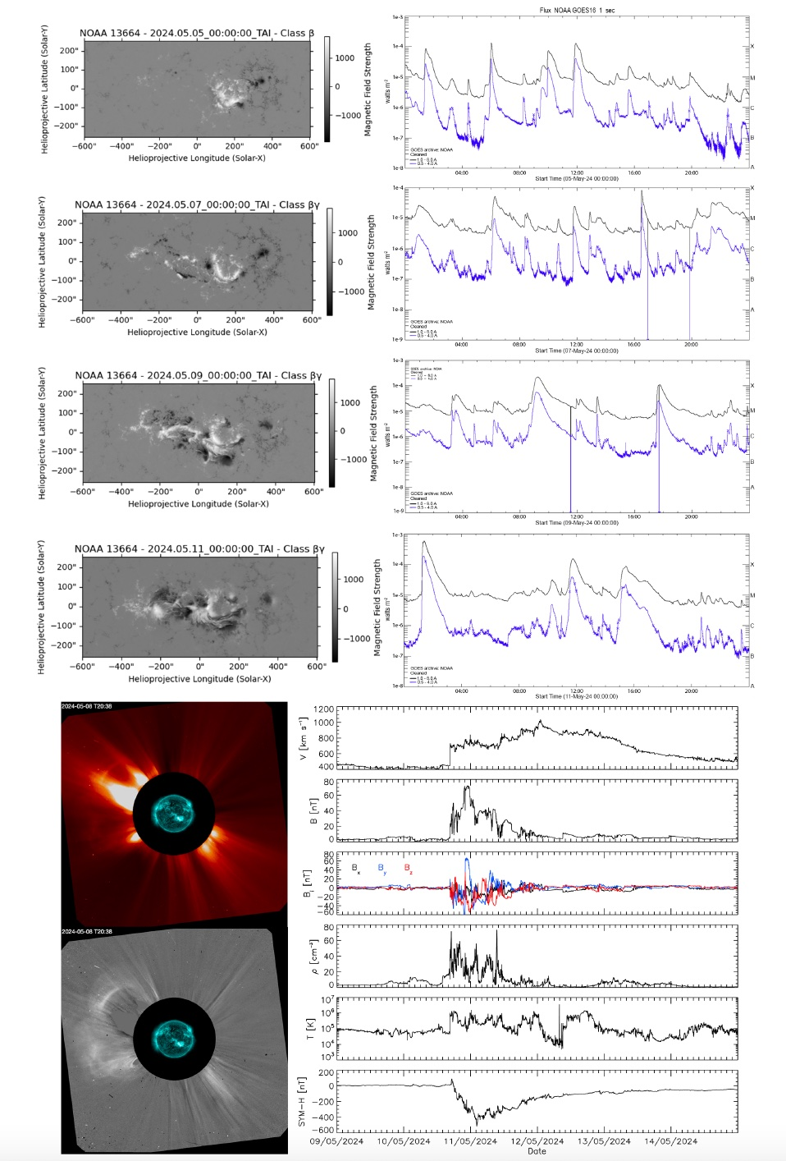
the may 2024 superstorm
objective: to predict the whole chain of events characterizing the may 2024 superstorm using AI
technically:
active region classification
flare forecasting
prediction of the CME travel time
prediction of geoeffectiveness

Slide 18
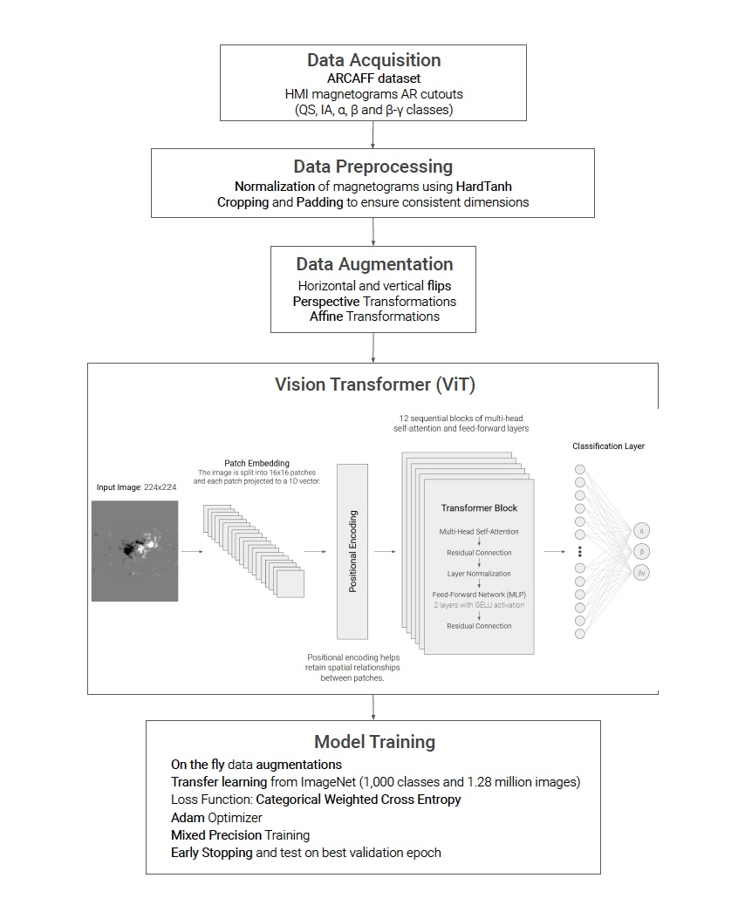
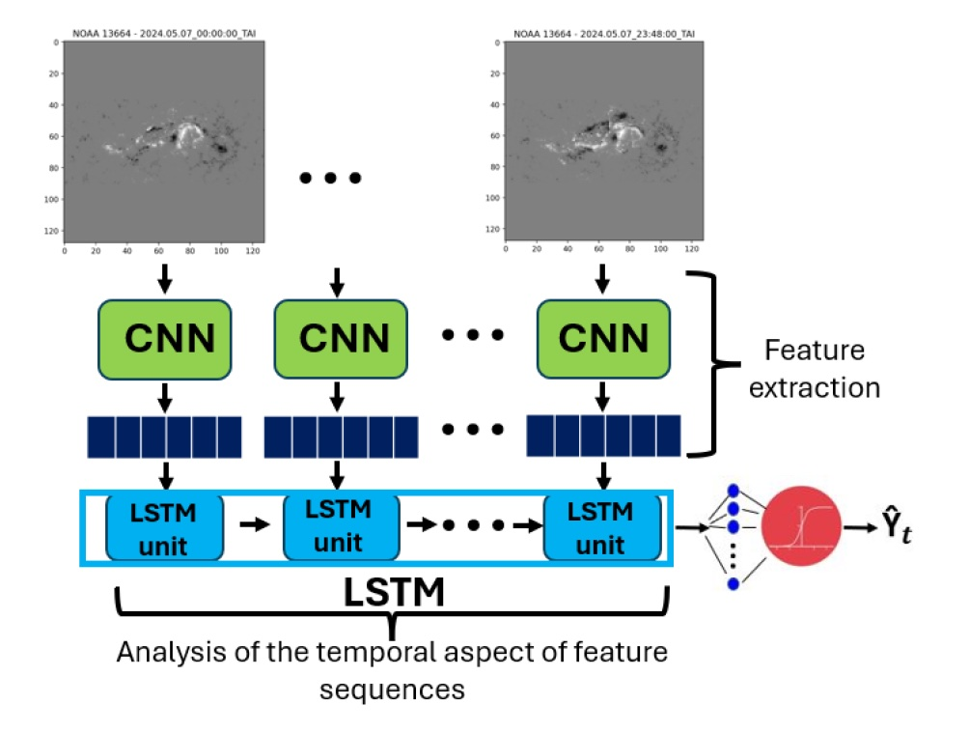
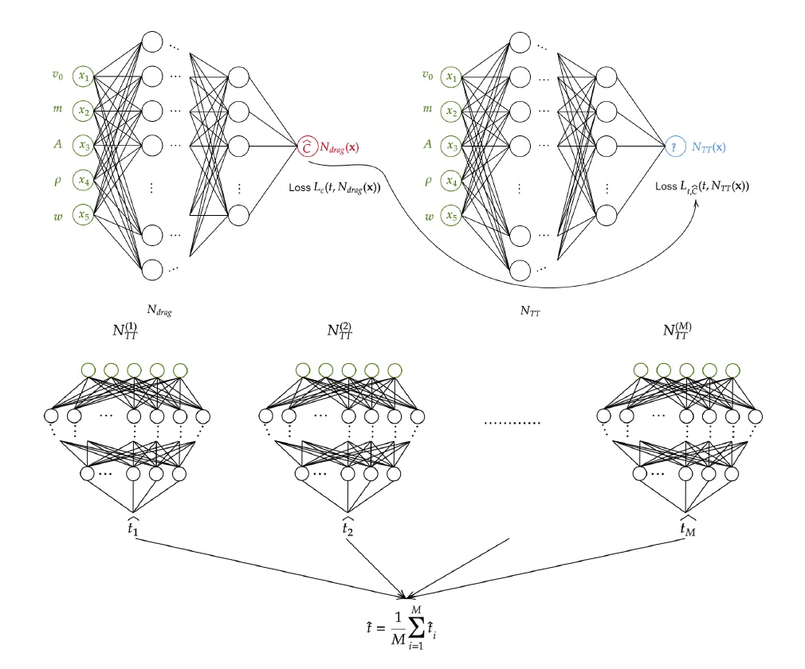
AI methods
ViT for AR classification
video-based deep learning
for flare forecasting
physics-driven machine learning
for CME travel time prediction
score oriented loss functions for geoeffectiveness prediction
V$\left(θ\left(x\right),y\right)\text{= − }\text{TSS} \left(\overline{CM}\left(y,θ\left(x\right)\right)\right)$

Slide 19
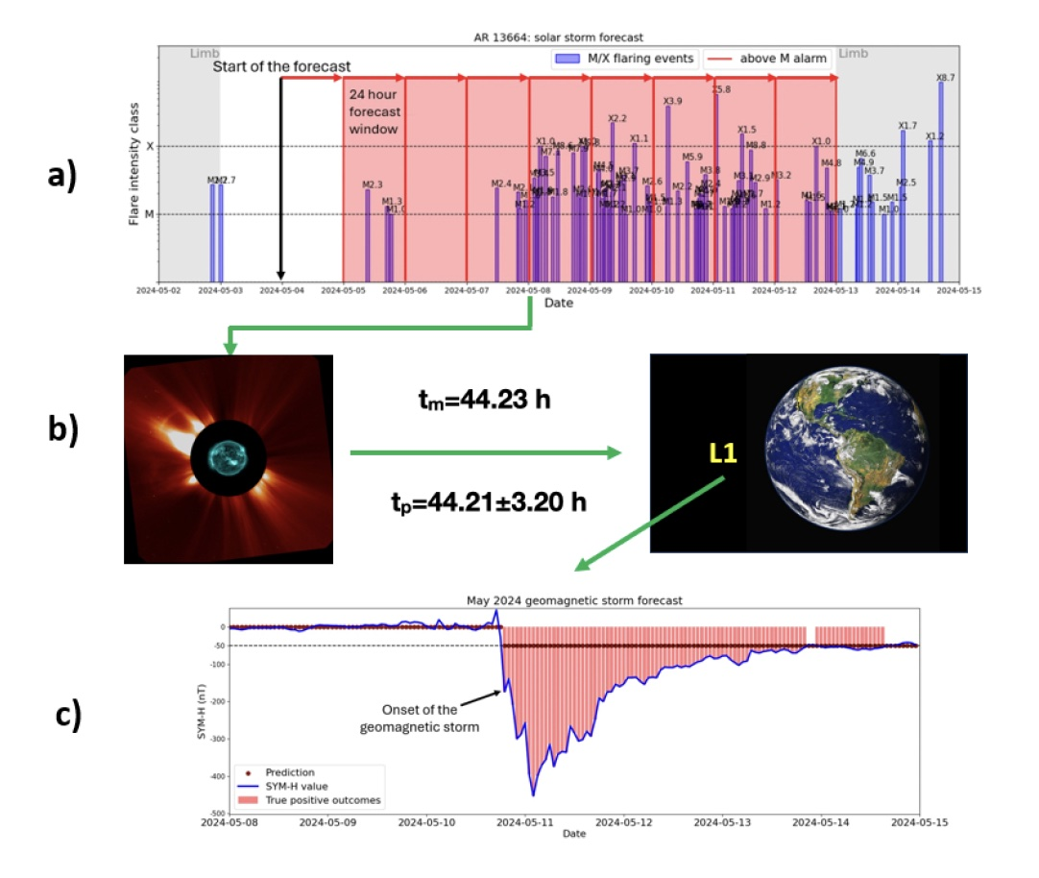
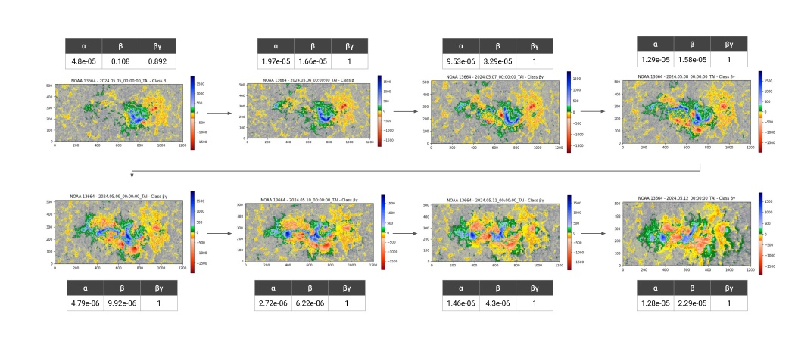
classification and prediction results

Slide 20
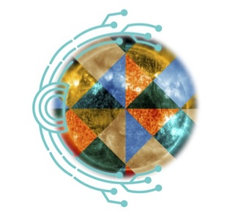

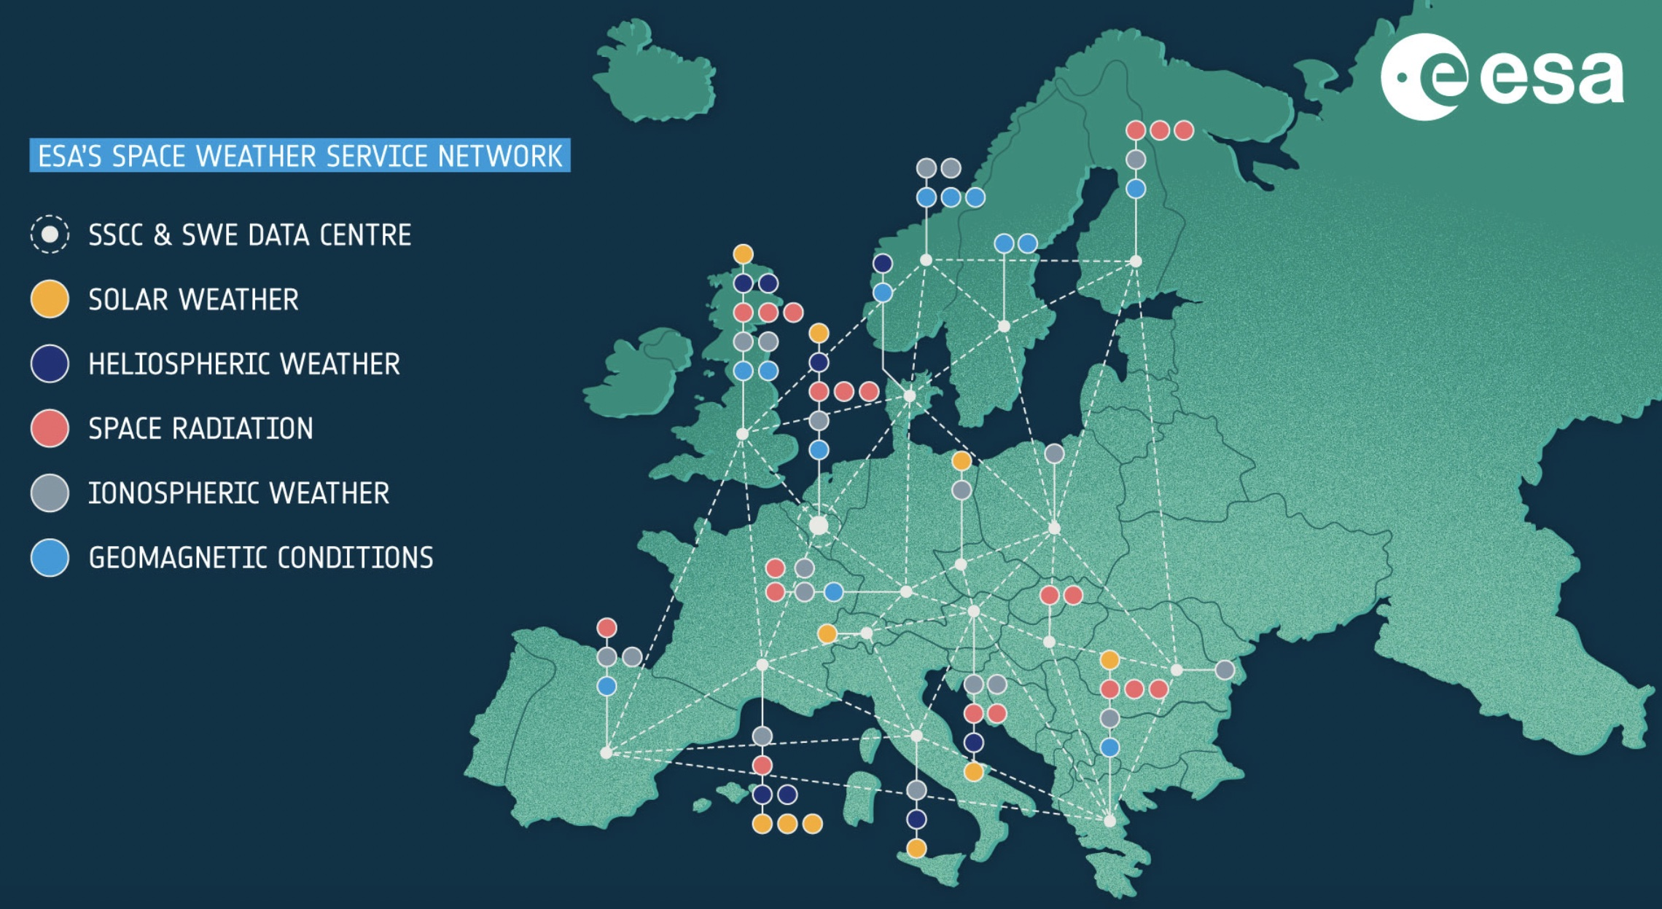



the active sun @MIDA
MIDA people:
anna maria massone (UNIGE)
sabrina guastavino (UNIGE, OATo)
paolo massa (FHNW)
federico benvenuto (UNIGE)
cristina campi (UNIGE)
andrea tacchino (UNIGE)
francesco marchetti (UNIPD)
edoardo legnaro (UNIGE)
emma perracchione (POLITO)
manuele filaci (UNIGE)
anna volpara (UNIGE)
mattia rossi (UNIGE)
katia bahamazava (POLITO)
gianluca audone (POLITO)
fabiana camattari (UNIGE, OATo)
barbara palumbo (UNIGE, FHNW)
margherita lampani (UNIGE)
miriana catalano (UNIGE)
alessia pellegri (UNIGE, POLITO)
external collaboratos:
gordon emslie (WKU)
sam krucker (FHNW)
andre csillaghy (FHNW)
shane maloney (DIAS)
daniele telloni (OATo)

Slide 21

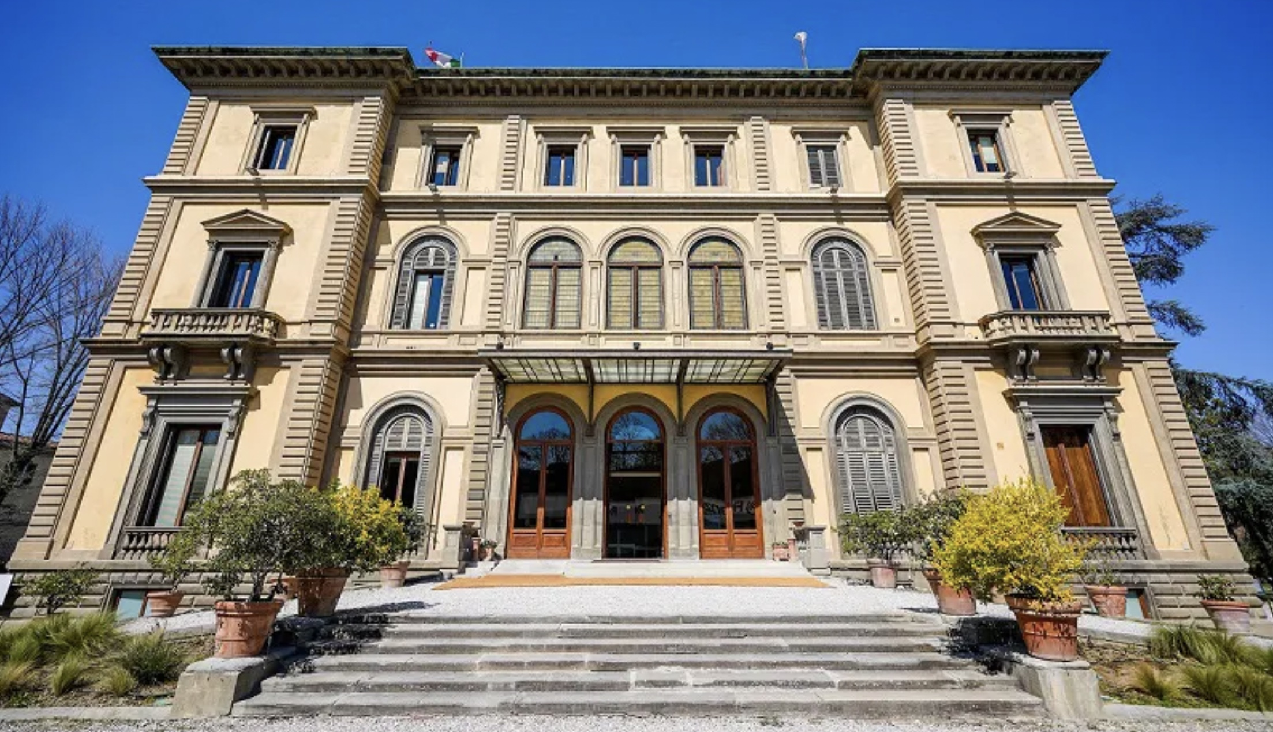
european space weather week 2026
ESWW 2026
florence, italy
november 2-6 2026

