Slide 1
Helium line emission in eruptive prominences:
Towards analysis of Metis and ASPIICS data
Petr Heinzel
&
Metis/ASPIICS team collaborators

Slide 2
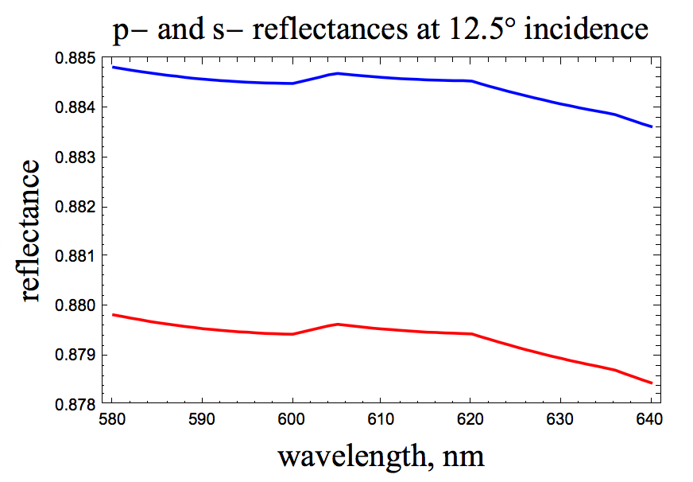
Antonucci+ 2020 (Metis paper)
HeI D3 line
587.7 nm
HeI D3 line undetectable in the corona => VL Metis filter gives ‘pure‘ VL signal
BUT: in erupting prominences and CME cores D3 can be detected as
part of the total VL signal
Then what about D3 polarization ?

Slide 4
Labrosse & Gouttebroze 2001

Slide 5
D₃ polarization with the HAZEL non-LTE code
only VL polarization
Heinzel, Štěpán, Jejčič et al. 2020

Slide 6
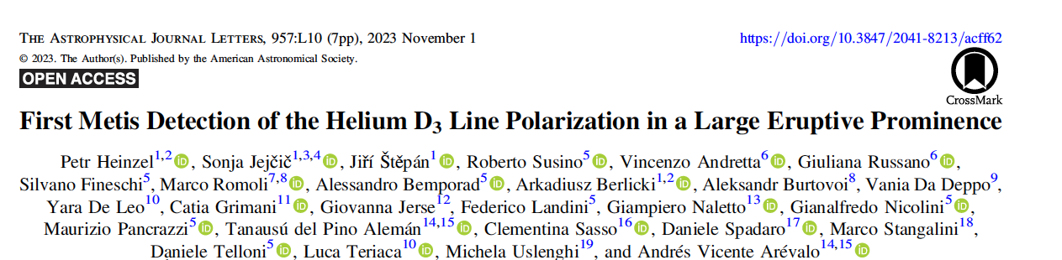

Slide 7
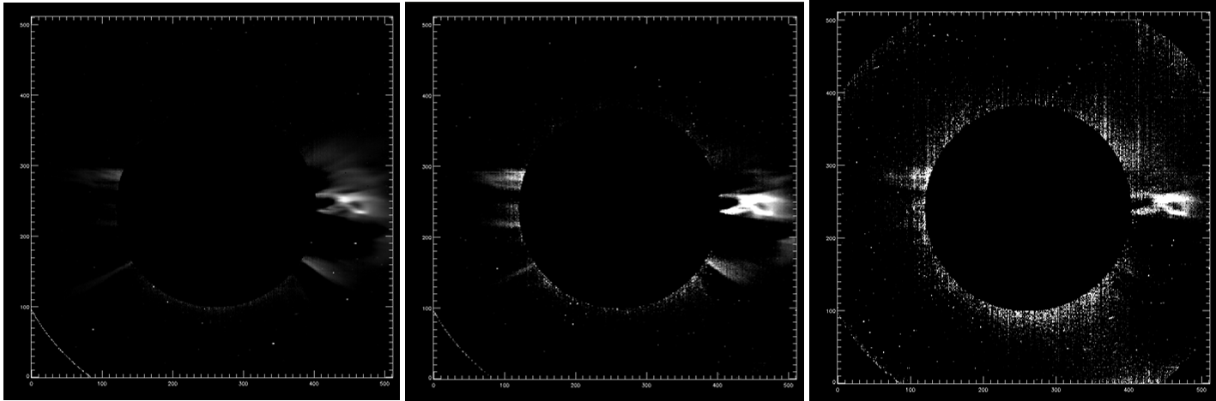
01:05 UT on April 26, 2021

Slide 8
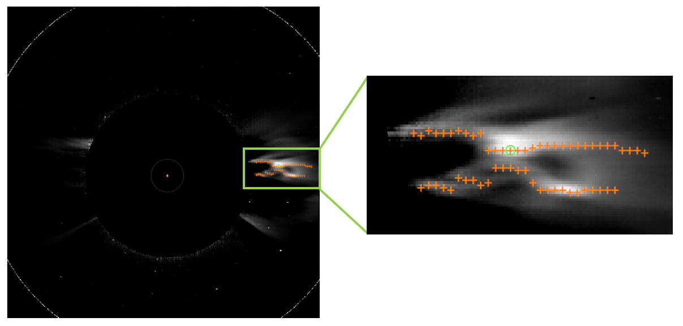
inclination of the prominence plane to Metis PoS is 19.3 deg

Slide 9
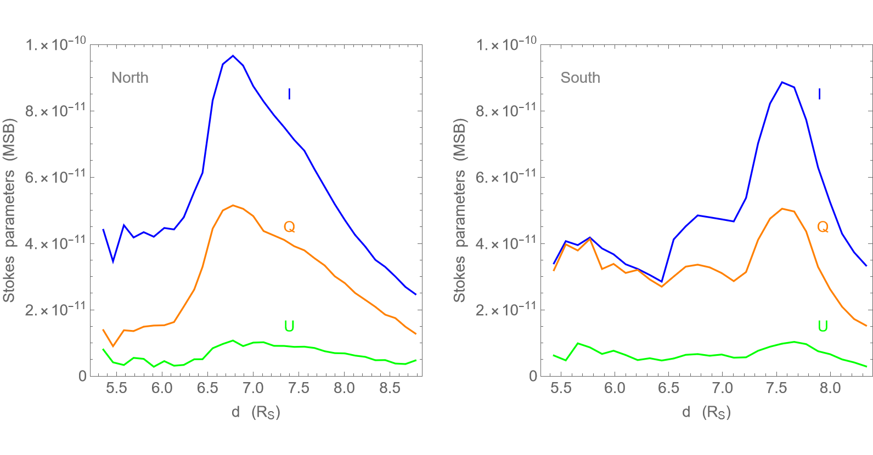

Slide 10
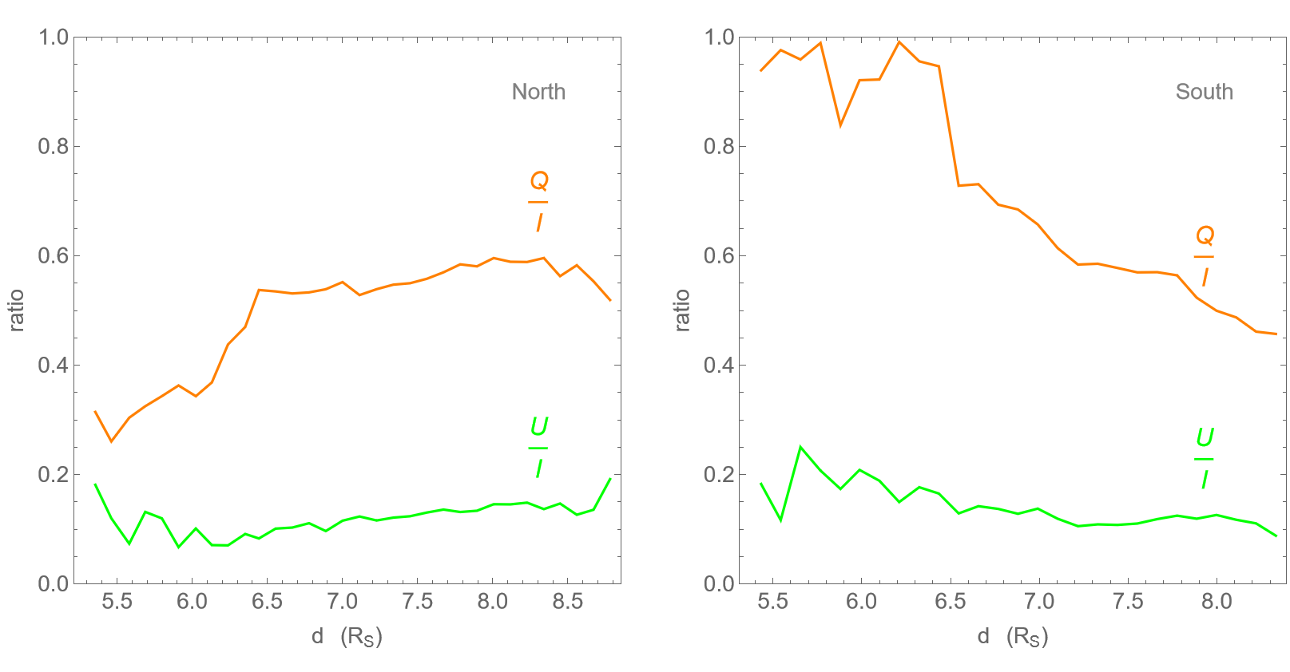

Slide 11
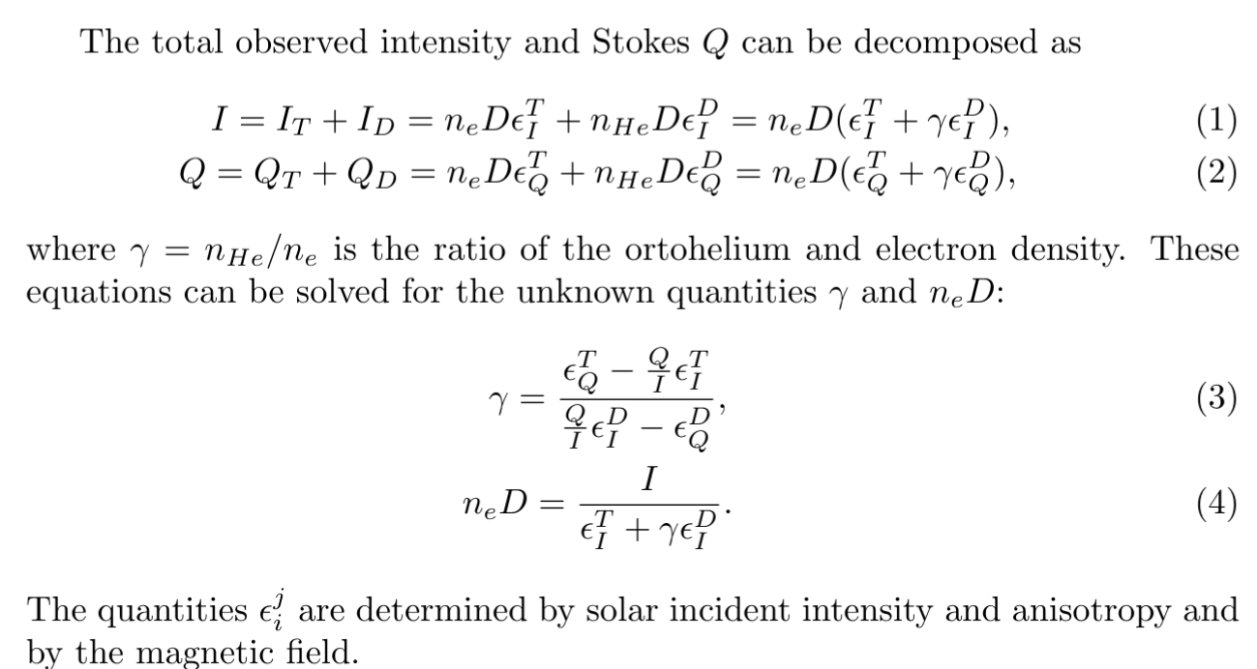

Slide 12
PRELIMINARY RESULTS
pure Thomson scattering: Q_T/I_T = 83 %
Broad-band Thomson VL is the integral over Metis passband 580 - 640 nm,
with the limb-darkened wavelength-dependent continuum according to Allen and with the Metis VL-channel reflectance
B=0
I_D3/I_tot = 51 % Q_D3/I_D3 = 24 %
B large
I_D3/I_tot = 36 % Q_D3 = 0

Slide 13
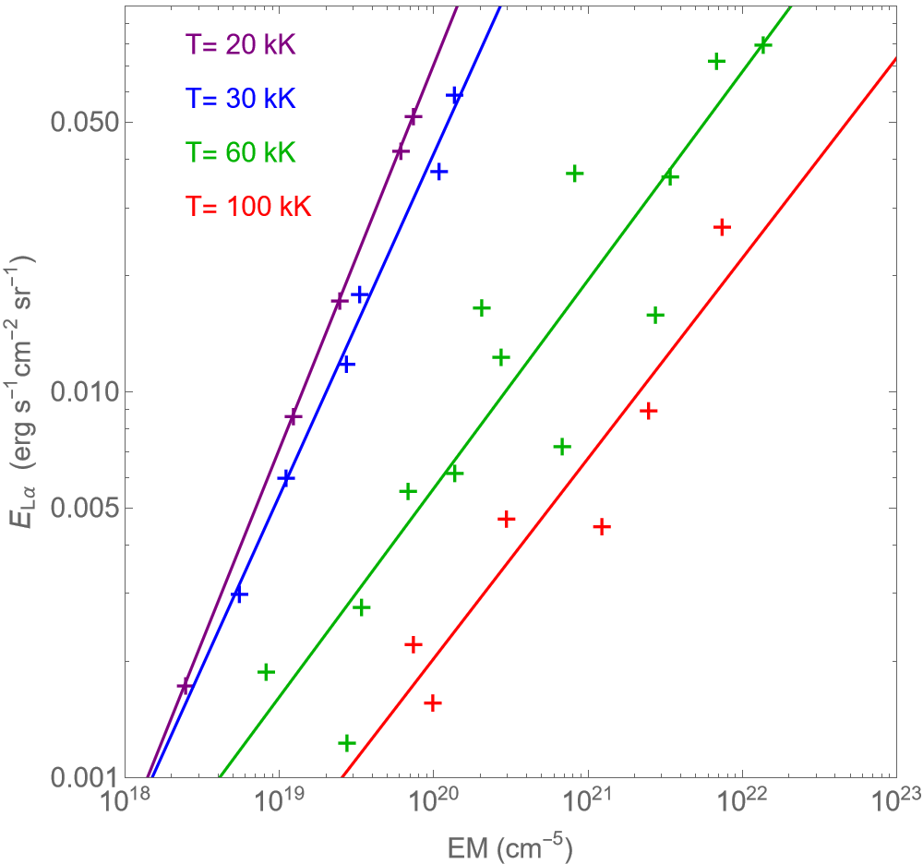
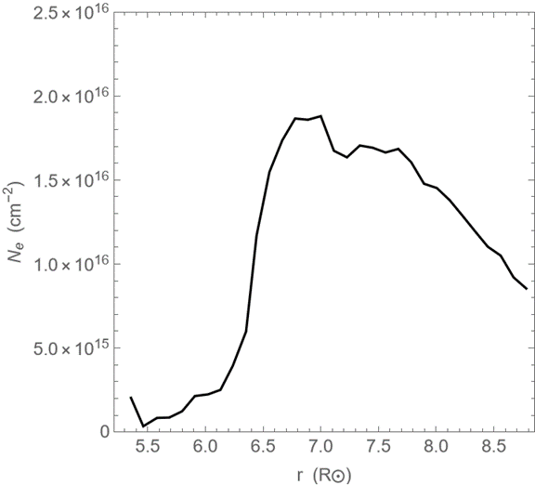
Graphical method
$$n_{e}=\frac{EM}{N_{e}}$$
$$D_{eff}= \frac{N_{e}}{n_{e}}$$
$$EM=n_{e}^{2} D_{eff}$$
Jejčič & Heinzel 2009

Slide 14
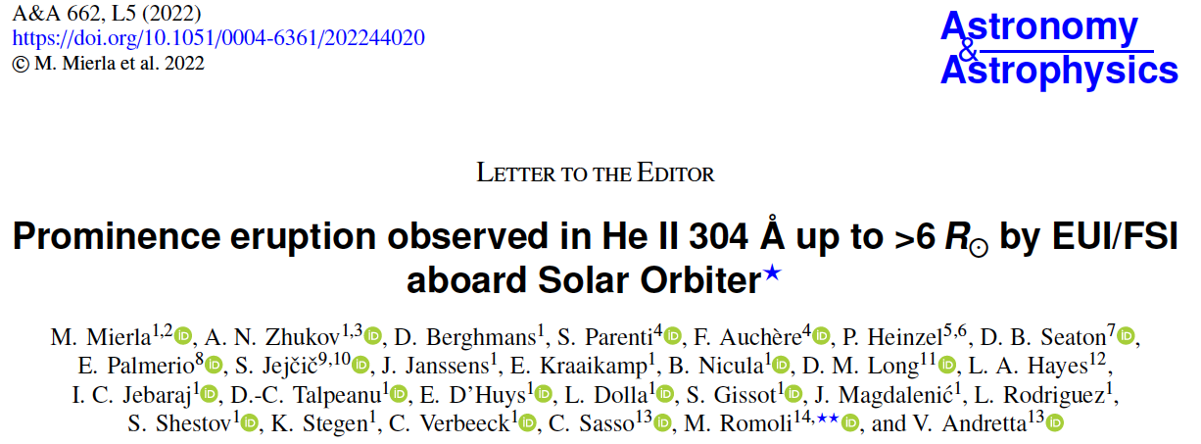

Slide 15
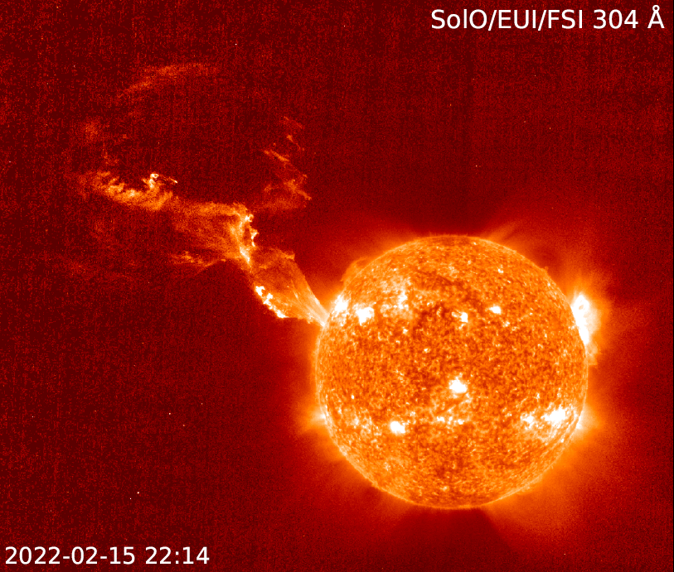
Mierla et al. 2022

Slide 16
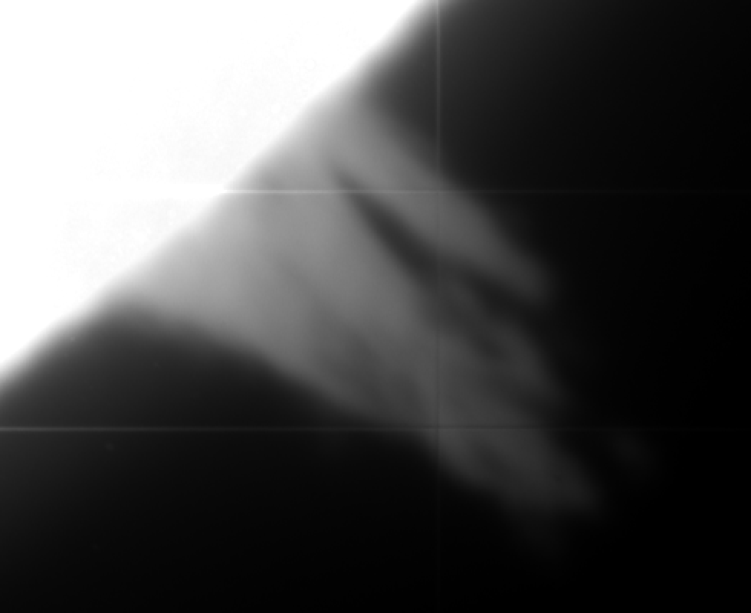
HSFA2: Prominence observed on 26-08-2011, 12:20 UT
Left: HSFA2 Hα slit-jaw image of the prominence
Right: HSFA2 Hα slit-jaw image of the prominence with overlaid slit positions

Slide 17
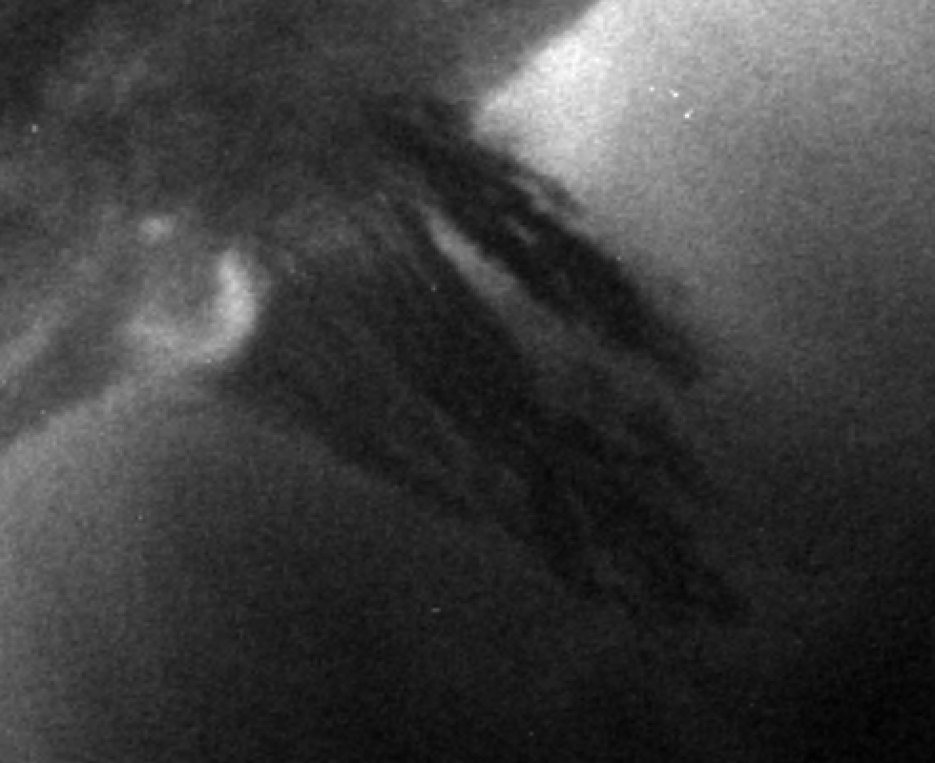
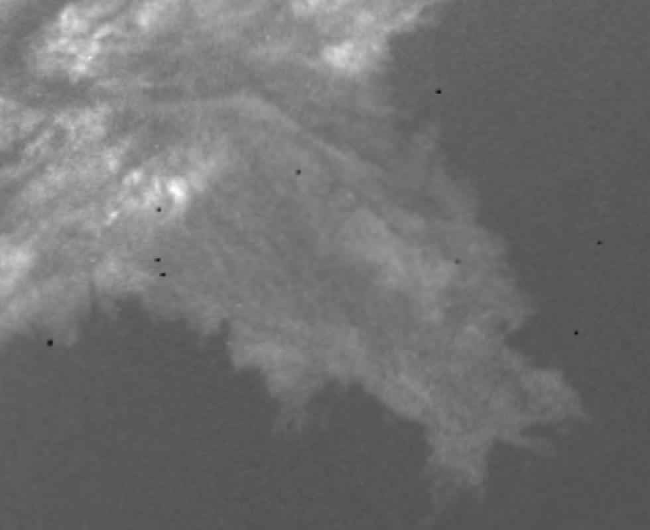
Prominence observed on 26-08-2011
Left: AIA 211 Å image
Right: AIA 304 Å image

Slide 18
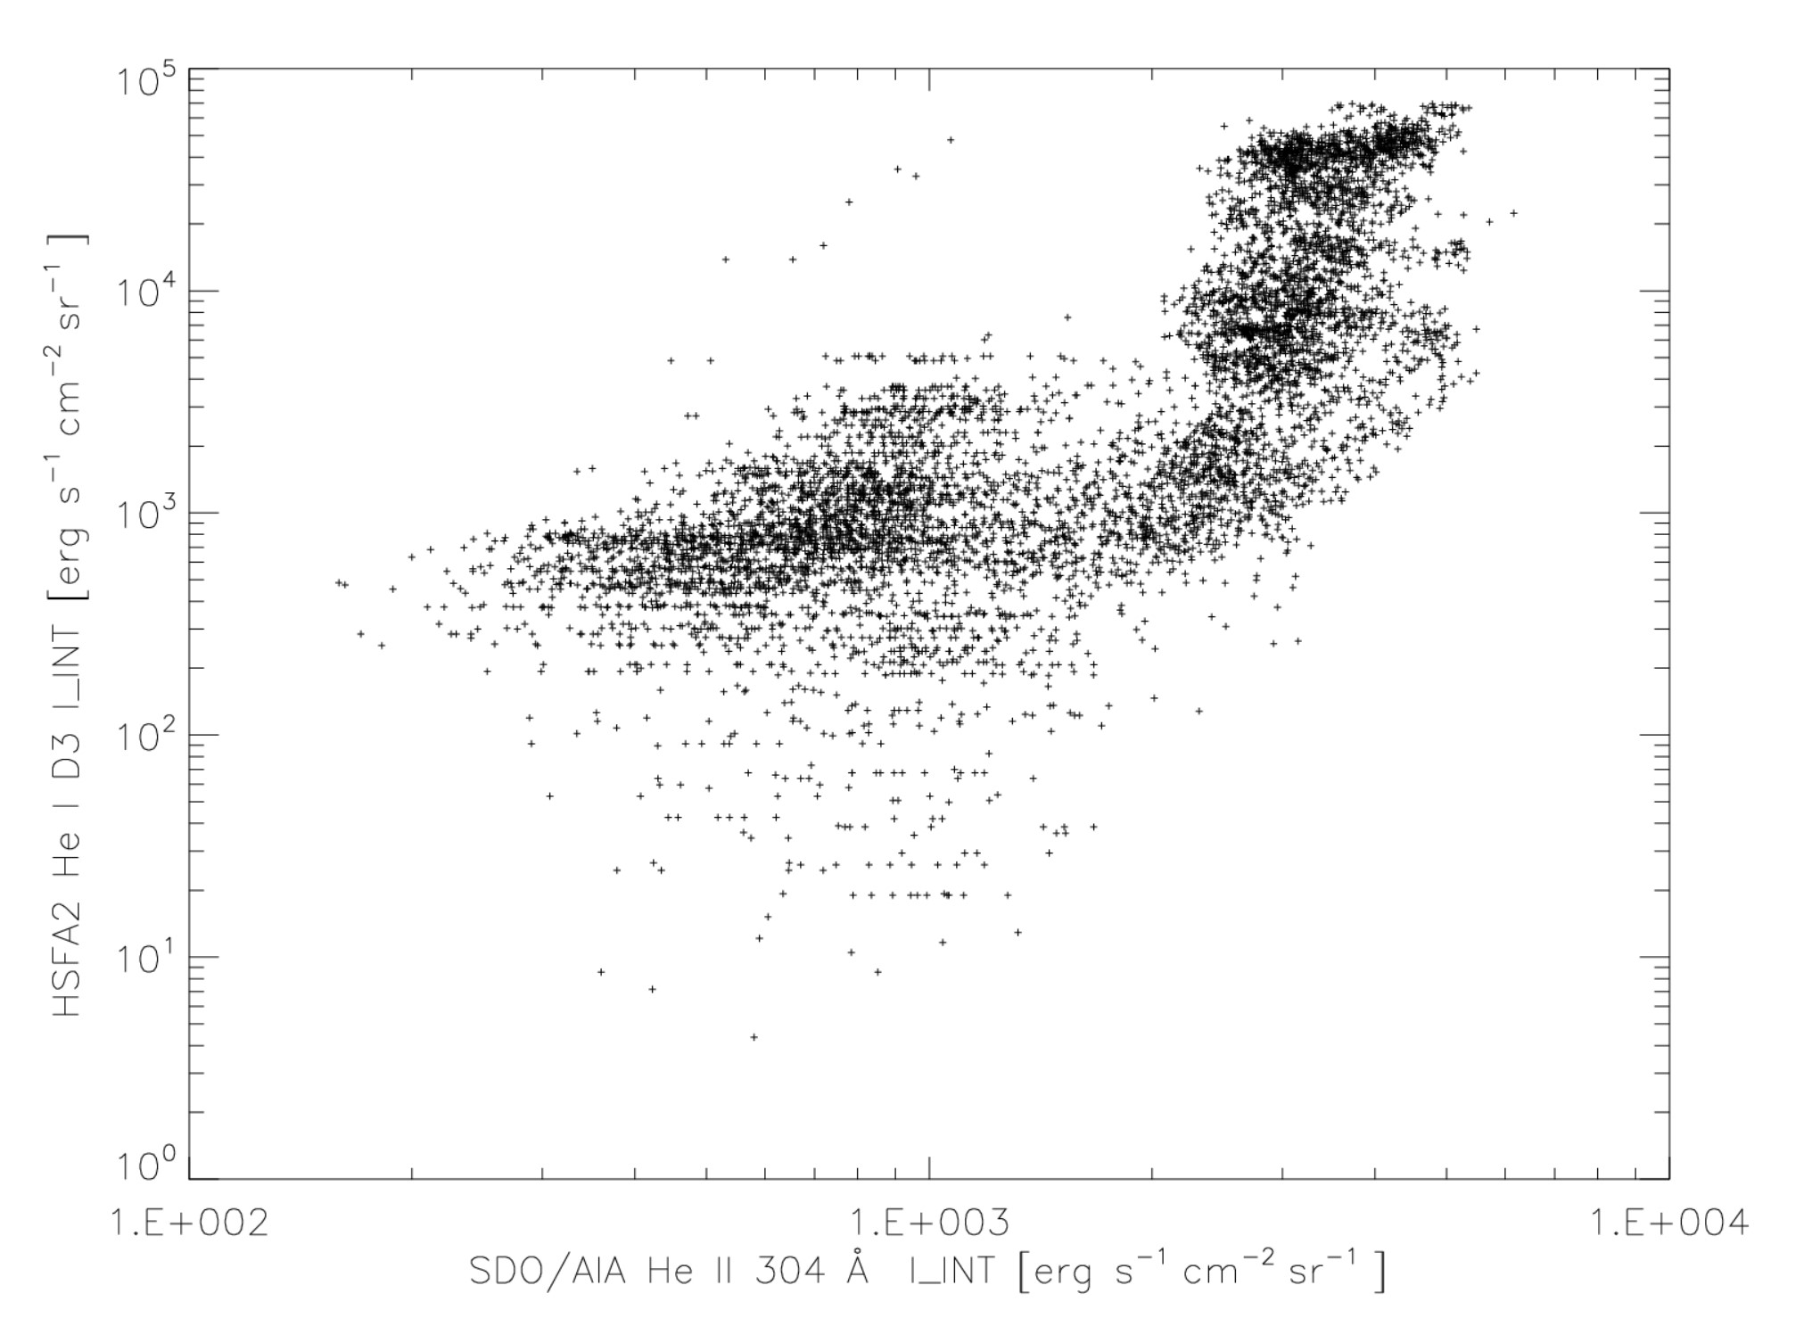
Comparison of integrated intensities of He II 304 Å (AIA) and He I D3 (HSFA2) lines.
Berlicki and Zapior, 2024

Slide 19
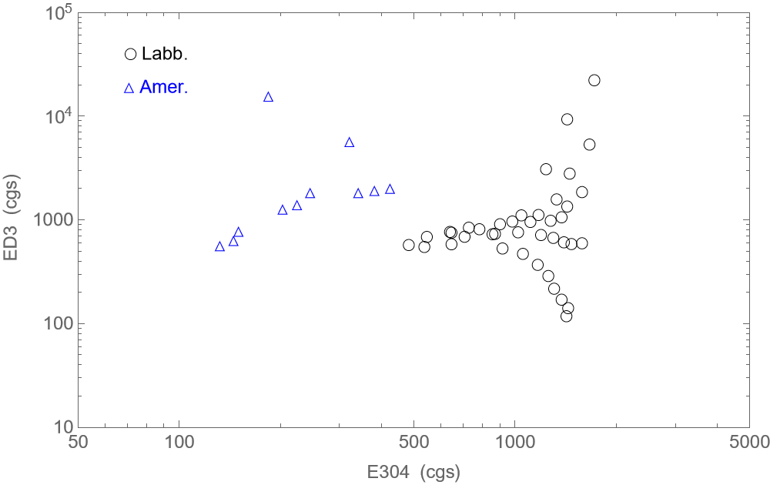
Labrosse and Gouttebroze 2001
Heasley, Mihalas, Poland 1974

Slide 20
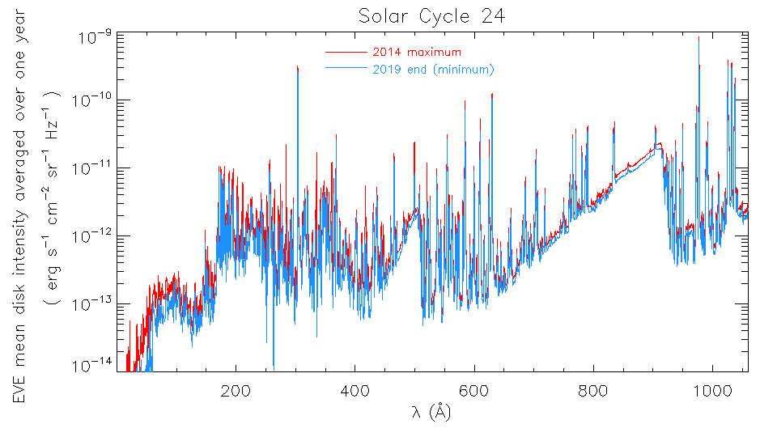

Slide 21


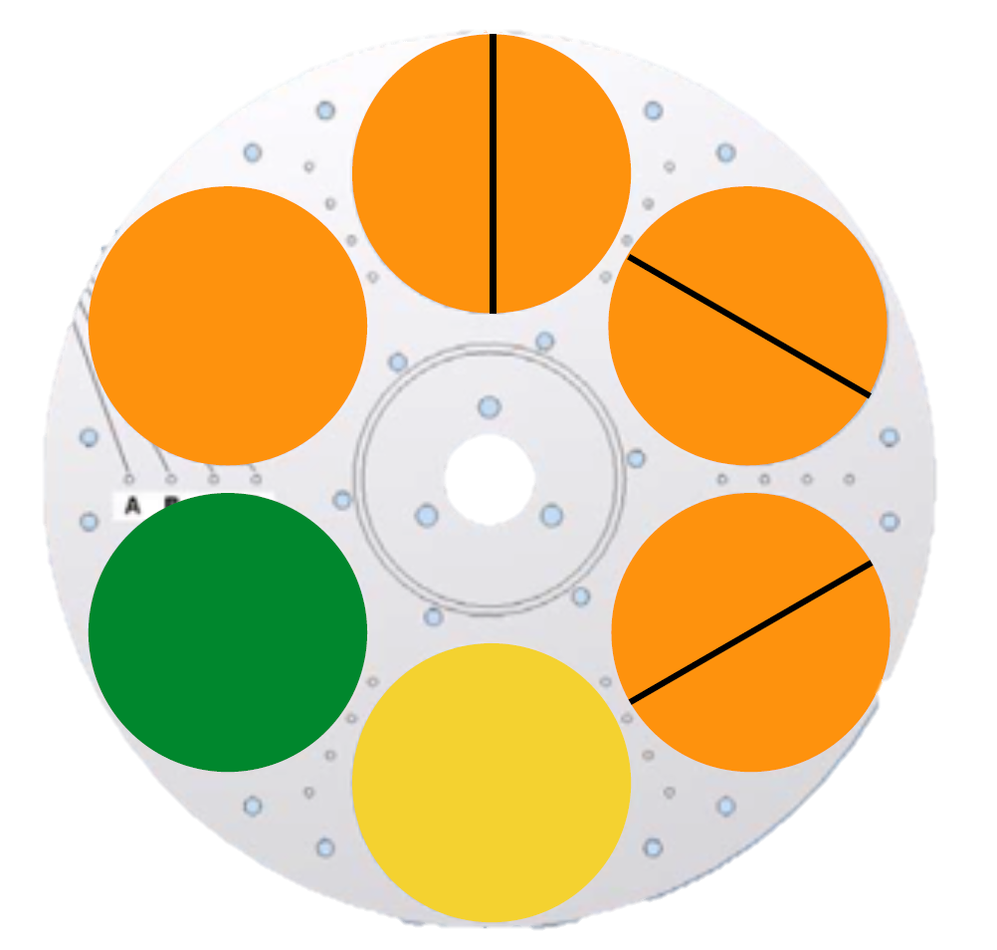






Slide 22
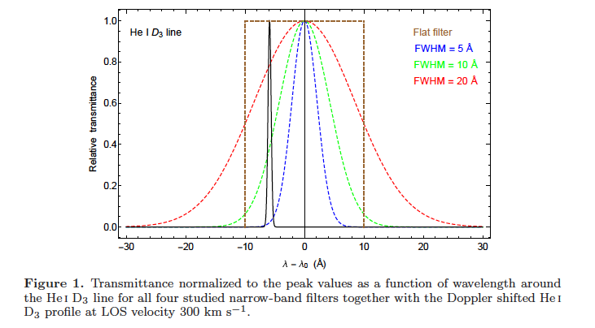
Jejčič et al. 2018

Slide 23
Prominence non-LTE models of He emission
Classical 1D models:
Heasley, Mihalas, Poland 1974 static prominences
Labrosse and Gouttebroze 2001 static prominences
Labrosse and Glinchey 2012 eruptive prominences
MALI 2D models:
Leger and Paletou 2009 static prominences
Heinzel 2025 – new code with improved illumination, modeling
of D3 and 304 lines at very large altitudes and
flow velocities, to be compared with L-alpha,
304 (EUI) and D3 observations

