Slide 1
Metis Observations of Geoeffective Events
2nd Metis Science Meeting
Istituto Nazionale di Astrofisica
Naples, 28th January 2025
Preity Sukla Sahani, Vincenzo Andretta, Giuliana Russano,
Clementina Sasso, Silvio Giordano and the Metis Team

Slide 2
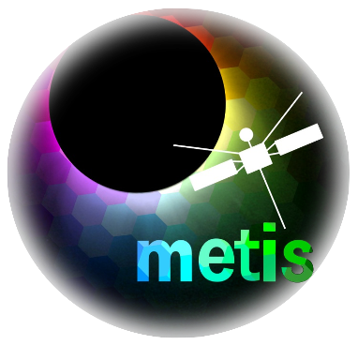
Introduction
Data Selection and Results
Summary and Conclusion
Future Works

Slide 3
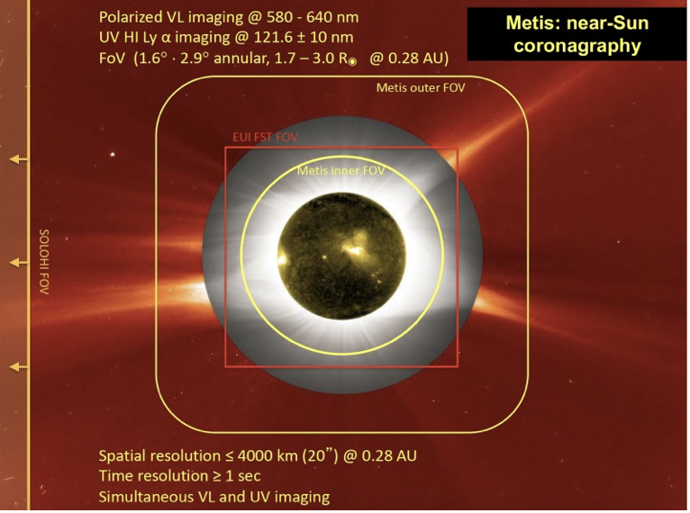
The Metis Coronagraph
Solar Orbiter joint mission by ESA and NASA launched in February 2020 to sun.
The Metis coronagraph is one of the 10 instruments onboard SolO.
Observes in VL (580-640 nm) and UV narrow spectral range centered on the Lyman α line of Hydrogen (121.6 nm).
High spatial (4000 km/pixel) and temporal (1s/ image) resolution.
Image Courtesy : M. Romoli
Notes:
Multiwavelength POV and comprehensive analysis of the solar events

Slide 4
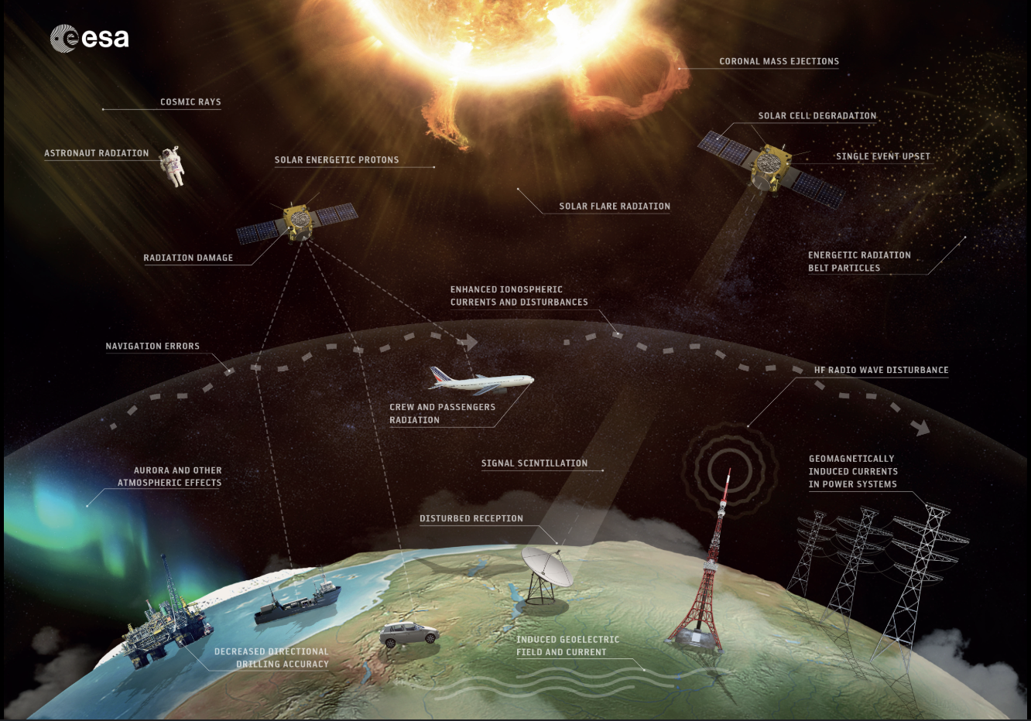
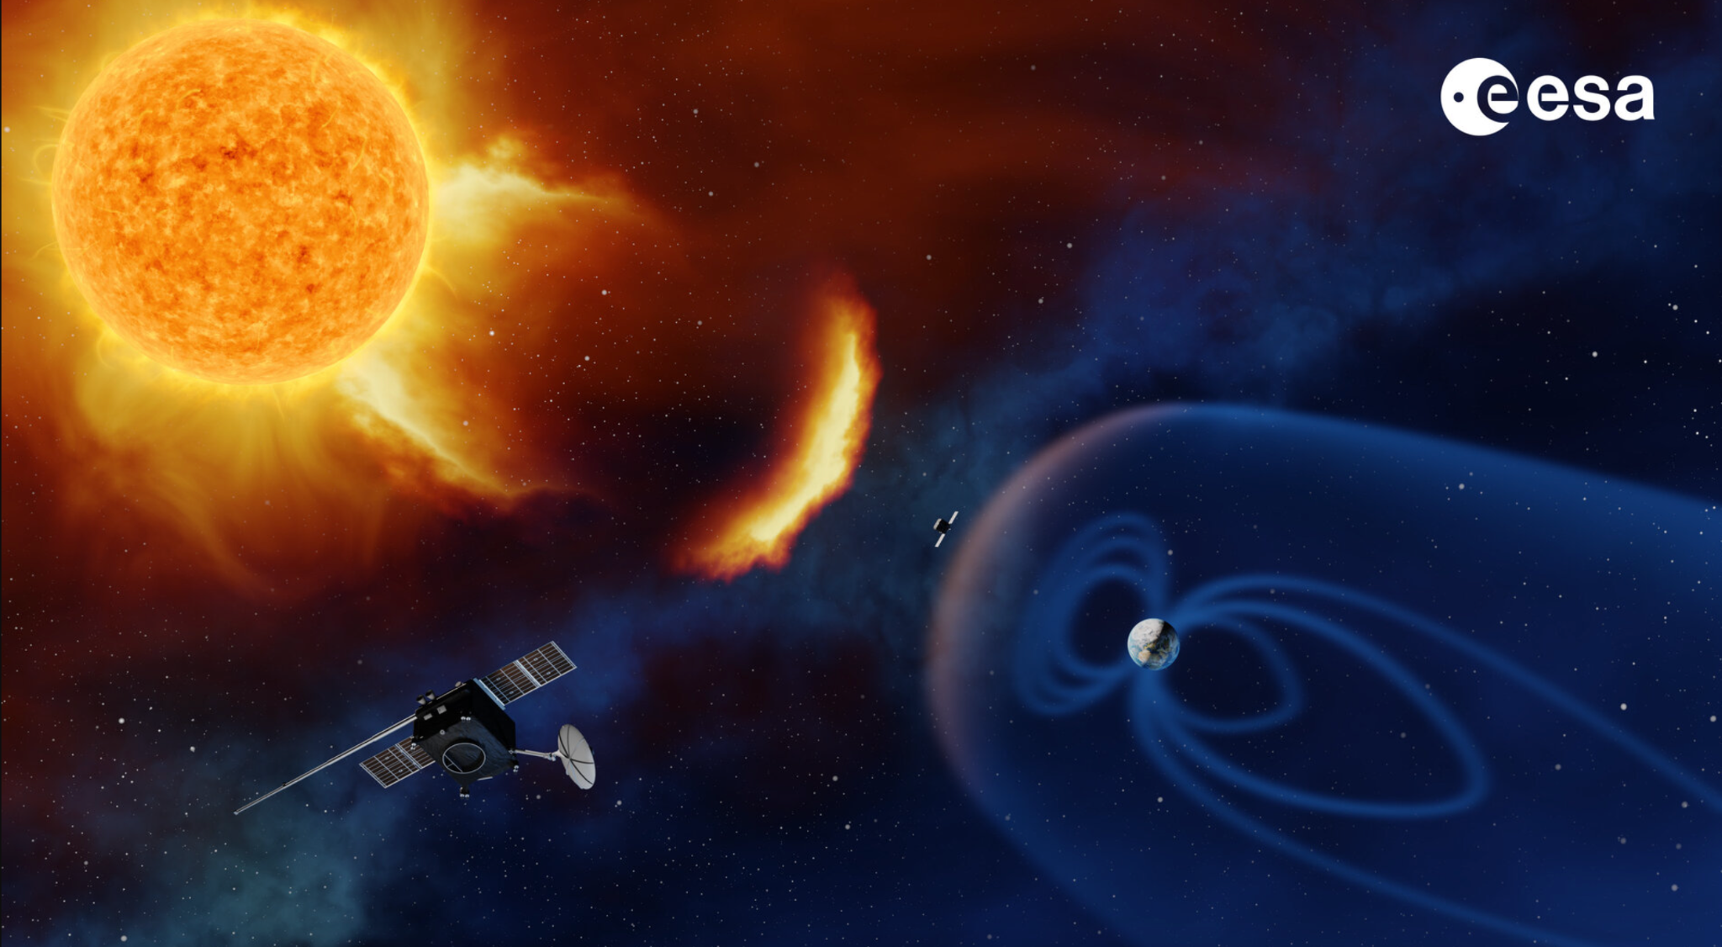
Space Weather Effects

Slide 5
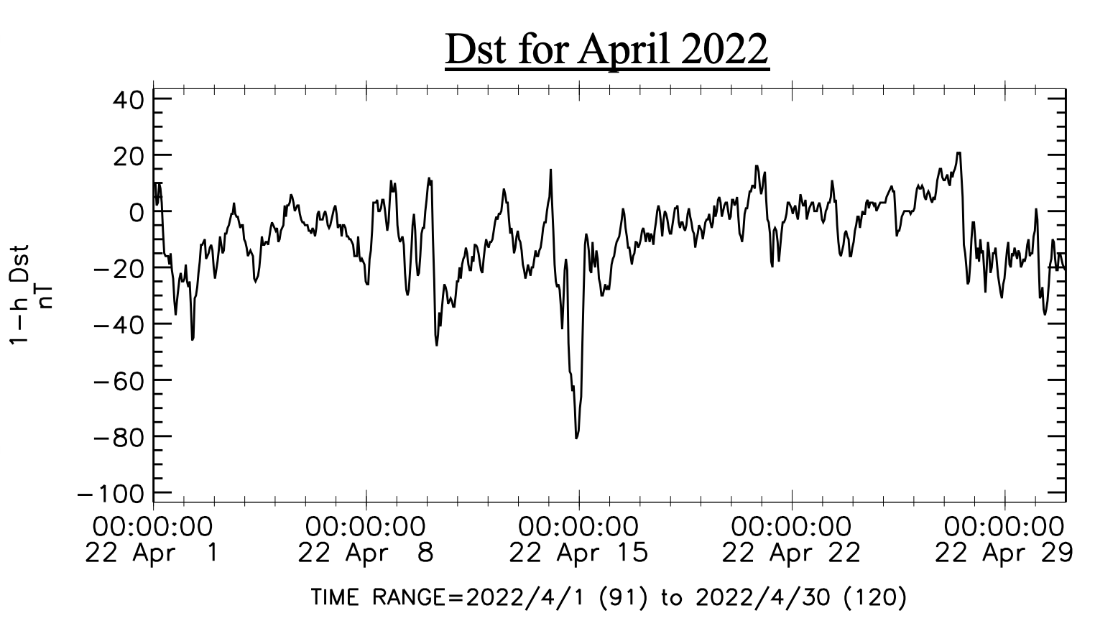
Geomagnetic Storms
Can cause decrease in Earth’s magnetic field called Geomagnetic storms.
Measured using Disturbance Storm Time (Dst) Index through ground based magnetometers.
Peaks represent the geomagnetic storms : main phase and recovery phase.
Dst peak : -81 nT
Data taken from OMNI 1 hr Database

Slide 6
Motivation for the Research
As these events affect the general public, it is important to study them.
The Metis team is building a catalogue of solar eruptive events observed using the Metis coronagraph. It is now complete from the cruising phase (late 2020s) until 01-01-2023 and has 401 events.
Making a subset of this catalogue having events which are geoeffective i.e are affecting earth.
Notes:
As we saw before these affect the general public and thus need to be studied. Today I will be talking about this particular point.

Slide 7
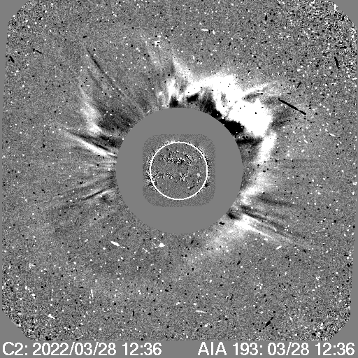
Workflow of the project
Drag Based Model and Drag Based Ensemble Model
(Calgovic etal; 2022)
WSA-Enlil Model
(Vic Pizzo etal; 2011)
Data from SOHO LASCO CME Catalogue

Slide 8
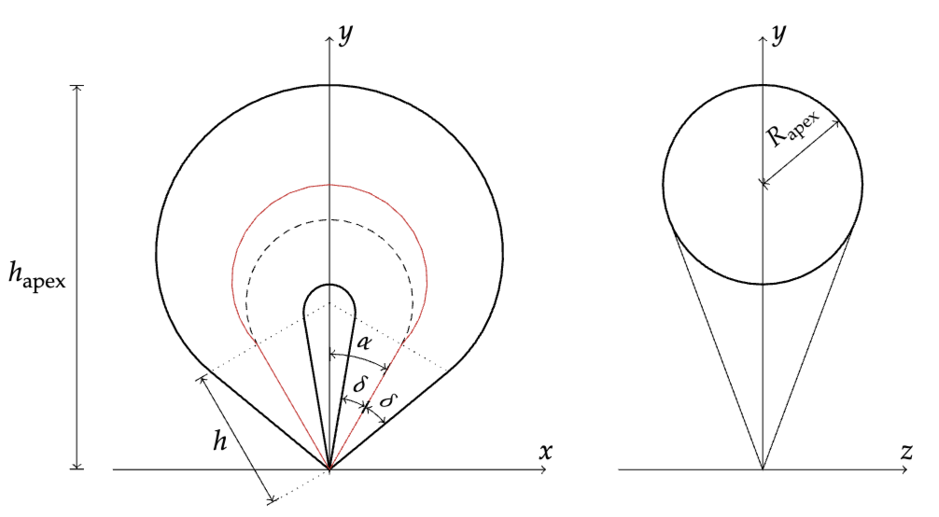
3D Reconstruction using GCS
A three-spacecraft constellation is taken using LASCO C2, STEREO COR2-A and Metis.
Models the 3D structure of CMEs, is fitted using coronagraph images.
Has six parameters defining model position and geometry.
GCS fitting with tool ‘GCS in Python’
in three viewpoints simultaneously.
Thernisien et al. 2006 ApJ

Slide 9
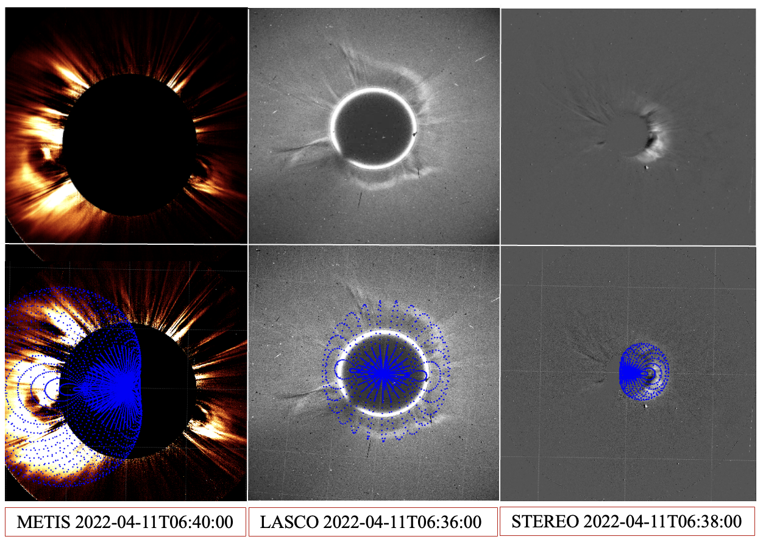
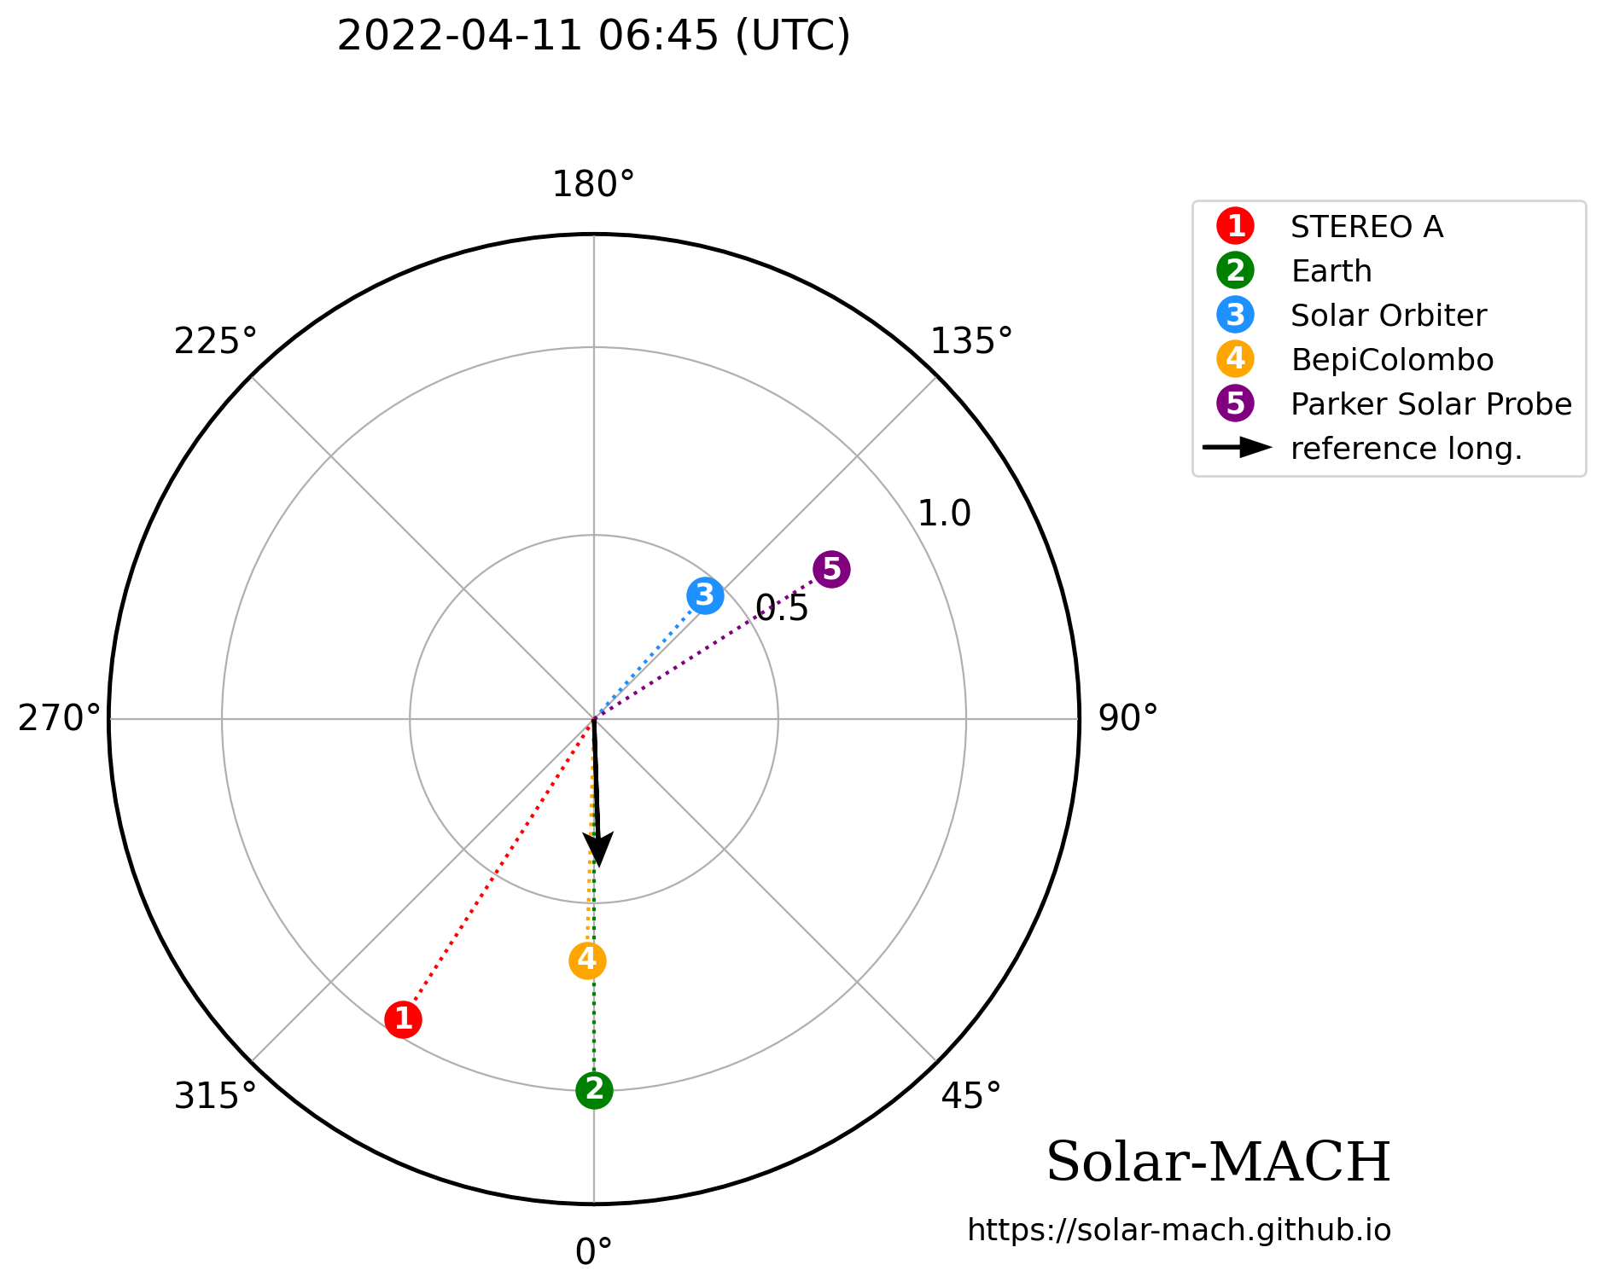
Event of 11 April 2022
Notes:
1,3,4,5 represent the position of different spacecrafts at that date and time. Black arrow shows the direction of propagation of this event information of which we get through the GCS fit

Slide 10
Event of 11 April 2022
Parameters obtained through GCS Fitting
The following parameters were obtained after fitting:
CME angular half width can be calculated from half
angle, tilt angle and aspect ratio.(Calgovic etal; 2022)
For this case, it is given as 54.1 deg.
Longitude of CME : 2.2 deg
Latitude of CME : -3.0 deg
Apex Height : 4.7 R☉
Half Angle : 20.32 deg
Tilt Angle : 90 deg
Aspect ratio : 0.81
Thernisien et al. 2006 ApJ

Slide 11
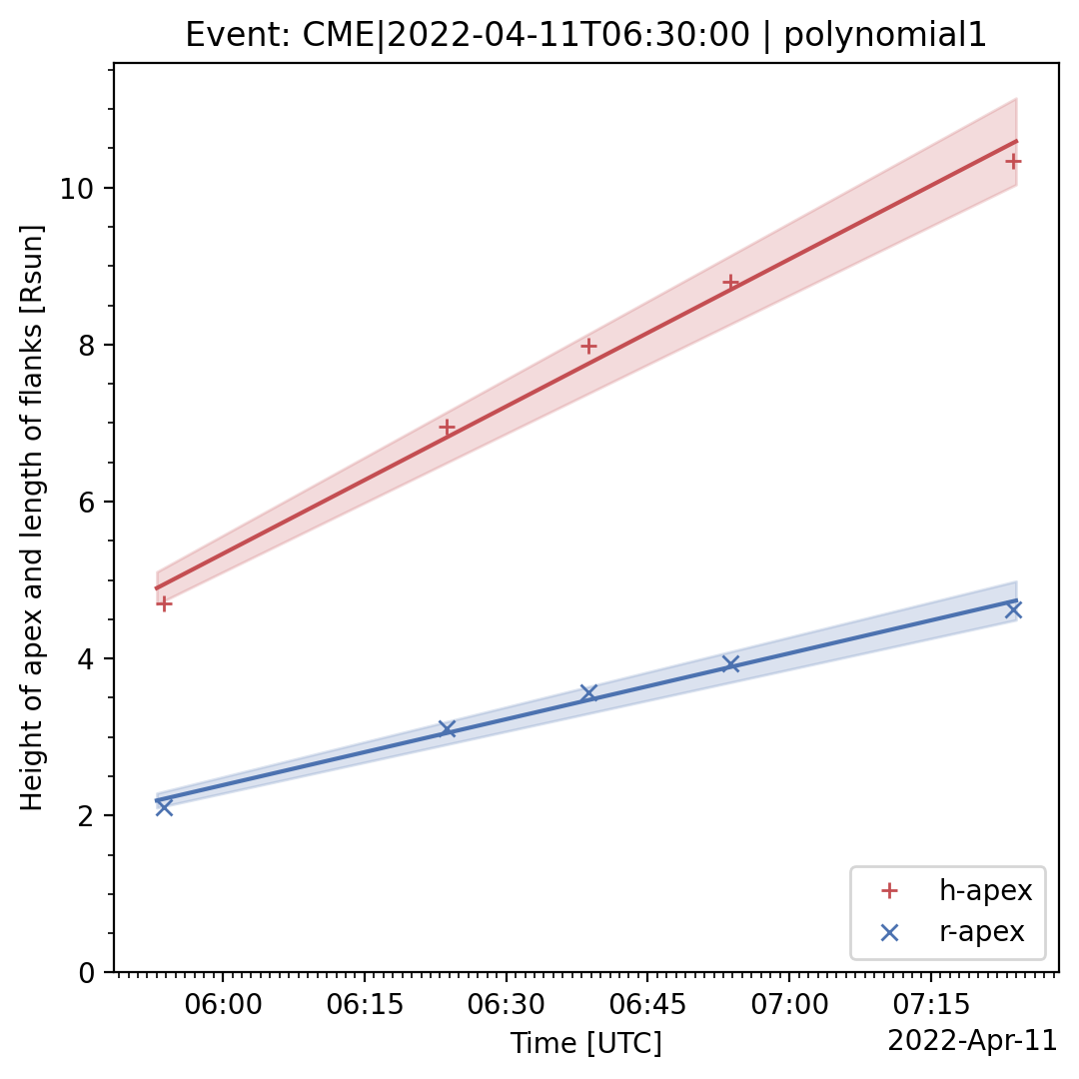
Event of 11 April 2022
CME apex velocity from height-time profile obtained by fitting sequential images using ‘Pythea’.(Athanasios Kouloumvakos et al; 2022)
Also called CME 3D Speed.
This method of obtaining the CME speed is also known as GCS Forward Modelling Method . (Minta et al; 2023)

Slide 12
Event of 11 April 2022
Parameters obtained through GCS Fitting
The following parameters were obtained after fitting:
The 3D speed was obtained to be 730 ± 40 km/s.
Longitude of CME : 2.2 deg
Latitude of CME : -3.0 deg
Apex Height : 4.7 R☉
CME angular width : 54.1 deg
Thernisien et al. 2006 ApJ

Slide 13
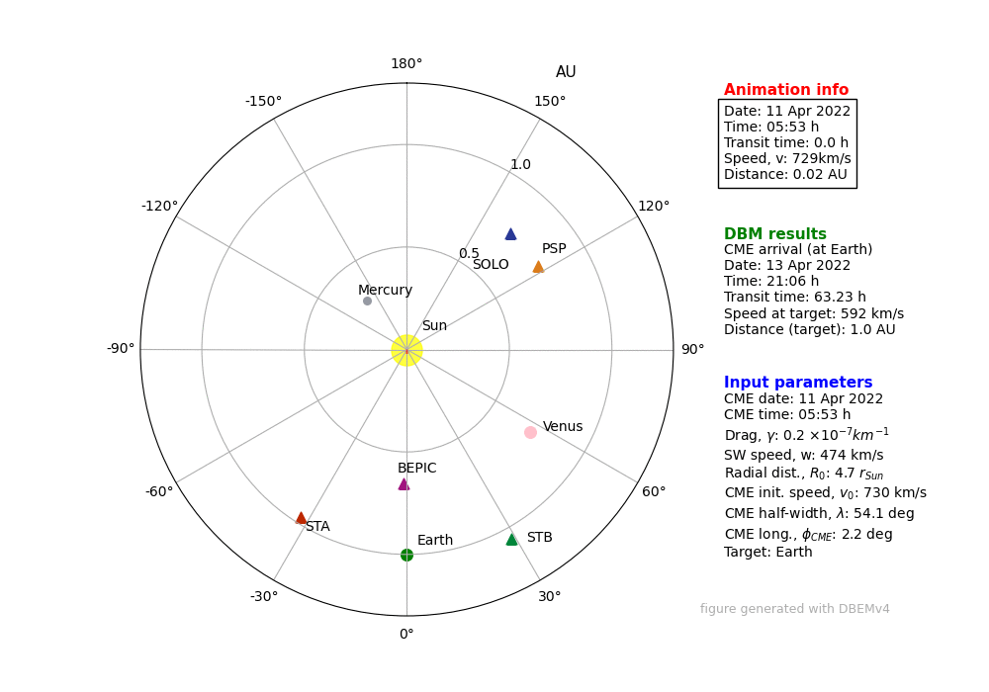
Event of 11 April 2022
Checking for geoeffectiveness: DBM and DBEM
DBM: Calculates the transit time of the CME in the heliosphere under the influence of magnetohydrodynamic drag or solar wind interaction.
Propagation based on CME initial parameters and ambient solar wind.
CME 2D geometry defined as a cone with leading edge initially a semicircle flattening with time.

Slide 14
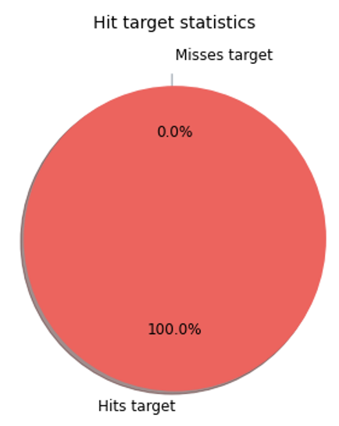
Event of 11 April 2022
Checking for geoeffectiveness: DBM and DBEM
DBEM: Probabilistic predictions of CME arrival times assuming input parameters follow a normal distribution i.e u =ū 土 Δu
ū = mean of the distribution (input parameter) and Δu =3σ where 99.7 % of measurements found.
Random samples drawn from this distribution. In our case 10,000 samples taken.

Slide 15
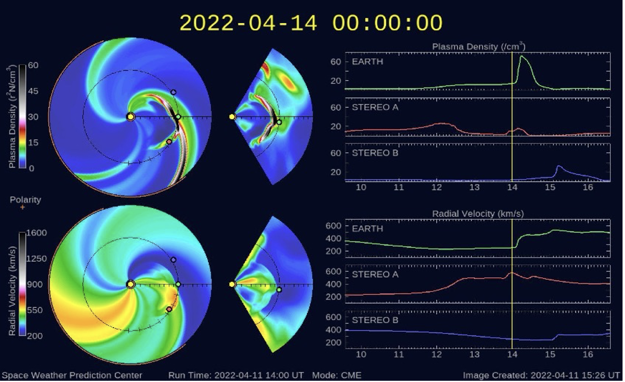
Event of 11 April 2022
Checking for geoeffectiveness: WSA-Enlil Model
WSA: Semi-empirical near-Sun model approximating the outflow at the base
of the solar wind.
Enlil: Sophisticated 3D magneto- hydrodynamic model which simulates outflow up to 2 AU.
CME highlighted by enhanced solar wind region in the radial velocity and plasma density plots.

Slide 16
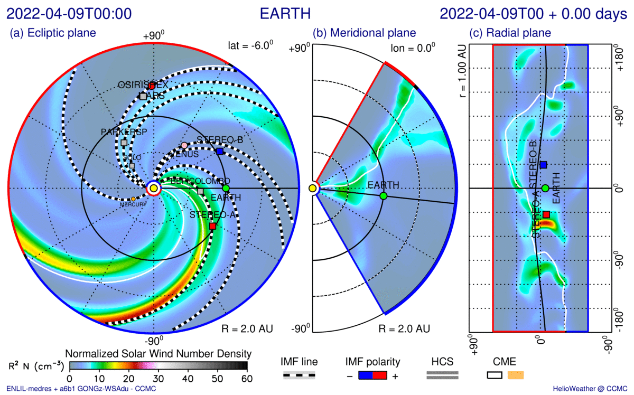
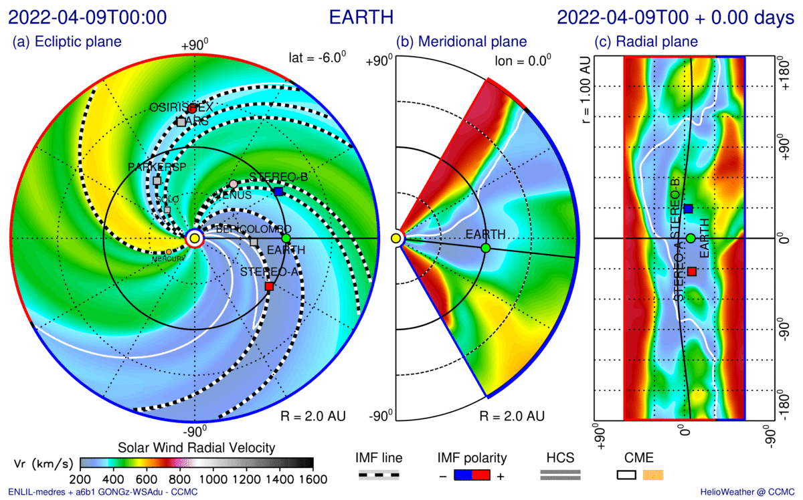
Event of 11 April 2022
Checking for geoeffectiveness: WSA-Enlil Model
Number Density plot
Radial Velocity plot

Slide 17
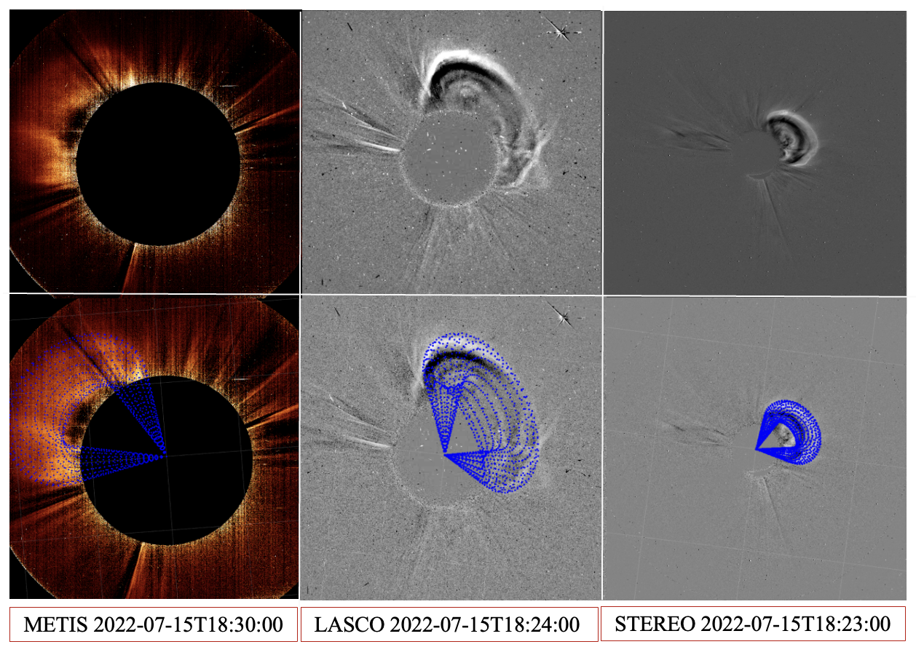
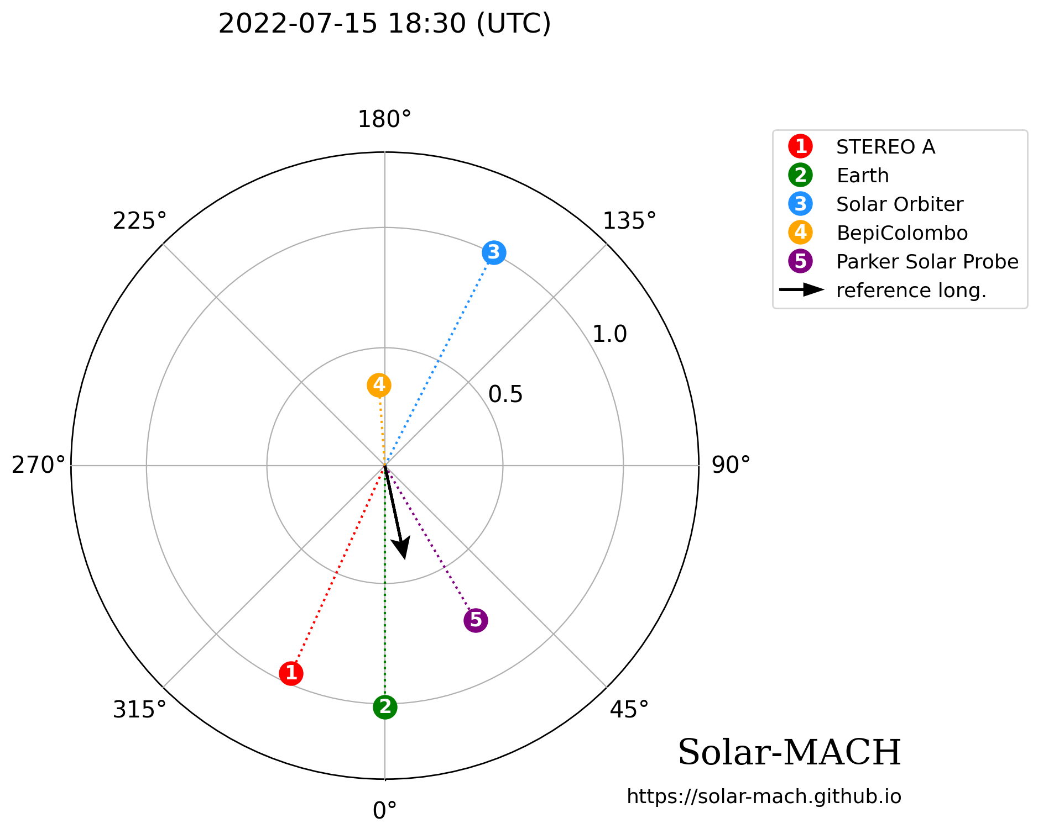
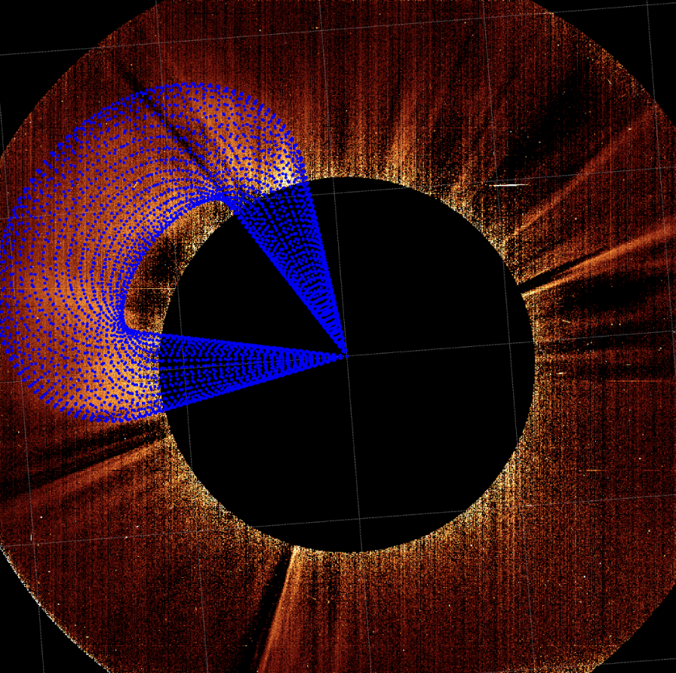
Event of 15 July 2022

Slide 18
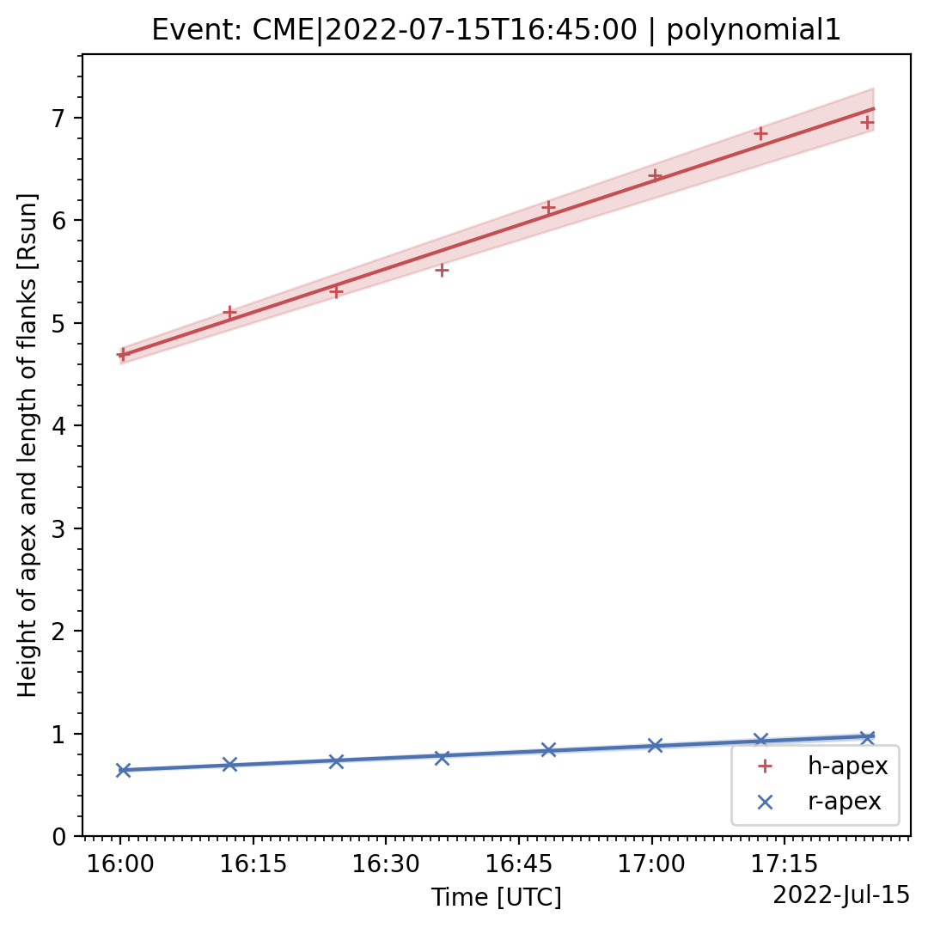
Event of 15 July 2022
Parameters obtained through GCS Fitting
The following parameters were obtained after fitting:
The 3D speed was obtained to be 329 ± 20 km/s.
Longitude of CME : 22.5 deg
Latitude of CME : 12.33 deg
Apex Height : 5.46 R☉
CME angular width : 18.1 deg

Slide 19
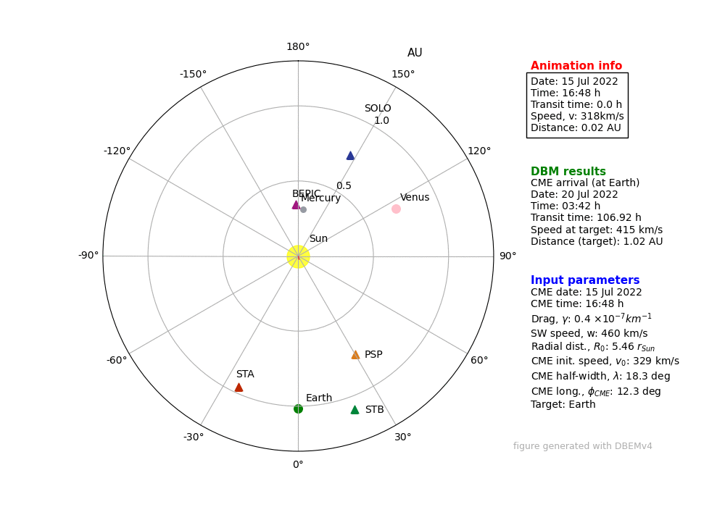
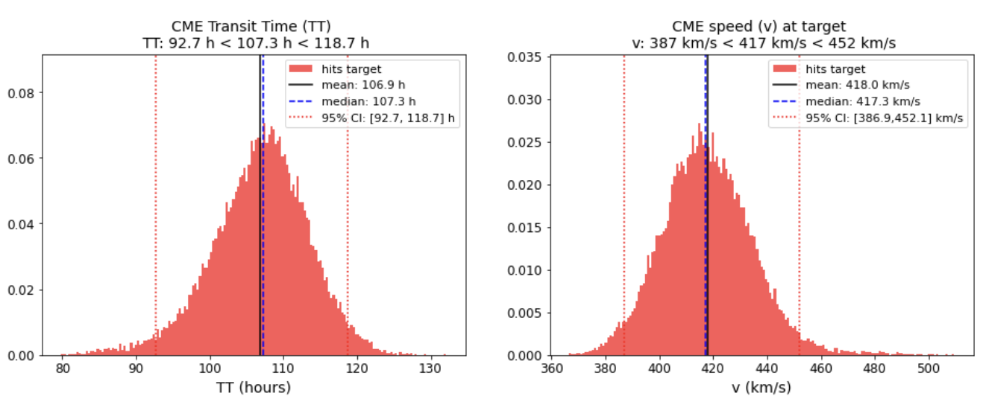
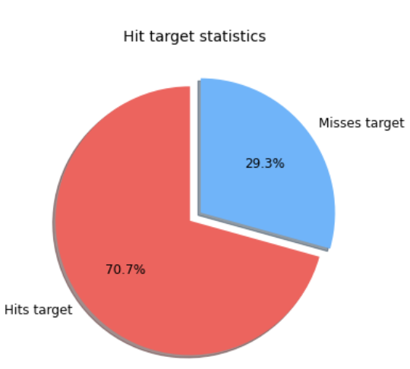
Event of 15 July 2022
DBM and DBEM Results

Slide 20
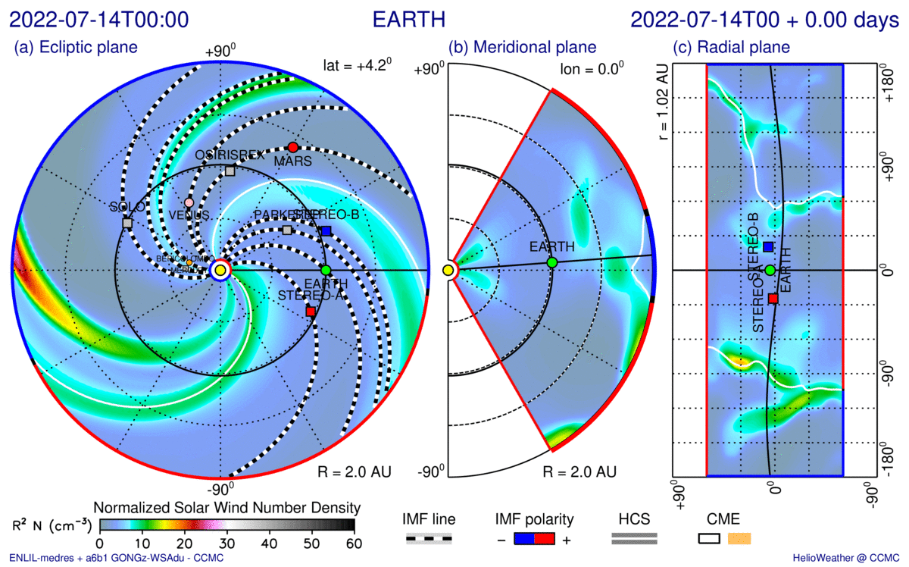
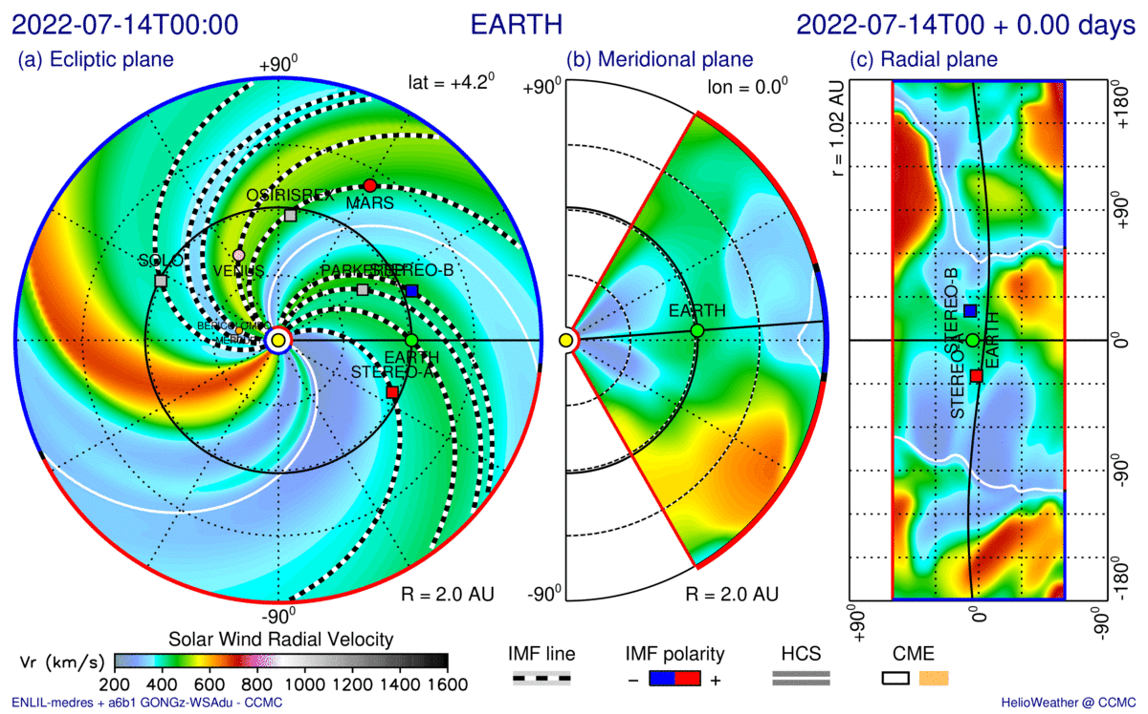
Event of 15 July 2022
WSA-Enlil Model Results
Number Density plot
Radial Velocity plot

Slide 21
Summary and Conclusion
Observed date and time in Metis PoV [in UT] | GCS Parameters |  |  |  |  |  | 3D Velocity [km/s] | DBEM % of hitting Earth | WSA- ENLIL Peak
 | Lon [ deg] | Lat [ deg] | Half Angle [ deg] | Aspect Ratio | Apex Height [R☉] | Tilt Angle [deg]
02-09-2022 21:32 | -31 | -40 | 23.23 | 0.30 | 9.00 | -21.50 | 610±20 | 64.3 | Y
30-12-2022 18:30 | 14.62 | -19.50 | 15.40 | 0.16 | 15.88 | 62.50 | 480±40 | 58.8 | Y
Metis provides an additional viewpoint improving the accuracy with which the physical parameters and chances of geoeffectiveness are determined for these solar events.

Slide 22
Future Works
Geoeffective events of the cruising phase as well as after 2022 events need to be studied including the CMEs causing brilliant auroras on Earth in 2024.
Further analysis for CME propagation can be done using the EUHFORIA (Pomoell et al; 2018) model, which along with simulating the transit times of CMEs in heliosphere also simulates the B_{Z} , the Dst indices, solar wind predictions and geomagnetic storms.
Notes:
Until now we analysed five distinct events
Here is a quick overview, but I won't go into detail
It is listed:
the event ID from the original Kay-Gopalswamy list
The time of first observation in COR1
The speed fitted in the LASCO CME catalogue.
The arrival time at 1 AU from Richardson & Cane's ICME list.
And the source region location in EUV
((given as heliographic latitude and Stonyhurst longitude, based on EUV observations of the post-eruption arcade))
((Moving forward, we plan to expand this analysis to include more events))
09:15

Slide 23
THANK YOU!

Slide 24
Calculation of the half width
Taken from Calgovic etal; 2022, SolPhy

Slide 25
Workflow of the project
Drag Based Model and Drag Based Ensemble Model
(Calgovic etal;2022)
COMPARISON AMONG THEM
WSA-Enlil Model
(Vic Pizzo etal;2011)
EUHFORIA
(Pomoell etal;2018)
Data from SOHO LASCO CME Catalogue
Notes:
So, traditionally, space weather forecasting has relied heavily on the SOHO spacecraft located at the L1 Lagrange point between Earth and the Sun
While SOHO provides invaluable data, its single perspective offers only a two-dimensional plane-of-sky projection of structure of CMEs
On the left, you can see a halo event imaged by SOHO LASCO. Especially for these events, the limited perspective can lead to misinterpretations of a CME's true geometry and direction, as well as overlapping features
Moreover, specific quantities are generally underestimated or overestimated, which leads to inaccurate propagation modeling
02:00

