Slide 1
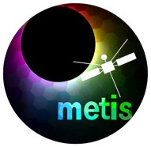
Metis status and science so far
Marco Romoli, Roberto Susino & the Metis Team
January 27th, 2025
2nd Metis Science Meeting, Catania, January 27-29, 2025

Slide 2
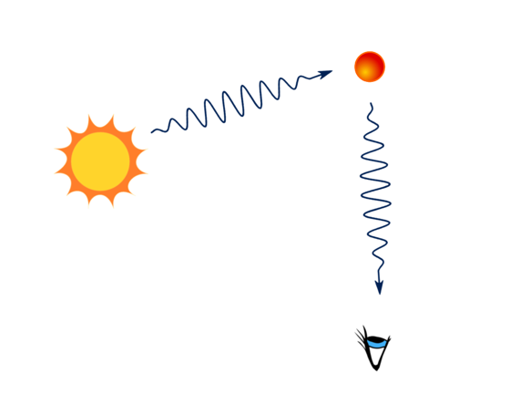
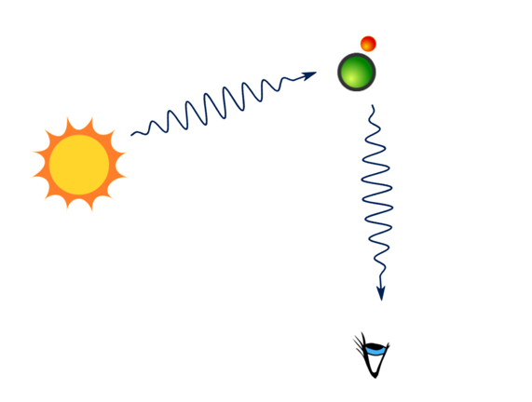
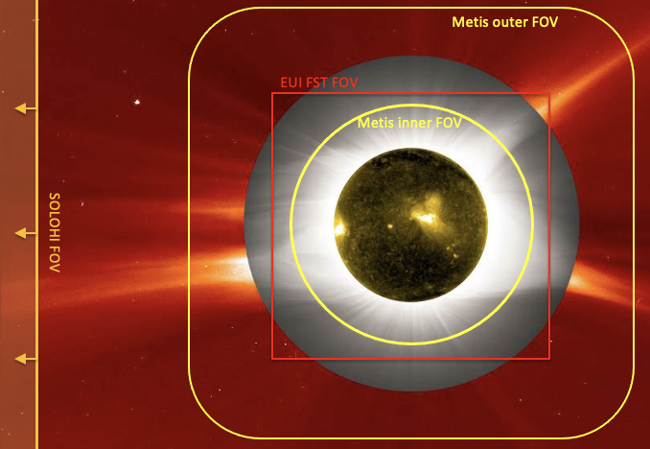
Metis: the Solar Orbiter coronagraph
Metis is an externally-occulted coronagraph designed to provide full imaging of the extended corona in:
total and polarised visible-light brightness (580-640 nm)
UV HI Lyman-α line (121.6 ± 10 nm)
Metis observations allow the investigation of the:
density distribution of coronal e⁻ and HI atoms (protons)
2D solar-wind outflow (HI/proton component)
large-scale dynamics of e⁻ and HI in CMEs and other solar transients
FoV (1.6° ⋅ 2.9° annular, 1.7 – 3.0 R◉ @ 0.28 AU)
e⁻
Lα
HI
K-corona B, pB
Lα
Thomson scattering
Resonant scattering

Slide 3
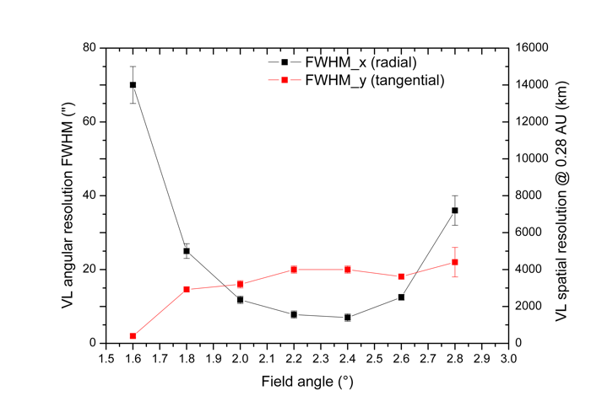
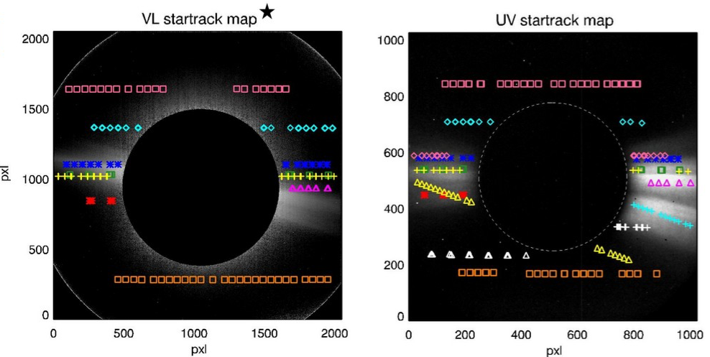
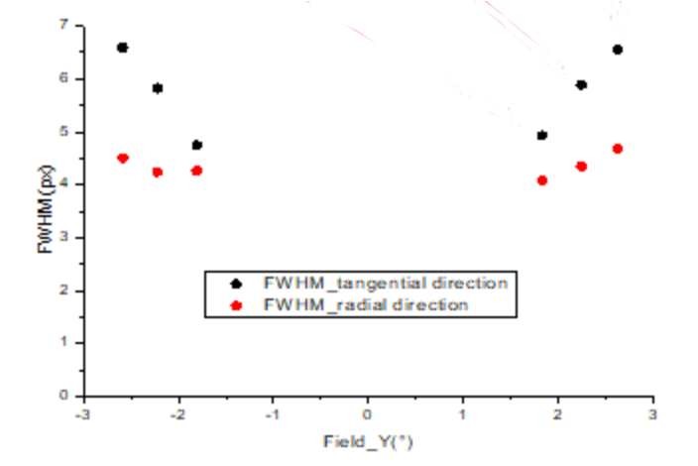
Metis performance:
Spatial & temporal resolution
Radiometric calibration
VL and UV radiometric calibration performed on ground is checked periodically using bright UV stars, with dedicated observations.
Radiometric calibration under refinement for Data release 2.
Spatial resolution: checked in-flight with Star observations
VL
< 2pxl
Specs resolution
Pixel size
UV
Cruise Phase
Between 4 and 7 pxls
Specs resolution
NMP
Temporal resolution: UV: > 1s limited by countrate VL: 60s in pB, 20s in tB, >1s in fixed polarization
Pixel size
De Leo+, 2024
De Leo+, 2025 in press

Slide 4
UVD Anomaly
The UV detector displays a variable radiometric behaviour with periodic fluctuations in intensity
The work to understand a eventually correct the issue is in progress.
Test correction for radial perturbations
Proof of concept in principle promising, but needs more work.
To be verified: how frequent are these kind of “symmetric” perturbation.
Courtesy of V. Andretta

Slide 5
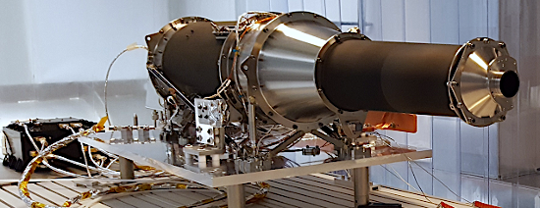
Bemporad+, 2024 Frassati+ 2024 Russano+ 2024 Heinzel+ 2023 Niembro+ 2023 Zimbardo+ 2023
Mierla+ 2023 Rodriguez+ 2023 Bemporad+ 2022 Andretta+ 2021
Understanding coronal mass ejections (CMEs) beyond 1.7 R☉: propagation and evolution, physical parameters inside all features of the eruption (CME front, cavity, shock front and eruptive prominence)
Grimani+, 2021, 2023, 2024
VL detector cosmic ray matrices to monitor the galactic and solar proton flux during the solar cycle
Bemporad+, 2023
Corso+, 2025 in progress
Solar wind velocity on the plane of the sky by means of the Doppler dimming technique
Solar system objects: comets, asteroids
F-corona
Antonucci+2023 Telloni+ 2023
Romoli+ 2021 Capuano+ 2021
UV stars
Ventura+, 2023
Andretta+, 2025 in progress
VL pB and B imaging -> electron density
UV imaging -> proton density
Telloni+, 2021, 2022, 2023
Electron density fluctuations measured in the VL show the presence of propagating blobs and wave structures at different frequencies
Evolution of the solar corona dynamic and thermal state into the heliosphere (PSP quadrature).
Switchbacks in the solar magnetic field
Study structure and dynamics of the full corona: magnetic field morphology , steady coronal features
Telloni+, 2023
Unprecedented temporal coverage (> 1s) and spatial resolution (> 5000 km)
Synergy with space and ground based assets
(PSP, SOHO, STEREO, DKIST, and more)
Vasquez+, 2023, 2024
Abbo+, 2025 submitted

Slide 6
What’s next: Out-of-ecliptic in NMP and EMP
Cruise
Nominal Mission
Extended Mission
More perihelia at 0.29 au
In-situ instruments are operating 24/7
3 Remote-Sensing Windows of ~10 days each per ~6-months orbit, around perihelia, min/max latitude and other interesting configurations
Plus: Regular remote-sensing synoptic observations
-17° in Feb 2025
-24° in Jan 2027
-30° in Apr 2028
-33° in Jul 2029
Notes:
Min. latitude - Perihelion - Max. Latitude
2024 MAR 24 2024 APR 04 2024 APR 28
-7.99 deg. 0.29 AU 7.99 deg.
2024 SEP 20 2024 SEP 30 2024 OCT 25
-7.99 deg. 0.29 AU 7.99 deg.
2025 MAR 22 2025 MAR 31 2025 APR 28
-16.8 deg. 0.29 AU 16.8 deg.
2025 SEP 07 2025 SEP 16 2025 OCT 14
-16.8 deg. 0.29 AU 16.8 deg.
2026 FEB 22 2026 MAR 03 2026 MAR 31
-16.8 deg. 0.29 AU 16.8 deg.
2026 AUG 10 2026 AUG 19 2026 SEP 16
-16.8 deg. 0.29 AU 16.8 deg.
2027 JAN 28 2027 FEB 06 2027 MAR 02
-23.5 deg. 0.28 AU 23.5 deg.
2027 JUN 27 2027 JUL 06 2027 JUL 29
-23.5 deg. 0.28 AU 23.5 deg.
2027 NOV 23 2027 DEC 03 2027 DEC 26
-23.5 deg. 0.28 AU 23.5 deg.
2028 APR 25 2028 MAY 07 2028 JUN 03
-29.6 deg. 0.32 AU 29.6 deg.
2028 SEP 22 2028 OCT 04 2028 OCT 31
-29.5 deg. 0.32 AU 29.6 deg.
2029 FEB 18 2029 MAR 03 2029 MAR 30
-29.6 deg. 0.32 AU 29.6 deg.
2029 JUL 23 2029 AUG 11 2029 SEP 06
-32.9 deg. 0.37 AU 33.0 deg.
2029 DEC 20 2030 JAN 08 2030 FEB 03
-33.0 deg. 0.37 AU 33.0 deg.
2030 MAY 19 2030 JUN 06 2030 JUL 03
-33.0 deg. 0.37 AU 33.0 deg.
——-
Venus GAM on:
2020 DEC 27
2021 AUG 09
2022 SEP 04
2025 FEB 18
2026 DEC 24
2028 MAR 18
2029 JUN 10
2030 SEP 02

Slide 7
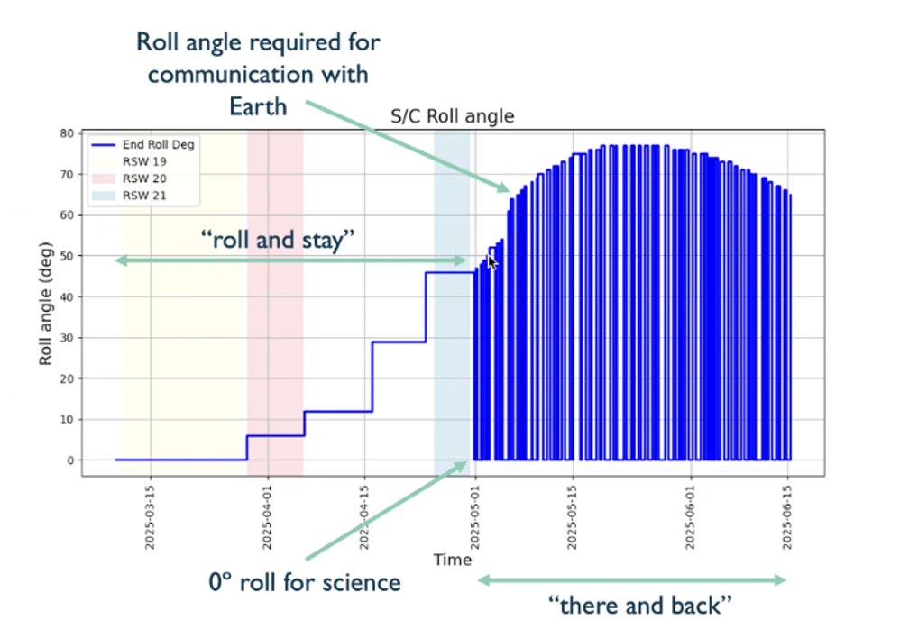
What’s next: Out-of-ecliptic in NMP and EMP
VGAM-4 on February 18, 2025 to 17deg inclination wrt ecliptic plane
Communication rolls

Slide 8
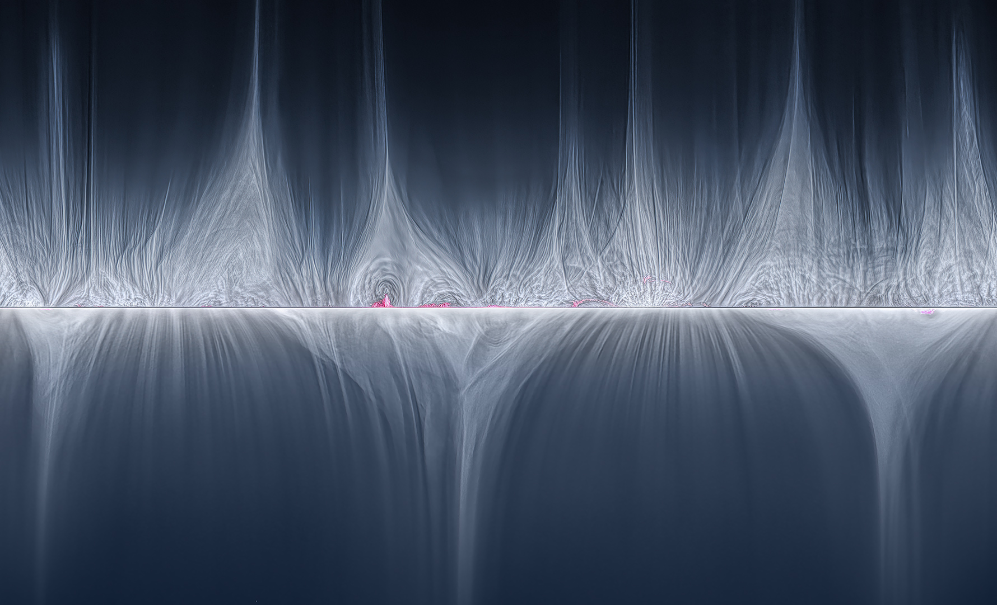
?
2023: Solar Max
2030: Solar Poles
Credits: P. Ward, Barden Ridge Observatory
2017: Solar Min

Slide 9
Out-of-ecliptic science
The out-of ecliptic vantage point, later in the Solar Orbiter mission, offers the opportunity to coronagraphs to observe for the first time the corona from mid-latitudes and to investigate:
the longitudinal extent of coronal features and solar wind with possible longitudinal patterns related to the magnetic field polarity
the longitudinal structure and distribution of the propagating CME plasma and their geoeffectiveness
Monitoring of galactic cosmic rays modulation out-of-ecliptic would be very important

Slide 10
Summary of proposed SOOPs for LTP19 (Mar-Jun 2025)
Below the proposed SOOPS for LTP19 perihelion in the second quarter of 2025
First year with SOLO out of the ecliptic
SOOP Pole-to-Pole (Coord. A. Burtovoi) RSW20 Latitudinal scan of solar corona for morphology, 3D latitudinal tomographic reconstruction and F-corona. Cosmic rays pole-to-pole scan.
SOOP Dark Halos: (Coord. Serena Lezzi) New SOOP proposal to be performed in coordination with Earth based assets (RSW19) SOOP Density fluctuations: at larger heights (RSW19) Run the SOOP away from perihelia (distance ~0.35 au), to observe the corona up or above 4 solar radii.
SOOP Eruption watch: Eruption watch: improvements of CME watch (anywhere it fits in RSW19-RSW21)
Comets: No comets, Comet-like asteroid (RSW 20): Phaethon (V. Da Deppo, A. Corso)
Stars: Calibration stars (V. Andretta)
Sun-Earth conjunction, X-calibrations with Earth-based coronagraphs and Stereo in RSW19 (inferior) (A. Burtovoi).
SOOP_Coronal-He-Abundance Coordinated coronagraphic mode of EUI above 0.45au RSW19 (Sun-Earth line) (Coord. Andretta, Auchère)
Science Activity Plan (SAP)

Slide 11
Metis observation
Solar Orbiter is on the ecliptic plane until February 2025.
Observations strongly limited by telemetry
Metis observations performed:
during Remote Sensing Windows (RSWs) within the framework of the Solar Orbiter Observing Plans (SOOPs) with payload shared objectives (30 days/orbit)
along the rest of orbit as synoptics (the cadence has been reduced to allow
During Target of Opportunities (UV star observations and joint observations with other assets)

Slide 12
Metis activity in the Cruise Phase and the first orbit of the Nominal Mission Phase (NMP)
Metis observations are listed in the Metis webpage: http://metis.oato.inaf.it/obs_summary_new.html#
RSWs
Cruise Phase Obs.
Synoptics
Synoptics/Only VL (typically @ >0.6au)
Launch
Cruise Phase
Commissioning
RSCW1
2020
NMP
RSCW2
RSCW3
RSCW4
2021
1st perihelion
2nd perihelion
RSW1
RSW2-3
RSW4-5-6
2022
3rd perihelion
4th perihelion
RSW7
RSW8-9
RSW10-11-12
2023
5th perihelion
6th perihelion
RSW13-14-15
RSW16-17-18
2024
VGAM-4
7th perihelion
8th perihelion
RSW19-20
RSW21
RSW22-23
RSW24
2025
Interruptions in the flow of observations due to: S/C off-pointing or unexpected Metis and/or S/C switch off

Slide 13
Synergies
This decade will provide for the first time multi-point of view
observations of the solar corona
Parker Solar Probe: WISPR (2018)
SOHO: Lasco (1995)
STEREO-A: Secchi (2008)
Solar Orbiter: Metis, EUI and SOLOHI (2020)
ASO-S: Lyman-alpha Solar Telescope (LST) (2022)
Aditya L1: Visible Emission Line Coronagraph (VELC) (2023)
Proba3: ASPIICS (2024)
CODEX Coronal Diagnostics Experiment ISS coronagraph (2024)
PUNCH: Polarimeter to Unify the Corona and the Heliosphere (2025)
These measurements are combined with disk imagers data to identify the sources
Solar Orbiter EUI coronagraphic mode
FeIX/FeX 17.4nm (now also HeII 30.4 nm)
‘Wavelets Optimized Whitening’ algorithm enhances the visual appearance of the movie.
Synergies with space- or ground-based ecliptic observatories necessary
EUV Disk + corona imagers to provide a full coverage of the corona from the limb out to the alfvenic surface
Metis – PSP in quadrature for connectivity
Notes:
Disk imagers SDO EUI HINODE SPICEessential for soirces

