Slide 1
Metis data
R. Susino & the Metis team
2nd Metis Science Meeting - Napoli - January 27th 2024

Slide 2
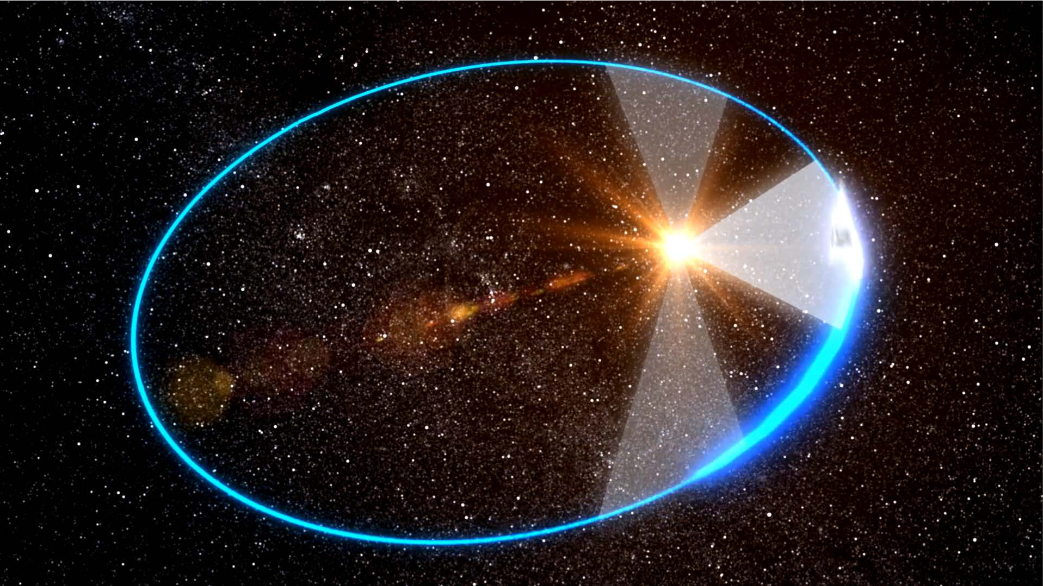
Solar Orbiter/Metis observation structure
High latitude window
Remote-sensing windows (RSWs) → VL + UV
observations targeted to address mission science objectives
coordination of RS instruments - Solar Orbiter Observing Programs (SOOPs)
Out of RS-windows
synoptic program - coordinated observations at constant cadence → VL + UV (< 0.6 au)
opportunities (comets, conjunctions/quadratures) → VL + UV
Every day: low-latency (LL) obsevations → VL + UV (< 0.6 au)
Perihelion window
Out of RS-windows
Low latitude window

Slide 3
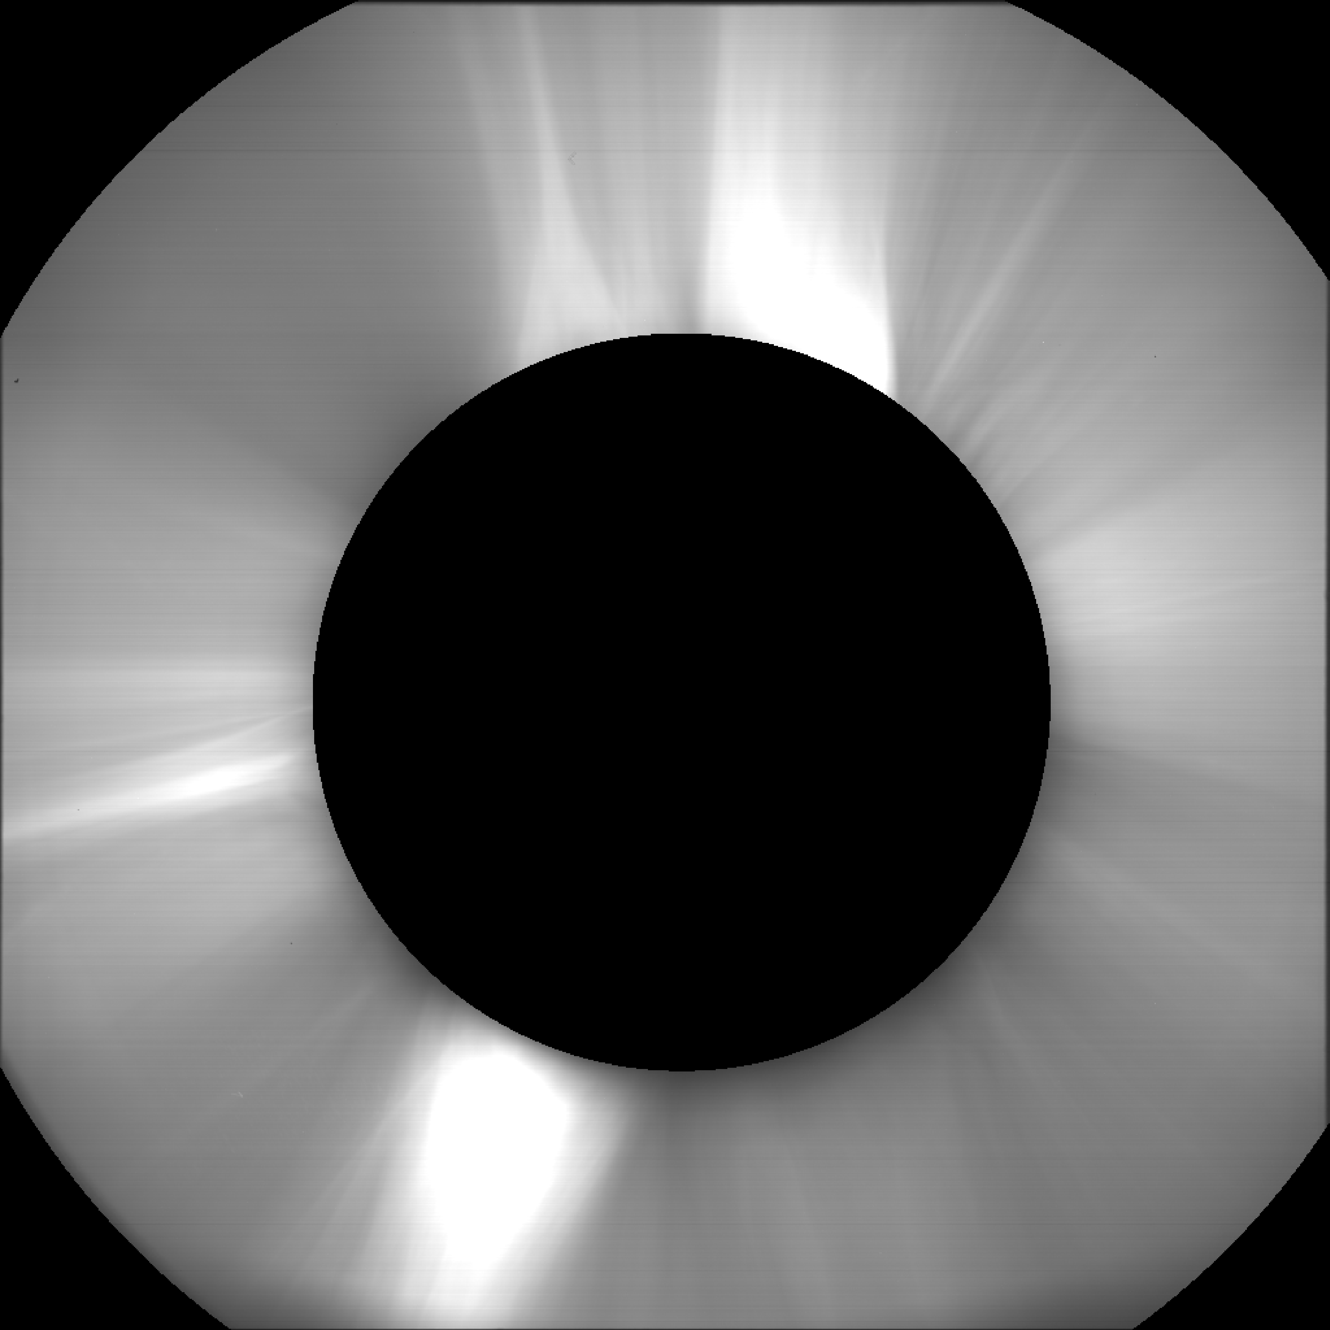
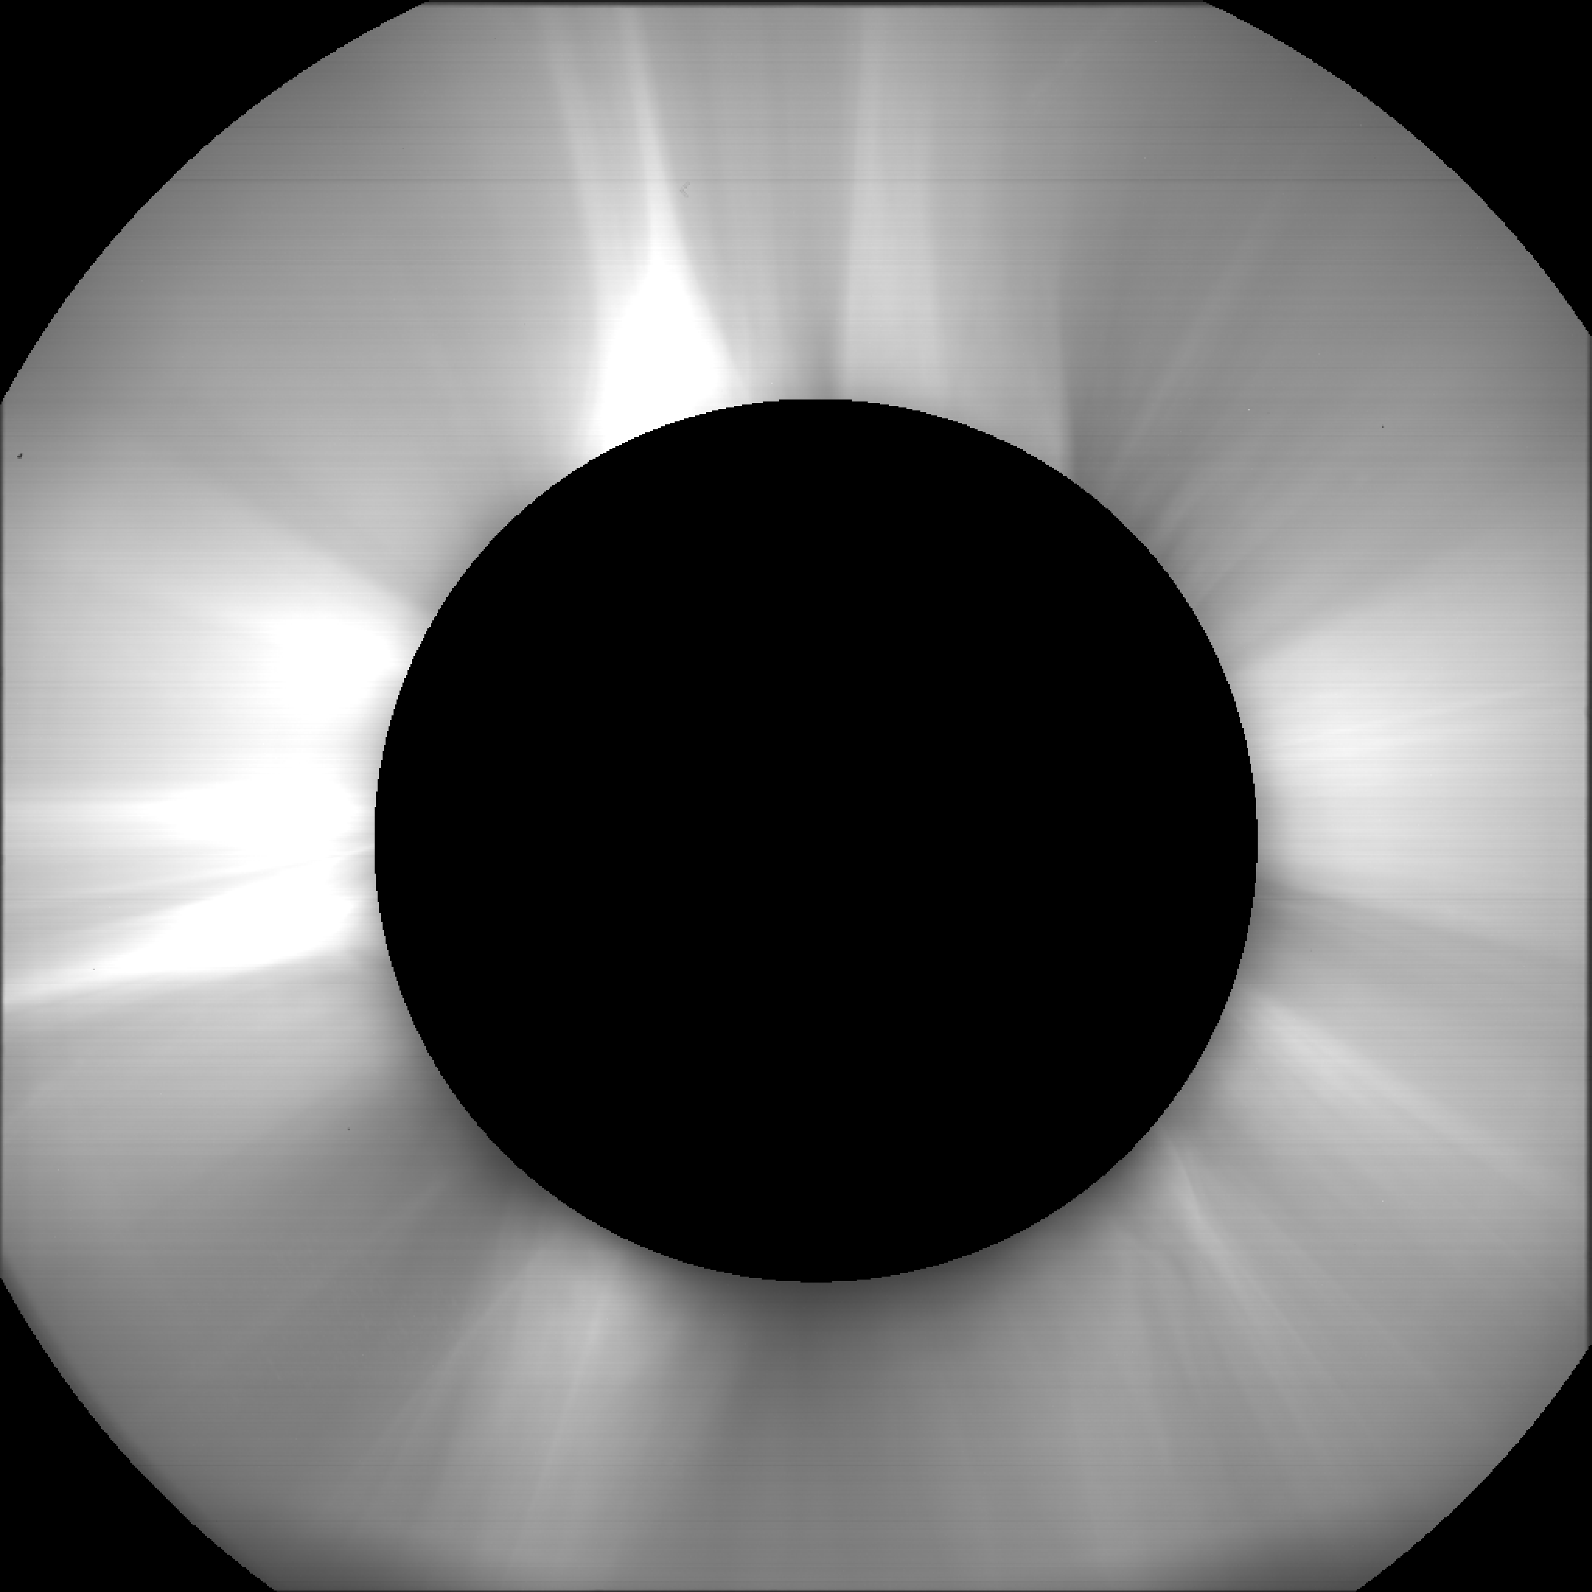
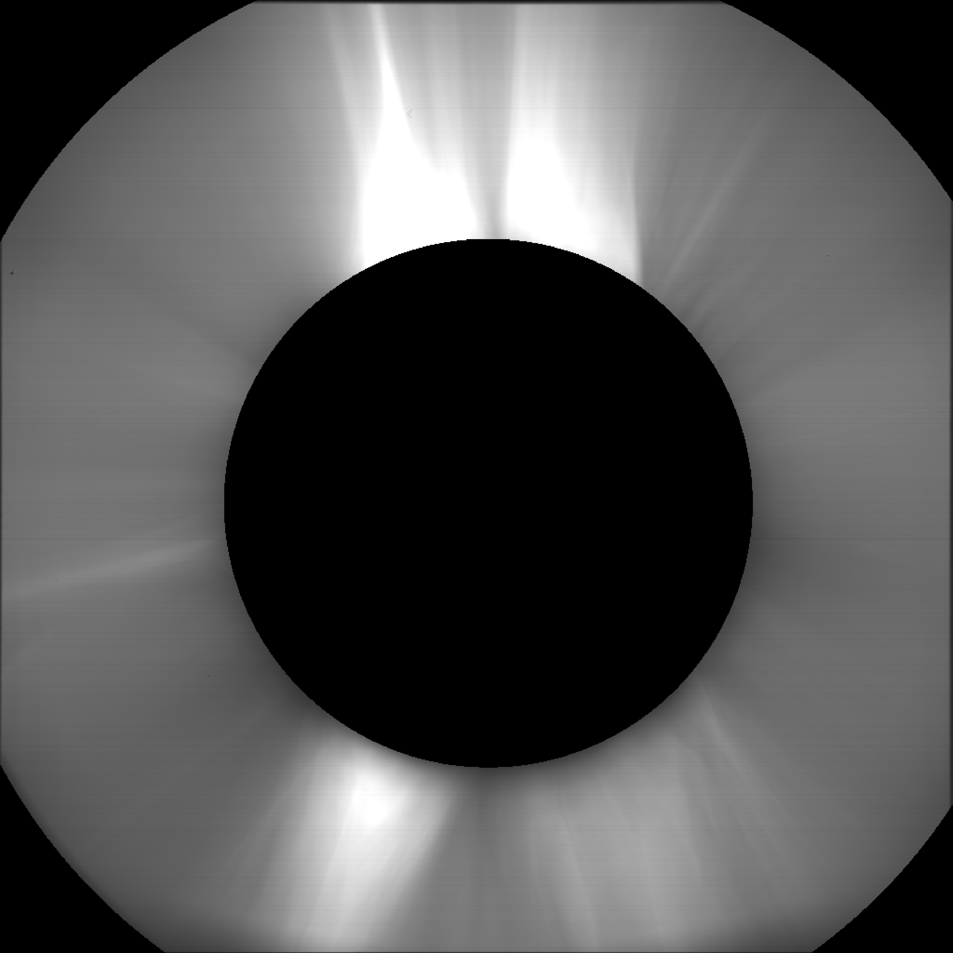
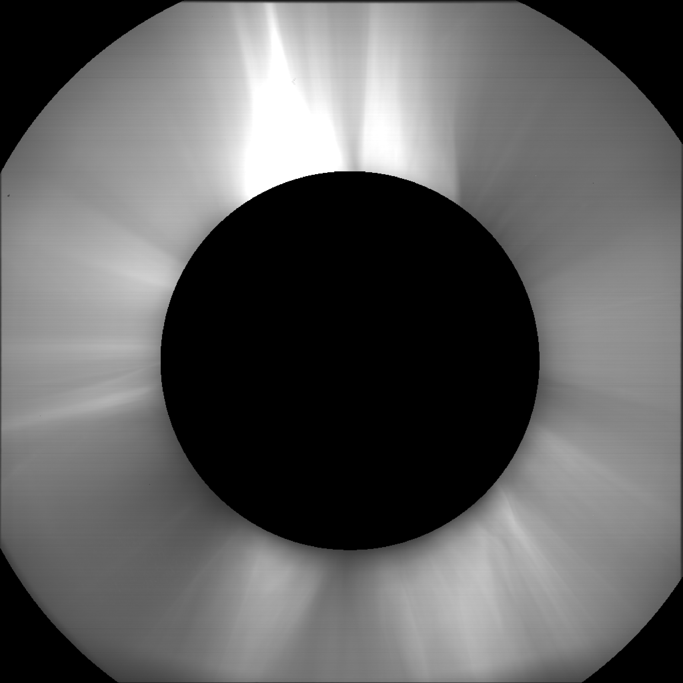
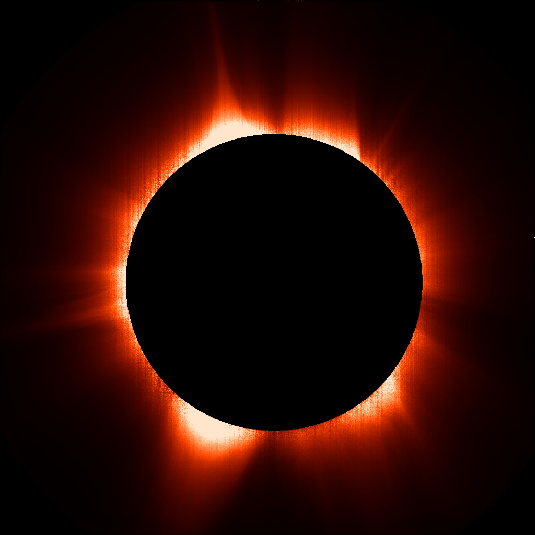
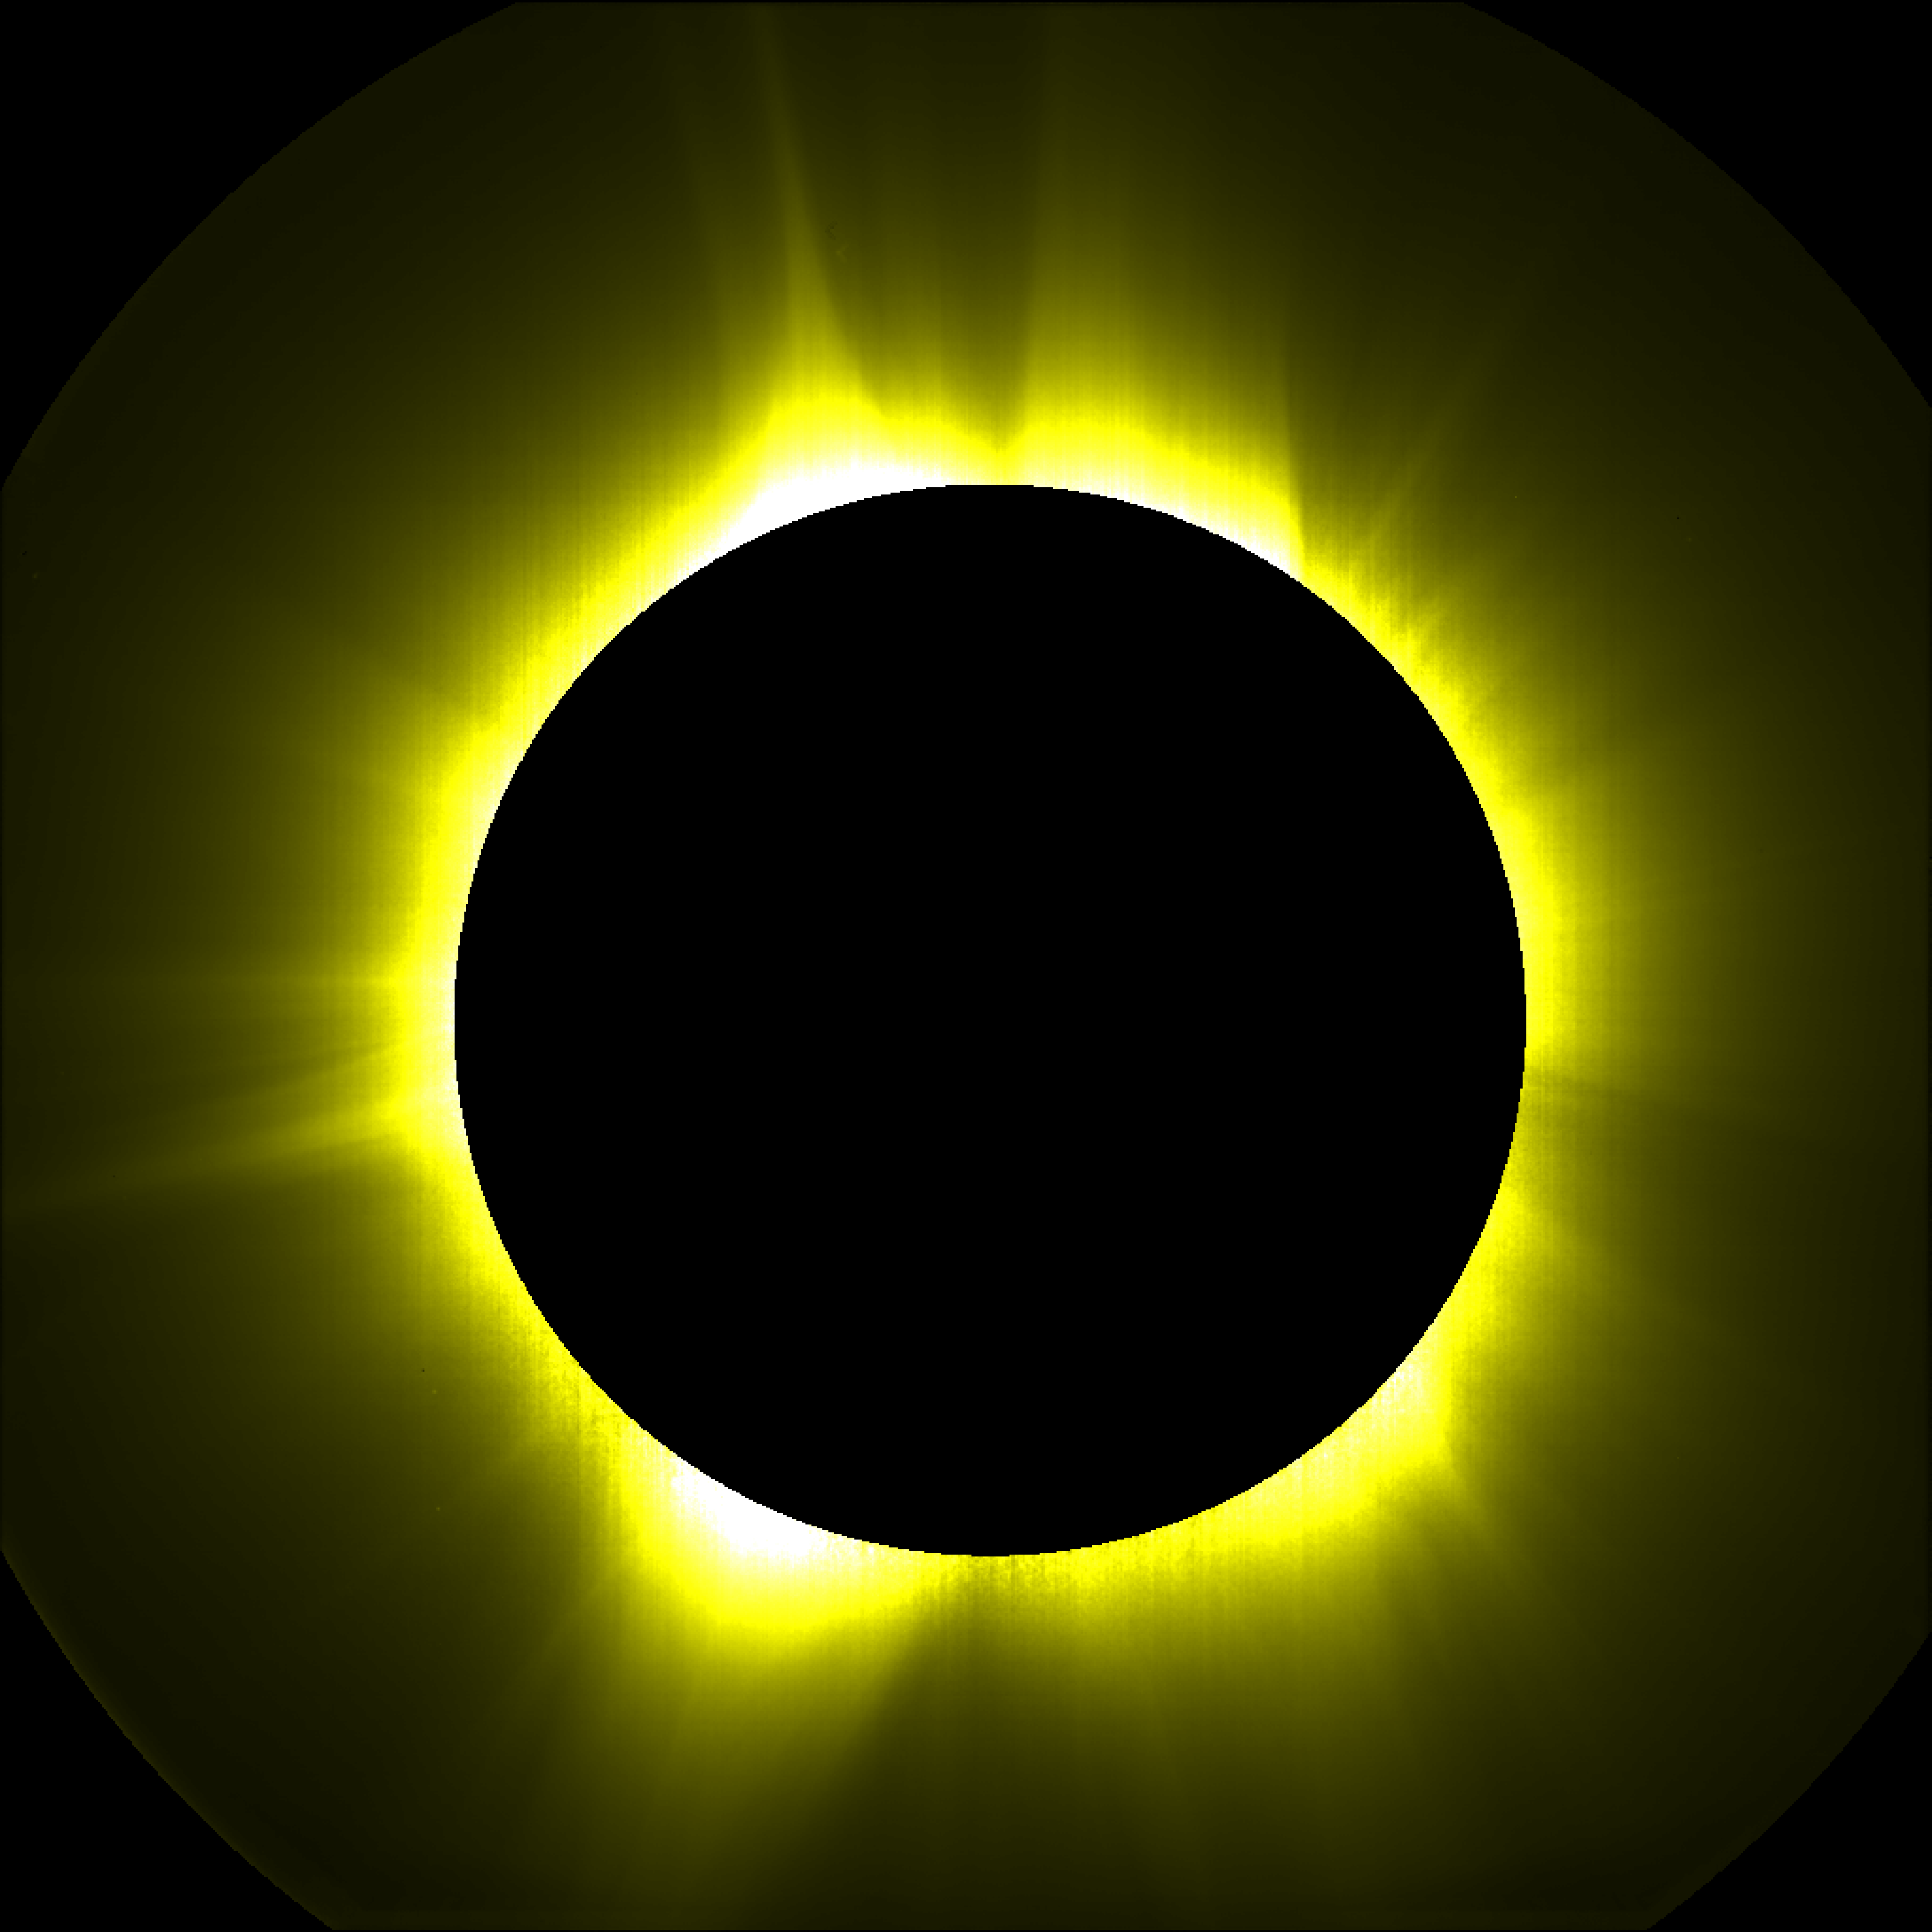
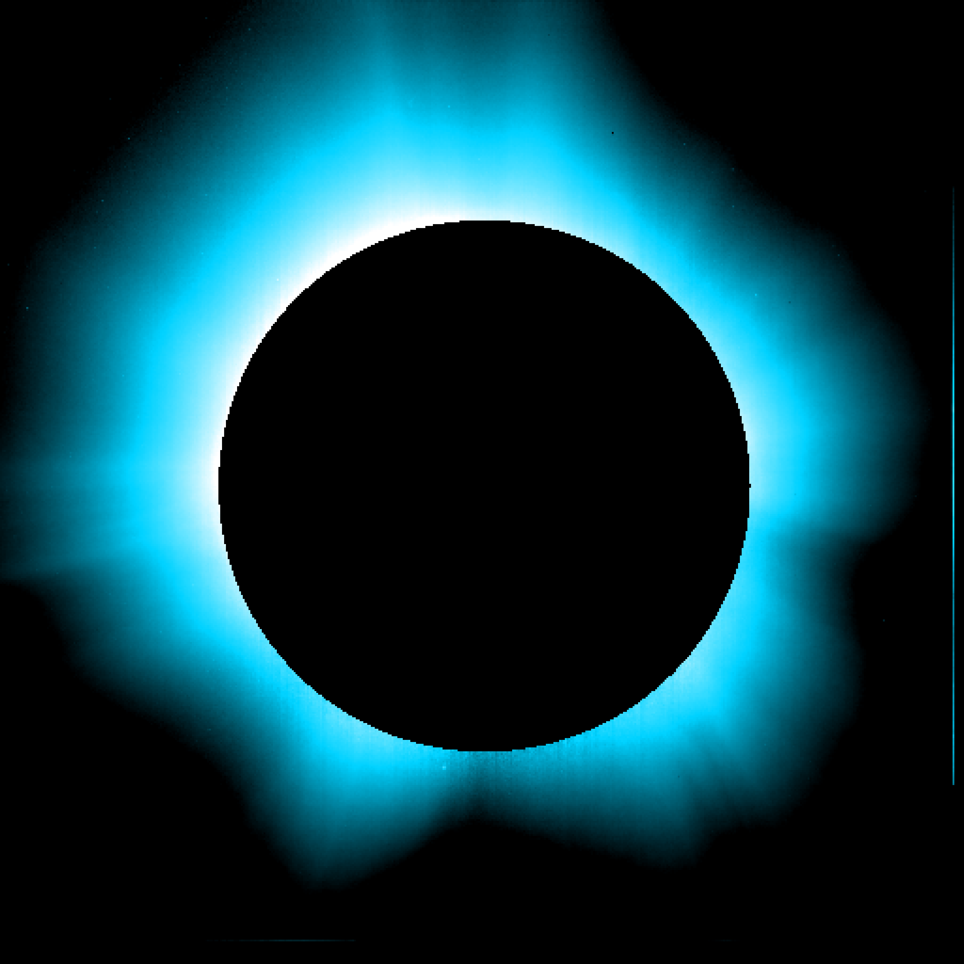
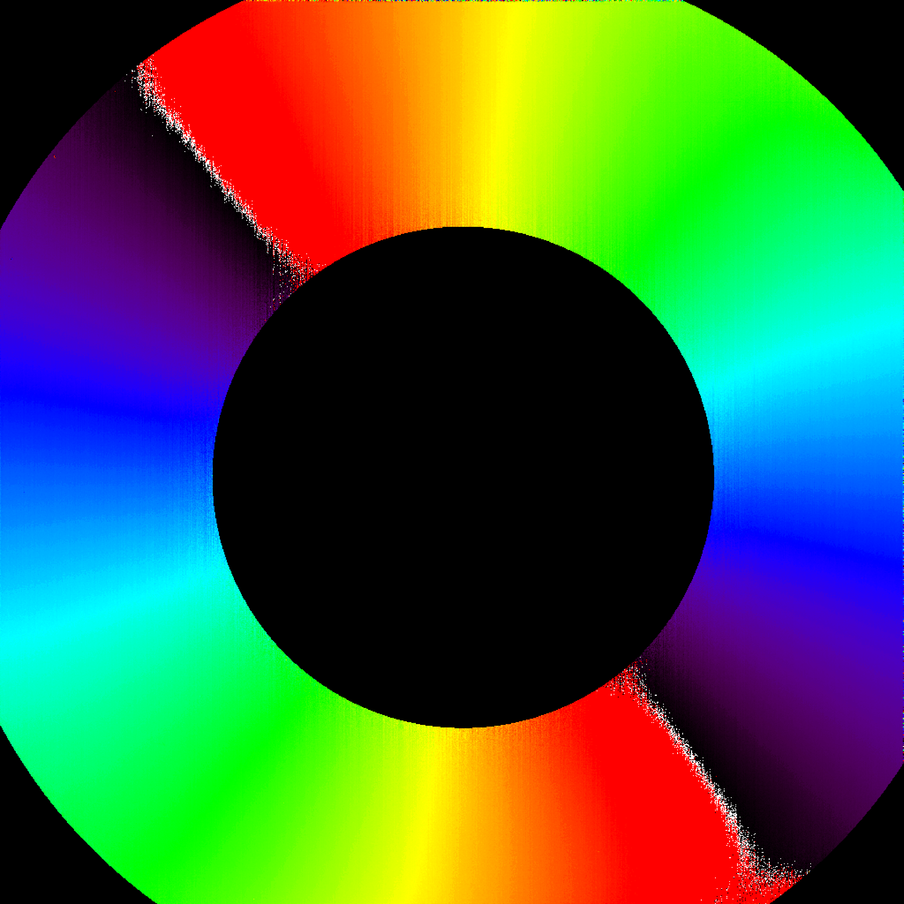
Data types
45° pol.
Visible-light channel
sequences of 4 polarimetric images → polarised and total brightness, polarisation angle, Stokes parameters
single total-brightness images
fixed-polarisation images
UV channel
analogue-mode images
0° pol.
135° pol.
90° pol.
pB
B
HI Lyα
pol. angle

Slide 4
Data types & on-board processing
On-board processing
frame average
binning, masking
compression (lossless, lossy)
cosmic-ray/SEP correction
Secondary data products
light curves (for each pB sequence)
cosmic-ray/SEP correction maps (twice per day)

Slide 5
On-ground processing and calibration
Level 0 (L0)
uncalibrated data (units of DN) obtained from telemetry packets, that are uncompressed and formatted in standard FITS format
metadata contain only the information that is available from the telemetry packet headers
Level 1 (L1)
uncalibrated data (units of DN)
metadata contain extra engineering data from housekeeping telemetry
all the available orbital and attitude information is used and coordinates expressed in scientific coordinate systems (WCS)

Slide 6
On-ground processing and calibration
Level 2 (L2)
calibrated data (physical units) corrected for
detector bias/dark current
flat-field
optical vignetting
exposure normalisation
radiometric calibration
demodulation (applied only to polarimetric acquisitions)
the most up-to-date calibration is always applied

Slide 7
On-ground processing and calibration
Level 2 (L2)
calibrated data (physical units) corrected for
detector bias/dark current
flat-field
optical vignetting
exposure normalisation
radiometric calibration
demodulation (applied only to polarimetric acquisitions)
the most up-to-date calibration is always applied
Calibration papers
De Leo et al. (2023) A&A 676, A45 - VL
Liberatore et al. (2023) A&A 672, A14 - VL
Uslenghi et al. (2024) SPIE 13103, 1310324 - UV
De Leo et al. (2024) A&A in press - UV

Slide 8
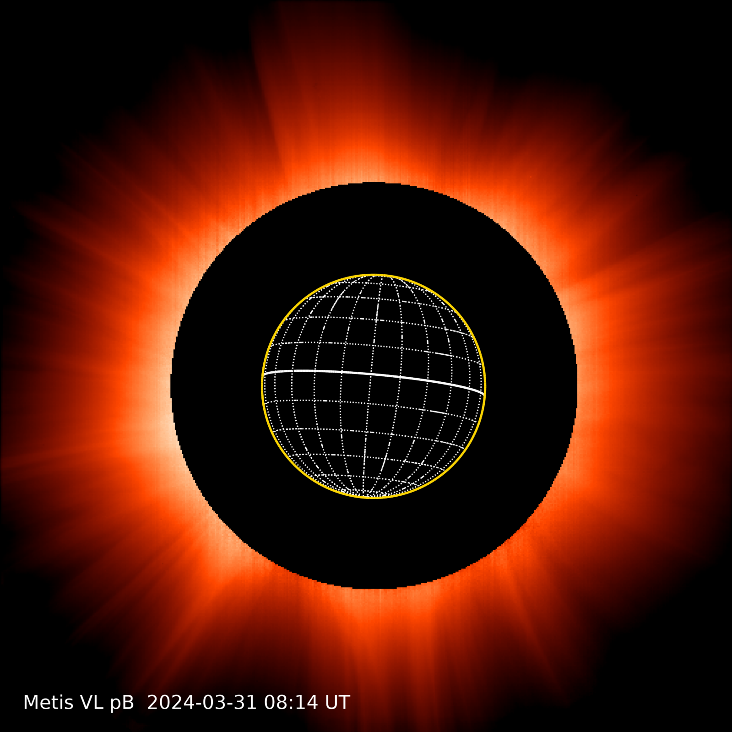
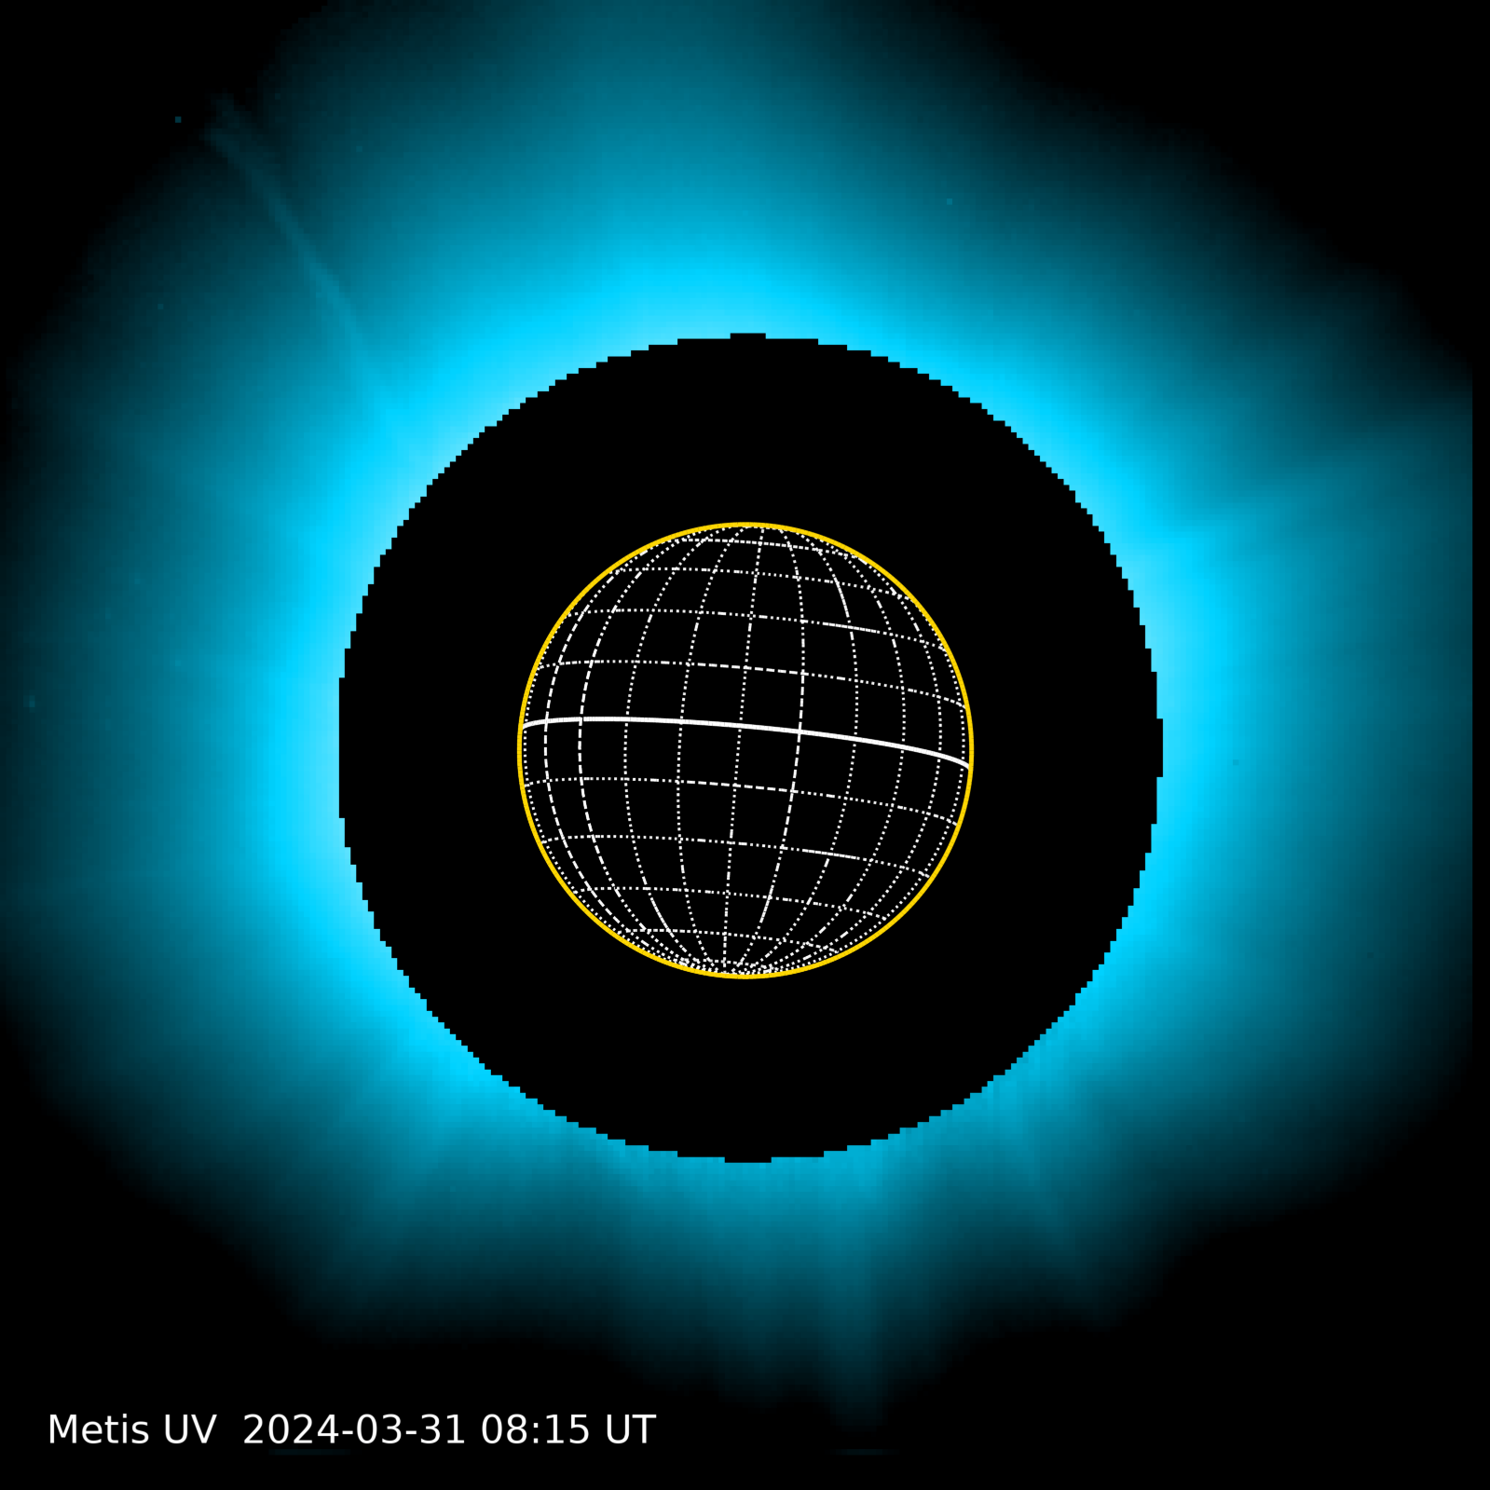
On-ground processing and calibration
Level 3 (L3)
science-grade data derived from L2 data: images, movies, Carrington maps; and data obtained after scientific analysis, e.g., electron-density maps, solar-wind outflow velocity maps → JP2000 and PNG images available soon

Slide 9
L2 FITS structure
Main
header
Stokes Q
Quality
matrix
Error
matrix
Image*
Stokes U
Quality matrix
image mask flagging:
saturated/bad pixels (NaN)
unreliable pixel values (0)
good pixels (1)
Error matrix
uncertainty map derived from measured counts through error propagation → under assessment
* VL pB, B, pol. angle, or Stokes I or UV Lyα intensity

Slide 10
Data flow
Telemetry
Metis pipeline
L0
Data
L1
L2
L2
Mission DB
Solar Orbiter Archive
Mission Operation Centre
Metis Operations Facility (Altec, Torino)

Slide 11
Statistics for the nominal phase
*
* perihelia
*
*
*
*
*

Slide 12
Data availability
Nominal-phase L2 data
publicly available through the Solar Orbiter Archive (SOAR) at https://soar.esac.esa.int/soar/ (~ 90 days after download) → data available up to March 2024
L2 data not yet available on the SOAR, L0, L1, or cruise-phase data
available upon request, please write to metis@inaf.it
For the Metis team (authentication required)
data available on the Metis mission DB (maintained by Altec) at http://mission-db-pro.metis.altecspace.it:8888

Slide 13
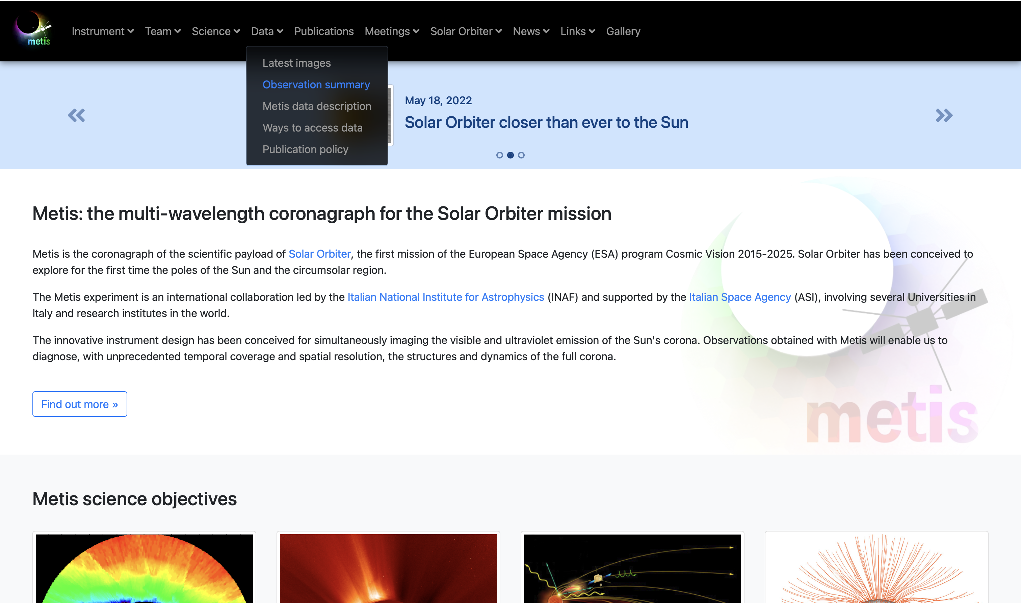
http://metis.oato.inaf.it

Slide 14
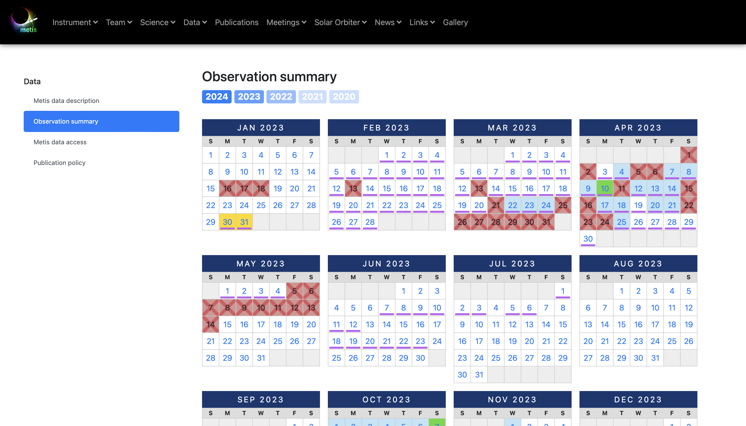
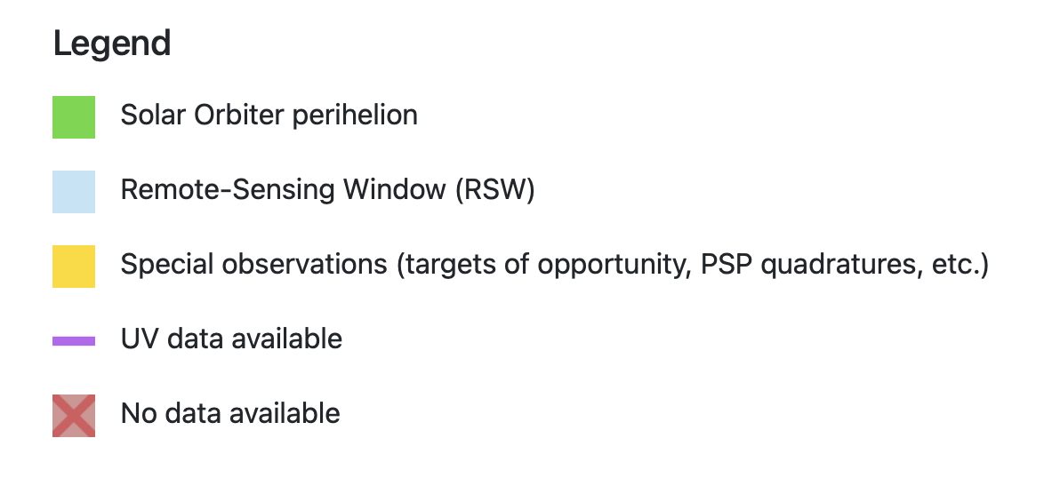

Slide 15
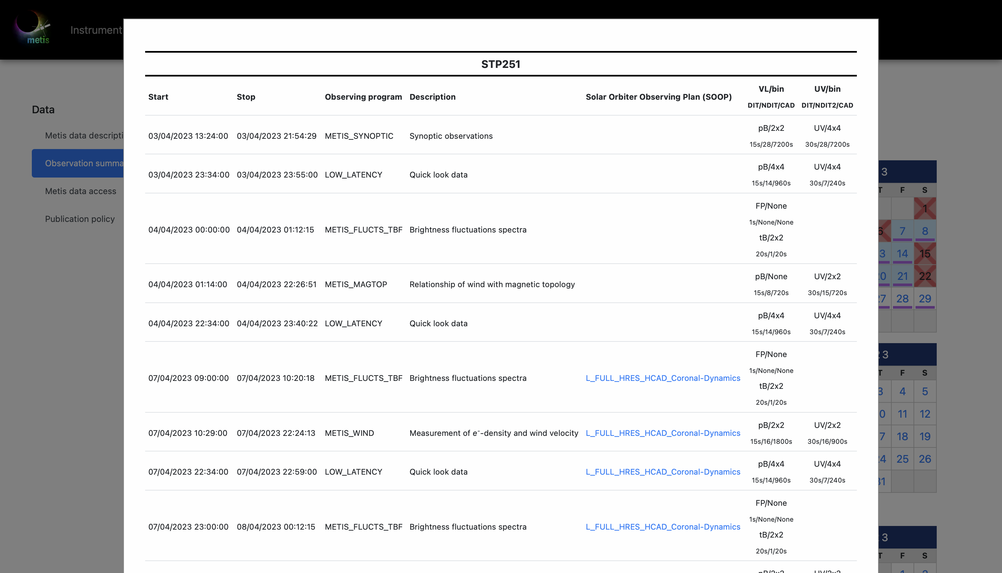

Slide 17
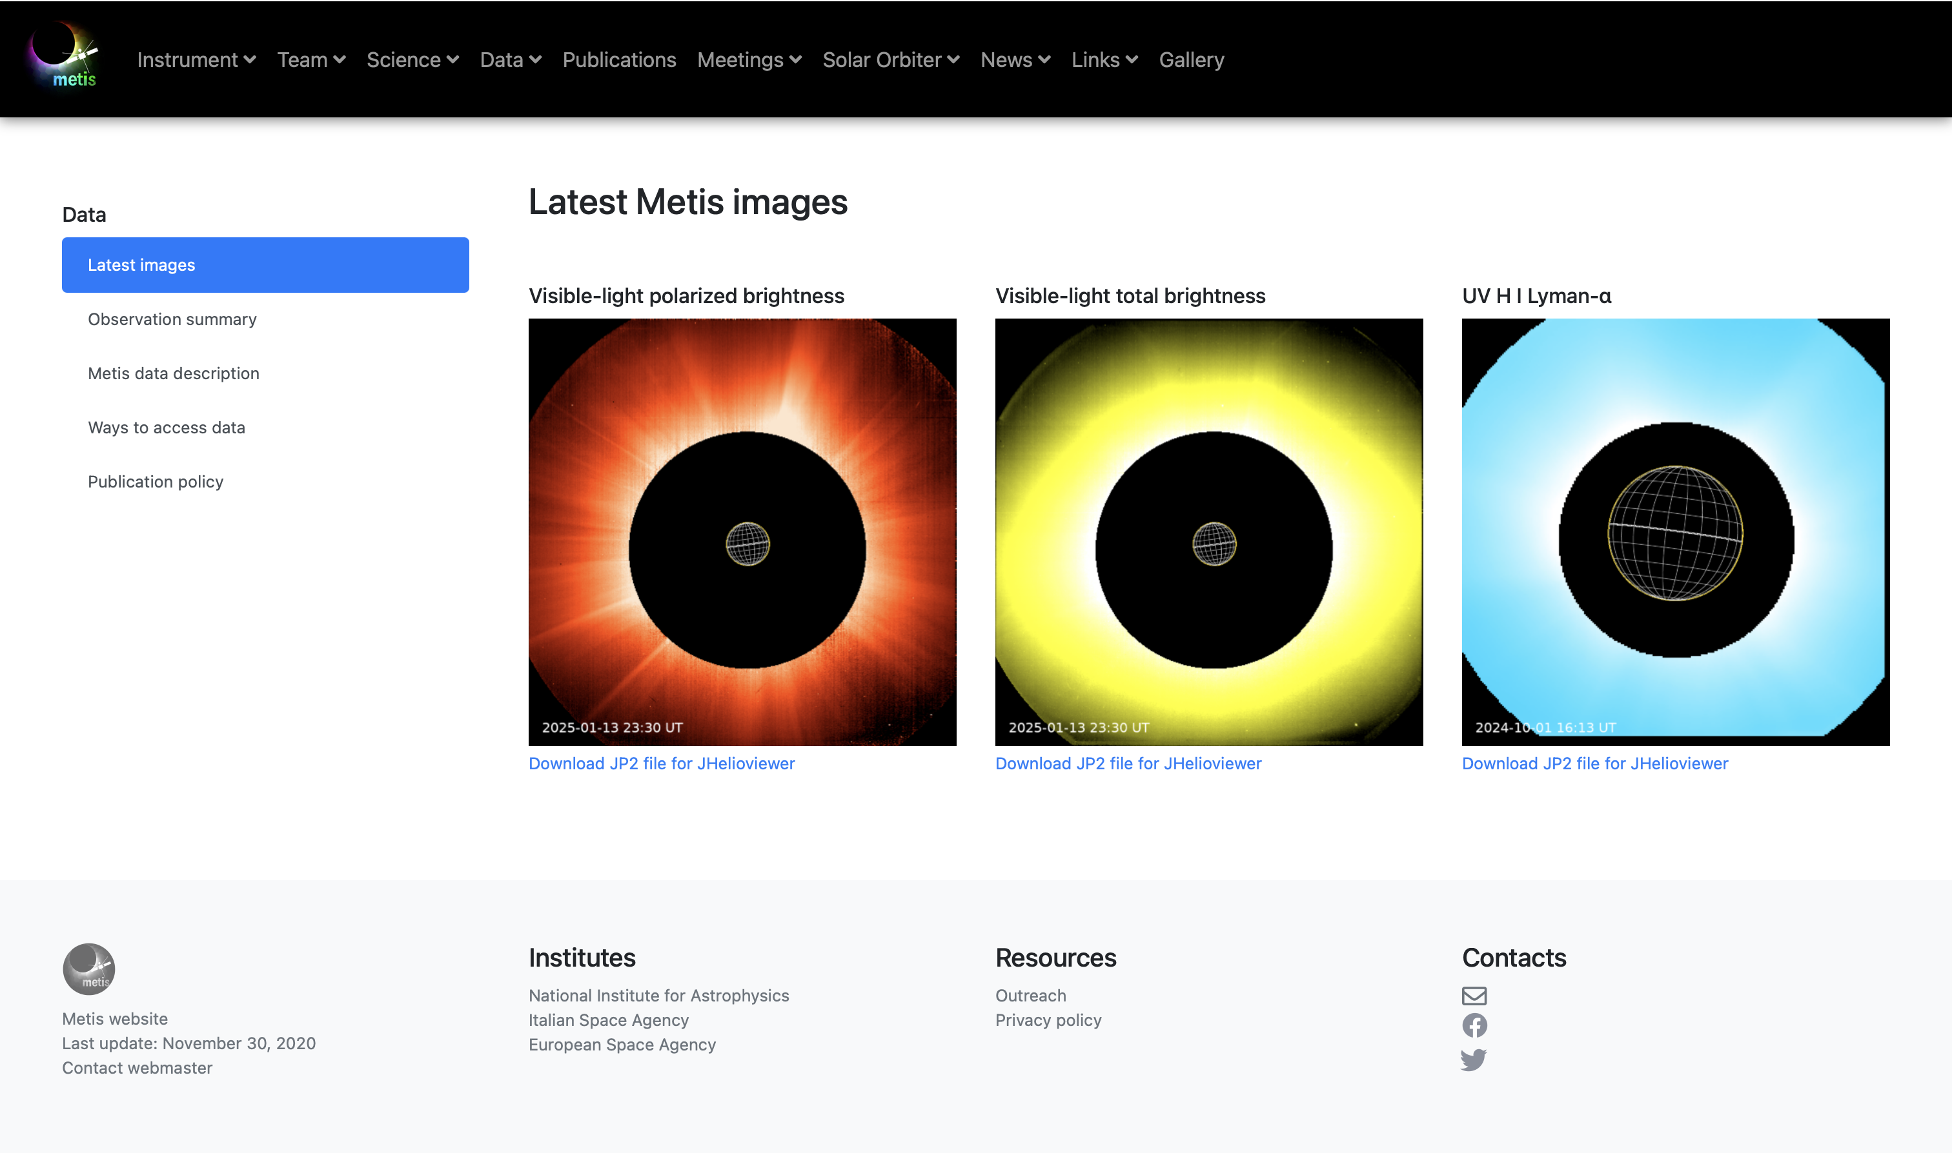

Slide 18
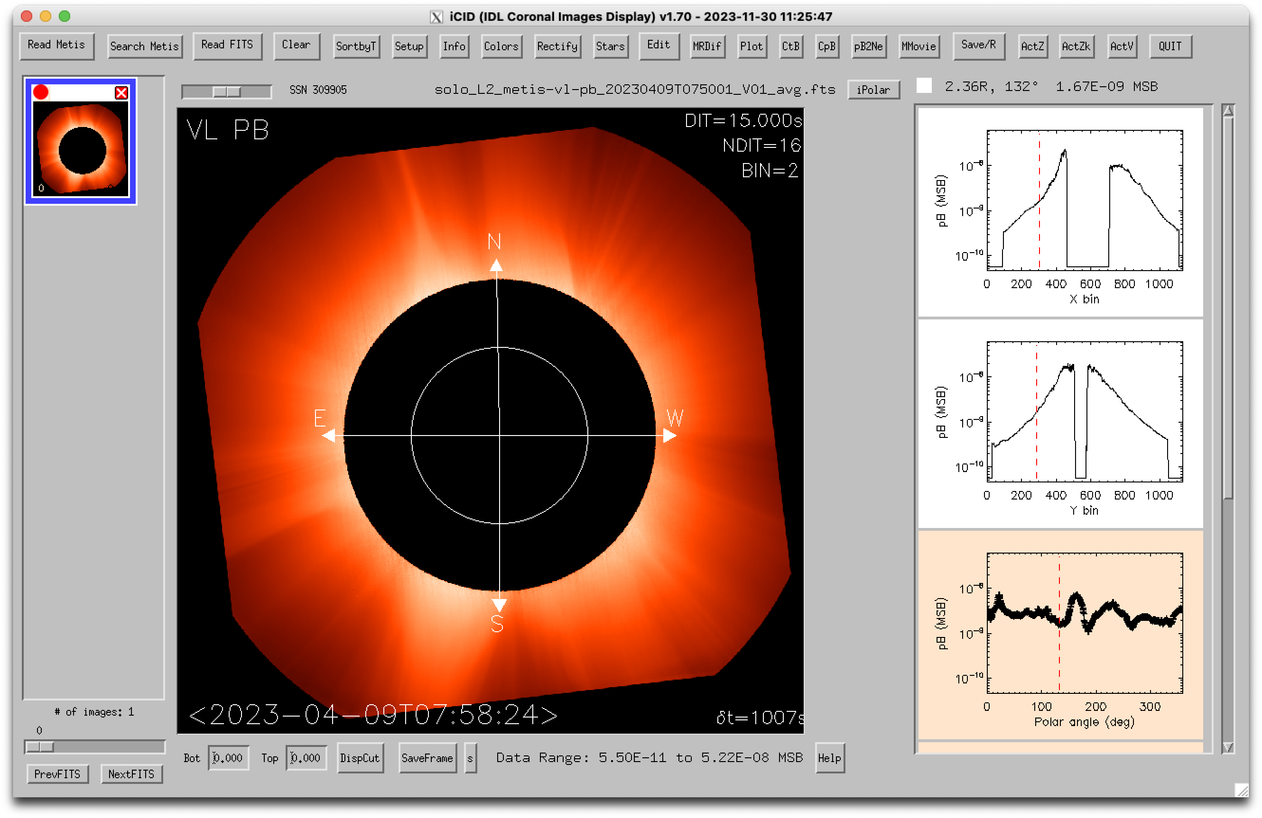
How to look into Metis data?
With any tool that can handle FITS files...
Recommended: iCID (IDL Coronal Images Display, developed and maintained by Silvio G.) or the python version pyCID (developed and maintained by Aleksandr B.)

Slide 19
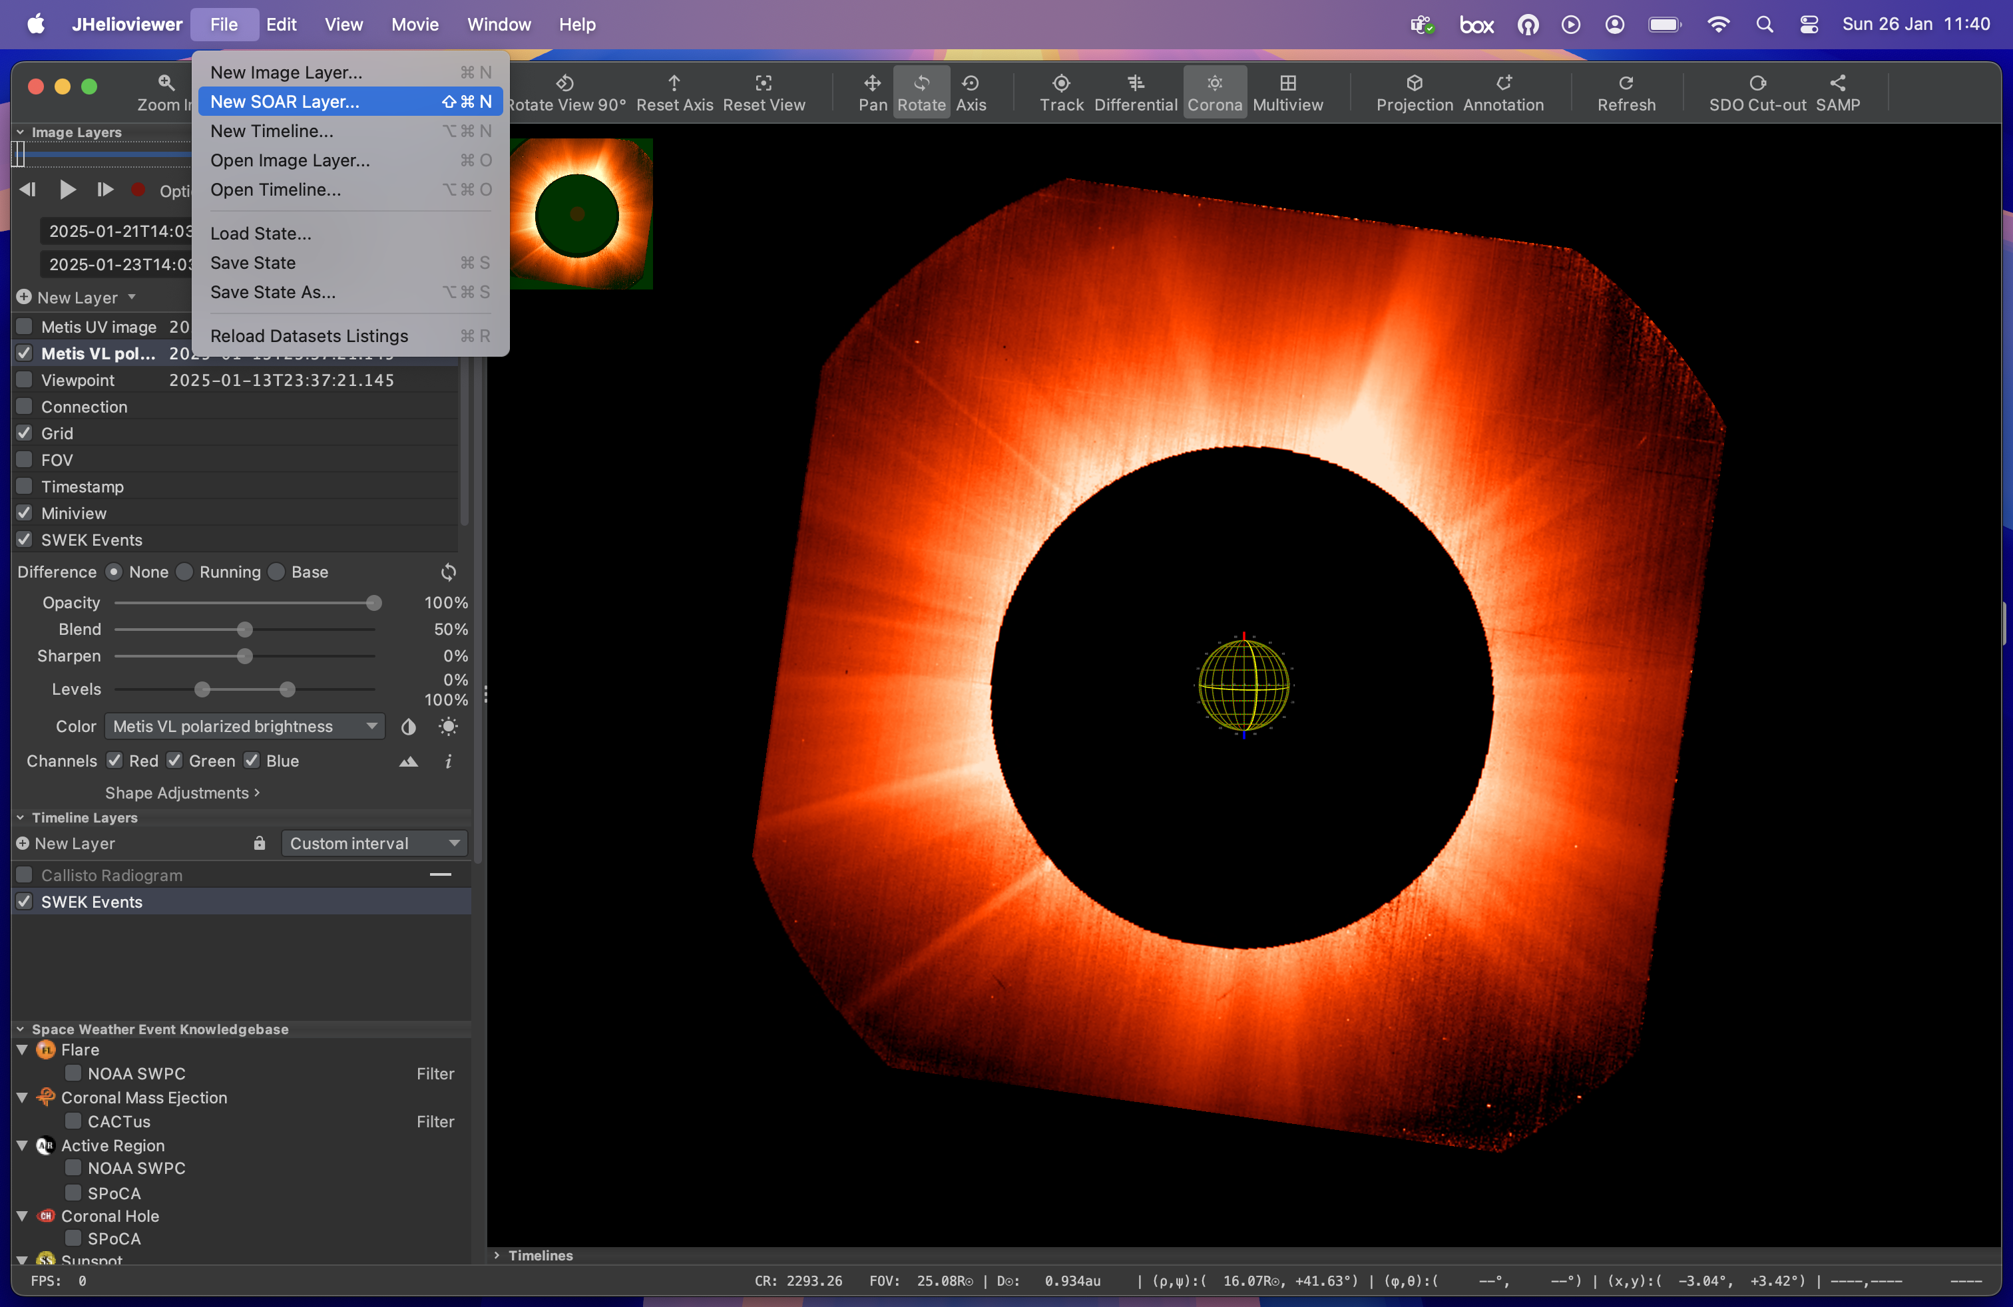
JHelioviewer

Slide 20
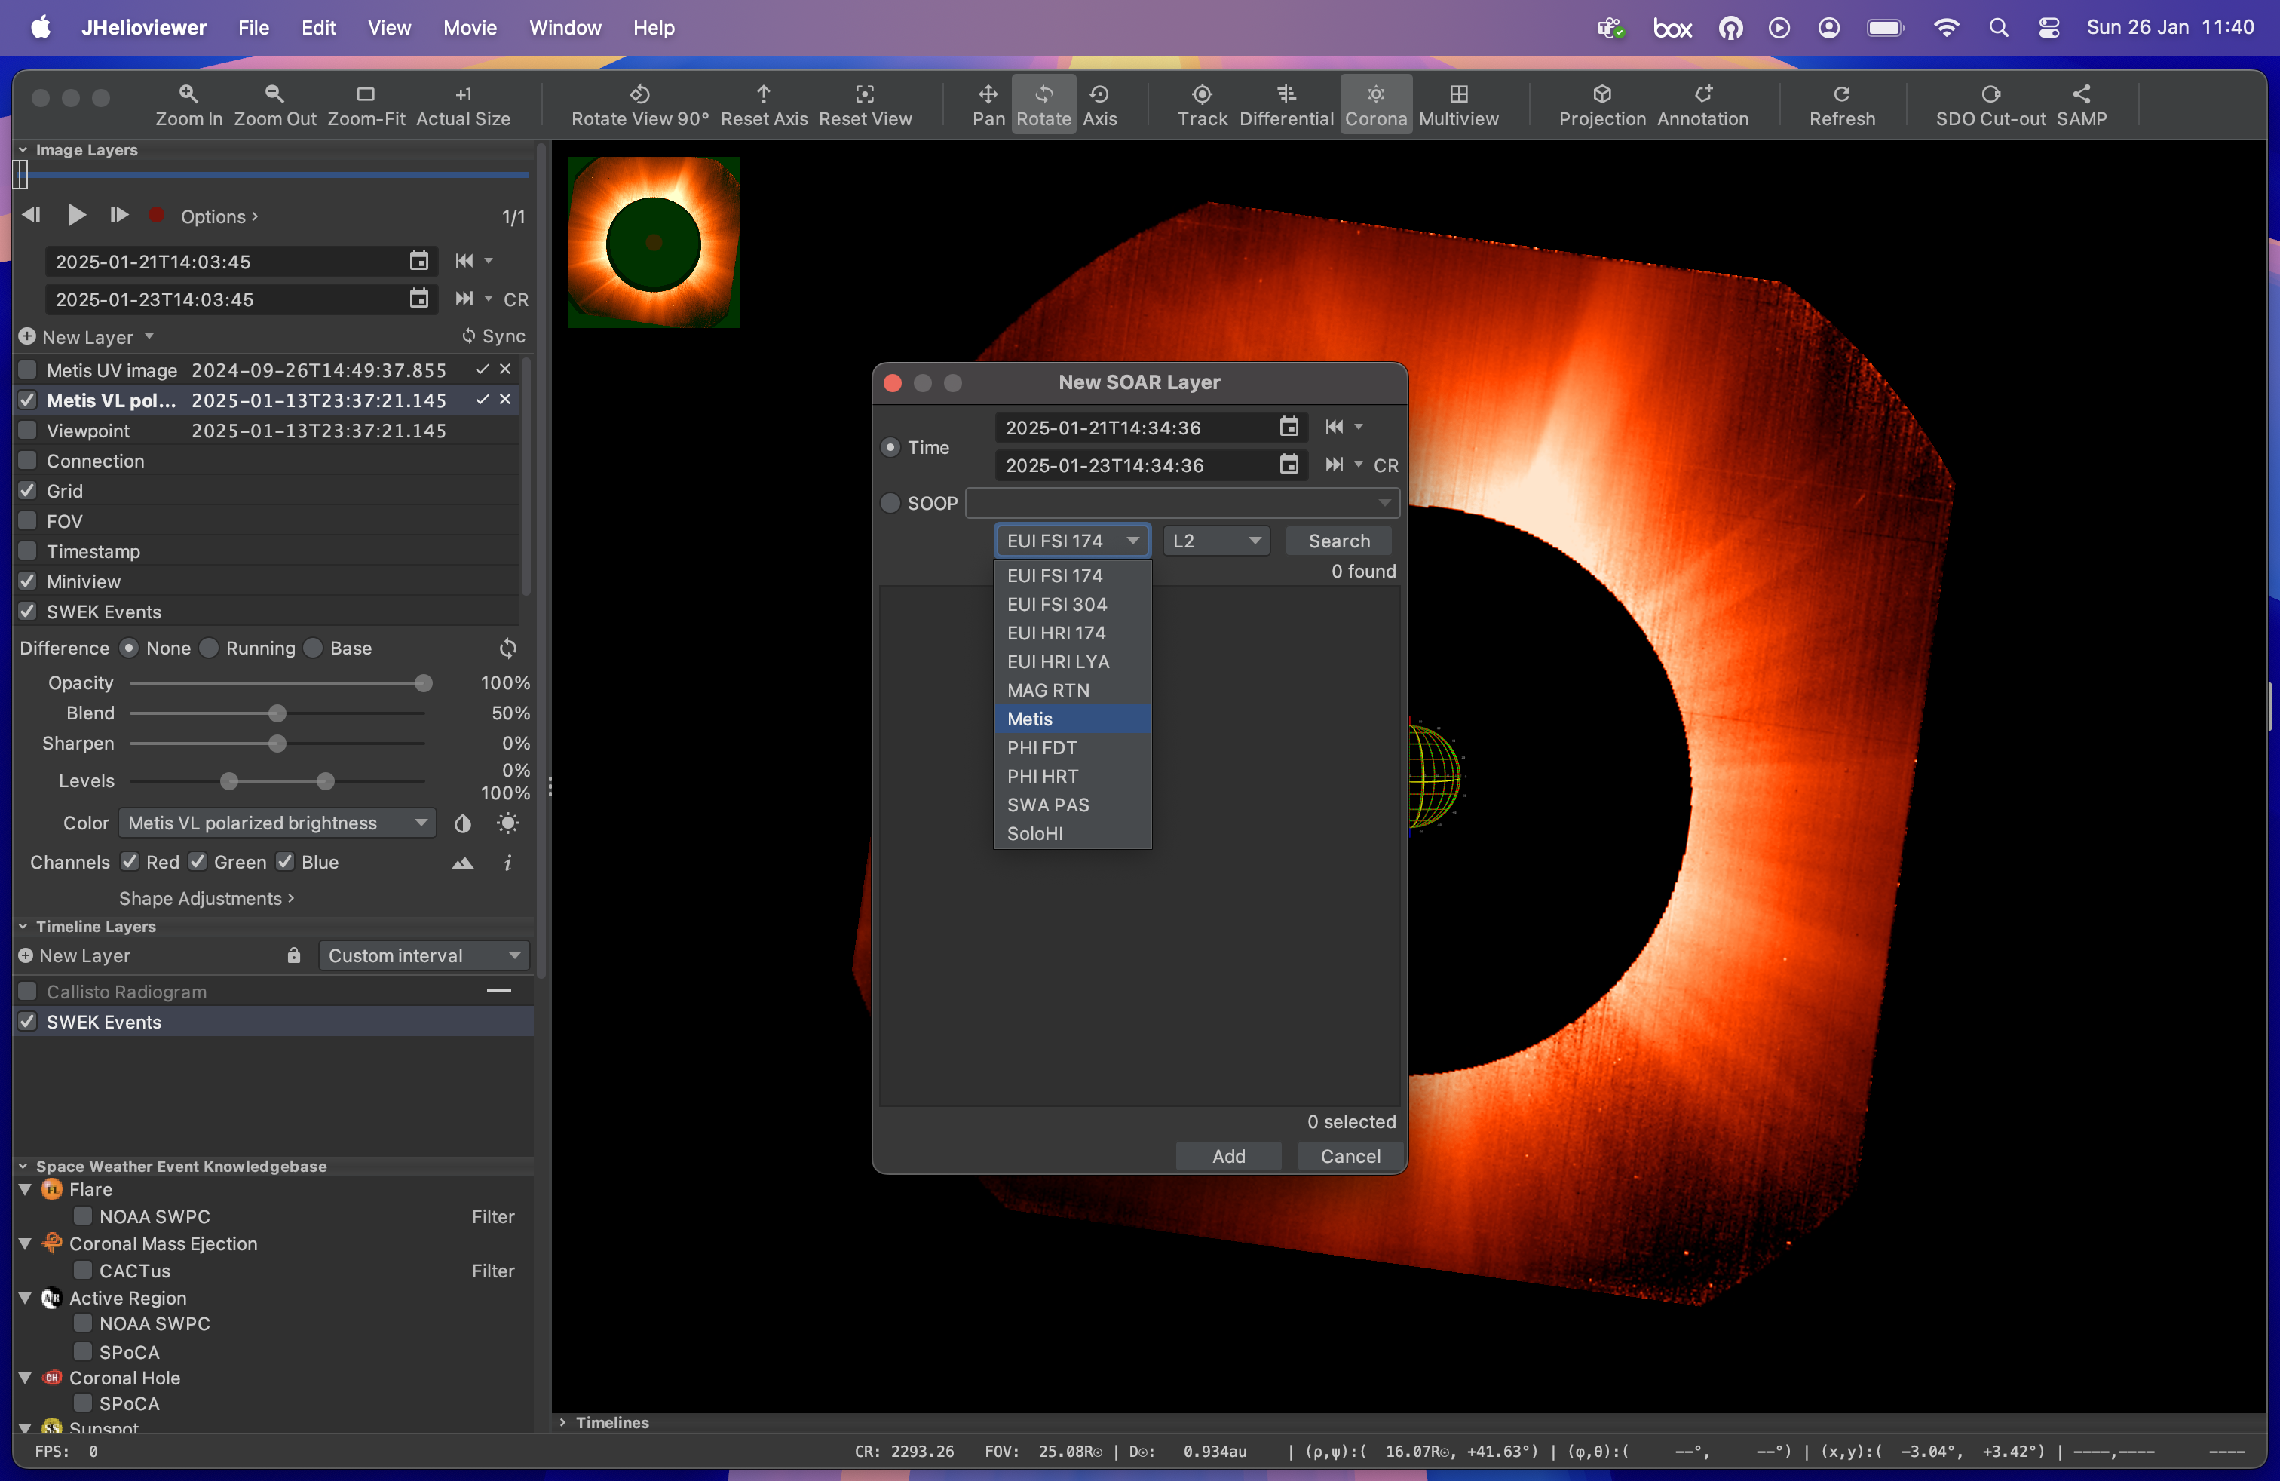
JHelioviewer

Slide 21
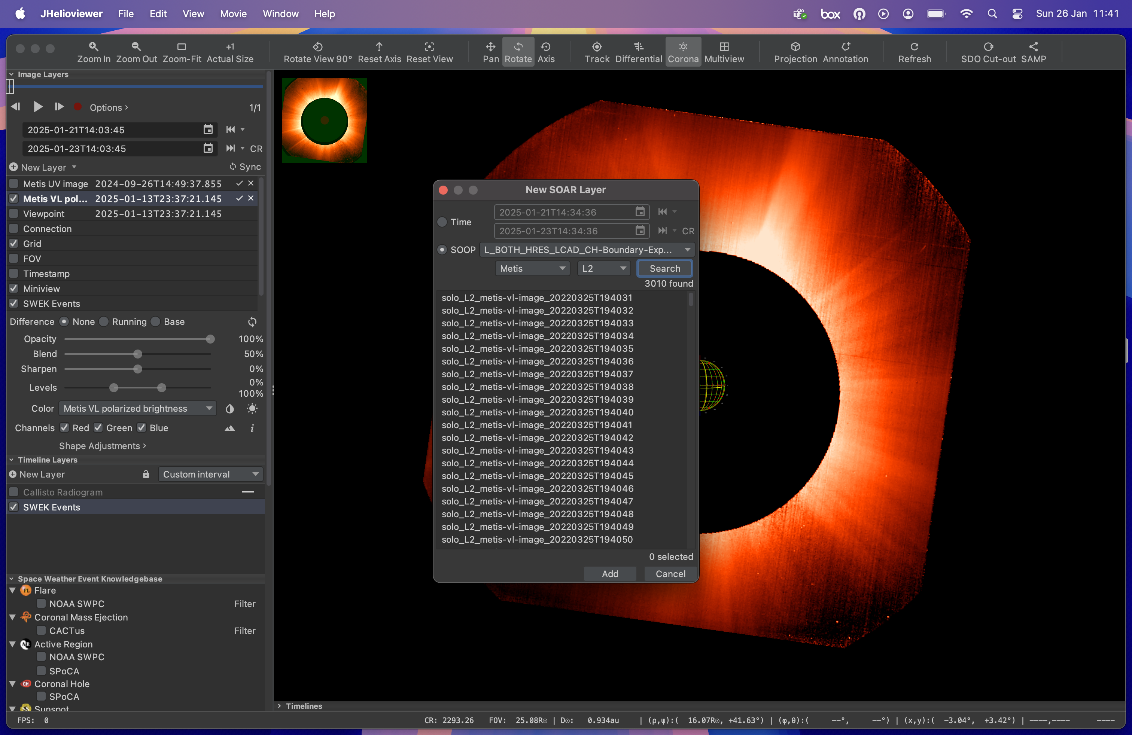
JHelioviewer

Slide 22
Reference documents and useful links
Metis Data Product Description Document: http://metis.oato.inaf.it/docs/METIS-OATO-SPE-021_2.2_Solar_Orbiter_Metis_Data_Product_Description_Document.pdf
Metis Instrument Paper: https://www.aanda.org/articles/aa/pdf/2020/10/aa35338-19.pdf
Metis website: http://metis.oato.inaf.it
iCID: https://drive.google.com/drive/folders/1BESI7qkb2PQ_44RjmCOmapFPL93IYSCL?usp=drive_link and pyCID: https://www.ict.inaf.it/gitlab/metis/utilities/pycid.git
JHelioviewer: https://www.jhelioviewer.org

