Slide 2
Summary of the conference
The data: 61 fantastic talks + 20 great posters
Rate calculation : 4.7 x 10⁻¹⁵ Gyr⁻¹
Does not favour the hypothesis that I can do this

Slide 6
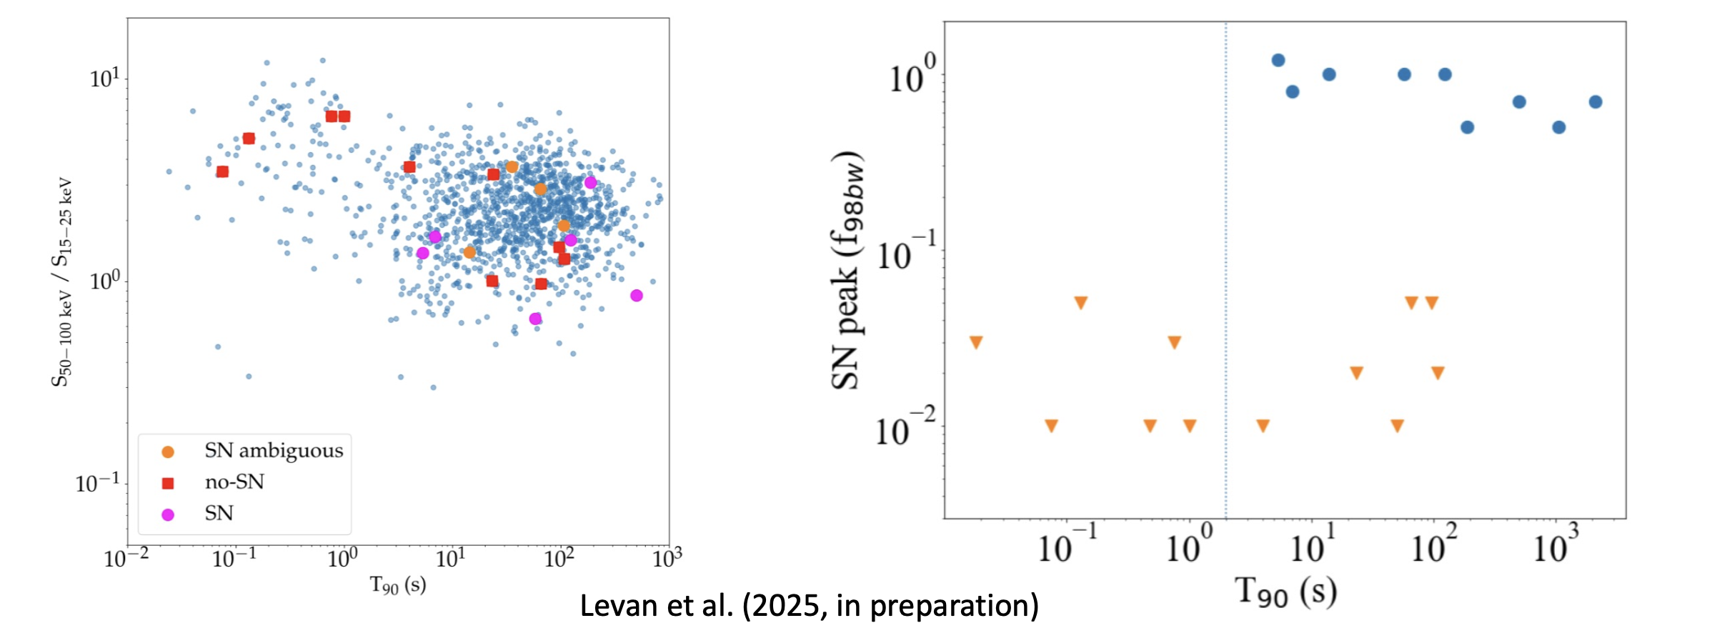
From Daniele Malesani’s talk
From Elena Pian’s talk

Slide 8
Stefano Valenti’s talk

Slide 9
Peter Brown’s
Talk
Assaf Horesh’s talk

Slide 12
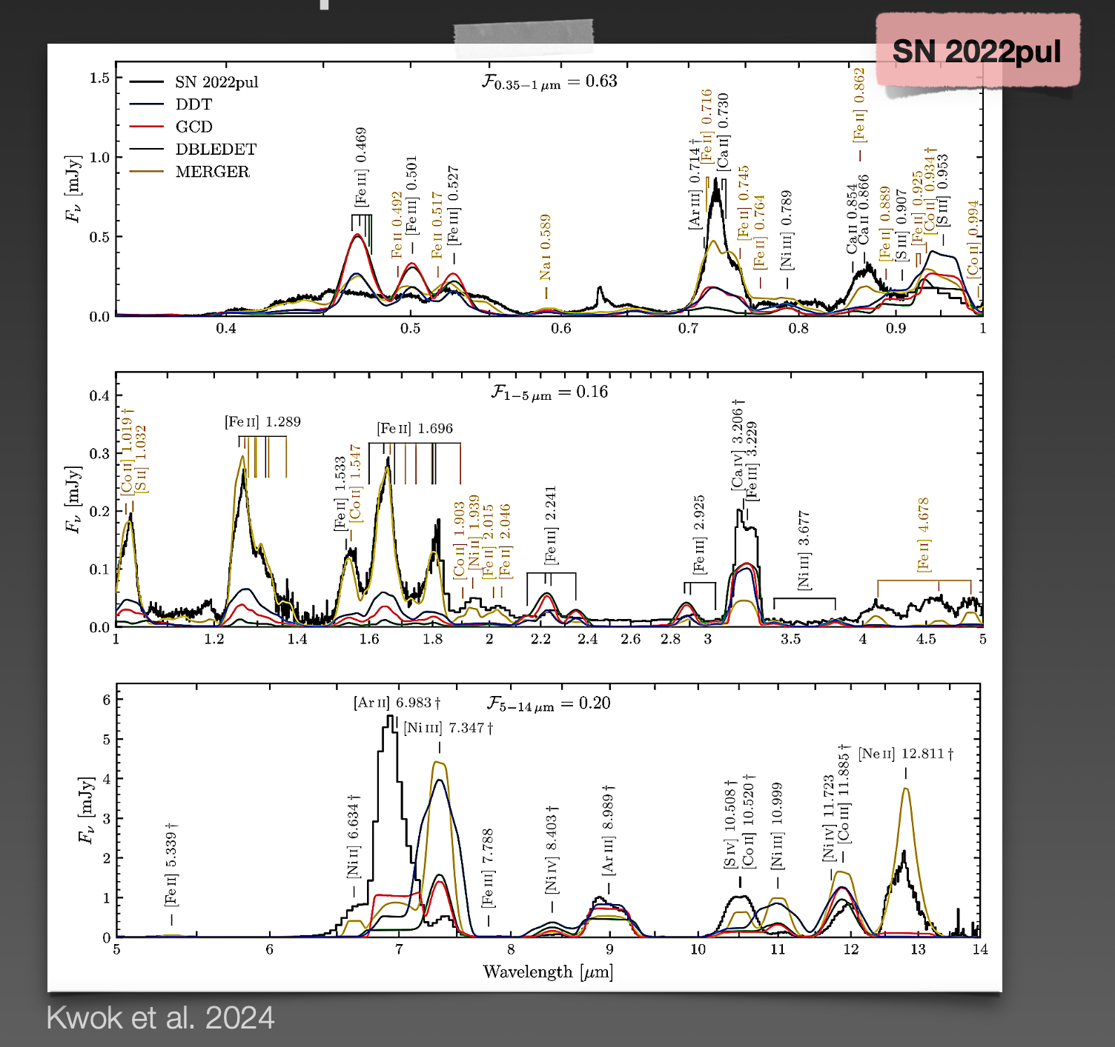
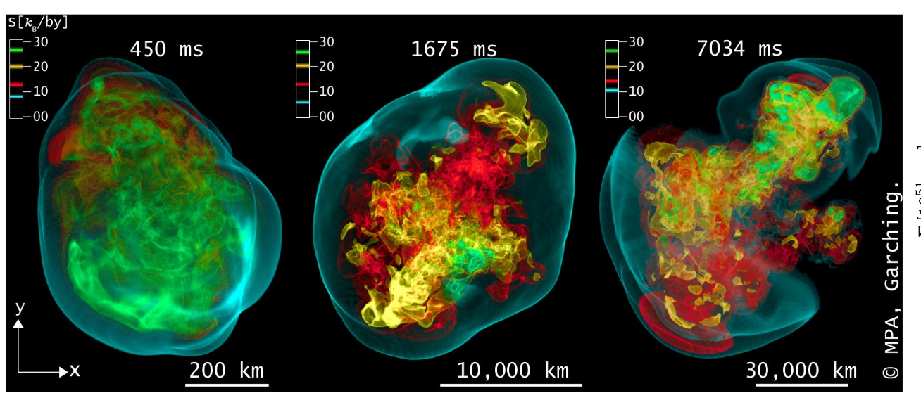
Stefan Taubenberger and
Saurabh Jha’s talks
Thomas Janka’s talk

Slide 14
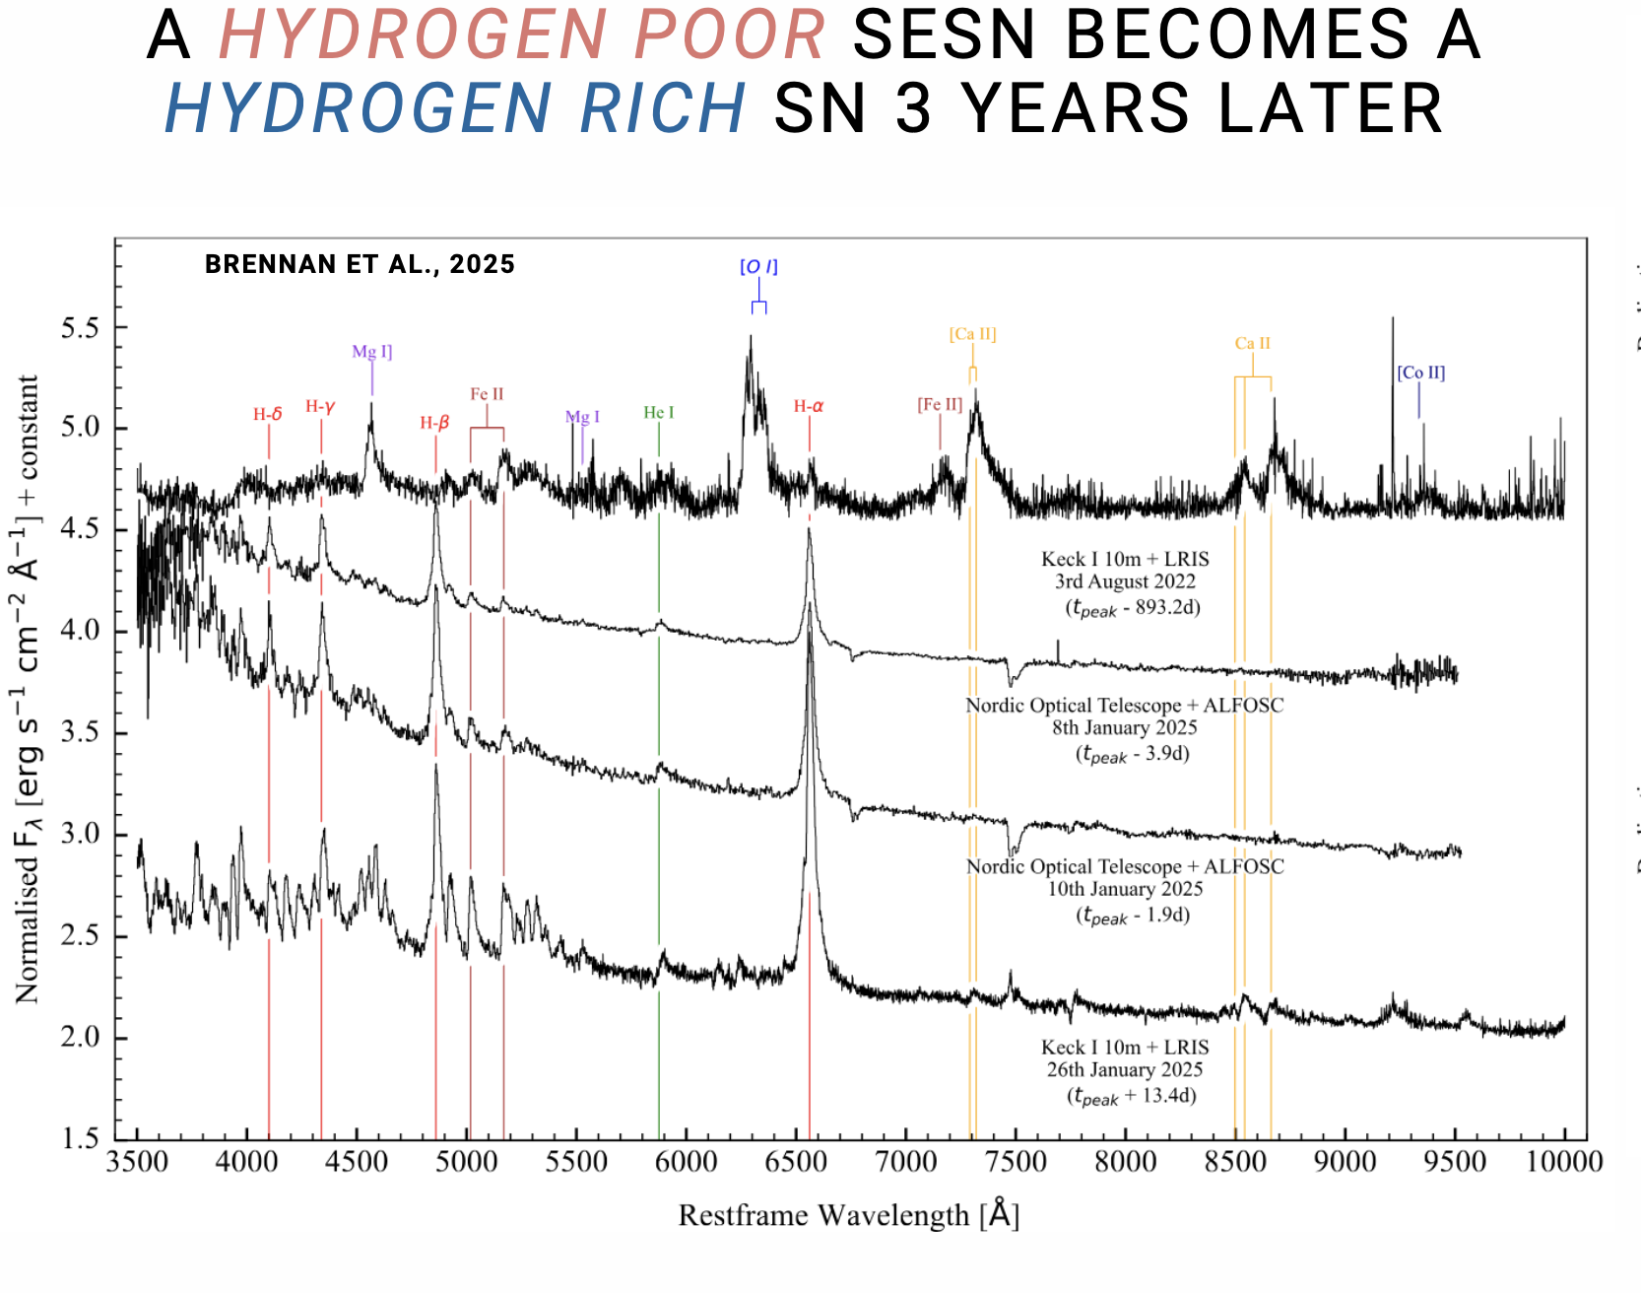
Nathan Smith – LBVs may all result from mergers
Sean Brennan’s talk
Manos Zapartas’ talk

Slide 16
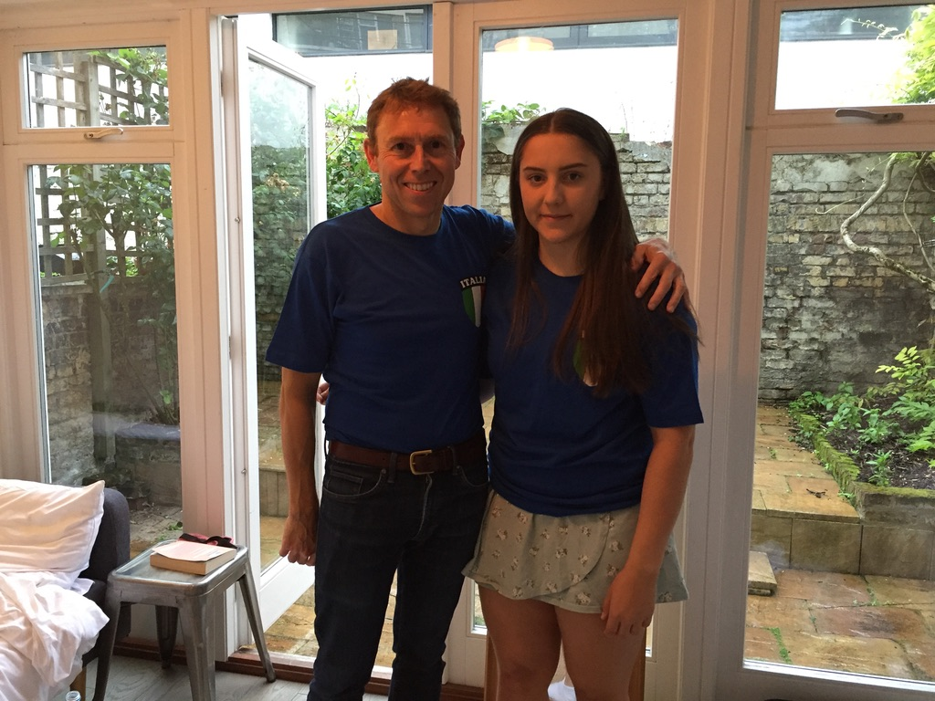
England vs Italy, Euro 2020 final

