Slide 1
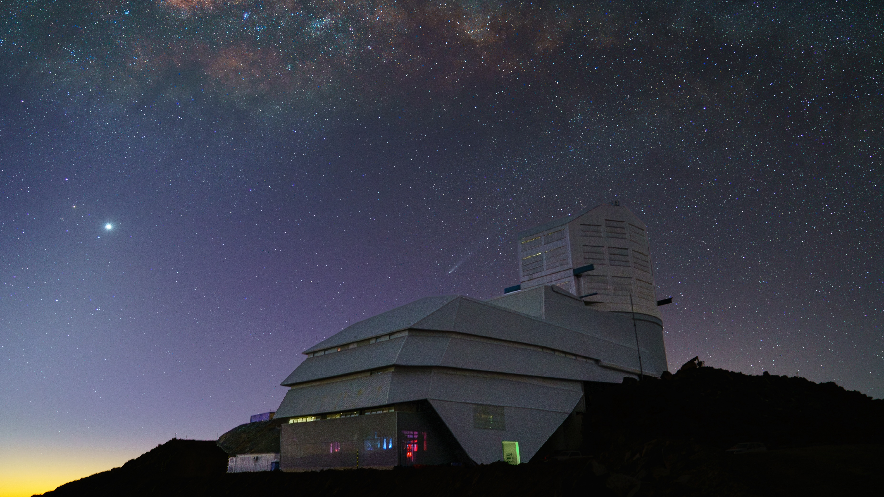
Core-collapse supernovae parameters in the LSST era
Andrea Simongini (INAF-OAR)
F. Ragosta, I. Di Palma, S. Piranomonte
andrea.simongini@inaf.it

Slide 2
SNe in Numbers*
10 million over 10 years
14 thousands in high detail
6.8 $×{10}^{−5}$ Sne ${Mpc}^{−3} yr^{−1}$
70 % IIP
15 % Ib/c
10 % IIL
0.05 % IIn
*Credits: Ivezic et al. 2019

Slide 3
Our Work
Address the possible limits of CCSNe parameters estimation using only LSST light curves.
Analysis of 6730 simulations with the software CASTOR.
Simongini et al. 2025 currently under review at A&A

Slide 4
DATA.

Slide 5
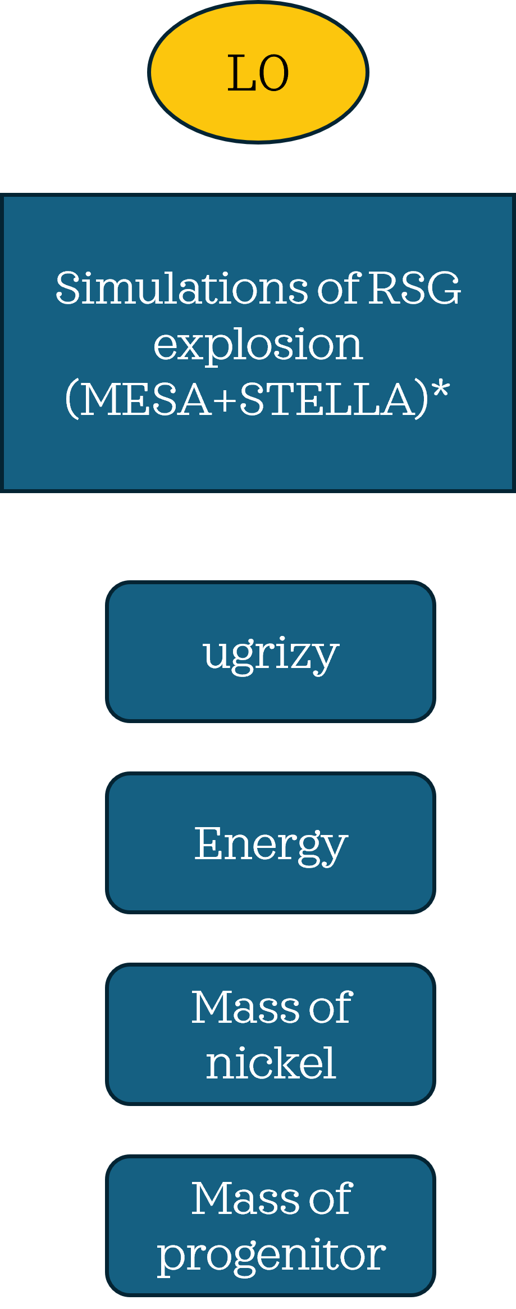
*Credits: Moriya et al. 2023

Slide 6
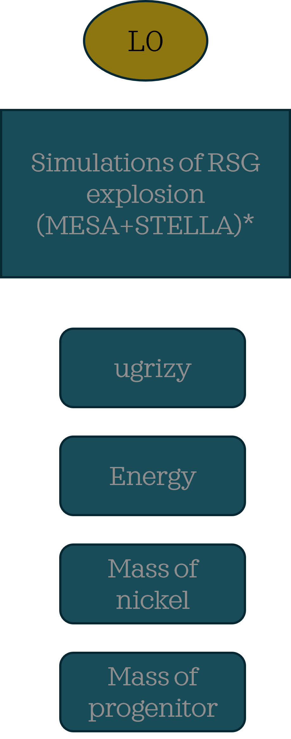
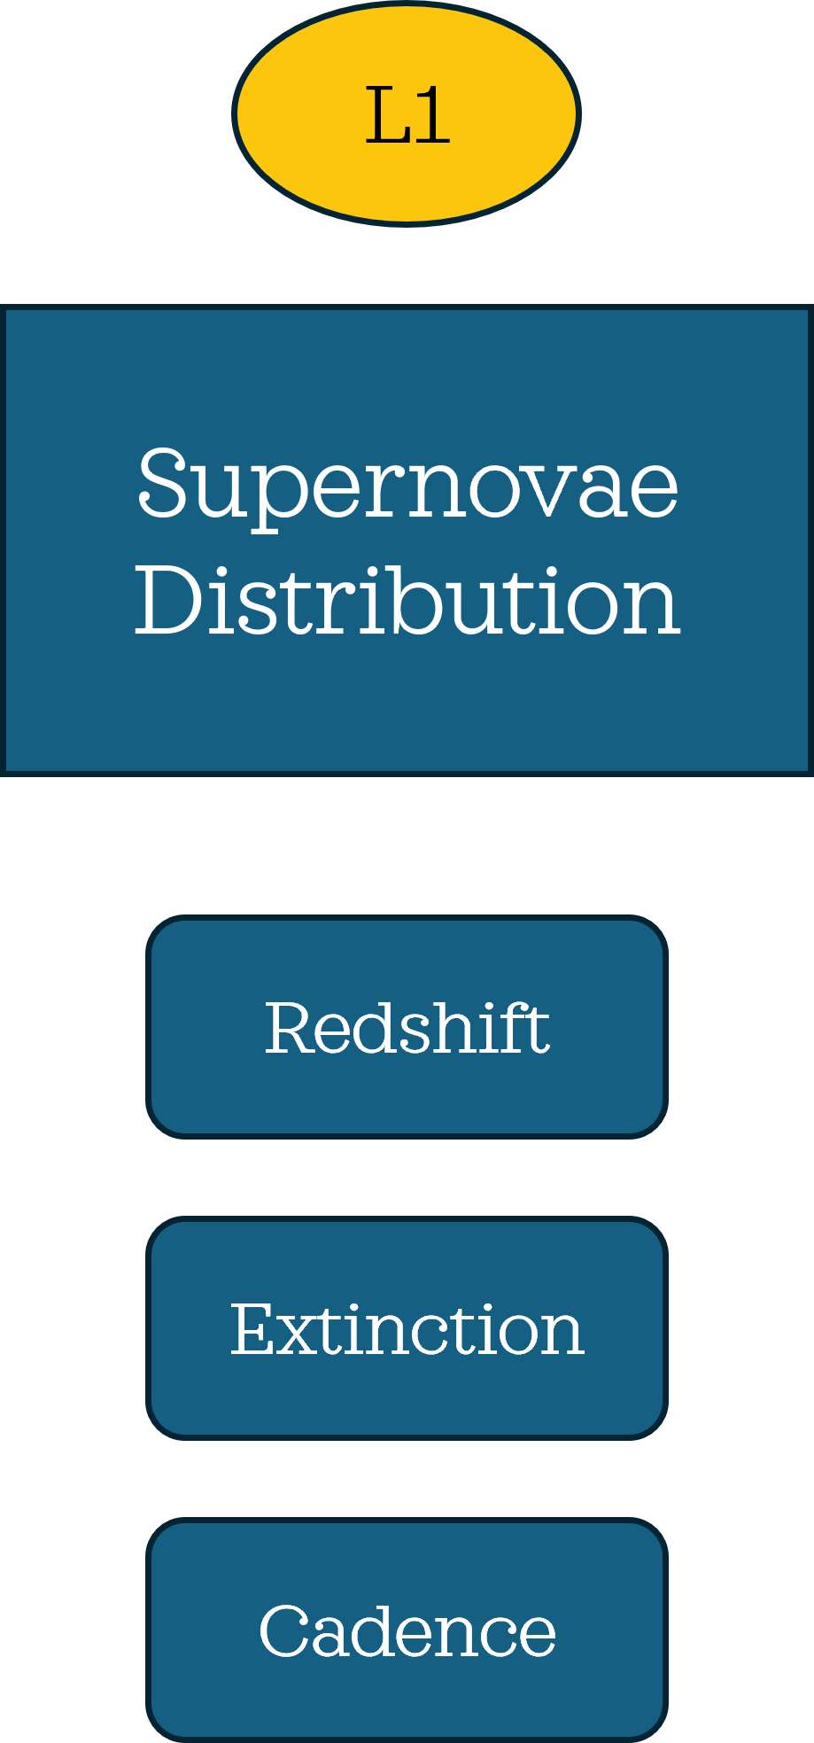
*Credits: Moriya et al. 2023

Slide 7
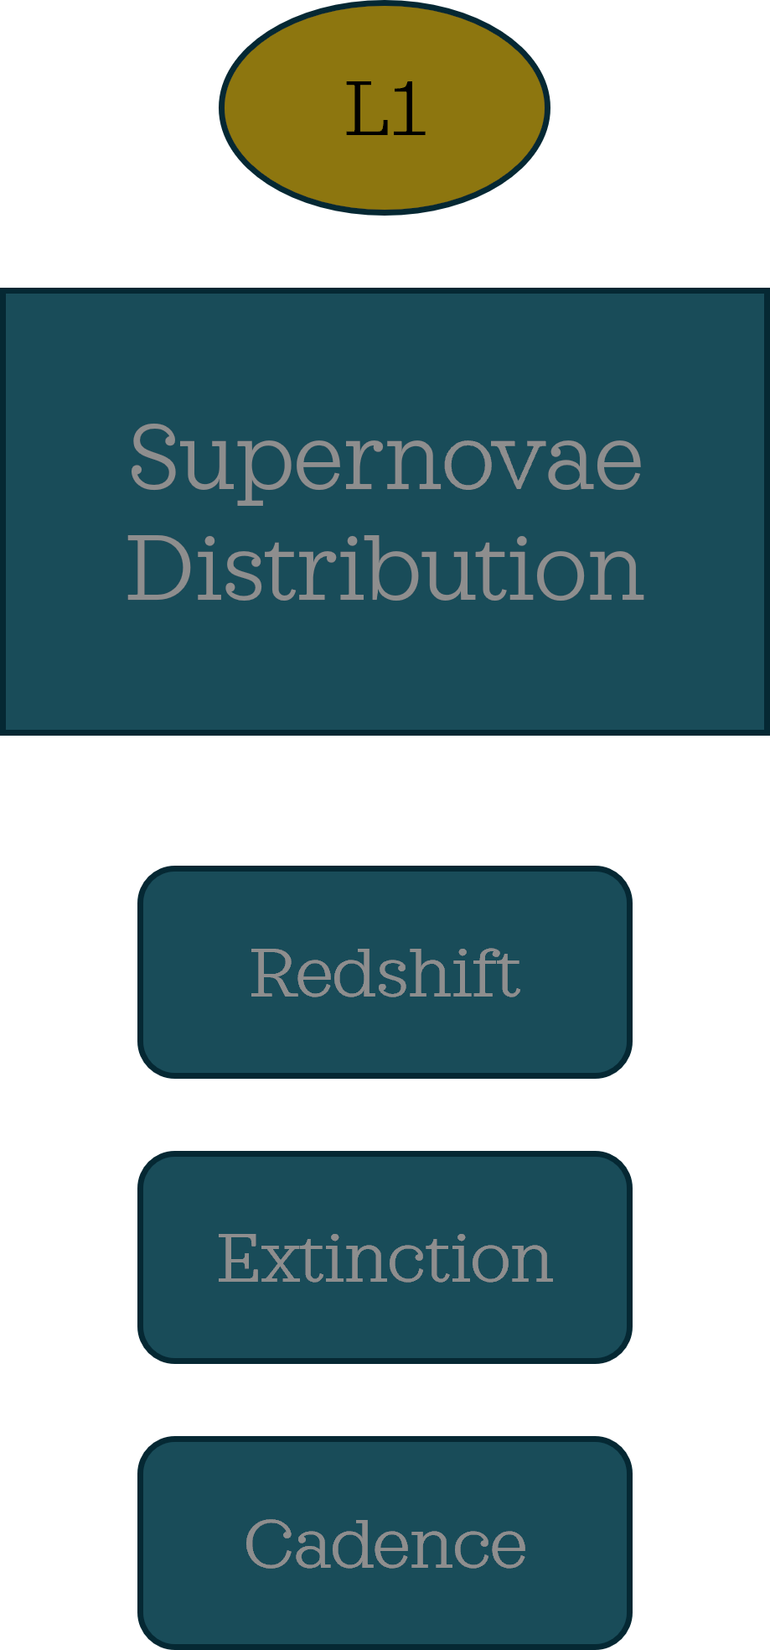
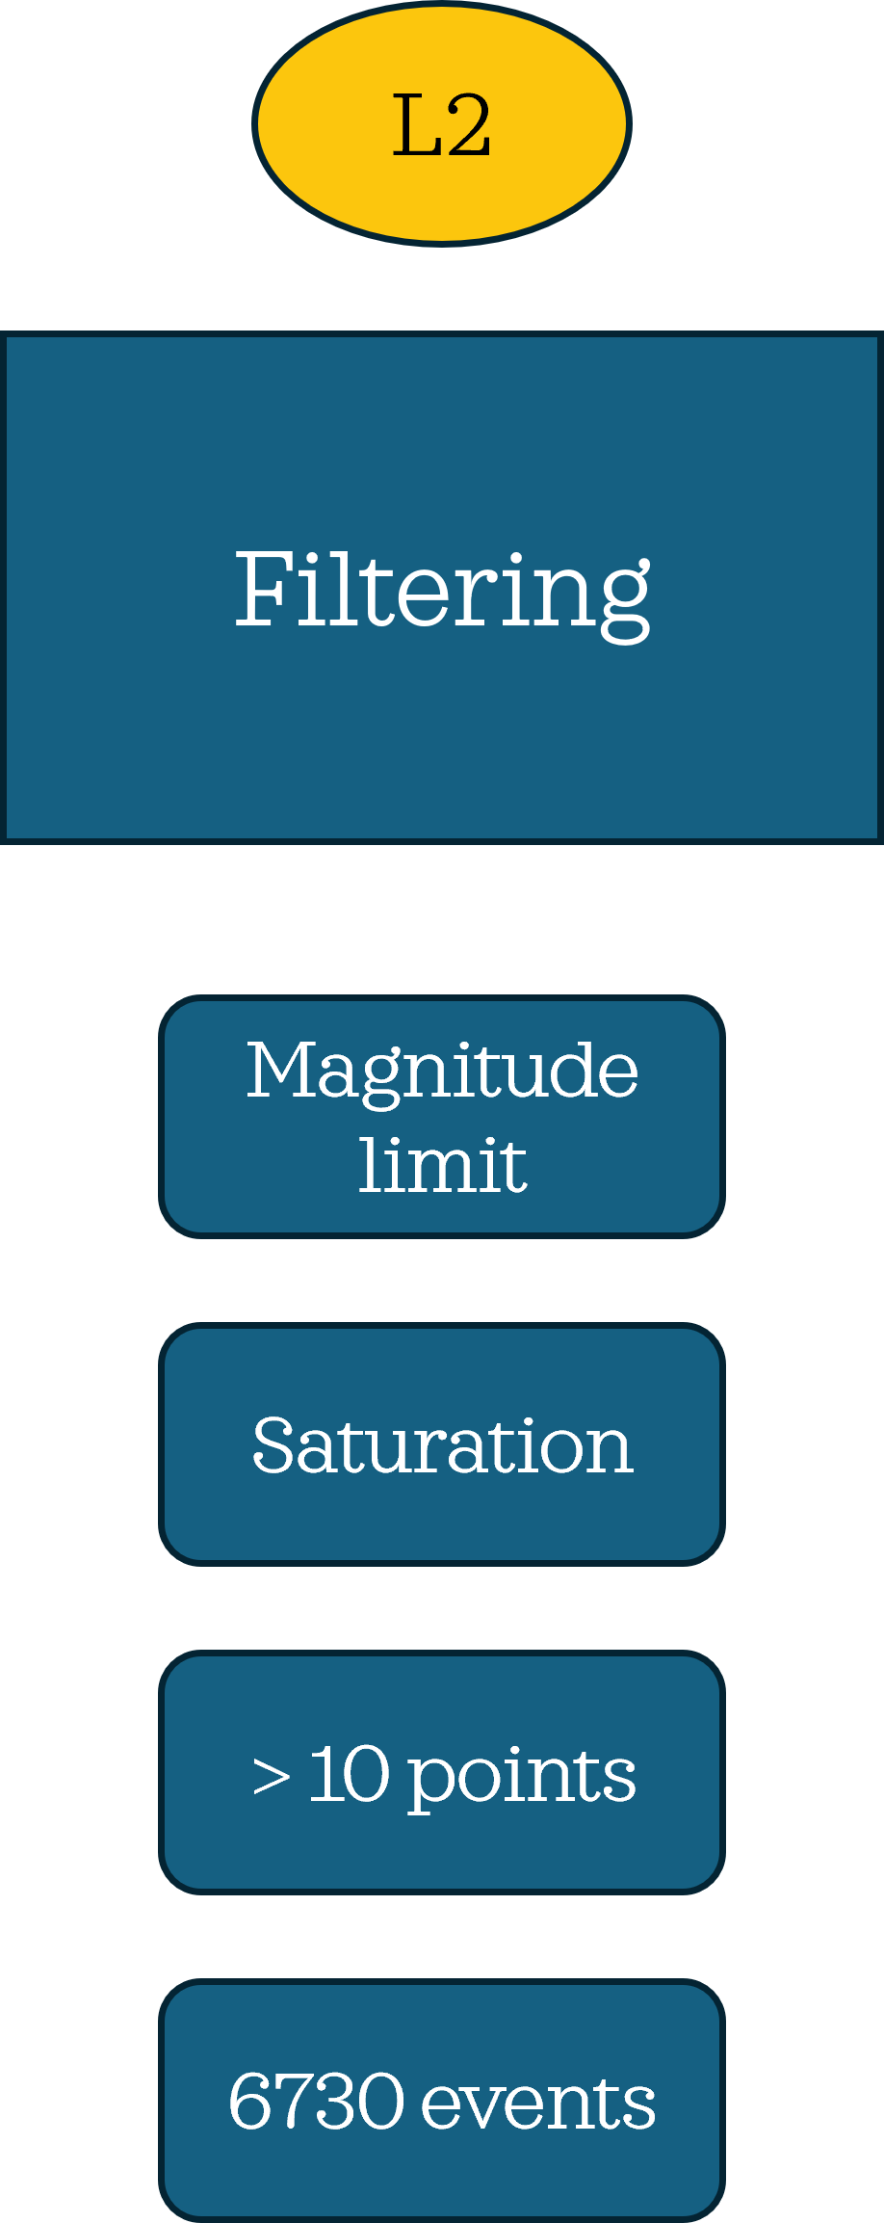
*Credits: Moriya et al. 2023

Slide 8
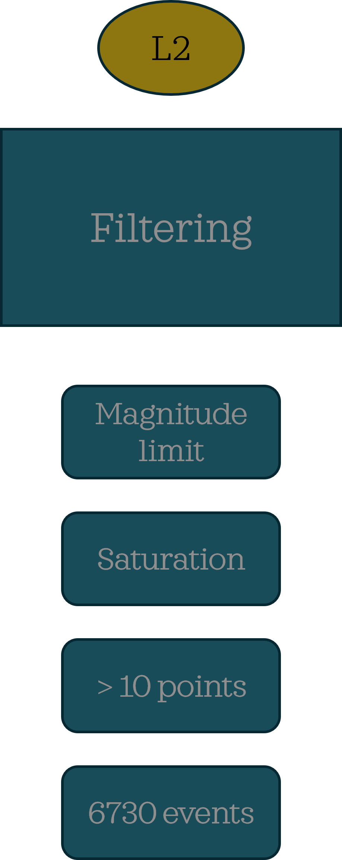
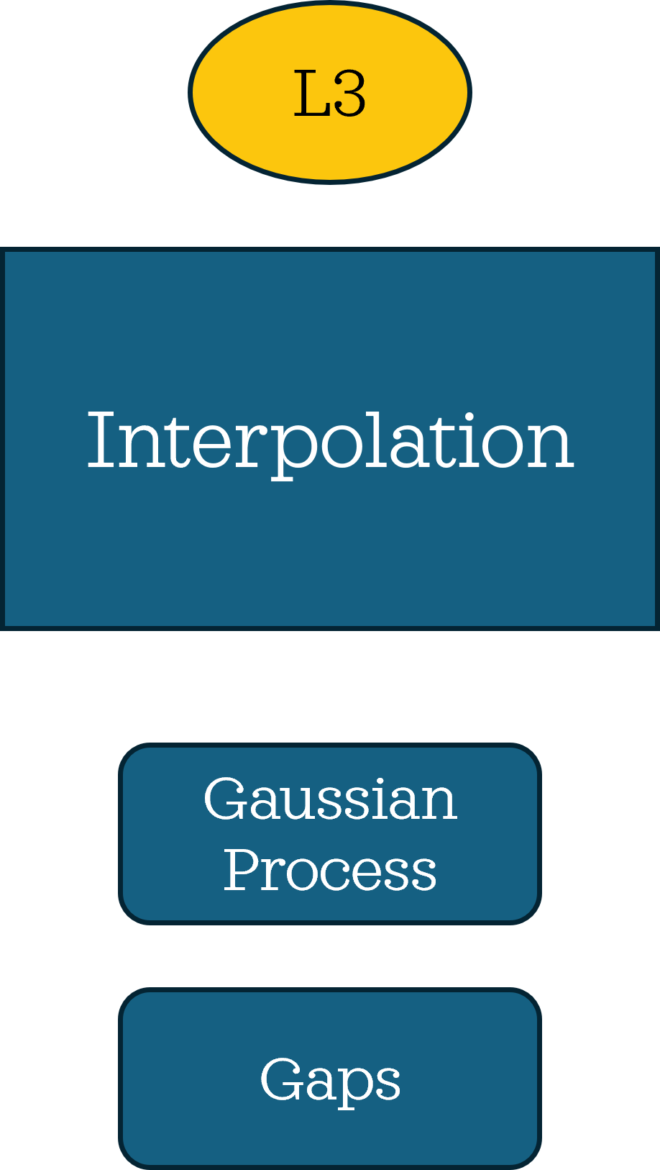
*Credits: Moriya et al. 2023

Slide 9
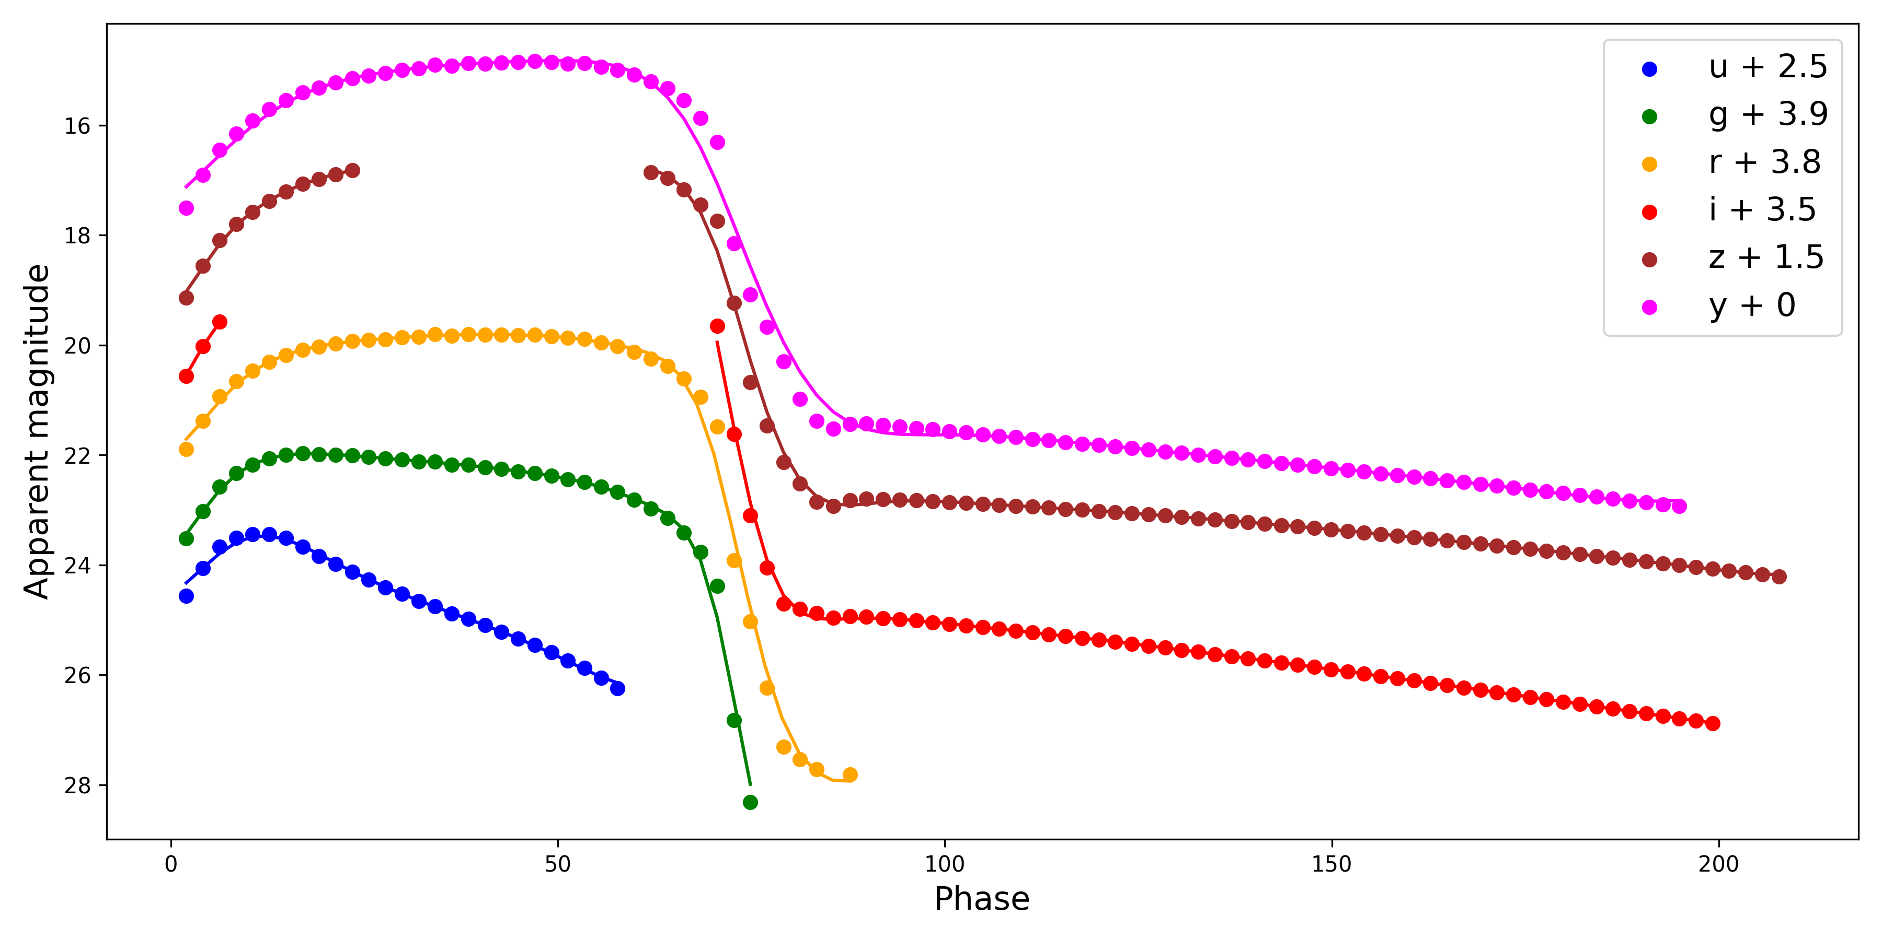

Slide 10
ANALYSIS.

Slide 11
CASTOR*
*Credits: Simongini et al. 2024, 2025

Slide 12
CASTOR*
*Credits: Simongini et al. 2024, 2025

Slide 13
CASTOR*
*Credits: Simongini et al. 2024, 2025

Slide 14
FIGURES OF MERIT.

Slide 15
KL divergence
The Kullback–Leibler (KL) divergence is a statistical tool that quantifies the difference between two distributions.
$$D_{KL}=\sum_{i}{P_{i}log_{2}\left(\frac{P_{i}}{Q_{i}}\right)}$$

Slide 16
KL divergence
FoM
The Kullback–Leibler (KL) divergence is a statistical tool that quantifies the difference between two distributions.
$$D_{KL}=\sum_{i}{P_{i}log_{2}\left(\frac{P_{i}}{Q_{i}}\right)}$$
We define the FoM as the relative deviation of two distributions on a single-event base. It quantifies the relative error of estimation.
$$FoM=\frac{1}{n}\sum_{i}{\frac{\left|S_{i}−T_{i}\right|}{T_{i}}}$$

Slide 17
RESULTS.

Slide 18
Disclaimer: we are looking for ugly things !!!!!
RESULTS.

Slide 19
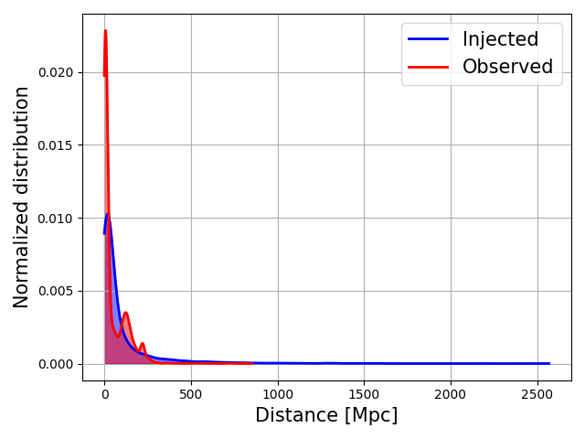
Distance.
$$D_{KL}=1.20$$
$$FoM=2.75$$

Slide 20
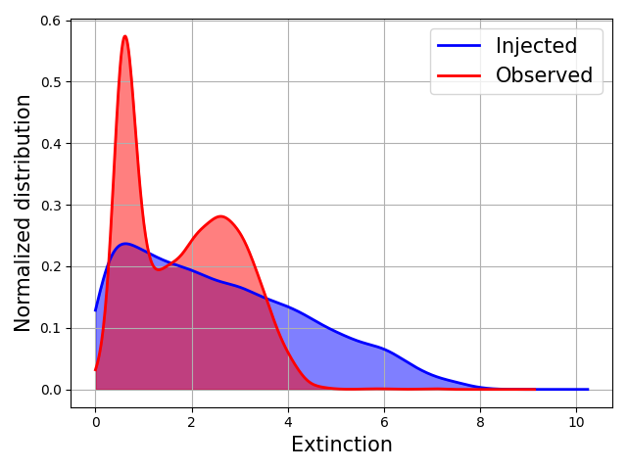
Extinction.
$$D_{KL}=0.53$$
$FoM=2.5$7

Slide 21
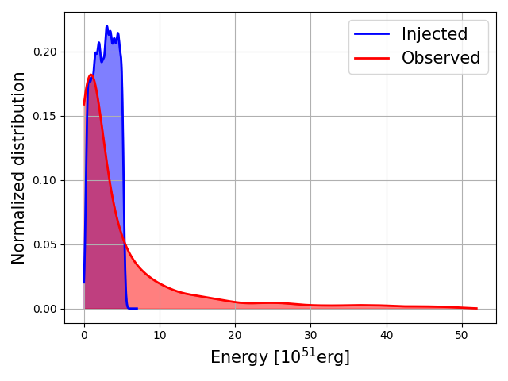
Energy.
$$D_{KL}=1.49$$
$$FoM=1.69$$

Slide 22
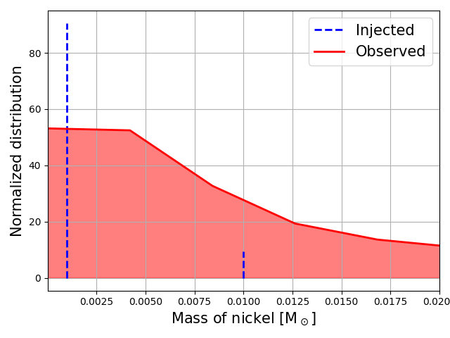
Mass of Nickel.
$$D_{KL}=2.15$$
$$FoM=15.9$$

Slide 23
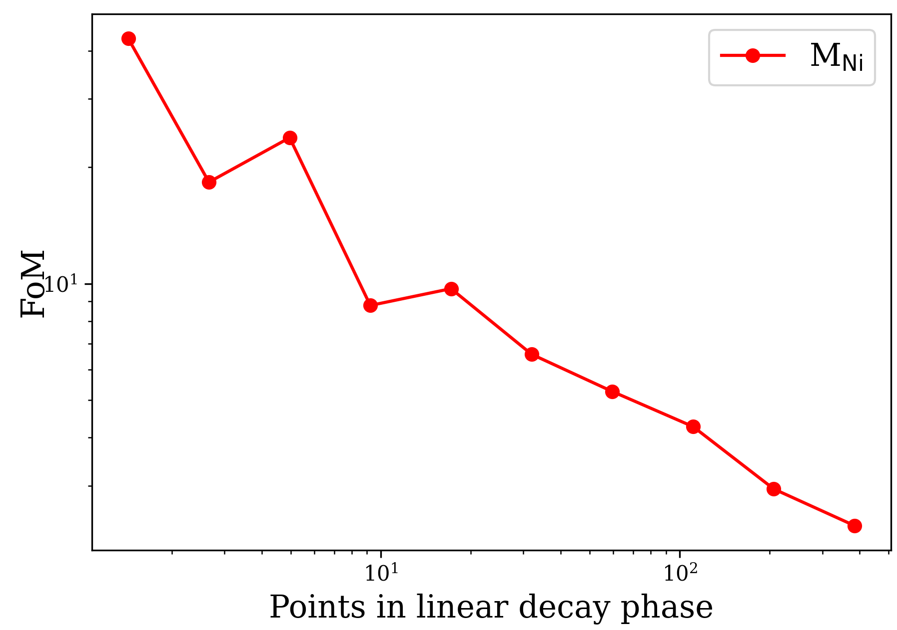
Mass of Nickel.
$$D_{KL}=2.15$$
$$FoM=15.9$$

Slide 24
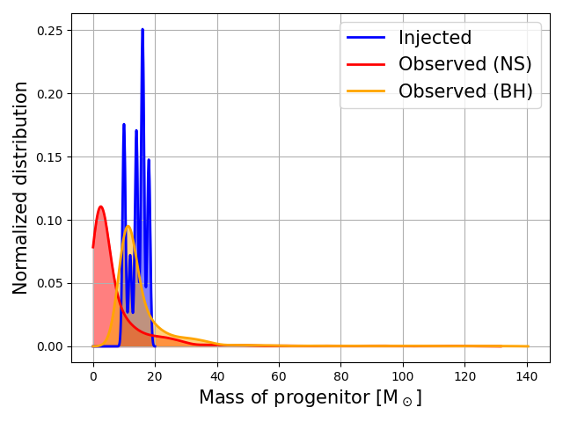
Mass of Progenitor.
$$D_{KL}=0.74$$
$$FoM=0.84$$
$$D_{KL}=0.18$$
$$FoM=0.52$$

Slide 25
CONCLUSIONS.

Slide 26
Main problems:
Saturation: high errors in extinction and energy.
Number of filters: if limited, leads to underestimation.
Technological limit: LSST alone will not suffice for a precise characterization of some events (need for spectrographs).
The number of points observed in the linear decay phase has a huge impact in mass of nickel reconstruction.
Best reconstructed supernova:
A SN in the range z = 0.01-0.1 with average extinction and peak luminosity, with at least 4 filters and >10 points in the linear decay phase.

Slide 27
APPENDIX.

Slide 28
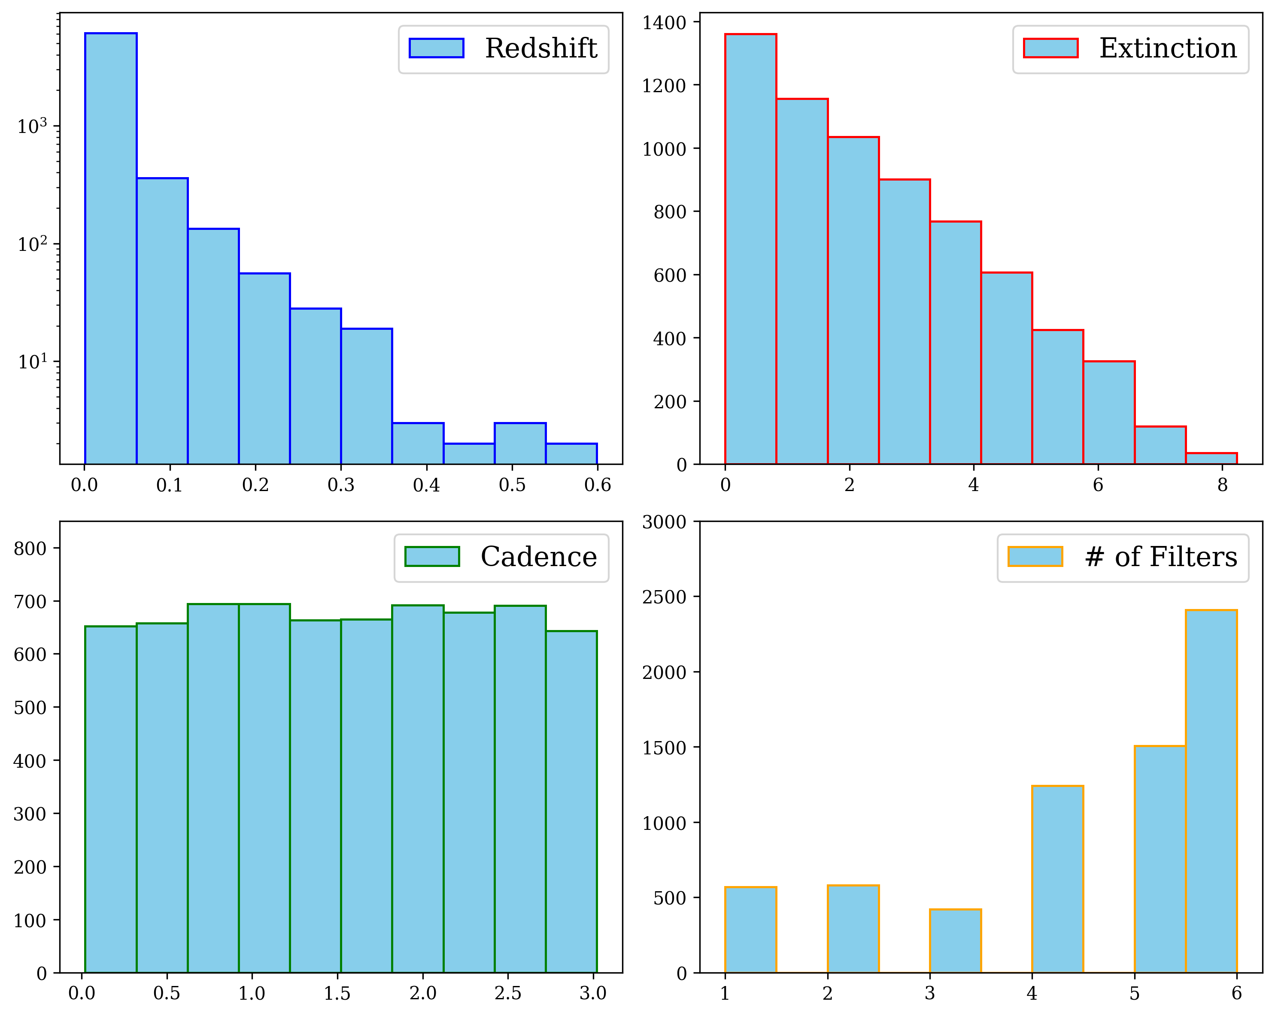
A1.
Distributions of the simulations

Slide 29
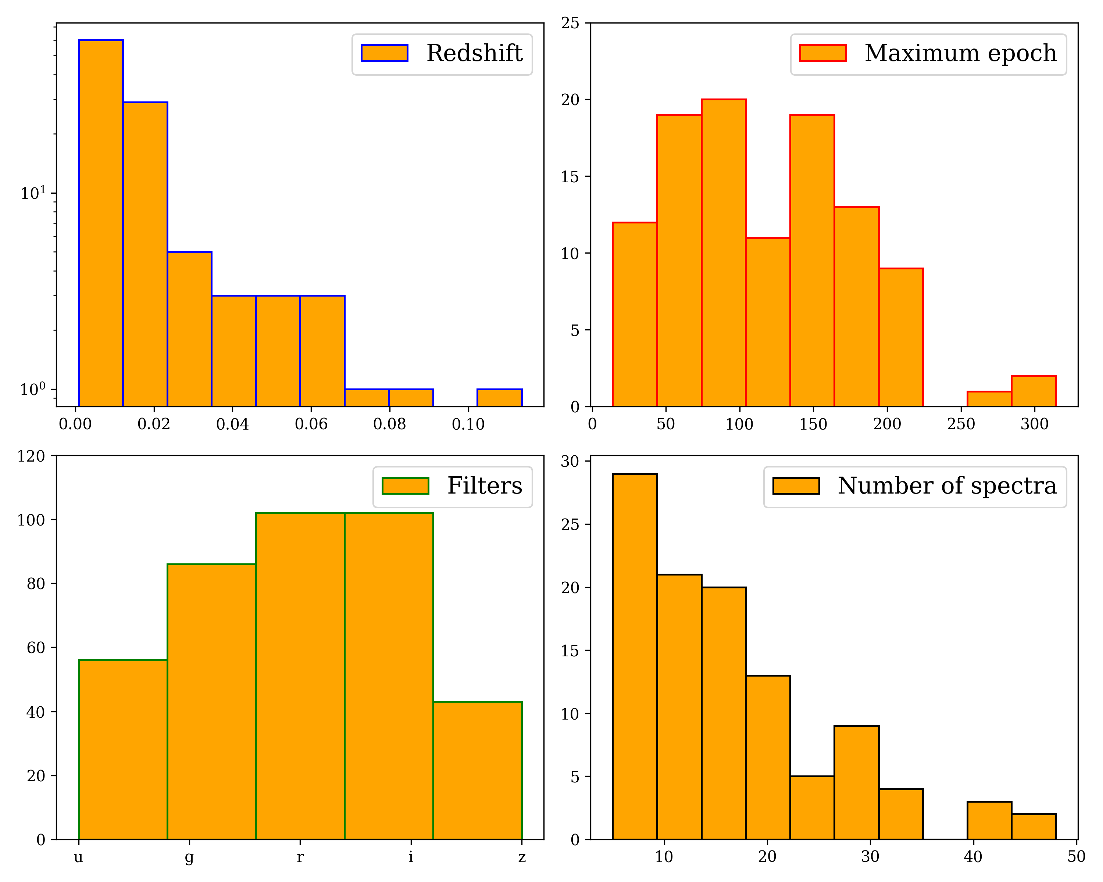
A2.
Distributions of the training set

Slide 30
A3.
Injected parameters
Mass of the progenitor
10, 12, 14, 16, 18 M⊙
Explosion Energy:
0.5, 1, 1.5, 2, 2.5, 3, 3.5, 4, 4.5, 5 $×{10}^{51}$erg
Mass of nickel:
0.001, 0.01 M⊙

Slide 31
A4.
Kernel for GPs
We use a mixture of three Matérn kernel functions setting the lengthstcale parameter as the min, max and mean value of the sampling step.
$k\left(x\right)=A\left.\left(1+\frac{\sqrt{3x}}{σ}\right.\right)\exp\left.\left(−\frac{\sqrt{3x}}{σ}\right.\right)$

Slide 32
A5.
Distance
Distance is estimated using the Hubble’s law:
$$d=\frac{cz}{H_{0}}$$
Where the redshift is taken from the relative shift of emission lines in the synthetic spectra using the Doppler’s law.

Slide 33
A6.
Extinction
Extinction is estimated using the Cardelli’s law with the prescriptions from McCall 2004.
The $E_{B−V}$ parameter is taken as the difference between the peak magnitude of a blue and a visible filter.
When the number of filters is < 3 (or there are not the right filters) we simply use the model from Cardelli et al. 1989 averaging over the available filters.

Slide 34
A7.
Energy
We estimate energy using the model from Simongini et al. 2024.
Defining $ξ$ as the neutrino contribution (from SN1987A model) we define the explosion energy as:
$$E=ξL_{bol}t_{rise}$$

Slide 35
A8.
Mass of progenitor
We estimate the mass of progenitor combining the models from Arnett 1982 and Simongini et al. 2024 assuming perfect mass conservation.
The mass of progenitor is defined as:
$M_{pro}=M_{rem}+M_{ej}=M_{rem}+\frac{10}{3}\frac{E}{v_{ej}^{2}}$

Slide 36
A9.
Mass of nickel
We estimate the mass of nickel using the model from Lusk & Baron 2017.
The mass of nickel is defined as:
$$M_{Ni}=\frac{L_{Ni}}{s}$$
with:
$$s=3.90×{10}^{10}e^{−γ_{1}t}+6.78×{10}^{9}\left(e^{−γ_{2}t}−e^{−γ_{1}t}\right)$$

Slide 37
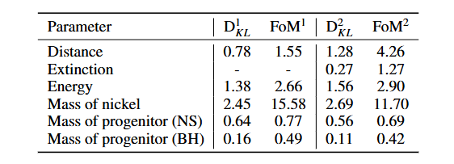
A10.
Additional tests
As additional tests we made two extra runs with (1) fixed extinction and (2) light curves with no saturation.

Slide 38
A11.
Mass of nickel
We bin the FoM of the Mass of nickel in terms of the number of points that are observed in the linear decay phase. We notice a huge improvement.

