Slide 1
Constraining Type Ia Supernova progenitors through the rate with the LSST
Vincenzo Petrecca
Università di Napoli Federico II – INAF OACN

Slide 2
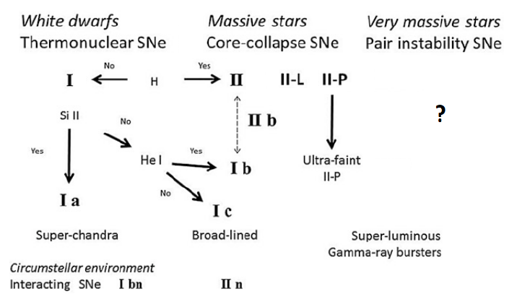
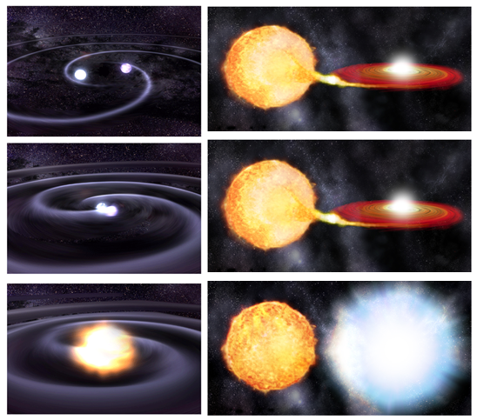
Supernova types and progenitors
(Turatto 2003)
- Single Degenerate (SD) – a WD accreting mass from a non-degenerate star up to the Chandrasekhar limit
- Double Degenerate (DD) – two WDs spiraling together and eventually merging

Slide 3
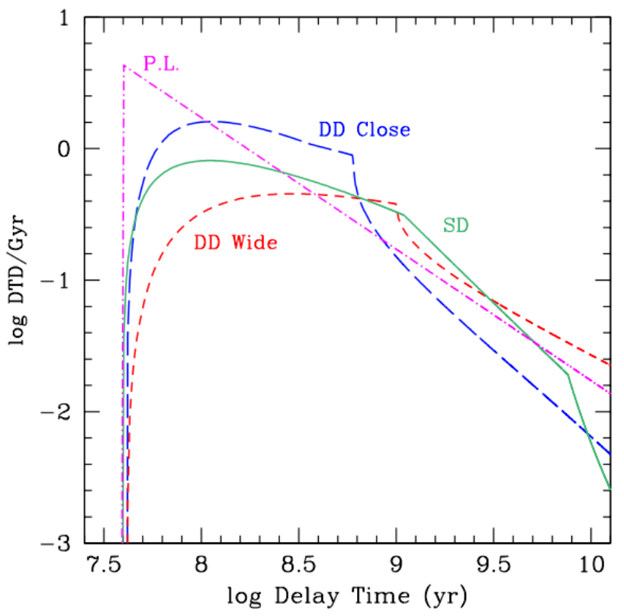
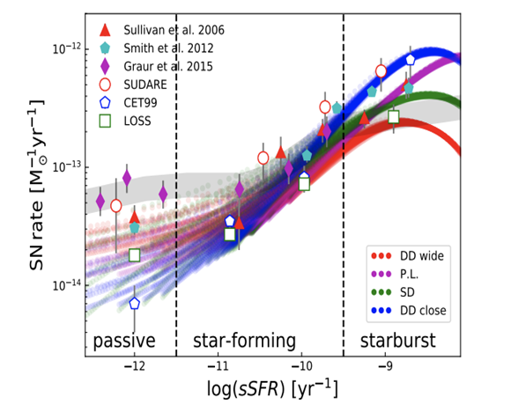
Measuring the rate to find SN Ia progenitors
The SNIa rate results from the convolution of the
Delay Times Distribution (DTD) and the
Star Formation History (SFH) over the whole galaxy lifetime:
The SNIa rate can help distinguish the progenitor scenarios, but present-day uncertainties are too large!
Greggio & Cappellaro (2019)
Botticella et al. (2017)

Slide 4
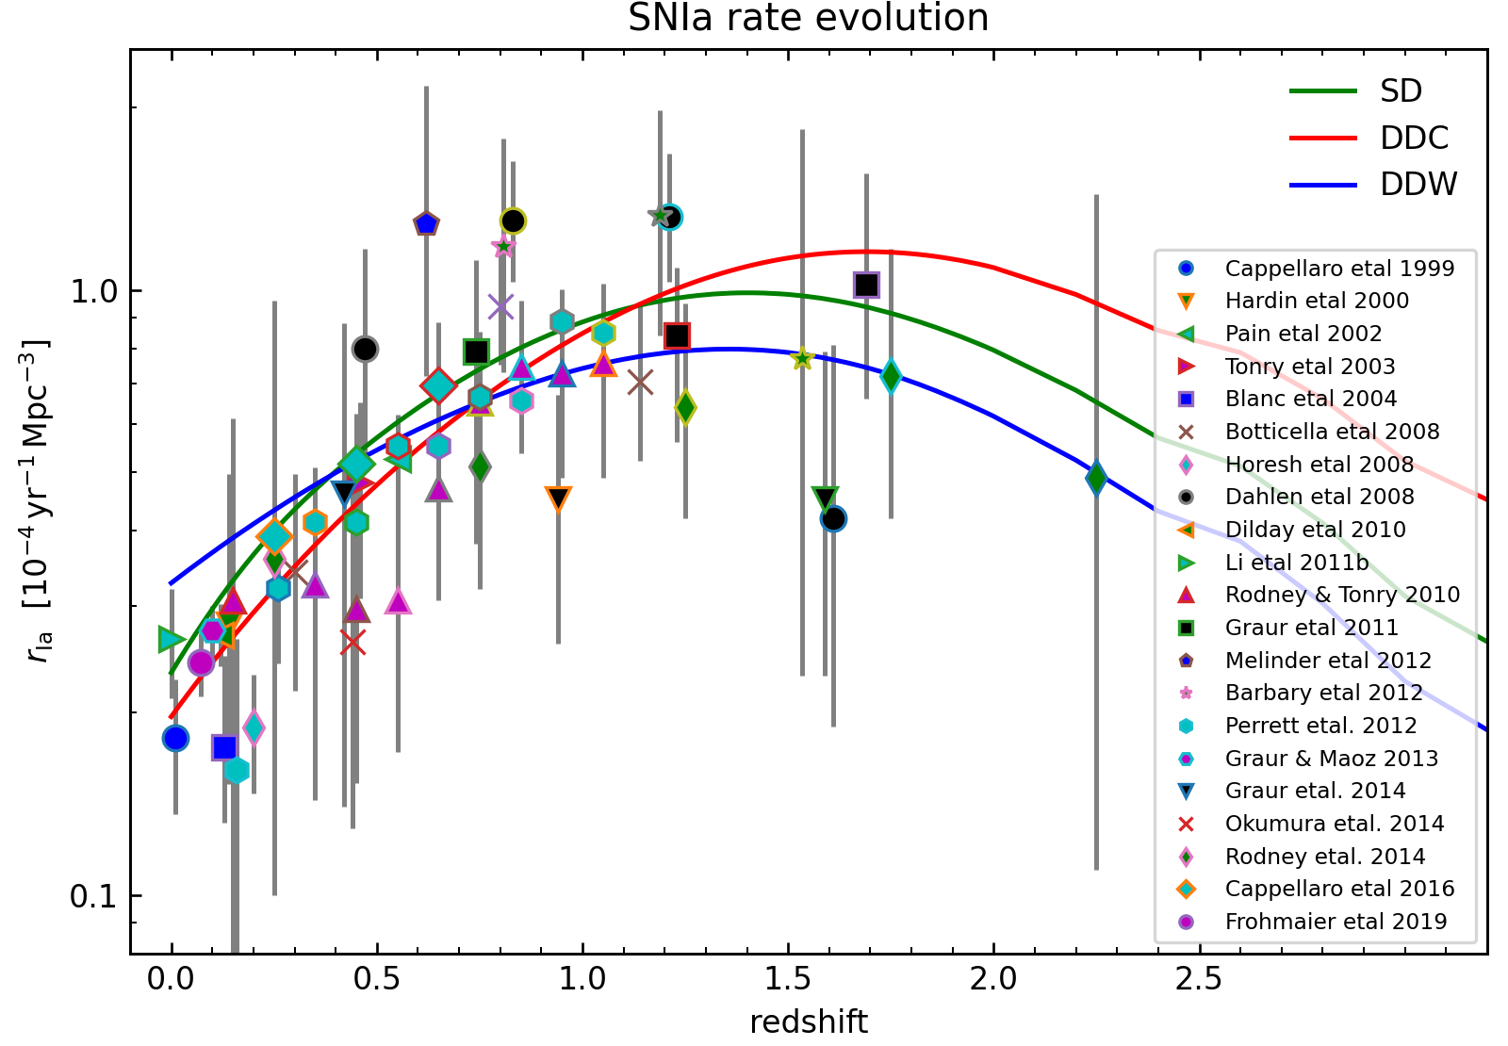
Present day scenario

Slide 5
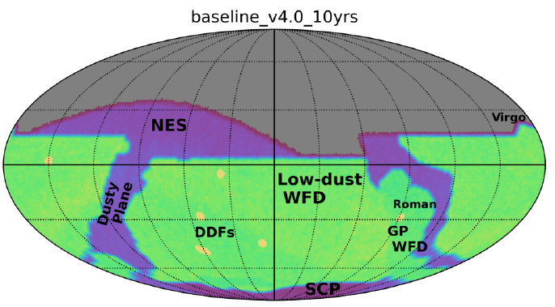
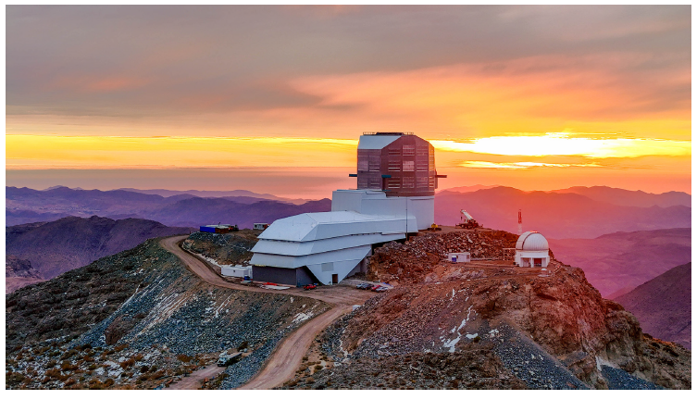
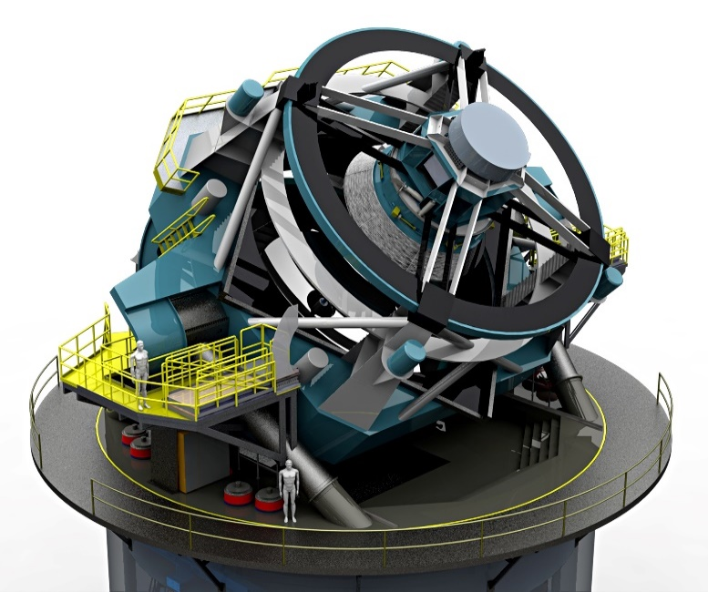
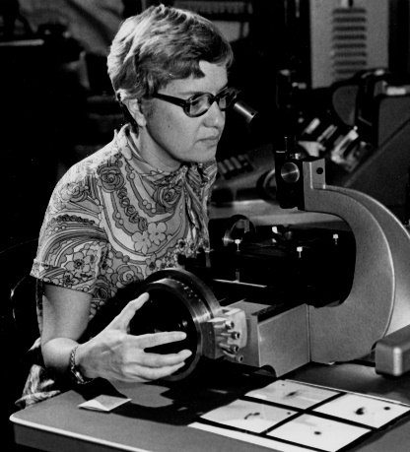
The Legacy Survey of Space and Time (LSST)
First light by the end of 2025, it will image the entire Southern sky every few nights for 10 years
Telescope with an 8.4 m primary mirror (FoV $9.6 \deg^{2}$) and a 3.2 Gigapixel camera composed of 189 CCDs and ugrizy filters (wavelength range 320 – 1050 nm)
$\sim {10}^{6}$ transients per night ($\sim$20 Tb of raw data) through Difference Image Analysis (DIA) and alert streams to other facilities within 30s from detection

Slide 6
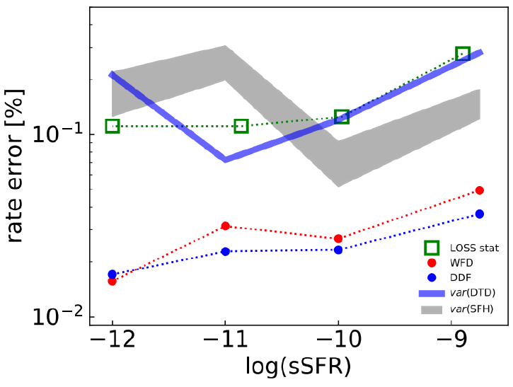
The upcoming Rubin LSST
LSST will dramatically reduce the statistical uncertainties, but other sources of error are still at play:
survey strategy;
detection efficiency;
photometric calibrations;
artifact contamination;
photometric redshifts;
host-galaxy association;
photometric classification;
etc.
Greggio & Cappellaro (2019)

Slide 7
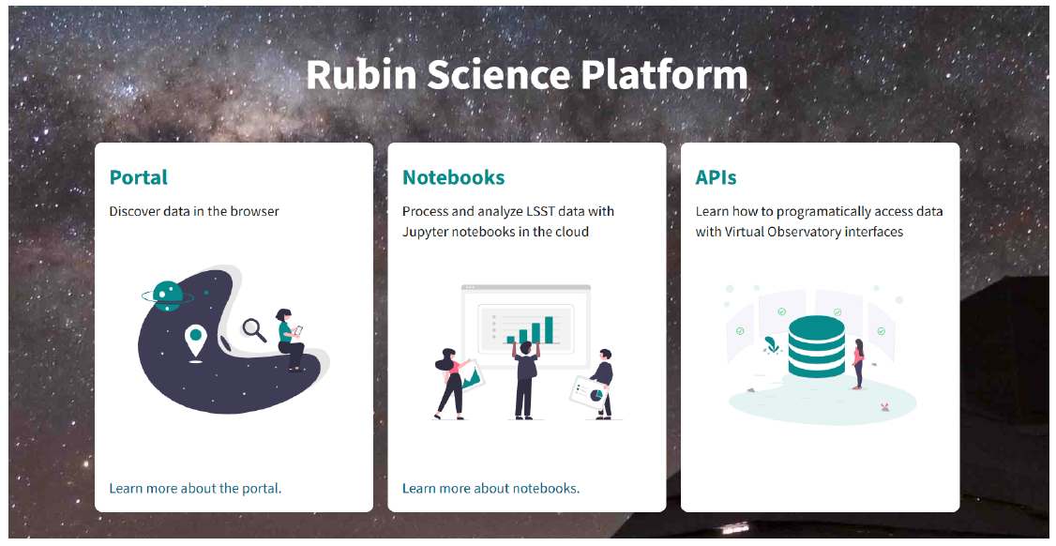
The Rubin Data Preview 0 (DP0)
SN Ia sample from Sánchez et al. (2022)
$\sim 15$ square degrees of DC2 universe (minion_1016)
Difference Image Analysis (DIA)
$5884$ simulated SN Ia with $z≤1$ (no other SN types!)
$2186$ SNe detected ($S/{N>5}$) on difference images
600 SNe observed in at least 5 distinct nights
The Dark Energy Science Collaboration (2021)

Slide 8
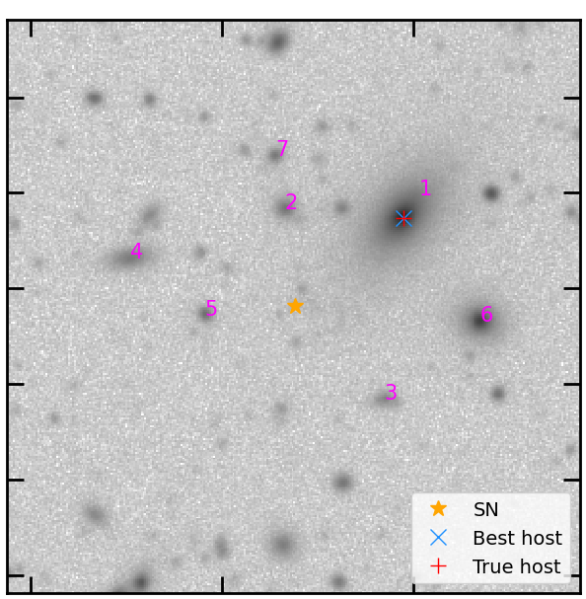
Host-galaxy association
The probability of occupation of a galaxy is proportional to its stellar mass and the SN position traces the light in the galaxy
Correlations between SN type and host galaxy properties are not included in the simulation
We used both Angular Separation and Directional Light Radius (DLR, Gupta et al. 2016) to rank host candidates in a region of ${30}^{′′}$ around the transient:
$$d_{DLR}=\frac{Angular separation}{DLR}$$
$$DLR=\frac{r_{Kron}}{\sqrt{{\left(a/b\sin{θ}\right)}^{2}+{\left(\cos{θ}\right)}^{2}}}≡\frac{r_{Kron}}{C}$$
If $d_{DLR}>4$, the SN is defined “host-less”
89% correctly associated
(vs 80% using angular separation only)
Code publicly available!
Petrecca et al. (2024)

Slide 9
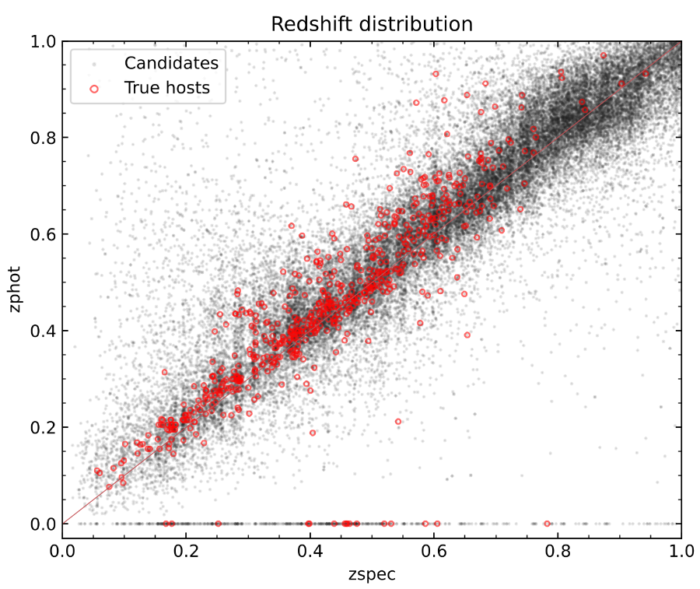
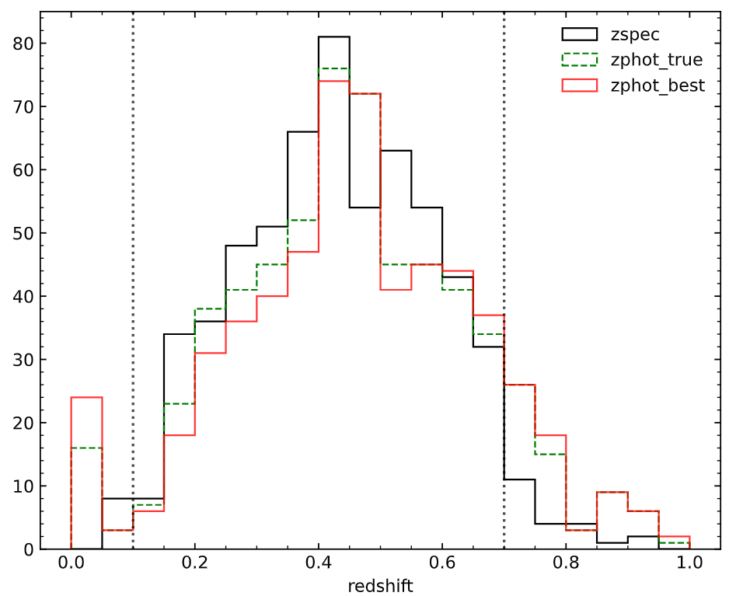
Photometric redshifts
Crossmatch of galaxies with catalogue of photometric redshifts for DC2 produced BPZPipe with training set complete up to $mag_{i}<25$
Weighted mean of posterior PDF as photo-z point estimate
Error:
Outlier fraction: $∆z>3σ_{IQR} →7\%$
$15/600$ true SNIa hosts have catastrophic outliers
$$σ_{IQR}=rms\left(∆z\right)=rms \left(\frac{z_{spec}−z_{phot}}{1+z_{phot}}\right)=0.05$$

Slide 10
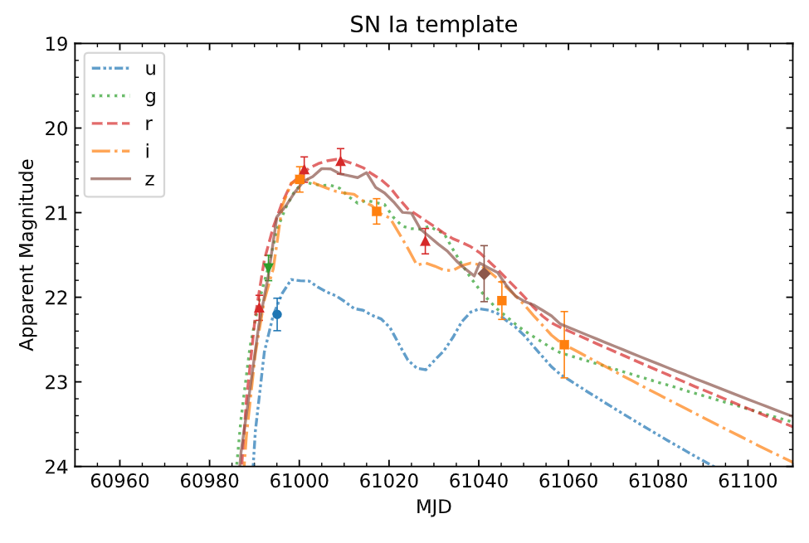
Photometric classification
Photometric SuperNova IDentification (PSNID; Sako et al. 2011)
Bayesian template fitting with:
SALT2 fitting (Guy et al. 2010):
SNANA
SuperNNova (Möller & Boissière 2020): recurrent neural network trained on ELAsTICC
* No contamination from other SN types!

Slide 11
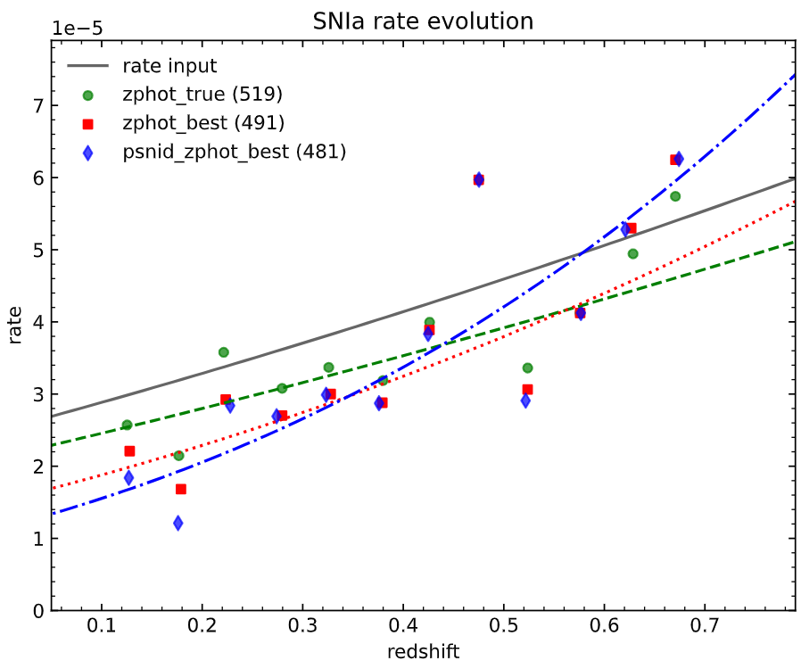
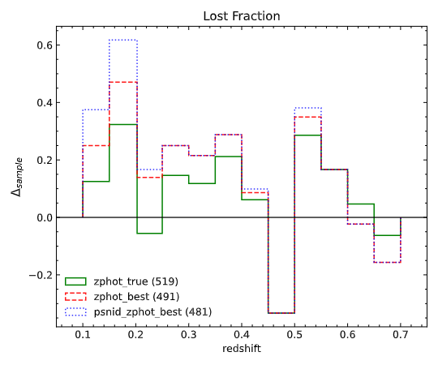
Recovered SNIa rate from Rubin DP0
SNIa rate as function of redshift for different subsets, to analyze the impact of source of uncertainty
$$r_{v,fit}(z)=α×{10}^{−5}{\left(1+z\right)}^{β} Mpc^{−3}yr^{−1}$$

Slide 12
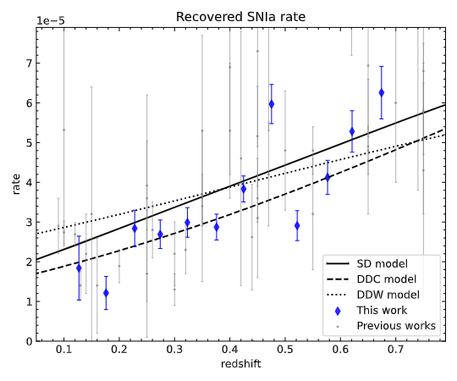
Recovered SNIa rate from Rubin DP0
SNIa rate as function of redshift for different subsets, to analyze the impact of source of uncertainty
LSST will break down statistical uncertainties, but we need to reduce the overall error (up to 17%) to constrain SN progenitors
The major impact on the SN rate is due to photometric redshift (10%). Possible improvements:
- Synergies with other facilities (e.g. NIR from Euclid)
- High-performance photo-z algorithms
- Spectroscopic information for nearby galaxies
We need further simulations to include the effect of contamination and correlations between transient type and host-galaxy properties

Slide 13
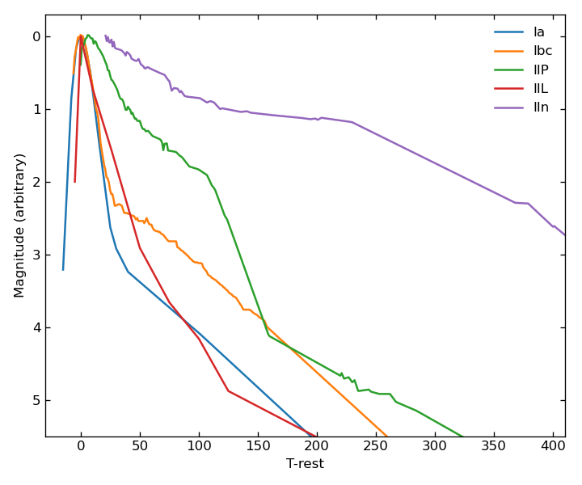
Going beyond DP0: new simulations
DTD for different SN progenitors
Galaxy sample, SFH, mass, etc.
SN templates
K-correction
Extinction
LSST filter throughputs
LSST observing strategy
Expected SNe for each galaxy and rate
Detection efficiency
Observed light curves
Observed SNe for each progenitor scenario

Slide 14
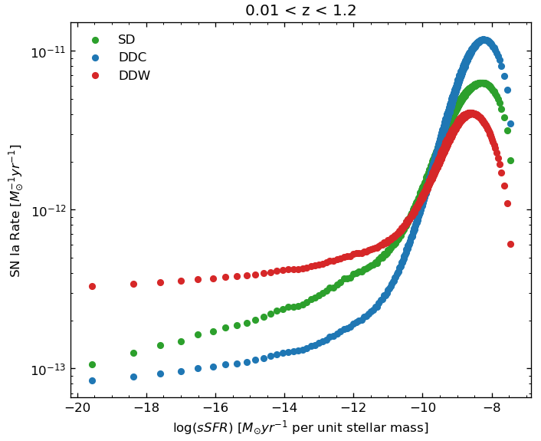
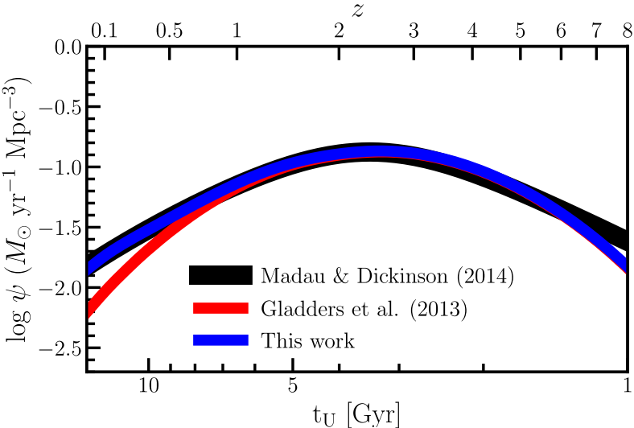
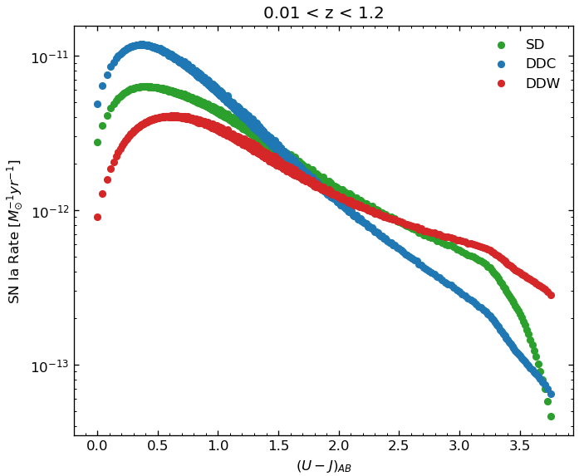
A new simulated universe
Cavallo & Greggio (2023)

Slide 15
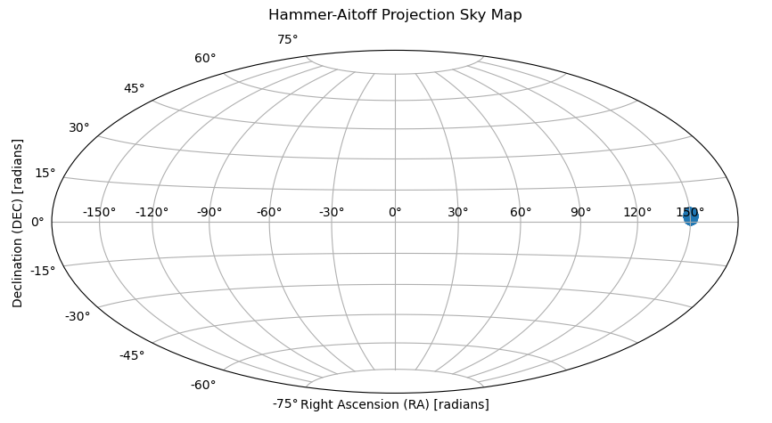
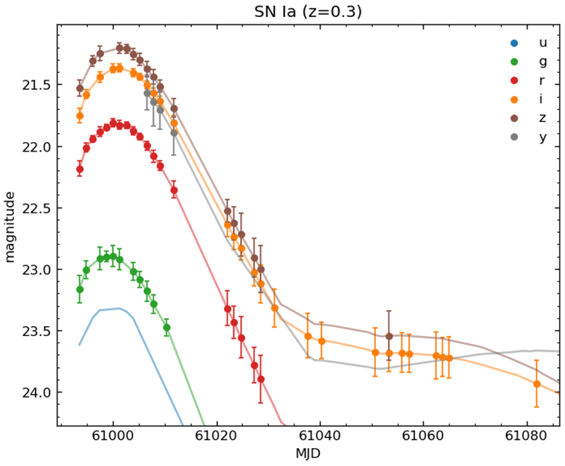
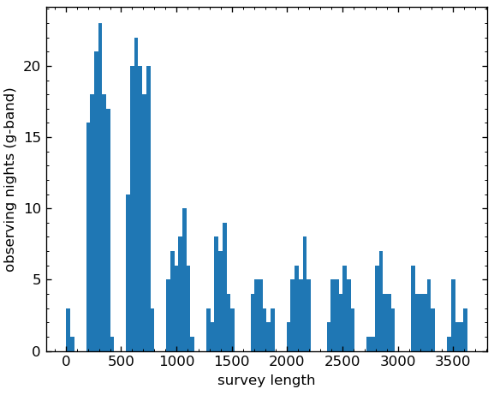
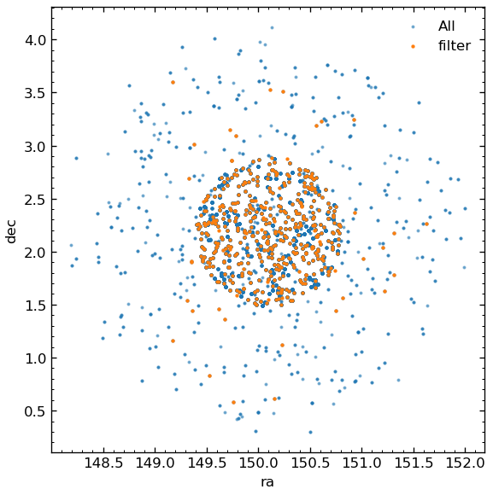
Rubin observed light curves (baseline_v3.4_10yrs)
COSMOS field (DDF)

Slide 16
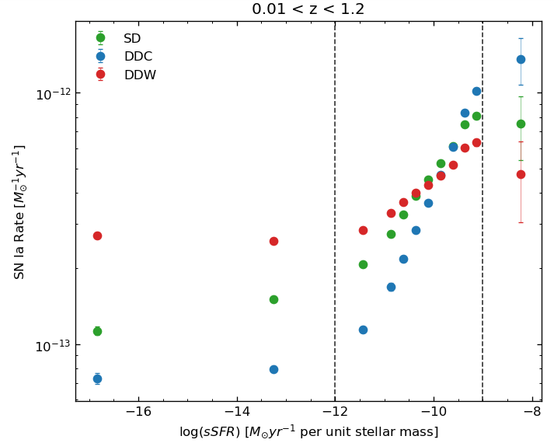
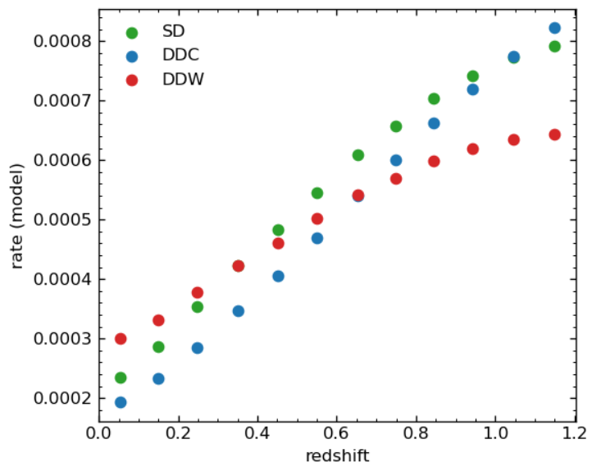
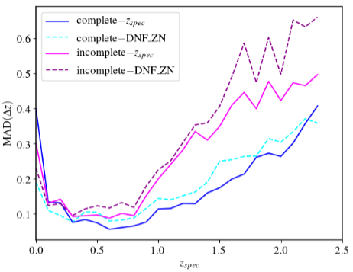
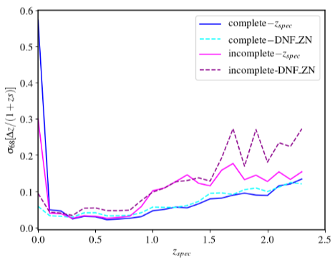
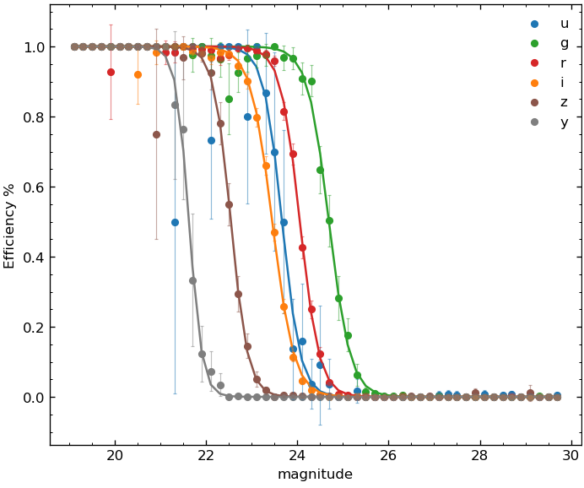
Uncertainties on the rate…
Detection efficiency and sampling effects
Host-galaxy association (up to $10\%$ from previous work)
Photometric redshift uncertainty (from DES)
Classification efficiency (from ELAsTiCC + simulations )
Toribio San Cipriano et al. (2024)

Slide 17
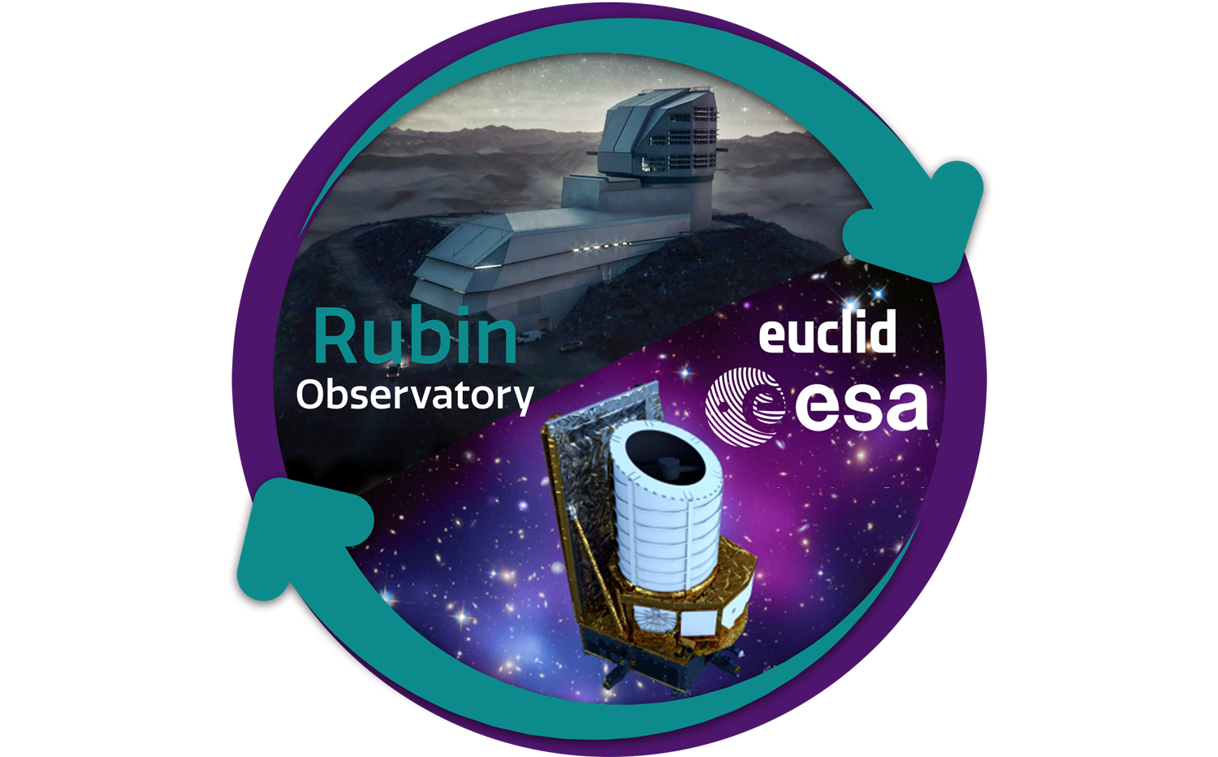
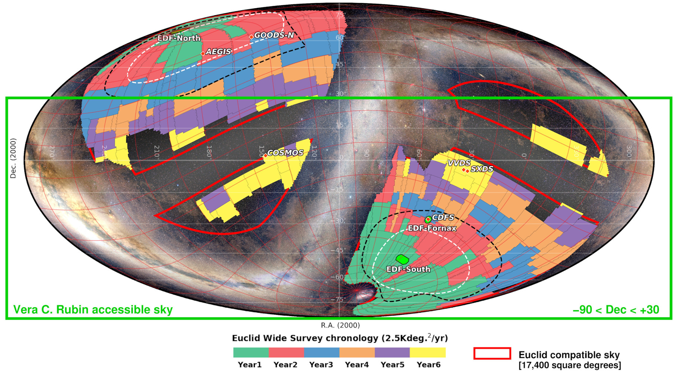
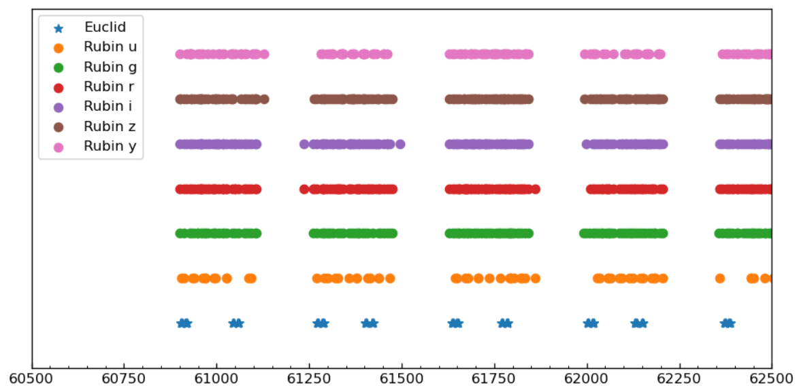
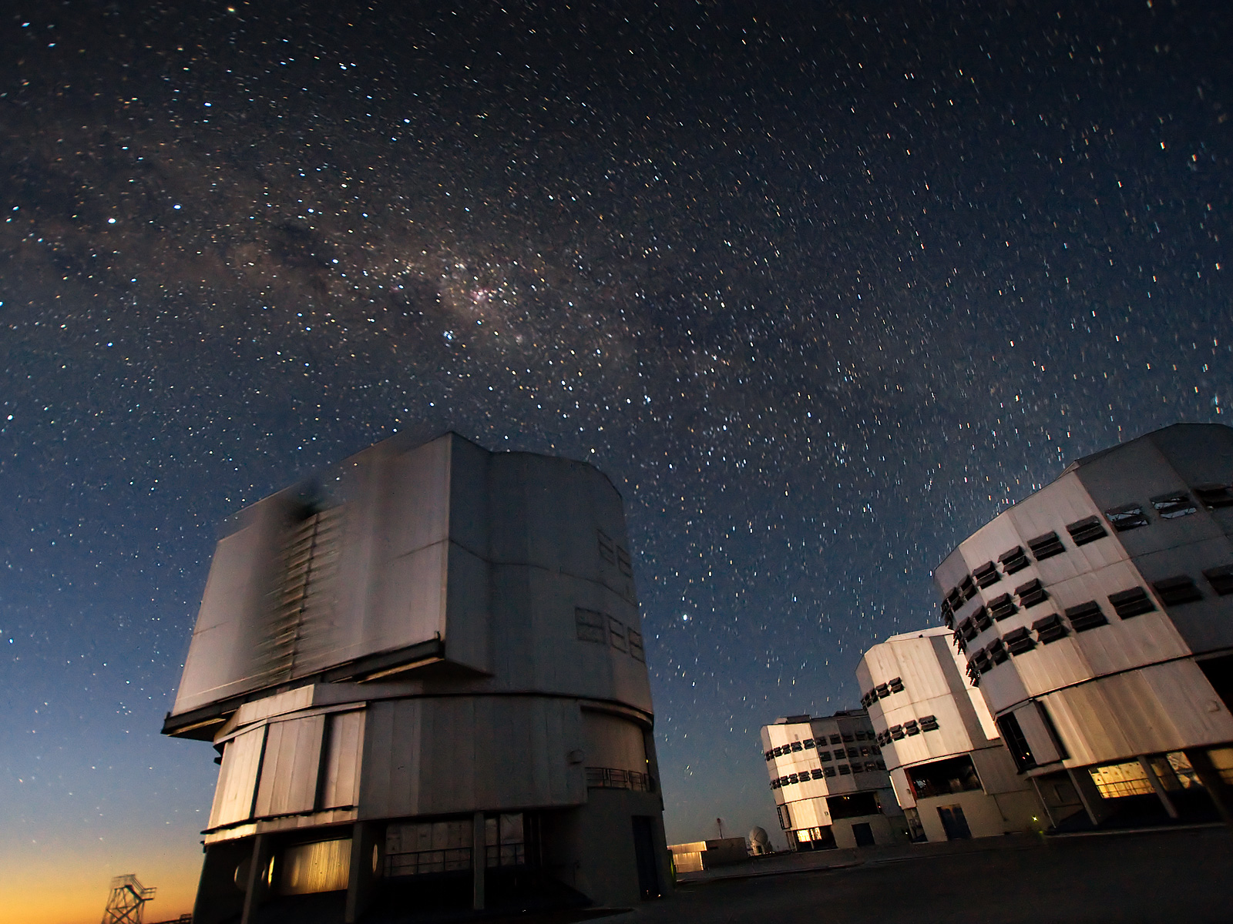
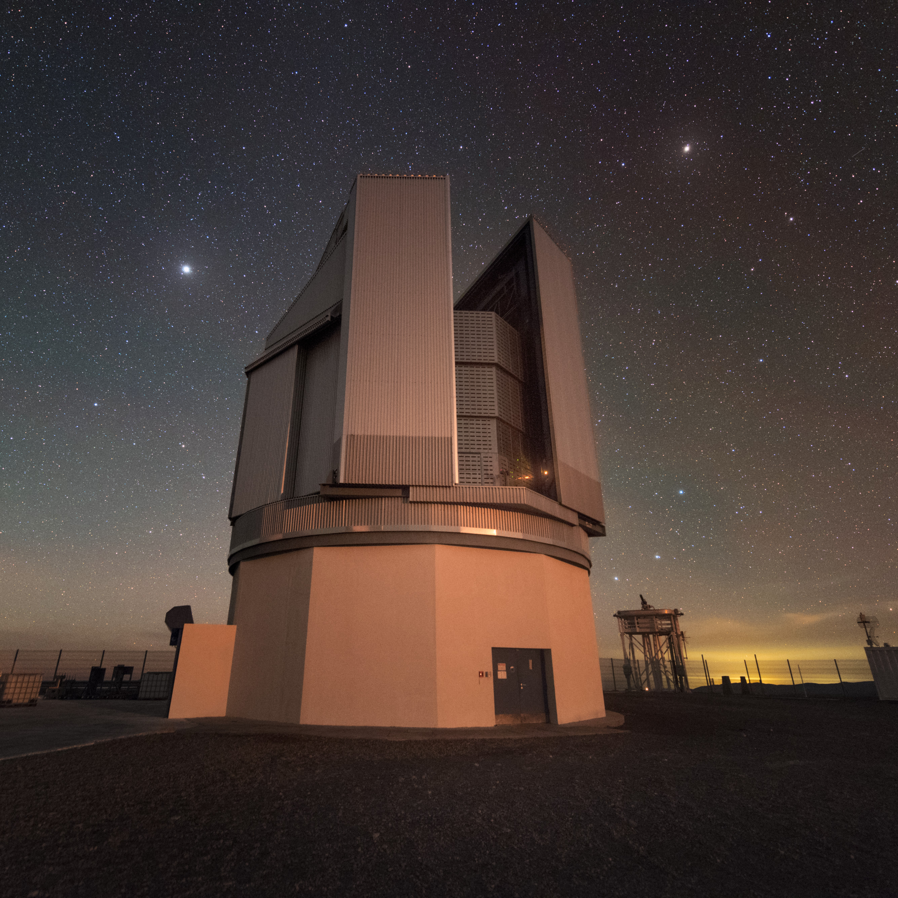
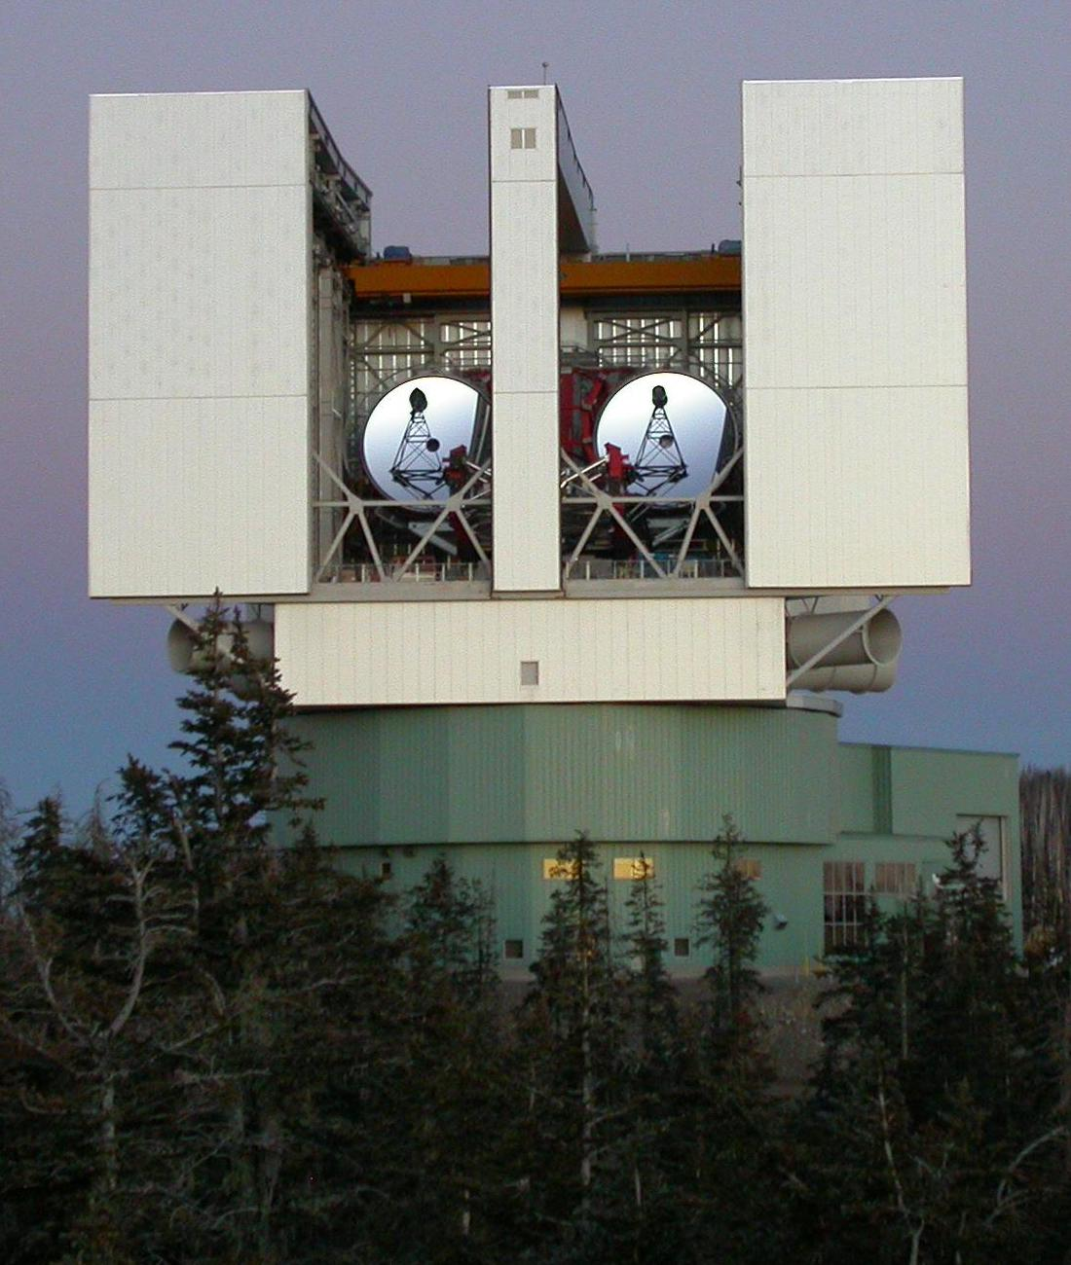
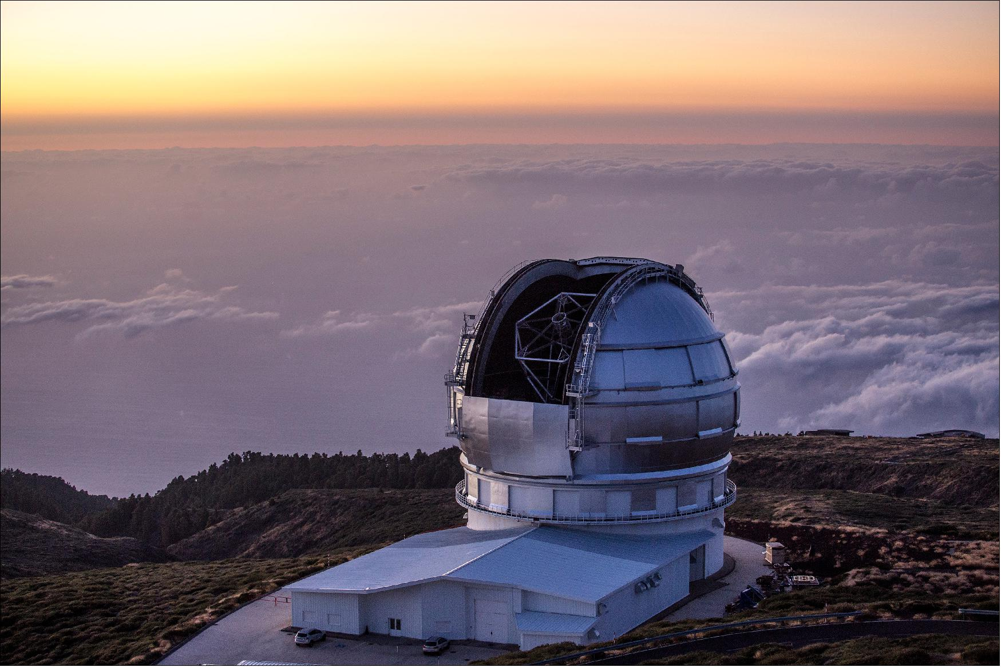
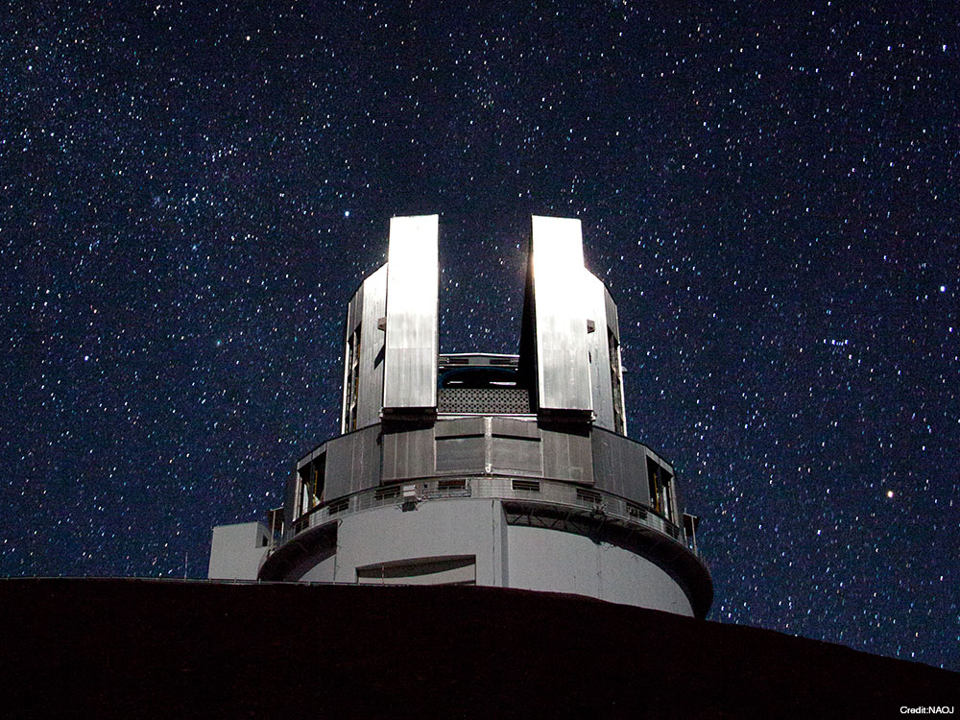
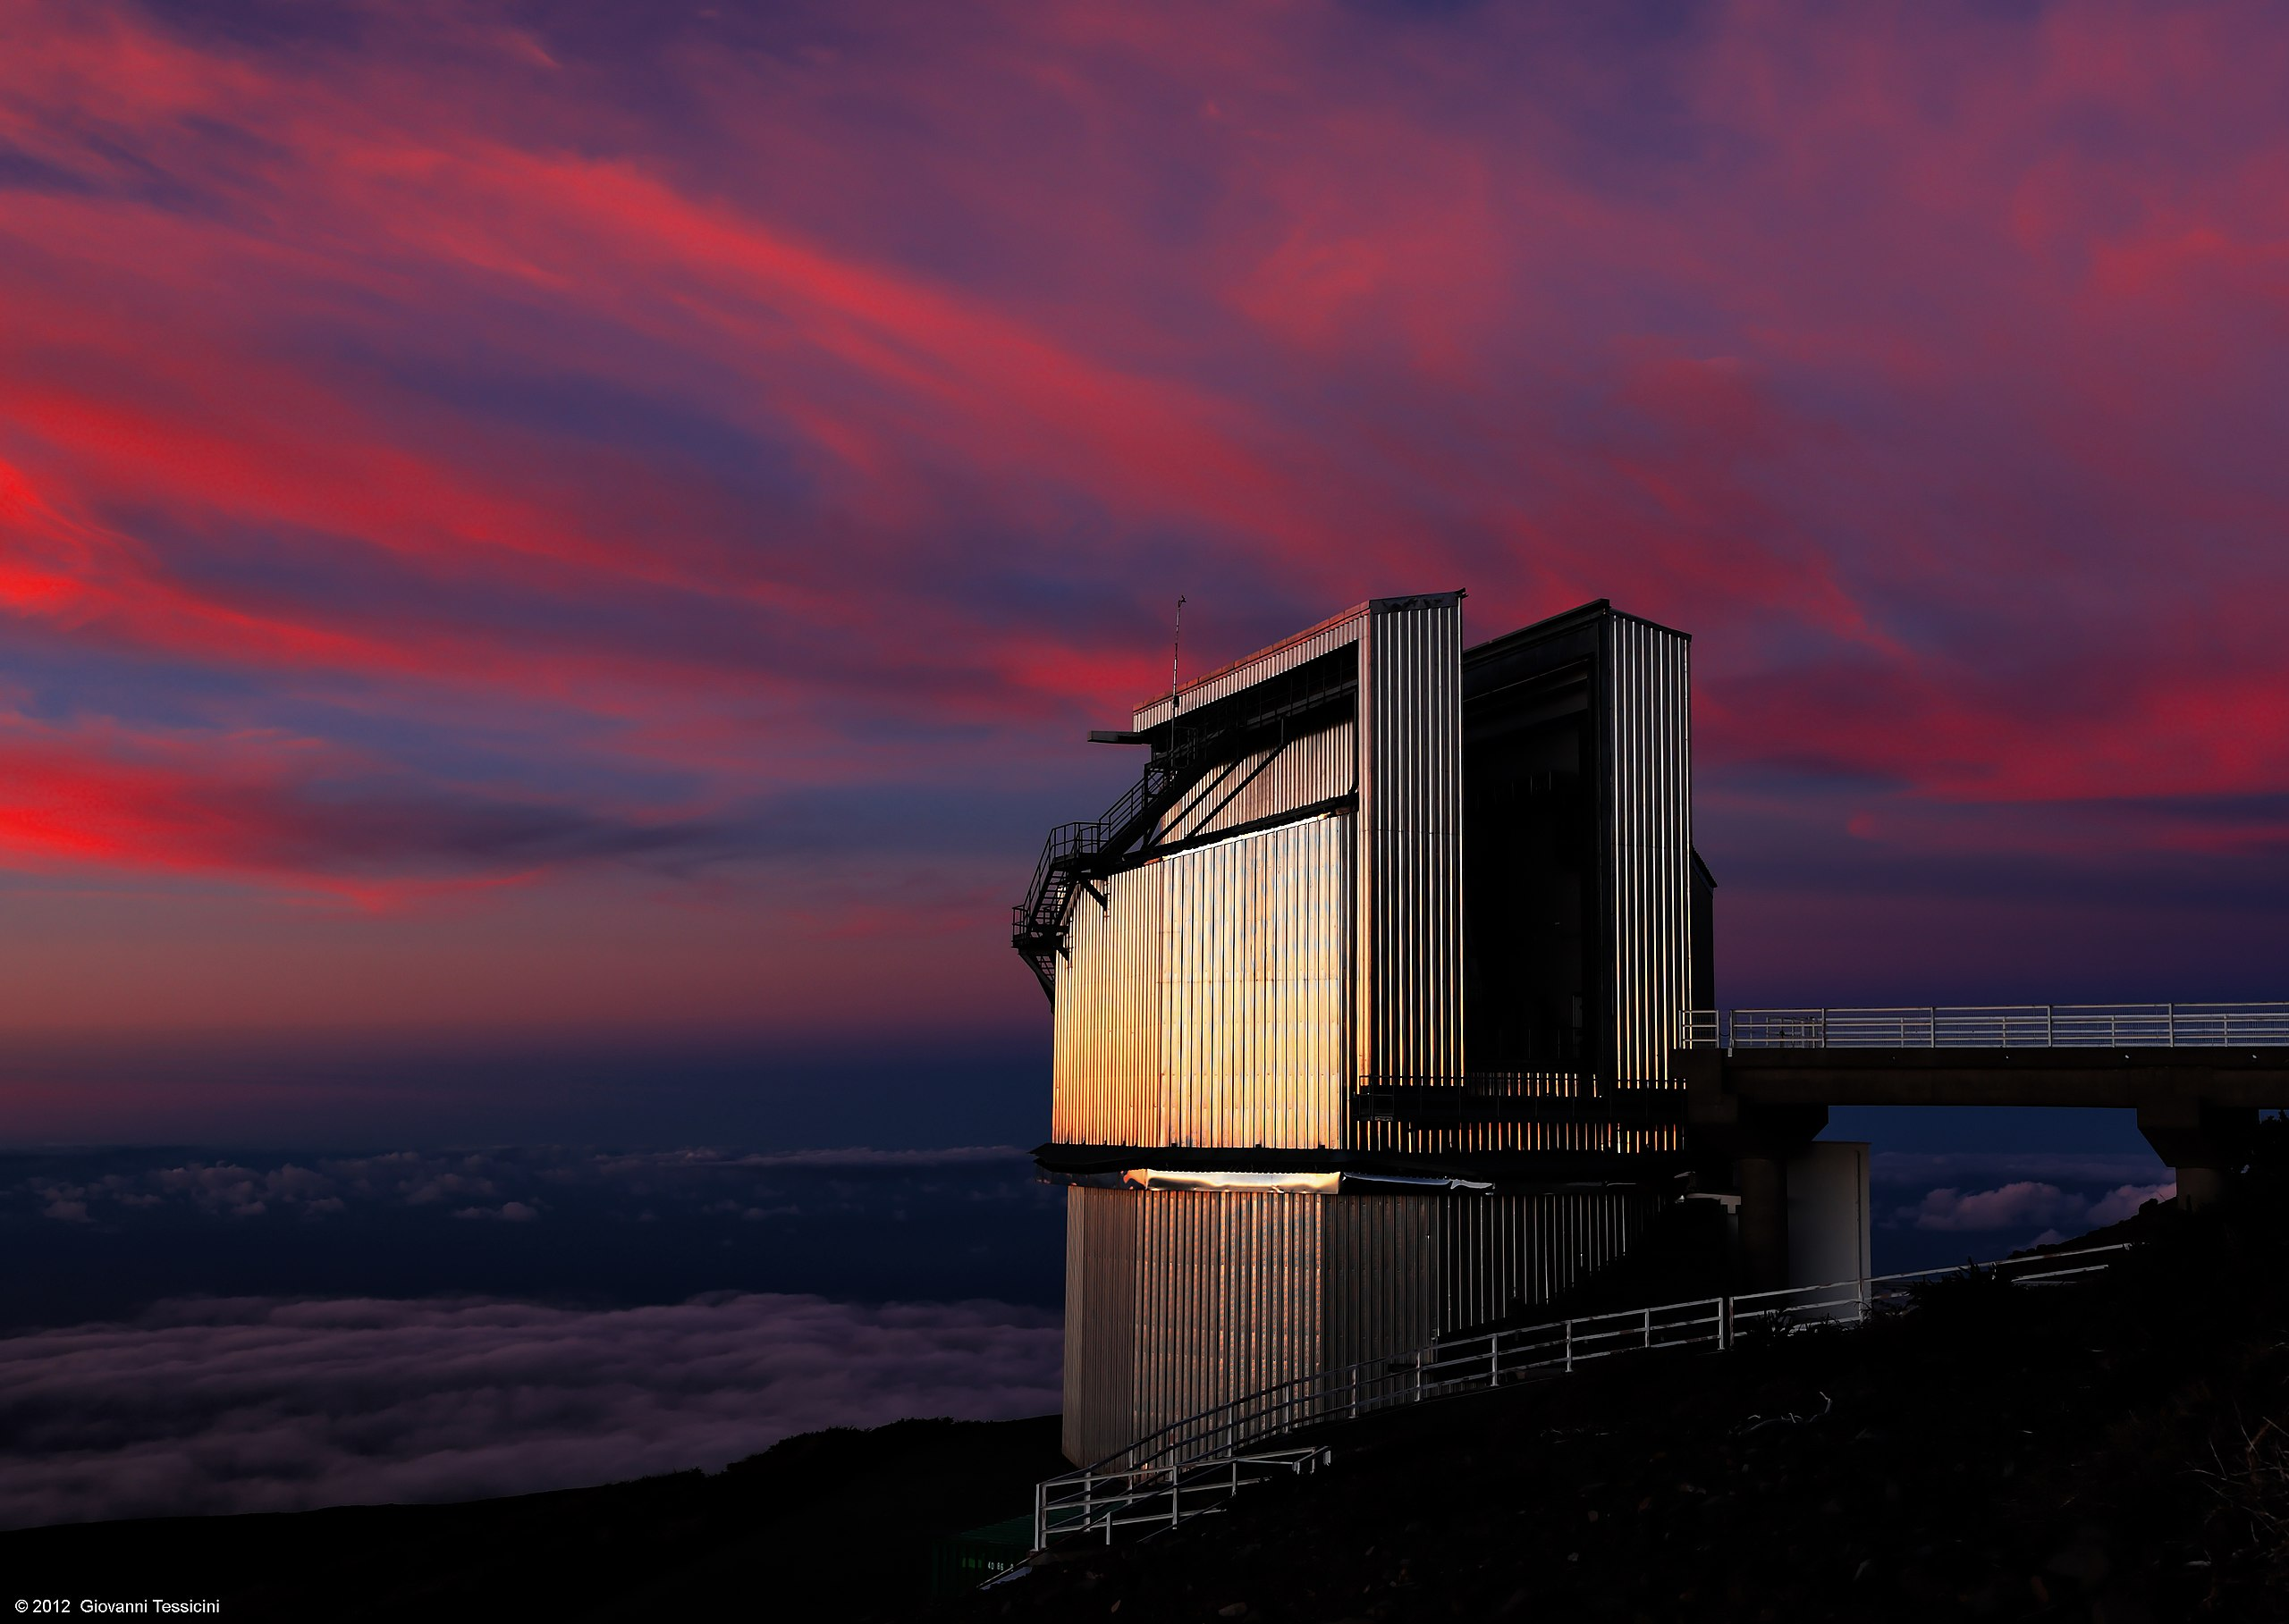
Synergies with EUCLID and other surveys
Cross-match with Rubin strategy
EDF-S
Guy et al. (2022)
LBT
GTC
TNG
VST
SUBARU
VLT

Slide 18
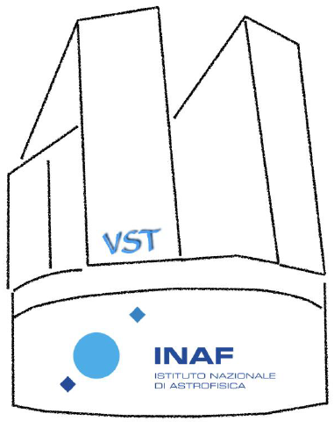
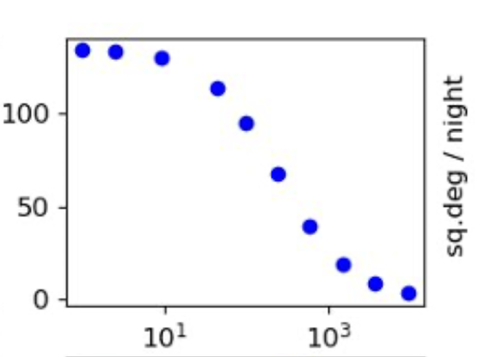
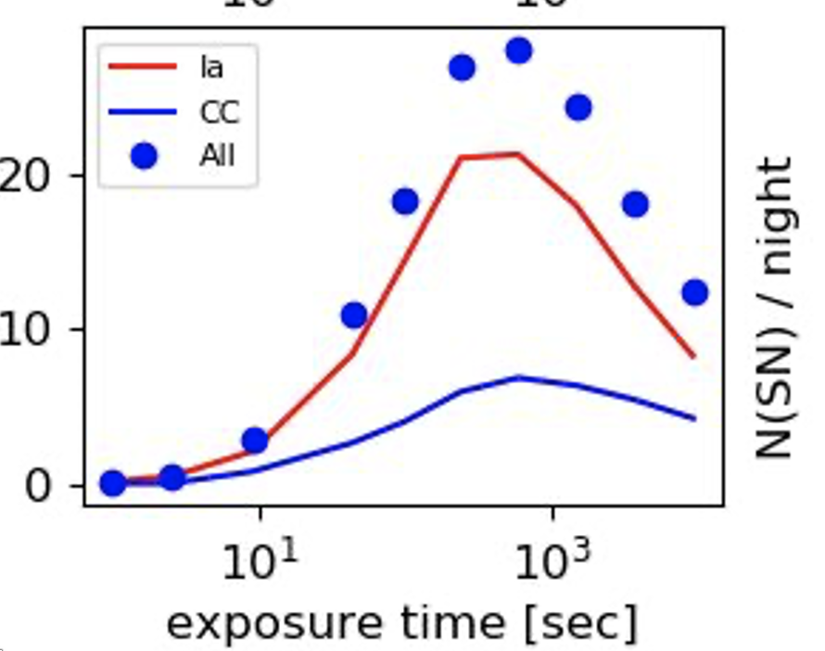
VESTA:
VST-Euclid Synergies for Time-domain Astronomy
1 year of photometric monitoring (280h) of 4 square degrees in the EDF-S
Survey start: October 2024
Cadence: weekly (couples with gr or ri bands)
VST is the ideal facility to conduct a support survey for Euclid in preparation for LSST:
Wide-field camera (1 square degree FoV)
Excellent image quality and depth
Same pixel scale of LSST (0.2 arcseconds)
Very similar photometric system of LSST
Location (Cerro Paranal) like the location of LSST (Cerro Pachón)
Great past experience with transient surveys (e.g. SUDARE)
Currently reducing and analyzing data!

Slide 19
Short take-home message:
Synergies are important!

Slide 20
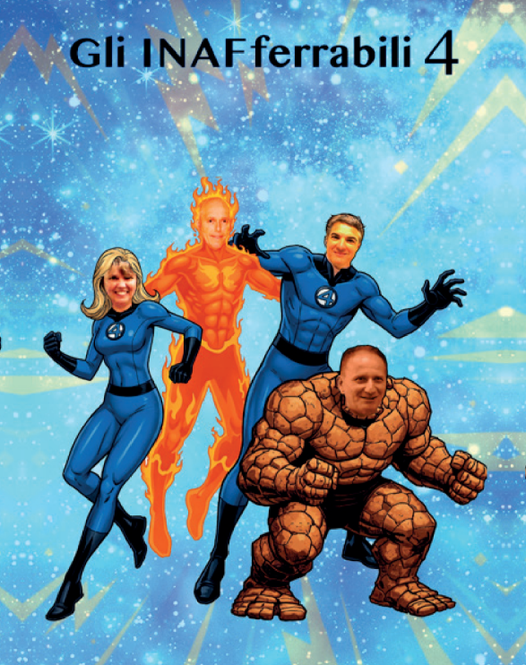
Thank you!

Slide 21
BACKUP SLIDES

Slide 22
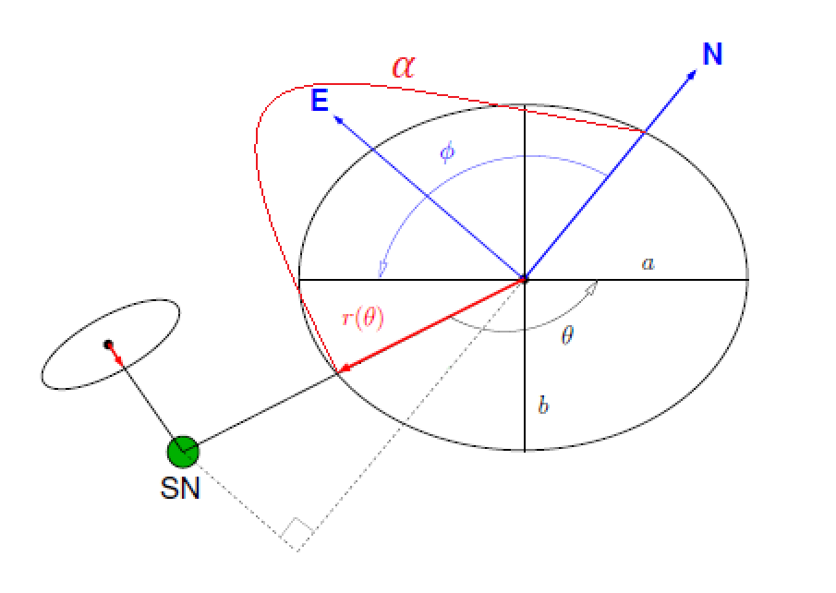
Host association details (adapted from Gupta et al. 2016)
For each SN candidate, we retrieve all the objects within 30”.
We assume the isophotes of the galaxy are self-similar ellipses and get the Stokes parameters $Q$ and $U$ from the adaptive second moments of source intensity $I_{xx},I_{yy},I_{xy}$. Then, we derive the position angle $φ$ and the axis ratio $a/b$ of the galaxy:
We measure the position angle α of the SN relative to the candidate host galaxy and get the angle θ from geometry.
The equation of an ellipse in polar coordinates with origin at the center is:
We define $r(θ)$ as the Directional Light Radius DLR and normalize the angular distances by it.

Slide 23
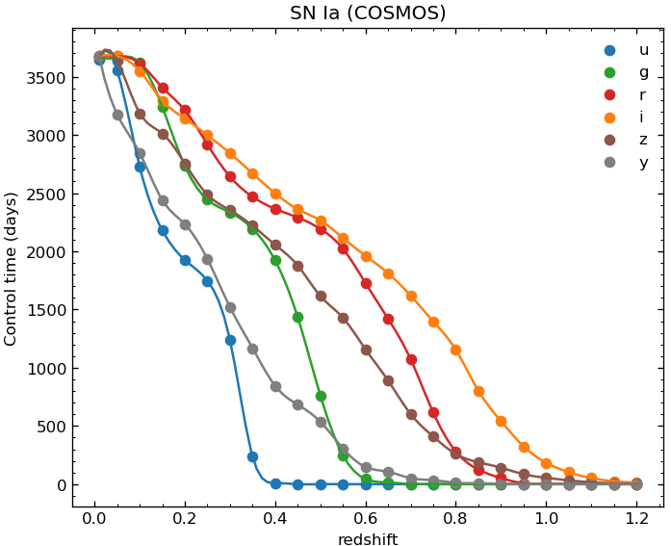
Sampling effects: Control Time
(Sánchez et al. 2022)
Defined as in Cappellaro et al. 2015:
$$CT_{SN}\left(z\right)=(t_{end}−t_{start})\frac{\sum_{j=1}^{N}{p(x_{j})}}{N}$$
Where for each event $x_{j} …$
SN Ia Control Time
$$p\left(x_{j}\right)=1−\prod_{i=1}^{K}{\left[1−ε_{i}(m_{i})\right]}$$
detection efficiency

