Slide 1
The Volumetric Rate of Type Ia Supernovae in the Dark Energy Survey
Ed Charleton Supervisors: Mark Sullivan, Chris Frohmaier
1

Slide 2
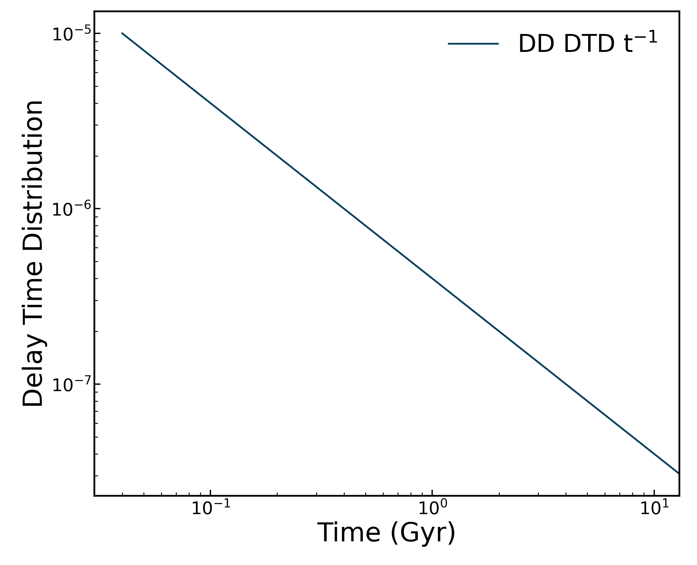
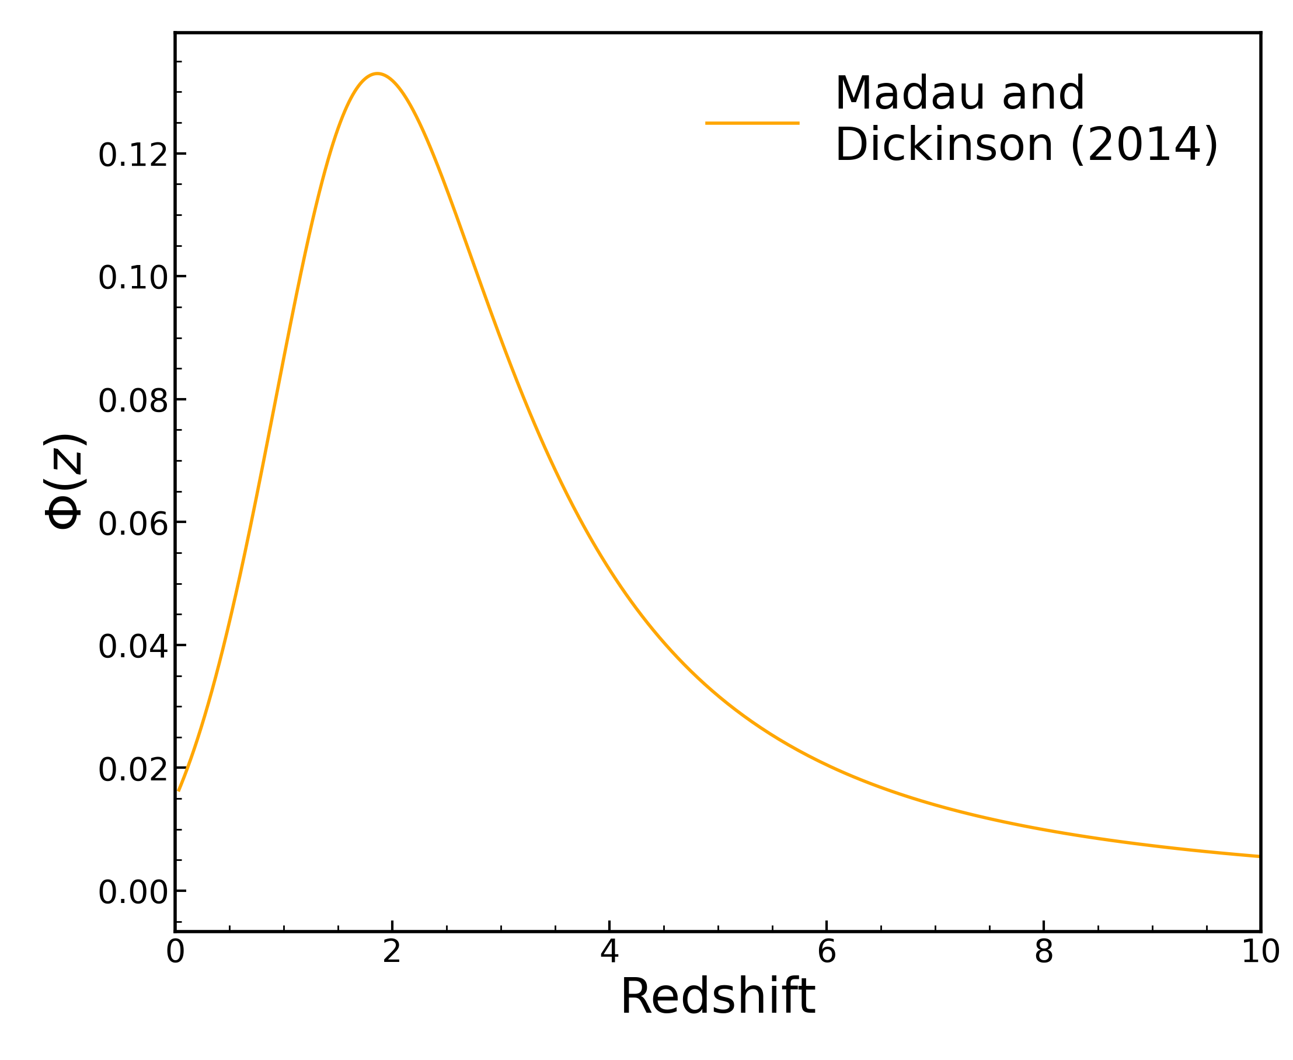
Volumetric Rates and Delay Time Distributions
$$\text{SNe} {\text{Mpc}}^{−3} {\text{yr}}^{−1}$$
$$r_{V}$$
$$DTD$$
$$SFH$$
$$DTD ∗SFH=r_{V}$$
Type Ia progenitors are hard to observe directly
Measuring the timescale from birth to supernova, we can infer the progenitor
The Volumetric Ia Rate in DES
Ed Charleton
2

Slide 3
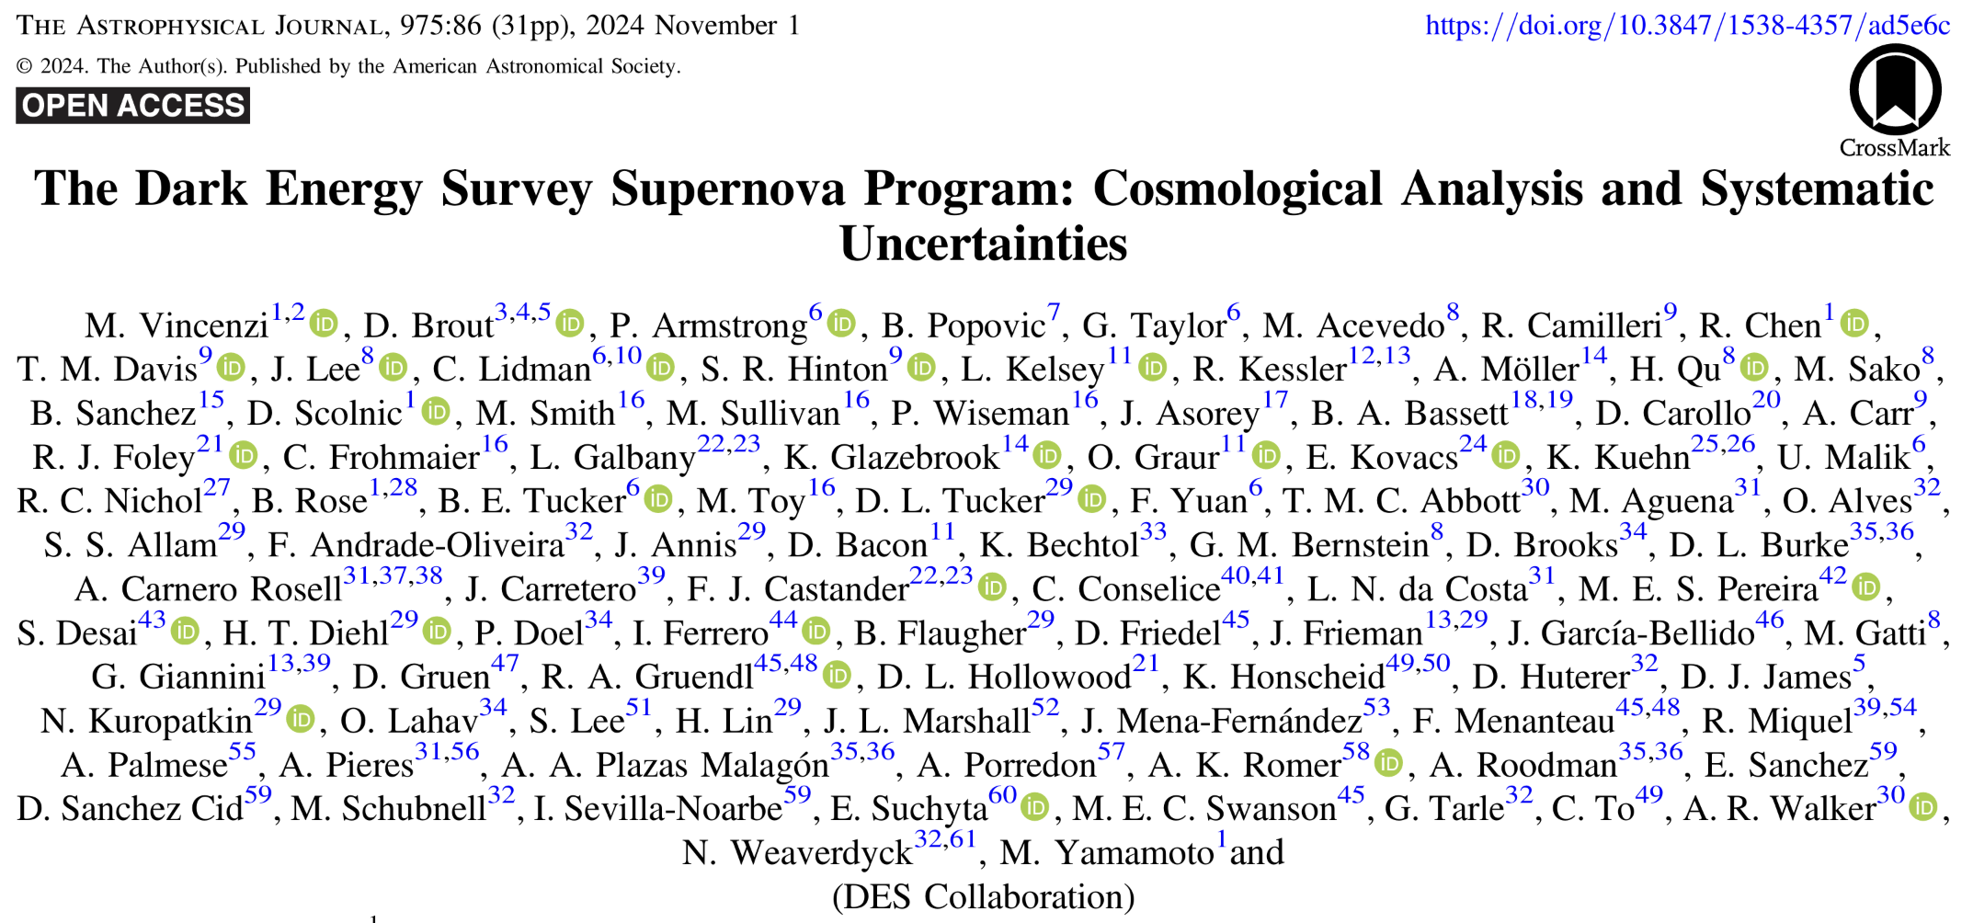
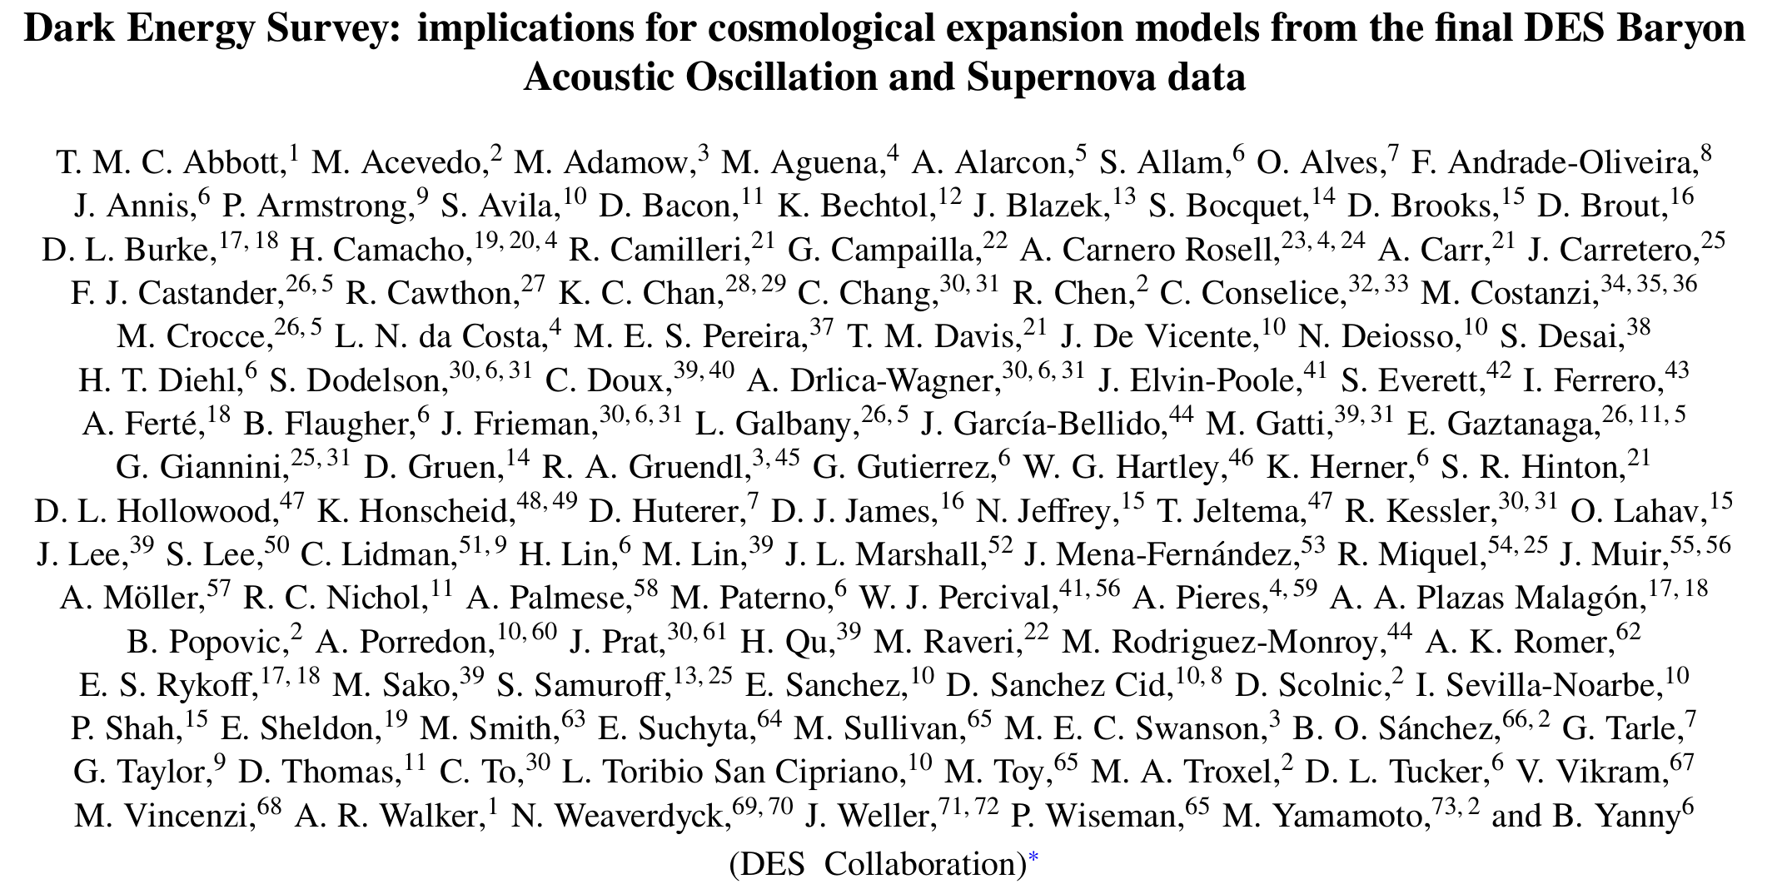
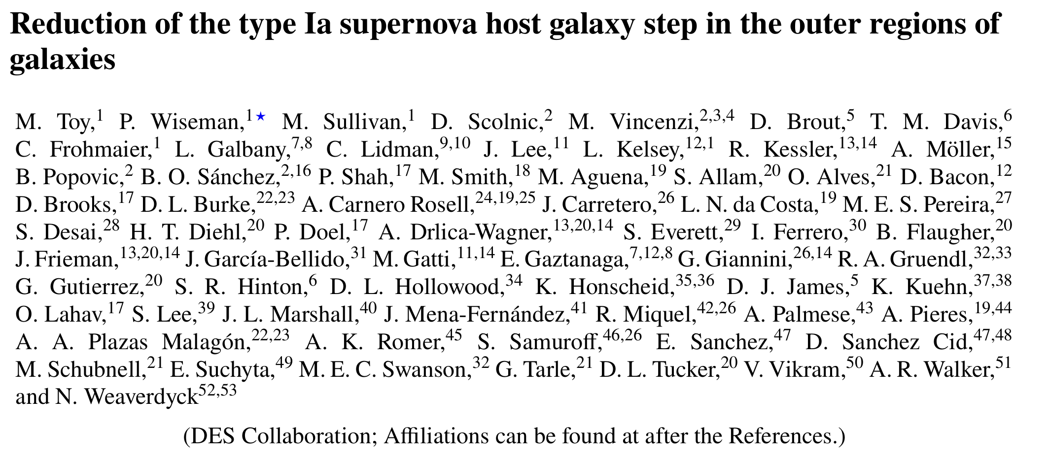
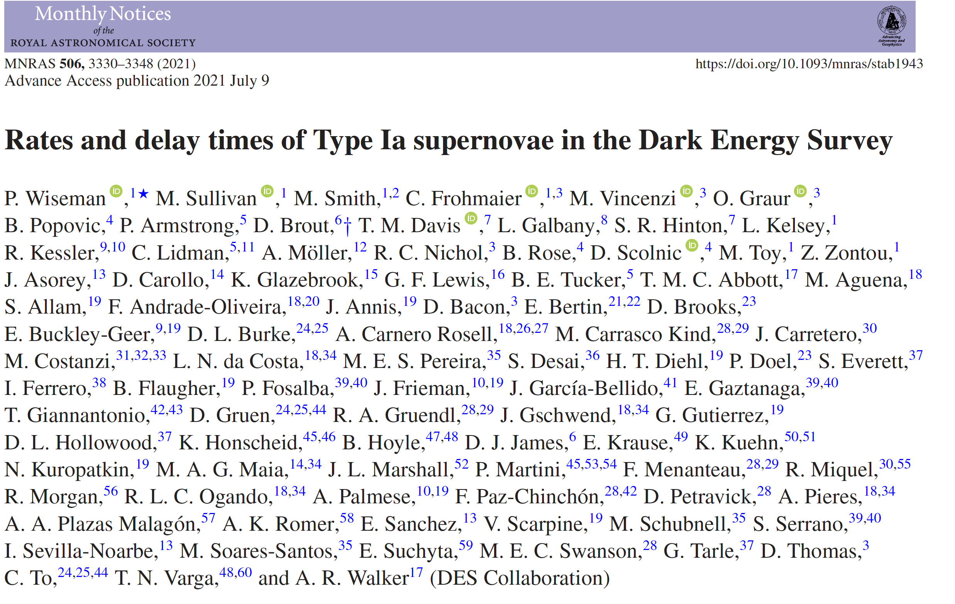
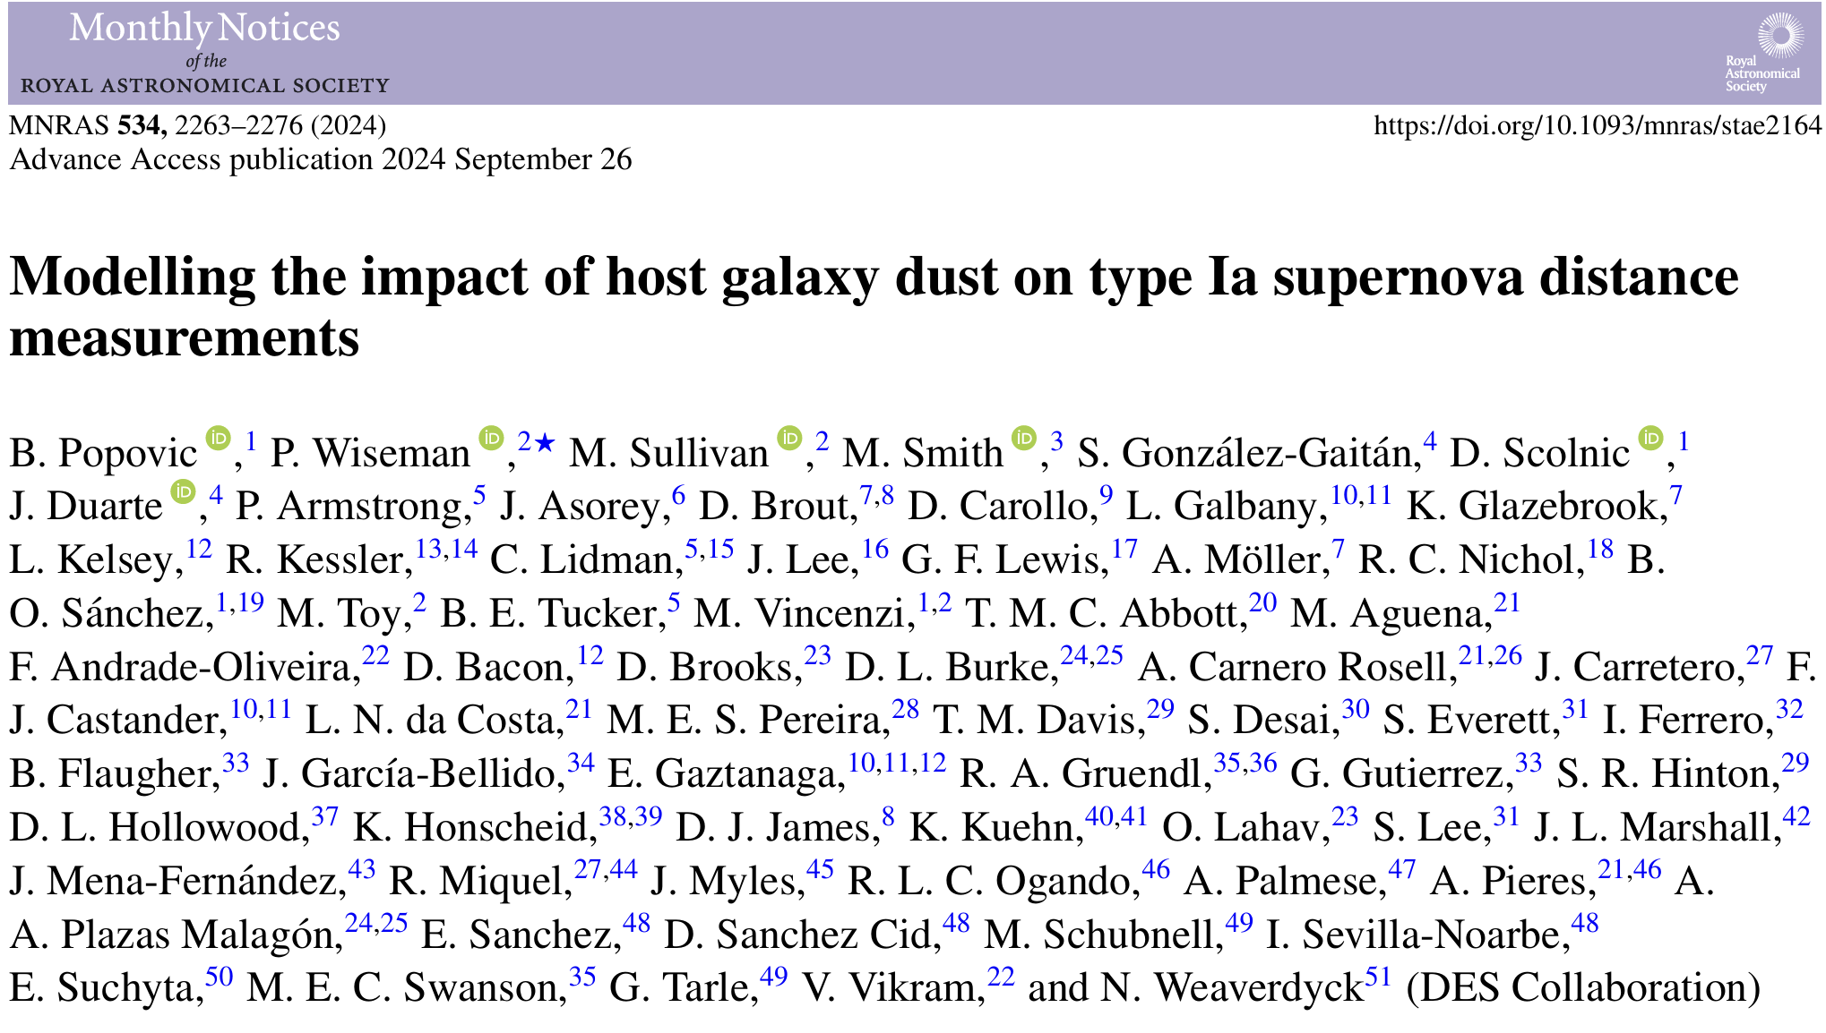
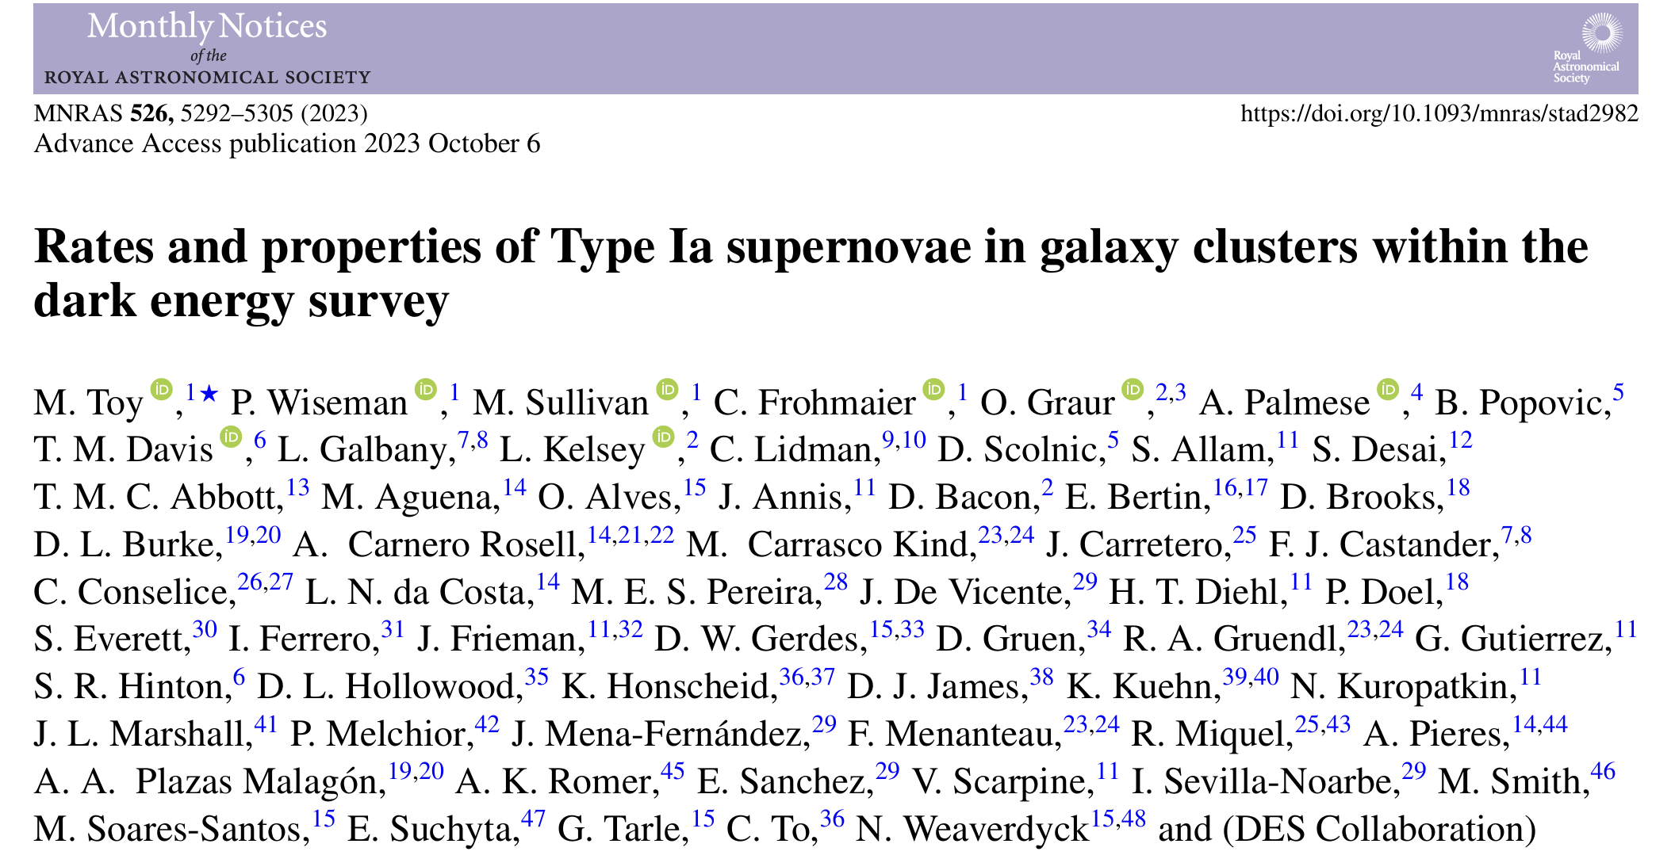
Dark Energy Survey
5 year survey, 27 deg², in griz
10, 2.7 deg² fields, 8 shallow and 2 Deep
Observed down to a depth of ~23.5/24.5th mag
The Volumetric Ia Rate in DES
Ed Charleton
3

Slide 4
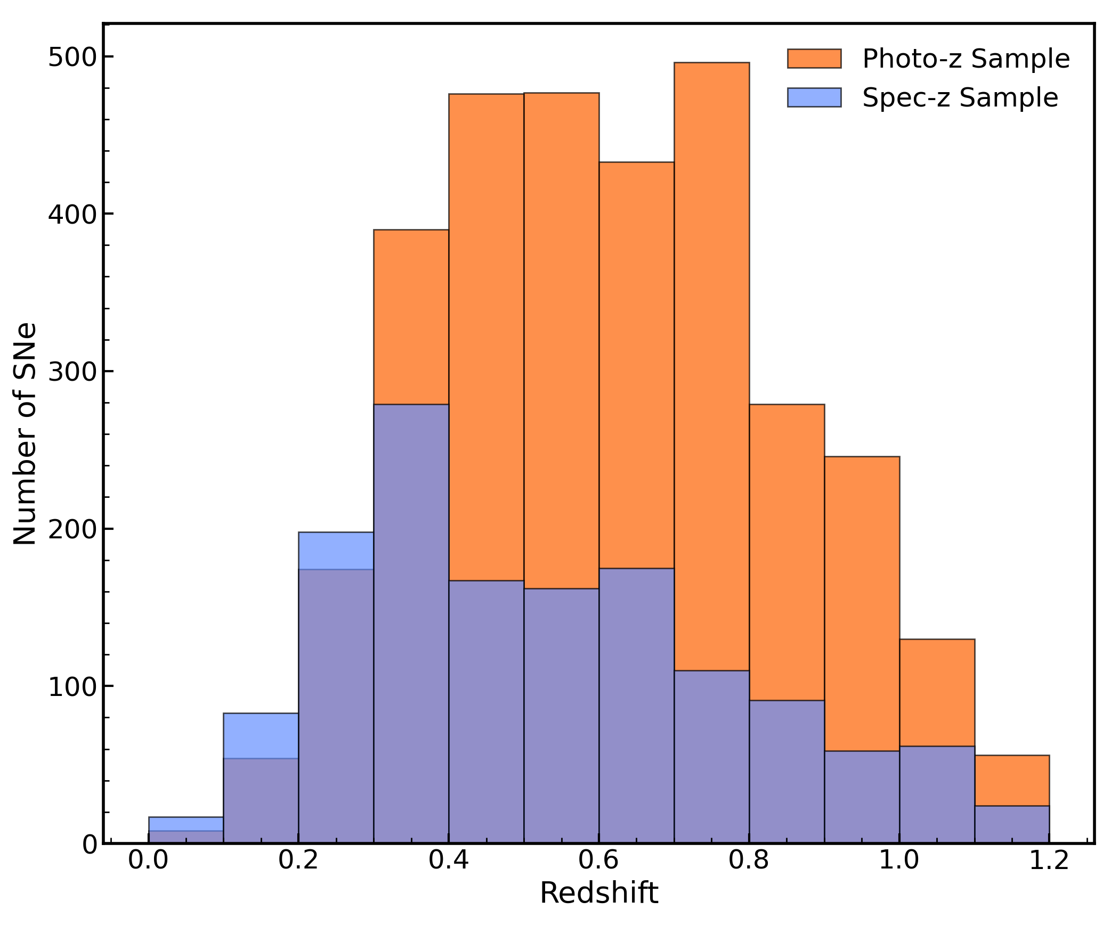
The Photo-z Sample
Total of 1427 Ias for the Spec-z sample (Vincenzi et al. 2024)
Spec-zs of host galaxies from OzDES (Lidman et al. 2020)
Sample doubles to 3219 Ias for the Photo-z sample (Möller et al. 2024)
The Volumetric Ia Rate in DES
Ed Charleton
4

Slide 5
Photometric classification and redshift
SNe classified by SuperNNova (Möller and de Boissière 2019)
Accurate and pure to ~97% without redshift when classifying Type Ia or not Type Ia (Möller et al. 2024)
Supernova Photo-zs from SALT3 fitting (Shiamtanis et al. in prep)
Figure adapted from Shiamtanis et al. (in prep)
The Volumetric Ia Rate in DES
Ed Charleton
5

Slide 6
Count all Supernovae
Volumetric Rate as a function of redshift
$$r_{V\left(z\right)}=\frac{1}{VΔT}\sum_{i=1}^{N}{\frac{1+z_{i}}{ε_{i}}}$$
Account for time dilation
$$r_{V\left(z\right)}$$
$$\sum_{i=1}^{N}{}$$
$$1+z_{i}$$
$$V$$
$$ΔT$$
$$ε_{i}$$
Comoving Volume
Detection Efficiency
Timespan of Survey
$$ε=\frac{\text{Detected} \text{SNe} }{\text{Total} \text{SNe}}$$
The Volumetric Ia Rate in DES
Ed Charleton
6

Slide 7
Detection Efficiencies
~10⁶ SNe simulated with SNANA (Kessler et al. 2009) to mimic DES
Use simulations to estimate the missed supernova of a given observed x1, c, and z
Observed distributions for x1 and c from Scolnic and Kessler (2016)
The Volumetric Ia Rate in DES
Ed Charleton
7

Slide 8
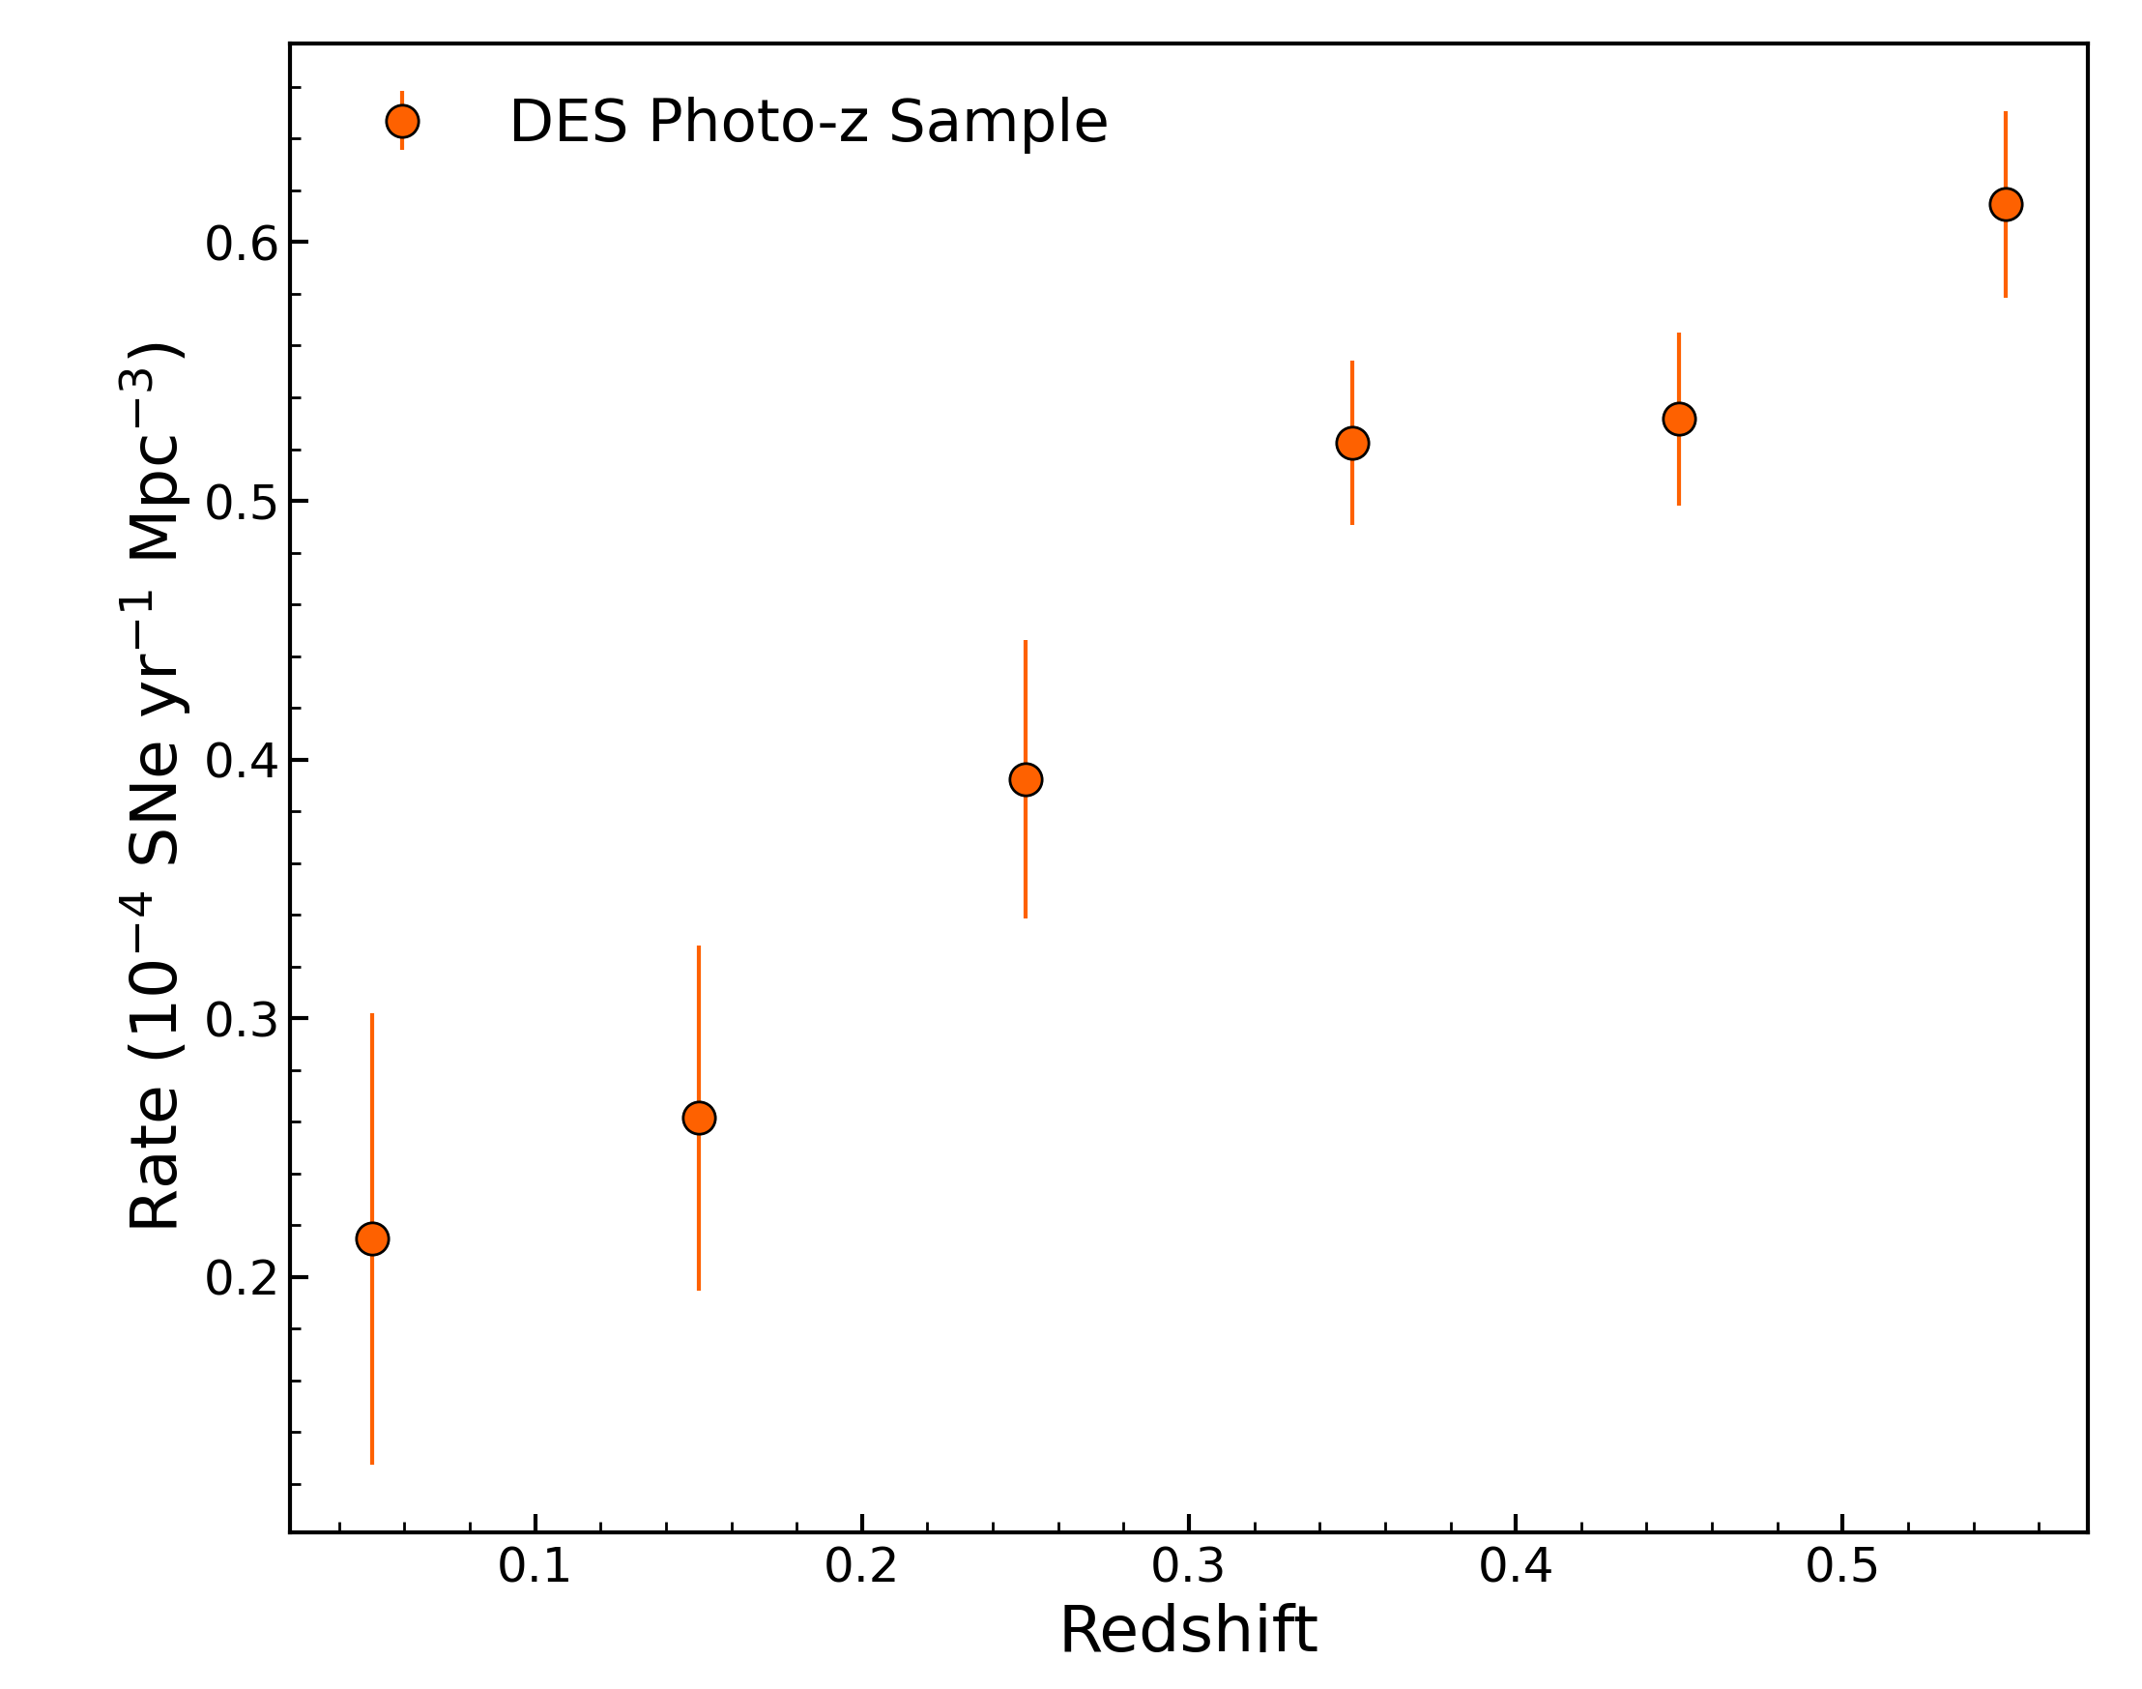
The Photometric Rate
Statistical Errors only
Rate calculated up to a redshift of 0.6 More SNANA simulations required at z > 0.6
The Volumetric Ia Rate in DES
Ed Charleton
8

Slide 9
Comparison to previous works
The Volumetric Ia Rate in DES
Ed Charleton
9

Slide 10
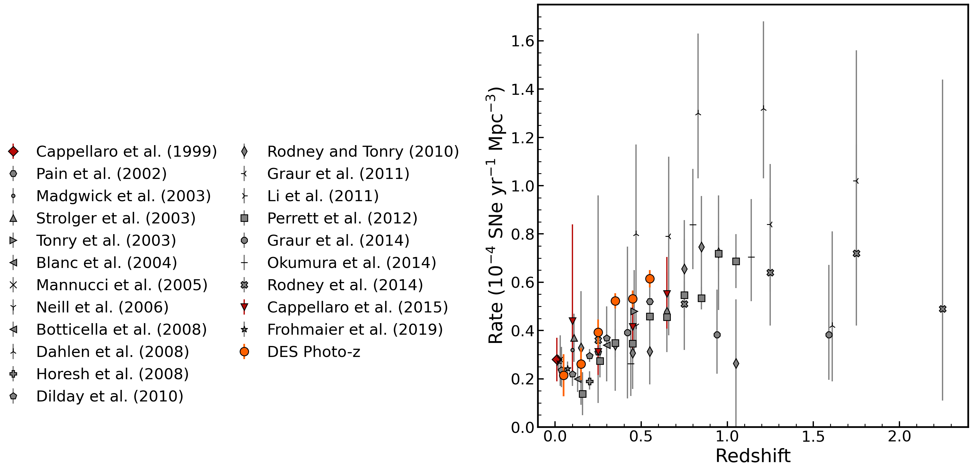
Comparison to previous works
The Volumetric Ia Rate in DES
Ed Charleton
10

Slide 11
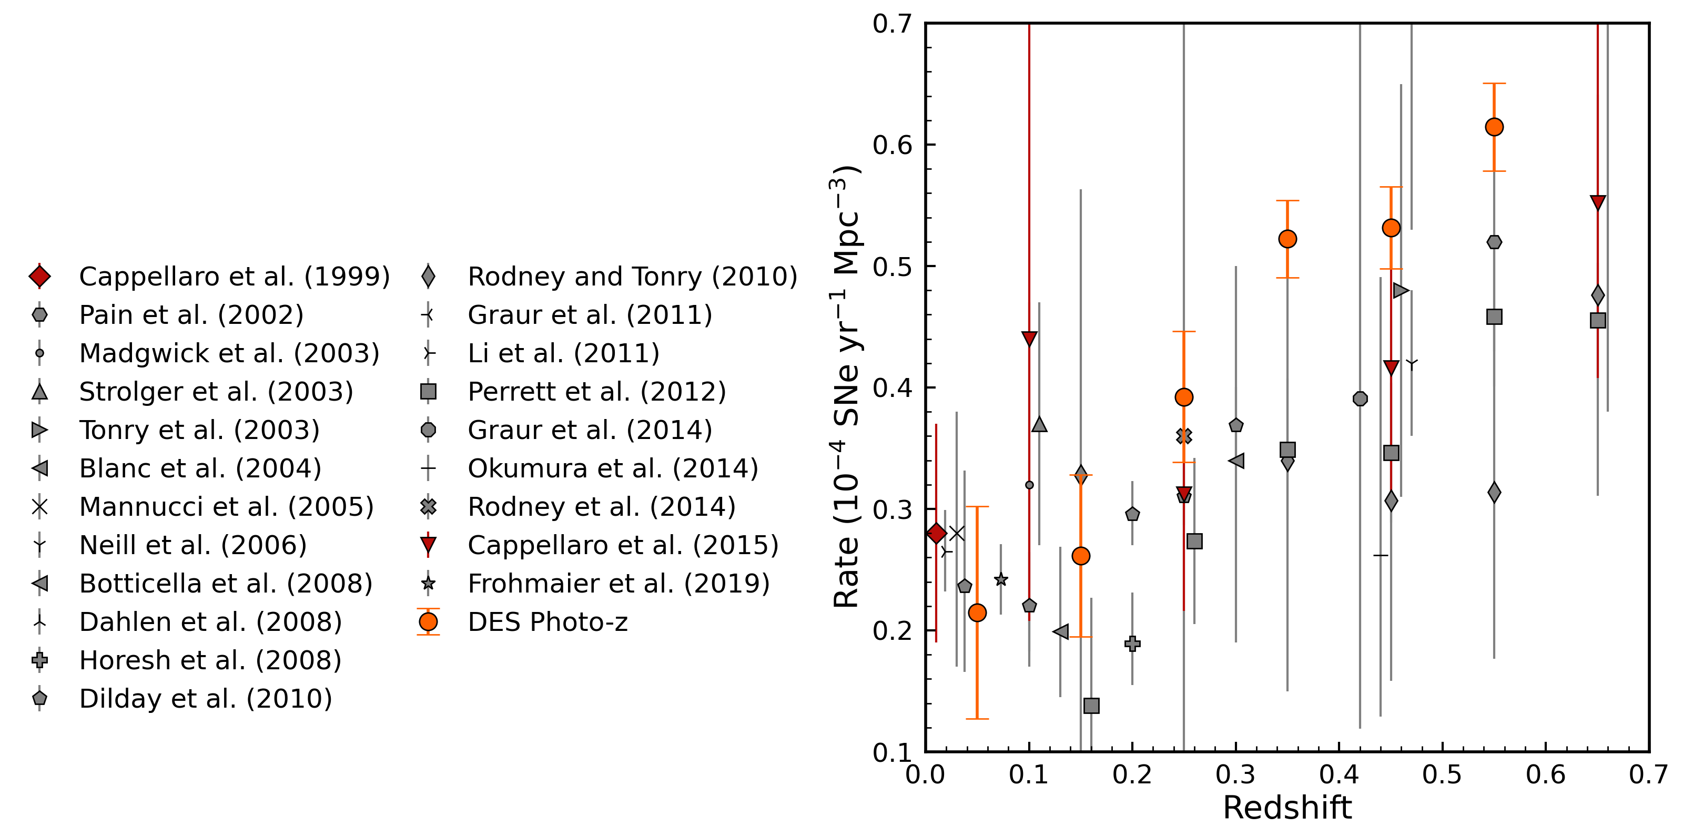
Comparison to previous works
The Volumetric Ia Rate in DES
Ed Charleton
11

Slide 12
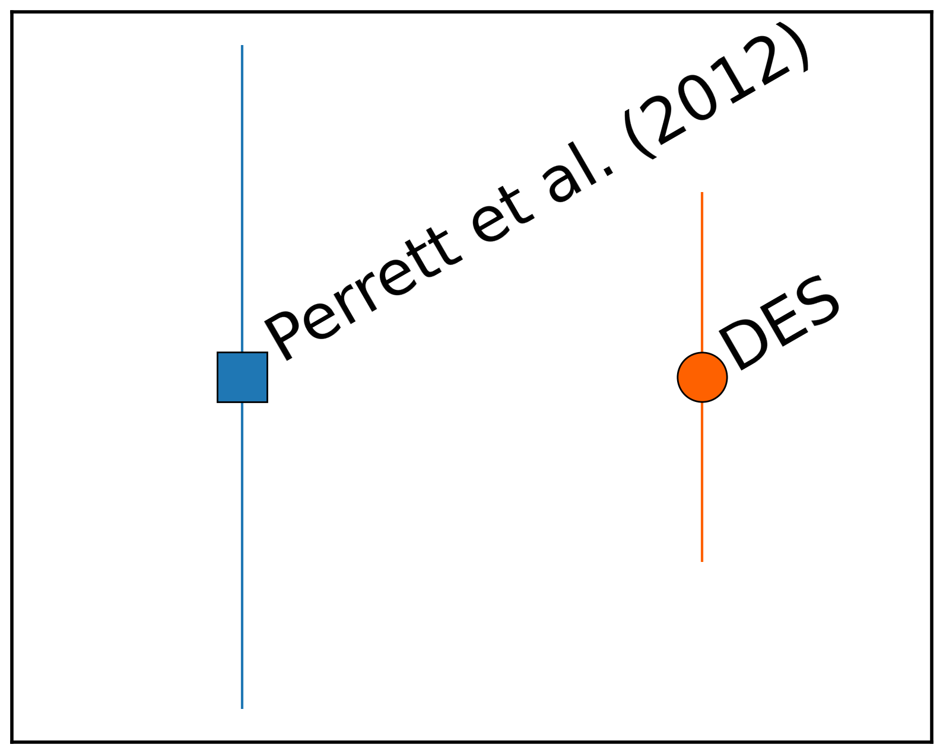
Comparison to previous works
The Volumetric Ia Rate in DES
Ed Charleton
12

Slide 13
Rate with DTD
PRELIMINARY
Preliminary fit of $t^{β}∗SFH$ SFH from (Madau & Dickinson 2014)
DTD from literature + DES Photo-z: $$β\text{ = −1.}\text{05}\text{±}\text{0.06}$$
DTD from DES Photo-z sample:
$$β\text{ = −1.}\text{27}\text{±}\text{0.30}$$
The Volumetric Ia Rate in DES
Ed Charleton
13

Slide 14
Summary and Future Work
A volumetric rate has been calculated using the DES photo-z sample of ~1600 Type Ia SNe up to z = 0.6, with plans to probe the ~1600 supernova at higher z > 0.6
Literature consistent with the DES Photo-z Rate at z < 0.6
Future work will focus on:
Improve simulations to constrain efficiencies at high z
Calculate systematic uncertainty for the entire sample
Find Iron yield from Ias
Test other forms of the DTD
The Volumetric Ia Rate in DES
Ed Charleton
14

