Slide 1
H₀ Tension: transient vs static perspectives The TRGB-SBF project with the JWST
Michele Cantiello
With: D. Anand, J. Blakeslee, E. Brocato, J. Jensen, G. Raimondo and B. Tully

Slide 2
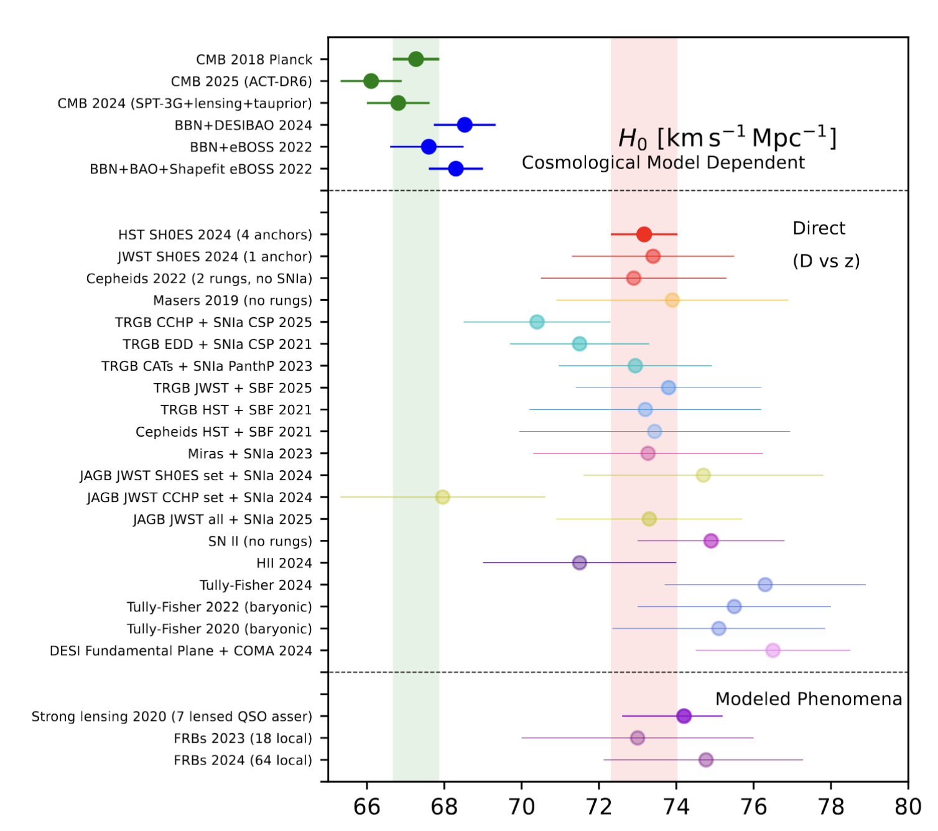
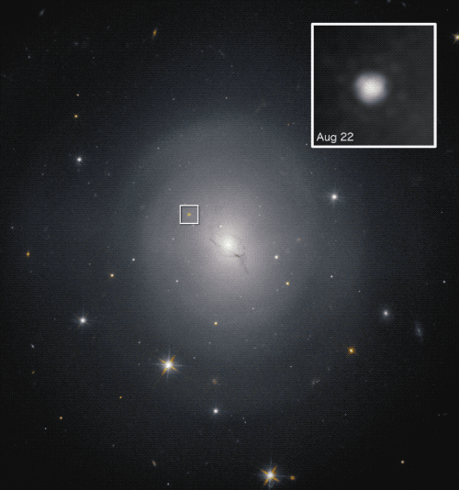
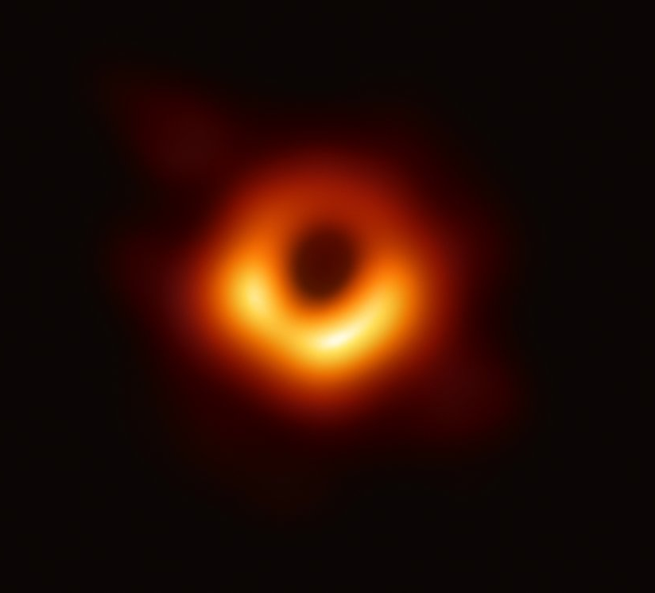
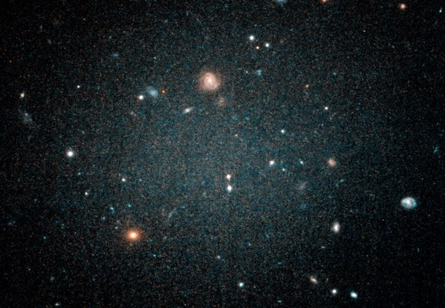
[Extra-Galactic] Distances
Reliable distances are required to understand most observed objects & phenomena
Errors in distances imply significant fractional uncertainties in derived quantities
Masses (e.g., central black holes, dark matter halos); Physical sizes;
Dynamical time scales; Star Formation Rates; Ages…
Precise extragalactic distances play a key role in the H₀ controversy, a major issue in modern cosmology
NGC1052-DF2 DM-less
NGC4993 GW/EM
M87 EHT/SMBH
Notes:
- An independent distance for NGC4993 brakes the inclination/distance degeneracy useful, e.g., for independent H0 measure [see below #1]
- For M87 the distance has an impact on the estimate of the BH mass: “For an assumed distance of 16.8 Mpc, the ring diameter is consistent with the expected “shadow” of a ∼6.5×10^9 Mo black hole.”
[1] “Only SNe Ia can provide competitive distance
measurements at these distances, but the chances of observing a
supernova in the same galaxy as a BNS merger are unlikely. In
this paper we have demonstrated that SBF distance measure-
ments are a particularly compelling approach to breaking the
distance-inclination degeneracy of the GW data.

Slide 3
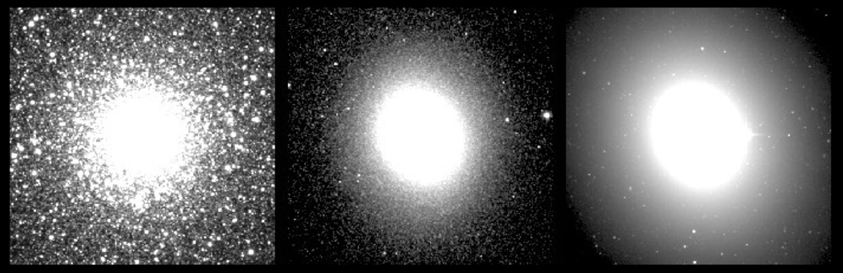
[SBF] Surface Brightness Fluctuations
Slide Basics: R. Kudritzki/M.Cantiello
Images: J. Blakeslee
MW Globular Cluster
~10 kpc
Messier 32
~770 kpc
Messier 49
~16500 Mpc
SBF def.: Ratio 2nd to 1st moments of stellar luminosity function
$$f_{SBF}≡\overline{f}≡\sum_{i}{n_{i}}f_{i}^{2}/\sum_{i}{n_{i}f_{i}}$$
$f^{2}$ ➔ bright stars weight more
Tonry & Schenider 1988
Tonry, Ajhar & Luppino 1990
Blakeslee, Ajhar & Tonry 1999…
Preferred targets: Elliptical galaxies with smooth surface brightness profiles.
Number of stars/pixel has Poisson fluctuations, more distant galaxies appear smoother.
Observed “mottling” is directly related to the target distance. Measurement error on this mottling $\sim$0.05 mag or less
Observed “mottling” is directly related to the target distance. Measurement error on this mottling ~0.05 mag or less
No dust or non-stellar-count fluctuations!
$$\overline{m}\sim \left\langle m_{RGB}\right\rangle$$
Notes:
No shortage of targets; no need for long observing campaigns; not a serendipitous event!
~5% uncertainties (more than competitive with Type Ia supernovae)

Slide 4
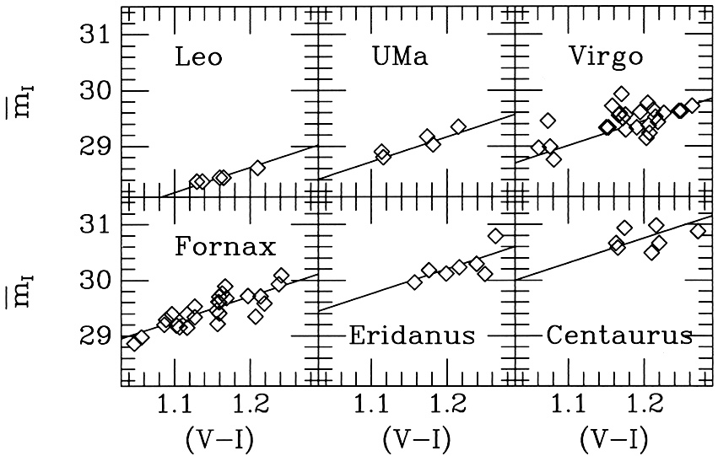
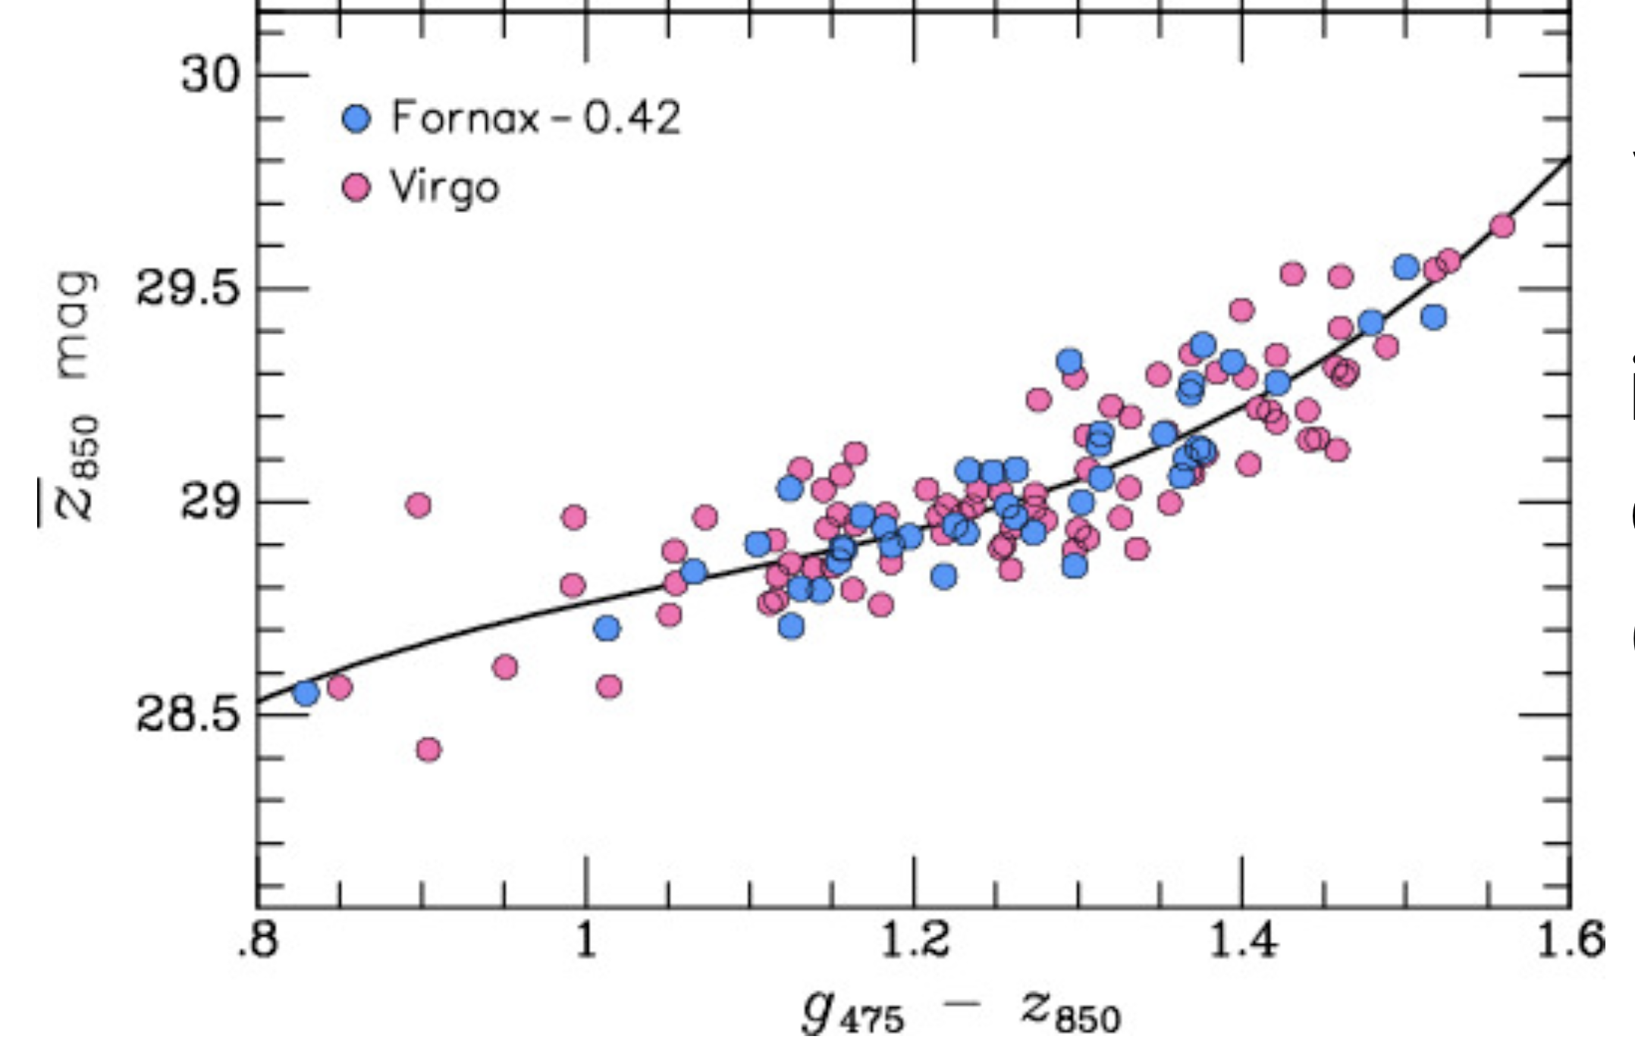
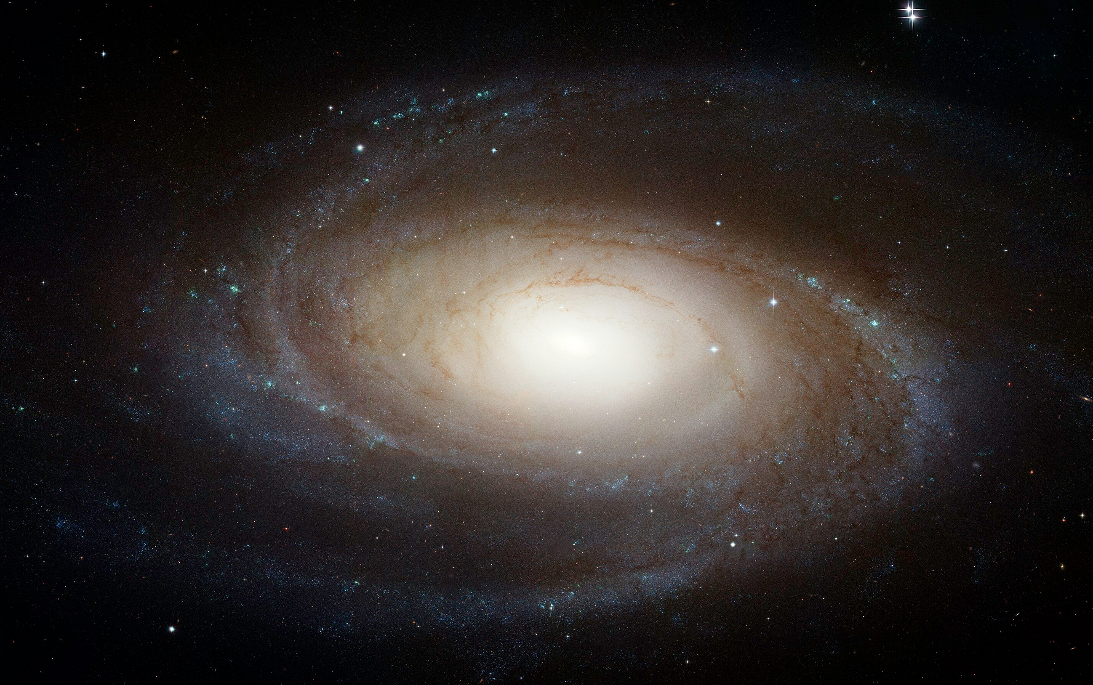
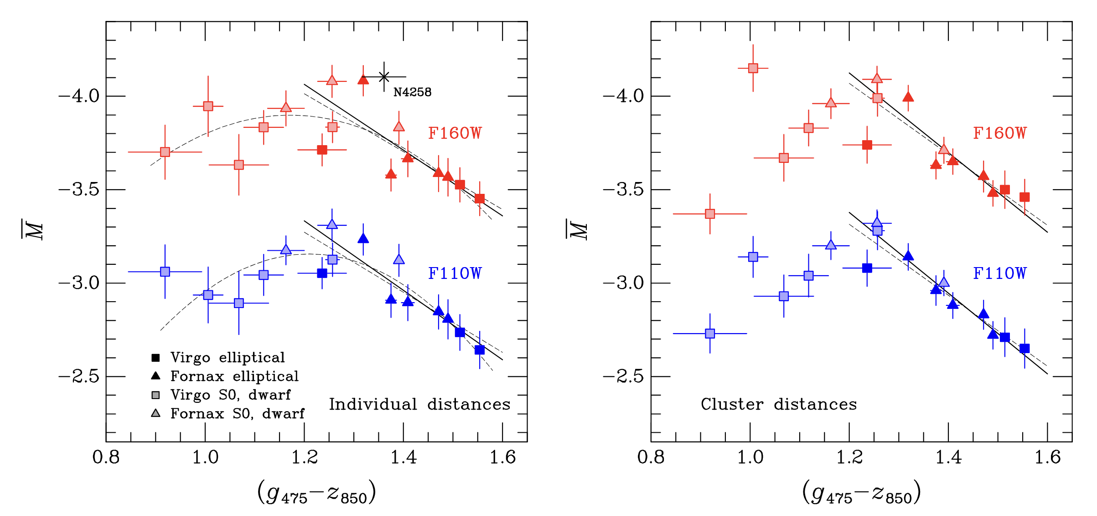
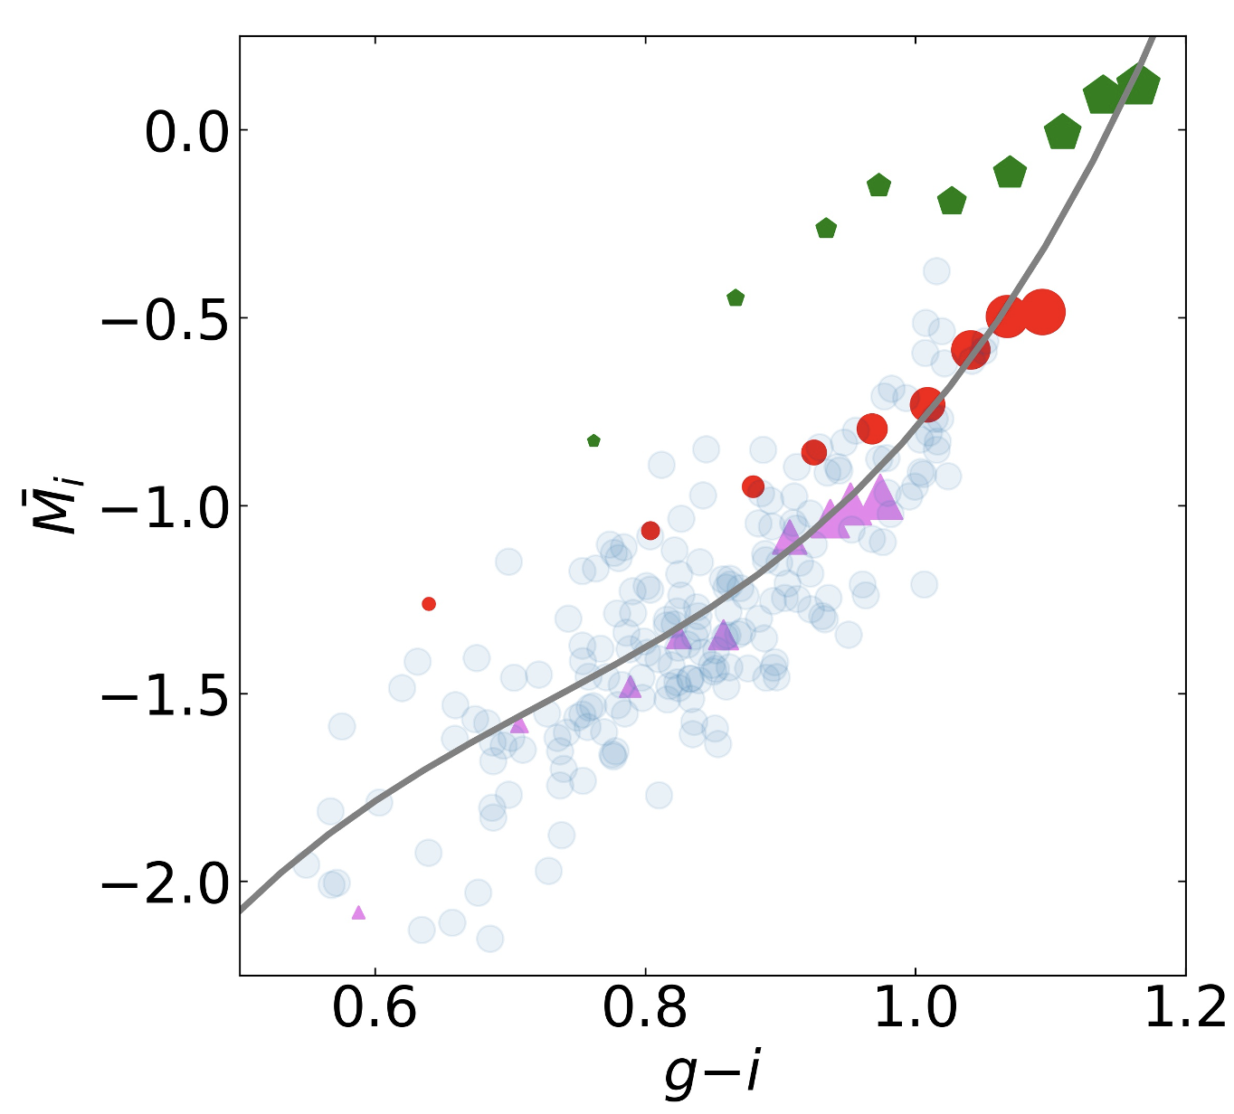
From $\overline{m}$ to distance modulus $μ_{0}=\overline{m}−\overline{M}$
$\overline{M}\sim$α∗color+β
$β$ tied to Cepheids!
Tonry et al. (1998)
Blakeslee et al. (2009)
TRGB
Calibrations from Stellar Population Sinthesys models
SBF ➔ Primary indicator
Jensen et al. (2015)

Slide 5
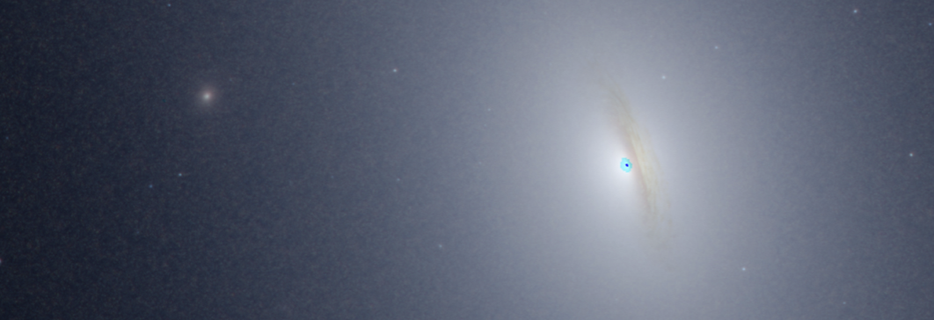
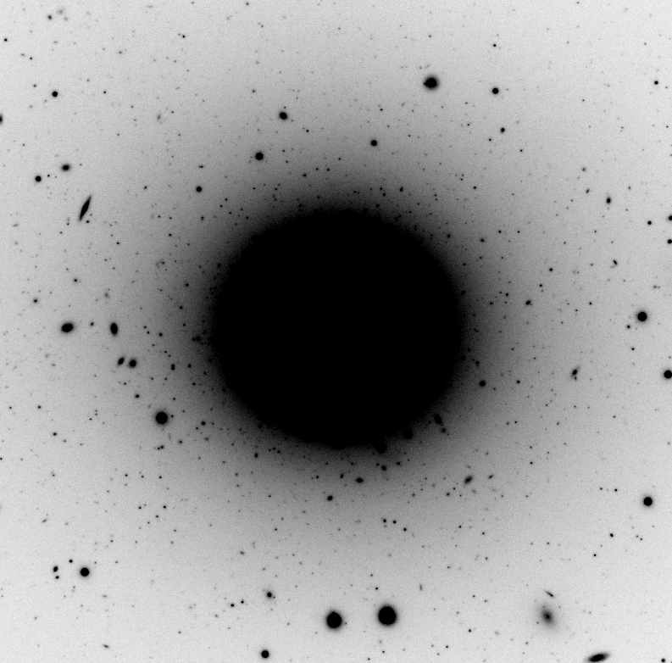
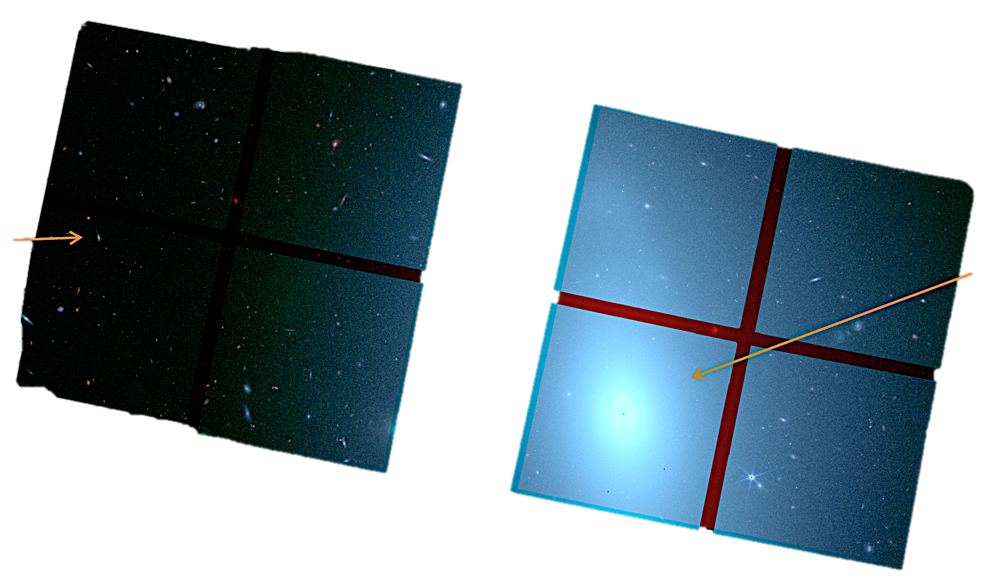
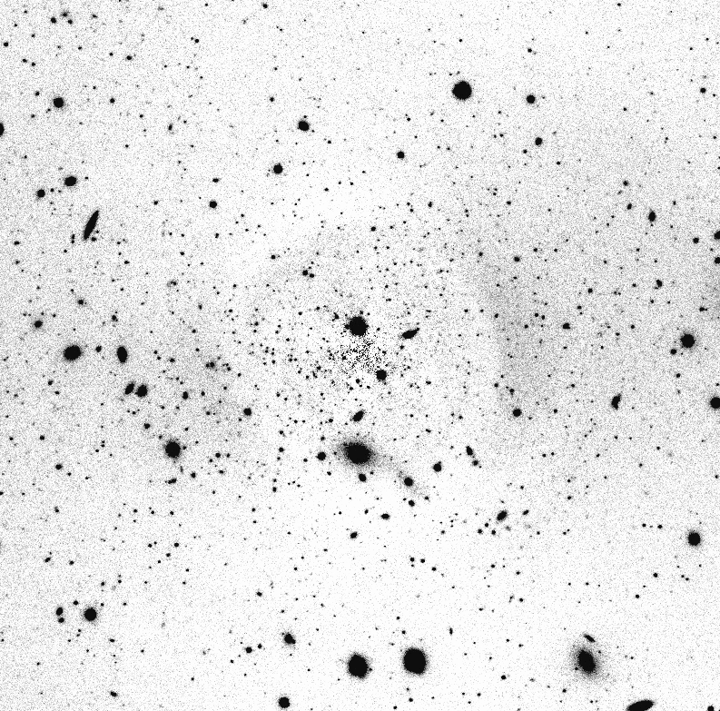
The TRGB-SBF project with the JWST
NIRCAM: perfect layout
TRGB SBF

Slide 6
The TRGB-SBF project with the JWST
A TRGB calibration of Surface Brightness Fluctuations (cycle 2; P.I. Brent Tully)
The JWST SBF Coma Cluster Survey: Building an Alternative Precision Distance Ladder for Cosmology (cycle 3; P.I. Joe Jensen)
Distance Scale Linkages between JWST Tip of the Red Giant Branch and JWST/HST Surface Brightness Fluctuations and SNIa in E Hosts (cycle 4; P.I. Brent Tully)
Toward a 1% measurement of H0 with all-sky SBF distances at substantial redshifts (cycle 4; P.I. Brent Tully)
HST (34 orbits) NGC1404 JWST (~5h)
Anand+24

Slide 7
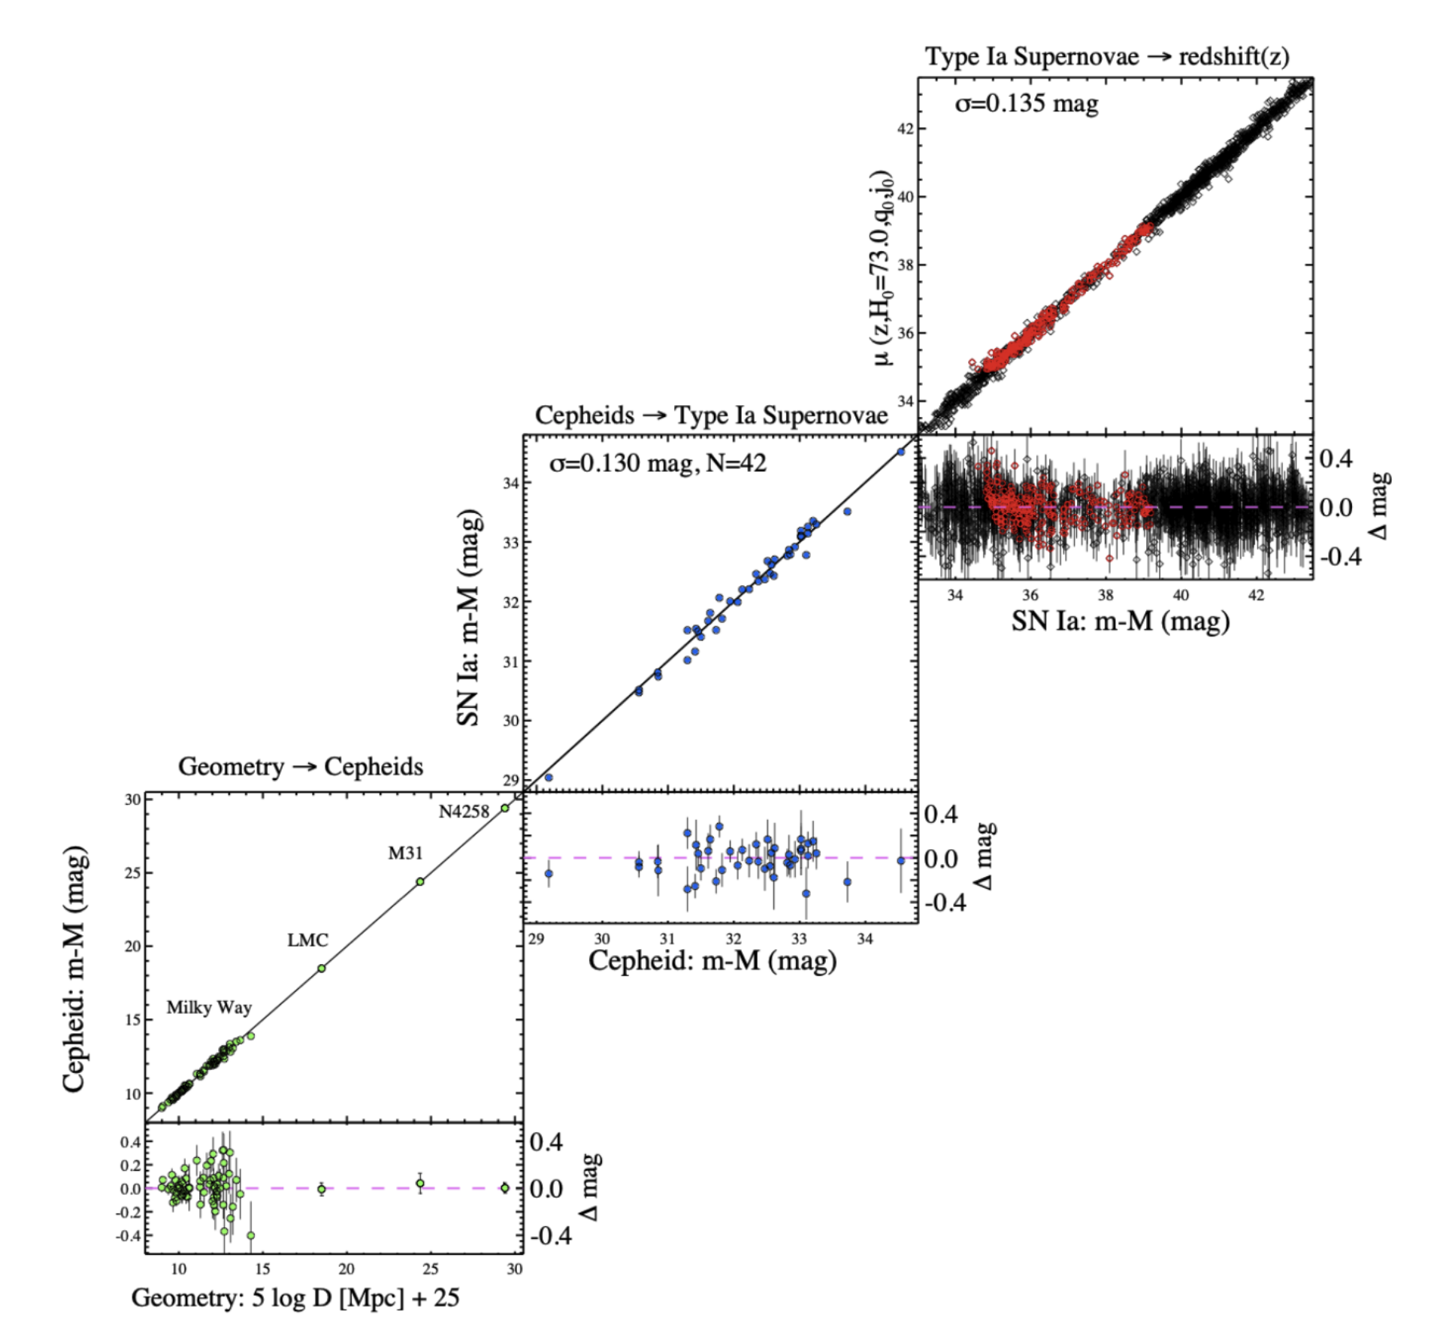
The TRGB-SBF project with the JWST
From a Pop I ladder…
Geometry → Cepheids
Cepheids → SneIa
SNeIa → Hubble flow

Slide 8
The TRGB-SBF project with the JWST
SBF → redshift(z)
… to a Pop II ladder
TRGB → SBF
Geometry → TRGB
TRGB → SBF
SBF → Hubble flow
SBF m-M
SBF m-M (mag)
Geometry → TRGB
TRGB m-M (mag)
TRGB m-M (mag)

Slide 9
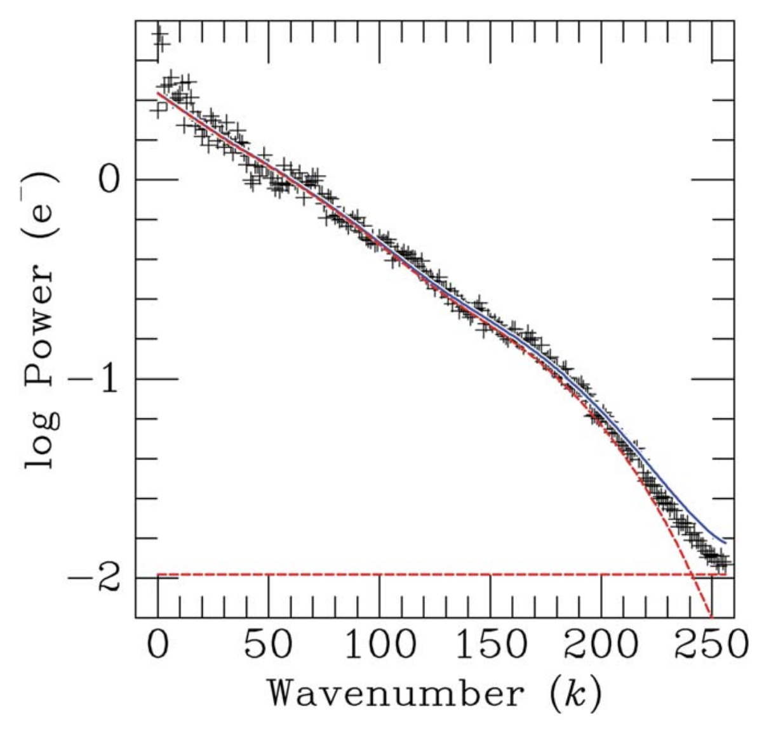
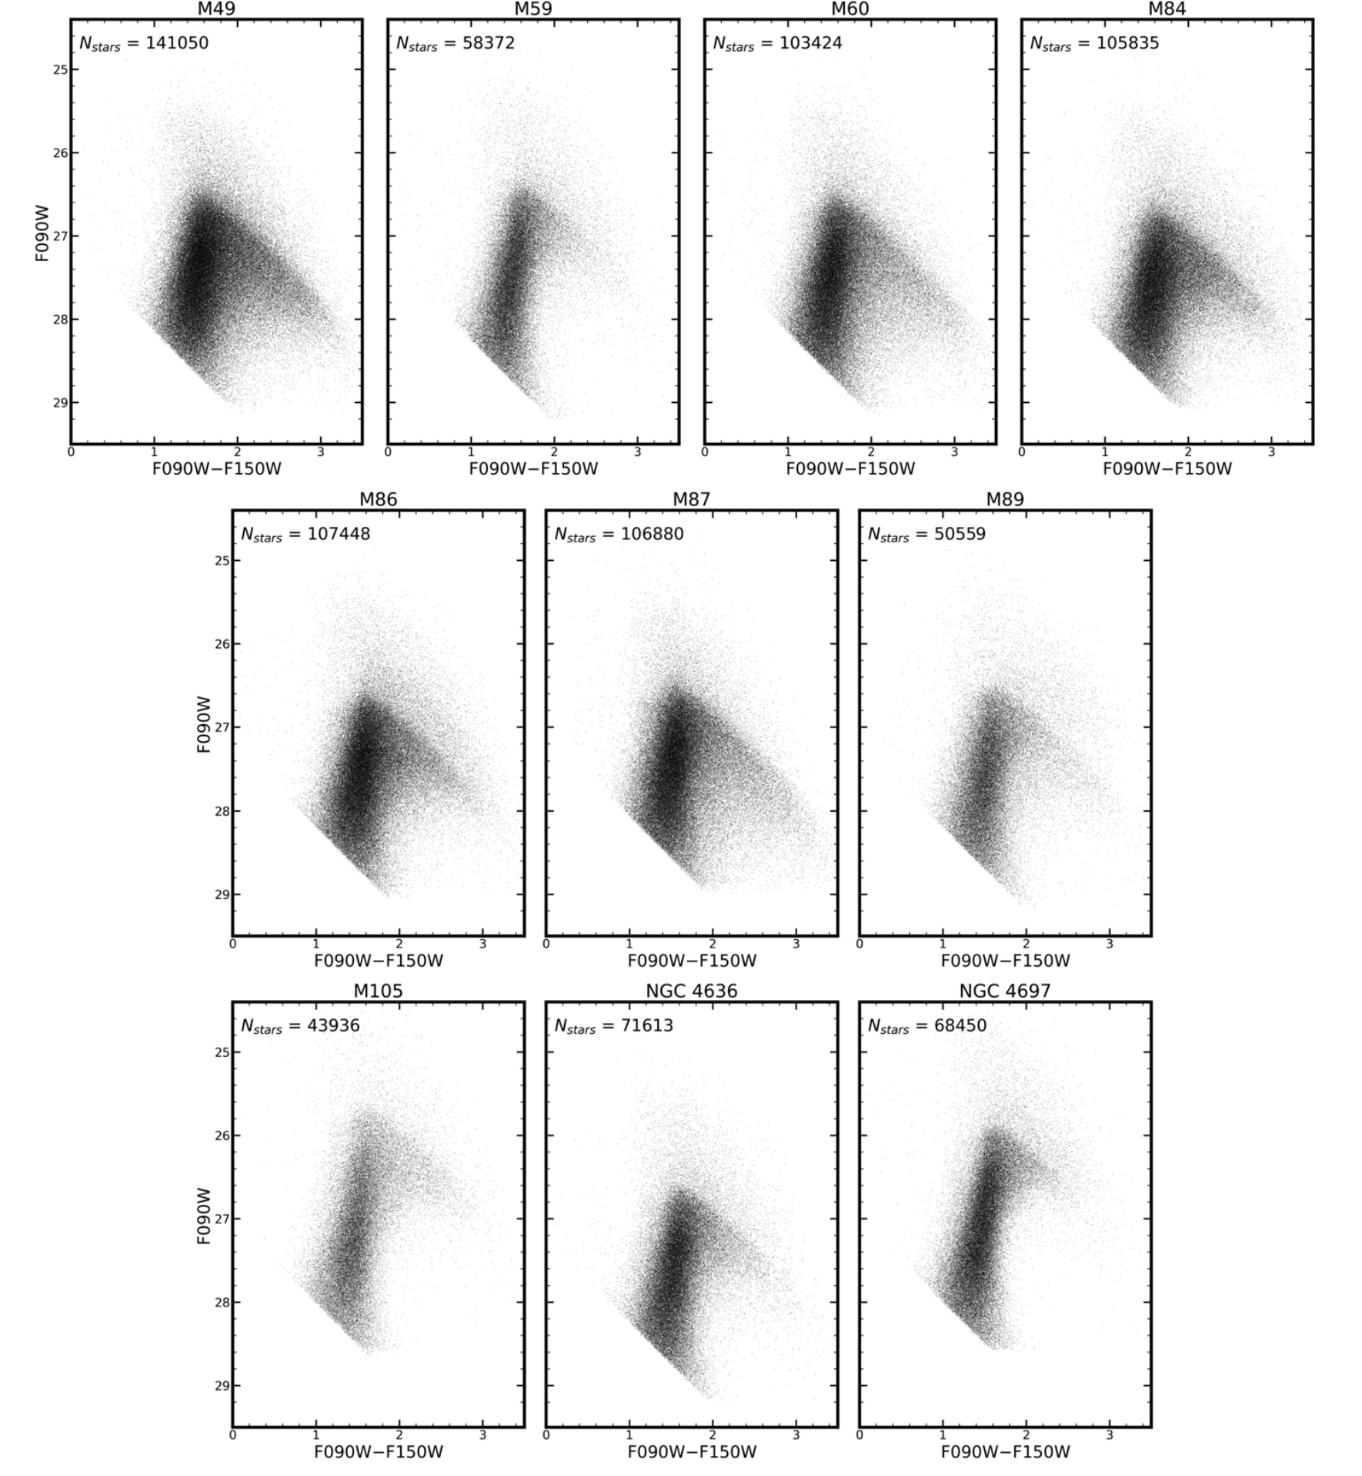
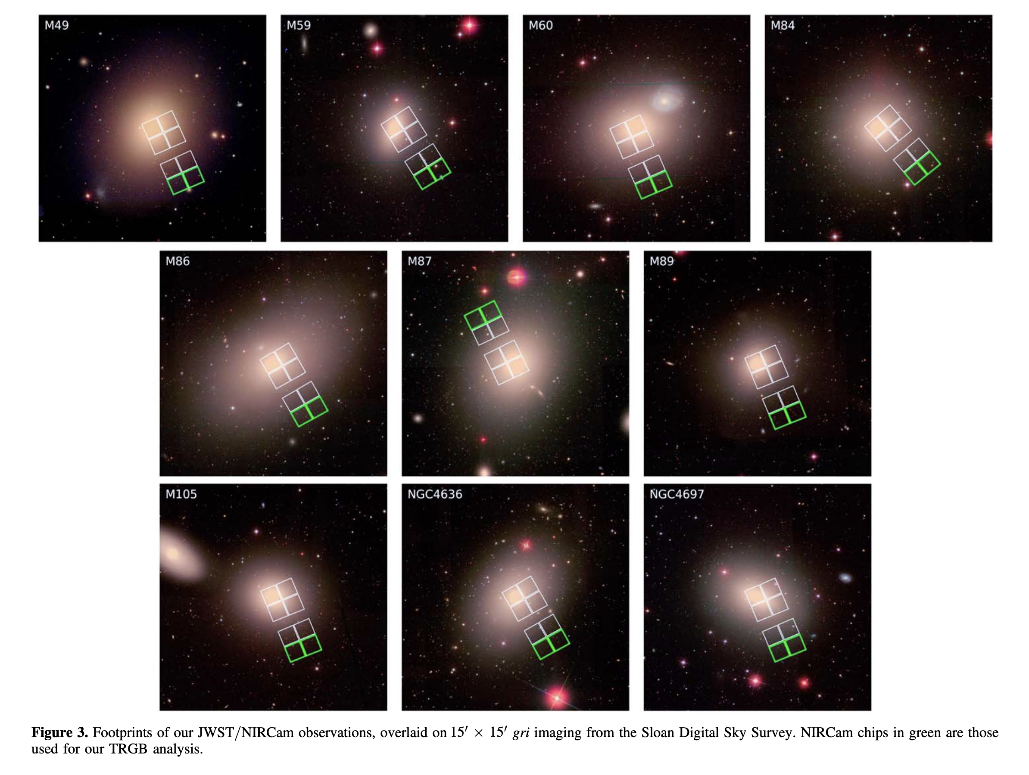
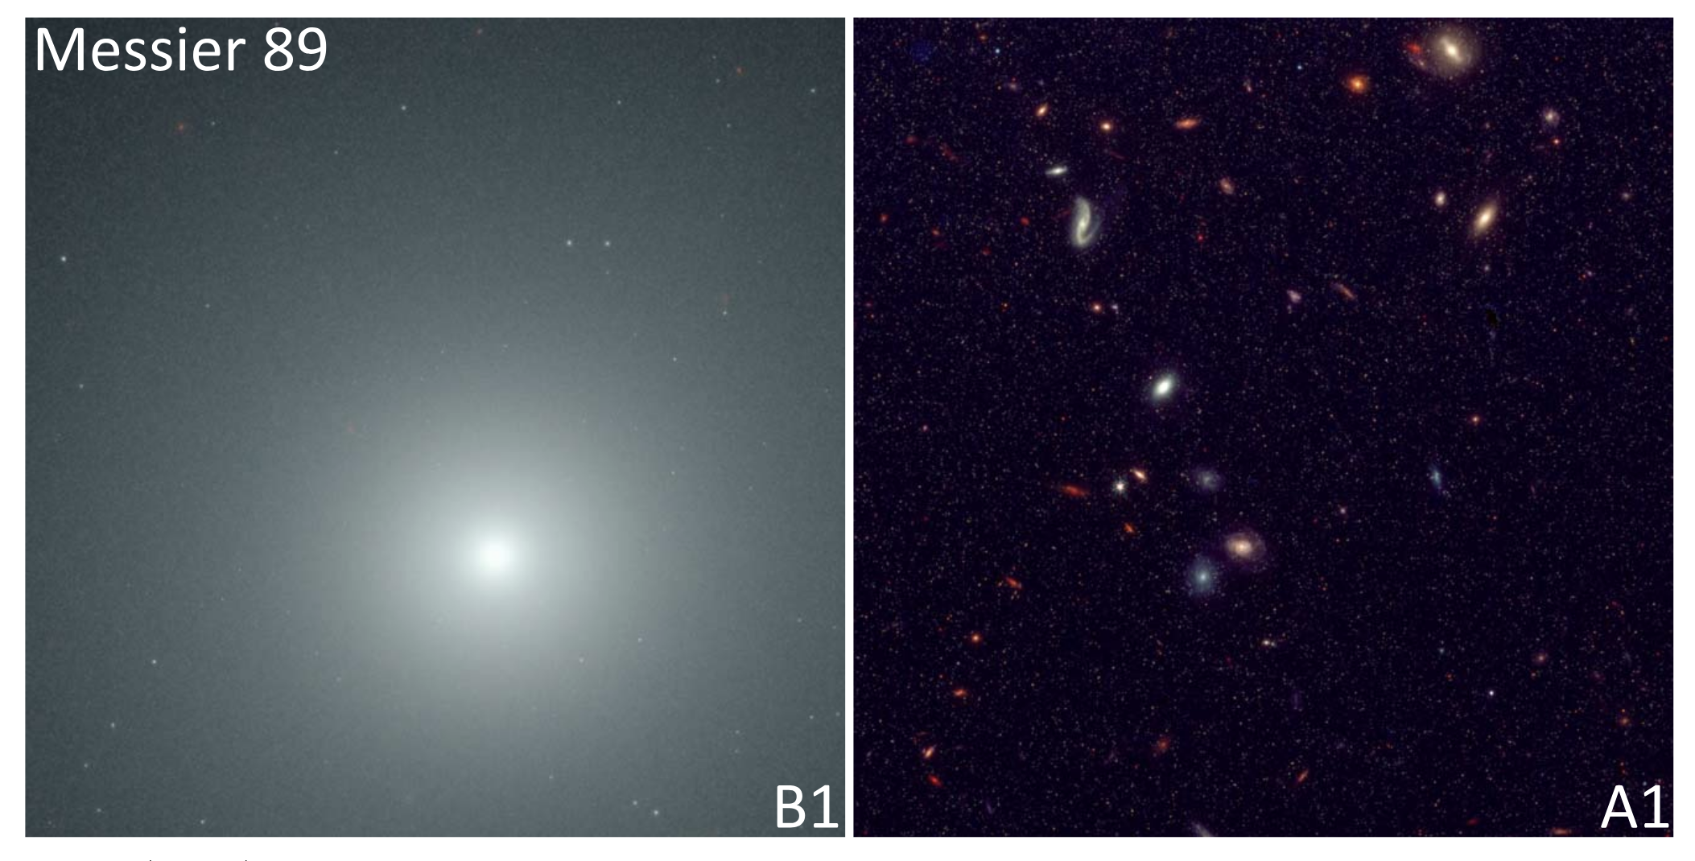
The TRGB-SBF project with the JWST
SBF analysis
in progress
Anand+25

Slide 10
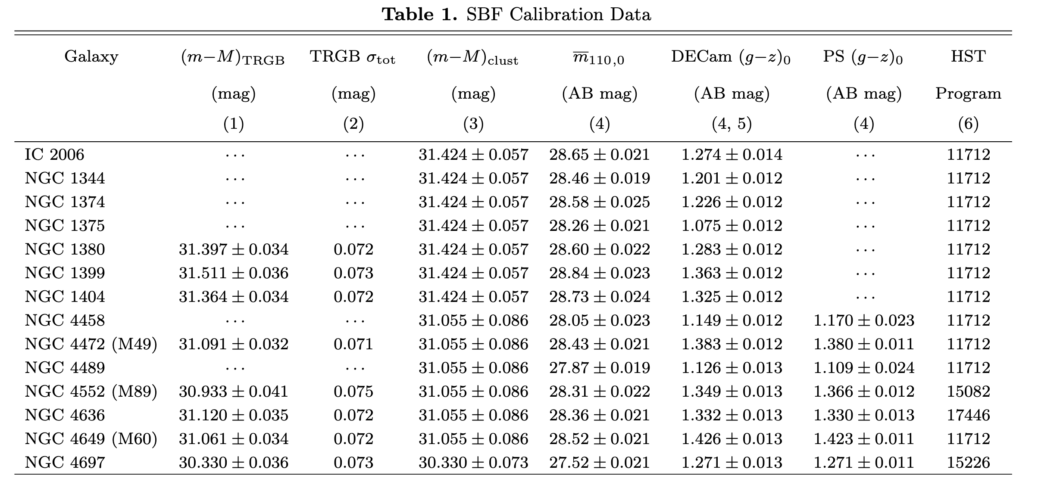
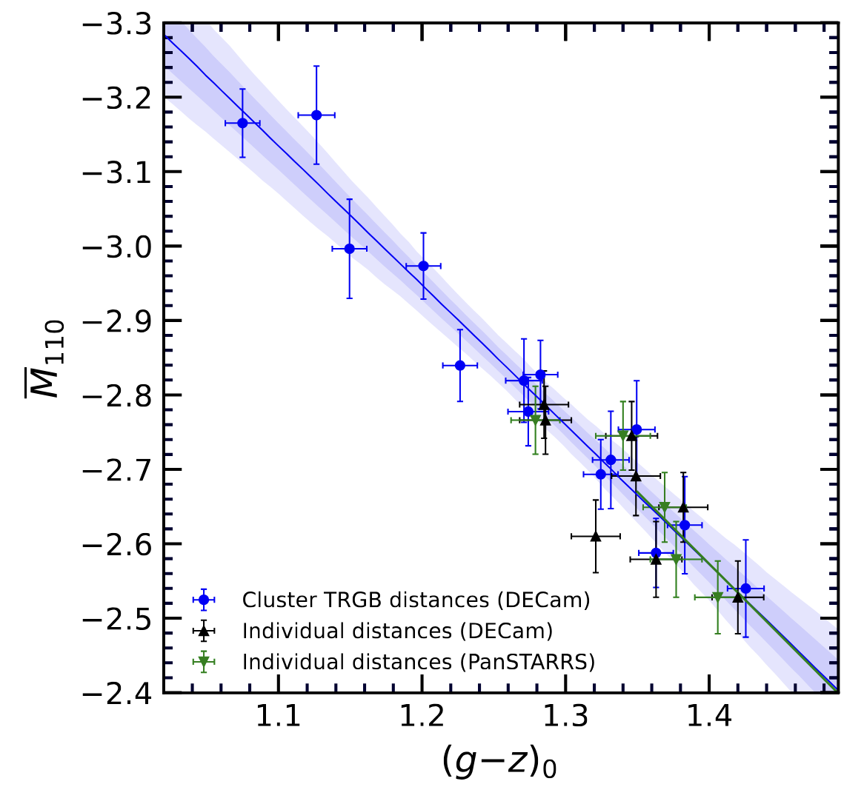
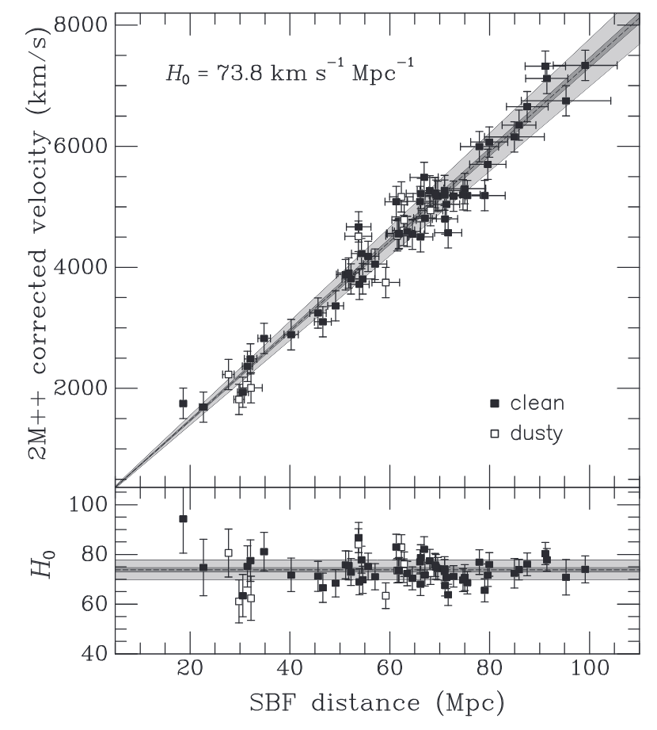
The TRGB-SBF project with the JWST
SBF analysis
in progress
Meanwhile…
Refining the HST SBF Distance Scale Calibration with JWST
(TRGB−SBF III, Jensen+25 arXiv)
H₀ = 73.8 ± 0.7 ± 2.3 km/s/Mpc
Anand+24,25, Jensen+21, Blakeslee+21
Notes:
The TRGB−SBF Project. III. Refining the HST Surface Brightness Fluctuation
Distance Scale Calibration with JWST

Slide 11
Future steps (TRGB-SBF)
Complete the TRGB analysis (including the new datasets)
Measure SBF for the TRGB calibrated galaxies
Measure SBF for the distant Coma-cluster sample
SBF beyond 100 Mpc
Calibrations & stellar population models (k-corrections)
H₀ = 73.8 ± 0.7 ± 2.3 km/s/Mpc
Independent of Cepheids & SNeIa

Slide 12
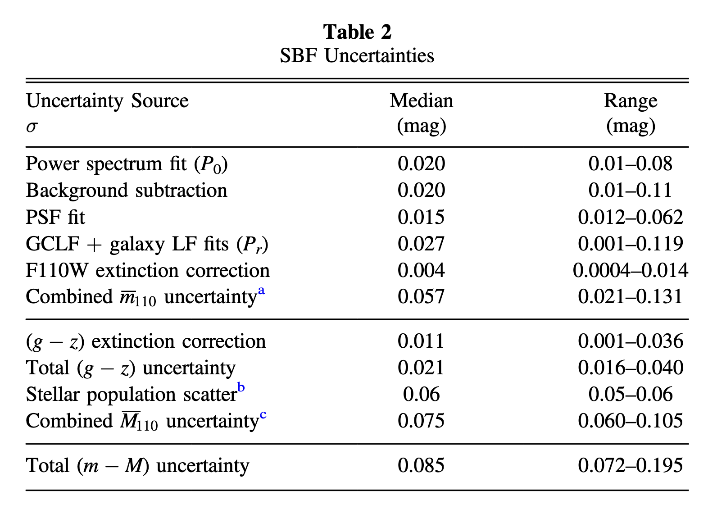
Notes:
- An independent distance for NGC4993 brakes the inclination/distance degeneracy useful, e.g., for independent H0 measure [see below #1]
- For M87 the distance has an impact on the estimate of the BH mass: “For an assumed distance of 16.8 Mpc, the ring diameter is consistent with the expected “shadow” of a ∼6.5×10^9 Mo black hole.”
[1] “Only SNe Ia can provide competitive distance
measurements at these distances, but the chances of observing a
supernova in the same galaxy as a BNS merger are unlikely. In
this paper we have demonstrated that SBF distance measure-
ments are a particularly compelling approach to breaking the
distance-inclination degeneracy of the GW data.

Slide 13
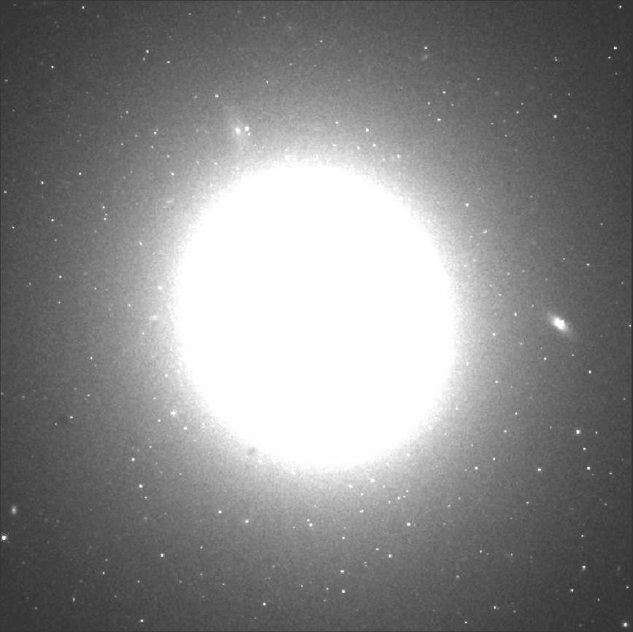
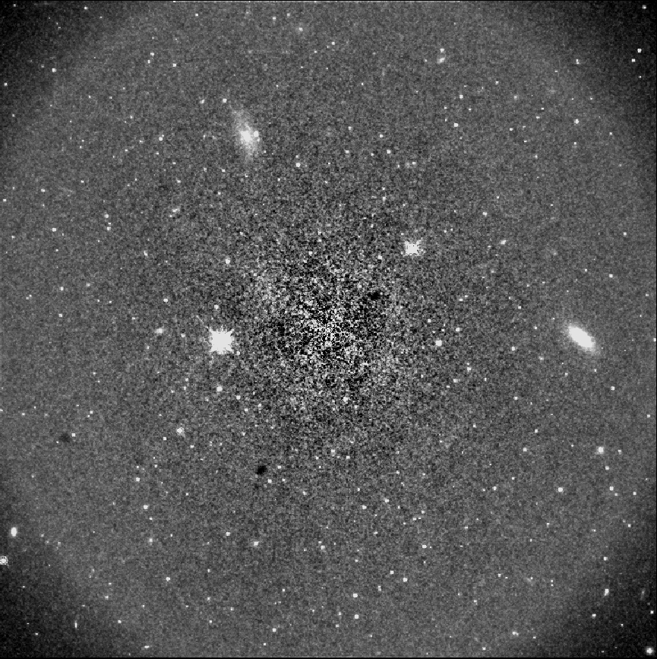
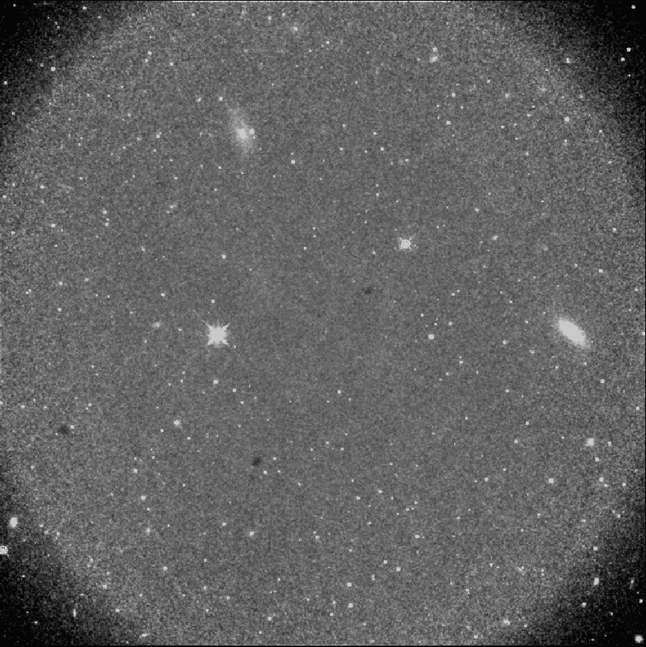
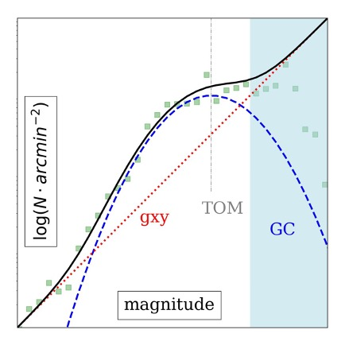
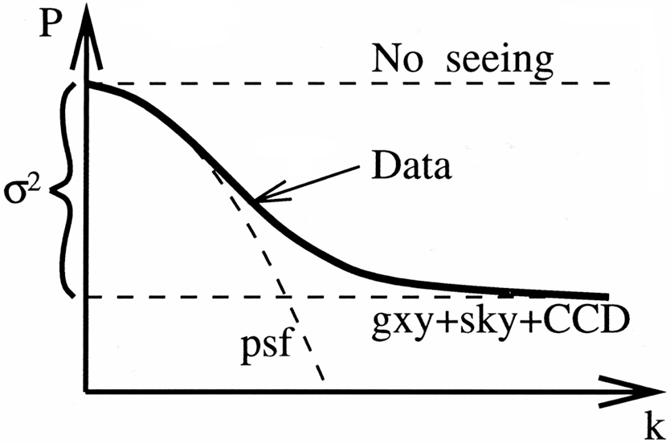
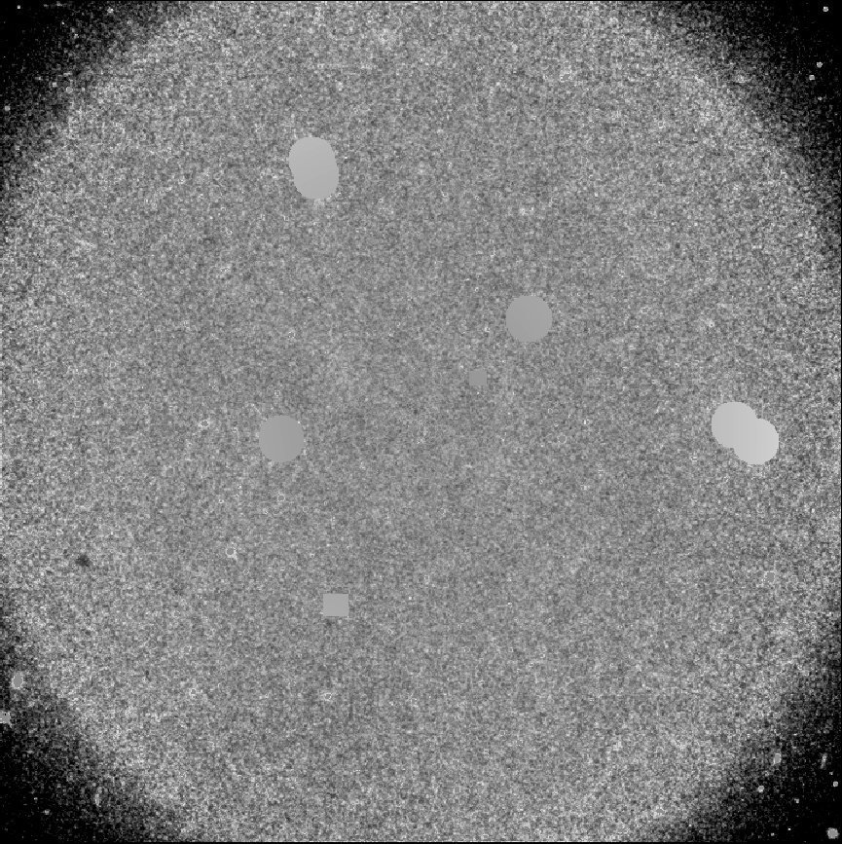
3. An SBF Primer Measuring $\overline{m}$
a.
The measurement entails many steps
Let’s summarize the main ones
NGC1399 HST/WFC3/IR
Galaxy modeling
Galaxy subtraction
Sources photometry
Sources masking
Power spectrum analysis $P_{0}$
Subtract spurious fluctuations $P_{r}$
b.
$$\left\langle f\right\rangle$$
Stellar counts fluctuations ${P_{f}=P}_{0}−P_{r}$
$P_{0}$: Total fluctuation term
$P_{r}$: Spurious fluctuation term
$$f−\left\langle f\right\rangle$$
$${\overline{m}}_{band}=−2.5\log\left(P_{f}\right)+m_{zp, band}$$
c.
e.
$$P_{r}$$
d.
$$P_{0}$$
$$\overline{m}$$
Heavy Human Intervention
f.
$$P\left(k\right)=P_{0}×E\left(k\right)+P_{1}$$

Slide 14
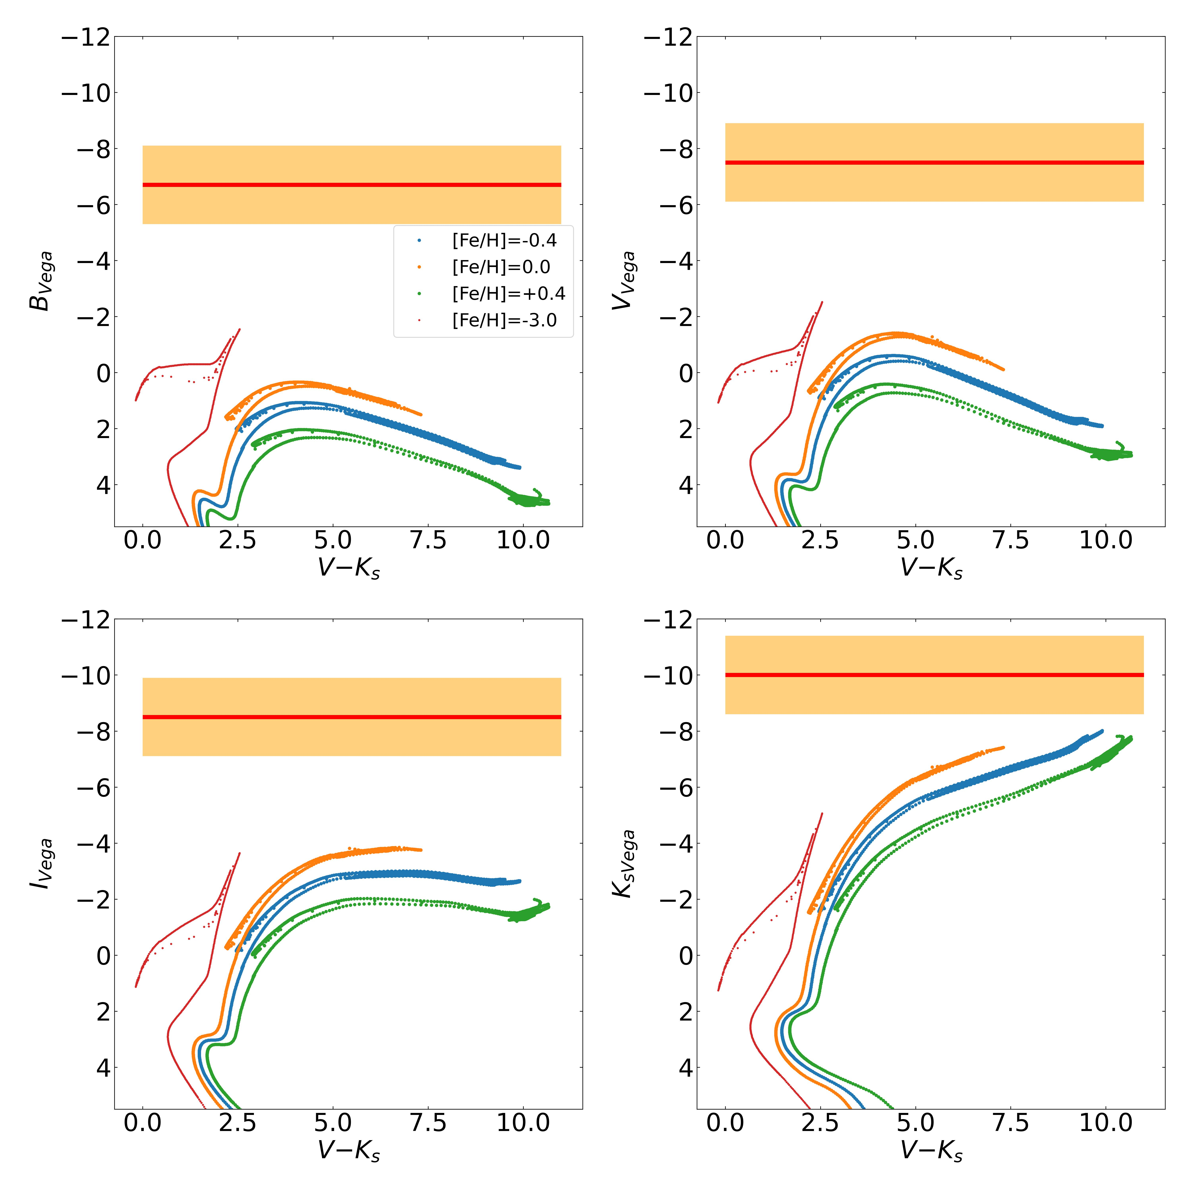
What stars contribute the most to SBF?
Shorter bands to are sensitive to hot-stars Longer bands to are sensitive to cool-stars
U/B ➔ Horizontal Bands
H/K ➔ RGB/AGB stars

Slide 15
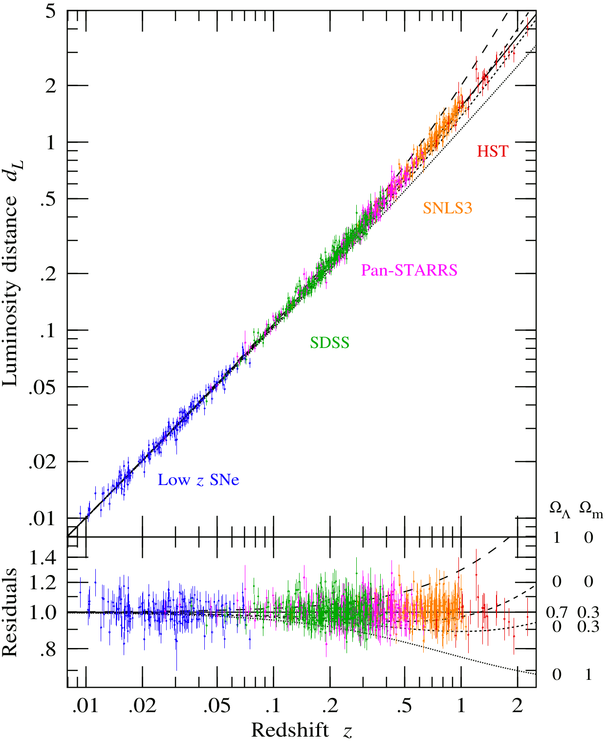
SBF with AO: perspectives
HST/VLT
~0.1” FWHM PSF/2.4m aperture
8m aperture/~0.8” FWHM PSF
~125 Mpc limit
~200 Mpc probably feasible, z~0.05
ELT+AO
Down to ~0.02” FWHM PSF
~39 m aperture (>250xHST collecting area)
High detector efficiency
➔ SBF beyond 300. ‘On paper’ out to 450 Mpc
Data: Scolnich+18
Fig.: Hamilton A.

Slide 16
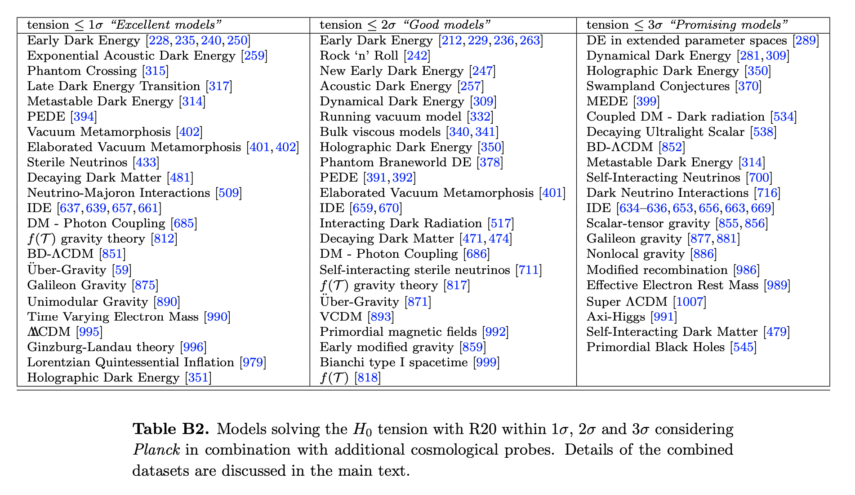
Examples of possible new physics
Sterile neutrinos
Relativistic hot/warm dark matter
Dark Energy is stronger than expected
More than one type of dark energy
Dark Matter interacts differently than expected due to gravity
General Relativity is not quite right
Spacetime curvature different than expected
Di Valentino et al. 2021

