Slide 1
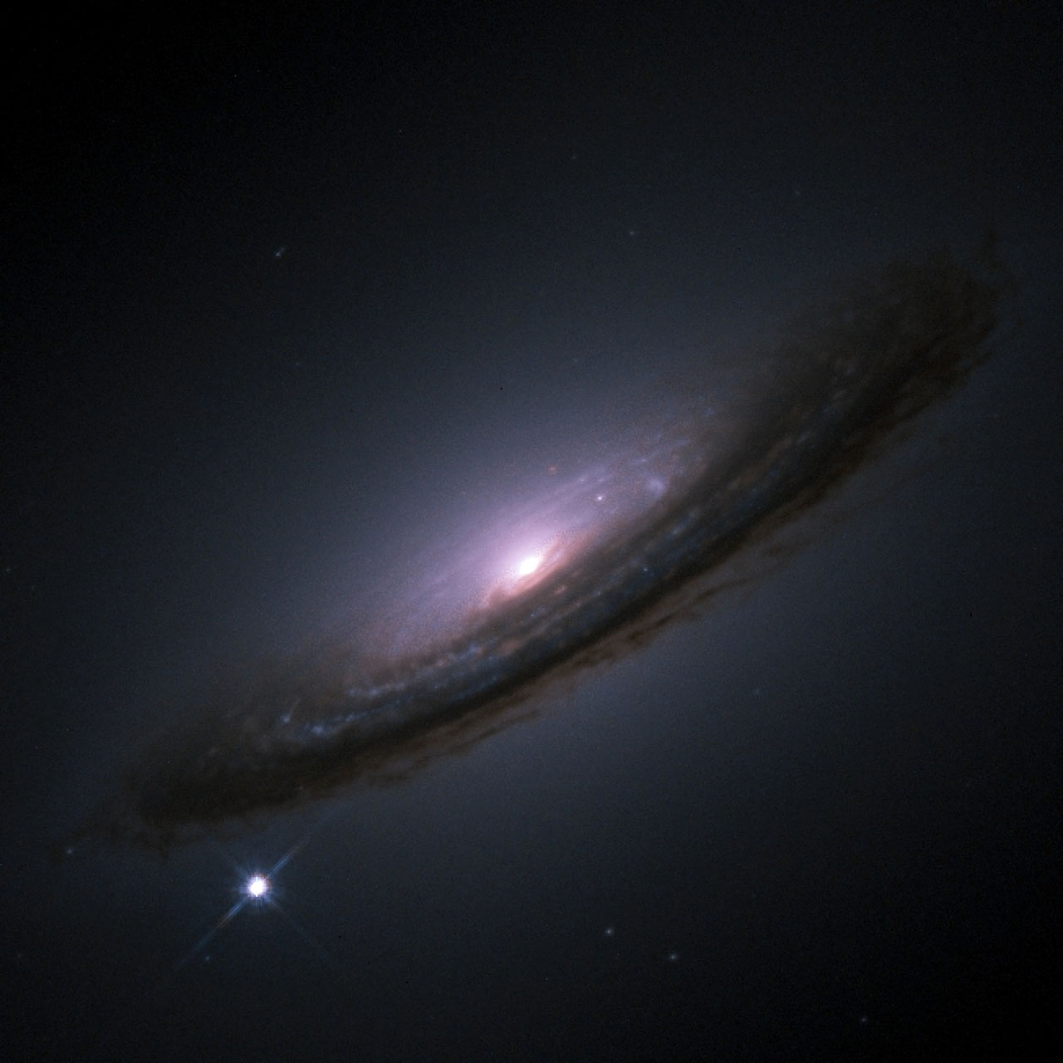


Beyond the Mass Step:
Improving the Hubble Diagram with Future Surveys through an [O II] Correction to SN Ia Light Curves
Credit: NASA/ESA
Bailey Martin
The Australian National University
Supervisors:
Chris Lidman (ANU)
Brian Schmidt (ANU)
Brad Tucker (ANU)
Dillon Brout (Boston University)
bailey.martin@anu.edu.au
An Extraordinary Journey Into the Transient Sky
3rd April 2025

Slide 2
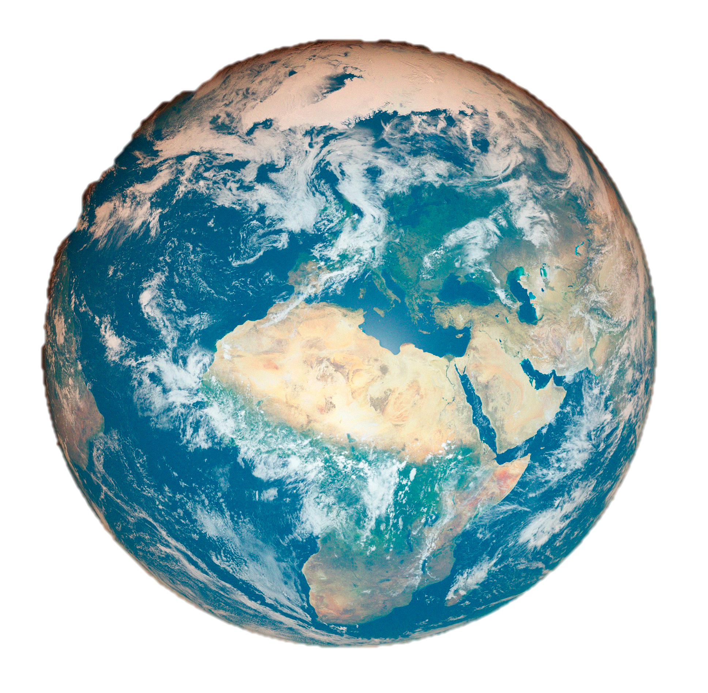
Type Ia Supernovae
What We See
Distance From Earth
bailey.martin@anu.edu.au
An Extraordinary Journey Into the Transient Sky
3rd April 2025

Slide 3
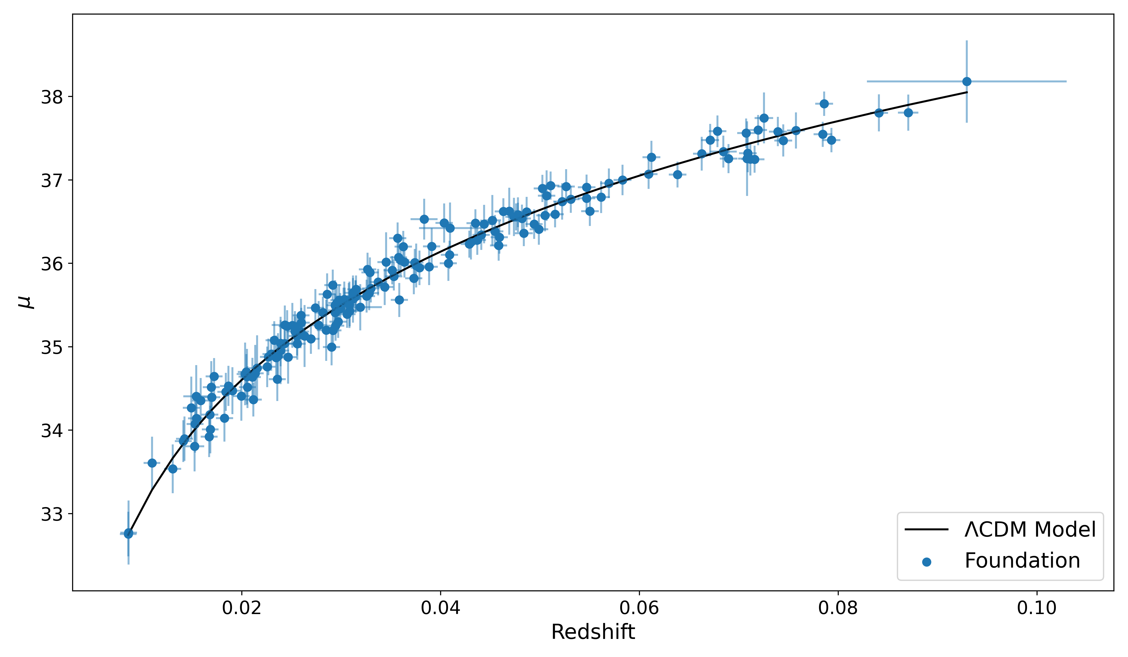

The Hubble Diagram
Distance Modulus $μ=m −M$
Martin et al. 2024
Distance
Recessional Velocity
bailey.martin@anu.edu.au
An Extraordinary Journey Into the Transient Sky
3rd April 2025
Notes:
Made from Foundation 2018
Overplot a model
Scatter too large for precision cosmology

Slide 4
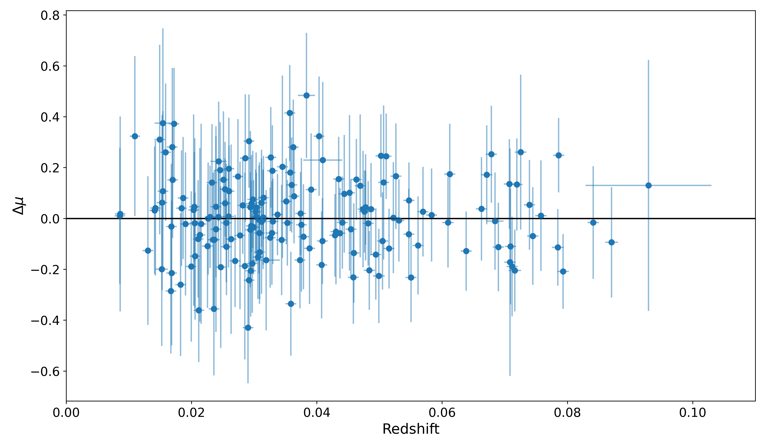
The Hubble Residual
Martin et al. 2024
Fainter
Brighter
bailey.martin@anu.edu.au
An Extraordinary Journey Into the Transient Sky
3rd April 2025
Notes:
Residual equiv to deviation in observed brightness
In new era, statistics improved enormously, leaving systematics dominating
One systematic is host galaxy

Slide 5

Type Ia SNe as Standardisable Candles
$$μ=m_{B}−M_{B}+αx_{1}−βc+δ_{host}+δ_{bias}$$
$μ=$ Distance Modulus
$m_{B}=$ Observed magnitude (B-band)
$M_{B}=$ Absolute magnitude (B-band)
$x_{1}=$ Stretch
$c=$Colour
$δ_{bias}=$ Selection Biases
$δ_{host}=$ Host galaxy correction
My Research
bailey.martin@anu.edu.au
An Extraordinary Journey Into the Transient Sky
3rd April 2025
Notes:
When standardising, we apply corrections w/ Tripp Eqn
Host correction done for the mass step

Slide 6
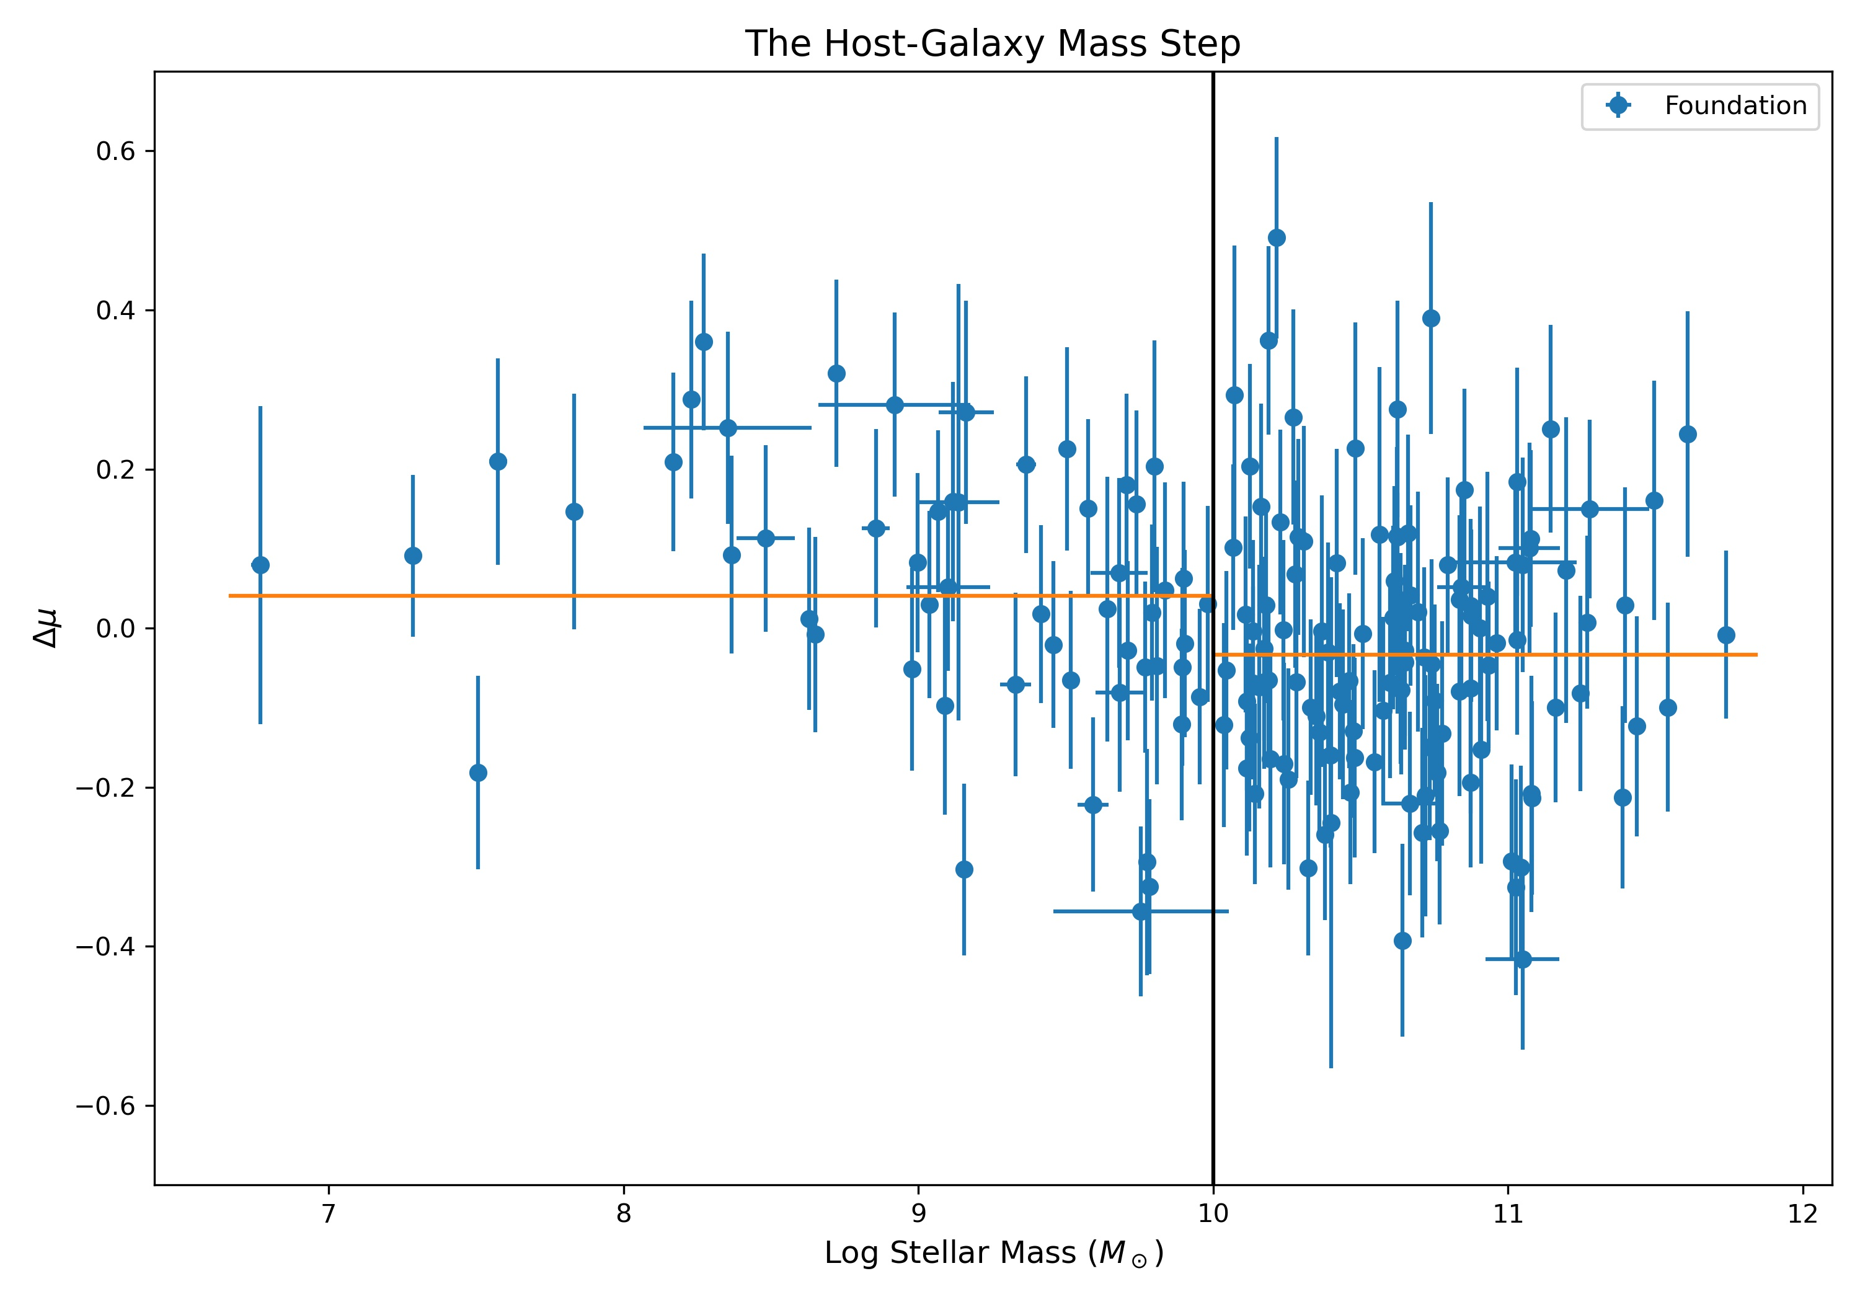
The Host Galaxy Mass Step
More massive galaxies host brighter SNe After Standard Light-Curve Corrections!
0.074 mag change in brightness
Fainter
Brighter
bailey.martin@anu.edu.au
An Extraordinary Journey Into the Transient Sky
3rd April 2025
Notes:
After correcting stretch and colour, more massive galaxies host slightly brighter SNe
Correcting reduces scatter in Hubble diagram, but physical driver is poorly understood

Slide 7
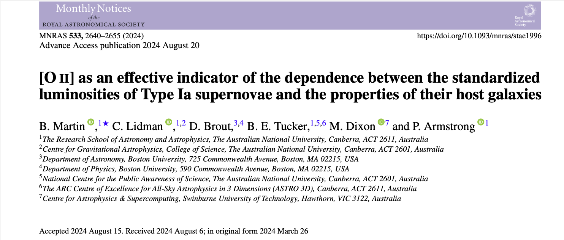
Paper 1
bailey.martin@anu.edu.au
An Extraordinary Journey Into the Transient Sky
3rd April 2025
Notes:
Obtaining IFU spectra for low-z hosts
In this paper, we find OII is more effective tracer than mass, and a feasible correction

Slide 8
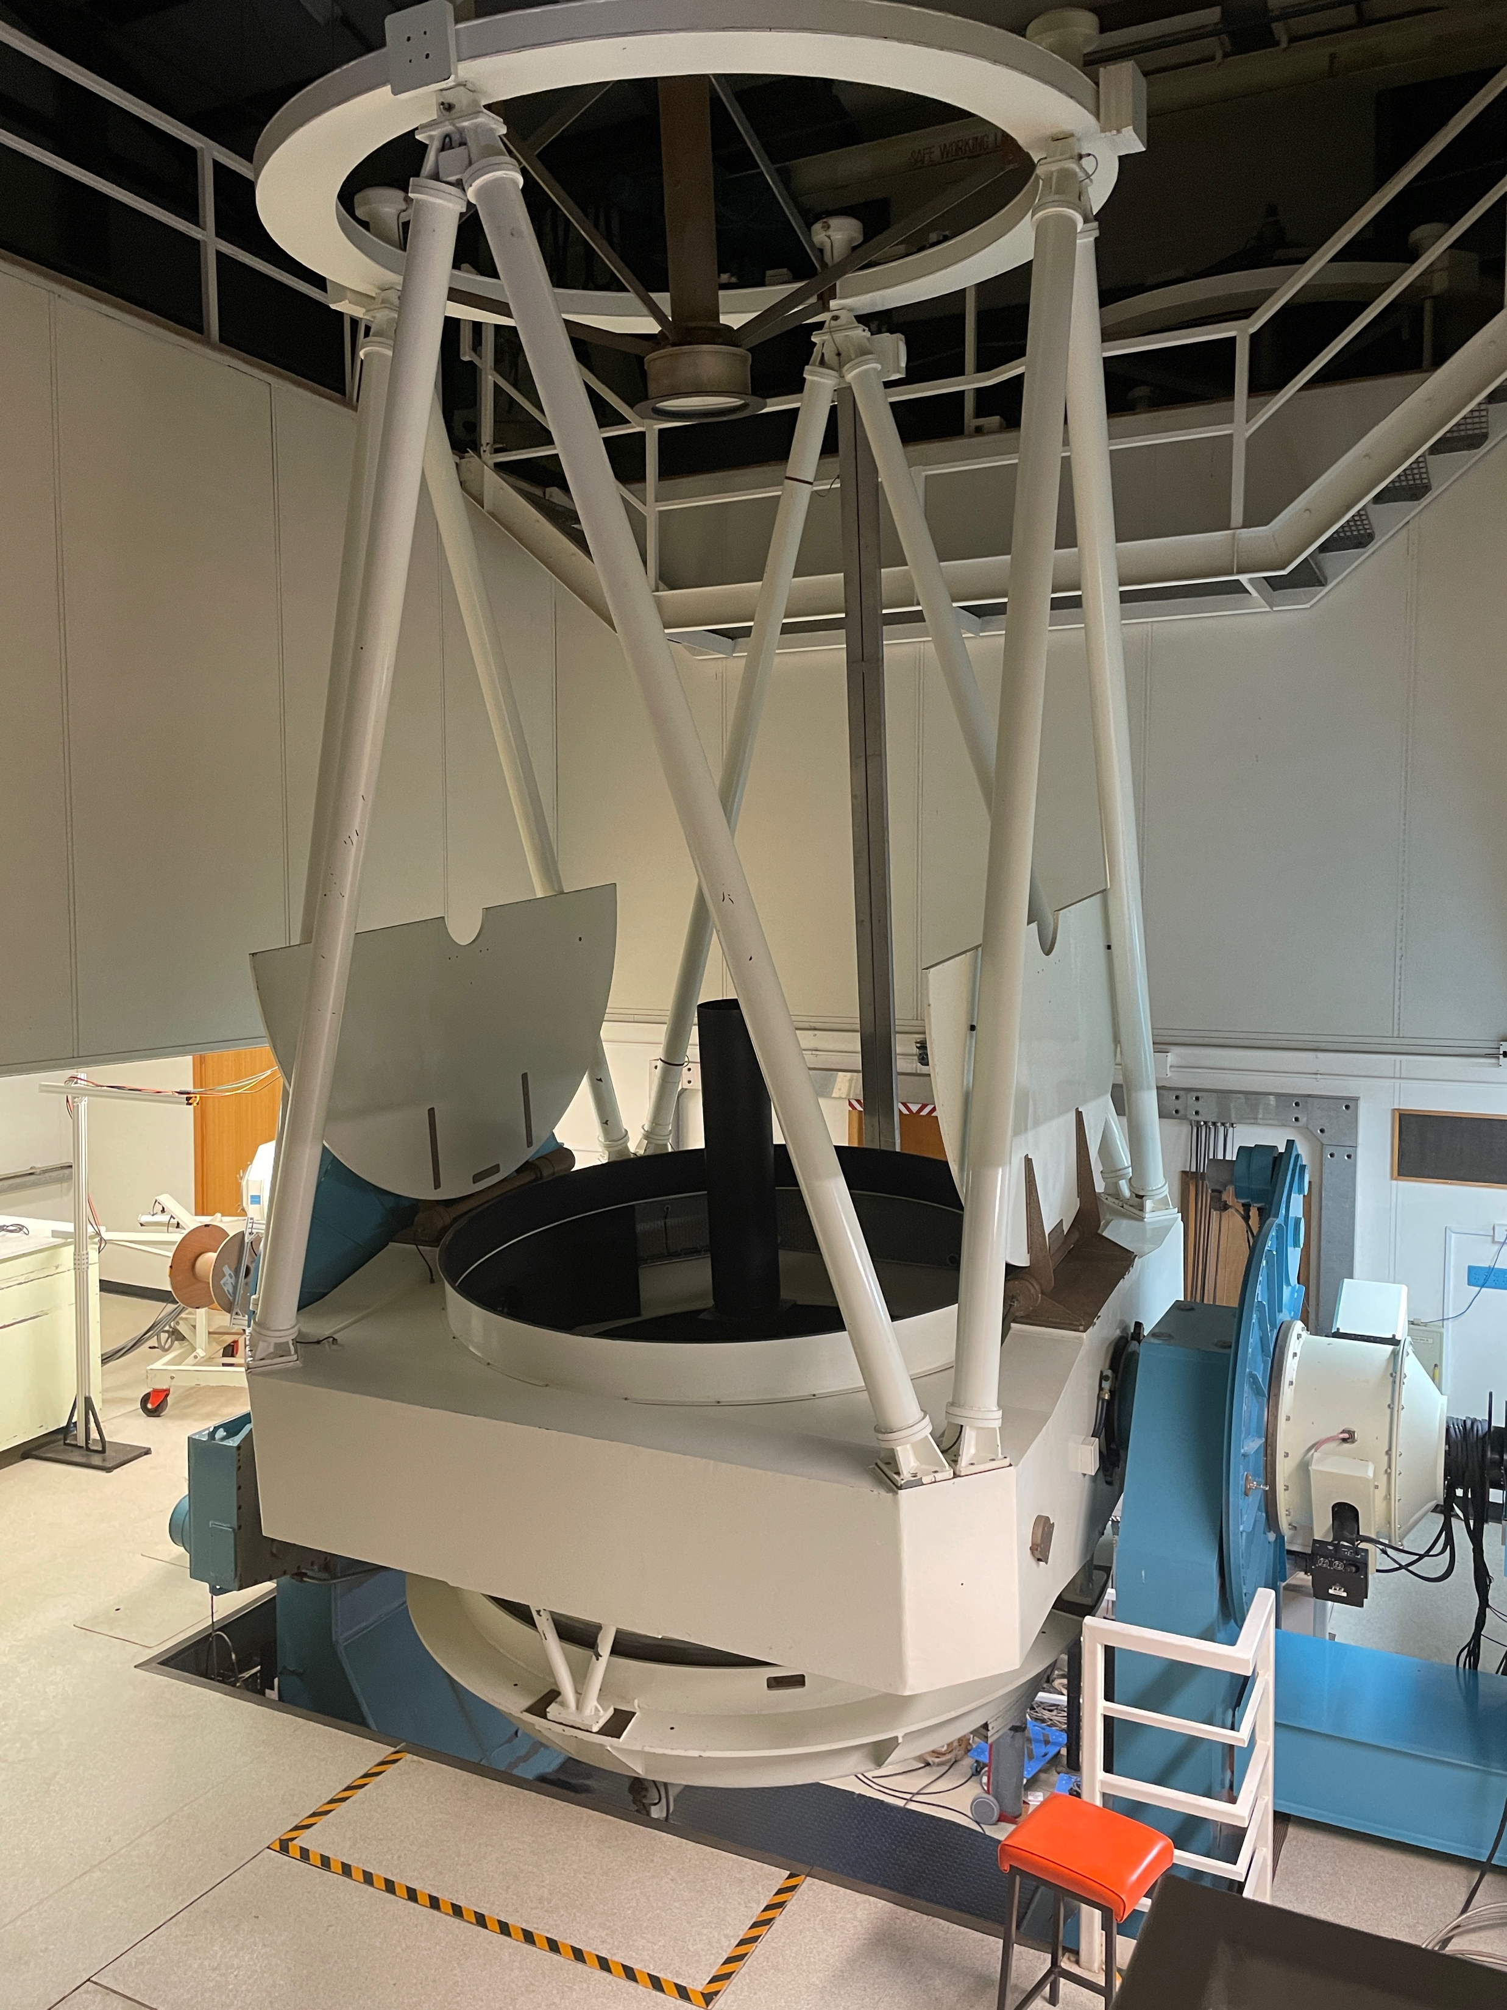
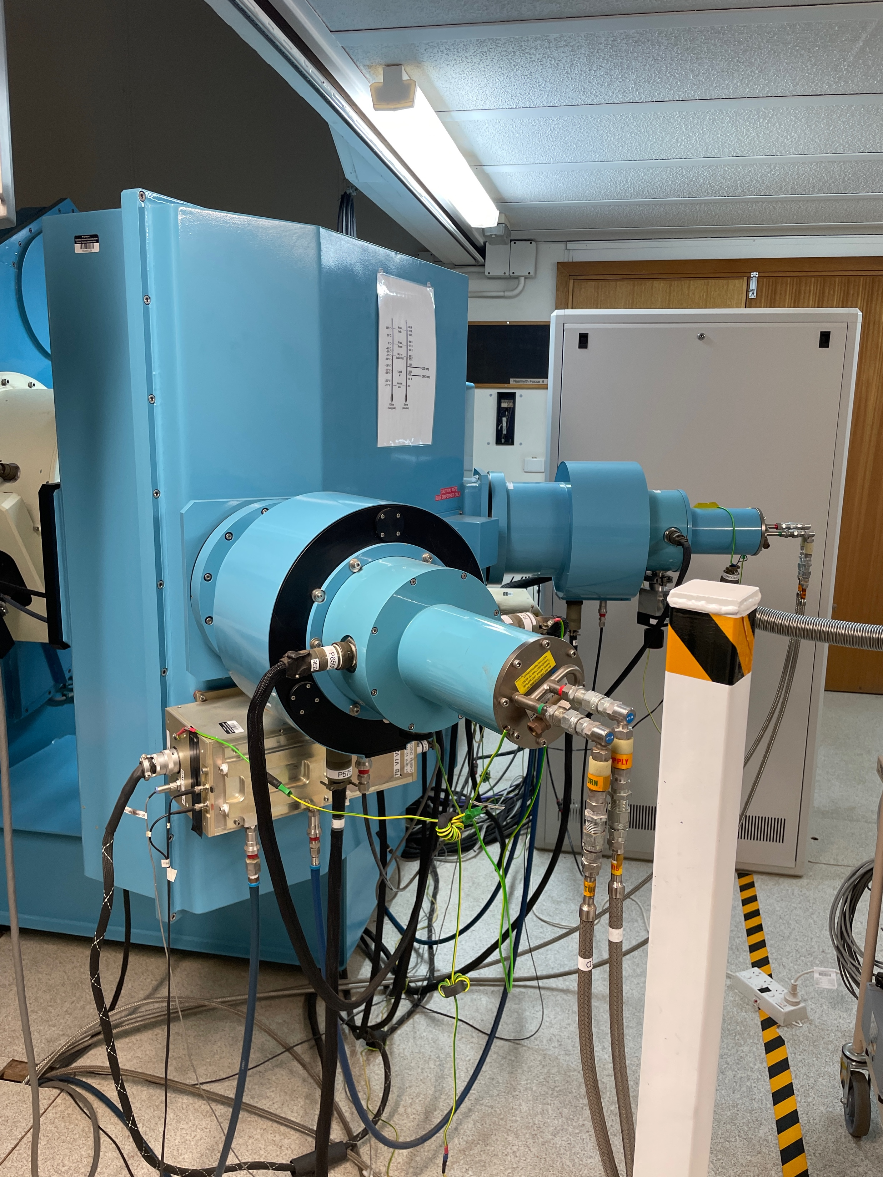

Observing Host Galaxies
WiFeS IFU Spectrograph on the ANU 2.3m Telescope
$3500−9000Å$
R ~ 3000
38 x 25 arcsec FoV
ANU 2.3m Telescope
WiFeS
bailey.martin@anu.edu.au
An Extraordinary Journey Into the Transient Sky
3rd April 2025
Notes:
I obtain spectra using WiFeS
IFU with resolution of 3000 between 3500 and 9000A
Past studies use wealth of high-redshift data available, but since SNR low spectra need to be stacked
In mine each galaxy’s spectrum has high enough SNR, increasing sample by order of magnitude

Slide 9
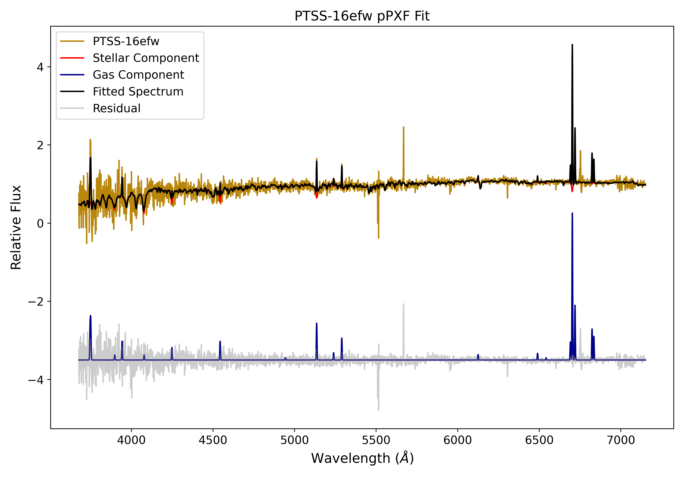
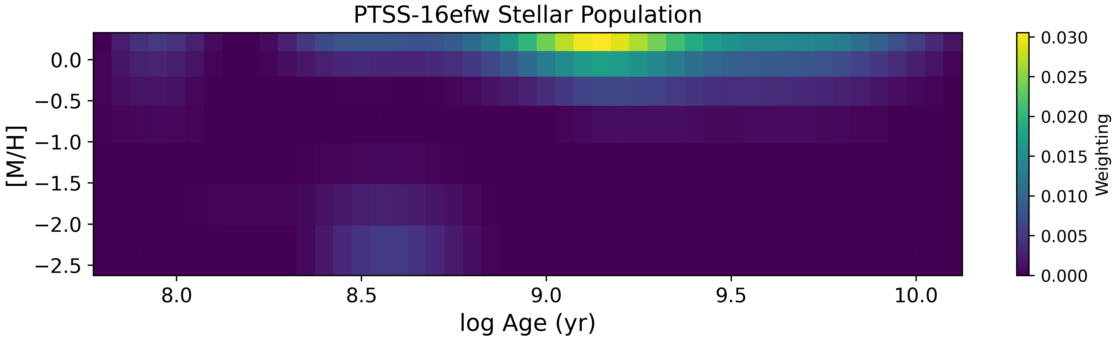
Fitting Host Spectra
Penalised Pixel Fitting (pPXF) python package (Cappellari & Emsellem 2004)
Utilises eMILES spectral library
Model can be broken down into Stellar and Gas components
Determine host properties from fit
bailey.martin@anu.edu.au
An Extraordinary Journey Into the Transient Sky
3rd April 2025

Slide 10
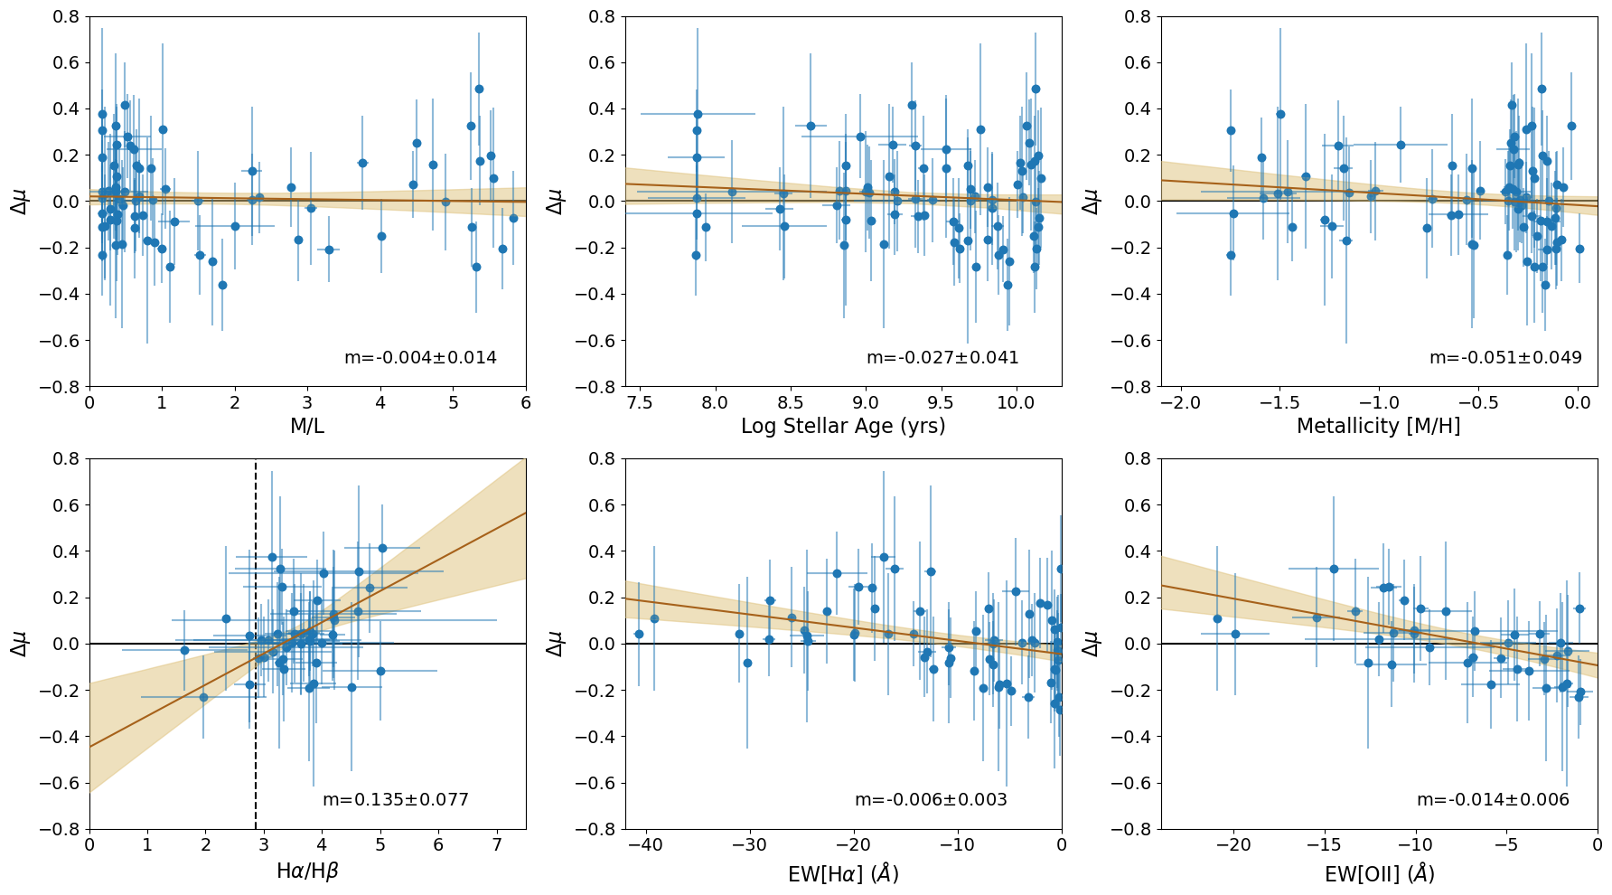
Results
Martin et al. 2024
Fainter
Brighter
bailey.martin@anu.edu.au
An Extraordinary Journey Into the Transient Sky
3rd April 2025
Notes:
Note: these are global properties, not local environments
On top are stellar properties, don’t see any immediately obvious trends.
On bottom are gas properties, bottom left is the Balmer decrement, which traces dust attenuation, and we find a weak trend that dustier galaxies have fainter SNe.
Then we have Halpha and OII equivalent Width, trace sSFR

Slide 11
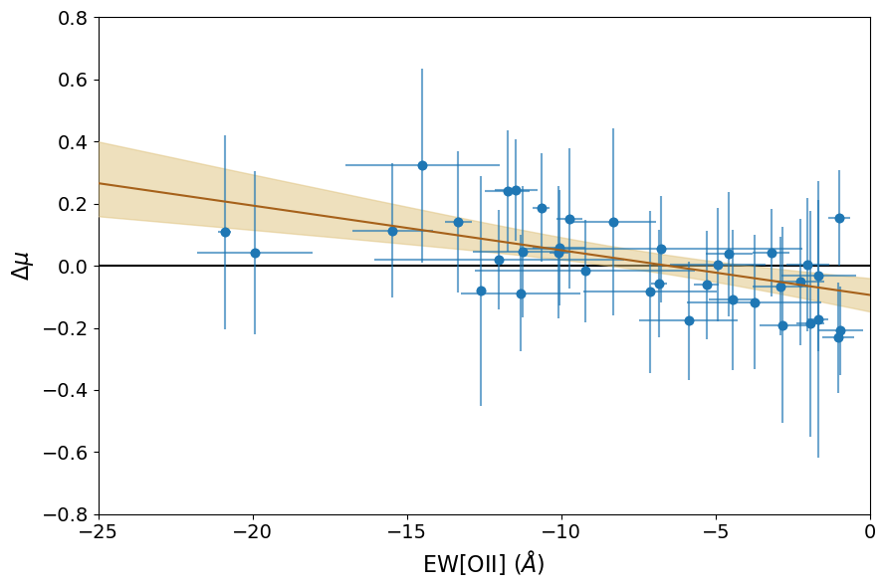
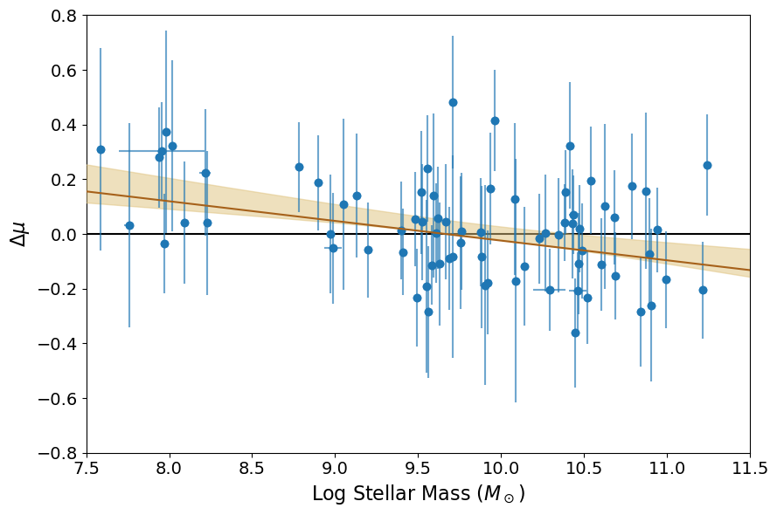


Results - sSFR
Martin et al. 2024
Fainter
$$2.3σ$$
$$2.6σ$$
Brighter
Higher sSFR
Higher Mass
bailey.martin@anu.edu.au
An Extraordinary Journey Into the Transient Sky
3rd April 2025
Notes:
More star forming give larger EW
We find 2.3 sigma correlation
This is equally as strong as the mass correlation, suggesting OII might also be a useful tracer

Slide 12
Correcting for Dust
$$μ=m_{B}−M_{B}+αx_{1}−βc+δ_{host}+δ_{bias}$$
It’s Dust! – Brout & Scolnic 2021
Dust attenuation law varies
with host stellar mass
Does it account for host correlations???
bailey.martin@anu.edu.au
An Extraordinary Journey Into the Transient Sky
3rd April 2025
Notes:
Recently Dillon and dan came up with new scatter model
Involves varying the dust attenuation law as a function of mass
Expect that if dust is the driver, when we apply their corrections, host property correlations should disappear

Slide 13
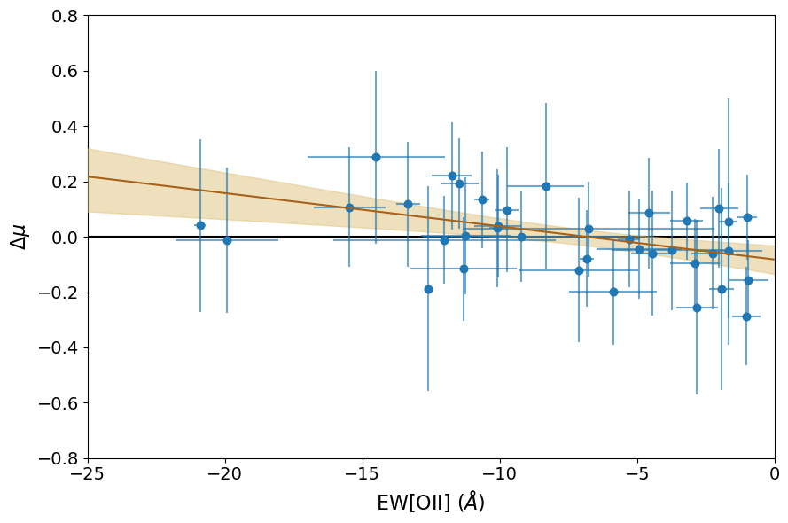


Results – Mass Correction
Before
After
2.3$σ$
2.0$σ$
Martin et al. 2024
bailey.martin@anu.edu.au
An Extraordinary Journey Into the Transient Sky
3rd April 2025
Notes:
Still see a 2 sigma correlation after the correction
Suggests we still aren’t capturing the systematic effects of host galaxies as a whole

Slide 14
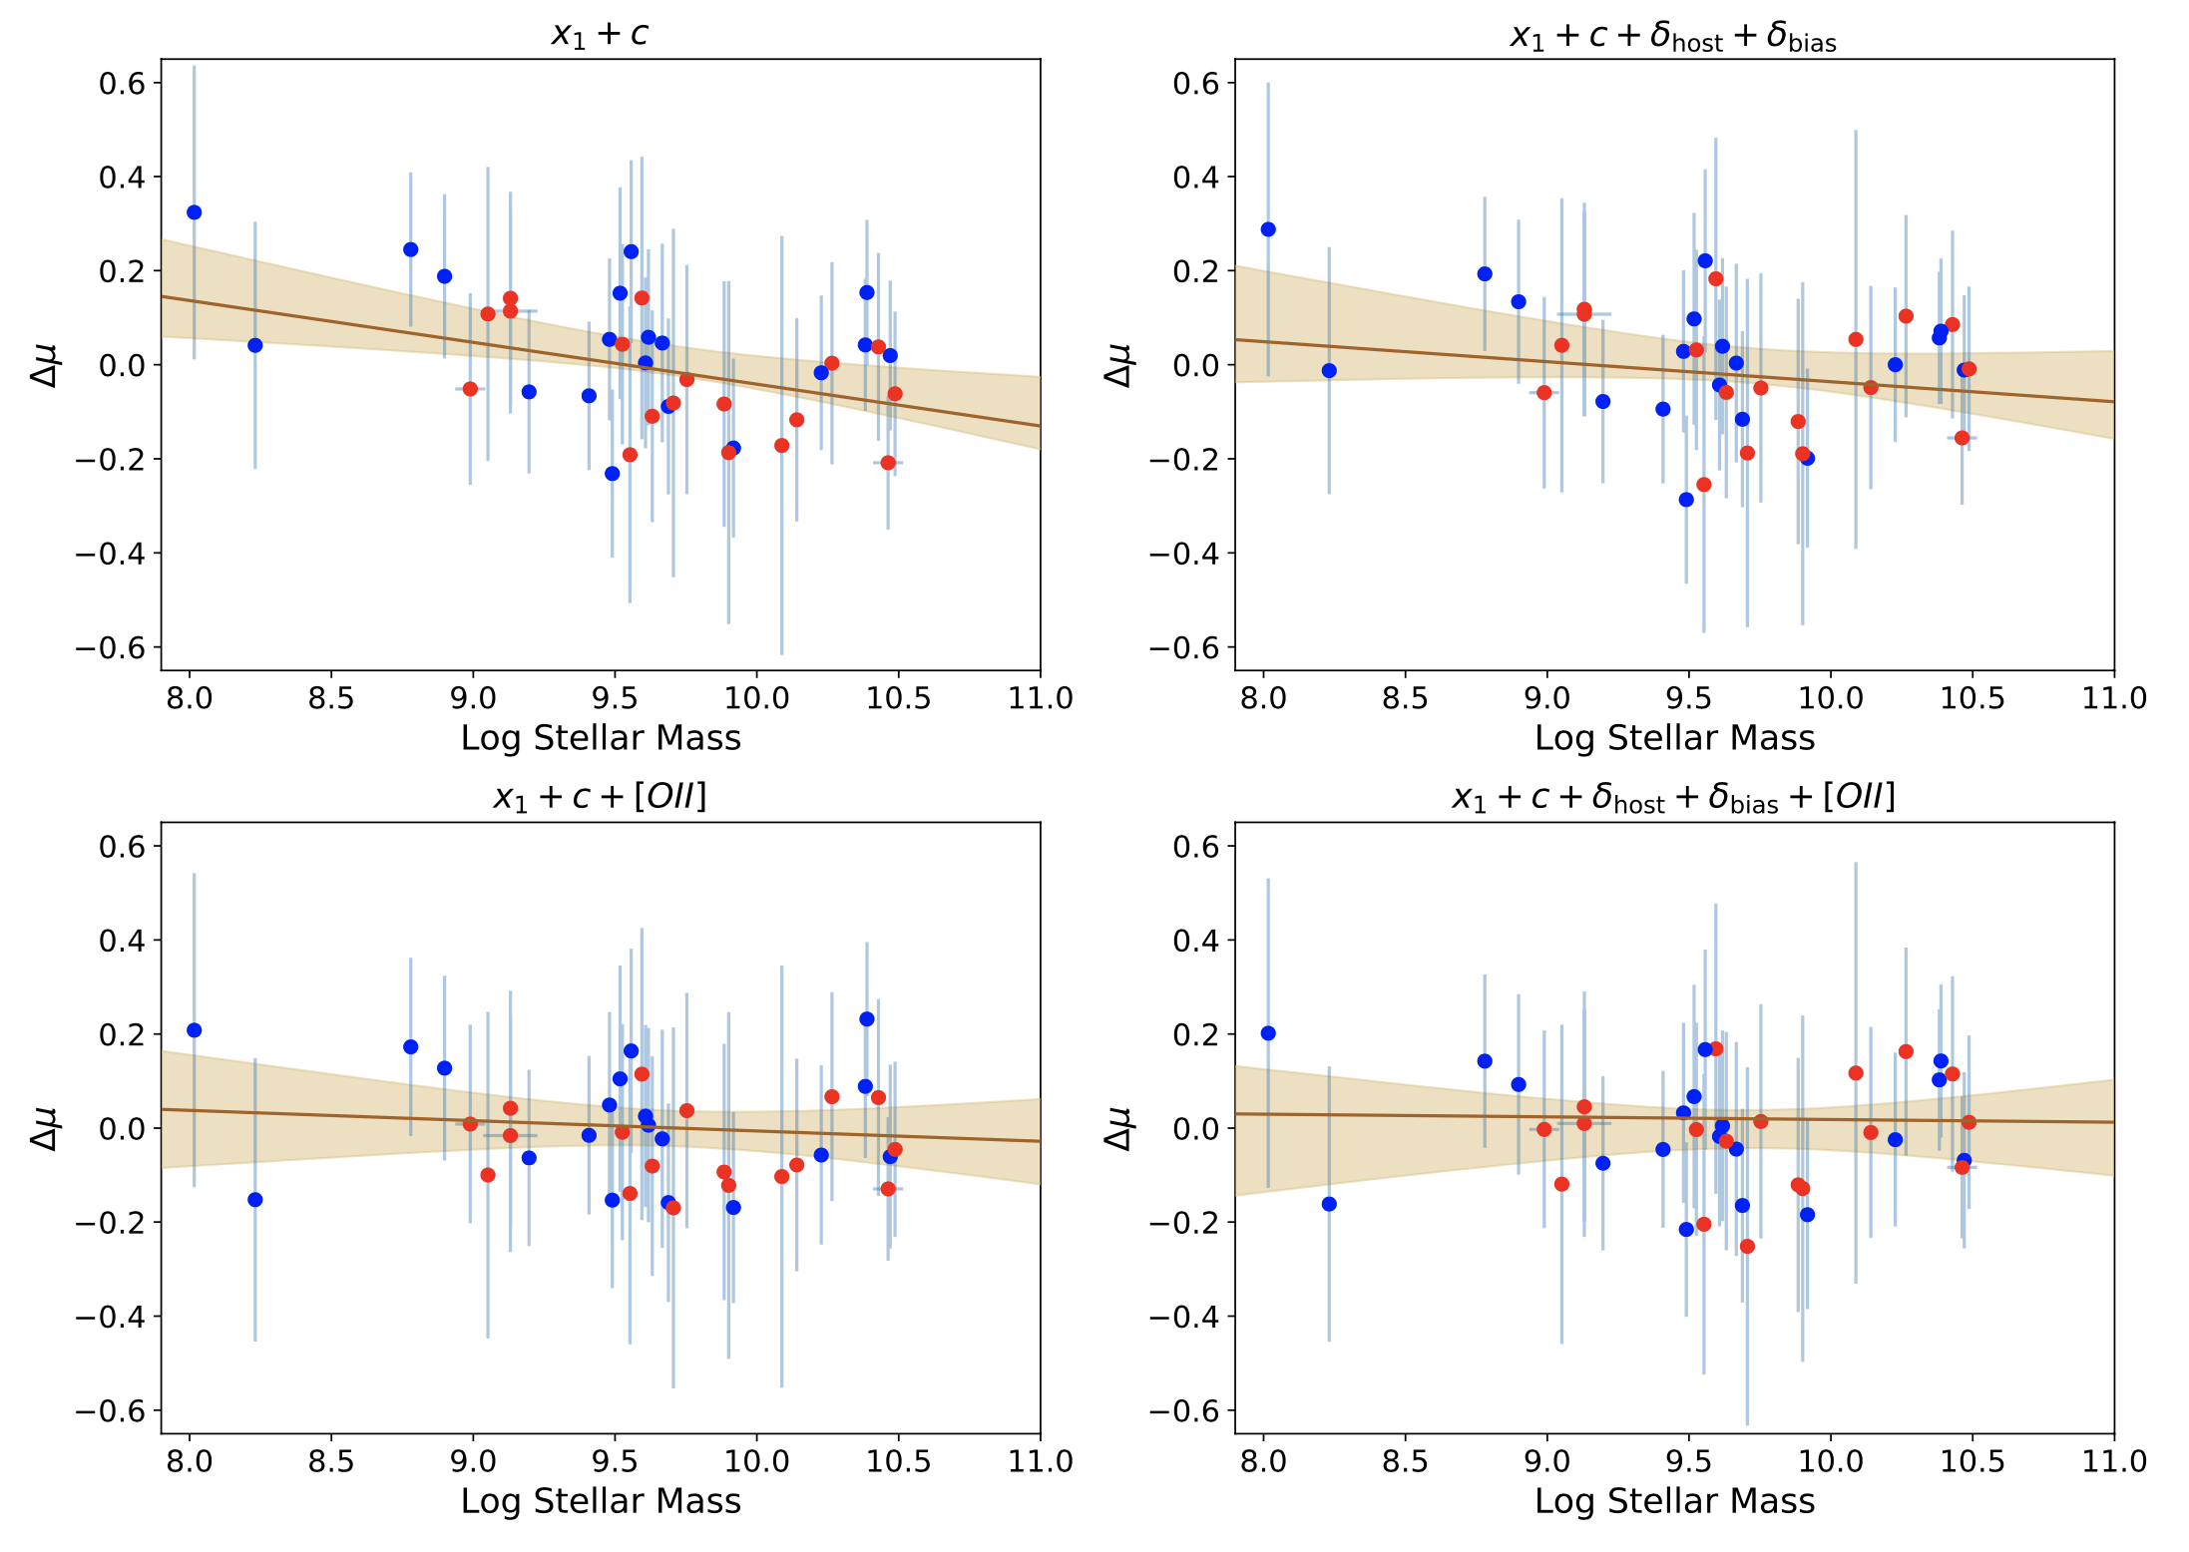








Results – An OII Correction?
Martin et al. 2024
Scatter $=0.135±0.025$
OII Correction
Mass Correction
1.6$σ$
Scatter $=0.110±0.025$
Scatter $=0.119±0.026$
Scatter $=0.130±0.024$
0.3$σ$
0.1$σ$
0.7$σ$
bailey.martin@anu.edu.au
An Extraordinary Journey Into the Transient Sky
3rd April 2025
Notes:
Decided to see impact of OII correction
After OII correction, with no dedicated mass correction, the mass correlation disappears
OII correction also reduces scatter in Hubble residuals to a greater extent
Don’t see any clear improvement when both a mass and OII correction are applied
All suggests OII is a better tracer than stellar mass

Slide 15
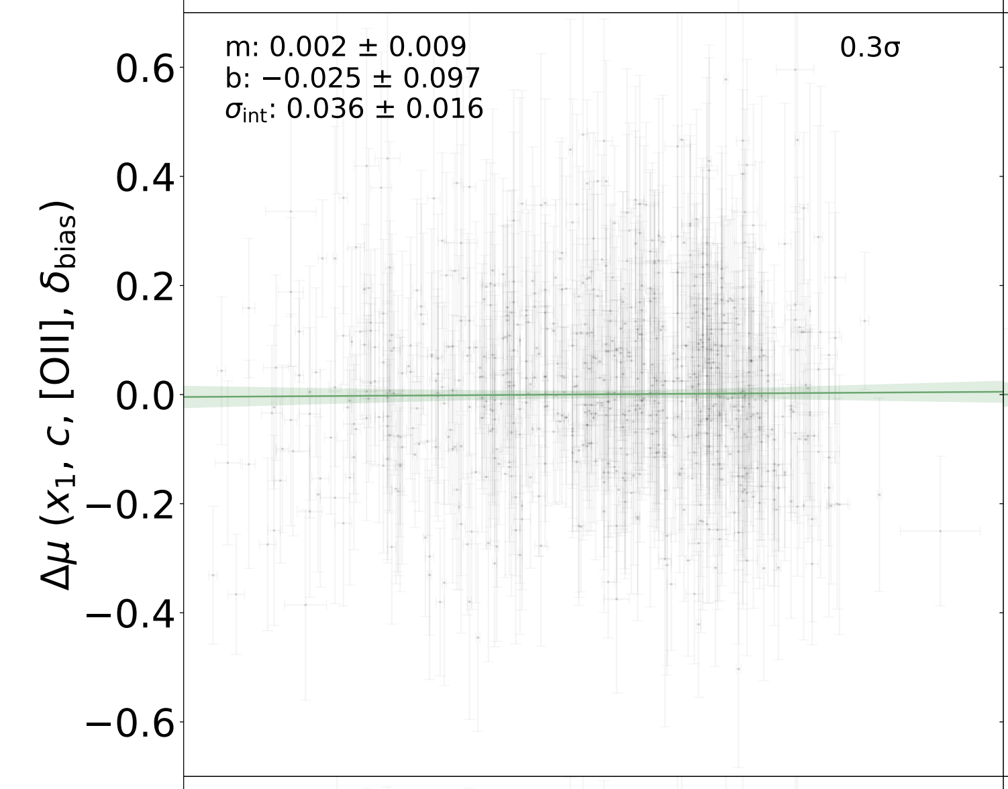
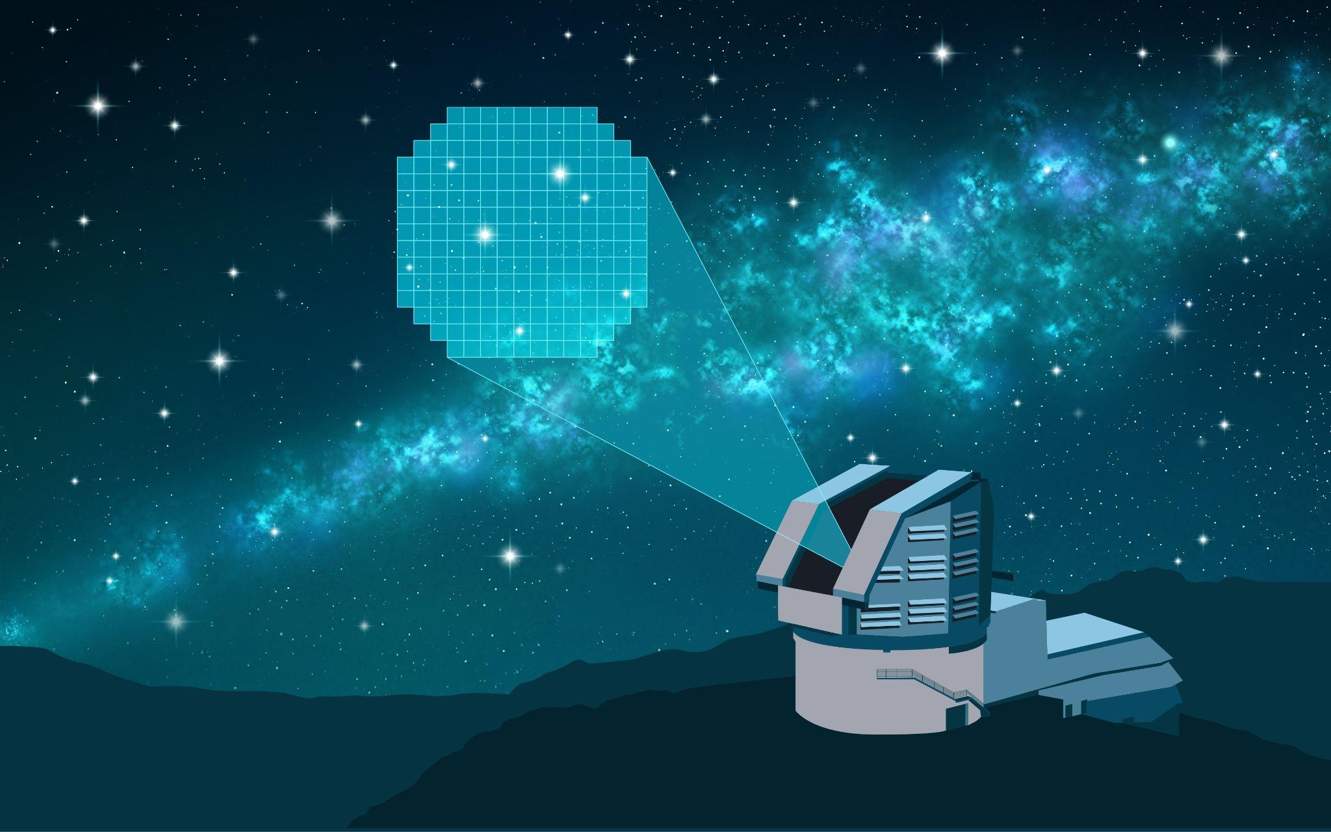
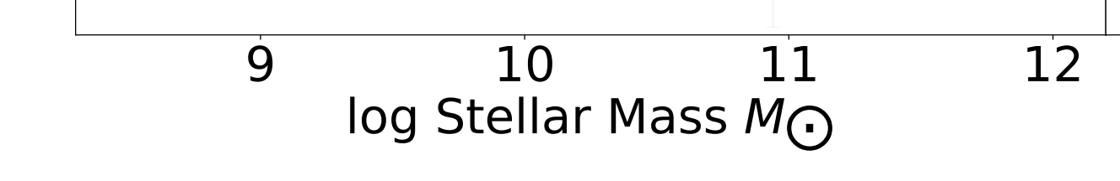

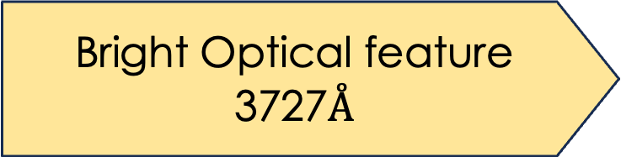
Looking Forward – OII in the Rubin Era
Dixon et al. 2024
Bright Optical feature
3727$Å$
Visible out to
$$z∼1.5$$
Host spectra already
taken for redshifting
bailey.martin@anu.edu.au
An Extraordinary Journey Into the Transient Sky
3rd April 2025
Notes:
Bright at 3727, meaning visible in optical/NIR to z~1.5
Host spectra taken anyway, so measuring and correcting is feasible
Mitchel Dixon demonstrated this with high redshift OzDES spectra. Finds OII correction removes mass correlation

Slide 16
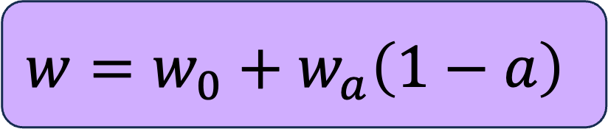
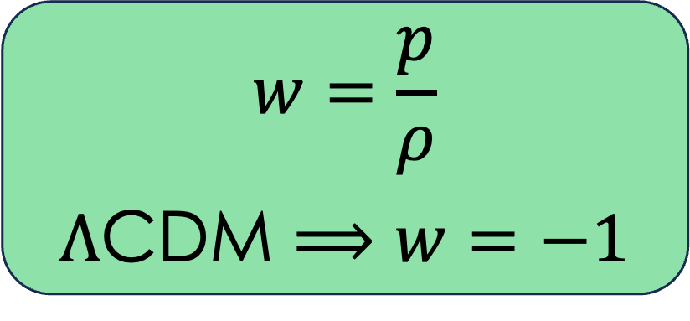
Dark Energy Equation of State
$$w=\frac{p}{ρ}$$
$Λ$CDM $⟹w=−1$
$$w=w_{0}+w_{a}\left(1−a\right)$$
DESI Collaboration 2024
bailey.martin@anu.edu.au
An Extraordinary Journey Into the Transient Sky
3rd April 2025
Notes:
Recently the groundbreaking results from DES 5 year sample and BAO observations with DESI about nature of dark energy
Instead of dark energy being described by einsteins cosmological constant Lambda, they find 4 sigma preference for dark energy that evolves over time
This is a bold claim, need to be sure there are no systematics at play before we rule out Lambda CDM

Slide 17
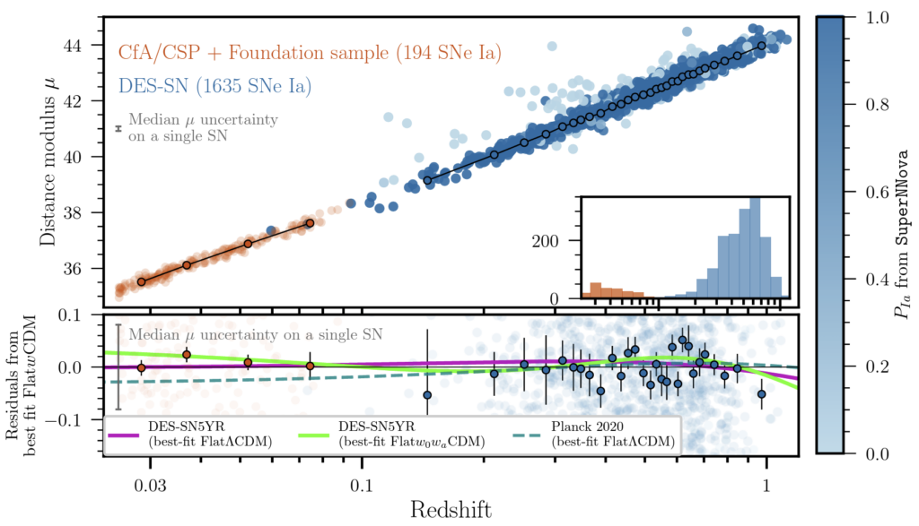
Current Hubble Diagram Anchor
Dark Energy Survey Collaboration 2024
Asteroid Terrestrieal-impact Last Alert System
(ATLAS)
Panoramic Survey Telescope And Rapid Response System
(PanSTARRS)
Carnegie
Supernovae
Project
(CSP)
All-Sky Automated
Survey for
SuperNovae
(ASASSN)
bailey.martin@anu.edu.au
An Extraordinary Journey Into the Transient Sky
3rd April 2025
Notes:
Hubble Diagram from DES
Problem is the low redshift sample of calibration SNe they use for their data
Is an assortment of SNe from different instruments, which induces instrumental biases

Slide 18
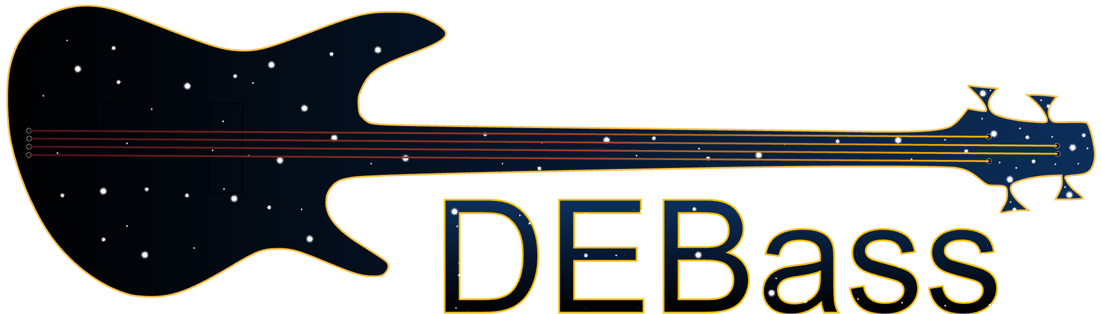
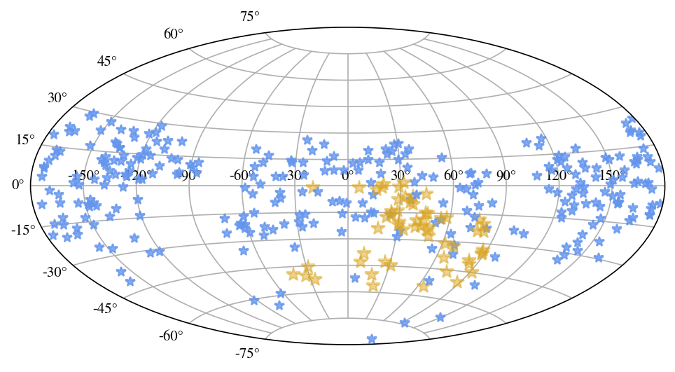
DEBASS – Survey Design
Targeted survey:
ATLAS, ASASSN, ZTF
Dark Energy Bedrock All-Sky Supernovae program
500 Low-z SNe Ia
Sherman et al. (in prep)
g r i z DECam photometry
10-15s exposures
Spectroscopic follow-up with ANU 2.3m Telescope
Dedicated post-SN host galaxy follow-up program
bailey.martin@anu.edu.au
An Extraordinary Journey Into the Transient Sky
3rd April 2025
Notes:
New survey DEBASS is a sample of 500 low-z type Ias with DECam
Same instrument as high-z DES sample
DEBASS is targeted survey with targets primarily selected from ATLAS
Photometry begins as soon as possible, before spectroscopic classification, in order to catch pre-peak data
In Aus, all SNe are followed up with ANU 2.3m Telescope to obtain spec classifications and redshifts
I am personally calculating the redshifts for the Hubble diagram and working with Chris on data reduction and classification
I am leading a dedicated host galaxy follow up program for DEBASS, in order to get detailed IFU spectra after SN has faded
This will extend sample in my first paper by another order of magnitude
Plot shows all SNe observed so far, yellow have SALT3 fits

Slide 19
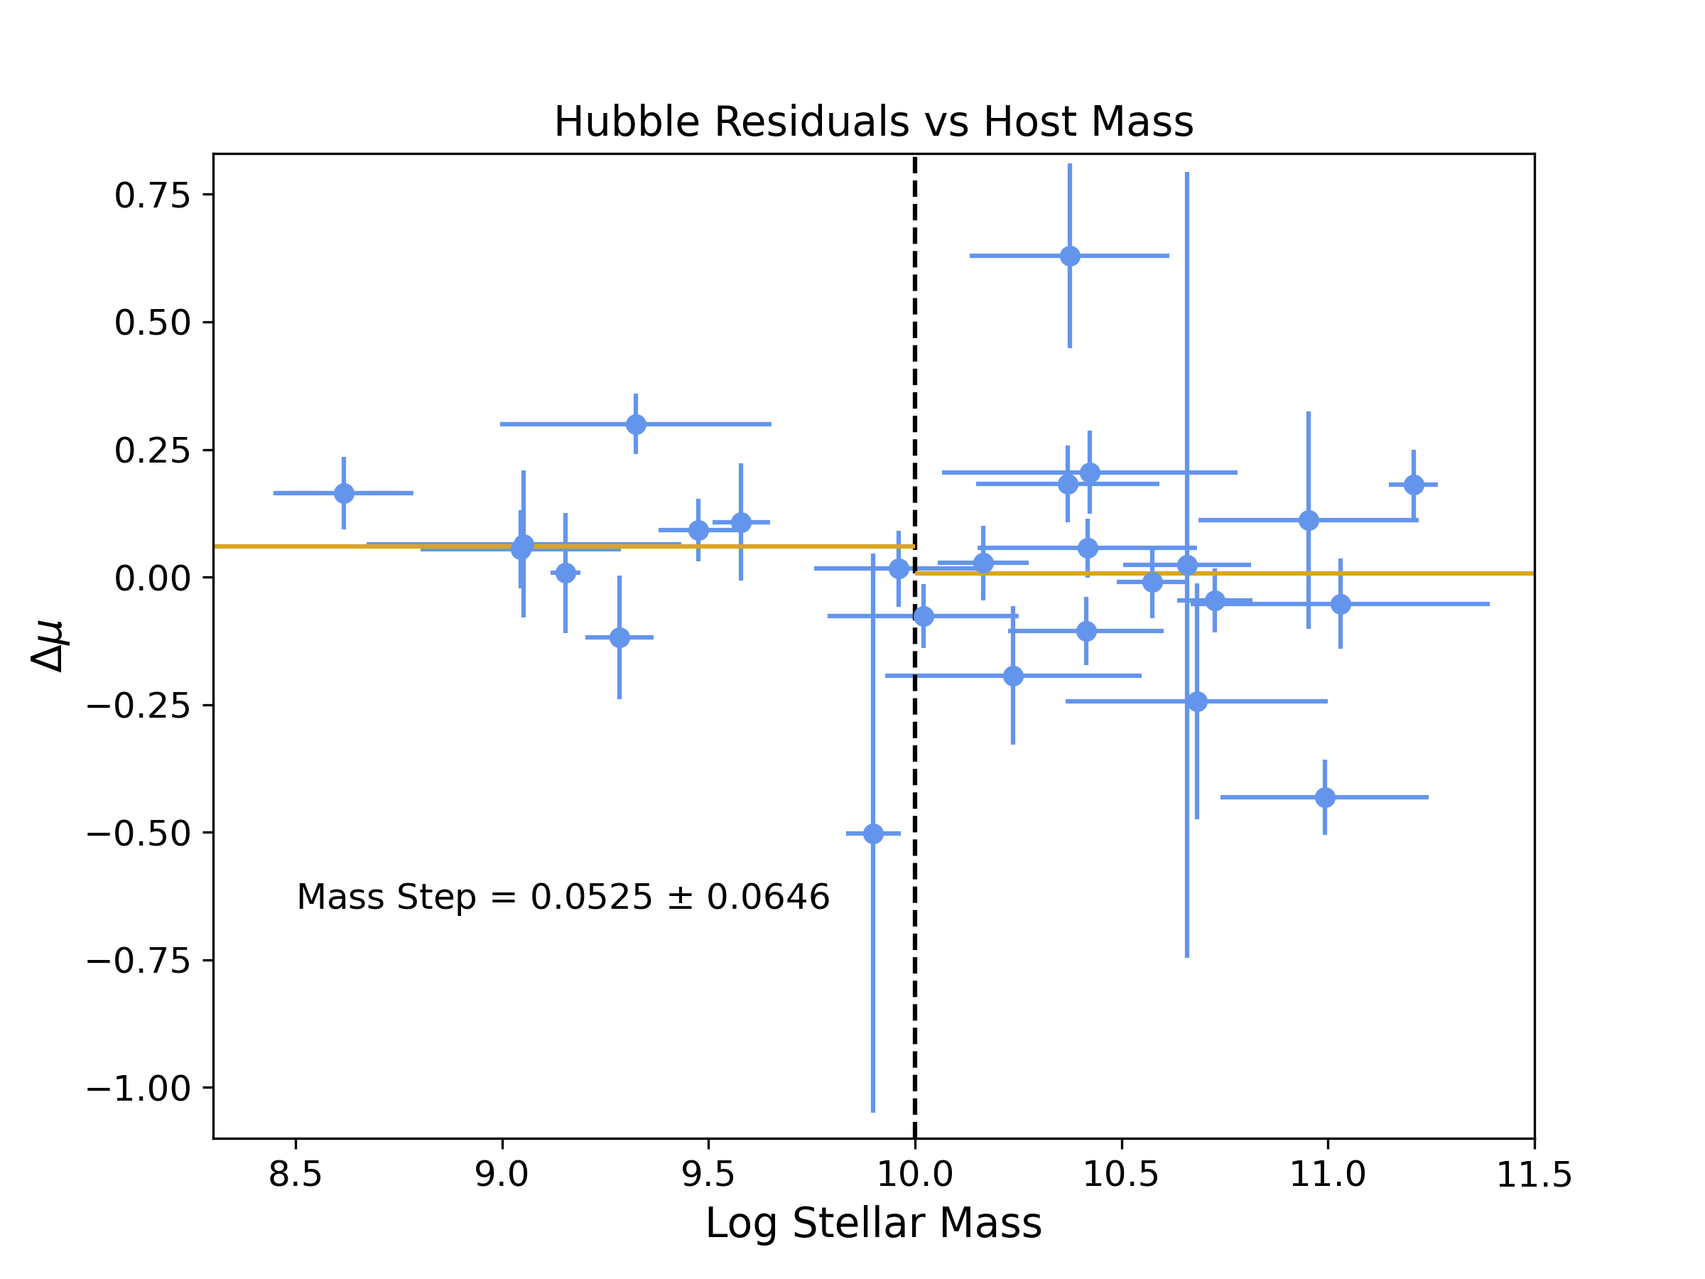
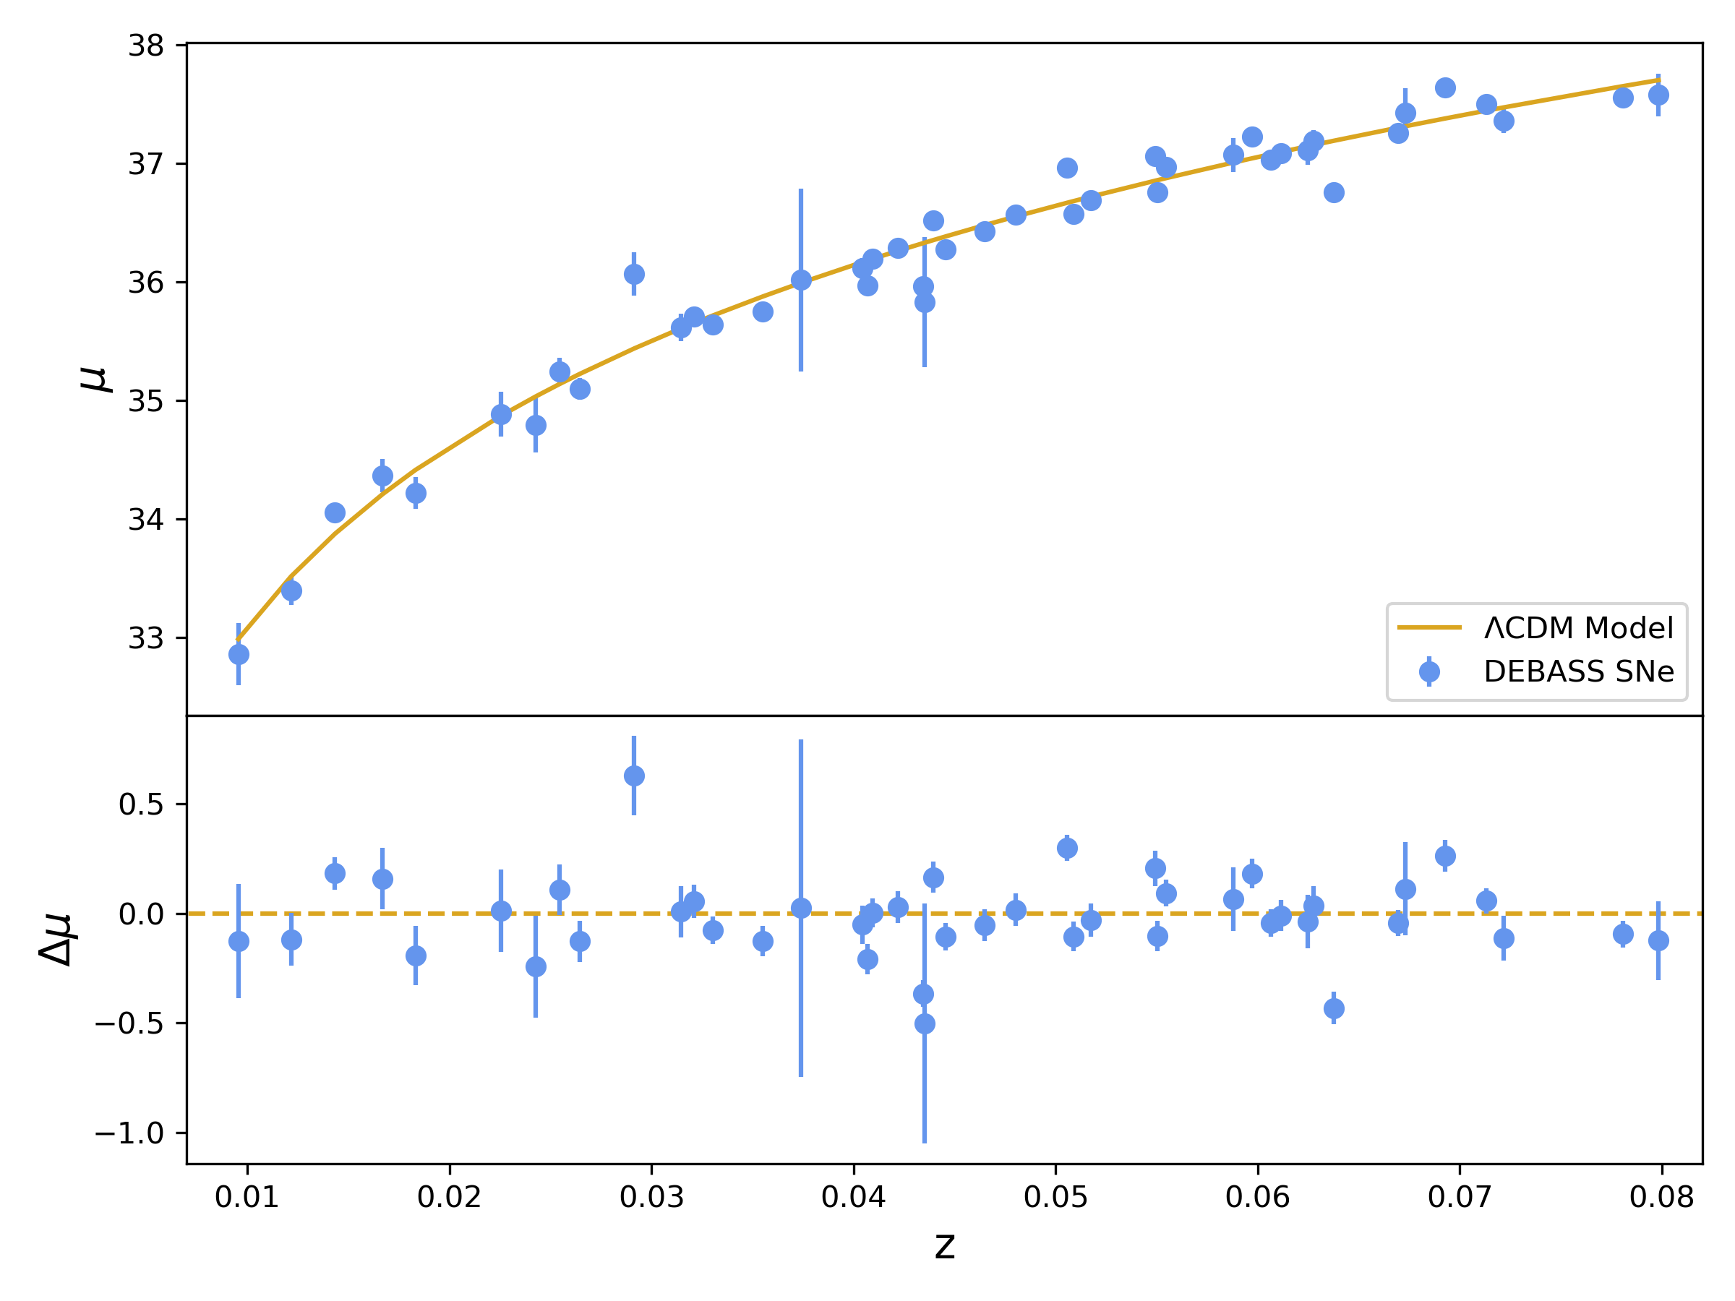
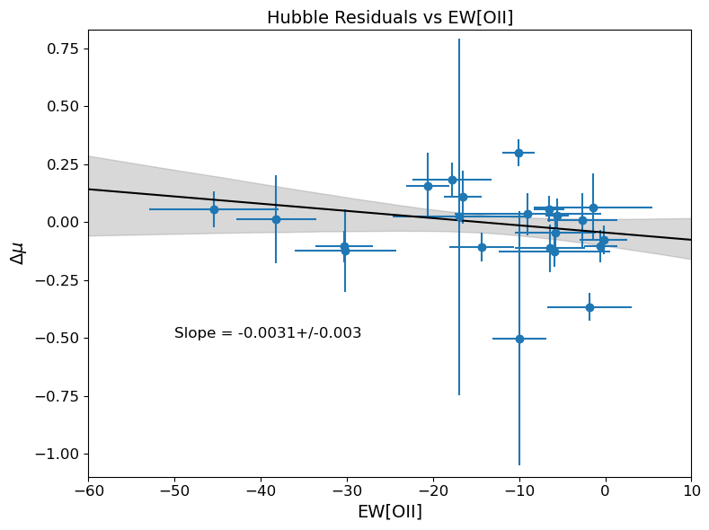

DEBASS – First Results
$σ=0.11$ mag
bailey.martin@anu.edu.au
An Extraordinary Journey Into the Transient Sky
3rd April 2025
Notes:
First DEBASS hubble diagram has scatter of 0.11mag, down from 0.16 in preexisting sample
These have been purely corrected for stretch and colour, so no host or bias corrections have been applied
I have also made some plots of Hubble residuals against host properties we have observed so far
Still see a mass step, still see OII correlation

Slide 20
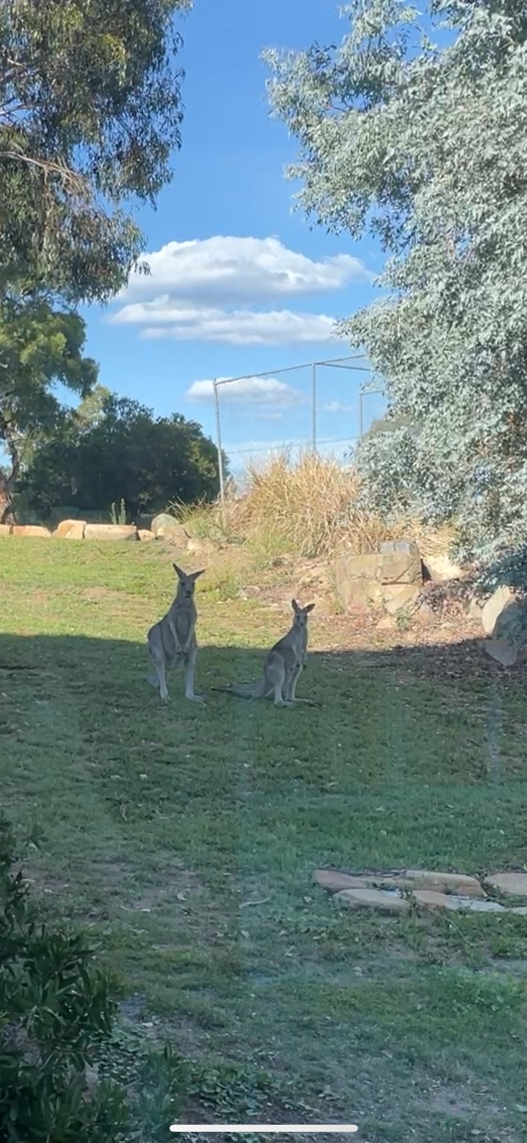

Summary
In the Rubin Era, systematics
will dominate statistics
Check out my paper!
EW[OII] is a more effective tracer of host systematics than stellar mass
Current low-z SN Ia sample contains significant instrumental biases
DEBASS is a new low-z sample of 500 SNe Ia from a single instrument
bailey.martin@anu.edu.au
An Extraordinary Journey Into the Transient Sky
3rd April 2025
Notes:
In rubin era, systematics will dominate statistics as largest source of error, one of which is host galaxy
We find that OII is a better tracer of this host systematic than stellar mass which has been used for the last decade
Another systematic impacting SN samples is the set of low redshift SNe used for calibration, as they contain instrumental biases
DEBASS is replacement HD anchor, comprising 500 Type Ias observed with a single instrument
Great opportunity for host galaxy investigation, and so I am leading a dedicated host follow-up

Slide 21
Extra Slides

Slide 22
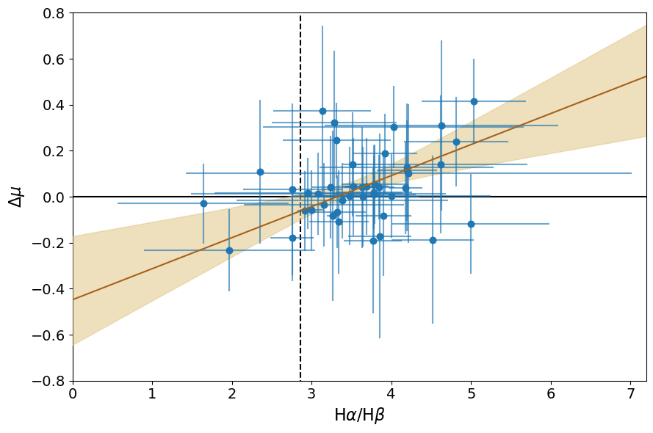

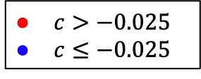
Results - Dust
$Hα/Hβ$ describes dust reddening
1.7$σ$ correlation for complete dataset
Driven by Blue SNe (2.2$σ$)
Red SNe show no correlation
Inaccurate colour correction?
Martin et al. 2024
$c>−0.025$
$c≤−0.025$
Fainter
Brighter
Dustier
bailey.martin@anu.edu.au
An Extraordinary Journey Into the Transient Sky
3rd April 2025

Slide 23


Results – Mass Correction
Before
After
2.2$σ$
2.2$σ$
Martin et al. 2024
bailey.martin@anu.edu.au
An Extraordinary Journey Into the Transient Sky
3rd April 2025

Slide 24
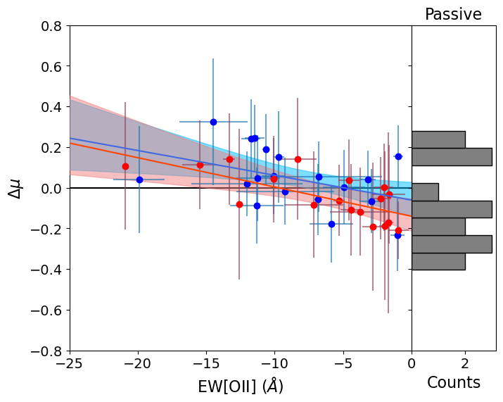
What about Passive Galaxies?
bailey.martin@anu.edu.au
An Extraordinary Journey Into the Transient Sky
3rd April 2025

Slide 25
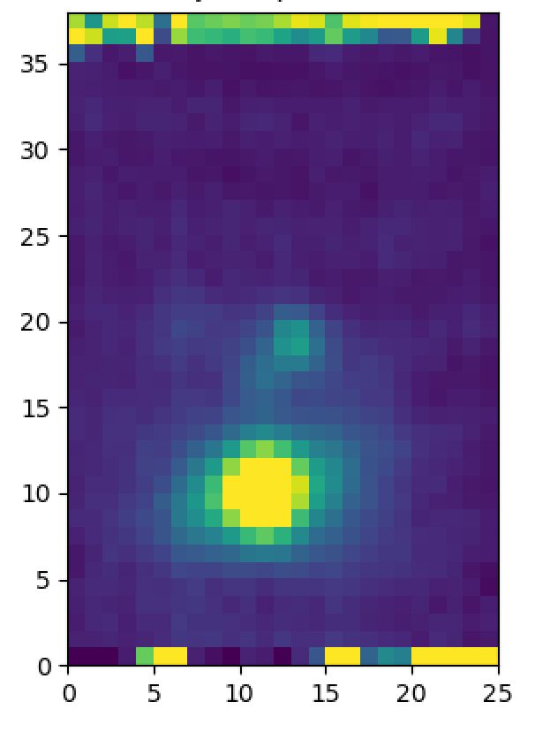
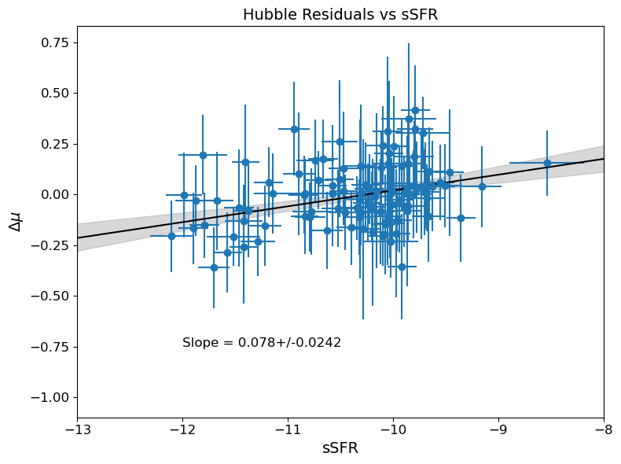

Future Work
IFU Spectra for
Local Environments
Multi-Wavelength
MIR – WISE
Radio – Wallaby (HI)
bailey.martin@anu.edu.au
An Extraordinary Journey Into the Transient Sky
3rd April 2025

Slide 26




Results – An OII Correction?
Martin et al. 2024
1.7$σ$
OII Correction
Mass Correction
0.2$σ$
0.1$σ$
1.4$σ$
bailey.martin@anu.edu.au
An Extraordinary Journey Into the Transient Sky
3rd April 2025

Slide 27
The Current Picture
Photometry
Spectroscopy
Gas-Phase Metallicity
Stellar Age
Pan et al. 2014
Childress et al. 2013
Campbell et al. 2016
Rose et al. 2019
Galbany et al. 2022
sSFR
Stellar Mass
IFS
Kelly et al. 2010
Lampeitl et al. 2010
D’Andrea et al. 2011
Sullivan et al. 2010
Rigault et al. 2020
My Work
Uddin et al. 2017
Dixon et al. 2022
Smith et al. 2020
Kelsey et al. 2021
*Not an exhaustive list
bailey.martin@anu.edu.au
An Extraordinary Journey Into the Transient Sky
3rd April 2025

Slide 28

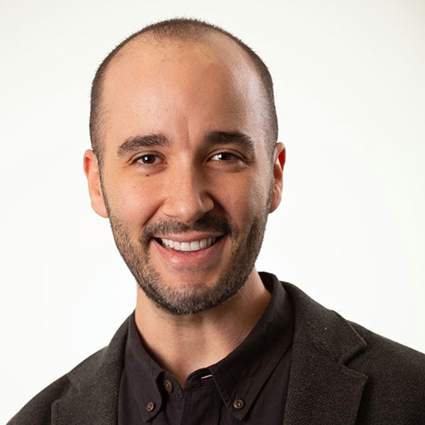

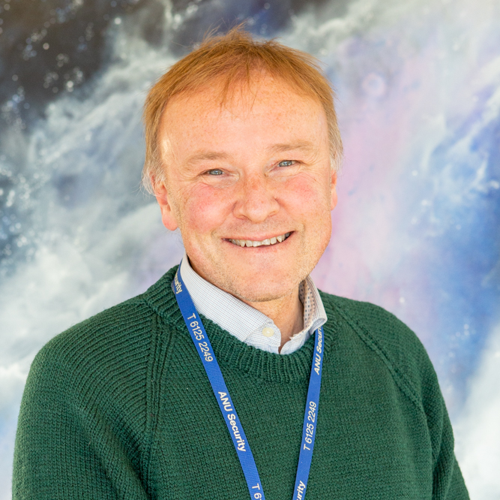


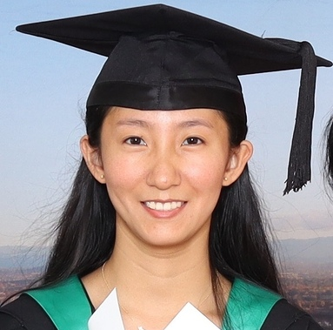

DEBASS Team
Bailey Martin
(ANU)
SN Classification
Redshifts
Host galaxy follow-up lead
Dingyuan Cao
(ANU)
Host galaxy masses and U-R colour
dDLR measurement
Patrick Armstrong
(ANU)
DEBASS data products
Database manager
Nora Sherman
(Boston)
Light-curve fitting
Cosmological
analysis
Chris Lidman
(ANU)
Australian DEBASS lead
SN classification
Maria Acevedo
(Duke)
Light-curve fitting
Cosmological
analysis
Dillon Brout
(Boston)
DEBASS PI
Target Selection
Observing
prep
bailey.martin@anu.edu.au
An Extraordinary Journey Into the Transient Sky
3rd April 2025

