Slide 1
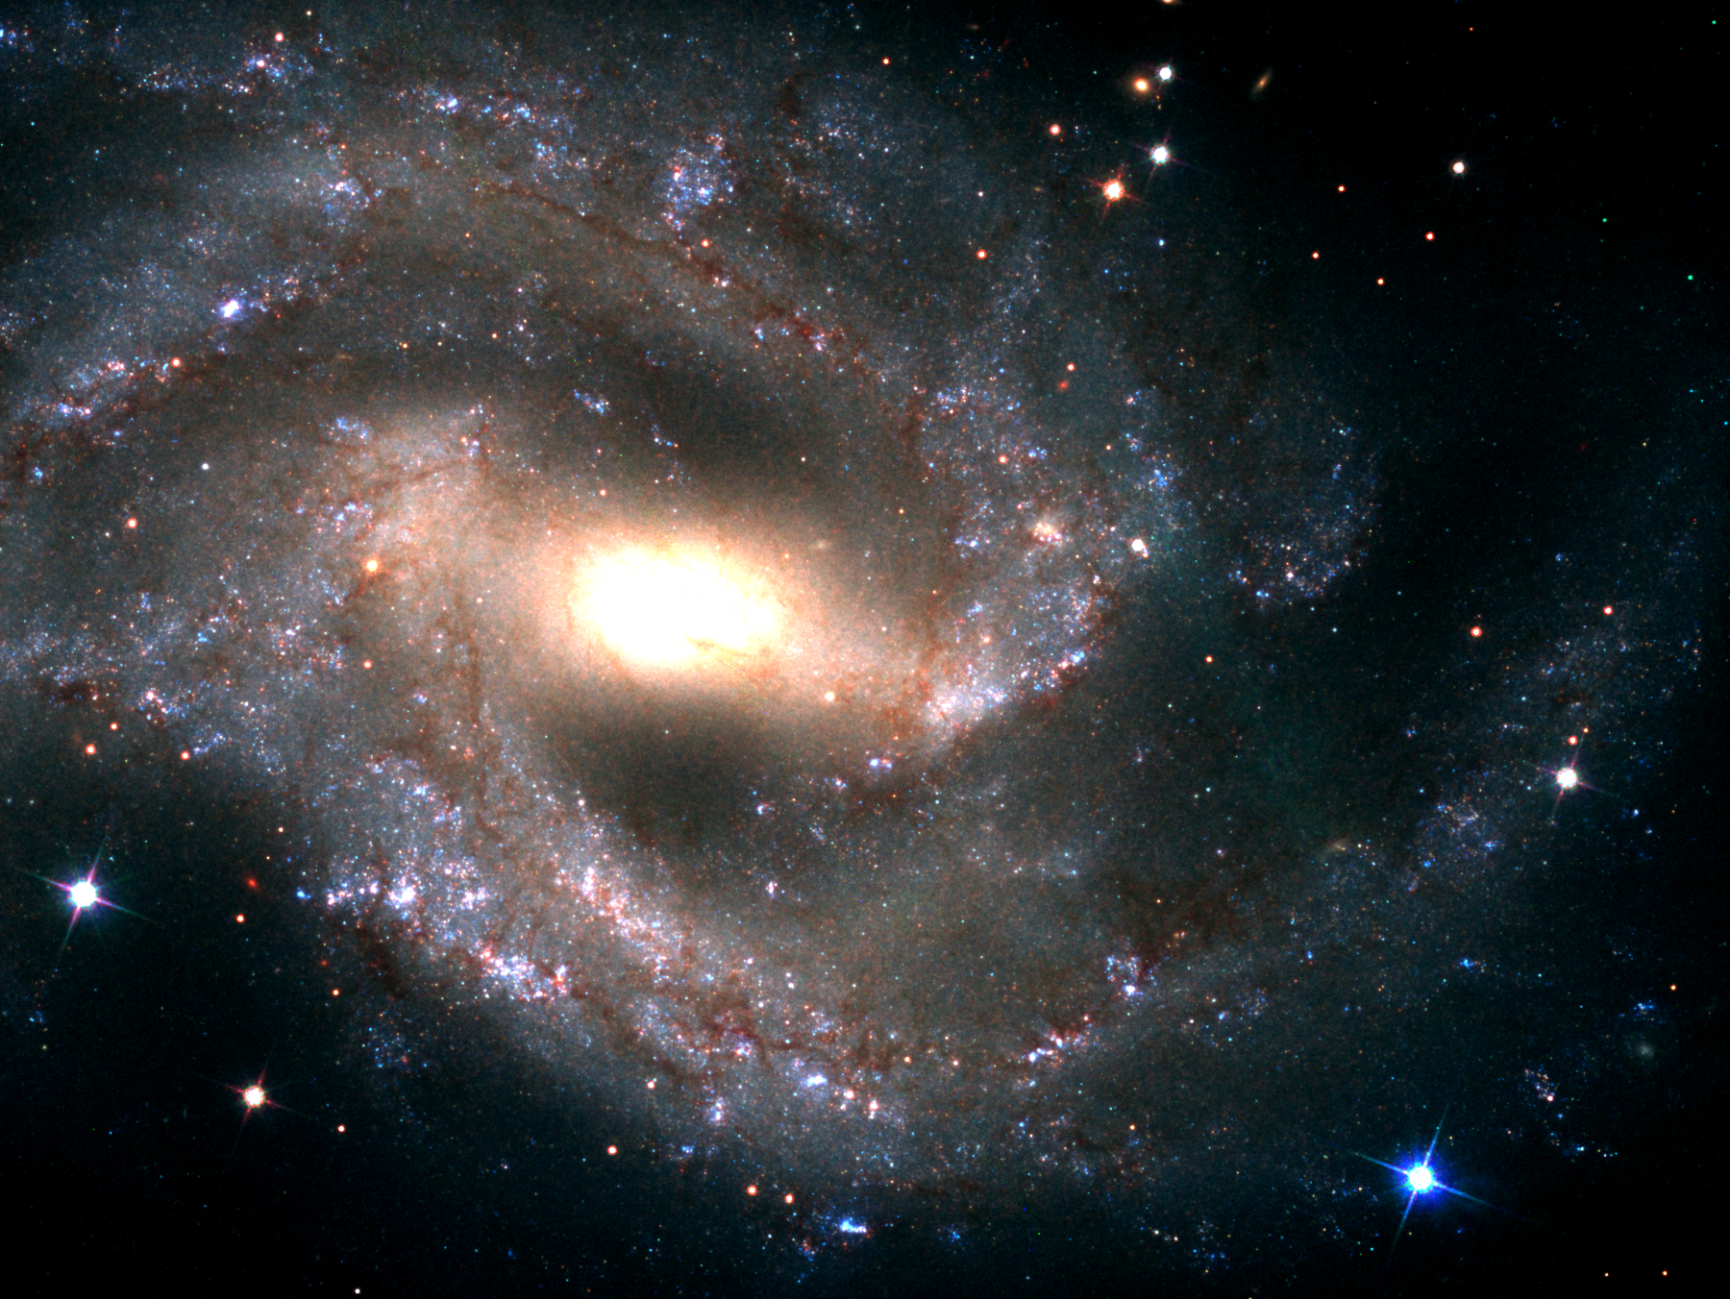
Looking Ahead: Late-time observations of Type Ia supernovae with the
Hubble Space Telescope
Huei Sears (Rutgers University)
Or Graur, Saurabh W. Jha, + others!
SN 2018gv

Slide 2

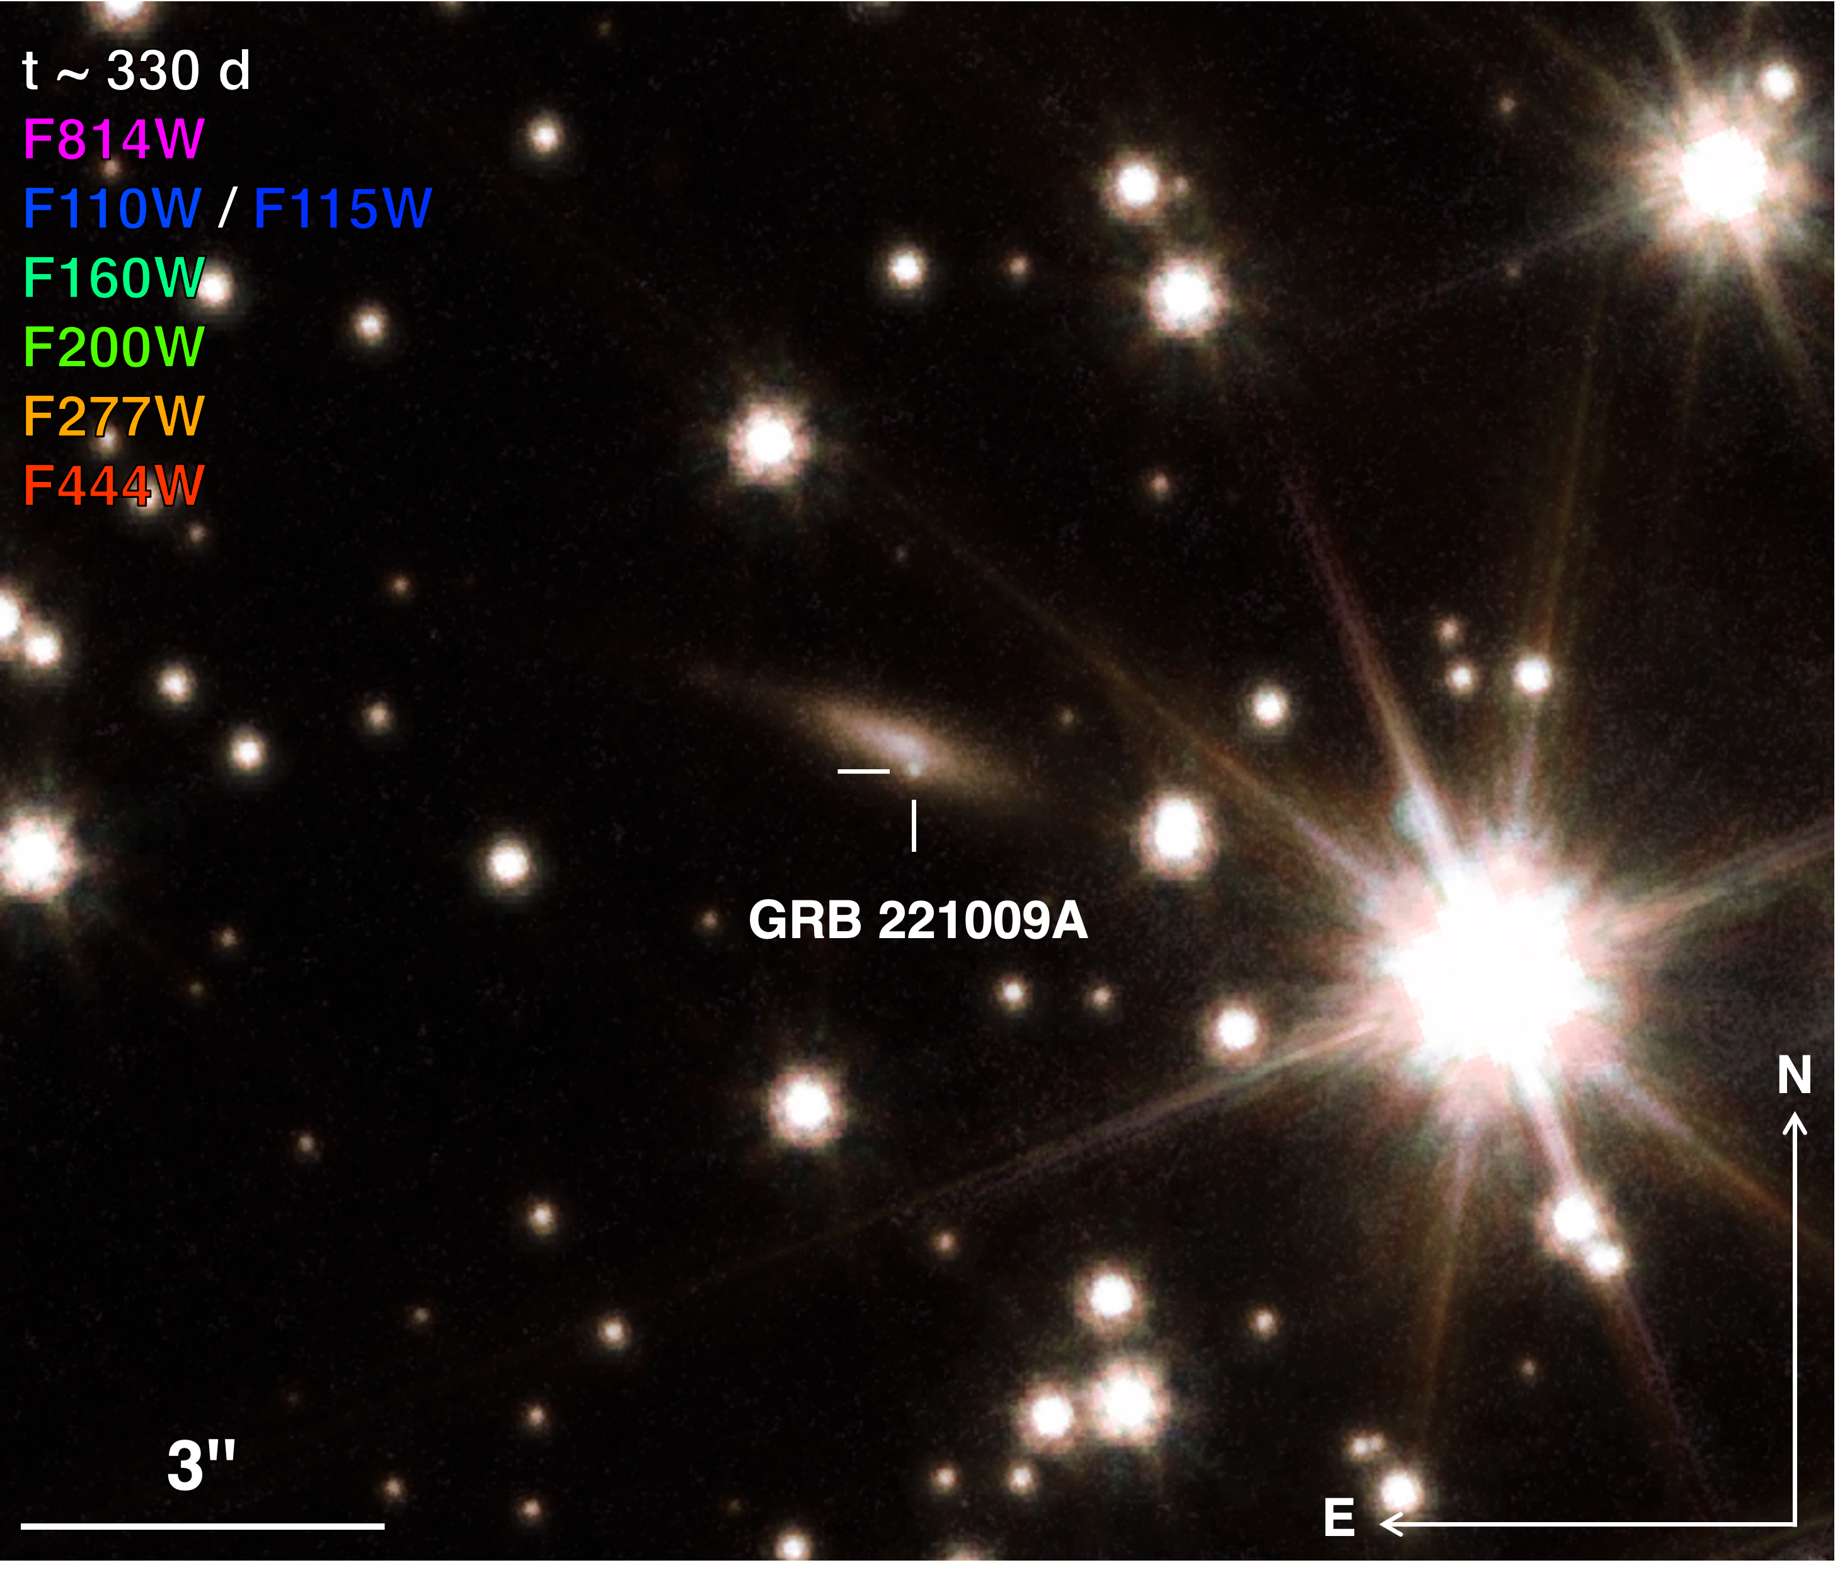
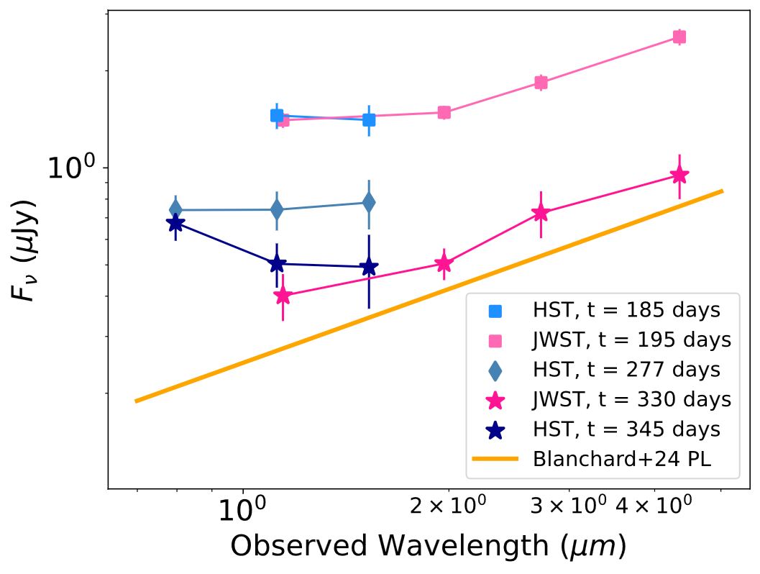
late-time HST + JWST observations of
GRB 221009A
with Ryan Chornock, Peter Blanchard, Raffaella Margutti, + others!
Sears+ 2025
Huei Sears (huei.sears@rutgers.edu)
An Extraordinary Journey Into The Transient Sky 04/03/2025

Slide 3
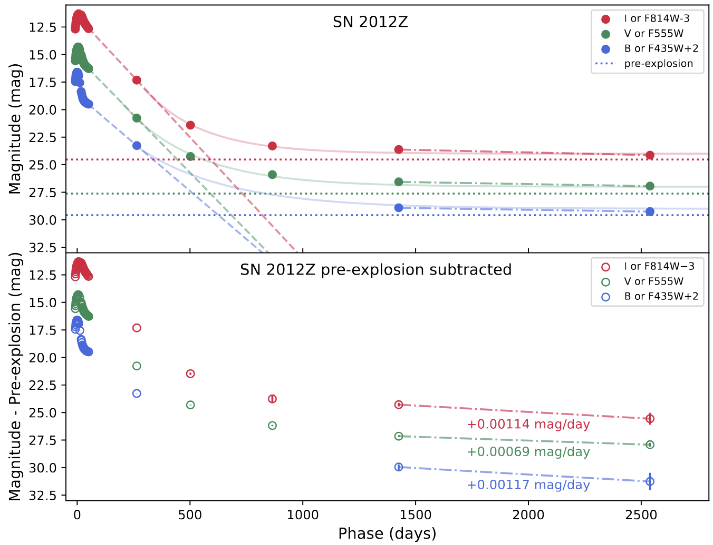
late-time HST observations of
SN 2012Z
led by Michaela Schwab, a post-bacc at Rutgers!
arXiv: 2504.01063
Huei Sears (huei.sears@rutgers.edu)
An Extraordinary Journey Into The Transient Sky 04/03/2025

Slide 4


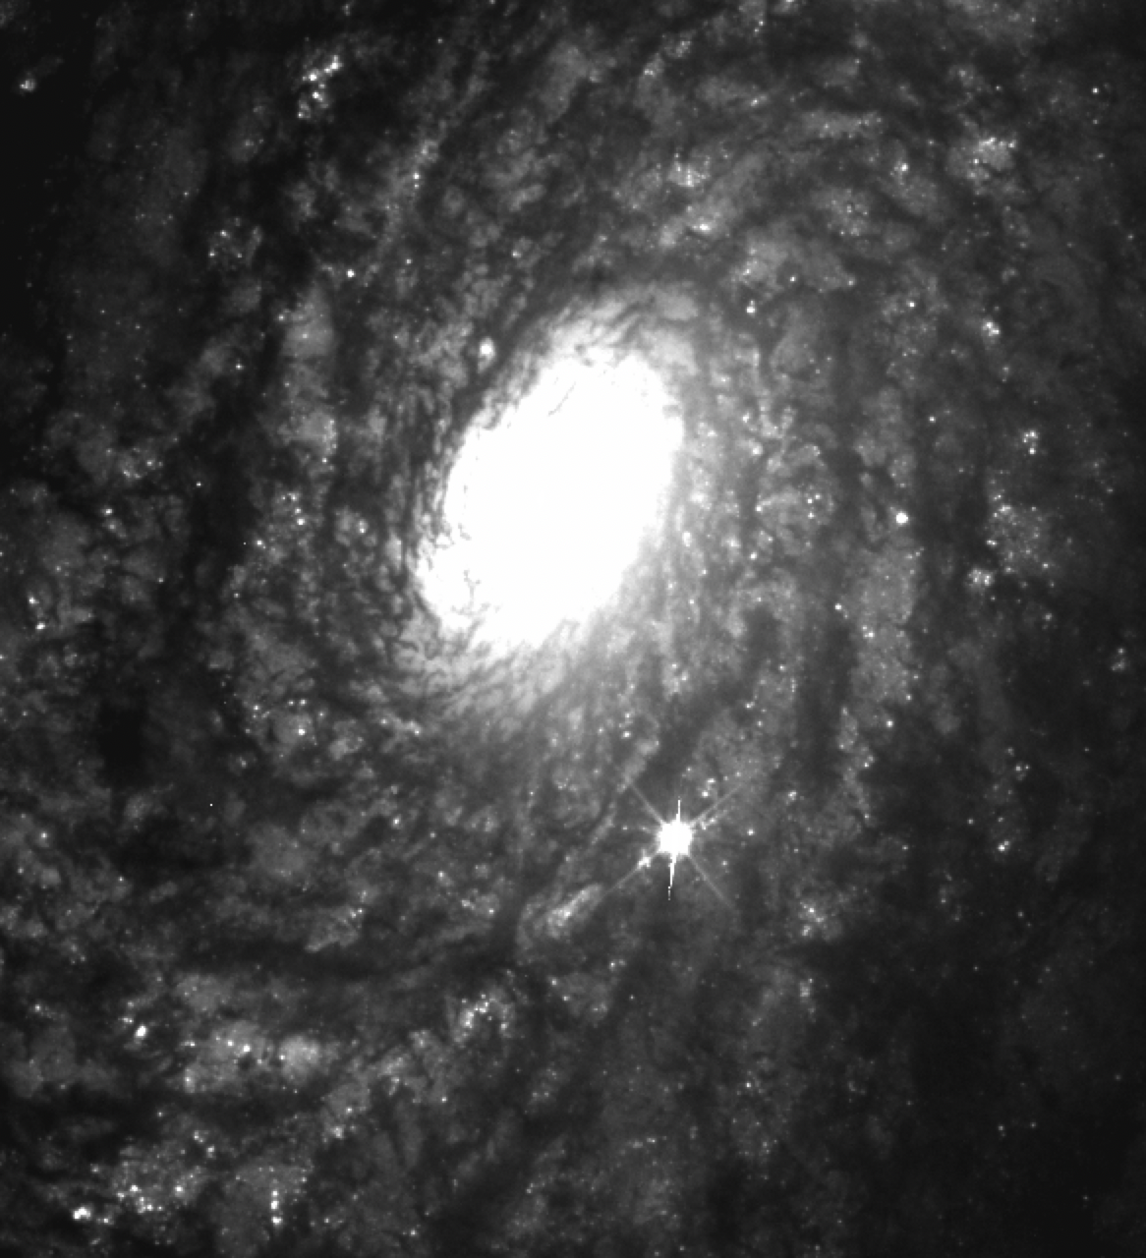
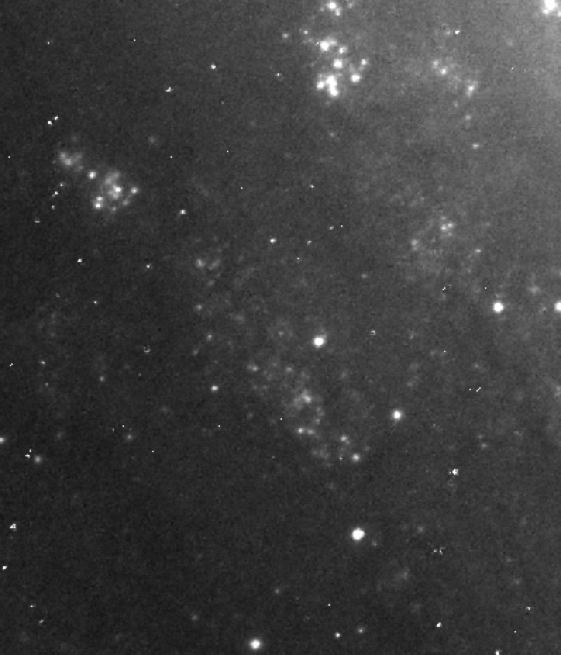
late-time HST observations of
Type Ia SNe
with Or Graur, Saurabh W. Jha, + others!
2021J
2021jad
Huei Sears (huei.sears@rutgers.edu)
An Extraordinary Journey Into The Transient Sky 04/03/2025

Slide 5
SN Ia cosmology is now limited by systematics, one of which is the nature of the progenitor. Why?
Because Type Ia supernovae are not homogeneous.
i) Do all Type Ia subtypes come from the same channel?
ii) We only use “normal” Type Ia supernovae for cosmology, but are we
selecting them properly?
narrow Hydrogen
CO WD + SD?
Ian (Ia-CSM)
bright
Ia-91T
M. Phillips+2024
weak Si
Ia-99aa
Same progenitor?
Silicon
“normal”
Ia
CO WD + WD?
Ia-91bg
faint
slow
Ia-02es
slower
Ia-02cx (Iax)
CO WD + He?
Huei Sears (huei.sears@rutgers.edu)
An Extraordinary Journey Into The Transient Sky 04/03/2025

Slide 6
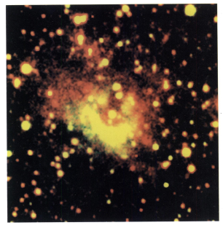
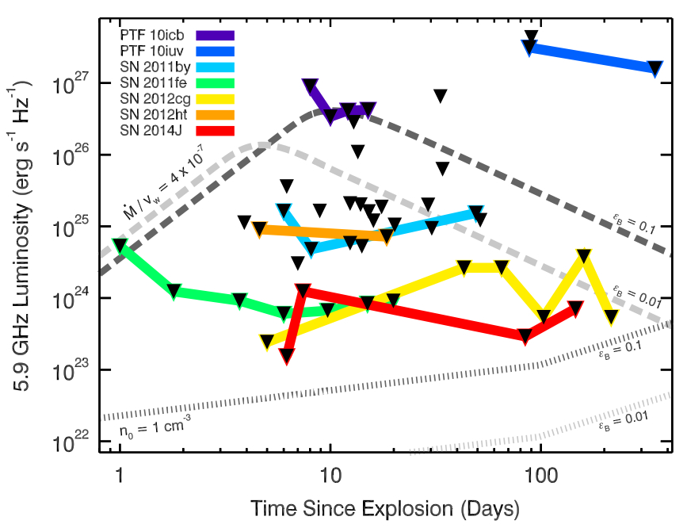
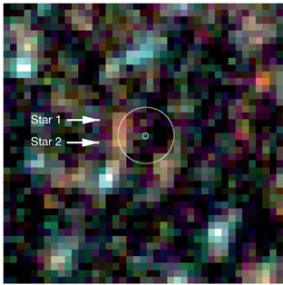
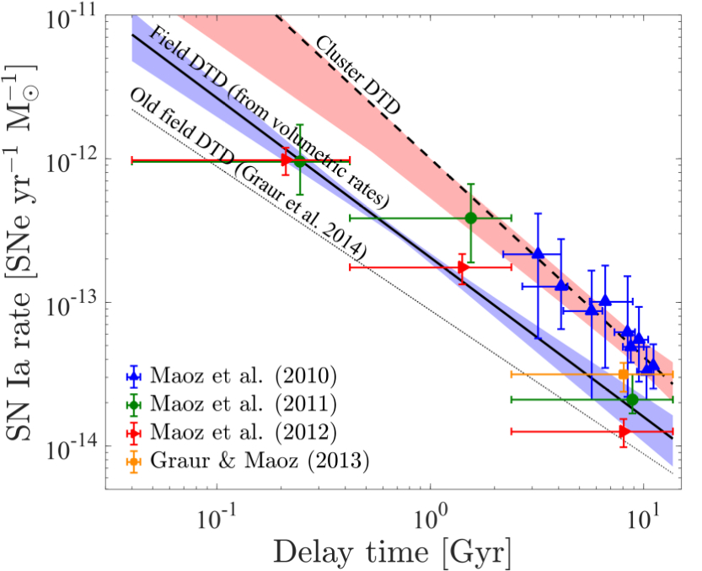
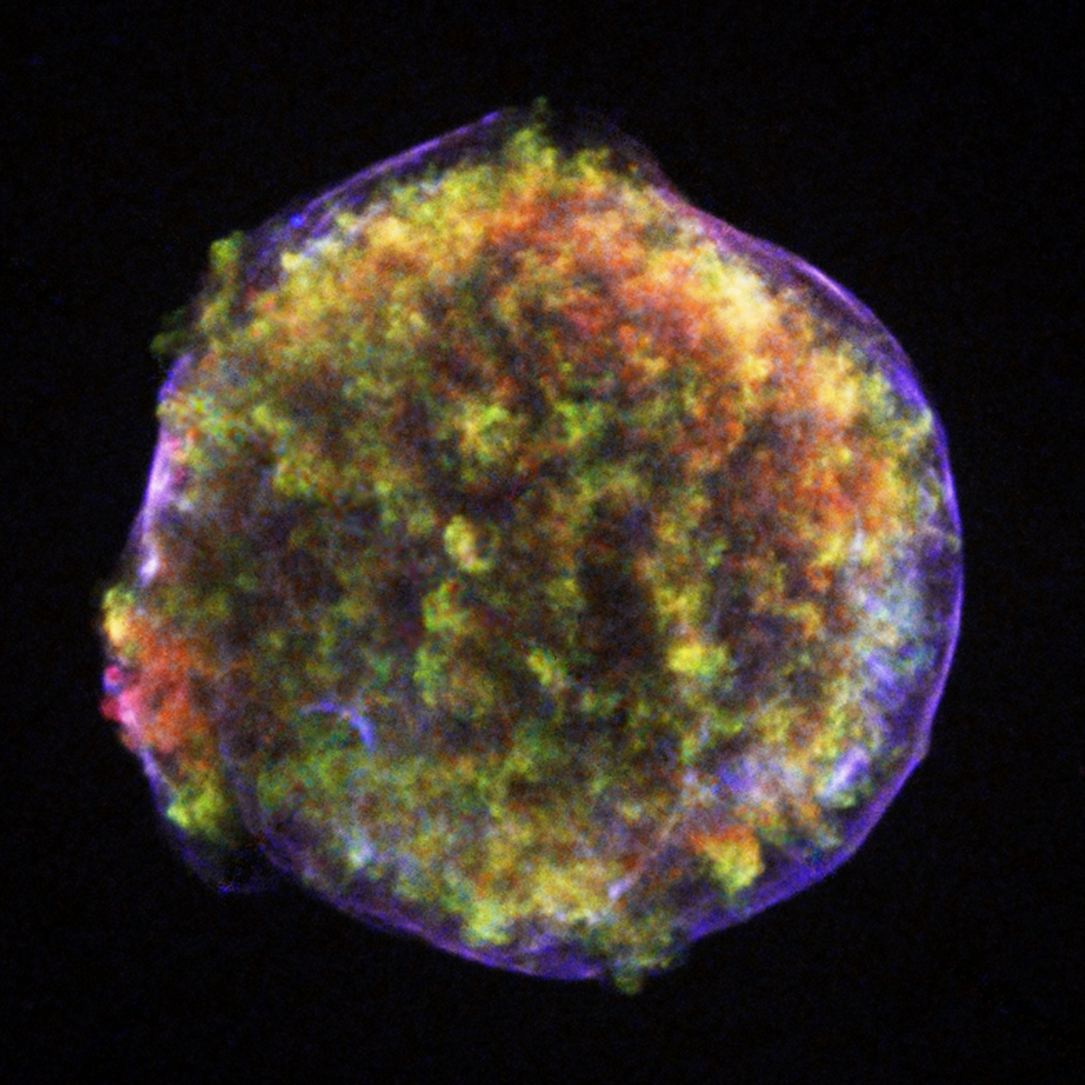
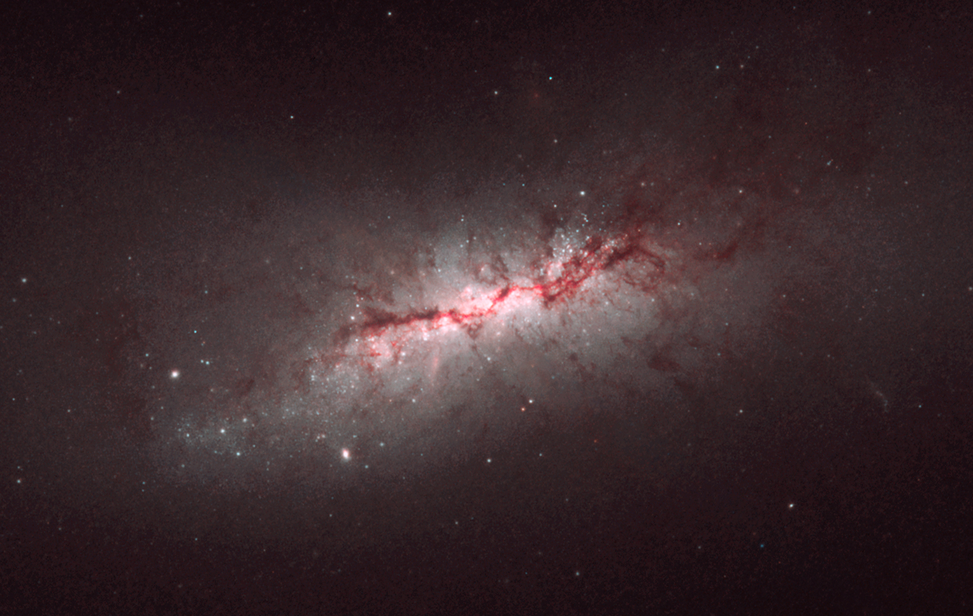
Various methods probe the progenitor system hundreds of thousands of years before the explosion to thousands of years afterwards. But there is a gap!
Ionization nebulae
Pre-explosion images
Radio / X-rays
Rates
Remnants
time
(years)
-10⁵
-10⁴
-10³
-100
-10
-1
explosion
1
10
100
1000
Late-time light curves
Huei Sears (huei.sears@rutgers.edu)
An Extraordinary Journey Into The Transient Sky 04/03/2025

Slide 7

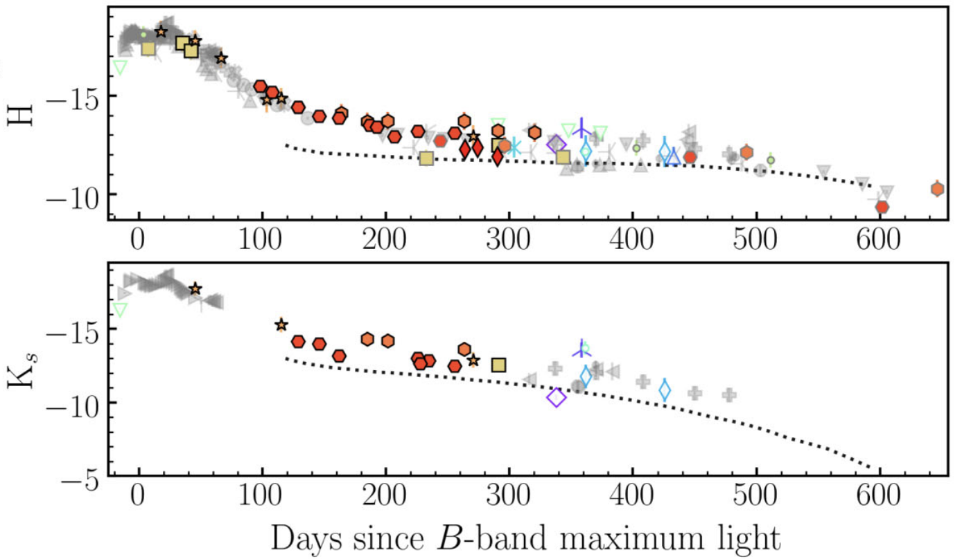
Late-time observations have shown evidence for a NIR plateau; peak L is correlated with plateau brightness + over-luminous SNe decline slower!
Deckers+2023; also Graur+2020
Huei Sears (huei.sears@rutgers.edu)
An Extraordinary Journey Into The Transient Sky 04/03/2025

Slide 8

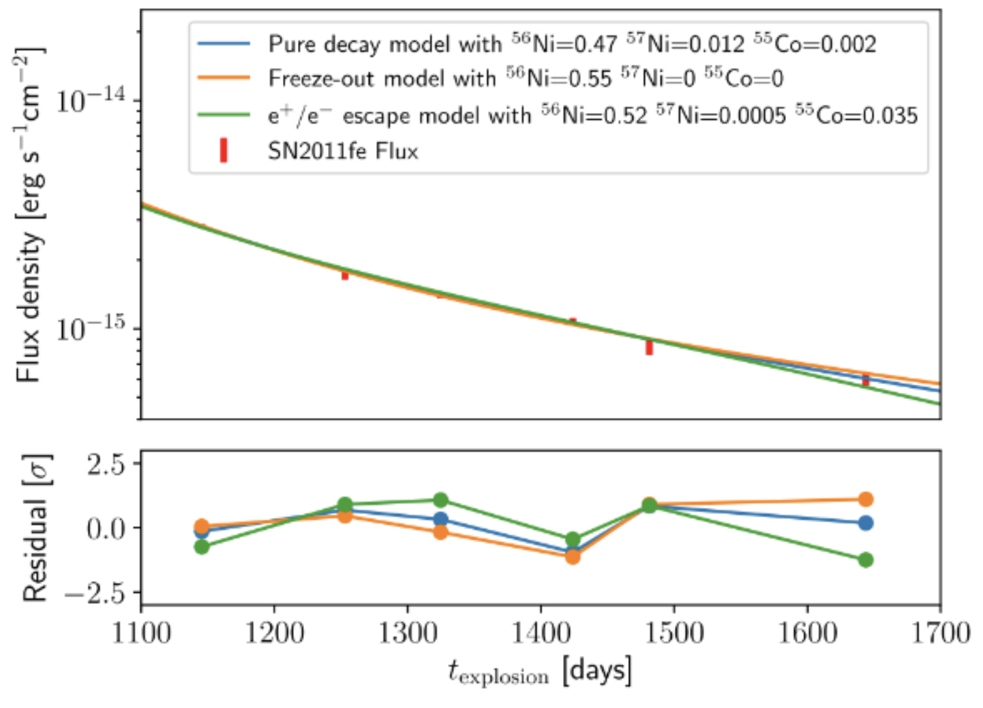
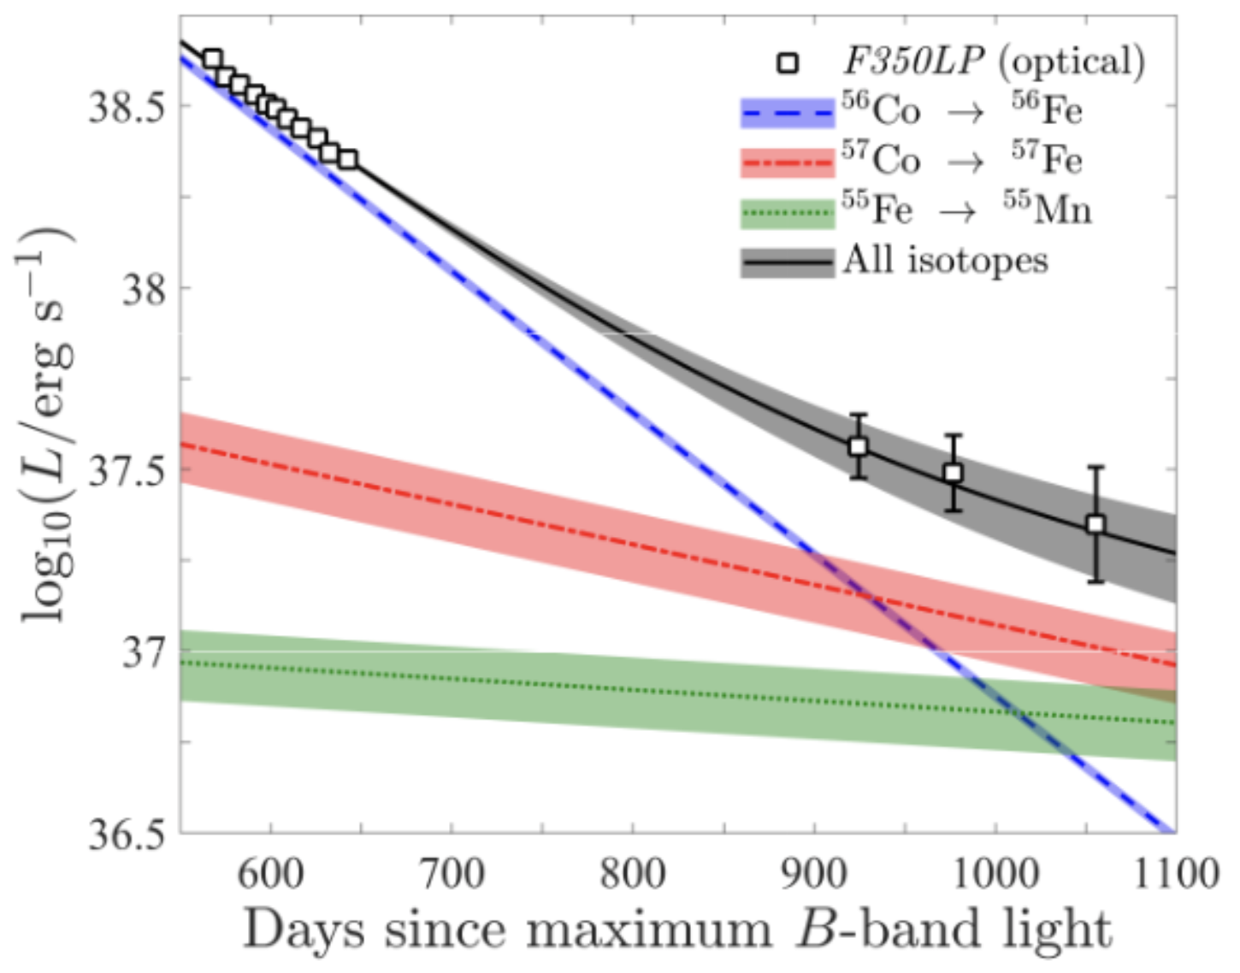
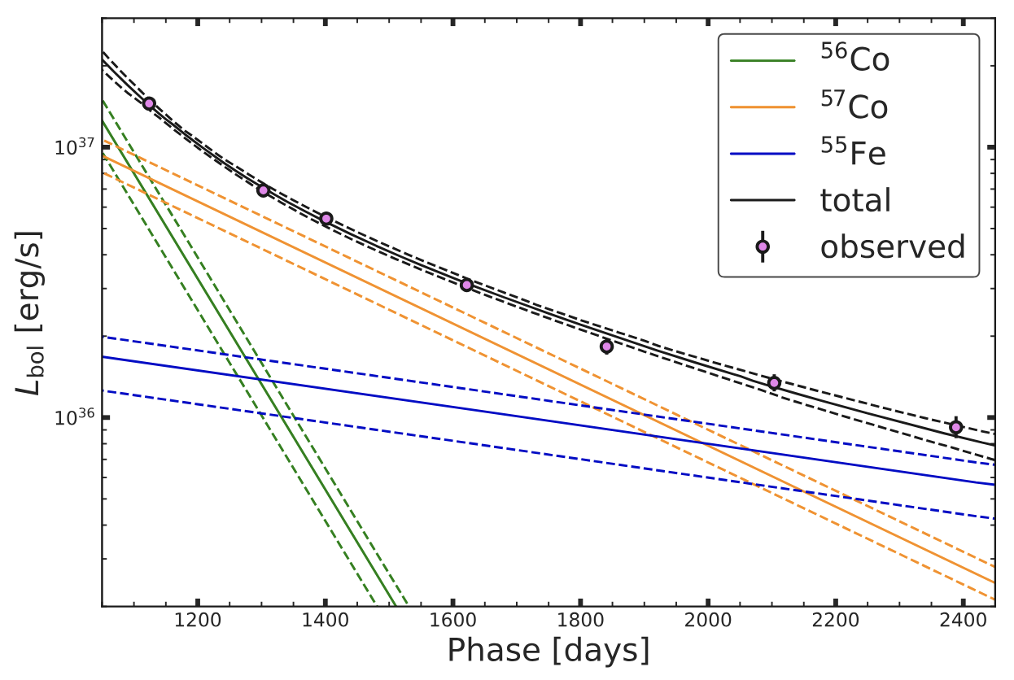
several ideas for what is powering the late-time light curve, but all seem to be consistent with 11fe…
Graur+2016
Kerzendorf+2016
Tucker+2022
2012cg was fit also fit well by
radioactive decay
Huei Sears (huei.sears@rutgers.edu)
An Extraordinary Journey Into The Transient Sky 04/03/2025

Slide 9

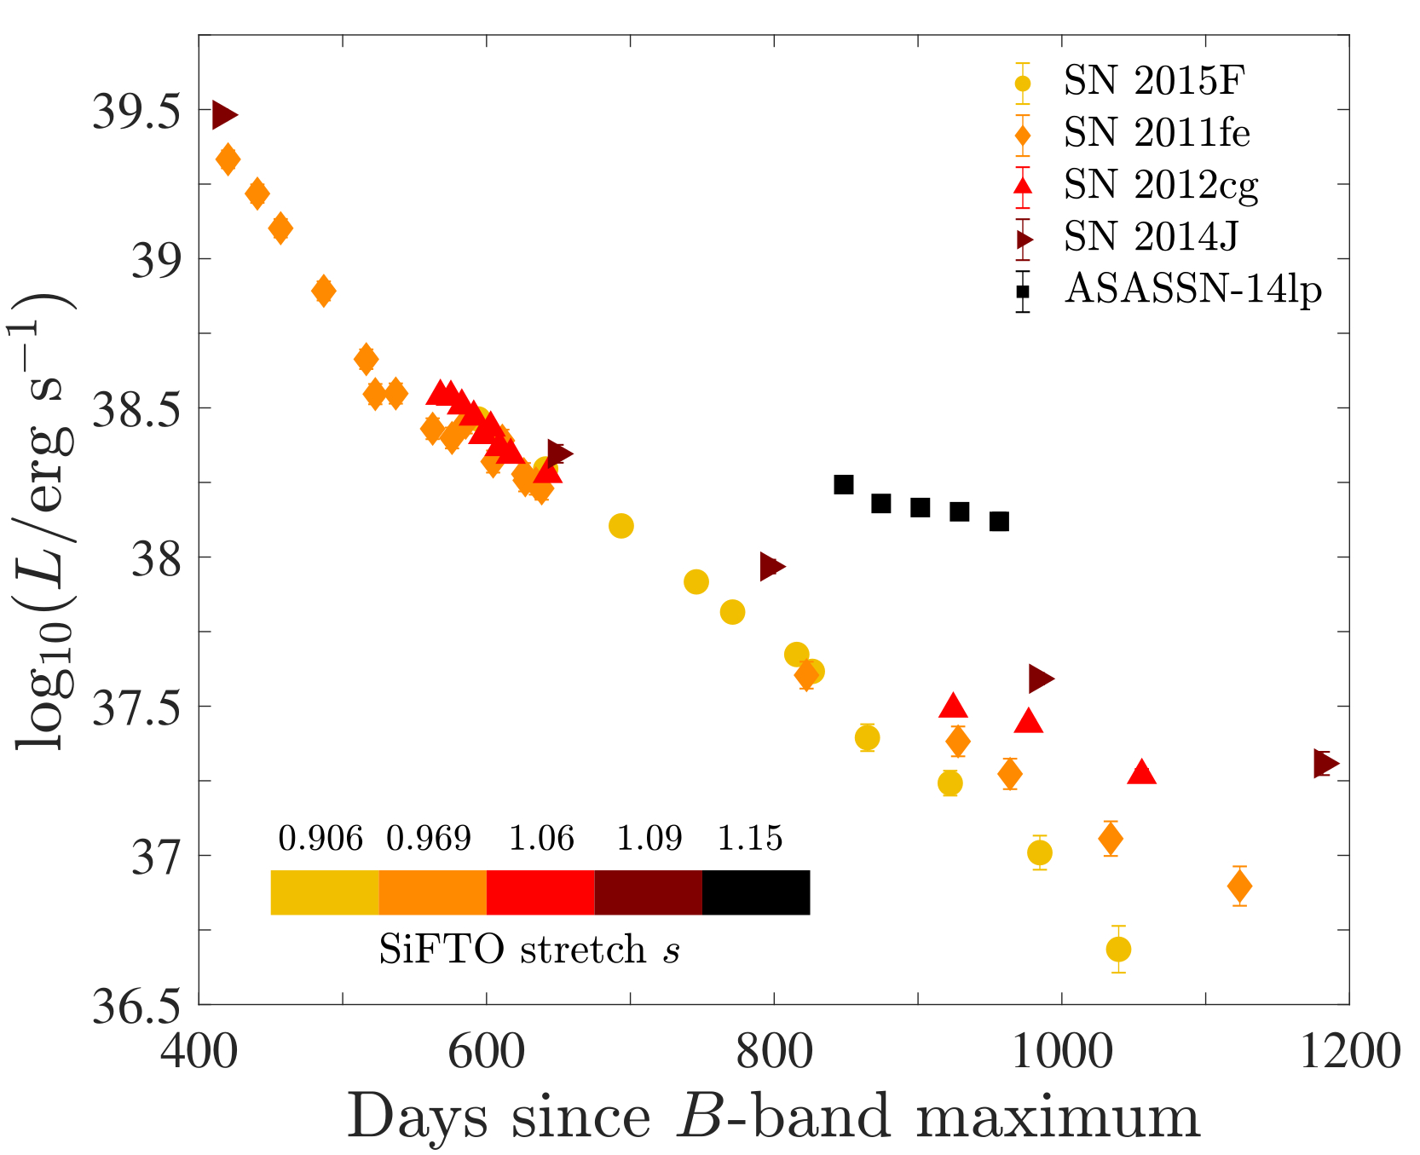
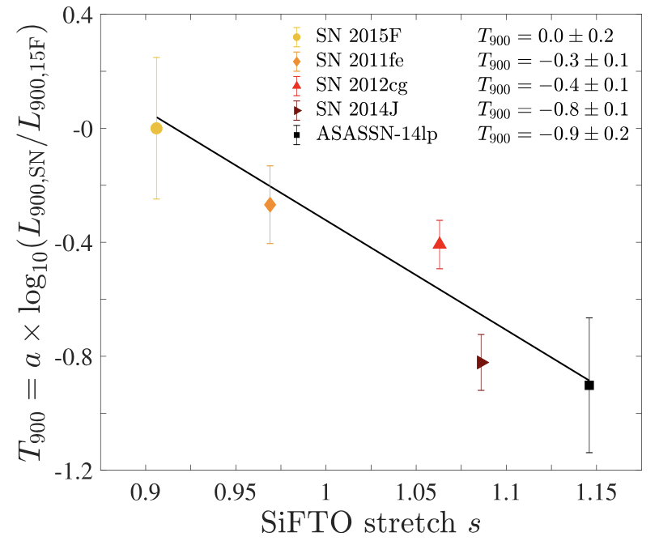
Seems to be a correlation between the late-time decay slope and the stretch which could be used to better standardize them!
Graur+2018d; see also Jacobson-Galán+(2018)
Huei Sears (huei.sears@rutgers.edu)
An Extraordinary Journey Into The Transient Sky 04/03/2025
SN100 04/04/2025

Slide 10
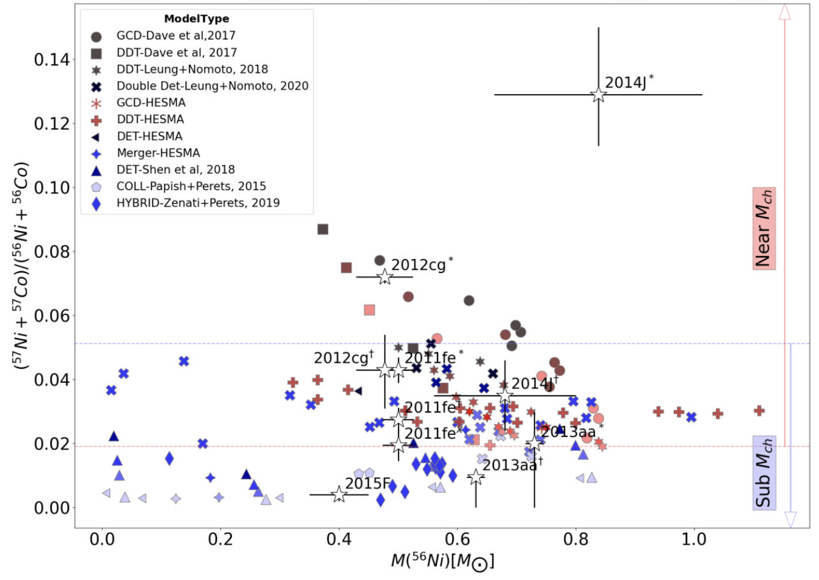
Late-time estimations of the Ni57/Ni56 ratio imply both SD and DD progenitor paths, but more SNe are necessary
Tiwari+2022
Huei Sears (huei.sears@rutgers.edu)
An Extraordinary Journey Into The Transient Sky 04/03/2025
SN100 04/04/2025

Slide 11
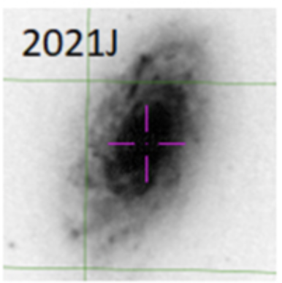
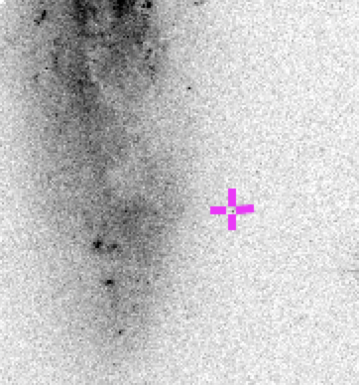
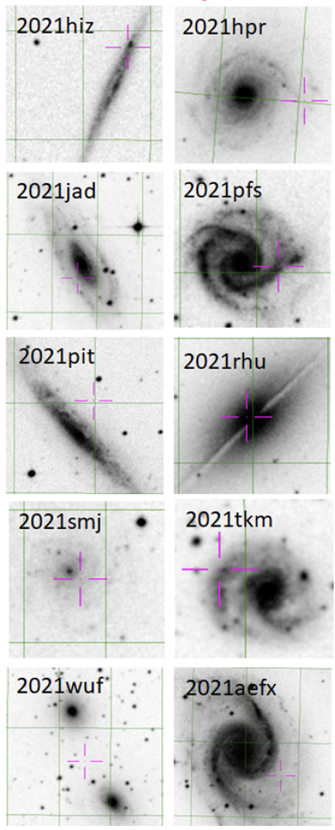

Sample of 12:
close-by (z < 0.01) Type Ia SNe
observed with HST in F555W / F438W / F625W
~500 - ~1300 days post-peak
2021xju
Huei Sears (huei.sears@rutgers.edu)
An Extraordinary Journey Into The Transient Sky 04/03/2025

Slide 12


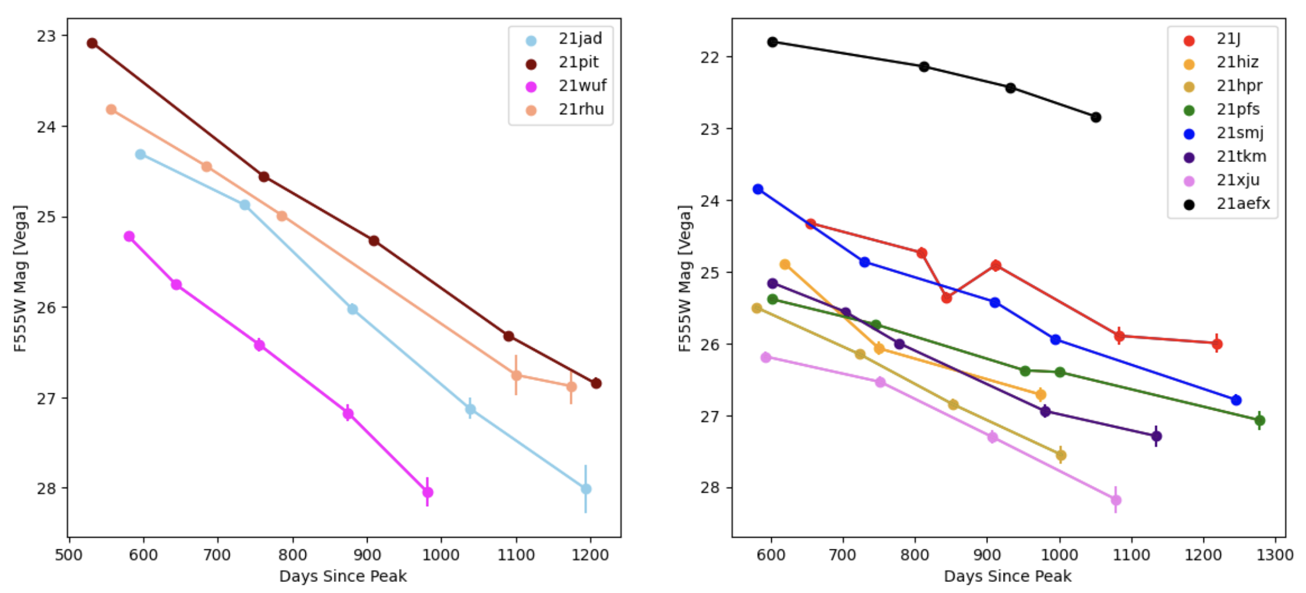
Binary split in the late-time slopes?
21wuf (91T-like) very similar to 3 other normal Ias
Huei Sears (huei.sears@rutgers.edu)
An Extraordinary Journey Into The Transient Sky 04/03/2025

Slide 13
91T-like SNe are known to be very luminous and slow-declining – this is true compared to 11fe at late times too
V band data from LCO/GSP
Huei Sears (huei.sears@rutgers.edu)
An Extraordinary Journey Into The Transient Sky 04/03/2025

Slide 14

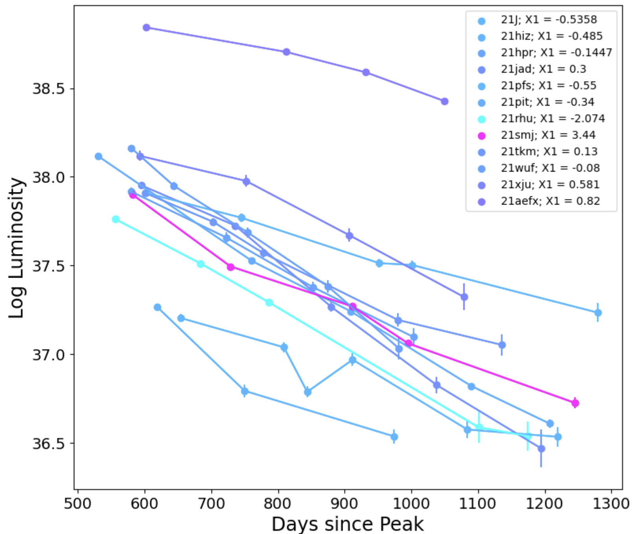
Correlation between stretch and slope is not obvious… but analysis is not complete, and not all data are in !
Huei Sears (huei.sears@rutgers.edu)
An Extraordinary Journey Into The Transient Sky 04/03/2025

Slide 15
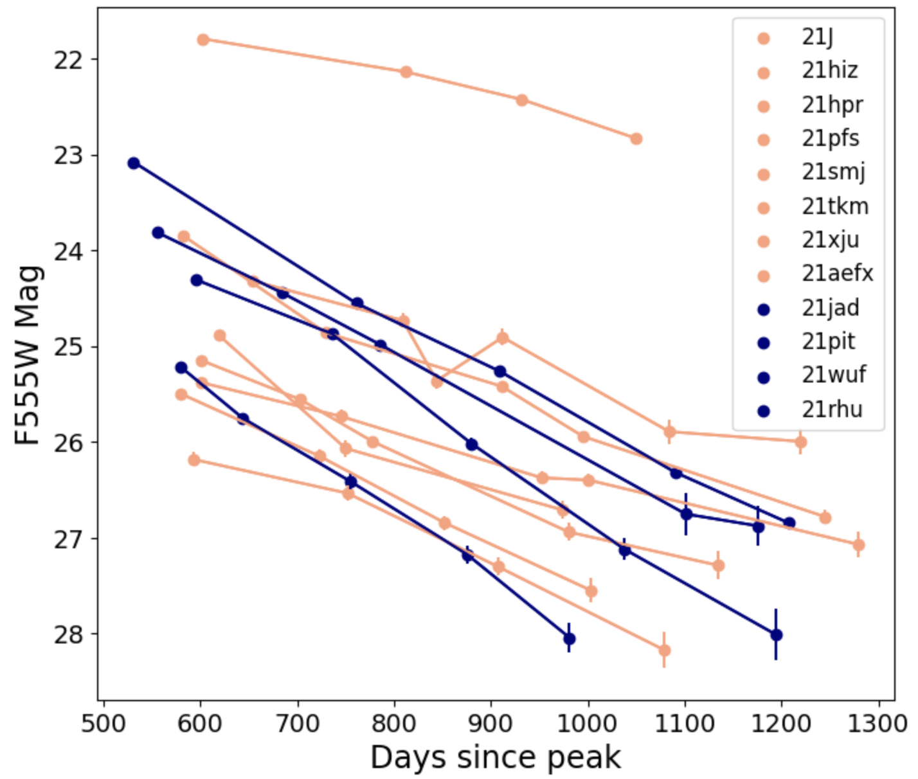

Grazie mille per la vostra attenzione!
Sears, Graur, Jha + in prep.
Late-time (t ~ 1100 days) light curves seem to show a dichotomous split in late-time decay…
But I still need to:
exclude light echo contamination
add systematic uncertainty
template subtract
Other places to find me:
🦋: starlights.bsky.social
📸: corecollapsesupernovae
🟢: 0000-0001-8023-4912
Huei Sears (huei.sears@rutgers.edu)
An Extraordinary Journey Into The Transient Sky 04/03/2025

