Slide 1
Non-LTE radiative transfer simulations: Improved agreement of the double detonation with normal Type Ia supernovae
Christine Collins
With Luke J. Shingles, Stuart A. Sim, Fionntan P. Callan, Sabrina Gronow, Wolfgang Hillebrandt, Markus Kromer, Ruediger Pakmor and Friedrich K. Ropke

Slide 2
Overview
I will present some new radiative transfer simulations for the double detonation explosion scenario, with new improved fully non-LTE radiative transfer
Overview of hydrodynamical models considered
Comparison of the synthetic observables in non-LTE compared to previous approximations

Slide 3
SNe Ia from Sub-M_{ch} white dwarfs
Sub-M_{ch} white dwarfs are promising SNe Ia progenitors
Can explain observed SN Ia luminosity variation
Increasing WD mass -> more ⁵⁶Ni -> brighter SN
Detonations in carbon-oxygen WD lead to good agreement with SN Ia observations (e.g. Sim+2010, Blondin+2017, Shen+2018)
These neglected the ignition mechanism
A physical mechanism to ignite a sub-M_{ch} WD is the Double Detonation
Ignited by an initial helium detonation

Slide 4
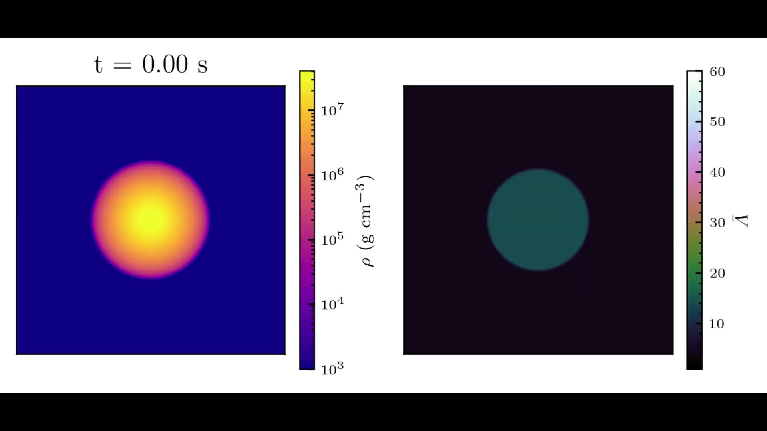
Double detonation
Simulation from Gronow+2021. Movie credit: Alexander Holas​
Progenitor model
Helium Shell
Carbon/Oxygen Core

Slide 5
Double detonation ejecta structure
Double detonation leaves imprint on ejecta
Heavy element nucleosynthesis in outer layers from the shell detonation
⁵⁶Ni
He shell detonation
Core detonation

Slide 6
Double detonation ejecta structure
Density of select elements
Heavy elements in the outer ejecta lead to strong absorption features and line-blanketing not expected in normal SNe Ia

Slide 7
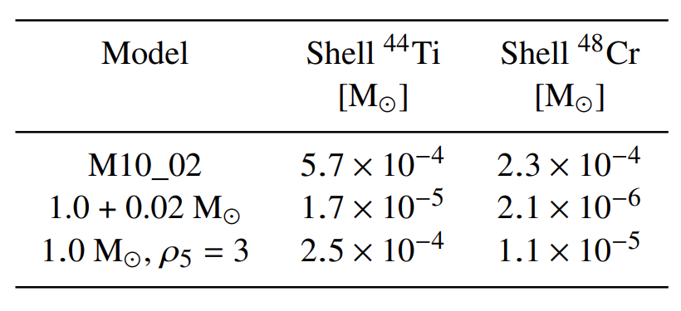
Double detonations have colours too red
All of our models are redder than observations
(series of double detonation hydrodynamical models from Gronow+2021 for different core and He shell masses)
General trend for double detonations
This is because of line-blanketing by the He detonation ash
B-V
It has been suggested that low mass He shells lead to less red colours
Lower masses of He detonation ash
Collins+2022
We have tested a model with a thin He shell
This includes the low He shell mass model (0.02 M⊙ He)
Townsley et al. 2019 and Shen et al. 2021 found this He shell mass leads to normal SNe Ia colours
Ours is still much too red – larger masses of Ti and Cr from the shell detonation
Townsley+2019
Shen+2021

Slide 8
Non-local thermodynamic equilibrium (NLTE)
These simulations did not use full NLTE radiative transfer
They were based on LTE approximations but used a dilute LTE scheme to approximate NLTE
(dilute blackbody representing the radiation field)
We call this scheme “classic ARTIS”
We have now carried out full NLTE simulations (using “ARTIS-NLTE”)
This includes
Full solution to the non-LTE equations
Non-thermal solver
Detailed bound-free estimators
Non-LTE radiation field model
Developed by Shingles+2020

Slide 9
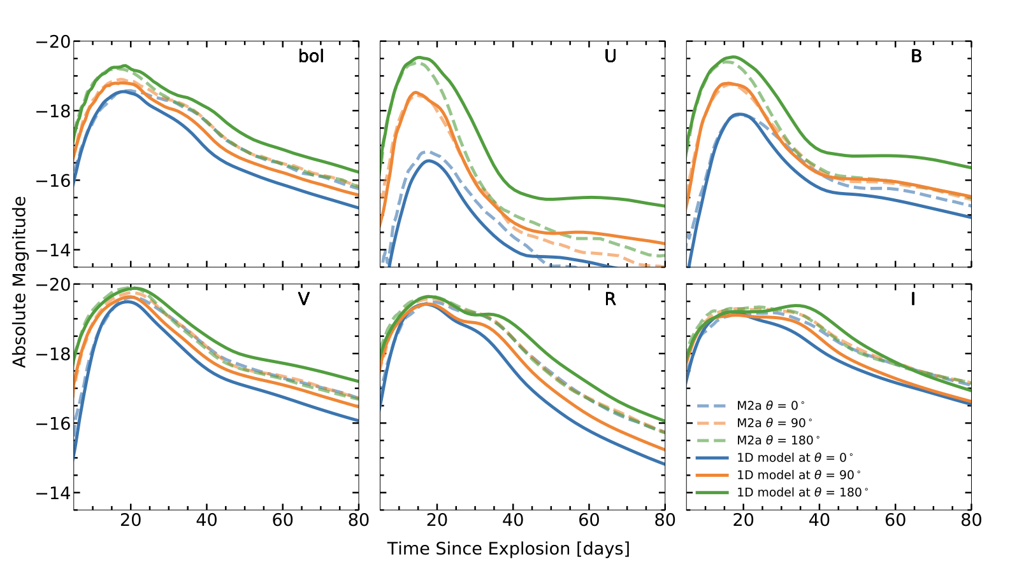
1D models to represent the 3D model
NLTE models very computationally expensive, so for now only 1D simulations
Models are very asymmetric
1D models were constructed by averaging ejecta lying within cones in different directions to mimic viewing angle effects (from Model M2a Gronow+2020, 0.05M_{ⵙ} He shell)
density
density

Slide 10
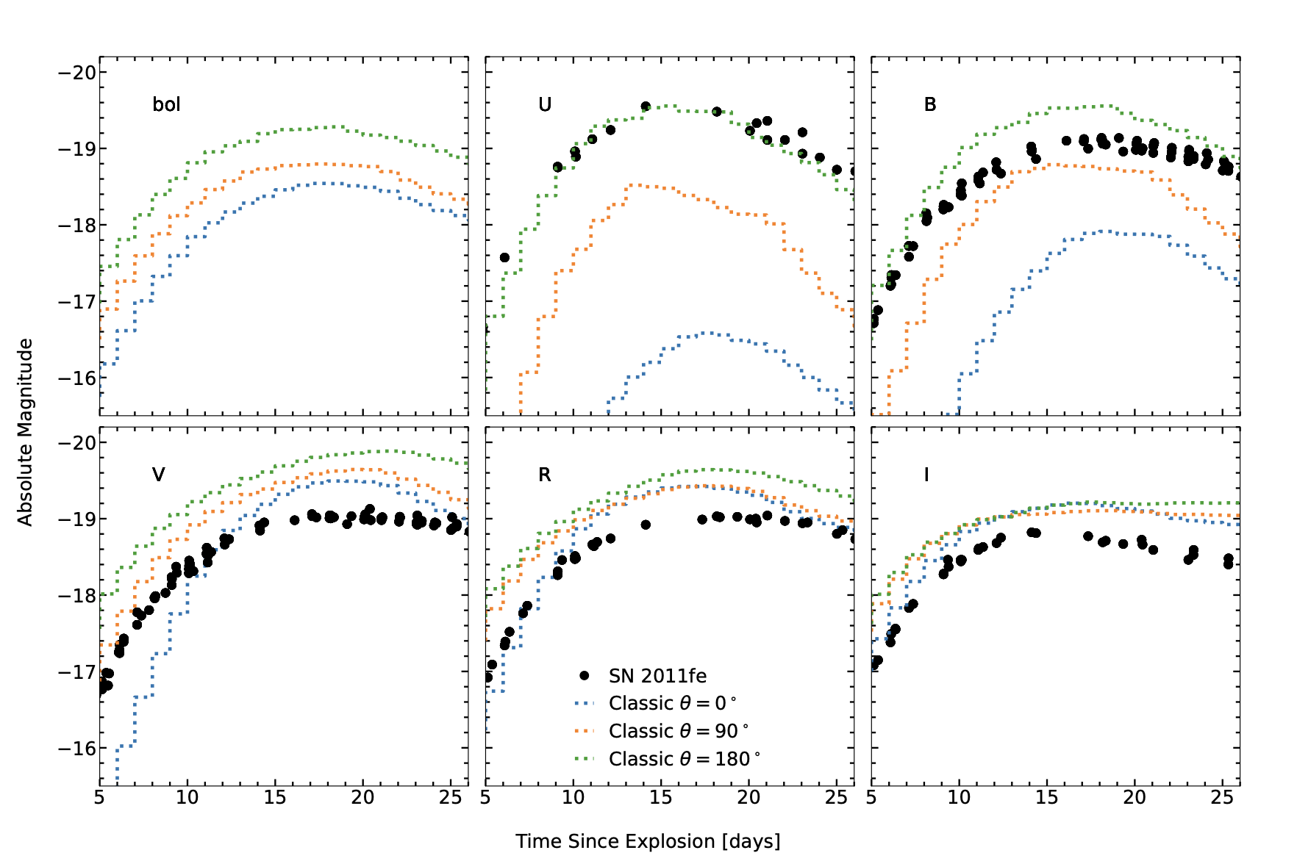
Classic ARTIS light curves (1D models)
Colours very red
U band much fainter than B
V and R too bright
Variation with direction (represented by 1D models) is greater than intrinsic scatter of observed SNe Ia

Slide 11
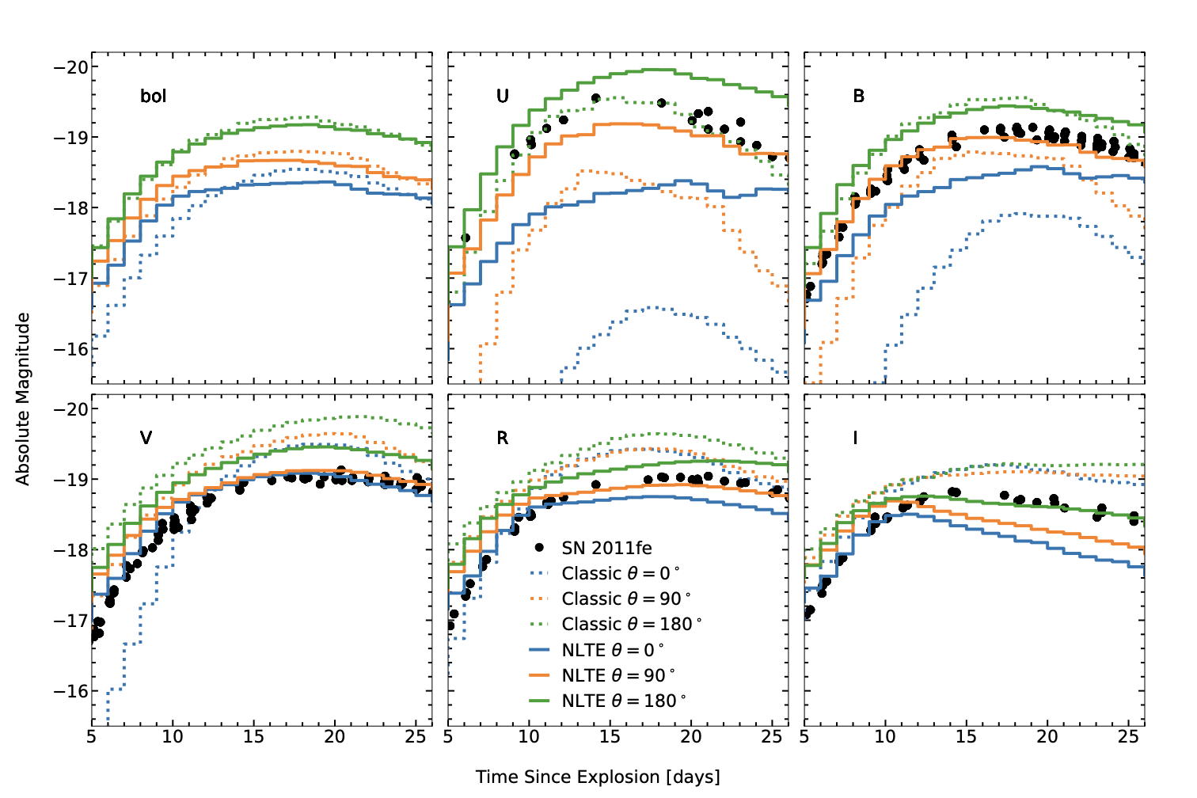
ARTIS-NLTE light curves
In non-LTE
Colours are much less red
Spread in brightness with direction is greatly reduced (i.e. synthetic observables become less asymmetric)
Even bolometric light curve changes in non-LTE

Slide 12
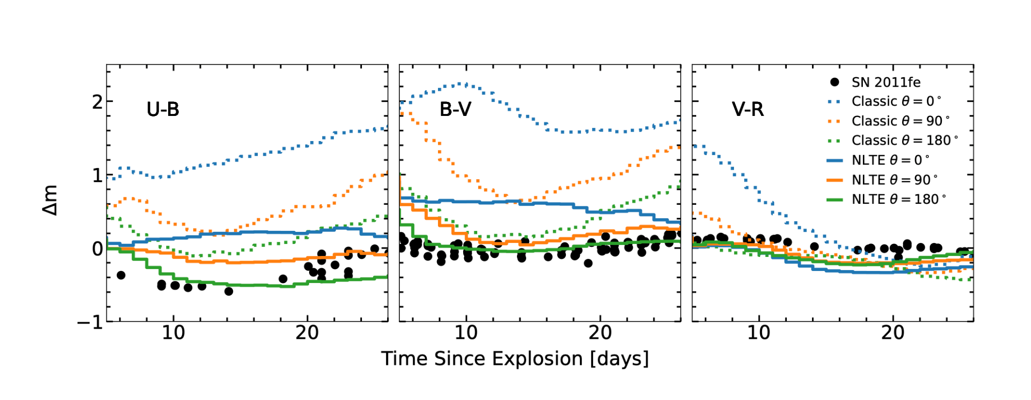
Difference in colour evolution
Non-LTE colours in all directions more similar to normal SN2011fe

Slide 13
Spectra – equatorial direction
Direction viewing towards equator
Most probable direction to view (if drawn from a random distribution of solid angle)
Without full NLTE strong Ti II absorption and too red SED
With full NLTE Ti II absorption is reduced and SED becomes bluer
Approximate
Full NLTE
In NLTE – more highly ionised
Reduced absorption by He detonation ash – in particular Ti II (In NLTE Ti III is most abundant)
NLTE spectra show much better agreement with normal SNe Ia

Slide 14
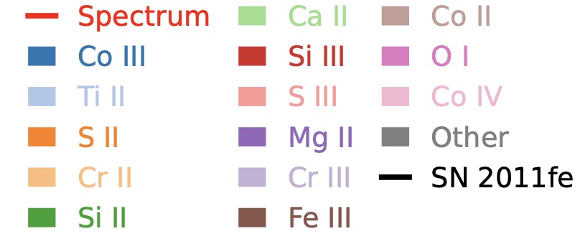
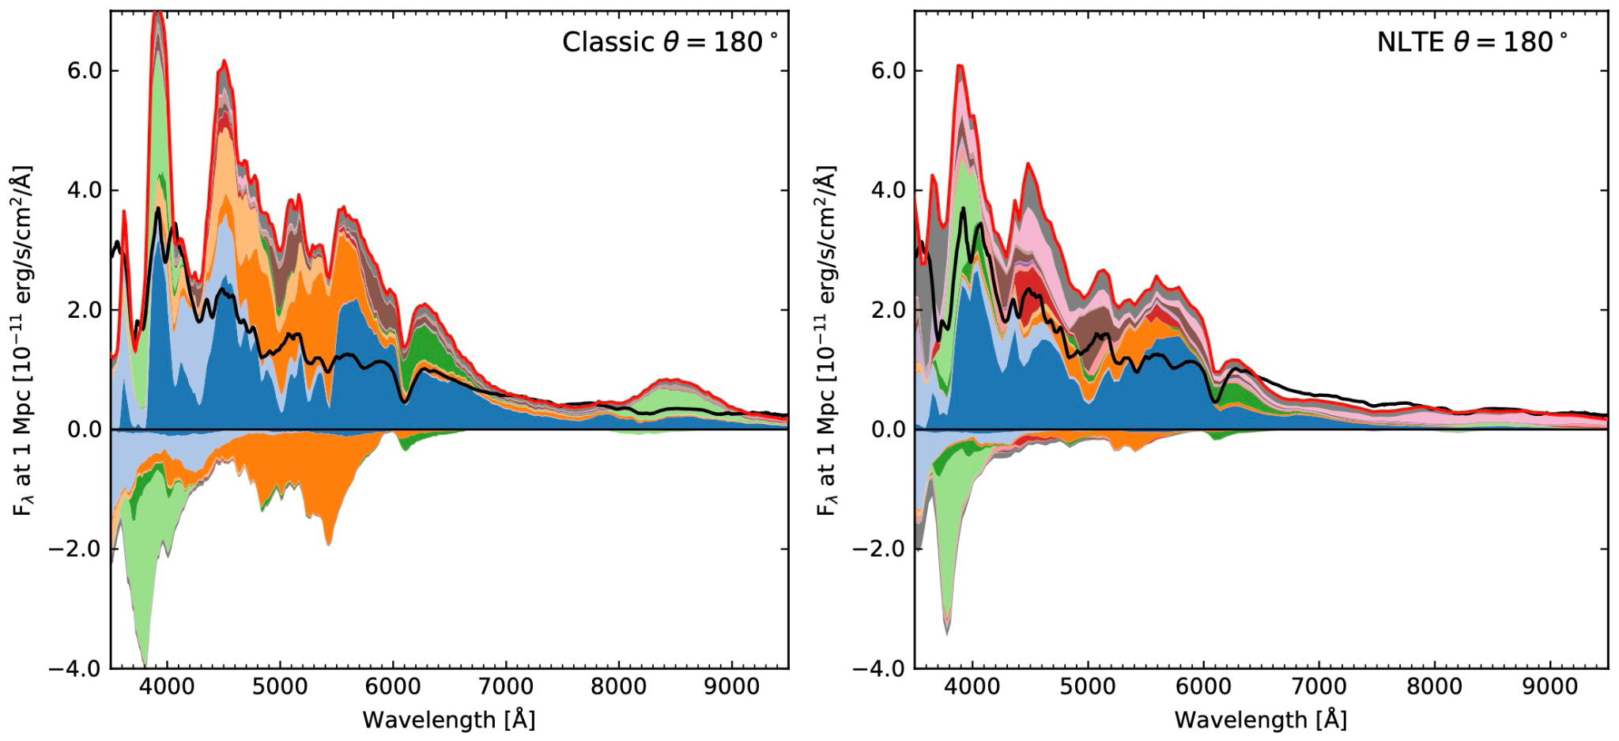
Spectra – poles
Approximate
Full NLTE
Less probable that SN would be viewed near the poles
One pole shows significantly increased absorption (higher abundances of He detonation ash)
Absorption reduced in NLTE, but still shows strong absorption
Maybe explains peculiar Ia’s
Opposite pole is brightest since ⁵⁶Ni is nearest the surface
This direction also shows better agreement with normal SNe Ia in full NLTE

Slide 15
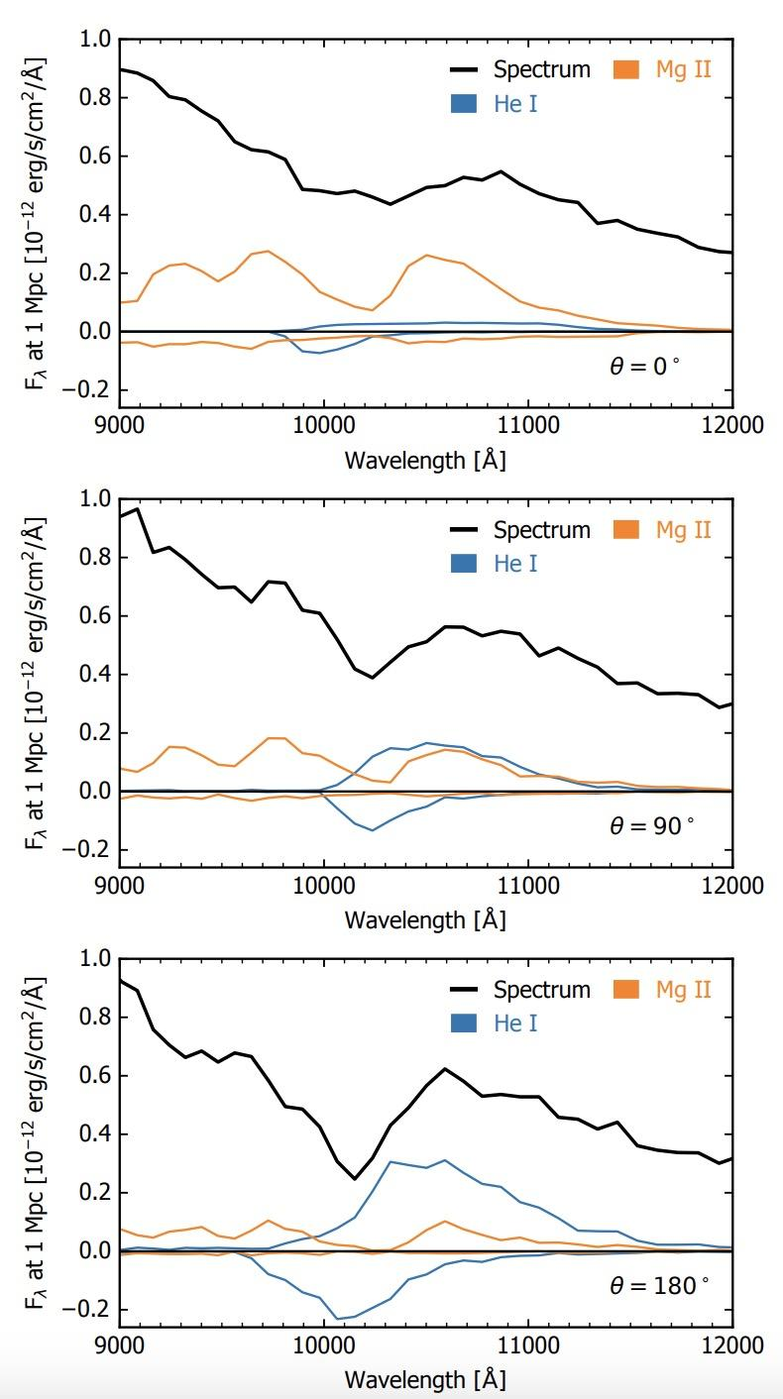
All three double detonation models show He feature
He I 10830 Å feature predicted in all 3 model directions
A treatment of non-thermal energy is required to simulate He (which we include here)
Different strengths and evolution shown by each model
Strongest and lasts the longest at θ=180◦

Slide 16
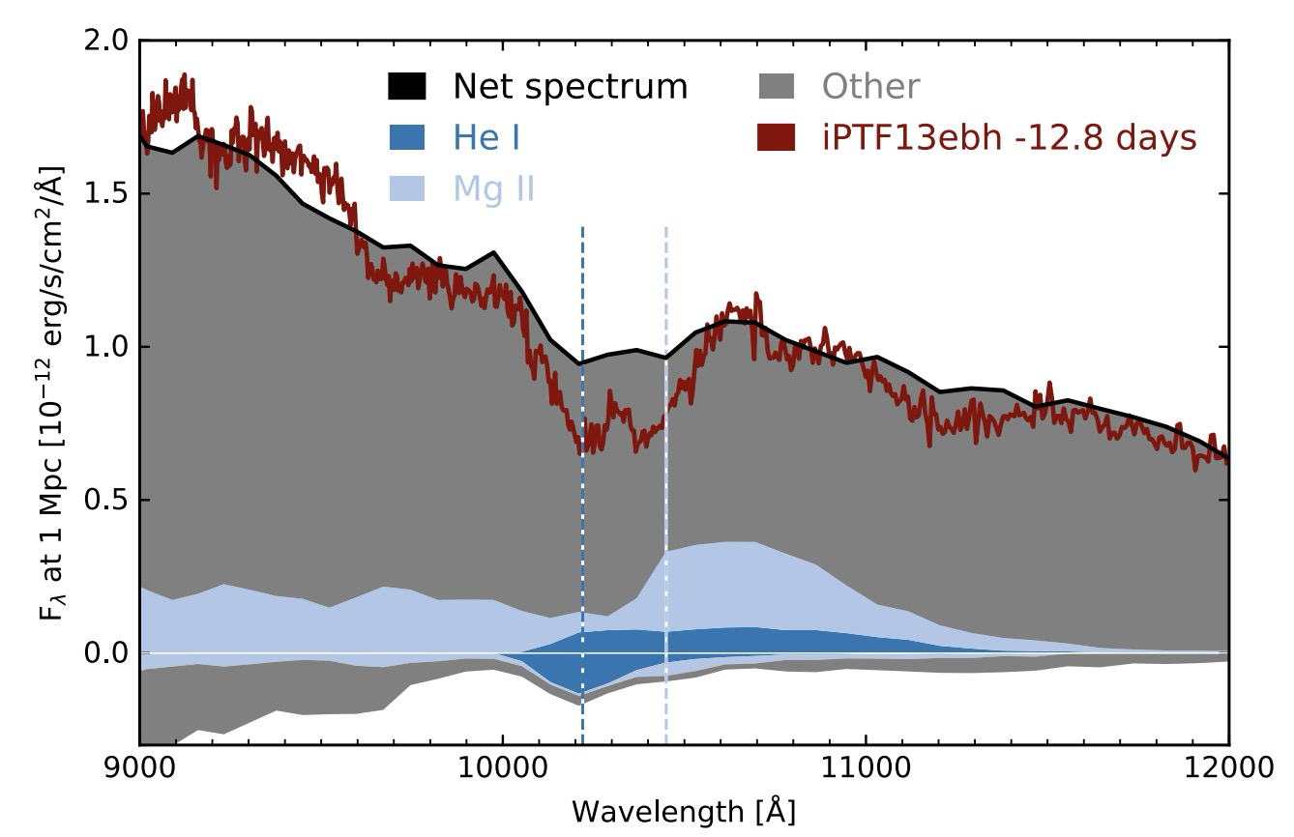
Helium may have been observed
Evolution similar to the transitional SN iPTF13ebh (Hsiao+2015)
Feature to the blue wing of the Mg II feature (previously identified as C I by Hsiao+2015)
The simulation does not predict clear optical He features or a clear 2 μm feature
Suggests there is no secondary feature observable to confirm presence of He
Callan+2025 have shown for another double detonation model that He 10830 Å is predicted
Spectrum for equatorial model
Collins+2023
He I absorption

Slide 17
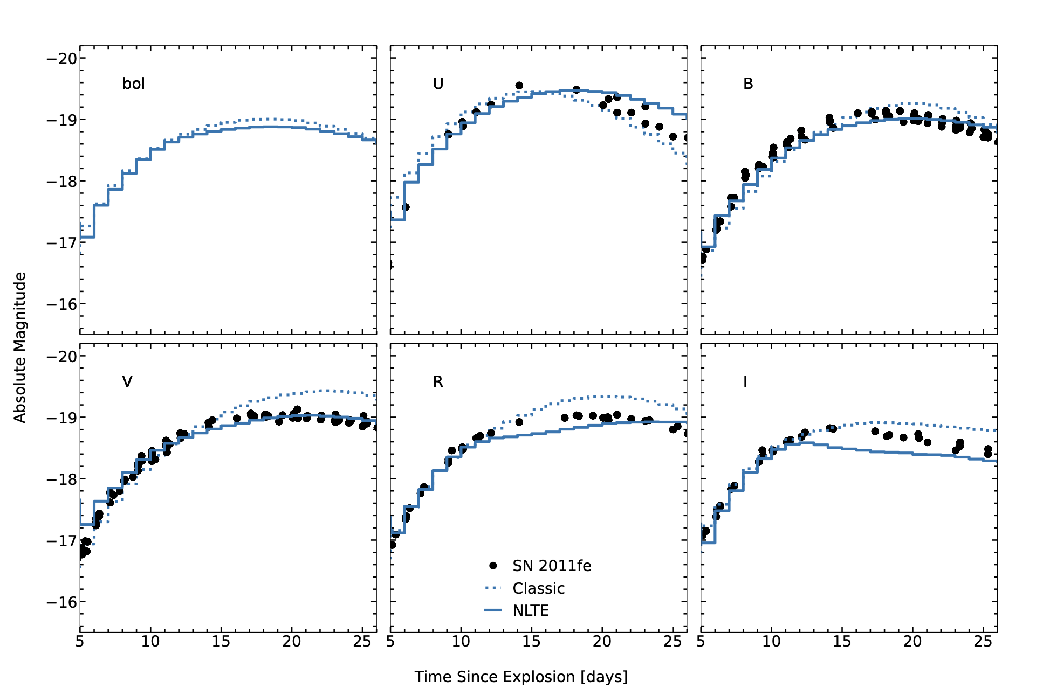
Pure detonation model (no He detonation)
Sim+2010 1.06 M_{ⵙ} model
No heavy elements in outer ejecta
Differences in non-LTE much less significant than double detonation
Non-LTE specifically important for double detonation because of the heavy elements in the outer ejecta

Slide 18
Summary
Non-LTE simulations are important – particularly for the double detonation explosion scenario
Higher ionisation states lead to reduced line blanketing, improving agreement with observations
He I 10830 Å appears to be a signature of the double detonation
The effect of NLTE needs to be explored for more double detonation models
Determine if these are general trends

