Slide 1
Paper!
The Type I Superluminous Supernova Catalogue II: Spectroscopic Evolution in the Photospheric Phase, Velocity Measurements, and Constraints on Diversity
Photospheric Spectra of SLSNe
Aysha Aamer Queen’s University Belfast

Slide 2
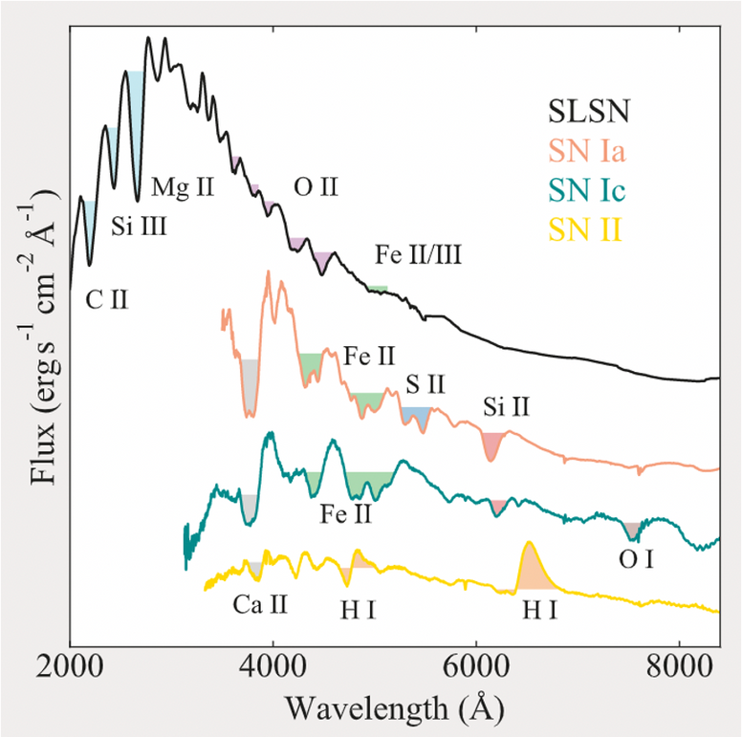
What are SLSNe?
Subset of core collapse supernovae 10-100 times brighter
Spectra characterized by steep blue continuum at early times with O II lines, indicative of high temperatures
They then evolve to look similar to SNe-Ic once they cool to similar temperatures with Fe, Mg and Ca lines
Nicholl+2021

Slide 3
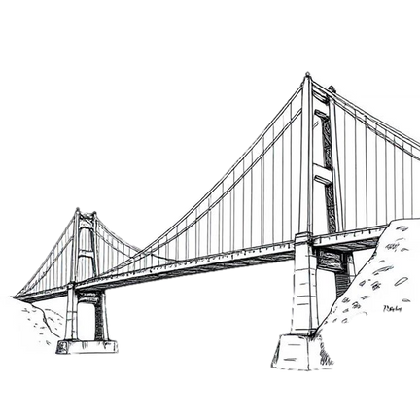
Why are they so puzzling?
There are lots of unanswered questions about these events
What is powering them?
Are there multiple subtyp es?
What is their connection to normal SNe Ic?
Why are they so diverse?

Slide 4
Master Catalogue of SLSNe
Aim to create a comprehensive data product for all SLSNe up to December 2022
Part 1 available now! (Gomez, et al 2024)
Spectra obtained from different sources, published and publicly available on WISeREP, Finding
Luminous and Exotic Extragalactic Transients (FLEET) program, and ePESSTO
This work will focuses on the photospheric spectra

Slide 5
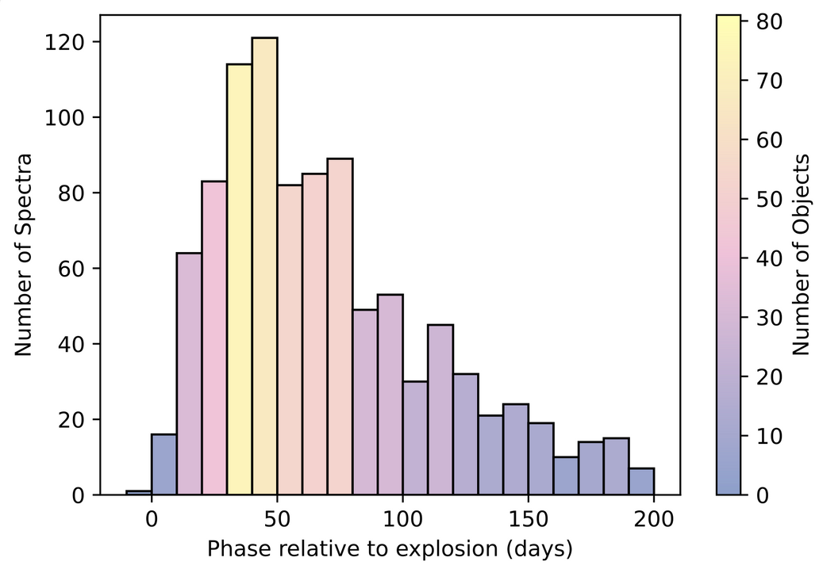
Sample Information
234 SLSNe events, up to Dec 2022 Started with 1252 spectra, reduced down to 974 after processing Spectra selected that are up to 200 days post explosion, and contain flux within 3000-9000Å
Inhomogenous data has now been standardized

Slide 6
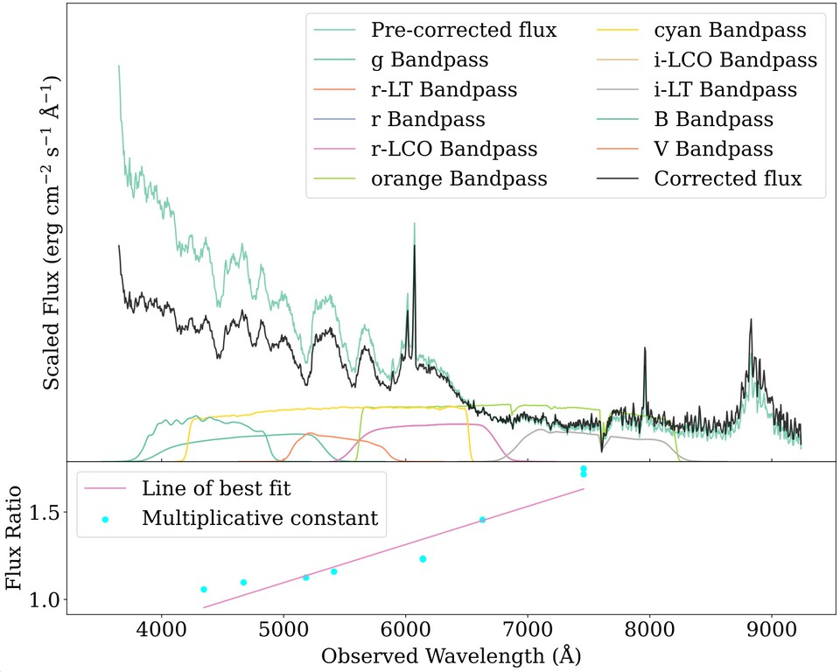
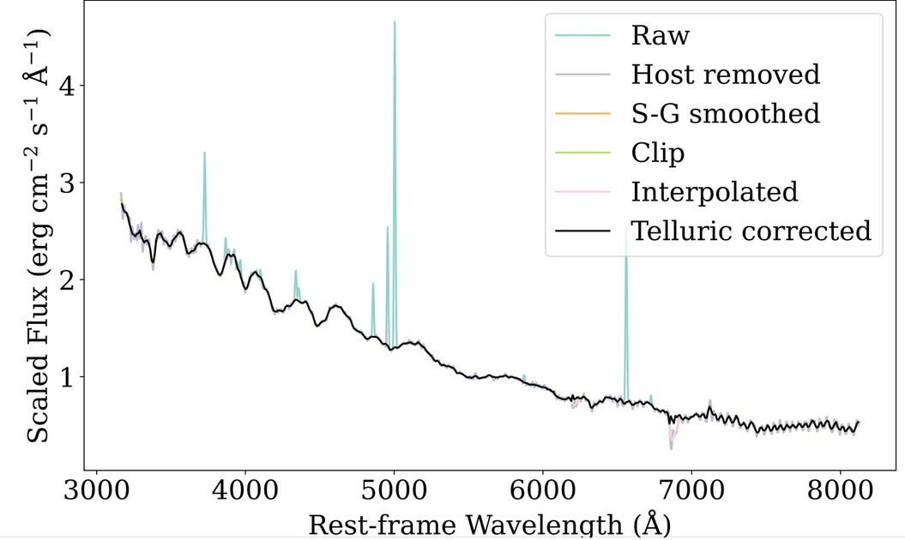
Data is redshift corrected, telluric corrected, extinction corrected, and flux corrected using light curve models Further processing also applied to coadd spectra, remove host galaxy lines, trim noisy spectra, remap and interpolate onto the same wavelength grid
Processing Spectra
SN2019szu at -29 days before peak (Aamer+2024)
PTF12dam at -22 days before peak (Nicholl+2013)

Slide 7
Results

Slide 8
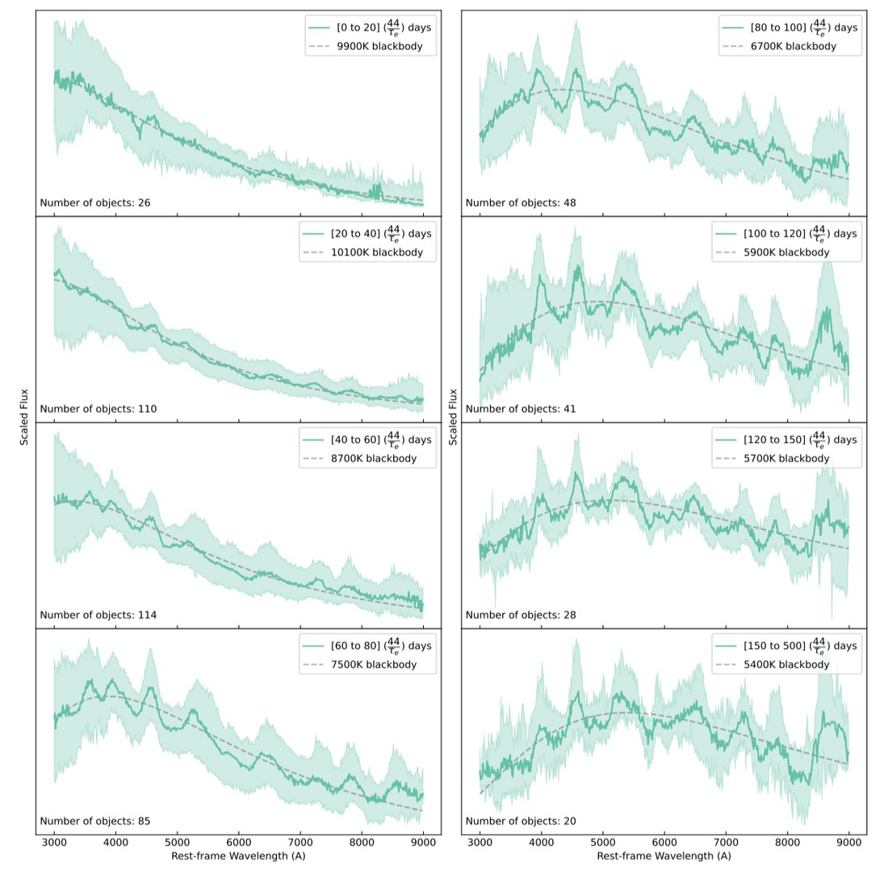
Average Spectra
Investigate behaviour as a function of time
Comparing spectra when grouped by phase from peak/explosion, and scaling to the light curve decline times to normalise evolution
Tighter when grouped by scaled phase from explosion
Temperature evolves from ~11000K to
~6000K
Possible He lines

Slide 9
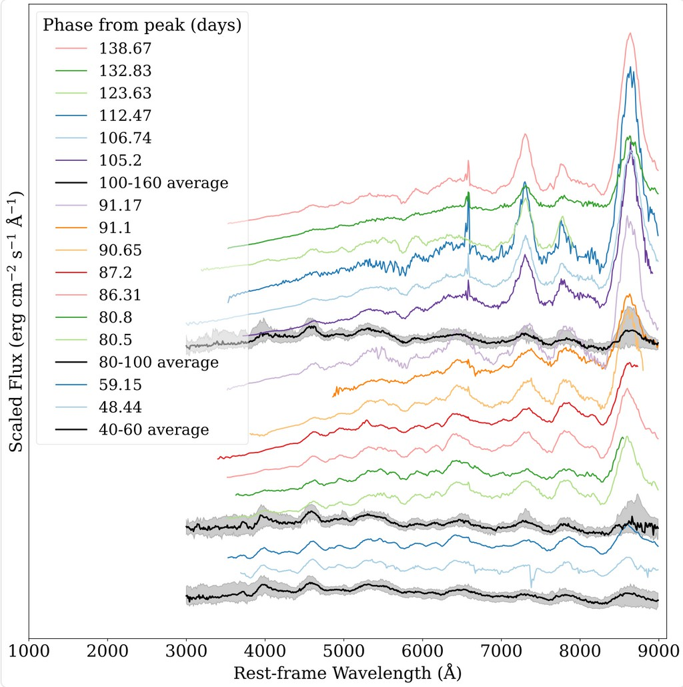
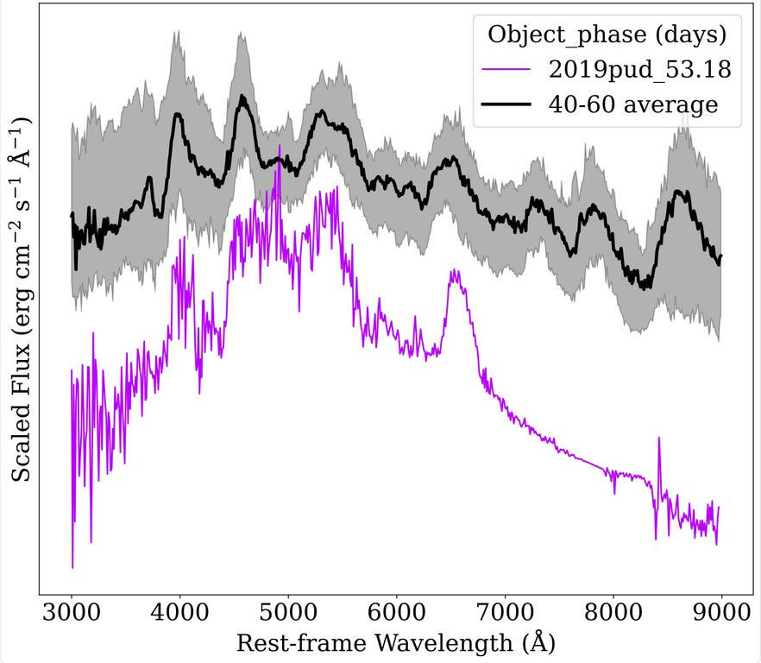
Subpopulations?
No but some outliers!
Spectra of SN2017egm after 40 days post peak (Zhu+2023, Lin+2023, Nicholl+2019)
Spectrum of SN2019pud at 53 days post peak (Kangas+2022)

Slide 10
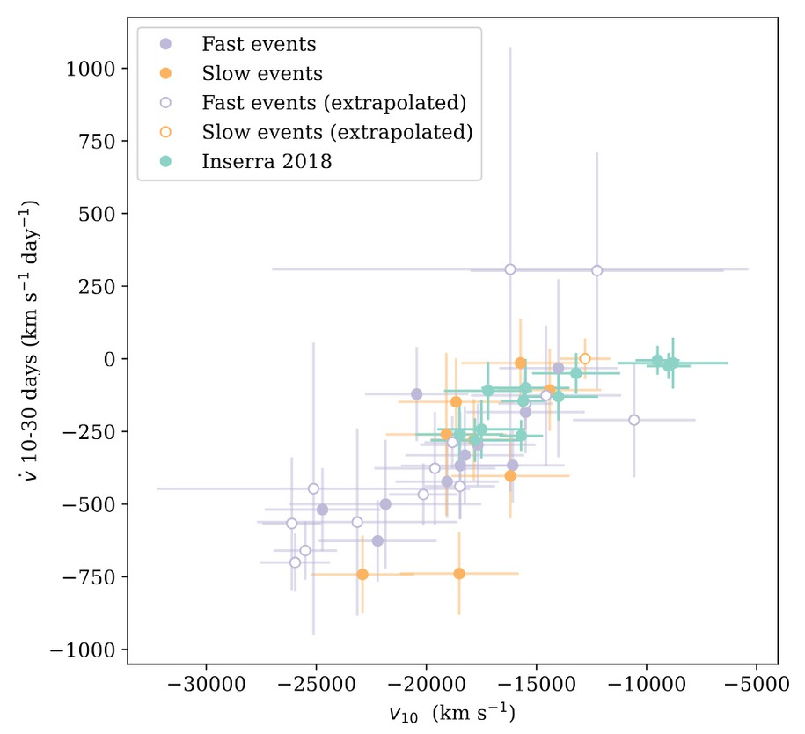
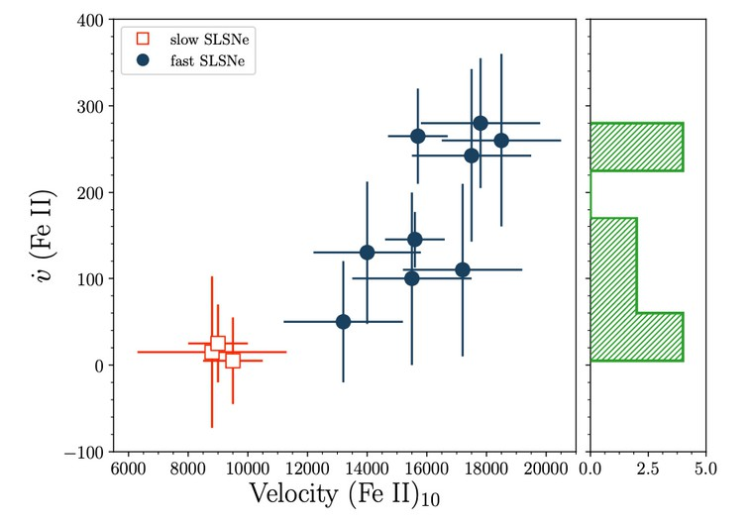
Velocity Evolution of Fe II λ5169
Fe II λ5169 closely traces photospheric velocity Looking at velocity gradient, best explained by SLSNe in homologous expansion with different scale velocities
Don’t see “fast” vs “slow” separation
Inserra+2018 (17 objects)
This work (50 objects)

Slide 11
Thank you for listening!
Do you have any questions?

