Slide 1

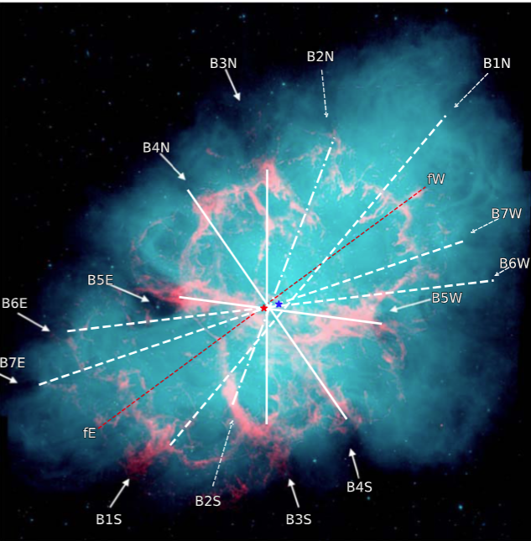
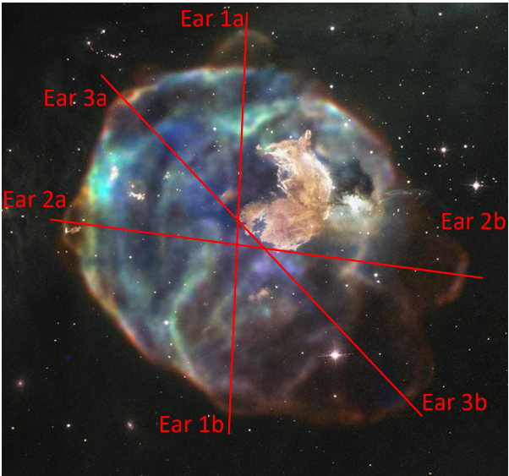
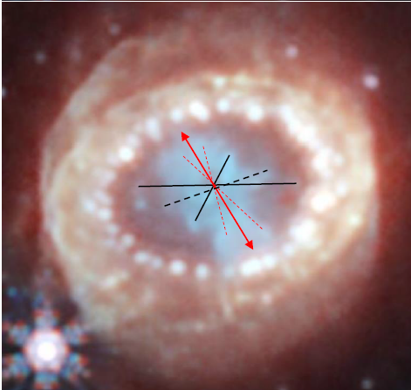
Pleasantness Review:
The primary role of jets in powering core-collapse supernovae
Noam Soker
Department of Physics, Technion, Israel, 2025
Dictionary translation of my name from Hebrew to English:
Noam = Pleasantness
Soker = Review

Slide 2
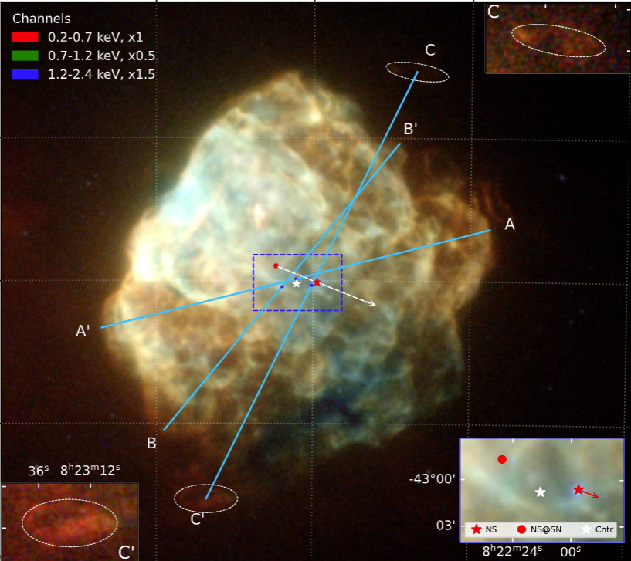
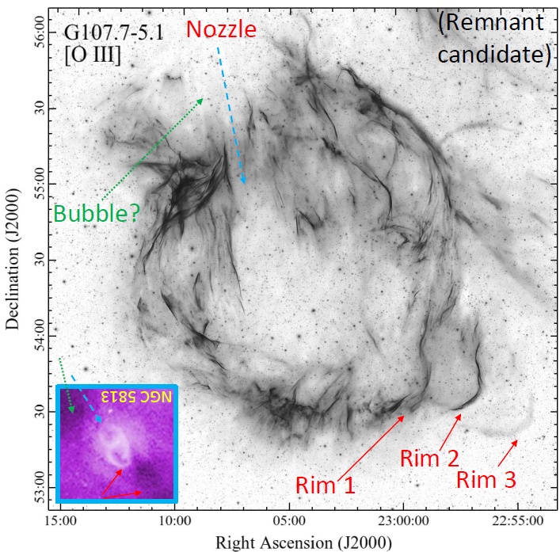
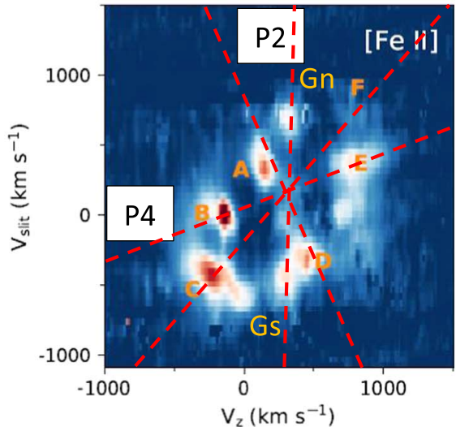
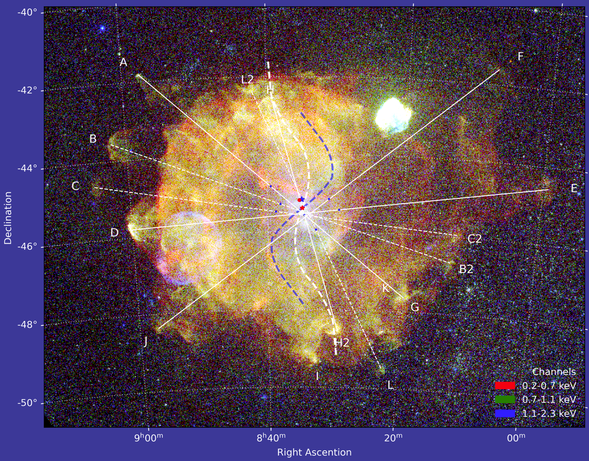
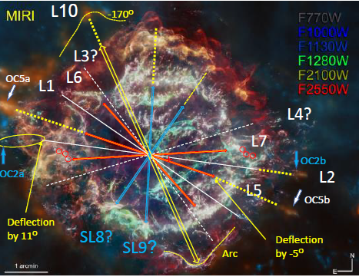
Summary
It is time the community considers the
jittering jets explosion mechanism (JJEM)
on an equal level to the competing
delayed-neutrino explosion mechanism.
(2) Supernova remnants show that jets explode
most (probably all) core-collapse supernovae.

Slide 3
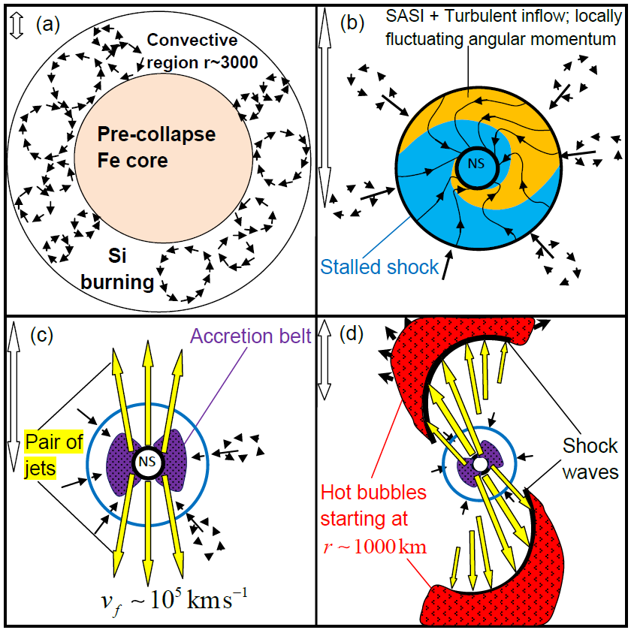
The jittering jets explosion mechanism
~500 km
Additional convection in the oxygen-burning shell at a somewhat larger radius.
Neutrino cooling

Slide 4
The jittering jets explosion mechanism
SASI:
Standing Accretion Shock Instability
~500 km
~500 km
The collapsing inner core (about 1Mo) stops when reaching nuclear densities at the center (r~20km), and a shock starts propagating out.
This shock does not have the energy to overcome the pressure of the infalling core material above ~100 km.
The shock stalls.
There is a need for an extra energy to trigger the explosion.

Slide 5
The neutrino-driven mechanism
(Bethe & Wilson 1985; more popular in the literature): Neutrino heating drives the explosion.

Slide 6
The jittering jets explosion mechanism
SASI:
Standing Accretion Shock Instability
~500 km
~500 km
The delayed neutrino mechanism:
A small fraction of the neutrinos that the newly formed neutron star emits heat the material behind the stalled shock and, by that, revives the shock and triggers the explosion.
Instabilities are critical to allow shock revival (spherical models do not work).
I will not discuss this mechanism here.

Slide 7
(2) The jittering jets explosion mechanism
(Soker 2010):
Stochastic jets drive the explosion in all core-collapse supernovae

Slide 8
The jittering jets explosion mechanism
SASI:
Standing Accretion Shock Instability
~500 km
~500 km
~500 km

Slide 9
The jittering jets explosion mechanism
~500 km
Jittering
Few to tens of
jets-launching
episodes.
Each lasting
0.01-0.1 sec
Each accretes
~0.01Mo and
launches
~0.001Mo in
jets.
Velocity of jets
~10^5 km/sec.
~500 km
~500 km

Slide 10
Method
We use the same extremely common and fully acceptable method to study active galactic nucleus feedback, the shaping of planetary nebulae, and HH objects of young stellar objects.
Observationally identify opposite pairs of morphological features that strongly suggest jets: bubbles, lobes, clumps, nozzles, and ears.
(poster by Dima Shishkin)
Ambient medium from observations or modeling.
Manually launch jets into the ambient medium.
(Poster by Jessica Braudo)
(4) Compare simulations with observations.
(Dima Shishkin + Jessica Braudo)

Slide 11
Method
We use the same extremely common and fully acceptable method to study active galactic nucleus feedback, the shaping of planetary nebulae, and HH objects of young stellar objects.
Observationally identify opposite pairs of morphological features that strongly suggest jets: bubbles, lobes, clumps, nozzles, and ears.
(poster by Dima Shishkin)
Ambient medium from observations or modeling and
manually launch jets into the ambient medium.
(poster by Jessica Braudo)
(4) Compare simulations with observations.
(Dima Shishkin + Jessica Braudo)

Slide 12
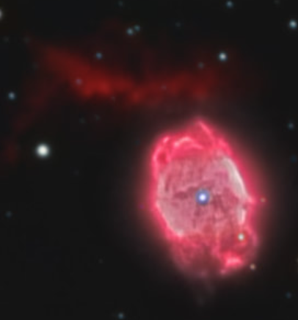
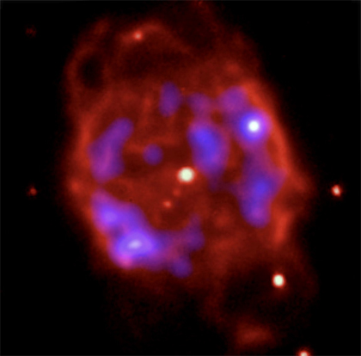
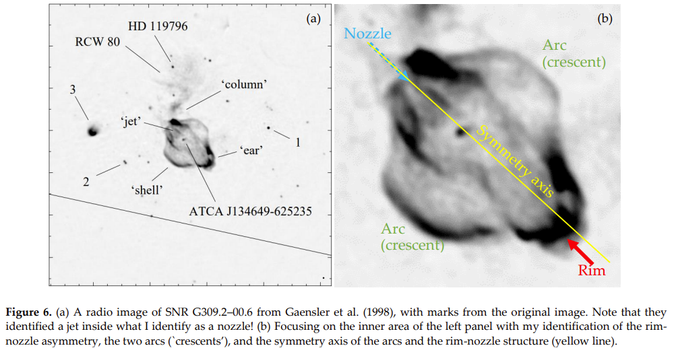
A supernova remnant and a planetary nebula
The planetary nebula
NGC 40, with its
Prominent
jet
Supernova remnant

Slide 13
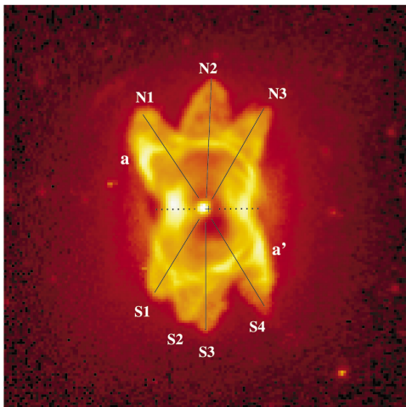
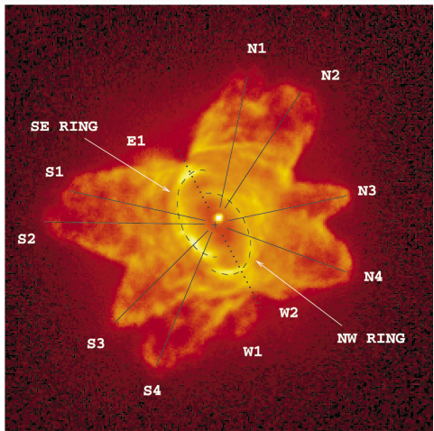
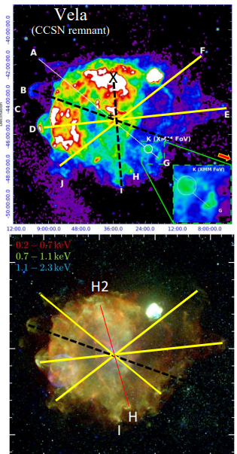
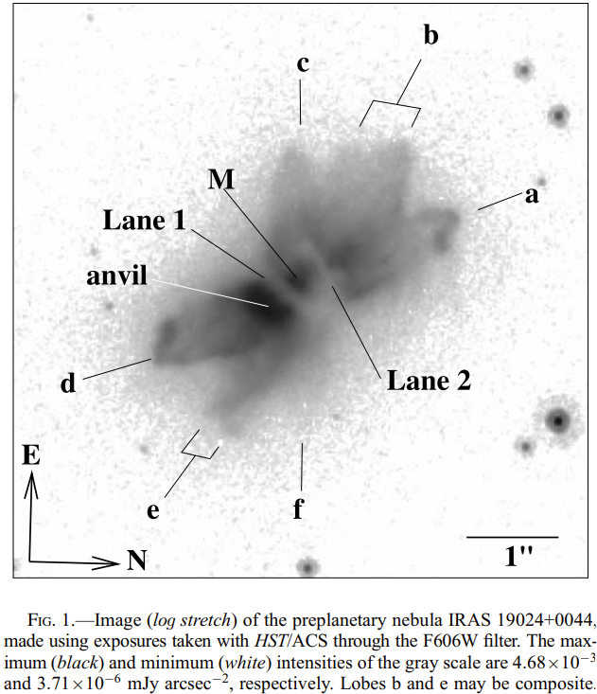
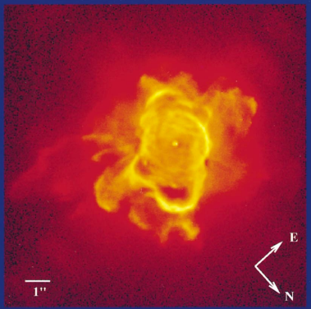
Planetary nebulae
(Sahai, R. 1998, 2000, 2005)
M1-37
He 2-47
Supernova remnant
Pre-planetary nebula
M 1-26

Slide 14
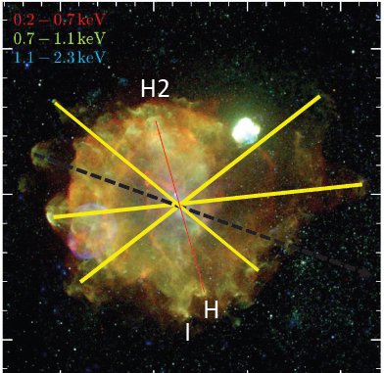
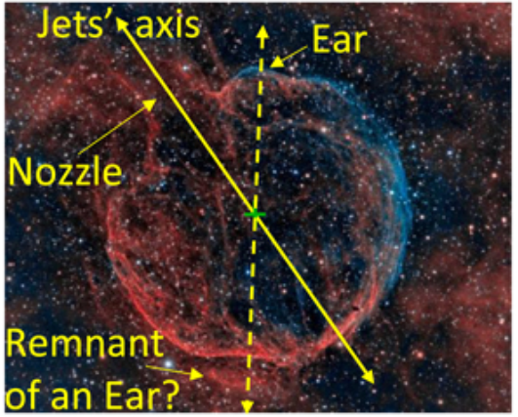
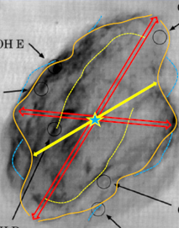
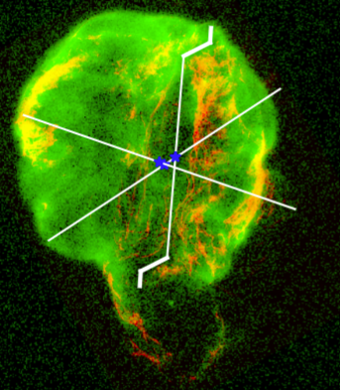
Point-symmetric
core-collapse supernova remnants.
Their morphologies are similar to those of systems known to be shaped by jets, like planetary nebulae and hot gas in clusters of galaxies

Slide 15
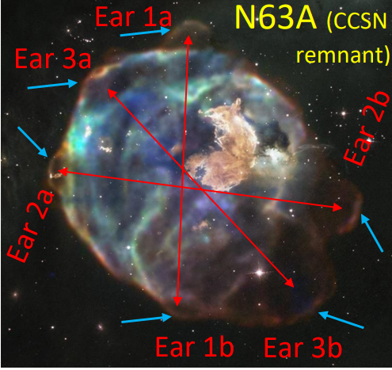
by Judy Schmidt based on images courtesy of NASA/CXC/SAO & NASA/STScI
Point-symmetrical
core-collapse supernova remnant
Soker (2024, the Open Journal of Astrophysics)
The Open Journal of Astrophysics

Slide 16
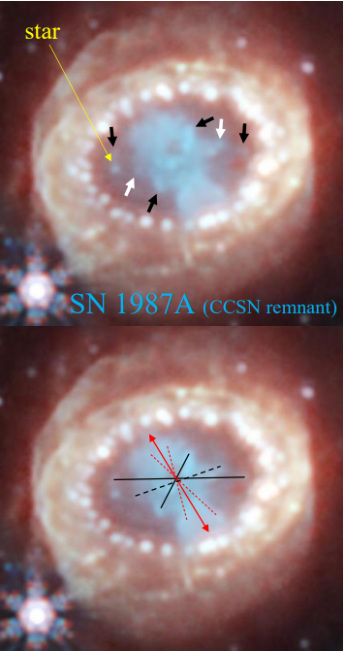
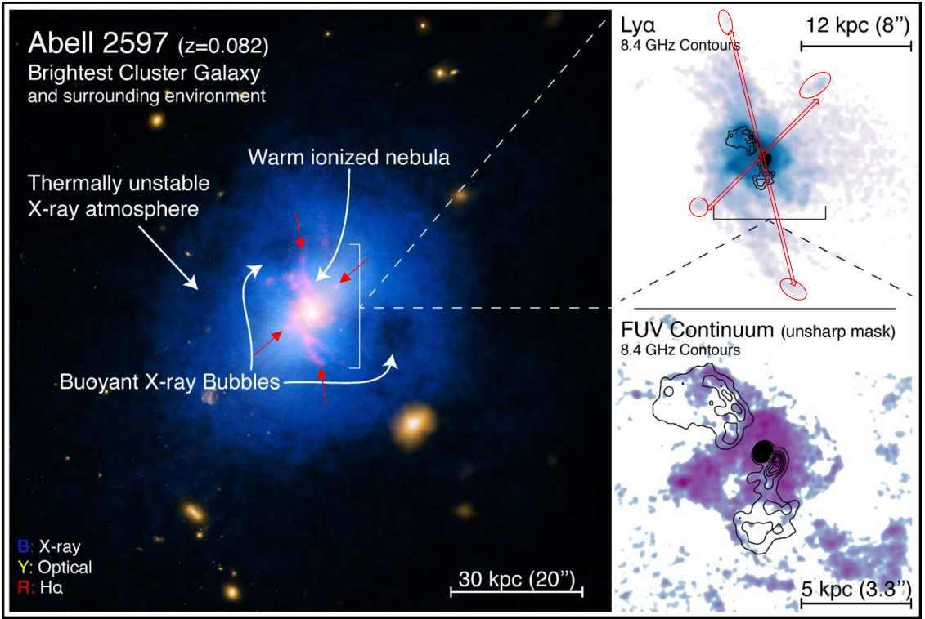
Galaxy cluster
SN 1987A
Core-collapse supernova remnant
NASA Webb Telescope Team, AUG 023; NASA, ESA, CSA: Matsuura, M. (Cardiff University), Arendt, R. (NASA’s Goddard Spaceflight Center & University of Maryland), Fransson, C.

Slide 17
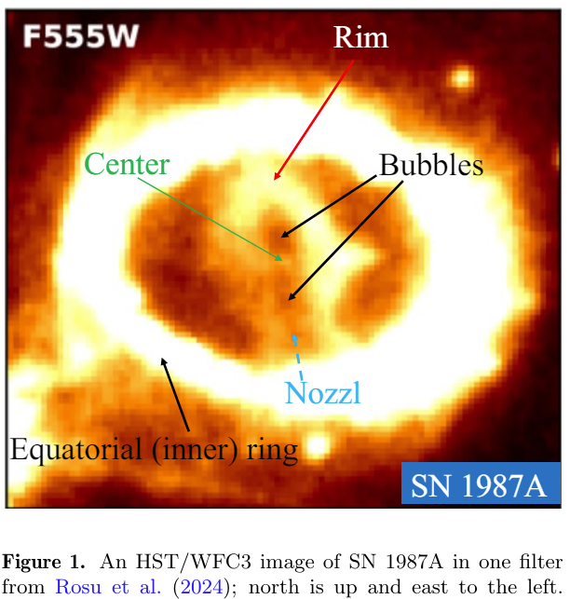
Supernova 1987
The equatorial ring is ~20,000 yr pre-explosion. It did not influence the inner ejecta yet.
Supernova 1987
Soker, N. 2024, “Supernova 1987A’s keyhole: A long-lived jet-pair in the final explosion phase of core-collapse supernovae”
(Research in Astronomy and Astrophysics)

Slide 18
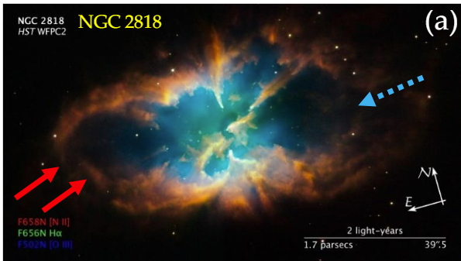
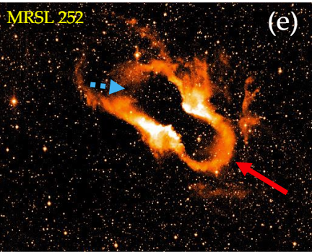
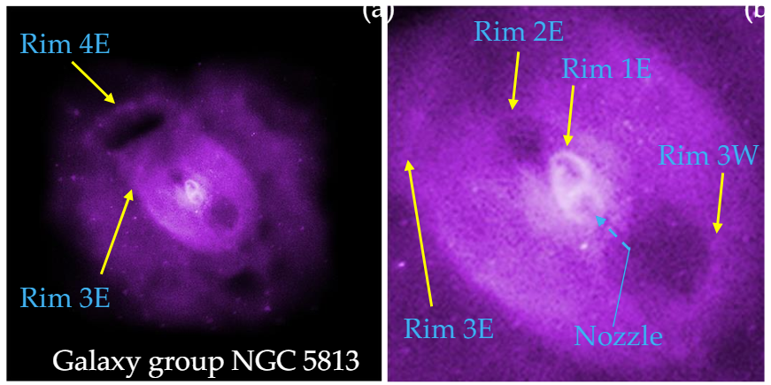
Planetary nebulae
Nozzle
Rim
Supernova 1987
Nozzle
Rim

Slide 19
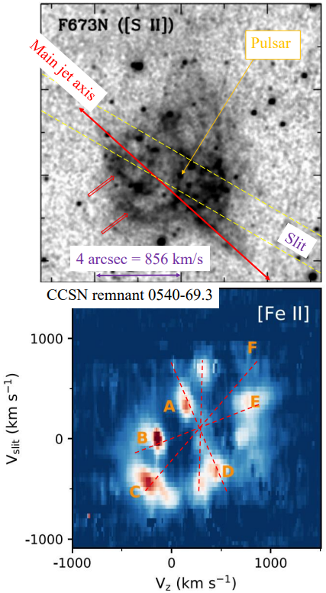
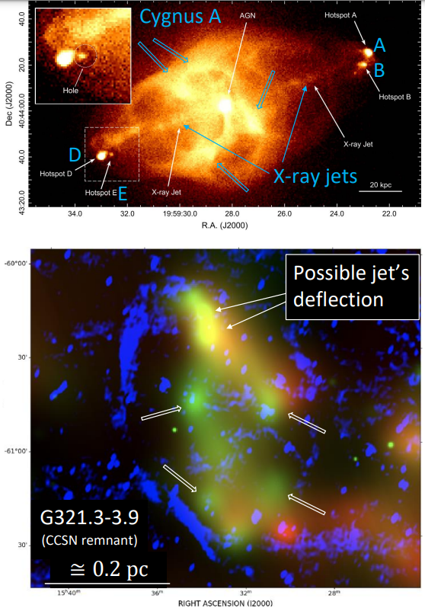
Galaxy cluster (X-ray) Snios et al. 2020
צביר גלקסיות (קרינת-X)
Core-collapse
supernova remnant
Morse et al. (2006)
Larsson et al. (2021)
.
Point-symmetric
wind-rose

Slide 20
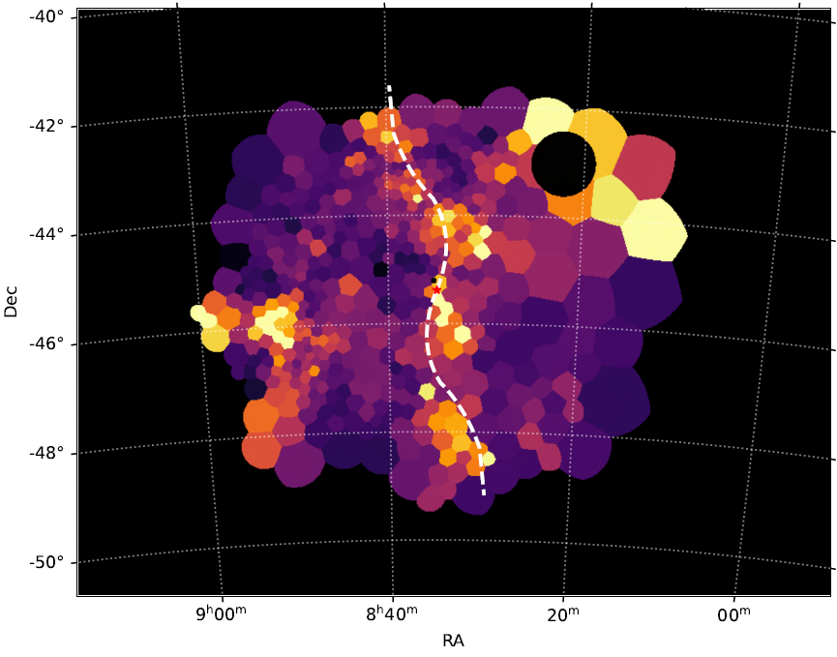
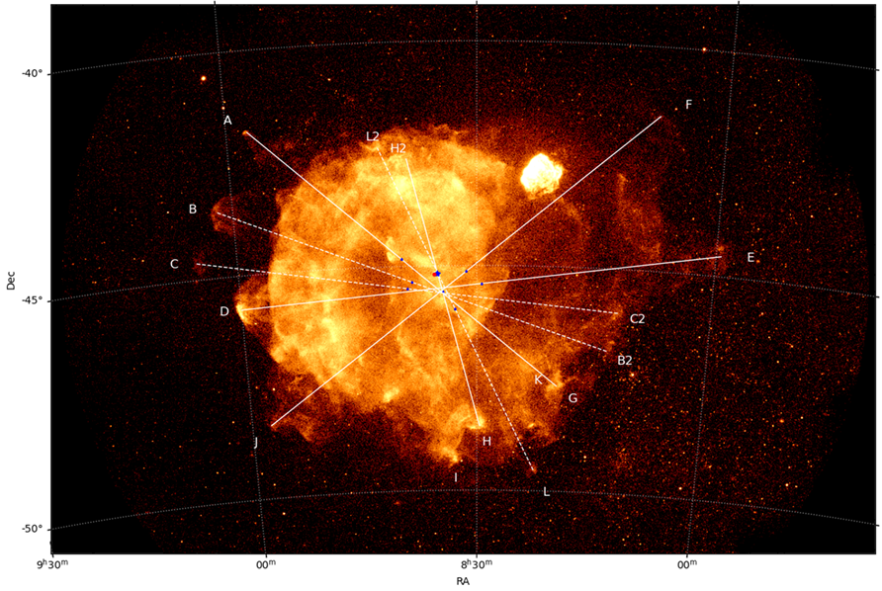
A new analysis of Vela by
Soker & Shishkin (2025)
Neon abundance from Mayer et al. (2023) eRosita observations. We added the S-shaped that we attribute to a pair of precessing jets.

Slide 21
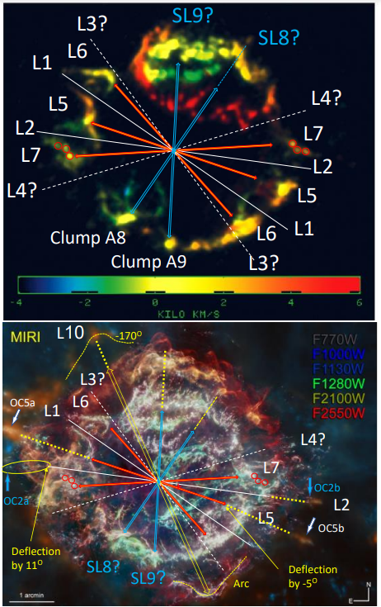
A velocity map in the 6.99μm [Ar II] line; (DeLaney et al. 2010).
Cassiopeia A
Core-collapse supernova remnant
Point-symmetric
wind-rose
(Bear & Soker 2025)
JWST (Milisavljevic et al. 2024)

Slide 22
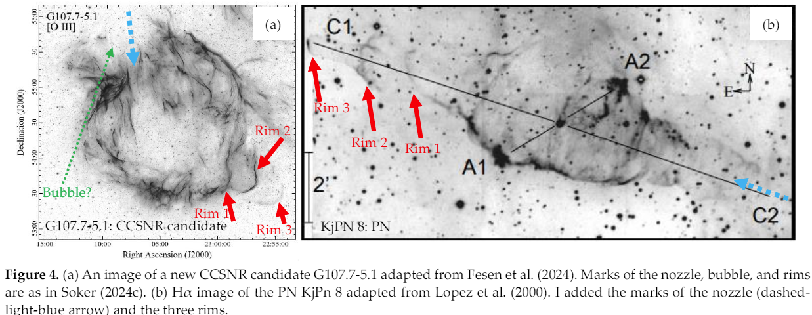
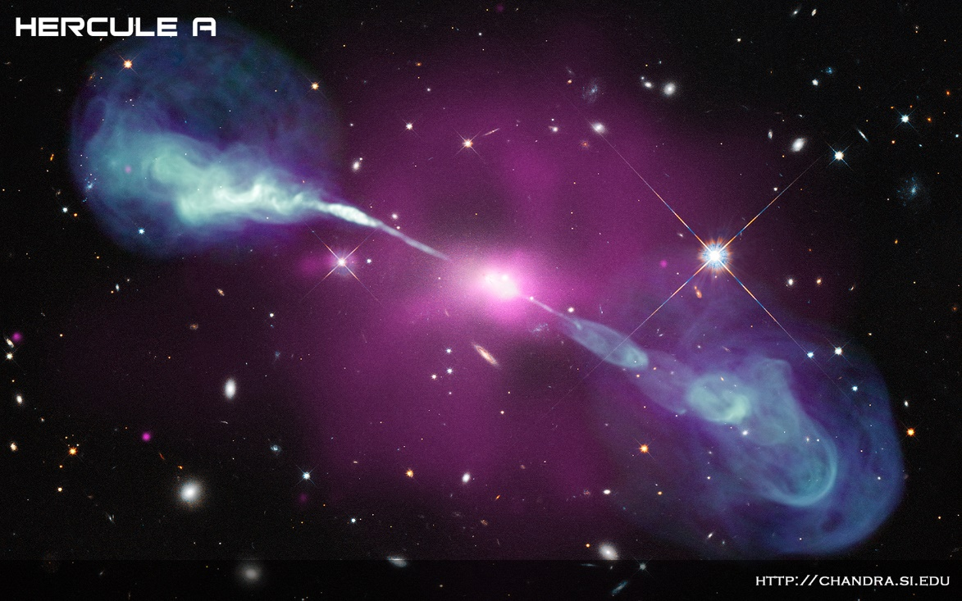
Core collapse supernova
Planetary nebula
Nozzle
Nozzle
Cooling flow galaxy
Soker, N. 2024, “Planetary nebula morphologies indicate a jet-driven explosion of SN 1987A and other core-collapse supernovae”
(Galaxies)
Rims seen in radio (jet)

Slide 23
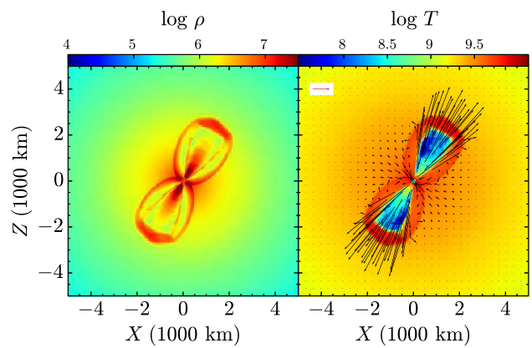
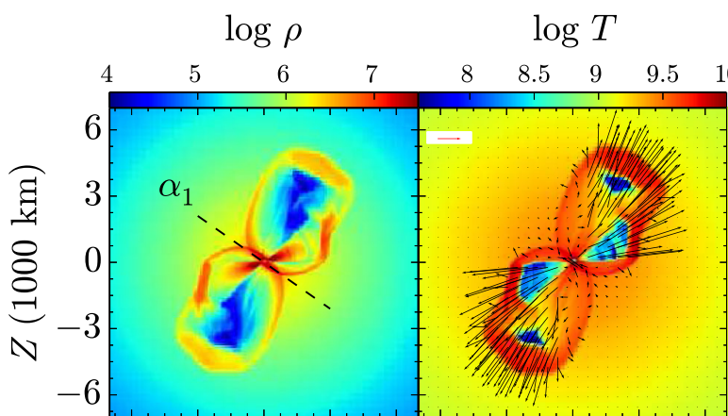
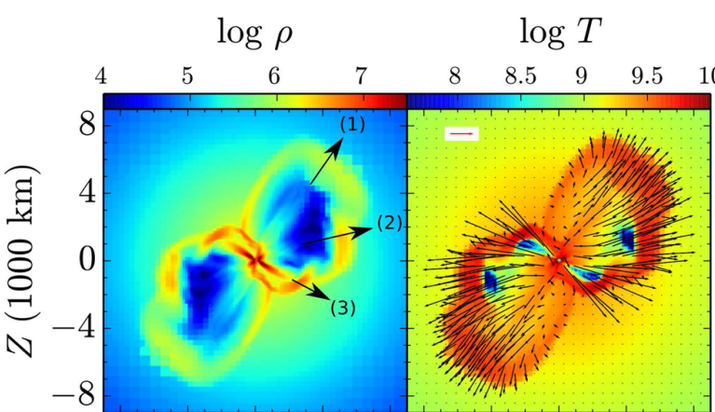
A simulation of 3-pairs of opposite jets launched within 0.15 seconds inside a core of a massive star just after the formation of the new neutron star.
A full 3D simulation.
Papish and Soker 2014, MNRAS, 443, 664

Slide 24
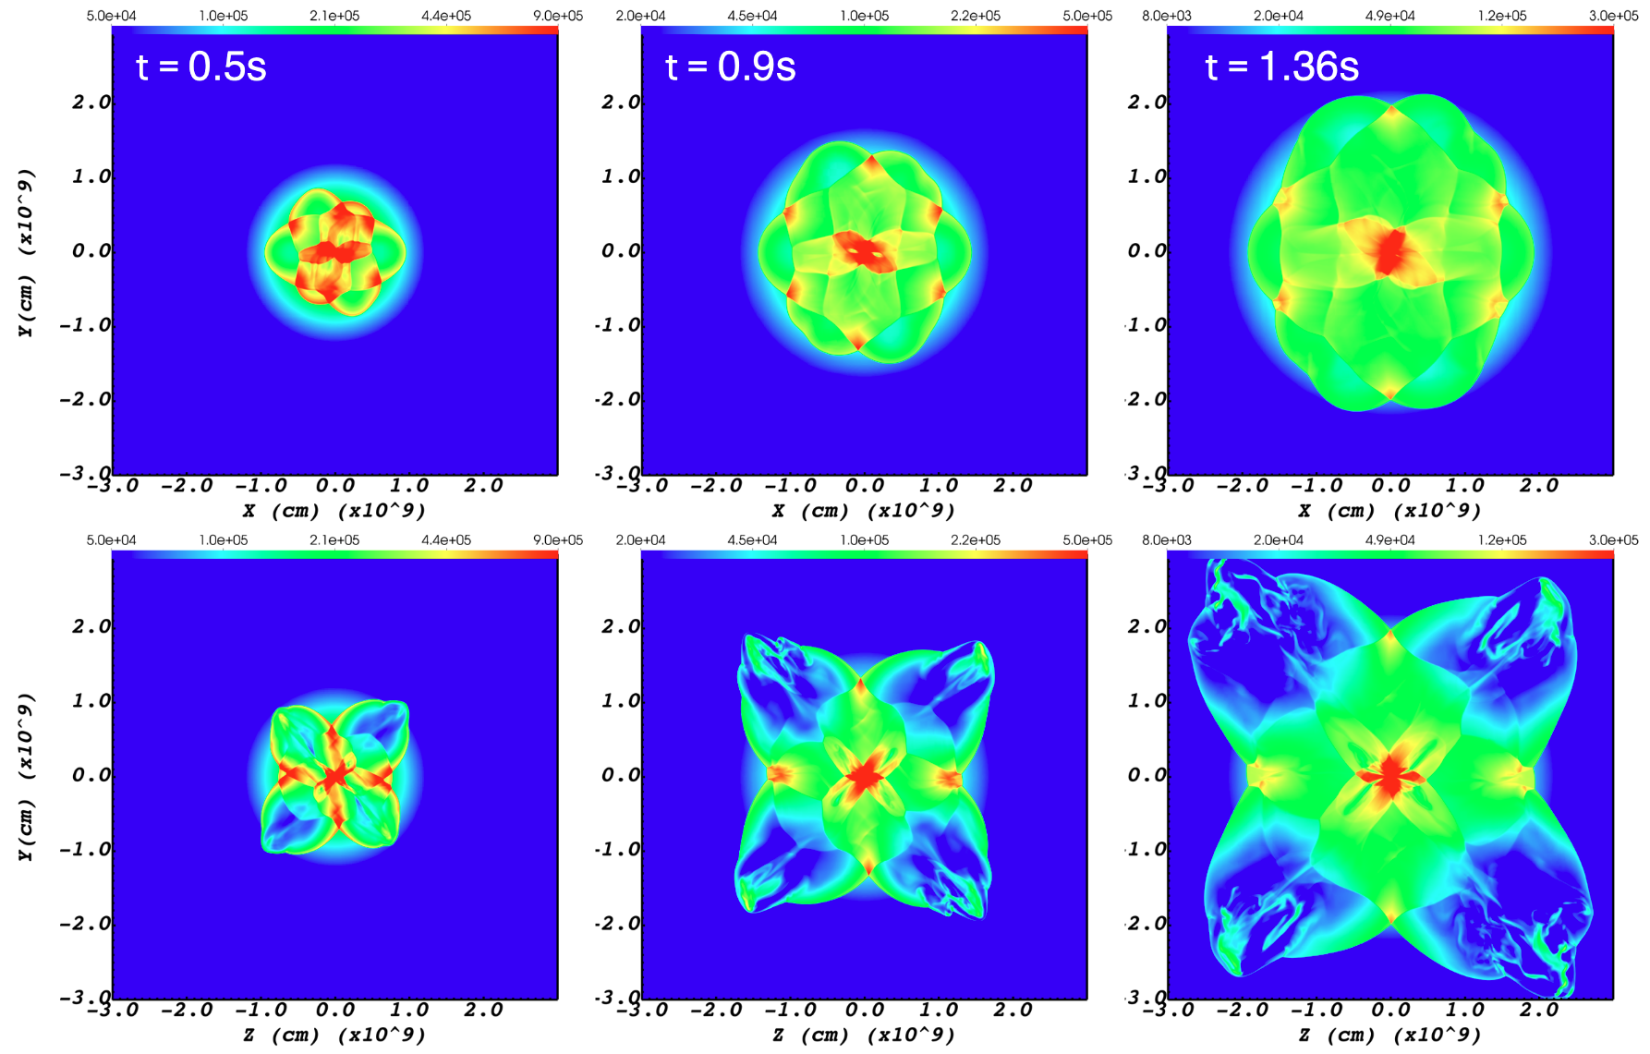
Jessica Braudo, Amir Michaelis, Muhammad Akashi, Noam Soker
(2025; Accepted for publication by astro-ph)
3D hydrodynamical simulations of the
Jittering Jets Explosion Mechanism
Braudo et al. (2025):
Three pairs of jets.
Evolution to r=30,000 km inside the star.
Poster by
Jessica Braudo
z=0 plane
x=0 plane

Slide 25
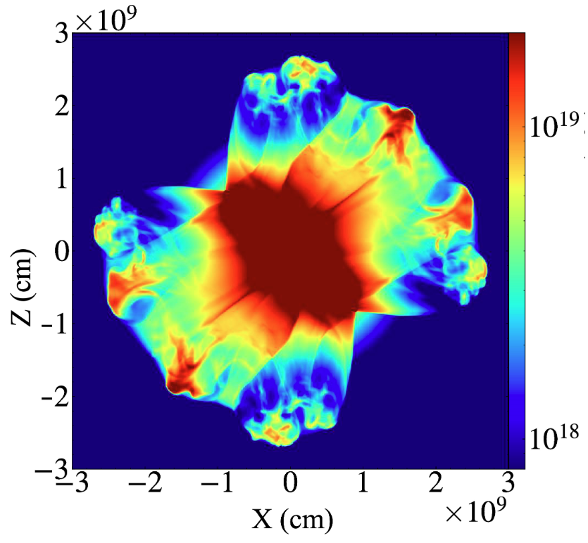
Jessica Braudo, Amir Michaelis, Muhammad Akashi, Noam Soker
(2025; Accepted for publication by astro-ph)
3D hydrodynamical simulations of the
Jittering Jets Explosion Mechanism
Braudo et al. (2025):
Emission measure maps (mimic observations).
3 pairs of jets
form
5 pairs of clumps
y=0 plane

Slide 26
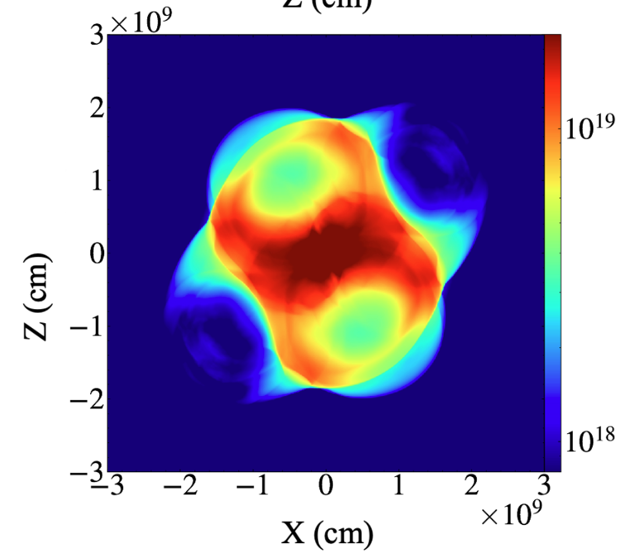
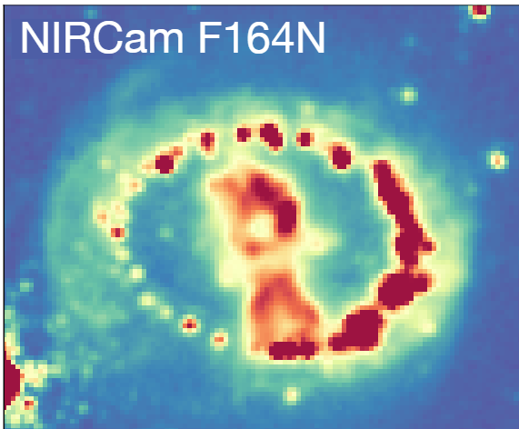
Jessica Braudo, Amir Michaelis, Muhammad Akashi, Noam Soker
(2025; Accepted for publication by astro-ph)
3D hydrodynamical simulations of the
Jittering Jets Explosion Mechanism
Braudo et al. (2025):
Emission measure maps (mimic observations).
SN 1987A: Pairs of bubbles (from Larsson, J.).
The ring was expelled 20,000 yrs before the explosion.
y=0 plane

Slide 27
Summary
It is time the community considers the
jittering jets explosion mechanism (JJEM)
on the same level as the competing
delayed-neutrino explosion mechanism.
(2) Supernova remnants show that jets explode
most (probably all) core-collapse supernovae.

Slide 28
Extra

Slide 29
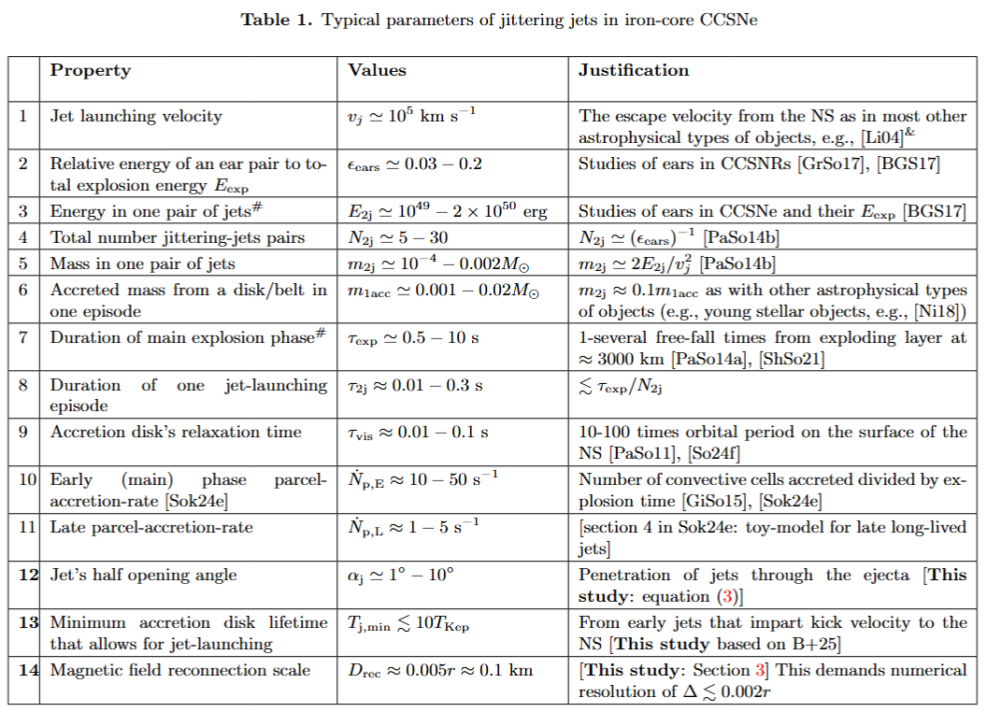
(Soker 2024)

Slide 30
ROSAT X-ray image
Aschenbach et al. (1995), based on
Sapienza et al. (2021)
Core-collapse
supernova remnant
Morse et al. (2006)
Larsson et al. (2021)
.
Point-symmetric
wind-rose
eROSITA X-ray
Mayer et al. (2023)

Slide 31
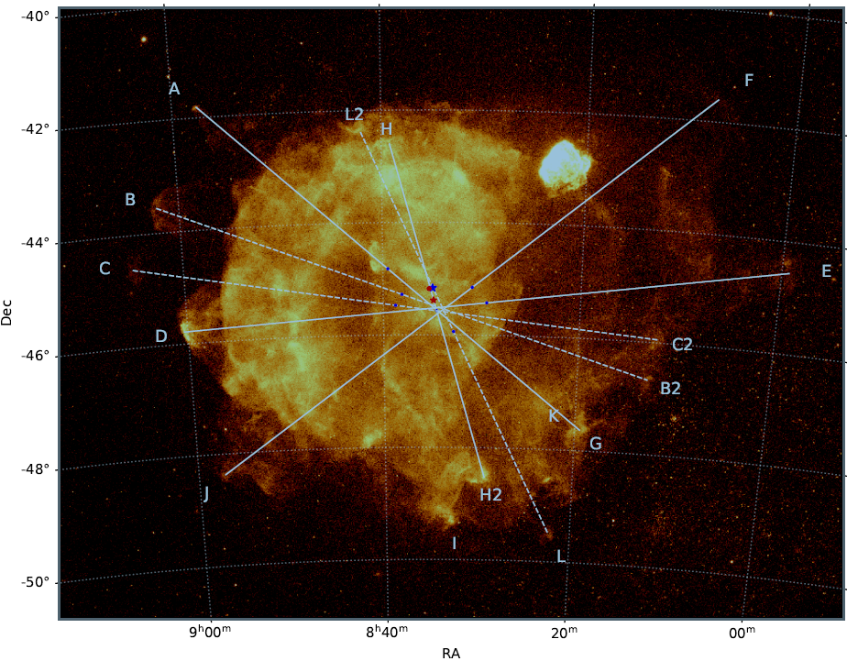
A new analysis of Vela by Soker & Shishkin
(2024)

Slide 32
A new analysis of Vela by Soker & Shishkin
(2024)
The point-symmetric wind-rose of Vela supernova remnant

Slide 33
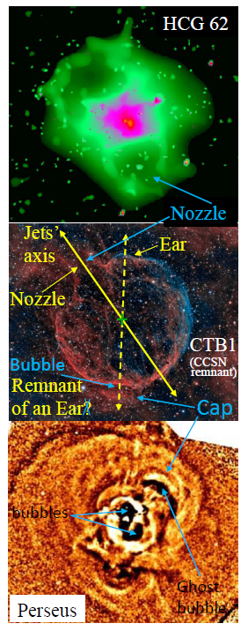
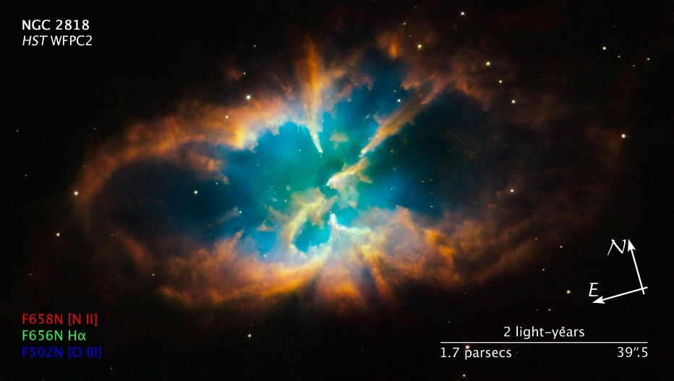
Galaxy group
NASA/CfA/J. Vrtilek et al.; also Gitti et al. 2010
Rim
HST planetary nebulae
Core-collapse supernova remnant
Kimberly Sibbald (also Reyes-Iturbide et al.
2024; image by Tomasz Zwolinskic)
Galaxy cluster
Fabian et al. (2006)
Rim
Nozzle

Slide 34
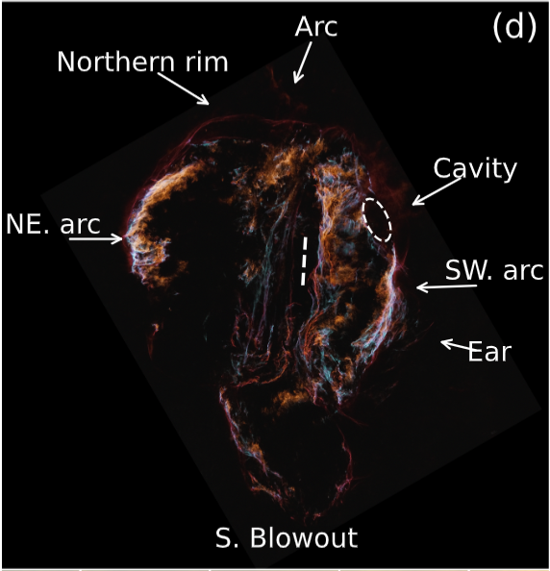
The Cygnus Loop
(Shishkin, Kaye, Soker 2024)
Visible image from Raymond, J. et al. (2023), made by Min Xie.
Labels from our paper.

Slide 35
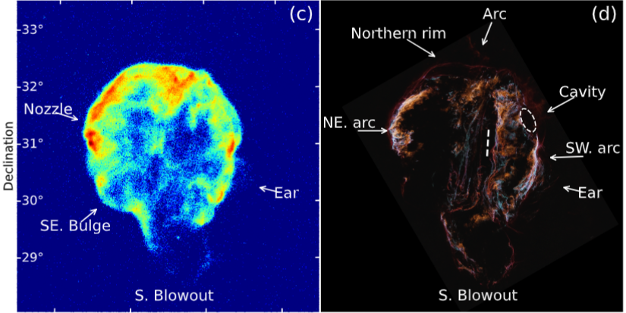
The Cygnus Loop
(Shishkin, Kaye, Soker 2024)
Visible image from Rayond, J. et al. (2023), made by Min Xie.
X-ray
Labels from our paper.

Slide 36
The Cygnus Loop
(Shishkin, Kaye, Soker 2024)
Visible image from Rayond, J. et al. (2023), made by Min Xie.
X-ray
Labels from our paper.

Slide 37
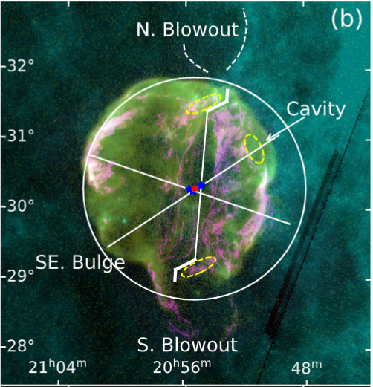
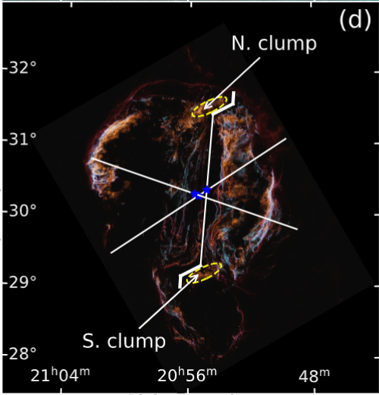
The Cygnus Loop
(Shishkin, Kaye, Soker 2024)
We identify a point-symmetric morphology in the Cygnus Loop supernova remnant. It was shaped by 3 pairs of jets.

Slide 38


The Crab Nebula: exploded in 1054
蟹状星云产生于公元1054年一次超新星爆发
Chinese astronomers recorded it for almost 2 years, 23 days in day light
中国天文学家于1054年首先发现并记载下来，剧烈的核爆炸使它在白天也可见，两年后肉眼才看不见
Neutron star
Visible light
X-ray
For its low explosion energy, ~1e50 erg, the neutrino-driven supporters use it as a loyal supernova to their model.

Slide 39


The Crab Nebula
Bays with dust filaments
Temim et al. (2024):
JWST image:

Slide 40
The Crab Nebula
Temim et al. (2024):
JWST image

Slide 41
Temim et al. (2024):
JWST image
The Crab Nebula
Shishkin & Soker
(posted today on astro-ph)

Slide 42

Jittering jets exploded the
Crab Nebula
Bays and not clumps because of the energetic pulsar wind nebula.

Slide 43
Supernova Remnant W44
(Soker 2024)
A composite image of W44 from NASA site.
Magenta: GeV gamma-ray from Fermi’s LAT;
Yellow: Radio from the Karl G. Jansky Very Large Array;
Red: infrared;
Blue: X-ray from ROSAT.
Credit: NASA/DOE/Fermi LAT Collaboration, NRAO/AUI, JPL-Caltech, ROSAT.

Slide 44

Supernova Remnant W44
(Soker 2024)
A radio image from Claussen et al. (1997)

Slide 45
Supernova Remnant W44
(Soker 2024)
A radio image from Claussen et al. (1997)

Slide 46
Supernova Remnant W44
(Soker 2024)
A radio image from Claussen et al. (1997)

Slide 47

Supernova Remnant W44
A radio image from Claussen et al. (1997)
Pair of jets
Pair of jets
An X-ray image of the cooling flow cluster of galaxies
RBS 797
(from \Ubertosi et al. 2021)

Slide 48
SUMMARY
?
Energetic jets must have shaped all these supernova remnants.
➔ The energy in the jets is the explosion energy (of all core-collapse supernovae).
➔ The jittering jets explosion mechanism

Slide 49
Status of debate
The delayed-neutrino explosion mechanism encounters severe problems:
Cannot explain explosion energies of >1.5e51erg.
Disagreement between groups. Hans-Thomas Janka (2024): “Results from different groups differ significantly.”
Predicts failed supernovae; observations do not support (e.g., Byrne & Fraser 2022; Strotjohann, et al. 2024; Beasor et al. 2024).
Cannot explain jets in remnants, particularly point-symmetric supernova remnants
(Soker, N. several papers in 2024 and 2025).
The jittering jets explosion mechanism can explain any explosion energy, predicts no failed supernovae, and naturally accounts for point-symmetric core-collapse supernova remnants.
Rule out the delayed-neutrino explosion mechanism.

Slide 50

Comparing the results of two groups using the neutrino-driven explosion mechanism
GR1d+: Boccioli, L, and Fragione, G. (2024)
S16: Sukhbold, T. Ertl, S. E. Woosley, J. M. Brown, and H. T. Janka (2016)
Zero-age main-sequence mass of progenitor

