Slide 1
Late-Time Shock Interaction in Core-Collapse Supernovae
Raya Dastidar on behalf of Amit Kumar
Universidad Andres Bello, Chile Royal Holloway, University of London, UK
Millenium Institute of Astrophysics, Chile University of Warwick, UK
In collaboration with Justyn Maund (RHUL)
An Extraordinary Journey Into The Transient Sky Conference
Padova, Italy

Slide 2
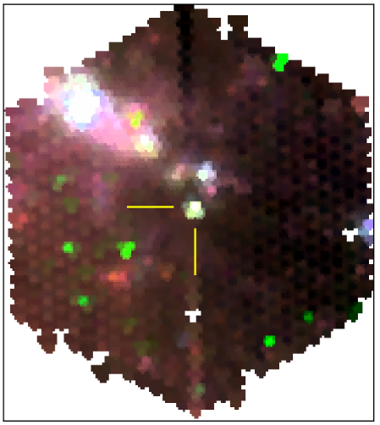
WEAVE multi-object survey spectrograph
Recently commissioned instrument on the 4.2m William Herschel Telescope.
Obtained on 2024 May 15 for programme WS2024A2-005 (PI: Justyn Maund)
spectral resolution of ≈ 2500

Slide 3
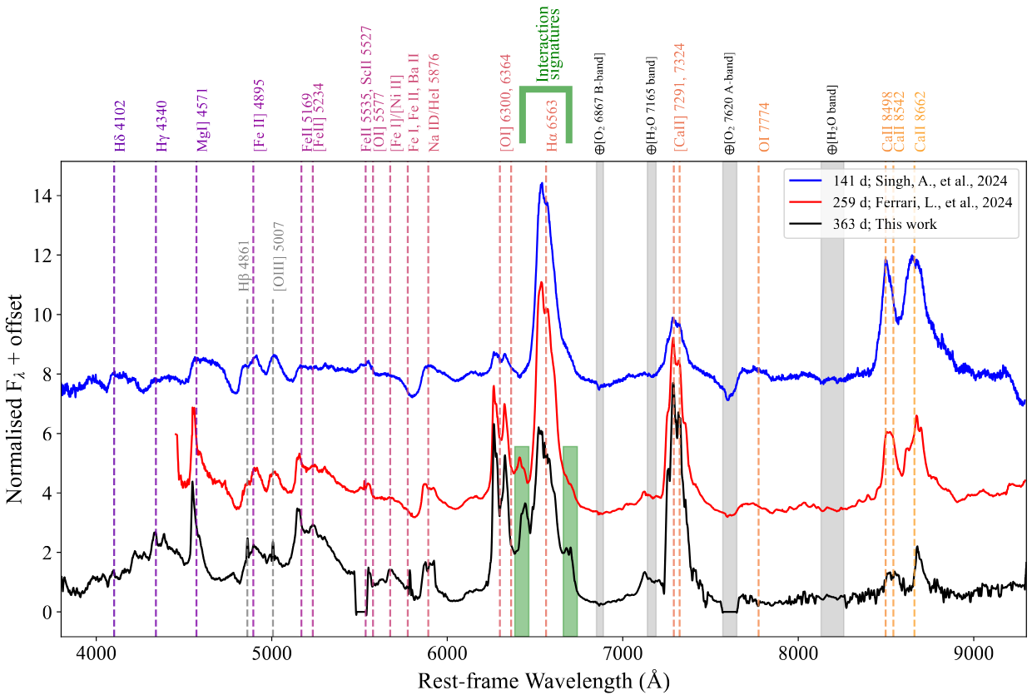
Nebular spectral evolution

Slide 4
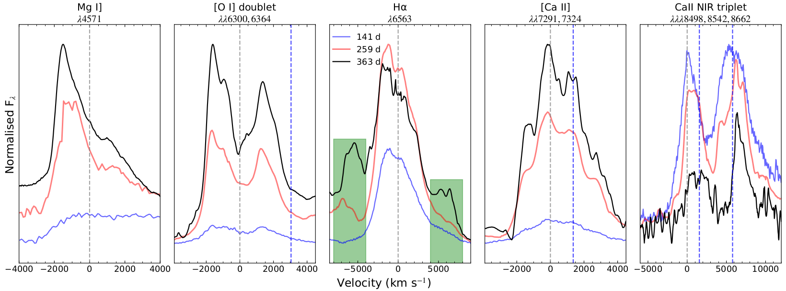
Features in velocity space

Slide 5
Features in velocity space
Broad central feature in all spectra
Emerging satellite features from 259d spectrum

Slide 6
What’s up at late times?
Forward Shock
high -velocity features
Tenuous CSM surrounding SN
SN shock
Dense Shell
Reverse Shock
Chugai 1990

Slide 7
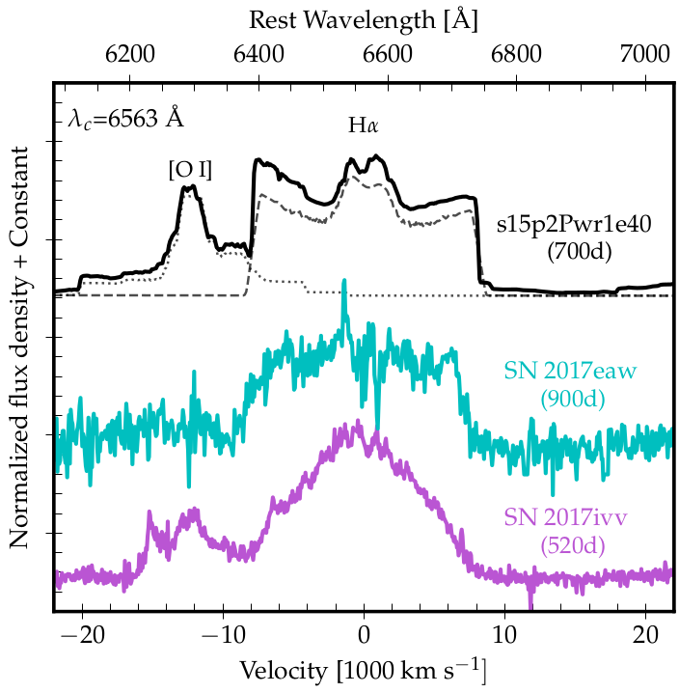
Dessart et al. 2023 modelled >+350d spectra of an RSG explosion
Incorporated shock power+radioactive decay energy
What’s up at late times?
SN
Ejecta
Dessart et al. 2023

Slide 8
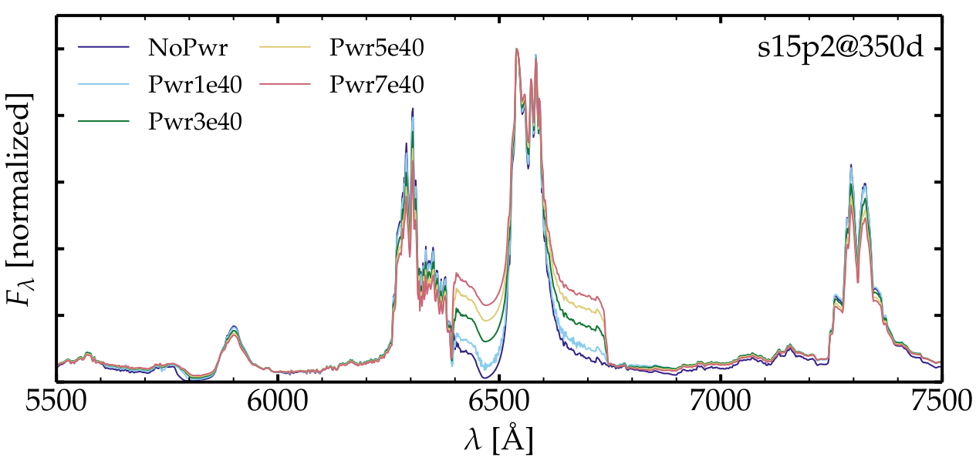
Dessart et al. 2023
Formed in the outer H-rich ejecta
Notes:
exponential decline of radioactive decay gets eventually swamped by ejecta-CSM interaction at late times

Slide 9
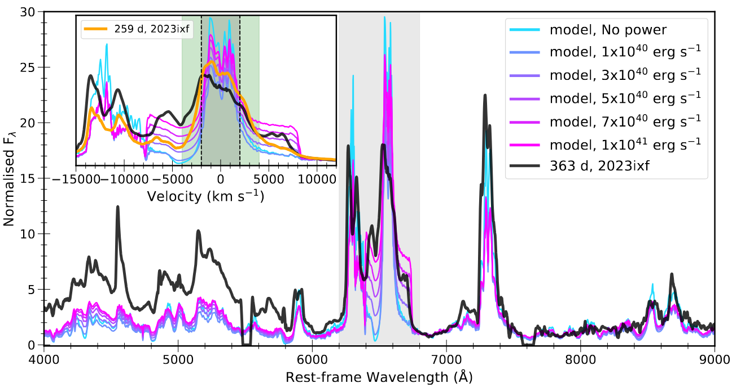
Kumar, Dastidar, Maund et al. 2025
Notes:
Blue side stronger than the red is possibly optical depth effect.
Comparison of the +363 d spectrum of SN~2023ixf with the +350 d nebular spectra models from Dessart2023. The models, representing various injected shock powers ranging from 10^{40} to 10^{41} erg/s, are indicated in the figure legend. The inset provides a close-up view of the [\ion{O}{i}] doublet and \ion{H}{$\alpha$} regions. For comparison, the +259 d spectrum of SN~2023ixf is also shown in the inset. The extent of the central \ion{H}{$\alpha$} component in the models (+/-2000 km/s) is marked with dashed lines, while the green shaded region highlights its extent in SN~2023ixf.

Slide 10
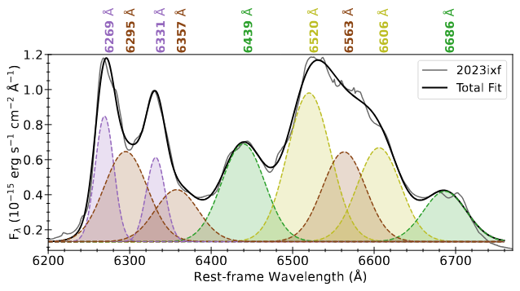
Multi-Gaussian fit
Three broad components (of same FWHM) to model the rest velocity components of Hα and [O I] doublet.
Δλ1
Δλ1
Two narrow components to fit the blue-shifted [O I] doublet.
Δλ2
Δλ2
Two sets of satellite components of Hα shifted by the same Δλ on either side.

Slide 11
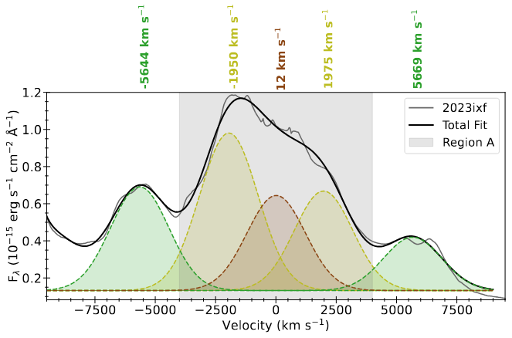
In velocity space
LV shell comp.
HV shell comp.

Slide 12
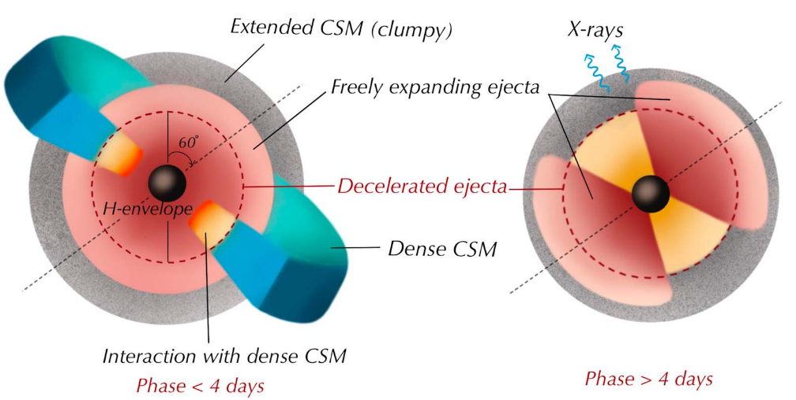
Formation of asymmetric shell
Singh et al. 2024

Slide 13
[O I] and [Ca II] profiles
Both are double peaked
The separation is equal to the intrinsic separation of the doublet.

Slide 14
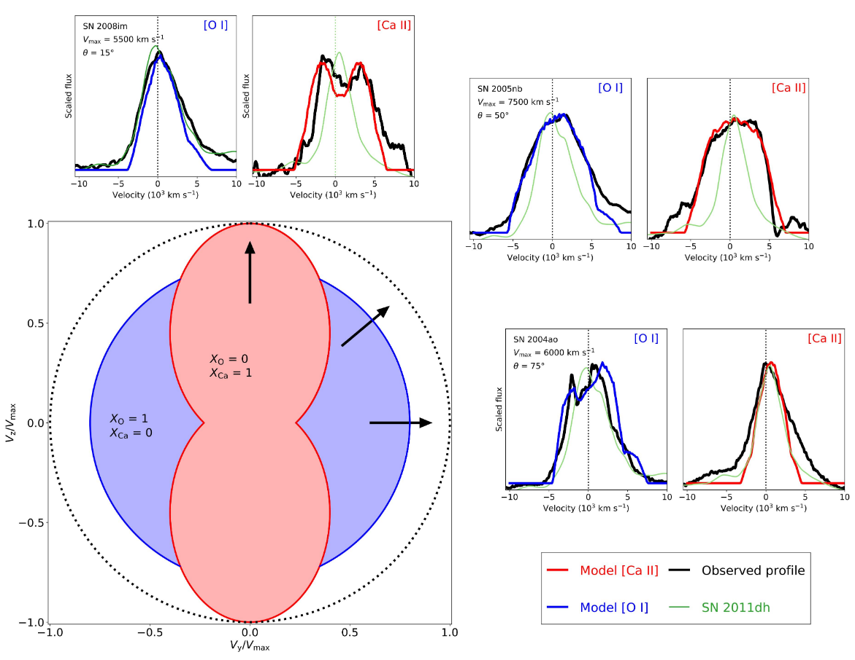
For SESNe
Fang et al. 2025

Slide 15
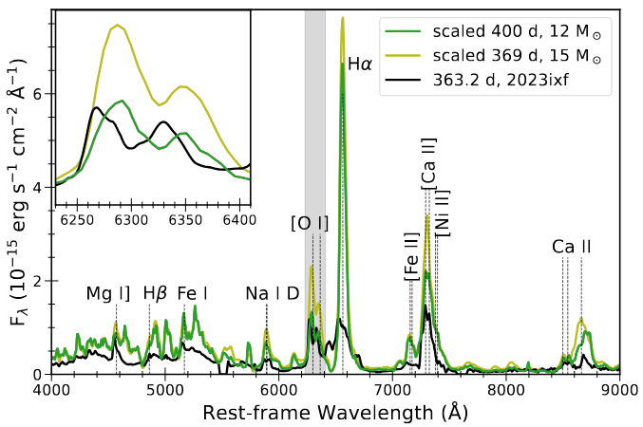
Comparison with Jerkstrand models

Slide 16
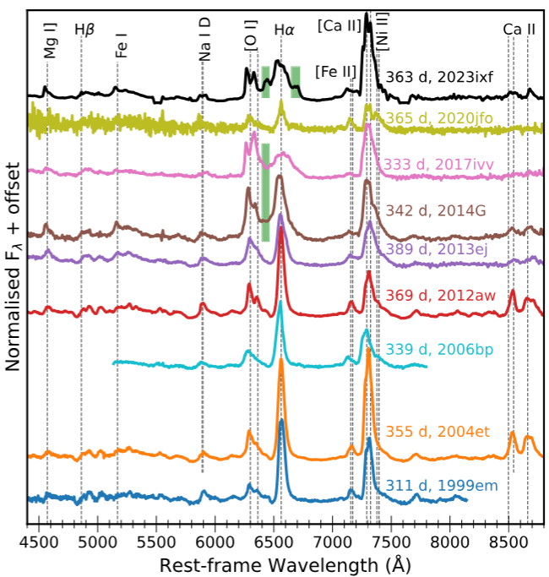
Comparison with other Type II SNe

Slide 17
Key takeaways
Blue-shifted Mg I] and [O I] suggests a clump of O-rich material moving towards the observer.
Two pairs of satellite components of Hα suggest an asymmetric shock-swept shell interacting with CSM ejected centuries before explosion.
Comparison with other SNe shows no prominent satellite features; in SN 2023ixf, their rapid formation suggests enhanced nearby mass loss.
Continued late-time follow-up of SNe with new and upcoming instruments such as WEAVE and SOXS can reveal its progenitor's mass-loss history a few hundred years before explosion.
Thank you!

