Slide 1
Binary progenitor systems for Type Ic supernovae
Martín Solar
Supervisor: Michał Michałowski
Co-supervisor: Jakub Nadolny
Adam Mickiewicz University in Poznań (Poland)

Slide 2
Binary progenitor systems for Type Ic supernovae
Martín Solar
Supervisor: Michał Michałowski
Co-supervisor: Jakub Nadolny
Adam Mickiewicz University in Poznań (Poland)

Slide 3
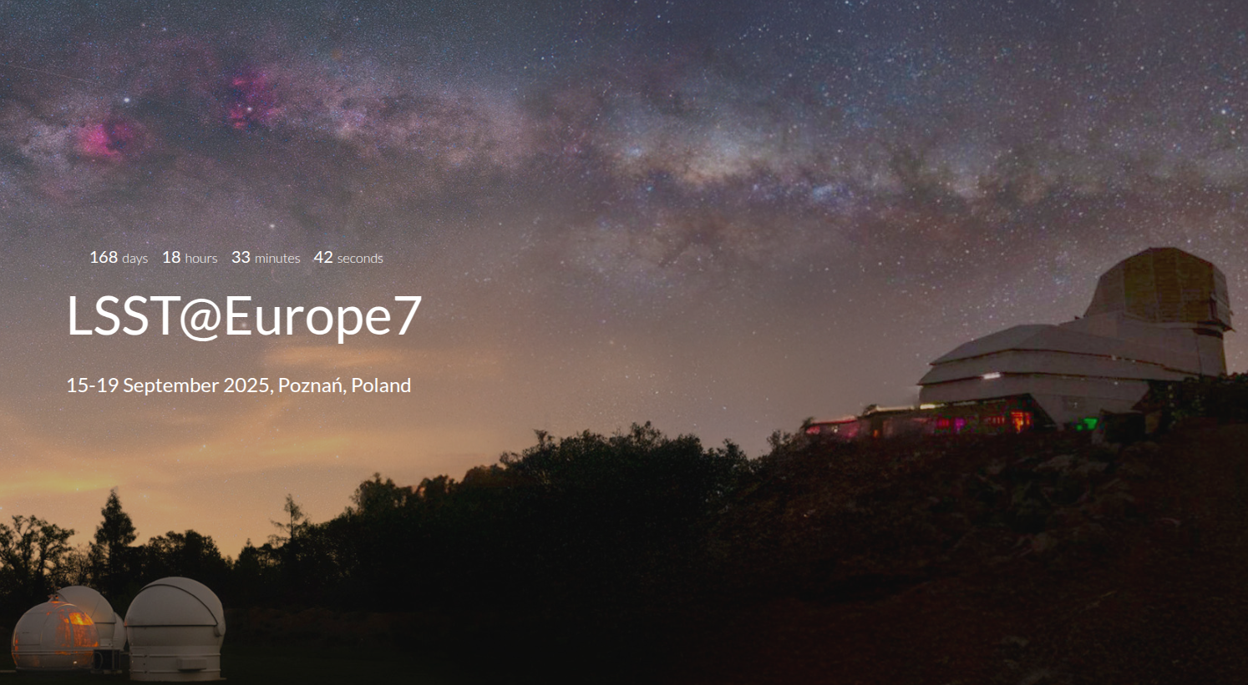

Slide 4
Star-Supernova-Interstellar medium connection
Molecular gas

Slide 5
Star-Supernova-Interstellar medium connection
Molecular gas
Star formation
Star

Slide 6
Star-Supernova-Interstellar medium connection
Molecular gas
Star formation
Stellar evolution
Supernova explosion
Star

Slide 7
Star-Supernova-Interstellar medium connection
Molecular gas
Star formation
Supernova feedback
Stellar evolution
Supernova explosion
Star

Slide 8
Star-Supernova-Interstellar medium connection
Molecular gas
Star formation
Supernova feedback
Type Ic SN
Stellar evolution
Supernova explosion
Star

Slide 9
Star-Supernova-Interstellar medium connection
Molecular gas
Star formation
Supernova feedback
Binary progenitors
Type Ic SN
Stellar evolution
Supernova explosion
Star

Slide 10
Star-Supernova-Interstellar medium connection
Molecular gas
Environment
Star formation
Supernova feedback
Binary progenitors
Type Ic SN
Stellar evolution
Supernova explosion
Star

Slide 11
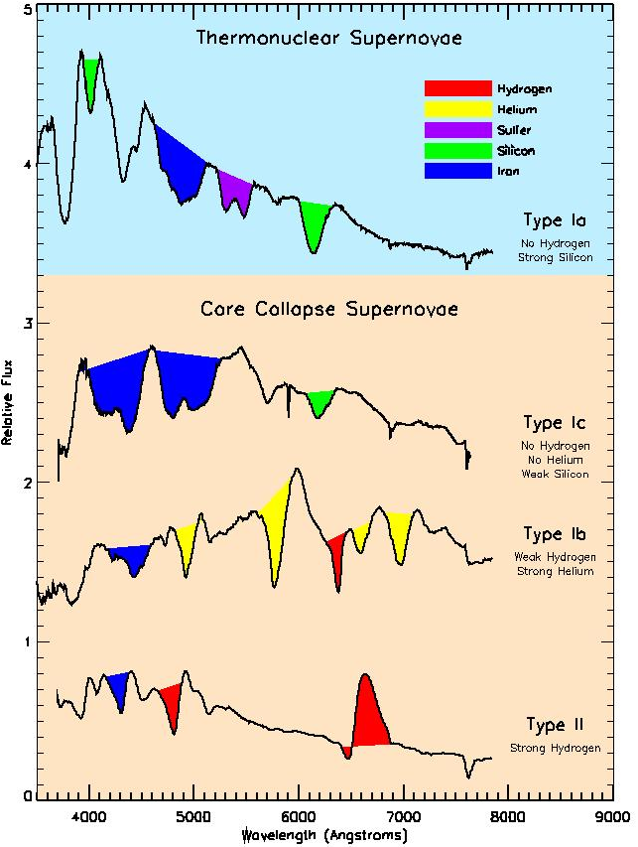
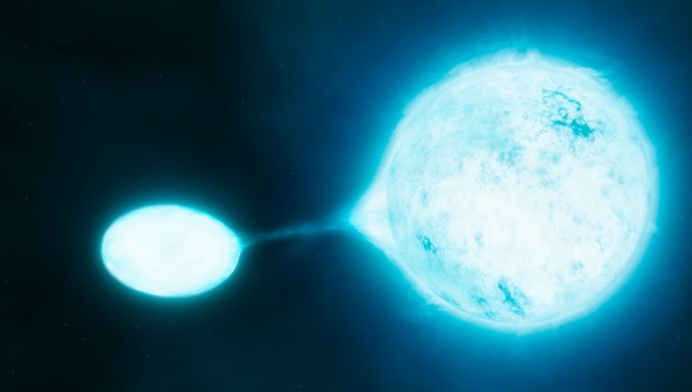
Type Ic SN progenitors: two candidates
Very massive star:
stellar winds
(M_{ZAMS} > 25 M⊙)
Binary system:
mass transfer
(M_{ZAMS} < 20 M⊙)
Credits: Daniel Kasen

Slide 12
Type Ic SN progenitors: two candidates
Very massive star:
stellar winds
(M_{ZAMS} > 25 M⊙)
Binary system:
mass transfer
(M_{ZAMS} < 20 M⊙)
M_{ZAMS} < 20 M⊙

Slide 13
Type Ic SN progenitors: two candidates
Very massive star:
stellar winds
(M_{ZAMS} > 25 M⊙)
Constrain initial mass
Binary system:
mass transfer
(M_{ZAMS} < 20 M⊙)
M_{ZAMS} < 20 M⊙

Slide 14
Powerful and robust method: SN environments
CO(2-1)
(rest frame
~ 230.530 GHz)
Tracer of H₂
Σ_{mol} [M_{ⵙ}/pc²]
Molecular gas surface density
at SN pixel position
Giant molecular clouds (GMCs)
Astrometric locations from past explosions
~100 pc

Slide 15
Spatial- and time-scales of GMCs
Credits: Schinnerer+2024

Slide 16
Spatial- and time-scales of GMCs
~100 pc
Credits: Schinnerer+2024

Slide 17
Spatial- and time-scales of GMCs
~100 pc
Time
Credits: Schinnerer+2024

Slide 18
Spatial- and time-scales of GMCs
~100 pc
Cloud lifetime → 30 Myr
Time
Credits: Schinnerer+2024

Slide 19
Spatial- and time-scales of GMCs
~100 pc
Gas formation → 20 Myr
Cloud lifetime → 30 Myr
Time
Credits: Schinnerer+2024

Slide 20
Spatial- and time-scales of GMCs
~100 pc
Gas formation → 20 Myr
Star formation → 3 Myr
Cloud lifetime → 30 Myr
Time
Credits: Schinnerer+2024

Slide 21
Spatial- and time-scales of GMCs
Stellar feedback → 7 Myr
~100 pc
Gas formation → 20 Myr
Star formation → 3 Myr
Cloud lifetime → 30 Myr
Time
Credits: Schinnerer+2024

Slide 22
Spatial- and time-scales of GMCs
Stellar feedback → 7 Myr
~100 pc
Gas formation → 20 Myr
Star formation → 3 Myr
Cloud lifetime → 30 Myr
Time
Credits: Schinnerer+2024

Slide 23
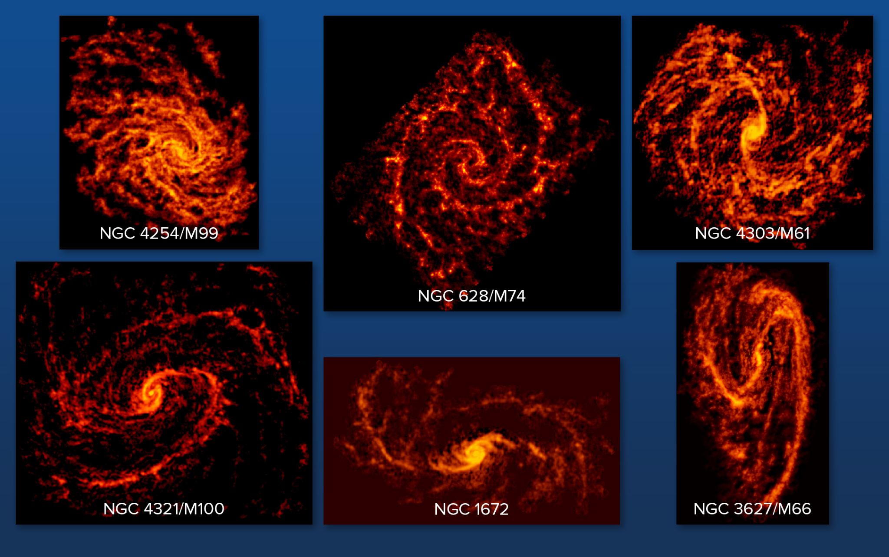
High-resolution observations in nearby galaxies
PHANGS-ALMA:
CO(2-1) emission line
74 face on (< 75º) and nearby (< 20 Mpc) spiral galaxies
~ 100 pc spatial resolution (typical size of GMCs)
30 Type II and 5 Type Ic SNe
Credits:
Leroy+2021a,b, and PHANGS collaboration

Slide 24
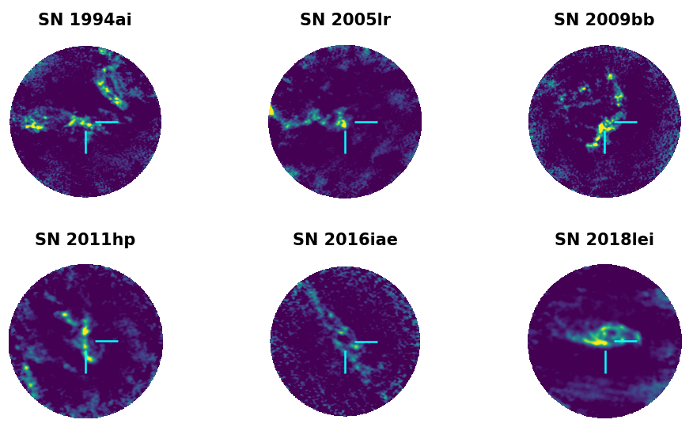
ALMA CO Supernova (ACOS) survey
ACOS:
CO(2-1) observations at 16 Type Ic SN positions
Resolution, distance and galaxy properties similar to PHANGS sample
PI: M. Michałowski (ID: 2021.1.00099.S)

Slide 25
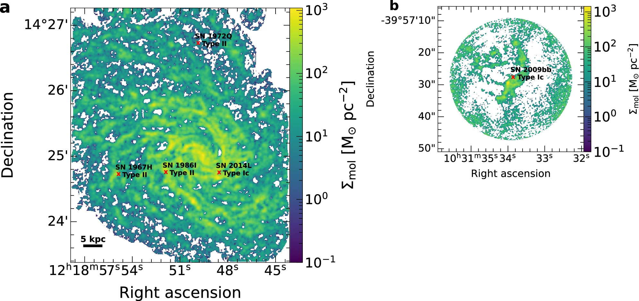
ALMA CO(2-1) observations collected
PHANGS-ALMA
+
ACOS surveys:
Type II SNe → 30
Type Ic SNe → 21
NGC 3279
By targeting a large sample we aim to uncover strong constraints on the overall SN populations and not provide the nature of individual SN progenitors
NGC 4254
Credits: Solar+2024

Slide 26
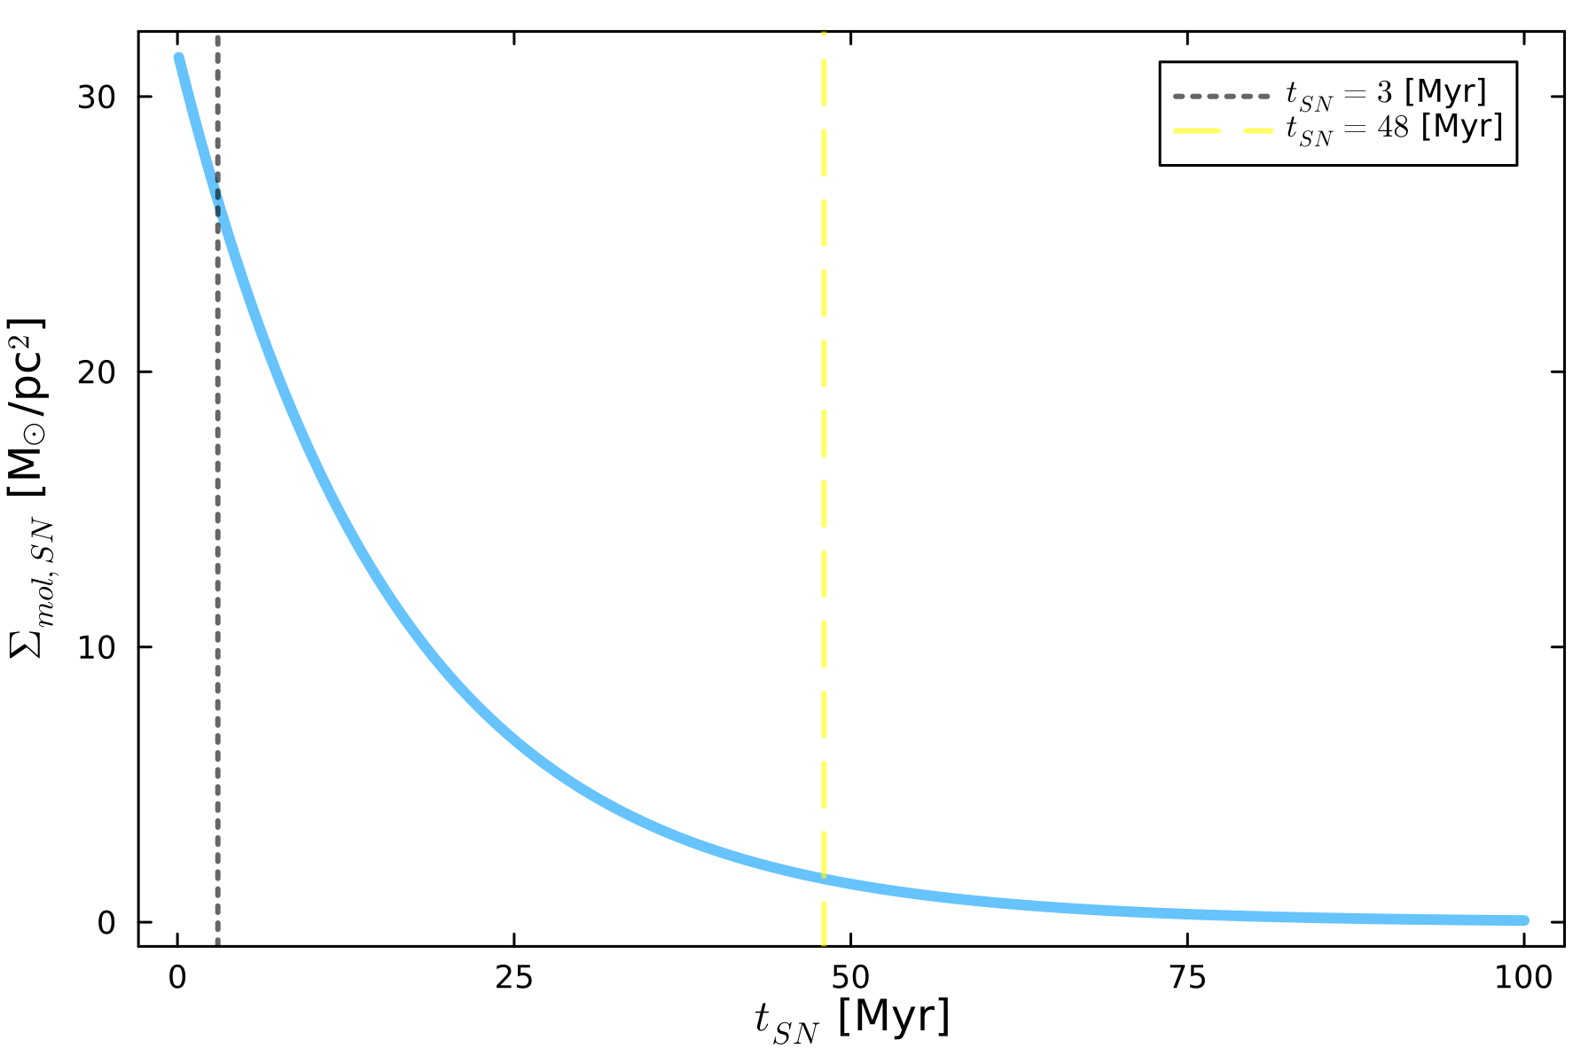
Molecular surface gas density at SN position
The molecular gas surface density Σ_{mol,SN} at the SN progenitor position decreases exponentially with time as:
Σ_{mol,SN} = Σ_{0,SN} × exp(-t_{SN}/τ_{GMC}),
where t_{SN} is the lifetime of the SN progenitor,
τ_{GMC} is the lifetime of the molecular cloud, and
Σ_{0,SN} is a normalisation constant
GMC parent vanishes with time (after starburst)

Slide 27
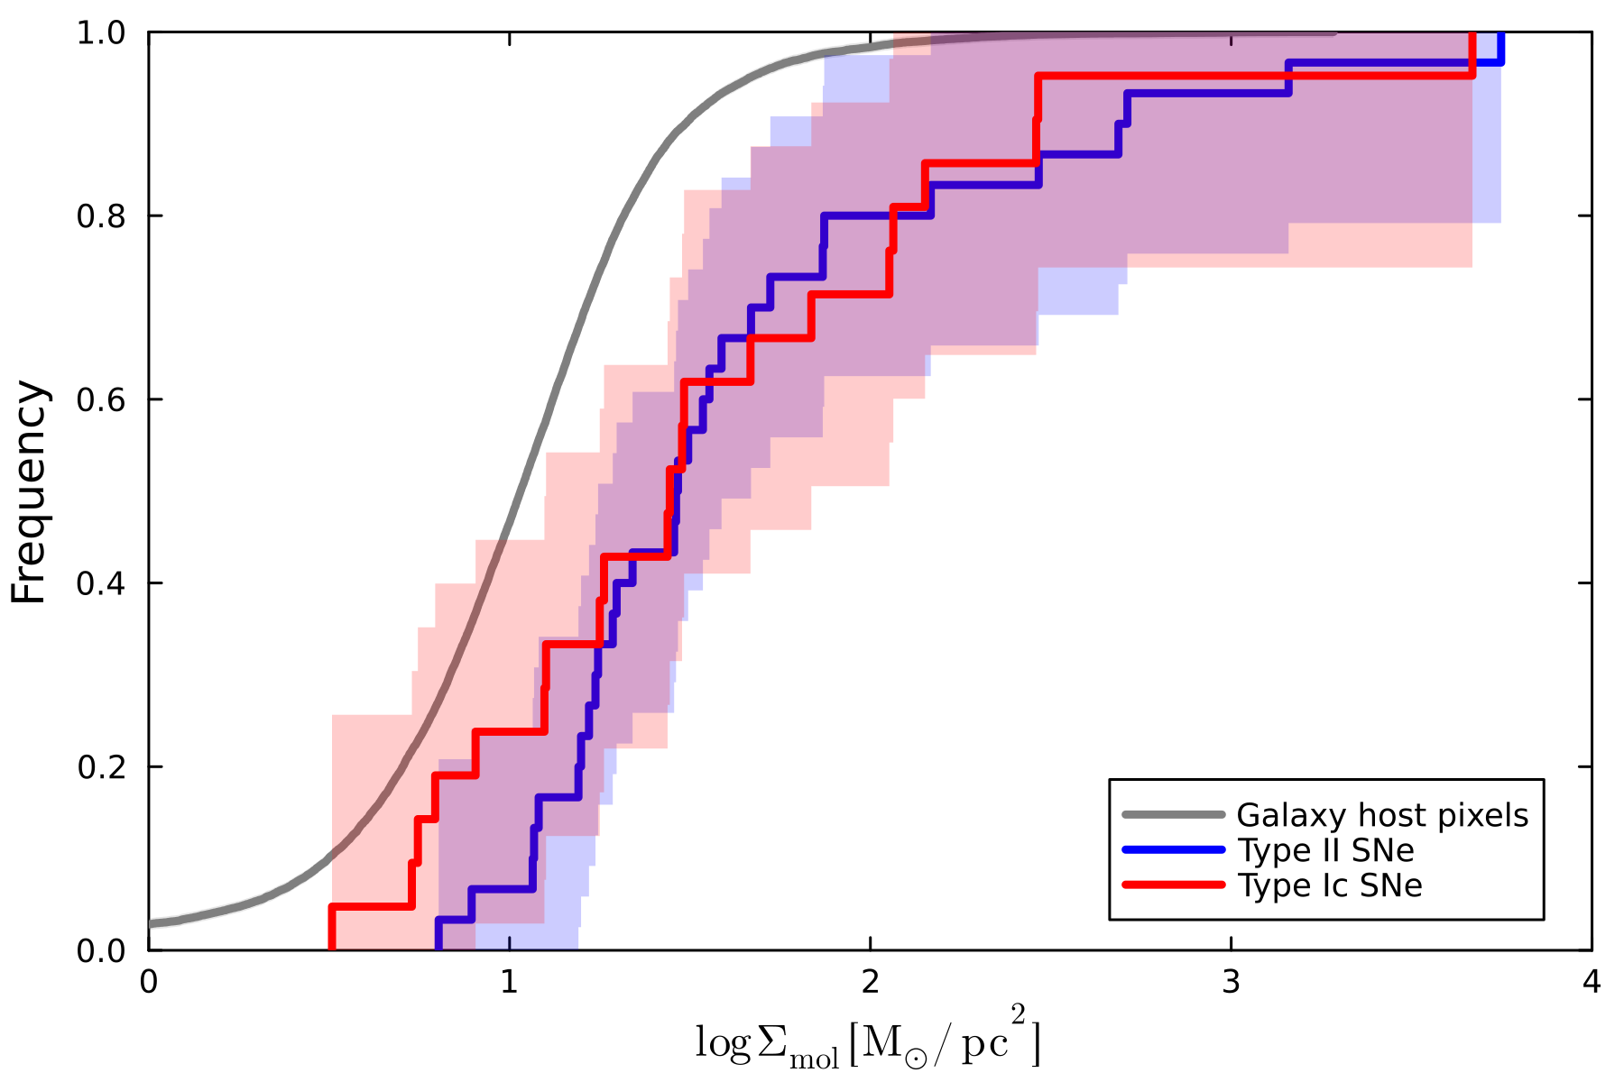
Type II and Ic SNe in similar Σ_{mol} environments
Type II SNe → Σ_{mol,II} = 20 ± 3 [M_{ⵙ} / pc²]
Type Ic SNe → Σ_{mol,Ic} = 21 ± 4 [M_{ⵙ} / pc²]
τ_{GMC} = 16 ± 5 [Myr] (Kim et al. 2022)
Σ_{mol,Ic}/Σ_{mol,II} = Σ_{0,Ic}/Σ_{0,II} × exp(-t_{Ic}/τ_{GMC})/exp(-t_{II}/τ_{GMC})
t_{II} - t_{Ic} = 0.4 ± 4.3 [Myr]
Credits: Solar+2024
The short progenitor lifetime difference suggests similar initial masses:
binary progenitor systems for Type Ic SNe

Slide 28
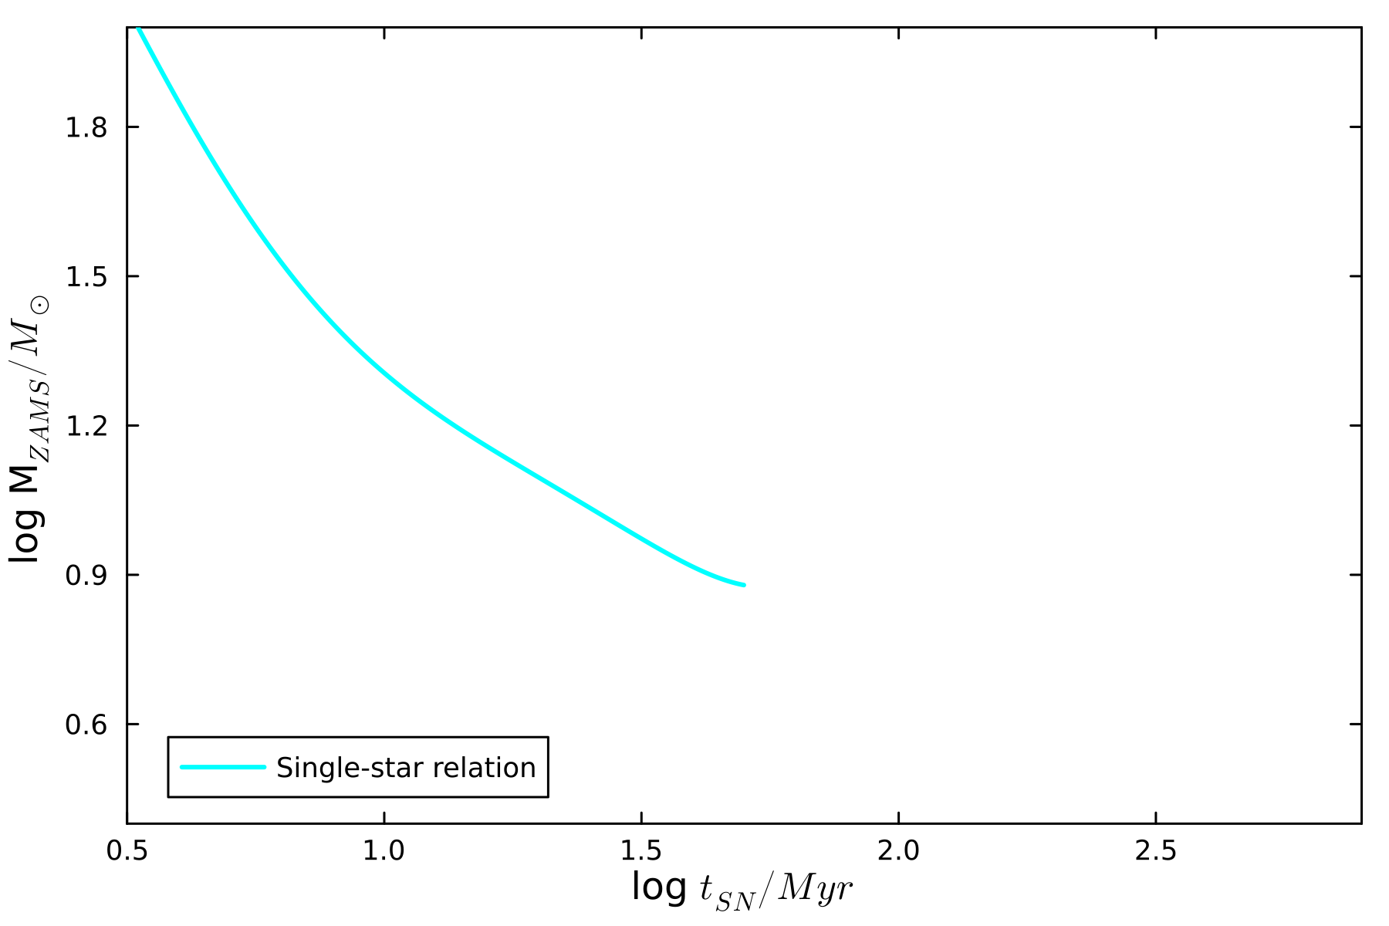
Statistical significance test → Simulations
Credits: Based on Zapartas et al. (2017)

Slide 29
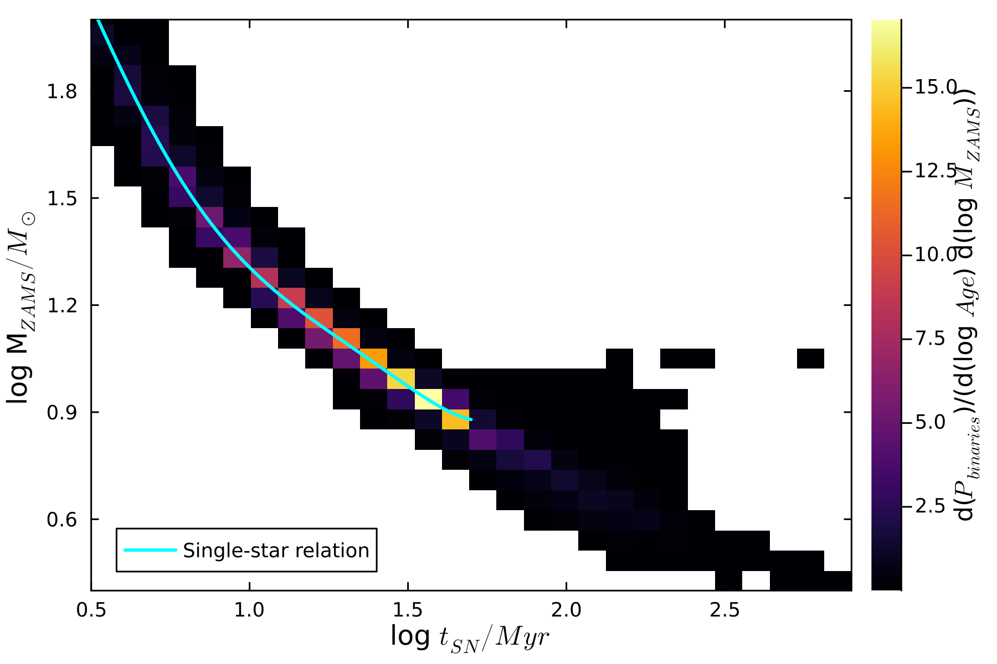
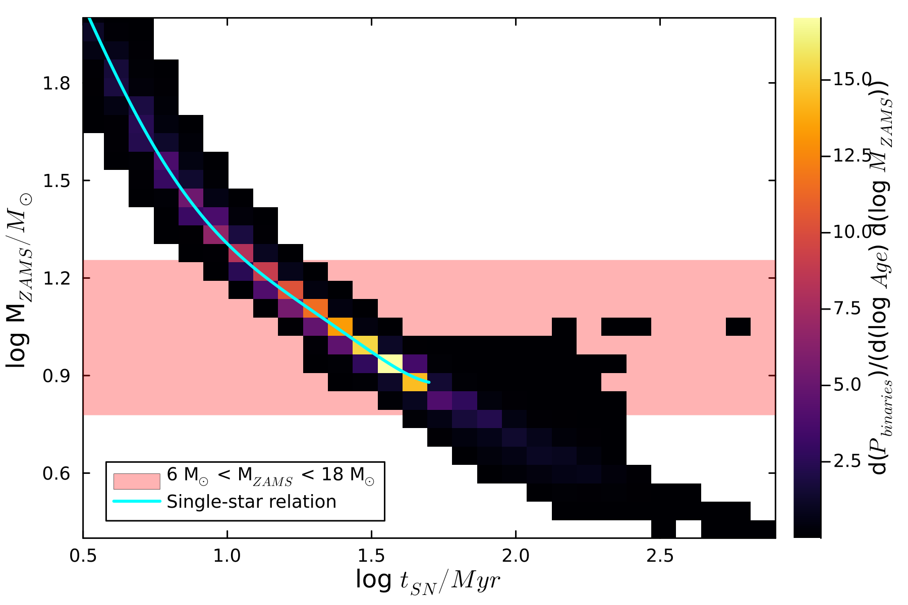
Statistical significance test → Simulations
Credits: Based on Zapartas et al. (2017)

Slide 30
Statistical significance test → Simulations
6 < M_{ZAMS} < 18 [M_{ⵙ}]
Credits: Based on Zapartas et al. (2017)

Slide 31
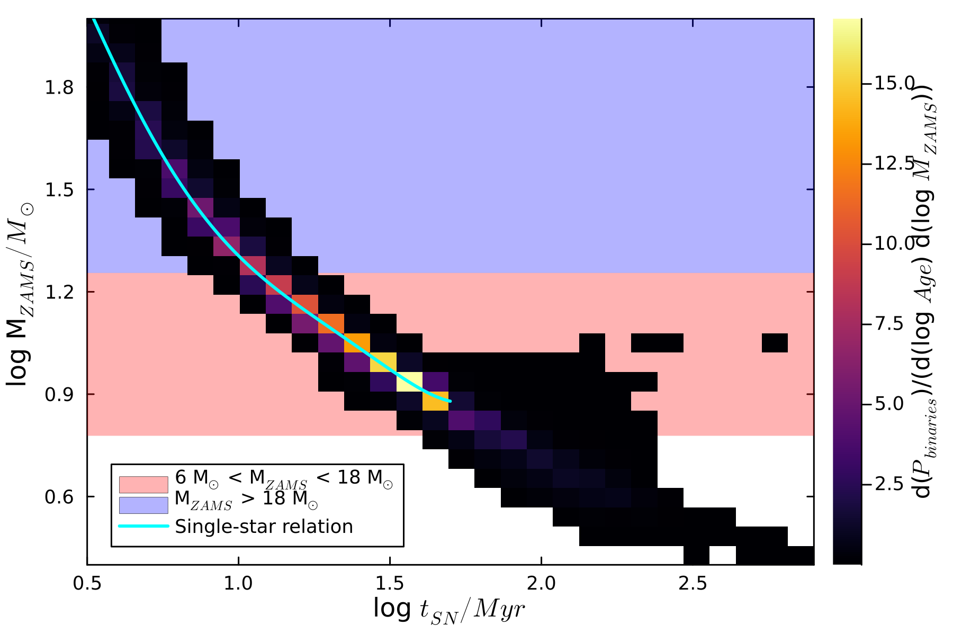
Statistical significance test → Simulations
M_{ZAMS} > 18 [M_{ⵙ}]
6 < M_{ZAMS} < 18 [M_{ⵙ}]
Research question:
→ Is it possible to distinguish between both distributions?
Answer:
→ Yes!
How?:
→ Monte Carlo simulations and Σ_{mol,SN} = Σ_{0,SN} × exp(-t_{SN}/τ_{GMC})
Credits: Based on Zapartas et al. (2017)

Slide 32
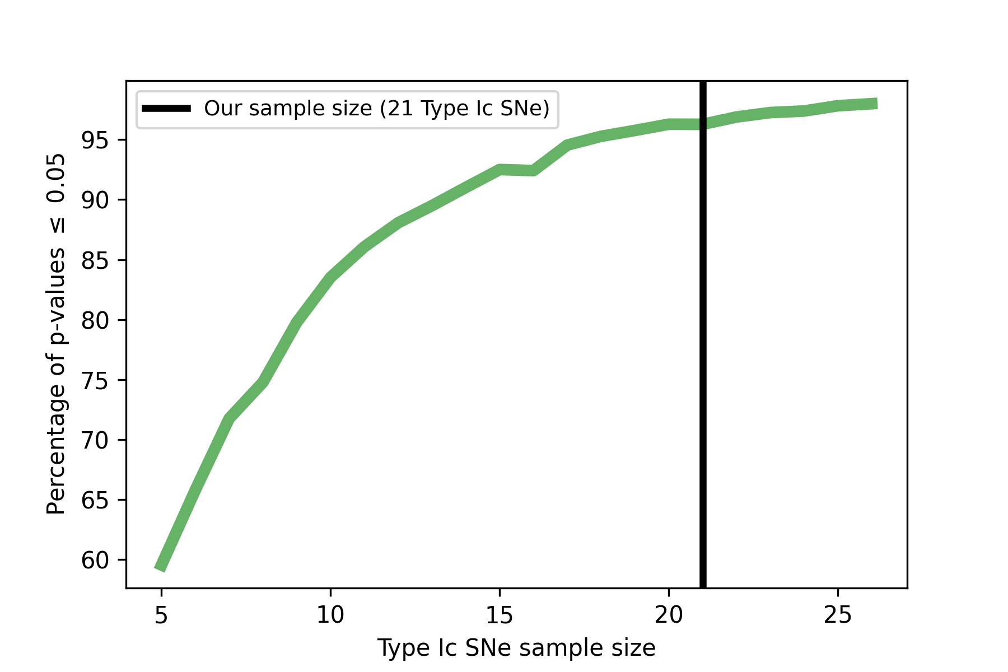
Statistical significance test → Sample size
10⁶ Monte Carlo simulations for each SN population
Kolmogorov-Smirnov test in order to reject the null hypothesis
For our current sample of 30 Type II and 21 Type Ic SNe
→ 95% of statistical significance

Slide 33
Summary:
CO(2-1) as tracer of SN progenitor lifetime
Type II and Ic SNe are found in similar H₂ cloud parent conditions
Both CCSNe have similar lifetimes, and hence, initial masses
Take-home → Binary progenitor systems for Type Ic SNe

Slide 34
PhD stipend within the National Science Center OPUS project
With whom? → dr. hab. Michał Michałowski
In what? → Supernovae and cosmic gas
Where? → Adam Mickiewicz University in Poznań

