Slide 1
A thorough investigation on the evolution of Helium rich interacting (Ibn) supernovae
An Extraordinary Journey Into The Transient Sky: from restless progenitor stars to explosive multi-messenger signals
Anjasha Gangopadhyay
Postdoctoral Fellow
Oskar Klein Center
Stockholm University
Sweden
A dazzling collection of supernova host galaxies! Courtesy : STSCI

Slide 2
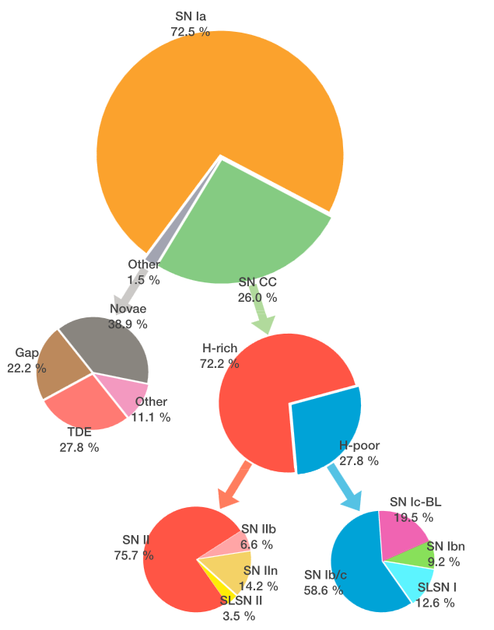
The extragalactic transient space:
Perley et al. 2020
Ho et al. 2021
Hiramatsu et al. 2024

Slide 3
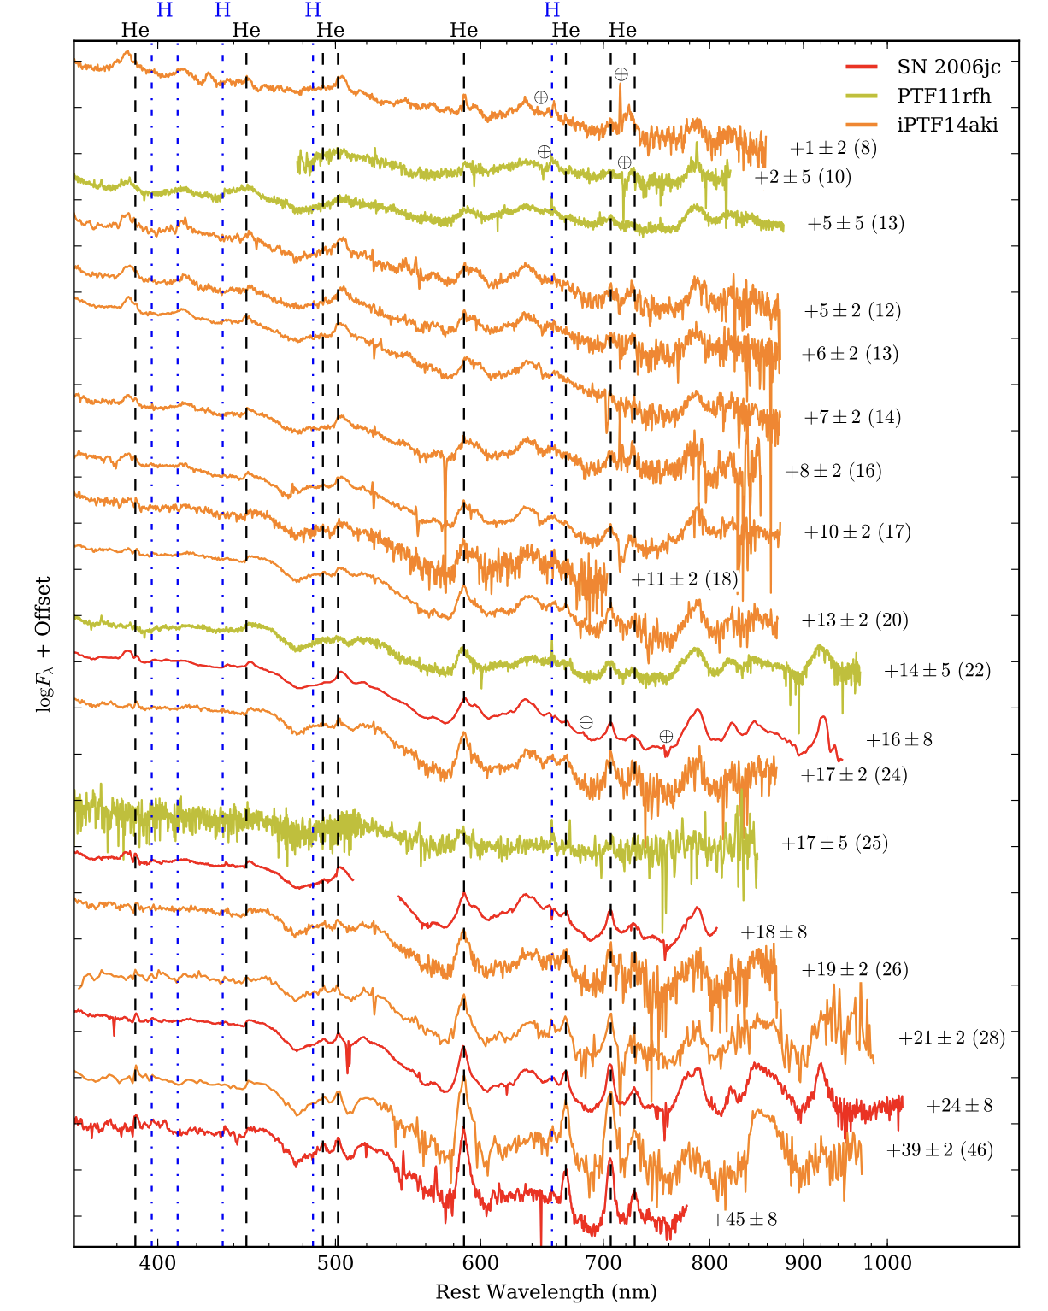
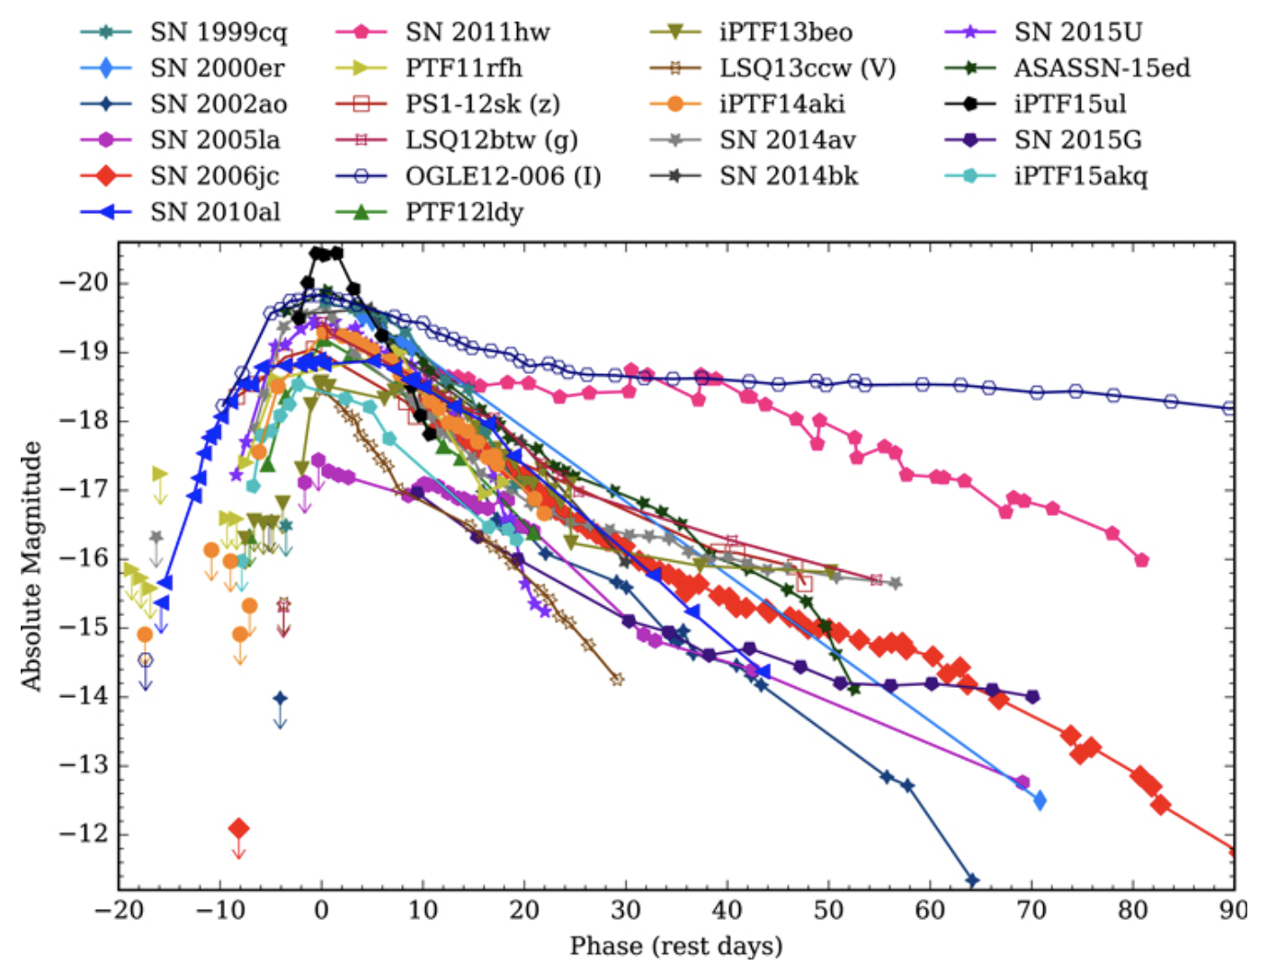
What we see observationally:
SNe Ibn are the ones which show narrow emission Helium lines due to interaction with a nearby circumstellar medium (CSM).
Ultra-Rapid Evolution: SNe Ibn brighten and fade much faster than other supernovae—some peak within days!
Dense Circumstellar Interaction: The explosion collides with helium-rich material lost by the progenitor star before death, producing unique spectral signatures.
Rare & Mysterious Origins: Unlike normal core-collapse SNe, Ibn progenitors remain elusive, often linked to Wolf-Rayet stars shedding mass before explosion.
A Cosmic Laboratory: These explosions provide insights into massive star evolution, mass loss, and the final stages of stellar life.
Hosseinzadeh et al. 2017

Slide 4
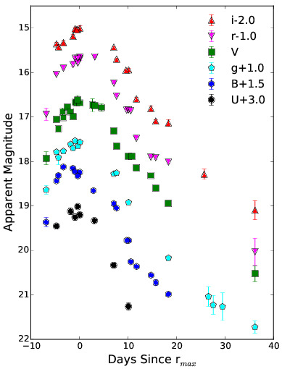
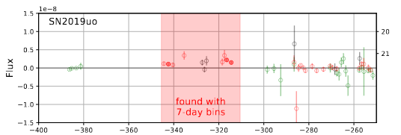
Some interesting SNe Ibns:
SN 2019uo : The second Ibn with flash features… The only SN Ibn after SN 2006jc with precursor detection!
Strotjohann, N, L; Ofek, O, Eran et al. 2021
Gangopadhyay, A; Misra, K; Hiramatsu, D. et al. 2020a; ApJ

Slide 5
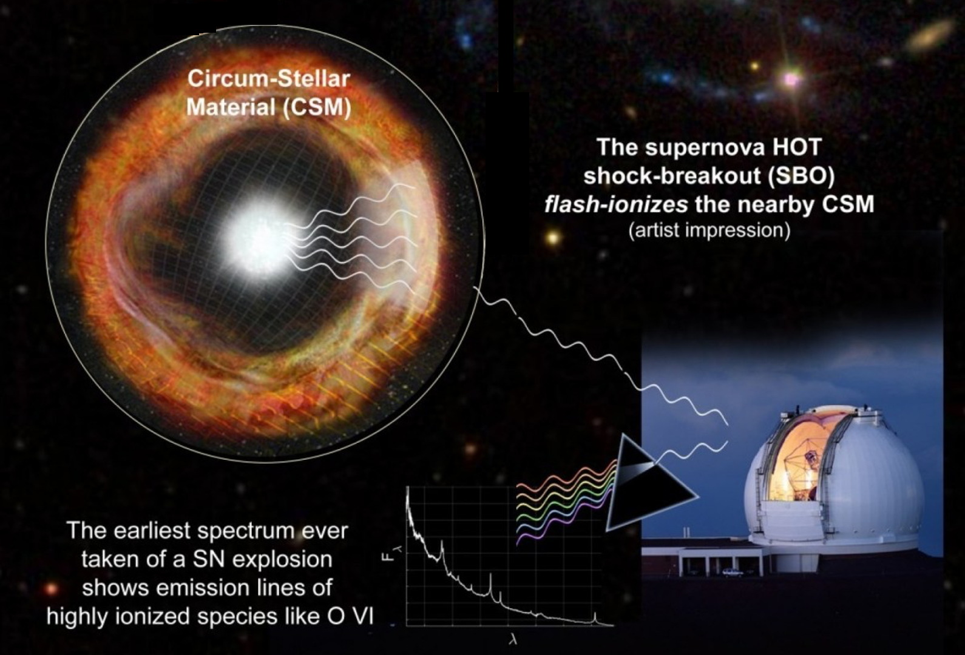
Yaron et al. 2017

Slide 6
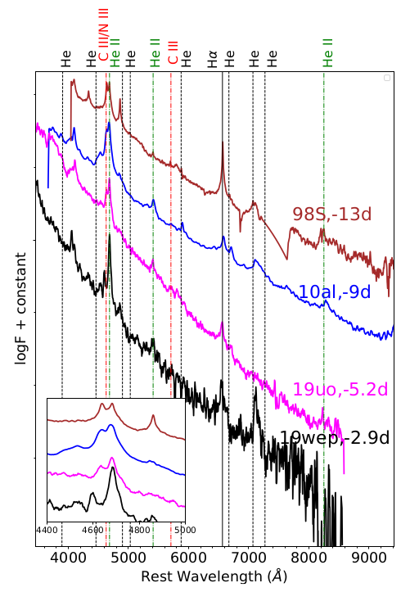
Flash ionisation signatures, along with SN 2019uo and 2019wep
Prominent lines of He II, CIII Ȧ features are seen.
SN 2019uo is the second type Ibn SN after 2010al to show such signatures.
These could be indicative that the progenitor could be a carbon, nitrogen Wolf Rayet star.
Gangopadhyay, A; Misra, K; Hosseinzadeh, G et al. 2020a, 2022; ApJ
Traditional belief

Slide 7
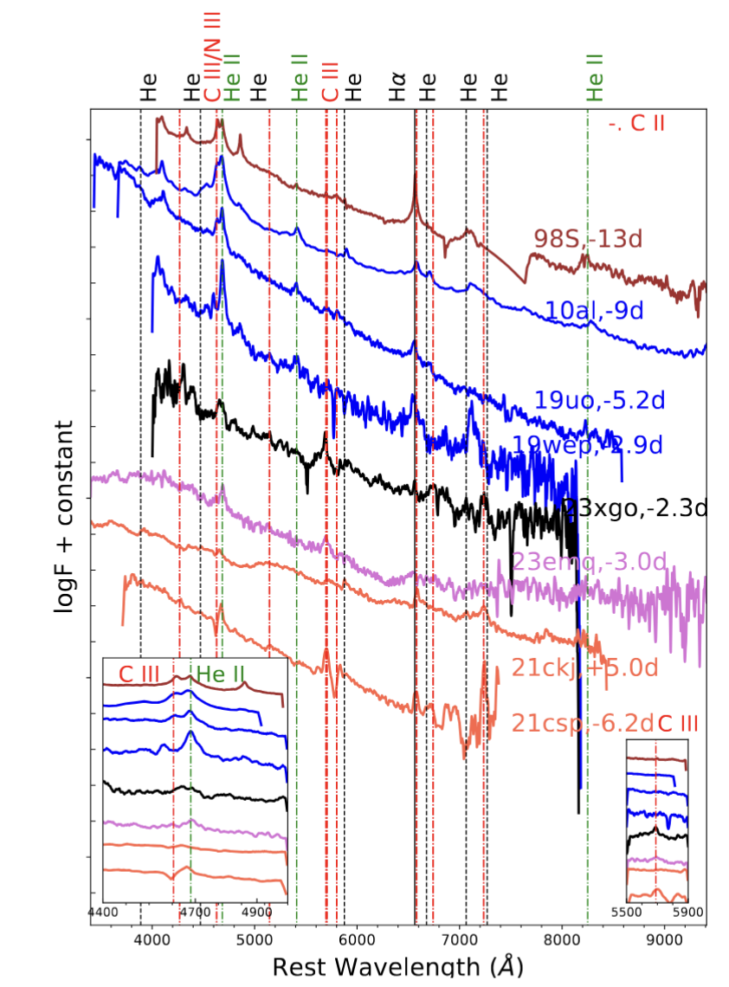
The unique case of SN~2023xgo (Icn → Ibn):
Early spectrum is compared with flash ionised SN IIn, 1998S, and a sample of early spectra of SNe Ibn and Icn.
The important questions at this stage are - (i) Do SNe~Ibn also show early spectroscopic signatures like this?
Yes, they do show at 4600 Ang, but 5696, not common.
2023emq showed. Could be N II 5680?
Gangopadhyay, A; Sollerman, J et al. to be submitted

Slide 8
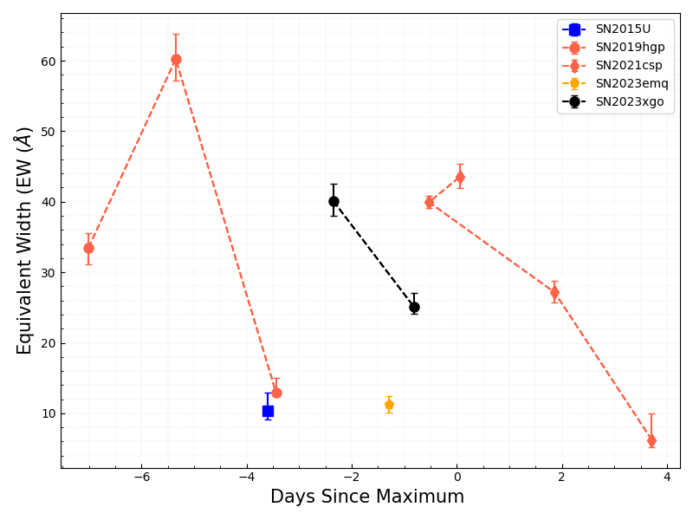
Equivalent Width estimations:
C III 5696 Ang
We measured the EW to find out the nature of the SN.
Other Ibn along with 2023emq, has much lesser EW for this line as compared with 2023xgo.
Very similar to SNe~Icn, so, C-rich CSM, or ionisation, temperature effect ?
If its N II, then may be completely unrelated to the SN Icn class.
Gangopadhyay, A; Sollerman, J et al. to be submitted

Slide 9
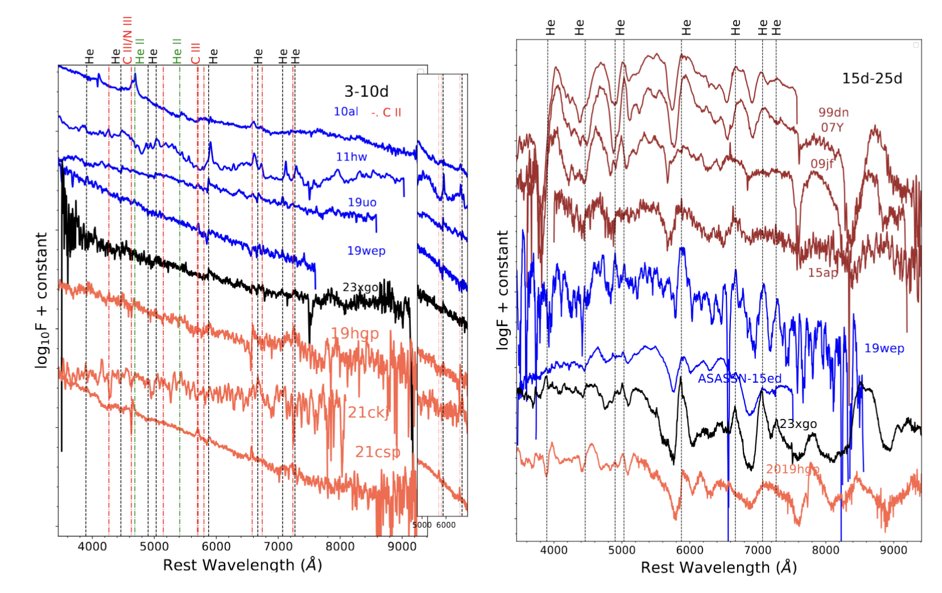
Recall Avishay’s Talk
Classification difficult, early spectrum similar.
Temperature and ionisation plays a very important role.
Either it is over abundance of carbon or its the low luminosity which governs such transitions.
Gangopadhyay, A; Sollerman, J et al. to be submitted

Slide 10
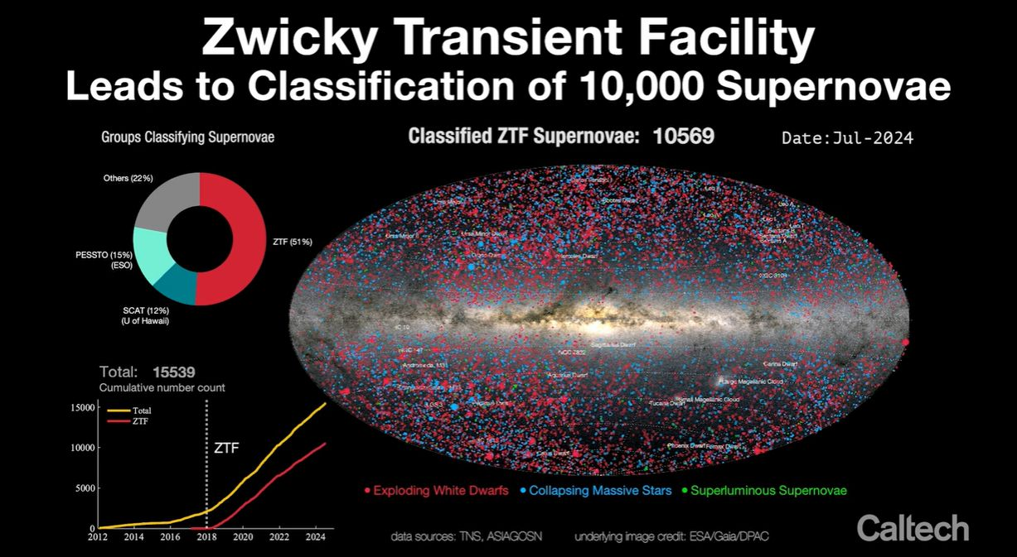
Only 36 SNe Ibn

Slide 11
Sample from Zwicky Transient Factory (40 SNe Ibn):
Gangopadhyay, Sollerman et al. in prep

Slide 12
36 SNe~Ibn from 2018 to 2024
Redshift < 0.1
Brightness upto 19.5 mag
Has at least one data point before maximum light
36 light curves so far
After cut off, left with 31 SNe Ibn
Intend to infer lightcurve and spectral properties
22 compiled SNe Ibn from 2006 to 2018 (Hosseinzadeh et al. 2017)
Studied lightcurve and spectral properties
Missing→ explosion properties?
Will fill in the gap!!!

Slide 13
Fast risers, consistent with fast transients and ultra stripped SNe.
Median absolute magnitude is lower than that obtained by Hosseinzadeh et al. 2017.
Gangopadhyay, Sollerman et al. in prep

Slide 14
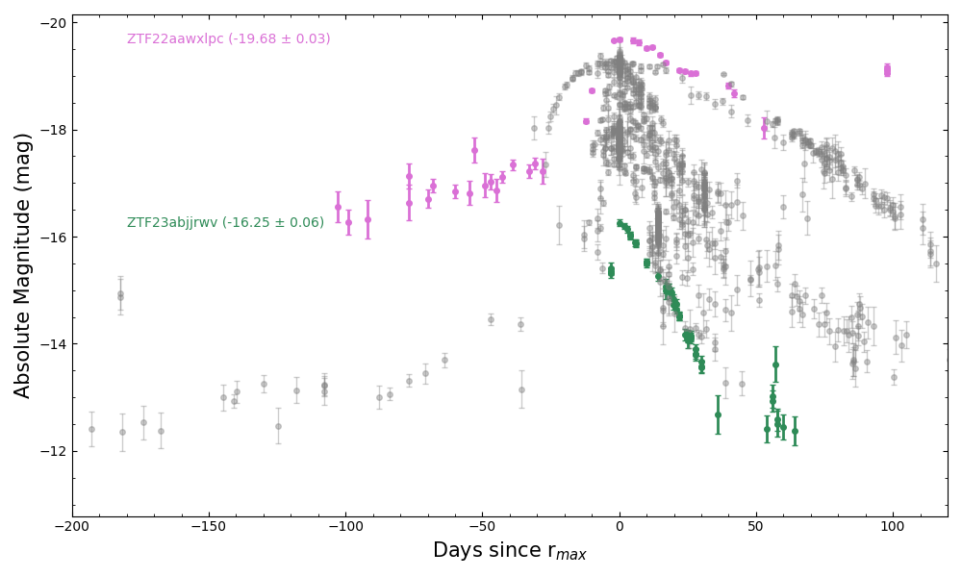
2009ip like hump
Precursor
Gangopadhyay, Sollerman et al. in prep

Slide 15
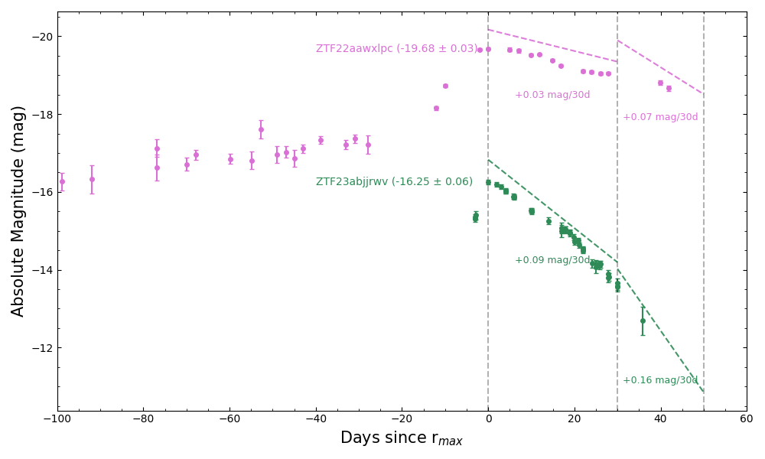
Gangopadhyay, Sollerman et al. in prep
Differs from Hosseinzadeh 2017

Slide 16
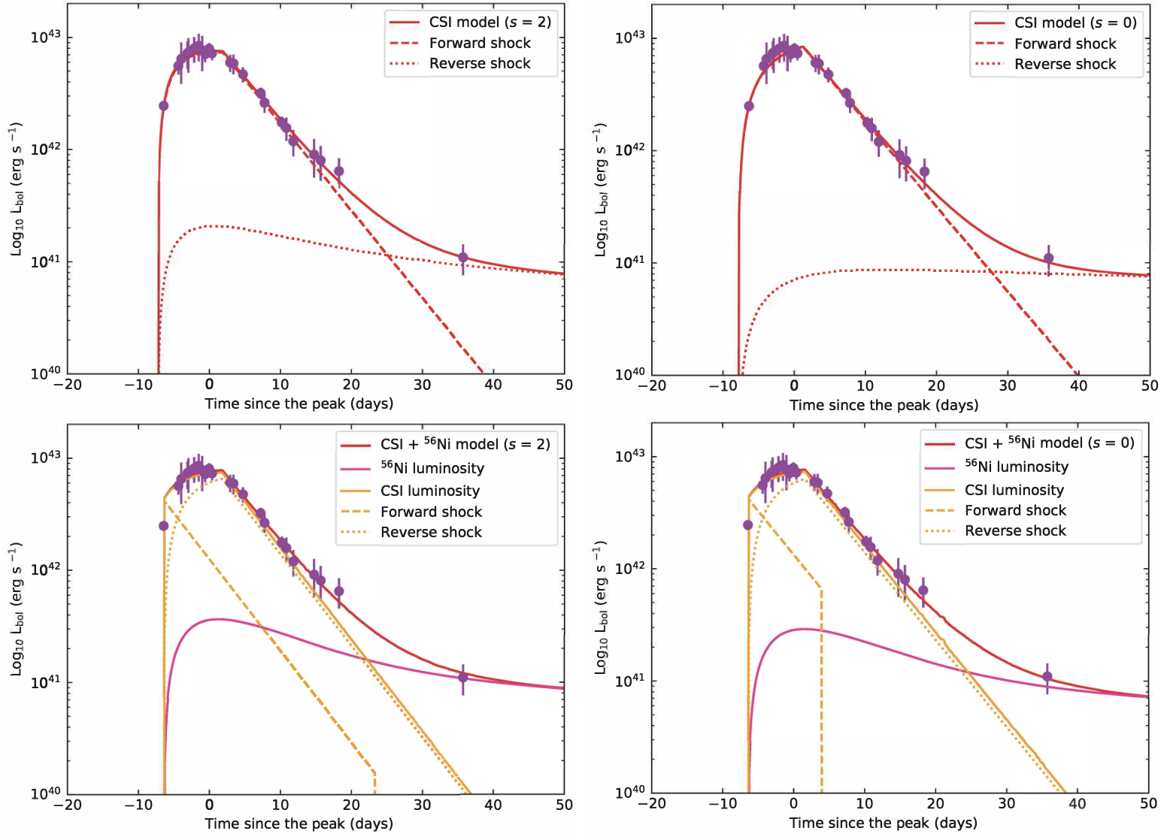
Explosion Properties and Progenitors:
Chatzopoulos 2012 + Arnett
Combination of forward and reverse shock + Ni powering the luminosity.
Gangopadhyay et al. 2020, 2022; ApJ

Slide 17
Mass-loss rates and finding best models:
Ni + CSM s=0 | v= 100 - 1000 km/sec | Mdot= 25 - 255 Msun/year | :-(
Ni + CSM s=2 | v= 100 - 1000 km/sec | Mdot = 0.19 -1.9 Msun/year
Taking R ~ 10¹⁴ cm from previous table and v_{w} = 100 - 1000 km/sec, the time at which shell is expelled prior to explosion ~ 10⁷ - 10⁸ sec i.e. between 163 - 1638 days.
Mass loss again consistent with eruptive LBVs transitioning to WR stars.

Slide 18
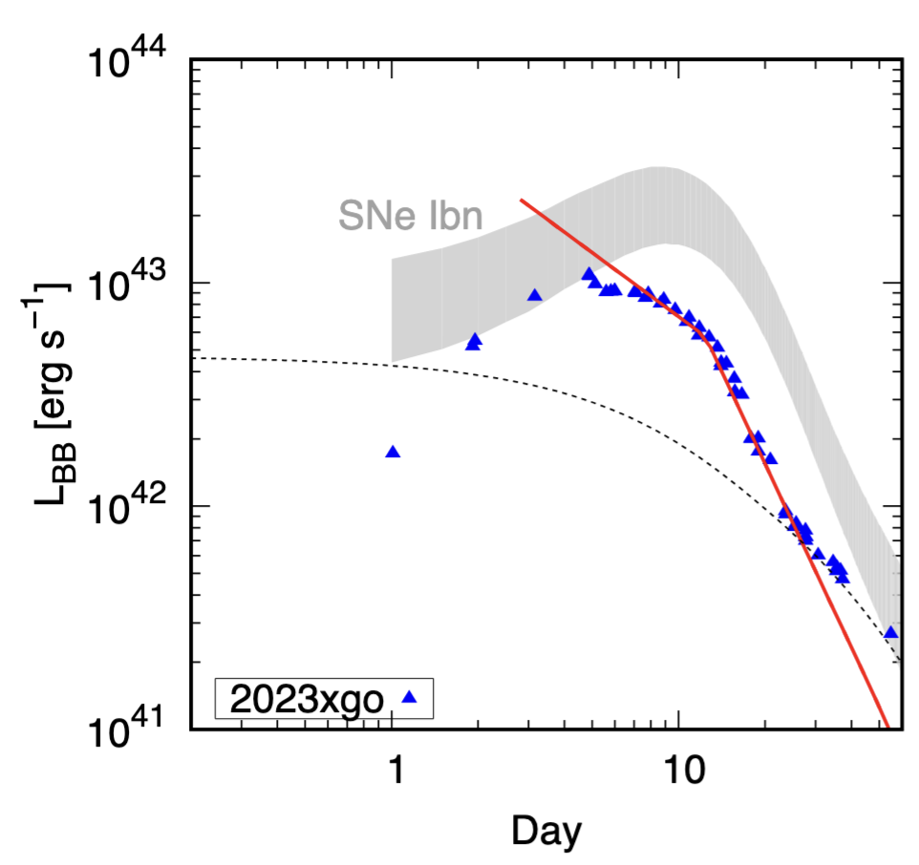
Hydrodynamical non-LTE modelling:
Based on formulations by Maeda & Moriya (2022), we model the light curve of SN~2023xgo.
Diffusion not taken into account
Density exponent ~ 2.9
CSM Radius at 10^15 cm.
Late time Ni ~ 0.05 Mo.

Slide 19
SN Ibn: PS1-12sk occurring in a elliptical brightest cluster galaxy
Search for low-level of star formation undetected by Sanders et al. (HST triggered).
White dwarf binary systems as a possible progenitor channel for SNe Ibn.

Slide 20
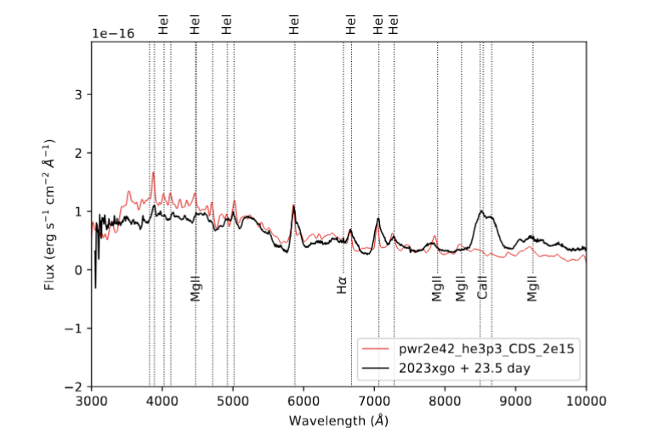
Desserts Ibn models on SN 2023xgo:
Matched the nebular phase spectrum. Non-LTE radiative transfer calculations from HERACLES.
Total luminosity of 2x 10⁴² erg/sec
He3 star
30% mass-loss rate
Low mass He stars in binary companionship
Low mass He stars in binary companion as possible progenitors!
Gangopadhyay, Sollerman; to be submitted
See also Wang, Goel, Dessert et al. 2024

Slide 21
Summary of SNe Ibn:
✔ Fast-Evolving Light Curves: Rapid rise and decay compared to other supernovae.
✔ Circumstellar Interaction: Strong interaction with a helium-rich environment.
✔ Progenitor Candidates: Likely linked to Wolf-Rayet stars but not confirmed. Low mass He stars in binary companion.
✔ Spectral Signatures: Dominated by helium emission with minimal hydrogen features.
✔ Rare & Diverse: Constitute a small fraction of core-collapse SNe but show a wide range of properties.
Open Questions:
❓ Progenitor Uncertainty: Are all Ibn progenitors Wolf-Rayet stars, or are other channels possible?
❓ Diversity in Light Curves: What drives the variation in rise times and peak luminosities?
❓ CSM Properties: What determines the density, structure, and extent of the circumstellar material?
❓ Explosion Mechanism: How do these SNe relate to other interacting transients like SNe IIn?
❓ Connection to Other Transients: Could some rapidly evolving transients be extreme cases of SNe Ibn?
Supernovae Ibn are a window into the late stages of massive star evolution, but many mysteries remain—solving them will advance our understanding of stellar death and transient astrophysics.

Slide 22
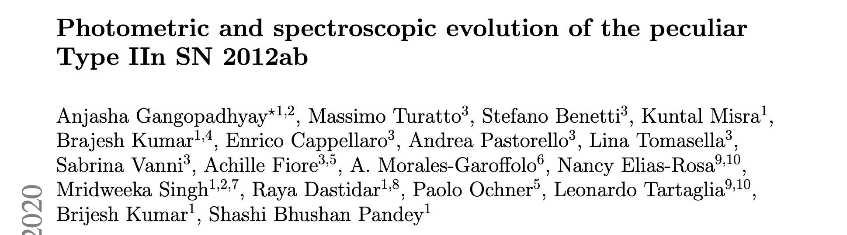
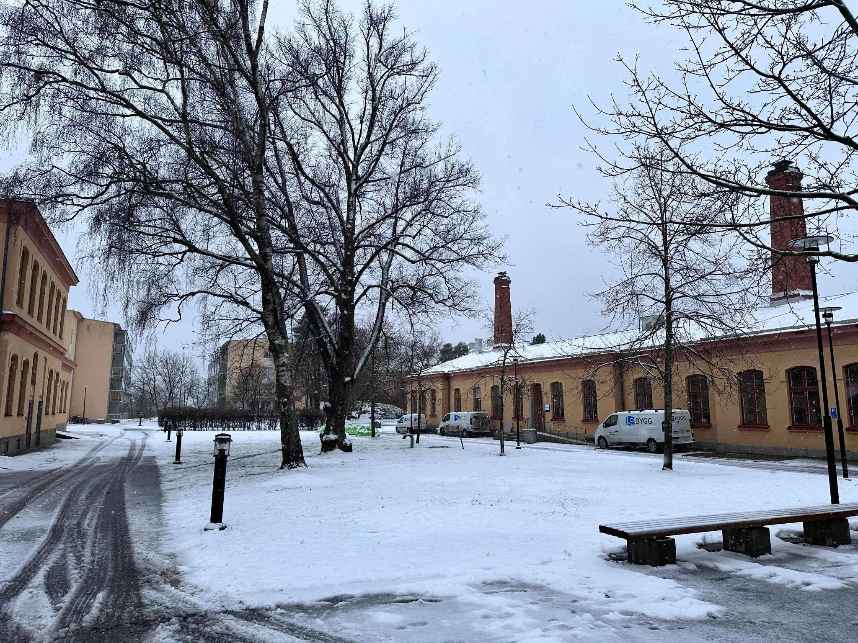
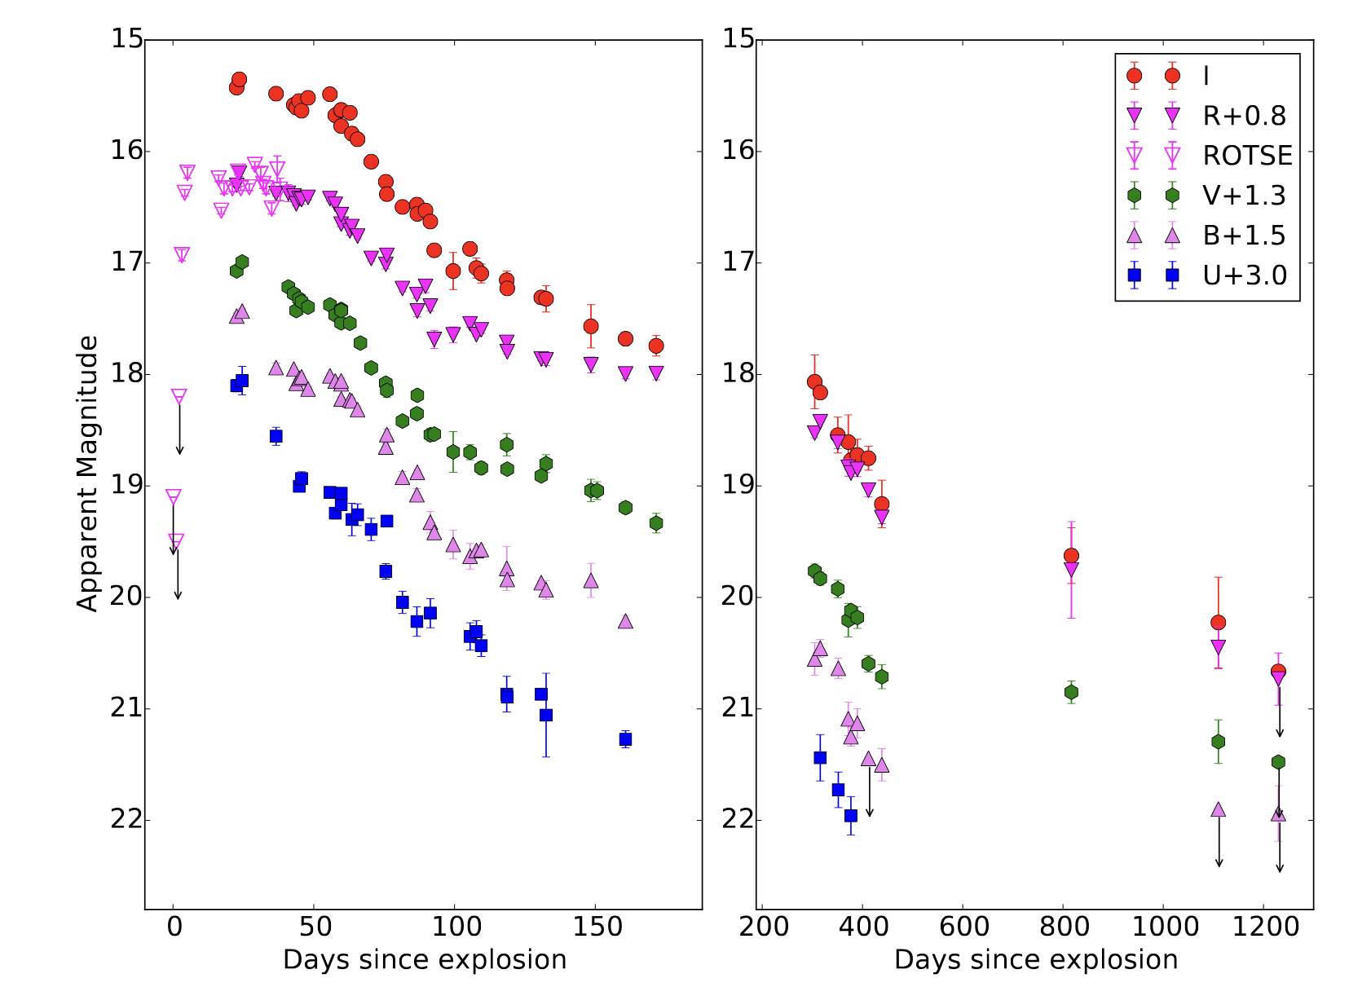
A glimpse of where i live now!
Special Thanks to Massimo Turatto for shaping my Ph.d in the direction of interacting supernovae

