Slide 1
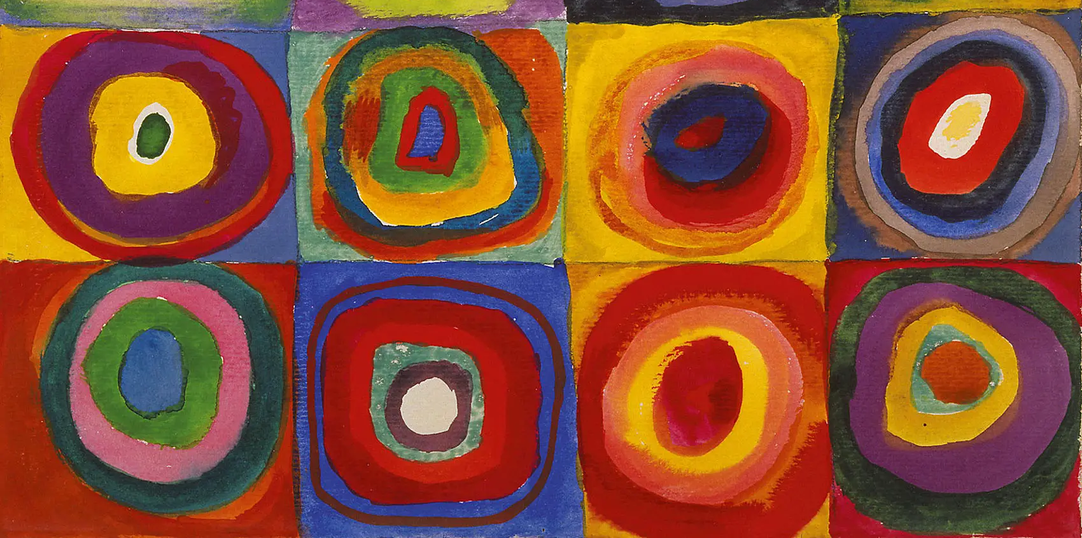
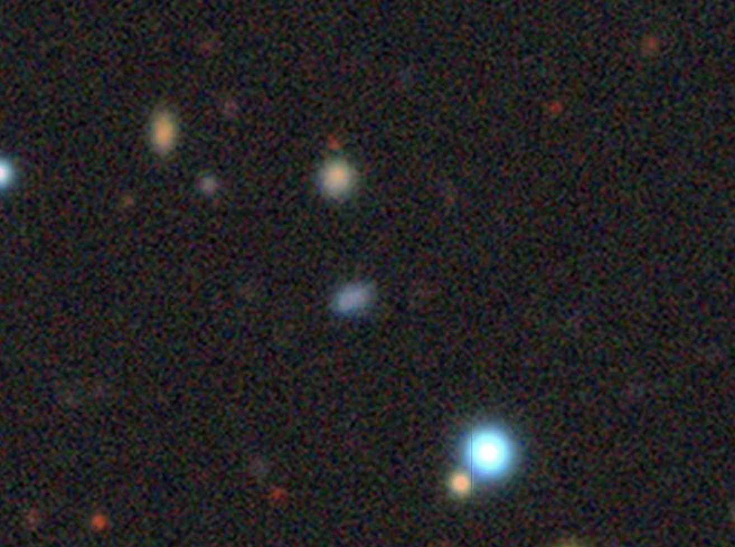
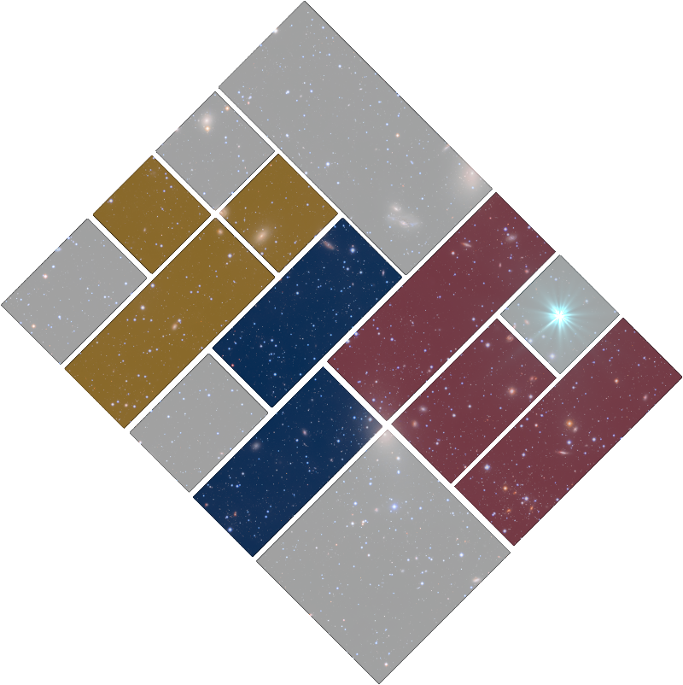
SN 2023zkd
A New Member of the Precursor Family
Alex Gagliano | Harvard CfA
gaglian2@mit.edu
An Extraordinary Journey into the Transient Sky | April 1 - 4, 2025

Slide 2
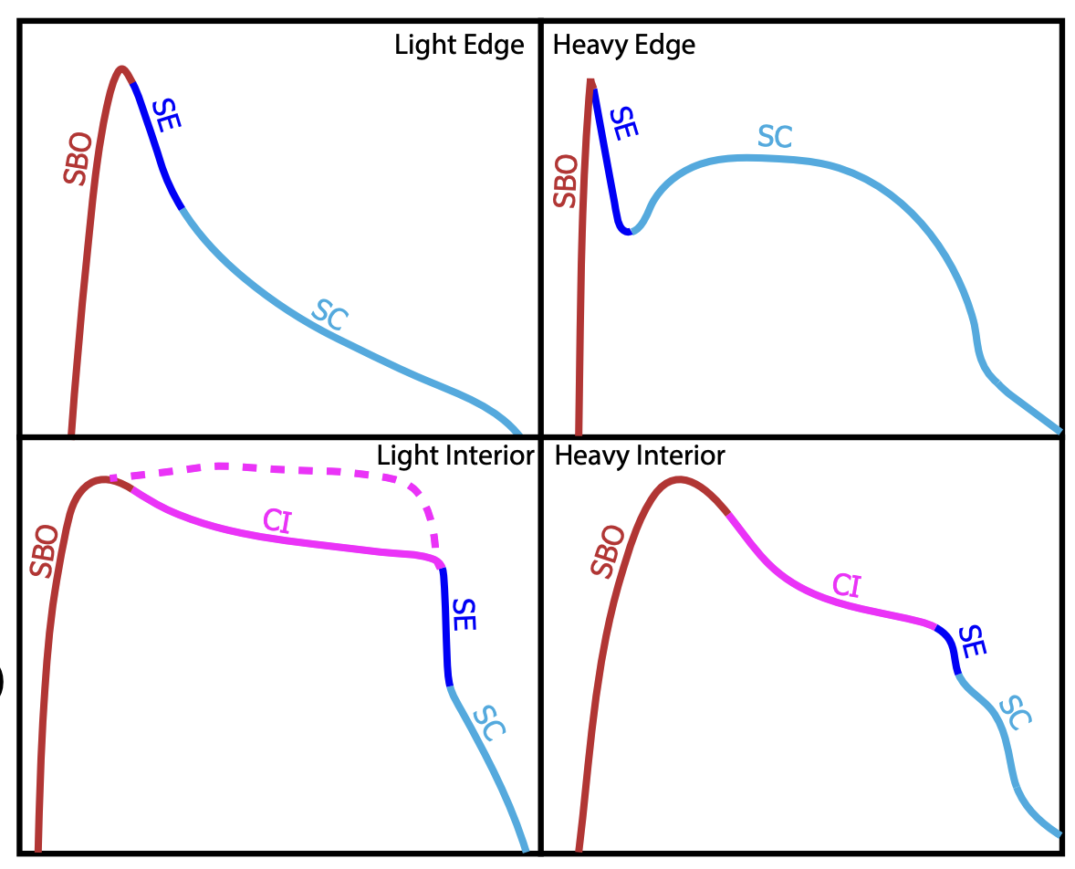
Circumstellar Interaction Breeds Diversity
Forward Shock
SN
Cold Dense Shell
Reverse Shock
V838 Mon., HST
Khatami & Kasen, 2024
The Peculiar SN 2023zkd
Alex Gagliano | gaglian2@mit.edu

Slide 3
Circumstellar Interaction Breeds Diversity
Forward Shock
What does the SN evolution imply about the nature of its circumstellar environment?
SN
Cold Dense Shell
Reverse Shock
V838 Mon., HST
Khatami & Kasen, 2024
The Peculiar SN 2023zkd
Alex Gagliano | gaglian2@mit.edu

Slide 4
Circumstellar Interaction Breeds Diversity
Forward Shock
SN
What does the SN evolution imply about the terminal behavior of its progenitor?
Cold Dense Shell
Reverse Shock
V838 Mon., HST
Khatami & Kasen, 2024
The Peculiar SN 2023zkd
Alex Gagliano | gaglian2@mit.edu

Slide 5
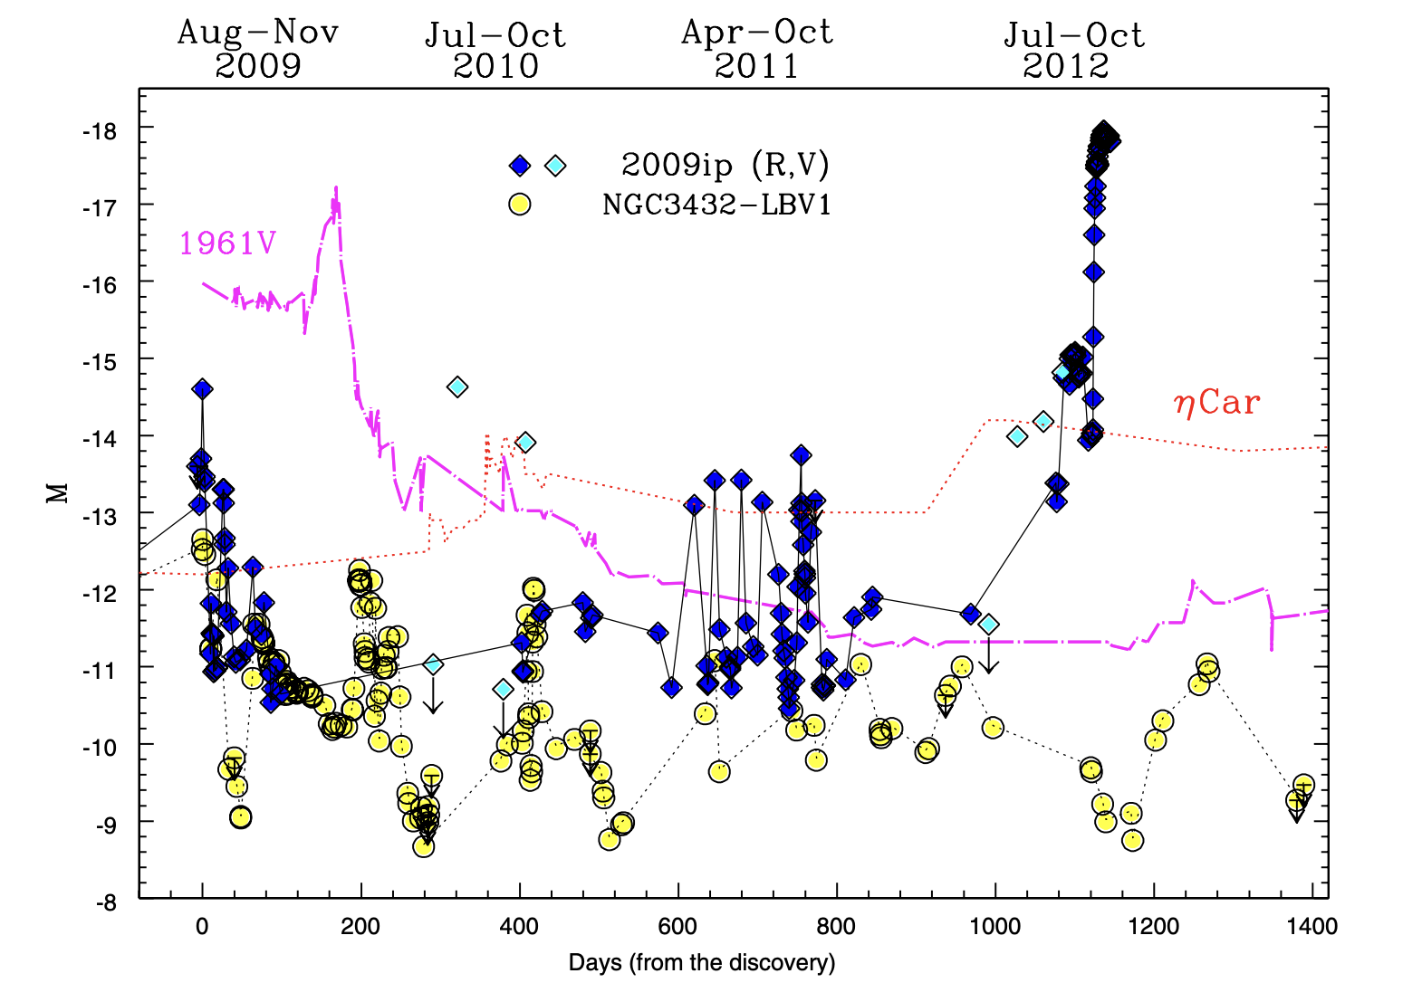
Probing Terminal Mass-Loss via Precursor Emission
2009ip firmly established the link between LBV eruptions and terminal explosions.
Systematic searches with PTF, ZTF have found that >30% of SNe IIn exhibit eruptive precursors. (Ofek+14, Strotjohann+21, Reguitti+24)
Precursor emission now also associated with SNe II (2020tlf, Jacobson-Galán+23) and SNe Ibn (2023fyq, Dong+24, Brennan+24; 2021foa, Reguitti+22, Farias+24, Gangopadhyay+24).
Pastorello+2013 (incl. Cappellaro, Turatto)
The Peculiar SN 2023zkd
Alex Gagliano | gaglian2@mit.edu

Slide 6
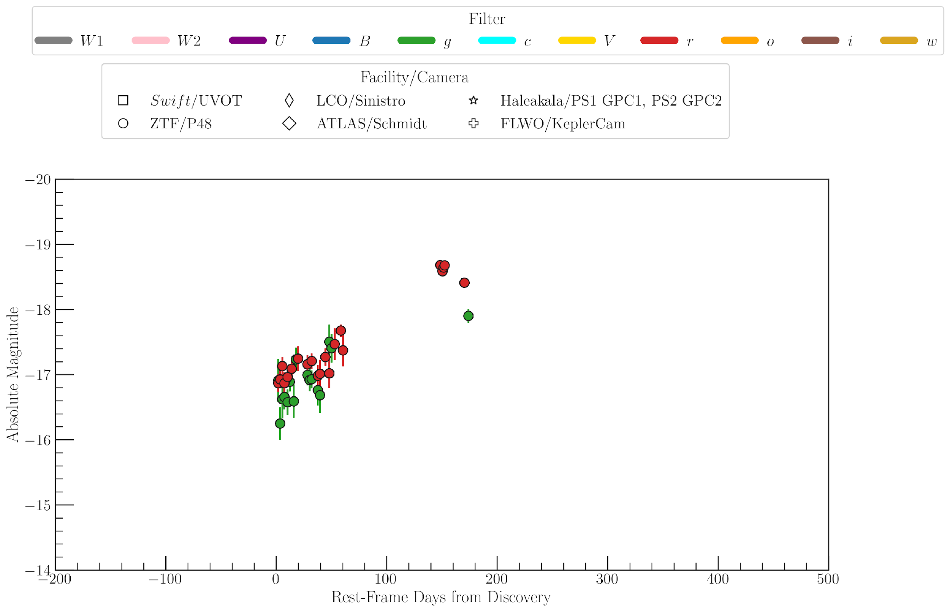
SN 2023zkd: An SN IIn at 250 Mpc
Flagged by LAISS on Jan 18th.
The Peculiar SN 2023zkd
Alex Gagliano | gaglian2@mit.edu

Slide 7
SN 2023zkd: An SN IIn at 250 Mpc
Flagged by LAISS on Jan 18th.
Flagged by LAISS on Jan 18th.
The Peculiar SN 2023zkd
Alex Gagliano | gaglian2@mit.edu

Slide 8
SN 2023zkd: An SN IIn at 250 Mpc
The Peculiar SN 2023zkd
Alex Gagliano | gaglian2@mit.edu

Slide 9
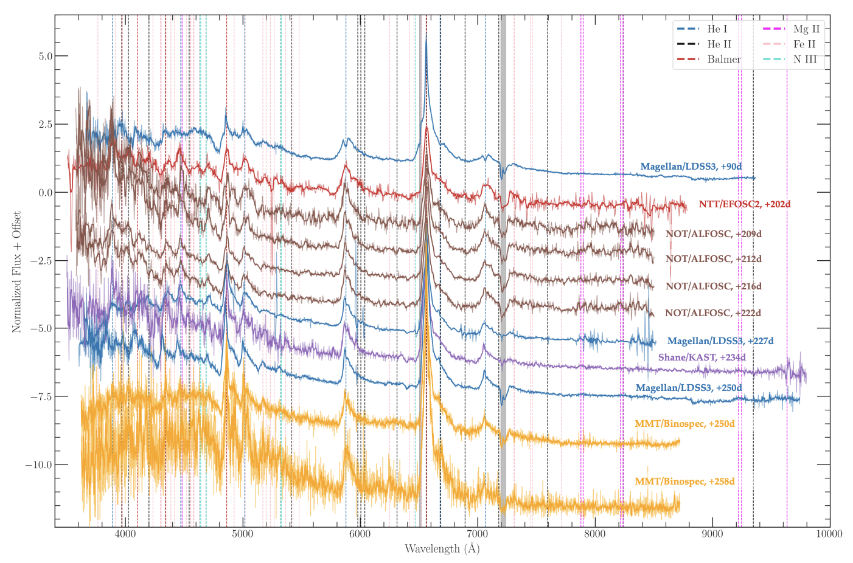
Spectroscopic Sequence: Slowly-Evolving, H+He-Rich
The Peculiar SN 2023zkd
Alex Gagliano | gaglian2@mit.edu

Slide 10
Spectroscopic Sequence: Slowly-Evolving, H+He-Rich
Highly asymmetric, multi-component H/He profiles throughout 2 peaks.
The Peculiar SN 2023zkd
Alex Gagliano | gaglian2@mit.edu

Slide 11
Spectroscopic Sequence: Slowly-Evolving, H+He-Rich
\
\
Forest of Fe II Lines (and other features)
The Peculiar SN 2023zkd
Alex Gagliano | gaglian2@mit.edu

Slide 12
Spectroscopic Sequence: Slowly-Evolving, H+He-Rich
\
\
\
Double-peaked He I profiles at +90d
(5016, 5876, 7065)
Symmetric emission or central absorption at rest?
\
The Peculiar SN 2023zkd
Alex Gagliano | gaglian2@mit.edu

Slide 13
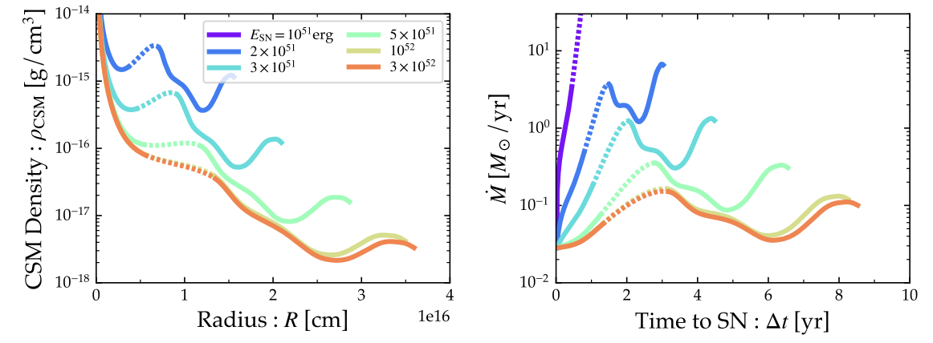
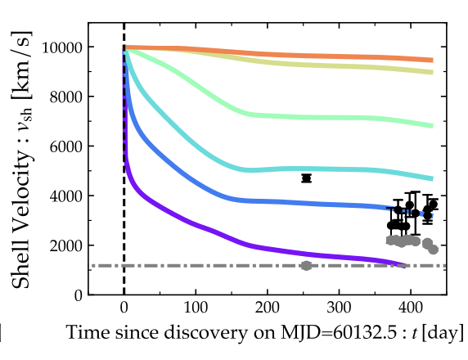
CSM Constraints from (One-Zone) Shock Modeling
The Peculiar SN 2023zkd
and (consistent with MOSFiT).
Alex Gagliano | gaglian2@mit.edu

Slide 14
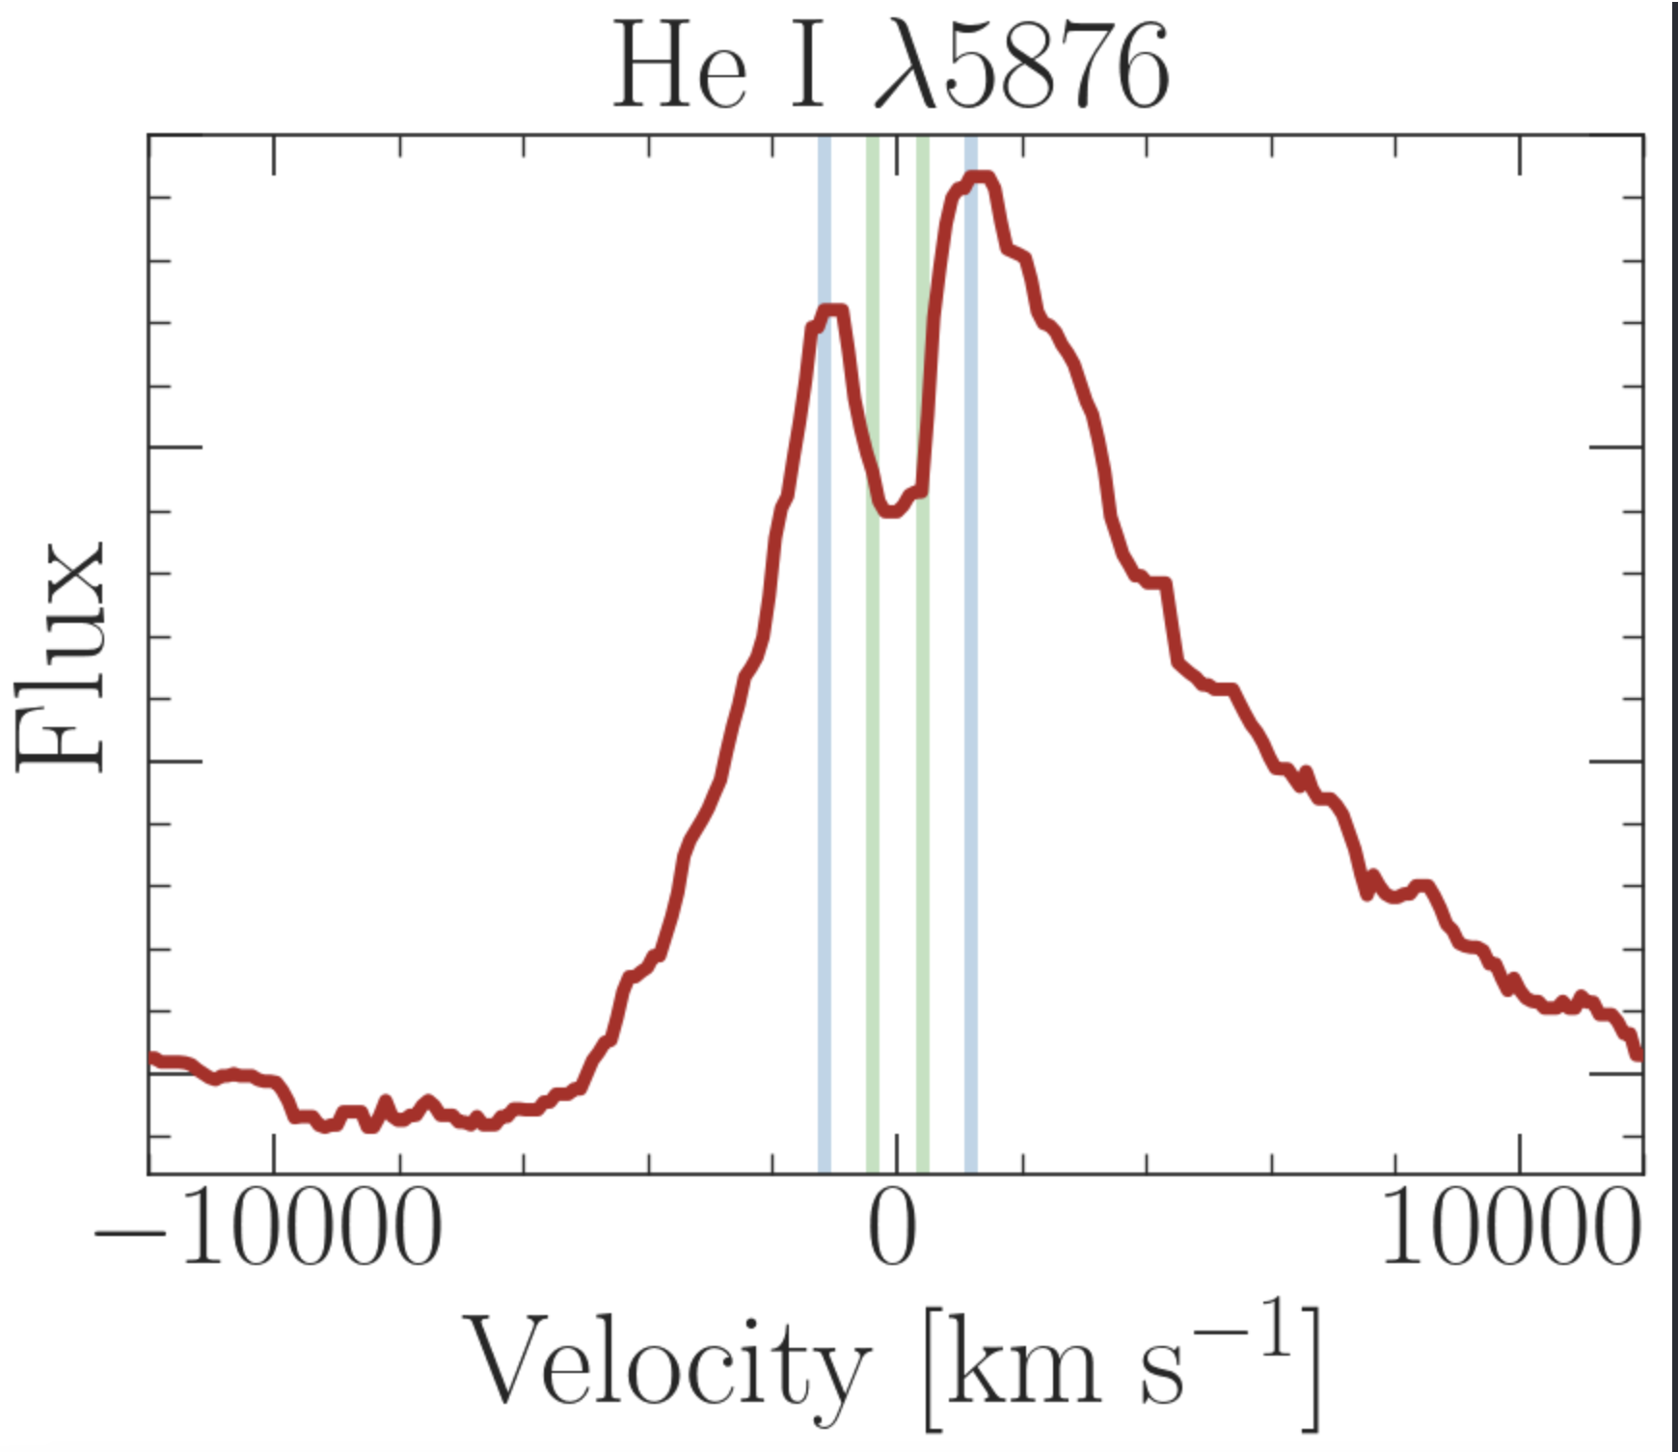
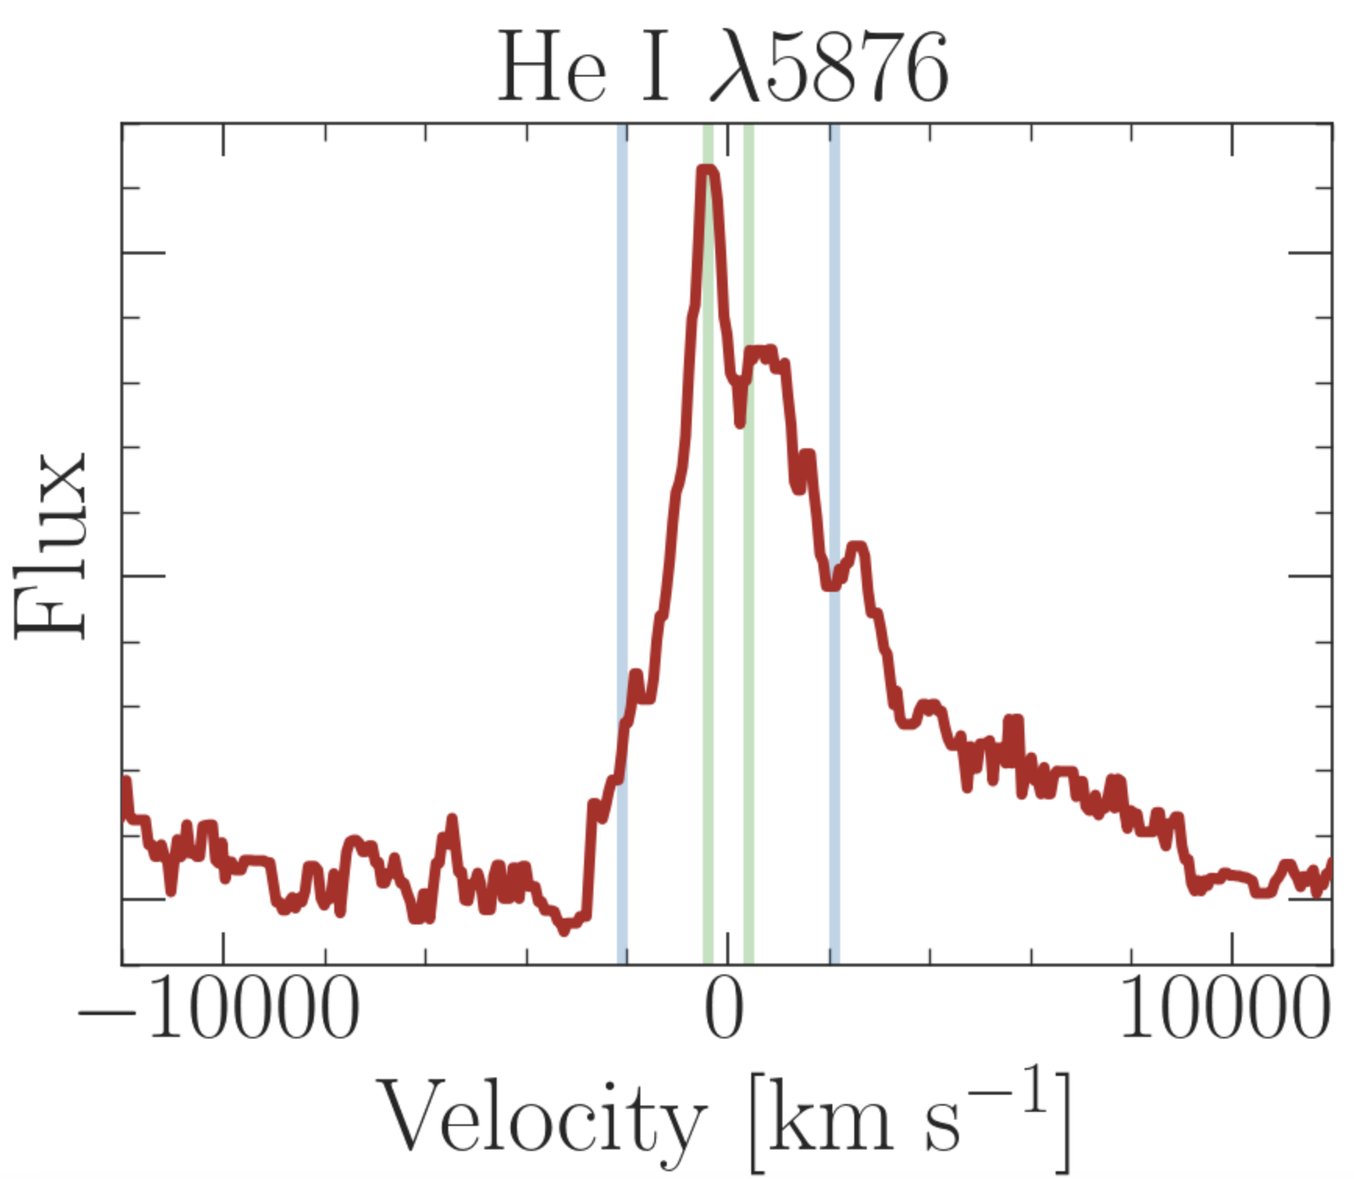
The Conceptual Picture: Structured, Axisymmetric CSM
Similar to e.g., Smith+17, Bevan+20, Metzger+22, Tsuna+24
The Peculiar SN 2023zkd
The Peculiar SN 2023zkd
Alex Gagliano | gaglian2@mit.edu
Alex Gagliano | gaglian2@mit.edu

Slide 15
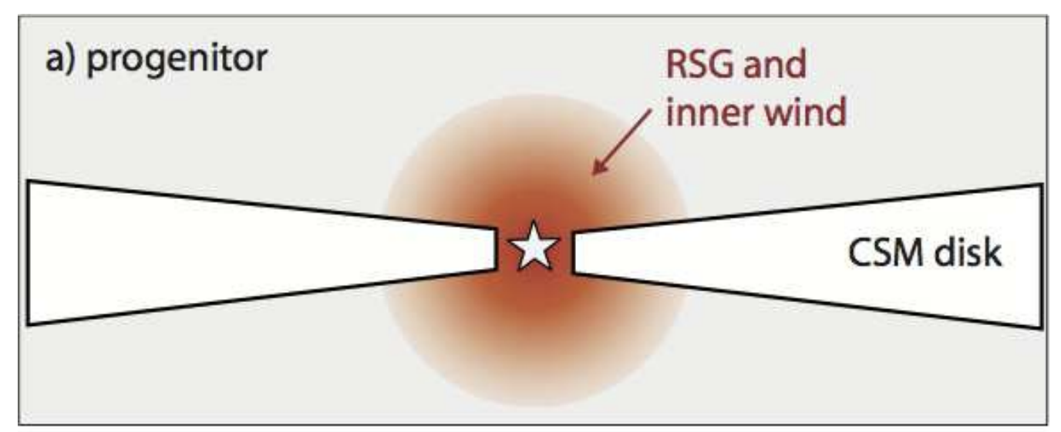
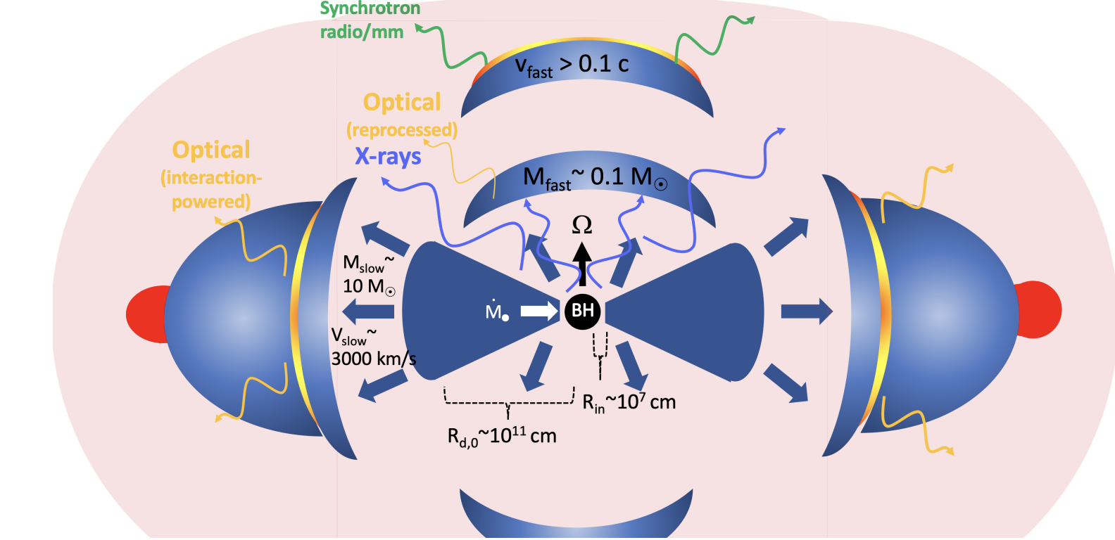
Dense, Equatorial CSM (& Precursor) Suggests Companion Interaction
Similar to e.g., Smith+17, Bevan+20, Metzger+22, Tsuna+24
Similar to e.g., Smith+17, Bevan+20, Metzger+22, Tsuna+24
The Peculiar SN 2023zkd
Alex Gagliano | gaglian2@mit.edu

Slide 16
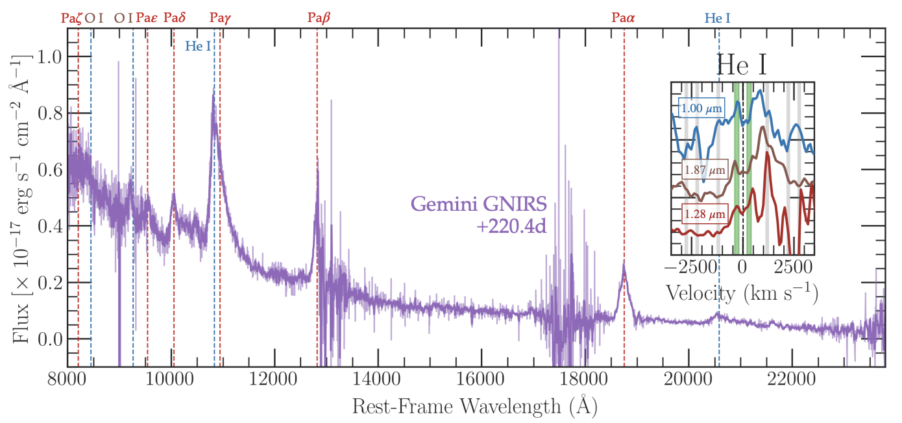
GNIRS Spectrum at Second Peak
Low-velocity component () supported by NIR spectrum at +220d.
High-resolution spec. follow-up of other SNe IIn in progress.
The Peculiar SN 2023zkd
Alex Gagliano | gaglian2@mit.edu

Slide 17
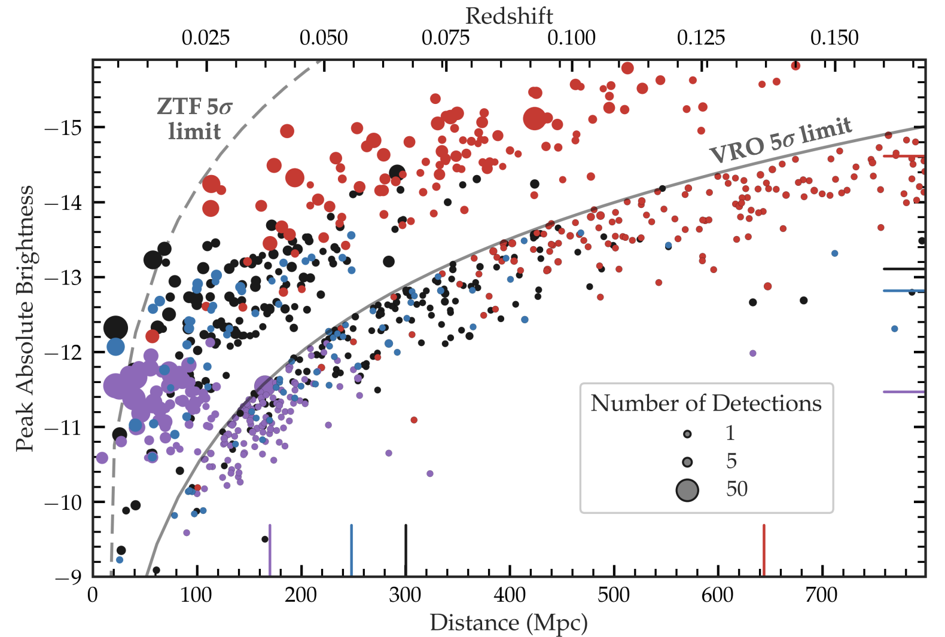
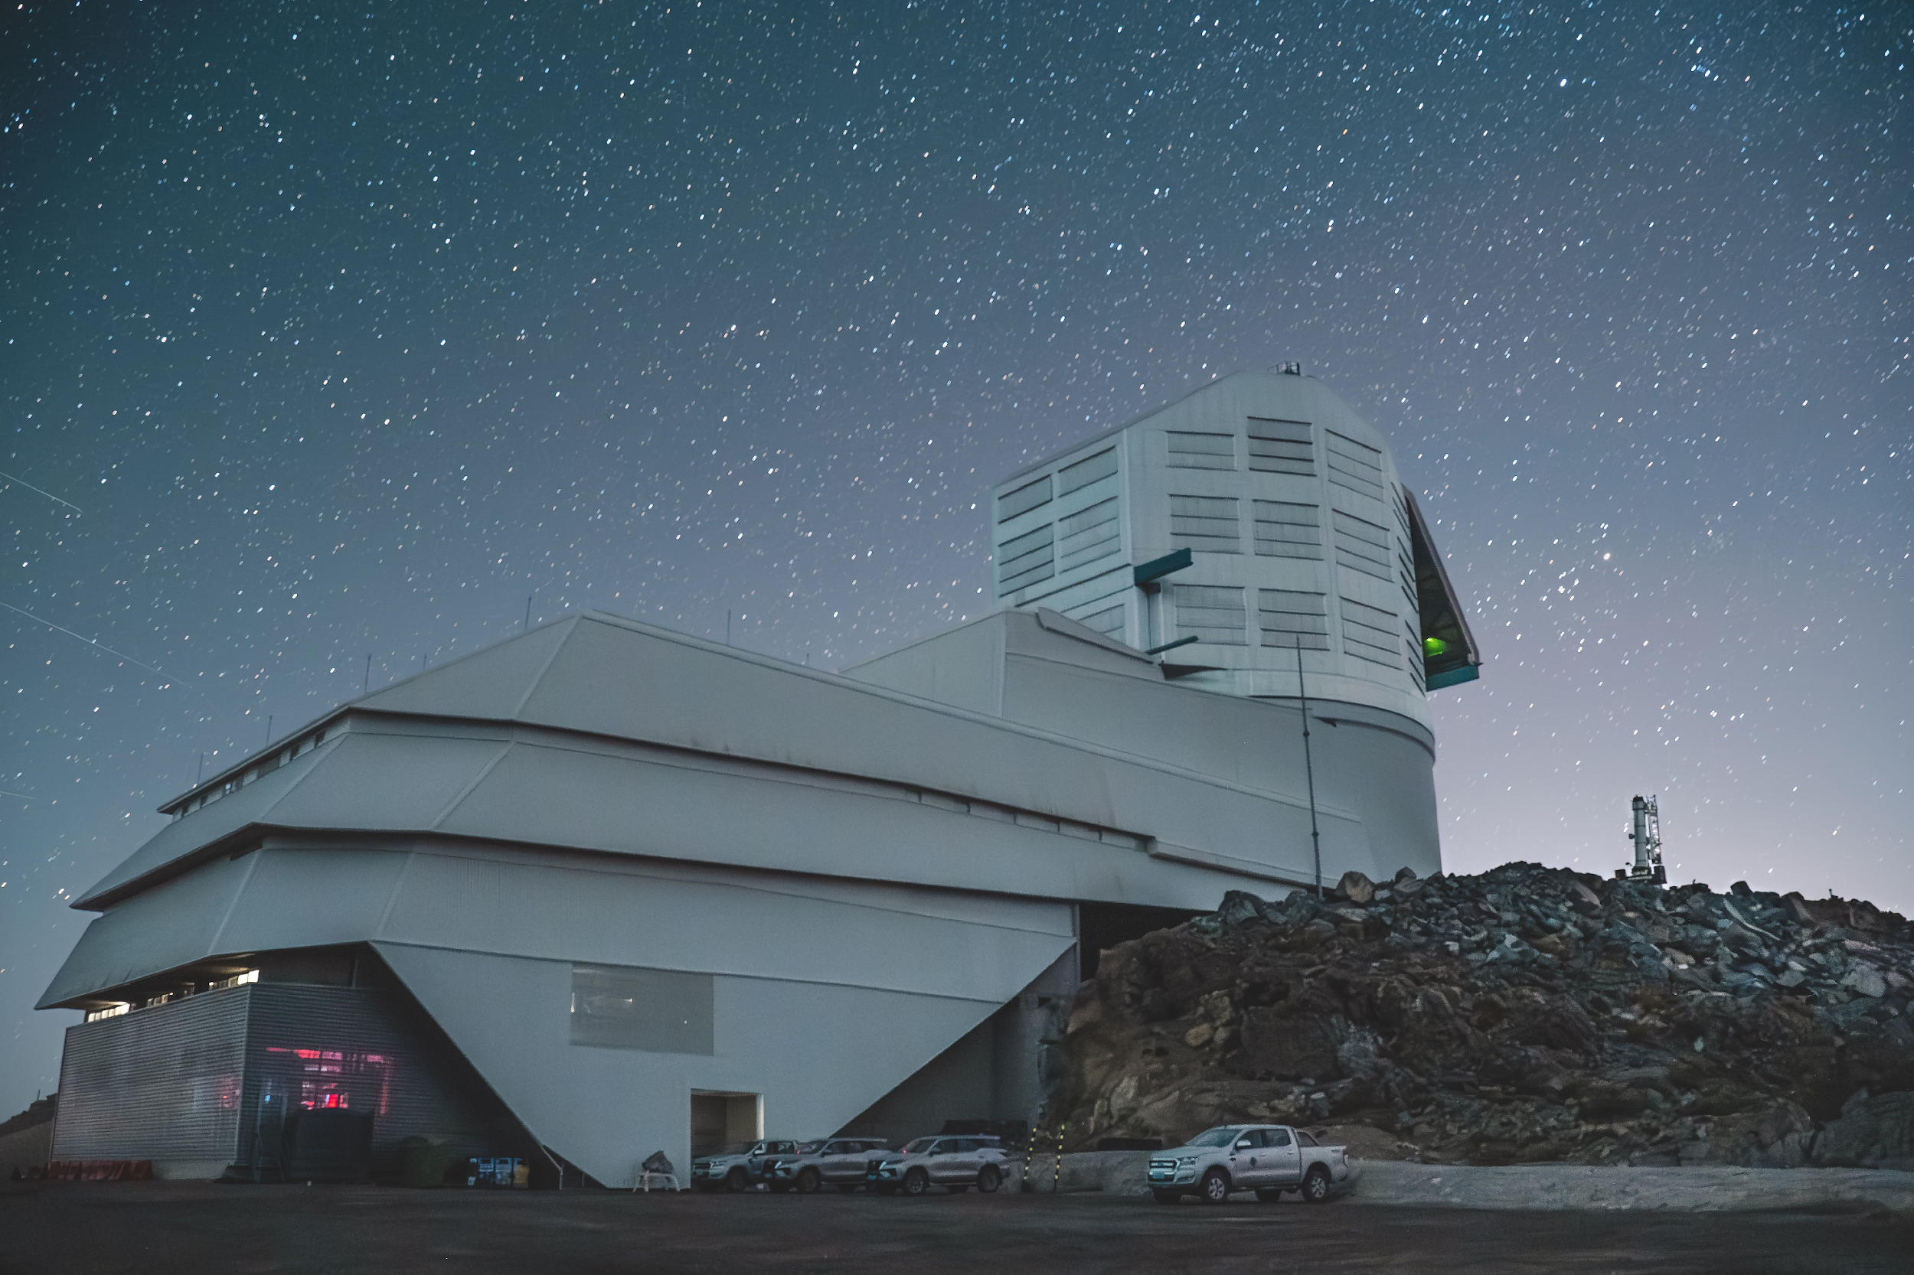
Precursor Searches with the Vera C. Rubin Observatory
LSST: 10 years, 18,000 deg
Single-visit depth of
>100 CCSN precursors/year to z~0.2 (Gagliano+2025a).
Aliro Pizarro Díaz/Rubin Observatory/NSF/AURA
https://arxiv.org/abs/2408.13314
The Peculiar SN 2023zkd
Alex Gagliano | gaglian2@mit.edu

Slide 18
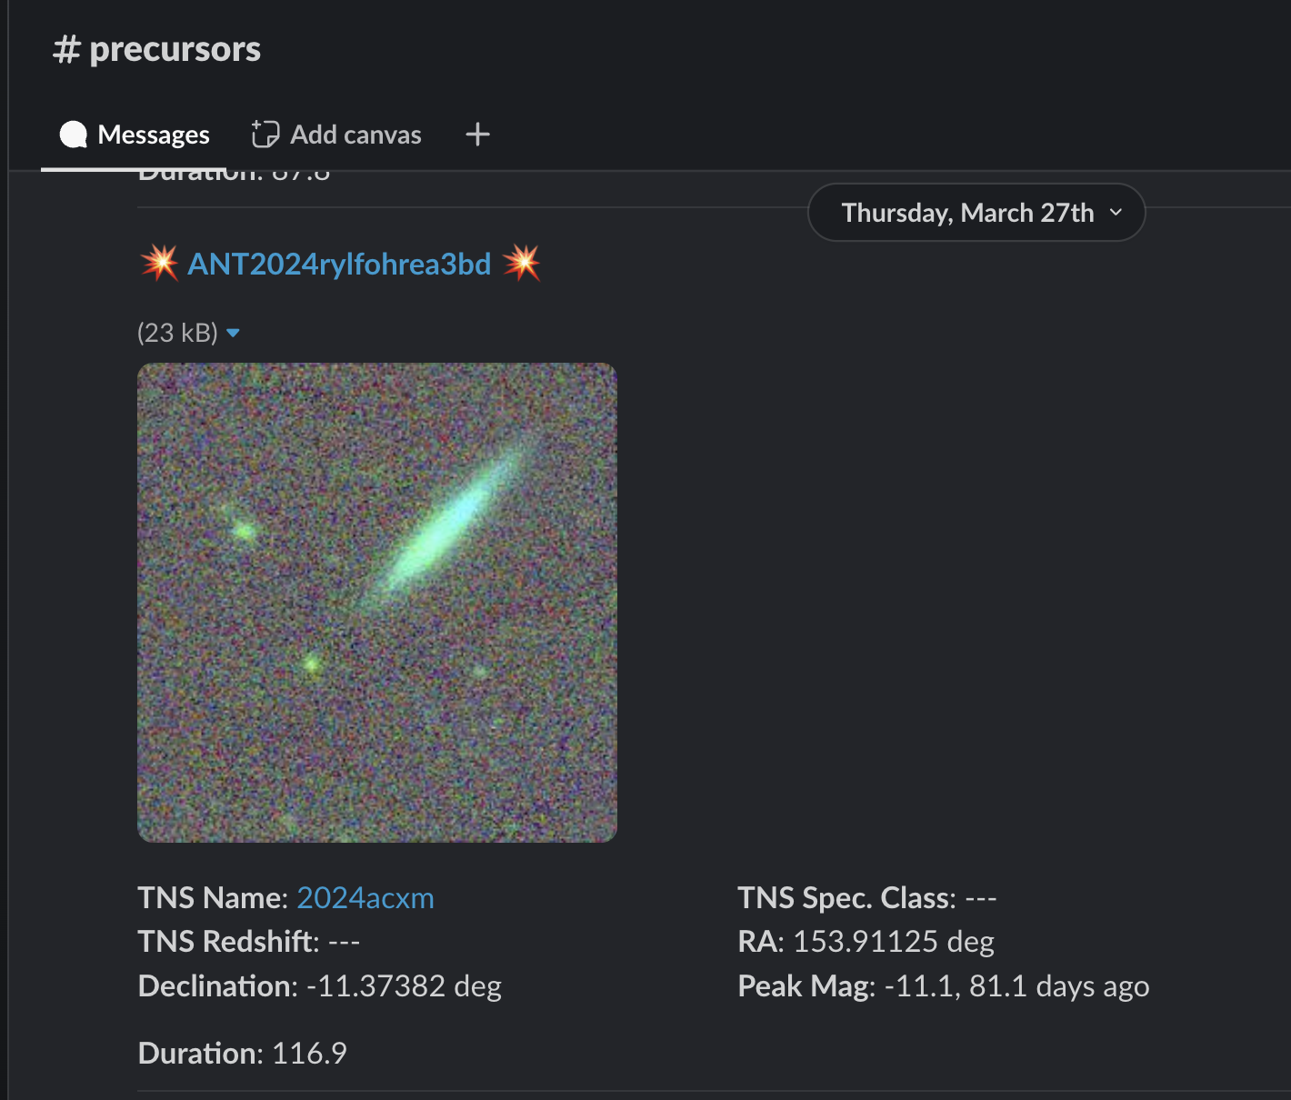
Online, Local Volume Searches Are Underway!
Quality cuts require reliable host-galaxy identification:
https://github.com/alexandergagliano/Prost
The Peculiar SN 2023zkd
Alex Gagliano | gaglian2@mit.edu

Slide 19
Conclusions
SNe with years-long, luminous precursors (e.g., 2023zkd; Gagliano+2025b) challenge single-star evolution models.
Rubin will discover hundreds more (Gagliano+2025a), but precursors are almost certainly as diverse as SNe:
Eruptive (2009ip-like) vs. slowly brightening (2023fyq-like) events
Dust-reprocessed SEDs
Multi-shell interactions…
We must keep pushing on multi-zone models and observational probes of CSM asphericity (e.g., Bilinski, Smith+24).
Congratulations to the Honorees!
The Peculiar SN 2023zkd
Alex Gagliano | gaglian2@mit.edu

