Slide 1
GalRSG: Pre-supernova outbursts in Red Supergiants The selection of targets
F. Bocchino, INAF-Osservatorio Astronomico di Palermo
CoI: S. Orlando & O. Petruk (INAF-OAPa), M. Miceli & M. Lauriano (UNIPA)
A. Pastorello (INAF-OAPd)
M. Limongi, A. Chieffi (INAF-OARm)
N. Pinciroli Vago (PoliMI)
An extraordinary journey into the transient sky
A conference in honour of E. Cappellaro, M. Della Valle, L. Greggio, M. Turatto
Padova 1-4 April 2025

Slide 2
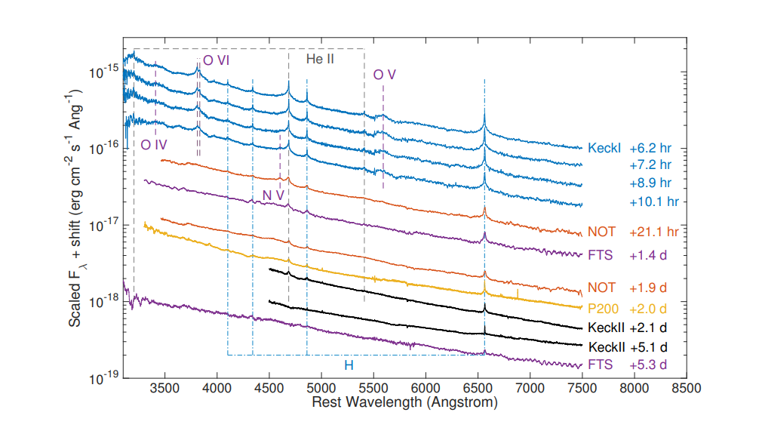
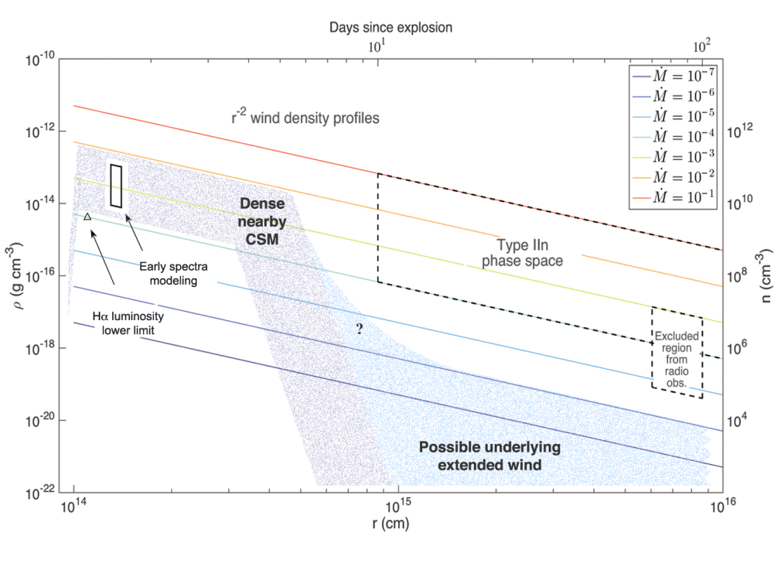
Confined dense CSM in «transitional» Type IIn -> IIP/L SNe
Early-time spectroscopy of SN2013fs reveals flash-ionisation signatures during the first 2 d after explosion
Consistent with massloss Mdot=10⁻³ M/yr for 1 yr, too much for standard RSG wind (< 10^{[-8,-5]})
See also SN2013fs (Bullivant+18), SN2023ixf, SN2024ggi (Jacobson-Galan 2023, 2024)
Bruch+23 argues (60+/-20)% of SNII may be like that.
Yaron+17
Notes:
Also SN2013fr (Bullivant+ 2018). Smith et al. (2015) argued that the degree of mass loss required to generate the characteristic features of SNe IIn extends to lower mass-loss rates, and that some SNe II would be classified as SNe IIn only if discovered sufficiently early after explosion, evolving into other types (SNe II-P, SNe II-L) as they age.

Slide 3
Models of Pre-SN outbursts in “low-mass” RSGs (∼8–15 M)
Nuclear flashes that ignites dynamical burning of oxygen (>∼1000d pre-SN), neon (∼200-100d), or silicon (∼10-20d) could lead to the ejection of the outer layers of the stellar envelope in the final years to months before explosion (Woosley et al. 1980; Meakin & Arnett 2007; Arnett et al. 2009; Dessart et al. 2010; Woosley & Heger 2015).
Alternatively, late-stage burning phases can induce gravity waves that propagate outwards and inject energy into the stellar envelope, leading to eruptions of ∼1 M worth of material in the final months before explosion (Quataert & Shiode 2012; Shiode & Quataert 2014; Fuller 2017; Wu & Fuller 2021).
Additionally, super-Eddington continuum-driven winds can be induced at the stellar surface during late-stage nuclear burning, which can then cause enhanced mass loss and detectable pre- SN emission (Shaviv 2001a, 2001b; Ofek et al. 2016).
However, this mechanism is unlikely to be present in RSGs and is more suited to supermassive (M_{ZAMS} ~ 30 M) luminous blue variable (LBV) stars.
(Jacobson-Galan+ 2022)

Slide 4
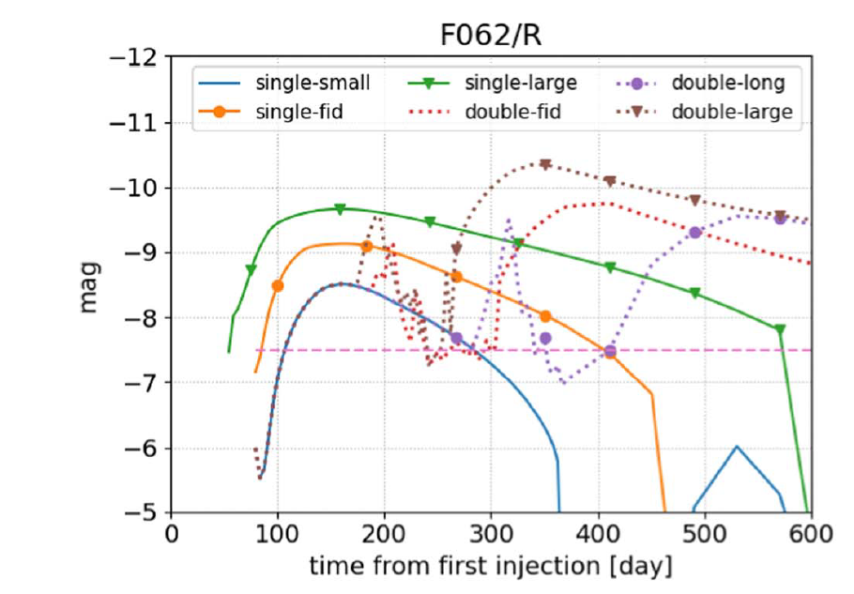
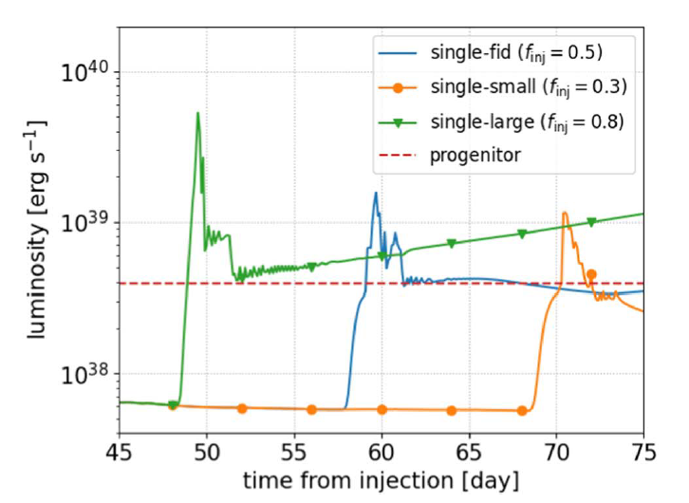
How outbursts may look like in “low mass” RSGs
Outburst model of Tsuna+23. 12.8 M RSG, R*=670 R, L=10⁵ L (see also Davies+22, Matsumoto+22)
10⁵ L RSG

Slide 5
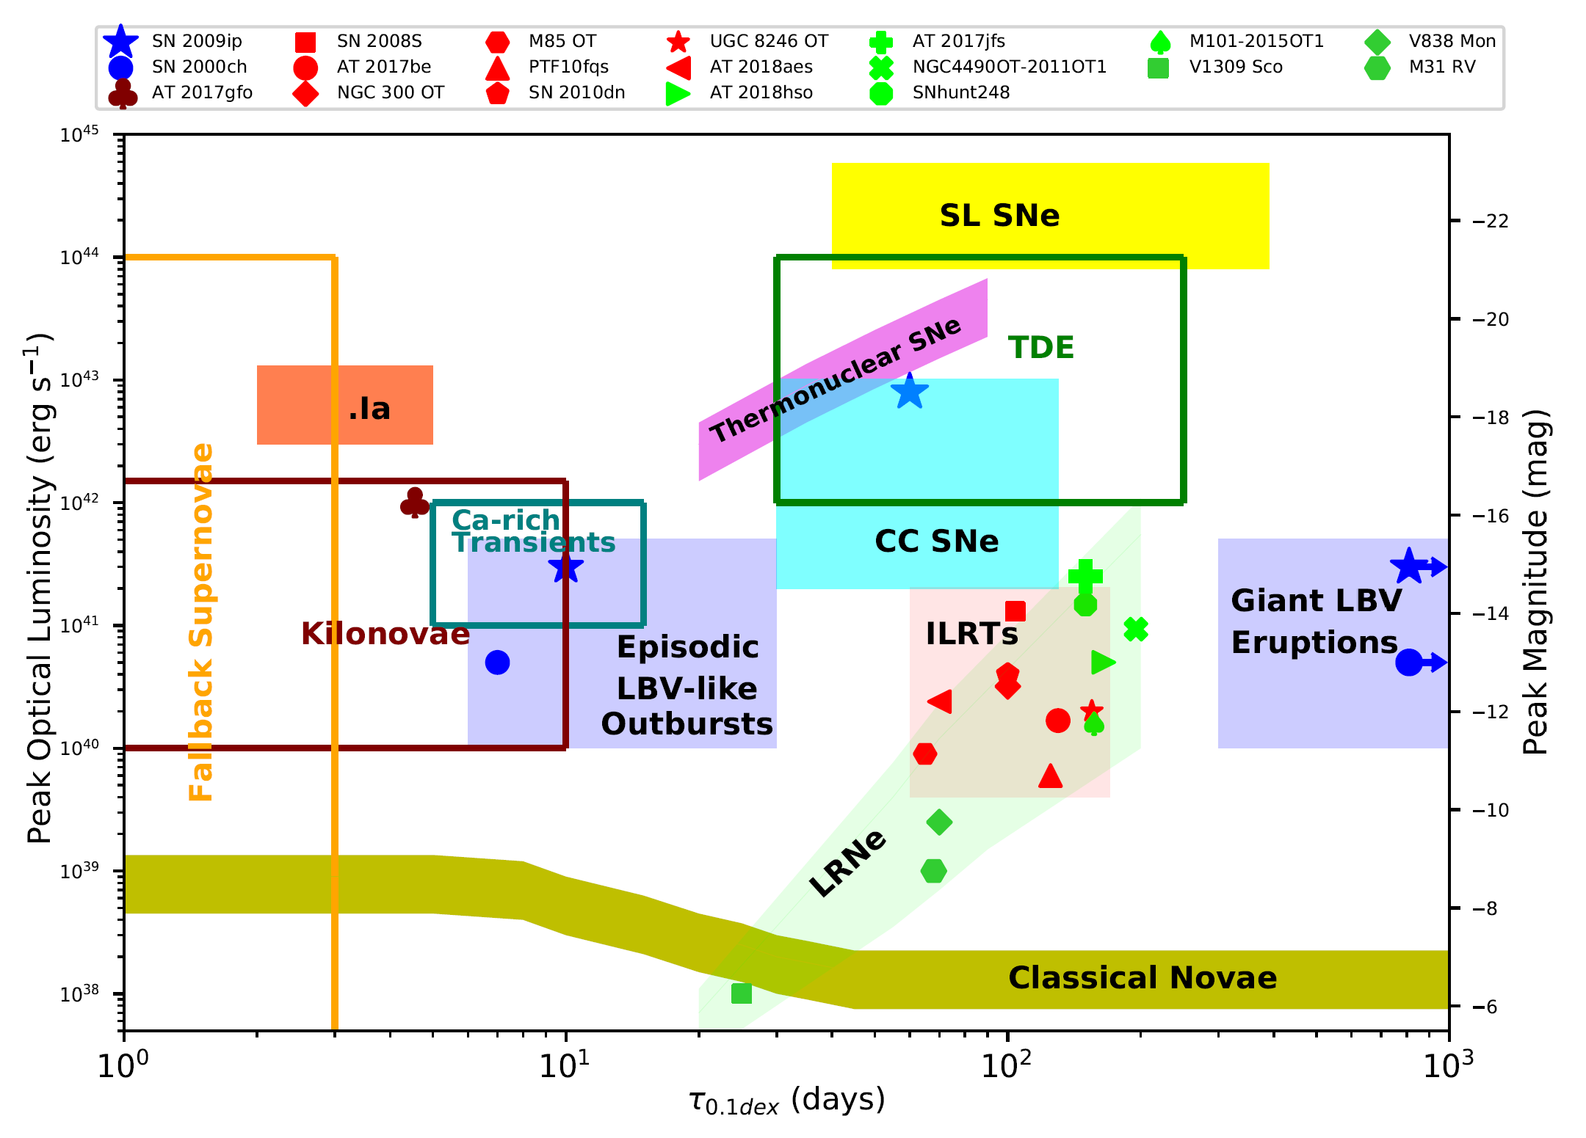
Gap transients + low-mass RSGs Pre-SN outbursts
Cai+ 2022, Universe 8, 493
RSG Pre-SN outbursts:
Shock breakout
RSG Pre-SN outbursts:
H-envelope recombination

Slide 6
Introducing GalRSG: a complementary approach to Pre-SN outbursts
TRADITIONALLY HERE COMES GalRSG
I look for as many SNe (extragalactic) as possible THEN I maybe detect a progenitor RSG
I closely monitor as many 8-15 M⊙ RSGs (the progenitor) as possible THEN I maybe detect a SN (or, if not, something possibly related or something interesting….see below)
Pros | Cons
High sensitivity allows us to target mid/low-L RSGs (i.e. the majority) and their outbursts. | Regular and short cadence, a few days at most, optimal 1-2 days, up to 10 (but feasible with small-to-medium telescopes)
Selection of homogeneous target RSGs (as much as possible) | Distance, absorption… the usual galactic problems…
Multi-band optical/NIR homogeneous coverage (grizJHK, time-resolved SED) | Very low prob for a SN (high risk, high gain) but a complete view of RSGs: P-L, Ṁ-L, Ṁ-Teff, MAD-L relations Time-resolved SED, Ṁ variability K-noise, granulation Legacy value of the LC database, any detected anomaly will be very informative
No need for large telescopes
Notes:
Even in case of non-detection of "outbursts", the long monitoring program of such a large sample
of RSGs will be useful to characterize the "canonical" RSG variability and to put it in relation with
convection, pulsation and mass-loss rate, as e.g. in Yang+ (2018), or to derive independent
measure of distances for those far-obscured RSGs that periodically pulsate and are not confirmed
member of clusters. As a consequence, this program will retain a high scientific return in any case.

Slide 7
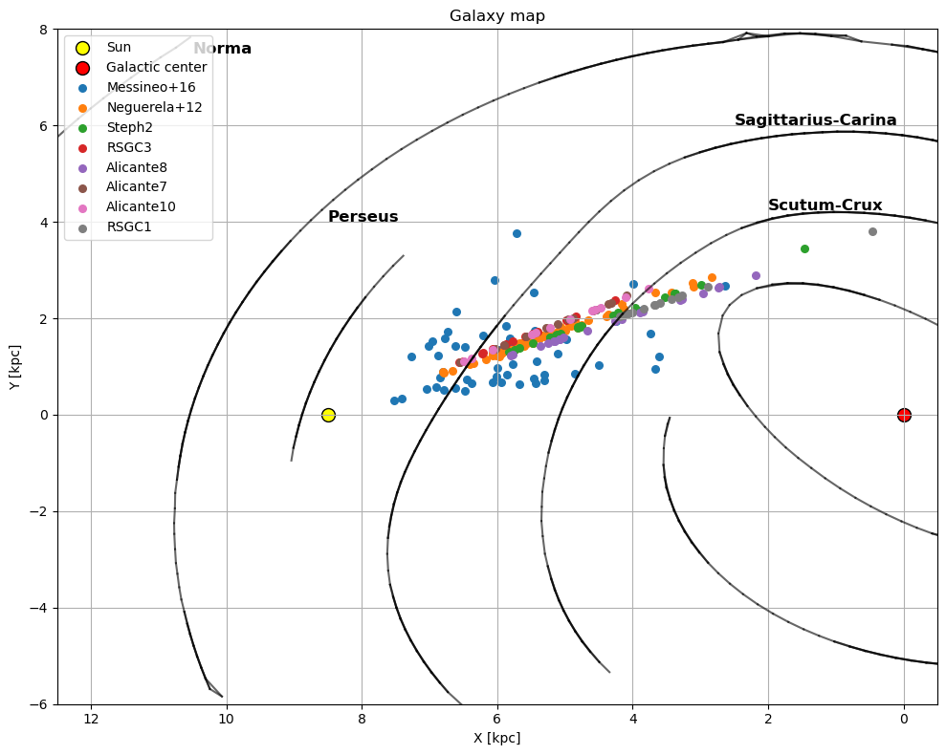
The GalRSG catalog
Scutum-Crux massive clusters, (RSGC*,Alicante*) d ~ 3-6 kpc and age ~ 10-15 Myr. Total 105 RSGs
Neguerela+12, +72 RSGs, … “Stephenson 2 is not an isolated cluster, but part of a huge structure likely containing hundreds of red supergiants ….”
Messineo+16, +62 RSGs, “Discovery of an extraordinary number of red supergiants in the inner Galaxy”
Grand Total: 239 RSGs (~ ¼ of all the known Galactic RSGs)

Slide 8
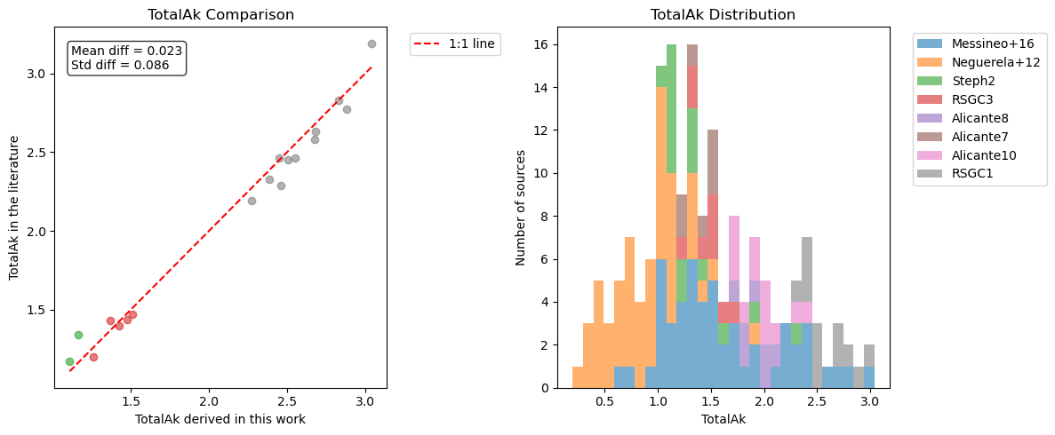
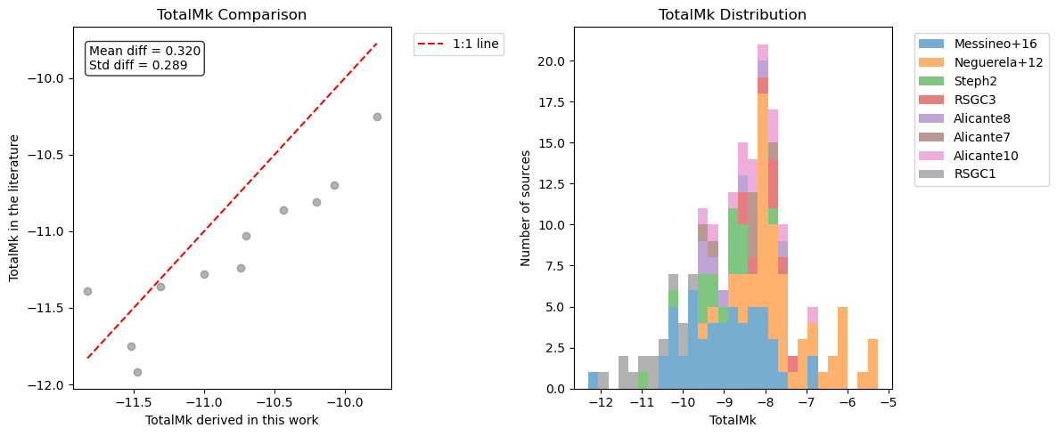
The GalRSG catalog: A_{K} and M_{K}
Derivation of stellar parameters using a procedure similar to Healy+23 and comparison to literature values when present
Distances from Bailer-Jones+21
ISM dust A_{J}, A_{K} from “Combined19” MWDUST model (Bovy+16)
From SpT to Teff using Teff scale of Levensque+05
From Teff to (J-Ks)₀ using MARCS and to E(J-Ks) using 2MASS
From E(J-Ks) to A_{K} using MWDUST, and then to M_{K}

Slide 9
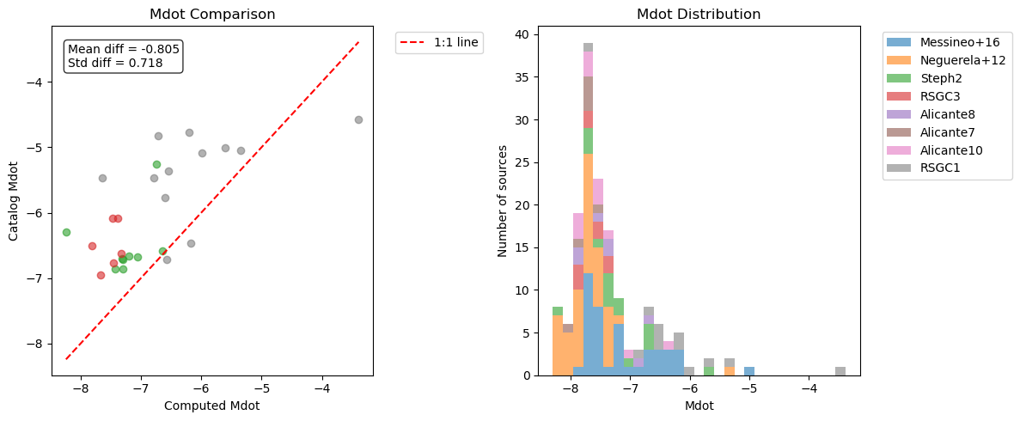
The GalRSG catalog: L/L ⊙ and Ṁ
Bolometric corrections BC_{K} from SpT using Levensque+05
From M_{K} to Lbol/L⊙
From Lbol and Teff to Ṁ using the scaling law of Antoniadis+24

Slide 10
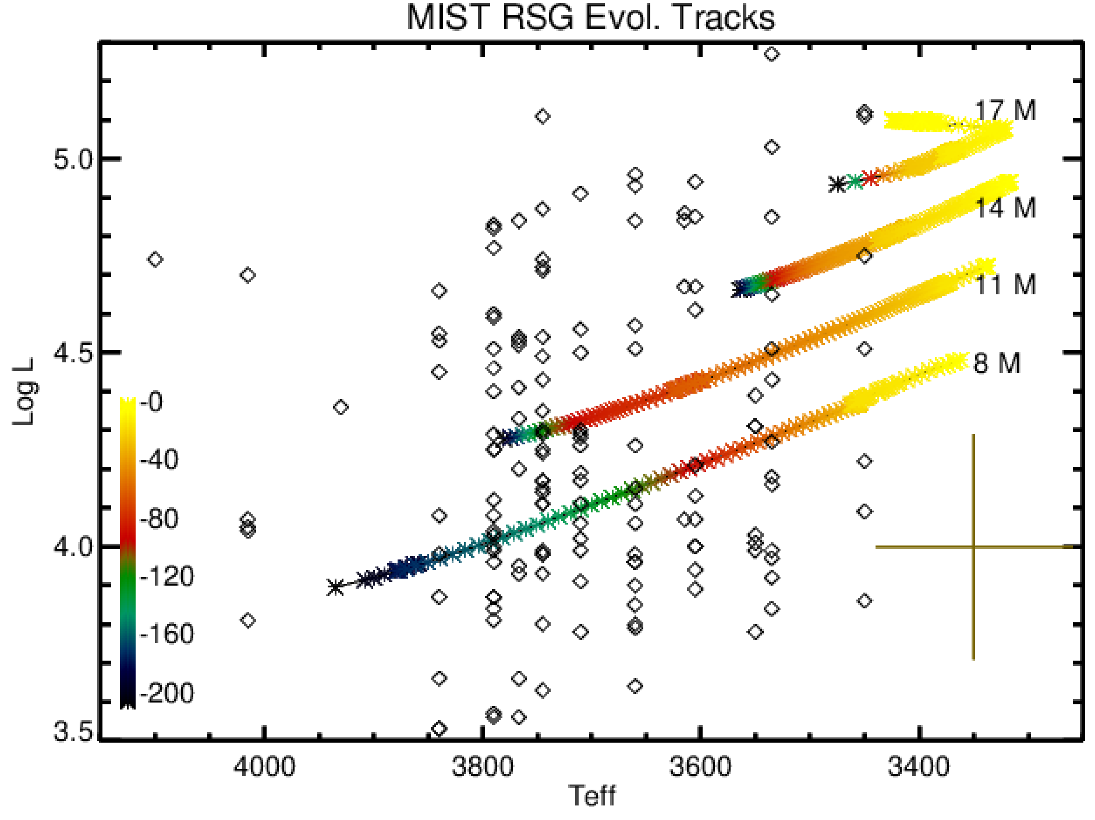
The GalRSG catalog : the HR diagram
We used the temperature scale of Levensque+05 (but see Tabernero+18), up to SpT M5
ky to SN
Bocchino et al., in preparation

Slide 11
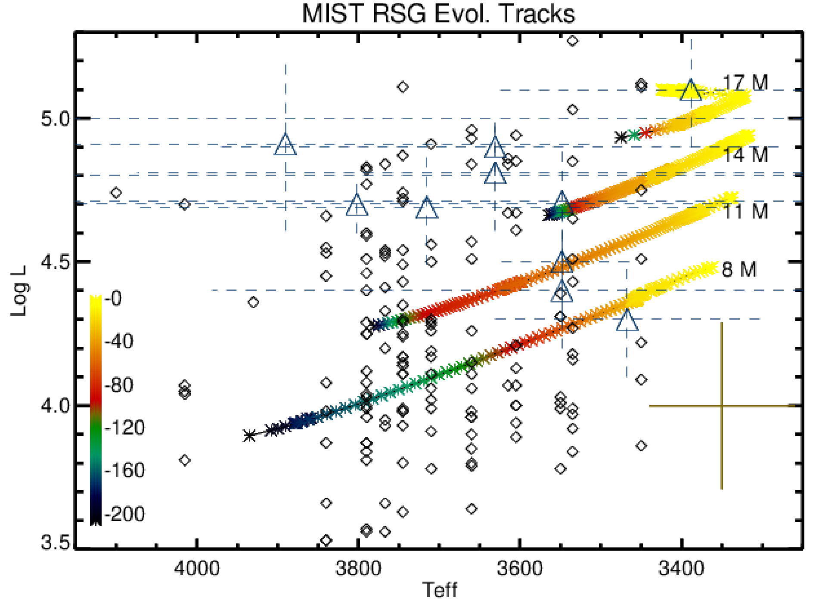
The GalRSG catalog : the HR diagram
We used the temperature scale of Levensque+05 (but see Tabernero+18), up to SpT M5
SN progenitors detected by Smartt+15
ky to SN
Bocchino et al., in preparation

Slide 12
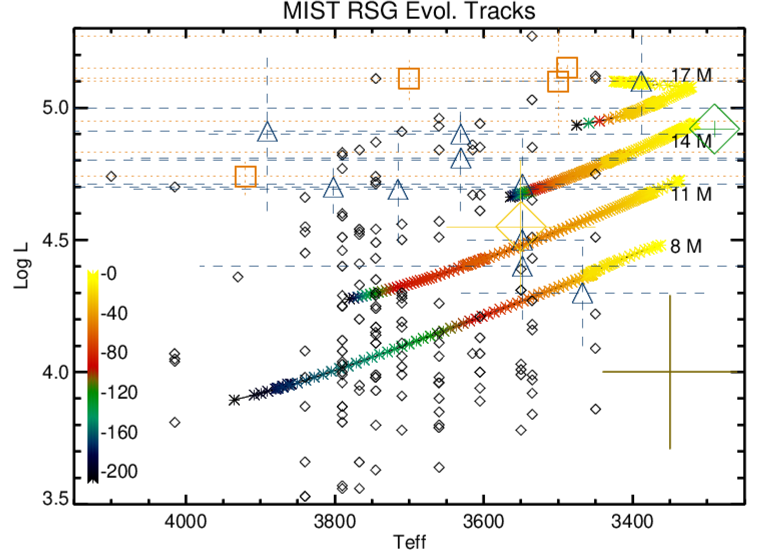
The GalRSG catalog : the HR diagram
We used the temperature scale of Levensque+05 (but see Tabernero+18), up to SpT M5
SN progenitors of Smartt+15
SN2023ixf (D=6.4 Mpc) Qin+24 and ref therein (dust enshrouded)
SN2024ggi (D=6.7 Mpc) Xiang+24
SN2024abfl (D=12-20 Mpc) Luo+24
Luminosity of known extragalactic SN progenitors have high L (Beasor+25 claim that L may be underestimated by 0.3dex…., see also Strotjohann+24)
ky to SN
Bocchino et al., in preparation

Slide 13
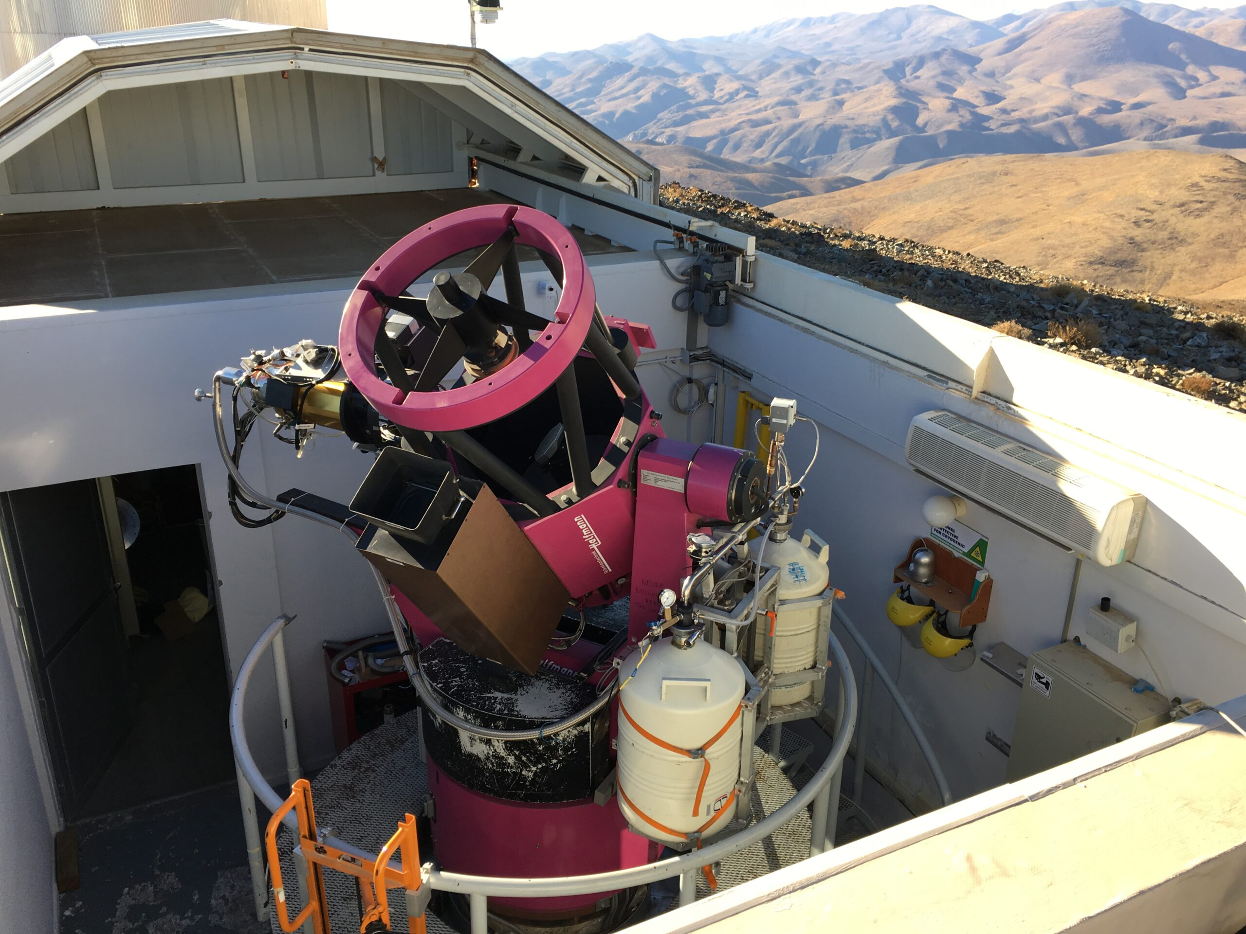
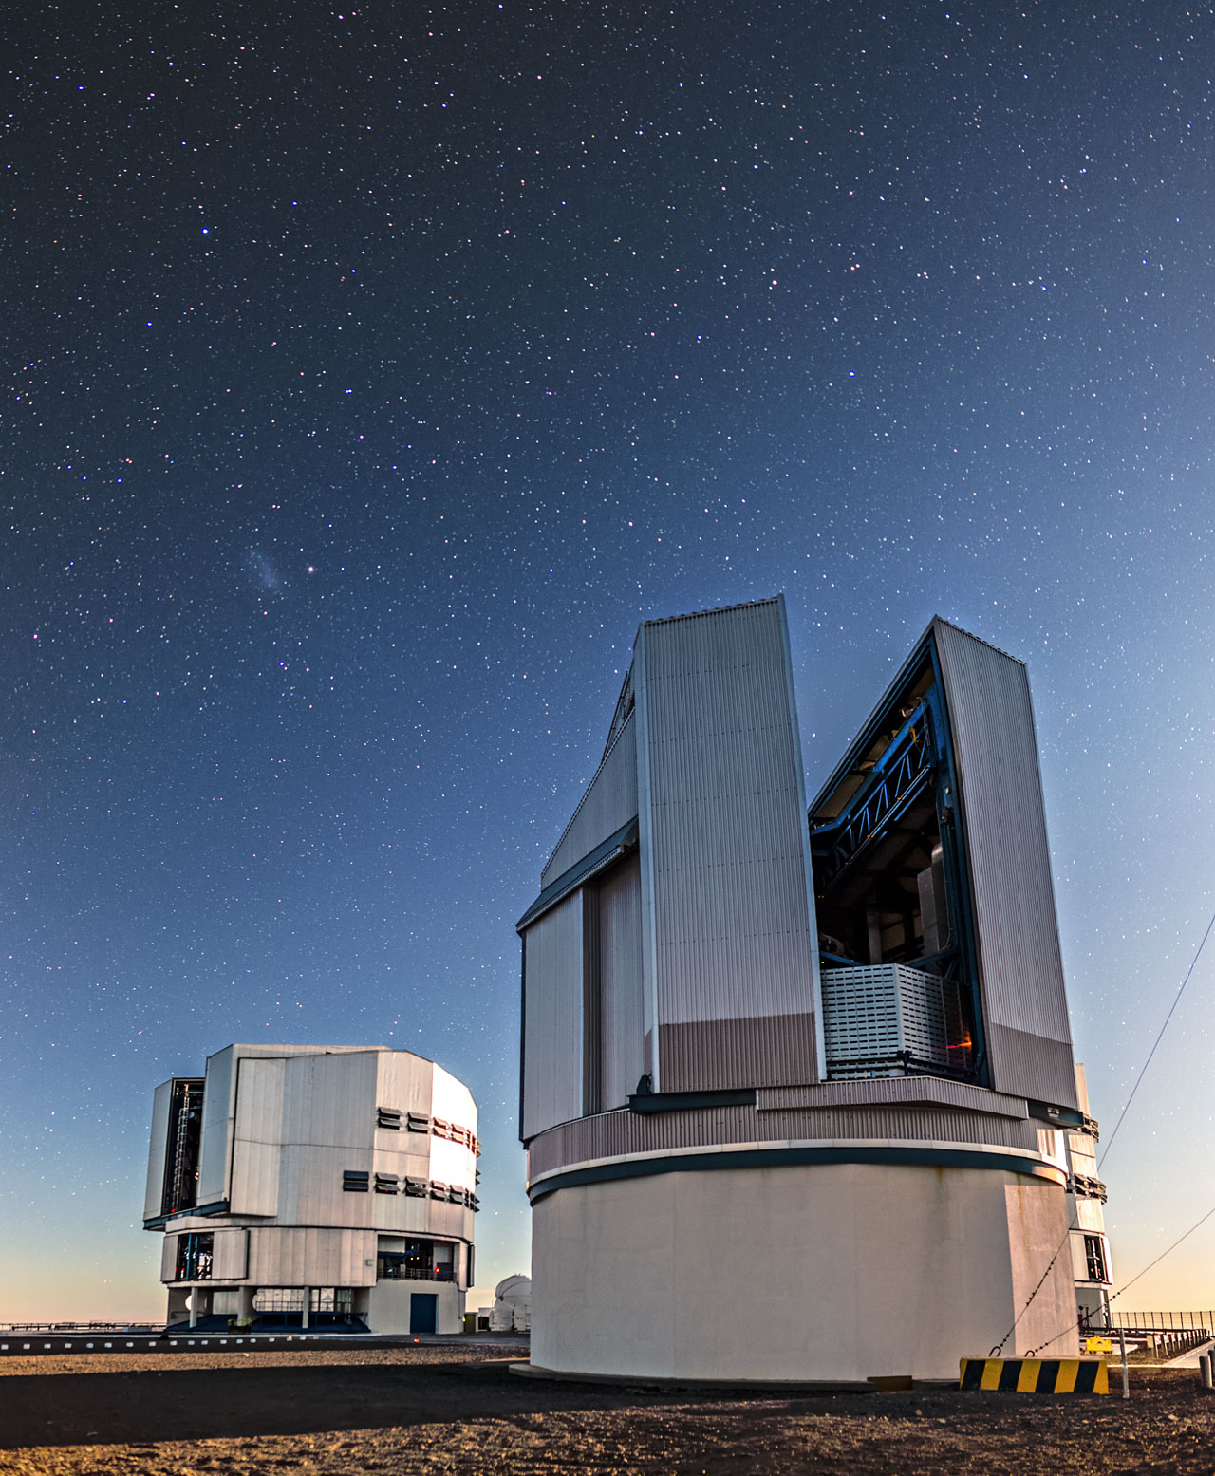
GalRSG Observational campaign
36cm C14@INAF-OAPa: pathfinder campaign (2022), filler for the high-L objects when others are unavailable
60cm INAF-REM for RSGs in clusters: 3-yr long term program (2023-2025)
2-day cadence, simultaneous griz-JHK images
2.6m INAF VST for Field RSGs: 2023-2024 + LP 2025-2027
Sloan i+z filters, 5-10 days cadence in 2023, 5 ± 2 days from 2024 on

Slide 14
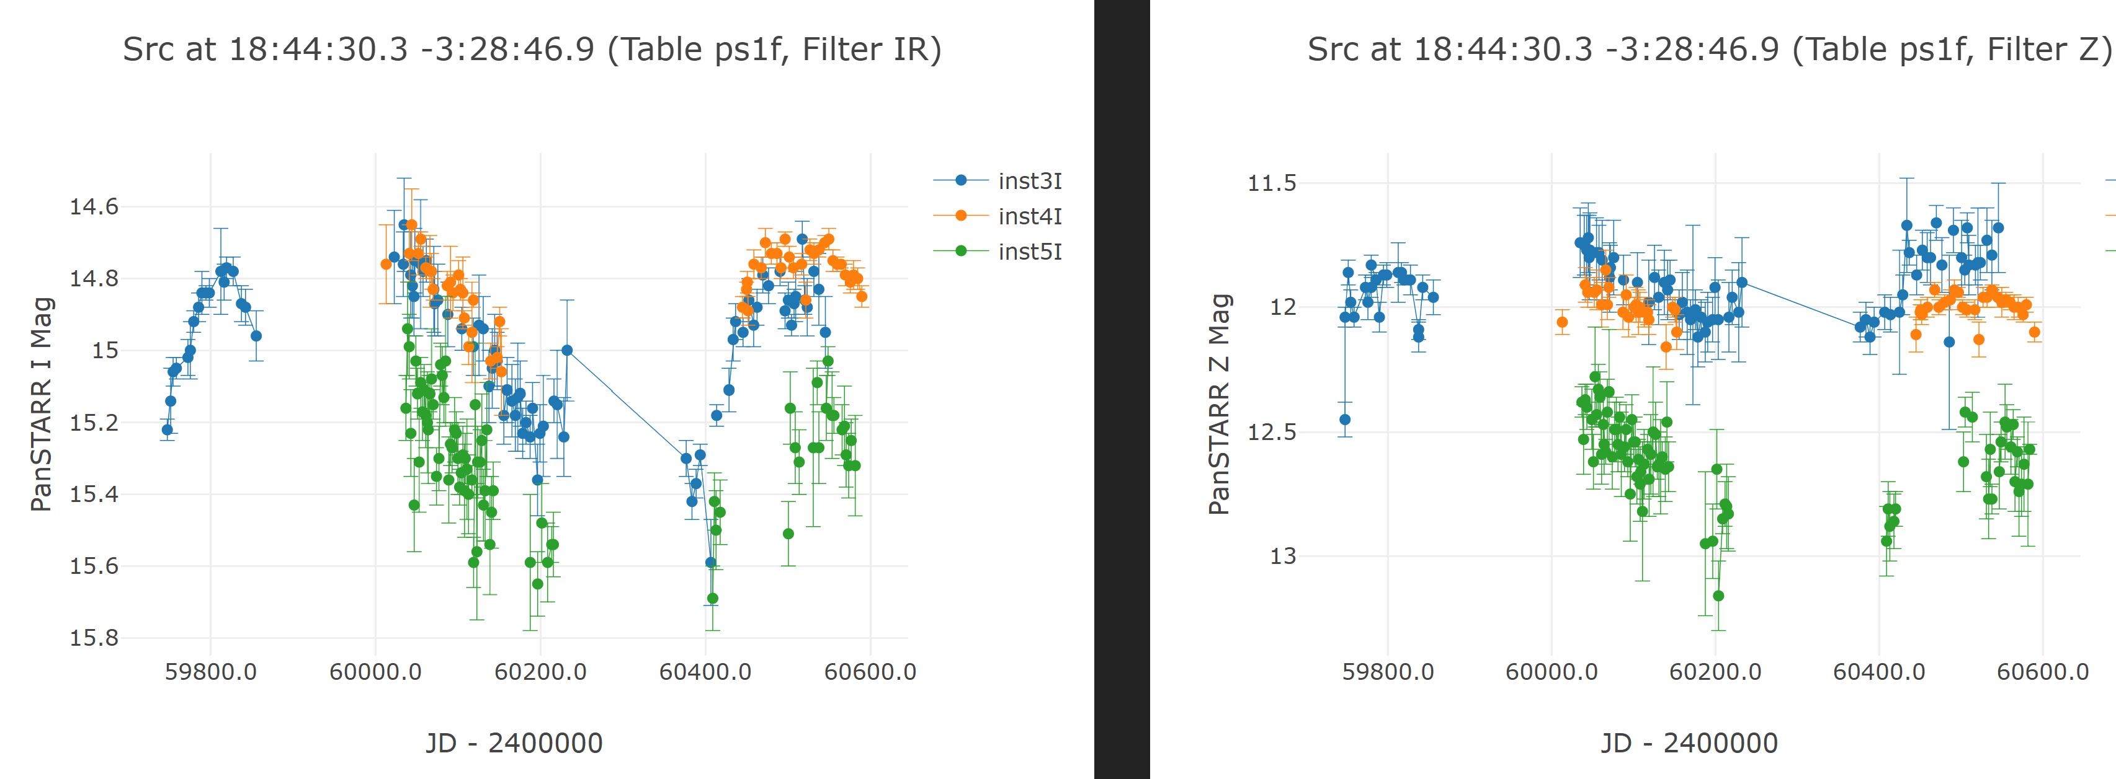
GalRSG: multi-telescope lightcurve examples
2022 2023 2024
Control star RSG Al7-A6
2022 2023 2024
INAF VST
C14@INAF-OAPa
INAF REM
Data analysis will include Anomaly Detection ML algorithms for regular and semiregular RSG lightcurves
and the development of ad-hoc alert systems

Slide 15
Conclusions
Why a multi-band optical/NIR monitoring campaign? All-sky surveys have difficulties in covering griz-JHK band simultaneously with 1-5 days cadence, for extragalactic (and often also for Galactic) RSGs
E.g. LSST baseline v3 survey cadence will be too long (max 795 visits/10yr with ugrizy filters) and will require complementary coverage
Why those specific RSGs? They are near, probably born during the same starburst episodes and putatively at the end of their life
Will you see a SN? Of course! 😁 Well…ok…maybe not. But any anomalies will be very informative, and a deep knowledge of RSGs and their variability is very important to understand SNe.
What’s next in the project? Machine learning approaches are being developed to pick-up unexpected behaviour in regular and semi-regular RSG light curves
Notes:
2MASS BandMagnitude Limit J15.8 H15.1 Ks14.3
LSST Baseline v3 at Survey Cadence Optimization Committee’s Phase 2 Recommendations (lsst.io)

