Slide 1
Cosmology and Multi-Messenger Astrophysics with Gamma-Ray Bursts
Lorenzo Amati
on behalf of the THESEUS Consortium

Slide 2
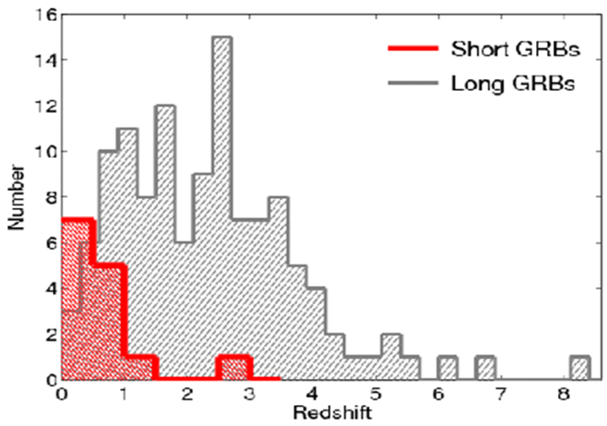
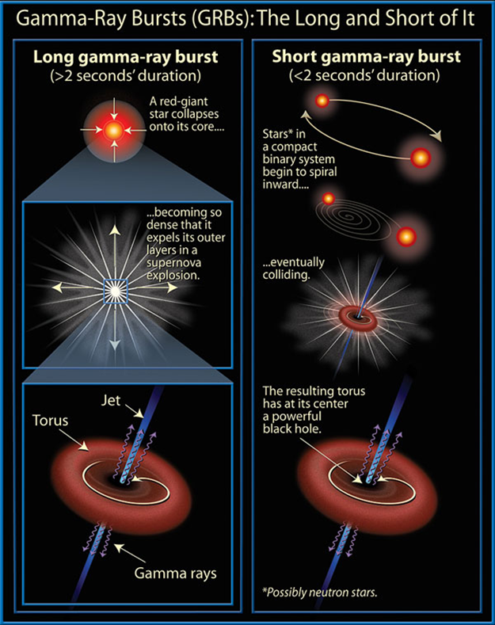
Gamma-Ray Bursts: the most extreme phenomena in the Universe
Long GRBs: core collapse of pecular massive stars, association with SN
Short GRBs: NS-NS or NS-BH mergers, association with GW sources

Slide 3
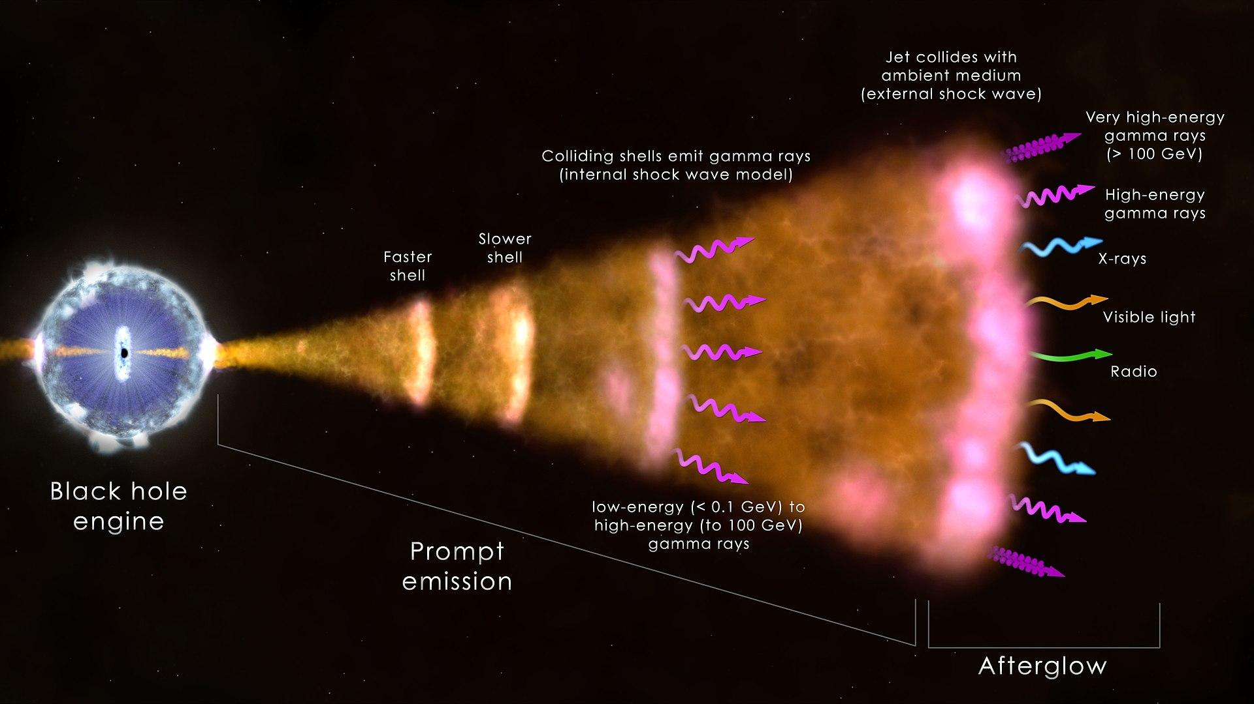
Gamma-Ray Bursts: the most extreme phenomena in the Universe
Long GRBs: core collapse of pecular massive stars, association with SN
Short GRBs: NS-NS or NS-BH mergers, association with GW sources

Slide 4
The ESA Cosmic Vision Programme
Selected missions
S1: CHEOPS (exoplanets, 2019)
M1: Solar Orbiter (solar astrophysics, 2020)
M2: Euclid (cosmology, 2023)
L1: JUICE (exploration of Jupiter system, 2023)
S2: SMILE (solar wind-magneto/ionosphere, 2025)
M3: PLATO (exoplanets, 2026)
F1: COMET INTERCEPTOR (solar system origin, 2026)
M4: ARIEL (exoplanets, 2028)
F2: ARRAKIHS (cosmology through faint galaxies, 2030)
M5: ENVISION (exploration of Venus, 2032)
L2: LISA (gravitational wave observatory, 2035)
L3: NEWATHENA (X-ray obs., cosmology, MMA, 2037)

Slide 5
The ESA Cosmic Vision Programme
Selected missions
M1: Solar Orbiter (solar astrophysics, 2017)
M2: Euclid (cosmology, 2020)
L1: JUICE (exploration of Jupiter system, 2022)
S1: CHEOPS (exoplanets, 2017)
M3: PLATO (exoplanets, 2024)
L2: ATHENA (X-ray observatory, cosmology 2028)
[L3: gravitational wawes observatory (eLISA) 2032 ]
Resonant keywords: cosmology (dark energy, dark matter, re-ionization, structures formation and evolution), fundamental physics (relativity, quantum gravity, QCD, gravitational wave universe), life (exoplanets formation + evolution + census, solar system exploration)

Slide 6
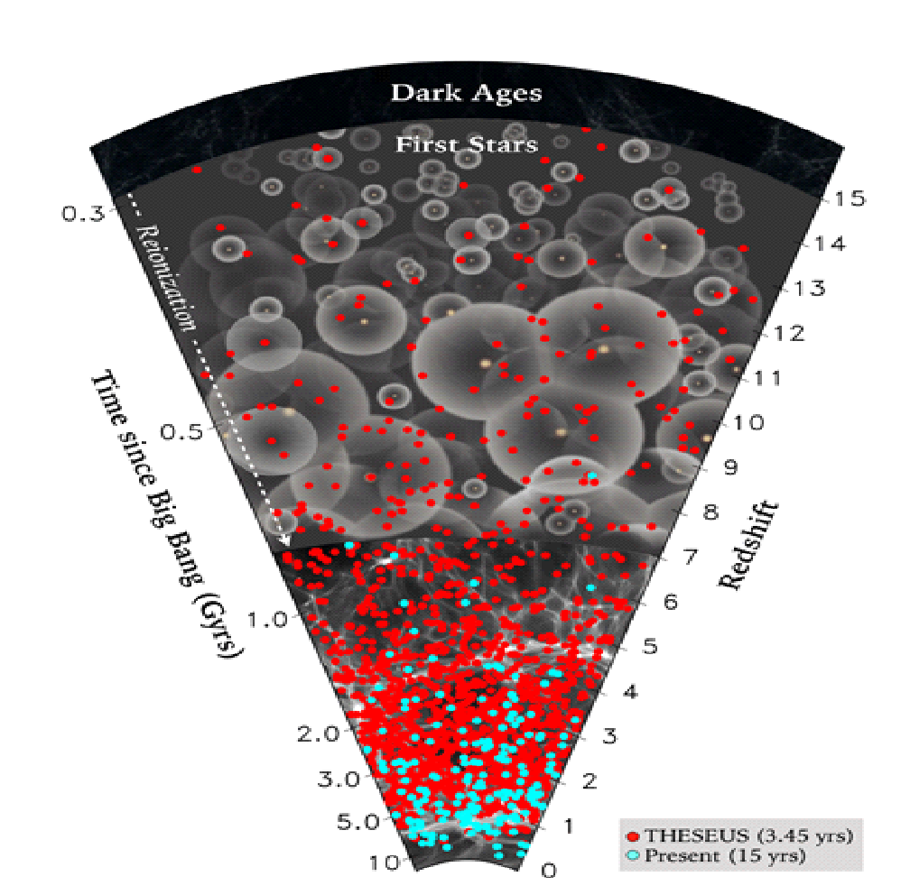
Next generation GRB missions (‘30s)
Probe the early Universe (first stars, first galaxies, cosmic reionization), by unveiling and exploiting the population of extremely distant cosmic Gamma - Ray Bursts (GRB)
Provide a fundamental contribution to multi-messenger astrophysics through GRB produced by merging neutron stars and other X/gamma-ray transient sources
Notes:
Presenter’s note:

Slide 7
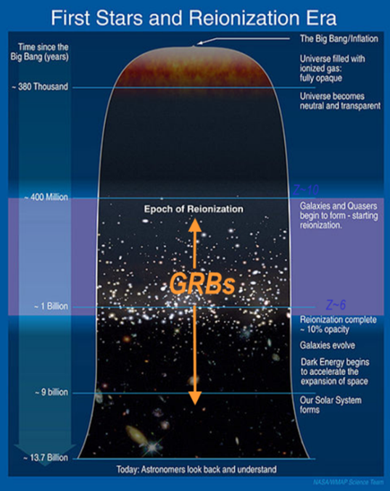
Shedding light on the early Universe with GRBs
Long GRBs: huge luminosities, mostly emitted in the X and gamma-rays
Redshift distribution extending at least to z ~9 and association with exploding massive stars
Powerful tools for cosmology: SFR evolution, physics of re-ionization, high-z low luminosity galaxies, pop III stars

Slide 8
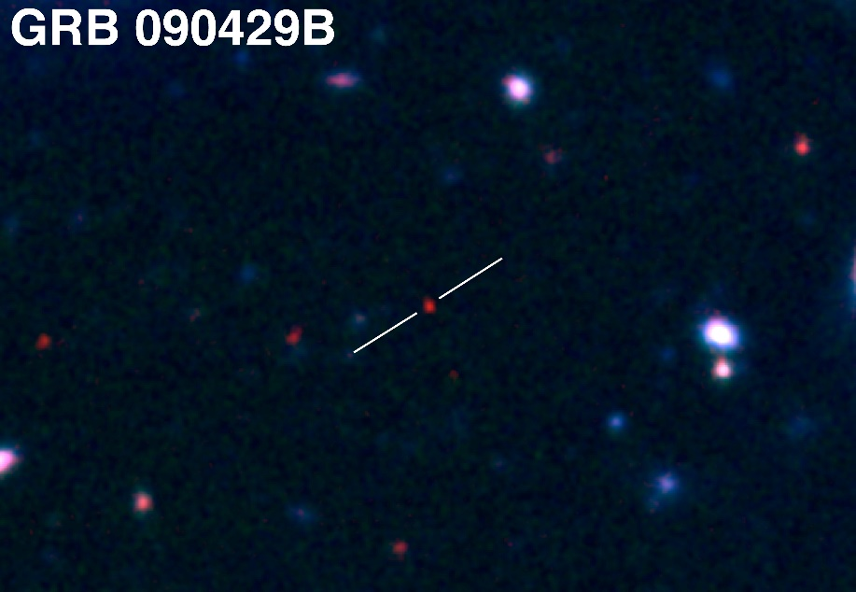
Shedding light on the early Universe with GRBs
A statistical sample of high–z GRBs can provide fundamental information:
measure independently the cosmic star–formation rate, even beyond the limits of current and future galaxy surveys
directly (or indirectly) detect the first population of stars (pop III)
Z = 9.4
Copyright: Gemini Observatory / AURA / Levan, Tanvir, Cucchiara

Slide 9
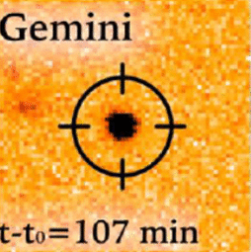
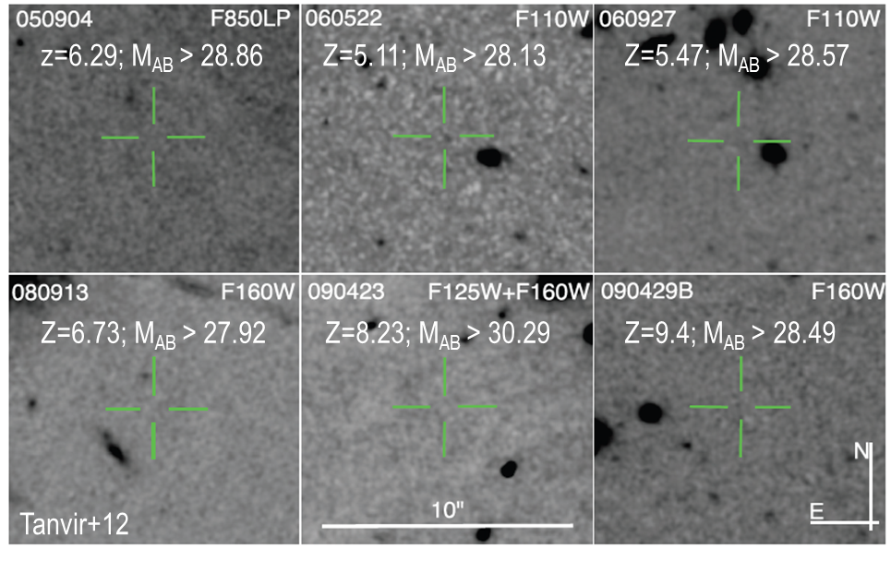
Detecting and studying primordial invisible galaxies
Robertson&Ellis12
Even JWST and ELTs surveys will be not able to probe the faint end of the galaxy Luminosity Function at high redshifts (z>6-8)

Slide 10
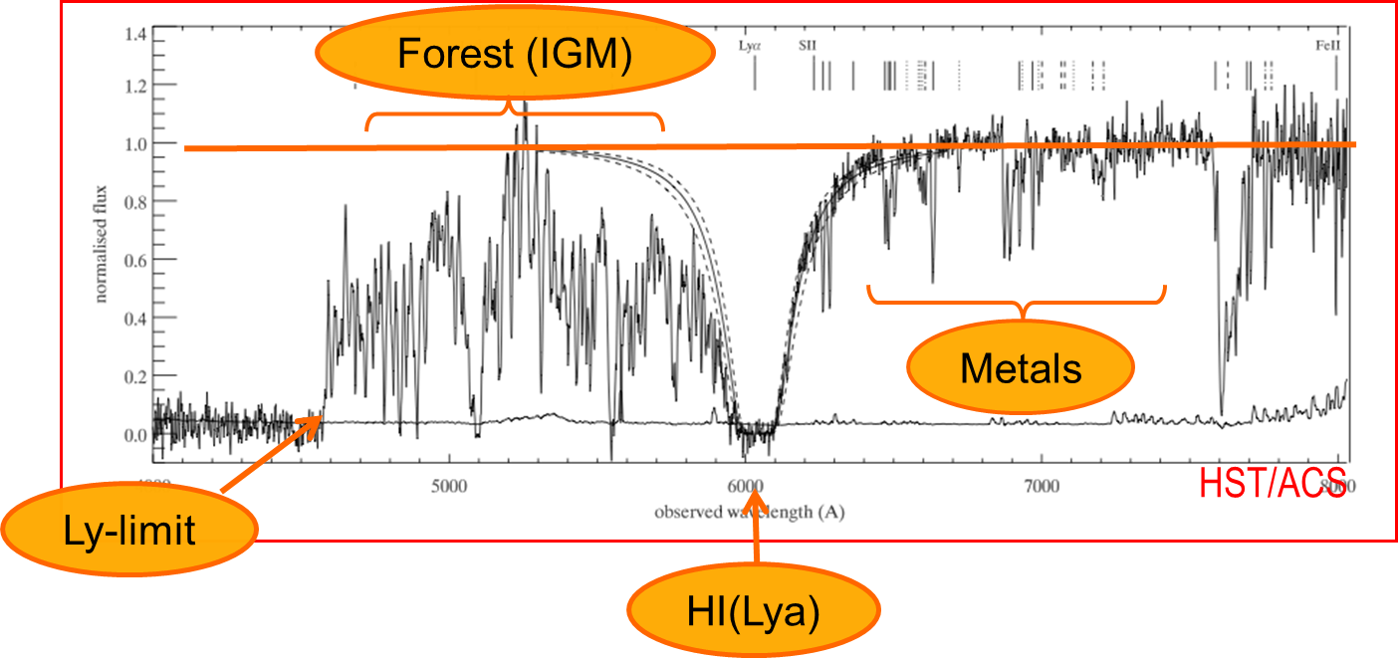
Detecting and studying primordial invisible galaxies
Robertson&Ellis12
Robertson&Ellis12

Slide 11
Detecting and studying primordial invisible galaxies
neutral hydrogen fraction
escape fraction of UV photons from high-z galaxies
early metallicity of the ISM and IGM and its evolution
Robertson&Ellis12
Robertson&Ellis12

Slide 12
Detecting and studying primordial invisible galaxies
neutral hydrogen fraction
escape fraction of UV photons from high-z galaxies
early metallicity of the ISM and IGM and its evolution
Beyond even JWST capabilities:
Primordial galaxies detection and characterization Independent on mass and luminosity
Allow absorption spectroscopy (needed because most metals are in neutral gas and and for dust ratio)
Properties of primordial IGM
Targets for JWST
Robertson&Ellis12
Robertson&Ellis12

Slide 13
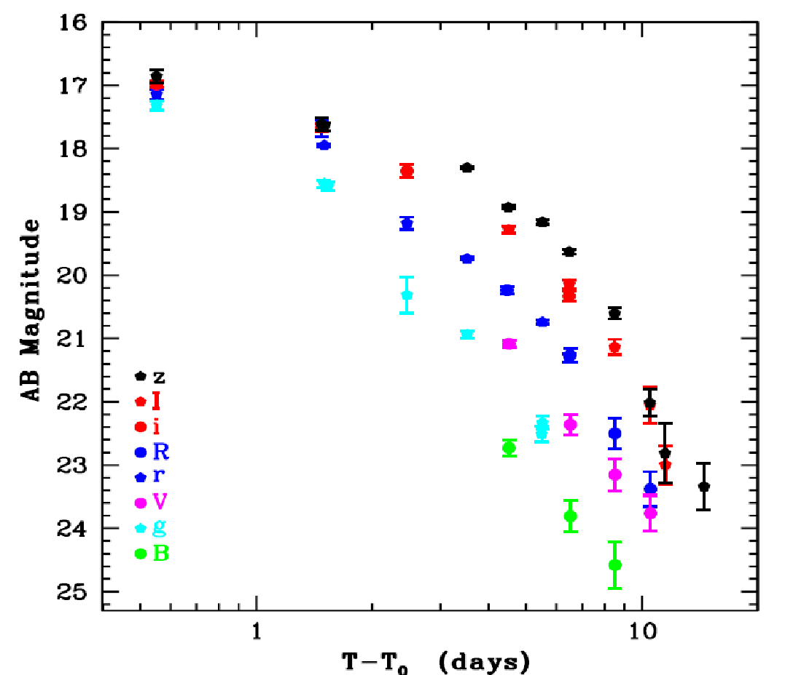
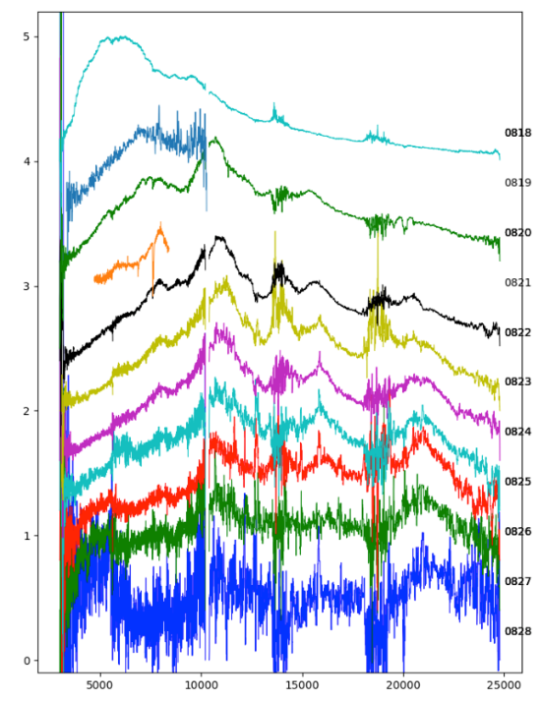
GRBs and multi-messenger astrophysics
GW170817 + SHORT GRB 170817A + KN AT2017GFO (~40 Mpc):
Notes:
Presenter’s note:

Slide 14
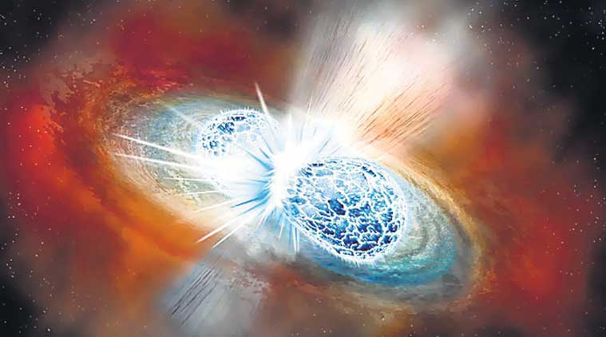
GRBs and multi-messenger astrophysics
GW170817 + SHORT GRB 170817A + KN AT2017GFO (~40 Mpc):
Notes:
Presenter’s note:

Slide 15
- 2018-2021: ESA Phase-A study (2018-2021) as M5 candidate - 2022: Selected for Phase 0 study (2023) within M7 process
- 2023: Selected for Phase-A study (2024-2026) as M7 candidate - M7 timeline: Phase-A (2024-2026), adoption 2028, launch 2037
Payload consortium: Italy, Germany, UK, France, Switzerland, Spain, Poland, Denmark, Belgium, Czech Republic, The Netherlands, Norway, Slovenia, Ireland, Hungary
Leads: L. Amati (INAF – OAS Bologna, Italy, lead proposer), A. Santangelo (Un. Tuebingen, D), P. O’Brien (Un. Leicester, UK), D. Gotz (CEA-Paris, France), E. Bozzo (Un. Genève, CH)
Amati et al. 2018 ( Adv.Sp.Res., arXiv:1710.04638 )
Stratta et al. 2018 (Adv.Sp.Res., arXiv:1712.08153)
Articles for SPIE 2020 and Exp..Astr. (all on arXiv)
http://www.isdc.unige.ch/theseus
http://www.isdc.unige.ch/theseus/

Slide 16
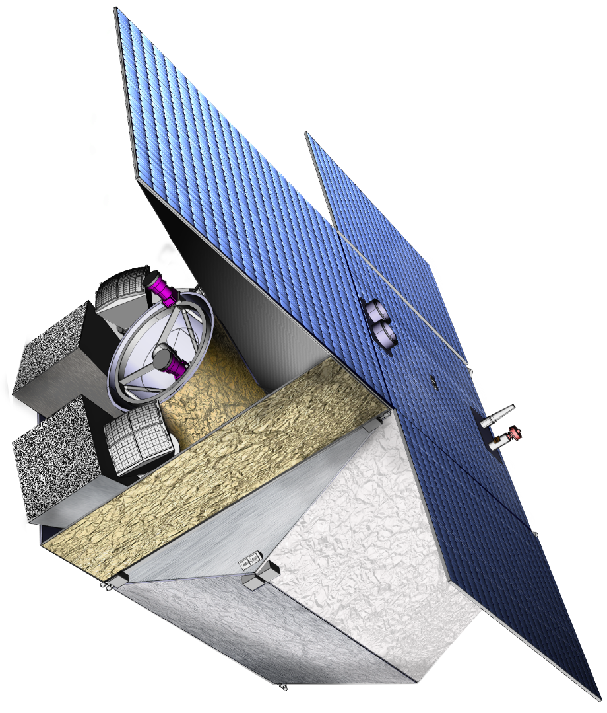
THESEUS Mission Concept
THIS BREAKTHROUGH WILL BE ACHIEVED BY A MISSION CONCEPT OVERCOMING MAIN LIMITATIONS OF CURRENT FACILITIES
Set of innovative wide-field monitors with unprecedented combination of broad energy range from gamma-rays down to soft X-rays, FOV and localization accuracy
Notes:
Presenter’s note:

Slide 17
THESEUS Mission Concept
THIS BREAKTHROUGH WILL BE ACHIEVED BY A MISSION CONCEPT OVERCOMING MAIN LIMITATIONS OF CURRENT FACILITIES
Set of innovative wide-field monitors with unprecedented combination of broad energy range from gamma-rays down to soft X-rays, FOV and localization accuracy
On-board autonomous fast follow-up in optical/NIR, arcsec location and redshift measurement of detected GRB/transients
Notes:
Presenter’s note:

Slide 18
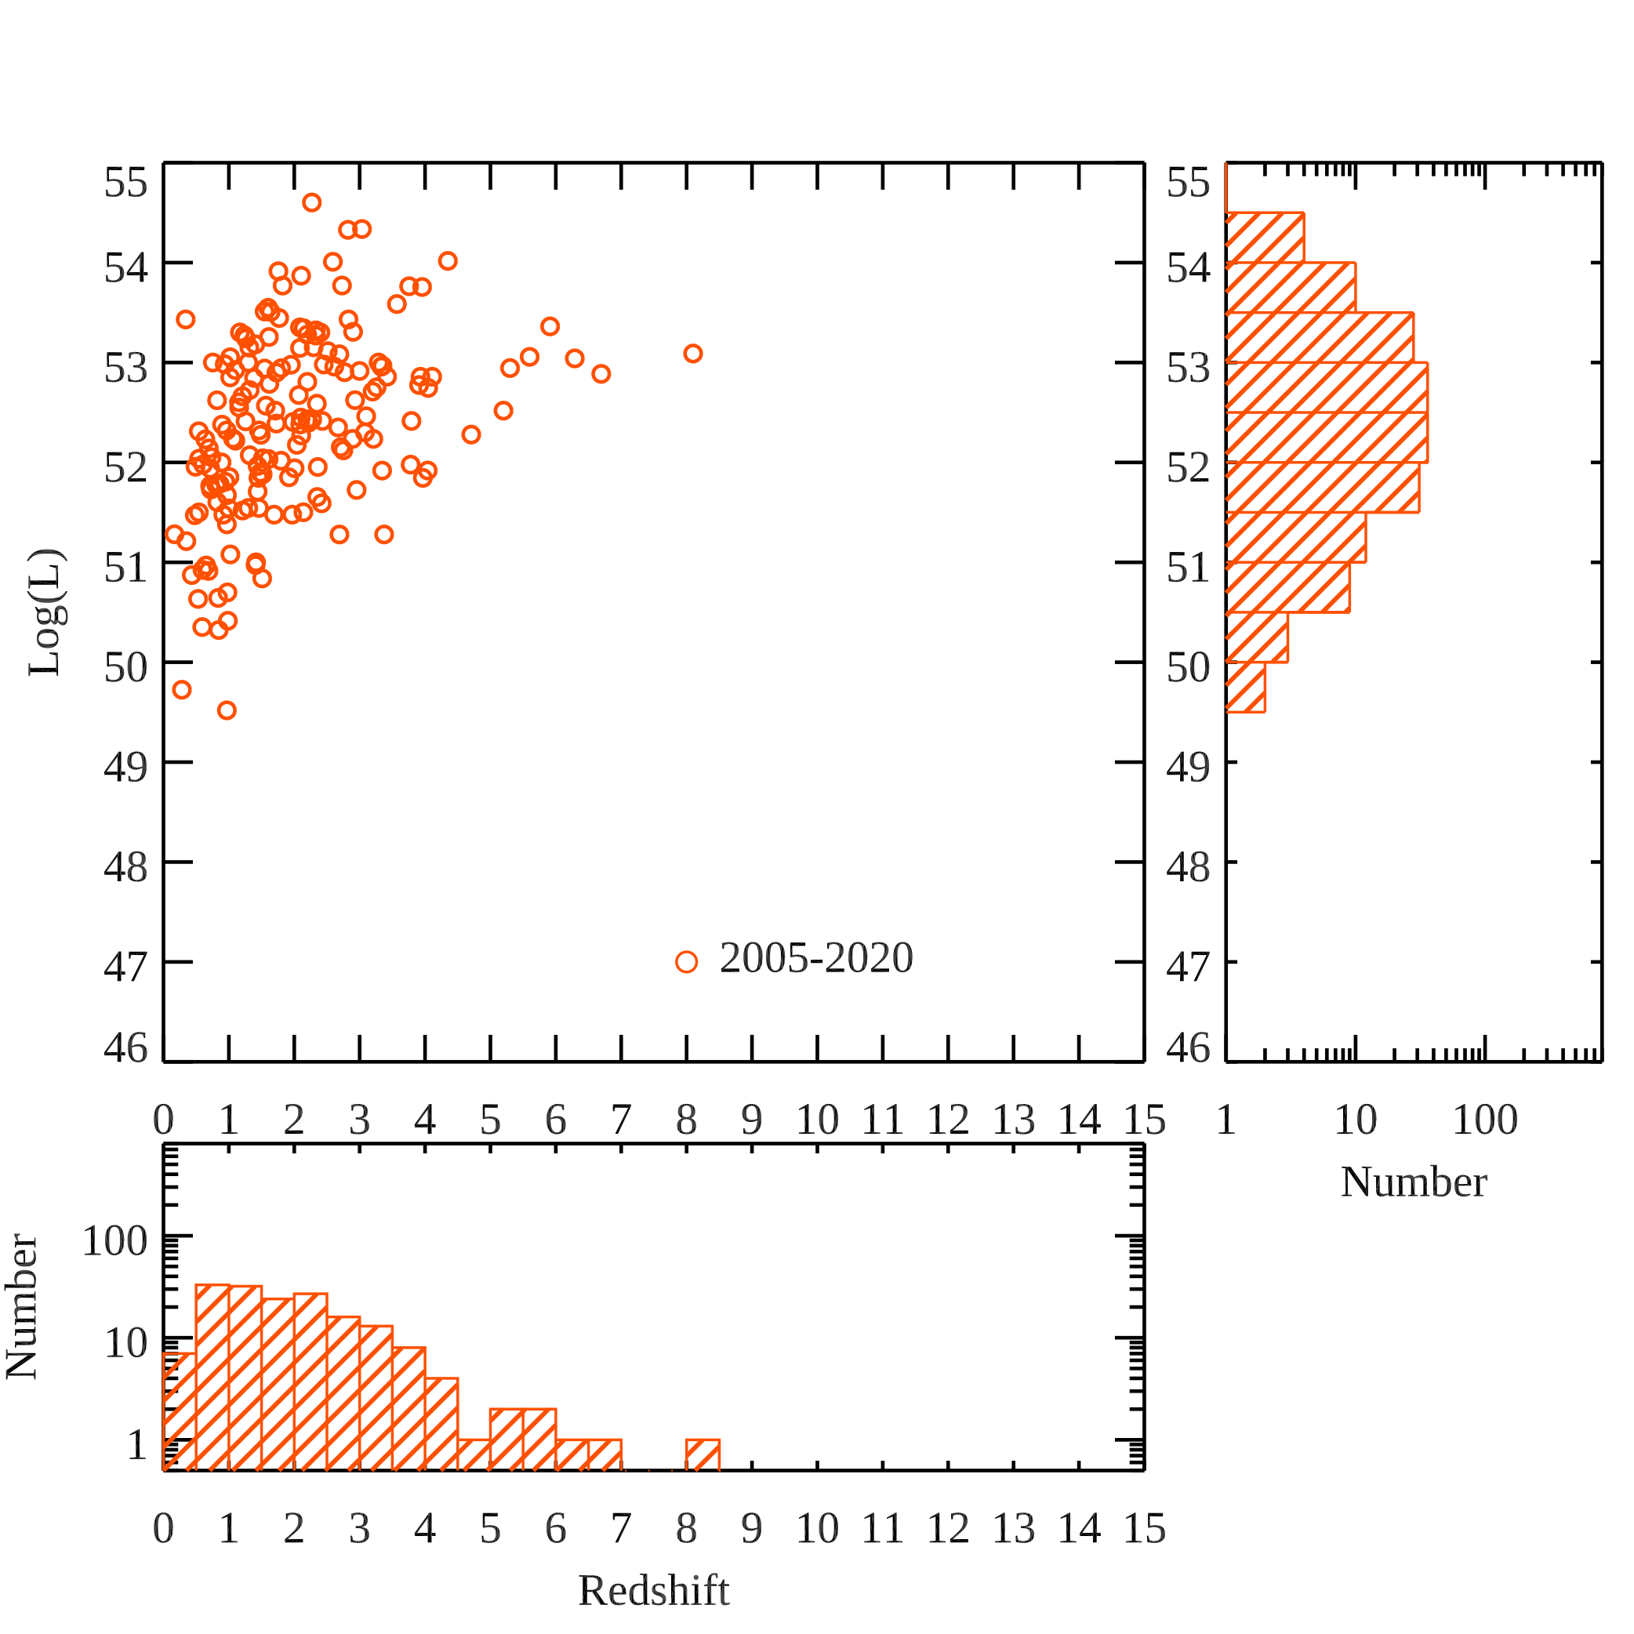
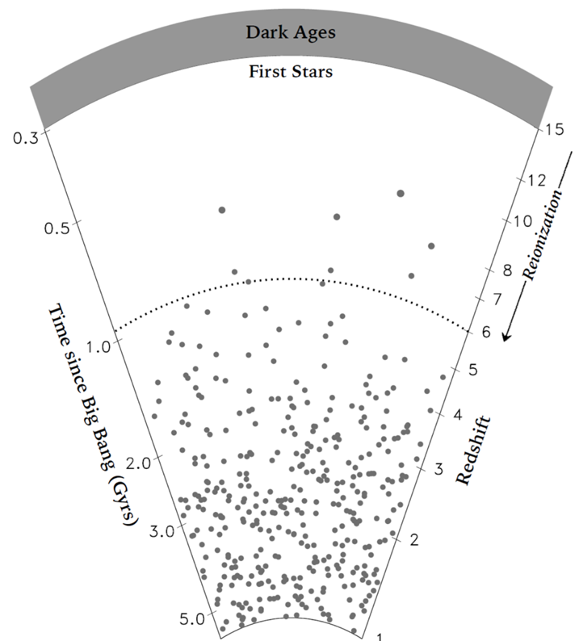
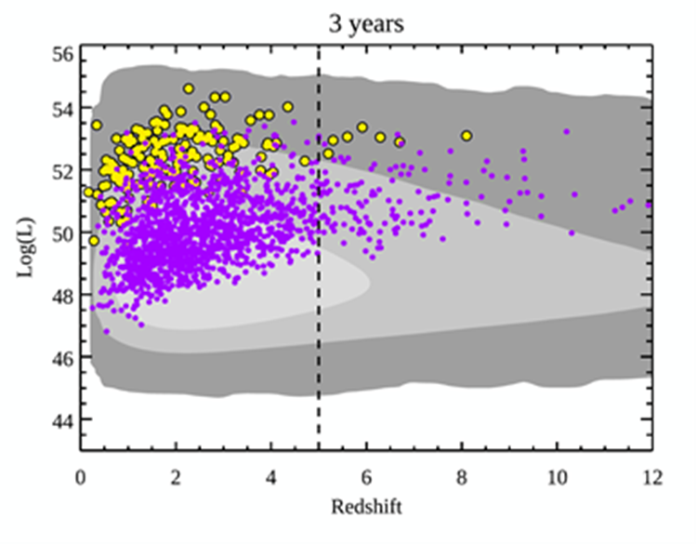
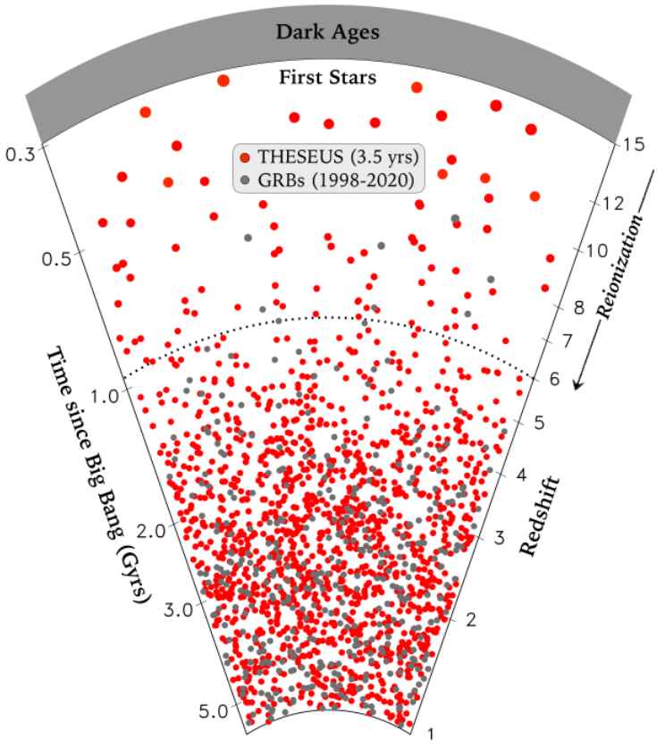
Expected performances: early Universe

Slide 19
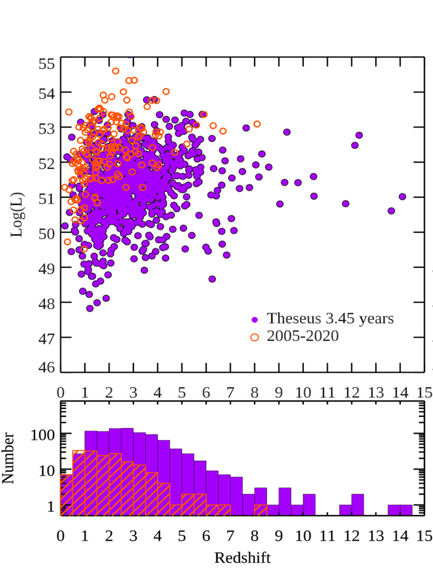
Expected performances: early Universe

Slide 20
The power of GRBs for cosmology
Most luminous and remote phenomena in the Universe, with isotropic-equivalent radiated energies in X-gamma rays up to more than 10⁵⁴ erg released in a few tens of seconds and a redshift distribution extending to at least z = 9-10.
GRBs as tools for exploring the early Universe at the end of the "dark ages" (reionization, first stars, star formation rate and metallicity evolution in the first billion of years)

Slide 21
The power of GRBs for cosmology
Most luminous and remote phenomena in the Universe, with isotropic-equivalent radiated energies in X-gamma rays up to more than 10⁵⁴ erg released in a few tens of seconds and a redshift distribution extending to at least z = 9-10.
GRBs as tools for exploring the early Universe at the end of the "dark ages" (reionization, first stars, star formation rate and metallicity evolution in the first billion of years)
b) Using GRBs to investigate the expansion rate and geometry of the Universe, thus getting clues to "dark energy" properties and evolution
Amati, Guidorzi, Frontera, Della Valle+ 2008; Amati & Della Valle 2013; followed by many more

Slide 22
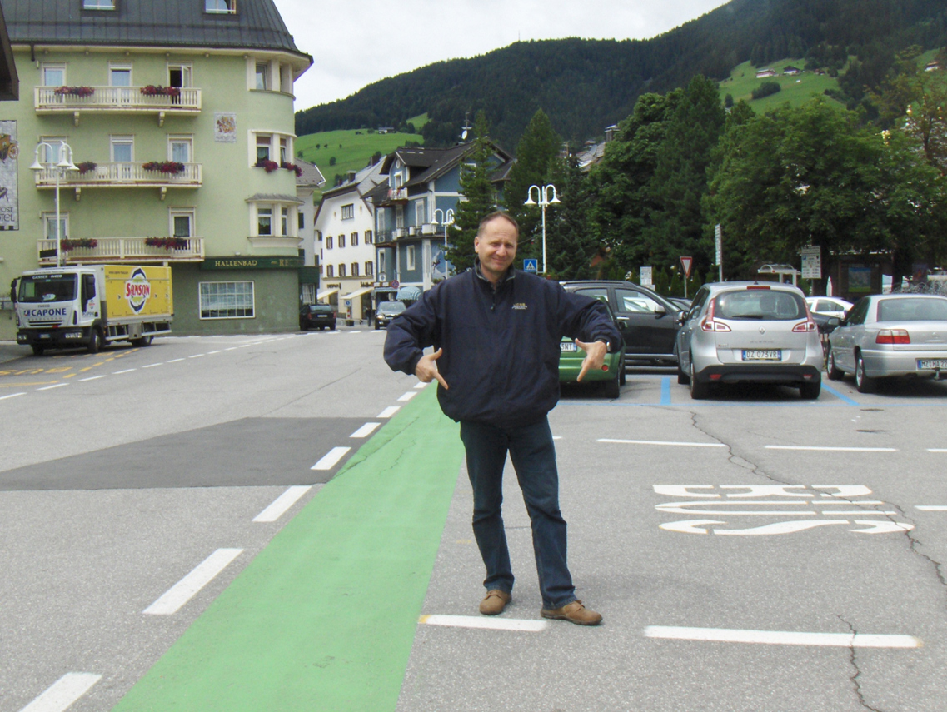
… an investigation prompted in 2008 by a “motivational speech” by MdV

Slide 23
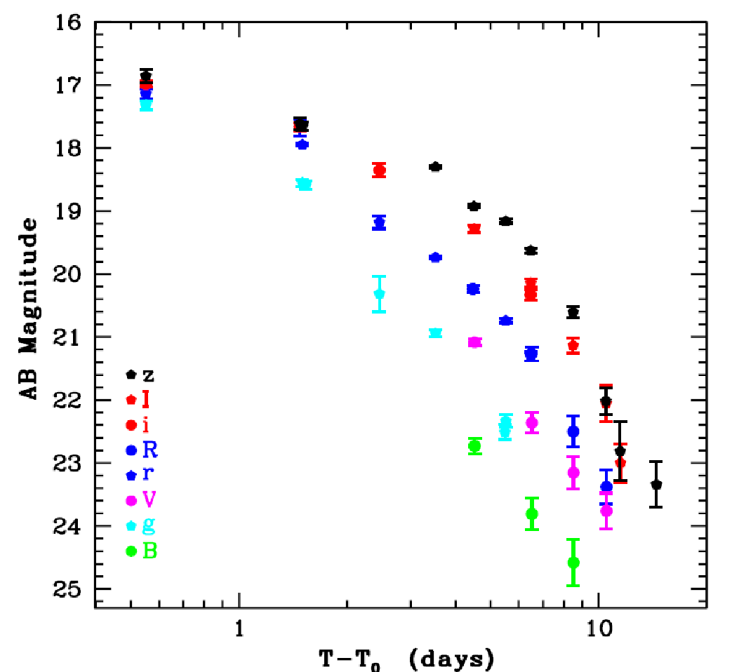
Multi-messenger science with THESEUS
THESEUS:
short GRB detection over large FOV with arcmin localization
Kilonova and/or IR afterglow detection, arcsec localization, characterization
Possible detection of weaker isotropic X-ray emission

Slide 24
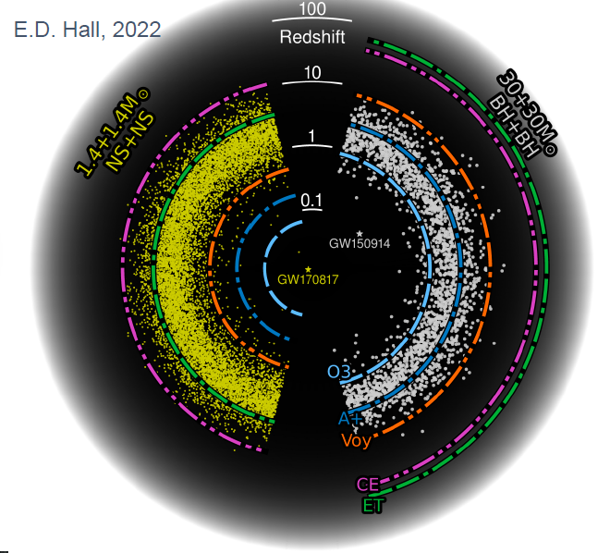
Multi-messenger science with THESEUS
M7 timeline: great synergy with 3G GW detectors (ET, CE)
Notes:
Presenter’s note:
Very brief explanation of the red and blue KN (we can take in case another figure). Focus on explain 1) the “standard short GRB”-aligned and “soft short GRB”-misaligned issue 2) the synergy with upgraded 2G to study KN and jet structure with off-axis afterglow 3) the statistical studies possible with synergies with 3G

Slide 25
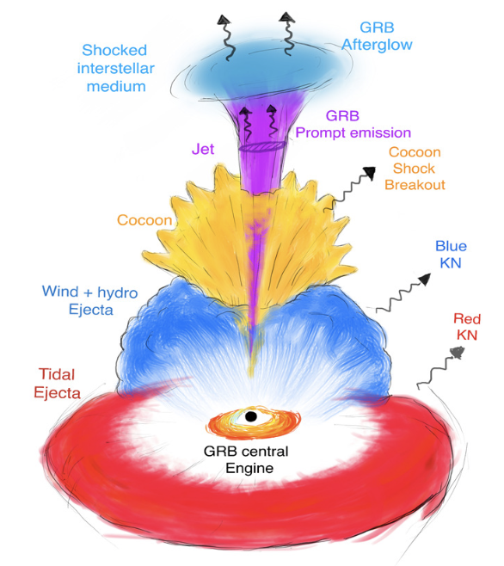
Multi-messenger science with THESEUS
INDEPENDENT DETECTION & CHARACTERISATION OF THE MULTI-MESSENGER SOURCES
Lessons from GRB170817A
Aligned GRBs
Misaligned GRBs
THESEUS + ET in 3 years:
~70 aligned+misaligned short GRB
additional long GRBs from mergers and possible GW-X-ray transients
Higher redshift events – X/𝛾 is likely only route to EM detection: larger statistical studies including source evolution, probe of dark energy and test modified gravity on cosmological scales
Notes:
Presenter’s note:
Very brief explanation of the red and blue KN (we can take in case another figure). Focus on explain 1) the “standard short GRB”-aligned and “soft short GRB”-misaligned issue 2) the synergy with upgraded 2G to study KN and jet structure with off-axis afterglow 3) the statistical studies possible with synergies with 3G

Slide 26
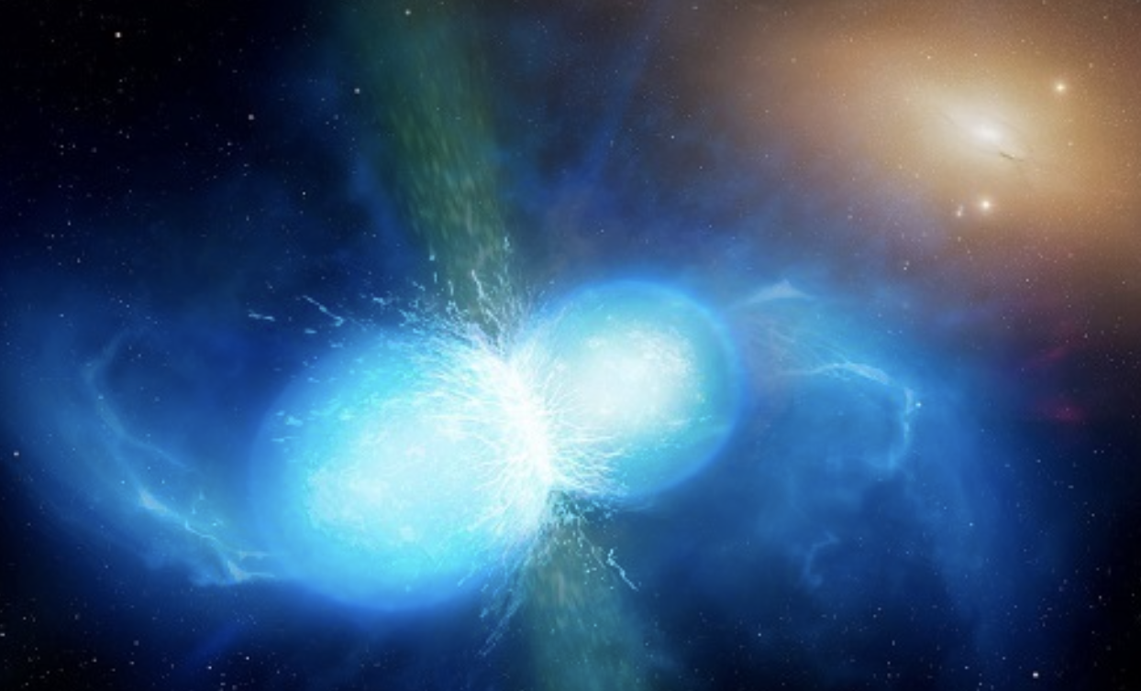
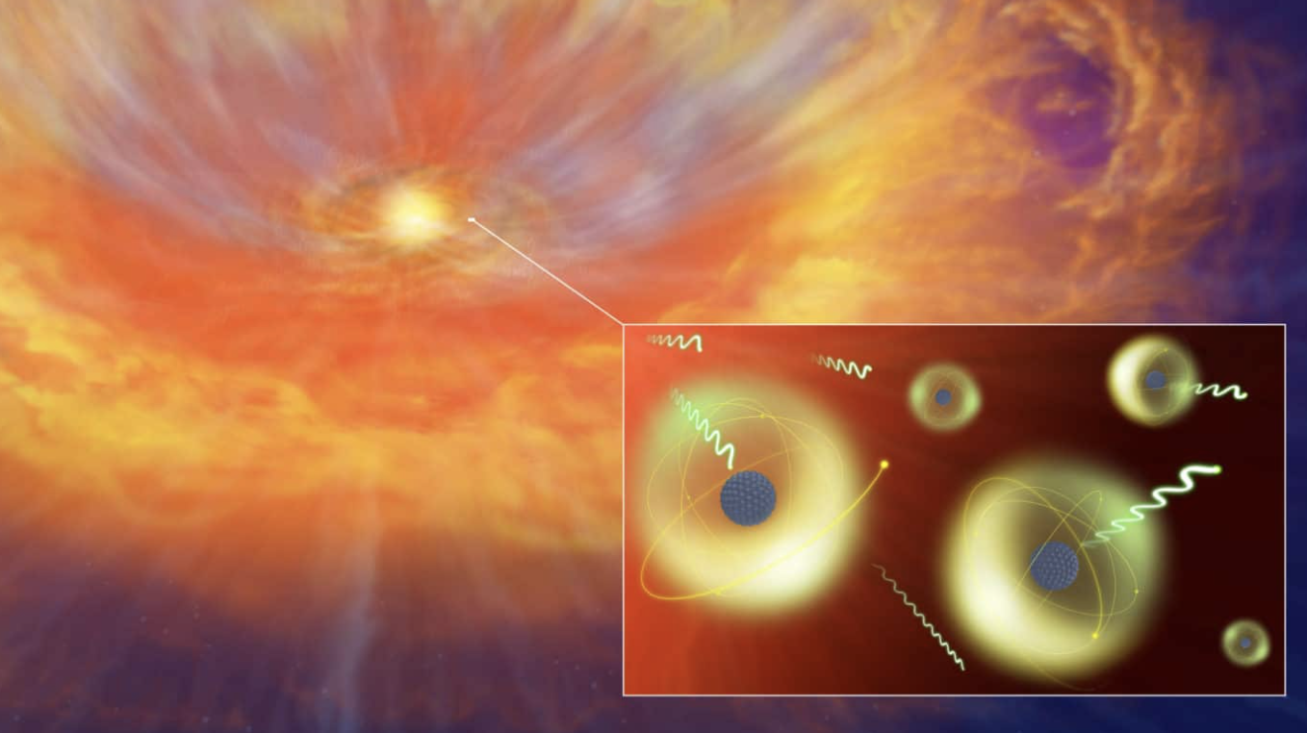
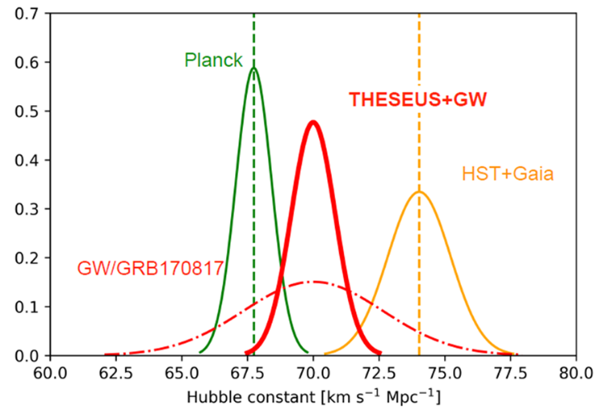
Multi-messenger science with THESEUS
INDEPENDENT DETECTION & CHARACTERISATION OF THE MULTI-MESSENGER SOURCES
Relativistic jet formation, equation of state, fundamental physics
Cosmic sites of r-process nucleosynthesis
New independent route to measure cosmological parameters
Notes:
Presenter’s note:

Slide 27
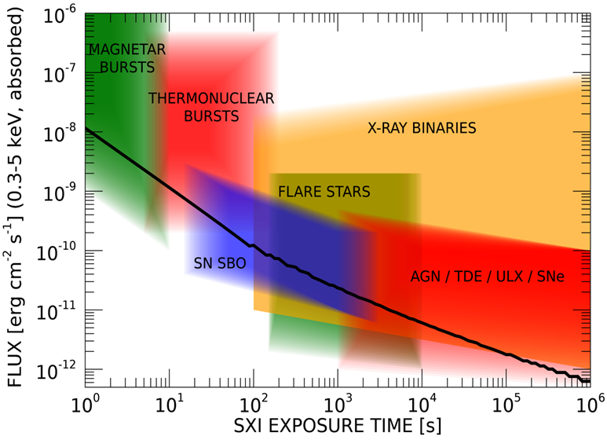
Exploring the transient sky
GRBs extreme emission physics, central engine, sub-classes & progenitors, cosmological parameters & fundamental physics
Study of many classes of X-ray sources by exploiting the simultaneous broad band X-ray and NIR observations
Provide a flexible follow-up observatory for fast transient events with multi-wavelength ToO capabilities and guest-observer programmes

Slide 28
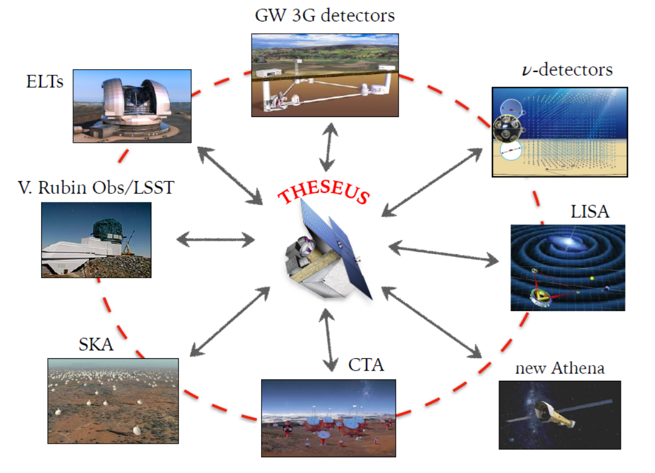
THESEUS: crucial synergies in the late ‘30s
The «M7» timeline will allow to widely broaden the mission scientific impact by taking advantage of the perfectly matched synergies with major facilities coming fully operative in the 2030s (e.g., 3G GW detectors)

Slide 29
In summary
GRBs are a key phenomenon for cosmology, multi-messenger astrophysics and fundamental physics
Next generation GRB missions, like THESEUS, developed by a large European collaboration and under advanced study by ESA will fully exploit these potentialities and also provide unprecedented clues to GRB physics and a substantial contribution to time-domain astronomy
The “M7” timeline will allow an unprecedented great synergy with future very large observing facilities, thus importantly enhancing their science return
Because of the wide scope of its science goals, the great synergies and timeline and a guest-observer programme, THESEUS scientific return will involve an unprecedented wide scientific community.
THESEUS: ESA/M7 Phase 0/A study, selection 2026, launch by 2037
SPIE articles on instruments, Adv.Sp.Res. & Exp.Astr. articles on science
http://www.isdc.unige.ch/theseus/

