Slide 1
AT2024wpp and the Herd Of Spherical Cows
Miika Pursiainen
An Extraordinary Journey into the Transient Sky
01/04/2025
Padova, Italy

Slide 2
AT2024wpp and the Herd Of Spherical Cows
Miika Pursiainen
An Extraordinary Journey into the Transient Sky
01/04/2025
Padova, Italy

Slide 3
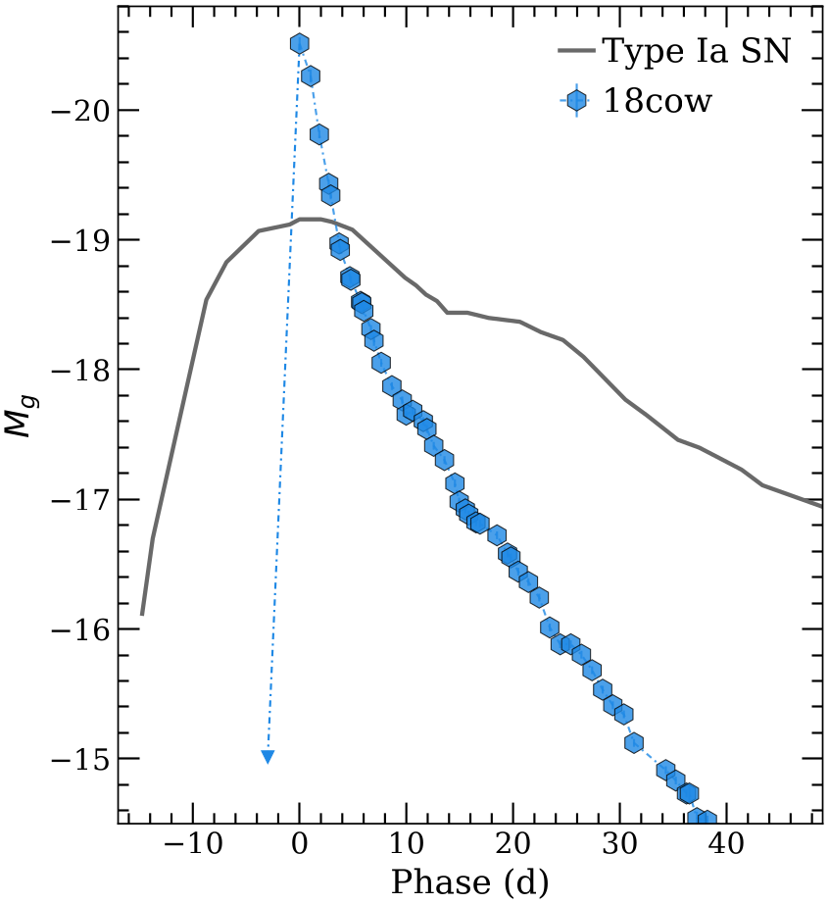
The Herd of Cow-like Events
AT2018cow
Extremely peculiar
Near-by: Amazing data-sets
>30 papers!
Fast and bright
e.g. Prentice et al. (2018), Perley et al. (2019)
Radio to X-rays
Compact object & accretion?
e.g. Margutti et al. (2019), Ho et al. (2019)

Slide 4
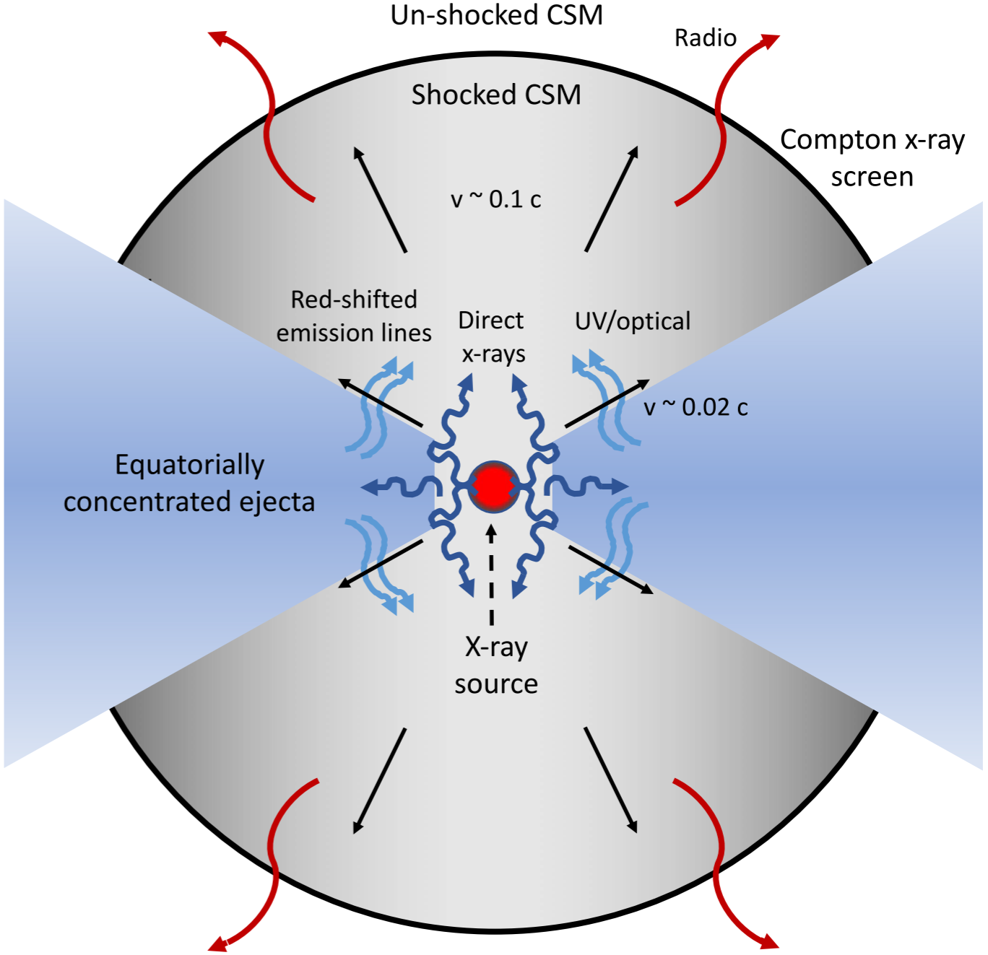
The Herd of Cow-like Events
What are they?
Now ~7 in literature
Also known as LFBOTs
Mechanism not yet understood
TDEs with IMBH?
BH + WR star merger?
Stratified ejecta & compact object
Equatorial torus (~4000km/s)
Polar outflow (0.1c)
Perfect for polarimetry!
Margutti et al. (2019)

Slide 5
Optical Polarimetry
Ellipticity
(b/a)
P
Electron Scattering
1.0
0%
Polarisation of an Ellipsoid
Probes the Geometry
Viewing Angle Dependent
0.8
1%
0.65
2%
0.5
3%
0.4
4%
(Höflich 1991)​

Slide 6
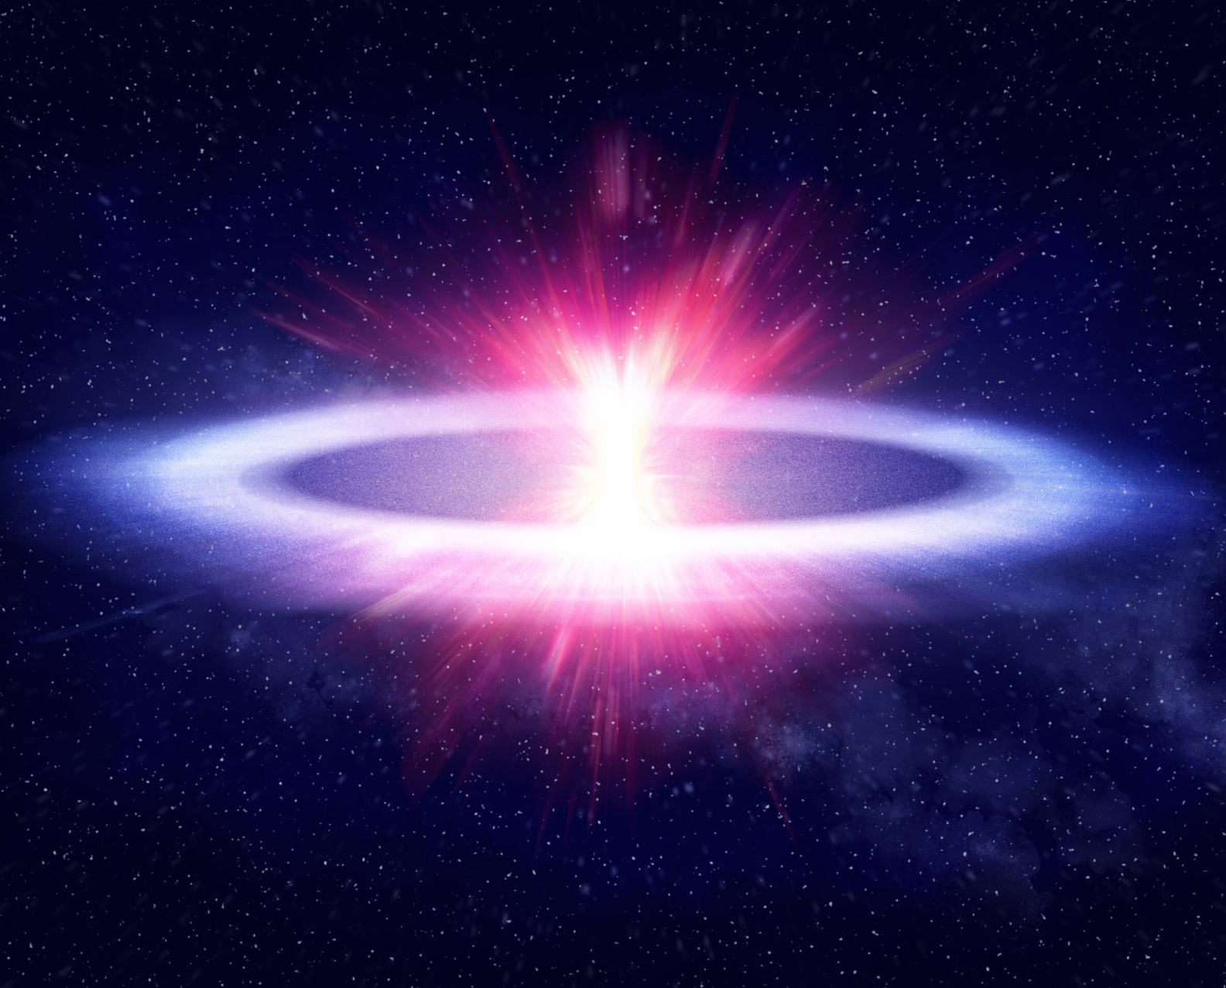
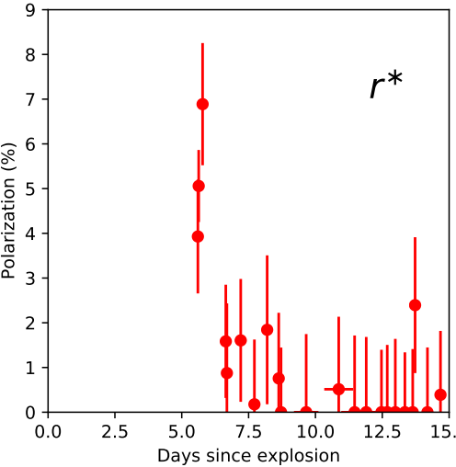
The Herd of Cow-like Events
Polarimetry
Only Cow has polarimetry
High at ~5% early on!
At >7d consistent 0%
Photosphere very thin!
Quickly replaced by more spherical
Shock breakout in disk?
Maund et al. (2023)
Ellipticity
(b/a)
P
0.4
4%
0.2
4.5%
Credit: Phil Drury, University of Sheffield

Slide 7
The Herd of Cow-like Events
AT2024wpp - Discovery
Discovered by ZTF 25/09
Redshift -> Bright!
X-rays
Radio
-> Another one for the herd!

Slide 8
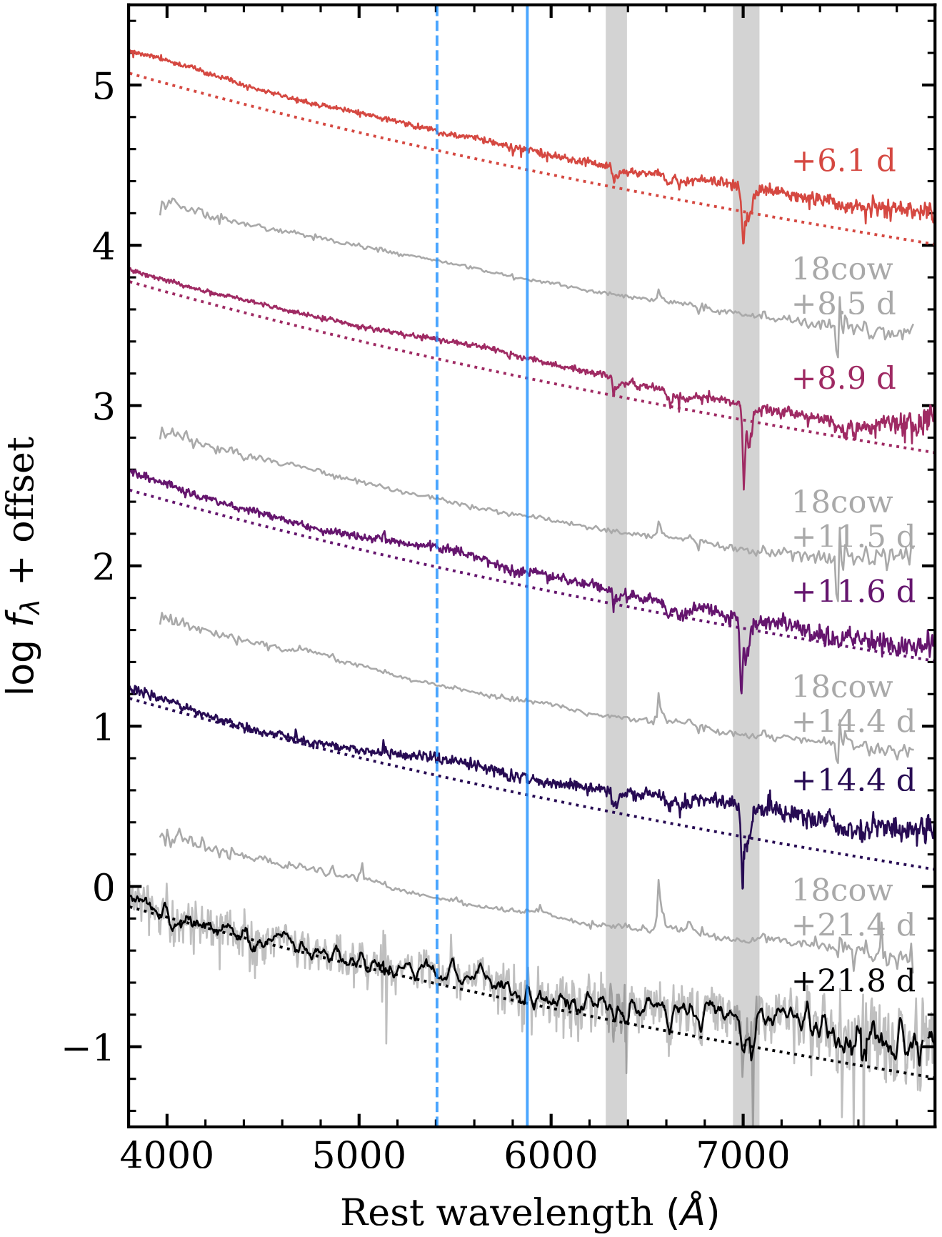
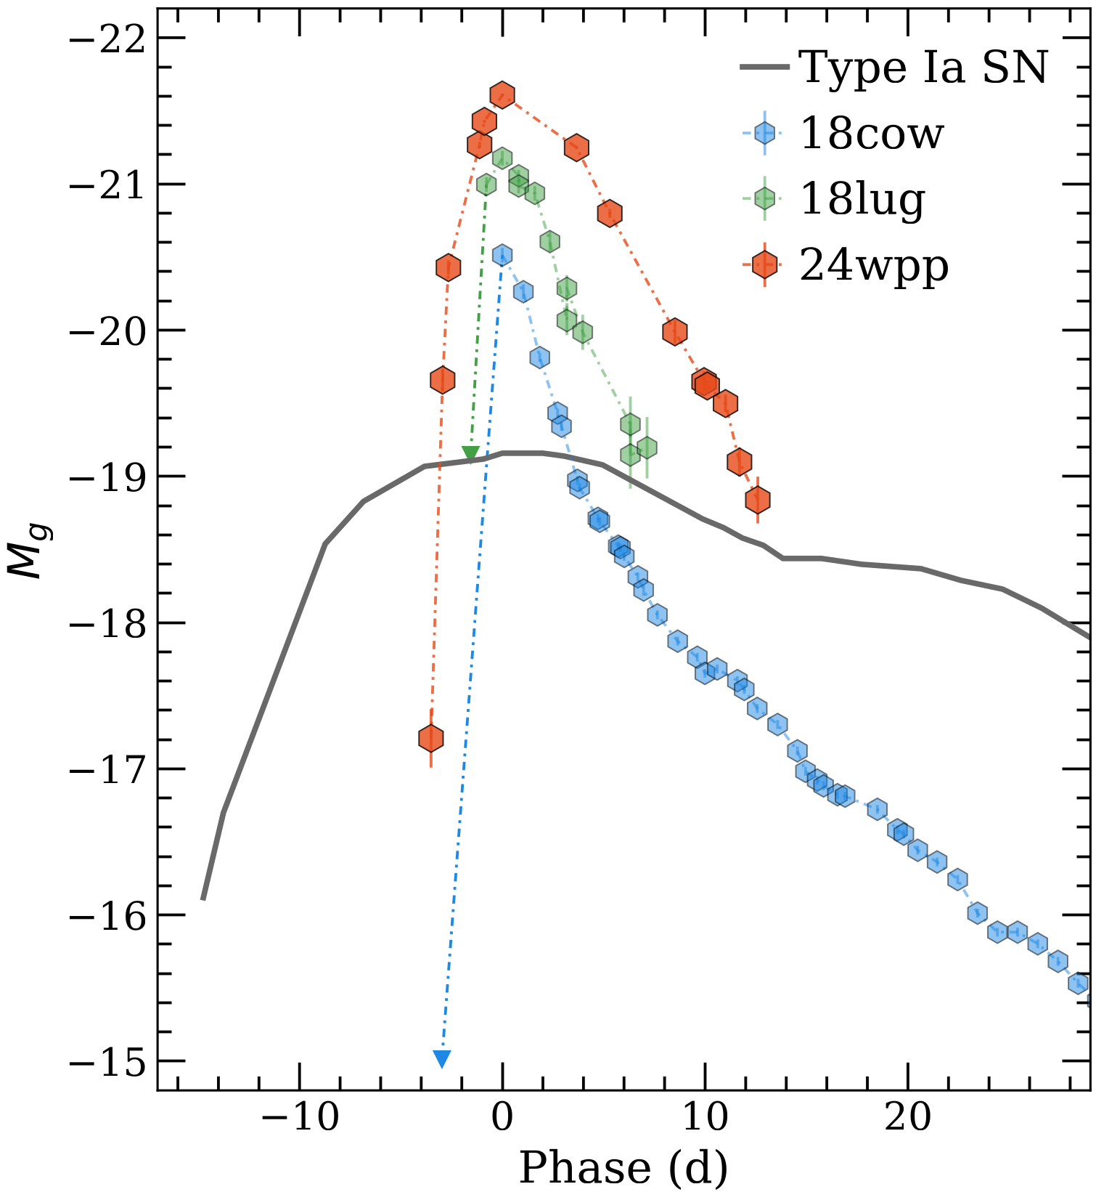
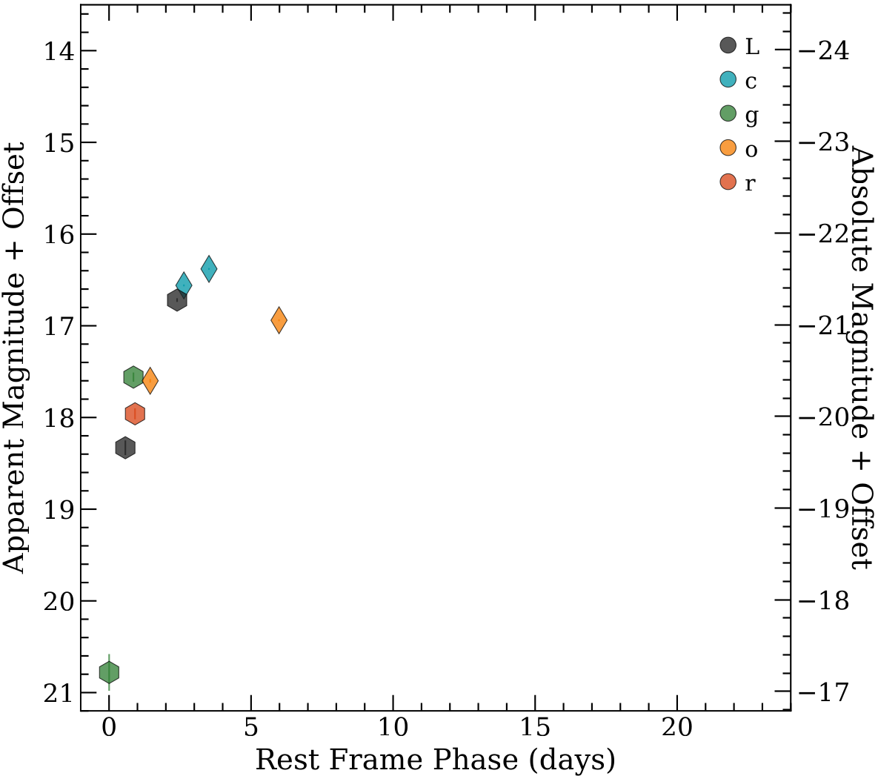
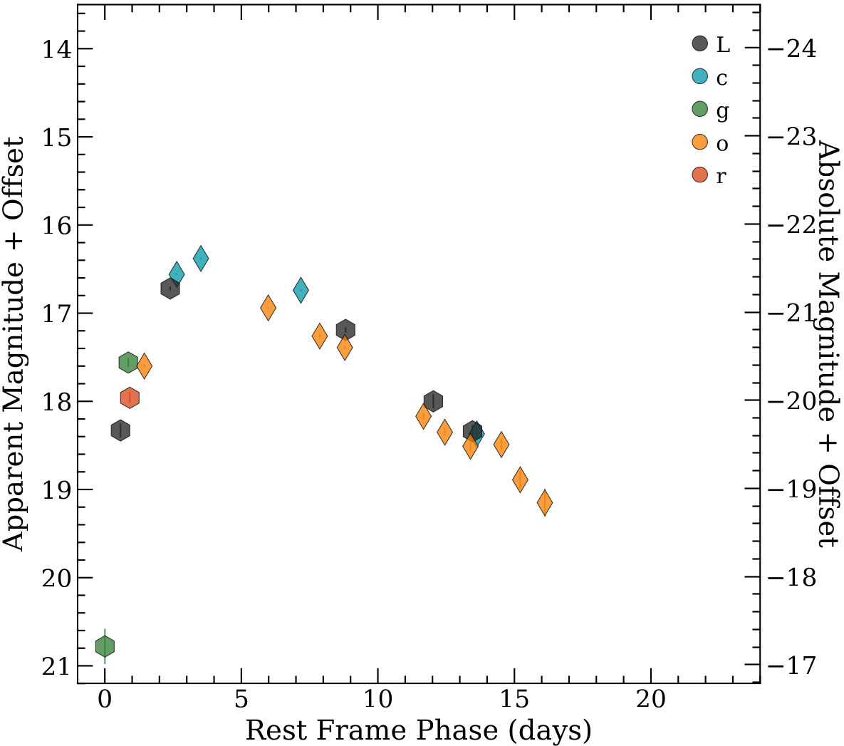
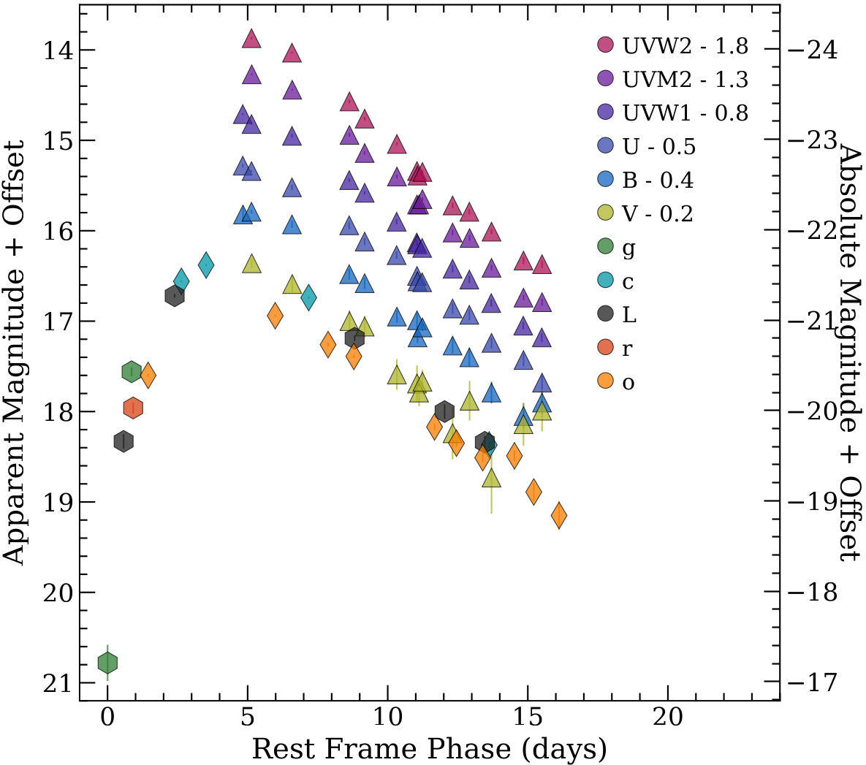
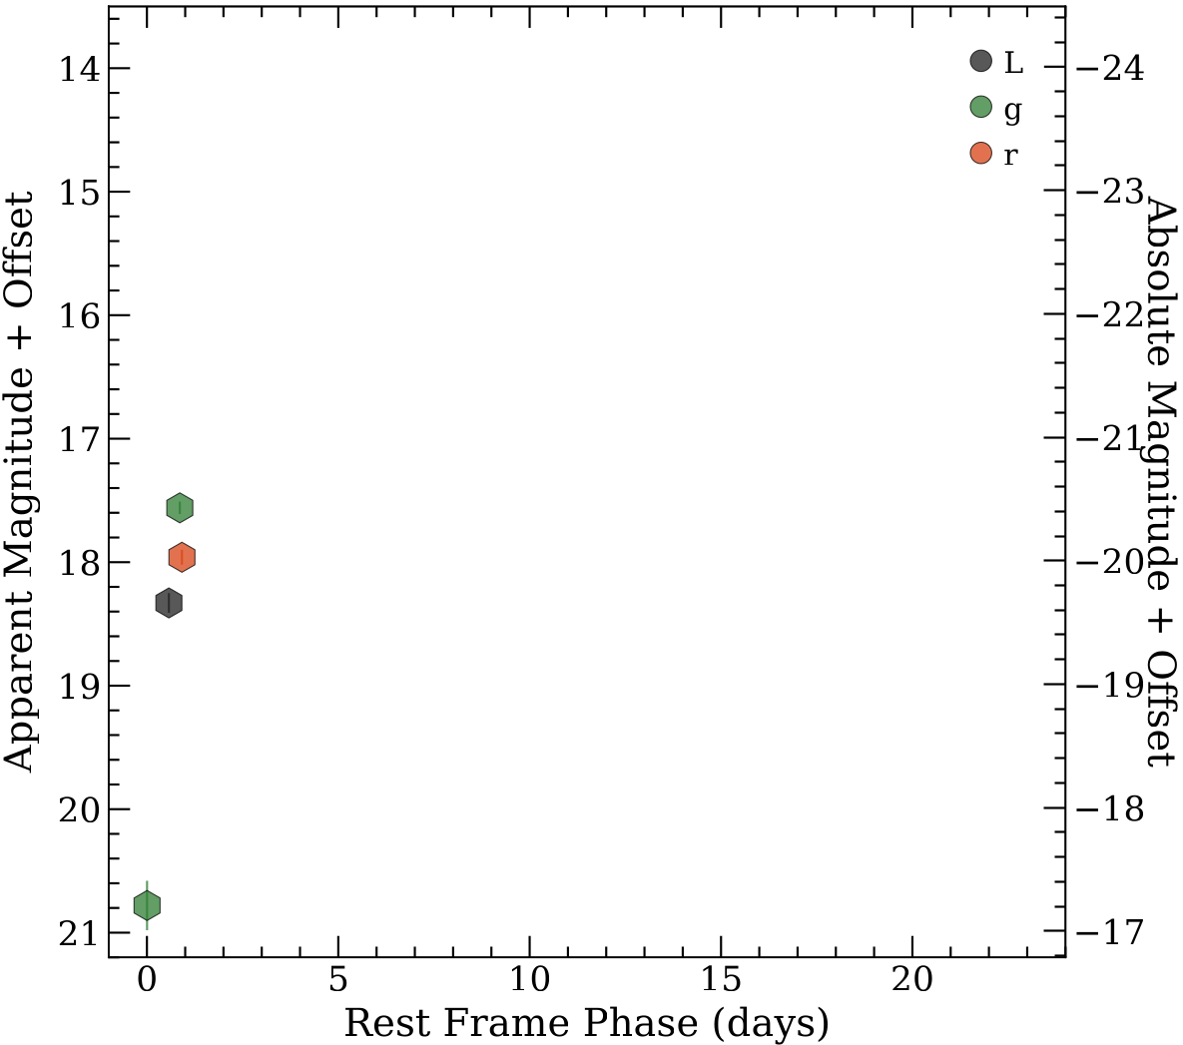
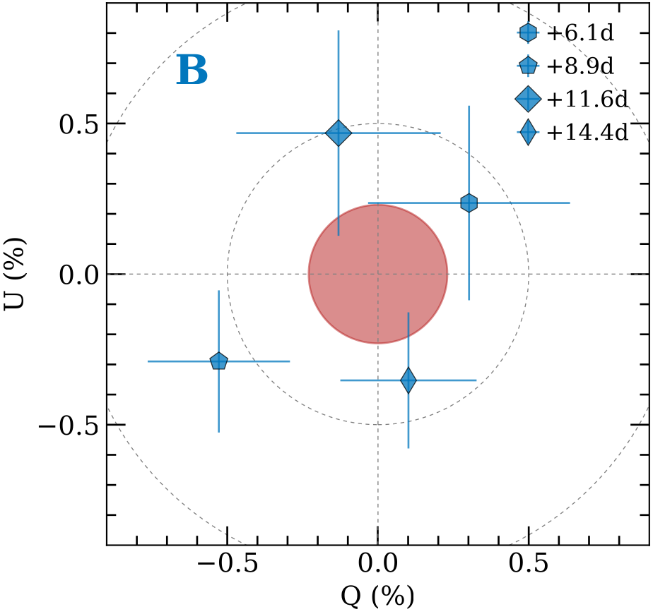
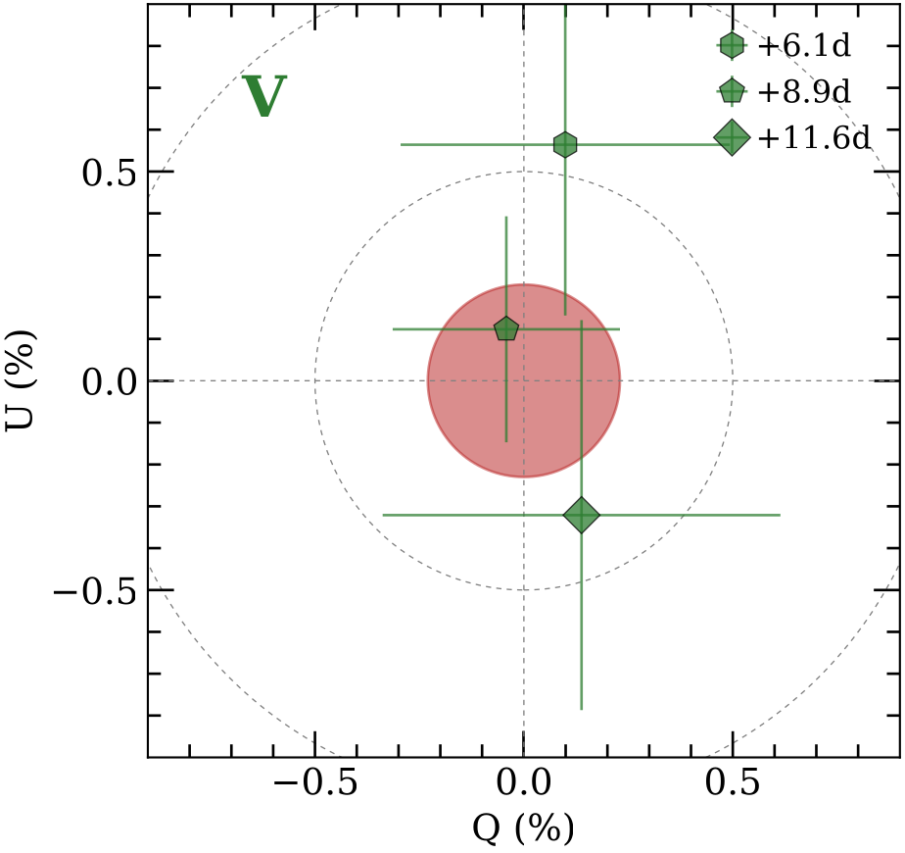
The Herd of Cow-like Events
Ellipticity
(b/a)
P
AT2024wpp in the Optical
0.9
0.5%
Light curve
$trise\sim 4.3d$, $M\sim −21.9$
$Δm \sim 0.25 mag/d$
Consistently blue
Time on NOT from 01/10
Featureless and blue spectra
Polarisation < 0.5%​
$$P = \sqrt{Q^{2} + U^{2}}$$

Slide 9
The Herd of Cow-like Events
AT2024wpp vs. AT2018cow
At >7d both P~0%
Photosphere in HV outflow
Two options
Preferential viewing angle?
Spherically symmetric?
HV outflows are spherical
More needed to probe the stratification
Pursiainen & Killestein et al. 2025
Margutti et al. (2019)

Slide 10
Summary
Ellipticity
(b/a)
P
0.9
0.5%
Polarimetry is a powerful tool to probe transient geometry
HV outflow in Cows spherical
Important piece of the puzzle
$$P = \sqrt{Q^{2} + U^{2}}$$

Slide 11
Extra Slides

Slide 12
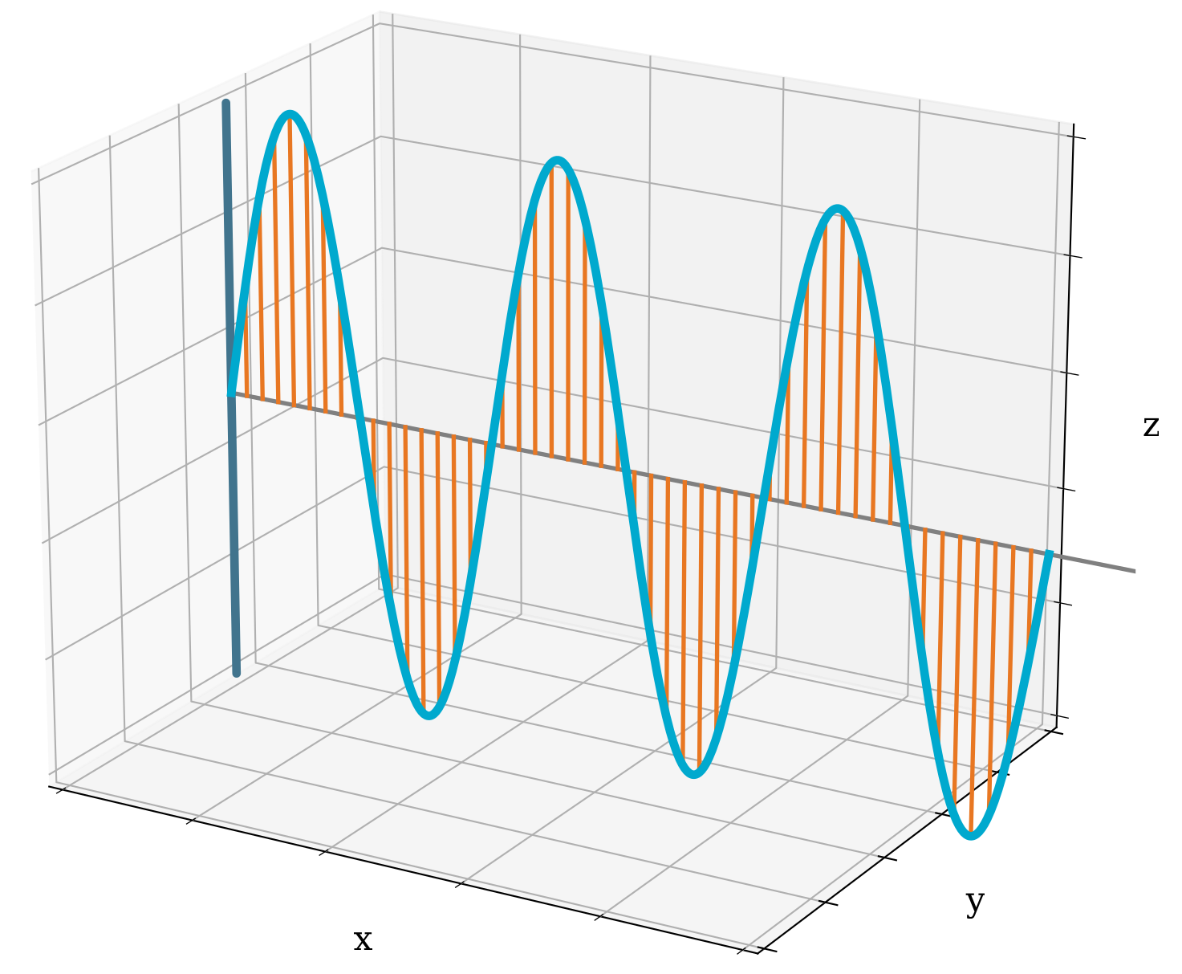
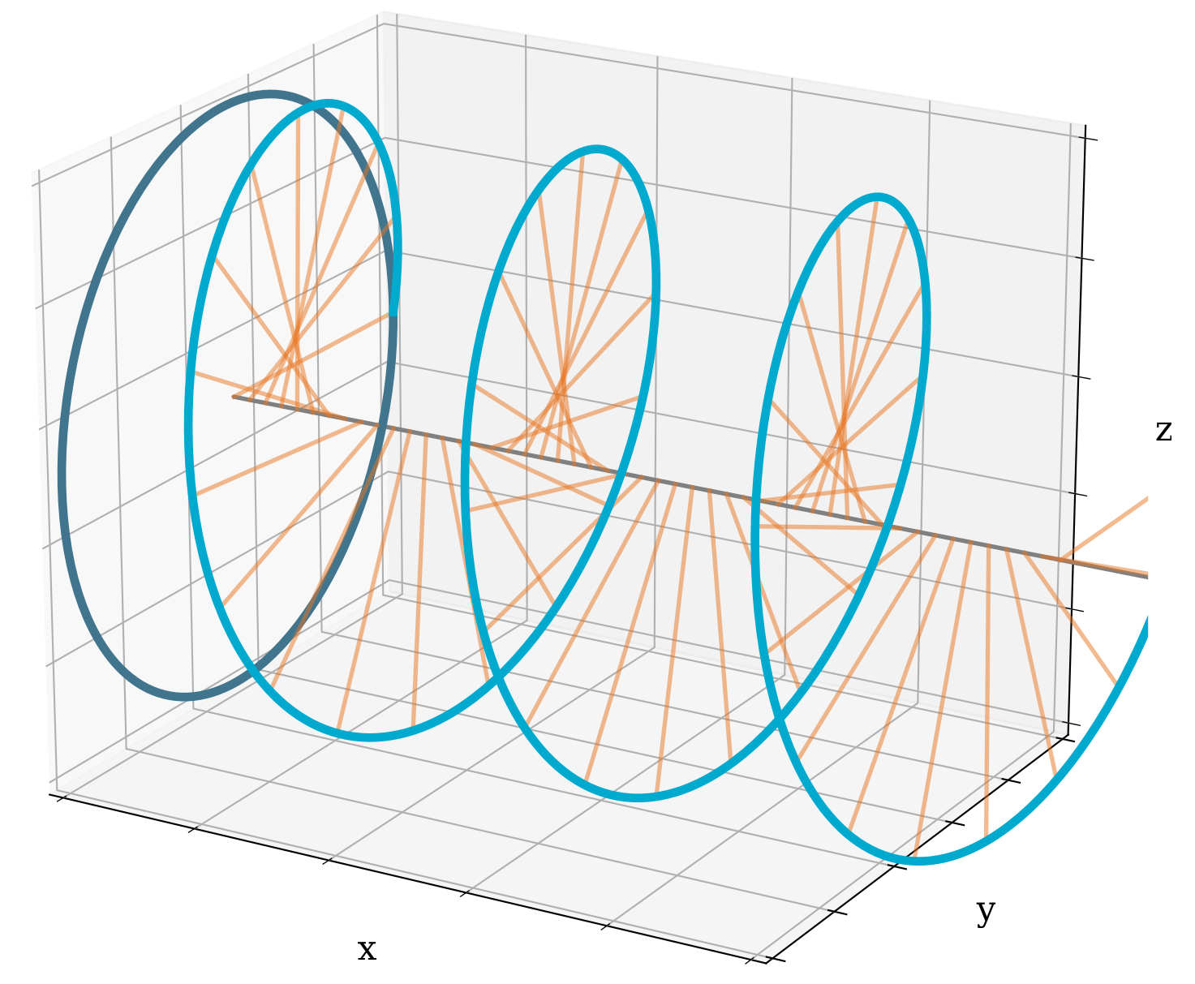
Optical Polarimetry
Basics
Circular Polarisation
Linear Polarisation

Slide 13
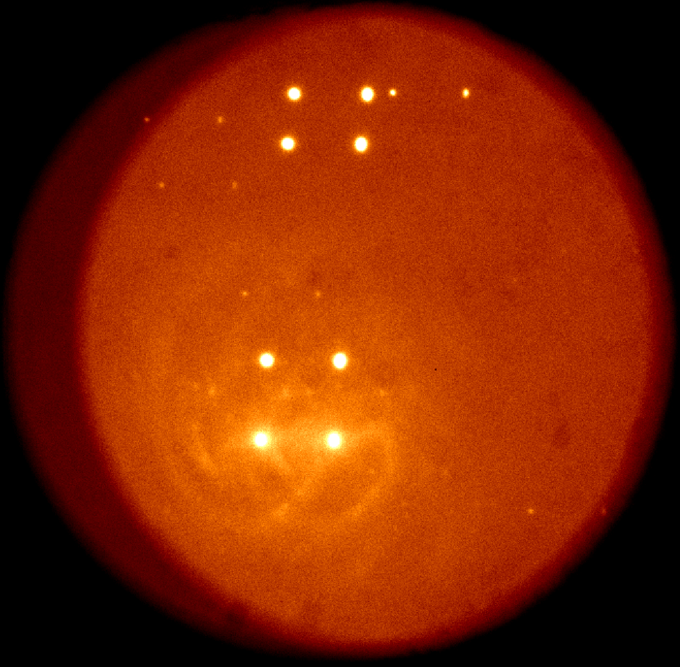
Optical Polarimetry
Observations
Direction of polarisation
VLT/FORS2 Impol AT2017gfo Covino et al. (2017)
0°
45°
NOT/ALFOSC Impol SN2024cld Killestein et al. (in prep)

Slide 14
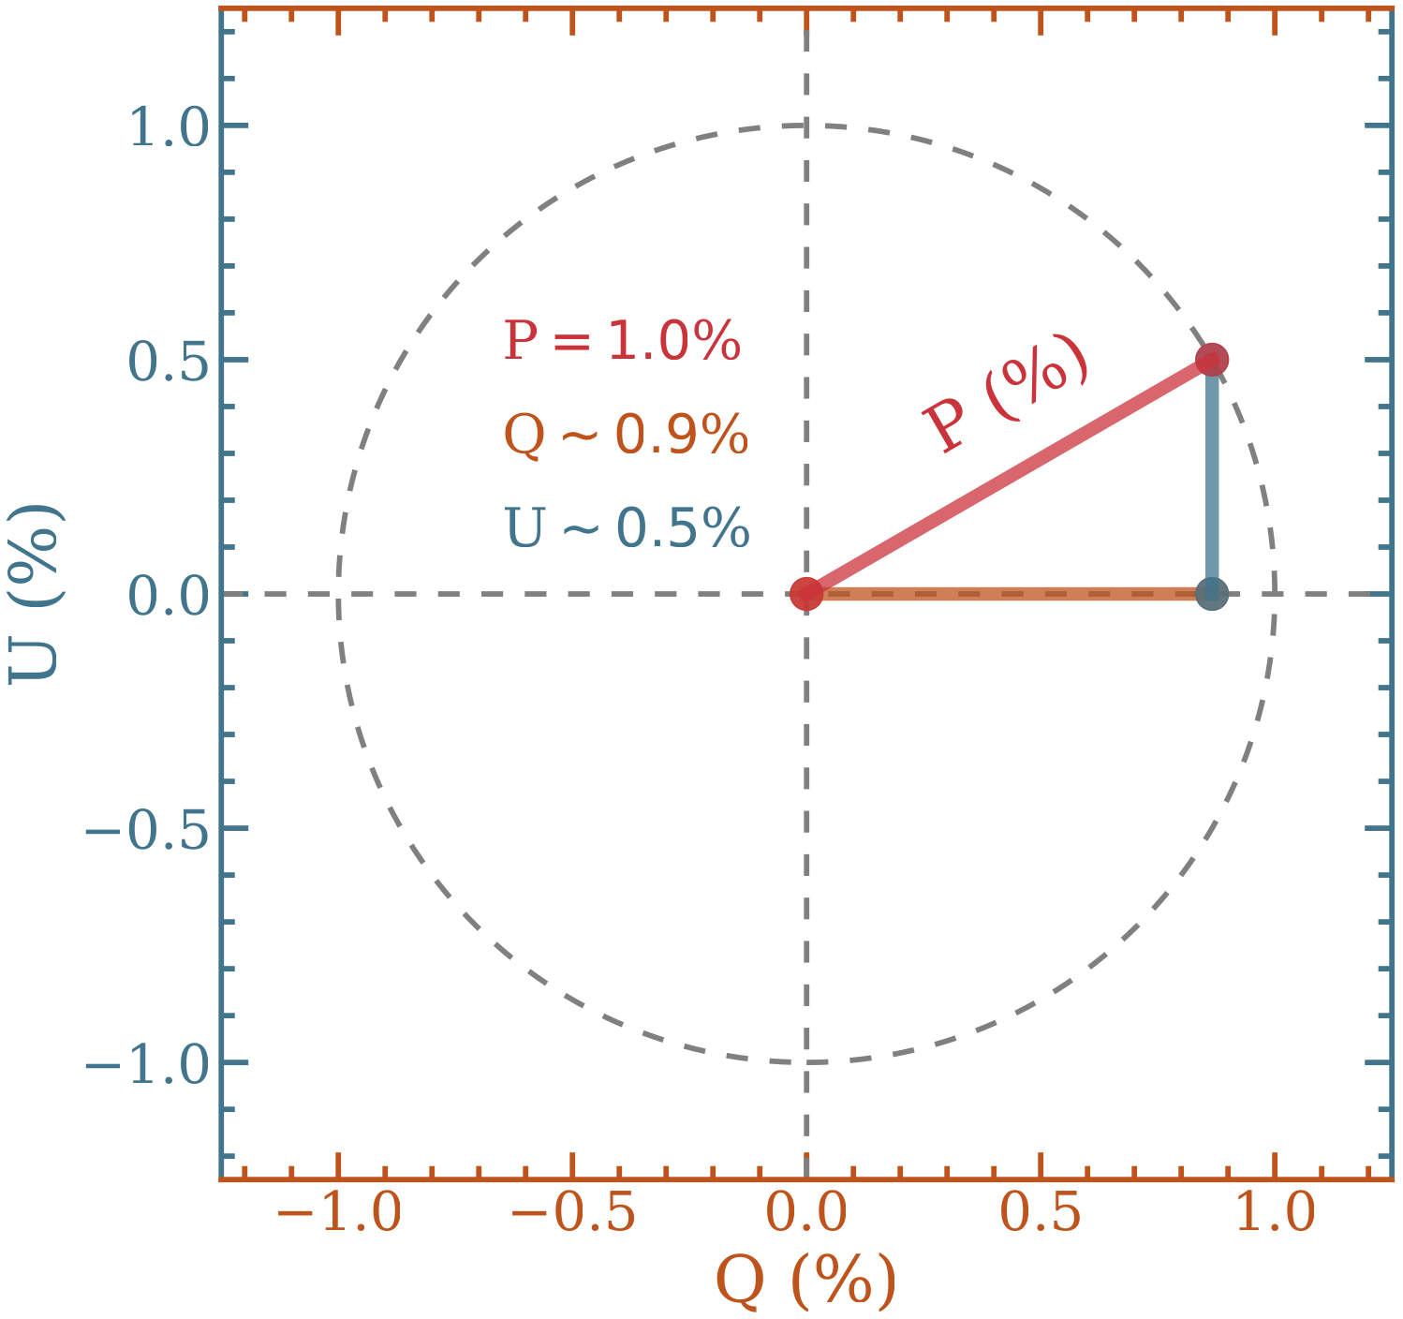
Optical Polarimetry
Quantifying Polarisation
Stokes Q and U
Direction & Amount
Q =
-
U =
-

Slide 15
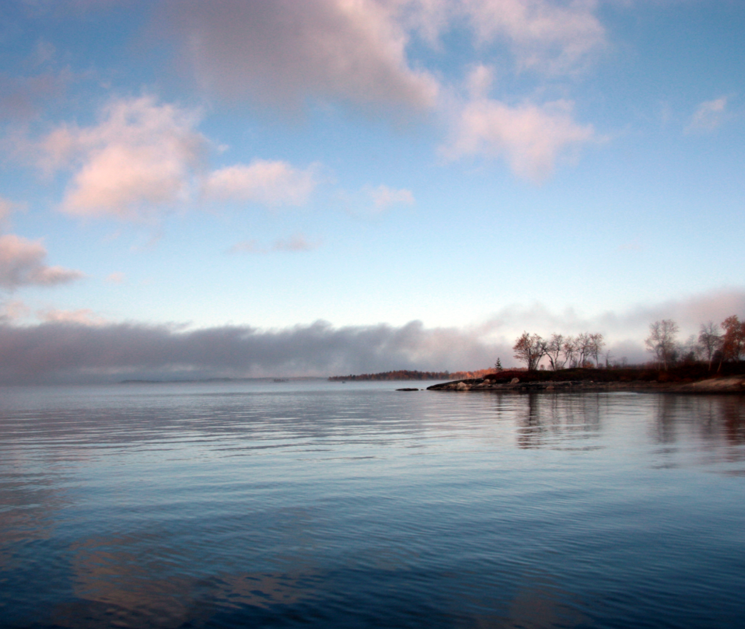
Optical Polarimetry
Sources of Polarisation
Majority of emission is unpolarised
Sources
Scattering by Electrons (Thomson)
Scattering by Molecules (Rayleigh)
Scattering by Small Grains (Dust)
Strong magnetic fields (Circular)...
Scattering by Electrons (Thomson)

Slide 16
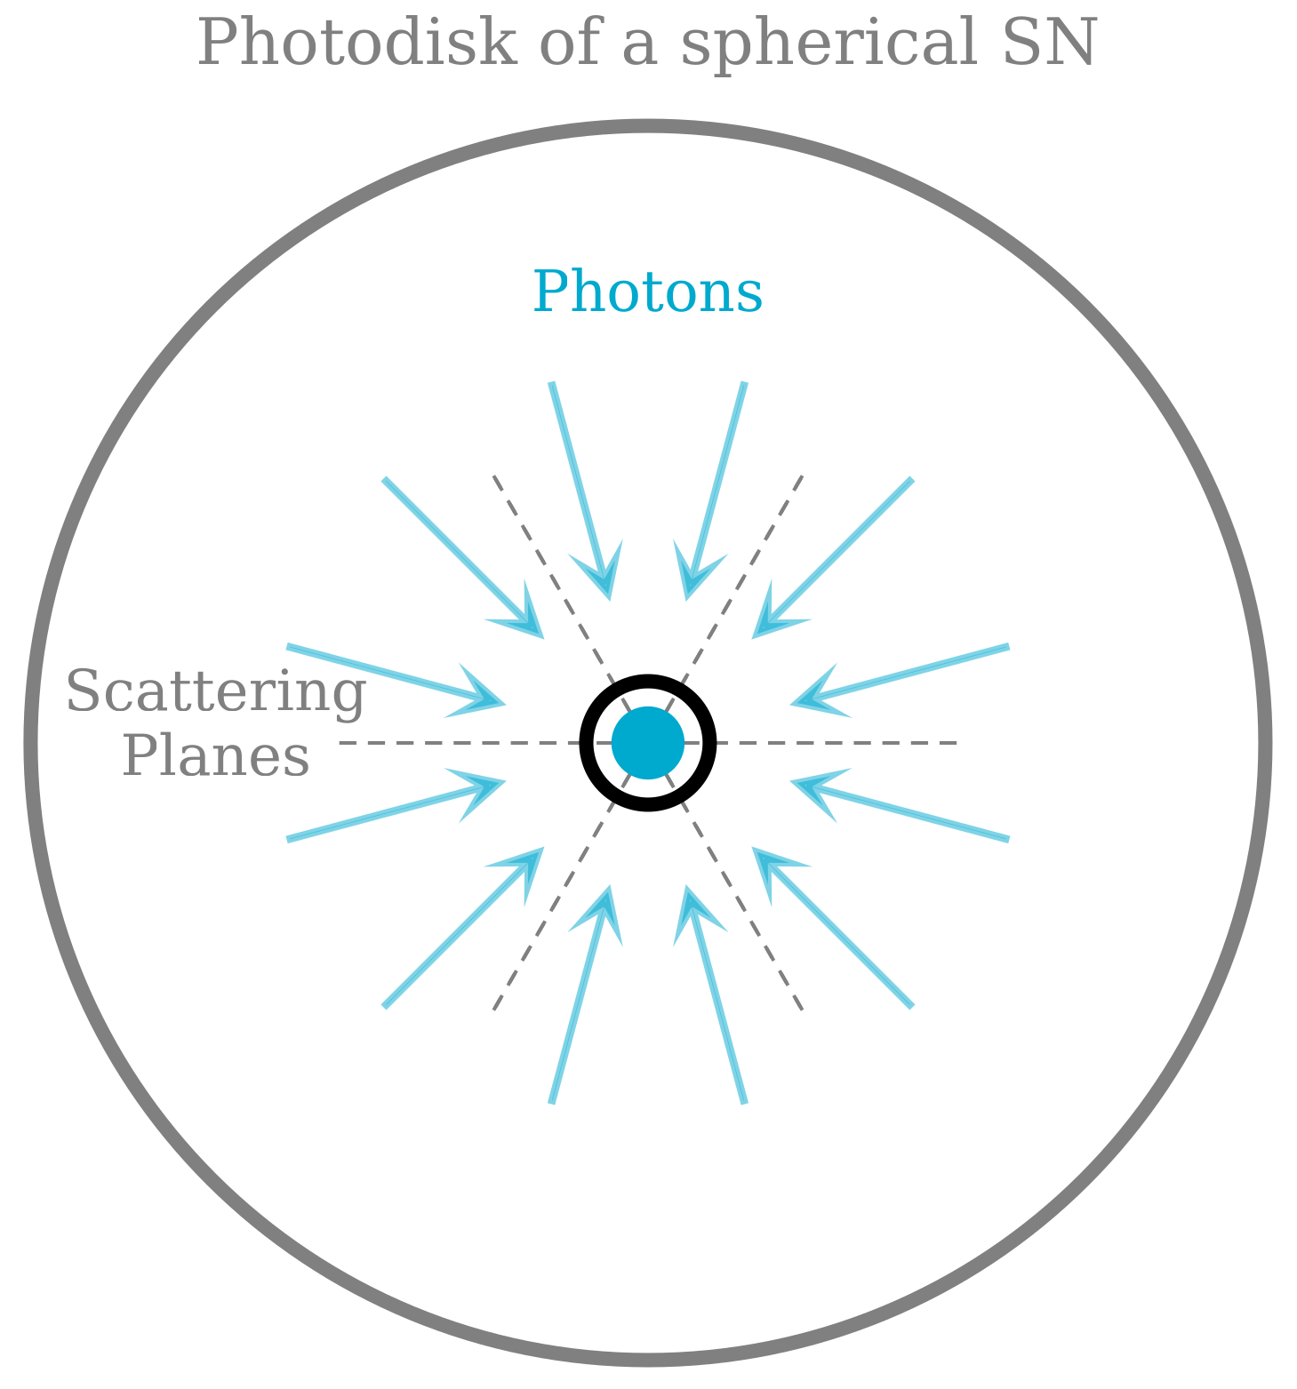
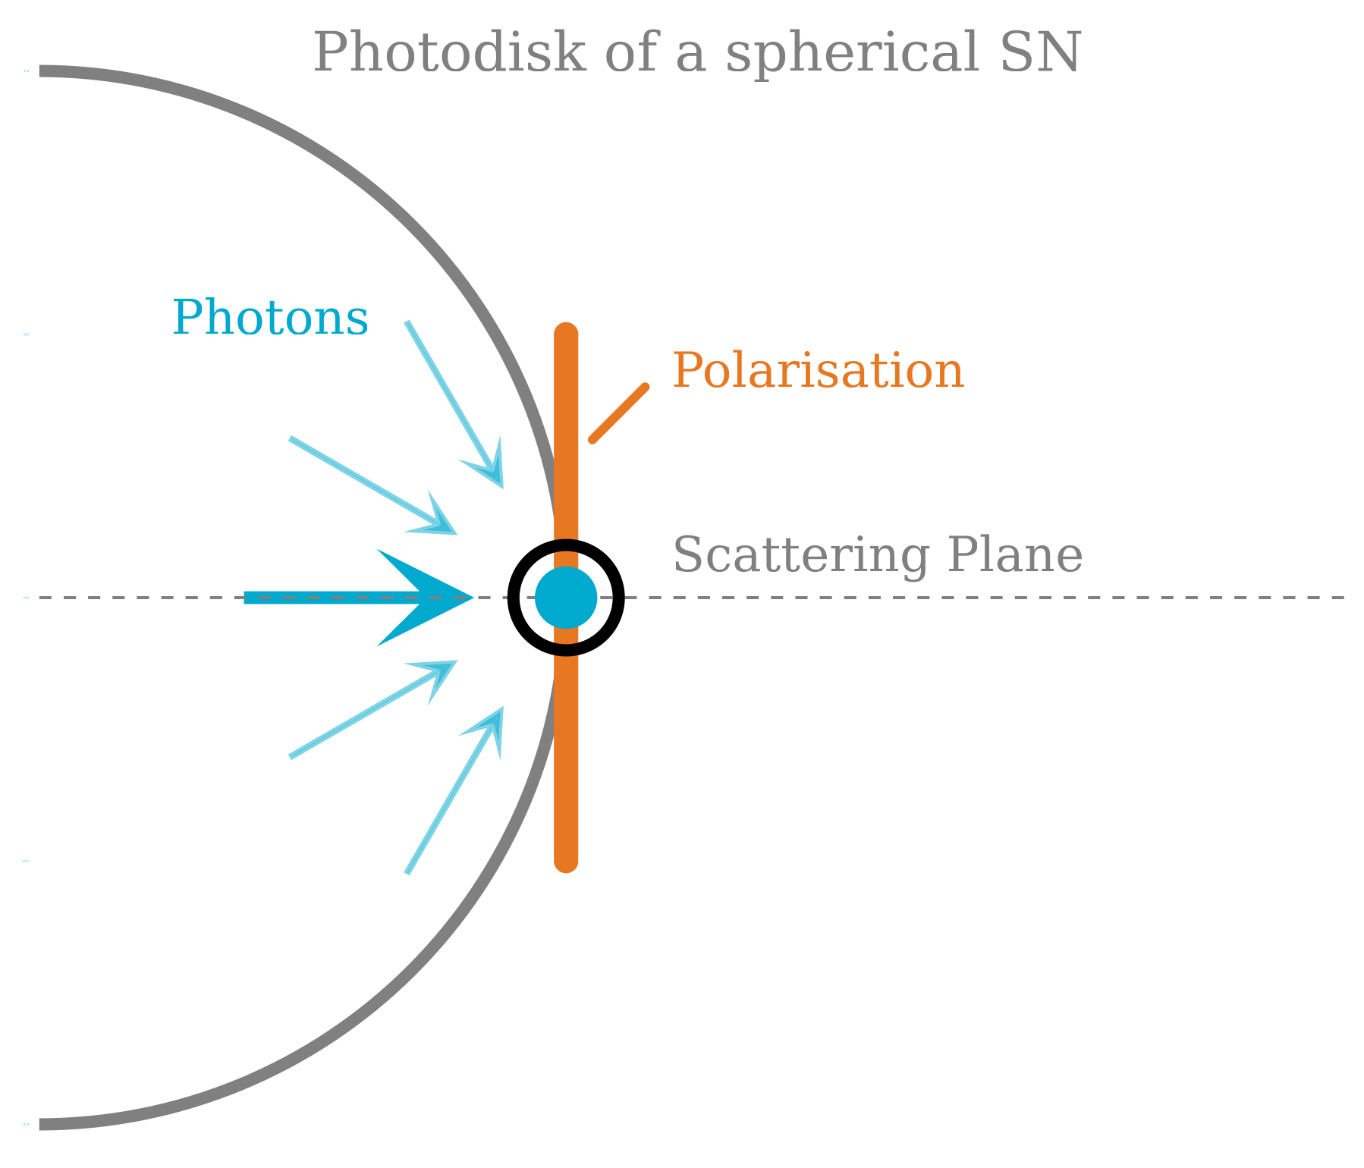
Optical Polarimetry
Electron Scattering
Polarisation perpendicular scattering plane

Slide 17
Optical Polarimetry
Supernovae
Q =
-
U =
-
Q = 0
U = 0
Q > 0
U = 0
Q > 0
U = 0

