Slide 1
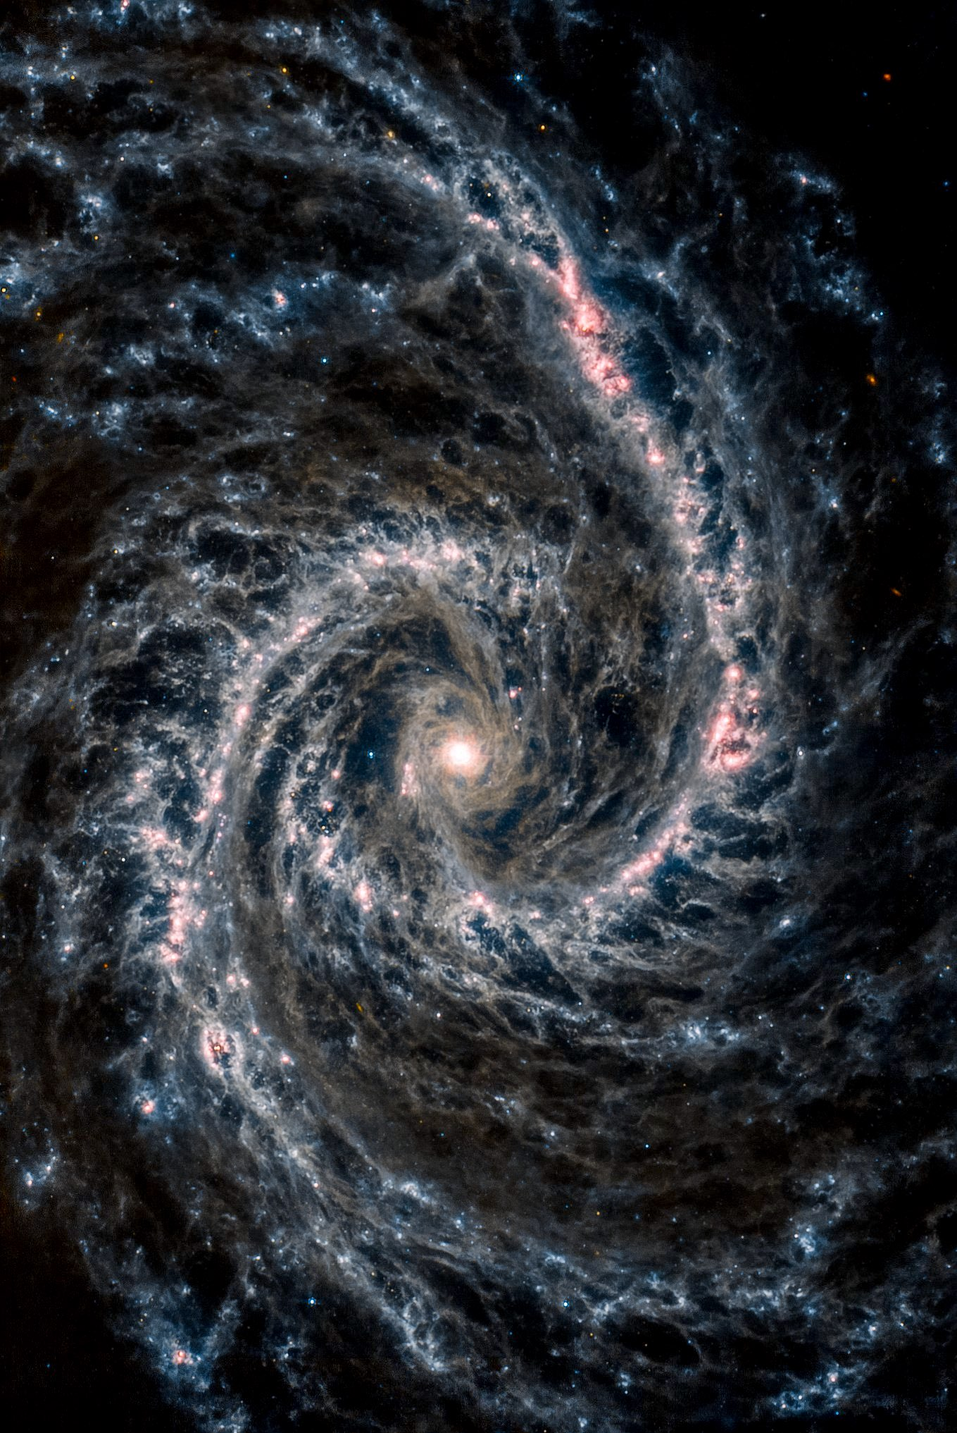

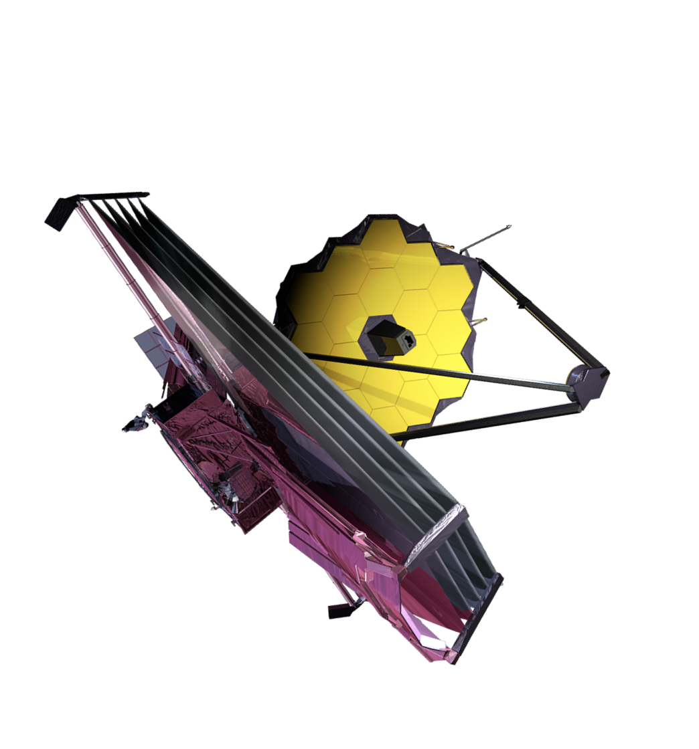
JWST Observations of White Dwarf Supernovae
Saurabh W. Jha
An Extraordinary Journey into the Transient Sky
April 1, 2025 Padova, Italy
SN 2021aefx
JWST/MIRI image of NGC 1566
data via JWST GO 2107 (PI: Janice Lee), processing by Judy Schmidt

Slide 2

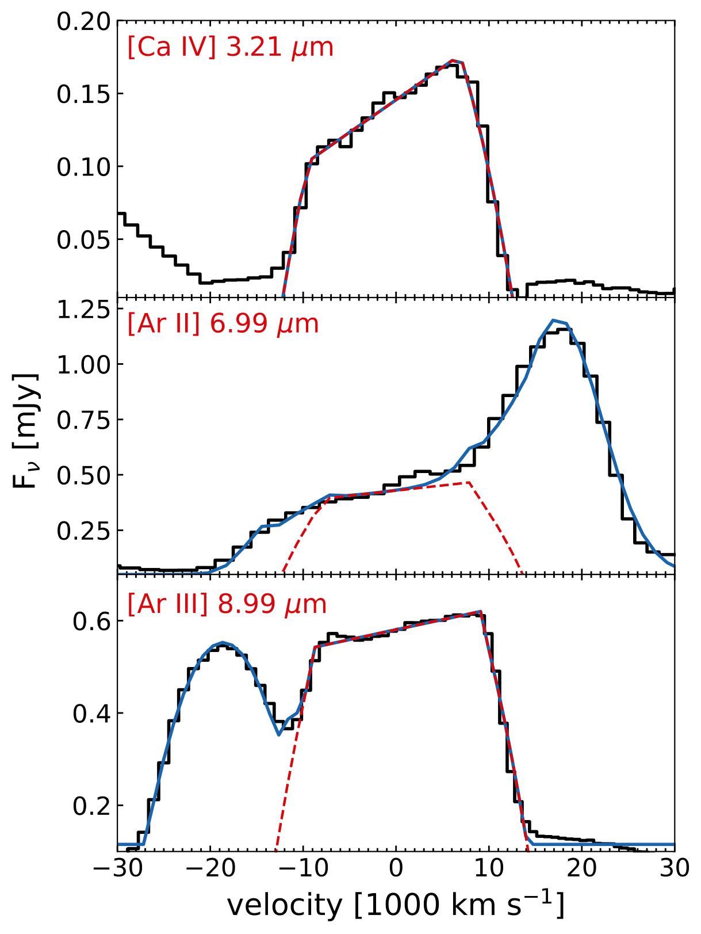
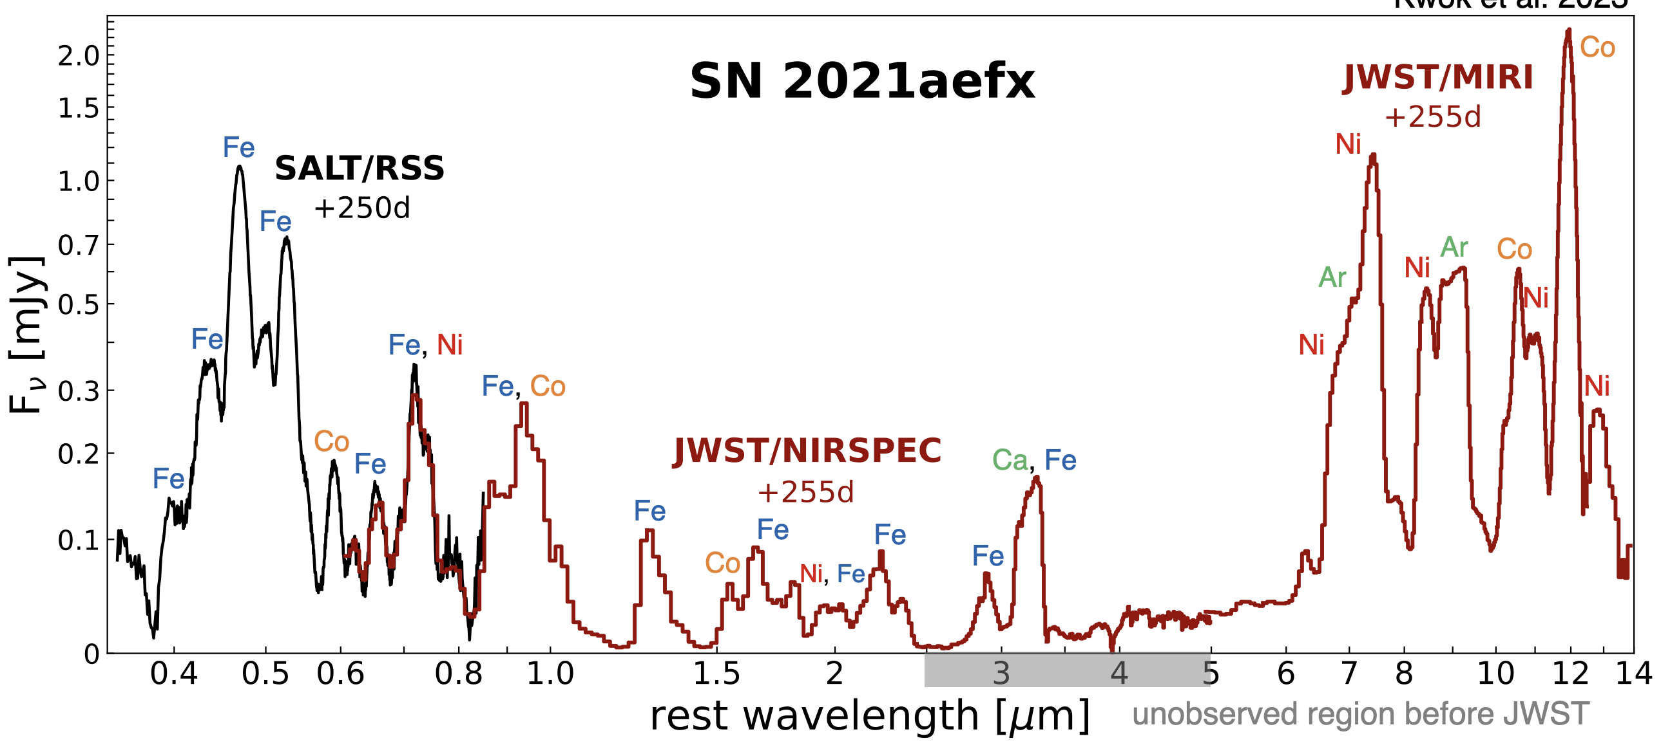
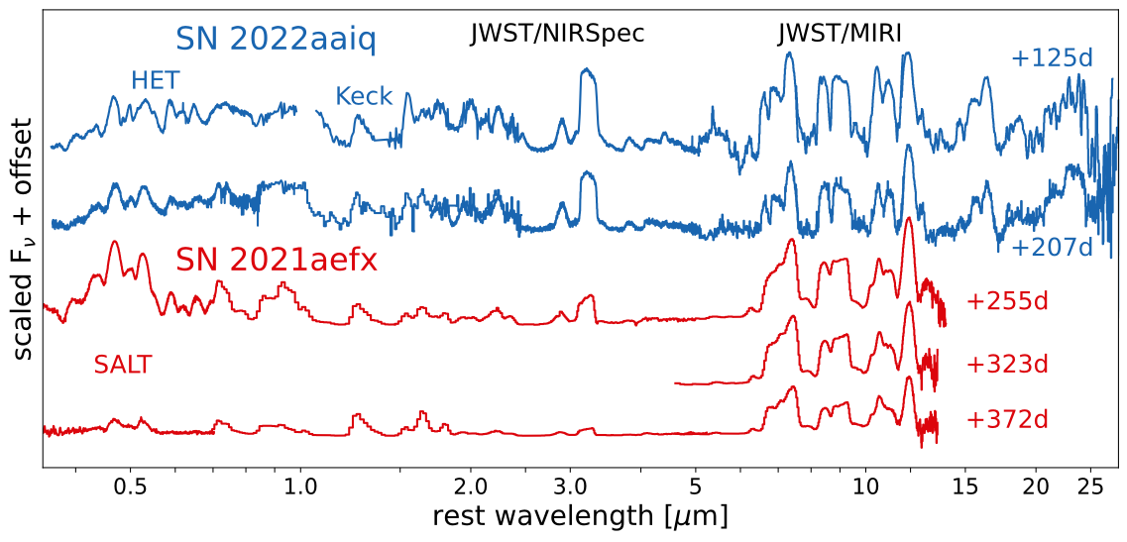
JWST observations of normal SN Ia 2021aefx
Strong, stable ⁵⁸Ni → high-mass white dwarf
SN 2021aefx
Kwok et al. (2023); DerKacy et al. (2023, 2024); Mayker Chen et al. (2023); Ashall et al. (2024)
[Ni IV]
Kwok et al. (in prep.)
unobserved before JWST
Kwok et al. (2023)
Kwok et al. (2023)

Slide 3
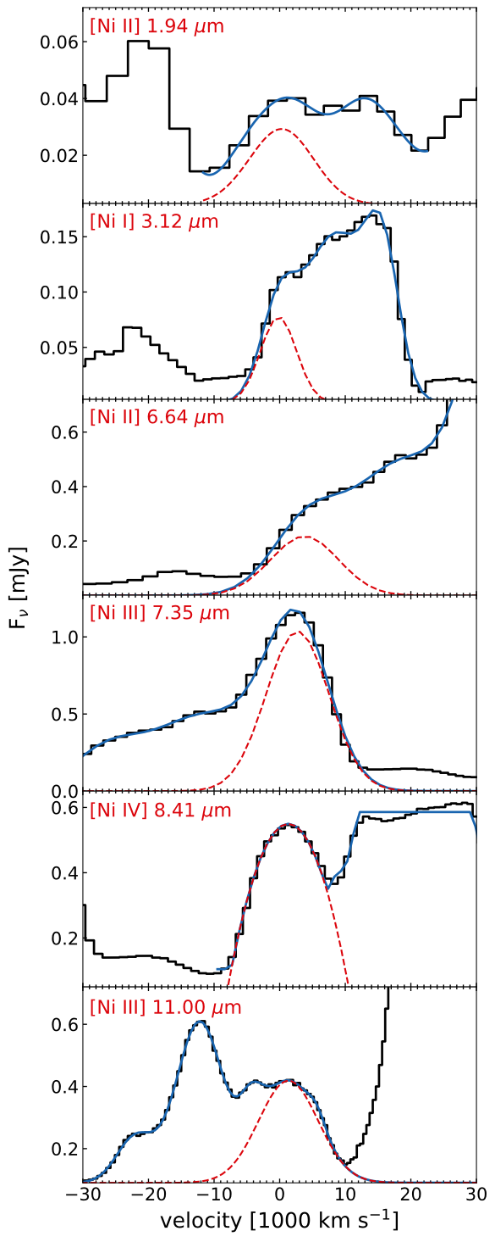
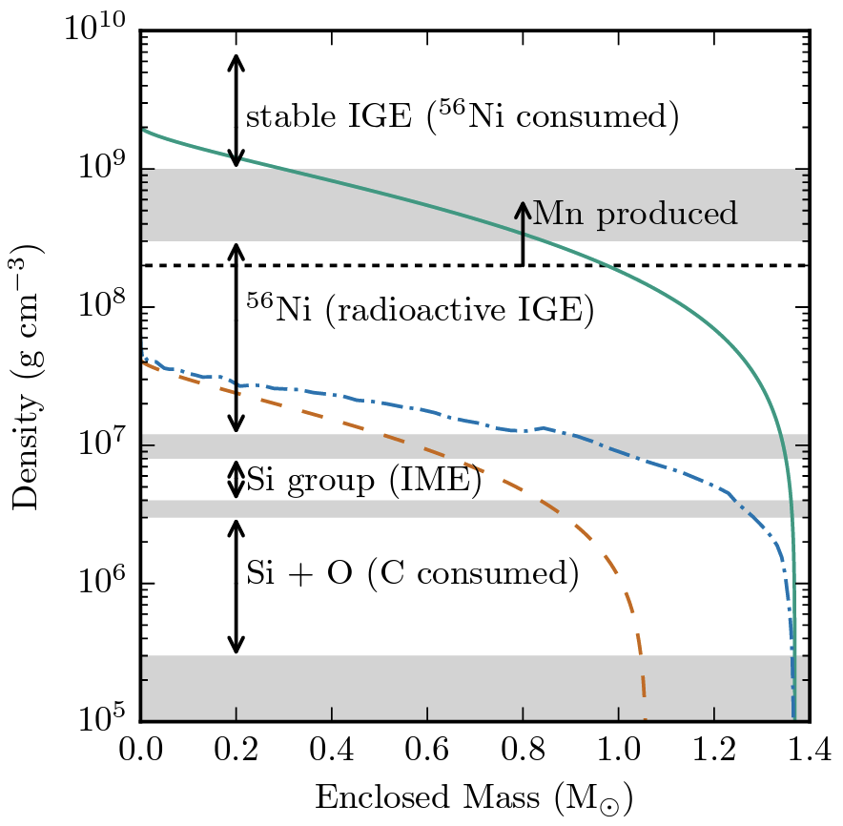
JWST observations of normal SN Ia 2021aefx
Strong, stable ⁵⁸Ni → high-mass white dwarf
Kwok et al. (2023); DerKacy et al. (2023, 2024); Mayker Chen et al. (2023); Ashall et al. (2024)
Seitenzahl & Townsley (2017)
SN 2021aefx
Kwok et al. (2023)

Slide 4
JWST observations of normal SN Ia 2021aefx
Strong, stable ⁵⁸Ni → high-mass white dwarf
Broad, flat-topped Ar, Ca → layered ejecta structure
→ some type of detonation involved
SN 2021aefx
Kwok et al. (2023); DerKacy et al. (2023, 2024); Mayker Chen et al. (2023); Ashall et al. (2024)
[Ni IV]
Kwok et al. (in prep.)
unobserved before JWST
Kwok et al. (2023)
Kwok et al. (2023)

Slide 5
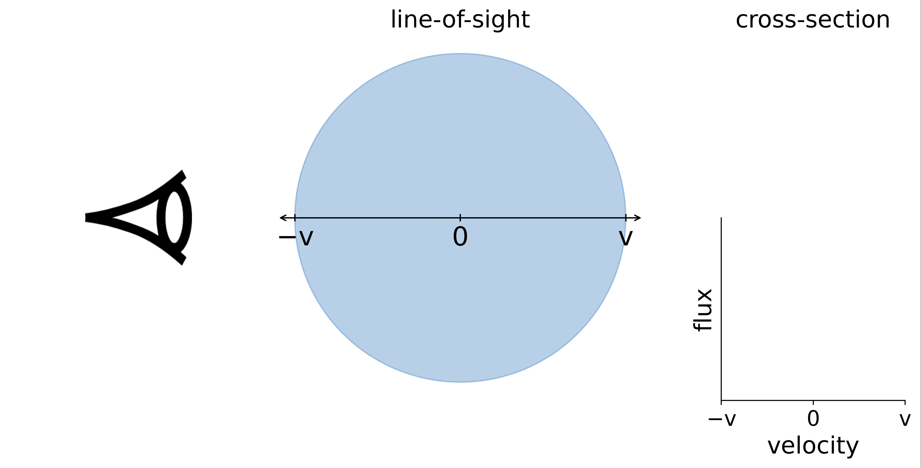
Ejecta Geometry from Emission Line Profiles
graphics by Lindsey Kwok
Notes:
update graphics with the left side observer so its not backwards

Slide 6
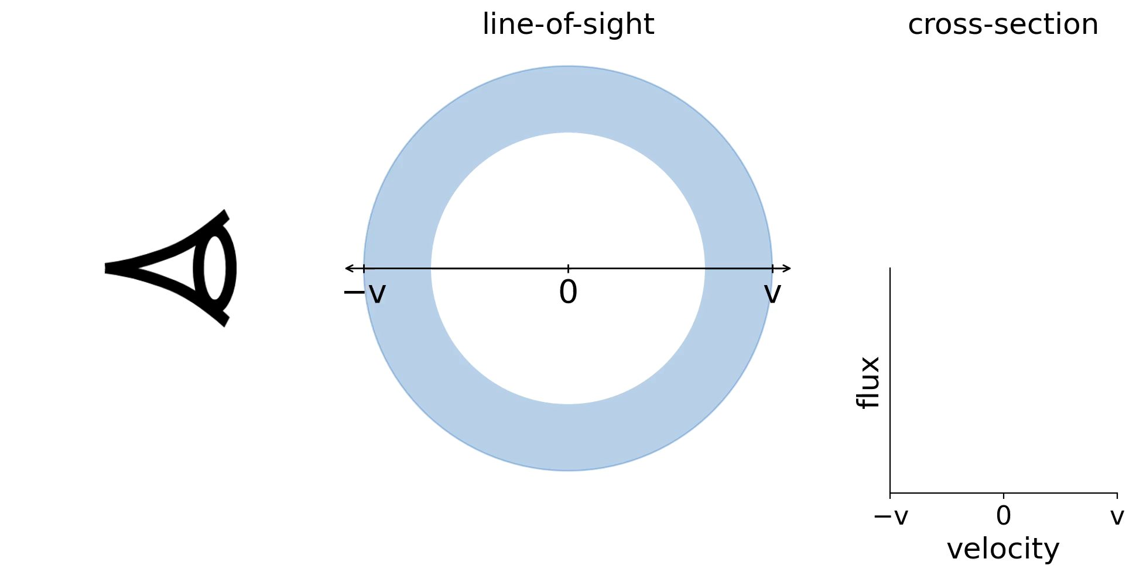
Ejecta Geometry from Emission Line Profiles
graphics by Lindsey Kwok
Notes:
update graphics with the left side observer so its not backwards

Slide 7
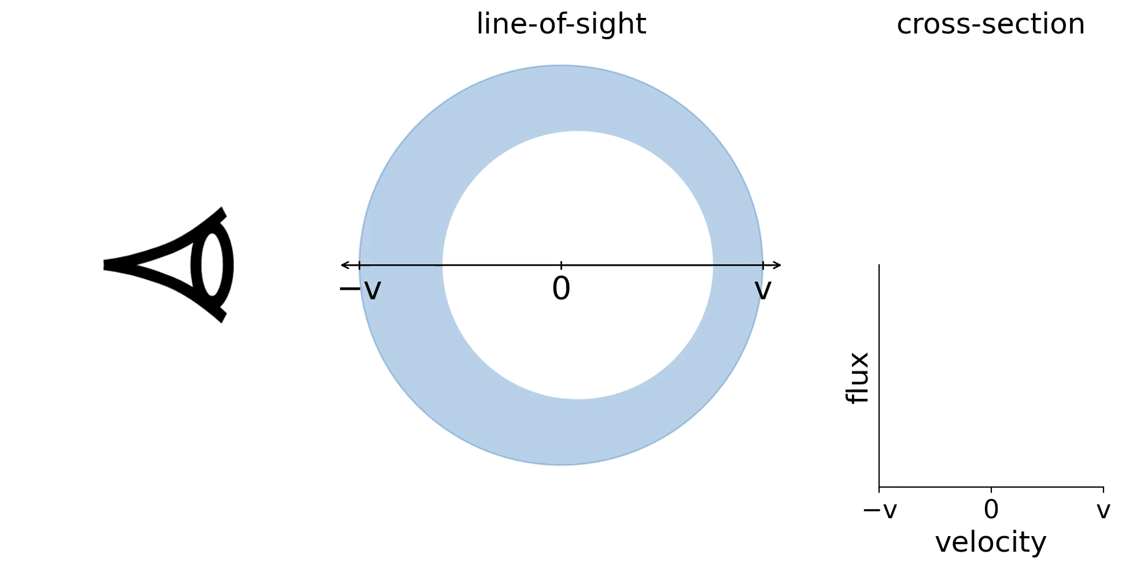
Ejecta Geometry from Emission Line Profiles
graphics by Lindsey Kwok
Notes:
update graphics with the left side observer so its not backwards

Slide 8
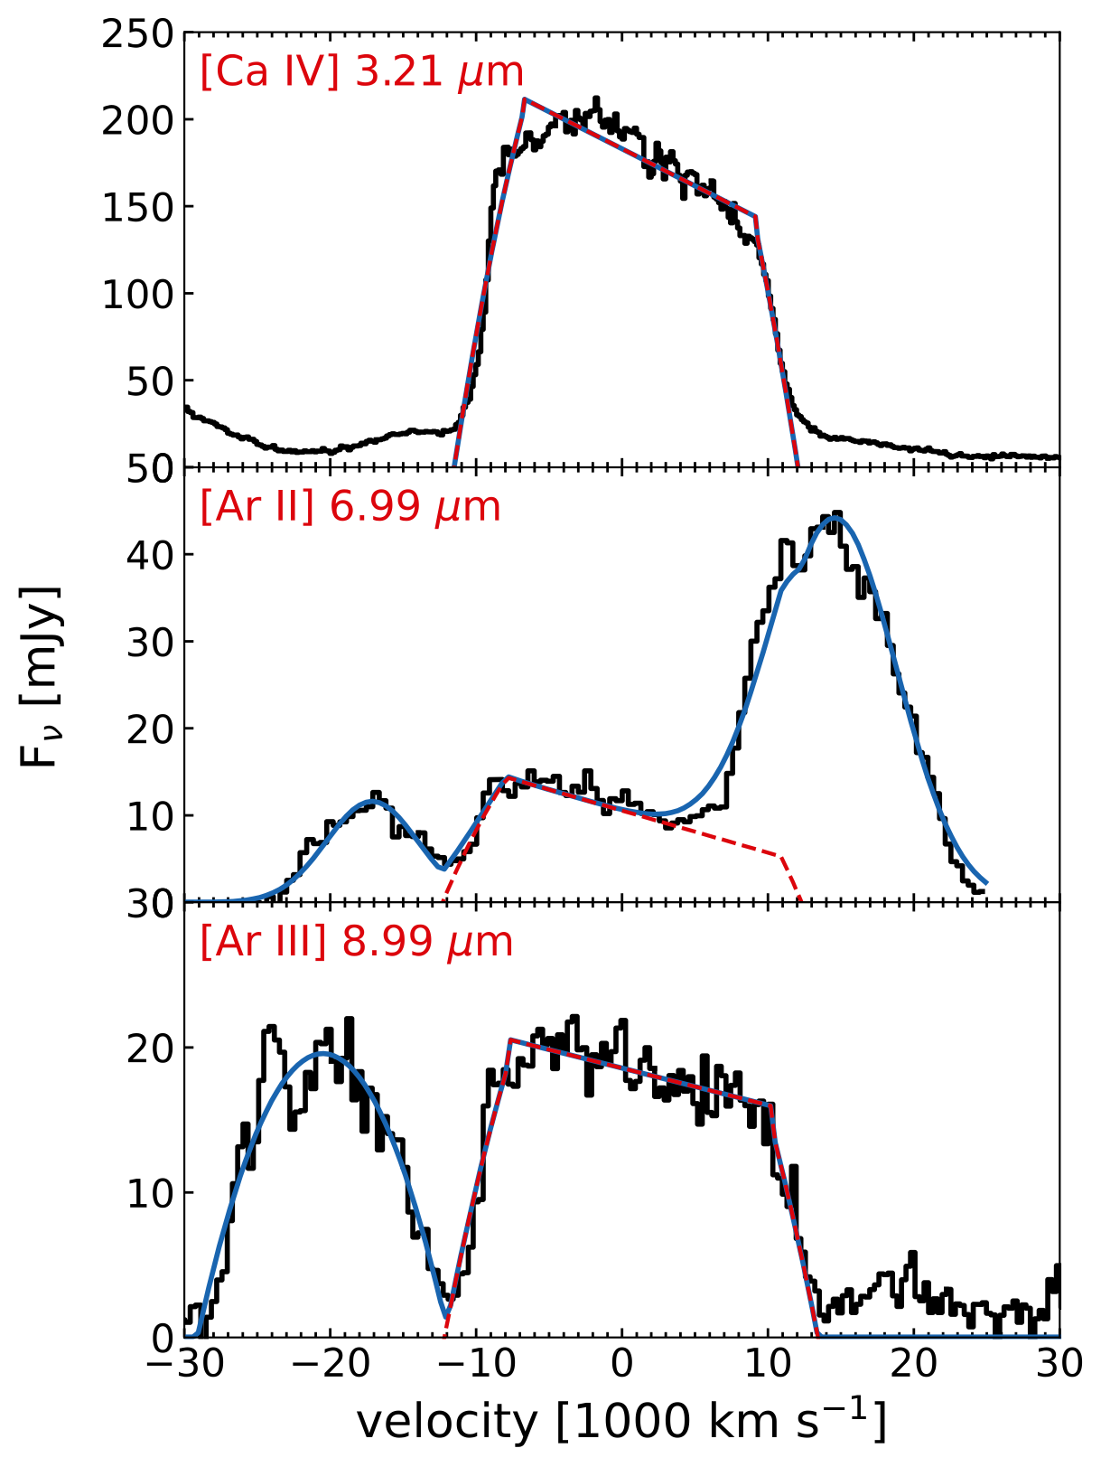
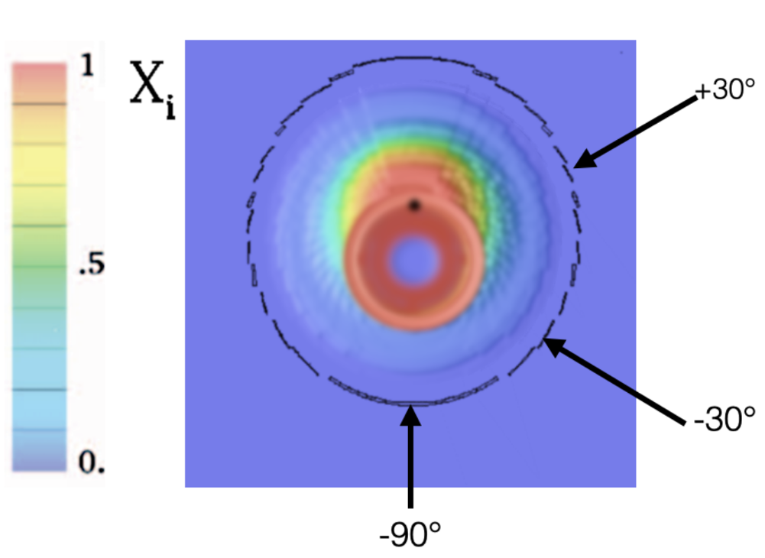
JWST observations of Normal SN Ia
variations in viewing angle
should produce different slopes for IME line profiles
as seen in JWST data!
SN 2021aefx
SN 2022aaiq
22aaiq
21aefx
DerKacy et al. (2023)
Kwok et al. in prep

Slide 9
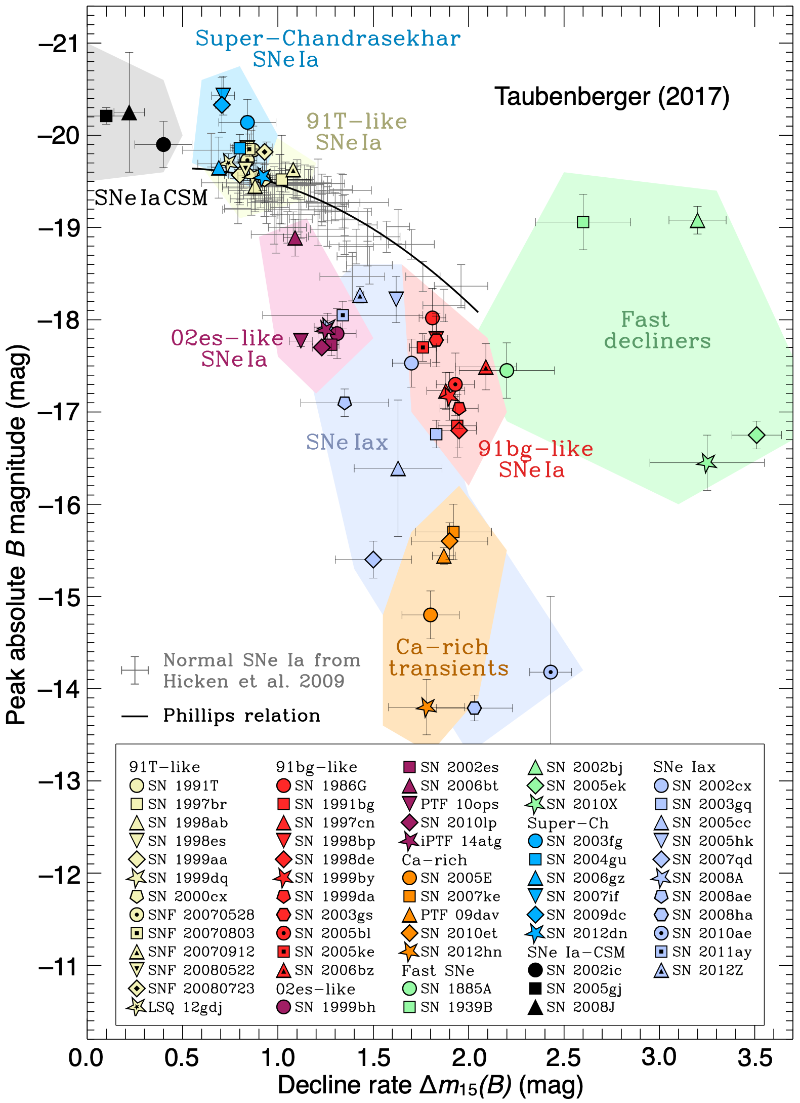
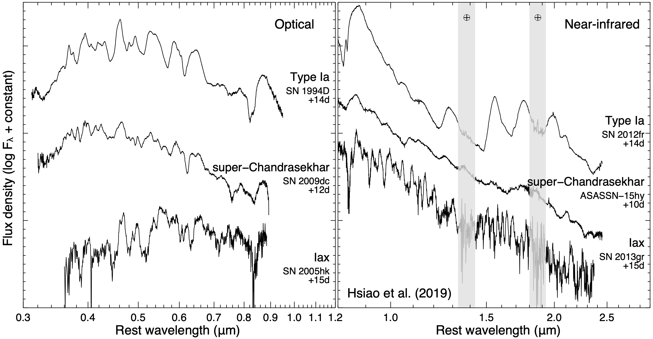
the thermonuclear supernova zoo
exploding white dwarfs:
much more than just normal SN Ia!
what can the outliers teach us?

Slide 10
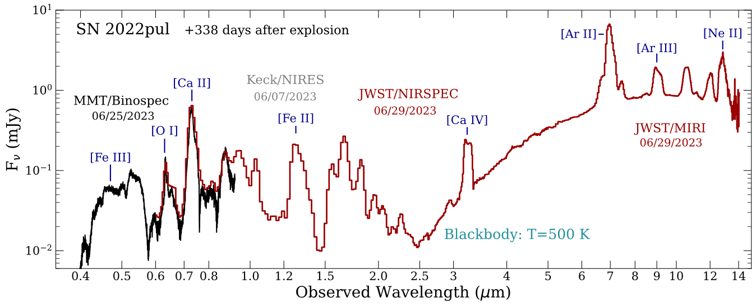
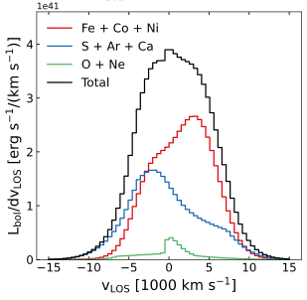
SN 2022pul: a peculiar 03fg-like WDSN
Dust!
Central O, Ne
Asymmetric line profiles
Strong Ar, Ca emission
Violent WD-WD merger within C/O CSM
Blondin et al. (2023)
Siebert et al. (2024)
Kwok et al. (2024)

Slide 11
SN 2022pul: a peculiar 03fg-like WDSN
Dust!
Central O, Ne
Asymmetric line profiles
Strong Ar, Ca emission
Violent WD-WD merger within C/O CSM
Blondin et al. (2023)
Siebert et al. (2024)
Kwok et al. (2024)

Slide 12
SN 2022pul: a peculiar 03fg-like WDSN
Dust!
Central O, Ne
Asymmetric line profiles
Strong Ar, Ca emission
Violent WD-WD merger within C/O CSM
Blondin et al. (2023)
Siebert et al. (2024)
Kwok et al. (2024)

Slide 13
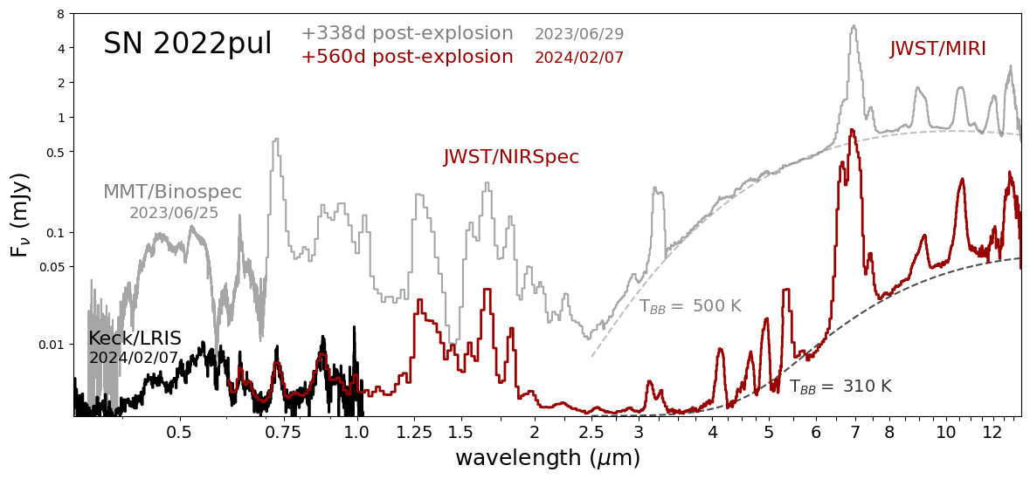
Spectral evolution in SN 2022pul
Johanssen et al. (in prep.)
Kwok et al. (in prep.)

Slide 14
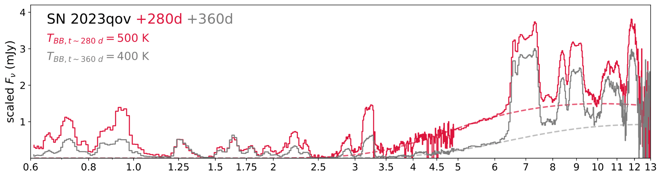
Cooling CSM dust in the normal SN Ia 2023qov
Ni
Co
Ar
Ni
Ar
Ni
Co
Ni
Fe, Co
Ca, Fe
Fe, Ni
Fe
Fe
Fe
Fe
Fe
Co
Ni, Fe
Dust Continuum
Macrie, Larison, Sears et al. (in prep)

Slide 15
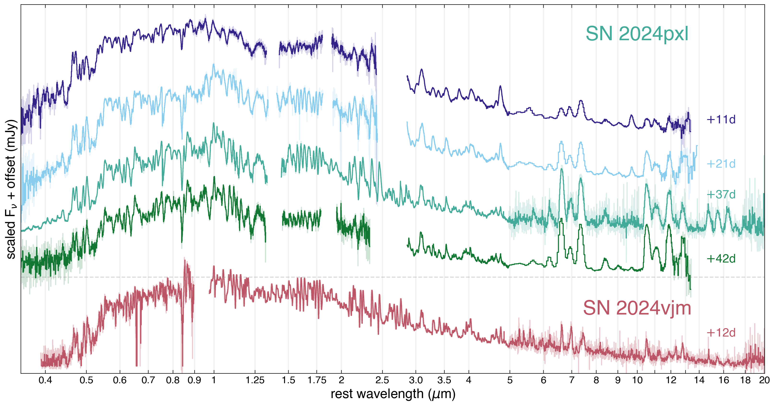
Getting Late Early: MIR Spectra of SN Iax
Kwok et al. (in prep.)

Slide 16
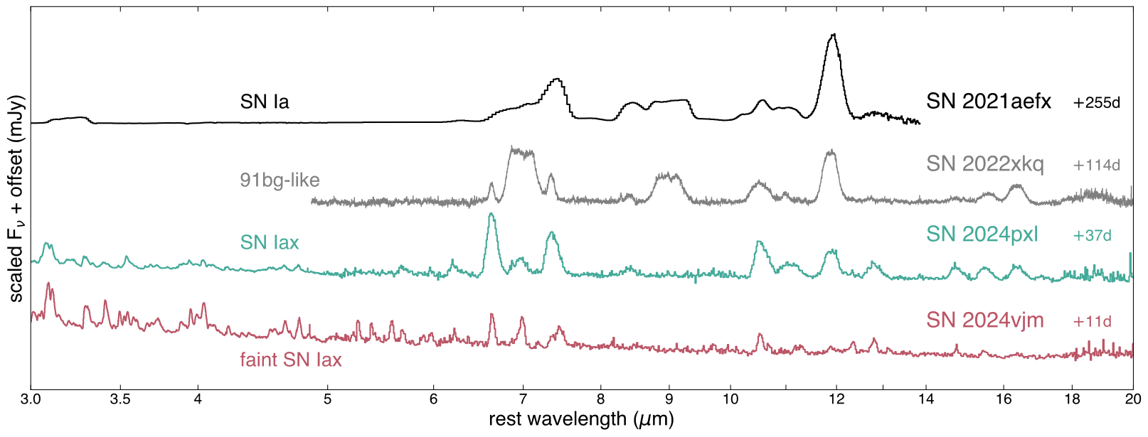
SN Ia vs. SN Iax in the MIR
flat topped IME and peaked IGE profiles in normal/91bg-likes → stratified ejecta → detonation
peaked IME and IGE profiles in SN Iax → mixed ejecta → deflagration?
Kwok et al. (in prep.)

Slide 17
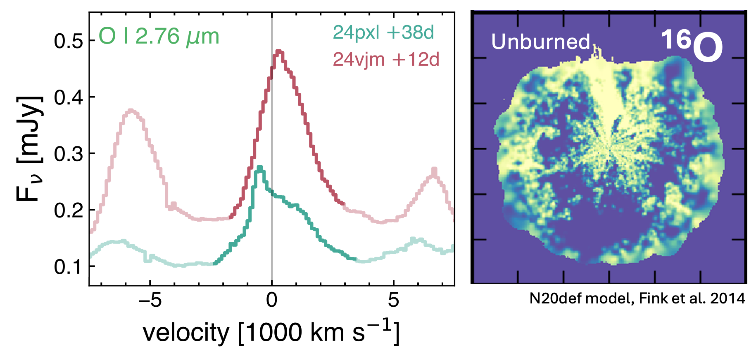
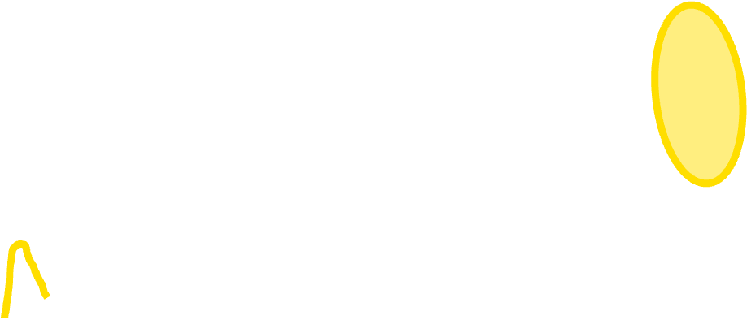

Getting Late Early: SN Iax as Deflagrations
Kwok et al. (in prep.)

