Slide 1

MIRSNAC Overview
Eddie Baron
JWST Observations of
Supernovae

Slide 2


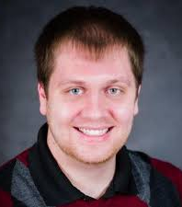


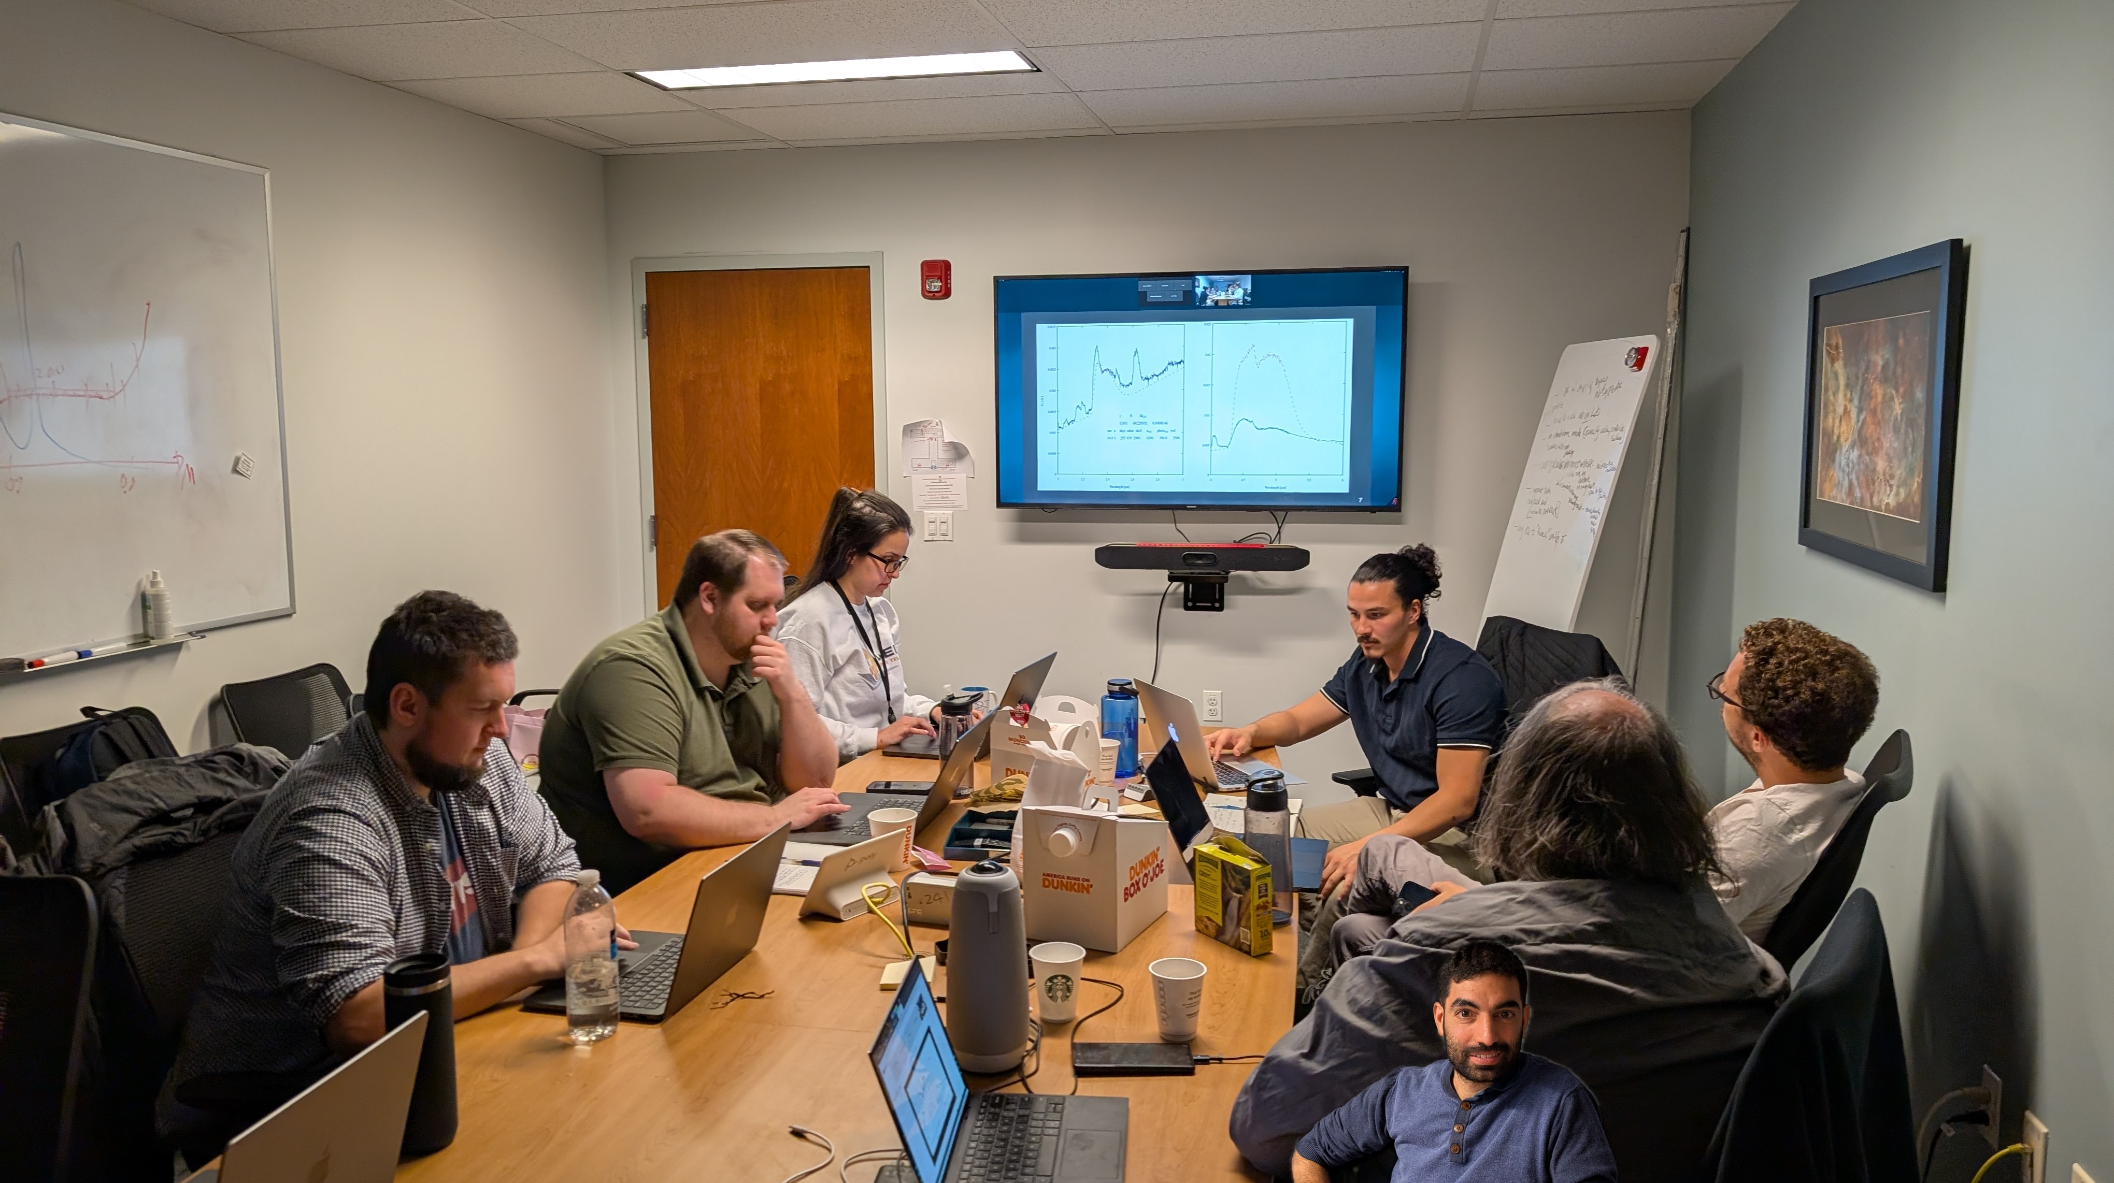
MIRSNAC Collaboration
Students
  Tyco Mera-Evans
  Elham Fereidoui
  Cameron Pfeffer
Postdocs
  Kyle Medlar
  Sagiv Shiber

Slide 3
All Types of Supernovae
We are using the opening of high-resolution observations in the MIR to advance our understanding of all Types of supernovae
SNe Ia : DerKacy+23 (2021aefx), DerKacy+24 (2022xkq), Ashall+24 (21aefx)
SNe II (2023ixf and 2024ggi)
SNe Ibc (see Melissa Shahbandeh’s talk)

Slide 4
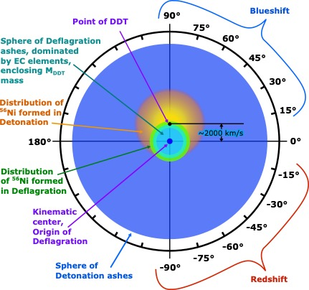
SNe Ia: Hoeflich Model
Bose+25

Slide 5
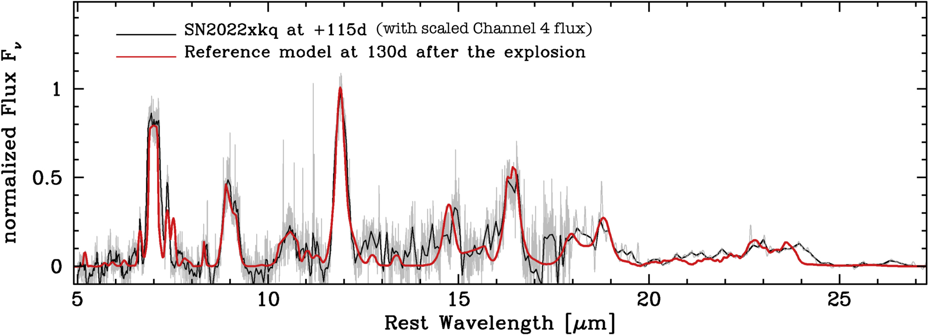
SN 2022xkq: Low Luminosity SN Ia
DerKacy+24

Slide 6
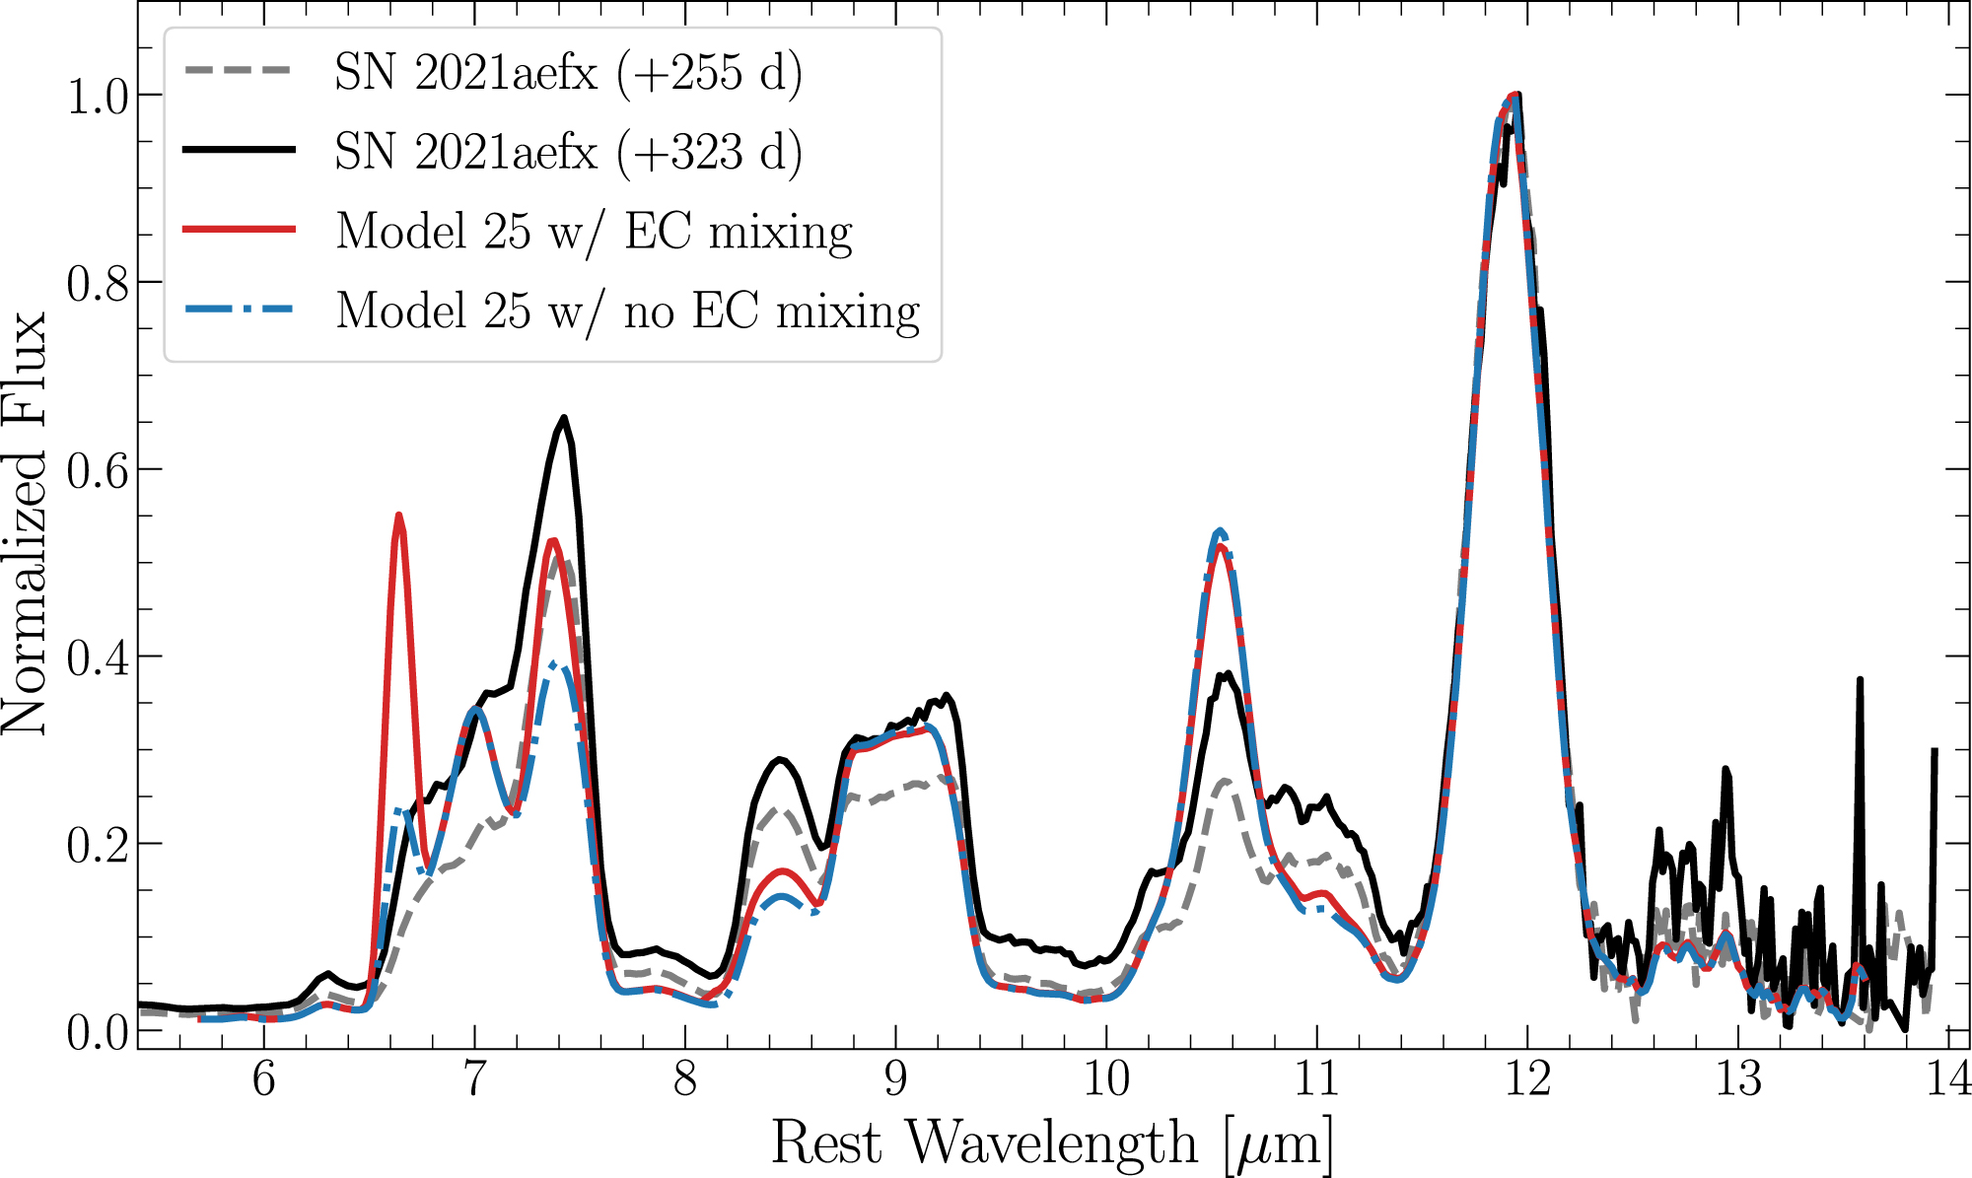
SN 2021aefx: Normal Bright Ia
DerKacy+23

Slide 7
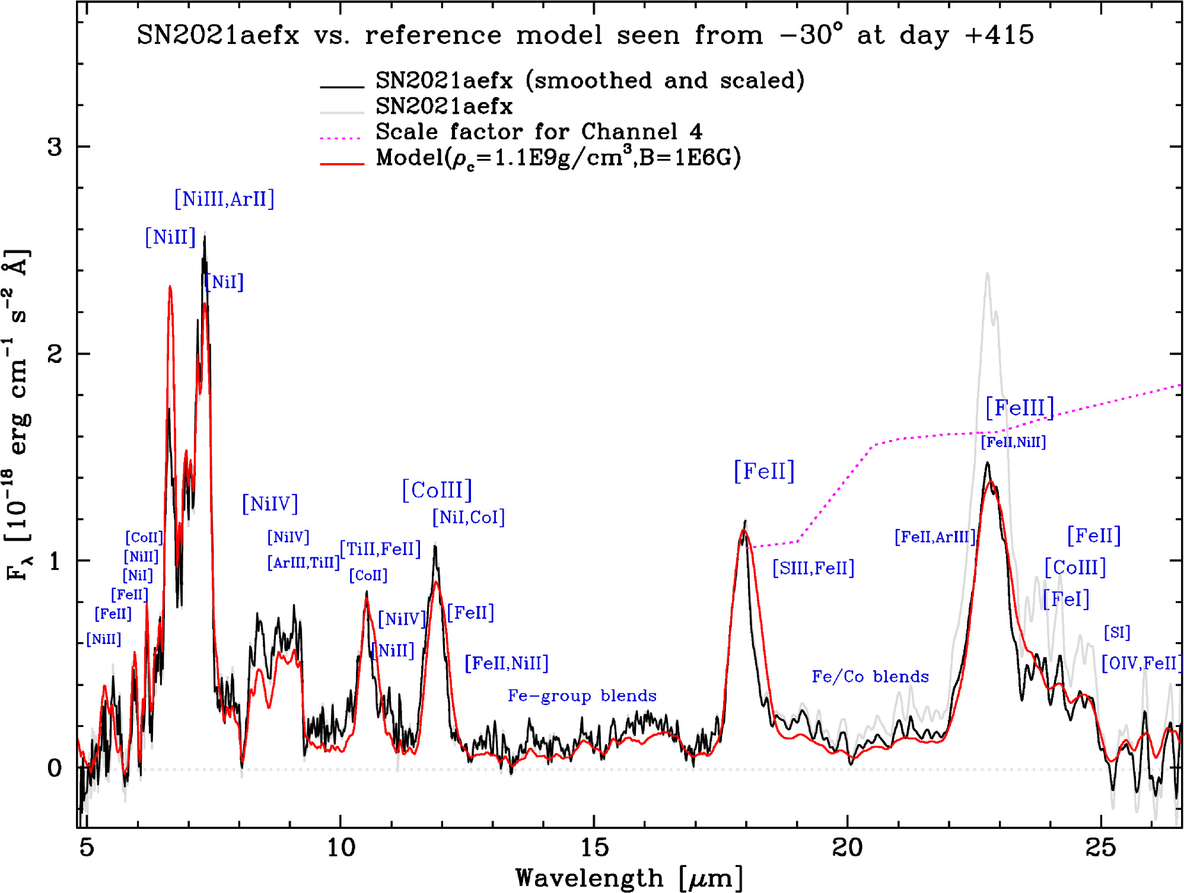
SN 2021aefx day +415
Ashall+24

Slide 8
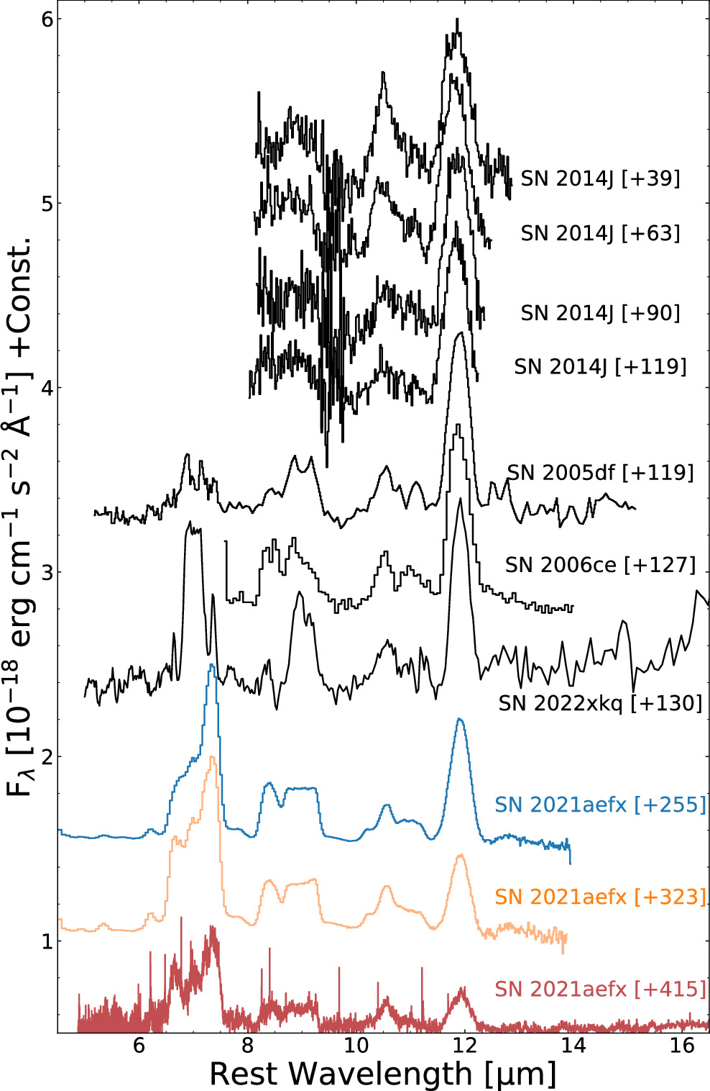
MIR Spectra of SNe Ia
Ashall+24

Slide 9
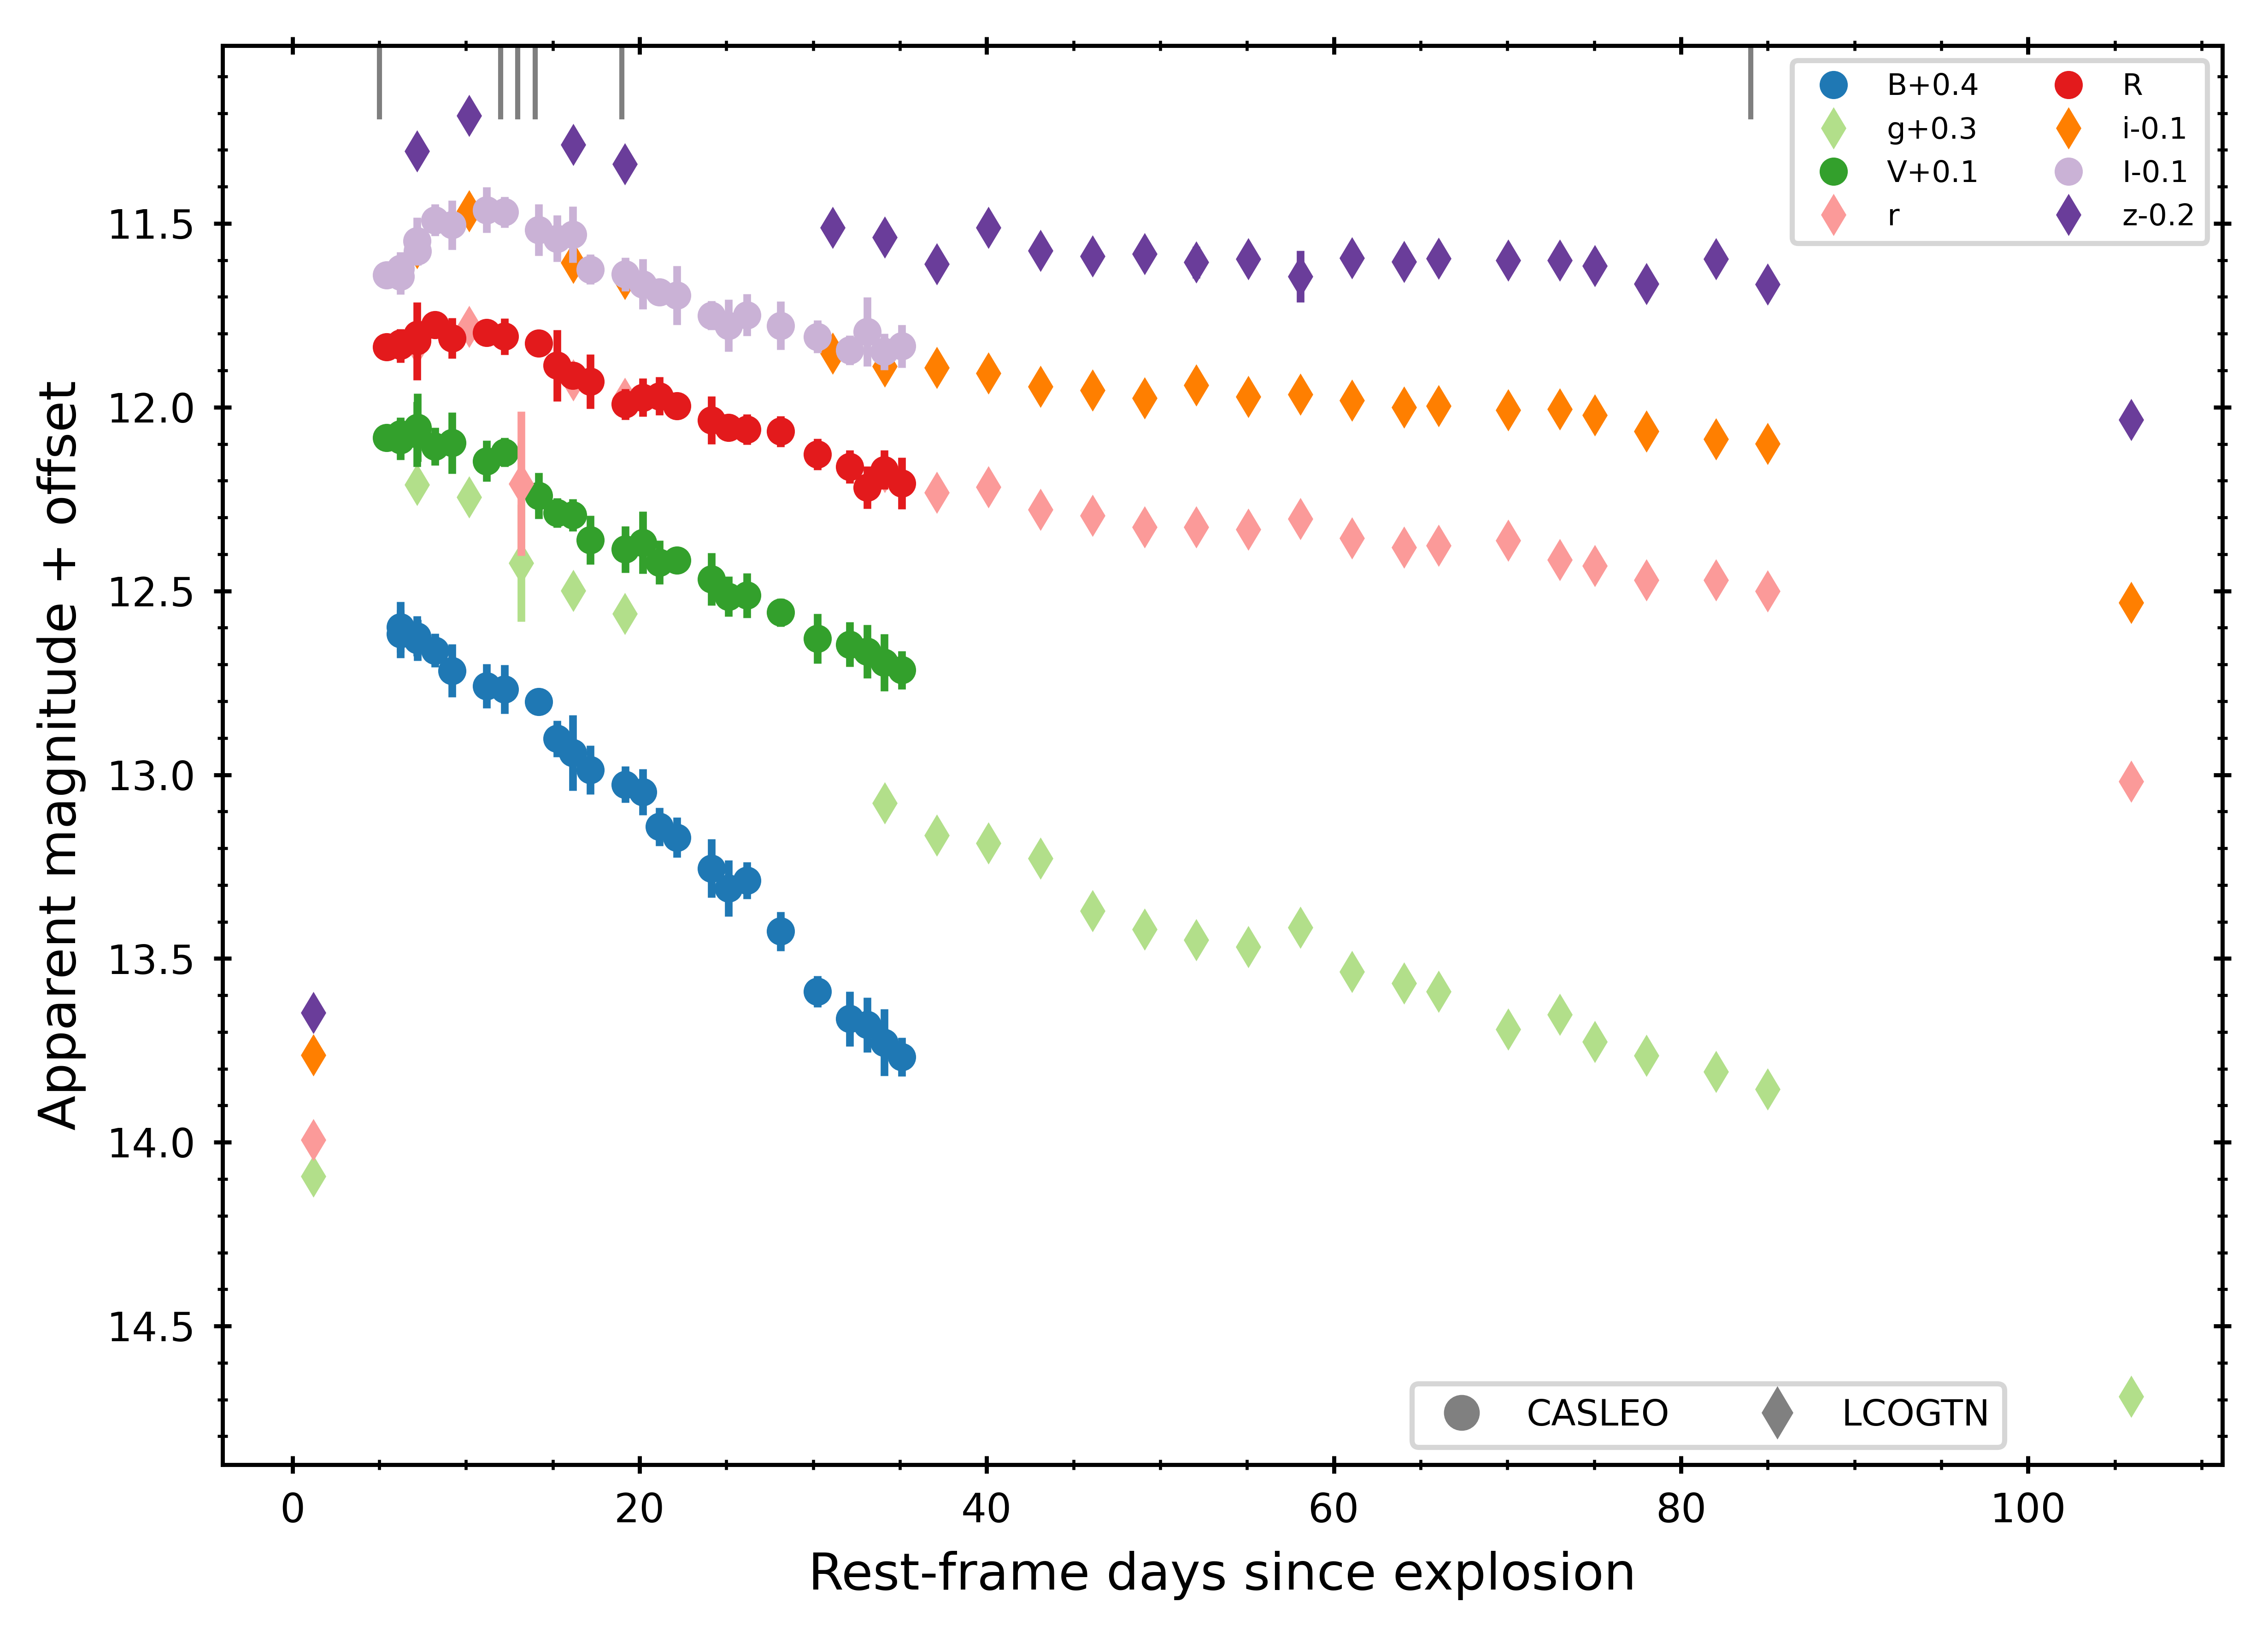
SN 2024ggi SN IIP
Ertini+25

Slide 10
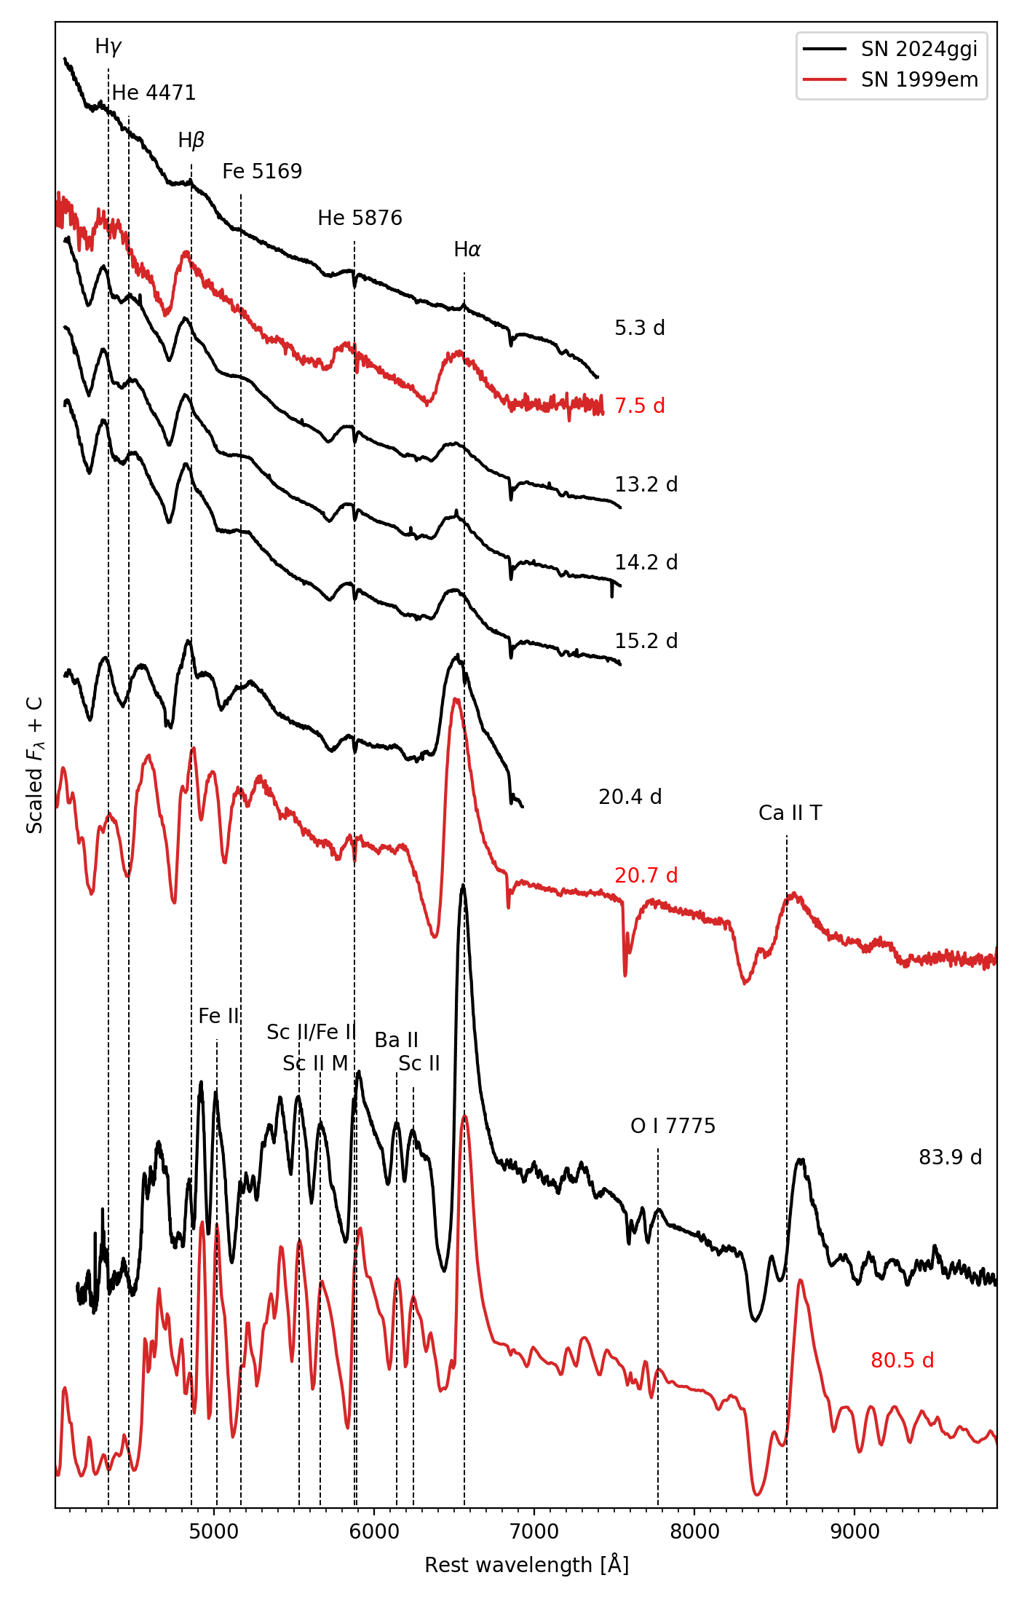
Optical Spectral Sequence
Ertini+25

Slide 11
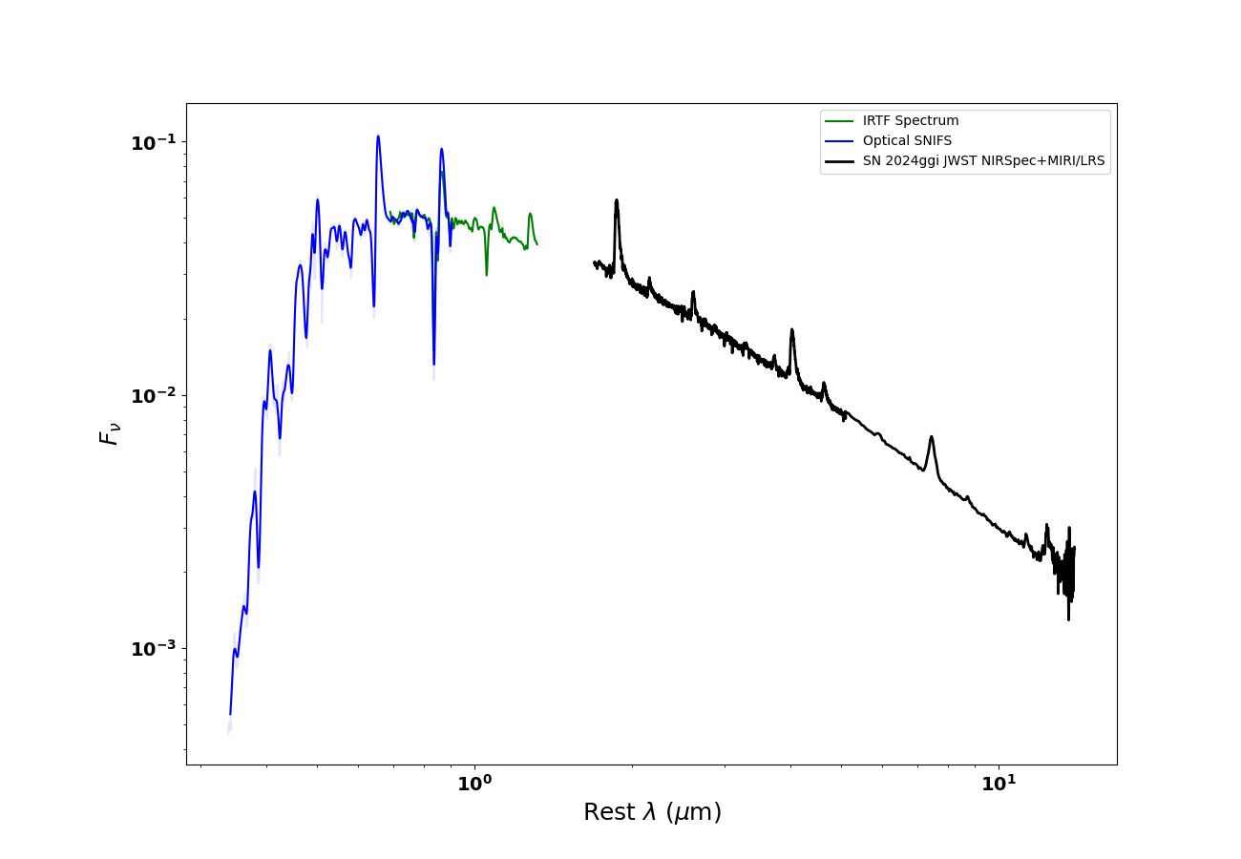
JWST +IRTF + Optical
Approx 55 days post explosion

Slide 12

Simple PHOENIX model
$ρ∝v^{−13}$
M = 9.1 $M_{☉}$
E = 0.5 foe
L = $2 x {10}^{9}$ $L_{☉}$
Solar Abundances

Slide 13
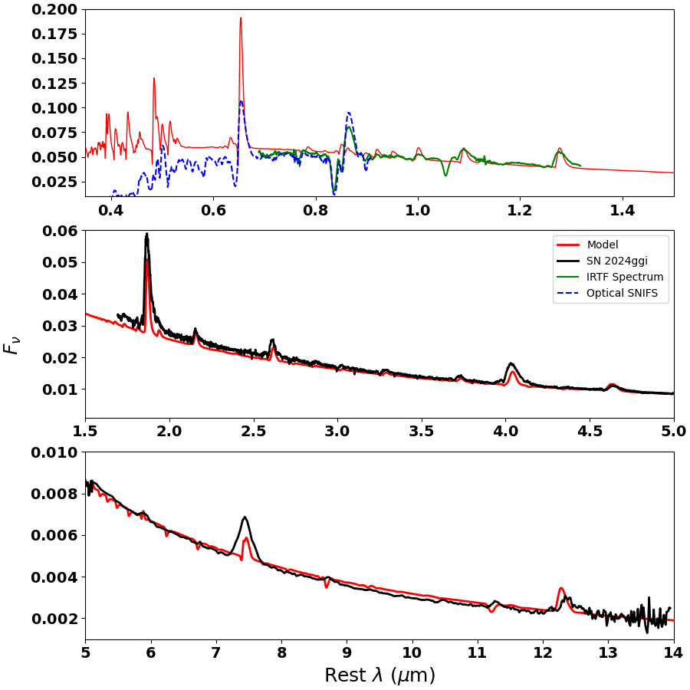
PHOENIX model vs Data
Baron+in prep

Slide 14
Summary
JWST opens a new window in the NIR+MIR for all types of SNe
Near Chandra DDT explosions can reproduce the NIR+MIR spectra of both normal bright and subluminous SNe Ia
Some SN IIP are well reproduced by simple spherical NLTE synthetic spectral modeling.
Clumping effects from Cool Dense Shell need to be addressed
Questions?

