Slide 1






Mansi M. Kasliwal
Professor of Astronomy
California Institute of Technology

Slide 2
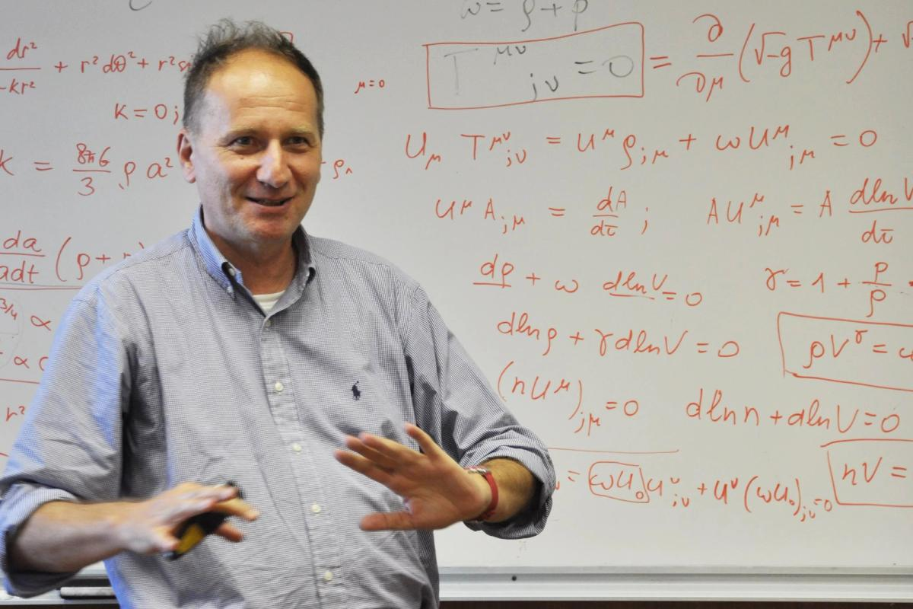
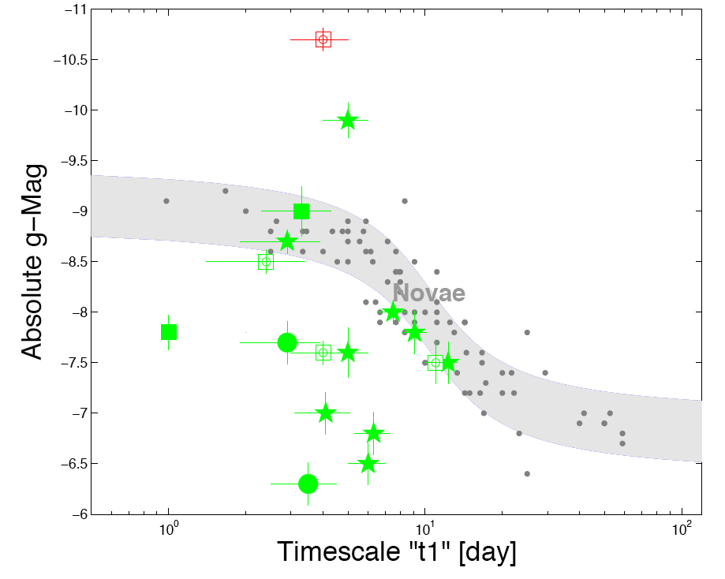
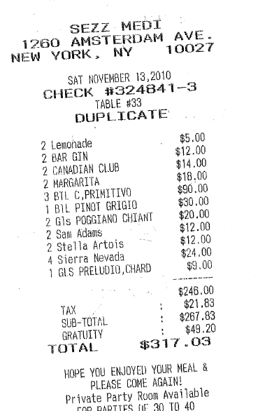
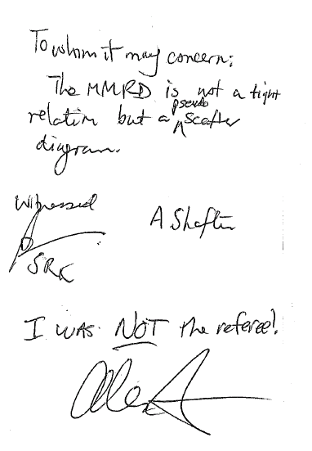
Congratulations, Enrico Cappellaro, Massimo Della Valle, Laura Greggio, Massimo Turatto!
Kasliwal et al. 2010 (first chapter of PhD thesis)

Slide 3
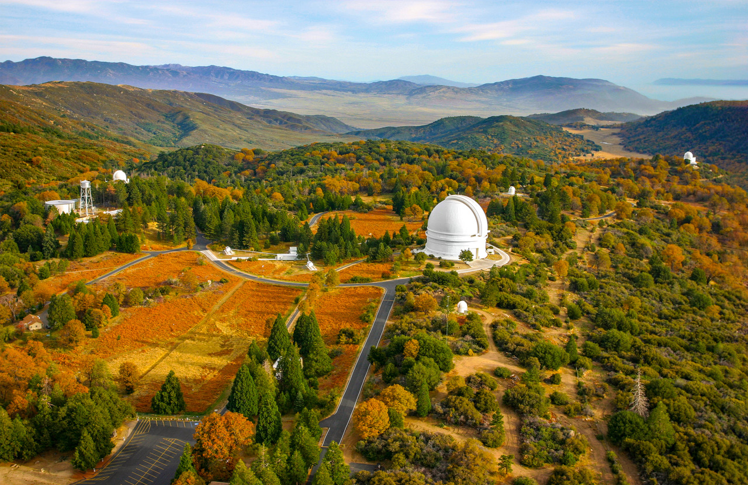

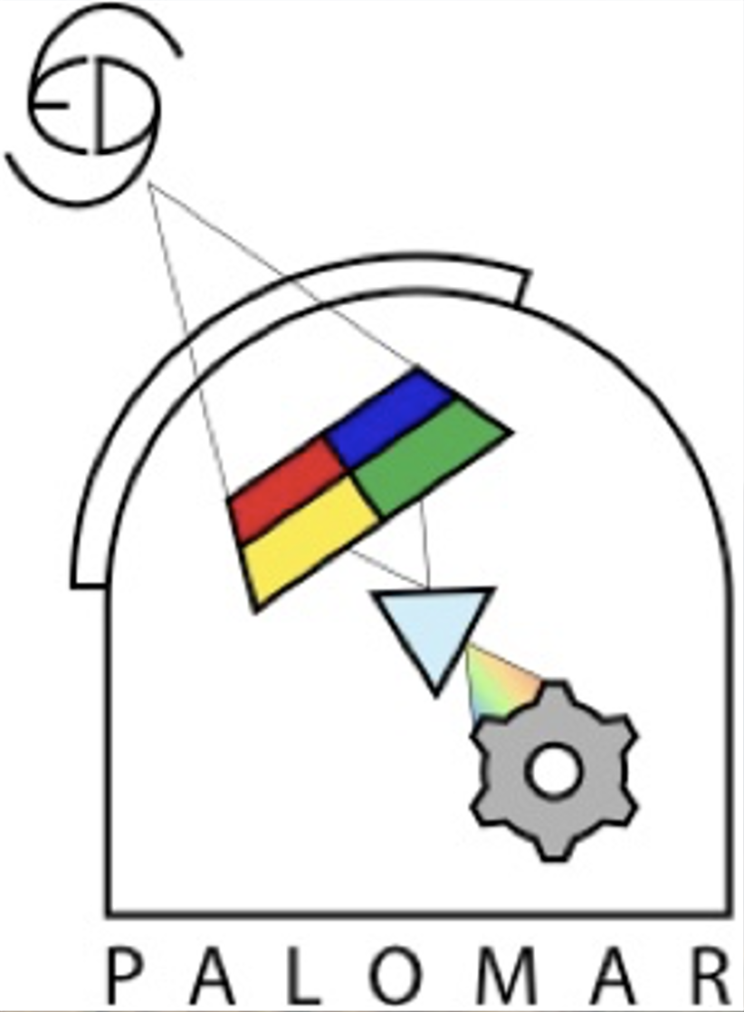
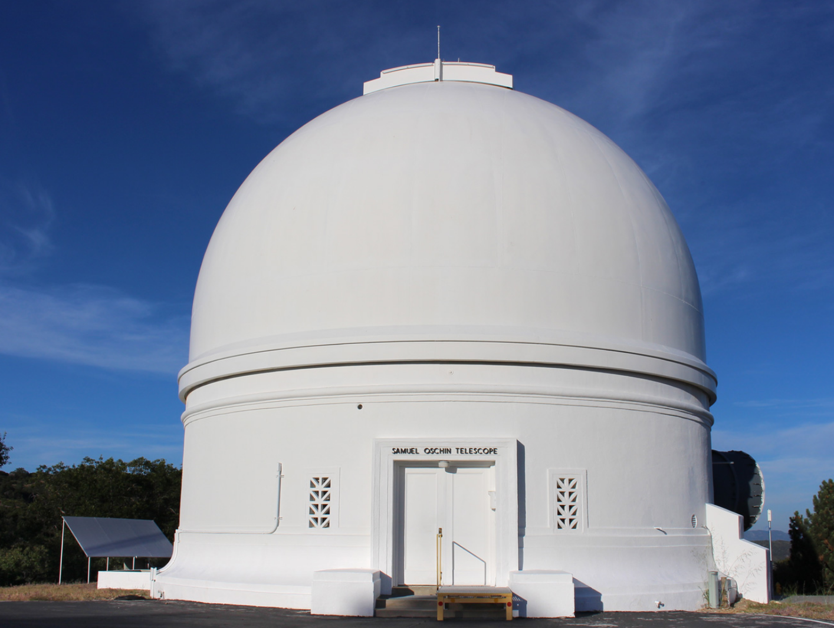
Time-Domain Discovery Engines
Palomar Observatory
Zwicky Transient Facility
Palomar Gattini IR

Slide 4
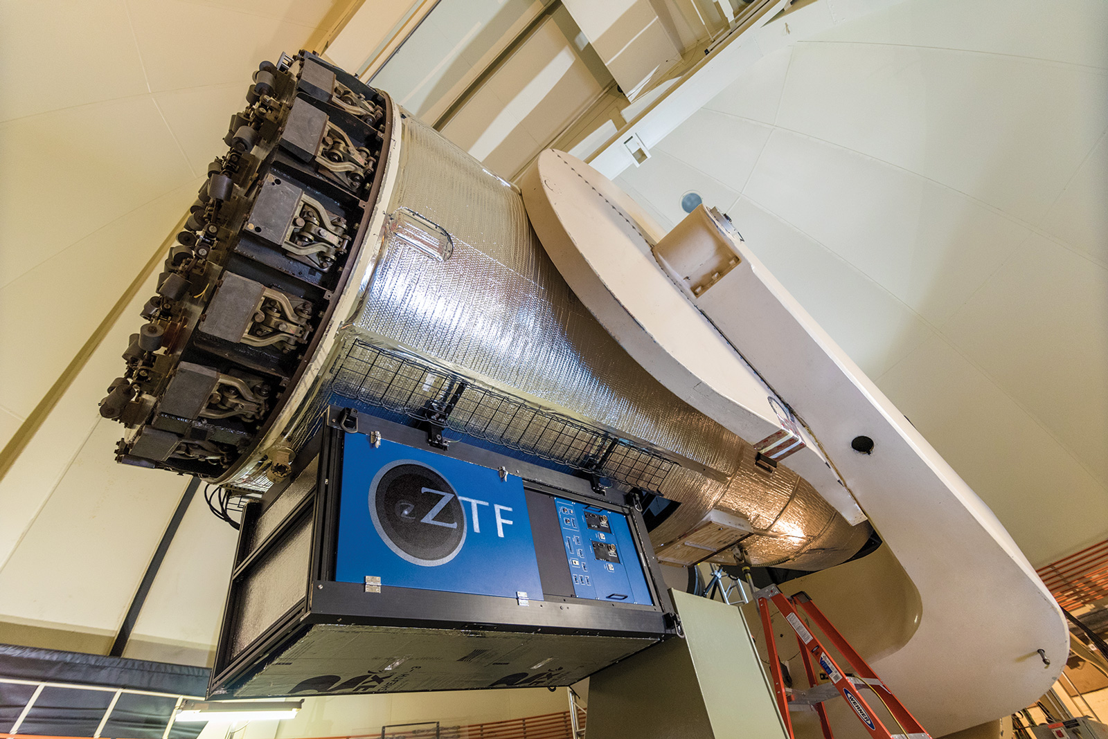
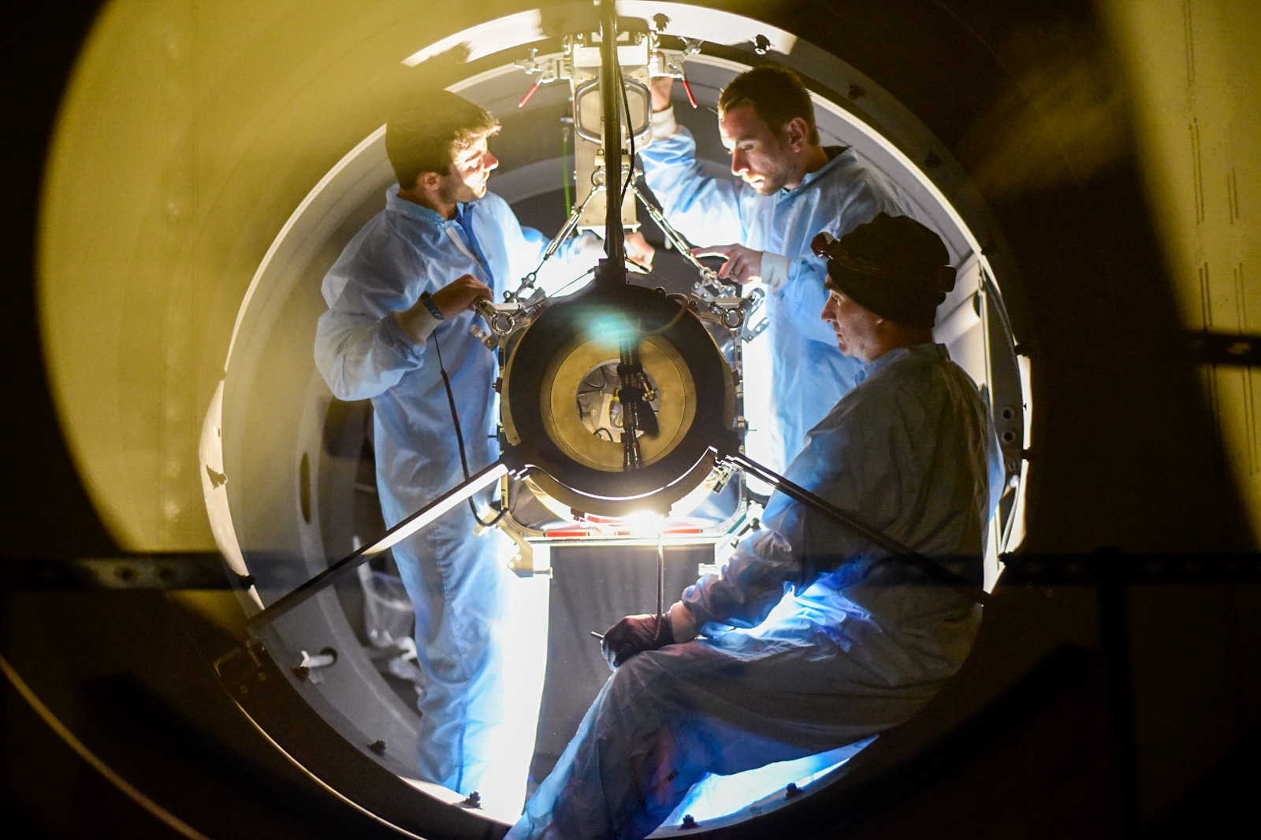
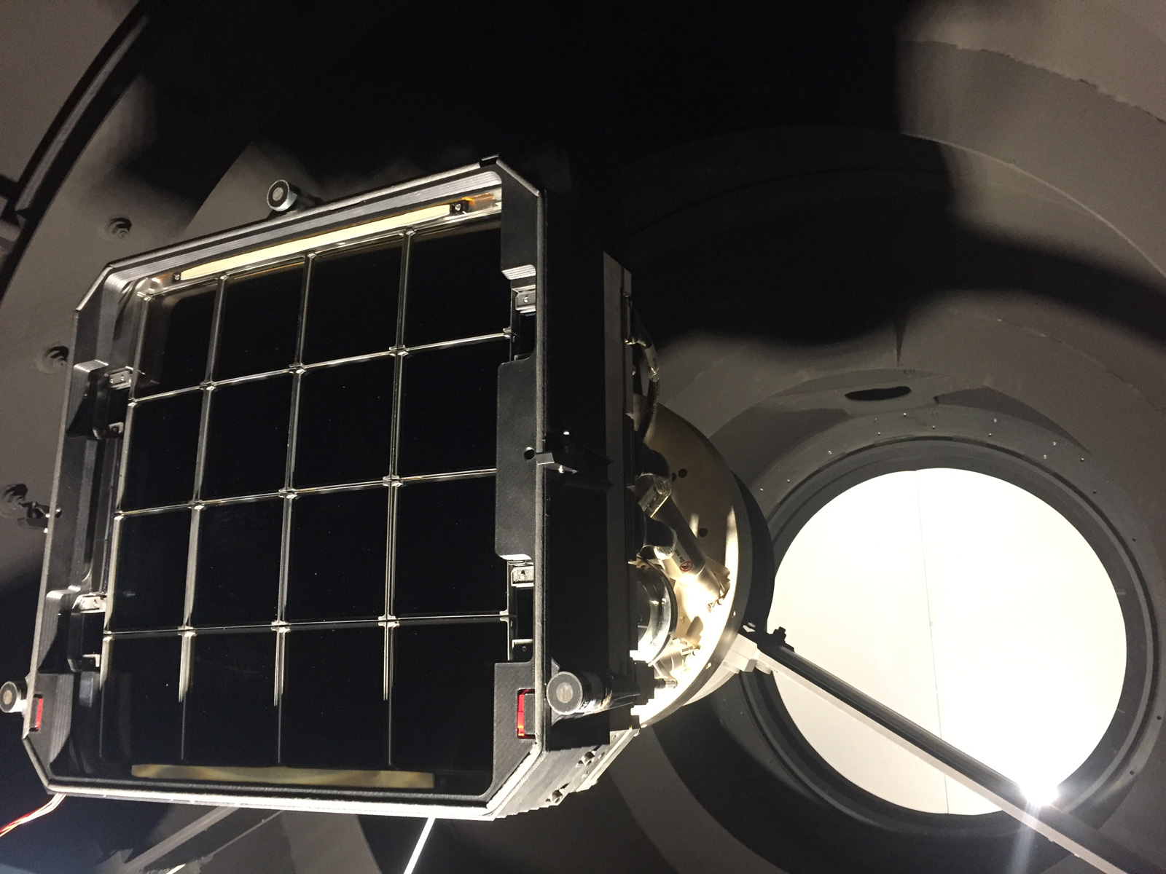
Zwicky Transient Facility
1034 refereed papers in 6 years
h-index = 62
16,528 citations

Slide 5
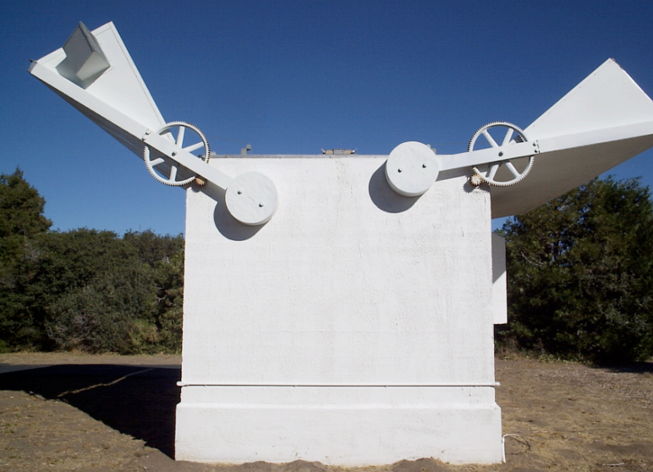
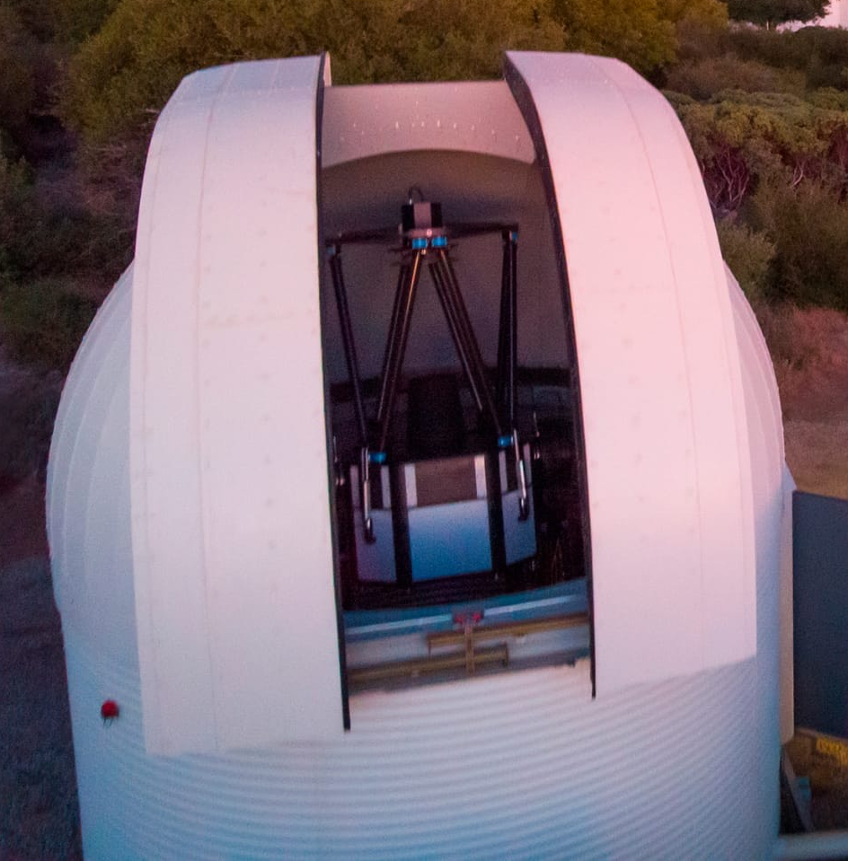
Opening the dynamic infrared sky
Palomar Observatory
Palomar Gattini IR

Slide 6
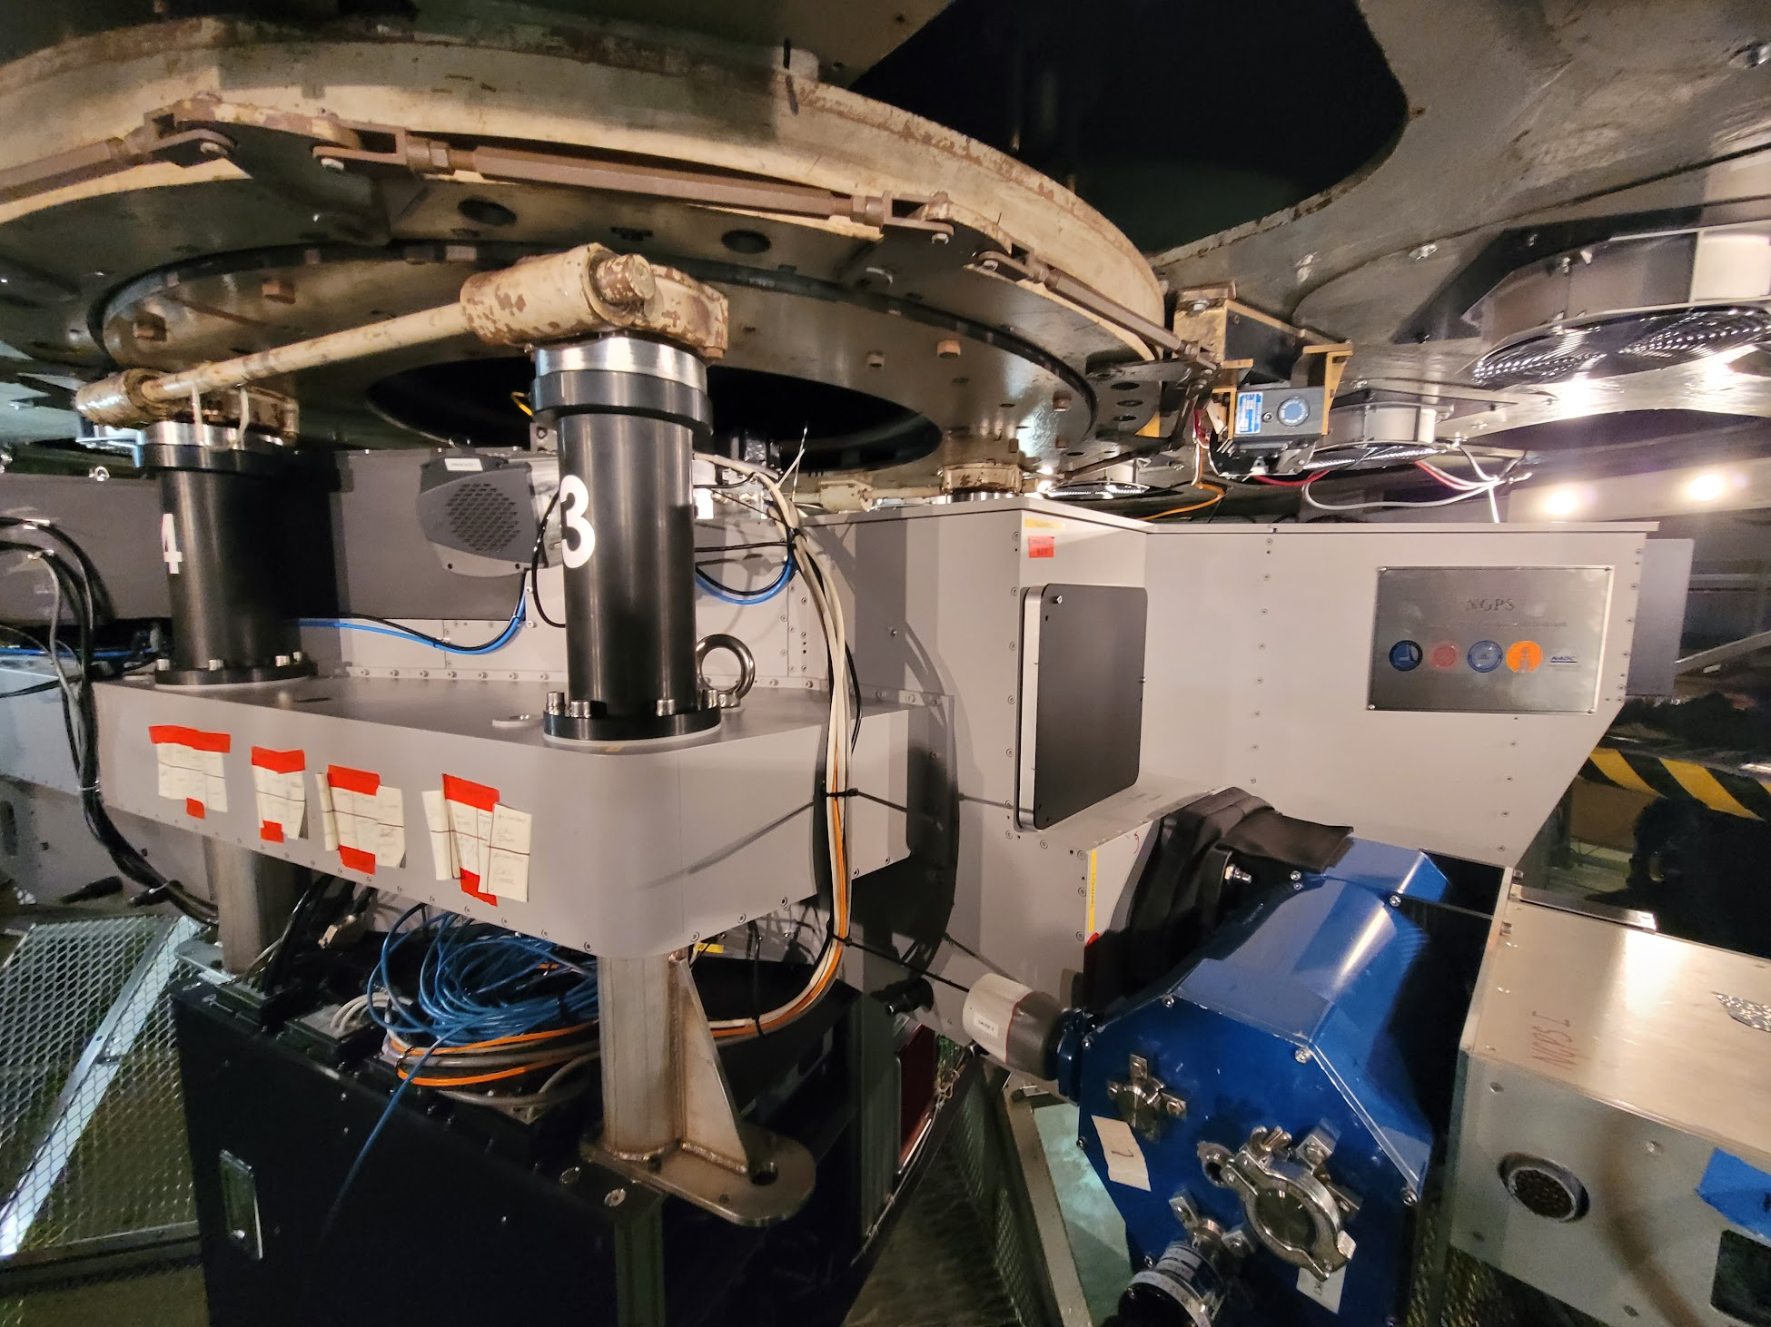
Palomar Observatory
Palomar Gattini IR

Slide 7
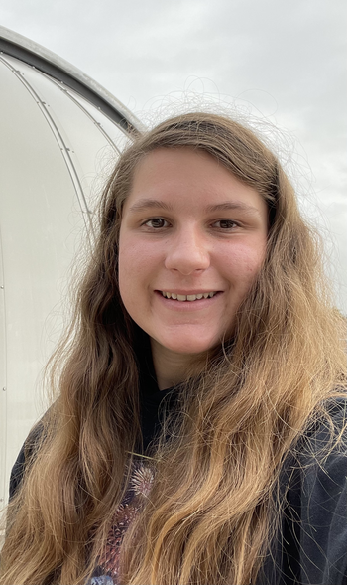

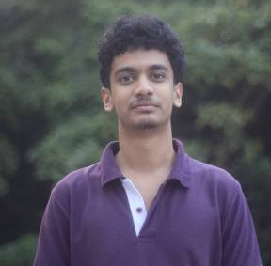
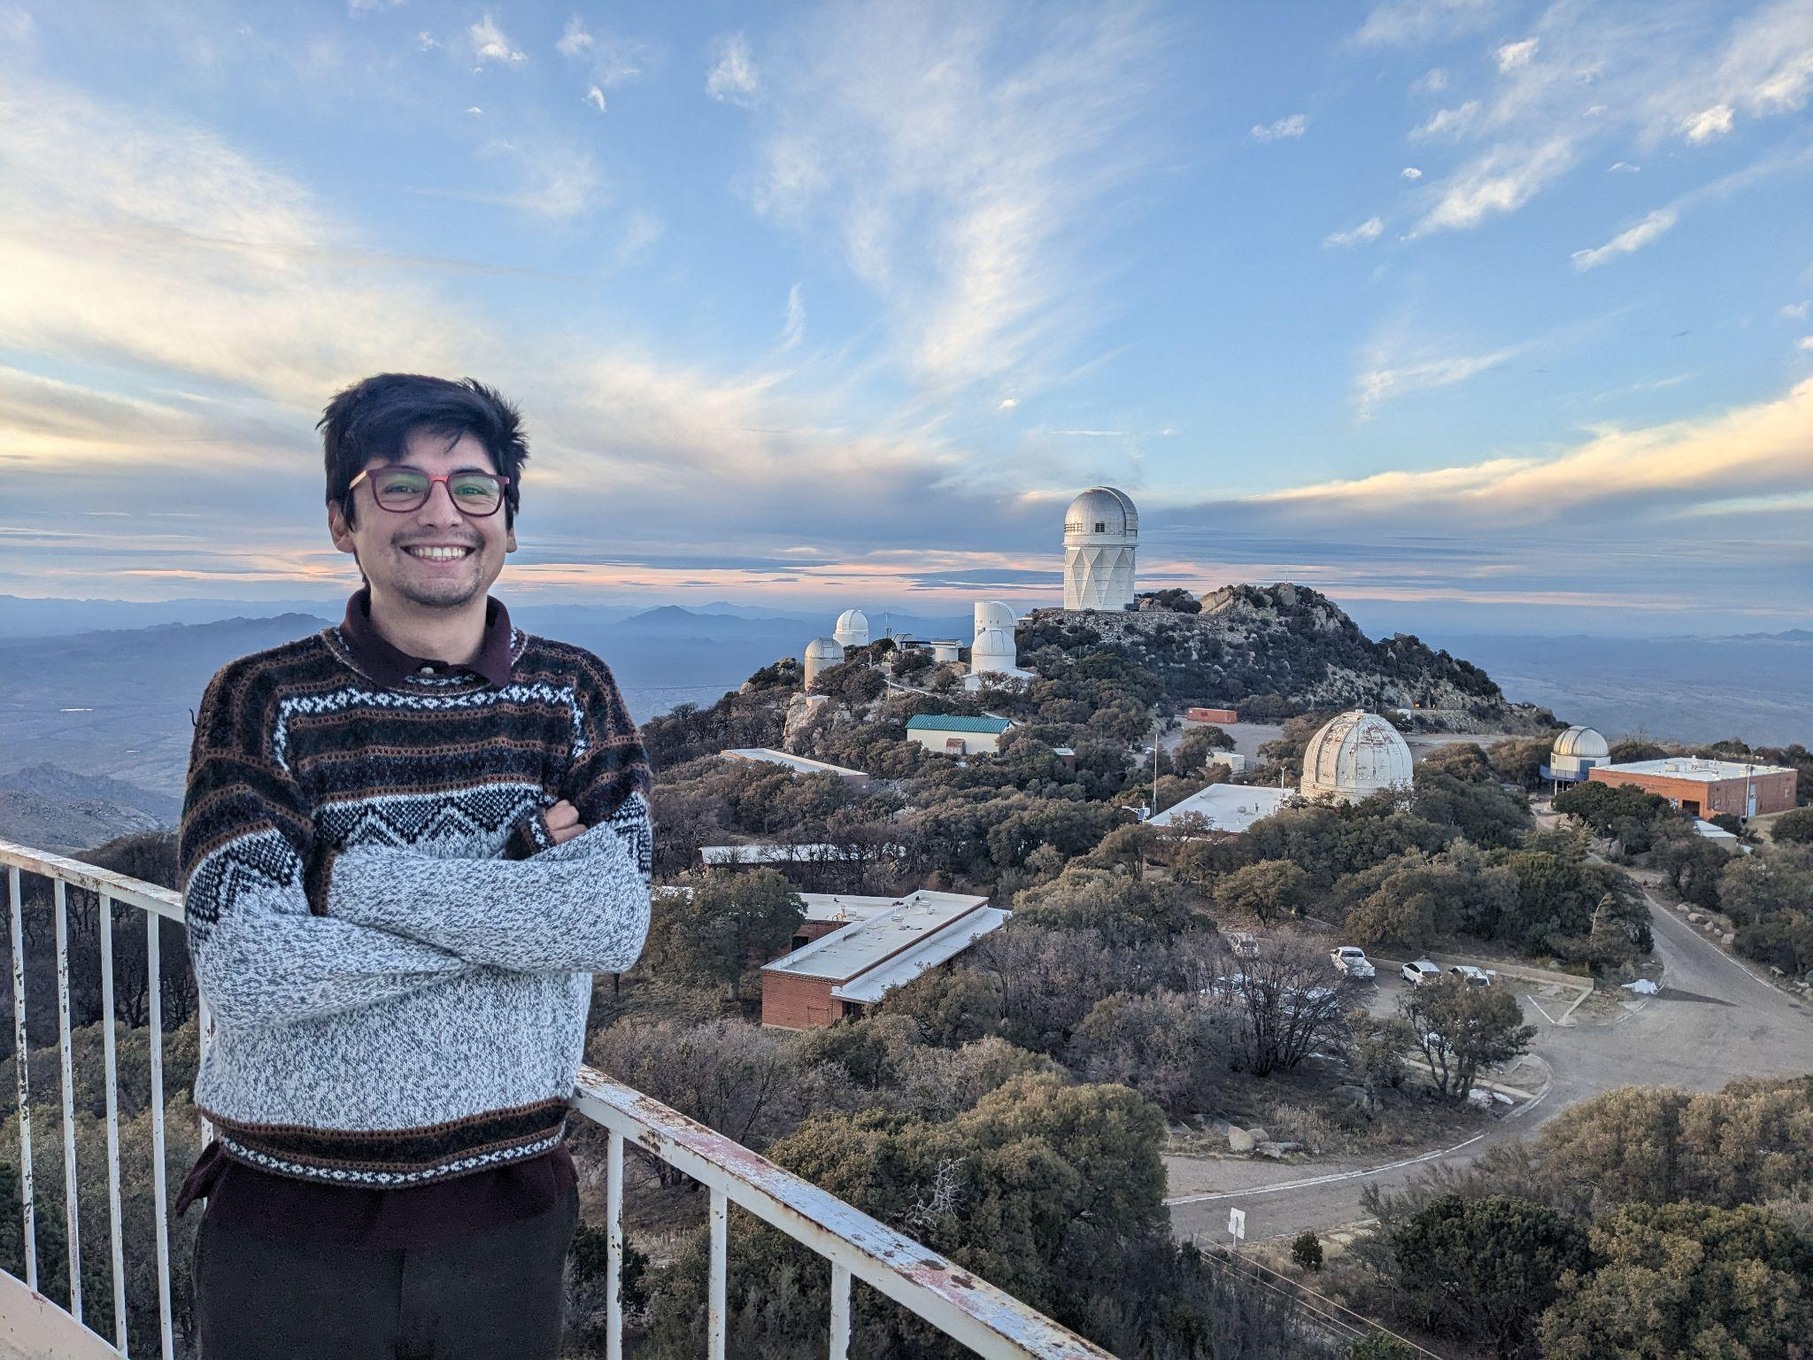

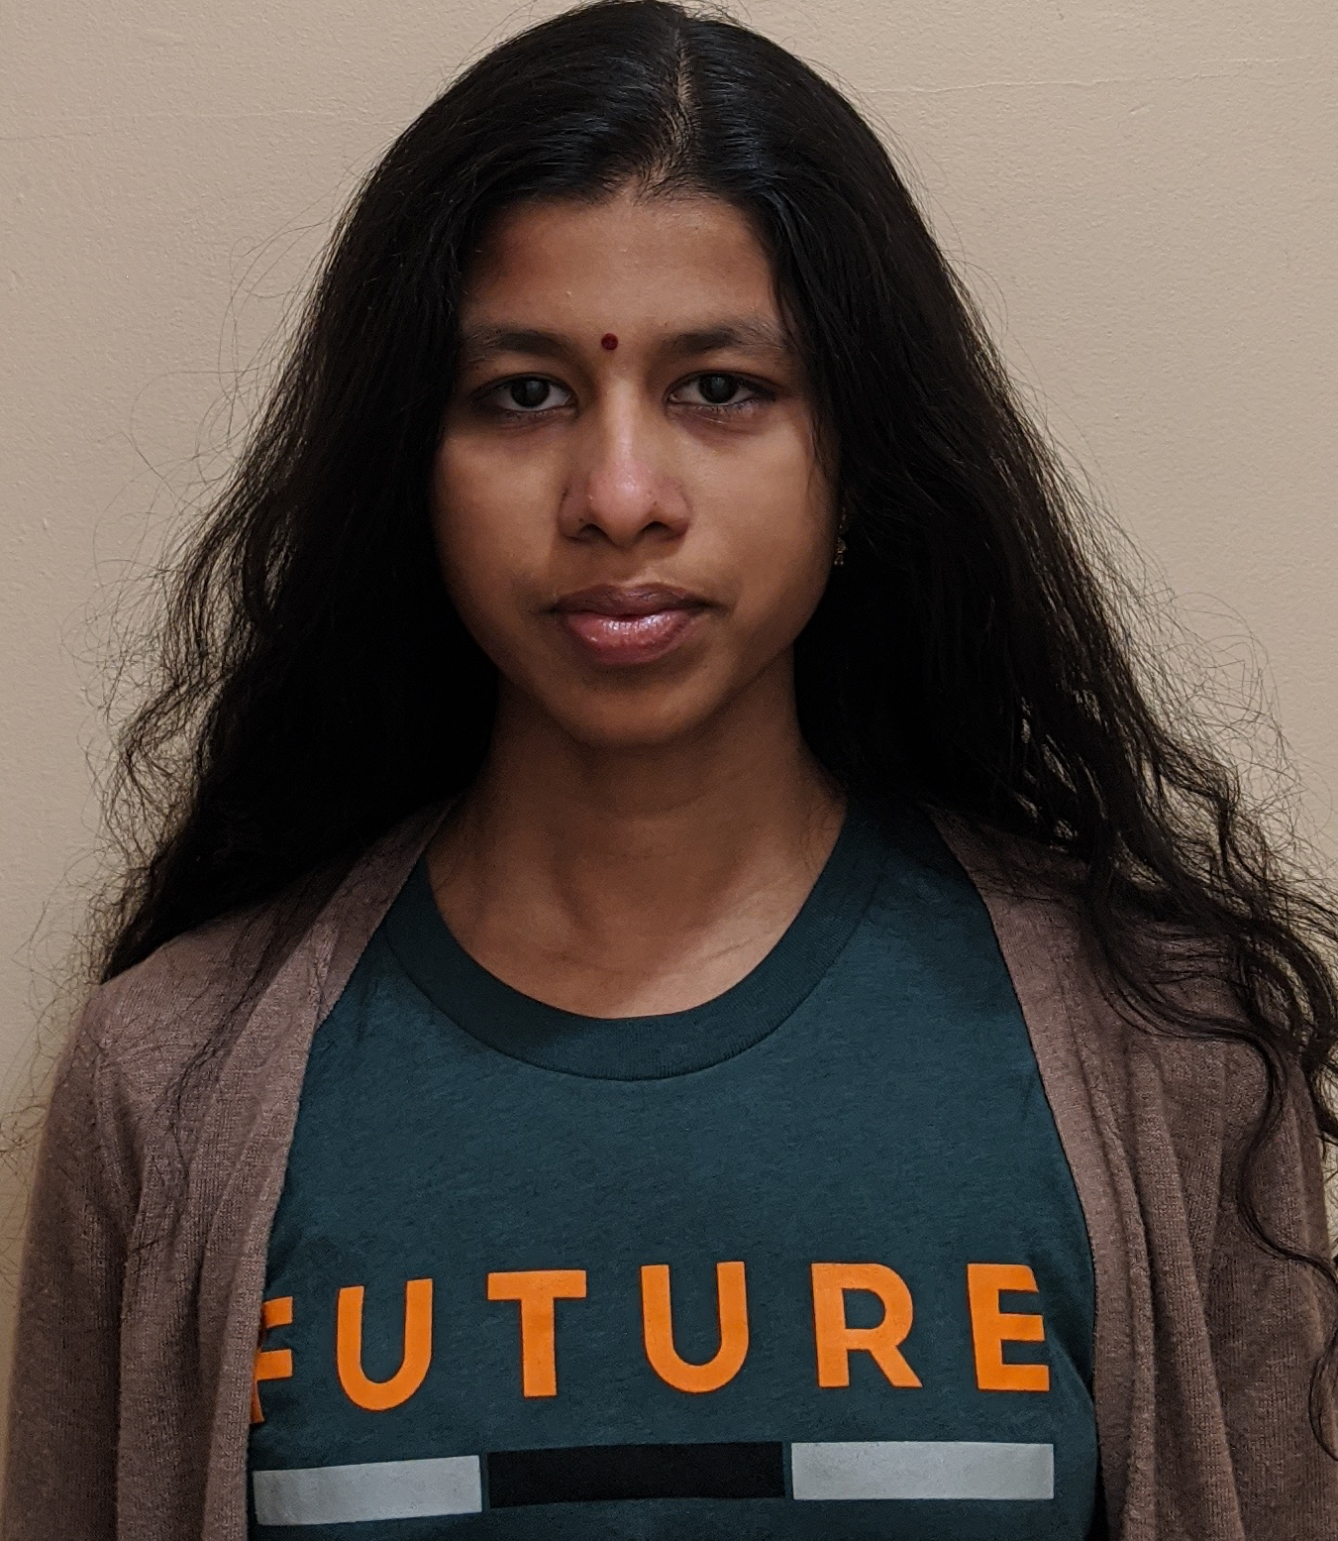

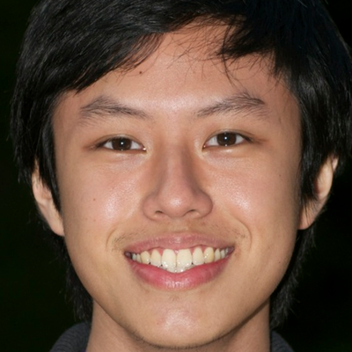

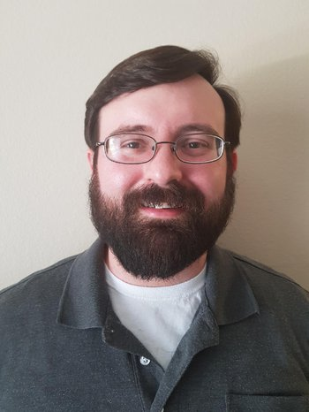
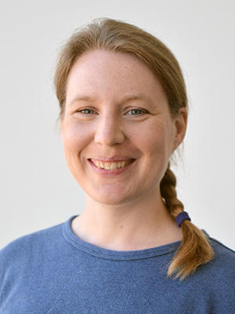


Kasliwal Research Group
Sam Rose
(Grad)
Nicholas Earley
(Grad)
Kaustav Das
(Grad)
Viraj Karambelkar
(Grad)
Tomas Ahumada
(Postdoc)
Robert Stein
(Now Fellow)
Shreya Anand
(Now Fellow)
Kishalay De
(Now Faculty)
Kaew Tinyanont
(Now Faculty)
Igor Andreoni
(Now Faculty)
Matt Hankins
(Now Faculty)
Ragnhild Lunnan
(Now Faculty)
Christoffer Fremling
(Now Staff)
Ryan Lau
(Now Staff)
Undergrads: Tawny Sit, Miranda Kong, Andy Tzanidakis, Gokul Srinivasaragavan, Stephanie Kwan, Lindsey Whitesides, Chris Cannella
Notes:
Missing Dave and Scott

Slide 8
Stellar Mergers

Slide 9
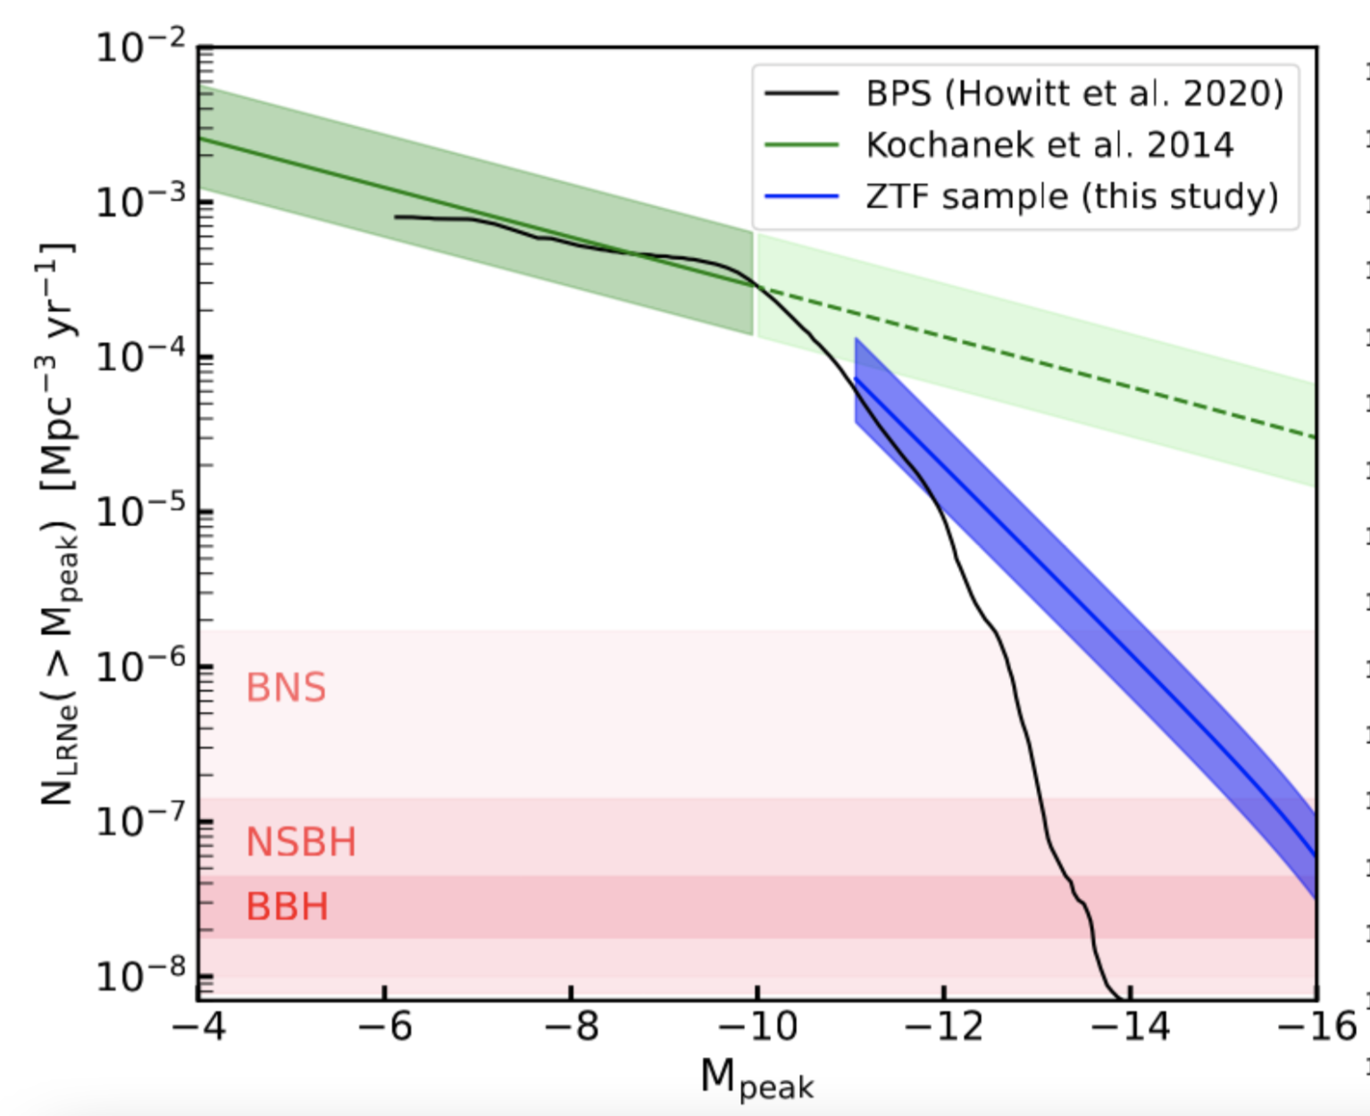
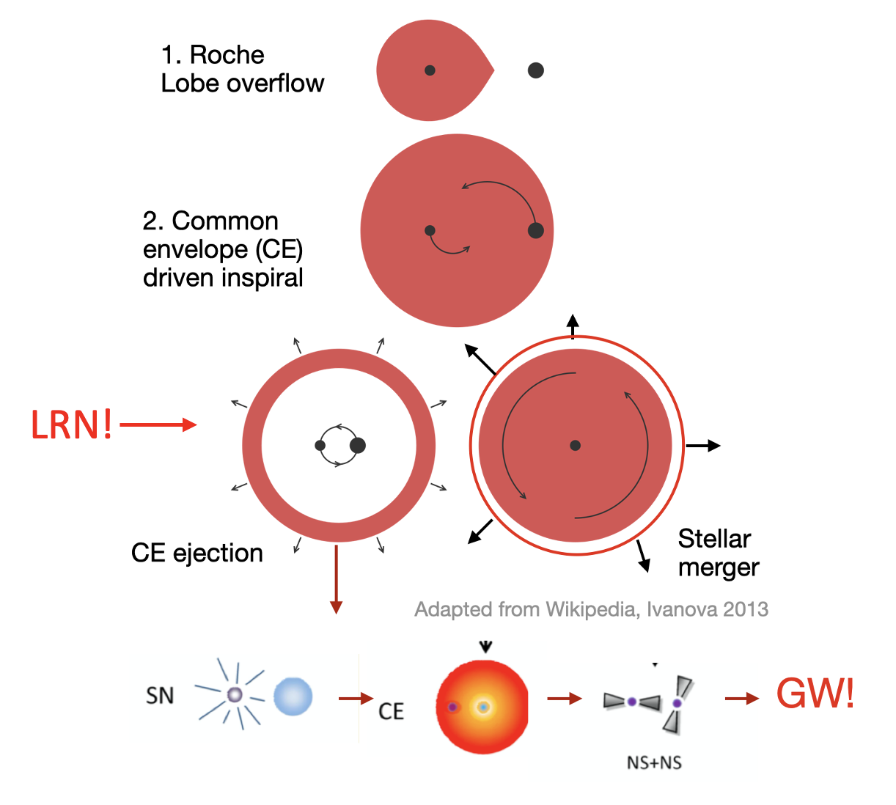
Common Envelope Ejections with ZTF
Viraj Karambelkar
Karambelkar et al. 2023
Rates of the most luminous LRNe are consistent with them being progenitors of merging double compact object systems

Slide 10
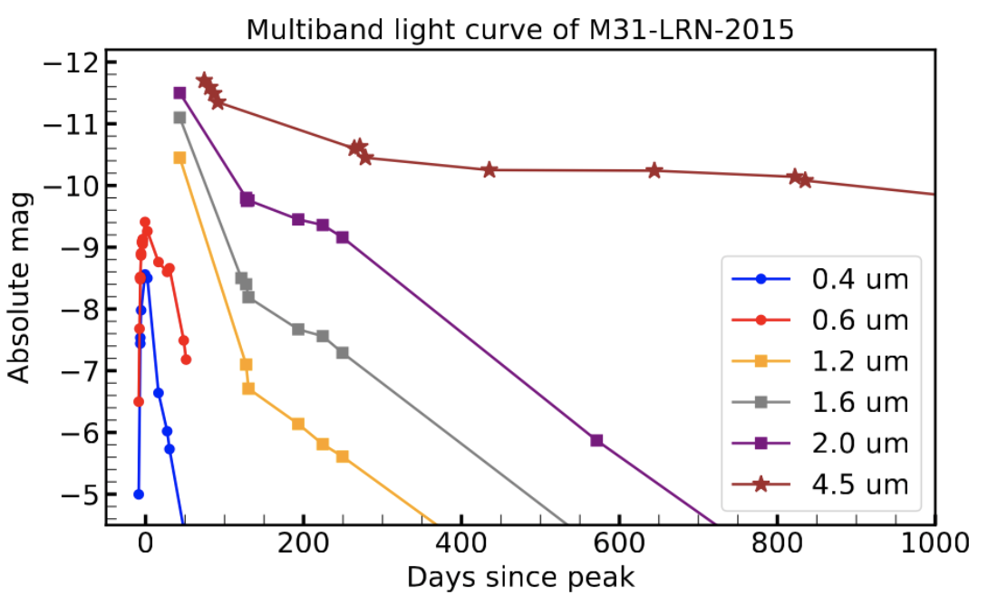
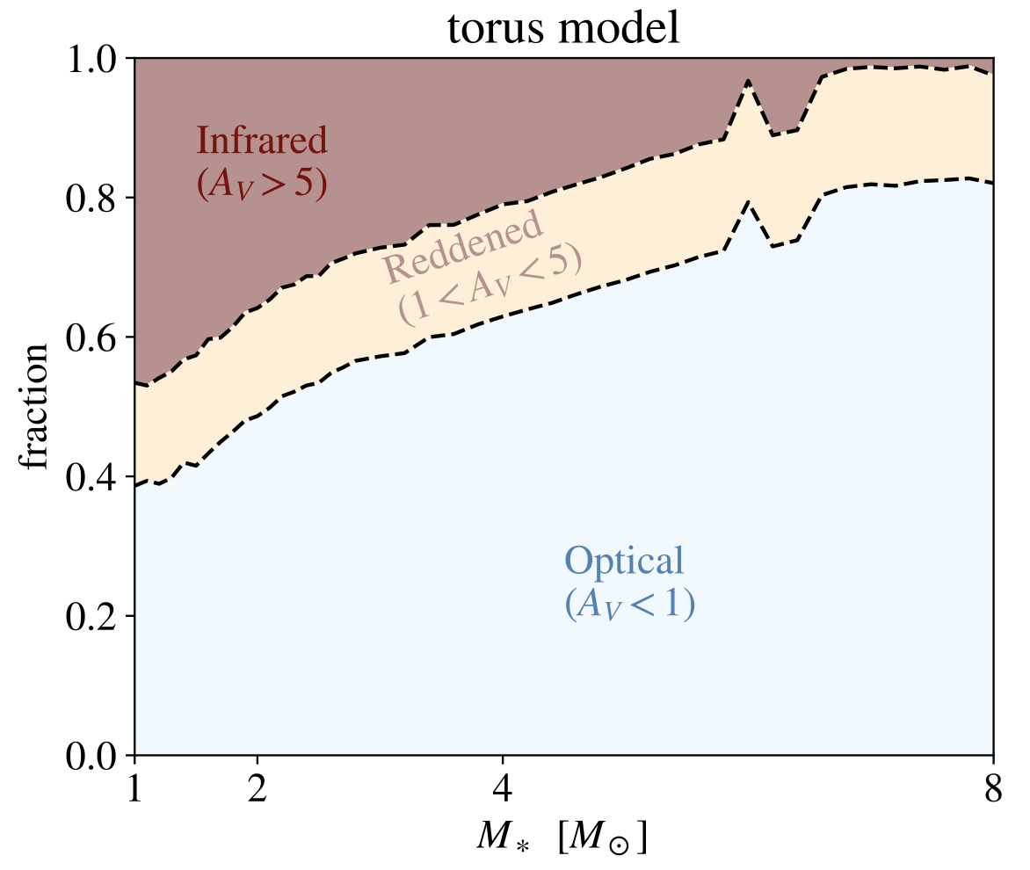
Are we missing some LRNe?
Optical searches are biased against finding the dustiest LRNe
Viraj Karambelkar
Blagorodnova, Karambelkar et al. 2021
MacLeod et al. 2022

Slide 11
Common envelope ejection in an AGB star
Viraj Karambelkar
Karambelkar et al. 2025a

Slide 12
Measuring dust contribution with JWST
Viraj Karambelkar
Karambelkar et al. 2025b, in prep

Slide 13
Cosmic Dust Budget

Slide 14
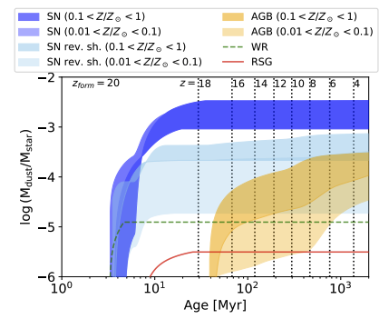
The Cosmic Dust Budget Problem
Schneider and Maiolino 2024

Slide 15
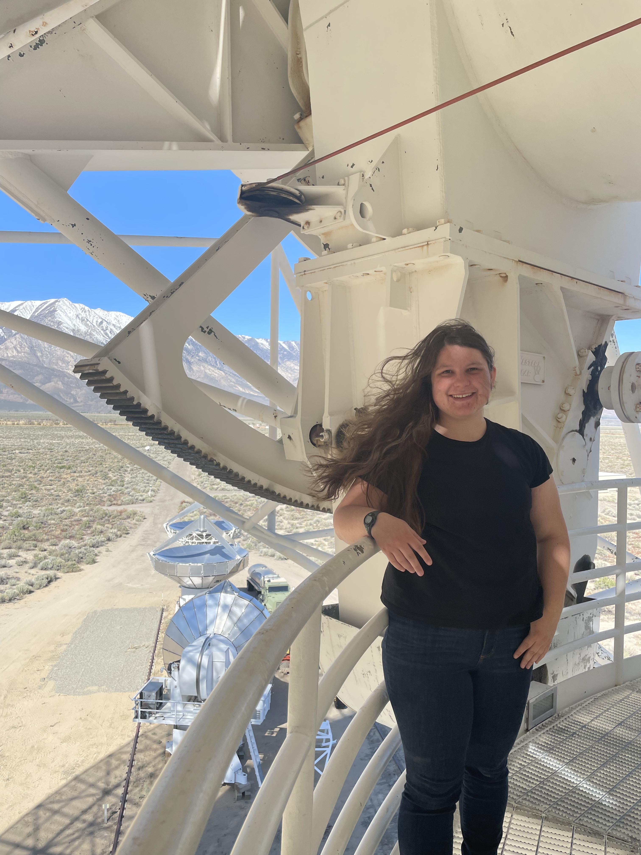
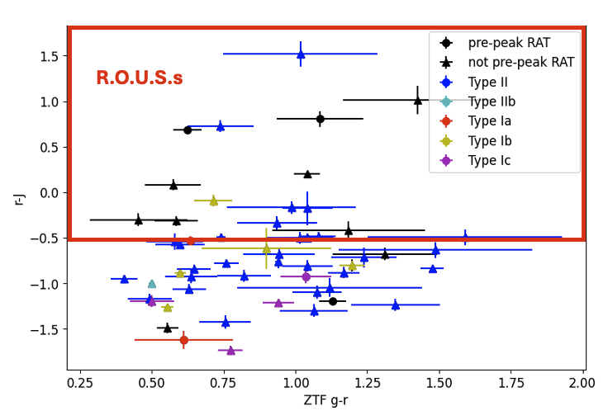
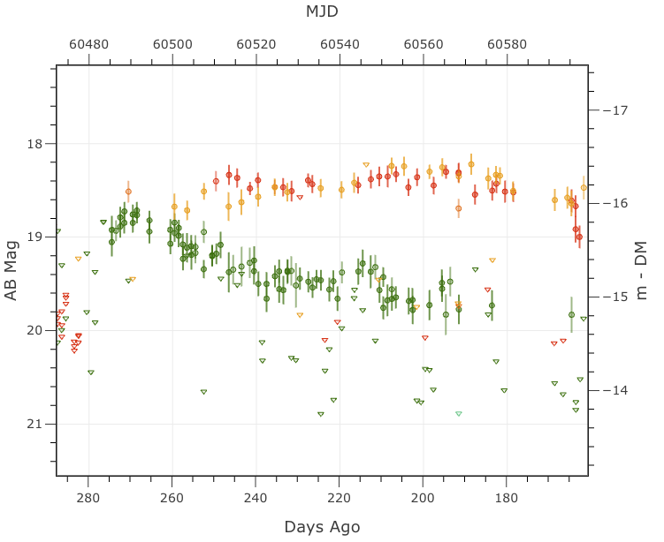
RATs with ZTF + WINTER:
Red Astronomical Transient Survey
Sam Rose: PhD student
Systematic follow-up underway to constrain dust contribution.
Schneider and Maiolino 2024

Slide 16
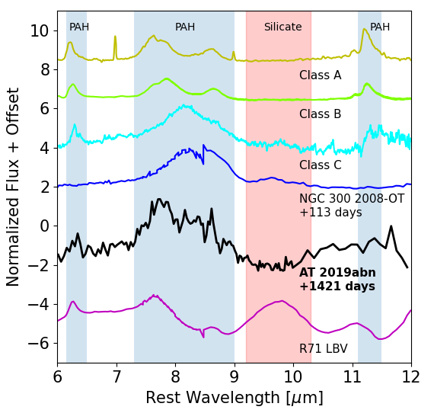
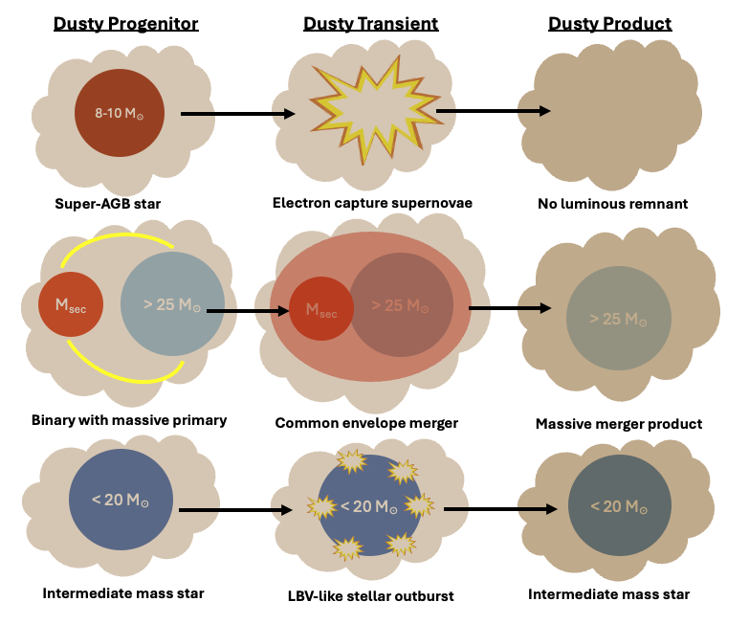
Are intermediate luminosity red transients (ILRT) electron capture SNe?
Sam Rose: PhD student
JWST/MIRI LRS
Rose+ 2025
PAH features in the MIRI spectrum of ILRT AT 2019abn suggest an SAGB progenitor consistent with electron-capture (Rose et al. 2025)
Image credit: S. Rose
Stay tuned for JWST Cycle 4 Observations (GO 7321, PI Rose)!

Slide 17
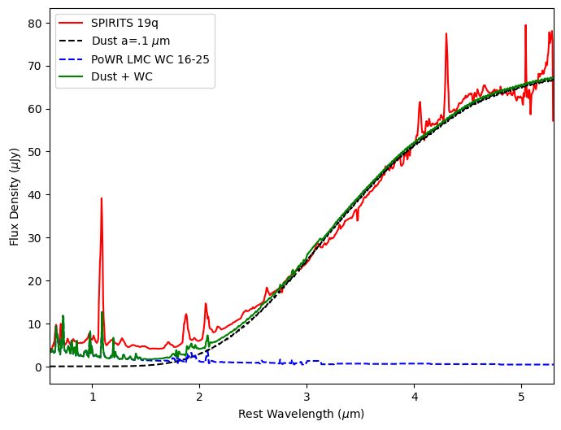
Carbon-rich dust from Wolf Rayet stars
SPIRITS 19q dust formation rate of 8 x 10⁻⁶ M☉/yr is comparable to the entire population of AGB stars in the LMC!
Sam Rose: PhD student
JWST/NIRSpec IFU
Image credit: R. Lau
Rose et al. in prep
Rose+ in prep.

Slide 18
Supernovae

Slide 19
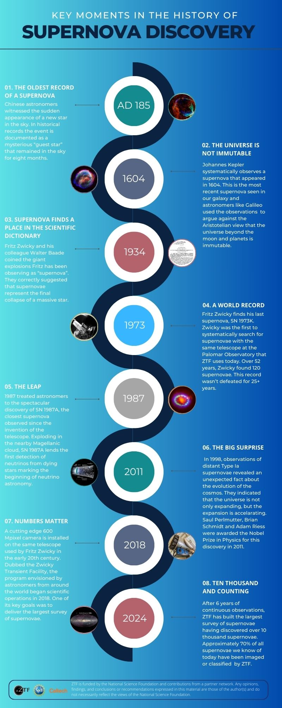
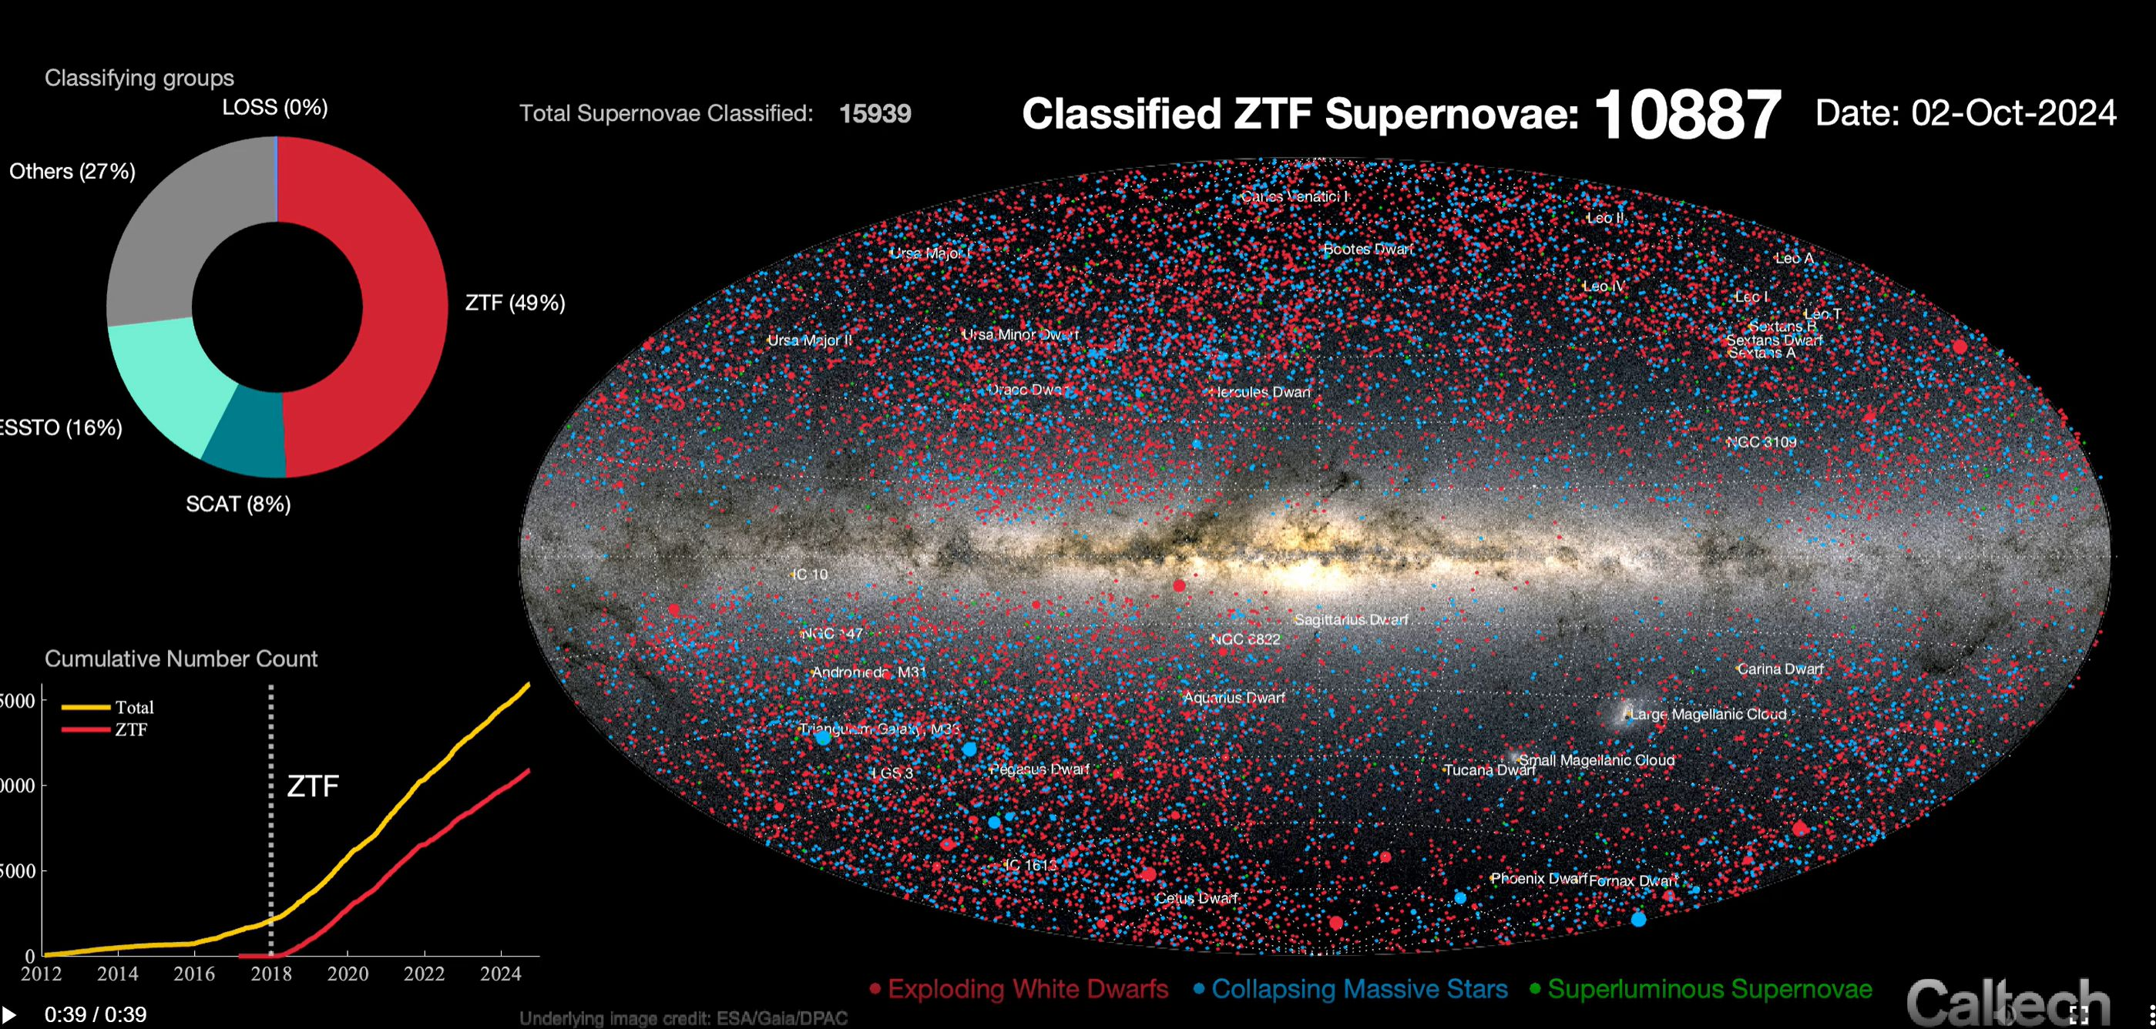
10K supernova

Slide 20
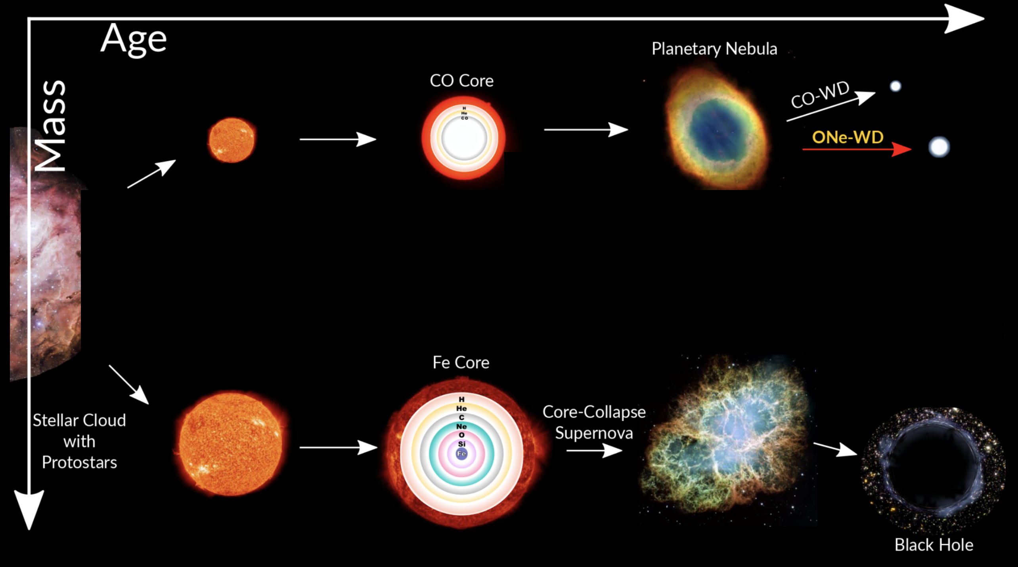
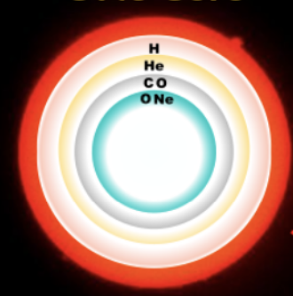
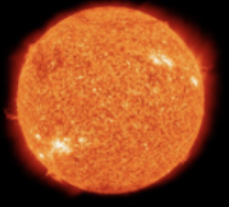
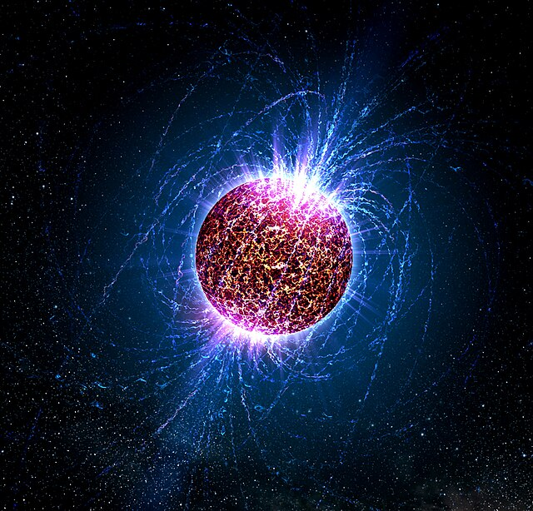
For low-mass stars
For intermediate-mass stars
8-12 M☉
ONeMg Core
Electron-capture Supernova
For high-mass stars
Neutron star or Black Hole

Slide 21




How do 8–12 M☉ stars explode?
Kaustav Das
Low Luminosity
Type IIP SN
Ultra-stripped SN
Double-peaked
Type Ibc SN
Ca-rich Type IIb SN
1
2
3
4
Das et al. 2025a
Das et al. 2024b
Das et al. 2024a
Das et al. 2023

Slide 22
How do 8–12 M☉ stars explode?
Low Luminosity
Type IIP SN
Ultra-stripped SN
Double-peaked
Type Ibc SN
Ca-rich Type IIb SN
1
2
3
4
Das et al. 2025a
Das et al. 2024b
Das et al. 2024a
Das et al. 2023

Slide 23
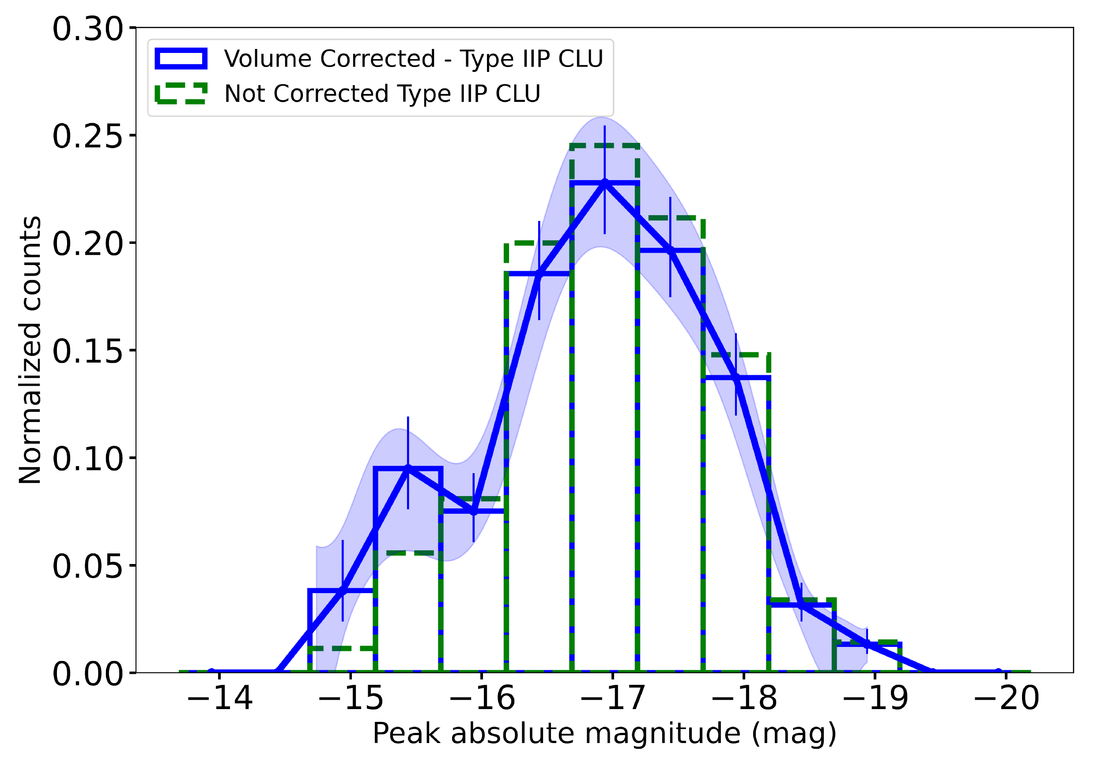
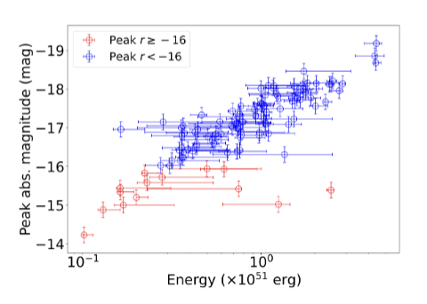
Largest sample of Type IIP SNe (230) from a systematic volume-limited survey, triples number of low-luminosity Type IIP SNe (36)
Low Luminosity Type IIP SN
Das et al. 2025a, 2025b
Before the CLU experiment
After the CLU experiment
Rate of LLIIP SNe
only ~9% of all CCSNe
< 1.5% fainter
than -14.5 mag

Slide 24
What do 8–12 M stars explode as?
Low Luminosity
Type IIP SN
Ultra-stripped SN
Double-peaked
Type Ibc SN
Ca-rich Type IIb SN
1
2
3
4
Das et al. 2025a
Das et al. 2024b
Das et al. 2024a
Das et al. 2023

Slide 25
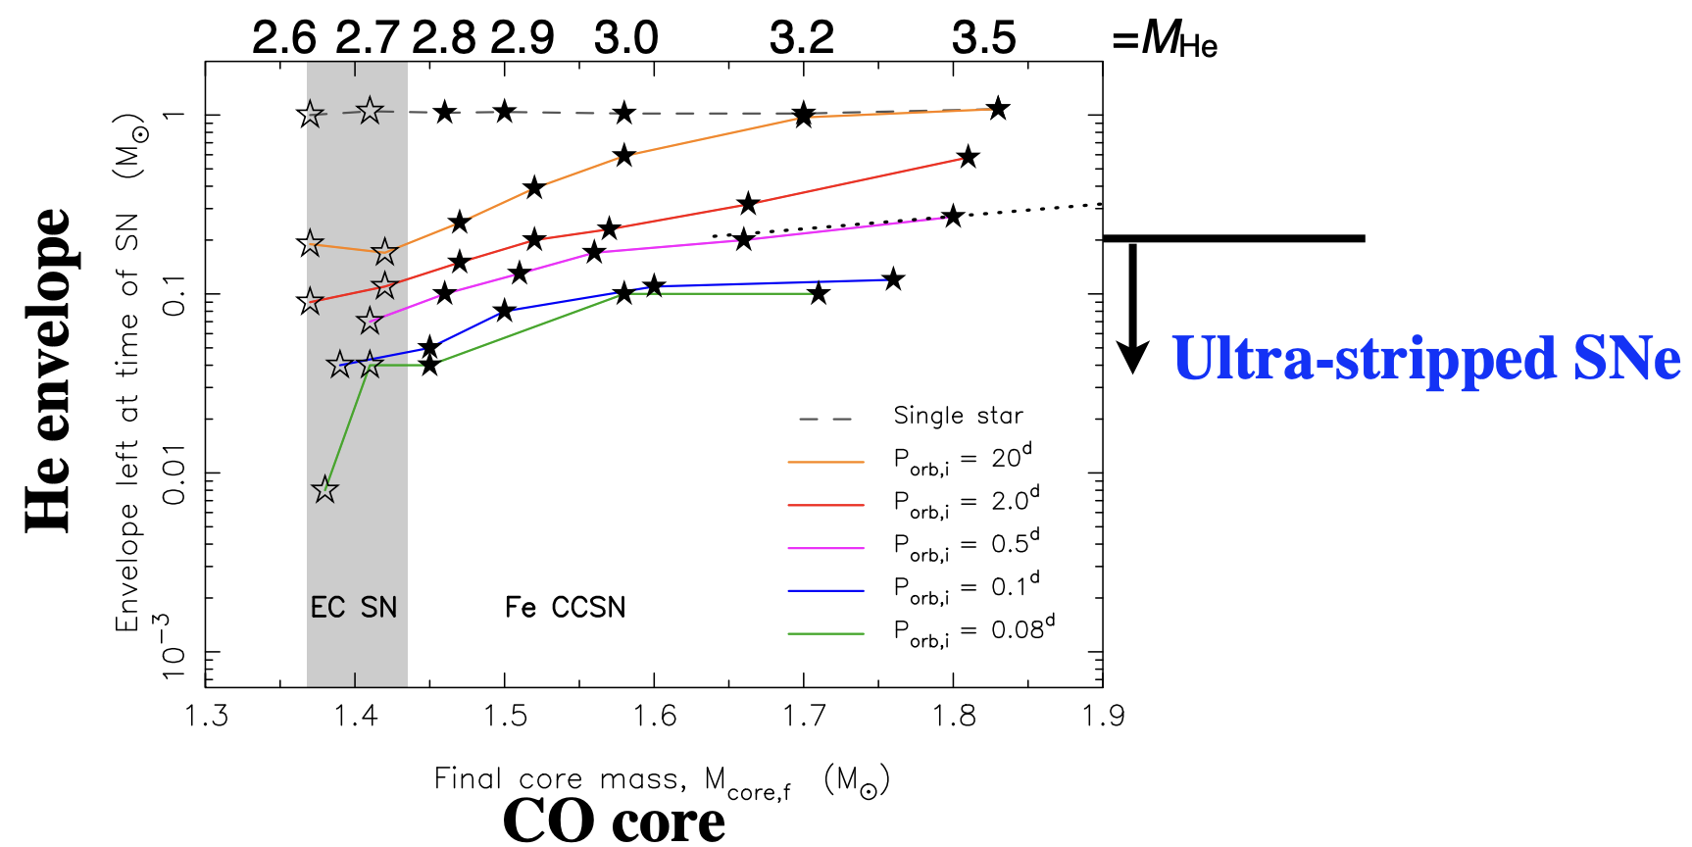

Interacting binary stars with 8—12 M$⊙$ form
He -stars < 2.6 M$⊙$ with CO core mass < 1.5 M$⊙$
Tauris et al. 2015
Clue: Look for the faint and fast-evolving stripped SNe

Slide 26

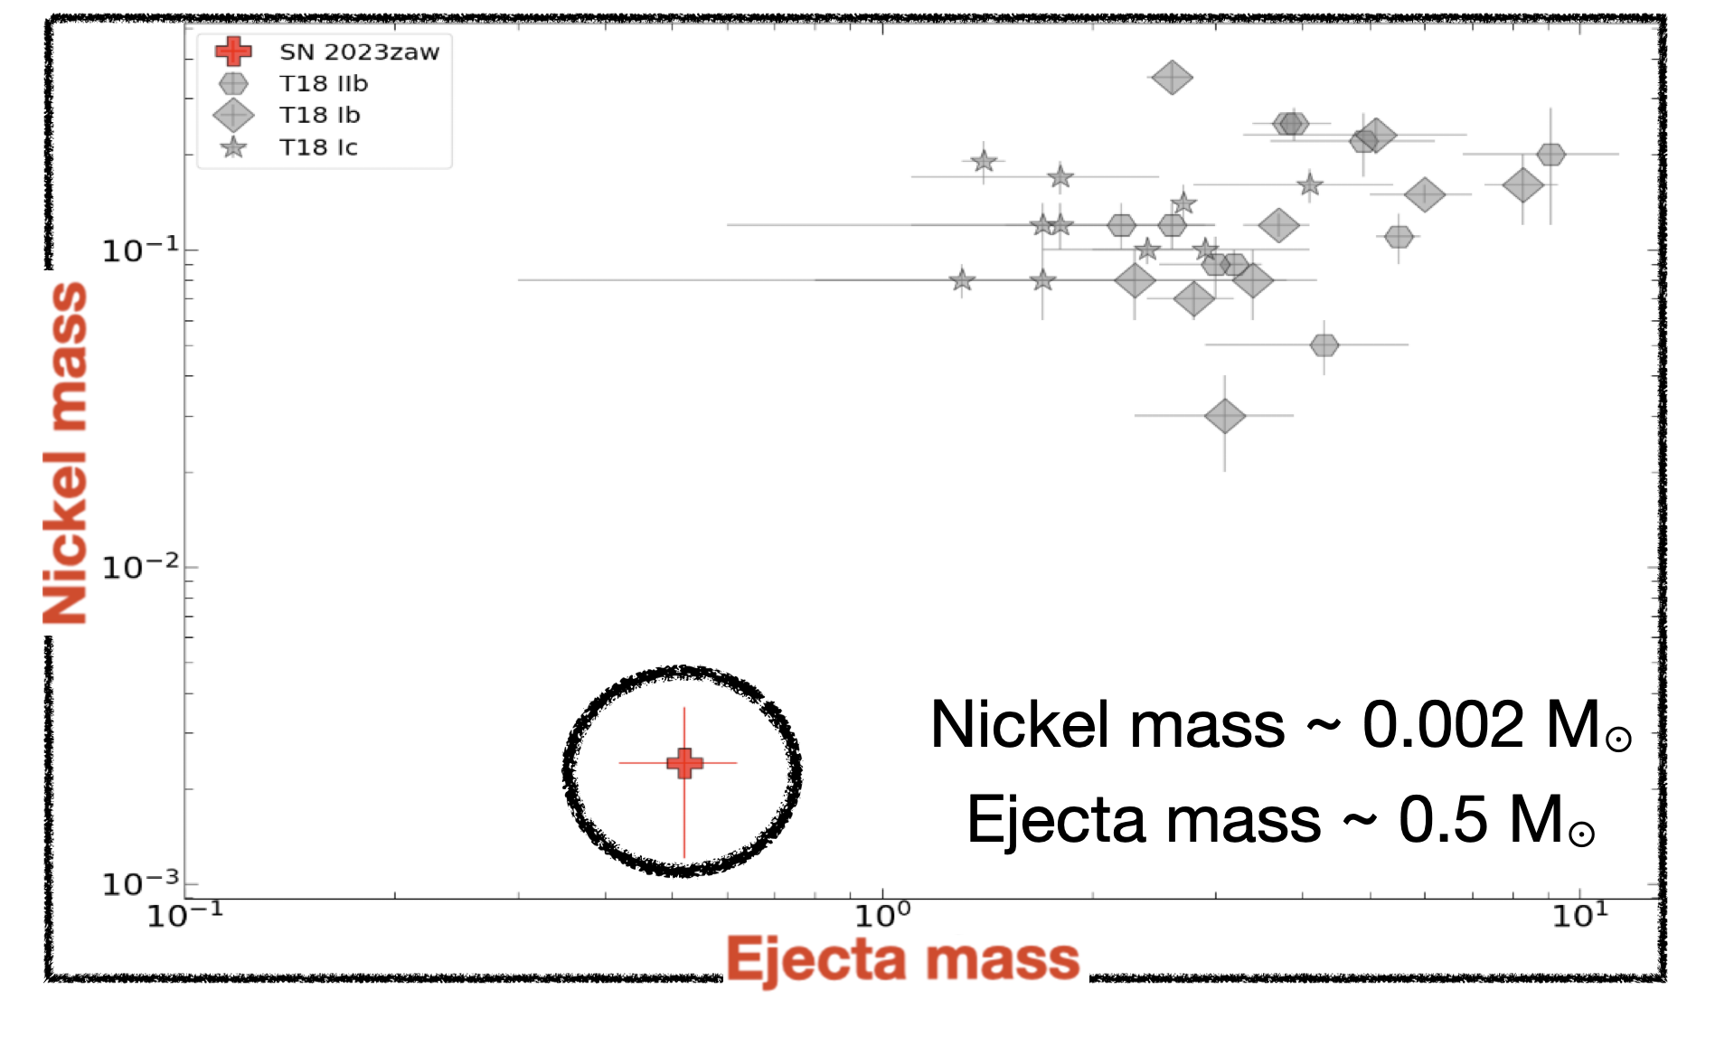
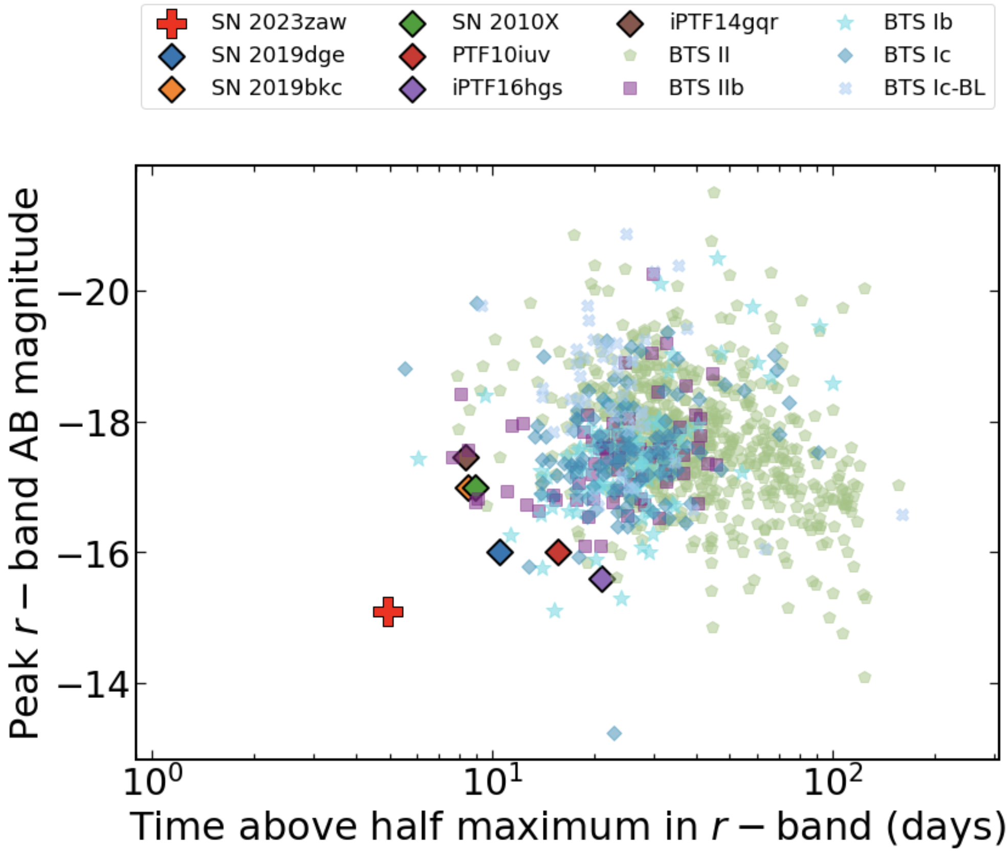

The lowest nickel mass in a stripped-envelope SN
SN 2023zaw: Fastest evolving sub-luminous transient to date
Das et al. 2024a
Notes:
One advantage of a systematic statistical survey is that it allows one to probe the phase space

Slide 27
How do 8–12 M☉ stars explode?
Low Luminosity
Type IIP SN
Ultra-stripped SN
Double-peaked
Type Ibc SN
Ca-rich Type IIb SN
1
2
3
4
Das et al. 2025a
Das et al. 2024b
Das et al. 2024a
Das et al. 2023

Slide 28
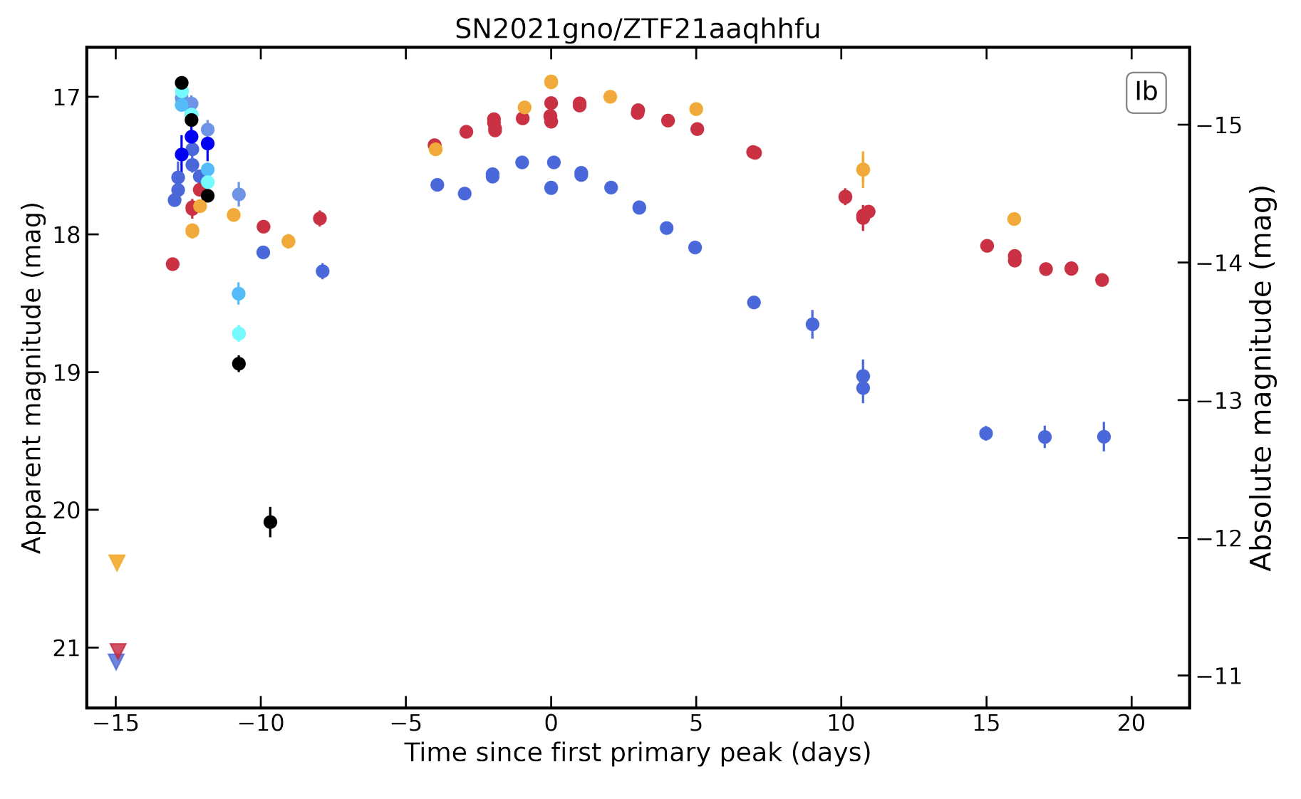
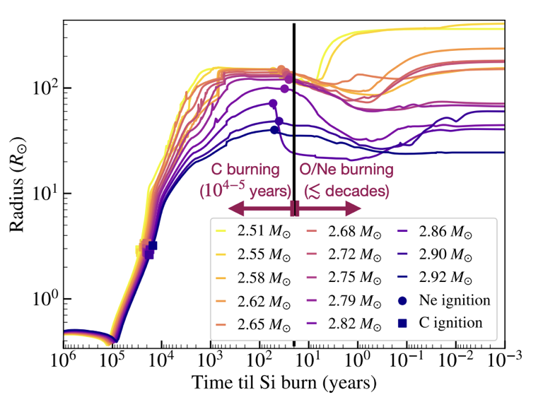
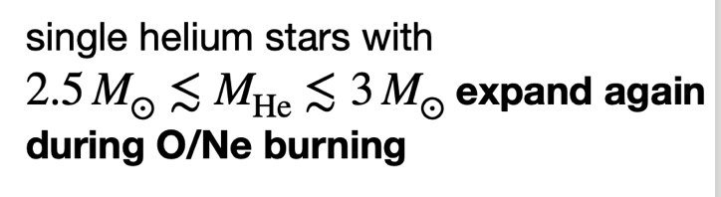
Sample of 14 double-peaked Type Ibc SNe in ZTF
Double-peaked Type Ibc SNe (Das et al. 2024b)
CORRELATION BETWEEN TWO PEAKS
Wu & Fuller 2023
Das et al. 2024a
Rate ~1—3% of core-collapse SNe

Slide 29
How do 8–12 M☉ stars explode?
Low Luminosity
Type IIP SN
Ultra-stripped SN
Double-peaked
Type Ibc SN
Ca-rich Type IIb SN
1
2
3
4
Das et al. 2025a
Das et al. 2024b
Das et al. 2024a
Das et al. 2023

Slide 30

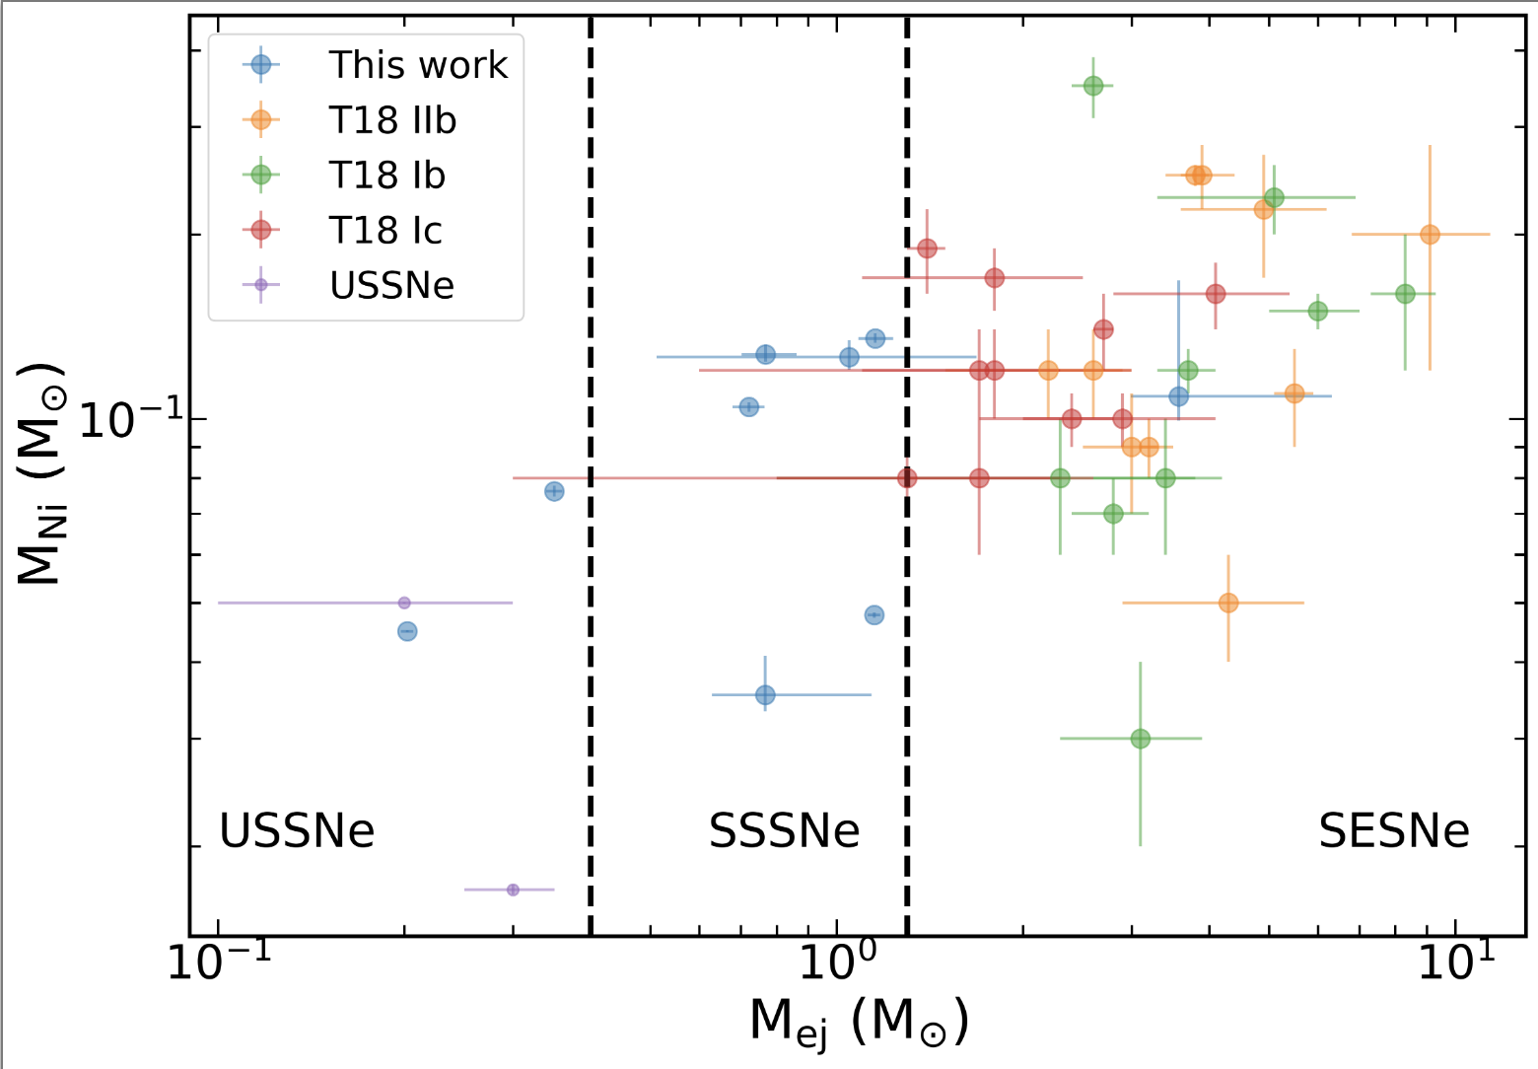
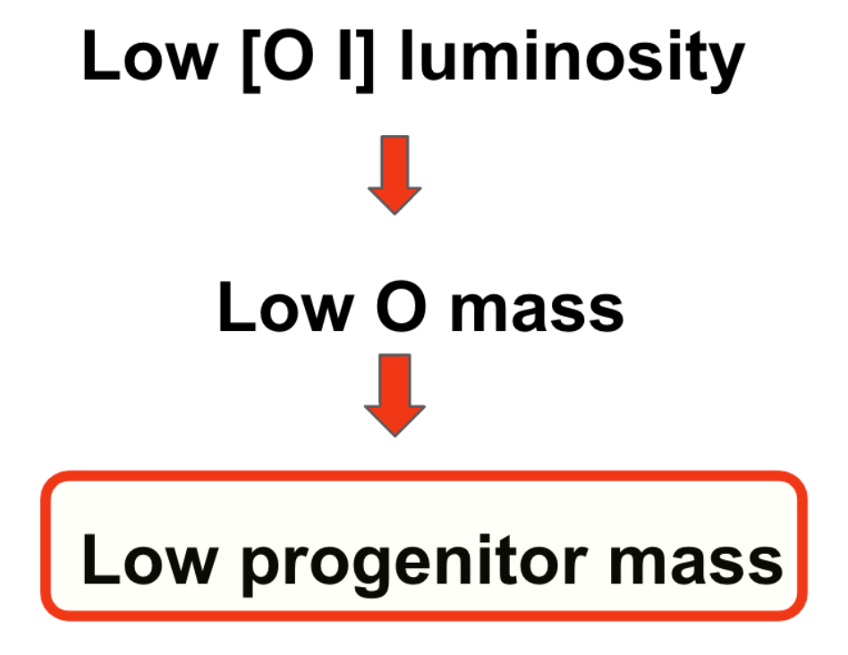

Strongly Stripped Supernovae
Ca-rich Type IIb SNe (Das et al. 2023)
In star-forming regions of star-forming galaxies
Shows hydrogen in photospheric phase
Ejecta mass < 1 M$⊙$
Ca-rich nebular spectra

Slide 31
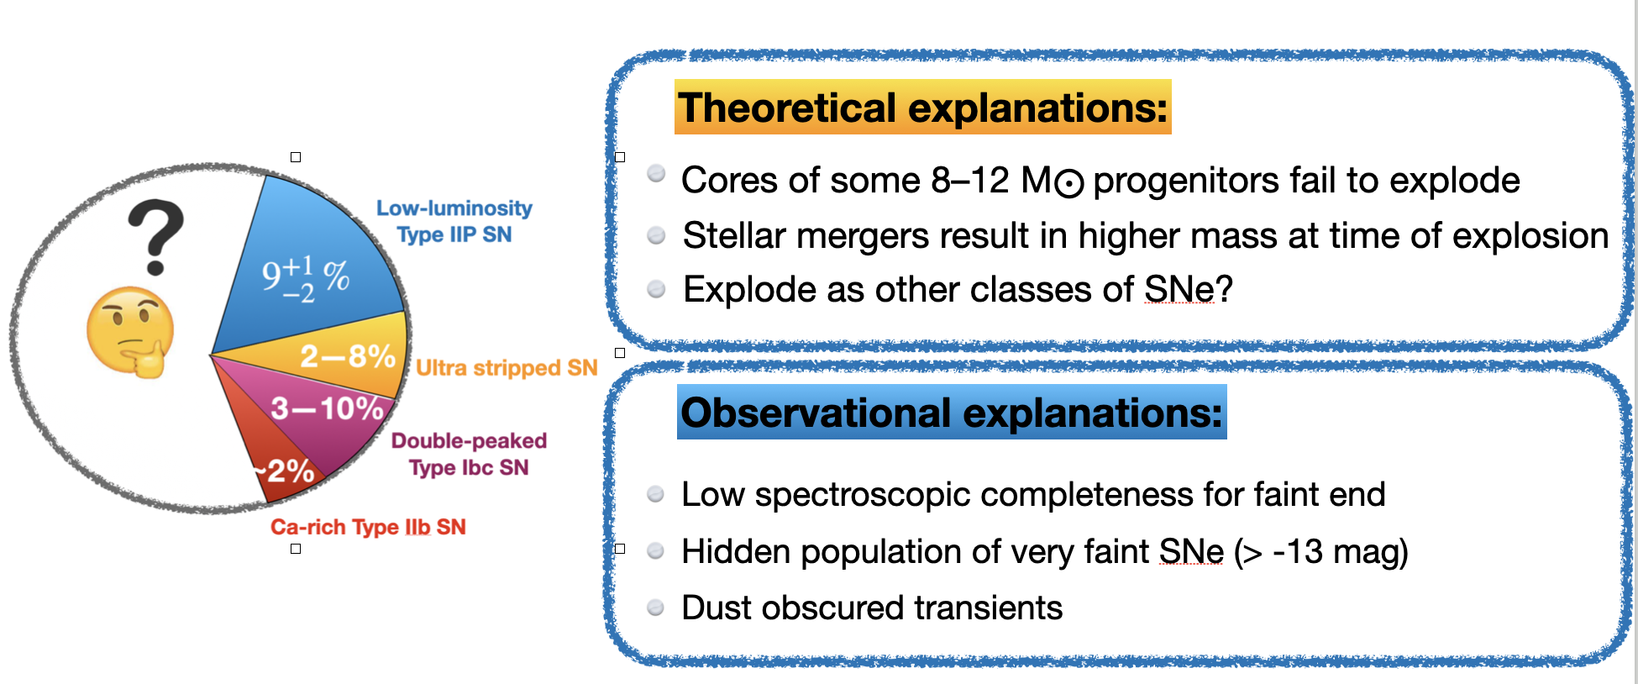
So do the rates actually add up?

Slide 32
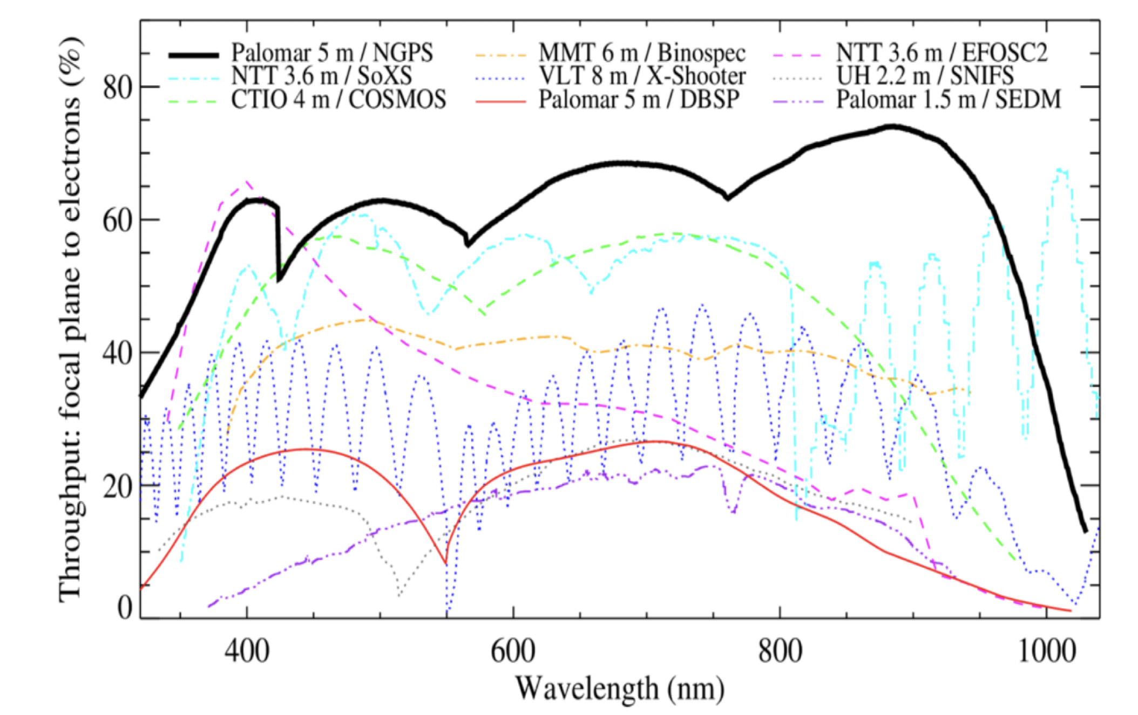
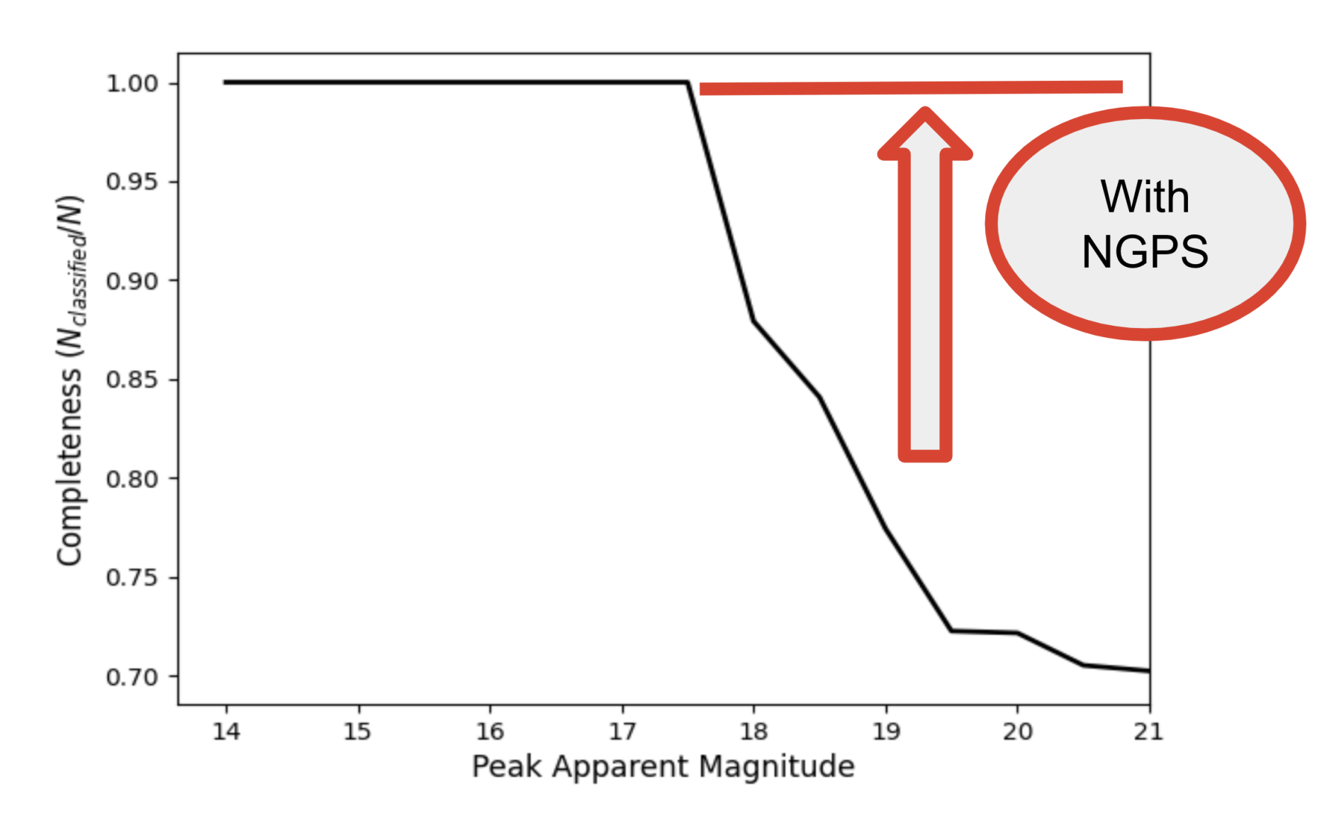
Kaustav Das
(Grad)
CATS150: Complete within 150Mpc (PI Kaustav Das) - Ongoing 1-year survey in 2025
Starting 2026, we plan to classify all transients in the ZTF+Rubin footprint

Slide 33
Future Surveyors

Slide 34


Roman Alerts Promptly from Image Differencing http://rapid.ipac.caltech.edu
Cryoscope in Concordia
(Kasliwal et al. 2025)

Slide 35



UVEX
The Ultraviolet Explorer
(PI Fiona Harrison)
UVEX provides:
Sensitive wide-field imaging in NUV and FUV
Rapid ToO UV spectroscopy
Selected by NASA as next MIDEX launch in 2030!
http://uvex.caltech.edu

Slide 36

Namaskar
नमस्कार

