Slide 1
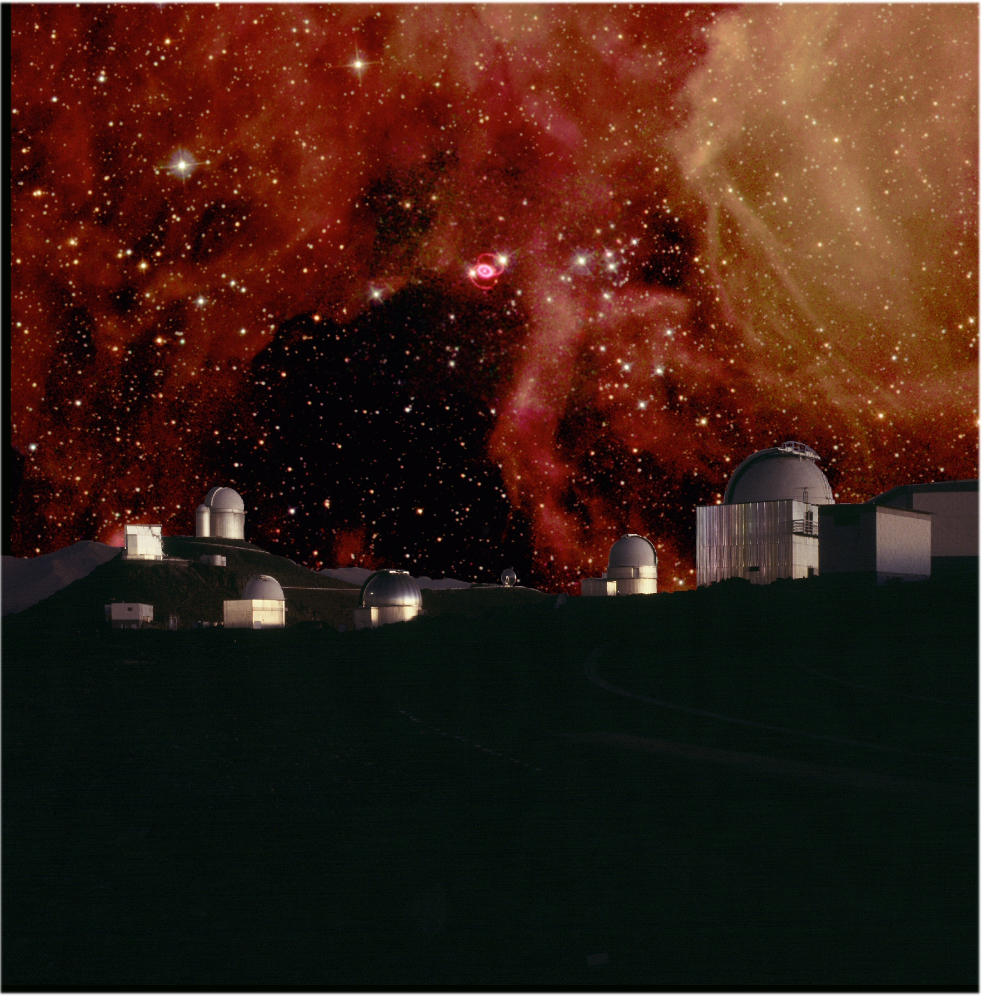
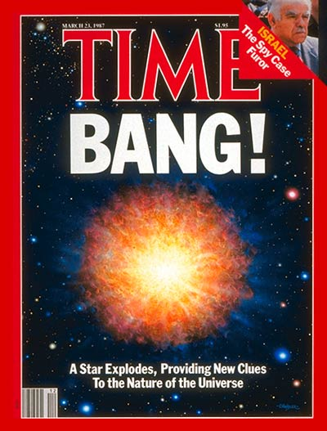
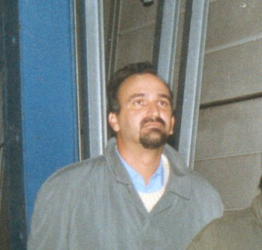




SN 1987A : 13917.21 days outburst
38 years 1 month 7 days 10 h
An Extraordinary Journey Into The Transient Sky, Padova, April 1st., 2025
Patrice.Bouchet@cea.fr
DAp/Irfu/CEA – Saclay
JWST/MIRI Head Centre of Expertise
CNRS : UMR AIM
Paris-Saclay University
Paris-Cité University
+ John Danziger (INAF, Italy)

Slide 2
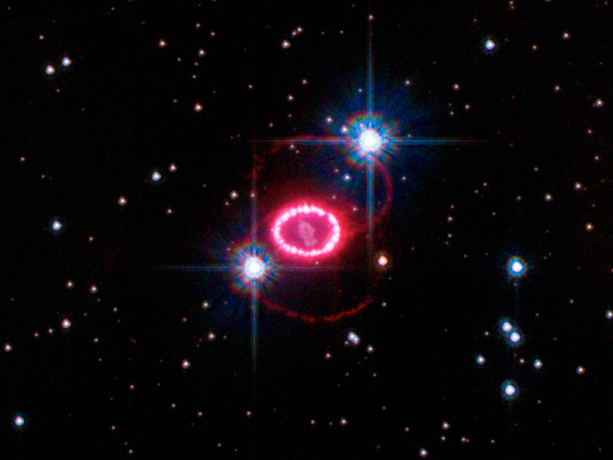
SN 1987A with JWST: The Formation & Evolution of Dust in a Supernova Explosion
A Joint GTO Program with MIRI-EC (PI’s: PB & M. Barlow) and Meixner’s US MIRI Science Time

Slide 3
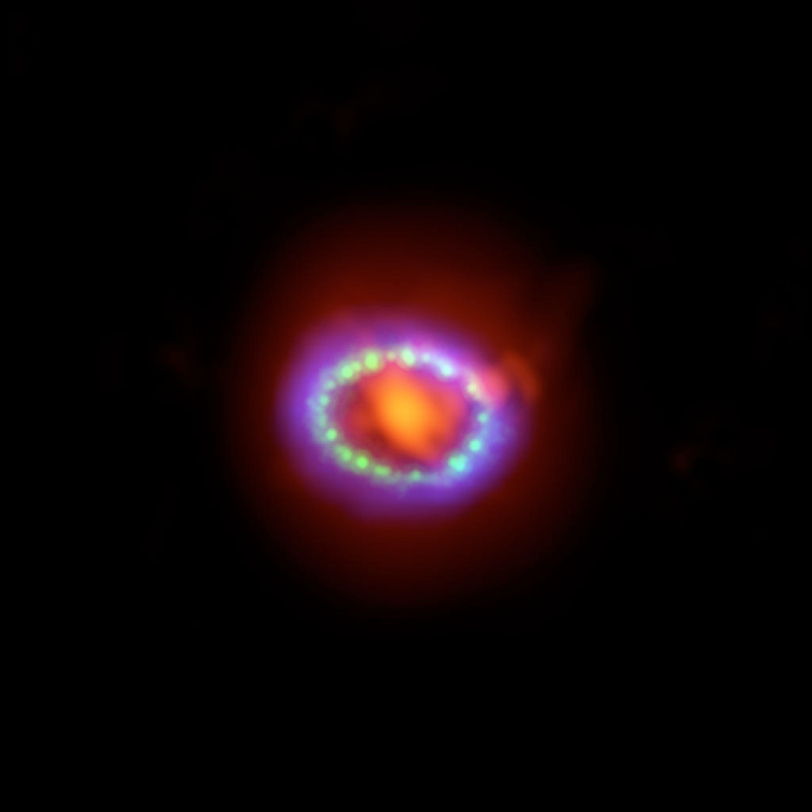
What can the JWST do for us?
Exquisite resolution in the infrared (0.6-28 microns) Accurately resolve both the ring and ejecta.
Sensitivity — detect faint emission from ejecta & the warm dust emission from the circumstellar ring.
Medium and high resolution IFU imaging spectroscopy provides line & continuum measurements of the gas & dust which is interacting with the expanding shock wave.
We are going to observe the ring and ejecta of SN1987A at three epochs using:
  MIRI/MIRIm imaging (F560W, F1000W, F1800W & F2550W)& LRS
  MIRI/MRS IFU and NIRSpec IFU imaging spectroscopy
  Plus parallel observations with the MRS & MIRI simultaneous imaging (when possible).
  88
  Total observing time : 18 hours
Notes:
We want to understand how massive stars age and explode,
how their ejecta form dust and molecules and how the blast
wave from their violent explosion affects their surroundings.
JWST MIRI imaging, MRS spectroscopy and NIRSpec IFU
spectroscopy will provide key emission line diagnostics and dust feature
and continuum measurements of SN 1987A.
The central stellar ejecta of SN 1987A is surrounded by a ring of
progenitor gas and dust that is being shocked by the blast wave of the explosion.
A large quantity (0.4-0.7 M) of dust in the stellar ejecta has an unknown
composition and our MIRI observations may provide the first constraints
through the imaging and MRS spectroscopy. Both the MRS and NIRSpec
IFU spectroscopy will measure key shocked line diagnostics that will constrain
the shock physics as well as the elemental abundances in both the ring and the
stellar ejecta. The environment of SN1987A has significant star formation, which
has been studied using HST imaging during parallel HST imaging spectroscopic
observations of SN 1987A. This star formation will be studied using parallel fields
when SN 1987A is the prime target

Slide 4
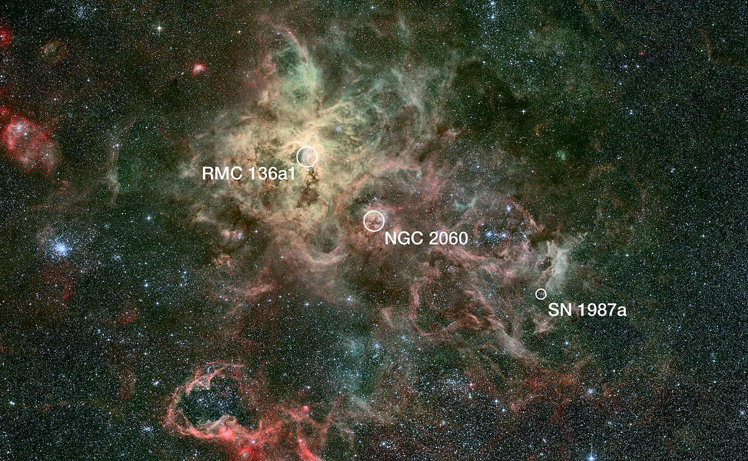
PARALLEL OBSERVATIONS
When MRS is prime:
MIRI simultaneous imaging in the 5.6, 7.7 and 25 micron filters to measure the dust emission from young stellar objects & the surrounding interstellar medium.
When MIRIm is prime
The MRS will provide critical background measurements of both the telescope emission & the ISM background. This is essential to reducing systematic issues with the MRS measurement of SN1987A.

Slide 5
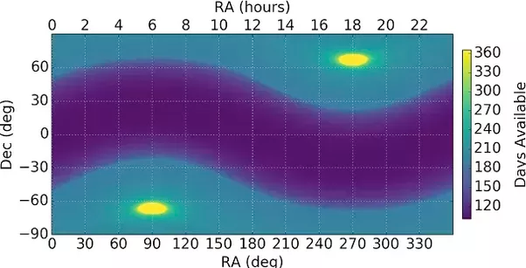
SN1987A is in the continuous viewing zone
We can observe changes in SN1987A over a wide temporal base-line.

Slide 6
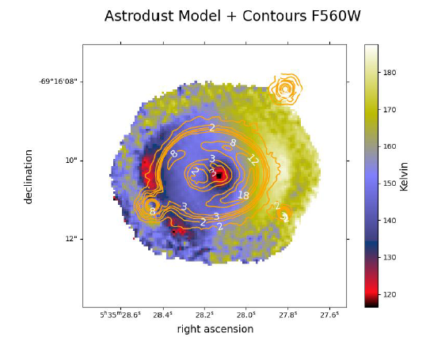
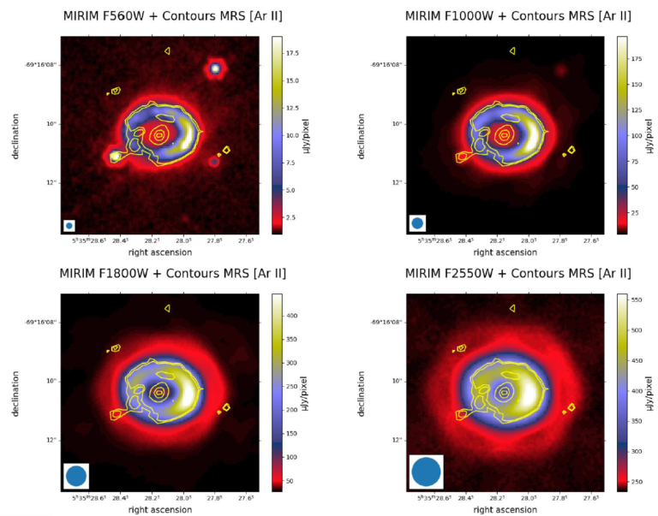
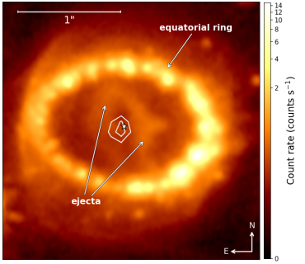
MIRI Imager (Bouchet et al., 2024)
Detailed map of temperatures and morphology of the SNR.
Some dust results from the evolution of the progenitor star (in the different rings), while others have condensed into the ejecta during the event: Destruction of dust in some areas, and further condensation of dust in others.
The initial shock wave has now reached the outer regions of the CSM

Slide 7
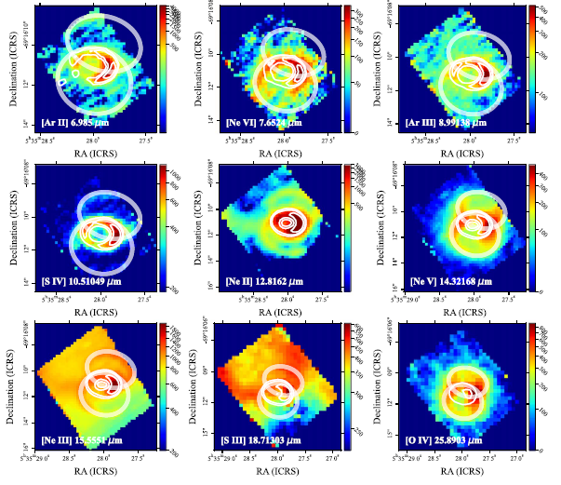
MIRI MRS (Jones et al., 2023)
When an expanding gas hits dense regions, it cools down : properties of this gas when it comes into contact with the equatorial ring, and after the shock.
Identification of chemical elements in less dense environments (the strong ionisation could have been produced by the progression of a shock wave sequence through the ring, or by the UV radiation associated with the origin of the event.
The smallest dust grains are more easily destroyed than those of larger dimensions
Identification and localization of the main elements that make up the ejecta

Slide 8
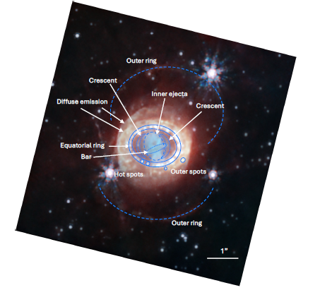
NIRCam (Matsuura et al., 2024)
The inside of the ejecta is composed mainly of iron which radiates at 1.6 µm.
A bar inside the ejecta (aligned ~ East-West)
2 croissants (H2) between ejecta and ER.
Hot spots also visible in the ER (bounded by the 2 ellipses), but also found outside this ring.
Continuous bright emission outside the ring.
Between 1 and 2.3 µm : emission from chemical elements in the ejecta and in certain regions of the equatorial ring (hot spots).
Between 3 and 5 µm : continuous emission from dust in the ejecta (dust that could also mask parts the center of the supernova), and a synchrotron emission in the equatorial ring and its exterior.
NIRCam filters : 1.5 and 1.6 µm in blue; 2 µm in yellow; 4 µm in orange; 4.4 µm in red.

Slide 9
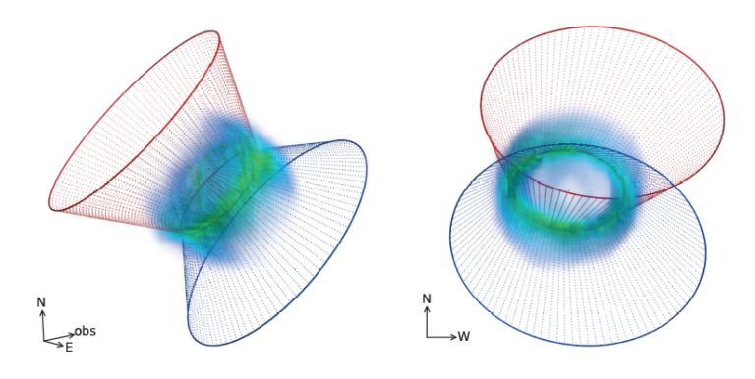
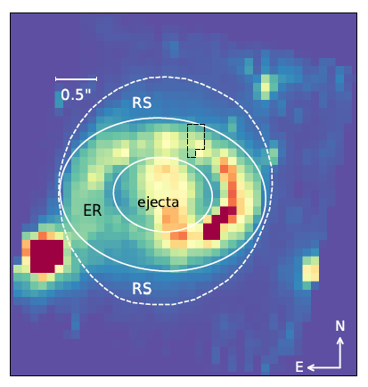
NIRSpec (Larsson et al., 2024)
3-D maps of Fe emissions inside the ejecta : geometry of the event
strongly asymmetrical morphology that resembles a broken dipole dominated by two large clusters of high speeds (about 2300 km/s).
the inside of these ejecta began to interact with the reverse shock
3-D maps of He in the reverse shock (any shock that propagates in a dense region generates an inverse shock) : traces the composition of the CSM.
Many lines of H2: most likely excited by extreme ultraviolet radiation, but could also result from a combination of collisions and recombinations in the low-temperature ejecta layers.
Several very strongly ionized coronal lines have been identified in the ER : T > 2 10⁶ K ➔ associated with the radiation observed in high energies, especially in X-rays
3D visualization He in the RS

Slide 10
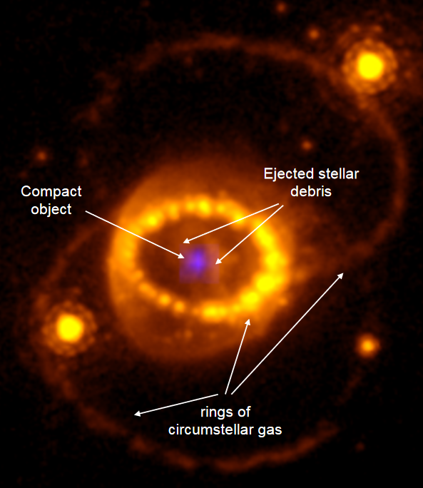
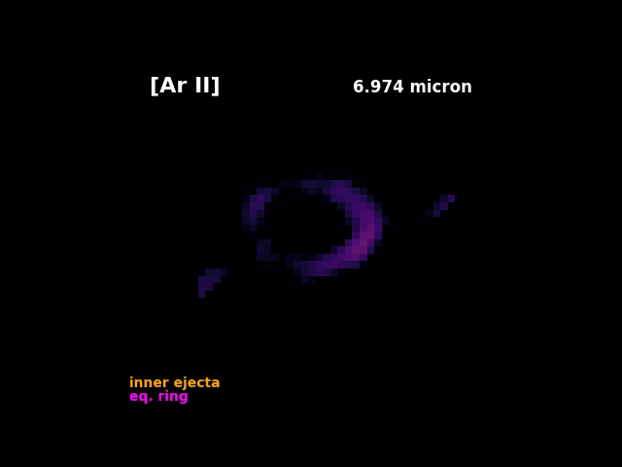
MRS + NIRSpec : A long-standing mystery finally solved
(Fransson et al., 2024)
The ionizing photons emitted by a neutron star must excite the emission lines of the heavy elements in the ejecta ➔ search for these emissions in data from the MRS and NIRSpec.
Strongly ionized lines from Argon and Sulphur (the elements produced by the nuclear combustion of O and Si. Already been detected but with insufficient resolutions (angular and spectral) to know whether they came from the ejecta or the ER. The observations have shown unambiguously that the emission is from a central source separate from the ring.
Potential sources could be only : (1) photons from PWN generated by a NS; (2) photons that come directly from a cooling NS; (3) accretion on a compact object; or (4) shocks in a PWN.
➔ all possible explanations involve the presence of a young neutron star, or black hole, at the centre of the ejecta.

Slide 11
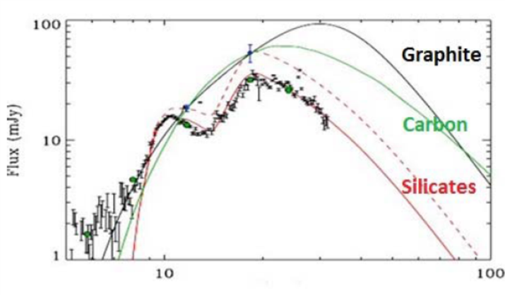

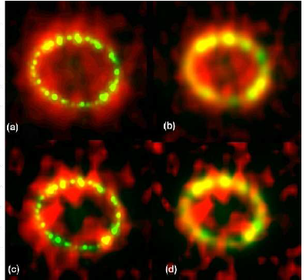



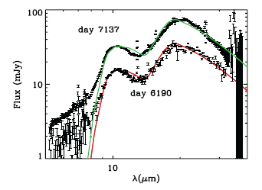

Rick Arendt
T-ReCS/Gemini HST/F625W
Spitzer
11.7 μm
19.6 μm
Eli Dwek
Bouchet et al., 2004, 2006

Slide 12
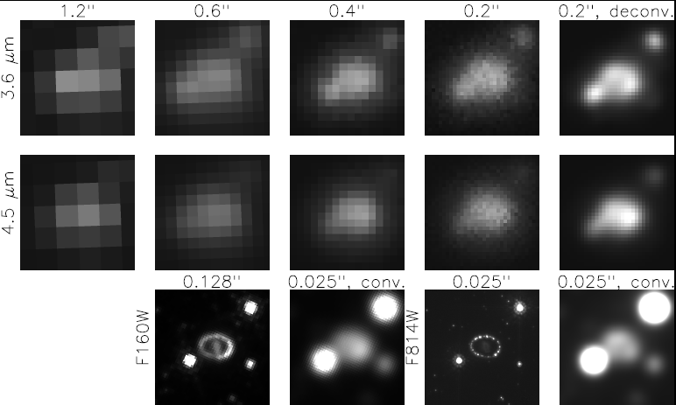
Near-IR excess emission arises from the ER!
Spitzer
IRAC
H
I
HST
WFC3
Bouchet et al., 2019

Slide 13
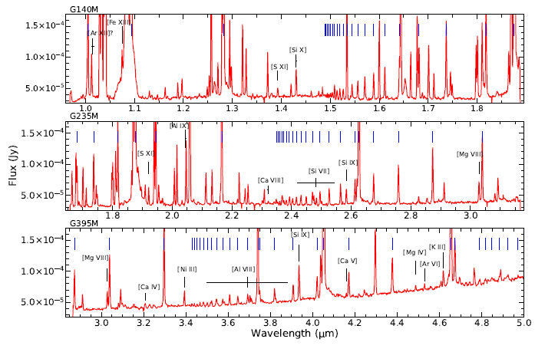
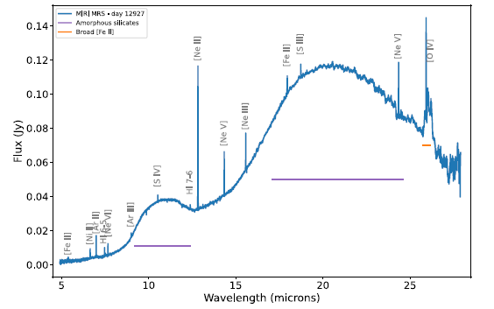
JWST
NIRSpec
MRS
Larsson et al., 2024
Jones et al., 2023

Slide 14
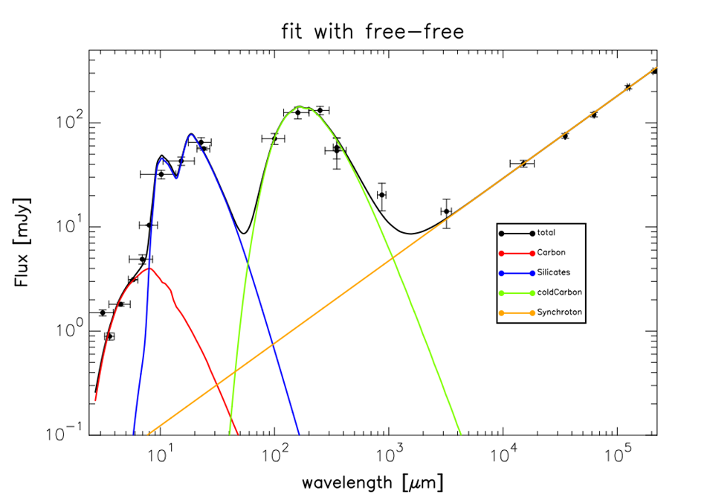
Conventional, « Canonical » fit of the SED in the littérature.
Bouchet et al., in prep.

Slide 15
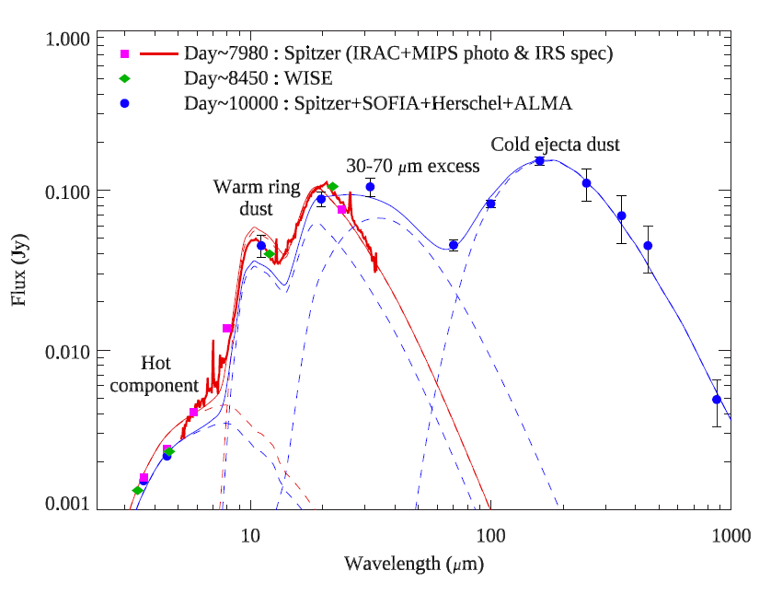
WISE: days 8330 – 8565
Herschel : day 9090
SOFIA : day 10732
??
T_{Dust} = 85 K
M_{Dust} = 3 – 4 10⁻⁴ M⊙
SOFIA Observations : Matsuura et al., 2019
➔ Pavlovian conditioning : dust, or BB, or grey BB ?

Slide 16
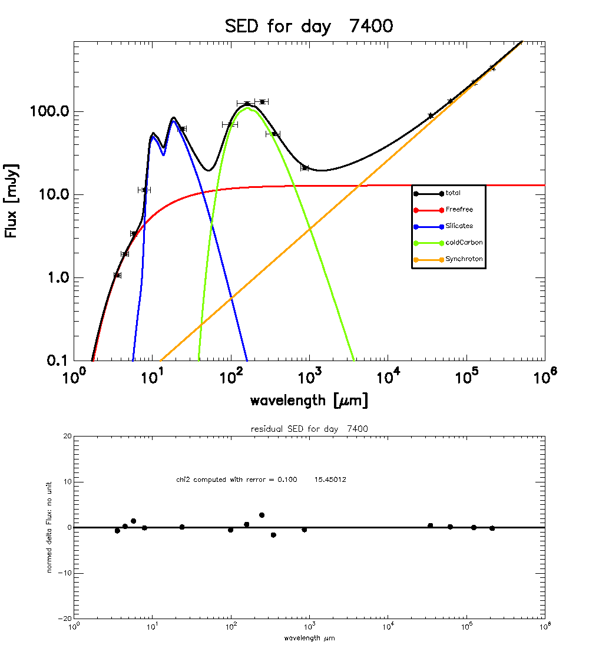
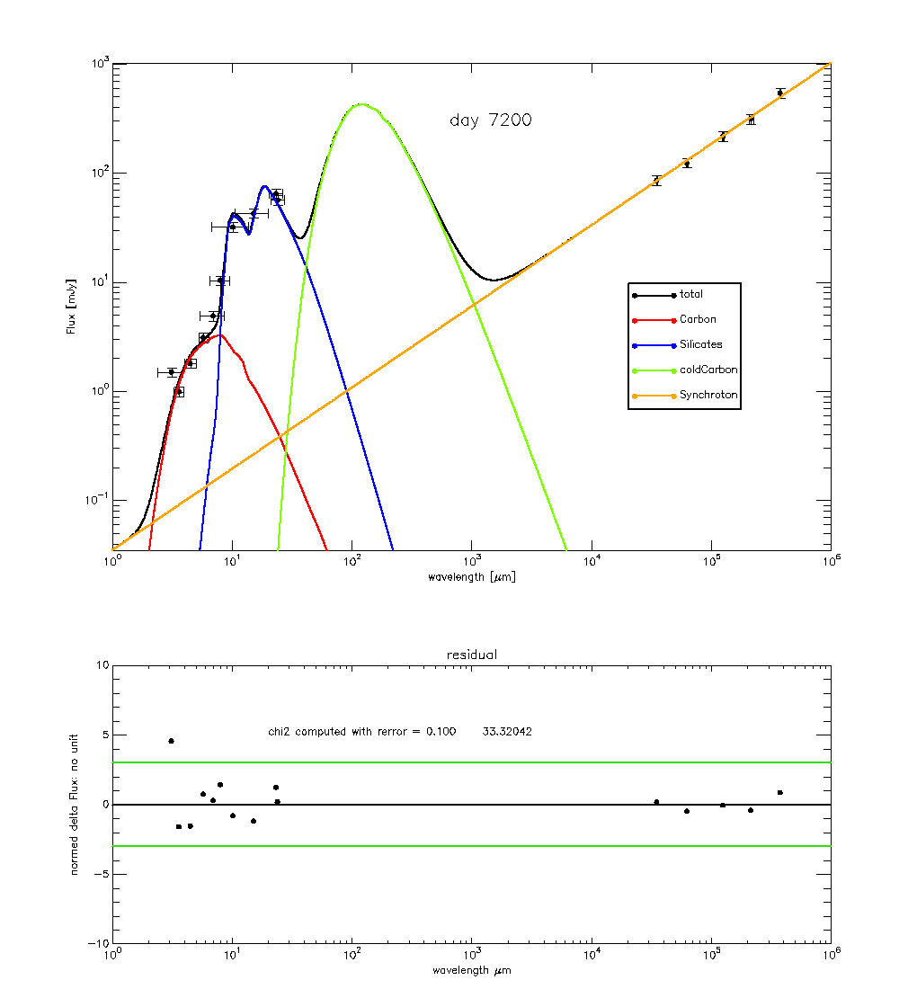
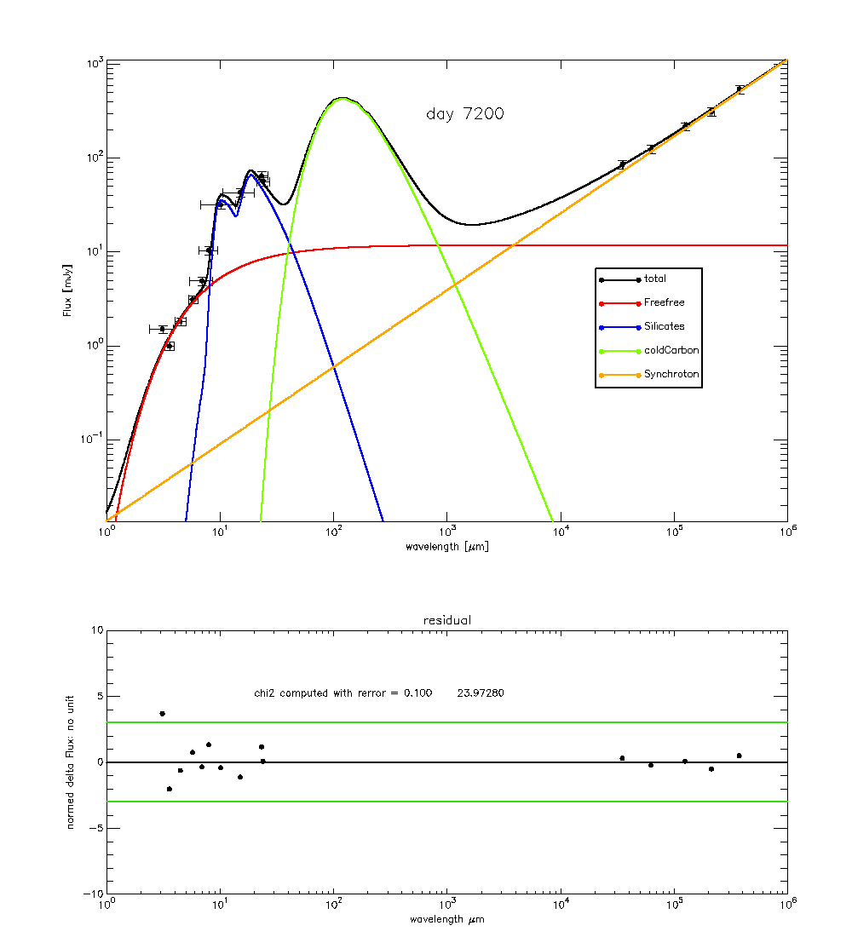
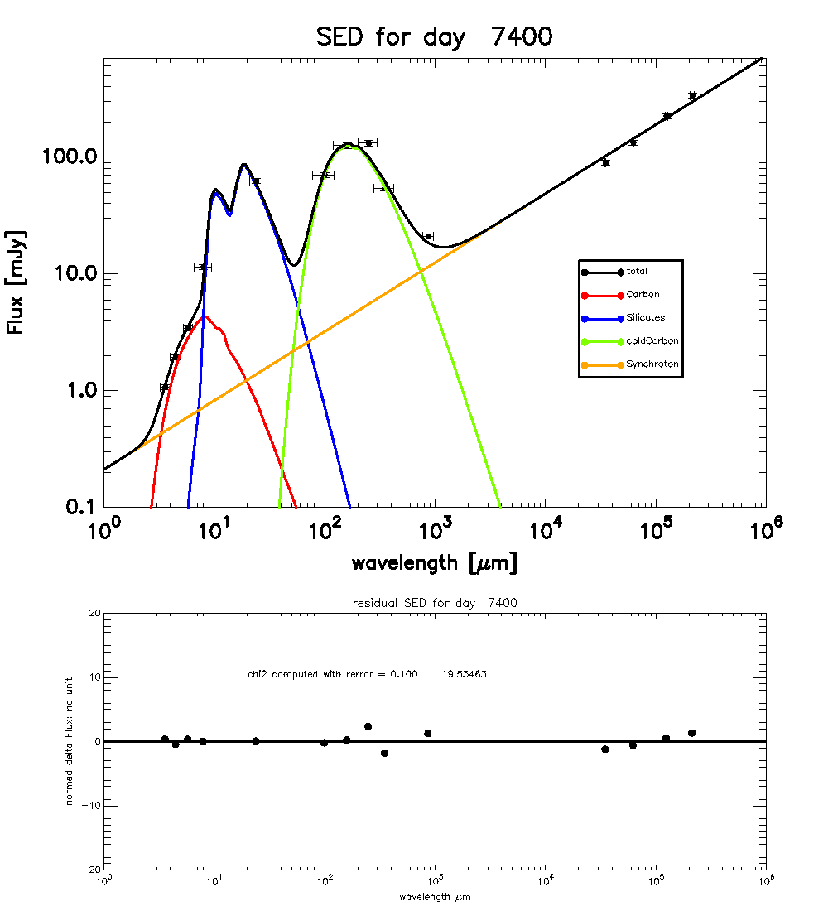

Slide 17
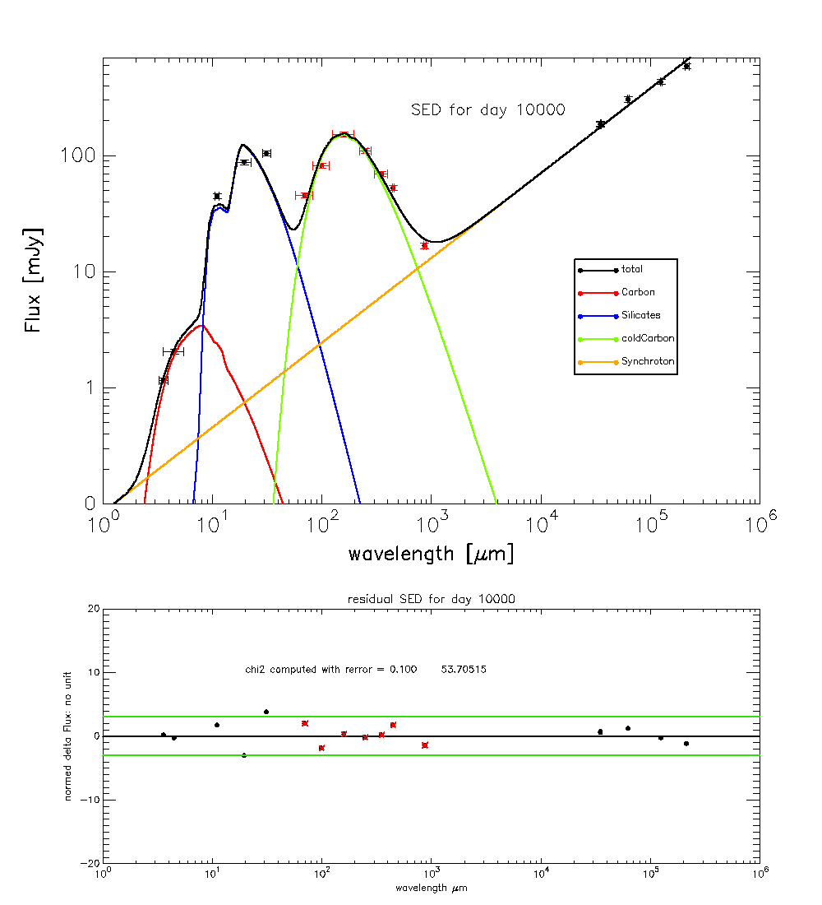
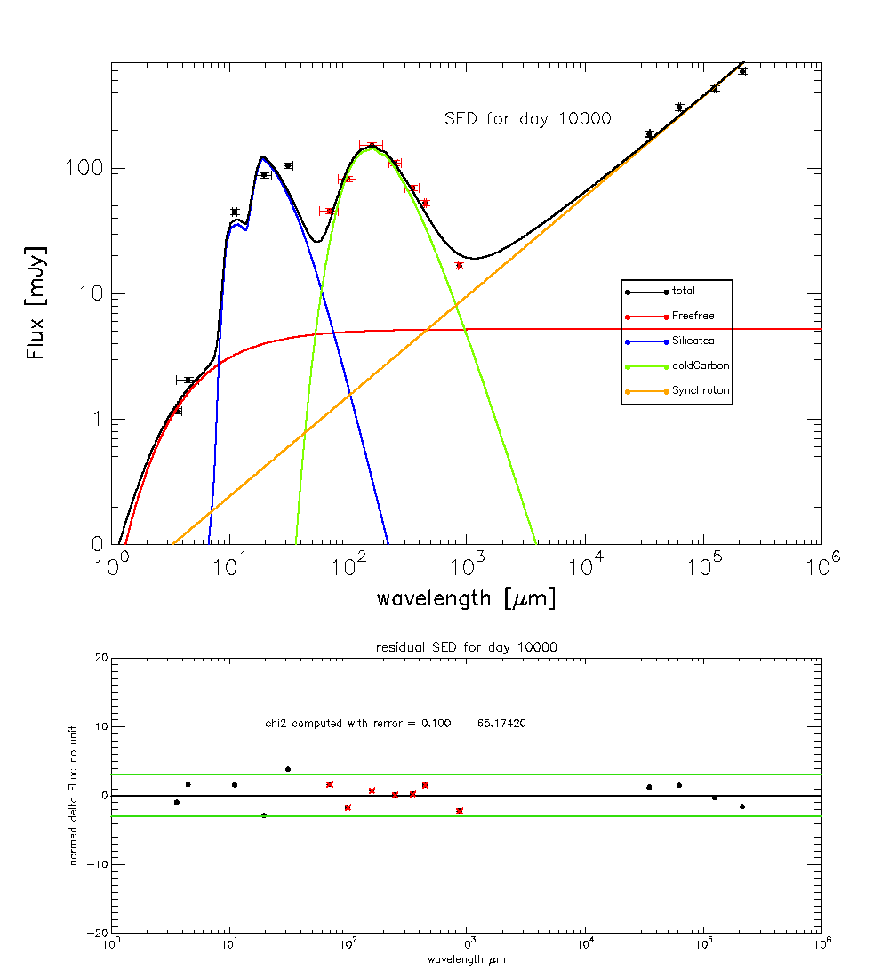

Slide 18
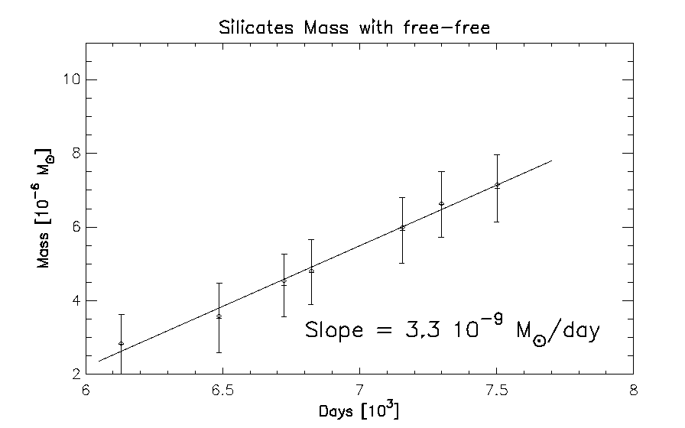
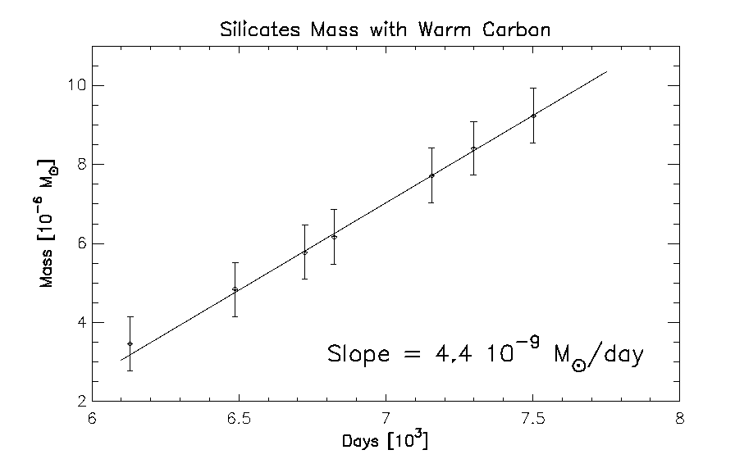
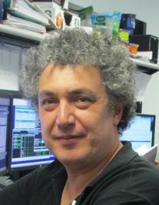
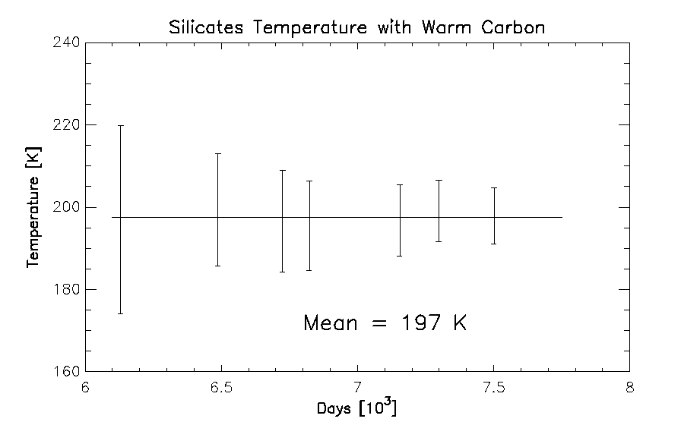
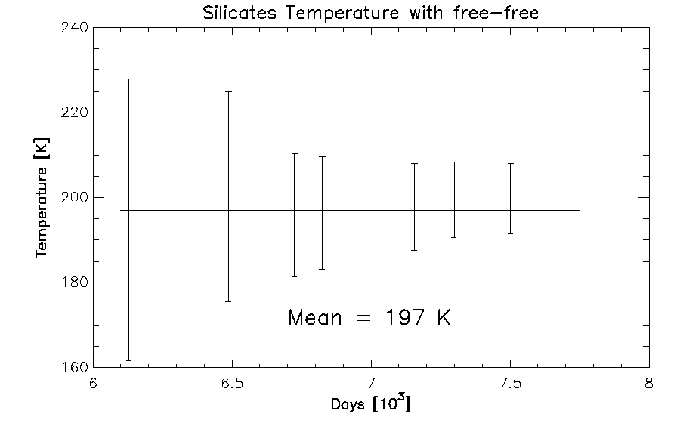

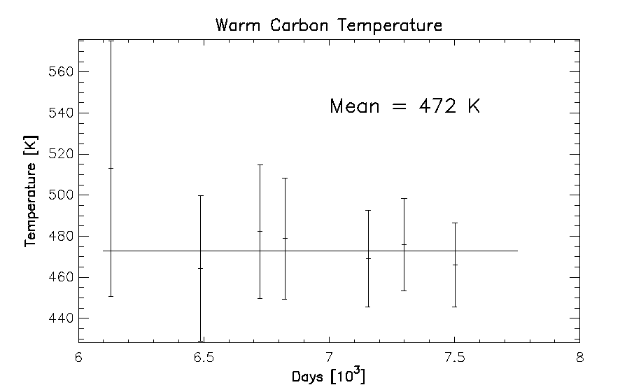
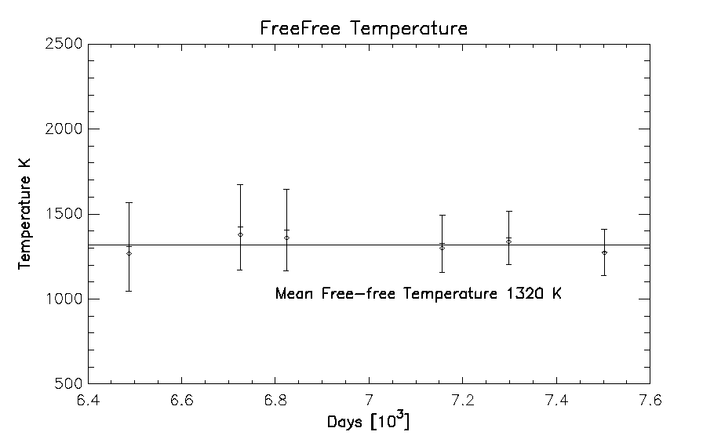
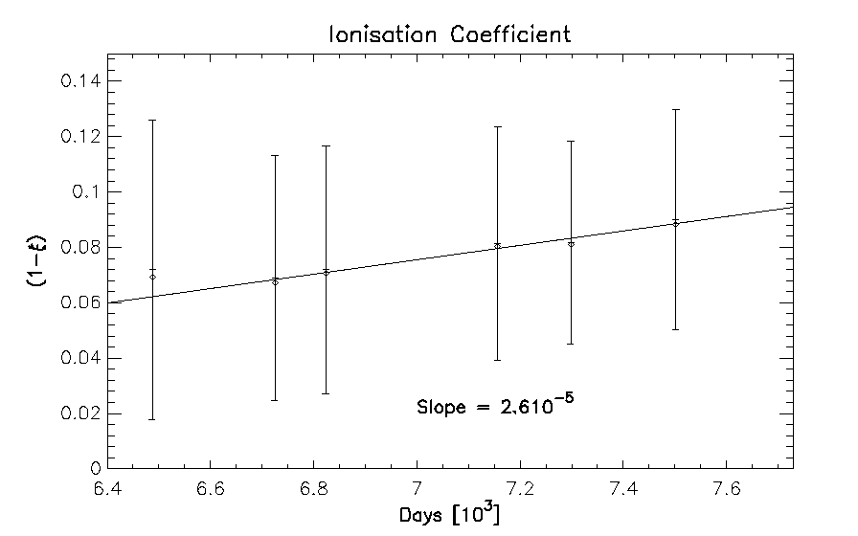
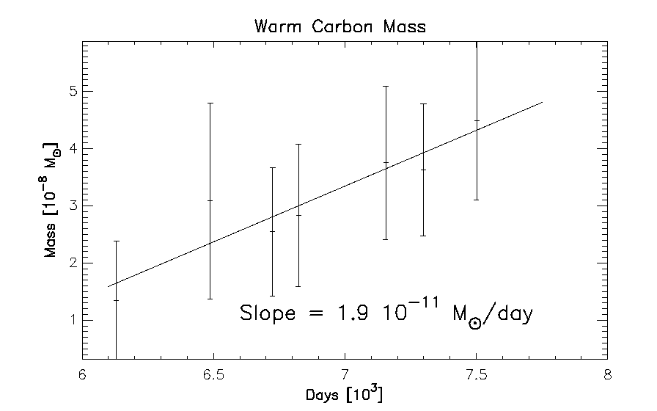
Alain Coulais
René Gastaud

Slide 19
Light Curves Spitzer Observations from Arendt et al. (2020)
A Gaussian function convolved with an exponential decay :

Slide 20
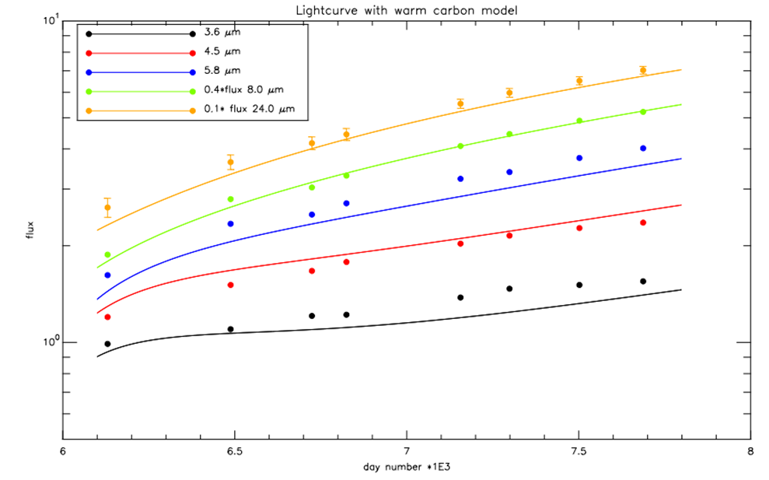
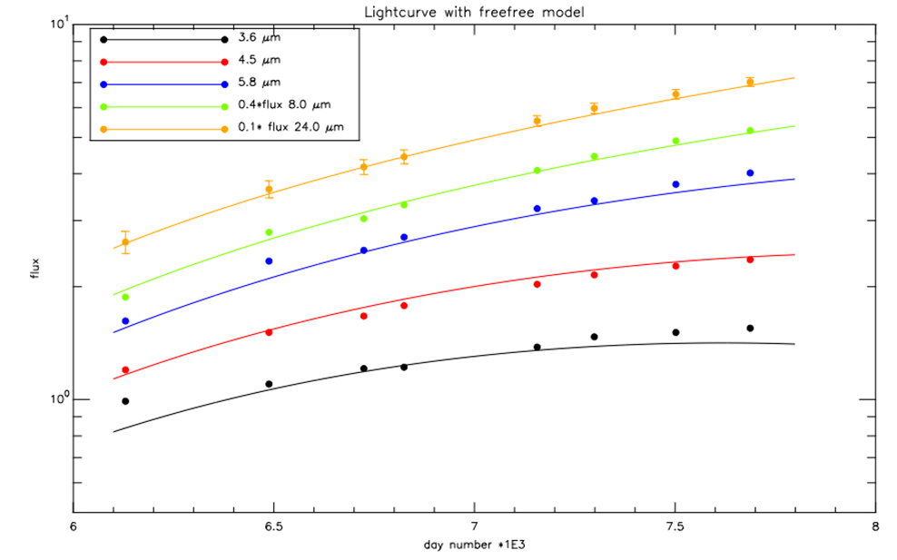
Light Curves: Data vs. Our Model
Warm Dust
Free Free

Slide 21
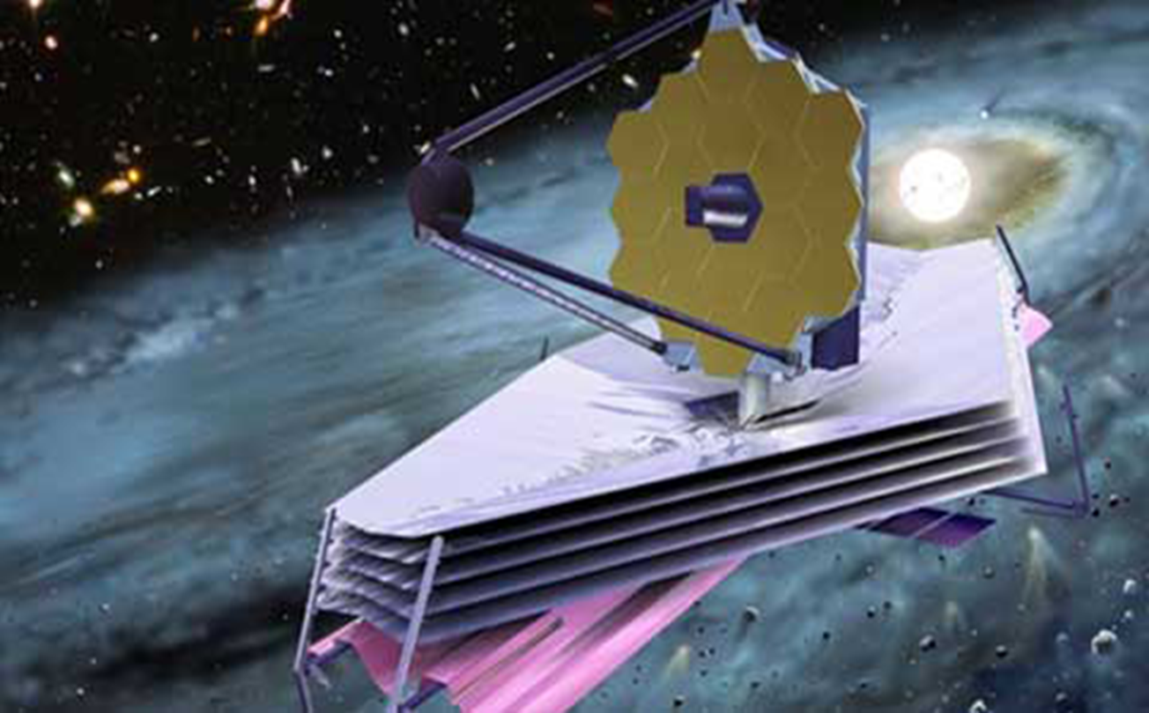
Science Goals
Study the interaction of the blast wave with the equatorial ring.
Determine the nature of the ring’s hot dust component.
Confirm SOFIA and/or free-free 30 μm measurement
Study the evolution of the dust and molecules in the ejecta.
Look for a remnant neutron star ??
Study the environment adjacent to SN1987A which has significant star formation (30 Dor!) using parallel fields.

Slide 22

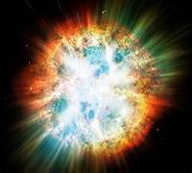
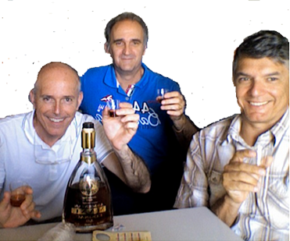

Merci à tous! Et Santé!
Grazie a tutti... e salute!

