Slide 1

SPECTRA-AI
Spectral Pattern Extraction for Classifying Transient Radiations in Astronomy with
Artificial Intelligence
Alberto Garinei - Guglielmo Marconi University
Spoke 3 :
Sara Cutini - INFN PG
Francesco Longo - Università di Trieste - INFN
Spoke 3 Progetti Bandi a Cascata, 24/09, 2024
ICSC Italian Research Center on High-Performance Computing, Big Data and Quantum Computing
Missione 4 • Istruzione e Ricerca
Notes:
Cover

Slide 2
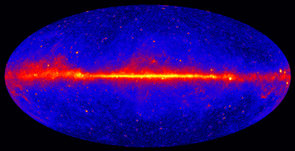

Project Overview
The SPECTRA-AI project aims to innovate astronomical observation by applying Artificial Intelligence (AI) to identify and analyze transient astronomical sources using high-energy gamma ray data.
Transient sources, such as gamma ray bursts, supernovae, and solar flares, are crucial for understanding the high-energy universe.
ICSC Italian Research Center on High-Performance Computing, Big Data and Quantum Computing
Missione 4 • Istruzione e Ricerca
Notes:
- Detecting these phenomena is challenging due to their fleeting nature and the vast amount of data produced by gamma ray experiments.

Slide 3
Technical Objectives, Methodologies and Solutions
Innovative machine learning techniques will be developed with the aim of searching for astronomical sources in high-energy gamma ray experiments.
Big data processing and visualization, via adopting innovative approaches for the analysis of large and complex data volumes and for their exploration.
ICSC Italian Research Center on High-Performance Computing, Big Data and Quantum Computing
Missione 4 • Istruzione e Ricerca
Notes:
Template e guide lines

Slide 4
Technical Objectives, Methodologies and Solutions
AI techniques in gamma-ray detection have already been successfully applied in various projects and space missions, such as:
machine learning algorithms to classify gamma-ray sources and detect new emissions.
neural networks to improve the accuracy in localizing and classifying gamma-ray sources.
Many of the artificial intelligence techniques currently employed in gamma-ray detection tend to focus on only one aspect: spatial, temporal, spectral/energetic.
ICSC Italian Research Center on High-Performance Computing, Big Data and Quantum Computing
Missione 4 • Istruzione e Ricerca
Notes:
Template e guide lines

Slide 5
Technical Objectives, Methodologies and Solutions
Deep Learning algorithms to process and analyze spatial, temporal and energetic data from telescopes and satellites.
Convolutional Neural Networks (CNN)
Recurrent Neural Networks (RNN)
Deep Learning architectures
LSTM (Long Short-Term Memory)
Attention-based models -Transformers
Graph Neural Networks (GNN)
ICSC Italian Research Center on High-Performance Computing, Big Data and Quantum Computing
Missione 4 • Istruzione e Ricerca
Notes:
Deep Learning algorithms to process and analyze spatial and temporal data from telescopes and satellites.
Deep Learning architectures:
Convolutional Neural Networks (CNNs) for images. CNNs are particularly effective in processing spatial and temporal data. They are used for:
Event Classification: Distinguishing between genuine gamma-ray signals and background noise.
Pattern Recognition: Identifying specific features in the data that correspond to different gamma-ray sources.
Recurrent Neural Networks (RNNs) and LSTM (Long Short-Term Memory). These networks are useful for analyzing temporal sequences in data:
Event Prediction: Anticipating the arrival of new gamma-ray events based on temporal patterns.
Signal Analysis: Interpreting temporal variations in detector data.
Attention-based models like Transformers for photon emission time series.
Graph Neural Networks (GNNs) to model spatial relationships between astronomical events and recognize complex patterns not easily detectable with traditional methods.

Slide 6
Technical Objectives, Methodologies and Solutions
Achieve a more comprehensive and accurate understanding of gamma-ray events, it is essential to simultaneously consider all these aspects.
ICSC Italian Research Center on High-Performance Computing, Big Data and Quantum Computing
Missione 4 • Istruzione e Ricerca
Notes:
Template e guide lines

Slide 7
Technical Objectives, Methodologies and Solutions
Achieve a more comprehensive and accurate understanding of gamma-ray events, it is essential to simultaneously consider all these aspects.
Multimodal Deep Learning Architectures
ICSC Italian Research Center on High-Performance Computing, Big Data and Quantum Computing
Missione 4 • Istruzione e Ricerca
Notes:
Template e guide lines

Slide 8
Technical Objectives, Methodologies and Solutions
Achieve a more comprehensive and accurate understanding of gamma-ray events, it is essential to simultaneously consider all these aspects.
Multimodal Deep Learning Architectures
Designed to handle multiple types of data simultaneously, each representing a specific aspect (spatial, temporal, spectral/energetic).
Convolutional Neural Networks (CNNs) for the Spatial Axis.
Recurrent Neural Networks (RNNs) or LSTMs for the Temporal Axis.
Networks for the Spectral/Energetic Axis.
Data Fusion: Once each branch has extracted the relevant features from their respective aspects, this information is fused in one or more subsequent layers of the network, enabling the model to simultaneously consider spatial, temporal, spectral, and energetic information for more accurate classification or detection.
These architectures can be divided into different branches, each specialized in processing a particular type of data, and then combine the information at a subsequent layer.
ICSC Italian Research Center on High-Performance Computing, Big Data and Quantum Computing
Missione 4 • Istruzione e Ricerca
Notes:
Template e guide lines

Slide 9
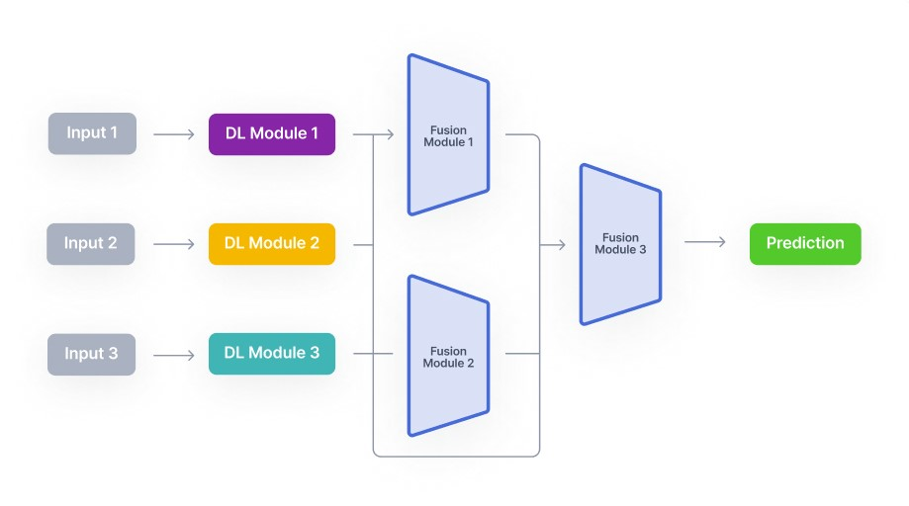
Technical Objectives, Methodologies and Solutions
Achieve a more comprehensive and accurate understanding of gamma-ray events, it is essential to simultaneously consider all these aspects.
Multimodal Deep Learning Architectures
ICSC Italian Research Center on High-Performance Computing, Big Data and Quantum Computing
Missione 4 • Istruzione e Ricerca
Notes:
Template e guide lines

Slide 10
Involved Staff and new recruitments
Involved Staff:
Prof. Alberto Garinei: Full Professor of Mechanical and Thermal Measurements
Prof. Francesca Fallucchi: Associate Professor of Computer Science
Prof. Matteo Martini: Associate Professor of Experimental Physics
Additional staff:
Three Associate Professors of the Department of Engineering Sciences
ICSC Italian Research Center on High-Performance Computing, Big Data and Quantum Computing
Missione 4 • Istruzione e Ricerca
Notes:
Template e guide lines

Slide 11
Involved Staff and new recruitments
Involved Staff:
Prof. Alberto Garinei: Full Professor of Mechanical and Thermal Measurements
Prof. Francesca Fallucchi: Associate Professor of Computer Science
Prof. Matteo Martini: Associate Professor of Experimental Physics
Additional staff:
Three Associate Professors of the Department of Engineering Sciences
Staff | Level | Additional staff | h | % personnel costs
ALBERTO GARINEI | Full Professor | N | 350 | 31%
MATTEO MARTINI | Associate Professor | N | 250 | 14%
FRANCESCA FALLUCCHI | Associate Professor | N | 250 | 14%
ERNESTO WILLIAM DE LUCA | Associate Professor | Y | 200 | 12%
ROMEO GIULIANO | Associate Professor | Y | 250 | 14%
UMBERTO DI MATTEO | Associate Professor | Y | 250 | 14%
ICSC Italian Research Center on High-Performance Computing, Big Data and Quantum Computing
Missione 4 • Istruzione e Ricerca
Notes:
Template e guide lines

Slide 12
Involved Staff and new recruitments
Preliminary budget: personnel and licensing costs
Updated budget: only personnel costs
 | BUDGET APPLICAZIONE | BUDGET RIMODULATO
Personnel costs | 78.640 € | 82.988 €
Indirect costs | 11.796 € | 12.448 €
Consultancy |  | - €
Licensing and hosting | 5.000 € | - €
Materials
TOT | 95.436 € | 95.436 €
ICSC Italian Research Center on High-Performance Computing, Big Data and Quantum Computing
Missione 4 • Istruzione e Ricerca
Notes:
Template e guide lines

Slide 13
Timescale, Milestones, SAL
SAL 1 – M4: end of WP1.1 – Algorithm dataset and system requirements
SAL 2 – M8: end of WP1 - First algorithm prototype
SAL 3 – M12: end of the project – Validated algorithm
ICSC Italian Research Center on High-Performance Computing, Big Data and Quantum Computing
Missione 4 • Istruzione e Ricerca
Notes:
Template e guide lines

Slide 14
Thanks!
ICSC Italian Research Center on High-Performance Computing, Big Data and Quantum Computing
Missione 4 • Istruzione e Ricerca
Notes:
Template e guide lines

