Slide 1
NEBULA
Cecilia Pisano and Giulia Tocco, Nurjana Technologies srl
Spoke 3 Progetti Bandi a Cascata, 24/09/2024
ICSC Italian Research Center on High-Performance Computing, Big Data and Quantum Computing
Missione 4 • Istruzione e Ricerca
Notes:
Cover

Slide 2
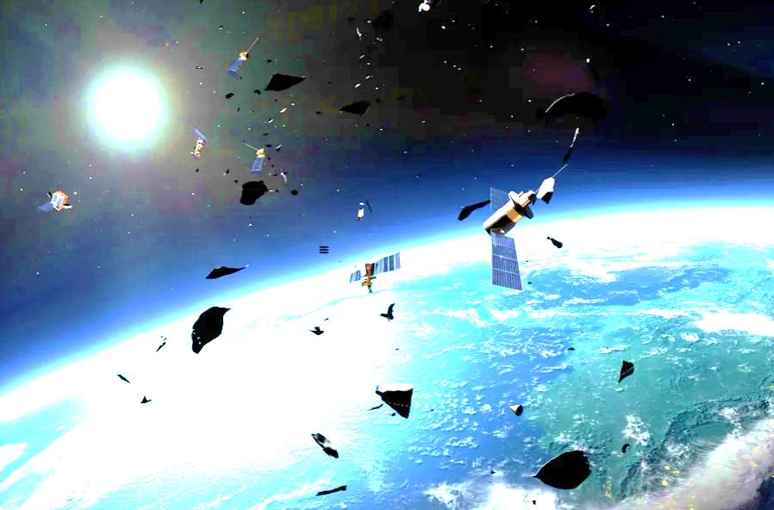
Project Overview
A CONTRIBUTION TO IMPROVING THE TECHNIQUES OF SPACE SITUATIONAL AWARENESS (SSA): SPACE-BASED REAL-TIME PRECISE OBSERVATION OF RESIDENT SPACE OBJECTS (RSOS)
Main strategy: processing data at the edge such to overcome ground limitations and reduce latency
Main issue: power and memory consumption limited for onboard space applications
Our solution: an optical integrated system Dynamic Camera (event-based) + Neuromorphic Processor
Project outcome: a hardware-in-the-loop testing setup. 3D Simulated Environment + AI Algorithms
ICSC Italian Research Center on High-Performance Computing, Big Data and Quantum Computing
Missione 4 • Istruzione e Ricerca
Notes:
Template e guide lines

Slide 3
Technical Objectives, Methodologies and Solutions
TESTING THE EFFICIENCY OF A TECHNOLOGY NOT BROADLY INVESTIGATED FOR SPACE APPLICATIONS: INCREASED AUTONOMY, LOW LATENCY, REDUCED POWER CONSUMPTION
Our tools
3D simulated environment (focus on dim small rapid moving objects), testbench (optical table, high refresh frequency screens and collimators, event based camera, neuromorphic processor), detection and tracking algorithms (focus on spiking neural networks)
Our methods
state of the art investigation, test-first approach and tests automation (parameters and criteria to establish power and computational efficiency), the best techniques for hardware/software integration
ICSC Italian Research Center on High-Performance Computing, Big Data and Quantum Computing
Missione 4 • Istruzione e Ricerca
Notes:
Template e guide lines

Slide 4
Involved Staff
Name | Level | Education
Cecilia Pisano | Medium | PhD in Finite Element Modelling of Nanocomposite Materials Responsible for R&D Department, research in AI alg.
Daniele Sirigu | Low | Master's degree in Computer Science Hw/Sw systems integration expertise
Davide Piras | Medium | Master's Degree in Electronic Engineering Responsible for Optical Systems Engineering
Edoardo Biasini | Low | Master's Degree in Aerospace Engineering
Emanuele Barca | Low | Master's Degree in Aerospace Engineering
Enrico Congiu | Low | Master's Degree in Aerospace Engineering
Mattia Ibba | Low | Bachelor's Degree in Computer Science
Michele Arduini | Low | Bachelor’s Degree in Aerospace Engineering Master's Degree in Engineering technology
Andrea Frau | Low | PhD in Advanced Control Systems and research in AI applied to Computer Vision
ICSC Italian Research Center on High-Performance Computing, Big Data and Quantum Computing
Missione 4 • Istruzione e Ricerca
Notes:
Template e guide lines

Slide 5
Timescale, Milestones, SAL
Activities and costs (Budget)
Activity | Description | €
A. | market enquiry | 10.821,61 €
B. | creation of simulated environment | 61.710,00 €
C. | Setup HIL | 28.903,33 €
D. | software integration | 41.710,00 €
E. | development and testing of AI algorithms | 41.710,00 €
F. | results analysis | 13.903,33 €
Total cost |  | 198.758,33 €
Activities and costs (Budget)
Cost Items | Months | Year 2024 | Total
Activity A | M1 | 10.821,67 € | 10.821,67 €
Activity B | M1 – M6 | 61.710,00 € | 61.710,00 €
Activity C | M2 | 28.903,33 € | 28.903,33 €
Activity D | M5 – M11 | 41.710,00 € | 41.710,00 €
Activity E | M5 – M11 | 41.710,00 € | 41.710,00 €
Activity F | M12 | 13.903,33 € | 13.903,33 €
Total cost |  | 198.758,33 € | 198.758,33 €
ICSC Italian Research Center on High-Performance Computing, Big Data and Quantum Computing
Missione 4 • Istruzione e Ricerca
Notes:
Template e guide lines

