Slide 1
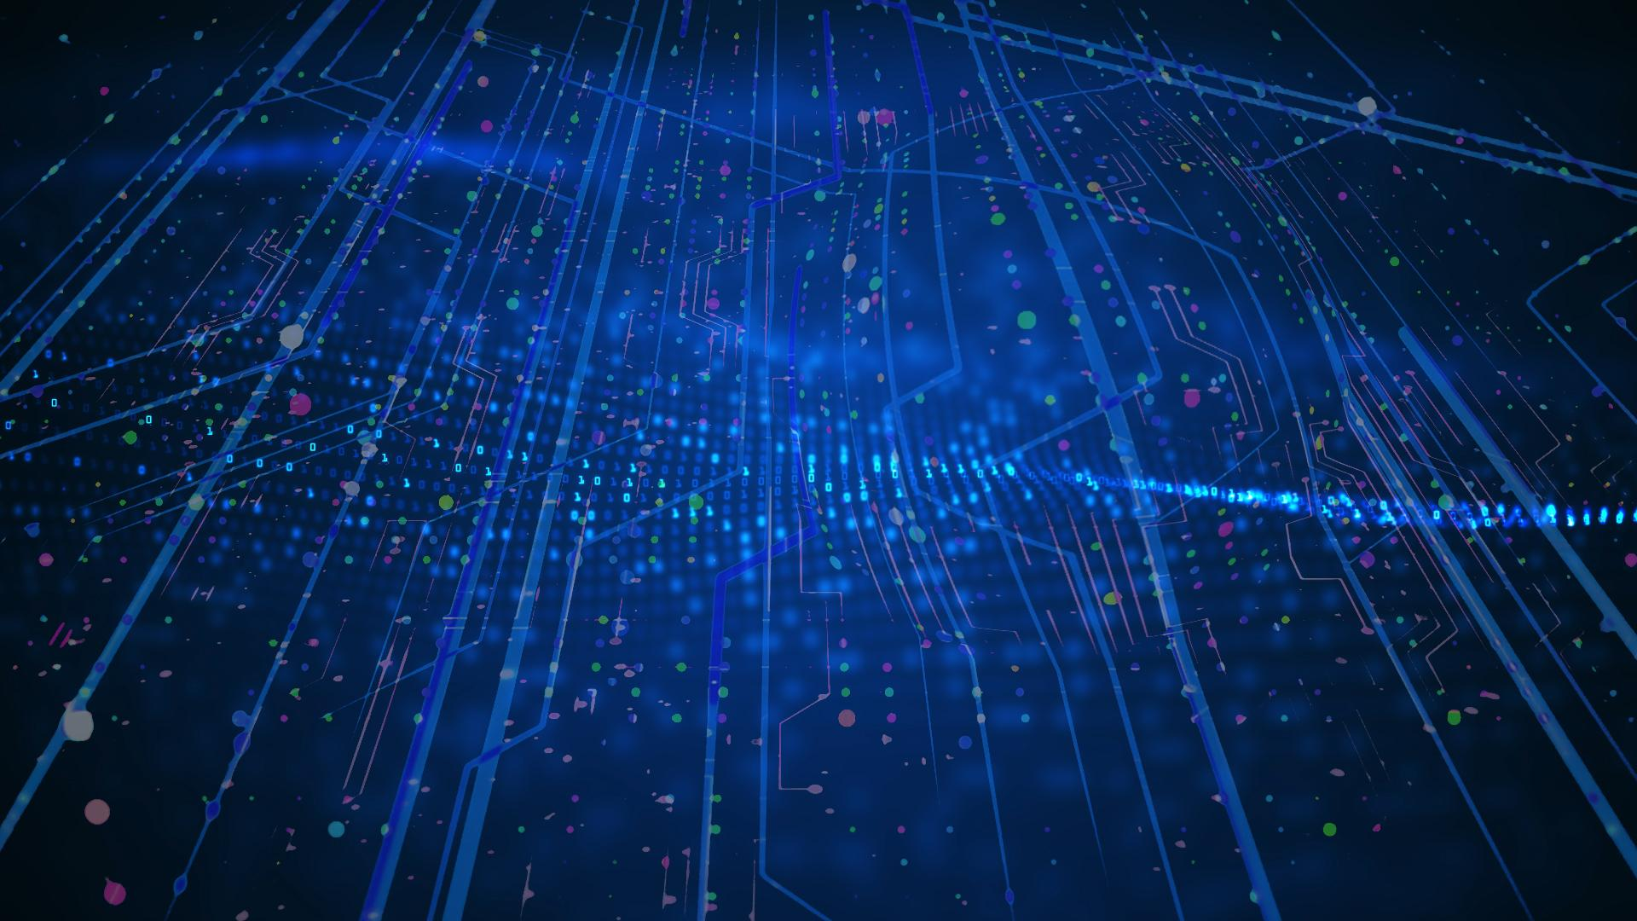
IDL DM Study and Archiving Ingestion Tests
Giacomo Coran – INAF OATs
Spoke 3 II Technical Workshop, Bologna Dec 17 -19, 2024
ICSC Italian Research Center on High-Performance Computing, Big Data and Quantum Computing
Missione 4 • Istruzione e Ricerca
Notes:
Cover

Slide 2
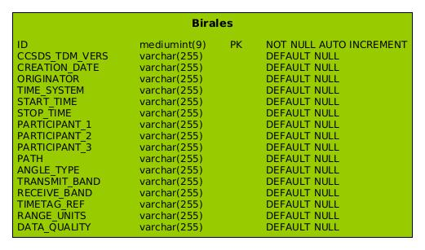
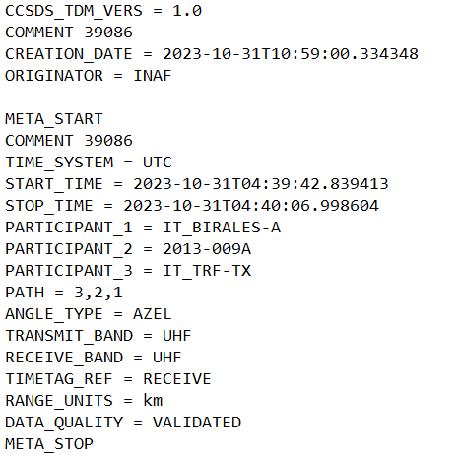
BIRALES Test Case & Efficient Physical Data Models
TDM files to archive satellite & space debris tracking data used for orbit determination
Developement of a logical data models for this use case
BIRALES data used as test case to develop an effective physical data model
ICSC Italian Research Center on High-Performance Computing, Big Data and Quantum Computing
Missione 4 • Istruzione e Ricerca

Slide 3
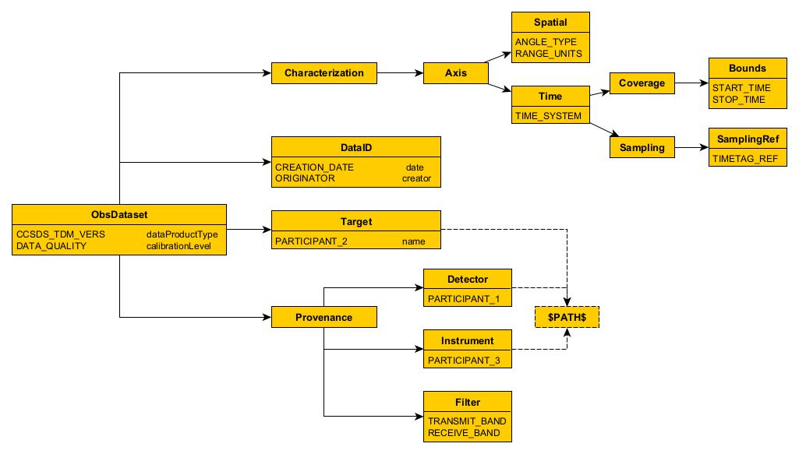
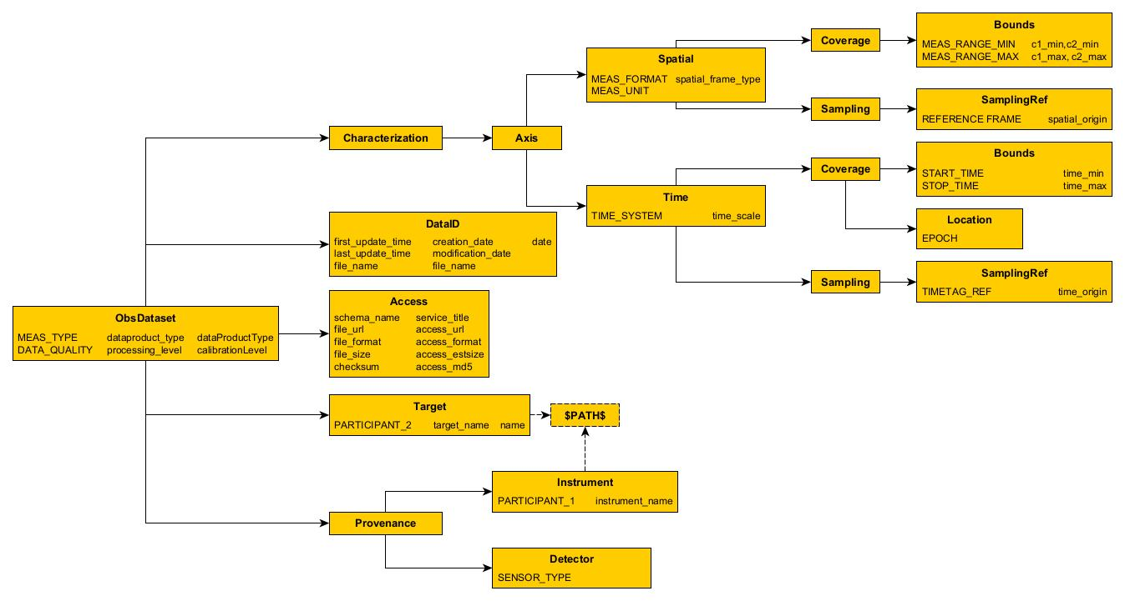
Birales
Logical Data Model
Mapping in the ObsCoreDM amplified in the description by CharacterizationDM, DatasetDM and ProvenanceDM documentation
Use of the EPNcore metadata dictionary to map TDM metadata in the IVOA standard
Necessary improvements in metadata description to respect interoperability
Necessary extension due to lack of an already dedicated data model
Standardization process required within international organizations
Space Debris
ICSC Italian Research Center on High-Performance Computing, Big Data and Quantum Computing
Missione 4 • Istruzione e Ricerca

Slide 4
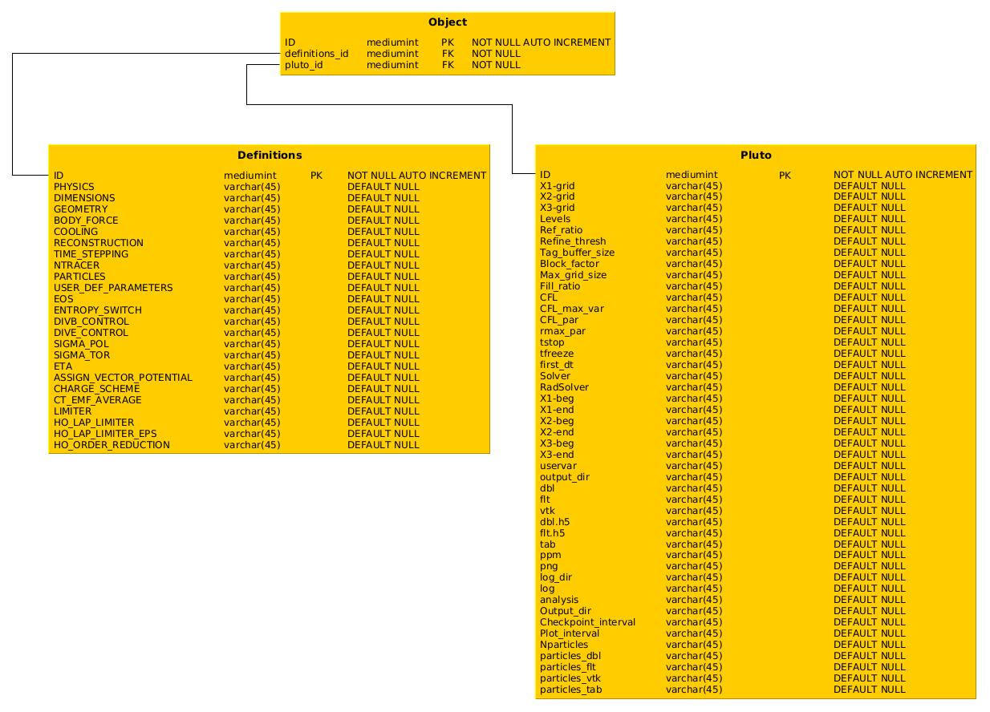
Simulative Data Model
Possible physical archiving structure rappresentation ready since April 2024
Missing the IVOA standardize logical model, the SimDM, since it is under refinement, locks the correction of the physical rappresentation
We could proceed with this version but the standard required for the interoperability would not be met
ICSC Italian Research Center on High-Performance Computing, Big Data and Quantum Computing
Missione 4 • Istruzione e Ricerca

Slide 5
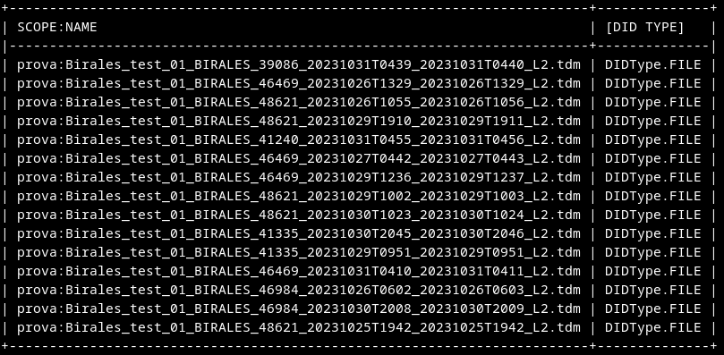
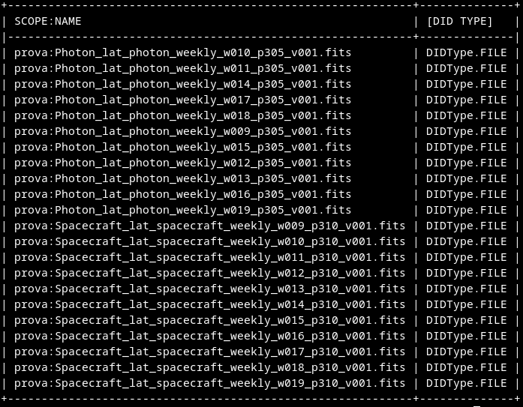
Ingestion Tests
Modified WP4 Importer software for data and metadata ingestion
Simple integration with the INFN blockchain, optimizing time and resources
Successful ingestion test with data correctly stored in MinIo
ICSC Italian Research Center on High-Performance Computing, Big Data and Quantum Computing
Missione 4 • Istruzione e Ricerca

Slide 6
Conclusions
2 out of 3 data sources identified, Birales for the space debris observations and Pluto and Ramses for the simulative cases (66%)
Identified possible solutions for the data models, both physical and logical (~50%)
Necessary development of a standardized data model, extended to satisfy satellites and space debris tracking (~20%)
Necessity to implement correct metadata description to respect international astronomical standards
Necessity to develop the standard to define the interoperability for simulative use cases (~15%)
Developed the ingestion software that takes care for data preprocess and metadata extraction (100%)
Successful ingestion processes for the Birales use case and Fermi tests (99%)
ICSC Italian Research Center on High-Performance Computing, Big Data and Quantum Computing
Missione 4 • Istruzione e Ricerca

Slide 7
Next Steps
Definition of a standardized logical data model for the community for the space debris and satellite tracking
Developement of the standardized IVOA conceptual data model for the simulative use cases
Definition of the final set of radio data to use as radio test case
Further ingestions and tests with more INAF data for the next months
ICSC Italian Research Center on High-Performance Computing, Big Data and Quantum Computing
Missione 4 • Istruzione e Ricerca

Slide 8
Thank you!
Spoke 3 II Technical Workshop, Bologna Dec 17 -19, 2024
ICSC Italian Research Center on High-Performance Computing, Big Data and Quantum Computing
Missione 4 • Istruzione e Ricerca
Notes:
Cover

