Slide 1

WP3 Status Report
F. Vitello - F. Gargano
Spoke 3 II Technical Workshop, Bologna Dec 17 -19, 2024
ICSC Italian Research Center on High-Performance Computing, Big Data and Quantum Computing
Missione 4 • Istruzione e Ricerca
Notes:
Cover

Slide 2

Scientific Rationale
To develop new methods and/or optimize existing prototype Machine Learning applications for the automated processing of large and complex data;
To develop and optimize existing solutions for high performance visualization, addressing on-site and remote visualization;
To develop integrated solutions starting from the outcome of the previous actions, in order to provide a unique and optimized eco-system for big and complex data sets.
ICSC Italian Research Center on High-Performance Computing, Big Data and Quantum Computing
Missione 4 • Istruzione e Ricerca
Notes:
Template e guide lines

Slide 3
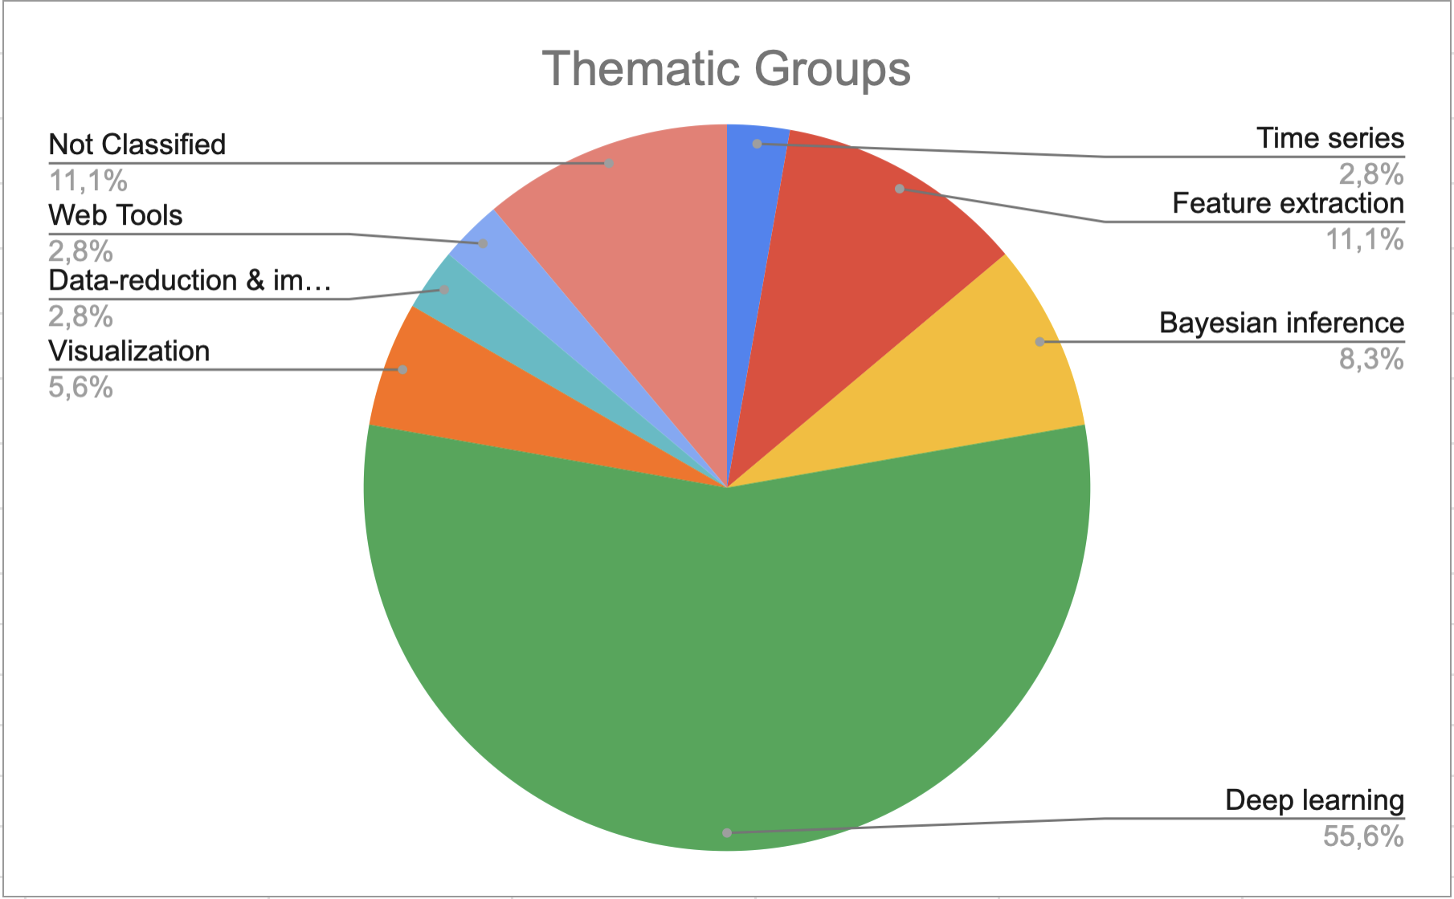
WP3 Organization
Regular Meeting: first Tuesday of each month.
  Offline report writing + Discussion on the activities carried out during the month;
  Participation has been declining in recent months;
35 declared use cases (15 are labeled as certain)
  Time series: 1 use case;
  Feature extraction: 4 use cases;
  Bayesian inference: 3 use cases;
  Deep learning: 20 use cases;
  Visualization: 2 use cases;
  Data-reduction & imaging: 1 use case;
  Web Tools: 1 use case;
  Not Classified: 4 use cases.
ICSC Italian Research Center on High-Performance Computing, Big Data and Quantum Computing
Missione 4 • Istruzione e Ricerca
Notes:
Template e guide lines

Slide 4
Milestone 9
TAR3.1 VisIVO KSP
  KPI: Code release on GitHub
TAR3.2 PULSAR timing array
  KPI: (i) Incorporation of Ness AI in ENTERPRISE has been achieved (ii) 10+ hands-on courses were completed (iii) test-plots of Ness AI with Normalizing Flows for simple case studies
TAR3.3 Radio U-NET
  KPI: Code and documents
TAR3.4 Machine Learning for complex N-body problems
  KPI: Codes and Documents
TAR3.5 Map-level emulator of CMB systematic
  KPI: Plots of statistical tests and metrics documenting the increased accuracy of the emulator. Brief scientific document defining our strategy for scalability to large number of emulations.
TAR3.6 Radial Velocities and metallicities from RR Lyrae spectra
  KPI: Documents
ICSC Italian Research Center on High-Performance Computing, Big Data and Quantum Computing
Missione 4 • Istruzione e Ricerca
Notes:
Template e guide lines

Slide 5
Milestone 9
TAR3.7 GAN for TODs generation
  KPI: Code and document
TAR3.8 Deep Learning for tracking reconstruction
  KPI: Code release on GitHub
TAR3.9 Supernovae characterization with Deep Learning
  KPI: Codes and Documents
TAR3.10 GAN models for Super Resolution cosmological simulations
  KPI: Code release
TAR3.11 Deep Learning for particle identification in calorimeter in space
  KPI: Codes release
TAR3.12 AI for source detection and classification
  KPI: Codes release and models.
ICSC Italian Research Center on High-Performance Computing, Big Data and Quantum Computing
Missione 4 • Istruzione e Ricerca
Notes:
Template e guide lines

Slide 6
Milestone 9
TAR3.13 Generative ML for galaxy emission
  KPI: Codes release
TAR3.14 STRATLEARN: ML for photometry
  KPI: Documents
TAR3.15 Poisson-FOCuS
  KPI: Code release on GitHub and Poster
TAR3.16 WP3 Activity monitoring
  KPI: Periodic teleconferences minutes
ICSC Italian Research Center on High-Performance Computing, Big Data and Quantum Computing
Missione 4 • Istruzione e Ricerca
Notes:
Template e guide lines

Slide 7
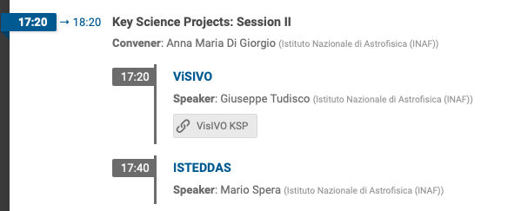
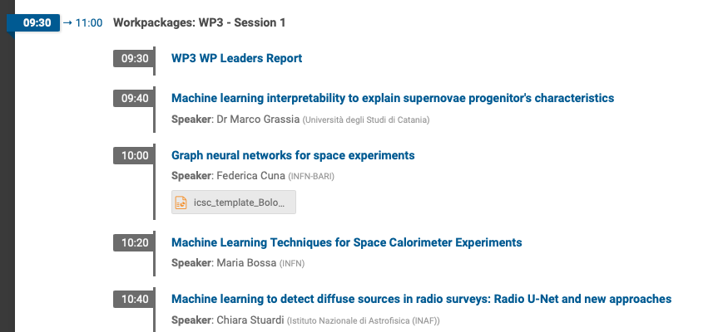
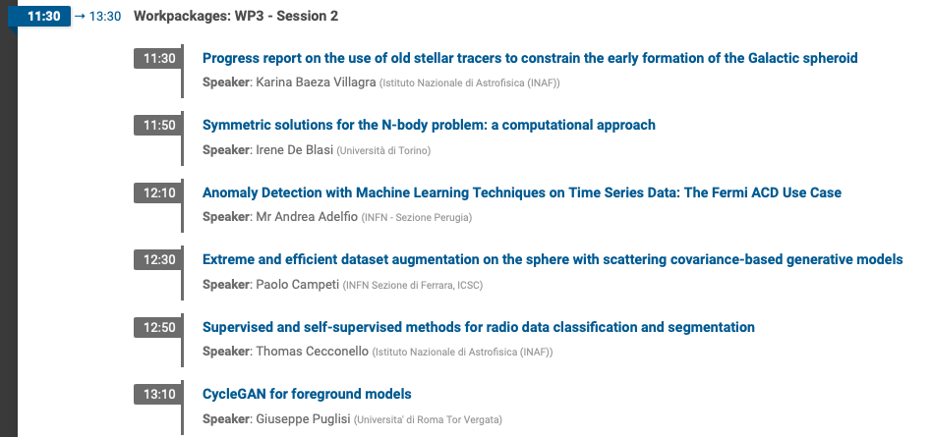
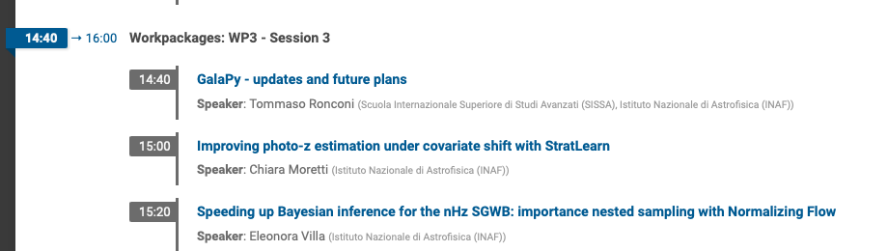
Timescale, Milestones and KPIs
Spoke 3 General meeting (Catania, June 2023):
1 talk
Spoke 3 Technical meeting (Trieste, October 2023): 13 talks
Spoke 3 General meeting (Isola d’Elba, May 2024): 19 talks
Spoke 3 Technical meeting (Bologna, December 2024): 13 talks + 2 KSP
ICSC Italian Research Center on High-Performance Computing, Big Data and Quantum Computing
Missione 4 • Istruzione e Ricerca
Notes:
Template e guide lines

Slide 8
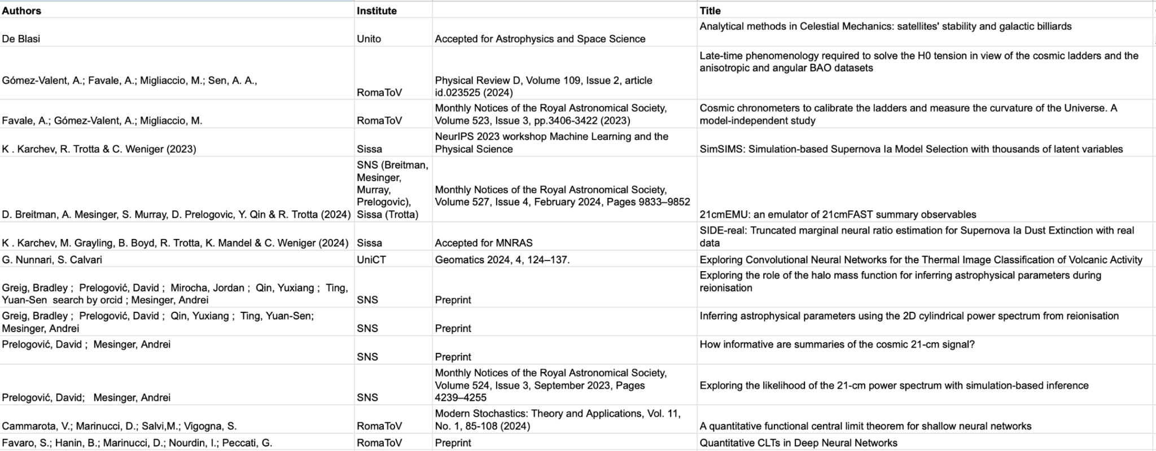
Publications
ICSC Italian Research Center on High-Performance Computing, Big Data and Quantum Computing
Missione 4 • Istruzione e Ricerca
Notes:
Template e guide lines

Slide 9
Publications
Not only publications:
Codes (on private repositories);
Catalogue/datasets (on private drive/repositories);
Conference presentations;
Reports;
ICSC Italian Research Center on High-Performance Computing, Big Data and Quantum Computing
Missione 4 • Istruzione e Ricerca
Notes:
Template e guide lines

Slide 10
Code | Report | Pubblication | Dataset
Milestone 6
TAR3.8 Machine Learning for complex N-body problems: preliminary code implementation
  KPI: code release on private repository and documentation
TAR3.9 Astronomical images segmentation with Machine Learning: Produce an updated version of caesar-mrcnn source finder based on TensorFlow v2.
  KPI: code release on public repository
TAR3.10 Self-Supervised techniques in Radioastronomy: first code implementation and dataset collection
  KPI: code release on public repository and documentation
TAR3.11 Bayesian inference of cosmological parameters from BOSS data: problem analysis
  KPI: publication
TAR3.12 Generative Deep Learning Networks for cosmological simulations: generate the training data.
  KPI: Dataset available
TAR3.13 WP3 Activity monitoring
  KPI: Periodic teleconferences minutes;
ICSC Italian Research Center on High-Performance Computing, Big Data and Quantum Computing
Missione 4 • Istruzione e Ricerca
Notes:
Template e guide lines

Slide 11
Code | Report | Pubblication | Dataset
Milestone 7
TAR3.1 Neural Network for galactic emission: extend maps in unobserved areas.
  KPI: Github repository available
TAR3.2 Space experiment: improved track reconstruction
  KPI: Github repository available
TAR3.3 Deep Learning for Supernovae: model refinement and code development.
  KPI: Code repository available
TAR3.4 GAIA: Application of Bayesian analysis to measure metallicity of RR Lyrae stars.
  KPI: Documents and Code Repository
TAR3.5 LiteBIRD experiment for HST: Development of the generative adversarial network prototype
  KPI: Code release and documents:
TAR3.6 21-cm power spectrum: precision Bayesian inference algorithms validation
  KPI: First code release, publication
TAR3.7 Machine Learning for complex N-body problems: code implementation on beta stage
  KPI: code release on private repository and documentation
TAR3.8 Astronomical images segmentation with Machine Learning: Astronomical images segmentation with Machine Learning: caesar-mrcnn pre-traing runs
  KPI: code release on public repository and conference paper
ICSC Italian Research Center on High-Performance Computing, Big Data and Quantum Computing
Missione 4 • Istruzione e Ricerca
Notes:
Template e guide lines

Slide 12
Code | Report | Pubblication | Dataset
Milestone 7
TAR3.9 Self-Supervised techniques in Radioastronomy: first code implementation and dataset collection
  KPI: code release on public repository and documentation
TAR3.10 Bayesian inference of cosmological parameters from BOSS data: The StratLearn method for photometric redshift estimation.
  KPI: publication and code repository
TAR3.11 Generative Deep Learning Networks for cosmological simulations: generate the simulation.
  KPI: Publication and dataset available
TAR3.12 Map-Level Emulator of CMB systematics: definition of an appropriate machine learning algorithm.
  KPI: Dataset available
TAR3.13 Organization of the Kick-Off meeting of the project HAzard Mapping and vulnerability MONitoring (HaMMon)
  KPI: kickoff meeting
TAR3.14 WP3 Activity monitoring
  KPI: Periodic teleconferences
TAR3.15 Data Augmentation for TOD data
  KPI: Reports
TAR3.16 Weak Lensing
  KPI: Documents
ICSC Italian Research Center on High-Performance Computing, Big Data and Quantum Computing
Missione 4 • Istruzione e Ricerca
Notes:
Template e guide lines

Slide 13
Innovation Grants, KSP, Cascade Funds
Innovation Grants:
  HaMMon (Hazard Mapping and vulnerability Monitoring)
  Fraud Detection
  Time series in the banking sector
Key Science Project:
4 projects liked to WP3 Activities: SKA (and Pathfinders) Regional Center HPC Services, ISTEDDAS. Revealing the populations of compact remnants in dense stellar systems, Multi-wavelength inference from the first billion years, VisIVO
Cascade Funds:
~15 sub themes and objectives linked to WP3 activities;
ICSC Italian Research Center on High-Performance Computing, Big Data and Quantum Computing
Missione 4 • Istruzione e Ricerca
Notes:
Template e guide lines

