Slide 1

Constraints on the sinking timescales of massive black holes using the OpenGadget3 code
Alice Damiano, Stefano Borgani, Milena Valentini, Luca Tornatore, Giuseppe Murante
Spoke 3 II Technical Workshop, Bologna Dec 17 -19, 2024
ICSC Italian Research Center on High-Performance Computing, Big Data and Quantum Computing
Missione 4 • Istruzione e Ricerca
Notes:
Cover

Slide 2
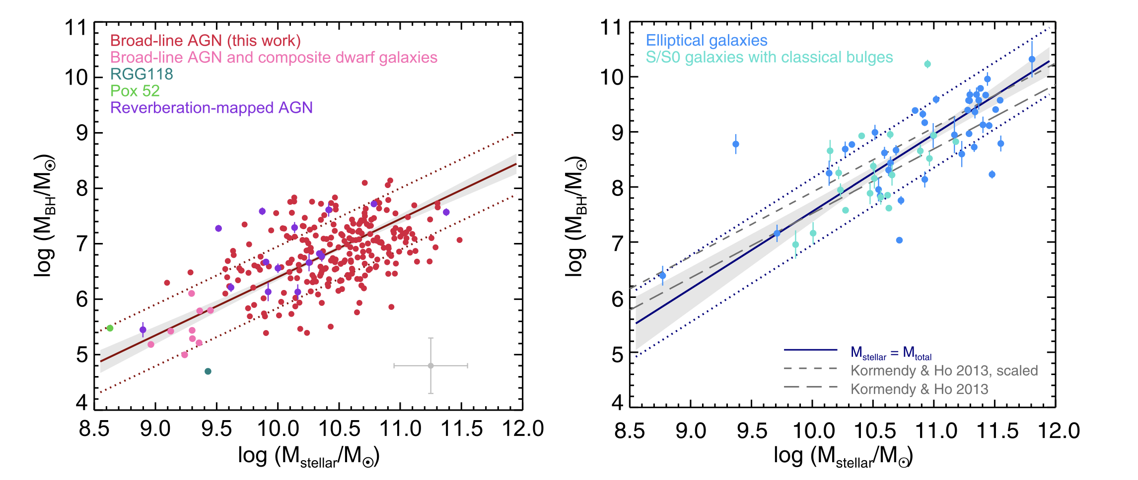
The scientific case
THE ROLE OF MASSIVE BLACK HOLES
The growths of massive black holes and their host galaxies are correlated. During their lifetimes, massive black holes accrete via gas accretion and merging. During accretion episodes, thermal and kinetic feedback energy is released.
Their inclusion in cosmological simulations is problematic.
Reines&Volonteri (2015)
Because of spatial and mass resolution, simulations resort on sub-resolution models to constrain the black hole dynamics, primarly driven by the dynamical friction force.
ICSC Italian Research Center on High-Performance Computing, Big Data and Quantum Computing
Missione 4 • Istruzione e Ricerca

Slide 3
Technical objectives
HAVING A FAST AND POWERFUL WAY TO CONSTRAIN THE BLACK HOLE DYNAMICS IN THE OPENGADGET3 CODE
Damiano et al., A&A, 692, A81 (2024)
Introducing a dynamical friction implementation
Testing the implementation against commonly adopted techniques
Test if the dynamical friction implementation produces “realistic timescales”
Reproduction of a simple scenario:
Calculate analytically the evolution of a BH in this scenario
Carry on simulations in the same set-up and compare analytical predictions and numerical outcomes
How the dynamics of massive black holes shapes the evolution of cosmic structures?
ICSC Italian Research Center on High-Performance Computing, Big Data and Quantum Computing
Missione 4 • Istruzione e Ricerca

Slide 4
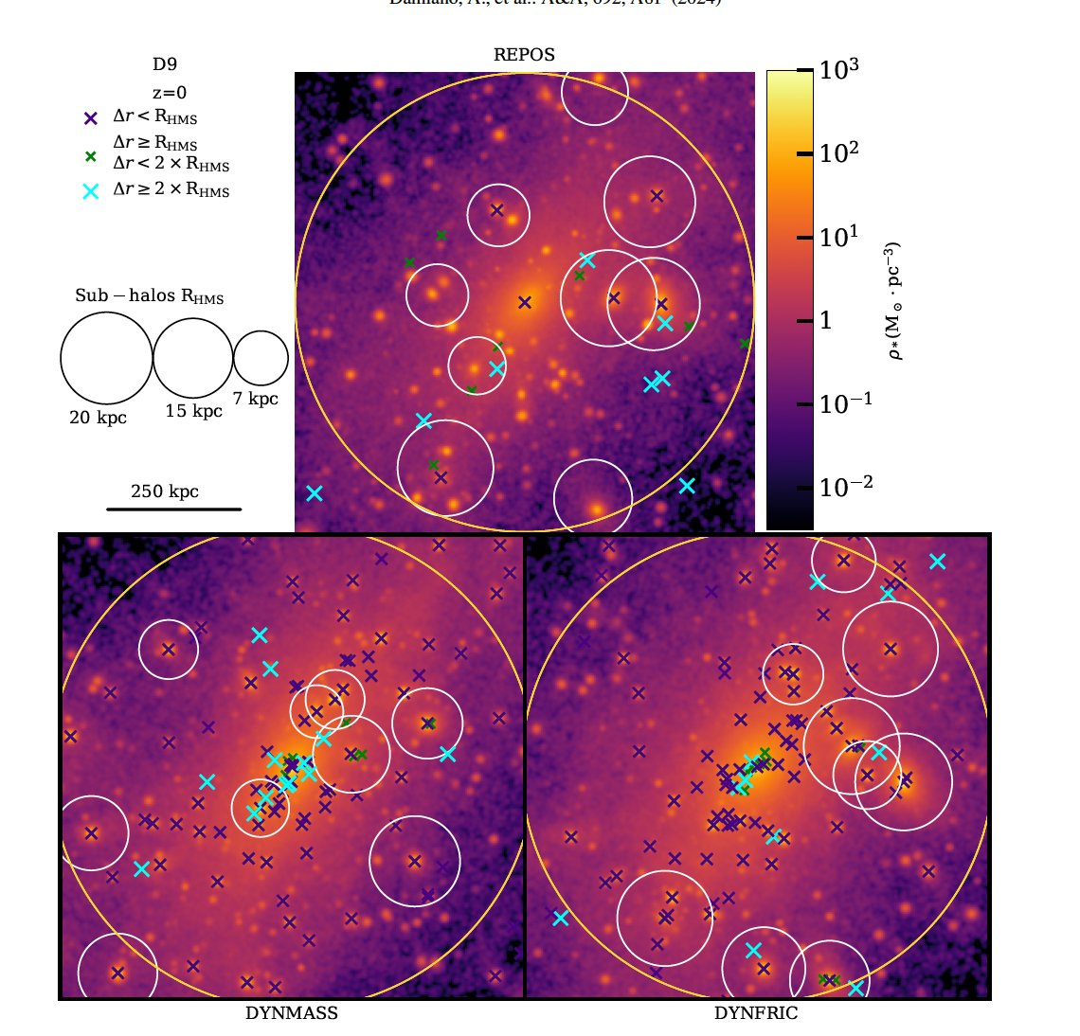
Methodology and results
Damiano et al., A&A, 692, A81 (2024)
WE APPLY A CORRECTION TO THE GRAVITATIONAL ACCELERATION TO ACCOUNT FOR THE INTERACTIONS
UNDER THE SOFTENING LENGTH.
Main results
Central BHs: comparable displacement between dynamical mass and dynamical friction
Wandering BHs: overestimated in the repositioning technique with respect to the other prescriptions
Mergers: repositioning produces more frequent and faster mergers
Black hole mass-stellar mass relation is barely affected by the different dynamical prescription adopted
ICSC Italian Research Center on High-Performance Computing, Big Data and Quantum Computing
Missione 4 • Istruzione e Ricerca

Slide 5
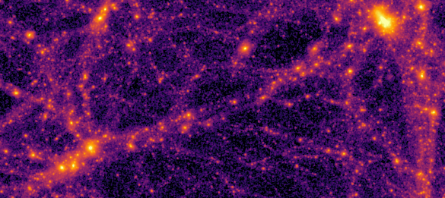

The library
ORBITAL TIMESCALES FOR SINKING
ICSC Italian Research Center on High-Performance Computing, Big Data and Quantum Computing
Missione 4 • Istruzione e Ricerca

Slide 6

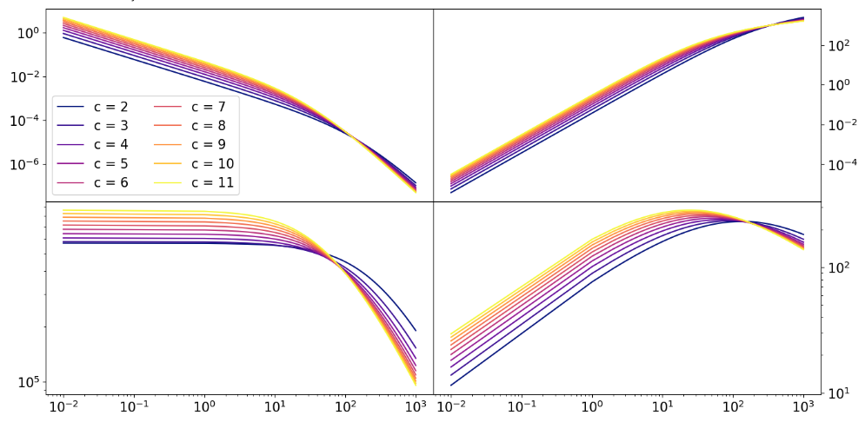
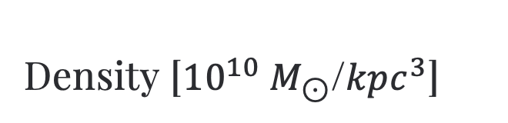
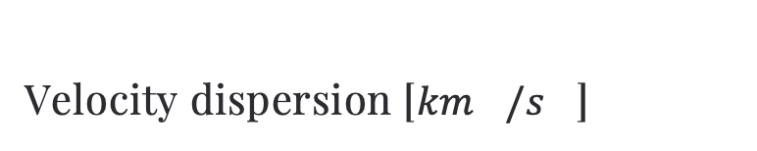
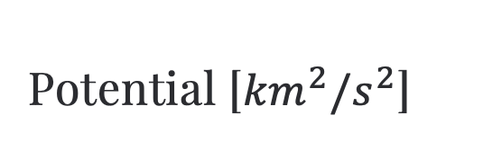

Code flow
The Otis Library
ORBITAL TIMESCALES FOR SINKING
Density [${10}^{10} M_{⊙}$/${kpc}^{3}$]
Mass [${10}^{10} M_{⊙}$]
Halo initialisation
Requires the halo concentration, and one between virial mass, virial radius, virial velocity.
Potential [${km}^{2}/s^{2}$]
Velocity dispersion [${km}^{}/s^{}$]
ICSC Italian Research Center on High-Performance Computing, Big Data and Quantum Computing
Missione 4 • Istruzione e Ricerca

Slide 7
Code flow
The Otis Library
ORBITAL TIMESCALES FOR SINKING
Black Hole initialisation
Requires the black hole mass, its initial velocity and initial position.
Halo initialisation
ICSC Italian Research Center on High-Performance Computing, Big Data and Quantum Computing
Missione 4 • Istruzione e Ricerca

Slide 8
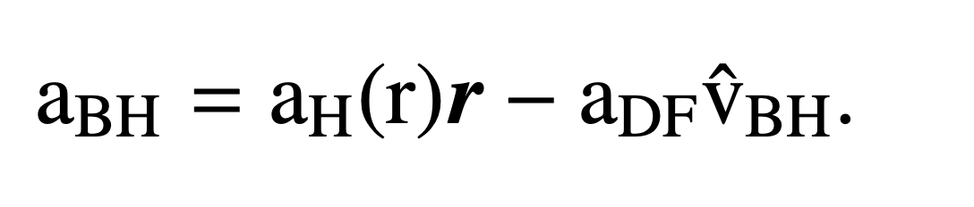
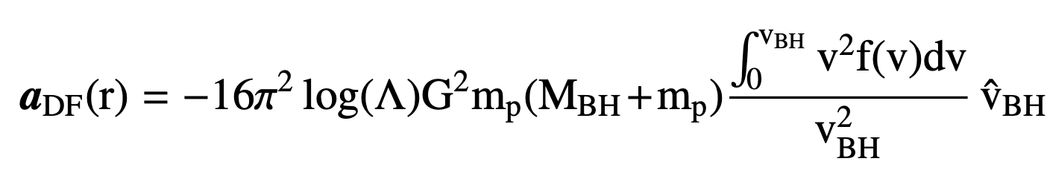
Code flow
The Otis Library
ORBITAL TIMESCALES FOR SINKING
Solve the eq. of motion
Black Hole initialisation
Halo initialisation
ICSC Italian Research Center on High-Performance Computing, Big Data and Quantum Computing
Missione 4 • Istruzione e Ricerca

Slide 9
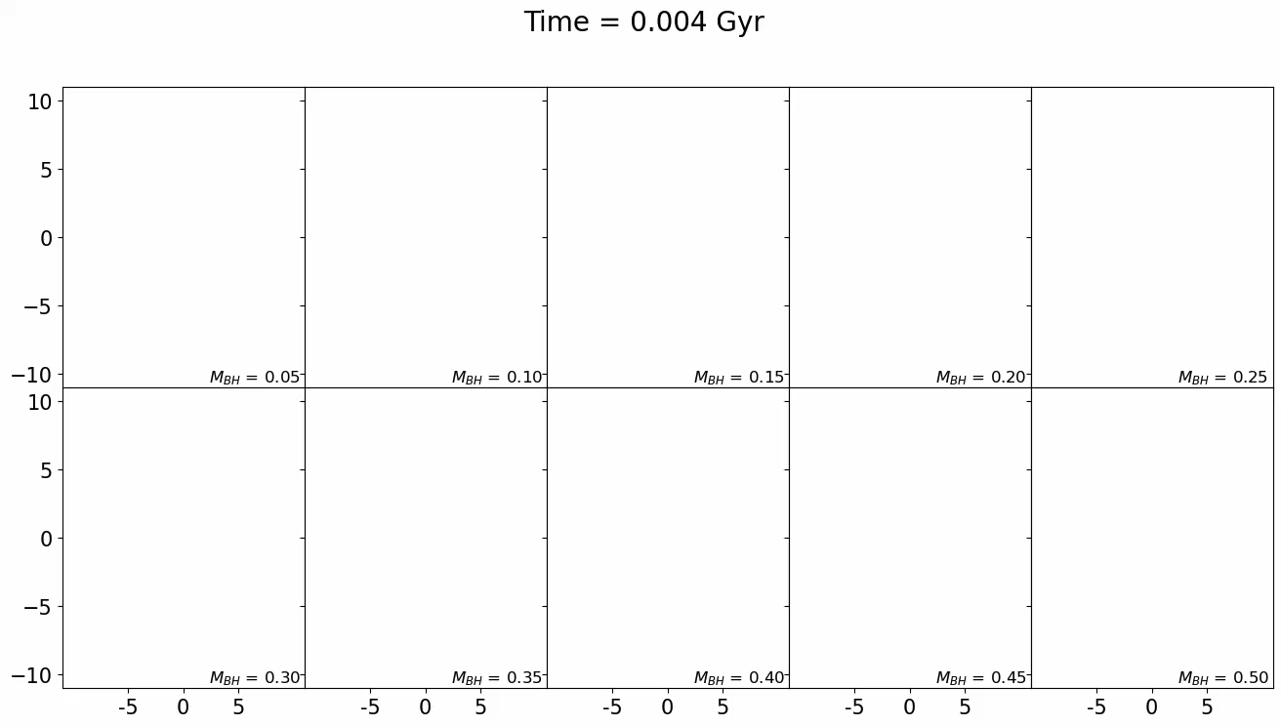
Code flow
The Otis Library
ORBITAL TIMESCALES FOR SINKING
Solve the eq. of motion
Black Hole initialisation
Halo initialisation
ICSC Italian Research Center on High-Performance Computing, Big Data and Quantum Computing
Missione 4 • Istruzione e Ricerca

Slide 10
Code flow
The Otis Library
ORBITAL TIMESCALES FOR SINKING
Solve the eq. of motion
Black Hole initialisation
Halo initialisation
ICSC Italian Research Center on High-Performance Computing, Big Data and Quantum Computing
Missione 4 • Istruzione e Ricerca

Slide 11
Numerical simulations
OPENGADGET3, MAKEGALAXY CODES
ICSC Italian Research Center on High-Performance Computing, Big Data and Quantum Computing
Missione 4 • Istruzione e Ricerca

Slide 12
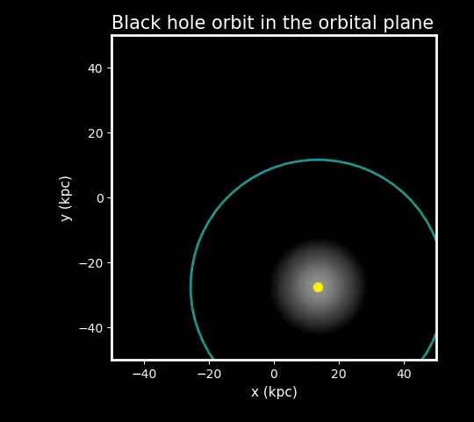
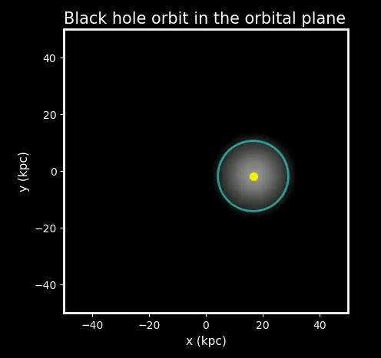
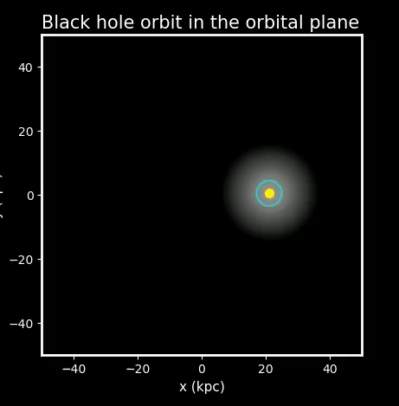
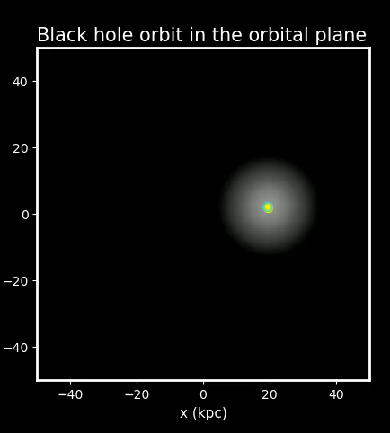
Numerical simulations
INITIAL CONDITIONS OF THE HALO FROM MAKEGALAXY CODE
Springel&White,MNRAS. 307, 62-178 (1999)
HALO SAMPLED AT INCREASING RESOLUTION
BLACK HOLE SEEDED AT A GIVEN INITIAL POSITION AND VELOCITY
Simulations performed at INAF-Pleiadi (USCVIII calls), ISCRA-B Project CLASH on LeonardoDCGP
ICSC Italian Research Center on High-Performance Computing, Big Data and Quantum Computing
Missione 4 • Istruzione e Ricerca

Slide 13
Main results
The application of the dynamical friction correction:
LEADS TO DECREASING SINKING TIMESCALES
PRODUCE SINKING TIMESCALES CONVERGING FOR INCREASING RESOLUTION
PRODUCE SINKING TIMESCALES CONVERGING TO THE ANALYTICAL PREDICTIONS (OTIS)
ICSC Italian Research Center on High-Performance Computing, Big Data and Quantum Computing
Missione 4 • Istruzione e Ricerca

Slide 14
Main results
THE LOW MASS RESOLUTION LIMIT
Refinement of the density calculation
Enlargement of the region where the dynamical friction is corrected
Contributions to the dynamical friction correction from closer particles are heavier.
Due to the poor resolution, the dynamical friction is unresolved also beyond the softening length.
Black holes lighter than the surrounding particles sink.
ICSC Italian Research Center on High-Performance Computing, Big Data and Quantum Computing
Missione 4 • Istruzione e Ricerca

Slide 15

Final steps
HAVING A FAST AND POWERFUL WAY TO CONSTRAIN THE BLACK HOLE DYNAMICS IN THE OPENGADGET3 CODE
Damiano et al., A&A, 692, A81 (2024)
Testing and comparison with other techniques
TEST THE SINKING TIMESCALES AGAINST NUMERICAL PREDICTIONS
Damiano et al. (in prep)
Develop analytical predictions
The Otis library
Reproduce simple set-up via numerical simulations and make stress-tests of the dynamical friction correction under decreasing resolution
Visualization tools in collaboration with
it4I - Ostraka within the SPACE project
Possible visualization with Visivo.
In collaboration with Prof. Lucio Mayer at UZH
INCREASE THE COMPLEXITY: MERGING SYSTEMS
The analytical library and the catalog of merging galaxies can provide a hybrid analytical-simulative interpretative background for the next generation of gravitational waves detectors.
ICSC Italian Research Center on High-Performance Computing, Big Data and Quantum Computing
Missione 4 • Istruzione e Ricerca

