Slide 1

Data Quality and Fraud Detection
Riccardo Crupi & Ylenia Maruccia
Spoke 3 II Technical Workshop, Bologna Dec 17 -19, 2024
ICSC Italian Research Center on High-Performance Computing, Big Data and Quantum Computing
Missione 4 • Istruzione e Ricerca
Notes:
Cover

Slide 2
Data Quality
ICSC Italian Research Center on High-Performance Computing, Big Data and Quantum Computing
Missione 4 • Istruzione e Ricerca
Notes:
Template e guide lines

Slide 3
Scientific Rationale
Anomaly detection plays a crucial role in ensuring data quality for time series datasets.
The objective of anomaly detection on time series data is to identify unusual patterns or outliers that deviate from the expected behavior. By detecting anomalies, we can ensure data quality, identify data integrity issues, and mitigate potential risks.
By identifying and managing anomalies, we can improve the quality of data in our systems by helping to identify:
Data measurements errors
Data entry mistakes
Data corruption
Network distruption
Intercept fraudulent transactions.
ICSC Italian Research Center on High-Performance Computing, Big Data and Quantum Computing
Missione 4 • Istruzione e Ricerca
Notes:
Template e guide lines

Slide 4
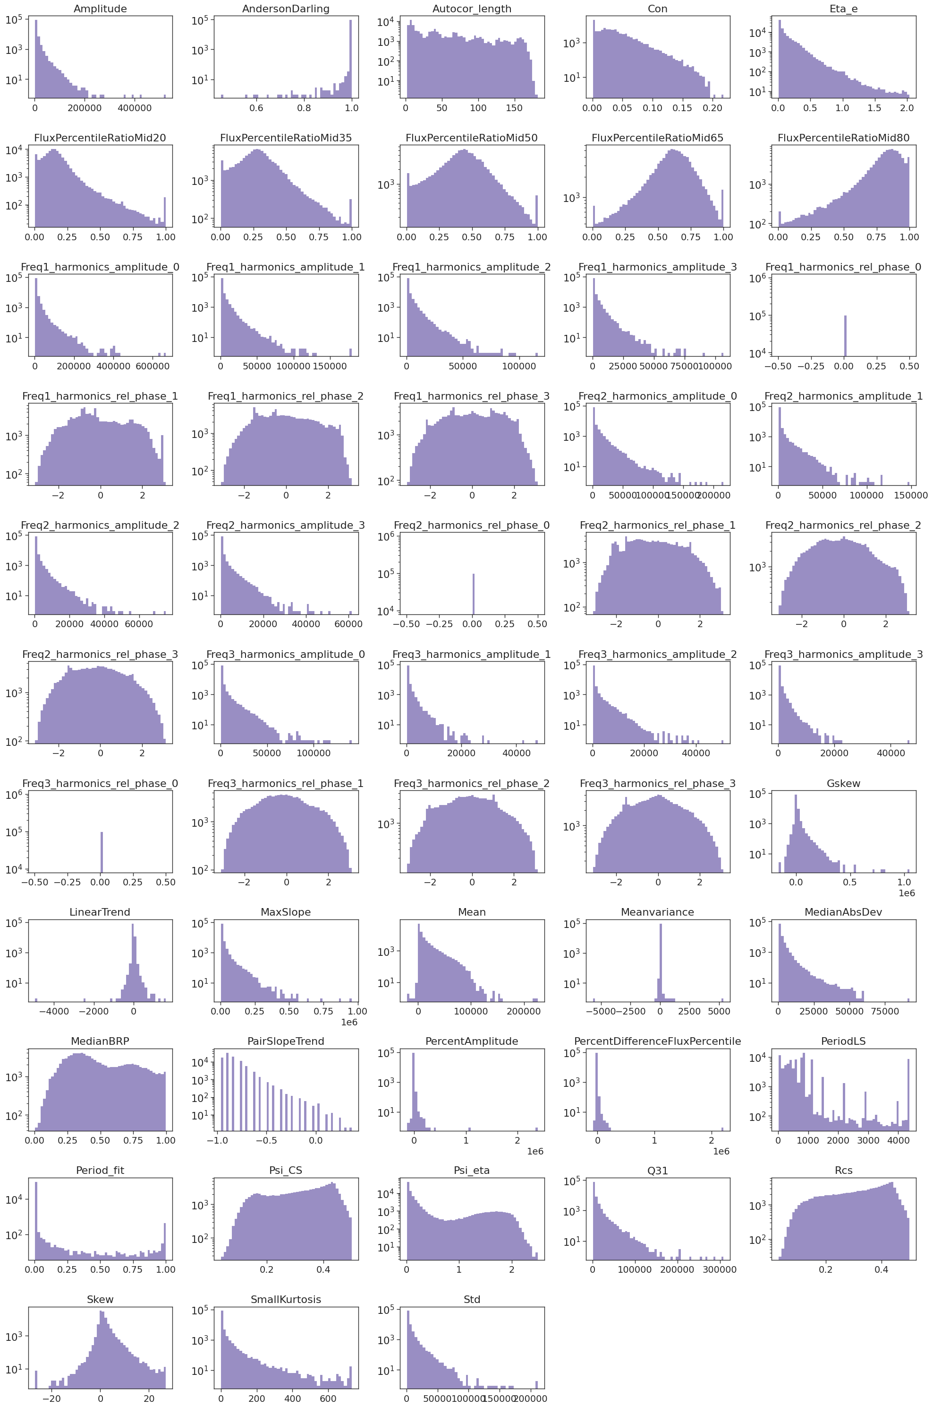
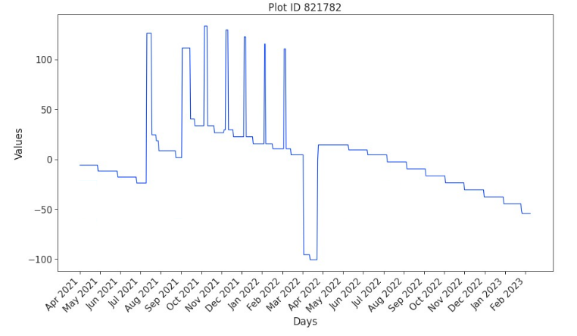
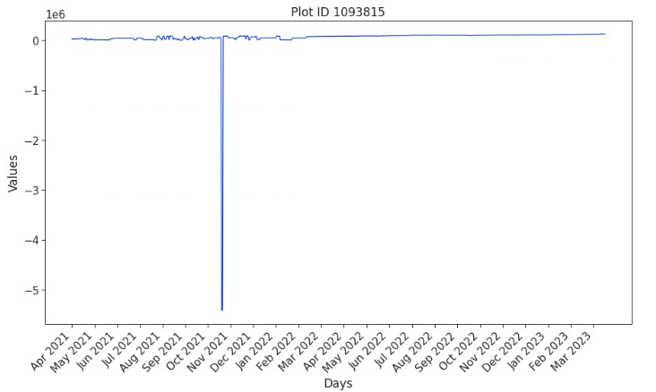
WHERE WE LEFT OFF IN MAY
Technical Objectives, Methodologies and Solutions
    Starting from the ISP dataset:
                Building time series representing each ID (total users: 2,636,027)
                Feature engineering: extracting statistical parameters for each time series (FATS library)
                First attempt for the identification of anomalies (K-Nearest Neighbours)
ICSC Italian Research Center on High-Performance Computing, Big Data and Quantum Computing
Missione 4 • Istruzione e Ricerca
Notes:
Template e guide lines

Slide 5
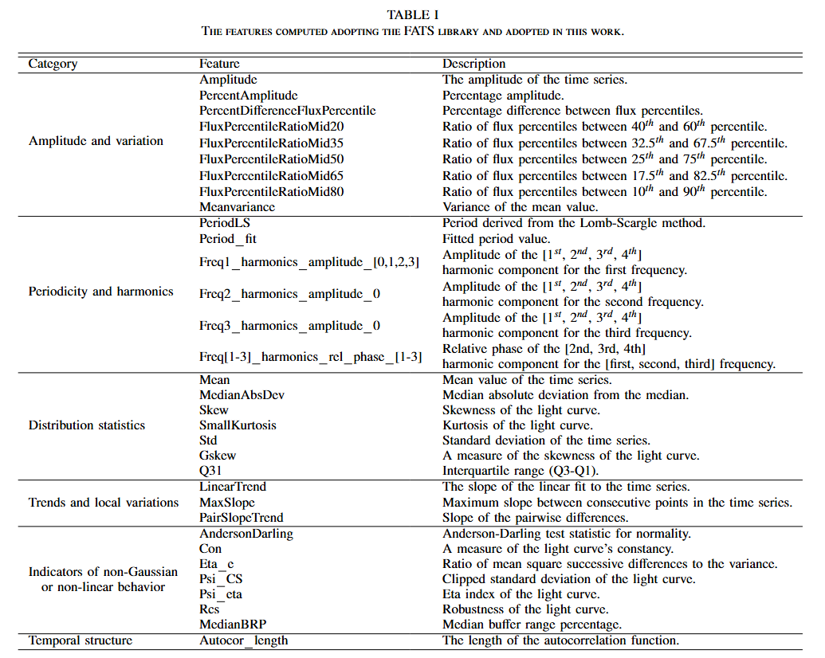
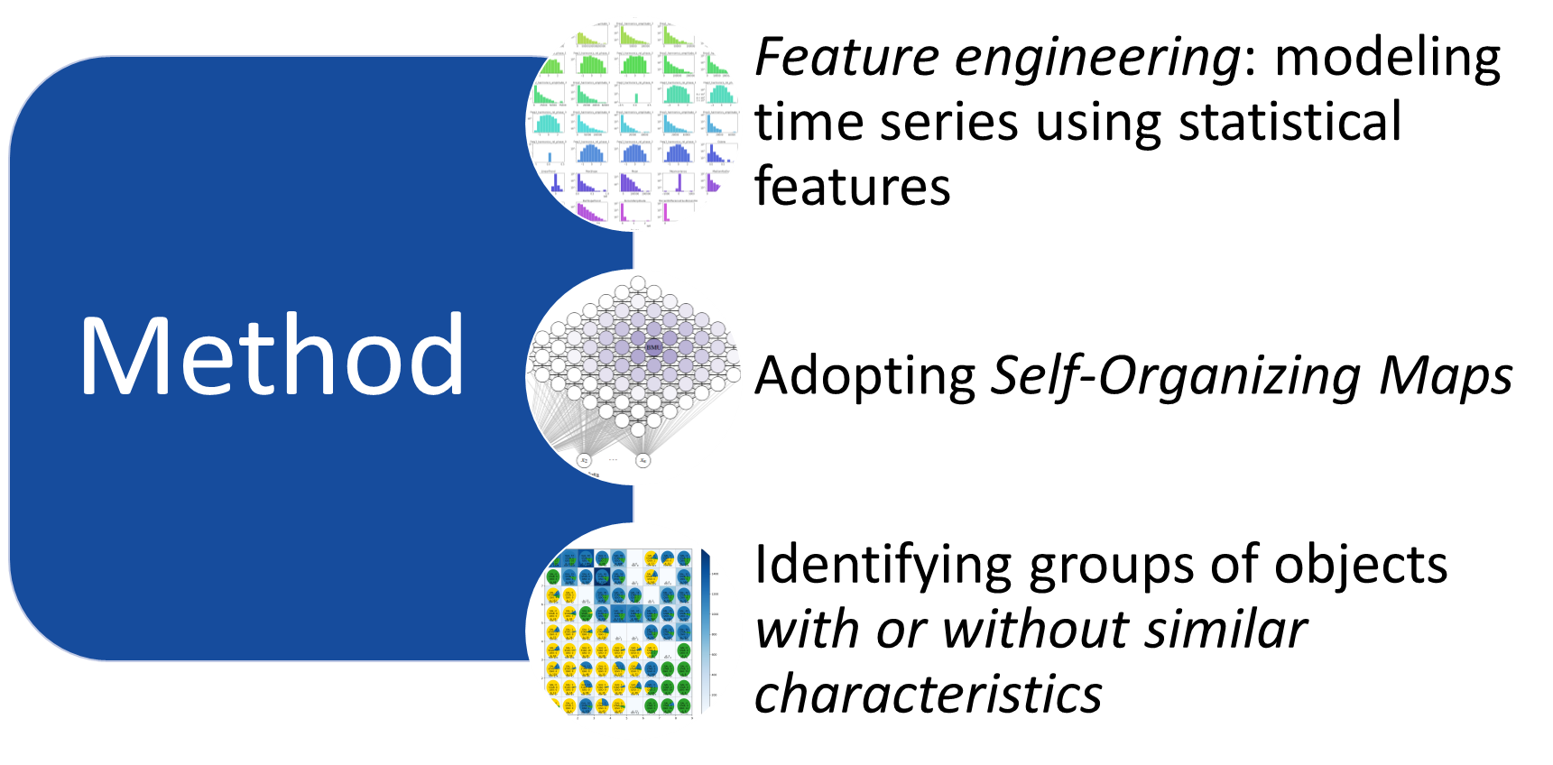
Technical Objectives, Methodologies and Solutions
ICSC Italian Research Center on High-Performance Computing, Big Data and Quantum Computing
Missione 4 • Istruzione e Ricerca
Notes:
Template e guide lines

Slide 6
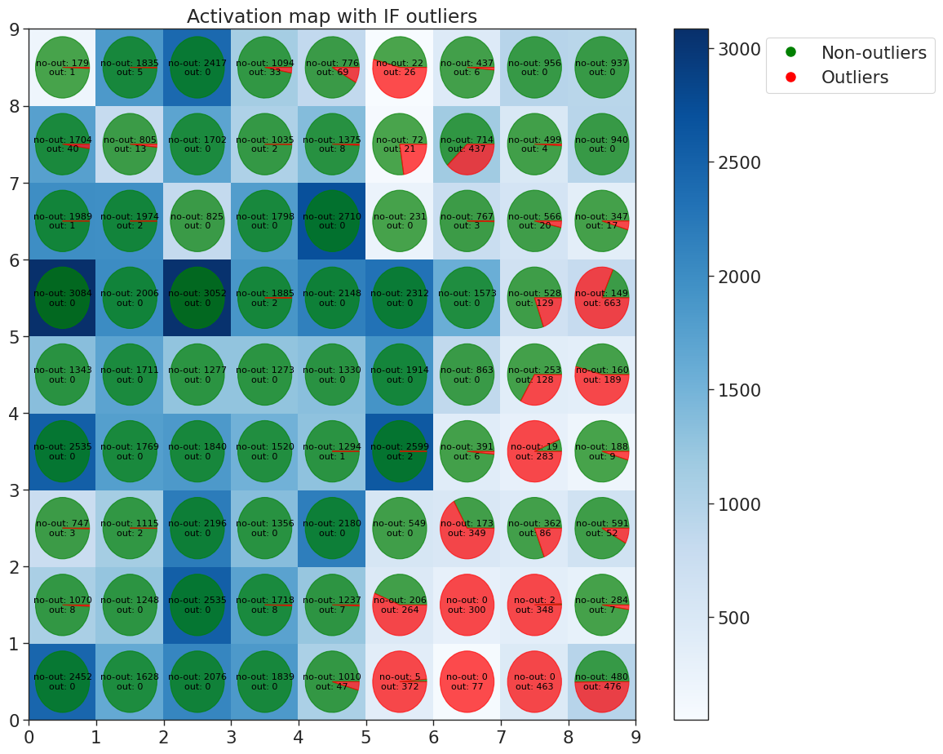
Main Results
    SOM
    Preliminary step: Isolation Forest with 5% of contamination. 4989 outliers found.
    Neighborhood function: Gaussian.
    The pies on the activation map show the distribution of outliers/not-outliers in output from the Isolation Forest.
ICSC Italian Research Center on High-Performance Computing, Big Data and Quantum Computing
Missione 4 • Istruzione e Ricerca
Notes:
Template e guide lines

Slide 7
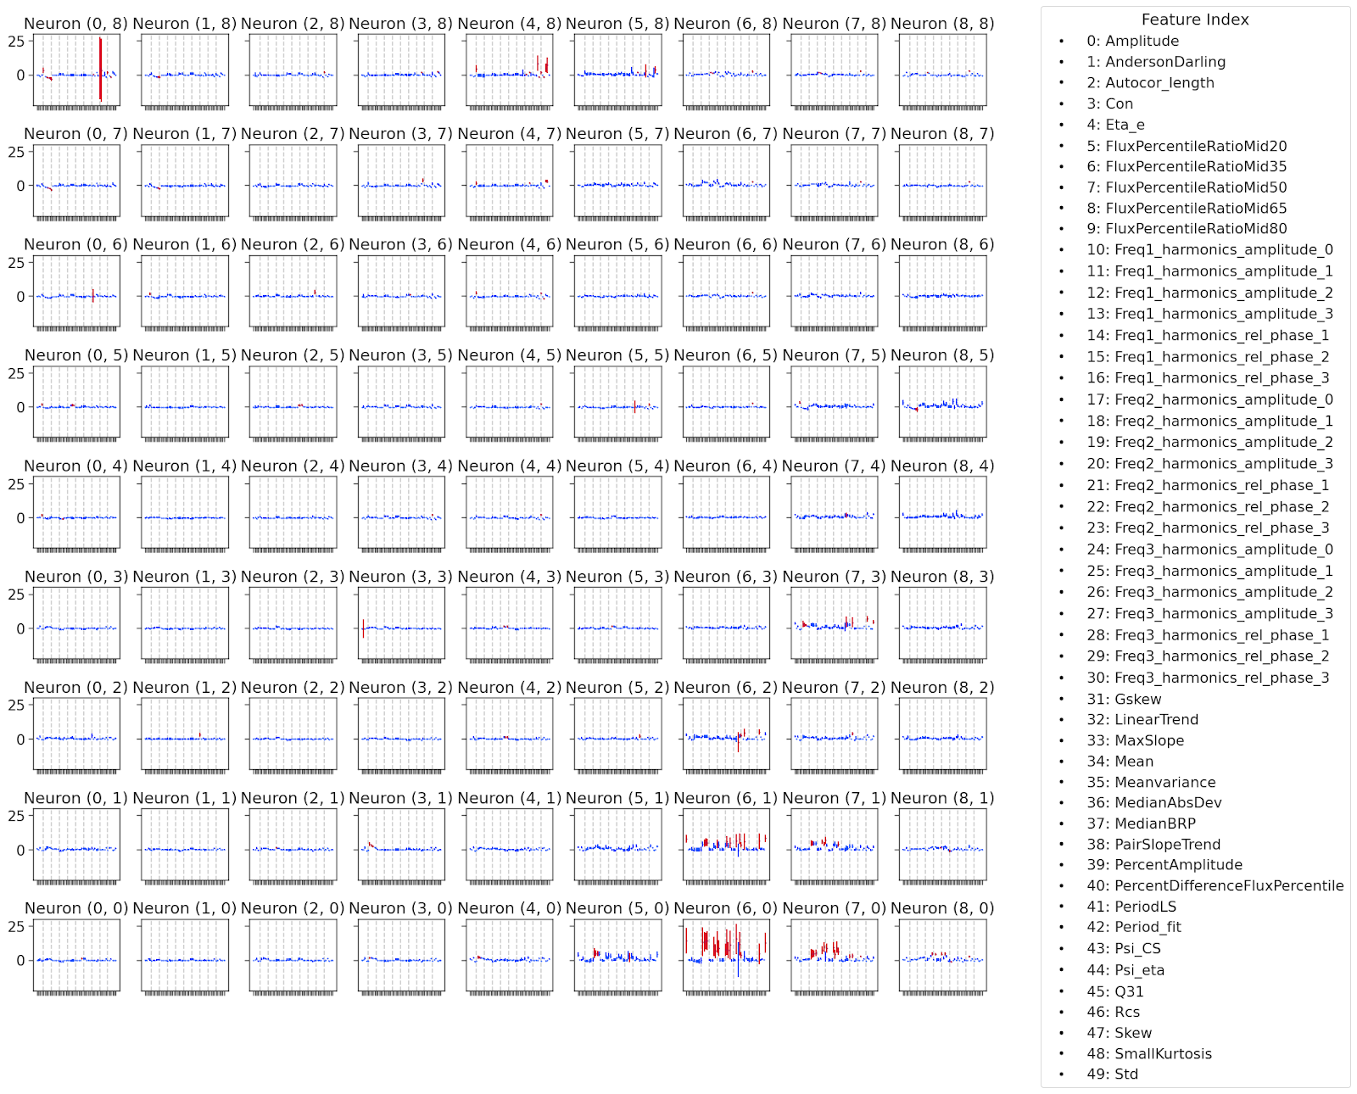
Main Results
For each neuron, we calculated the global mean and standard deviation. Features are in red if:
mean < global_mean - 2*global_std
or
mean > global_mean + 2*global_std
ICSC Italian Research Center on High-Performance Computing, Big Data and Quantum Computing
Missione 4 • Istruzione e Ricerca
Notes:
Template e guide lines

Slide 8
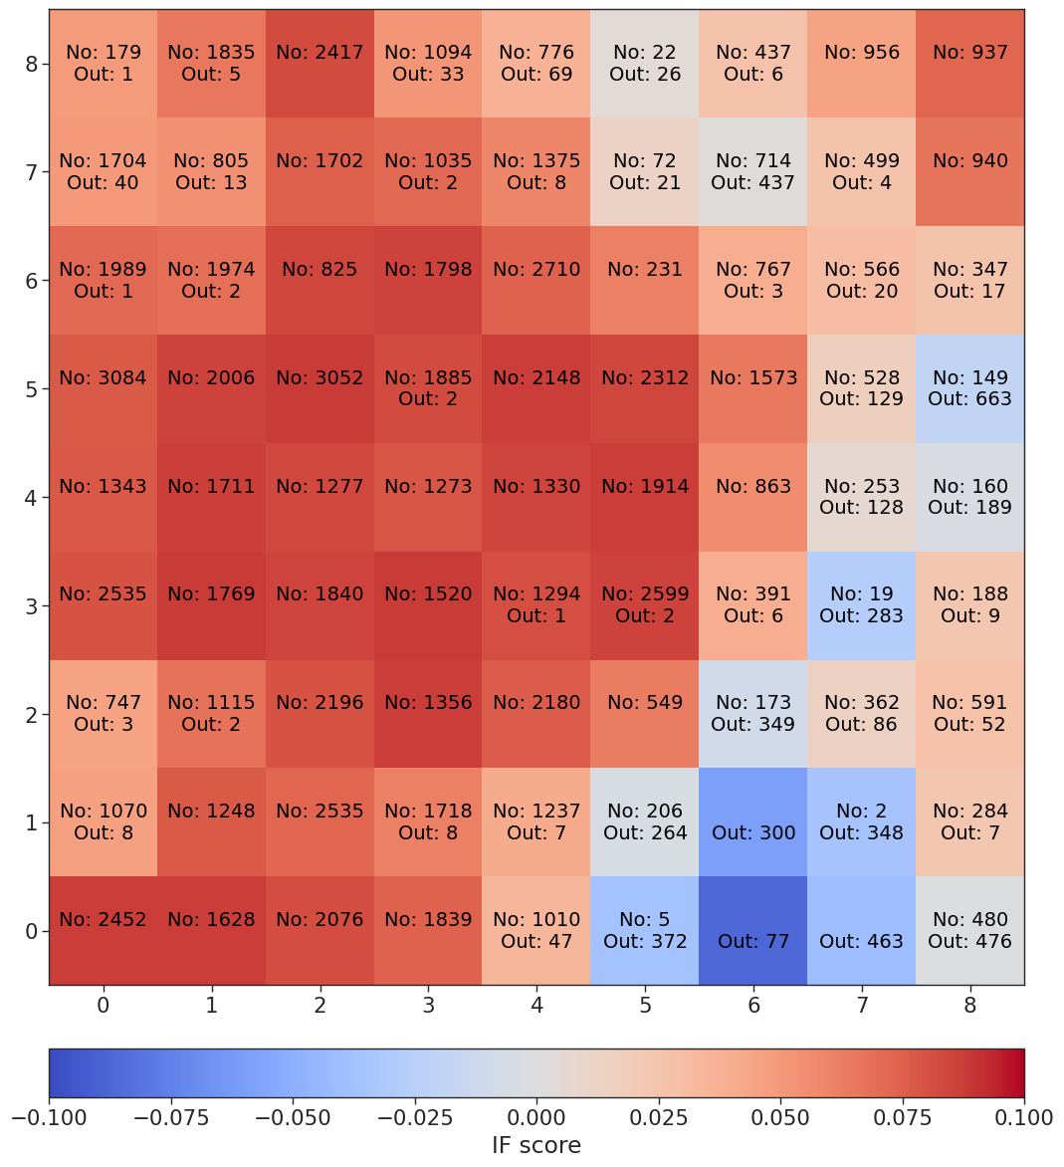
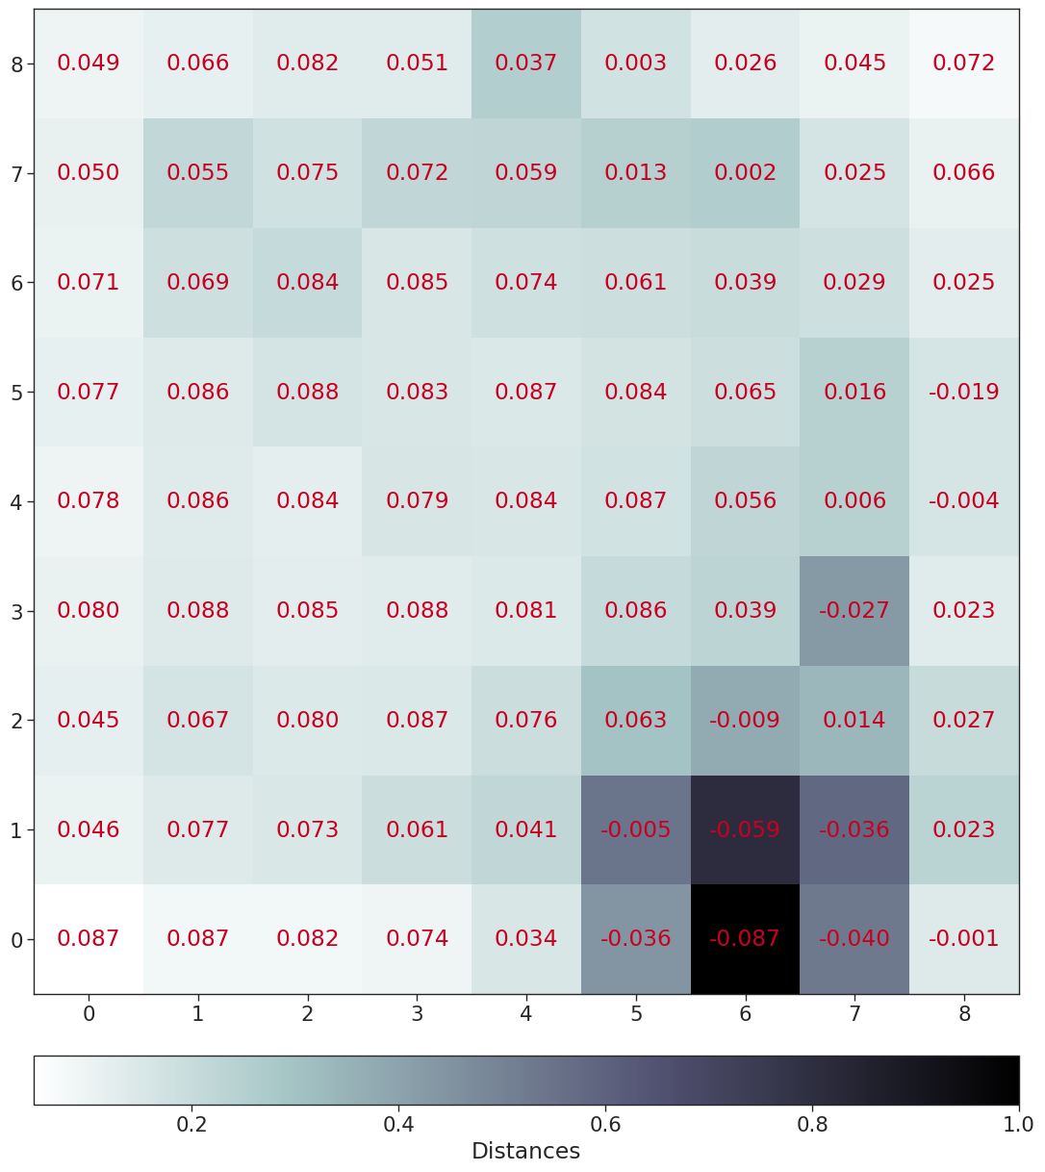
Main Results
In the left panel, the average IF score of the data points associated within each SOM neuron. Negative scores correspond to a predominance of anomalous data.
In the right panel, the U-matrix has been represented. Higher distances correspond to more sparse data. For each neuron, the IF mean score has been reported.
ICSC Italian Research Center on High-Performance Computing, Big Data and Quantum Computing
Missione 4 • Istruzione e Ricerca
Notes:
Template e guide lines

Slide 9
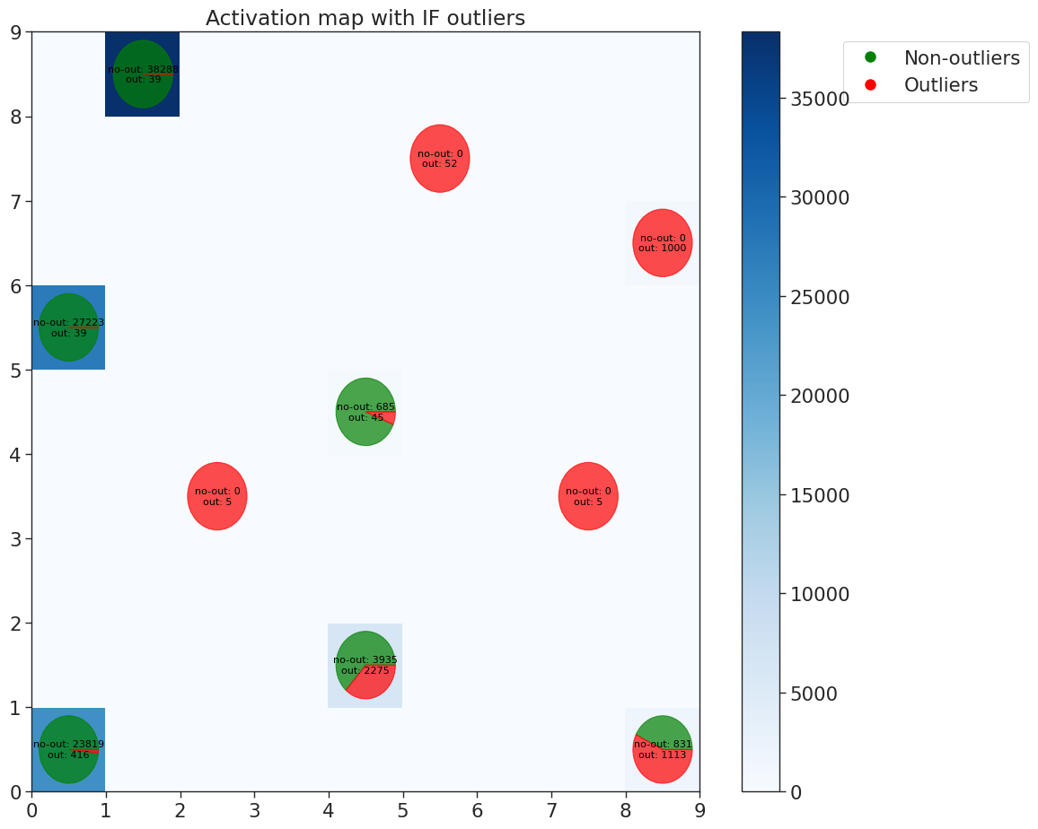
Main Results
    SOM
    Preliminary step: Isolation Forest with 5% of contamination. 4989 outliers found.
    Neighborhood function: Mexican Hat.
    The pies on the activation map show the distribution of outliers/not-outliers in output from the Isolation Forest.
ICSC Italian Research Center on High-Performance Computing, Big Data and Quantum Computing
Missione 4 • Istruzione e Ricerca
Notes:
Template e guide lines

Slide 10
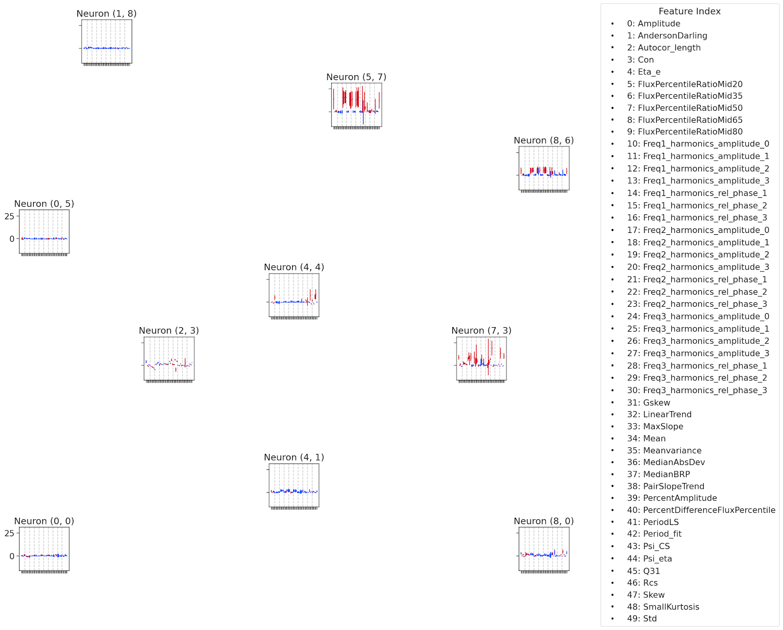
Main Results
For each neuron, we calculated the global mean and standard deviation. Features are in red if:
mean < global_mean - 2*global_std
or
mean > global_mean + 2*global_std
ICSC Italian Research Center on High-Performance Computing, Big Data and Quantum Computing
Missione 4 • Istruzione e Ricerca
Notes:
Template e guide lines

Slide 11
Main Results
The work package in the Spoke 3 corresponds to WP3.
Deliverable:
  M6 Data delivery – completed 100%
  M7 Preliminary results on data exploration and how to format the dataset, preprocessing the data – completed 100%
  M8 first prototype application with ML to one use case – completed 100%
  M9 Prototype with explainability – completed 100%
  M10 Python library that works on the banking dataset and environment – completed 15%
ICSC Italian Research Center on High-Performance Computing, Big Data and Quantum Computing
Missione 4 • Istruzione e Ricerca
Notes:
Template e guide lines

Slide 12



Final Steps
M10 Python library that works on the banking dataset and environment
1. Time Series → Features
2. Features → (x,y) SOM
3. Features → Threshold %
Function that allows to extract statistical features from the given input time series.
Function that allows to map the data onto the SOM.
Function that allows to assign a percentage with which establishing if an ID is Outlier/Not-outlier.
ICSC Italian Research Center on High-Performance Computing, Big Data and Quantum Computing
Missione 4 • Istruzione e Ricerca
Notes:
Template e guide lines

Slide 13
Fraud Detection
ICSC Italian Research Center on High-Performance Computing, Big Data and Quantum Computing
Missione 4 • Istruzione e Ricerca
Notes:
Template e guide lines

Slide 14
Technical Objectives, Methodologies and Solutions
Starting point
folder «punto_2», containing all product transactions and all events from January to September 2023 relating to BT that have had at least one fraudulent bank transfer.
Features exploration
Random forest experiment
Implement and evaluate a Random Forest model to classify fraudulent bank transfers
Analyze the distribution and correlation of features to identify possible relevant predictors for fraudulent bank transfers.
ICSC Italian Research Center on High-Performance Computing, Big Data and Quantum Computing
Missione 4 • Istruzione e Ricerca
Notes:
Template e guide lines

Slide 15
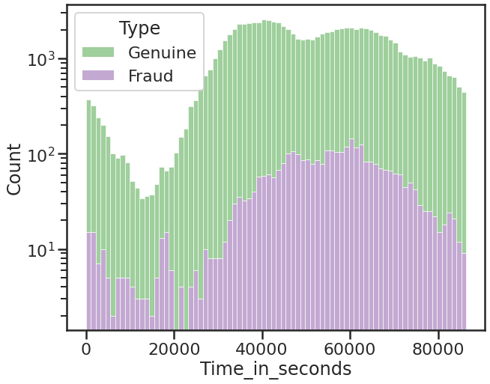
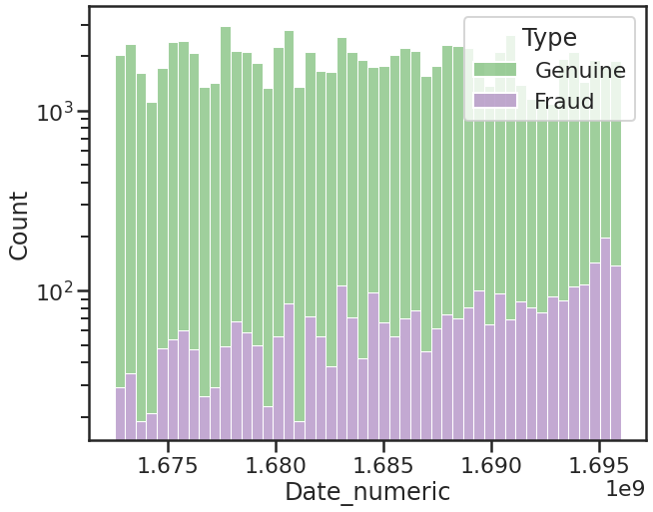
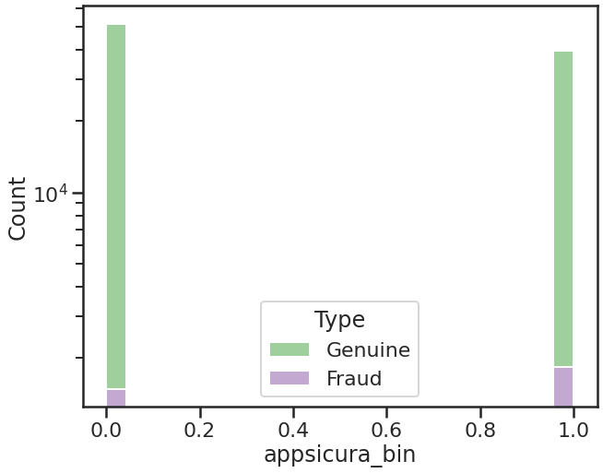
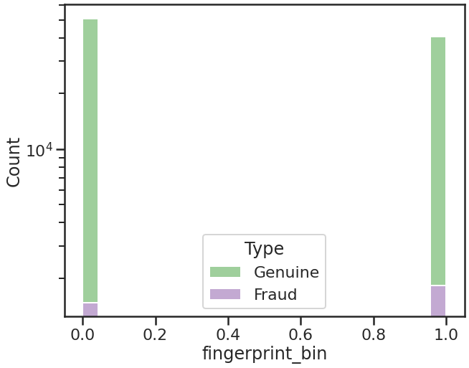
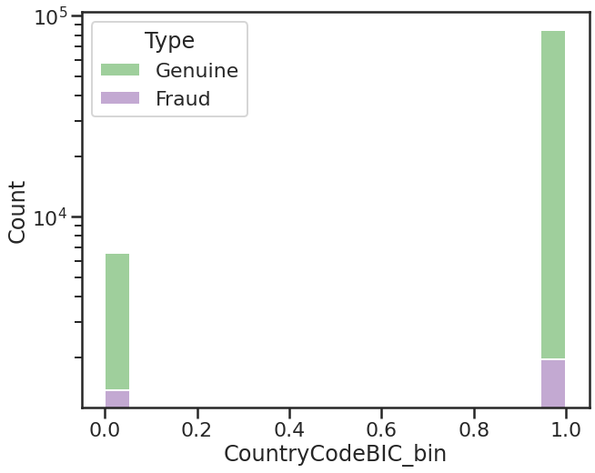
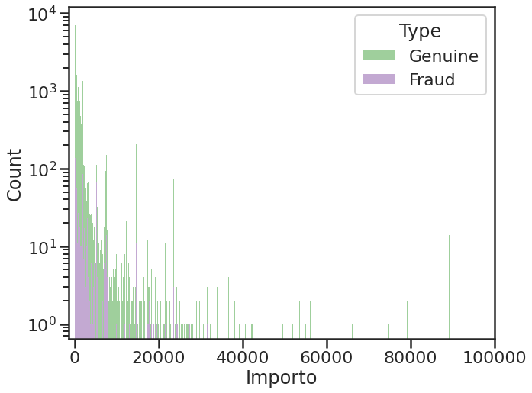
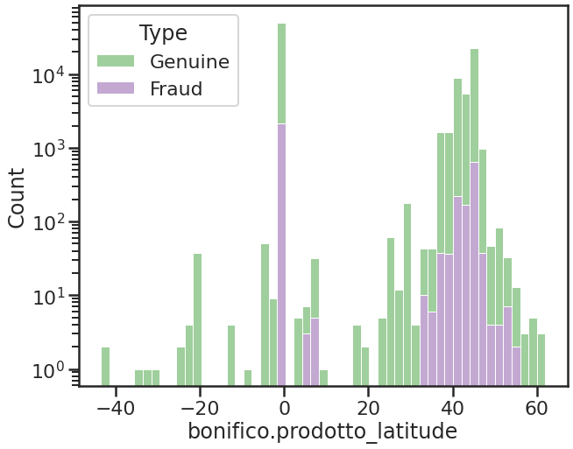
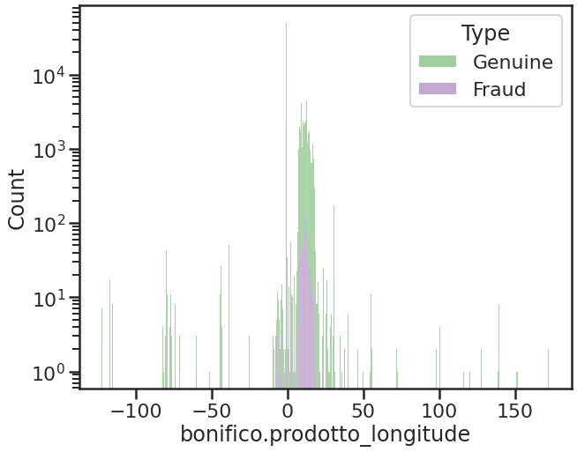
Main Results: Features exploration
ICSC Italian Research Center on High-Performance Computing, Big Data and Quantum Computing
Missione 4 • Istruzione e Ricerca
Notes:
Template e guide lines

Slide 16
Main Results: Random Forest
Features
Date_numeric
Time_in_seconds
appsicura_bin
fingerprint_bin
bonifico.prodotto_latitude
bonifico.prodotto_longitude
CountryCodeBIC_bin
instantpayment_bin
bonifico.prodotto_importooperazione
divisibile_per_2_bin
divisibile_per_3_bin
divisibile_per_5_bin
divisibile_per_10_bin
parte_decimale_00_bin
parte_decimale_50_bin
parte_decimale_99_bin
Target
bonifico.last_status
(0→ Genuine, 1→ Fraud)
Class weight
None: All classes are supposed to have weight one
Balanced: The “balanced” mode uses the values of y to automatically adjust weights inversely proportional to class frequencies in the input data as n_samples / (n_classes * np.bincount(y))
Balanced_subsample: The “balanced_subsample” mode is the same as “balanced” except that weights are computed based on the bootstrap sample for every tree grown.
ICSC Italian Research Center on High-Performance Computing, Big Data and Quantum Computing
Missione 4 • Istruzione e Ricerca
Notes:
Template e guide lines

Slide 17
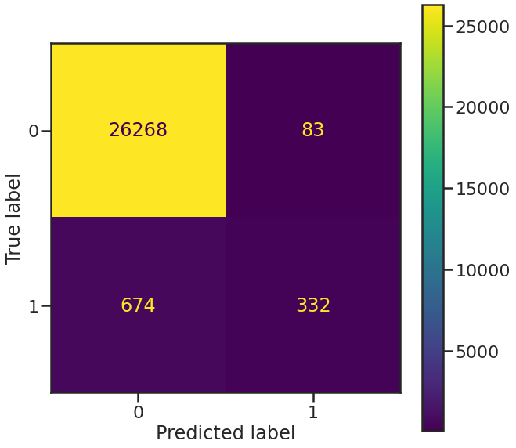
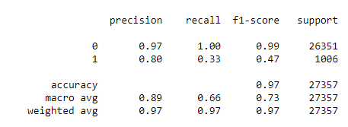
Main Results: Random Forest
Class weight: None
All classes are supposed to have weight one
ICSC Italian Research Center on High-Performance Computing, Big Data and Quantum Computing
Missione 4 • Istruzione e Ricerca
Notes:
Template e guide lines

Slide 18
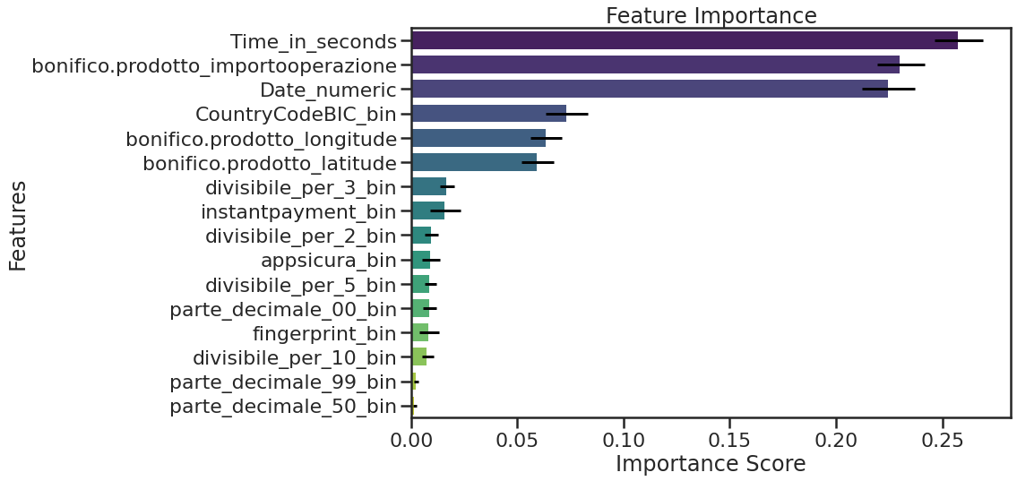
Main Results: Random Forest
ICSC Italian Research Center on High-Performance Computing, Big Data and Quantum Computing
Missione 4 • Istruzione e Ricerca
Notes:
Template e guide lines

Slide 19
Preliminary results and future works
Using any of the three methods, it is possible to recover up to 33% of fraudulent transactions, with an increase of just 0.3% in false positives.
At this preliminary stage, some features have not yet been utilized, while others have been categorized.
For example, CountryCodeBIC is set to 1 if it takes on the most frequent value, 0 otherwise.
Future steps
Expanding the set of features used and the dataset.
Adopting alternative approaches.
Including user profile features.
Preliminary results from Random Forest
ICSC Italian Research Center on High-Performance Computing, Big Data and Quantum Computing
Missione 4 • Istruzione e Ricerca
Notes:
Template e guide lines

Slide 20
Thank you for your attention!
riccardo.crupi@intesasanpaolo.com
ylenia.maruccia@inaf.it
ICSC Italian Research Center on High-Performance Computing, Big Data and Quantum Computing
Missione 4 • Istruzione e Ricerca
Notes:
Template e guide lines

Slide 21
Backup slides
ICSC Italian Research Center on High-Performance Computing, Big Data and Quantum Computing
Missione 4 • Istruzione e Ricerca
Notes:
Template e guide lines

Slide 22

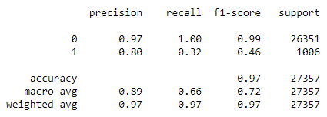
Main Results: Random Forest
Class weight: balanced
The “balanced” mode uses the values of y to automatically adjust weights inversely proportional to class frequencies in the input data as n_samples / (n_classes * np.bincount(y))
ICSC Italian Research Center on High-Performance Computing, Big Data and Quantum Computing
Missione 4 • Istruzione e Ricerca
Notes:
Template e guide lines

Slide 23
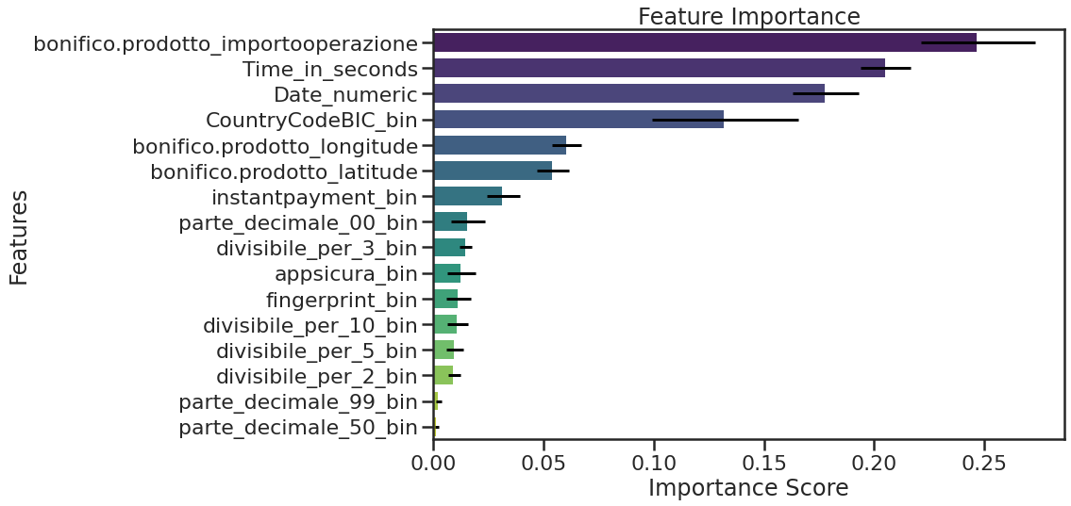
Main Results: Random Forest
ICSC Italian Research Center on High-Performance Computing, Big Data and Quantum Computing
Missione 4 • Istruzione e Ricerca
Notes:
Template e guide lines

Slide 24

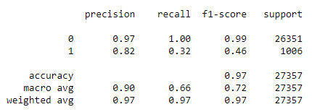
Main Results: Random Forest
Class weight: balanced_subsample
The “balanced_subsample” mode is the same as “balanced” except that weights are computed based on the bootstrap sample for every tree grown.
ICSC Italian Research Center on High-Performance Computing, Big Data and Quantum Computing
Missione 4 • Istruzione e Ricerca
Notes:
Template e guide lines

Slide 25

Main Results: Random Forest
ICSC Italian Research Center on High-Performance Computing, Big Data and Quantum Computing
Missione 4 • Istruzione e Ricerca
Notes:
Template e guide lines

