Slide 1
From Specification to Implementation: Latest Developments in Services and Archive Interfaces
Massimo Costantini – INAF OATs
Spoke 3 II Technical Workshop, Bologna Dec 17 -19, 2024
ICSC Italian Research Center on High-Performance Computing, Big Data and Quantum Computing
Missione 4 • Istruzione e Ricerca
Notes:
Cover

Slide 2
Where were we?
The project focuses on developing effective data management solutions
A framework specifically designed to address big data challenges in astrophysics, requiring customized data models and management strategies
A custom web application developed to provide a user-friendly interface for accessing and querying archived metadata
This presentation offers an update on the project’s latest advancements, the introduction of new services and enhancements in archive interfaces
ICSC Italian Research Center on High-Performance Computing, Big Data and Quantum Computing
Missione 4 • Istruzione e Ricerca
Notes:
Template e guide lines

Slide 3
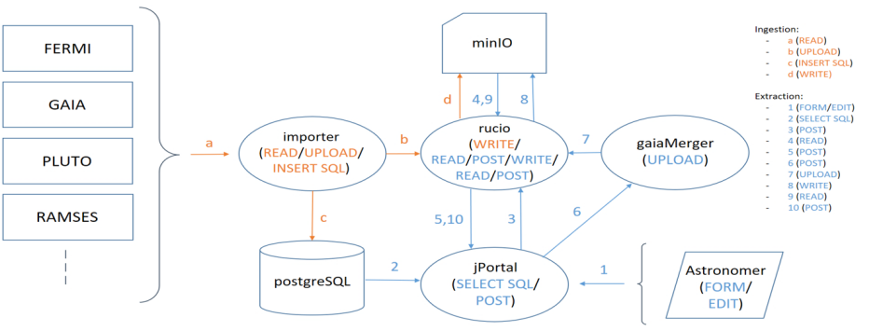
New Actors / Actions Schema
The new actor “gaiaMerger” enables users to generate HDF5 files containing only the selected sources or transits extracted from the Gaia catalogs, resulting in more compact data files compared to the originals.
ICSC Italian Research Center on High-Performance Computing, Big Data and Quantum Computing
Missione 4 • Istruzione e Ricerca
Notes:
Template e guide lines

Slide 4
Galzignano’s use cases
IDENTIFY ALL SOURCES WITH ALL TRANSITS
Direction: Alpha (RA), Delta (Dec) + Arc width (epsilon)
Range: Min/Max Alpha (RA), Delta (Dec)
Time interval: transit date range
COPY/PASTE a pre-built query using the integrated editor
ICSC Italian Research Center on High-Performance Computing, Big Data and Quantum Computing
Missione 4 • Istruzione e Ricerca
Notes:
Template e guide lines

Slide 5
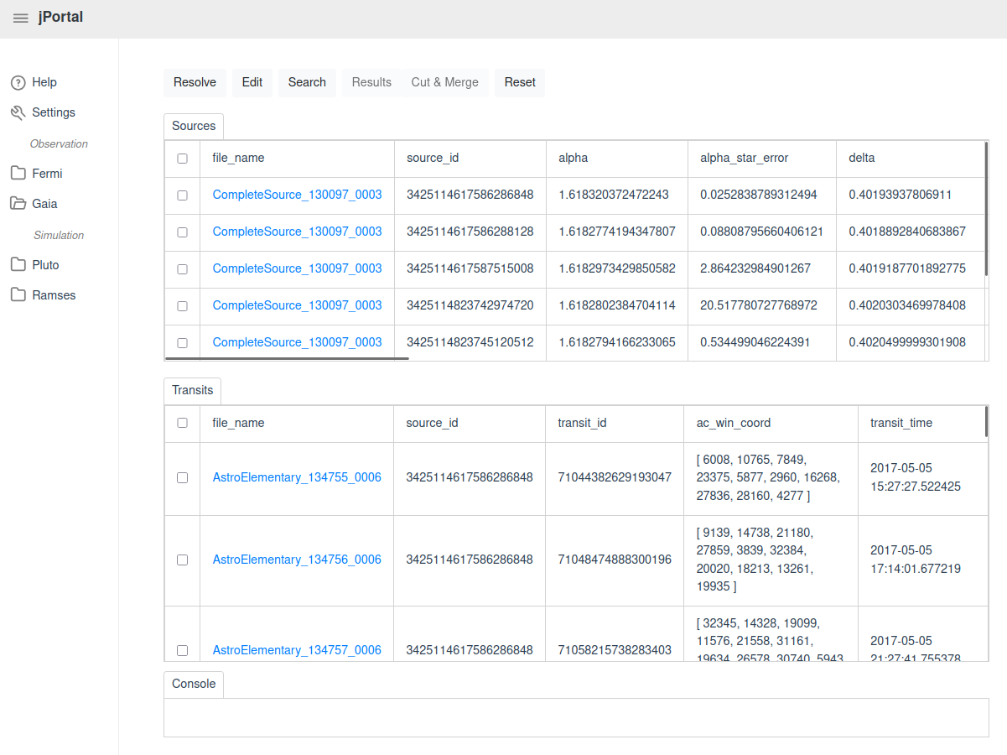
Results window
An example of a query result: one or more sources, transits or both, can be selected to be “Cut & Merged” by the gaiaMerger service.
ICSC Italian Research Center on High-Performance Computing, Big Data and Quantum Computing
Missione 4 • Istruzione e Ricerca
Notes:
Template e guide lines

Slide 6
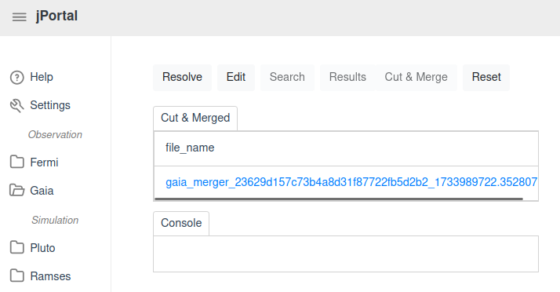
Gaia Merger
The resulting file can be downloaded via Rucio directly from the portal hiding the file’s actual location on the MinIO backbone for security reasons.
ICSC Italian Research Center on High-Performance Computing, Big Data and Quantum Computing
Missione 4 • Istruzione e Ricerca
Notes:
Template e guide lines

Slide 7
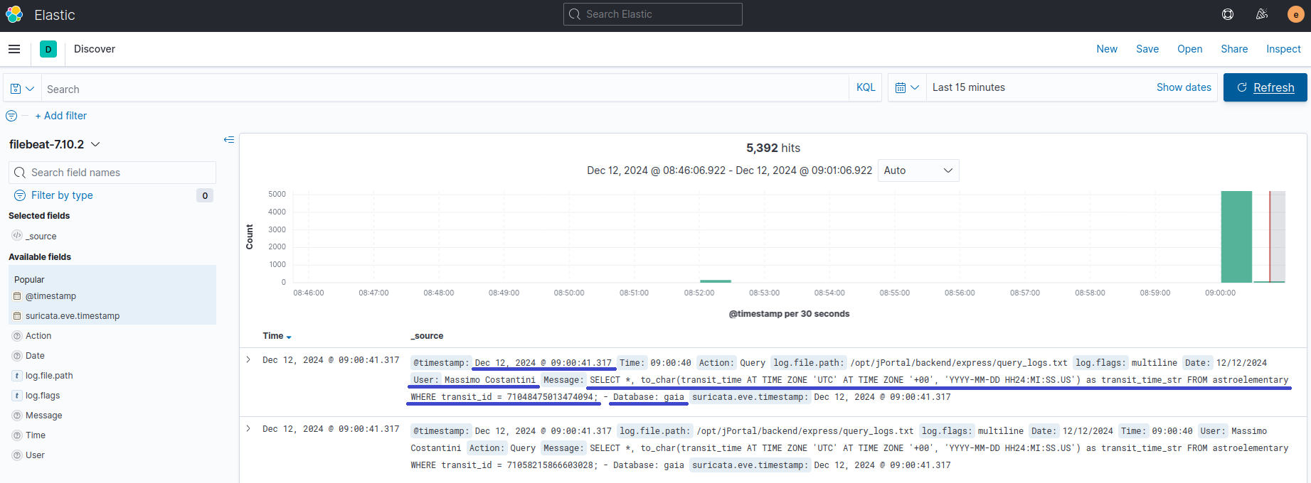
Elasticsearch / Kibana
All queries and downloads are logged using Elasticsearch and visualized via Kibana, including details such as timestamps, users and executed queries.
ICSC Italian Research Center on High-Performance Computing, Big Data and Quantum Computing
Missione 4 • Istruzione e Ricerca
Notes:
Template e guide lines

Slide 8
Next Steps
Interoperability: decide whether to send queries directly to PostgreSQL or through a TAP to obtain VOTables
Interoperability: utilize a Data Link to provide a list of available services
Fermitools integration: integrate Fermitools for enhanced functionality
Visualization tools integration: incorporate visualization tools for better data representation
Pluto and Ramses integration: implement integration with Pluto and Ramses
PostgreSQL sharding: compare performances between PostgreSQL sharding and Oracle
ICSC Italian Research Center on High-Performance Computing, Big Data and Quantum Computing
Missione 4 • Istruzione e Ricerca
Notes:
Template e guide lines

Slide 9
Thanks for your attention!
ICSC Italian Research Center on High-Performance Computing, Big Data and Quantum Computing
Missione 4 • Istruzione e Ricerca
Notes:
Template e guide lines

