Slide 1

WP4 DMs, Ingestion and Services Updates
Giacomo Coran
Spoke 3 II Technical Workshop, Bologna Dec 17 -19, 2024
ICSC Italian Research Center on High-Performance Computing, Big Data and Quantum Computing
Missione 4 • Istruzione e Ricerca
Notes:
Cover

Slide 2
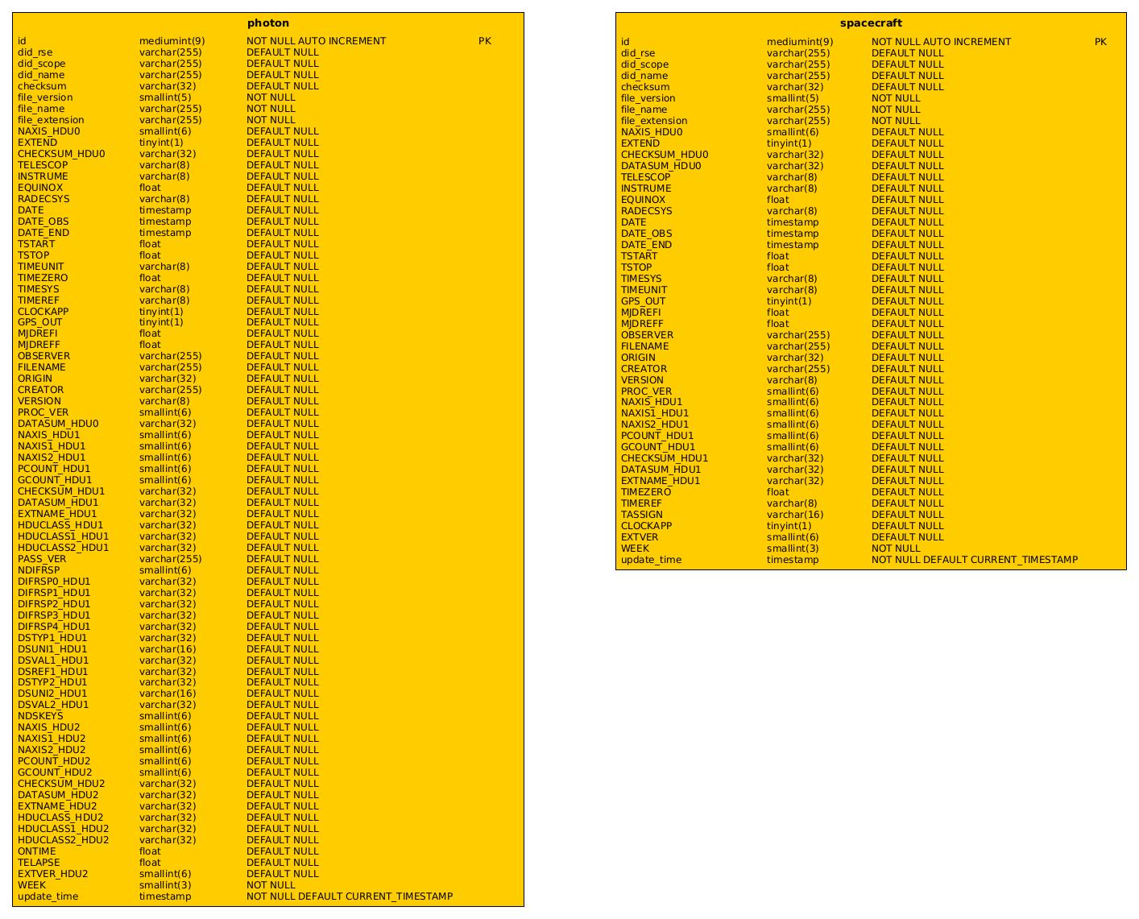
Fermi Use Case
Logical Data Model based on ObsCoreDM
Physical Data Model as rappresentation of the archiving tabular structure described in two tables
One table for the scientific data products
One table for the instrumental data
ICSC Italian Research Center on High-Performance Computing, Big Data and Quantum Computing
Missione 4 • Istruzione e Ricerca

Slide 3
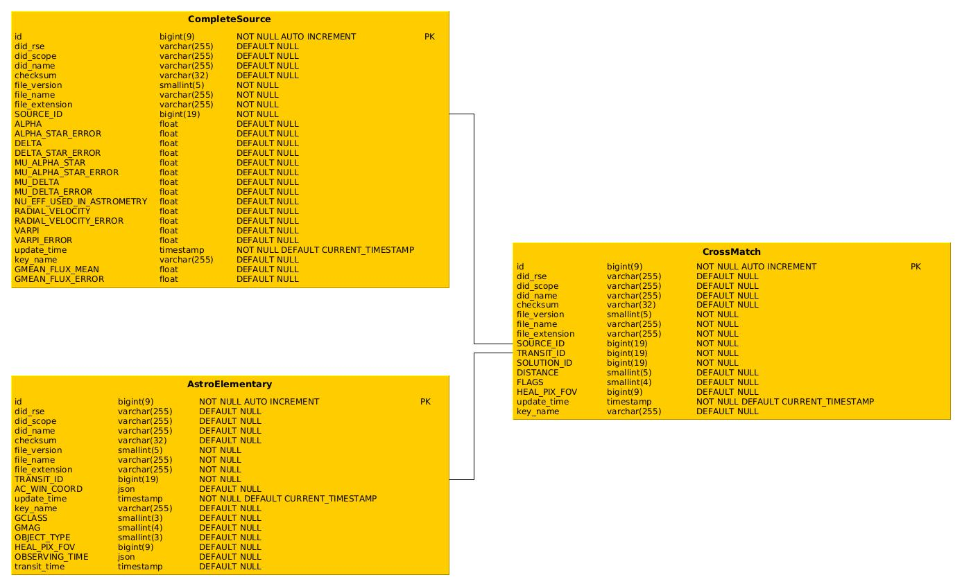
Gaia Use Case
Physical archive structure divided into three tables
One table for the observed sources
One table for the observed transits
One table to link them all
Minor adjustments on the transits table to provide better search capabilities
ICSC Italian Research Center on High-Performance Computing, Big Data and Quantum Computing
Missione 4 • Istruzione e Ricerca

Slide 4
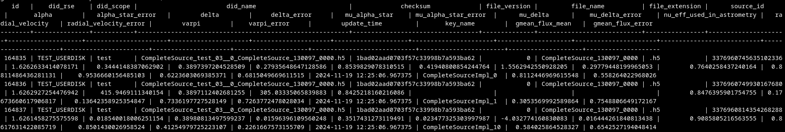
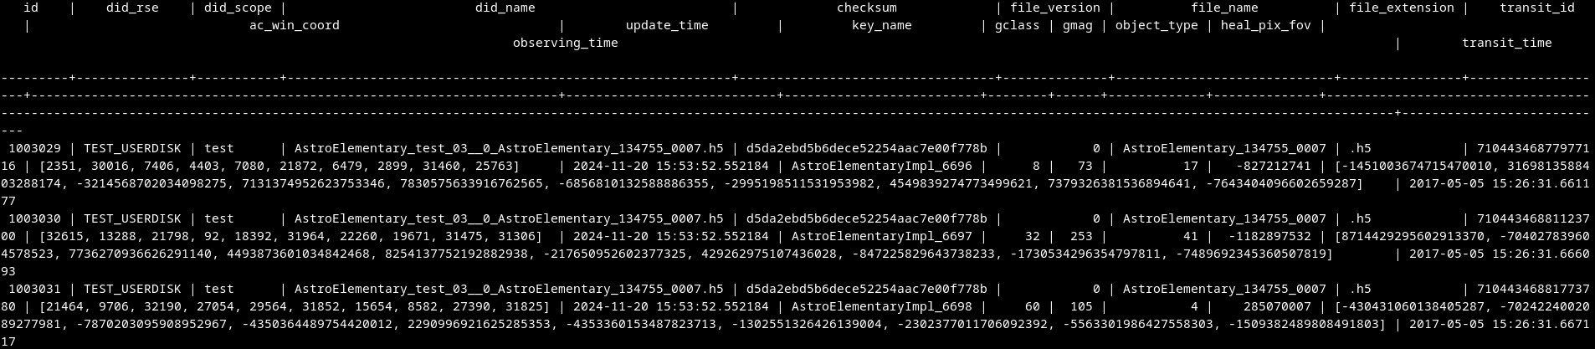
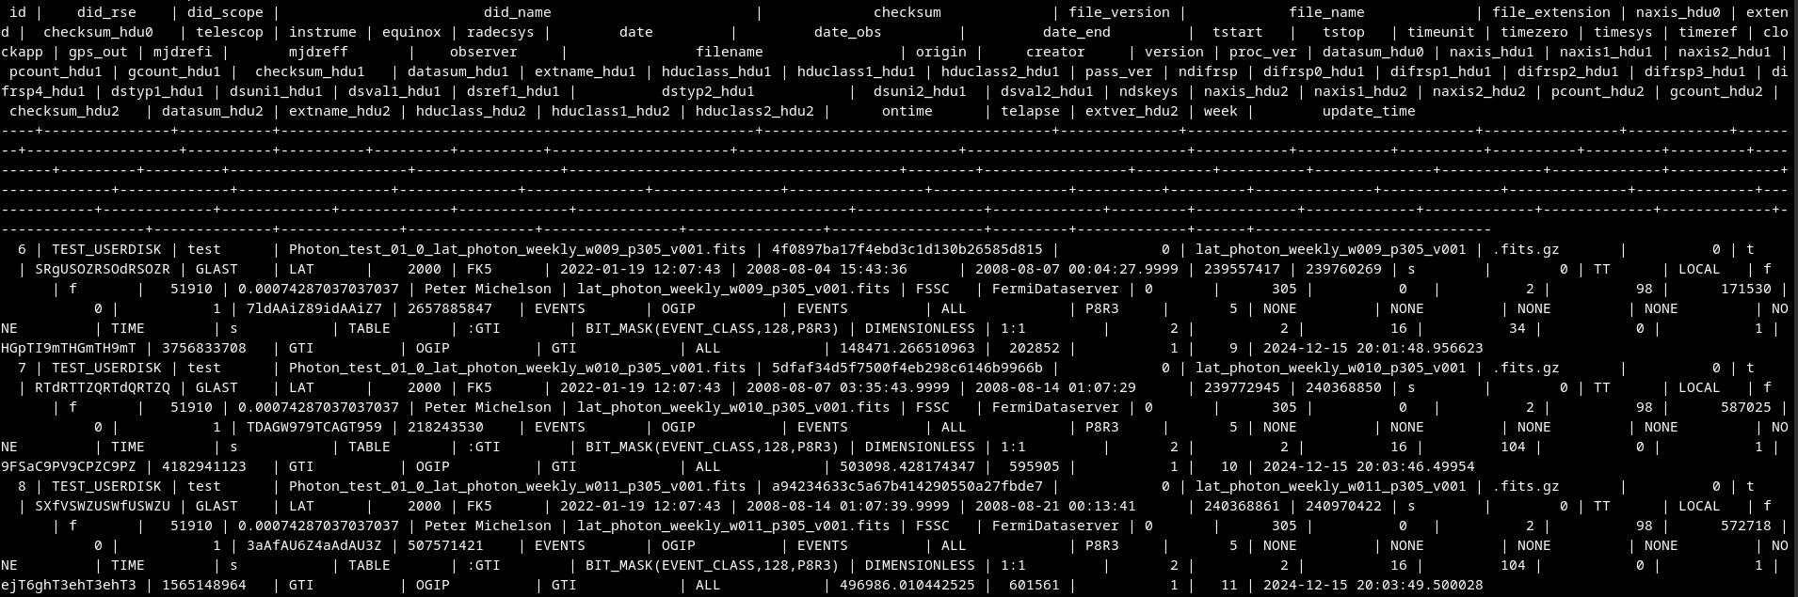
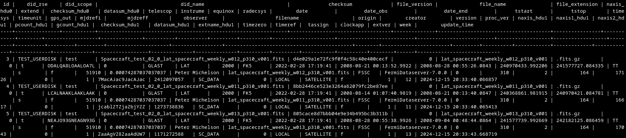
Data Ingestion
Minor adjustment to the extracting method to mirror the changes on the file structure and the consequent changes on the archiving structure
Data ingestion completed for the provided Gaia datasets
More than 800k entries in the Gaia Database
Data ingestion mostly completed also for Fermi
ICSC Italian Research Center on High-Performance Computing, Big Data and Quantum Computing
Missione 4 • Istruzione e Ricerca

Slide 5
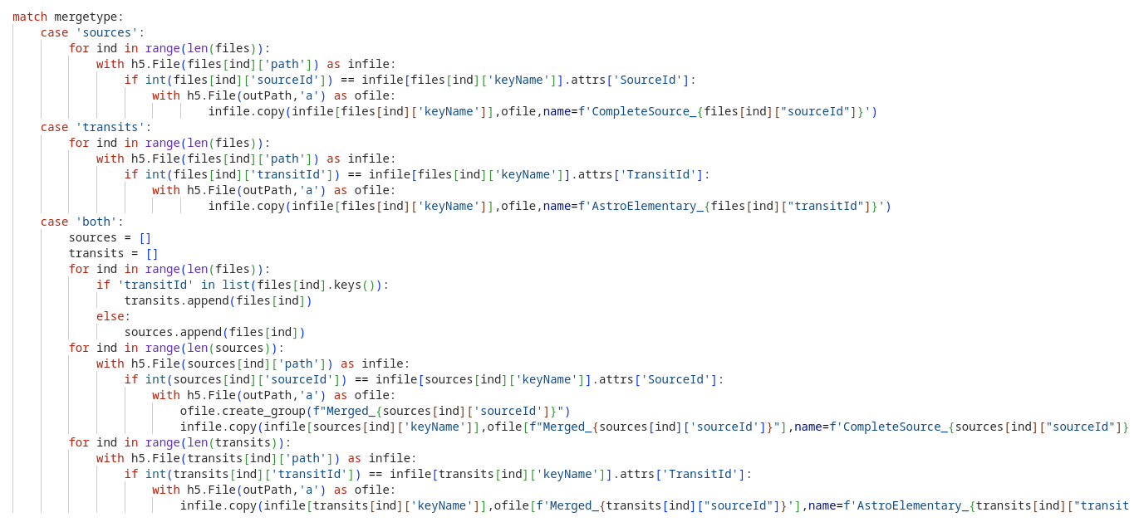
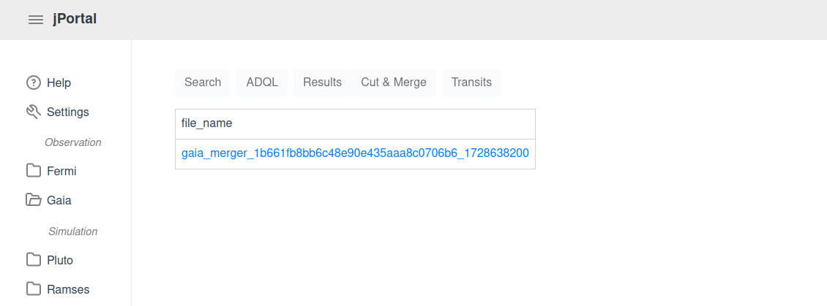
GaiaMerger
«Cut & Merge» Service
Generates new temporary files
For only sources or transit direct copy of the single groupes inside the newly generated file
For combination of sources and transits implemented file structure so that each transit resides with its related source within one single HDF5 group
Provides smaller data files to the users with only their selected sources and/or transits
Provides easy access to each single source to be studied
ICSC Italian Research Center on High-Performance Computing, Big Data and Quantum Computing
Missione 4 • Istruzione e Ricerca

Slide 6
Conclusions
Observative data are easily stored in the constructed archiving system
Good communication with data providers easily solves fine tuning problems
Data ingestion is fairly achievable even with few resources
The observative archive is «search-ready» for the developed portal
ICSC Italian Research Center on High-Performance Computing, Big Data and Quantum Computing
Missione 4 • Istruzione e Ricerca

Slide 7
Next Steps
Simulative Logical Data Models are next in line to be prepared
Simulative Physical DMs still requires the knowledge on the searchable metadata to be stored
TAP and Datalink implementation to provide access even to standardized clients
Ingestion of a larger second set of Gaia data
Implementation of other analysis services, as the connection to the Fermitools
ICSC Italian Research Center on High-Performance Computing, Big Data and Quantum Computing
Missione 4 • Istruzione e Ricerca

Slide 8
Thank you!
Spoke 3 II Technical Workshop, Bologna Dec 17 -19, 2024
ICSC Italian Research Center on High-Performance Computing, Big Data and Quantum Computing
Missione 4 • Istruzione e Ricerca
Notes:
Cover

