Slide 1






Mansi M. Kasliwal
Professor of Astronomy
California Institute of Technology

Slide 2
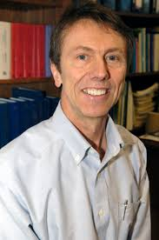
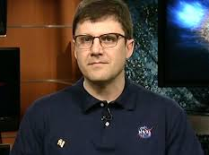
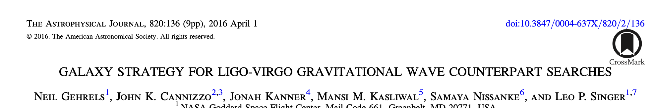
Happy 20th birthday, Swift!
Brad Cenko
Neil Gehrels

Slide 3
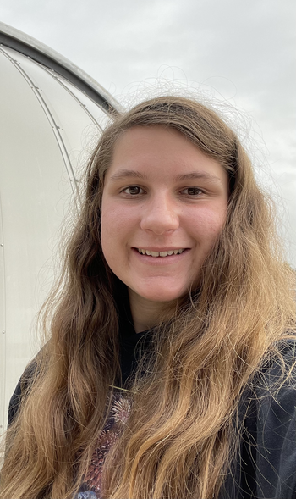
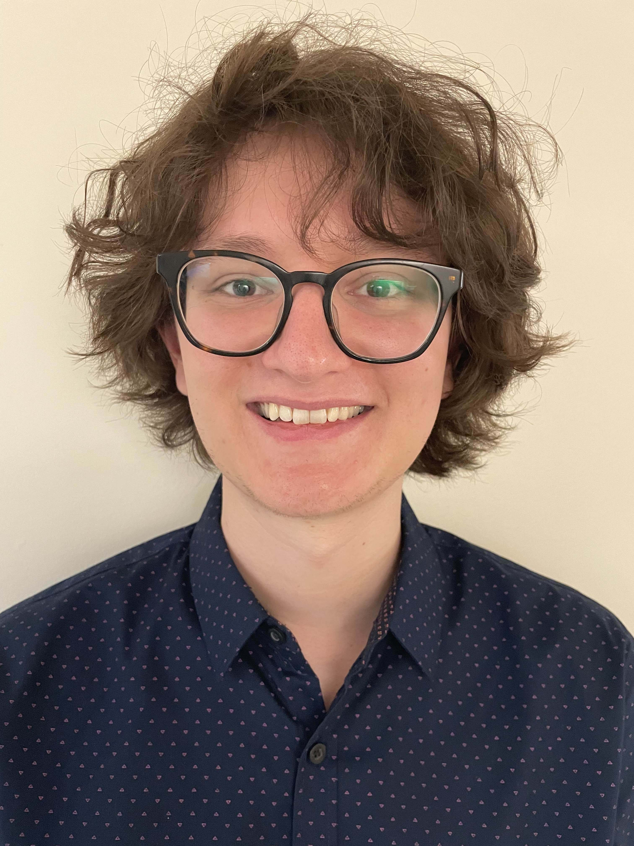
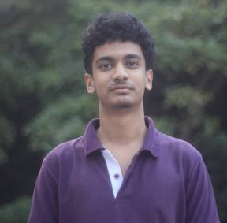
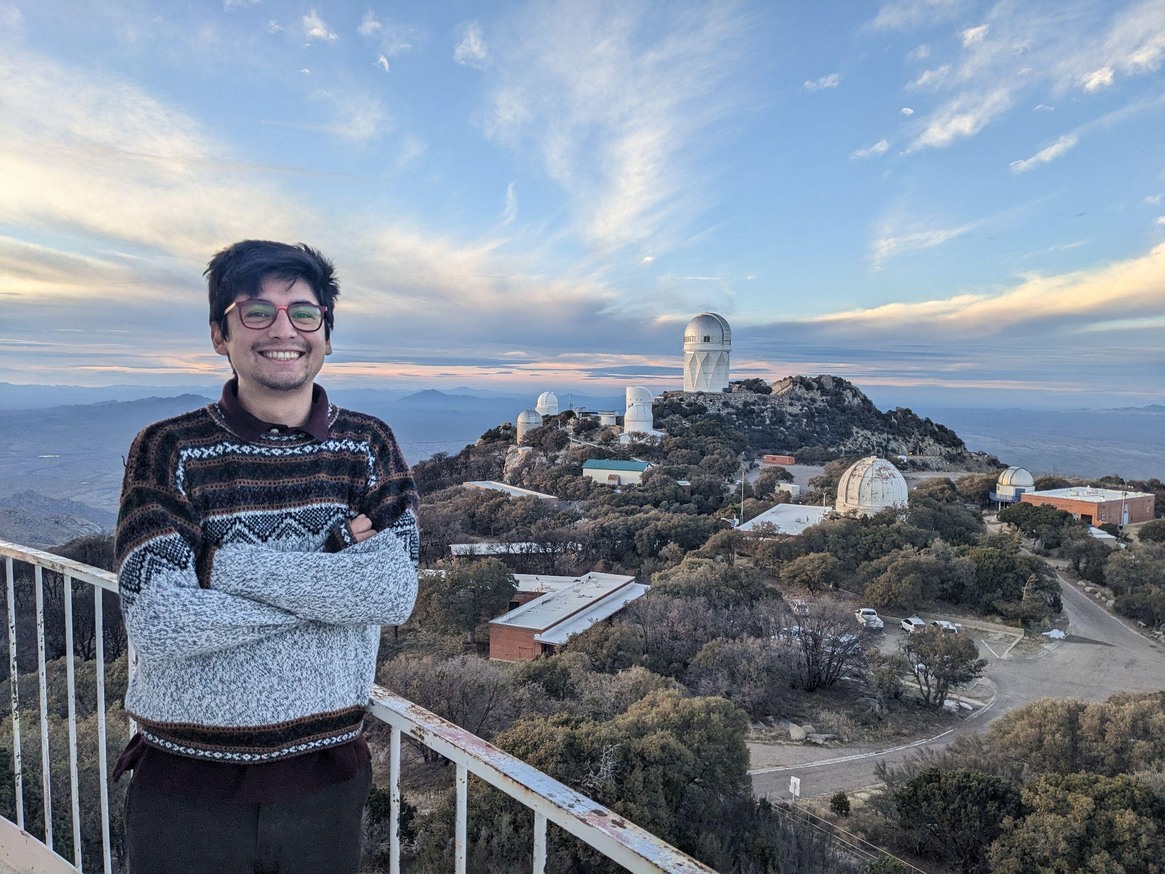
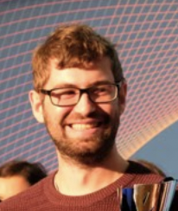
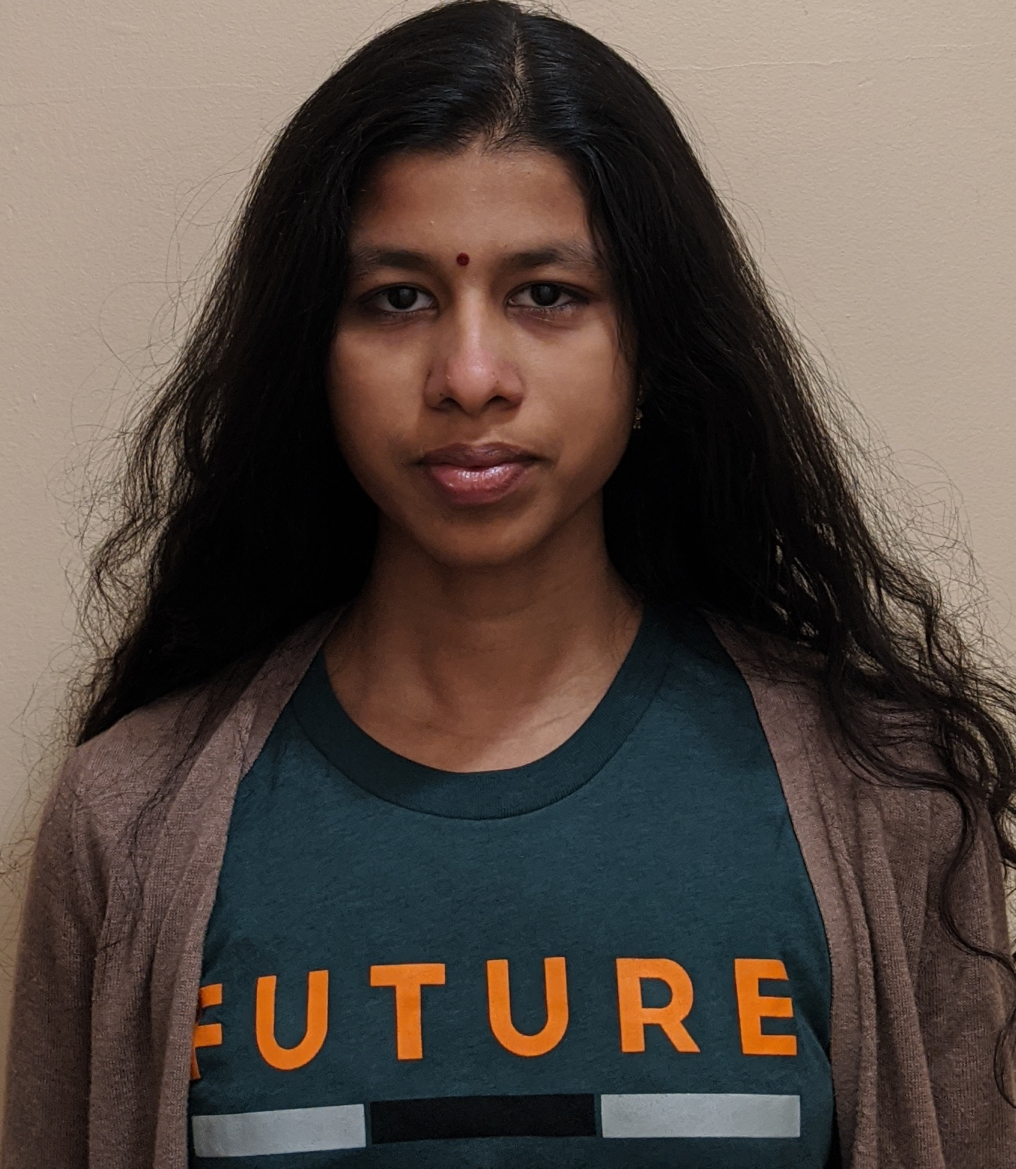
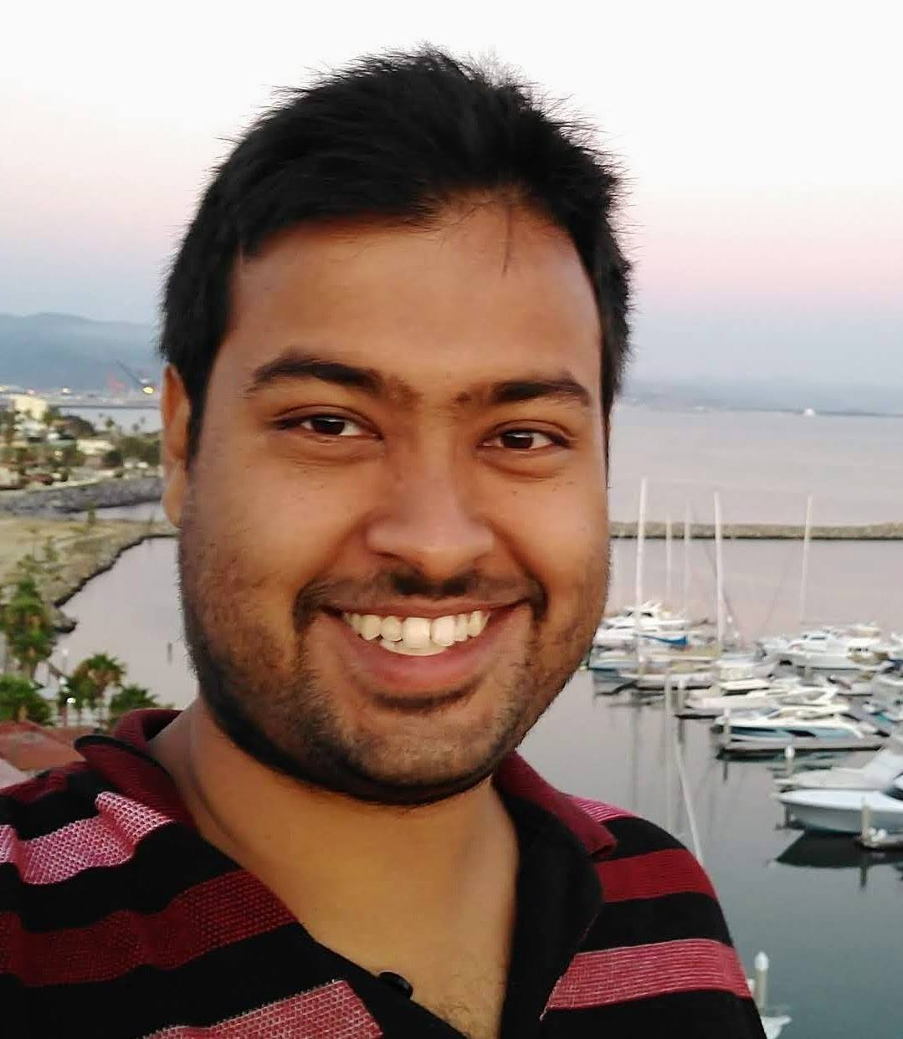
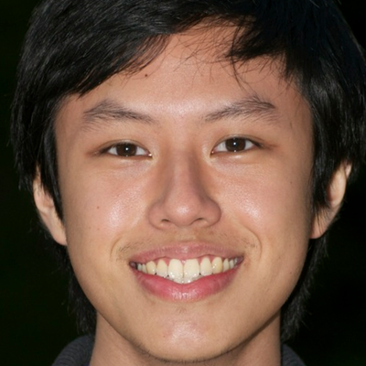
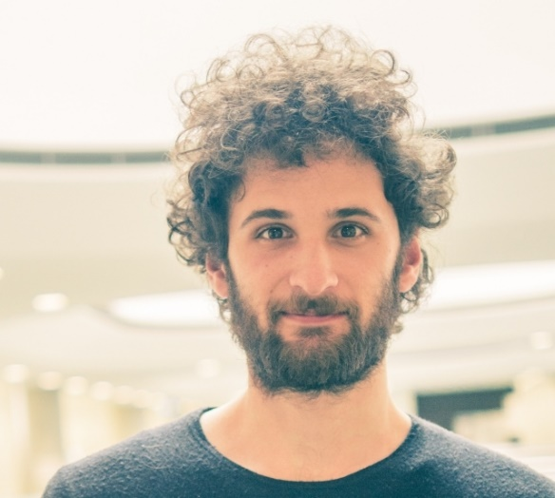
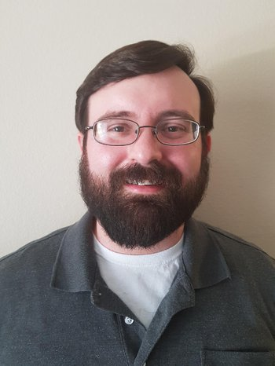
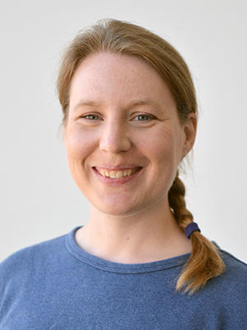
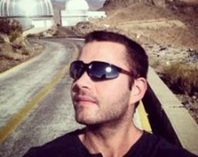
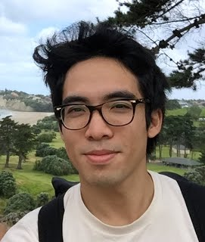
Kasliwal Research Group
Sam Rose
(Grad)
Nicholas Earley
(Grad)
Kaustav Das
(Grad)
Viraj Karambelkar
(Grad)
Tomas Ahumada
(Postdoc)
Robert Stein
(Now Fellow)
Shreya Anand
(Now Fellow)
Kishalay De
(Now Faculty)
Kaew Tinyanont
(Now Faculty)
Igor Andreoni
(Now Faculty)
Matt Hankins
(Now Faculty)
Ragnhild Lunnan
(Now Faculty)
Christoffer Fremling
(Now Staff)
Ryan Lau
(Now Staff)
Undergrads: Tawny Sit, Miranda Kong, Andy Tzanidakis, Gokul Srinivasaragavan, Stephanie Kwan, Lindsey Whitesides, Chris Cannella
Notes:
Missing Dave and Scott

Slide 4
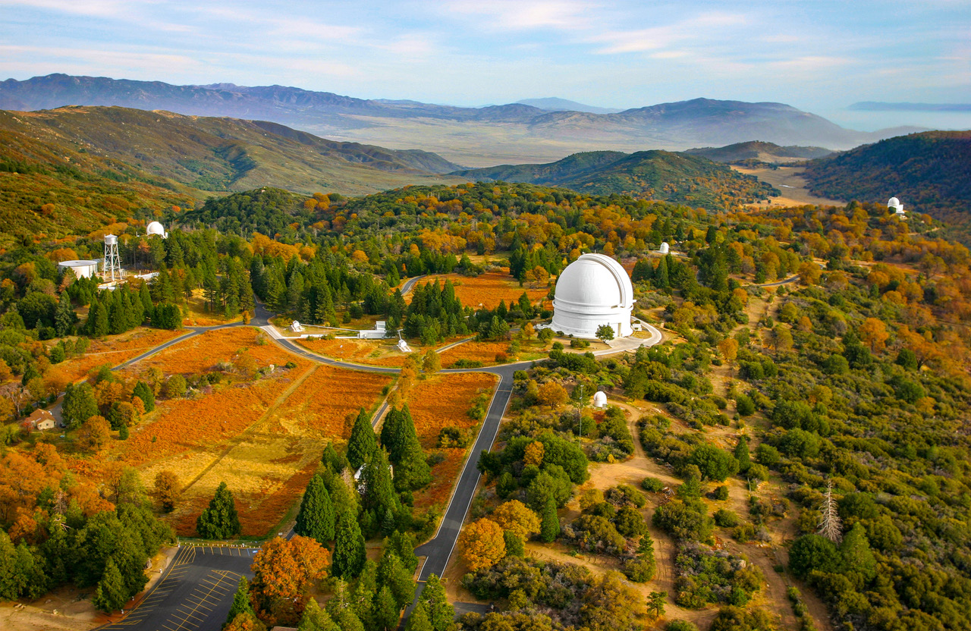

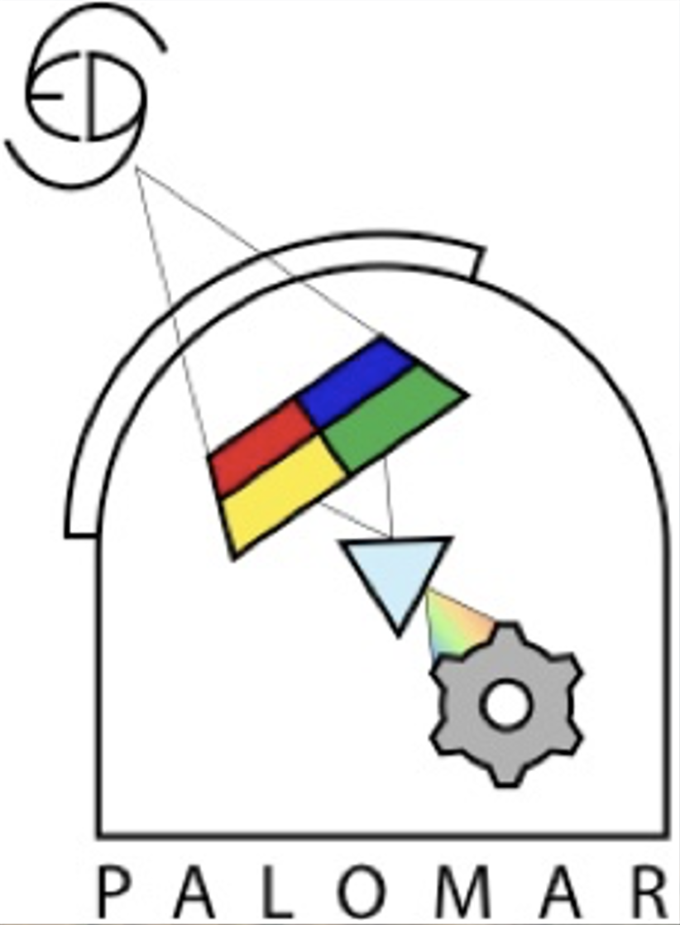
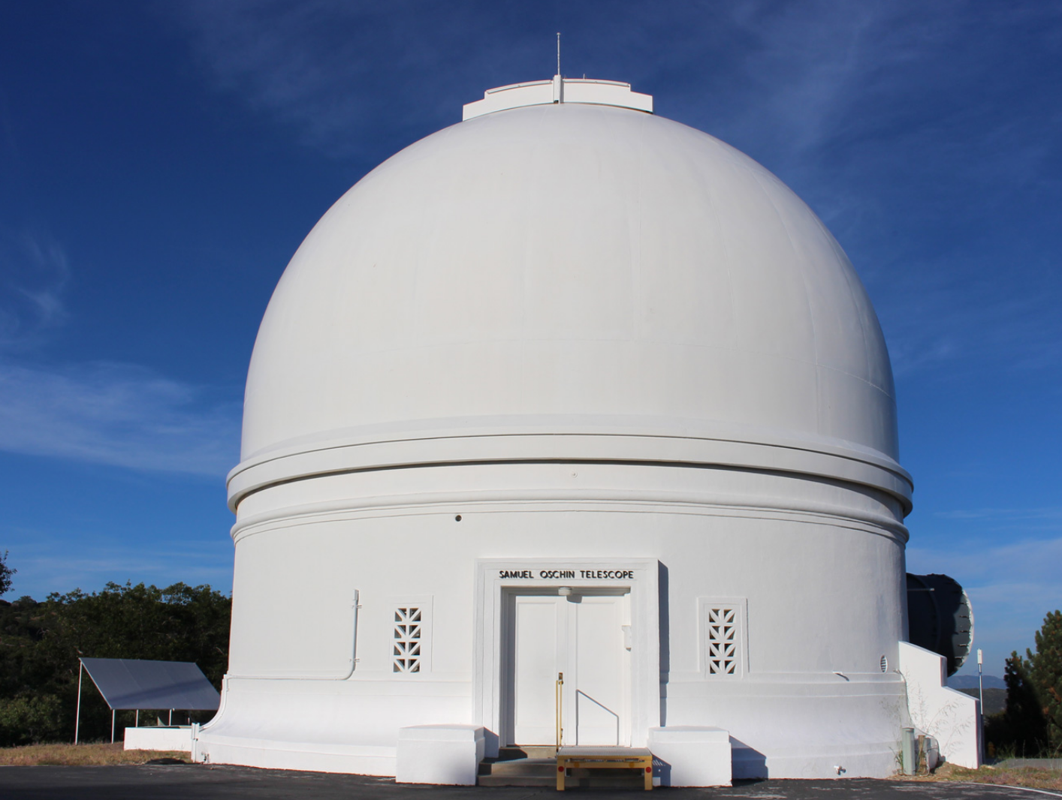
Time-Domain Discovery Engines
Palomar Observatory
Zwicky Transient Facility
Palomar Gattini IR

Slide 5
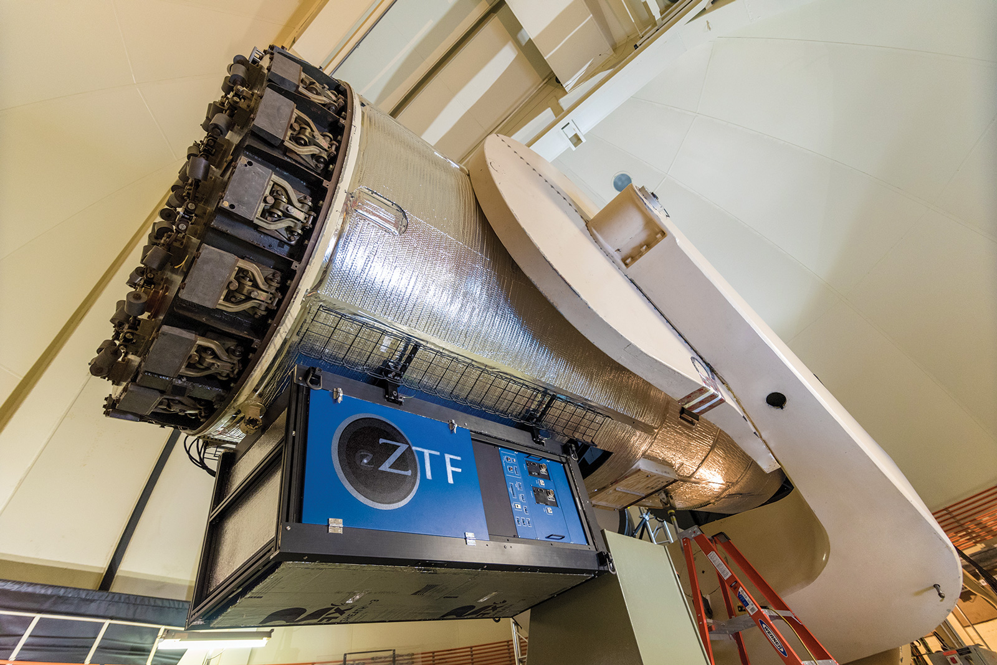
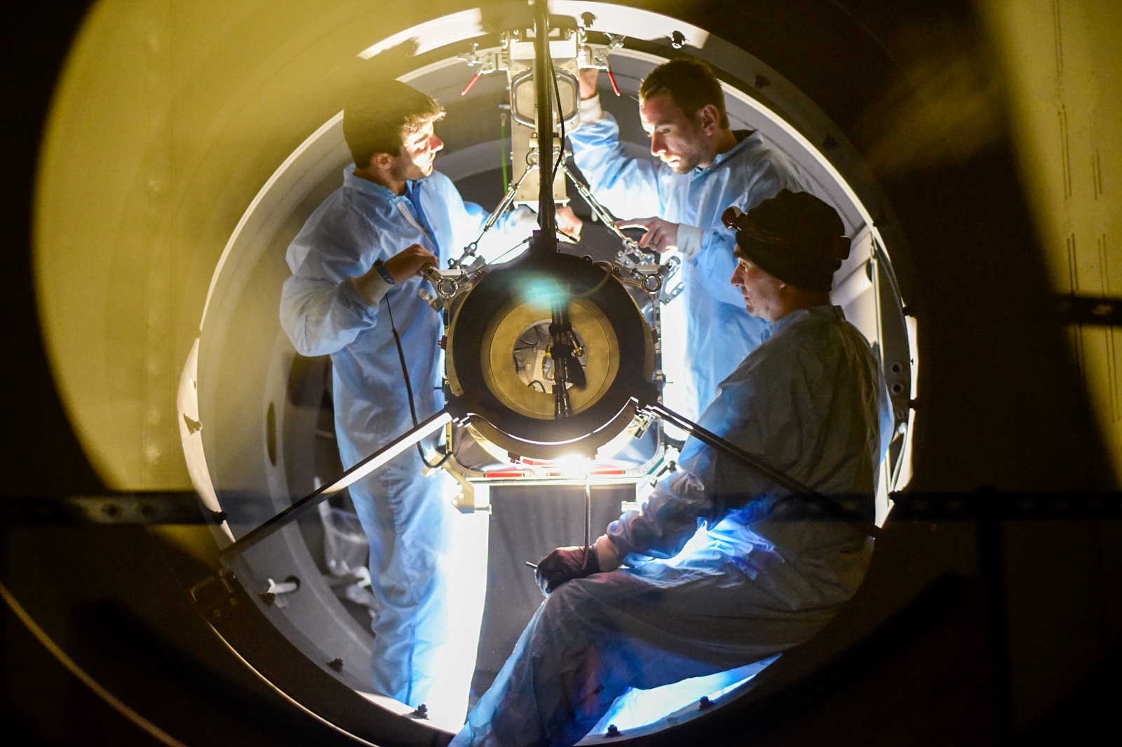
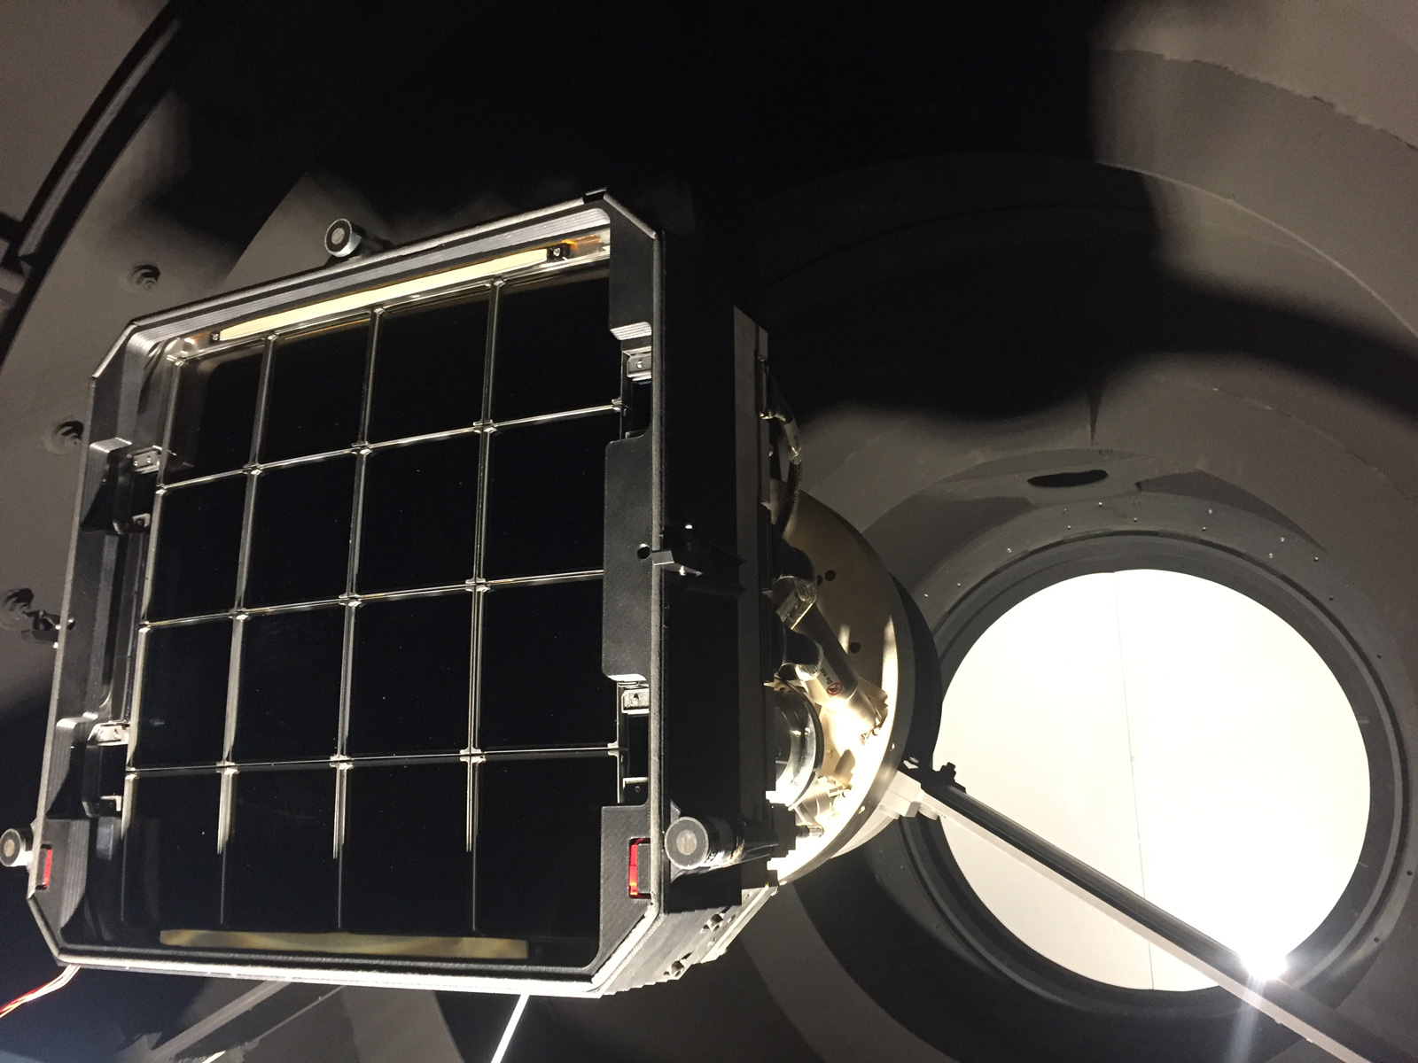
Zwicky Transient Facility
1034 refereed papers in 6 years
h-index = 62
16,528 citations

Slide 6
ZTF @ this conference
See talks by:
Gokul Srinivasaragavan
Brad Cenko
Wynn Jacobson-Galan
Daniel Perley
Nabeel Rehemtullah
Yuhan Yao
Erica Hammerstein
Raffaella Margutti
Genevieve Schroeder

Slide 7
Supernovae

Slide 8
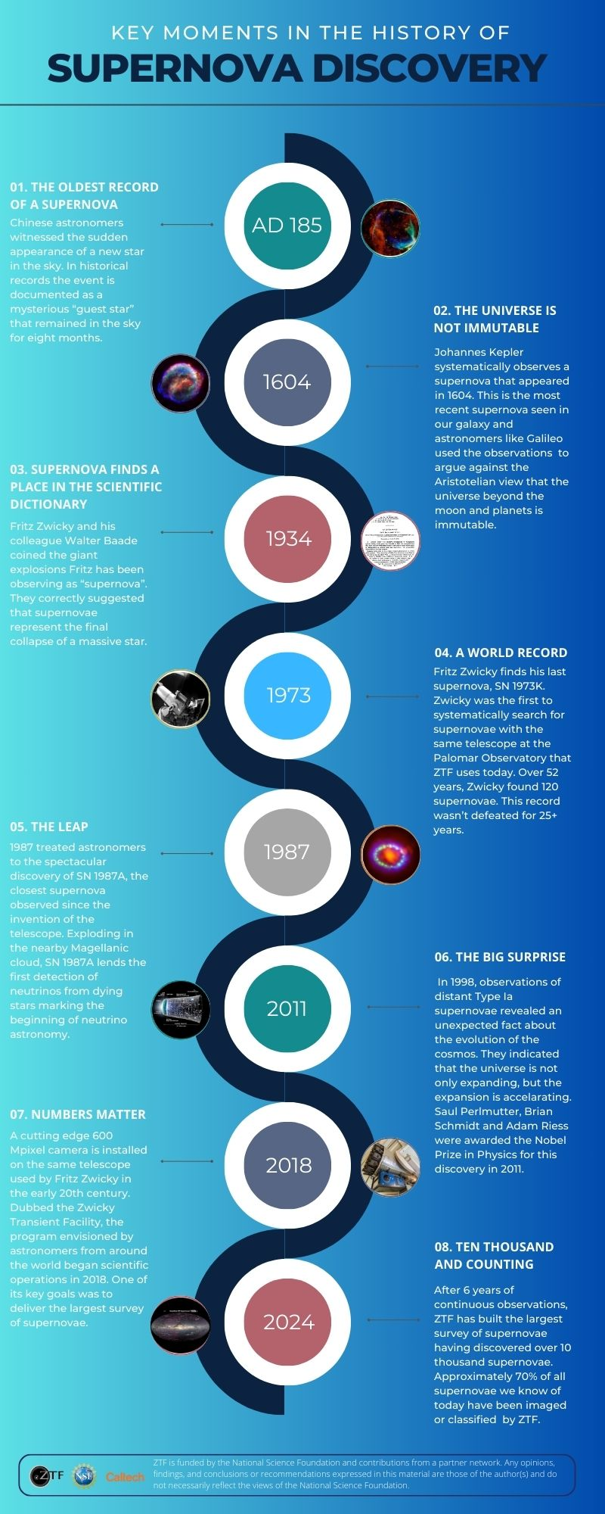
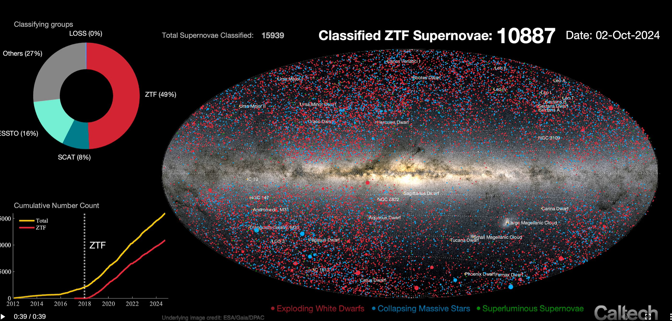
10K supernova

Slide 9
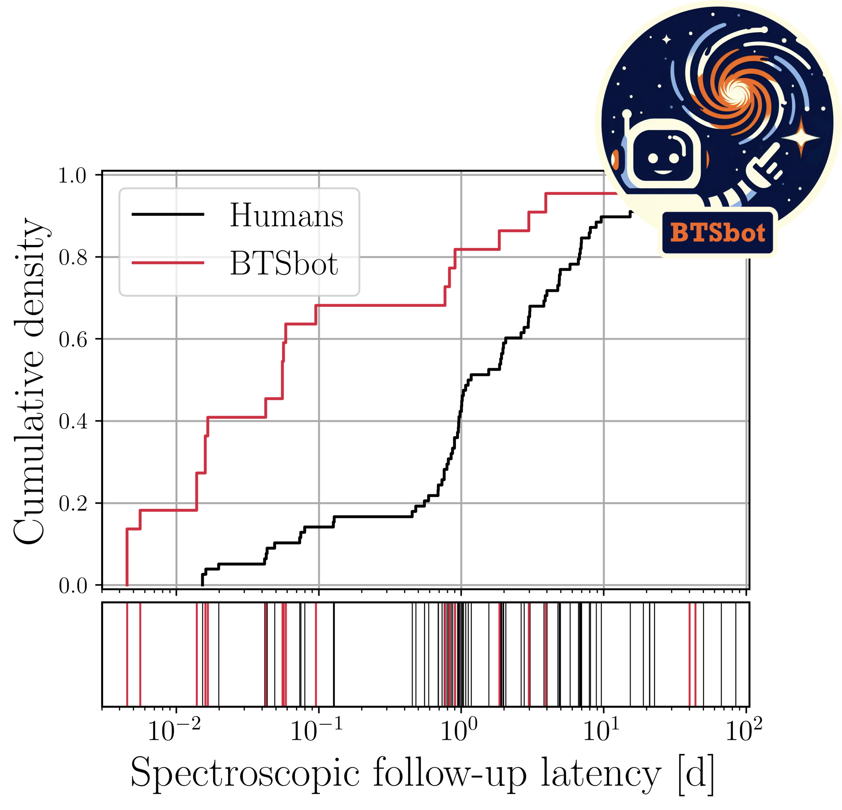
Swift Priority Zero Triggers
See Nabeel Rehemtulla’s talk on BTSBot for young supernovae
<45min between Swift trigger and data!
Enabled by the Fritz Marshal software
(a Caltech+Berkeley+UMN partnership)

Slide 10
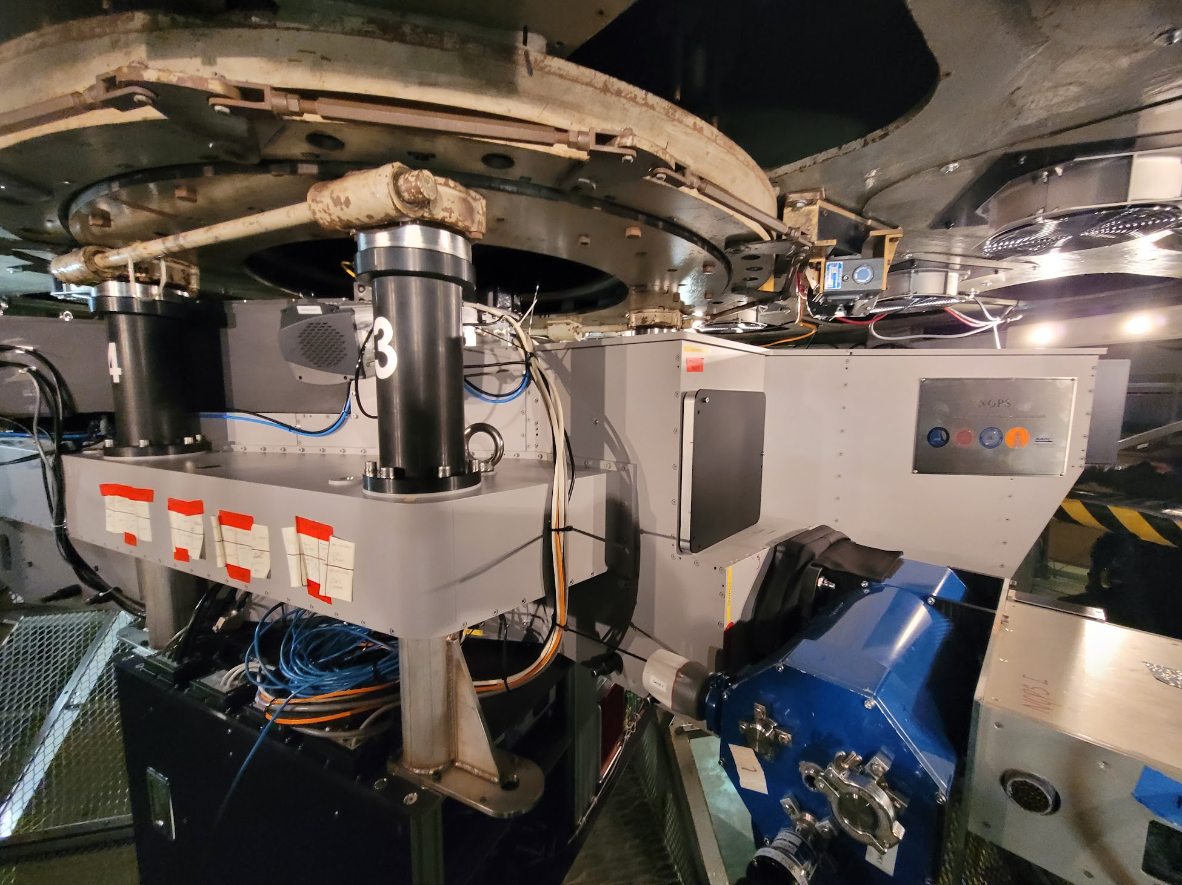
Palomar Observatory
Palomar Gattini IR

Slide 11
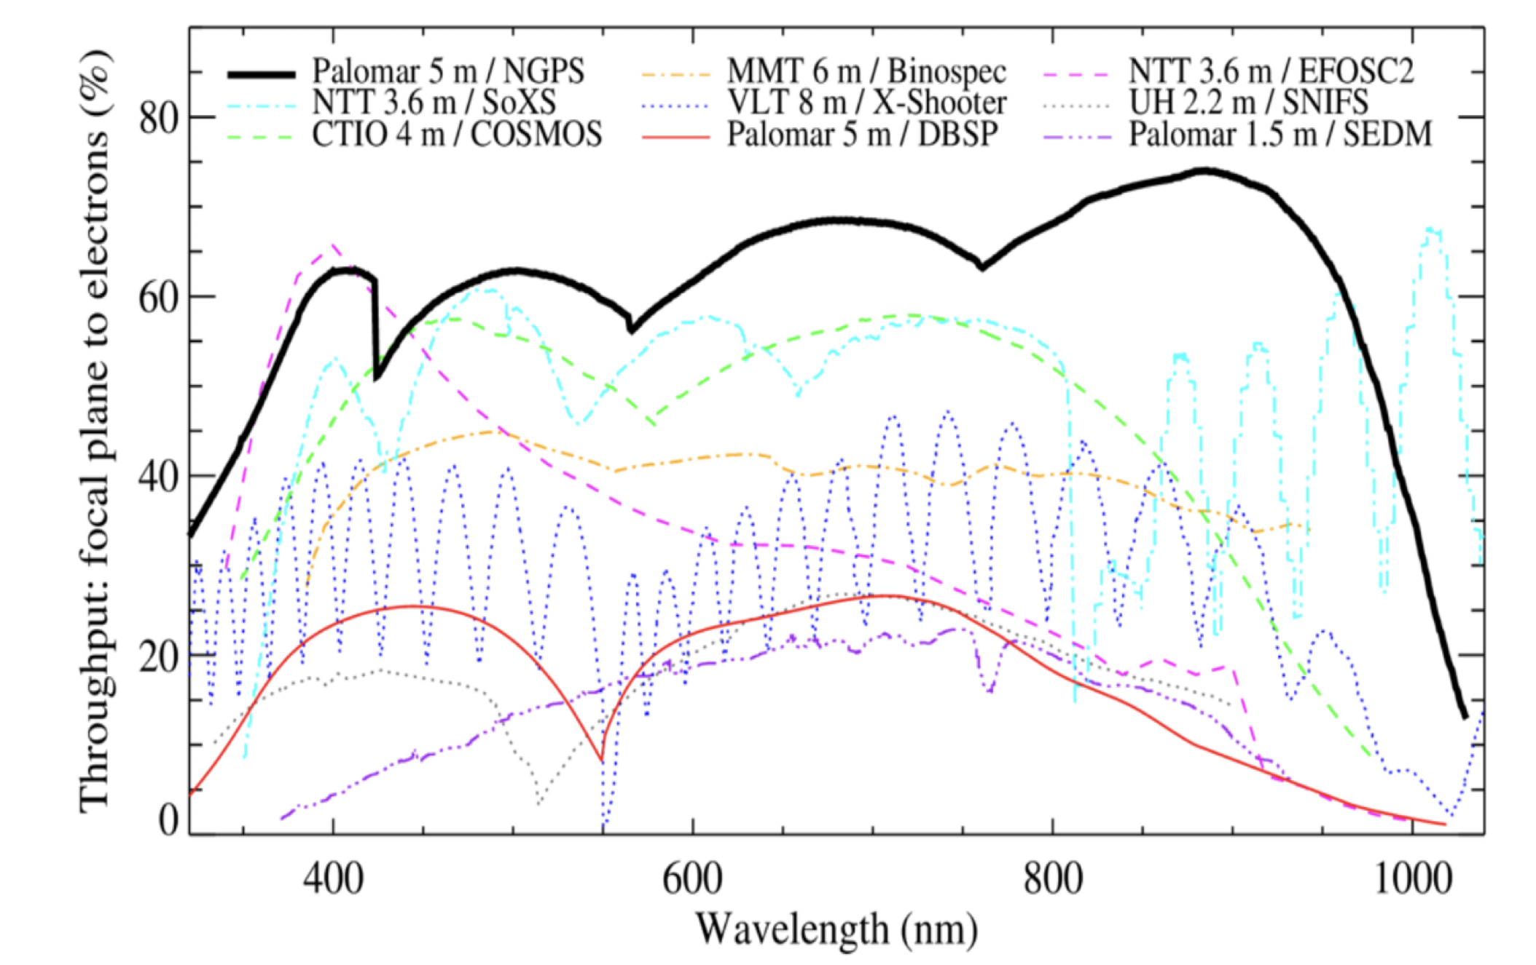
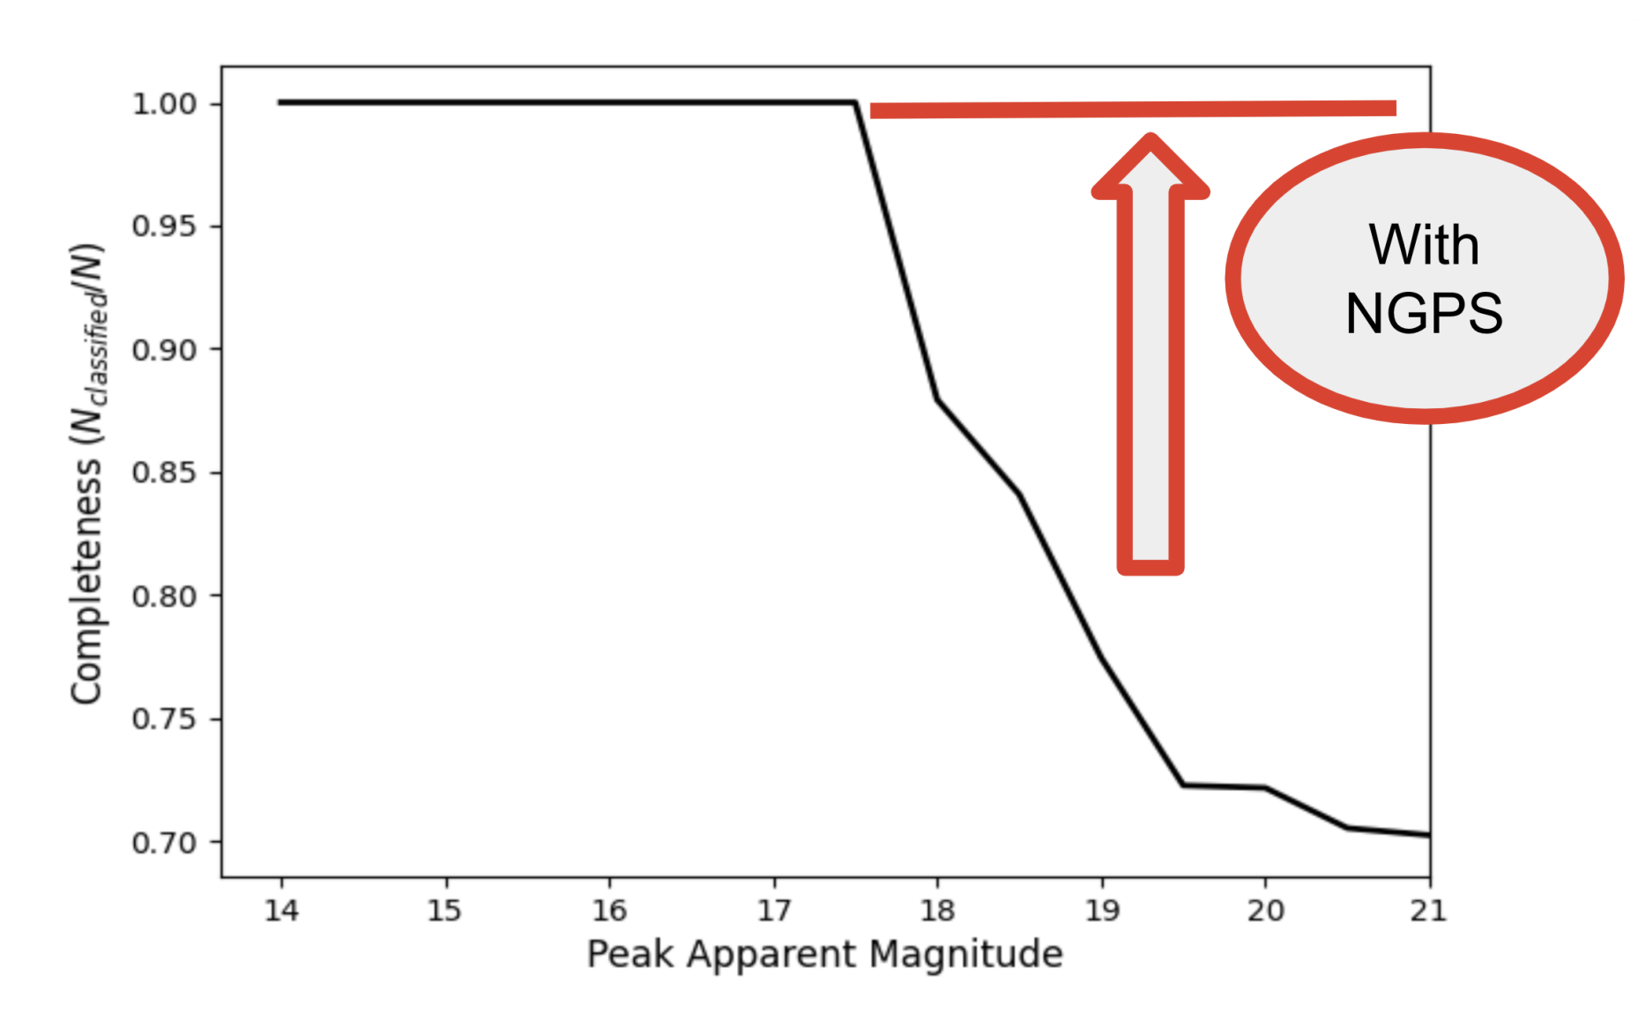
Kaustav Das
(Grad)
CATS150: Complete within 150Mpc (PI Kaustav Das) - Ongoing 1-year survey in 2025
Starting 2026, we plan to classify all transients in the ZTF+Rubin footprint

Slide 12
Multi Messenger Astrophysics

Slide 13
Search for kilonovae with ZTF
Tomas Ahumada
Shreya Anand
Kasliwal et al. 2019; Ahumada et al. 2024, 2025
Reminder: Evans et al. 2017, Science
(all the UV photons from BNS mergers to date)

Slide 14
ZTF for neutrino+EM connection: Type Ibn
Robert Stein
(Neil Gehrels Fellow)
Stein et al. 2025

Slide 15
ZTF for neutrino+EM connection: 3 TDEs
Robert Stein
(Neil Gehrels Fellow)
Stein et al. 2021; Stein et al. 2023; van Velzen et al. 2024

Slide 16
Fast Transients

Slide 17
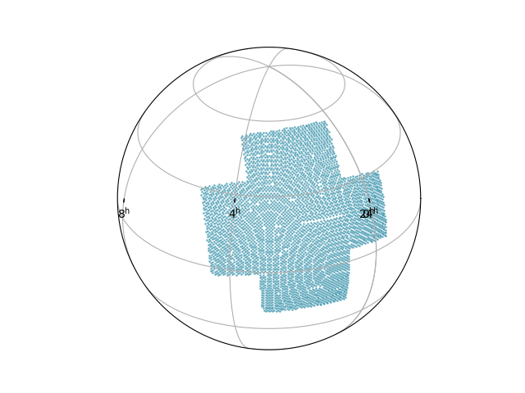
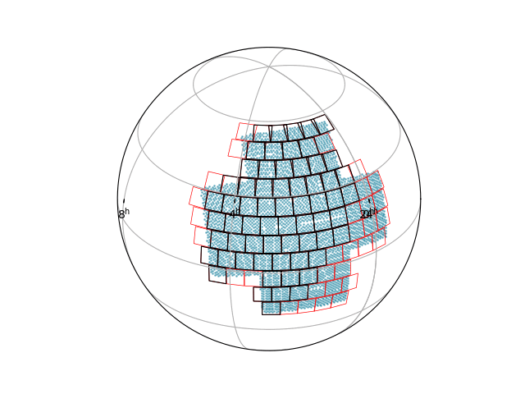
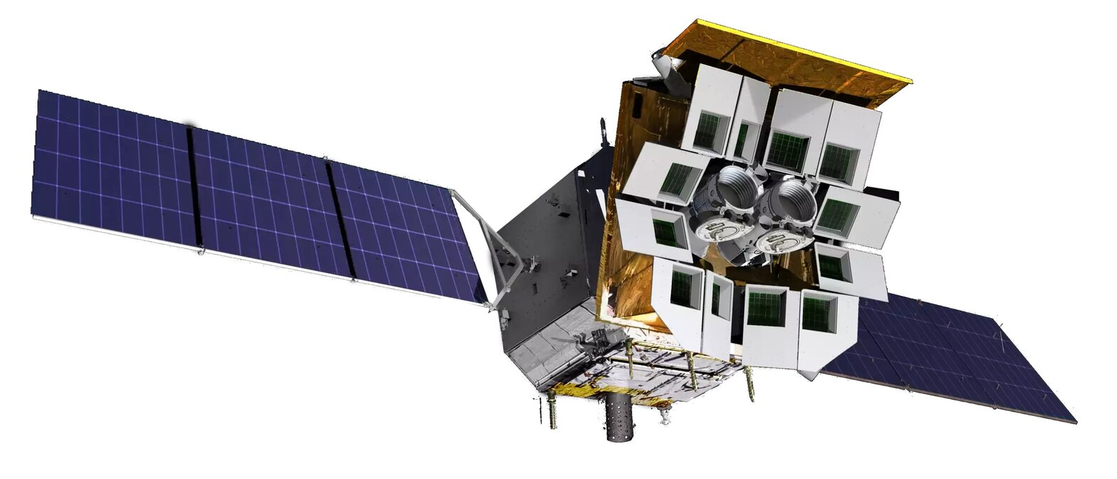
ZTF + Einstein Probe + Swift
FoV
WXT ~ 3600 sq deg
ZTF FoV ~ 47 sq deg
Exposures:
WXT ~ 20 min + 7 min overhead
ZTF ~30 s + 4 s overhead
Contemporary Coverage
~60% of WXT FoV
WXT/EP FoV
WXT/EP FoV + ZTF Fields scheduled
Einstein Probe

Slide 18
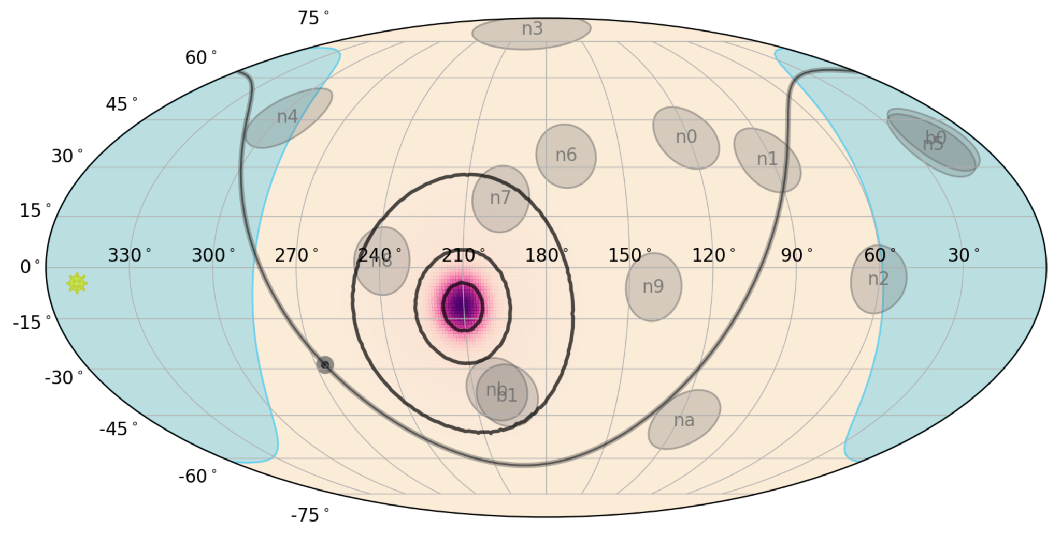
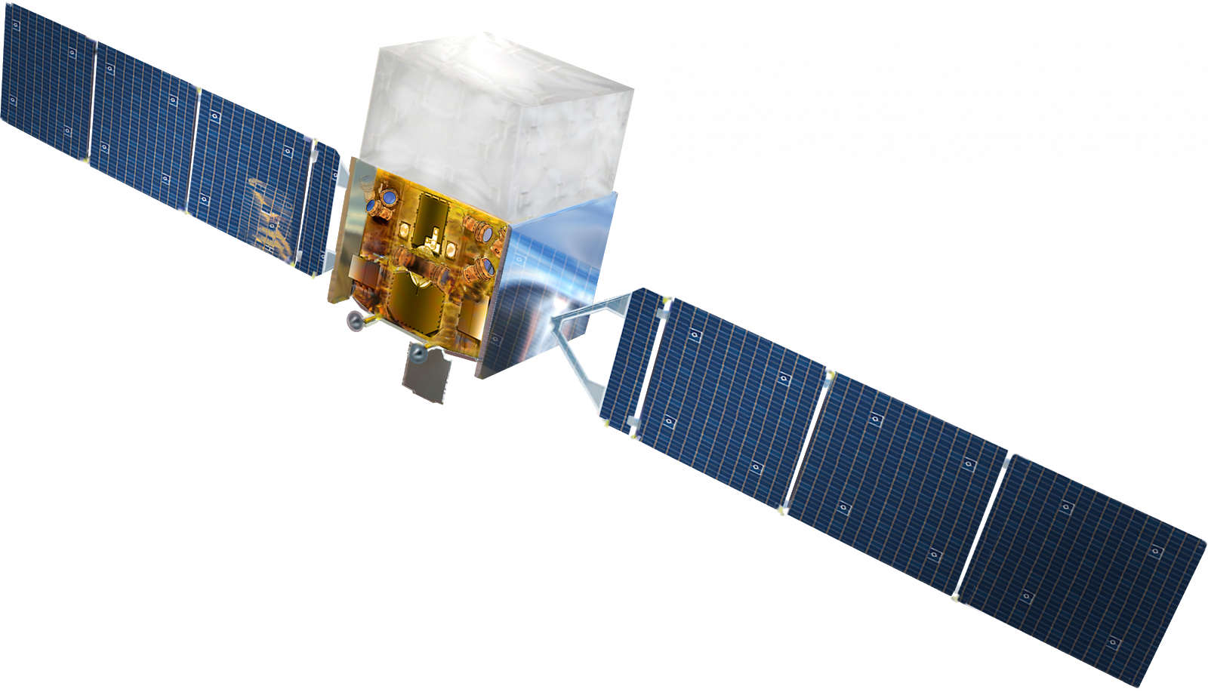
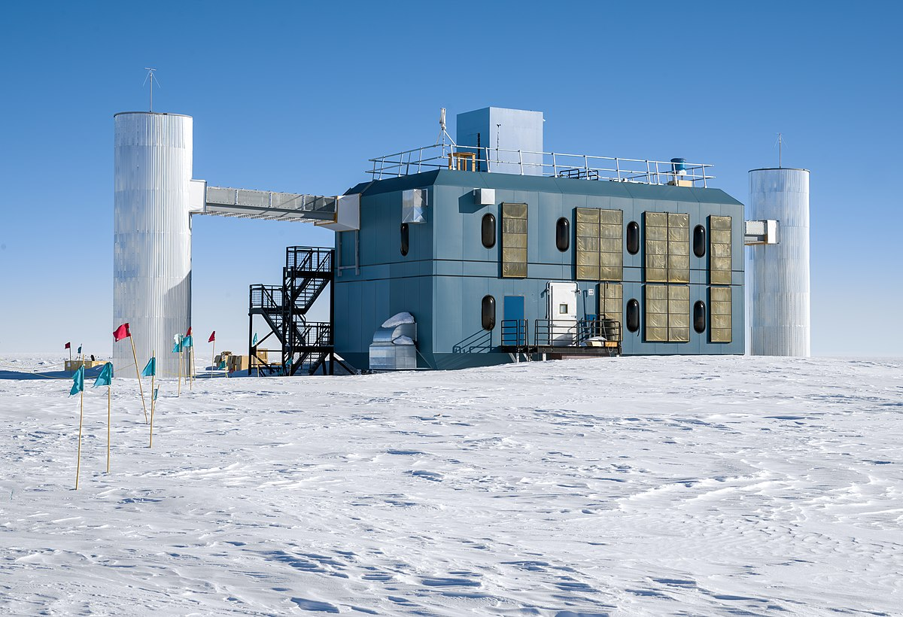
GRB250309B: Proof-of-concept

Slide 19
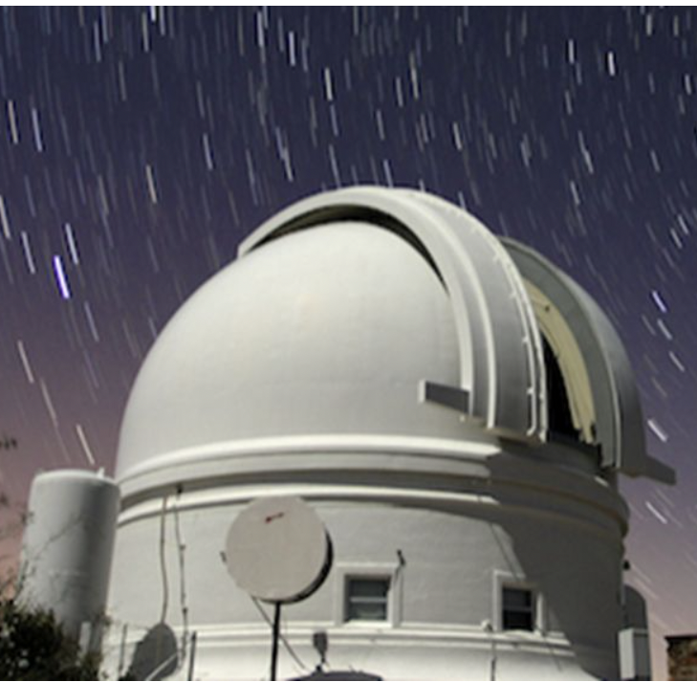
GRB250309B: Proof-of-concept

Slide 20
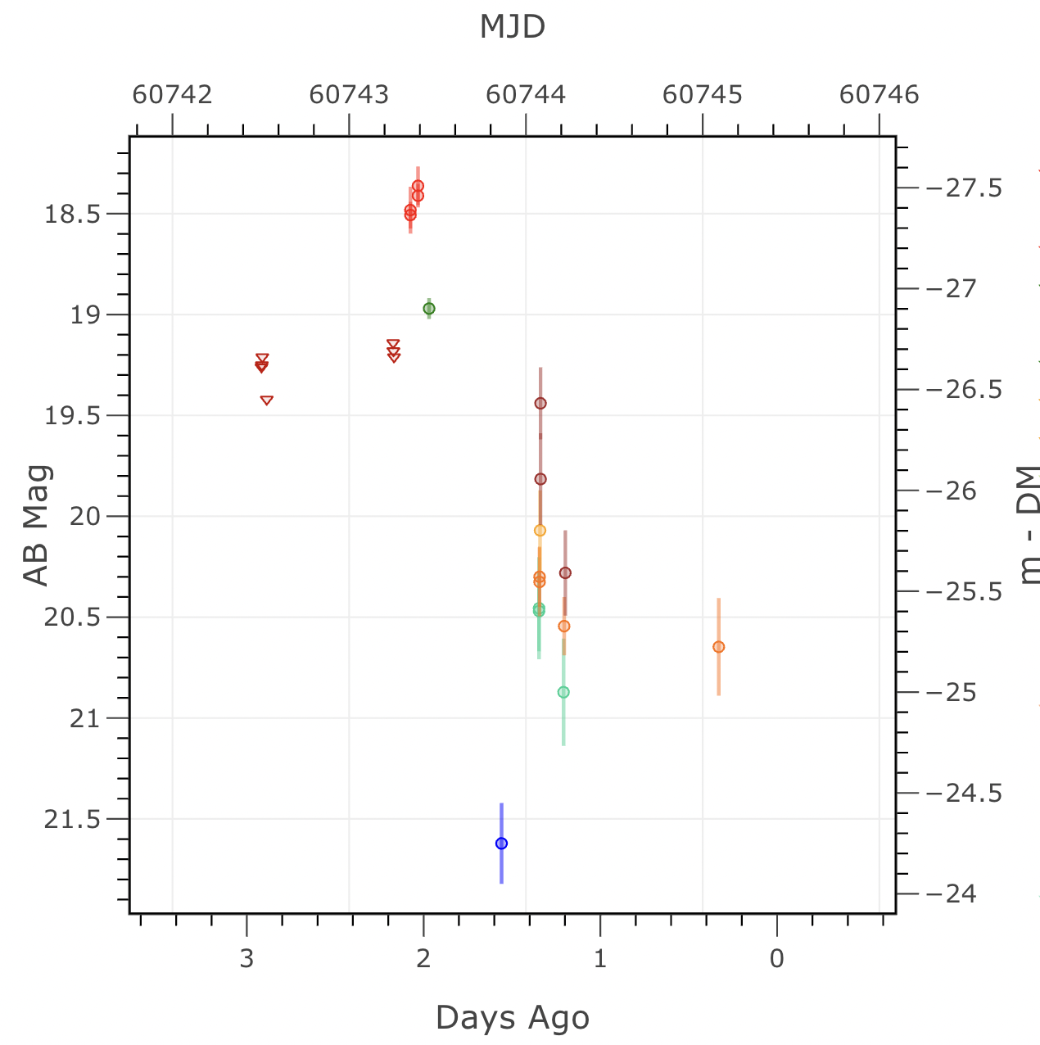
GRB 250309B:
Sadly, no GRB-neutrino association

Slide 21
Infrared Surveyors

Slide 22
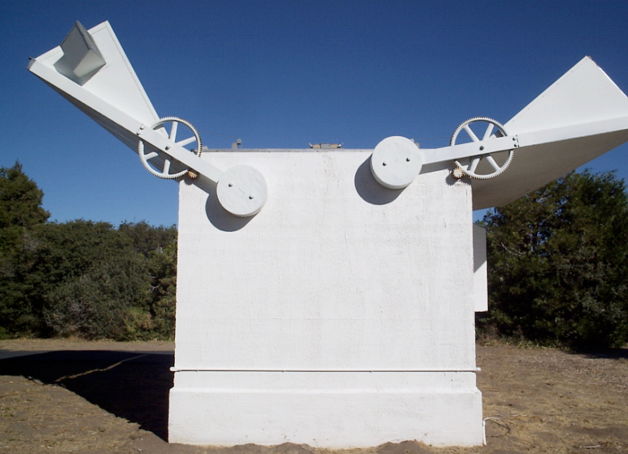
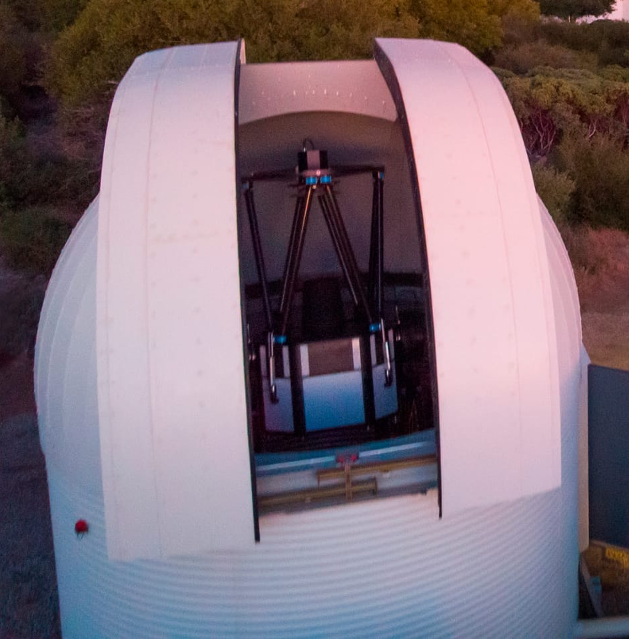
Opening the dynamic infrared sky
Palomar Observatory
Palomar Gattini IR

Slide 23
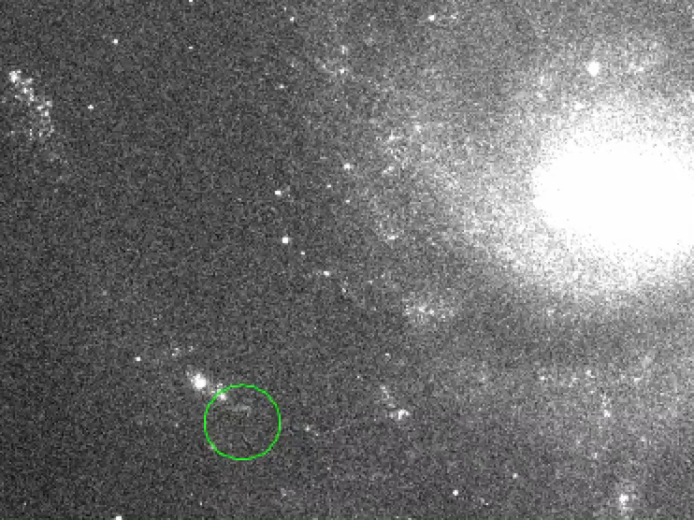
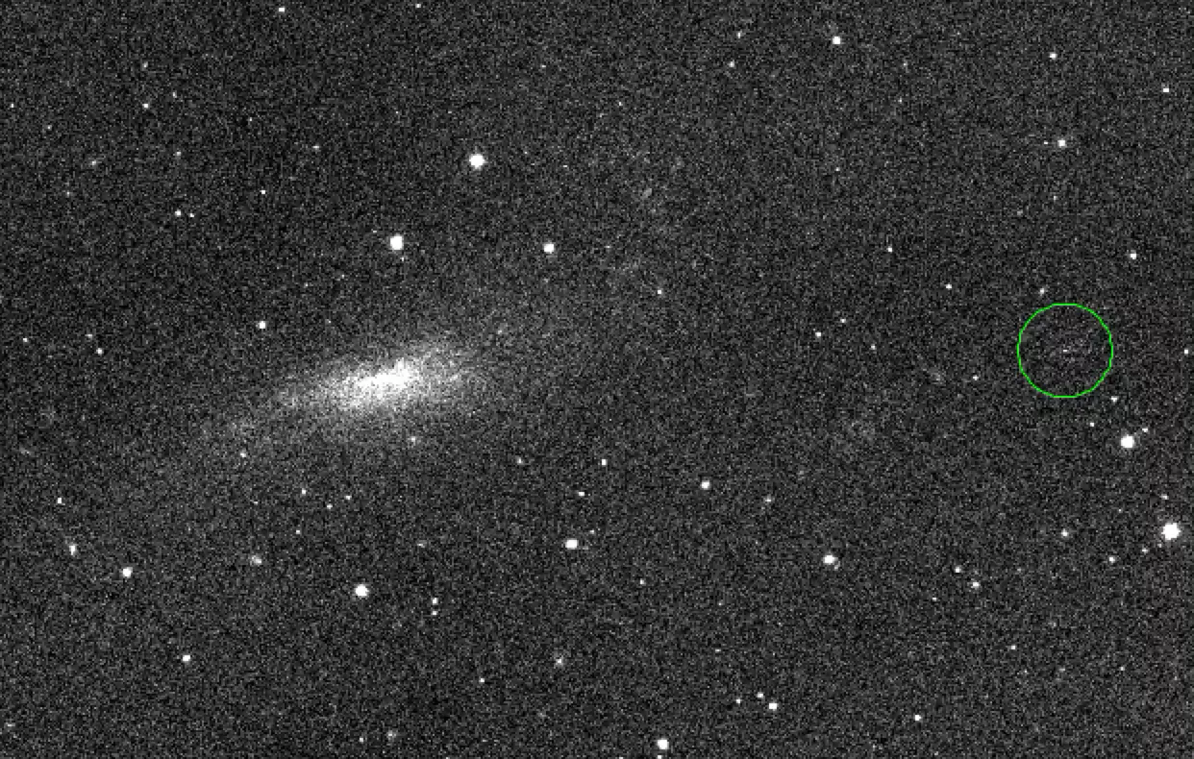
WINTER: A supernova, A stellar merger

Slide 24
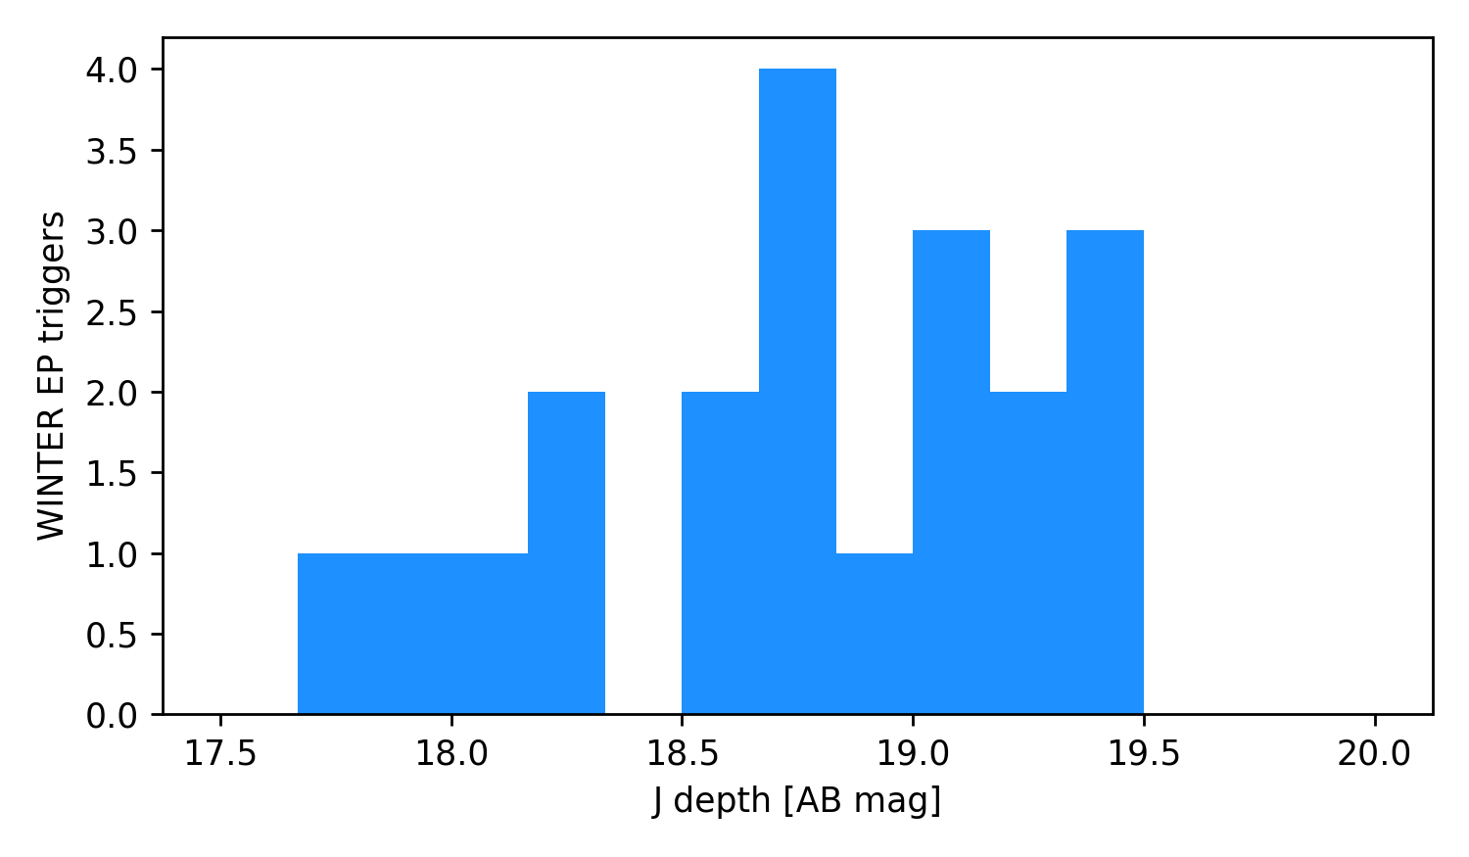
Fully automated EP follow-up with WINTER and SEDM
Every GCN from Einstein Probe and SVOM, gets fully-automated infrared and optical photometry from Palomar with WINTER and SEDM!
Software infrastructure, data science and machine learning are valuable tools for survey science to enable discoveries.

Slide 25
Ultra-Violet Surveyors
See talk by Eli Waxman on ULTRASAT
See talks by Brad Cenko and Raf Margutti on UVEX

Slide 26
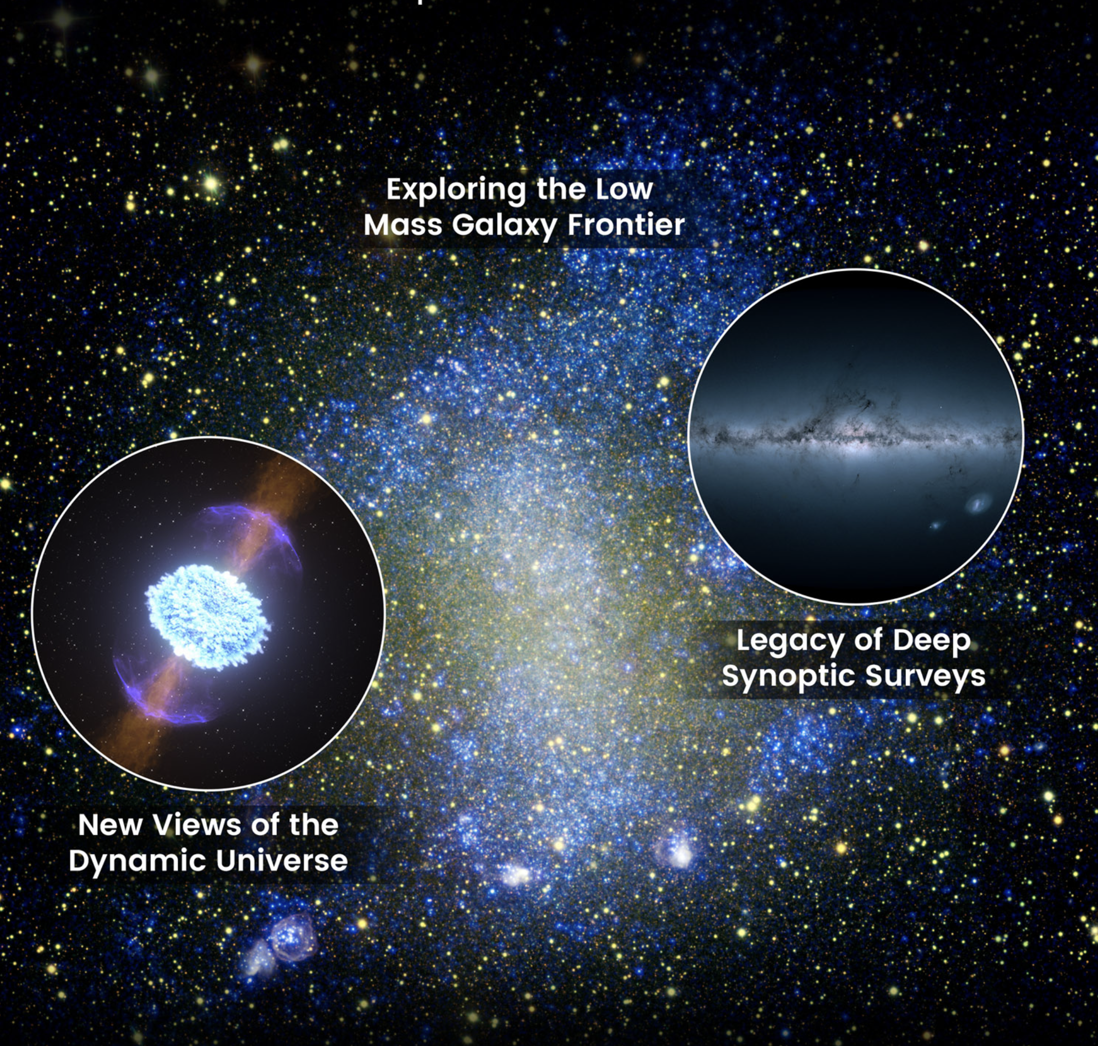
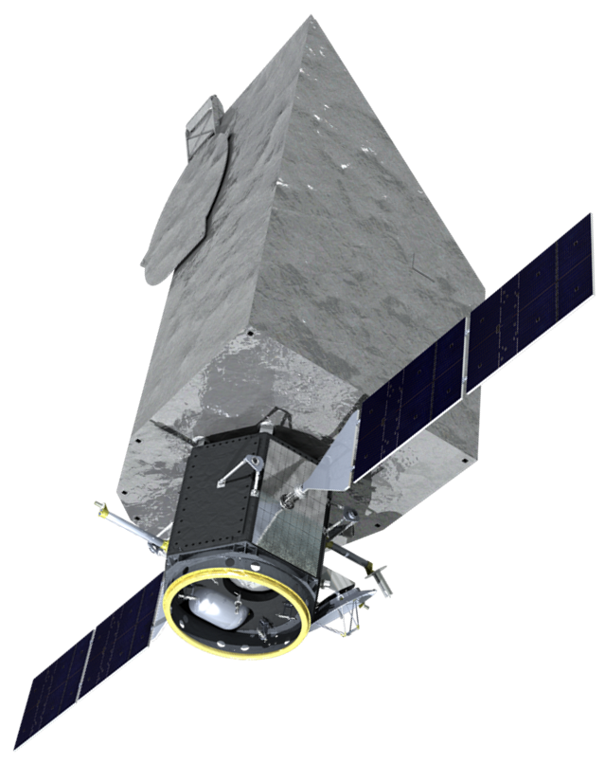
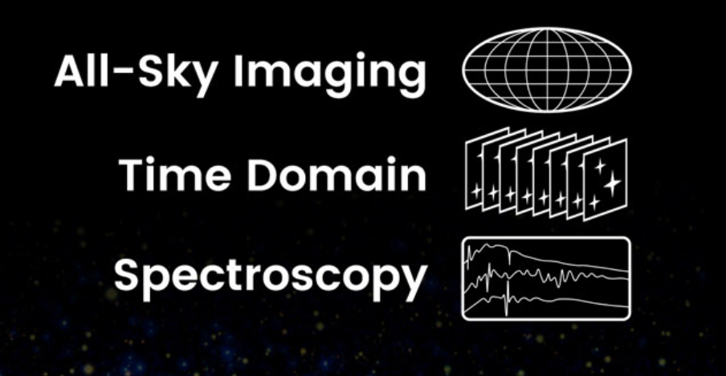
UVEX
The Ultraviolet Explorer
Fiona Harrison
Principal Investigator
Caltech
William Craig
Project Manager
UC Berkeley
Selected by NASA as next MIDEX launch in 2030!

Slide 27
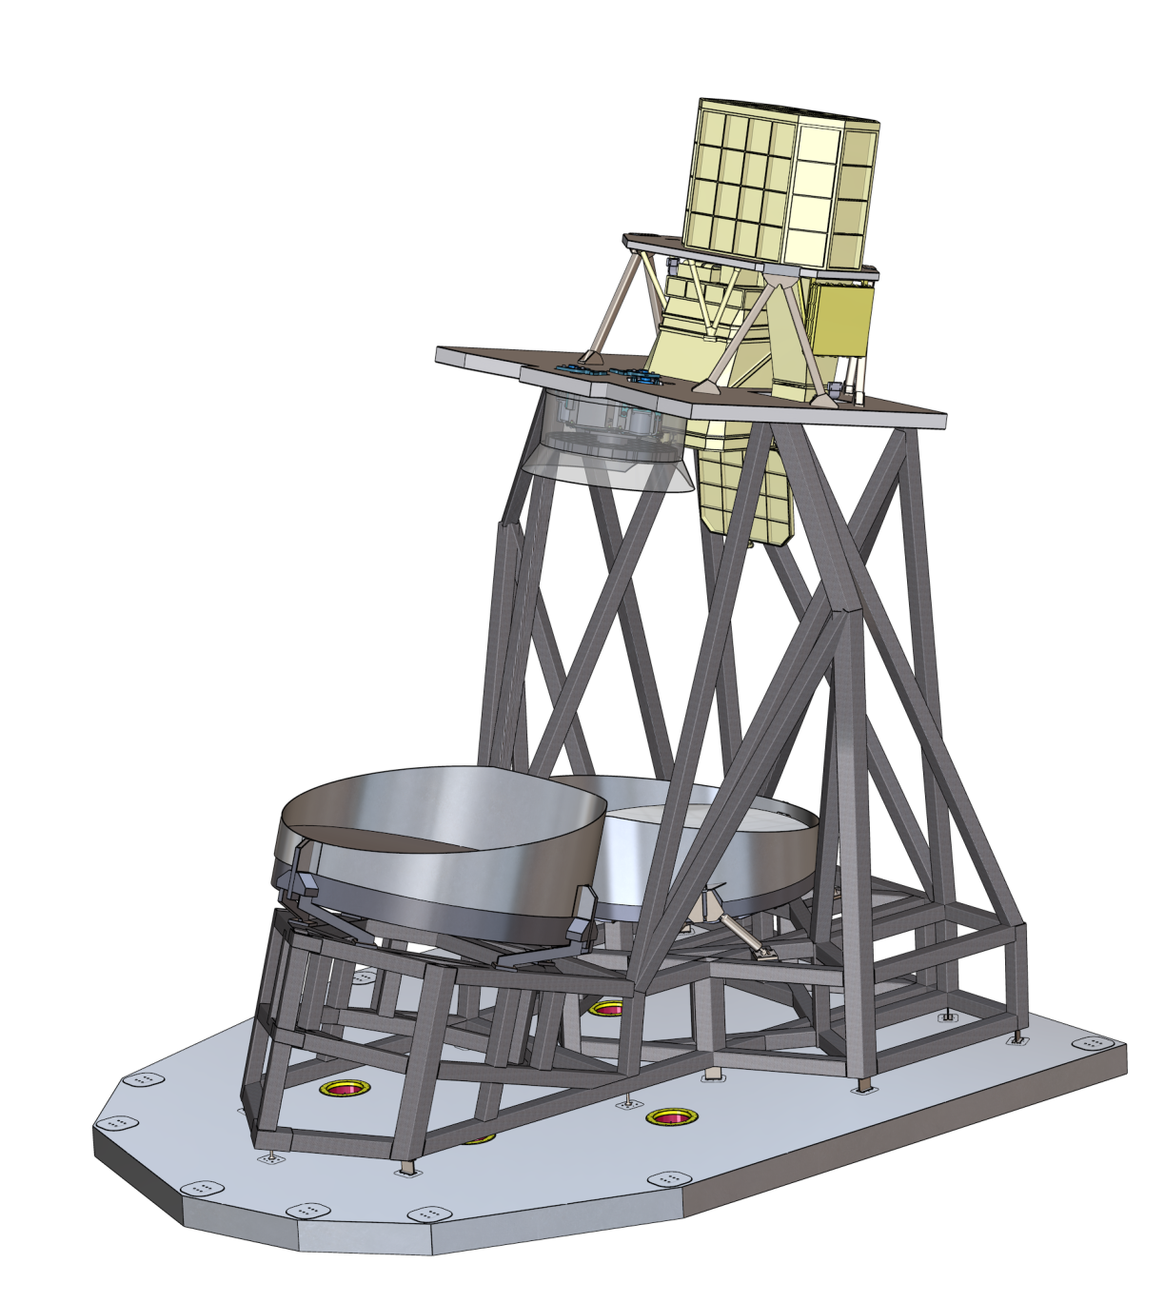
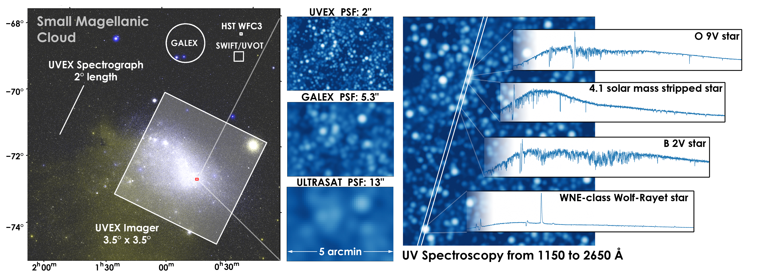
UVEX Capabilities
UVEX provides three crucial capabilities
Sensitive wide-field imaging in two ultraviolet bands
High angular resolution across large field of view
Broadband ultraviolet spectroscopy
HST/COS
Telescope design enables wide field imaging and spectroscopy with one instrument
Rapid response Ultra-violet Spectroscopy
should be welcome by Swift/UVOT afficionados!

Slide 28

Namaskar
नमस्कार

