Slide 1
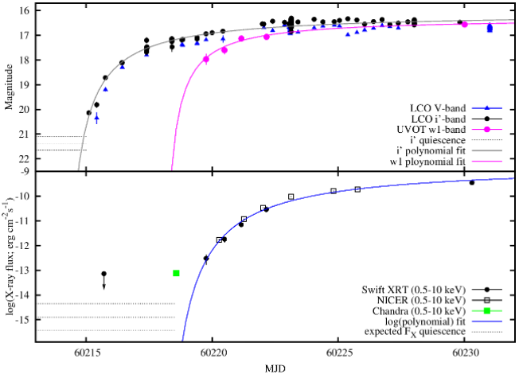
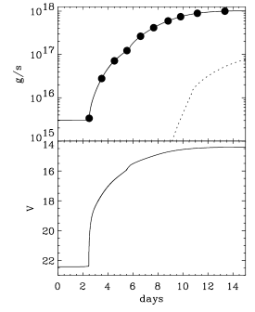
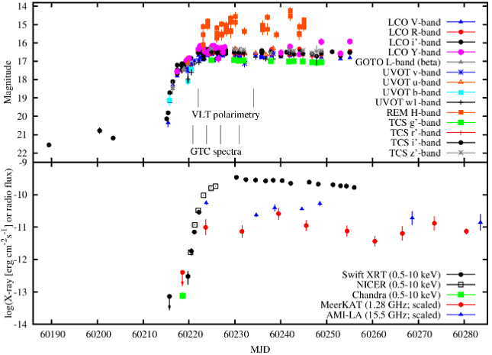
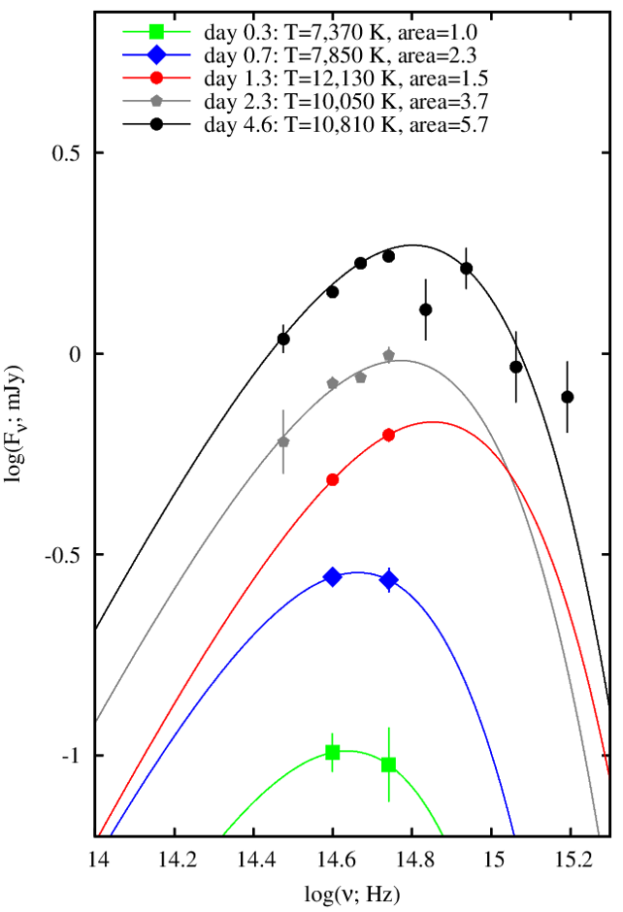
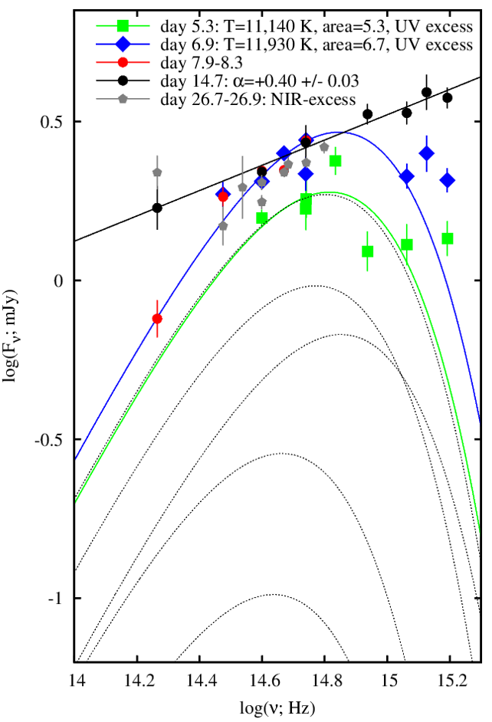
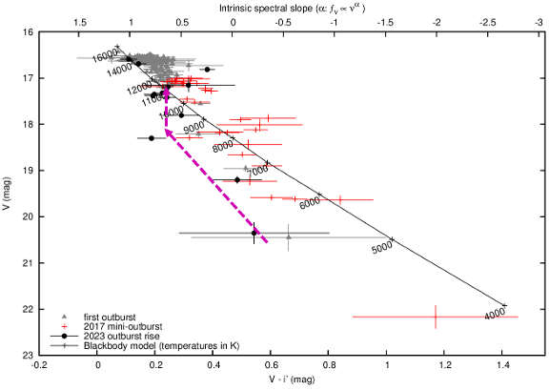
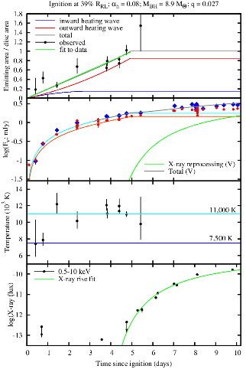
Witnessing the onset of a black hole outburst
Dave Russell, Kevin Alabarta, Jeroen Homan, Payaswini Saikia, et al.
New York University Abu Dhabi
Motivation
X-ray transients, the brightest X-ray sources visible from Earth, go into outbursts due to sudden increases in accretion onto a black hole or a neutron star. Models predict a delay between the ionization front in the accretion disc and the start of accretion. However, due to outburst unpredictability and sensitivity limits of X-ray all-sky monitors, the early stages of outbursts are often missed, leaving the trigger process observationally unconstrained.
Rise of the 2023 outburst
A delay is observed between a thermal instability in the accretion disc (optical brightening) and the start of black hole accretion (X-ray brightening). The optical rise precedes the X-ray fast rise by 4.4 +/- 0.2 days (optical already brightened by a factor of ~50-100, T_{eff} ~ 11,000 K). An X-ray precursor seen with Chandra. Swift and NICER constrain the rise.
Introduction : Swift J1753.5 - 0127
We report optical and X-ray monitoring of Swift J1753 with 12 telescopes, capturing the earliest detections of a LMXB outburst rise.
This is the clearest indication yet that the thermal-viscous instability is responsible for outbursts. This has implications for the switching on of AGN and TDEs.
The left panel displays the mass accretion rate and predicted optical magnitudes from numerical modeling of an irradiated, truncated disk based on the Disc Instability Model (Dubus et al. 2001). The right panel demonstrates that our Swift J1753 data largely agrees with these predictions.
Temperatures and change in area confirmed with CMD. There is a “ring of fire” that ignites We are witnessing the heating wave travelling through the accretion disc.
“Ring of Fire” igniting the outburst
The spectral energy distributions (SEDs) are consistent with a blackbody for the first 5 days, surface area increases 6-fold. Initially, surface temperature is ~7,000 K and ionized area is about 15-20 % the full disc size, which later increases to ~11,000 K during the outburst rise and the ionized area increases to the full disc
size. Temperatures and change in area confirmed with the color-magnitude diagram. There is a “ring of fire” that ignites. We are witnessing the heating wave traveling through the accretion disc.
Conclusion
Our findings show that:
a "ring of fire" ignites at the ignition radius, the location of maximum surface density in the accretion disc, initiating the heating wave.
As the accretion rate rises, increased pressure drives matter inward, filling the inner disc and causing the optical flux to increase.
Notably, mass accretion onto the black hole does not increase until the X-rays brighten, by which time the optical flux has already risen to 50–100 times its pre-outburst levels.
These results support the Disc Instability Model framework, where a heating front drives inward accretion, triggering irradiation and jet formation.
We constrain the viscosity parameter to be α~0.08 and the ignition radius to ~50% of the disc radius
REFERENCE : Russell D. M., et al 2025, in prep.
CONTACT : Dave Russell, NYUAD ( dr124@nyu.edu )

