Slide 1

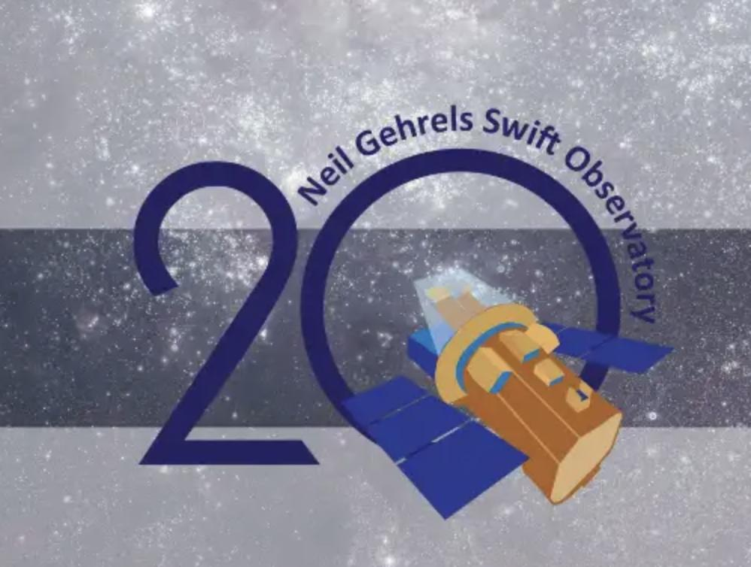

Celebrating 20 years of Swift discovery

Slide 2
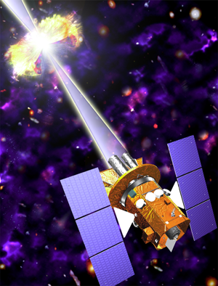
Swift Overview
Catching Gamma Ray Bursts on the Fly
Selected by NASA on October 14, 1999, for a lunch in 2003, launched on November 20, 2004
Objectives
  Determine origin of GRBs, including the short ones
  Use GRBs to probe the early Universe
  Perform hard X-ray survey
International collaboration:
  GSFC: lead institution
  PSU: lead university partner
  UK & Italy: key hardware collaborators
  Spectrum Astro: spacecraft provider

Slide 3
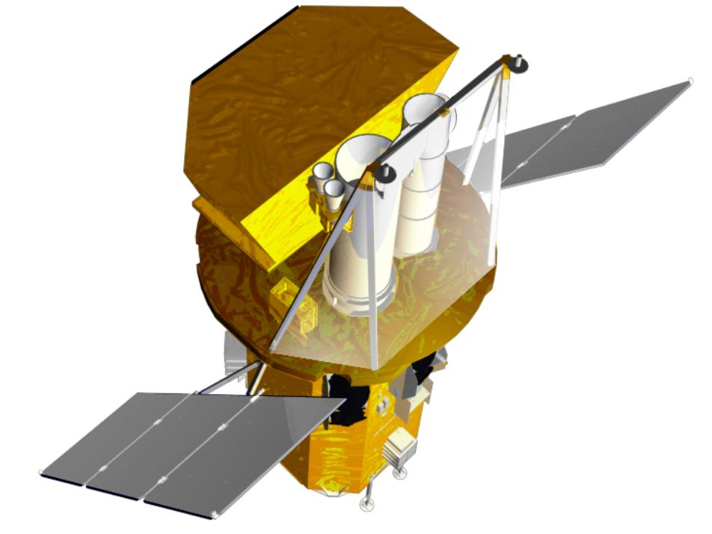
Swift Instruments and capabilities
Instruments
Burst Alert Telescope (BAT)
  New CdZnTe detectors
  Detect >100 GRBs per year depending on logN-logS
  Most sensitive gamma-ray imager ever
X-Ray Telescope (XRT)
  Arcsecond GRB positions
  CCD spectroscopy
(UVOT) UV/Optical Telescope
  Sub-arcsec imaging
  Grism spectroscopy
  24th mag sensitivity (1000 sec)
  Finding chart for other observers
Autonomous re-pointing, 20 - 70 sec
Onboard and ground triggers
UVOT
BAT
BAT
XRT
UVOT
XRT
Spacecraft
Spacecraft
Spacecraft

Slide 4
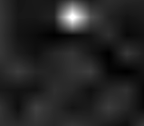
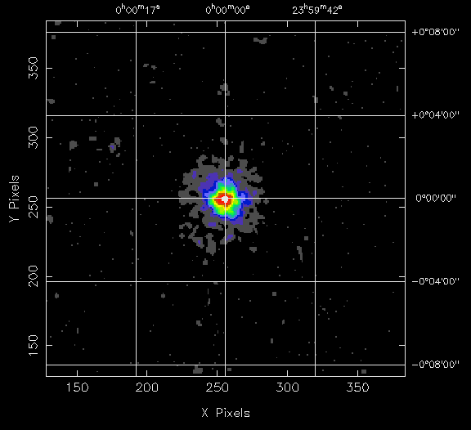
Observing Scenario
Burst Alert Telescope triggers on GRB, calculates position to < 4 arcmin
Spacecraft autonomously slews to GRB position in 20-100 s
X-ray Telescope determines position to < 5 arcseconds
UV/Optical Telescope images field, transmits finding chart to ground
BAT Burst Image
XRT Image
UVOT Image
BAT Error
Circle
T<10 sec
θ < 4'
T<100 sec
θ < 5''
T<300 sec

Slide 5
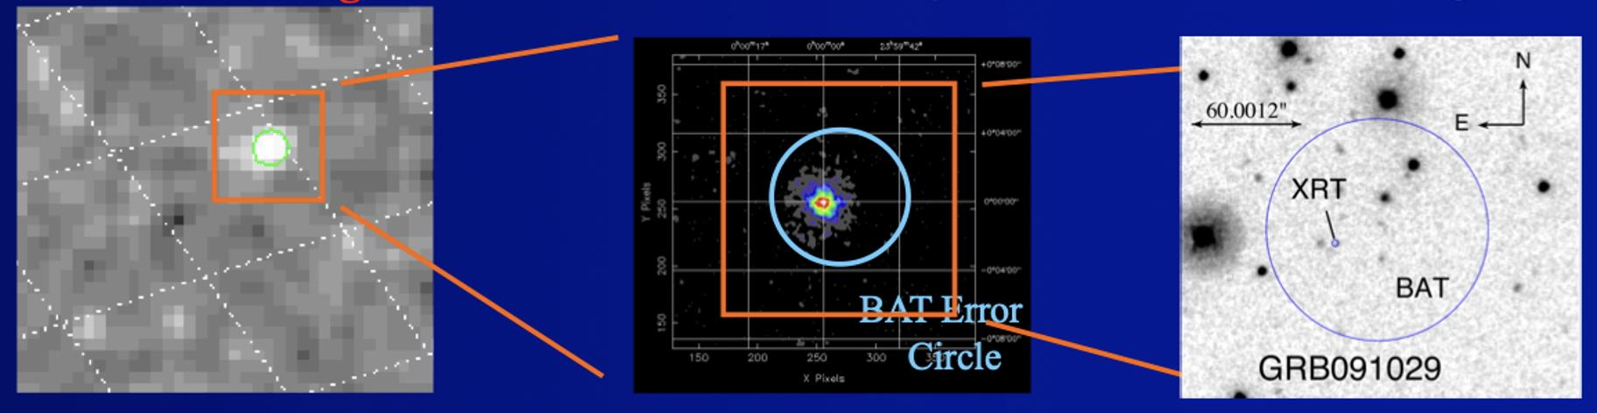
Observing Scenario
Burst Alert Telescope triggers on GRB, calculates position to < 4 arcmin
Spacecraft autonomously slews to GRB position in 20-100 s
X-ray Telescope determines position to < 5 arcseconds
UV/Optical Telescope images field, transmits finding chart to ground
BAT Burst Image
XRT Image
UVOT Image
BAT Error
Circle
T<10 sec
θ < 4'
T<100 sec
θ < 5''
T<300 sec

Slide 6
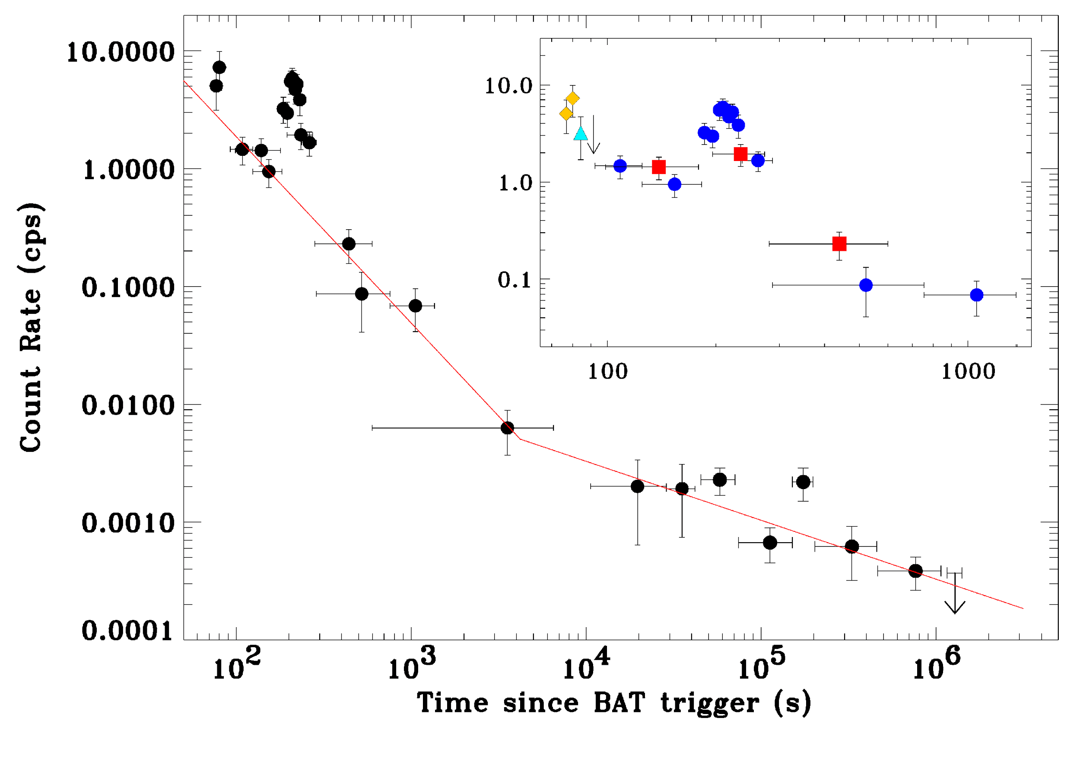
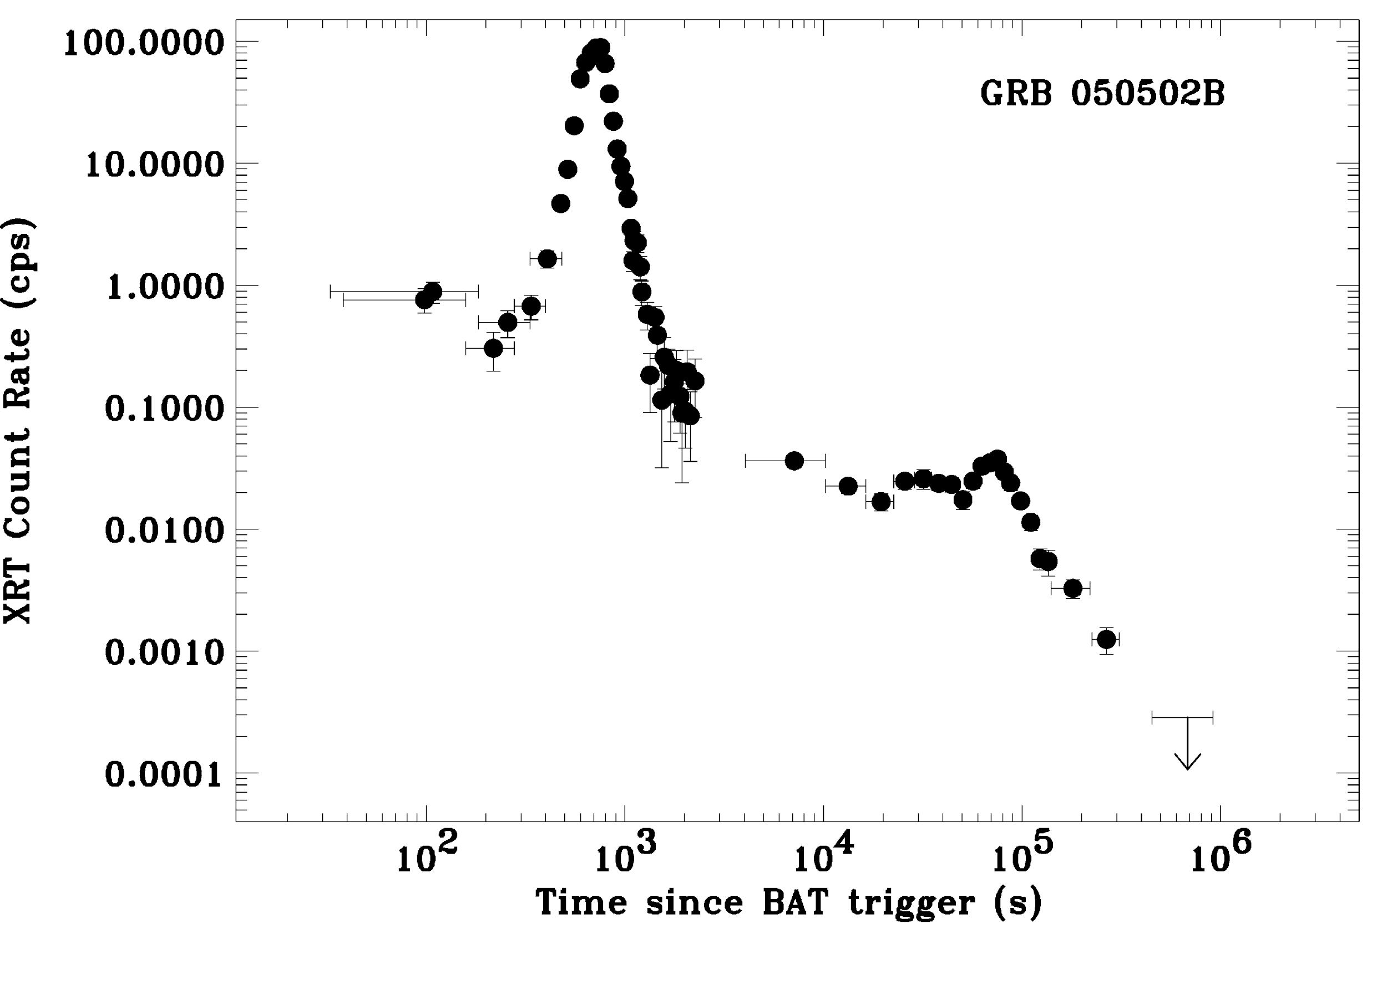
XRT: GRB050406, GRB050502B, ….
Burrows et al. 2005, Science 309, 1833; Falcone et al. 2006, ApJ 641, 1010; Romano et al. 2006 AA 450, 59

Slide 7
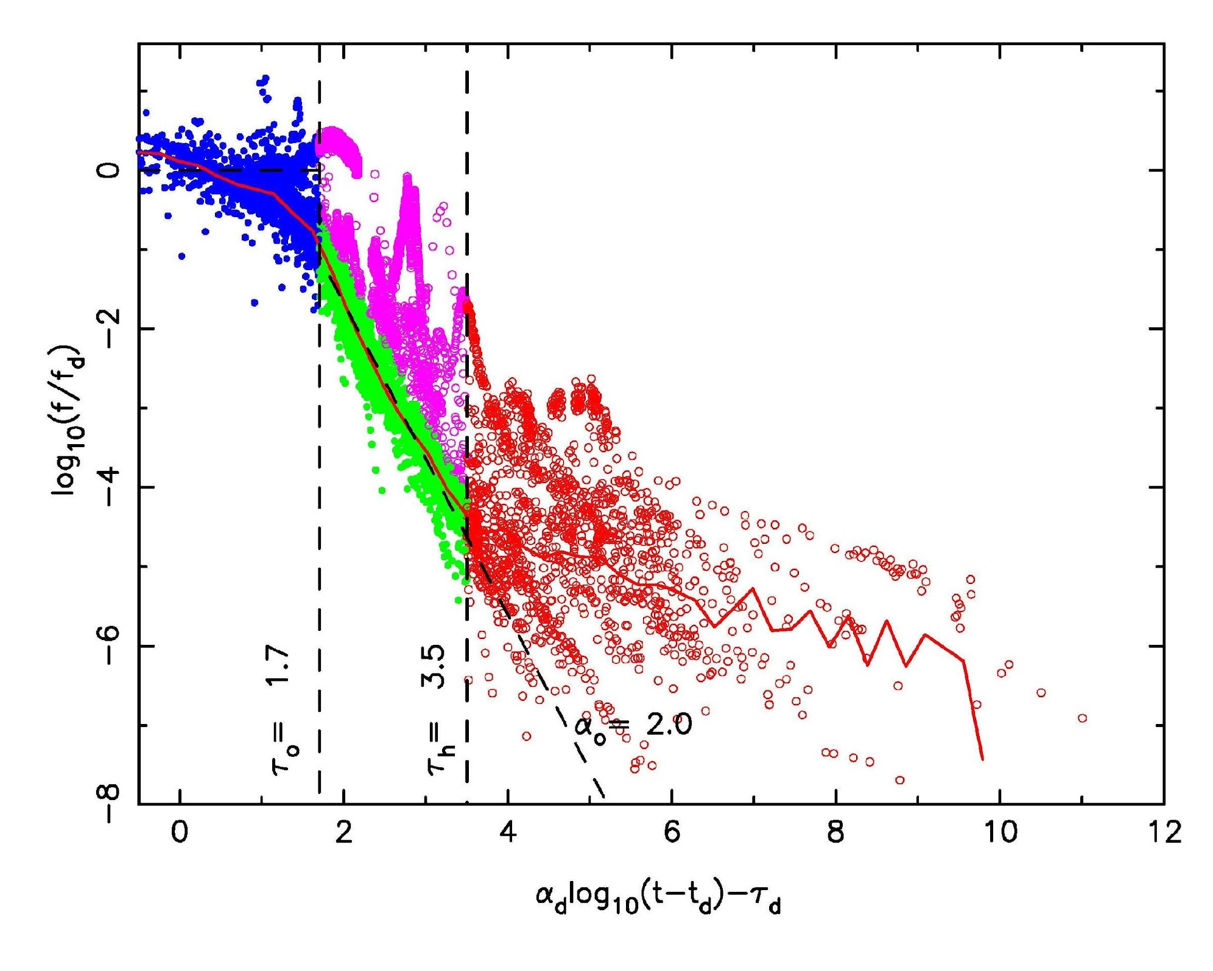
Summary of XRT light curves
Nousek et al. 2006 ApJ 642, 389
O’Brien et al. 2006, ApJ 647, 1213

Slide 8
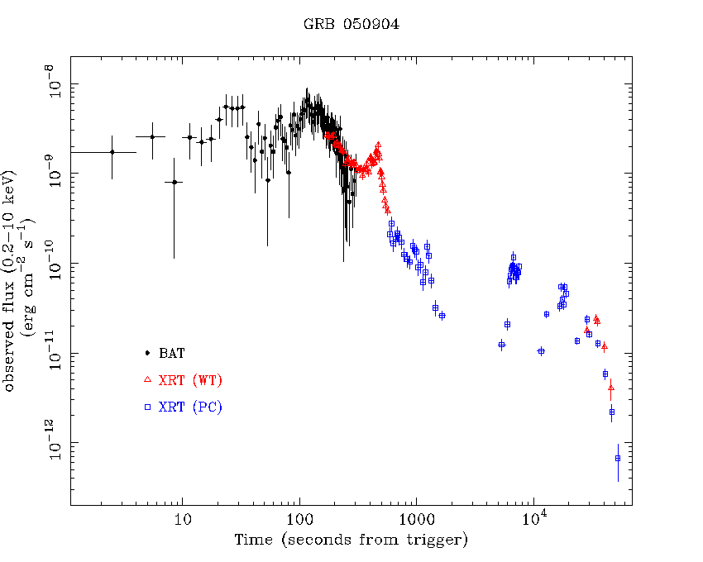
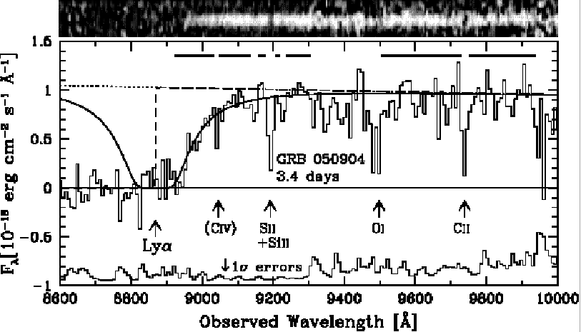
GRB050904: a very high redshift burst (z=6.29) and more burst up to z>8
Kawai et al. 2006, Nature
Cusumano et al. 2006, Nature 440, 164;
Watson et al. 2006, ApJ 637, L69

Slide 9
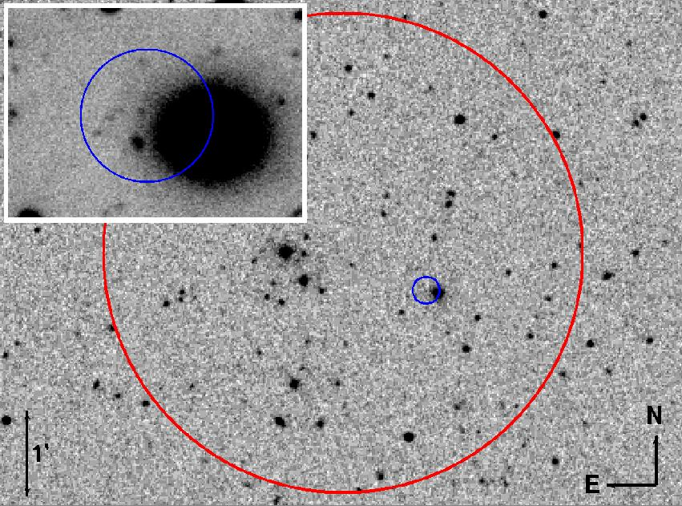
Optical Image – DSS + VLT
GRB050509B
BAT error box=2.3’
XRT error box=9.3”
Gehrels et al. 2005, Nature
Notes:
XRT error box=9.3”, at ~35 kpc from the center of an elliptical galaxy at z=0.225
No Chandra detection in 50 ks

Slide 10
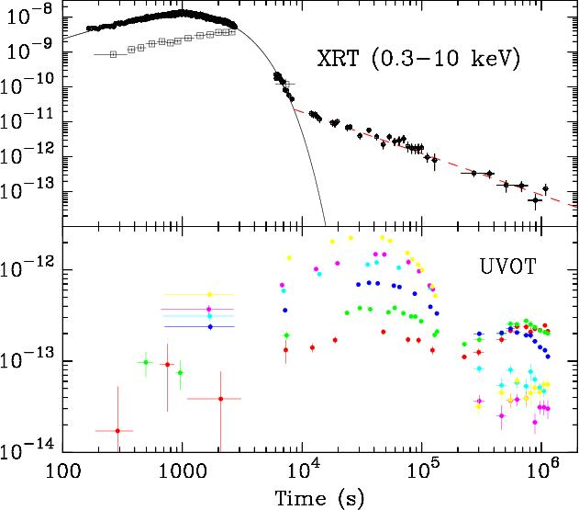
GRB 060218: for the first time we have seen a SN break-out
Campana et al. 2006, Nature, 442, 1008

Slide 11
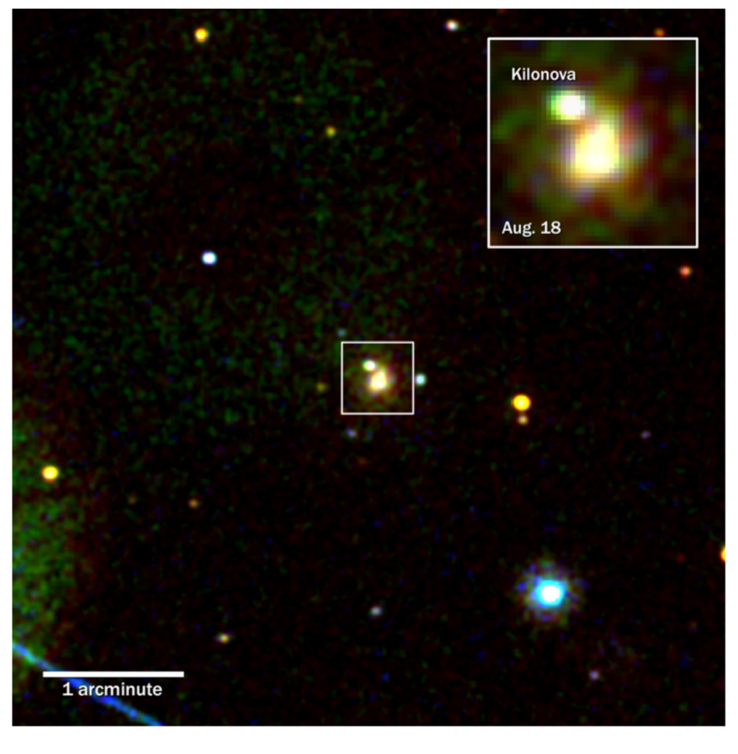
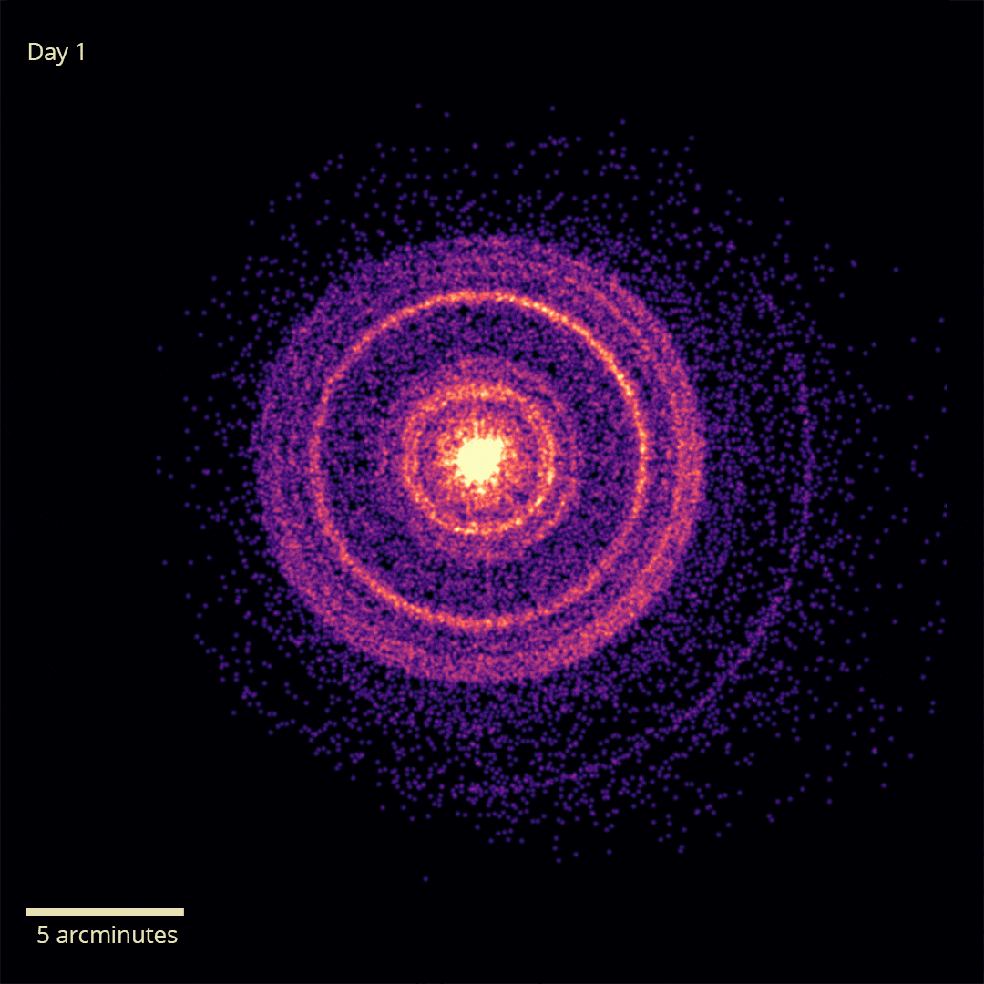
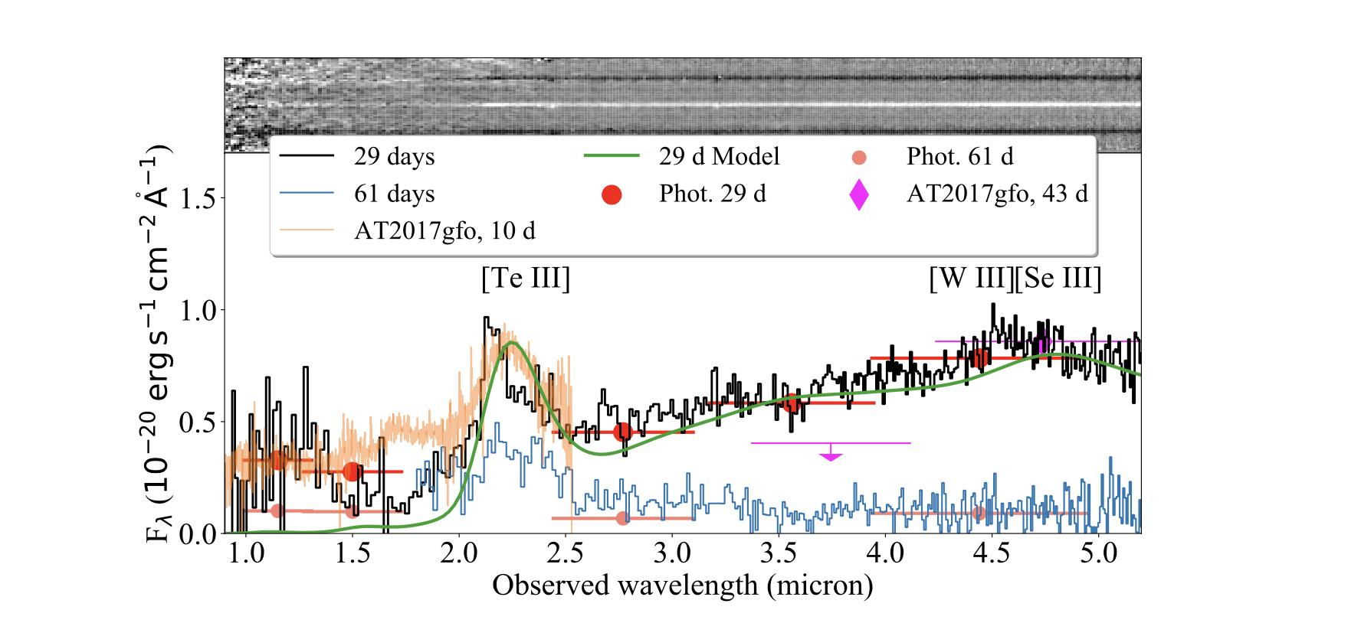
And more …
GRB080319B the naked eye GRB at z=0.9
GW170817-GRB170817A => detection of a bright UV kilonova
GRB221009 the monster GRB
GRB230307A the second brightest of all time with an associated kilonova
Evans et al., 2017, Science
Williams et al. 2023, ApJ
Tiengo et al. 2023, ApJ
Levan et al., 2023, Nature
Notes:
Tiengo PI del paper sugli echo con XRT+XMM

Slide 12
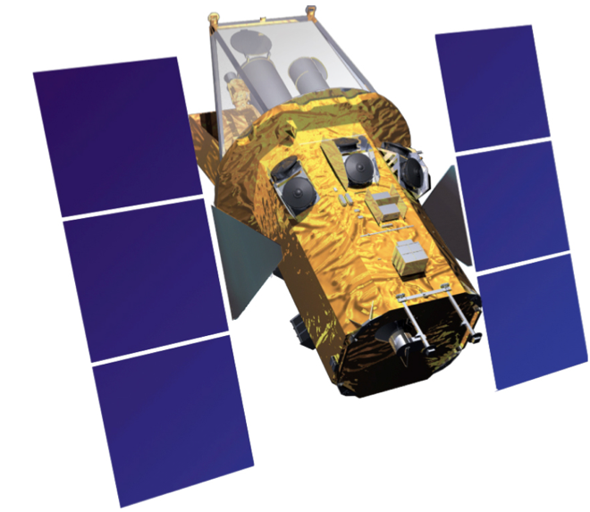
Swift - The legacy
A single, large and homogeneous sample of GRBs, with spectra and light curves, a database that will be used for a long time to come and to which unique and interesting sources continue to be added.
> 1600 GRB discovered with arcmin position
> 80% with arcsec position
> 70% repointed in <300 s
> 400 with redshift

Slide 13
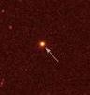
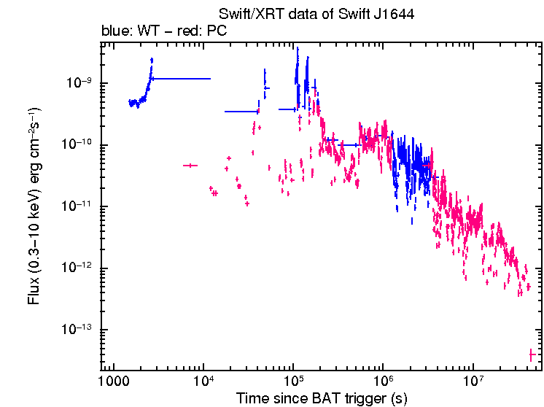
Swift Transient - Sw J1644+57: the onset of a jet
Highly erratic γ-ray and X-ray light curve, March 28, 2011
Like a GRB, but lasting 2 days instead of 20 second
Tidal disruption event beamed at us
E ~ 10⁵¹ ergs M_{BH} = 10⁶ – 10⁷ M_{solar}
Swift Light Curve
HST Image
t^{-4/3}
2 days
1.5 yrs
Center of galaxy at z=0.35
Burrows et al. 2012, Nature
Bloom et al. Science 2011

Slide 14
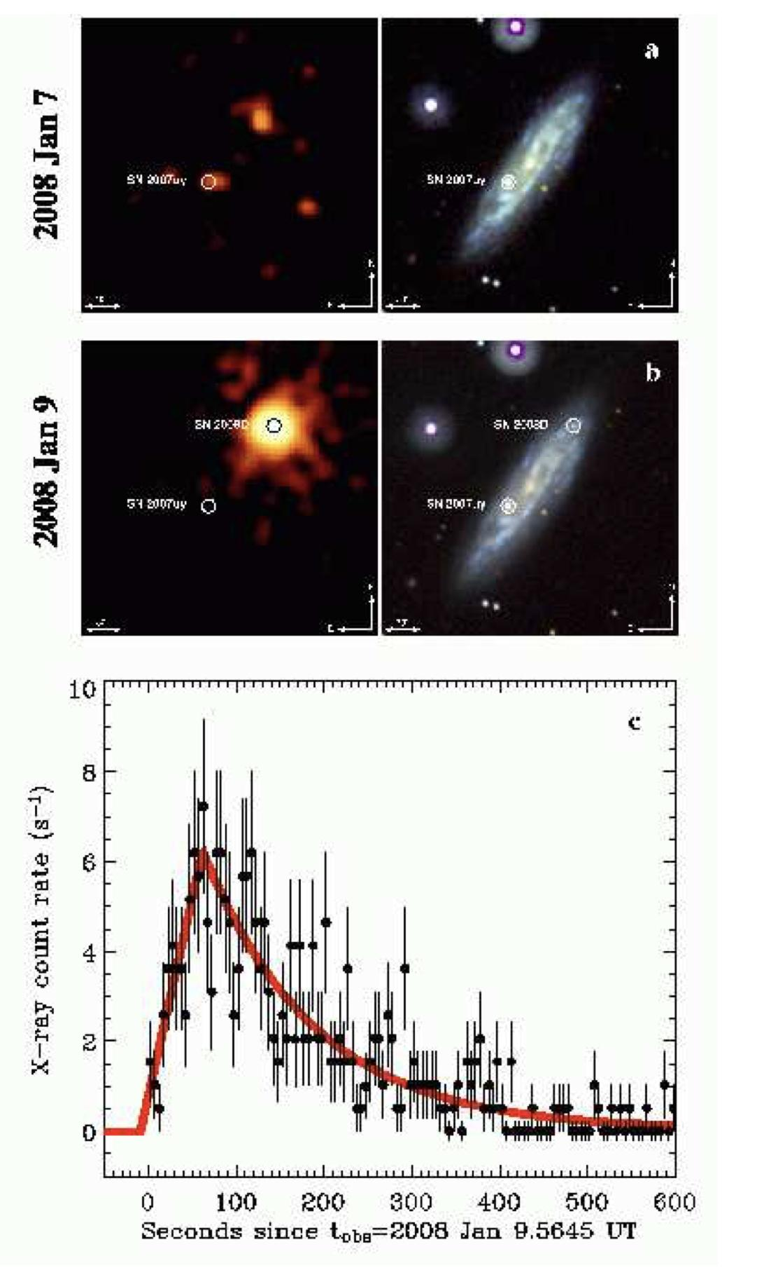
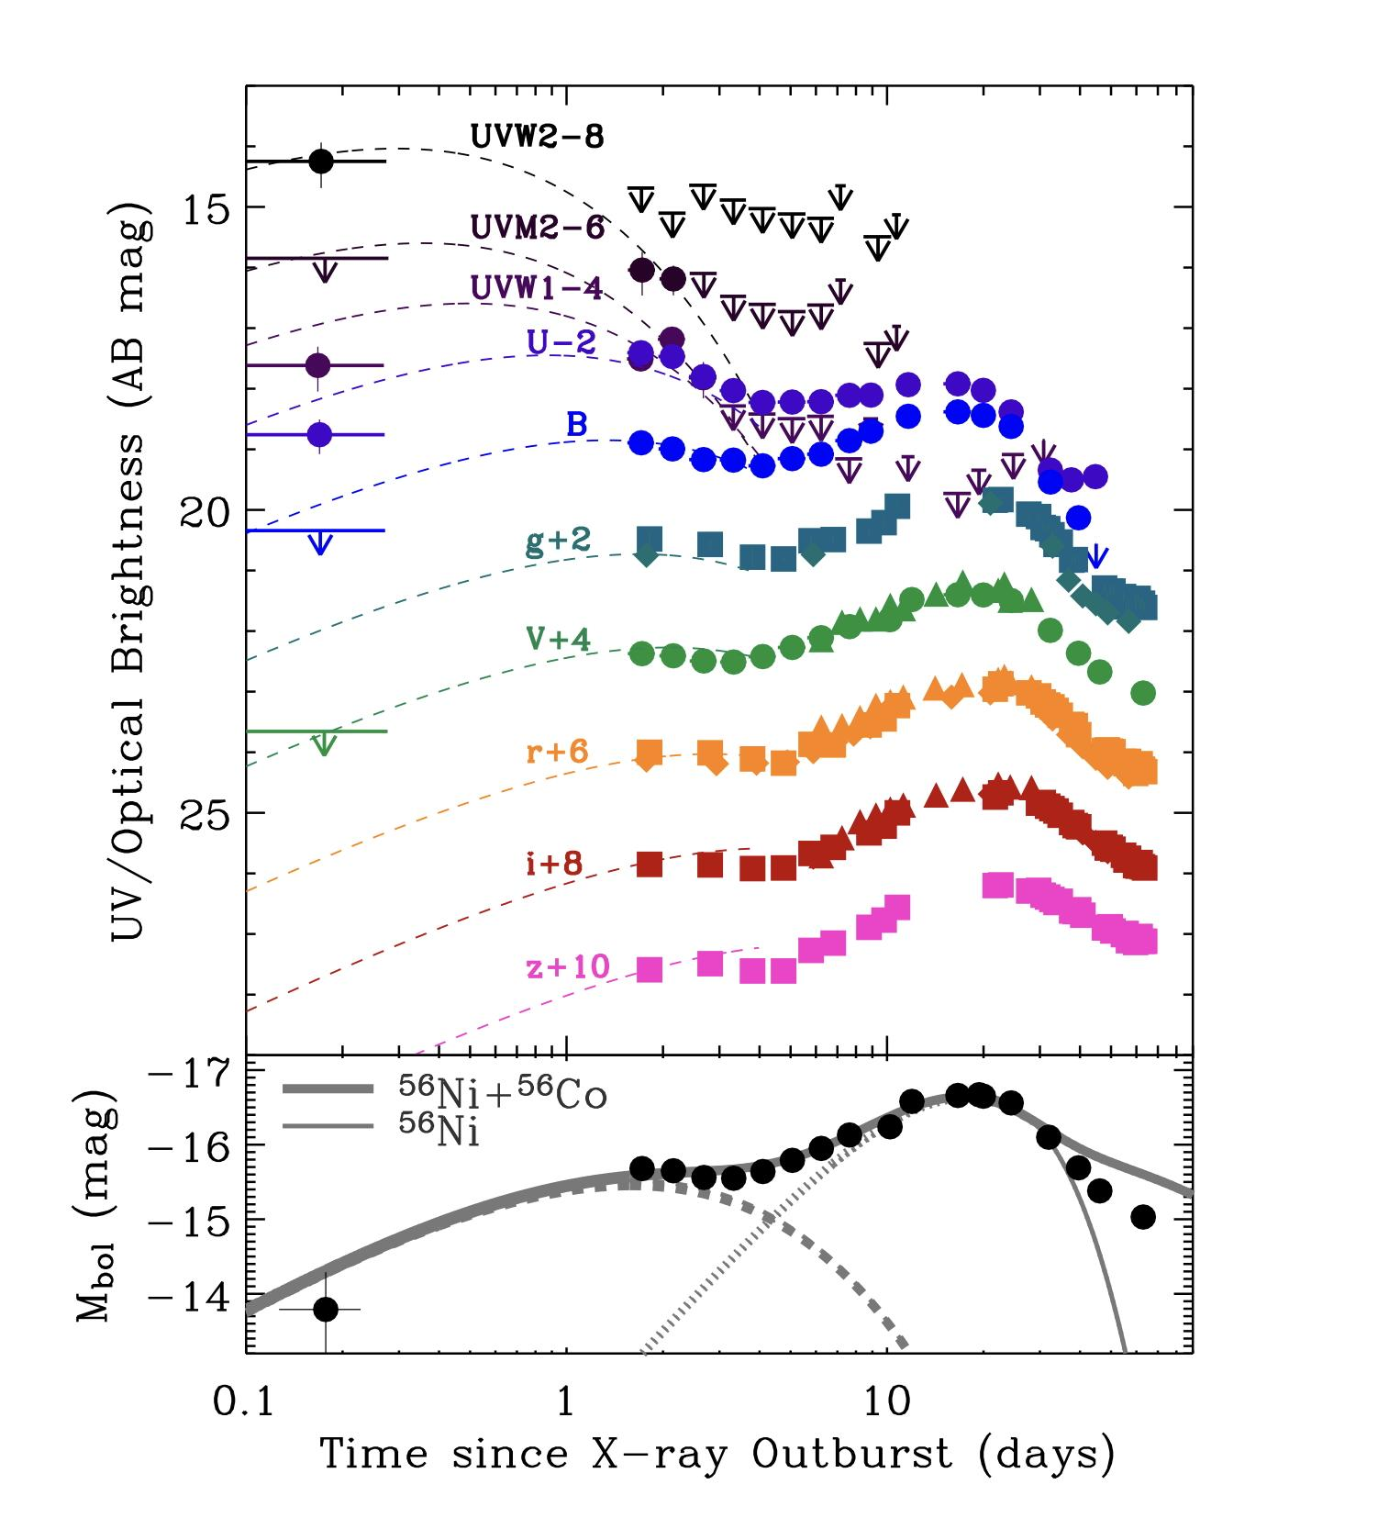
XRO 080109: catching a SN at the time of the explosion in the galaxy NGC2770
Soderberg et al. 2008, Nature, 453, 469
Notes:
Left image: top panel a) the galaxy NGC2770picture see in X and UV before explosion bottom panel b) the same after the explosion, bottom the X-ray light curve showing the time of explosion or shock break-out

Slide 15
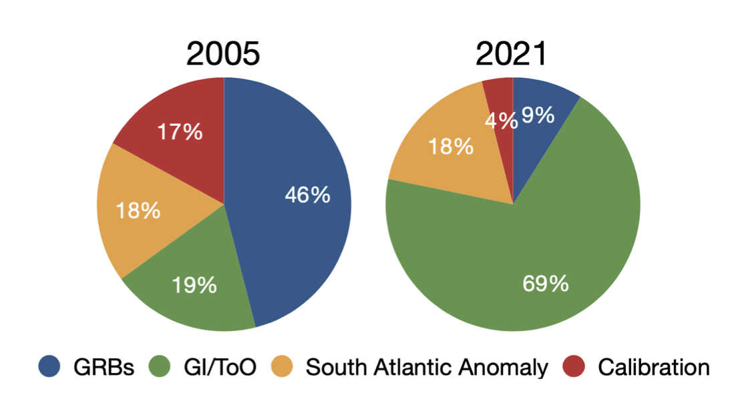
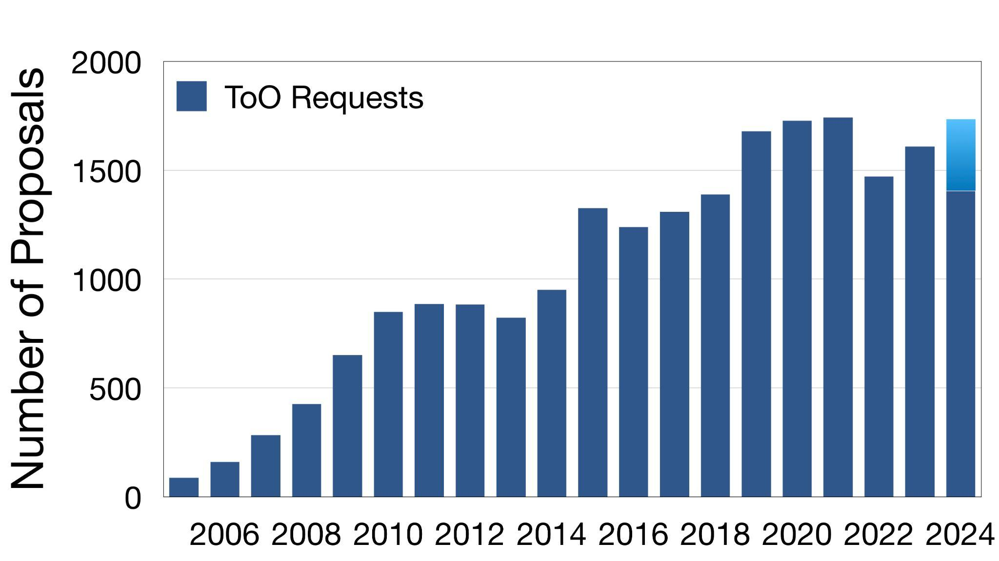
Swift keeps being a highly requested mission for both GI programs and ToO
>1700/yr ToO (>4.7/d)
Each with an assigned Figure of Merit
~99% approved

Slide 16
Swift: the reasons of a big success
Designed as a mission for the rapid follow-up of GRBs, Swift has proven to be highly flexible and dynamic to allow observations of virtually any type of astronomical source over periods ranging from minutes, to hours, days or months.
Fast response to ToOs observations (on average ~ 4-5 per day) with data publicly available to everyone from the start.
With the help of software automation, Swift can be operated 24/7 by a small team with rapid response to the various ToOs.

Slide 17
BACKUP

Slide 18
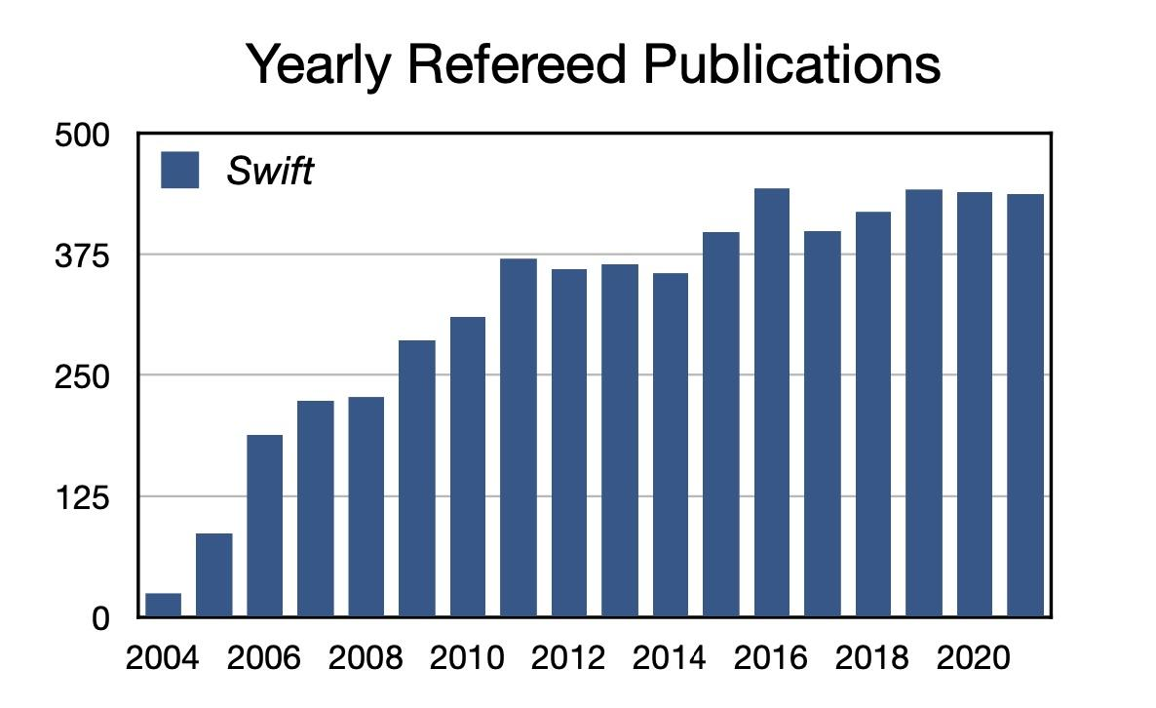
Rate of refereed publications remains extremely high
With tens of papers published on Nature and Science. One of the highest rate ever.

Slide 19
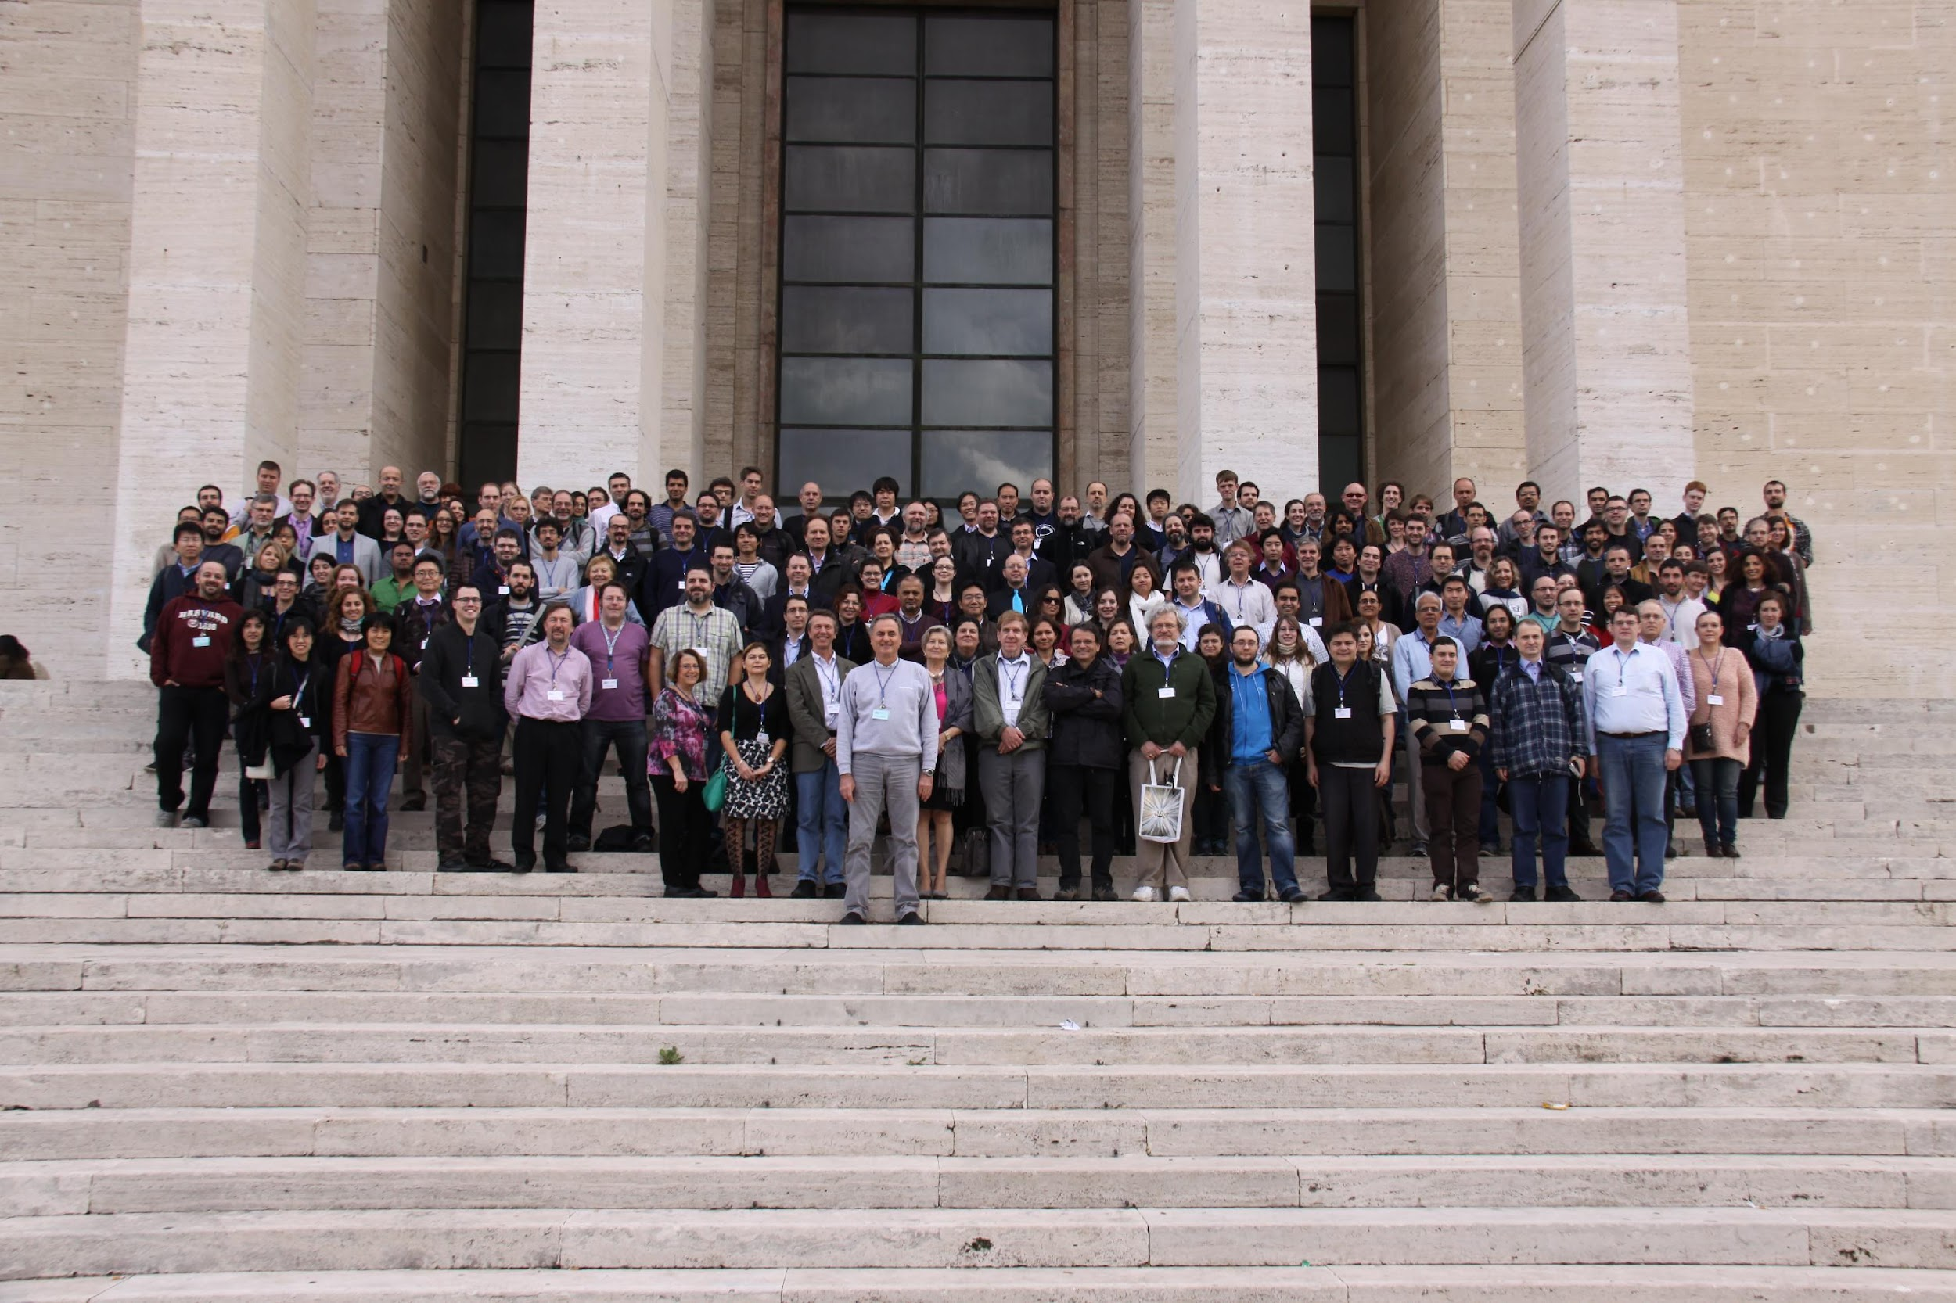
Swift10 Roma, 2014

