Slide 1

Sample of Extragalactic Fast X-ray Transients Discovered by Einstein Probe during its First Year
Qinyu WU
EPSC
NAOC

Slide 2
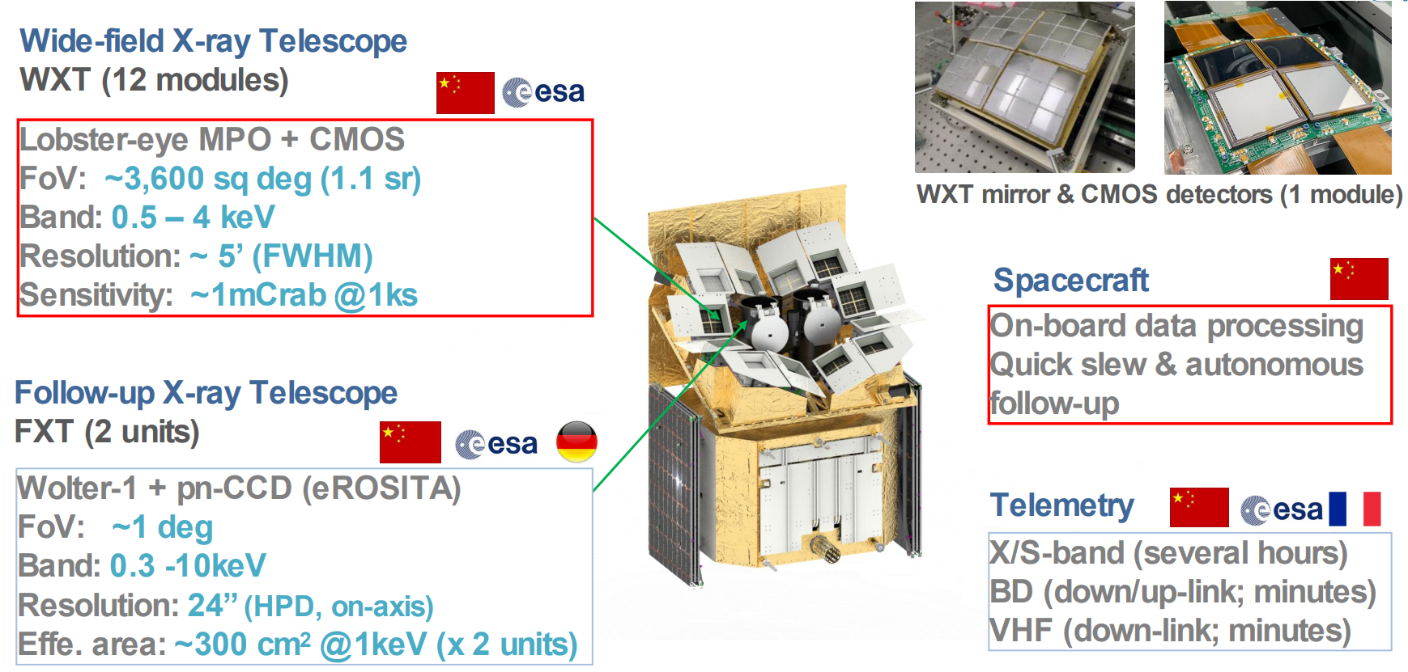
Einstein Probe
EP satellite
CMOS探测器耗尽层厚度对X射线性能影响研究
See more details in Prof. Yuan’s talk tomorrow
Yuan, et al. 2022 Einstein ProbeHandbook of X-ray and Gamma-ray Astrophysics

Slide 3
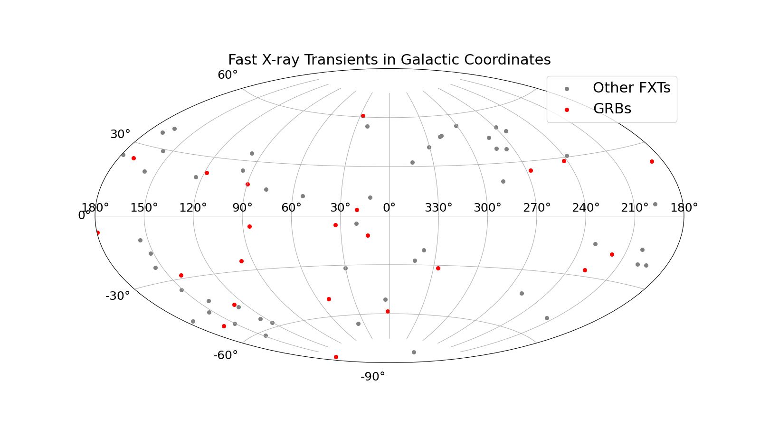
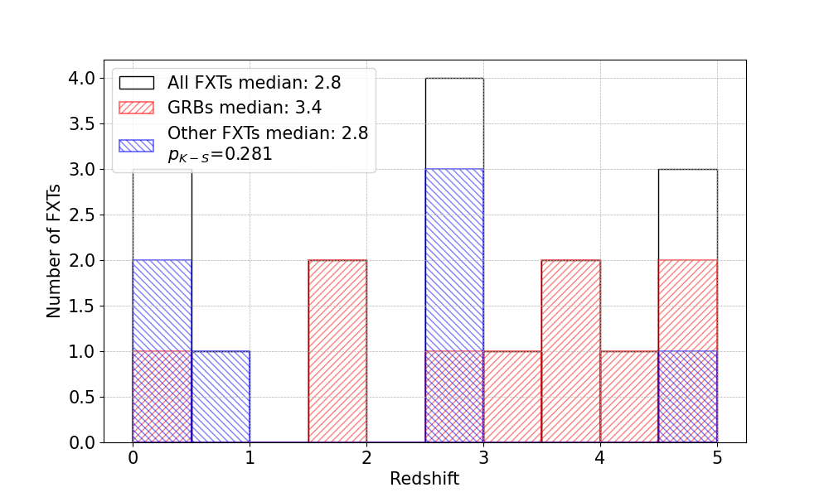
FXTs detected by EP-WXT
FXTs detected by EP-WXT
CMOS探测器耗尽层厚度对X射线性能影响研究
Identify Fast X-ray Transients (FXTs):
  Stellar flares and known burst sources excluded
  Significant variability within a single observation
  Duration from tens to several thousands of seconds
72 FXTs found (by the end of Feb.2025):
  22 with gamma-ray counterpart (GRB)
  53 with X-ray afterglow candidate
  29 with Optical afterglow candidate
  17 with redshift measurement

Slide 4
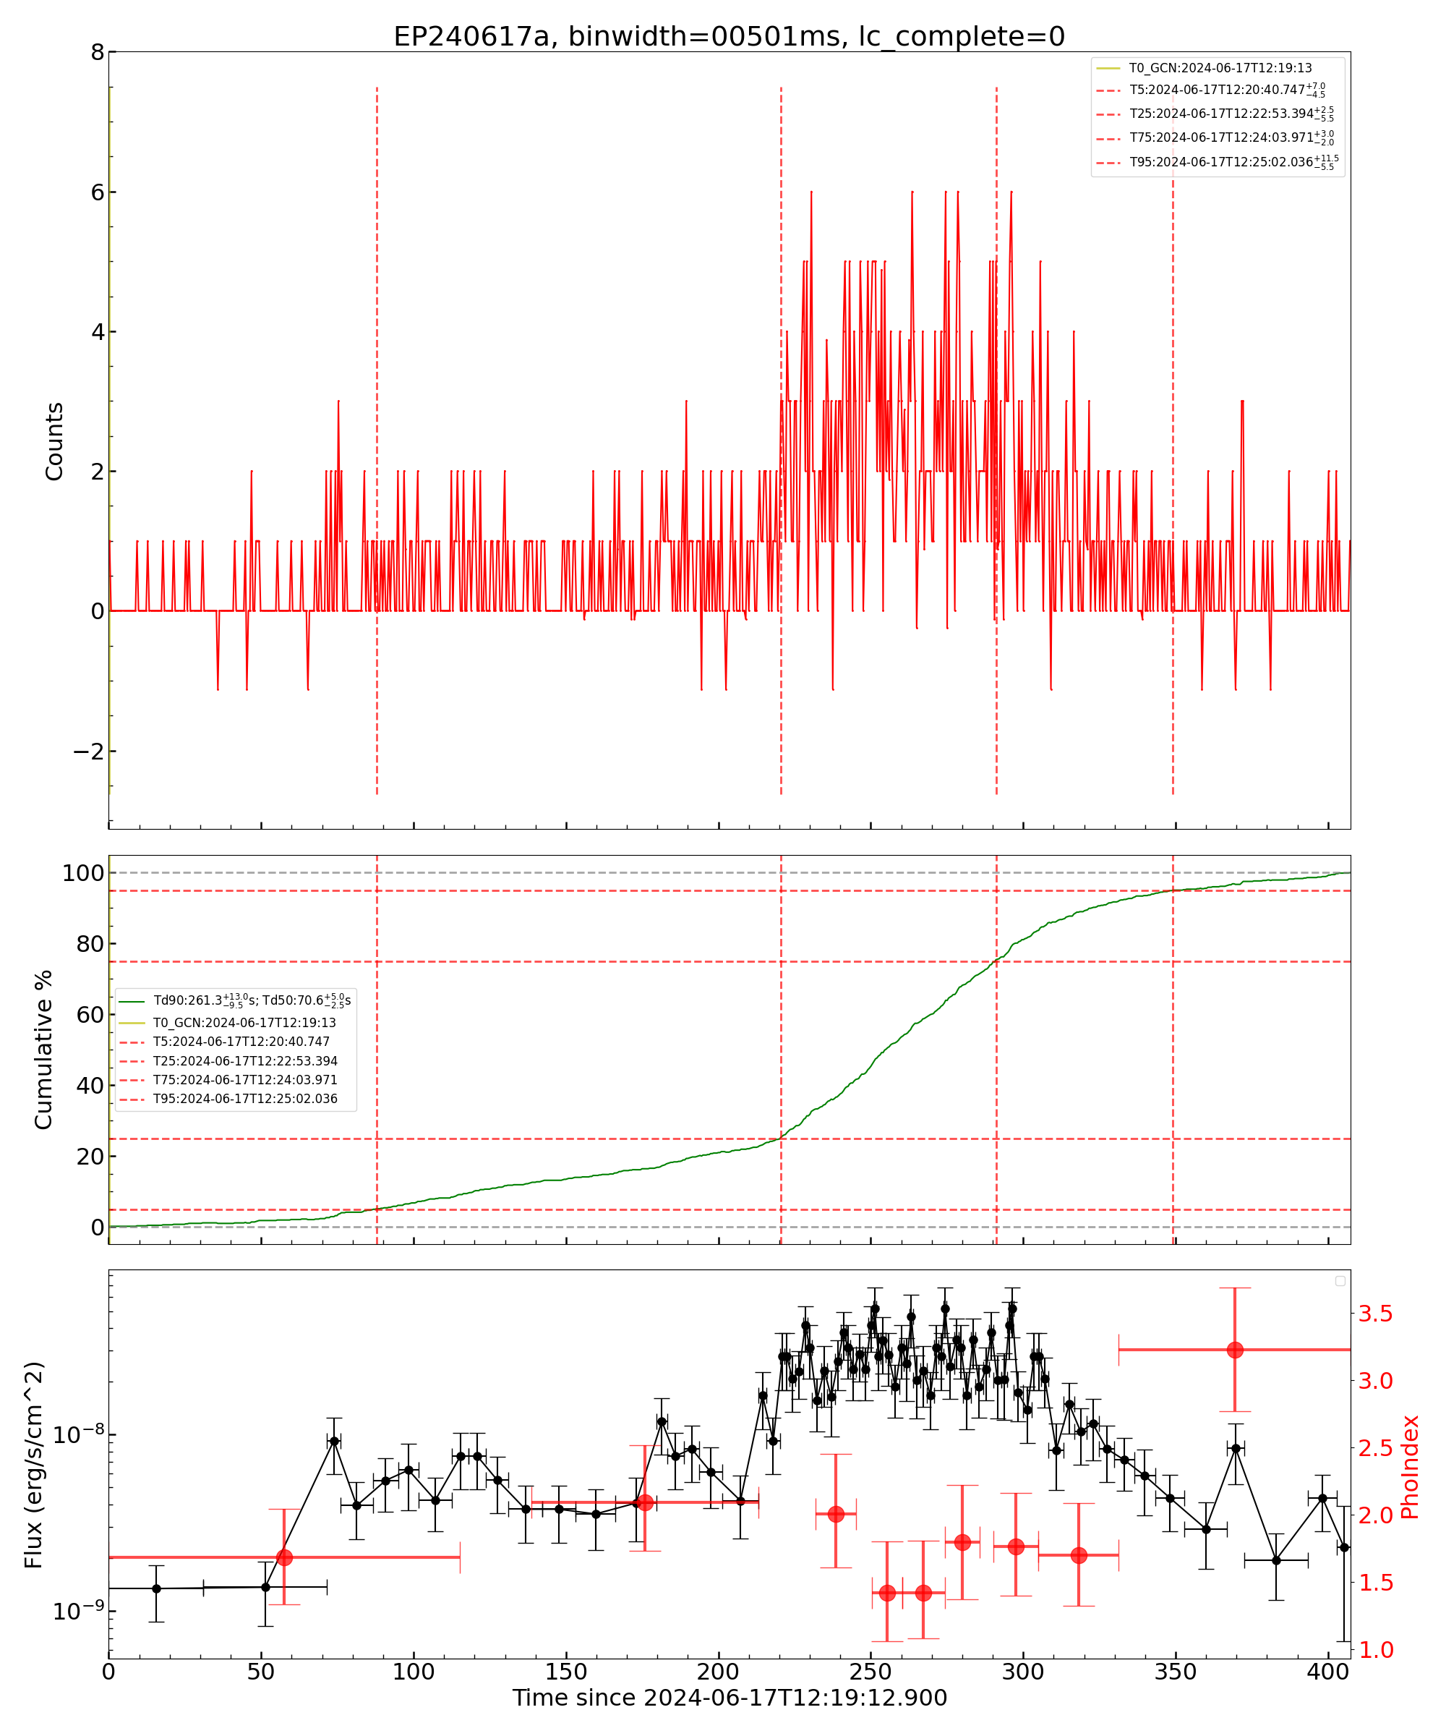
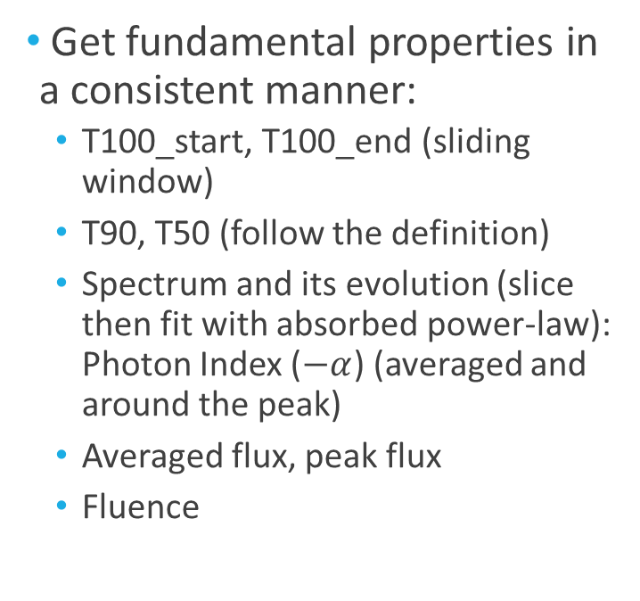
Get properties of FXTs
FXTs detected by EP-WXT
CMOS探测器耗尽层厚度对X射线性能影响研究
Get fundamental properties in a consistent manner:
  T100_start, T100_end (sliding window)
  T90, T50 (follow the definition)
  Spectrum and its evolution (slice then fit with absorbed power-law): Photon Index ($−α$) (averaged and around the peak)
  Averaged flux, peak flux
  Fluence

Slide 5
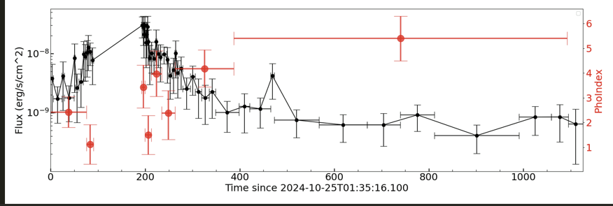
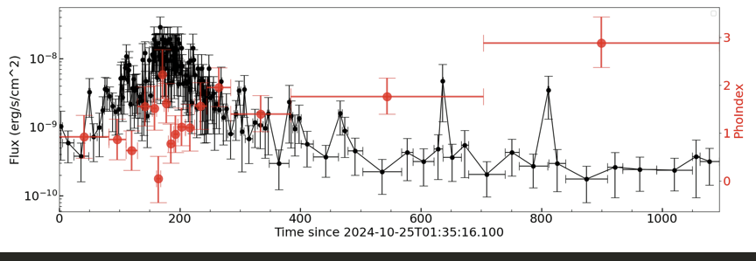
Reconstruct light curves with slew data
FXTs detected by EP-WXT
CMOS探测器耗尽层厚度对X射线性能影响研究
Incomplete light curve
72 FXTs:
  35 triggered by on-board proccessing unit
  19 of them conducted autonomous follow-up: incomplete light curves.
  Large FoV of WXT, source may be completely inside the FoV during slew.
  Slew data can help, but need careful correction due to the varying effective area.
Reconstructed light curve
EP241025a / GRB 241025A

Slide 6
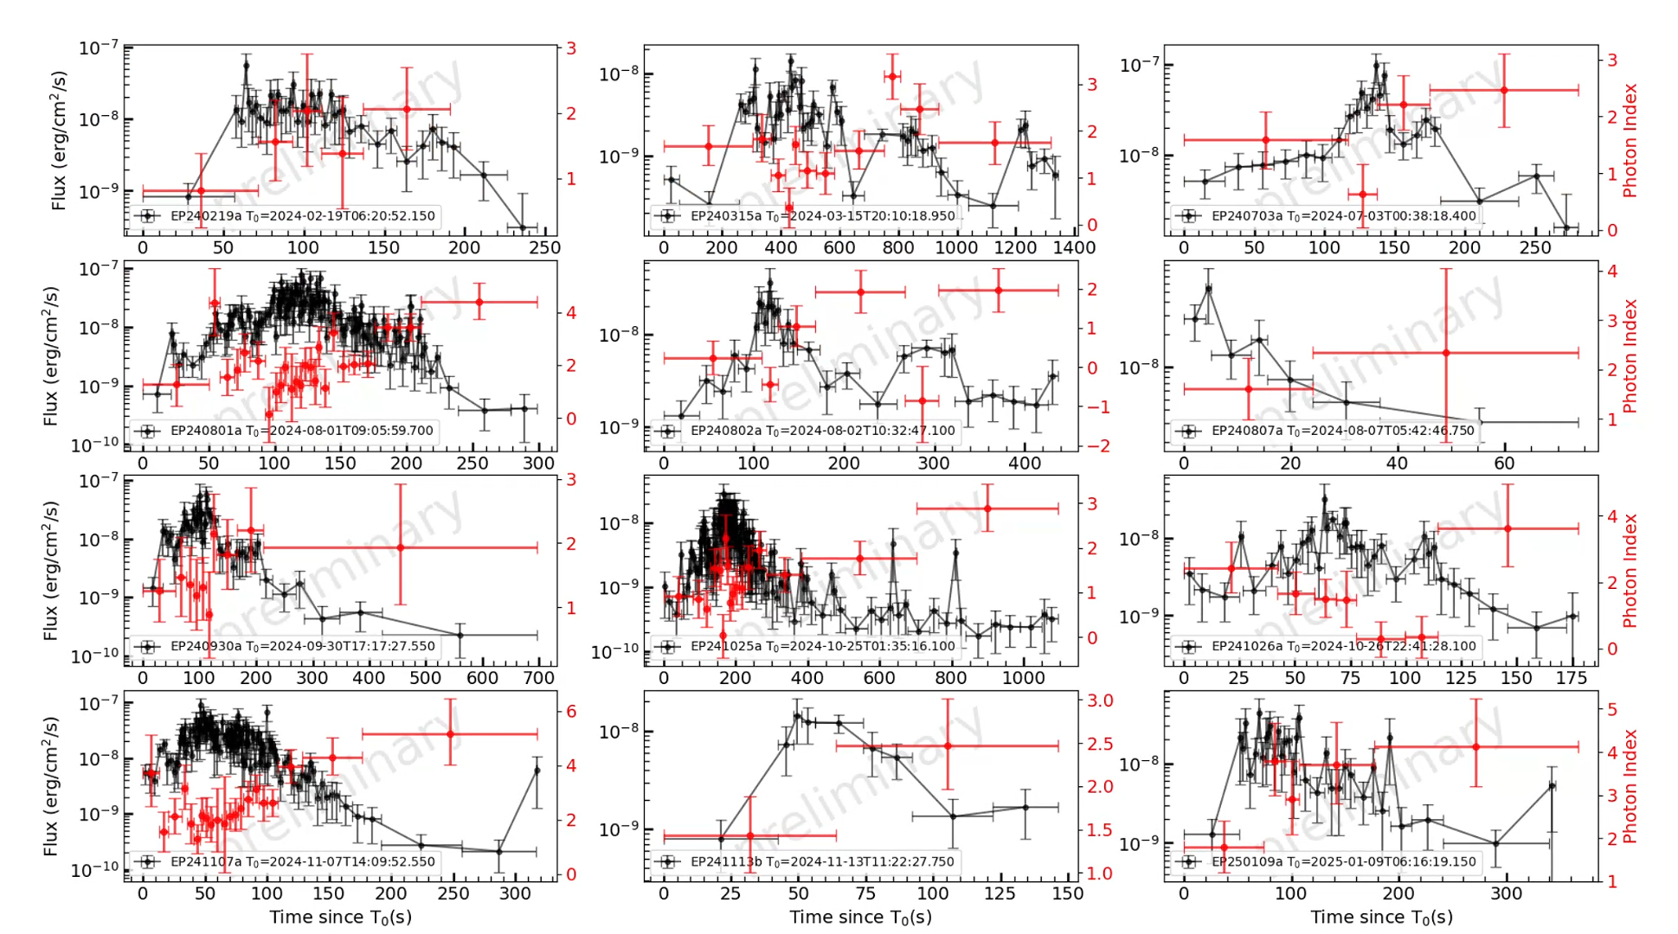
Sample with complete light curves
FXTs detected by EP-WXT
CMOS探测器耗尽层厚度对X射线性能影响研究
Light curve incomplete, 19 excluded from the sample:
  Earth occultation
  SAA region
  Outside the WXT-FoV during slew
53 FXTs with complete light curves:
  15 GRBs
  24 GRB-less FXTs (Fermi/GBM covered but no detection)
  14 unknown sources

Slide 7
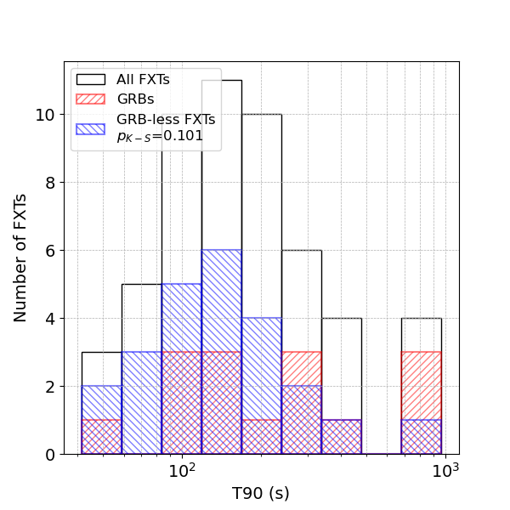
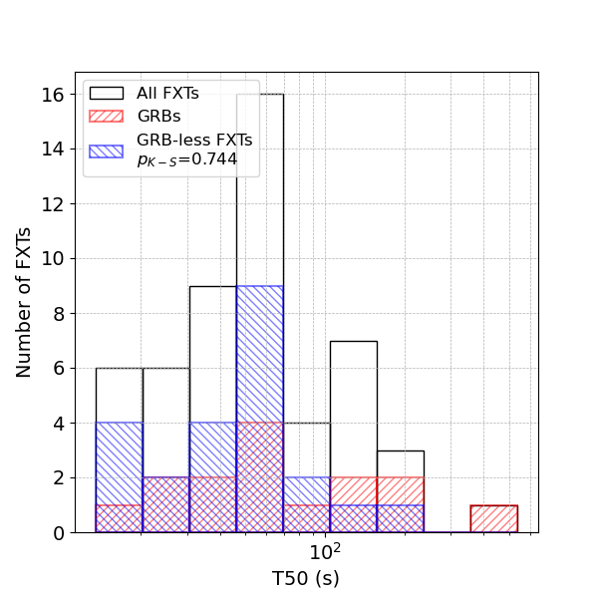
Compare the X-ray durations between FXTs
FXTs detected by EP-WXT
CMOS探测器耗尽层厚度对X射线性能影响研究
  The soft X-ray duration of GRBs and GRB-less FXTs show no significant difference

Slide 8
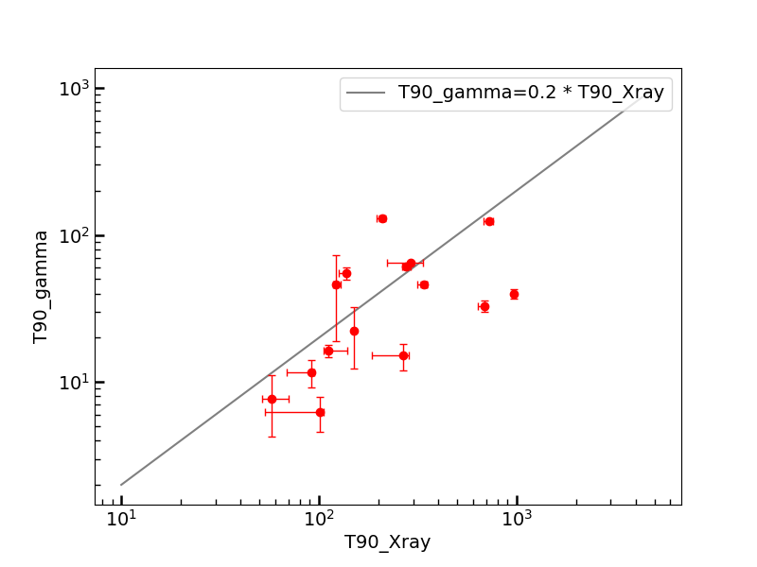
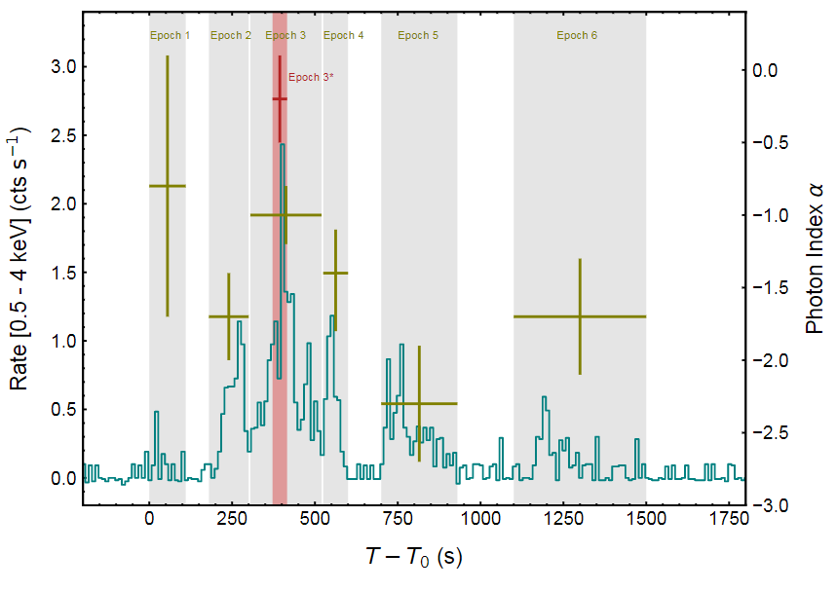
Compare durations in X-ray and gamma-ray band
FXTs detected by EP-WXT
CMOS探测器耗尽层厚度对X射线性能影响研究
EP240315a / GRB 240315C
EP241026a / GRB 241026A
Liu et al., 2024
  Durations in soft X-ray much longer than that in gamma-ray
  T90 roughly 5 times longer

Slide 9
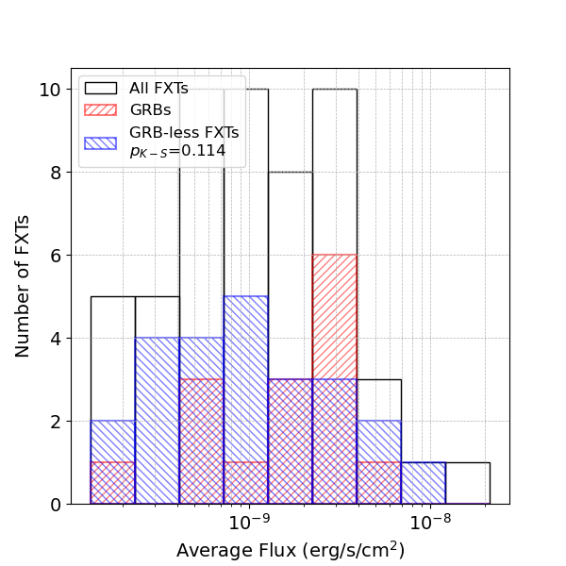
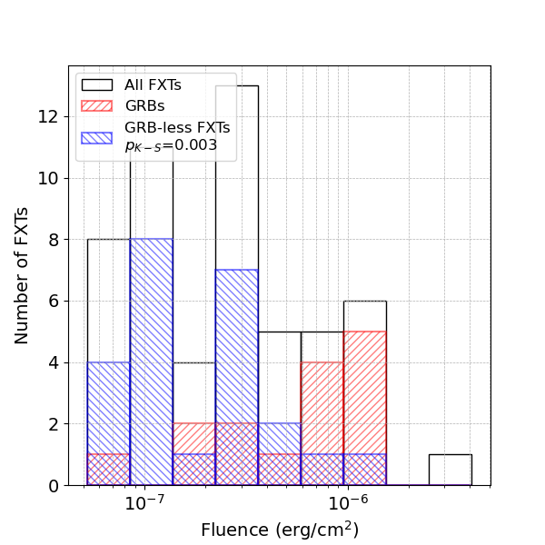
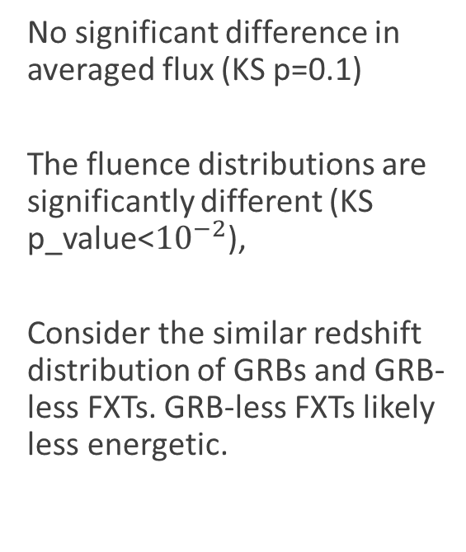
Averaged flux and fluence
FXTs detected by EP-WXT
CMOS探测器耗尽层厚度对X射线性能影响研究
  No significant difference in averaged flux (KS p=0.1)
  The fluence distributions are significantly different (KS p_value<${10}^{−2}$),
  Consider the similar redshift distribution of GRBs and GRB-less FXTs. GRB-less FXTs likely less energetic.

Slide 10
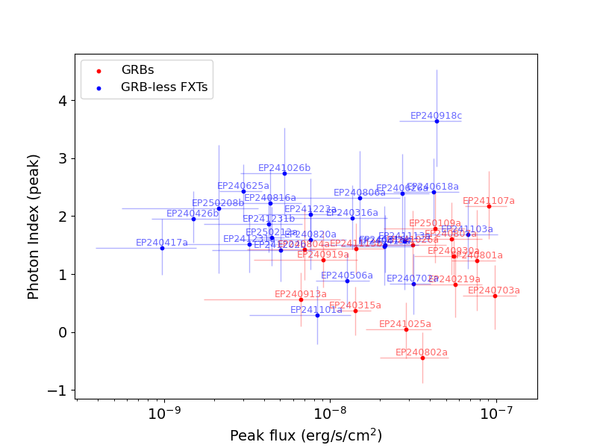
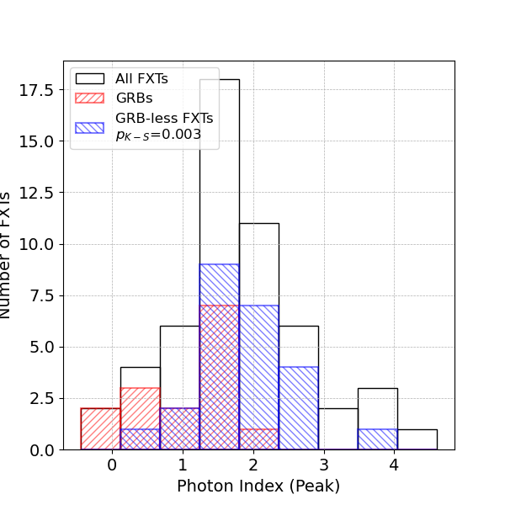
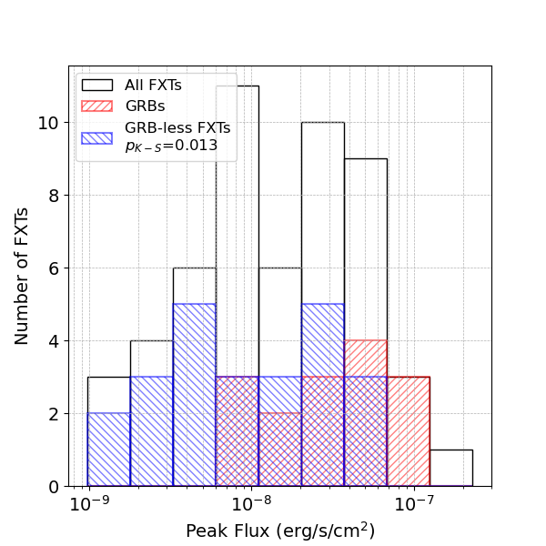
Peak flux and Photon index around peak
FXTs detected by EP-WXT
CMOS探测器耗尽层厚度对X射线性能影响研究
  GRB-less FXTs show softer (KS p=0.003) and weaker peak (KS p=0.013)

Slide 11
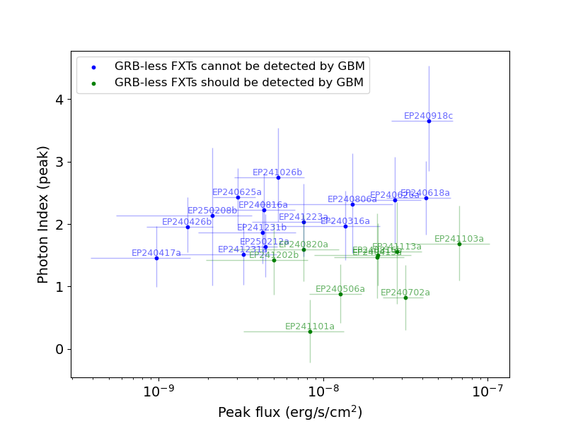
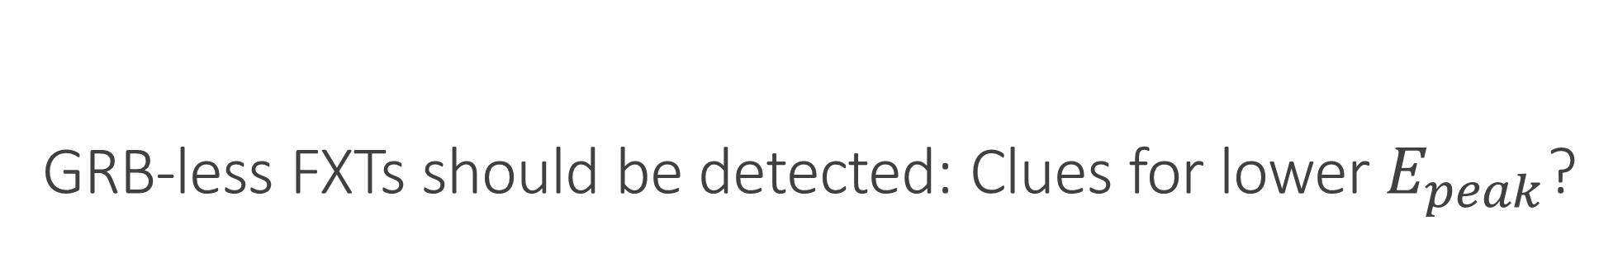
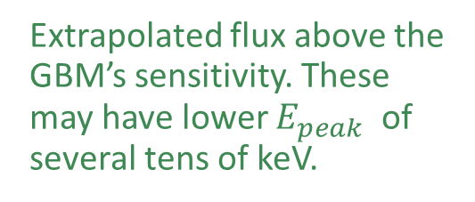
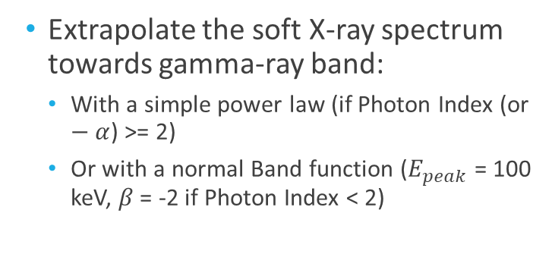
GRB-less FXTs should be detected: Clues for lower $E_{peak}$?
FXTs detected by EP-WXT
CMOS探测器耗尽层厚度对X射线性能影响研究
  Extrapolate the soft X-ray spectrum towards gamma-ray band:
    With a simple power law (if Photon Index (or $−α$) >= 2)
    Or with a normal Band function ($E_{peak}$ = 100 keV, $β$ = -2 if Photon Index < 2)
  Extrapolated flux lower than GBM’s sensitivity. EP has the ability to detect FXTs that below gamma-ray satellites’ limit
  Extrapolated flux above the GBM’s sensitivity. These may have lower $E_{peak}$ of several tens of keV.

Slide 12
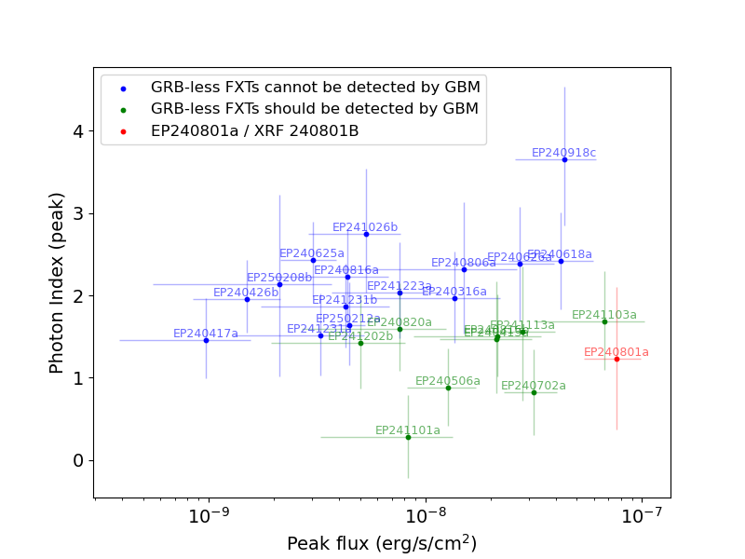
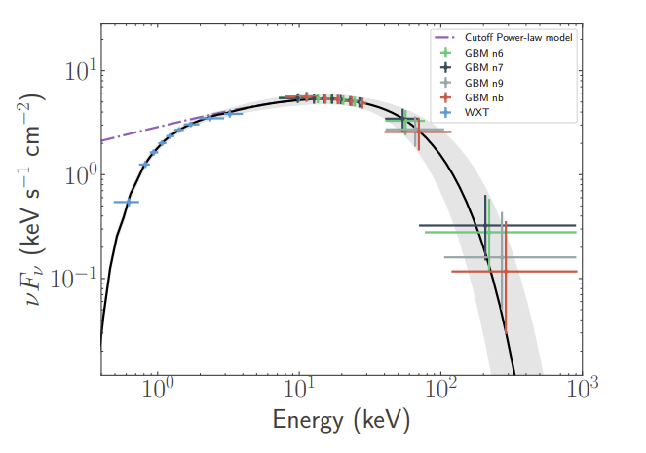
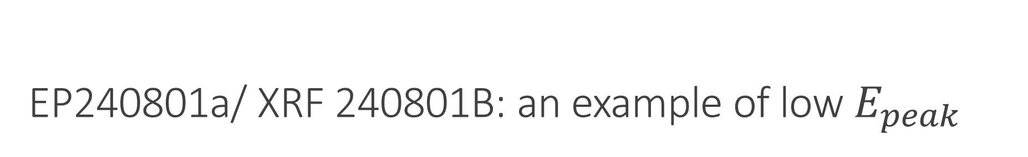
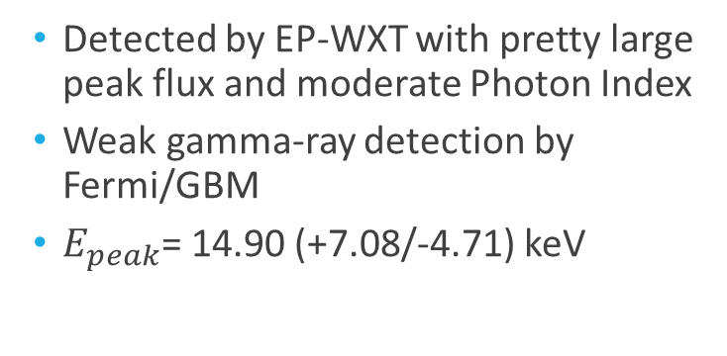
EP240801a/ XRF 240801B: an example of low $E_{peak}$
FXTs detected by EP-WXT
CMOS探测器耗尽层厚度对X射线性能影响研究
  Detected by EP-WXT with pretty large peak flux and moderate Photon Index
  Weak gamma-ray detection by Fermi/GBM
  $E_{peak}$= 14.90 (+7.08/-4.71) keV
Jiang et al., 2025

Slide 13
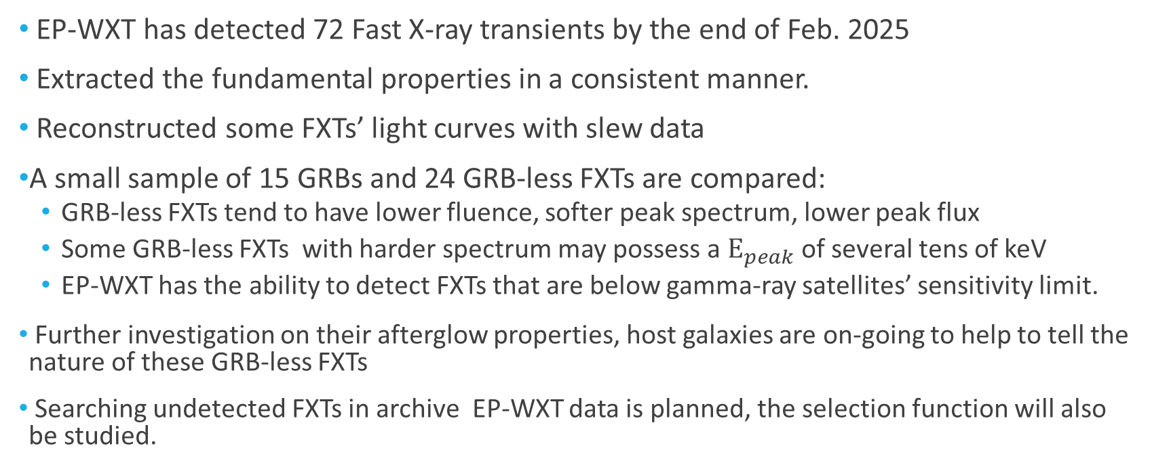
Summary
FXTs detected by EP
CMOS探测器耗尽层厚度对X射线性能影响研究
EP-WXT has detected 72 Fast X-ray transients by the end of Feb. 2025
Extracted the fundamental properties in a consistent manner.
Reconstructed some FXTs’ light curves with slew data
A small sample of 15 GRBs and 24 GRB-less FXTs are compared:
  GRB-less FXTs tend to have lower fluence, softer peak spectrum, lower peak flux
  Some GRB-less FXTs with harder spectrum may possess a $E_{peak}$ of several tens of keV
  EP-WXT has the ability to detect FXTs that are below gamma-ray satellites’ sensitivity limit.
Further investigation on their afterglow properties, host galaxies are on-going to help to tell the nature of these GRB-less FXTs
Searching undetected FXTs in archive EP-WXT data is planned, the selection function will also be studied.

