Slide 1
BTSbot-nearby
Rapid, autonomous follow-up of nearby infant supernovae with Swift/UVOT
Nabeel Rehemtulla
Northwestern University, CIERA, SkAI
Adam A. Miller, Theophile du Laz,
Wynn Jacobson-Galán, Avinash Singh

Slide 2
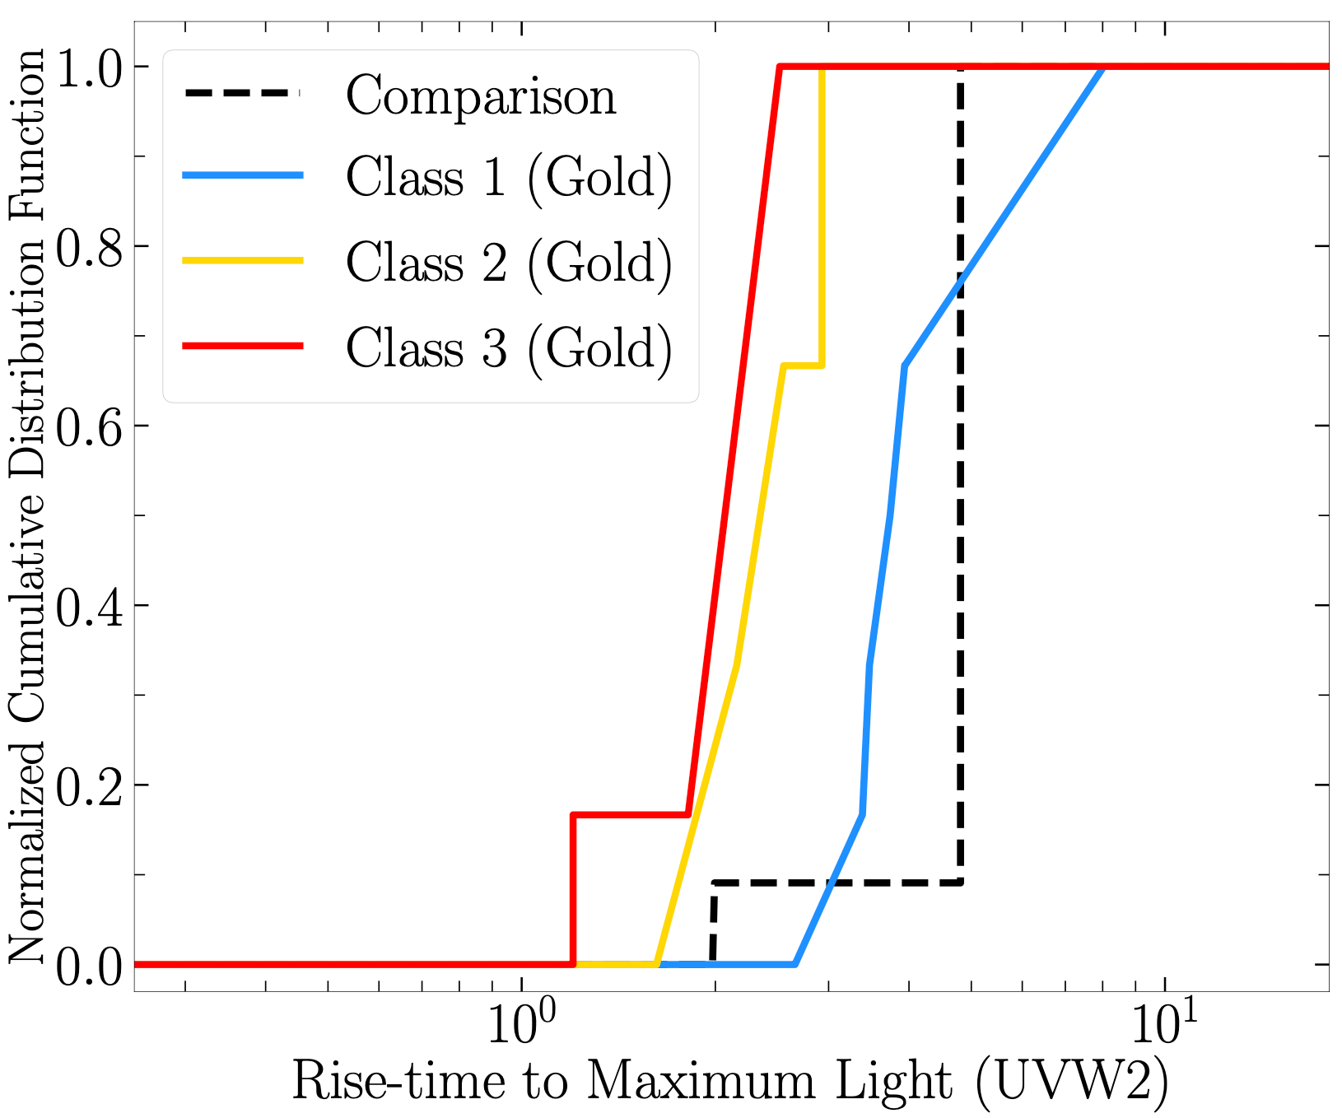
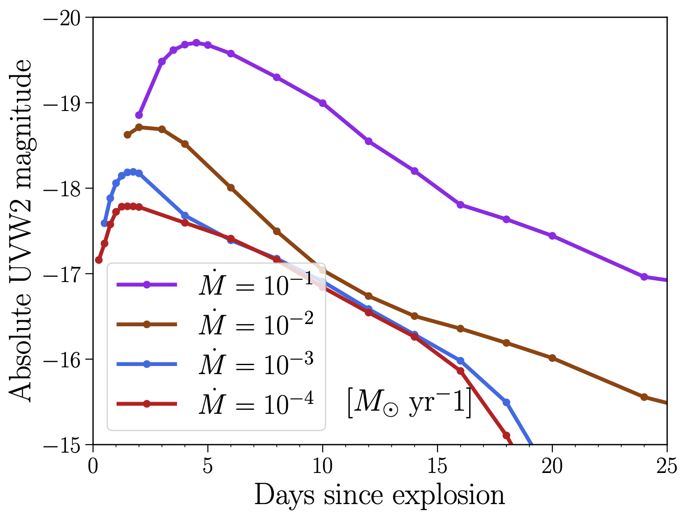
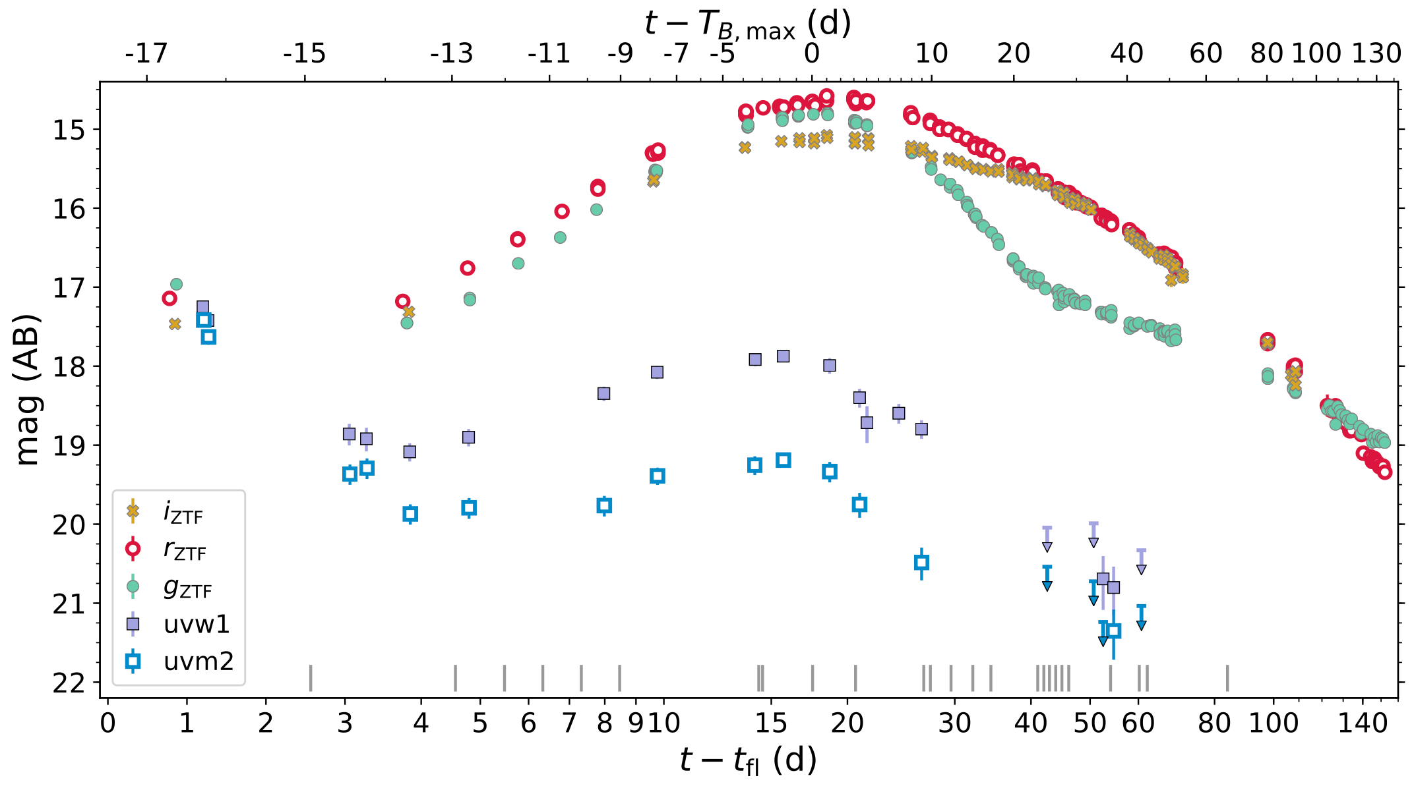
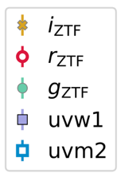
UV observations of infant SNe
Core-collapse SNe
Rise time ~3 days
Reveals progenitor mass loss rate
Thermonuclear SNe
Poor constraints on frequency of such flashes
Thick He-shell double-detonation
Dessart & Jacobson-Galán 2023
Miller+2020
Siebert+2020
Notes:
UV is fast and informative

Slide 3
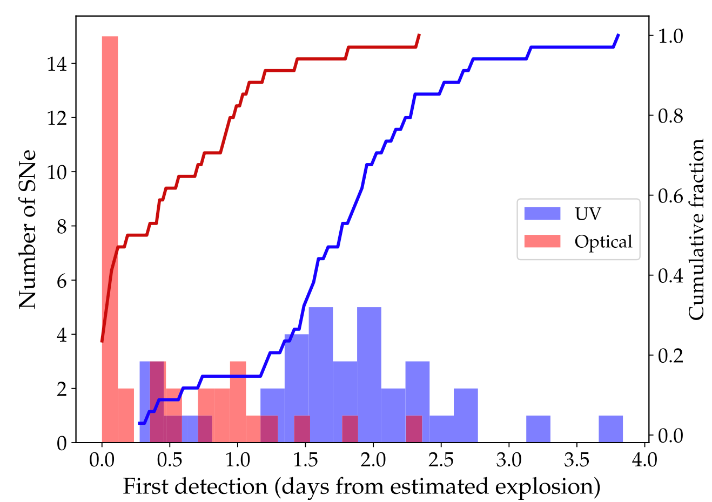
Latency in obtaining UV observations
Irani+2024
Often start ~1 day after optical
We’re missing the earliest UV information
Notes:
Latency in UV follow-up

Slide 4
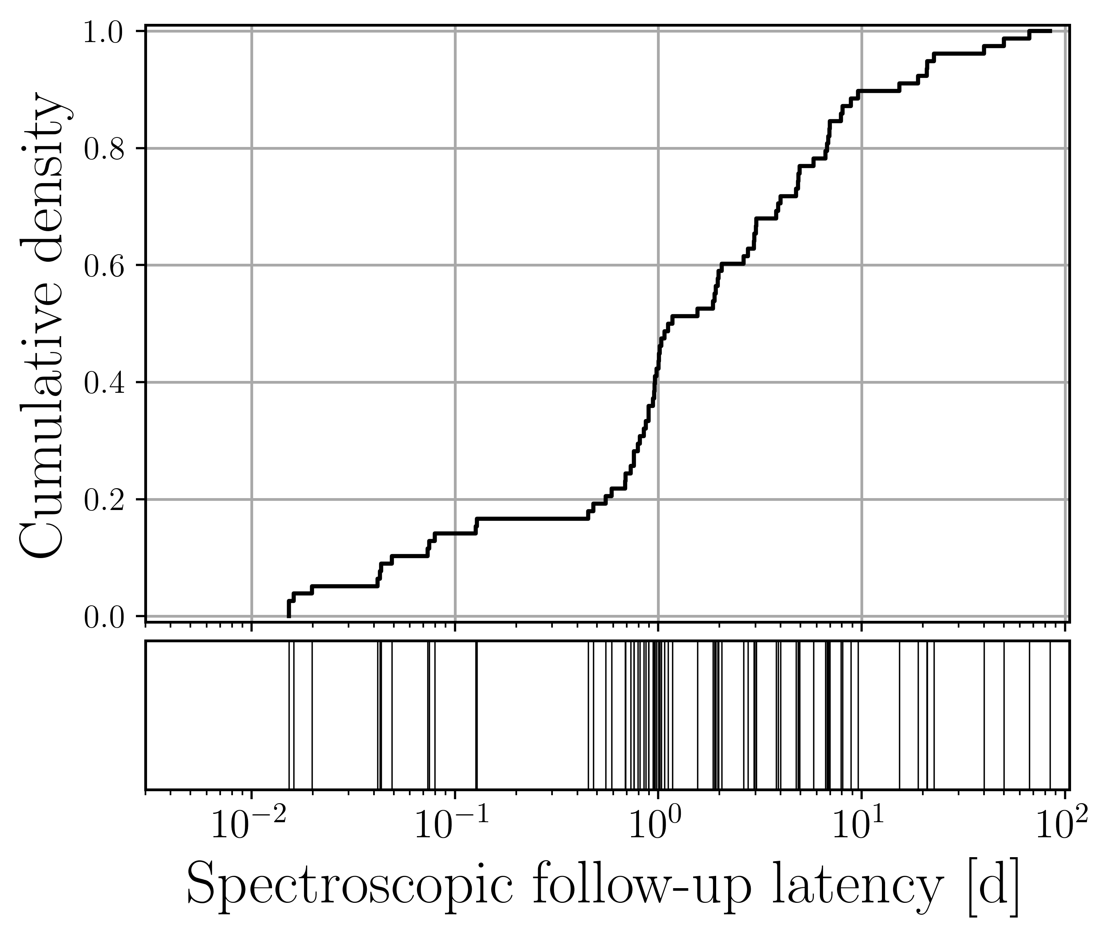
Latency in obtaining spectroscopic observations
First detection
Static alert filter satisfied
Follow-up requested
Follow-up taken
Delay between SN passing basic filters and first spectrum being obtain
We’re missing the earliest spectroscopic information
Rehemtulla+25
Notes:
Latency isn’t unique to UV (i.e. Swift being in space isn’t the reason). Ground-based spectroscopic follow-up is subject to similar latency
This metric is specifically defined to trace latency from “us”

Slide 5
Automating SN identification and follow-up
Achieved for GRBs
SNe are very different
Filtering problem
Typically, $0$ of $𝒪({10}^{5})$ alerts are new nearby SNe
High purity and completeness required
ZTF24abtwpxe in NGC 0955, 24 Mpc
Rehemtulla+24, Rehemtulla+25
Notes:
Full automation is a clear solution for latency, GRB people have achieved this
Doing this for SNe is a very different problem
discovery is in optical, so lots of FPs
very low tolerance for mistakes
Cutouts are NOT from a transient, rather satellite -> this is very challenging

Slide 6
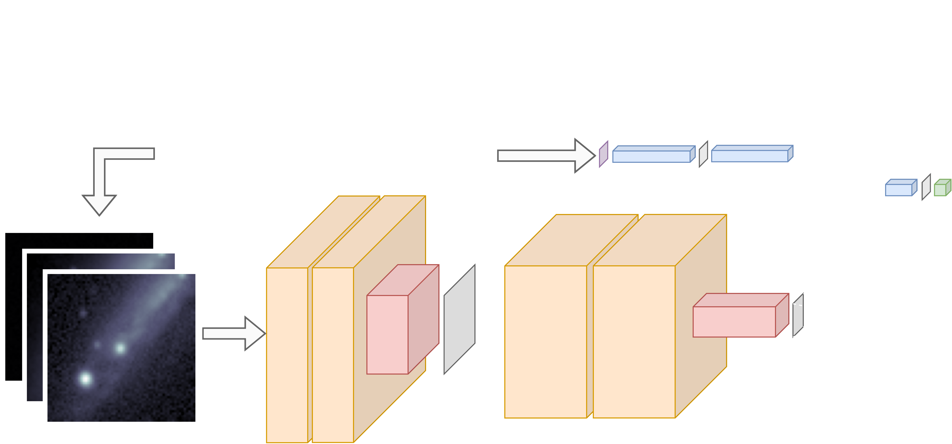
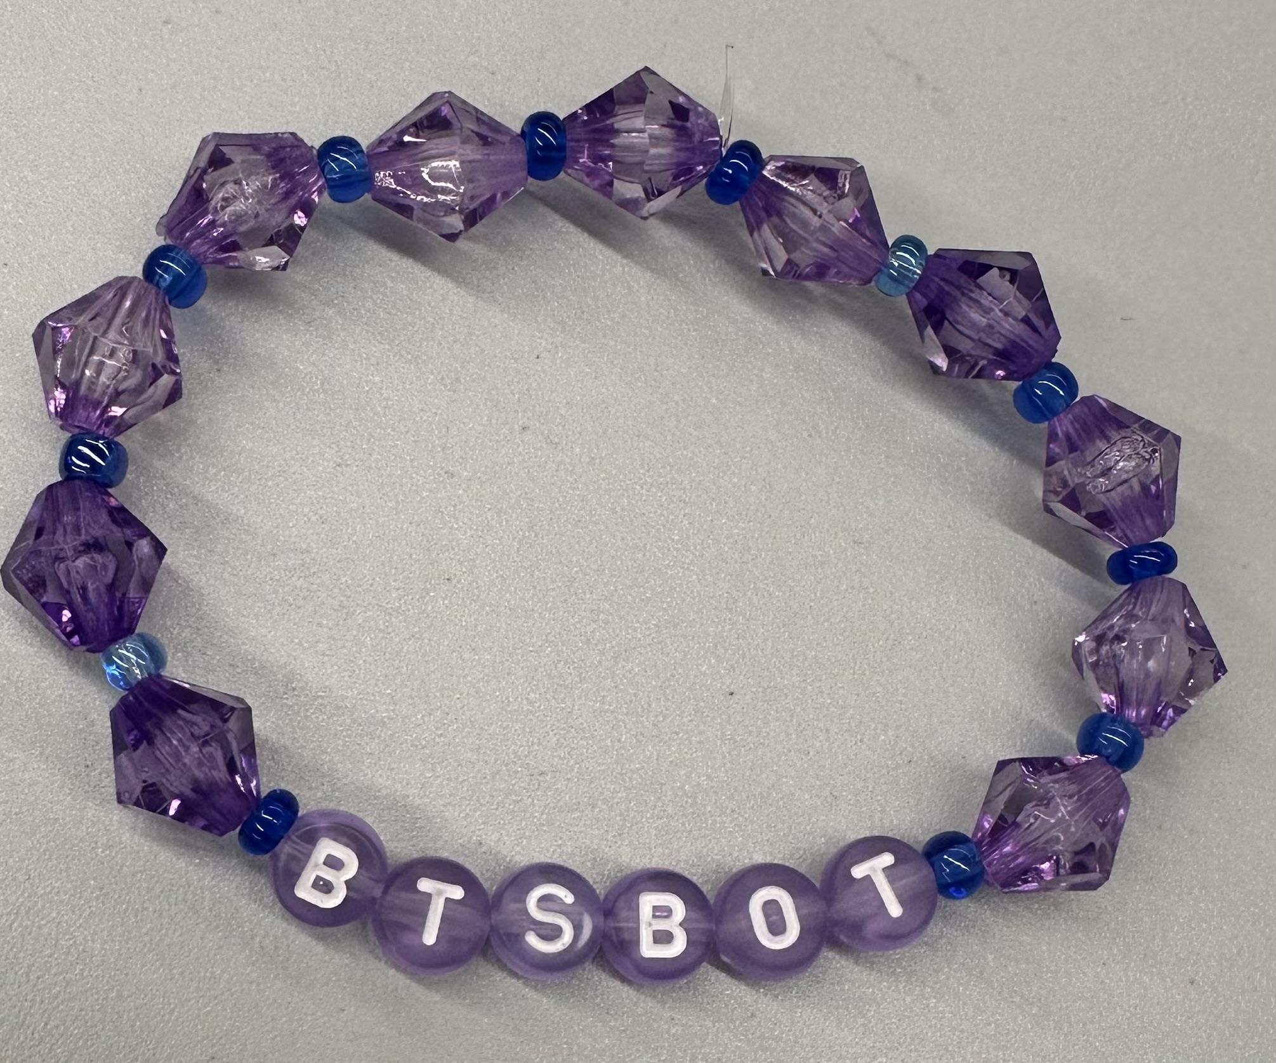
BTSbot-nearby: rapid, autonomous follow-up
Rehemtulla+24, Rehemtulla+25
Notes:
Challenge: make confident inference with minimal data
Multi-modality is the solution

Slide 7
BTSbot-nearby: rapid, autonomous follow-up
Simulated performance from 2021-2024:
95% completeness
93% purity
Filtering on ZTF data stream
Proximity to nearby ($D<60$ Mpc) NED galaxy
Well-constrained age
High BTSbot score
etc.
?
?
?
?
?
Upon satisfying all criteria, automatically send ToO trigger
?
?
Rehemtulla+24, Rehemtulla+25

Slide 8
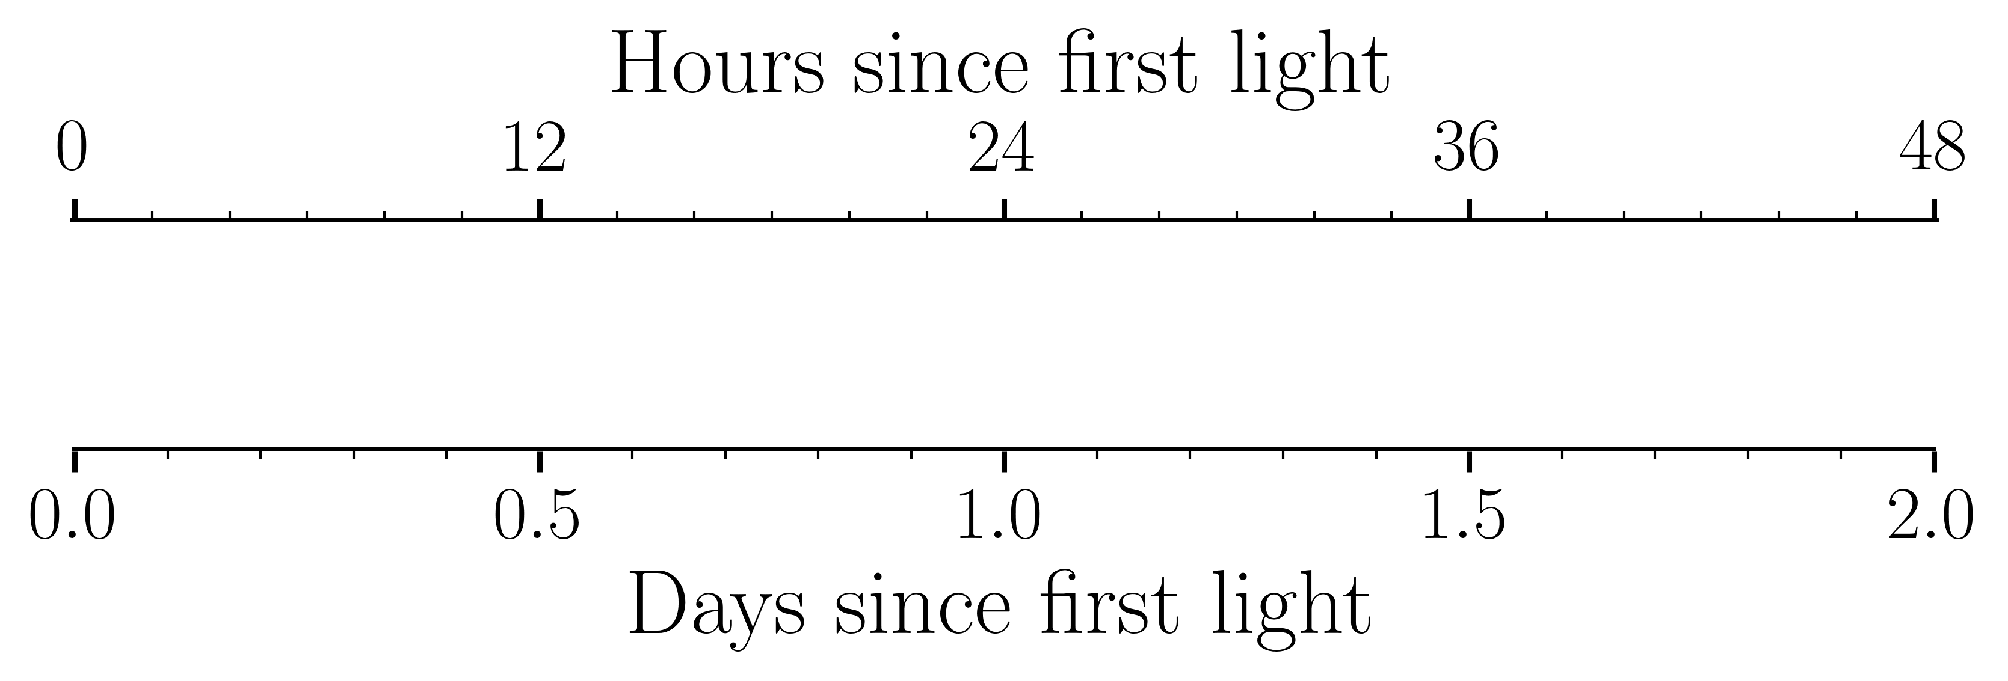
The BTSbot-nearby discovery of SN 2024jlf
Found by BTSbot
Passed SN filters
Found by human
First UV obs.
First spec.
${\text{MJD}}_{fl}=60457.62$ (Rehemtulla+25)
Notes:
First ZTF det
60458.249, 0.63
Filter pass
60458.329, 0.709
BTSbot ID
60458.329, 0.71
Spectrum obtained
60458.334, 0.714
Human ID
60458.397, 0.777
First UV
60458.77
t exp
60457.62

Slide 9
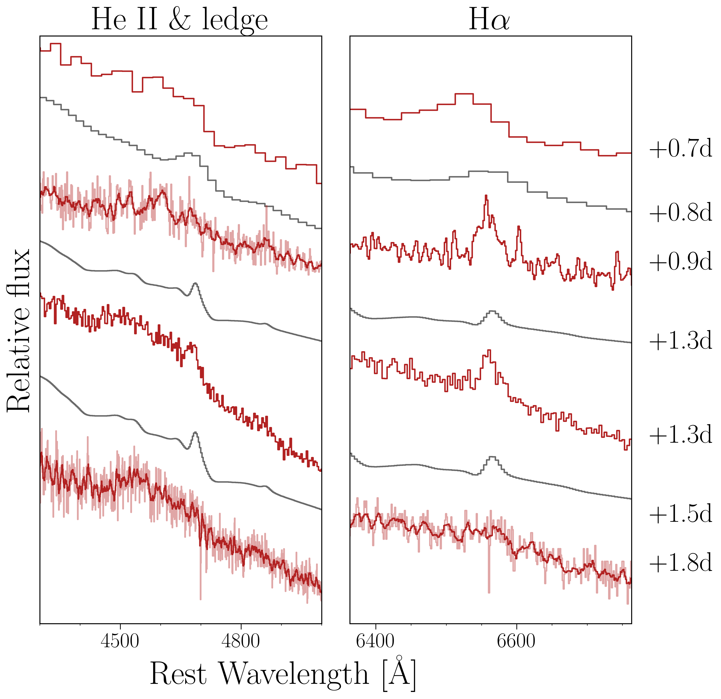
SN 2024jlf : Flash ionization in early spectra
Spectra starting at 0.7 d
H$α$, C IV, He II flashing
$\overset{·}{M}={10}^{−3}{\text{M}}_{⊙}{\text{yr}}^{−1}$ from CMFGEN match
Triggered by BTSbot-nearby
Rehemtulla+25,
Dessart+17, Dessart & Jacobson-Galán 23,
+0.9 d spectrum from G. Hosseinzadeh and GSP

Slide 10
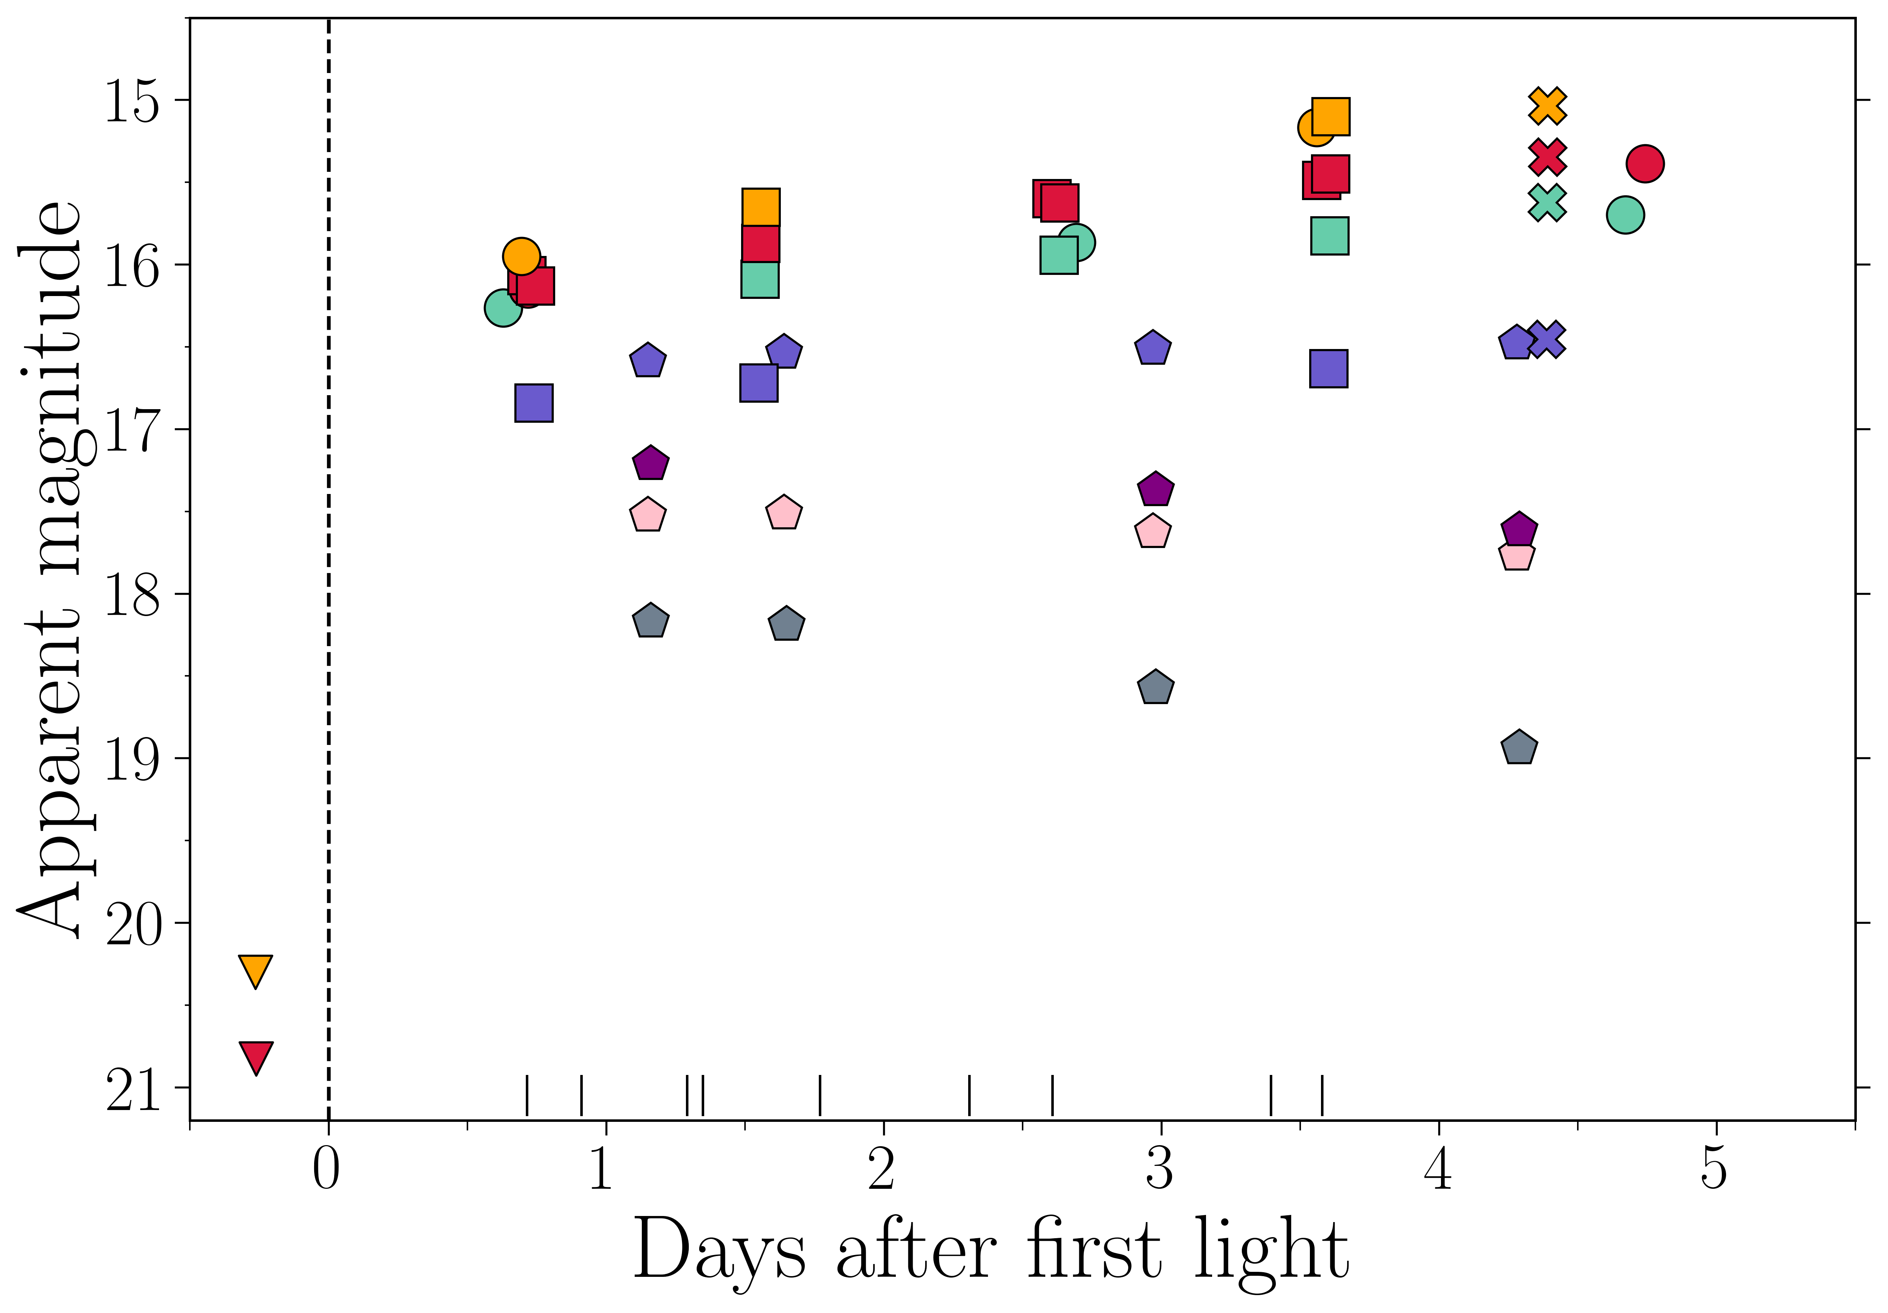
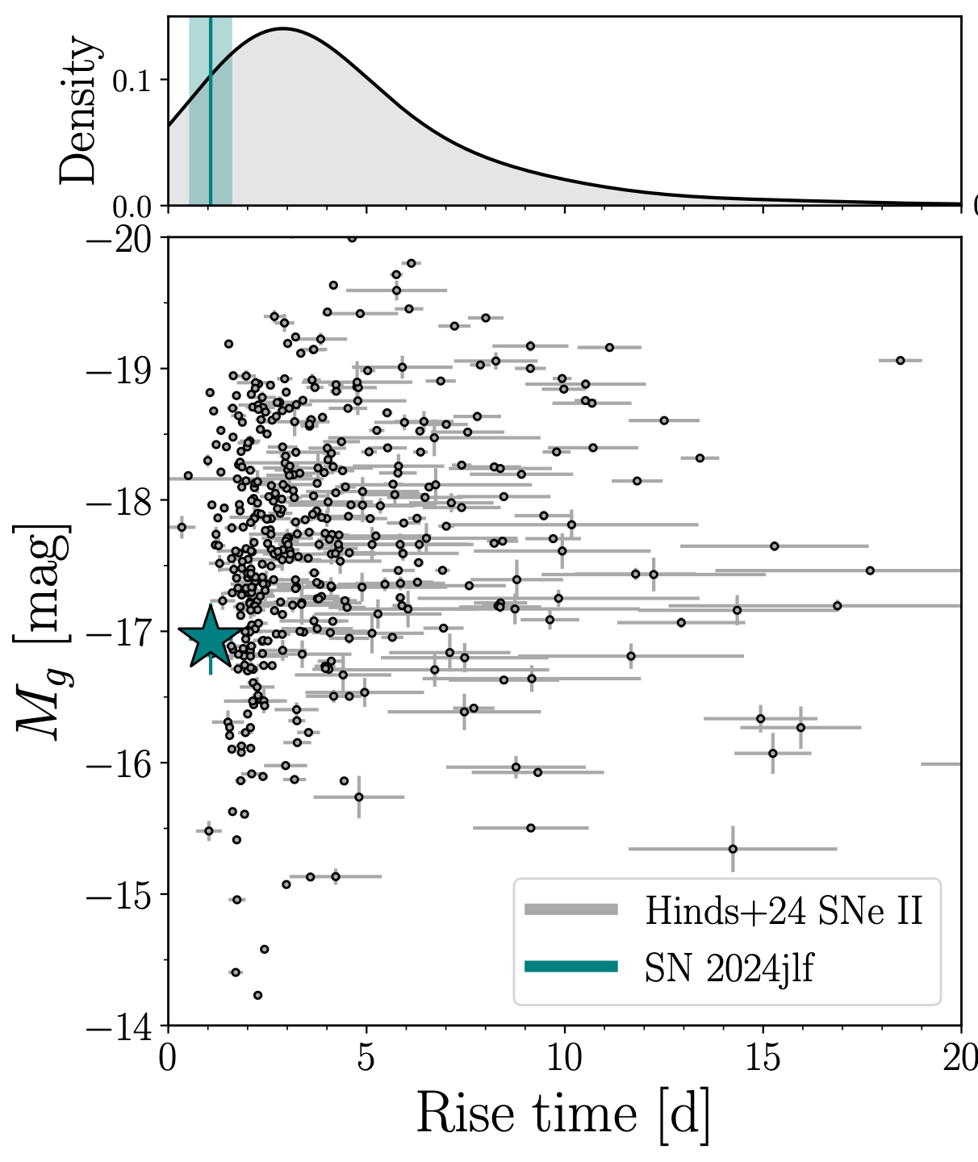
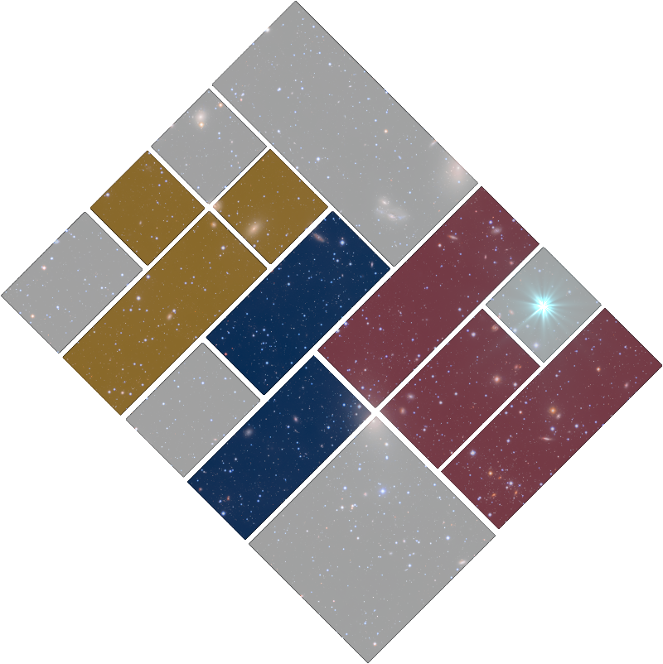
SN 2024jlf : Exceptionally rapid rise
Rehemtulla+25, Hinds+25

Slide 11
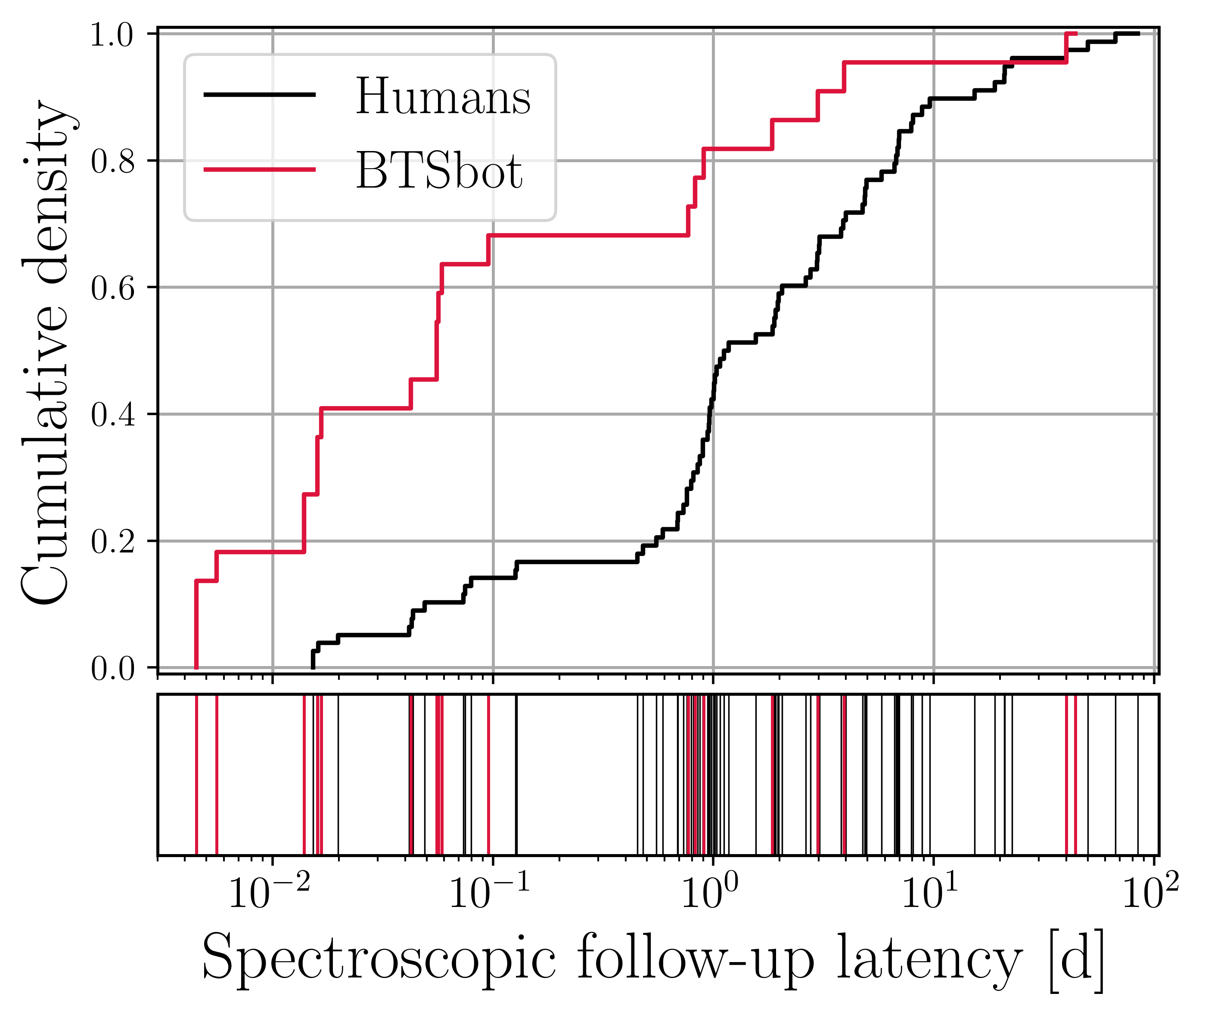
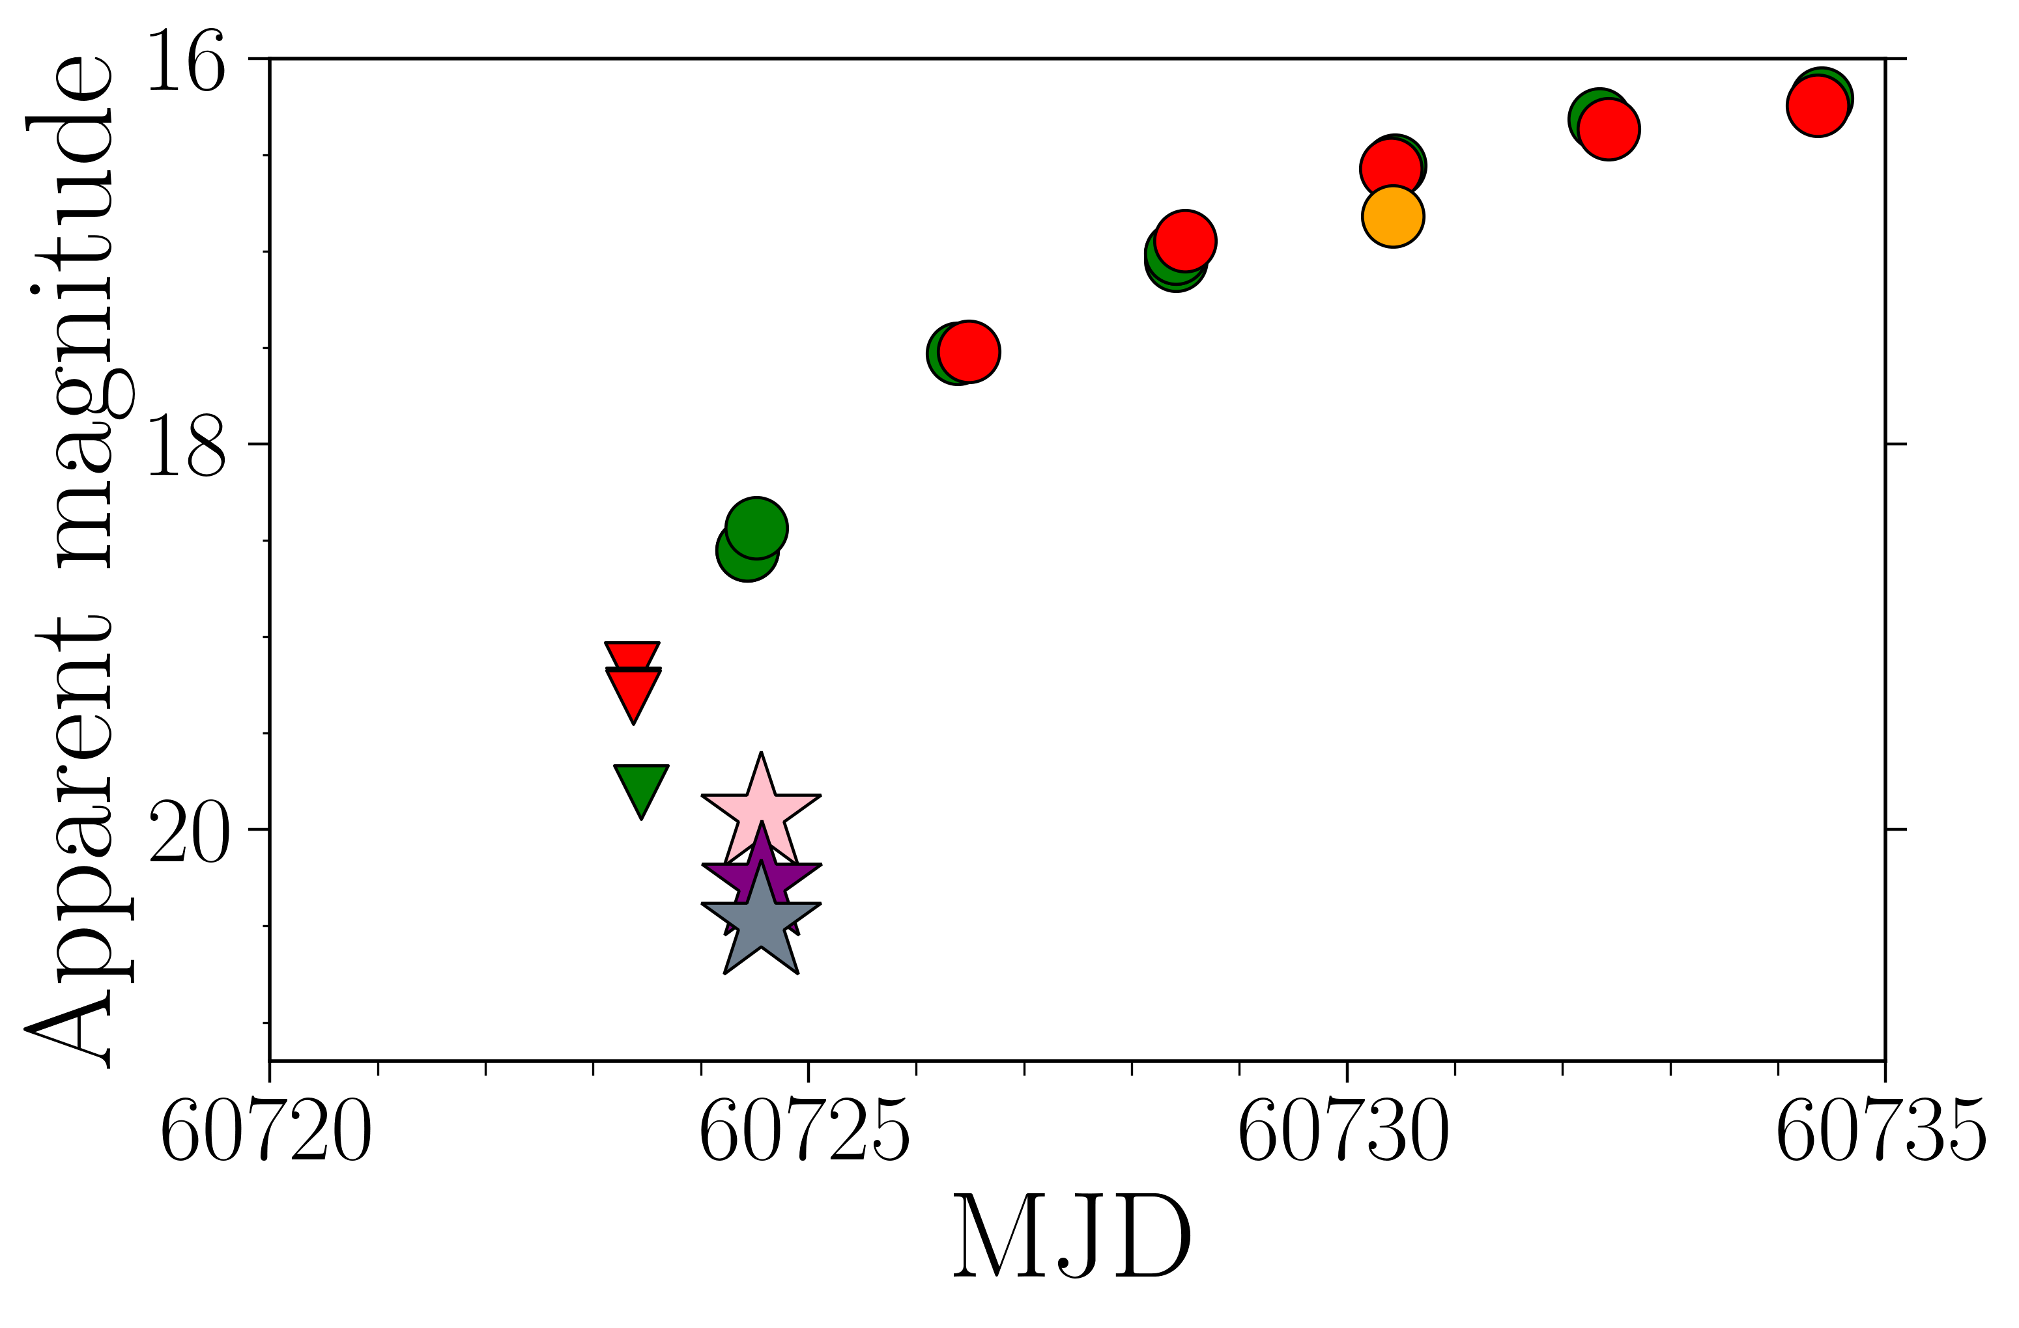
BTSbot-nearby makes ephemeral early-time phenomena accessible
Now triggering Swift
at urgency 0
$<45$ minutes between BTSbot trigger and Swift observation
Rehemtulla+25,
Tohuvavohu+25
Notes:
Add swift citation, double check time stamps
BTSbot trigger 60724.5258
Swift data 60724.556

Slide 12
Summary and future directions
BTSbot achieved full automation of (infant) SN identification and rapid follow-up
More systematically peer into earliest phases of SNe
Able to autonomously trigger Swift, Gemini, LCO, SOAR and soon MMT, SkyNet
12

Slide 13
Backup slides

Slide 14
Light curve properties and modeling
>4 mag/day rise
Faster than 90% of SNe II (Hinds+25)
Normal plateau
Model cannot reproduce initial rise
Overestimates UV
Rehemtulla+25,
Dessart & Jacobson-Galán 23
Notes:
Skip

Slide 15
Case study: SN 2023ixf
First ZTF detection
TNS report
First UV req.
First UV obs.
First spec.
${\text{MJD}}_{fl}=60082.83$ (Mao+2023)
TNS report (Itagaki 2023)
First spectrum (Perley & Gal-Yam 2023)
Notes:
Time of first light
60082.83 (Mao+23)
ZTF det
60083.32, 0.49
TNS report
60083.72, 0.89
UV submitted
60083.80, 0.97
First spectrum
60083.93, 1.1
First UV
60084.46 (wiserep), 1.63

Slide 16
Case study: SN 2024ggi
First ATLAS detection
TNS report
First UV obs.
First spec.
${\text{MJD}}_{fl}=60410.80$ (Shrestha+2024)
TNS report (Tonry+2024)
First spectrum (Zhang+2024)
Notes:
TODO: What was surprising about 24ggi
First light
60410.80 (shrestha+23), 0.34
First detection
60411.14 (shrestha+23)
First UV req (u1)
60411.35, 0.55
TNS report
60411.38 (tonry+23), 0.58
First spectrum
60411.61 (Zhai+24), 0.81
First UV
60411.58, 0.78

Slide 17
Science
Reference
Difference

Slide 18
BTSbot-nearby filtering
<15 kpc from NED galaxy at D<60 Mpc
BTSbot score > 0.7
Any non-detection and two detections within 2.5 days
Absolute magnitude < -11
No detections older than ~10 days
Not on TNS for more than 1.5 days
No classification on TNS
No existing classification, spectrum, or spectroscopic follow-up on Fritz (ZTF marshal)
Does not crossmatch with MPC object
To add/modify
Host galaxy association via DLR
Combine galaxy catalogs
Homogenize cosmology used for galaxy distance estimates
etc.
Rehemtulla+24b
Notes:
Make more clear phase is relative to first light
Early BTSbot obs motivated further, more expensive follow-up (Swift, NOT, etc.)

Slide 19
Physical parameter inference
Progenitor mass loss rate
CMFGEN: ${10}^{−3}M_{⊙}{yr}^{−1}$
STELLA: ${10}^{−4}M_{⊙}{yr}^{−1}$
Other parameters searched over by Moriya+23 grid
$$M_{⋆}=10M_{⊙}$$
$$M_{Ni}=0.04M_{⊙}$$
$$E=1.5×{10}^{51}erg$$
Duration of enhanced mass loss
CMFGEN: $∼1yr$
STELLA:$∼5yr$

Slide 20
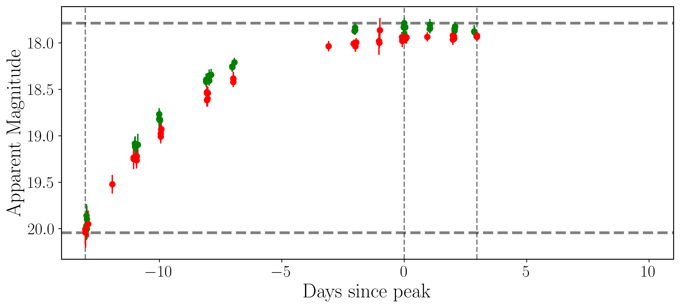
BTSbot architecture - light curve features
age
days_to_peak
days_since_peak
peakmag_so_far
maxmag_so_far
Rehemtulla+24

Slide 21
BTSbot architecture - all metadata features
sgscore{1,2} - Star-galaxy score of nearest two sources PS1-catalog
distpsnr{1,2} - angular distance to nearest two sources PS1-catalog
fwhm - Full Width Half Max
magpsf - PSF magnitude
sigmapsf - 1-sigma uncertainty in PSF magnitude
chipsf - Reduced chi-squared for PSF fit
ra, dec - Right Ascension and Declination
scorr - Peak pixel SNR in detection image
diffmaglim - Limiting magnitude for detection in difference image
ndethist - Number of ZTF detections at this location
chinr - DAOPhot chi parameter of nearest source in reference image
sharpnr - DAOPhot sharp parameter of nearest source in reference image
ncovhist - Number of times candidate appeared on any field and channel
nmtchps - Number of PS1 source matches within 30”
drb - Deep-learning based real/bogus score
sky - Local sky background estimate
days_since_peak - jd current alert minus jd brightest alert
days_to_peak - jd brightest alert minus jd first alert
age - Days since first detection (days_since_peak + days_to_peak)
peakmag_so_far - Brightest PSF magnitude so far
maxmag_so_far - Dimmest PSF magnitude so far
nnondet - Estimate of number of non-detections (ncovhist - ndethist)
zwickytransientfacility.github.io, Rehemtulla+24

Slide 22
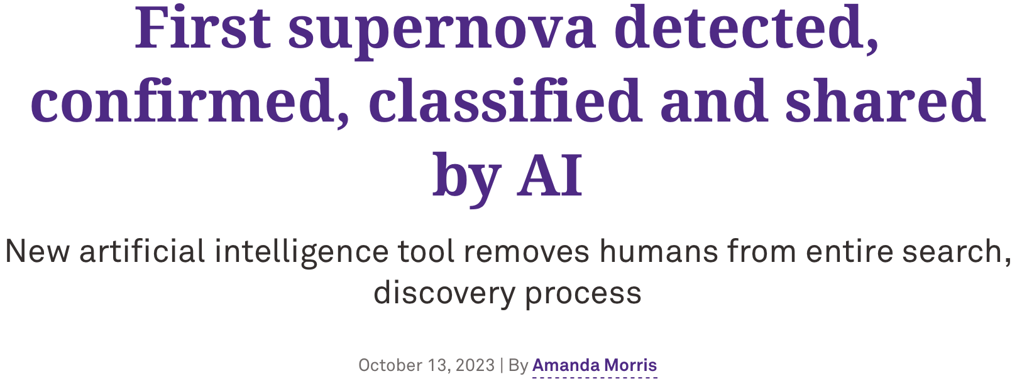
First fully-automated end-to-end discovery and classification
10⁵ alerts
from ZTF
$$→$$
~50 candidate transients
$$→$$
~5-10 new bright transients
$$→$$
Classified bright transients
sgscore
Tachibana & Miller 18
braai
Duev+19
BTSbot
Rehemtulla+24
pySEDM
Rigault+19
SNIascore
Fremling+21
Kowalski
Duev+19
SkyPortal
Coughlin+23
No humans in the loop from ZTF alert to classification on TNS
22

Slide 23
BTSbot-nearby filtering
<15 kpc from NED-LVS galaxy at z<0.014 (~D<60 Mpc)
BTSbot score > 0.7
Any non-detection and two detections within 2.5 days
Real/bogus score > 0.8
Absolute magnitude < -11
No detections older than ~10 days
Not on TNS for more than 1.5 days
No classification on TNS
No existing classification, spectrum, or spectroscopic follow-up on Fritz (ZTF marshal)
Does not crossmatch with MPC object
To add/modify
Host galaxy association via DLR
Combine galaxy catalogs
etc.
Rehemtulla+24b

