Slide 1
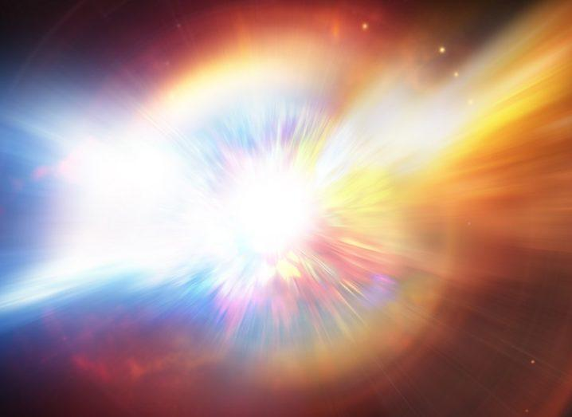
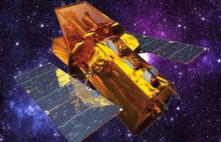
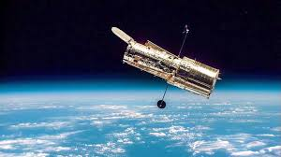


AT2024wpp and Luminous Fast Blue Optical Transients
New Developments from Swift and HST
Daniel Perley
(Liverpool John Moores University)

Slide 2
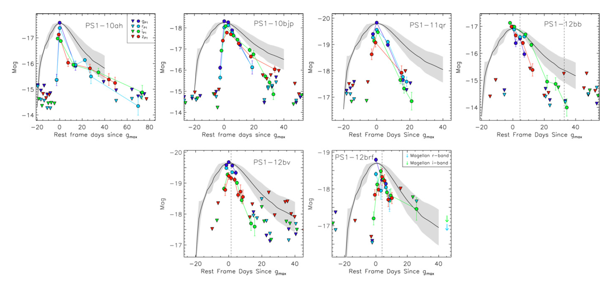
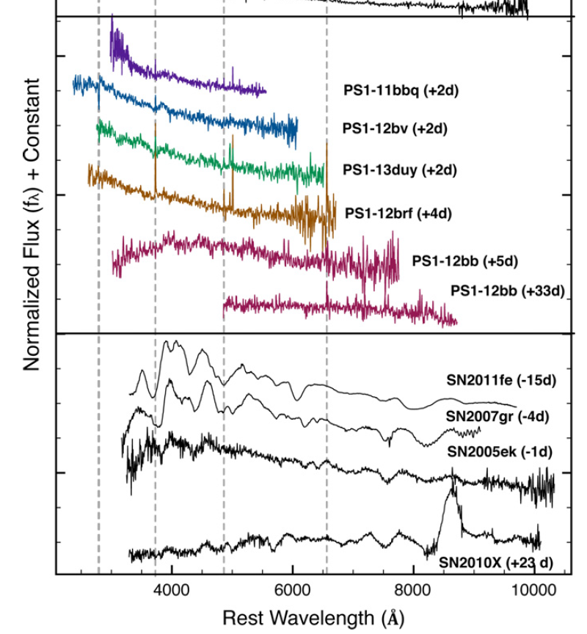
Fast, Blue Optical Transients
Light curves
Spectra
Drout+2014 (Pan-STARRS):
t_{1/2} < 12 days, M_{pk} < -16.5,
blue, featureless peak spectra
Pursiainen+2018 (DES) Rest+2018 (K2)
Tanaka+2016 (Subaru) Ofek+2010 (PTF)

Slide 3
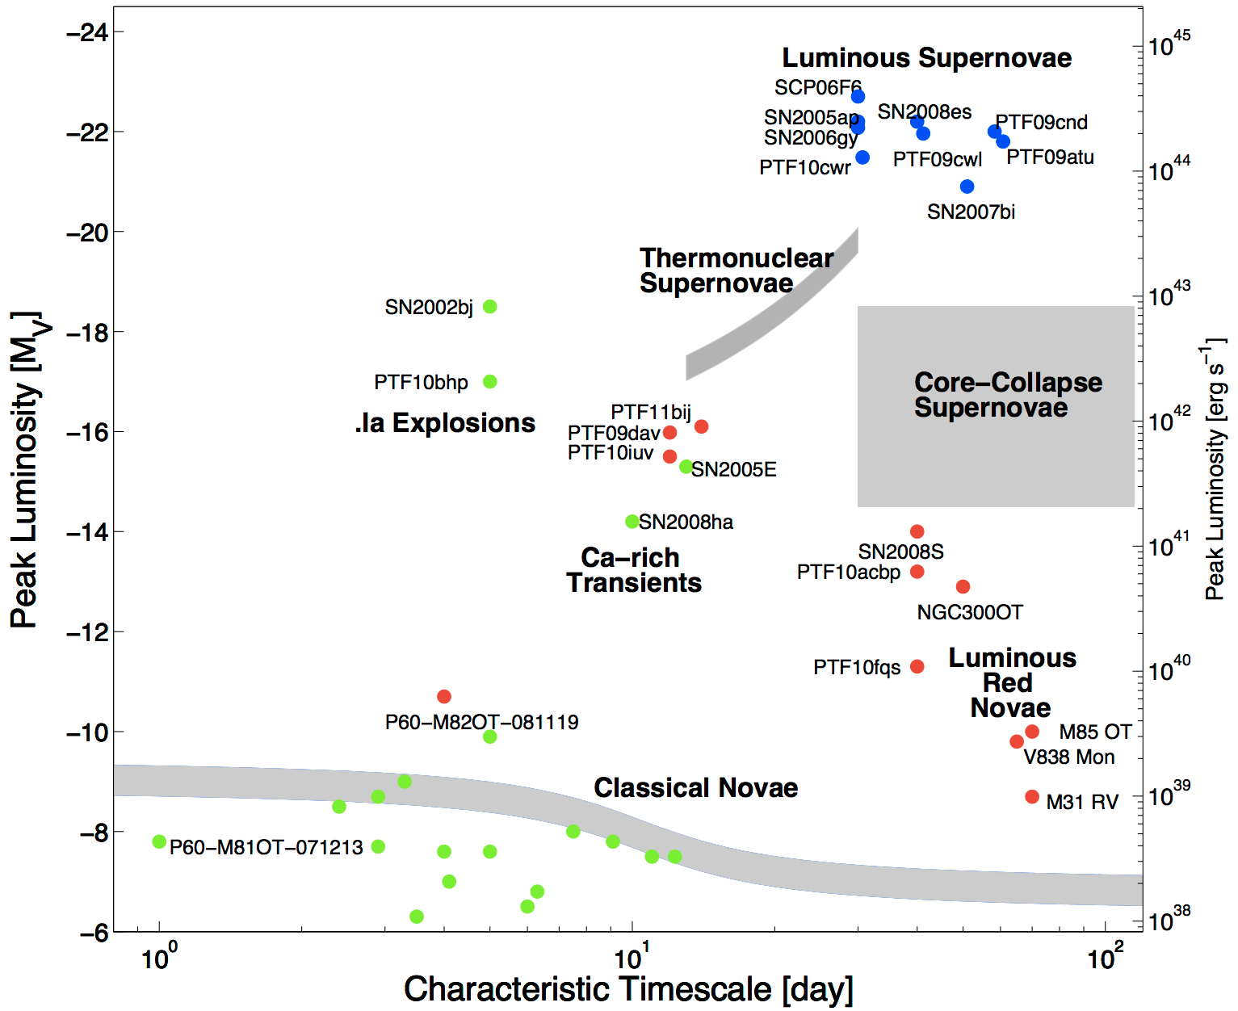
Physical Considerations
GRB afterglows
Too luminous to be nonterminal
Too fast to be radioactively powered
Too slow to be stellar shock breakout
FBOT
Superluminous
SNe
M_{Ni} ~ M_{ej}
M_{Ni} ~ 0.1 M_{ej}
LBV / Imposter
.Ia /
Ca-rich
ECSNe?
KN
Stellar
mergers
→ short-lived interaction with CSM
shell / inflated progenitor ?
Kasliwal+2011

Slide 4
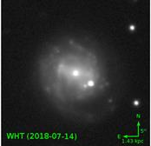

AT2018cow
Extremely fast rise (~2 days)
Persistently hot SED; shrinking photosphere
No recognizable broad features (even in UV)
Intermediate-width H/He lines at t > 15d
Luminous X-rays with <day variability
Luminous self-absorbed radio/mm
Hot/blue, sub-AU "remnant" at >1 year
Off-nuclear location
Prentice+2018
Perley+2019
Margutti+2019
Kuin+2019
Rivera Sandoval+2019
Ho+2019
Sun+2022
Ikenhaag+2022

Slide 5
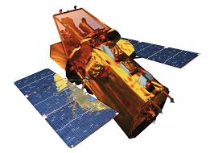
AT2018cow
Extremely fast rise (~2 days)
Persistently hot SED; shrinking photosphere
No recognizable broad features (even in UV)
Intermediate-width H/He lines at t > 15d
Luminous X-rays with <day variability
Luminous self-absorbed radio/mm
Hot/blue, sub-AU "remnant" at >1 year
Off-nuclear location
Prentice+2018
Perley+2019
Margutti+2019
Kuin+2019
Rivera Sandoval+2019
Ho+2019
Sun+2022
Ikenhaag+2022

Slide 6
Origins of AT2018cow
Fast rise, high luminosity: very energetic event
Fast variability: compact engine
Rapid optical fade, no lines: little ejecta
Radio/mm: "bubble" of pre-existing material
UV remnant / late flares: long-lived engine
Ho+2019, Margutti+2019, Pasham+2022
Ho+2019, Margutti+2019, Pasham+2022
Prentice+2018, Perley+2019, Margutti+2019, ...
Ho+2019, Margutti+2019, Ho+2023a ...
Sun+2022,2023, Inkenhaag+2023, Migliori+2023
Very unusual core collapse?
(failed "SN"?)
Perley+2019, Margutti+2019, Ho+2019, Gottleib+2022
Very unusual TDE?
(IMBH? / stellar BH?)
Perley+2019, Kuin+2019, Metzger+2022

Slide 7

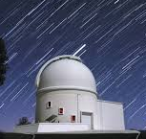

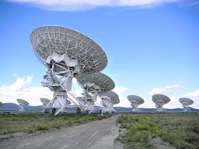
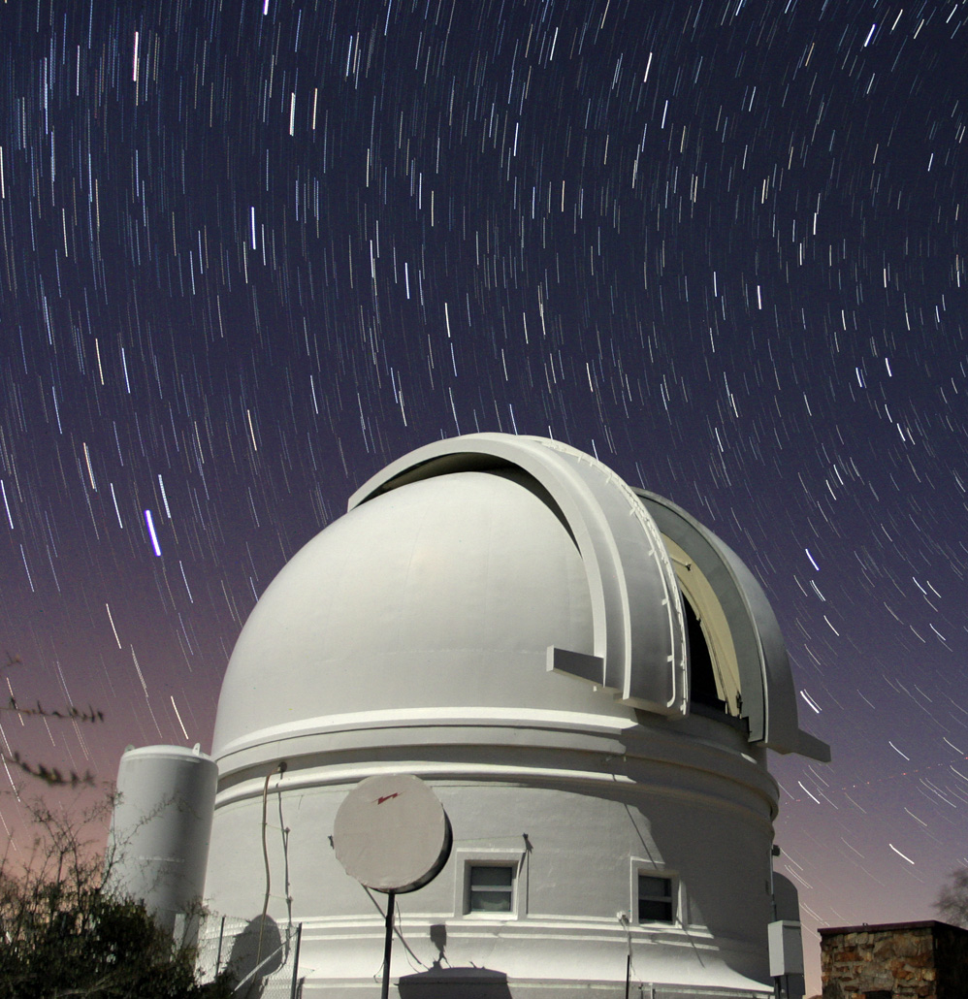
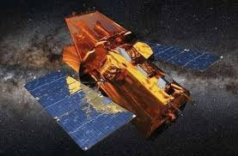
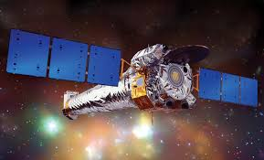
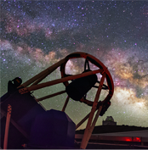
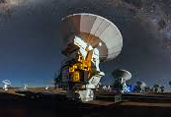
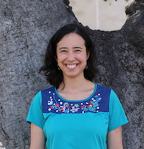
Expanding the Herd with ZTF and Swift
P60/SEDM
P48/ZTF
Swift
Liverpool Telescope
Find fast-rising
blue transient
Check for X-rays,
measure temperature
Anna Ho
(Cornell)
Confirm fast fade

Slide 8
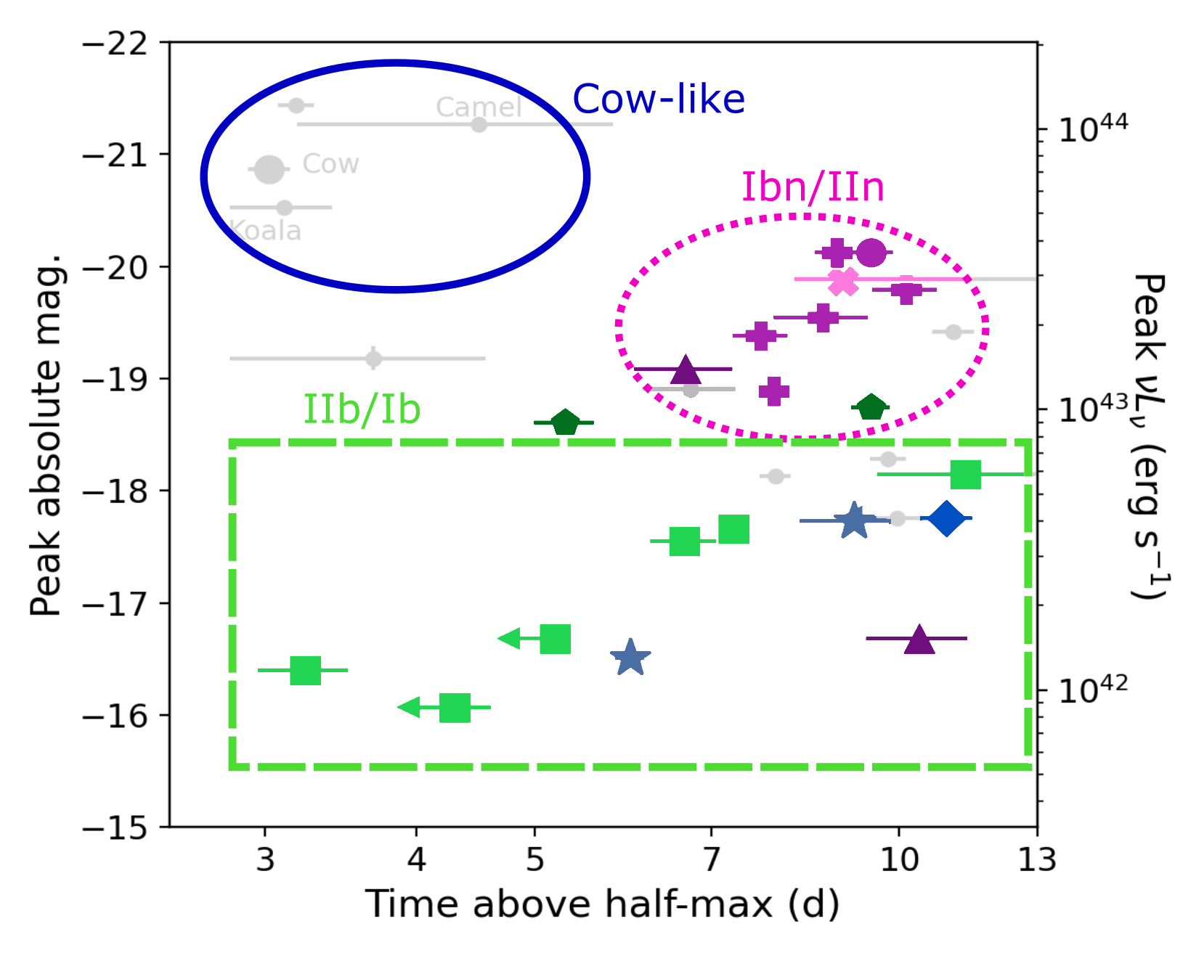
Parameter Space for "FBOTs"
LFBOT:
featureless,
radio-loud,
X-ray bright,
no SN develops
("cow-like")
Ibn/Icn (+IIn/Ic-BL):
Slower, interaction driven; no radio or X-rays, (usually) strong emission lines
II
IIb
IIn
Ibn/Icn
Ib
Ic
Ic-BL+int
featureless
IIb/Ib:
Stripped progenitor w/inflated envelope
Ho+2021

Slide 9
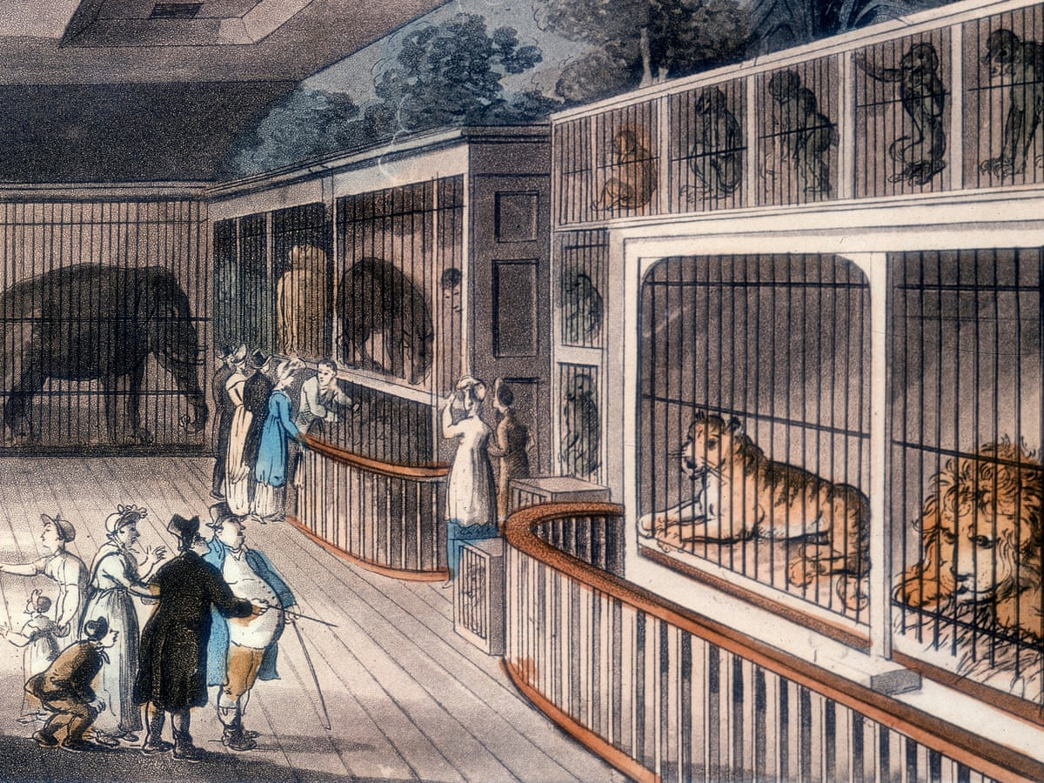
A Growing Menagerie
14 "Cow-like" events
CSS161010
AT2018cow ("Cow")
AT2018lug ("Koala")
AT2020xnd ("Camel")
AT2020mrf / SRGe J154754.2+443907
AT2021ahuo
AT2022tsd ("Tasmanian Devil")
AT2022abfc
AT2023fhn ("Fawn" "Finch")
AT2023hkw
AT2023vth
AT2024qfm
AT2024wpp ("Whippet")
AT2024aehp
Coppejans+2020,Gutierrez+2024
Ho+2020
Perley+2021
Yao+2022
Ho+2023
Chrimes+2023

Slide 10
Insights from Samples
In general: not much variation. Properties remain fundamentally distinct from other optical transients:
  No detections of broad lines
  No detections of a SN "bump", temp. remains hot
  Radio is always luminous, peaks in mm band
  X-ray is always luminous (behaviour varies a lot)
  Always in star-forming galaxies, usually in dwarfs, rarely/never from the nucleus
R_{FBOT} ~ 10⁻⁴ to 10⁻³ R_{cc}

Slide 11
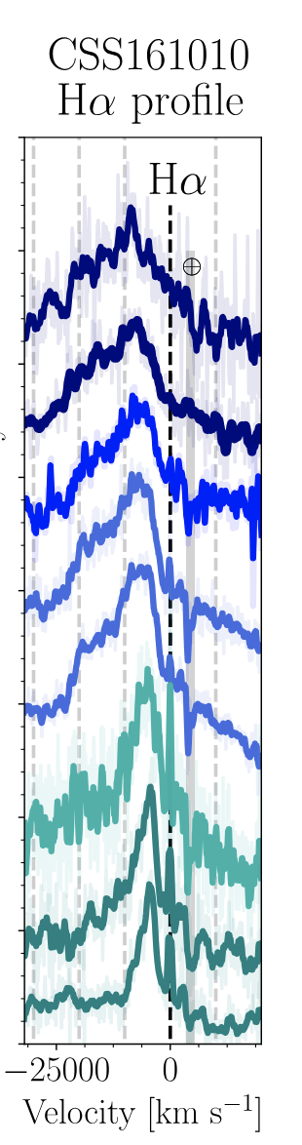
Insights from Individuals
Net blueshifted H lines from CSS161010
(pre-explosion stream at 8000 km/s...?)
Fast/luminous optical flares from AT2022tsd
(compact, long-lasting, unstable engine)
Gutierrez+2024
Ho+2023

Slide 12
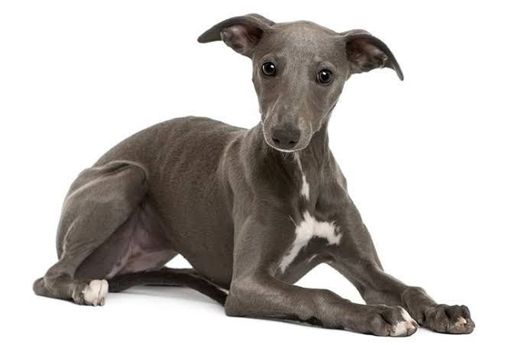
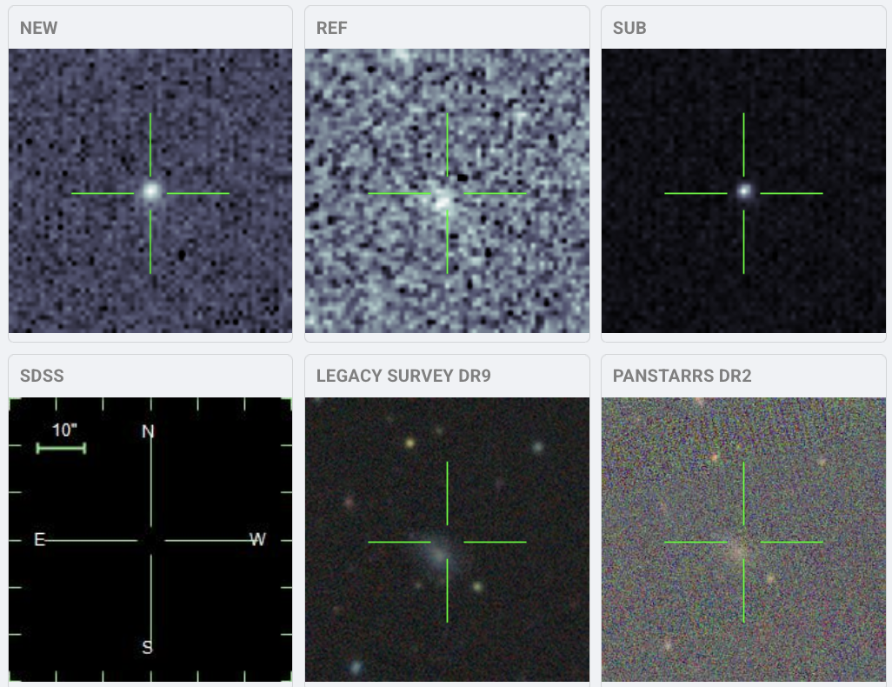
AT2024wpp (ZTF24abjjpbo)
whippet
"Nearby" (z=0.087),
recent LFBOT
Identified before
peak
HST spectrum
obtained at 20 d
AT2024wpp
Absolute Mag
Magnitude (AB)
W2
u
g
r
i
← HST spectrum
AT2018cow

Slide 13
HST (+NOT) spectrum
COS
STIS
ALFOSC

Slide 14
HST (+NOT) spectrum
19000 K blackbody
ISM lines
Ly-α

Slide 15
HST (+NOT) spectrum
SN 2021csp
(Icn)
High-velocity CSM lines (for comparison)

Slide 16
HST spectrum
SN 2021csp
(Icn)
High-velocity CSM lines (for comparison)

Slide 17
HST spectrum
2023ixf

Slide 18
HST spectrum
ASAS-SN14li
(TDE)

Slide 19
Featureless UV: Implications
Implies a thin / homogeneous optical "surface"
  Less likely: high orbital velocity, no UV species?
No dense wind above photosphere – contrary to expectations of stellar model
  But: radio indicates a less dense bubble is present
More evidence for an engine/accretion (not interaction) origin for late UV/optical power

Slide 20
Summary
LFBOTs: A genuinely new phenomenon
Shared set of properties: persistently hot, X-ray luminous, X-ray variable, radio luminous, dwarf star-forming hosts
Increasing challenges for stellar models
Fast and flexible UV/X-ray capabilities are vital!

Slide 22
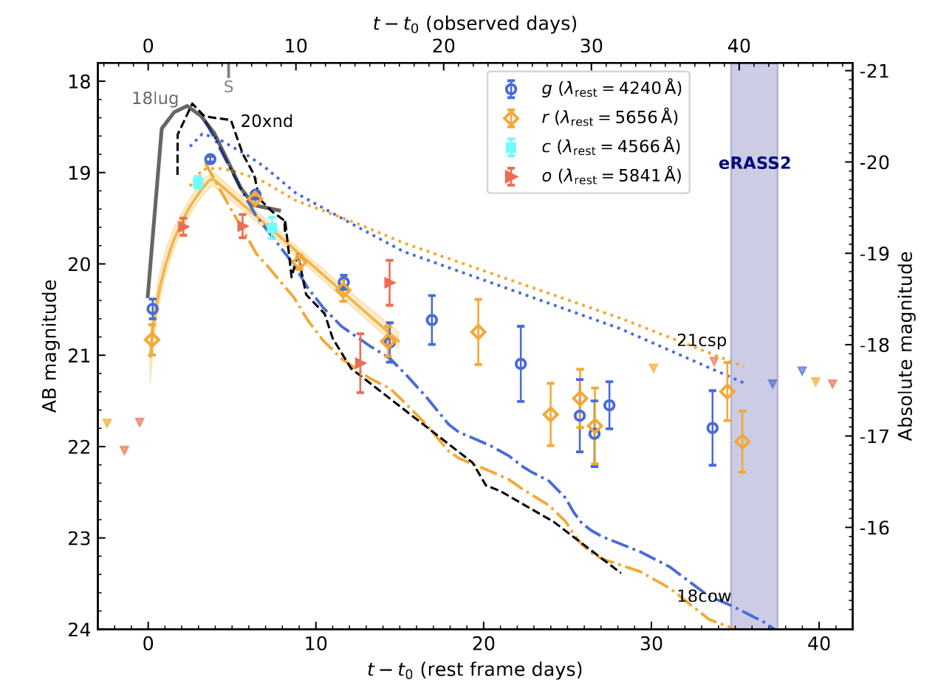

Optical Properties: Limited Variation
-21
-20
-19
-18
-17
-16
-15
Key features of 2018cow: fast rise, high luminosity, fast fade, no SN "bump"
Mostly, not entirely, generic
Koala
Taz
1998bw
(Ic-BL)
Absolute magnitude
20mrf
Finch
Camel
Cow

Slide 23
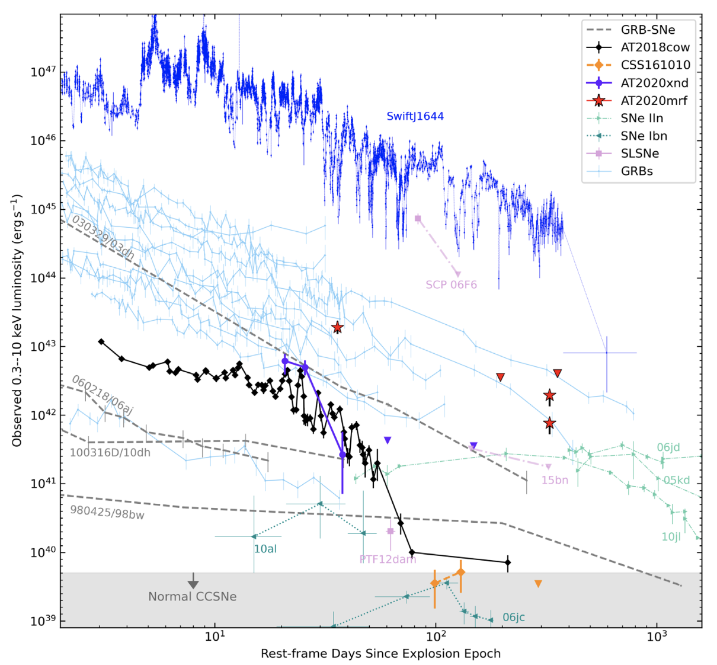
X-Rays: More Variety
All optically cow-like transients with deep X-ray observations are similarly luminous
Some are more luminous (esp. late!)
Variability less clear, but probably present (→ engine)
Relativistic TDE
GRB Afterglows
X-Ray luminosity (erg/s)
Taz
2020mrf
Camel
vth
Finch
Energetic SNe
Cow
IIn
?
Normal CCSNe
CSS161010
High-quality spectroscopy/ timing has not been possible
Modified from Yao+2022

Slide 24
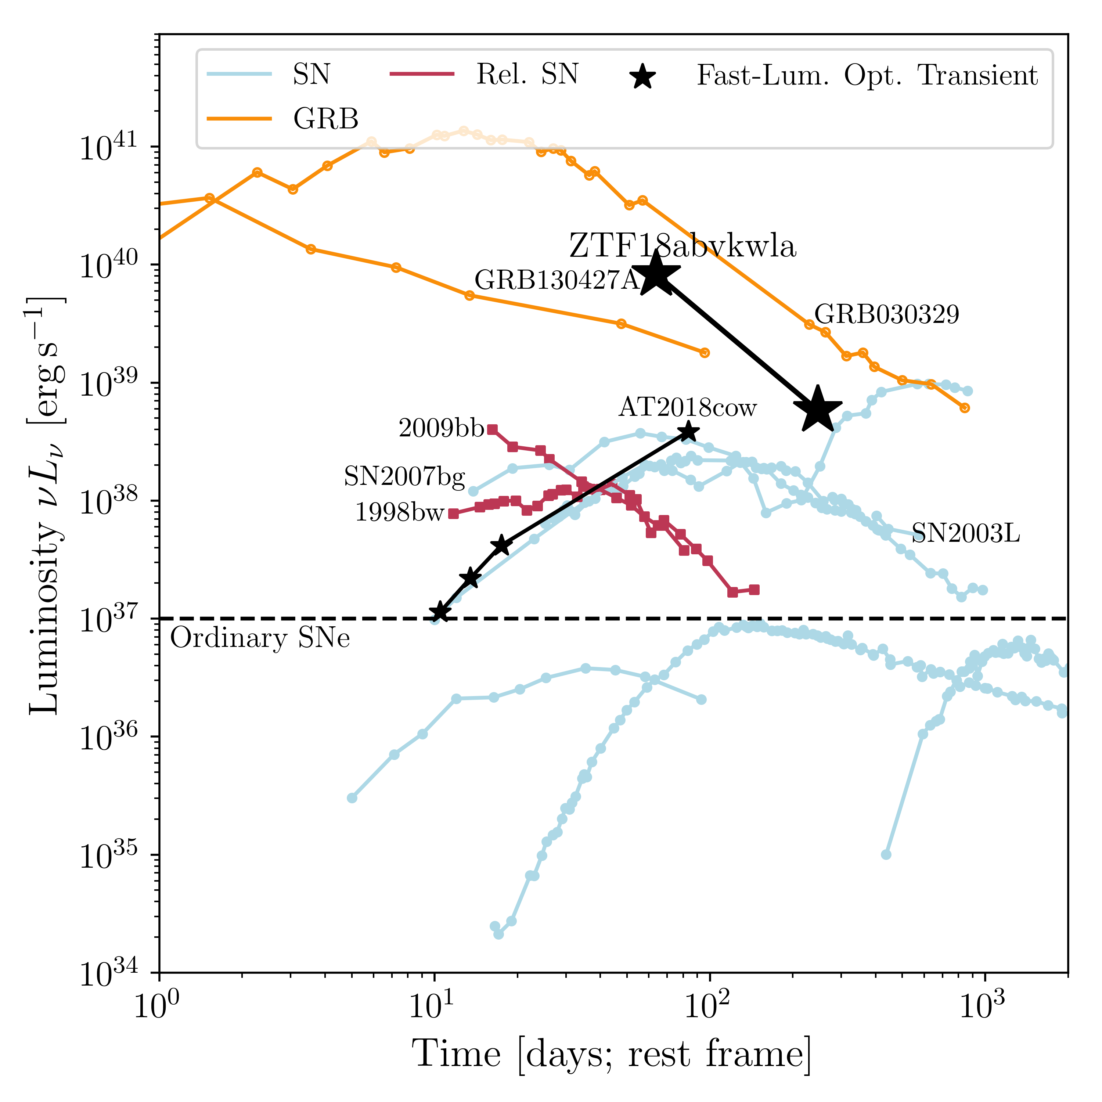
Radio
Most other LFBOTs: more luminous than 18cow!
F_{ν} peak always at high freq.* → dense/compact, mildly relativistic
Usually fades abruptly starting at a few months
→ CSM outer "edge"
GRB Afterglows
Coppejans+2020, Ho+2020,2022, Bright+2022
Camel
Koala
20mrf
Radio luminosity (erg/s)
Taz
Relativistic SNe
Cow
Normal CCSNe
CSS161010
* But, not always F_{ν} ~ ν^{2-2.5} below peak
Modified from Ho+2020

Slide 25
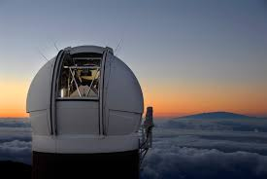
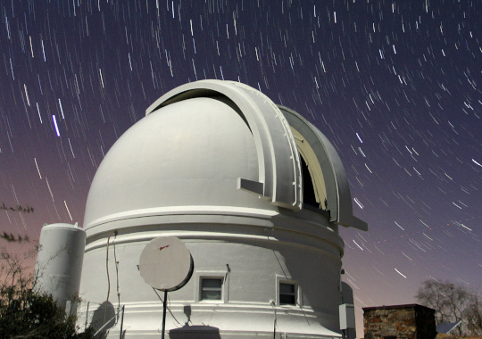
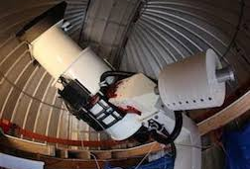
The Timescale-Luminosity Diagram
GRB afterglow
Pan-STARRS
10⁴⁸
-30
Orphan
afterglows
SLSN
PTF / ZTF
10⁴⁴
-20
"FBOT"
/"RET"
Ia
Ib/c
II
Peak absolute magnitude
KN
ILRT /
LRN
LBV
eruption
ATLAS
10⁴⁰
-10
nova
Dwarf nova
+ASAS-SN, TESS, ...
10³⁶
0
1hr
1d
10d
100d
Kasliwal+2011
Villar+2017
Inserra+2019
L_{peak}
(erg/s)
Characteristic timescale

Slide 26
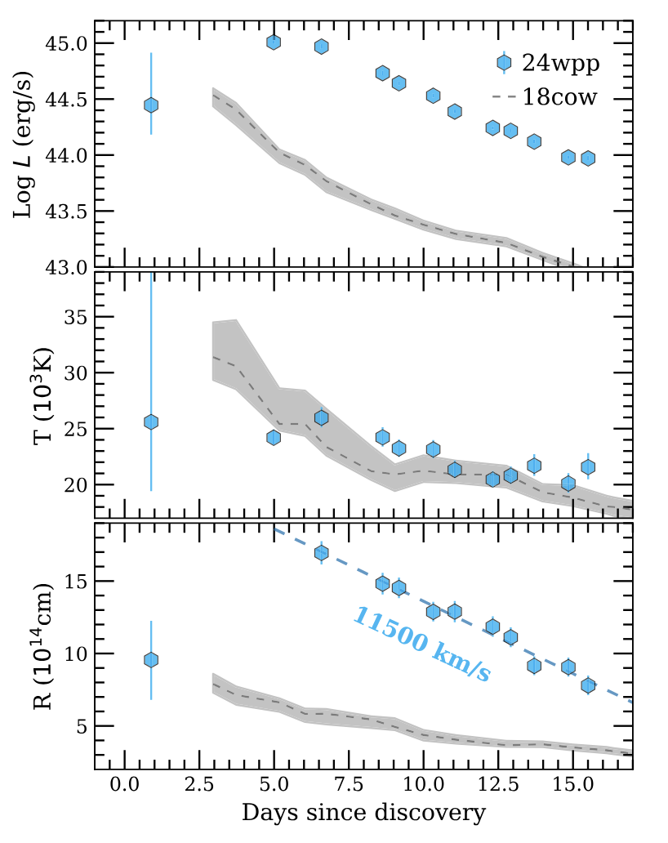
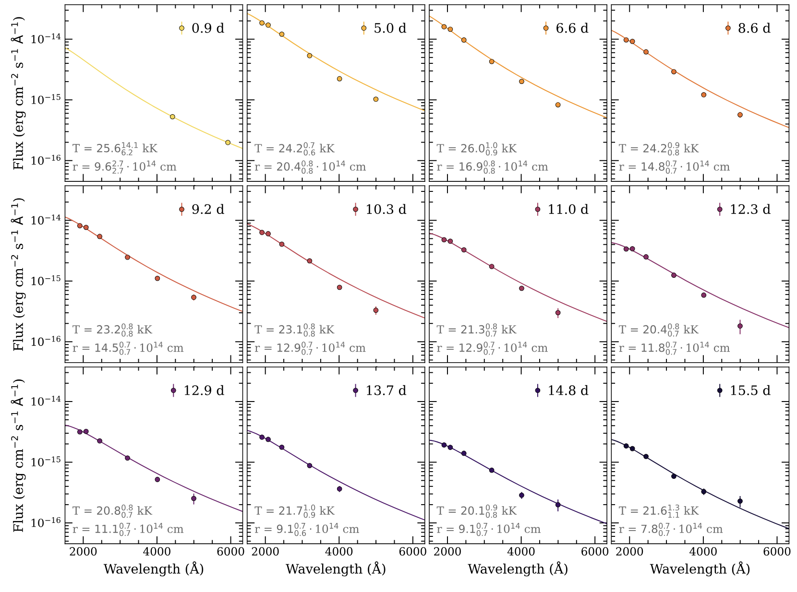
2024wpp Blackbody Evolution
Pursiainen+2025

