Slide 1
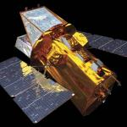


Swift20 – Florence 2025
Gamma-ray burst science at ESO enabled by 20 years of Swift
Nial Tanvir
Notes:
Key results:
090423
080319B ?
190114C
221009A
240315A

Slide 2
Key results:
060218
090423
080319B ?
190114C
221009A
TOUGH / SHOALS ?? / BAT6
UVES lines
SN2008D
Metallicities / NH ?
Anything La Silla / GROND ? / Dk1.5 / VISTA / ALMA ??
The contributions of ESO to Swift followup over 20 years

Slide 3

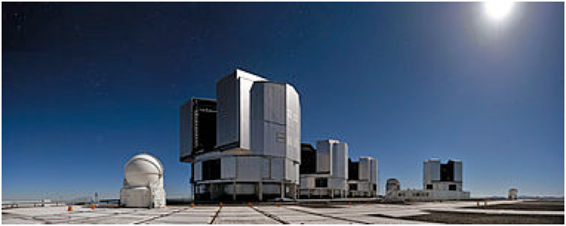
European Southern Observatory
Premier observatories at Paranal and La Silla
VLT – 4 x 8m optical/IR
Broad range of state-of-the-art instruments
X-shooter spectrograph, main work-horse 0.35-2.5 um
Rapid Response Mode for automatic triggers
Much observing done in service
40% of Swift redshifts from VLT

Slide 4
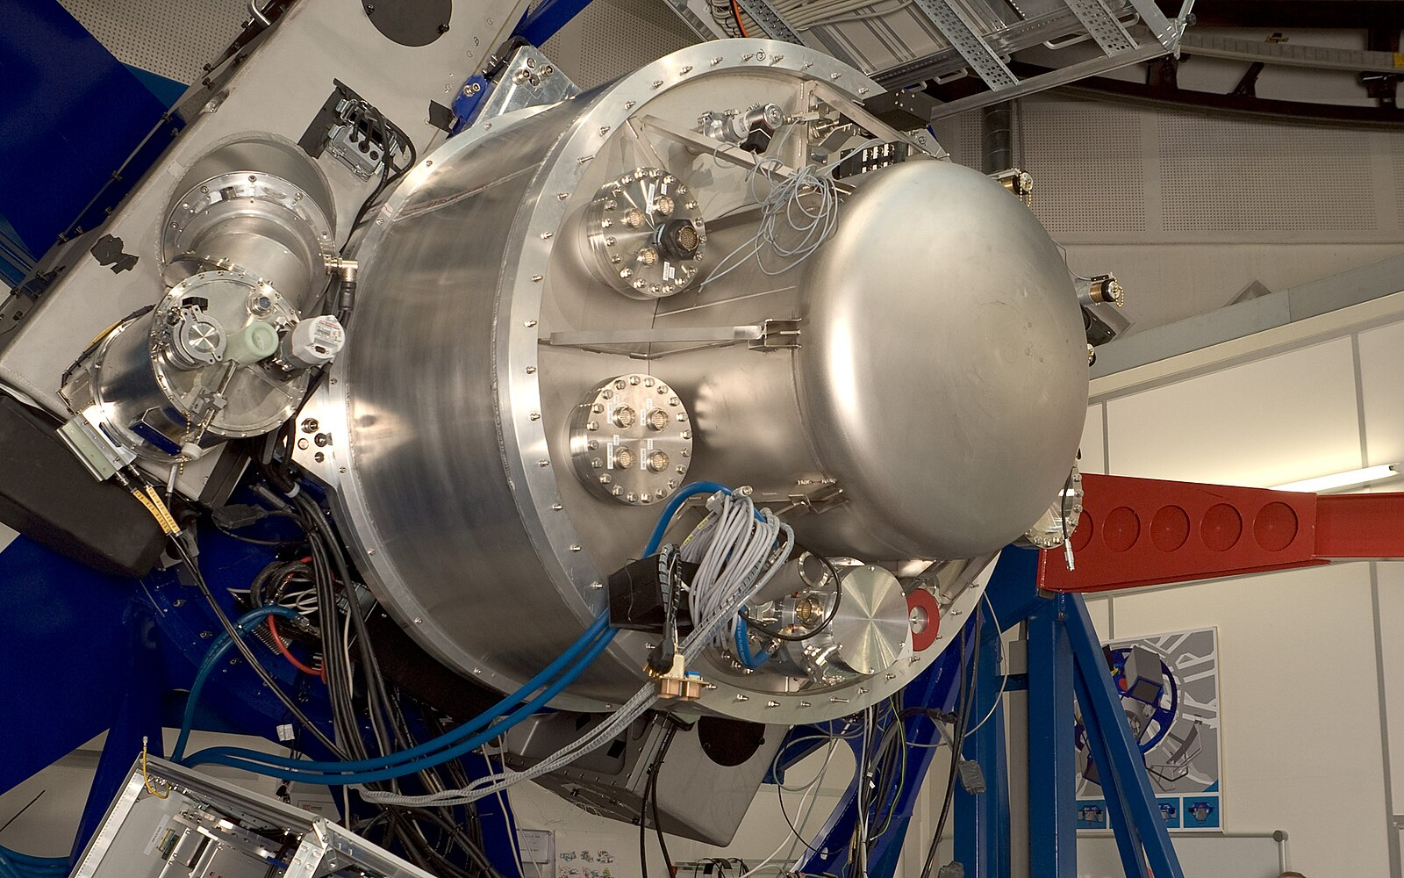
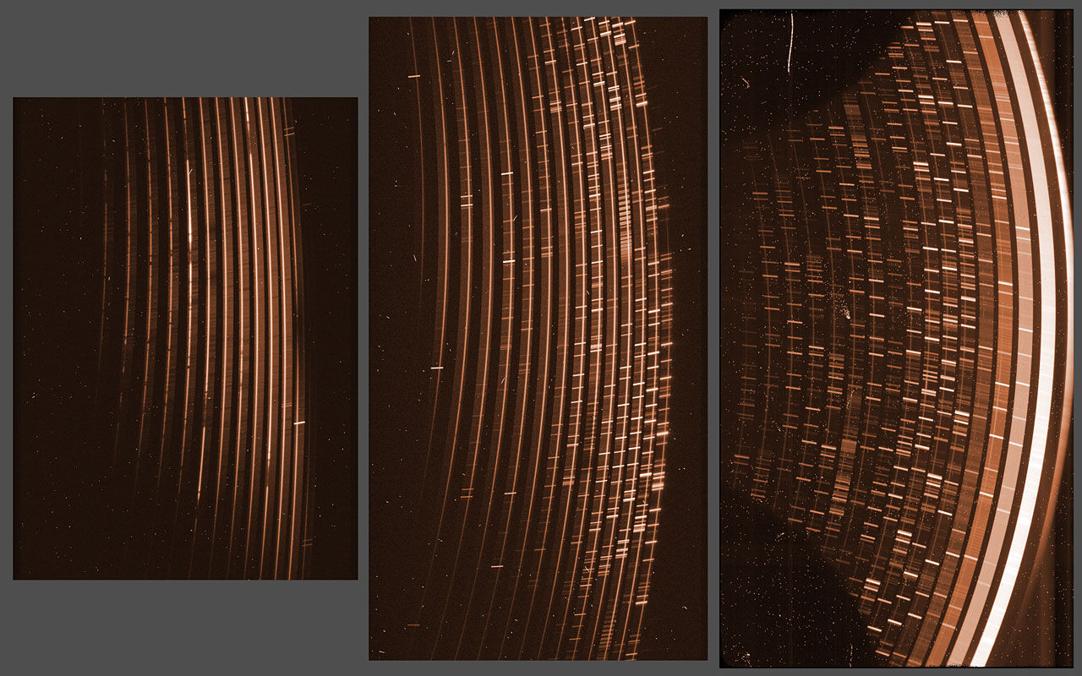
3 arm: UVB, VIS, NIR
Cross dispersed, medium resolution
Wavelength range ~0.35 to 2.5 um
X-Shooter
Ideal afterglow machine

Slide 5
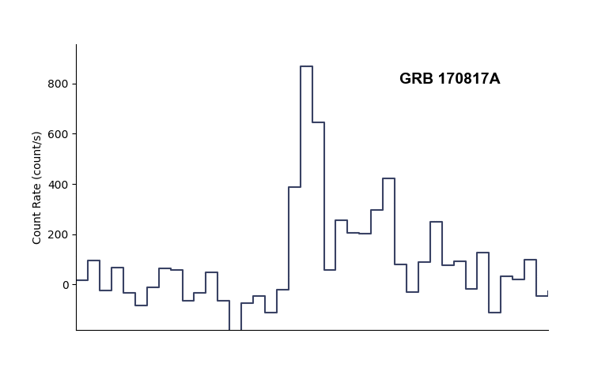
GRB 221009A
Brightest ever detected GRB discovered!

Slide 6
GRB 221009A
“Once per millennium” event!
GRB sample seen by Fermi /GBM in 15 years

Slide 7
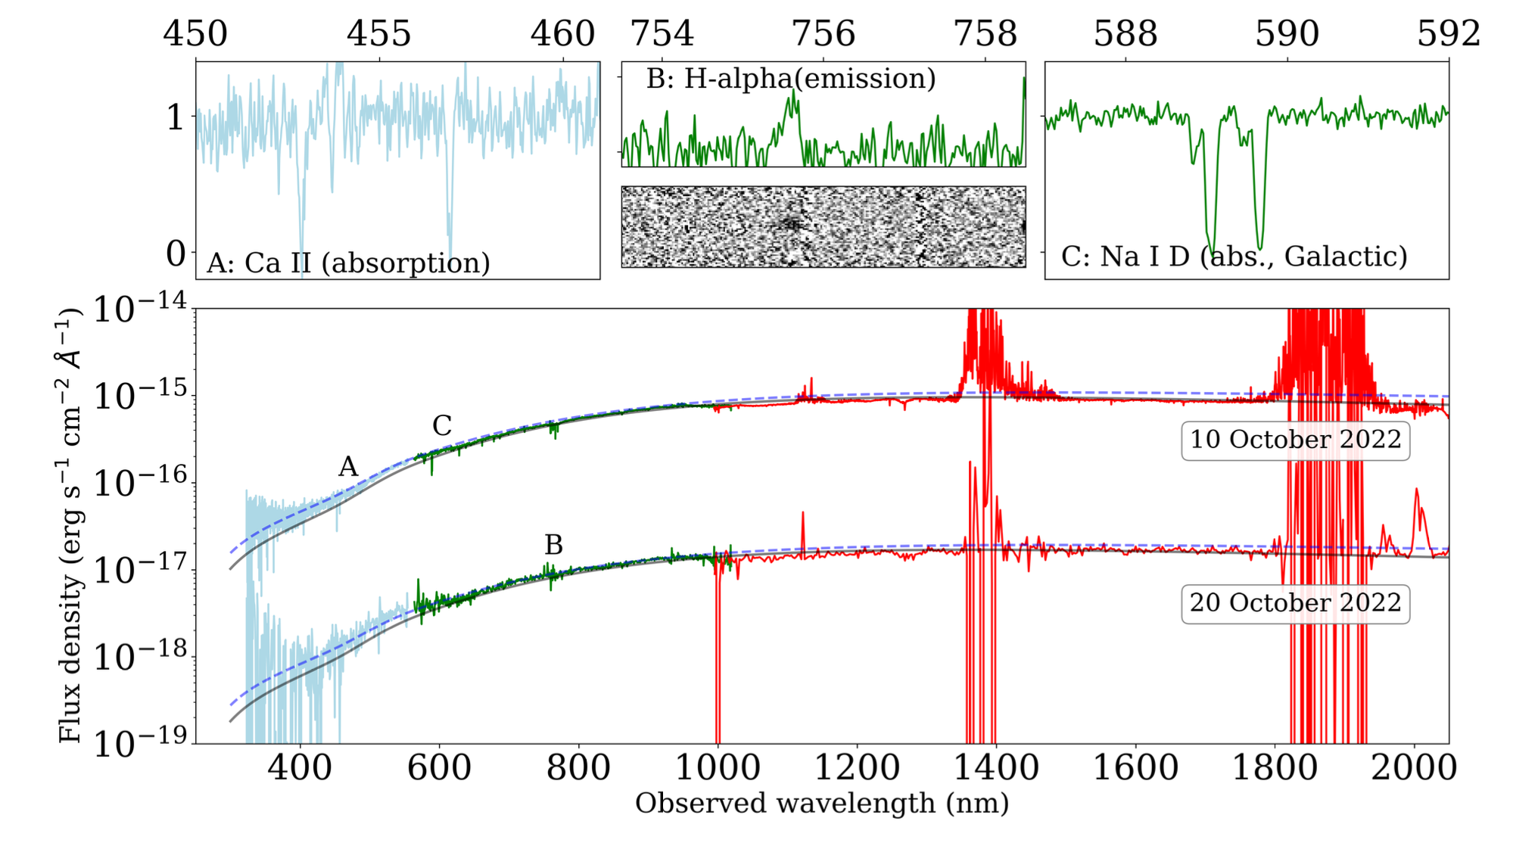
GRB 221009A
“Once per millennium” event!
GRB sample seen by Fermi /GBM in 15 years
Malesani et al. arXiv:2302.07891

Slide 8
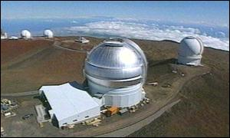
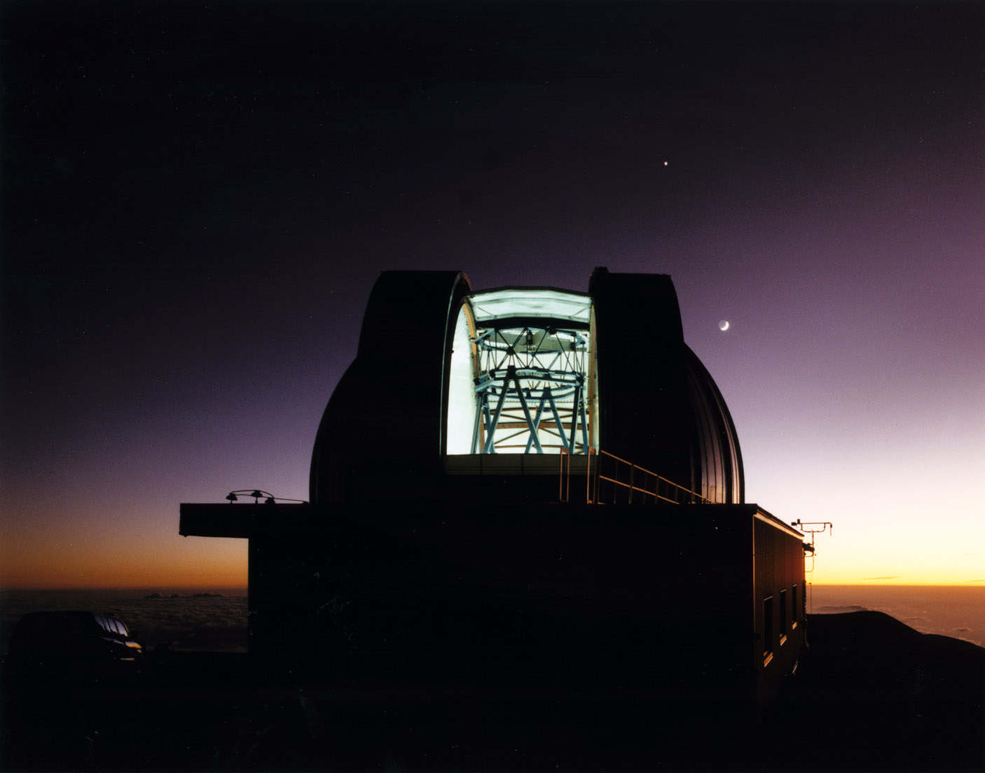
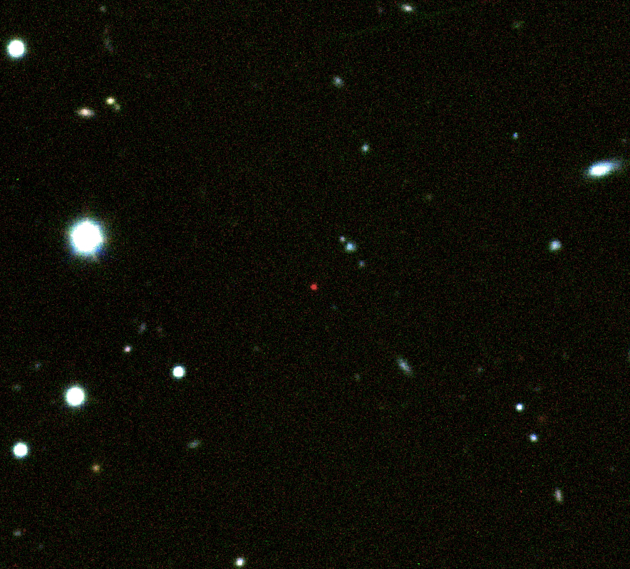
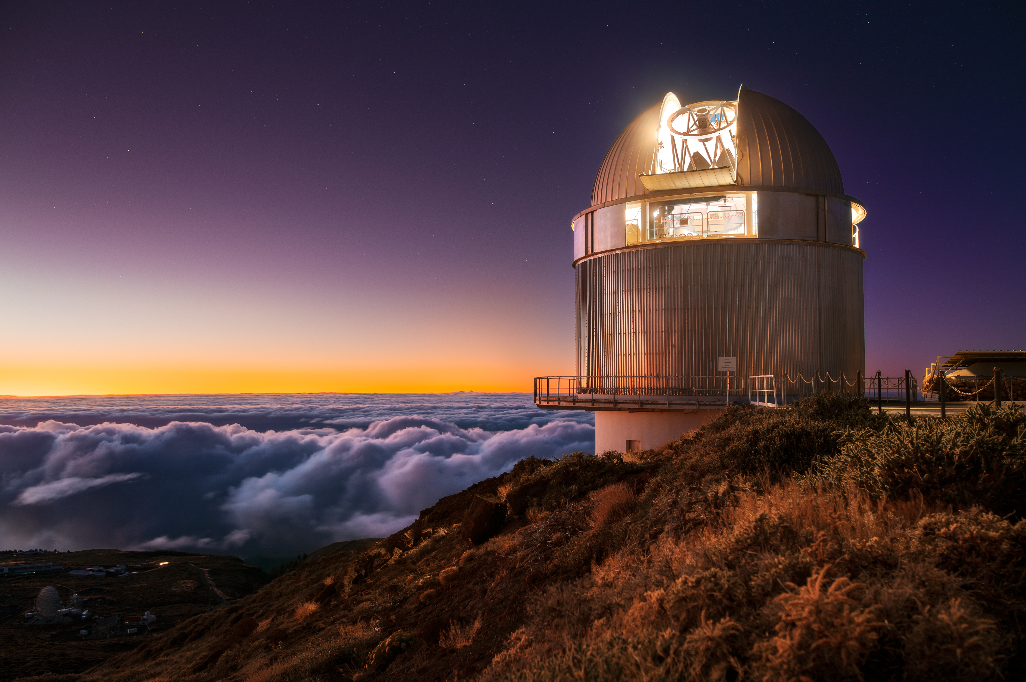
High spectroscopic redshifts
  ESO has been at forefront of obtaining spectroscopy of the highest redshift GRBs – but often making use of evidence from other telescopes to identify good candidates.

Slide 9
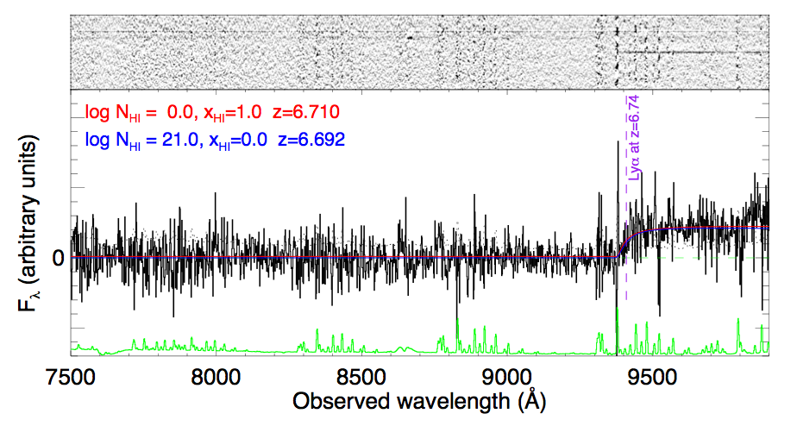
GRB 080913
FORS
Greiner et al. 2009

Slide 10
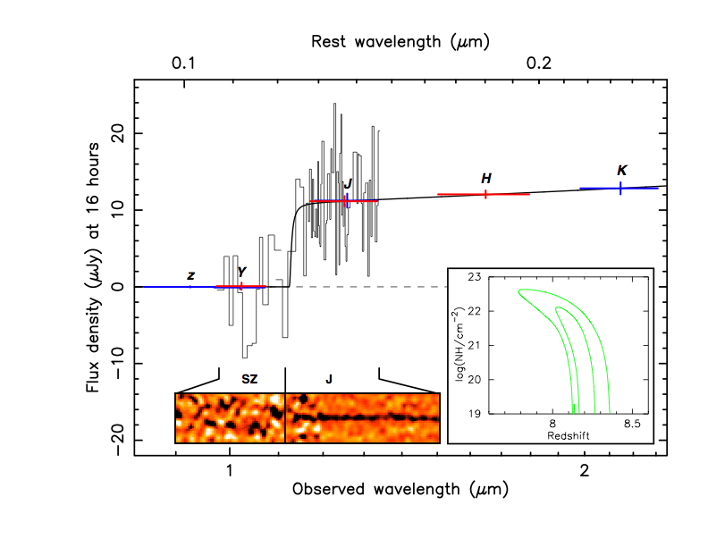
GRB 090423
ISAAC
z = 8.23 ± 0.08
Tanvir et al. 2009; Salvaterra et al. 2009

Slide 11
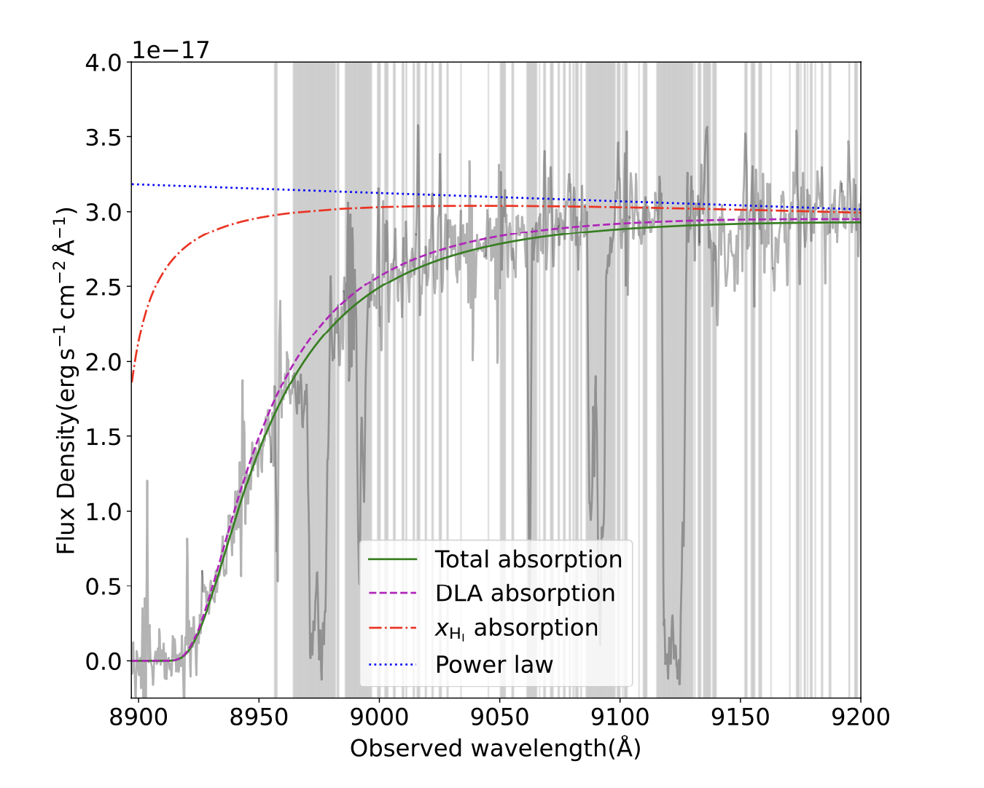
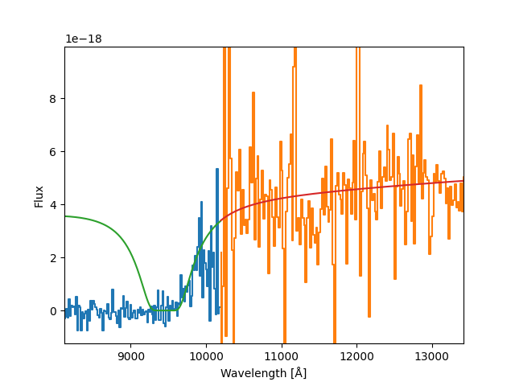
GRB 120923A
GRB 210905A
Fausey et al. 2025
z = 7.84 ± 0.09
Tanvir et al. 2018
z = 6.3
GRB 240218A
Saccardi et al. in prep.
z = 6.8
X-shooter
GRB 250314A
See Andrea’s talk
z = 7.3

Slide 12
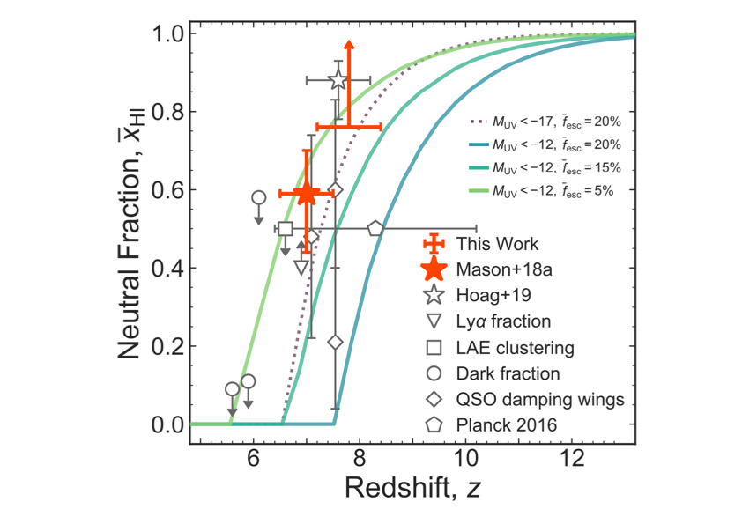
GRB 120923A
GRB 210905A
Fausey et al. 2025
z = 7.84 ± 0.09
Tanvir et al. 2018
z = 6.3
GRB 240218A
Saccardi et al. in prep.
z = 6.8
X-shooter
GRB 250314A
See Andrea’s talk
z = 7.3

Slide 13

HI column density evolution
NT et al. (2019) - updated
Reionization requires escape fraction >~10%
?
High column densities seen in optical spectra of most 2<z<5 GRBs suggest escape fractions for these stellar pops of < 2 %.

Slide 14
HI column density evolution
NT et al. (2019) - updated
Reionization requires escape fraction >~10%
High column densities seen in optical spectra of most 2<z<5 GRBs suggest escape fractions for these stellar pops of < 2 %.

Slide 15
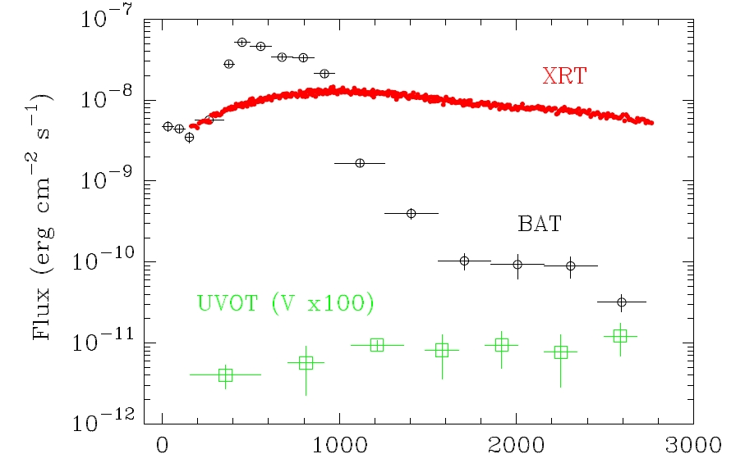
GRB 060218 / SN2006aj

Slide 16
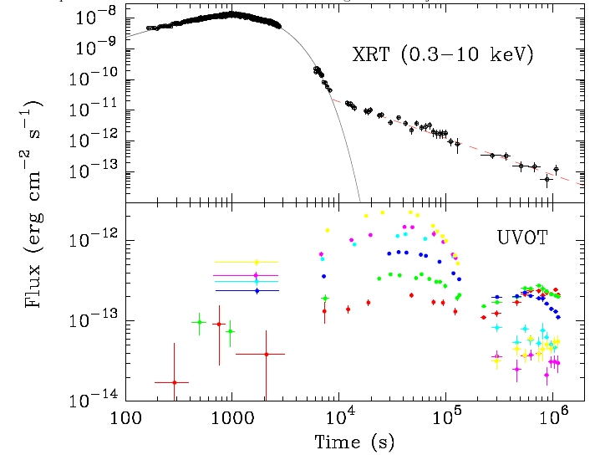
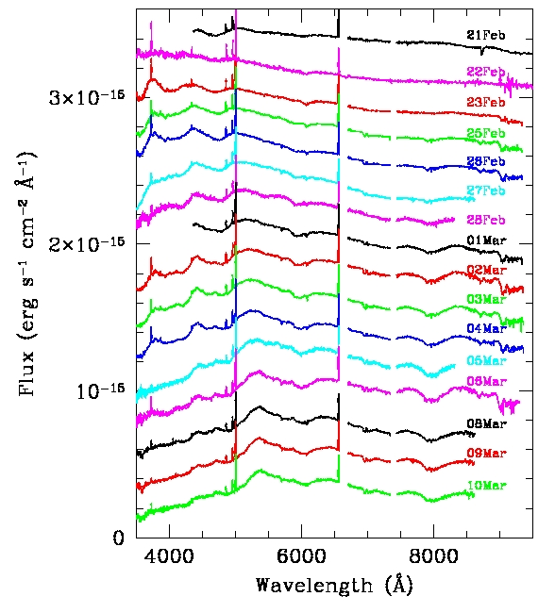
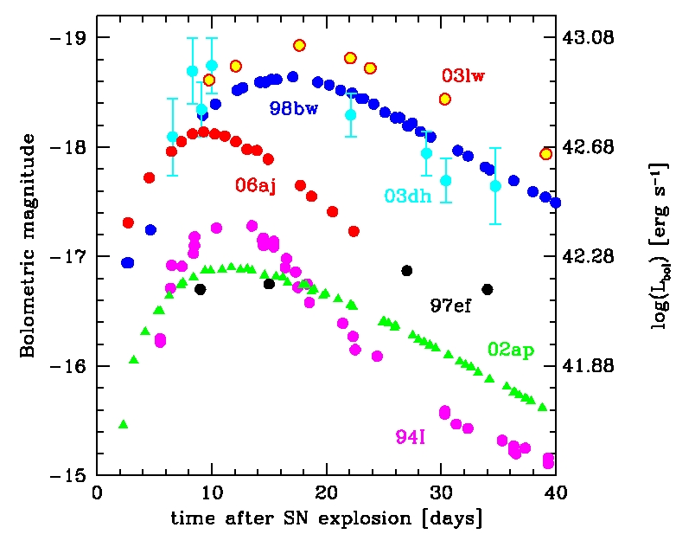
GRB 060218 / SN2006aj
z = 0.0331
Pian et al. 2006

Slide 17
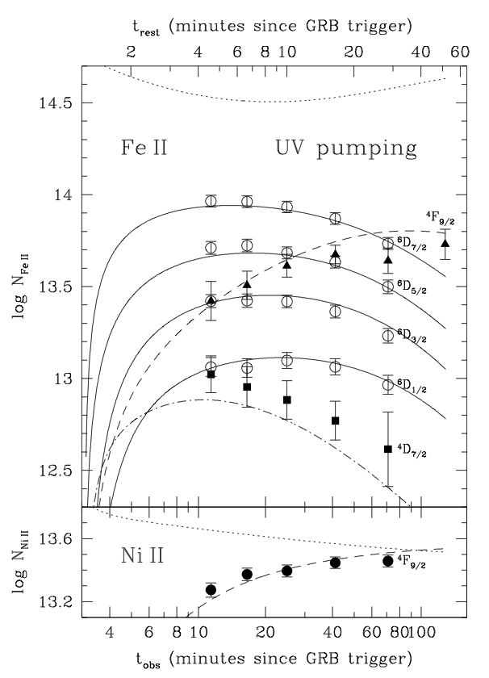
Time variable absorption lines
Vreeswijk et al. 2007
GRB 060418 showed evidence of time variable fine structure lines (FeII and NiII), which were well fitted by absorption from a distant absorber excited by UV/X from the GRB itself.
VLT triggered in “Rapid Response Mode”
UVES

Slide 18
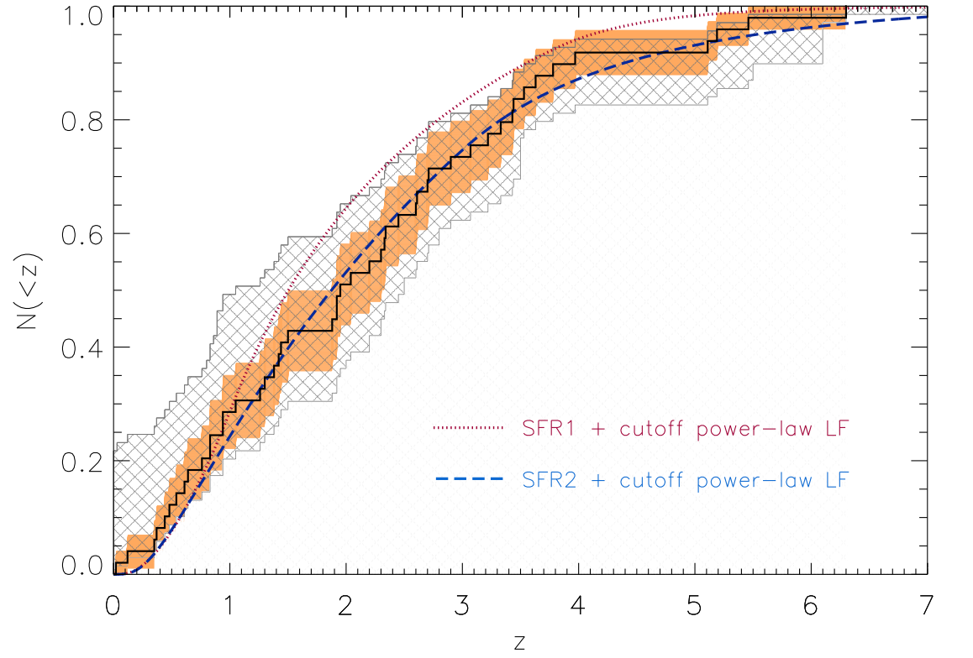
Statistical Studies
Swift has allowed construction of statistical samples of bursts and hosts that are larger and more uniform than other missions.
In particular, chasing the host galaxies has provided redshifts for bursts where they were lacking, providing nearly redshift-complete subsamples.
Jakobsson et al. 2012
Hjorth et al. 2012
See also Salvaterra et al. 2012 for BAT6 and Perley et al. 2016 for SHOALS.
TOUGH: The Optically Unbiassed GRB Host sample

Slide 19
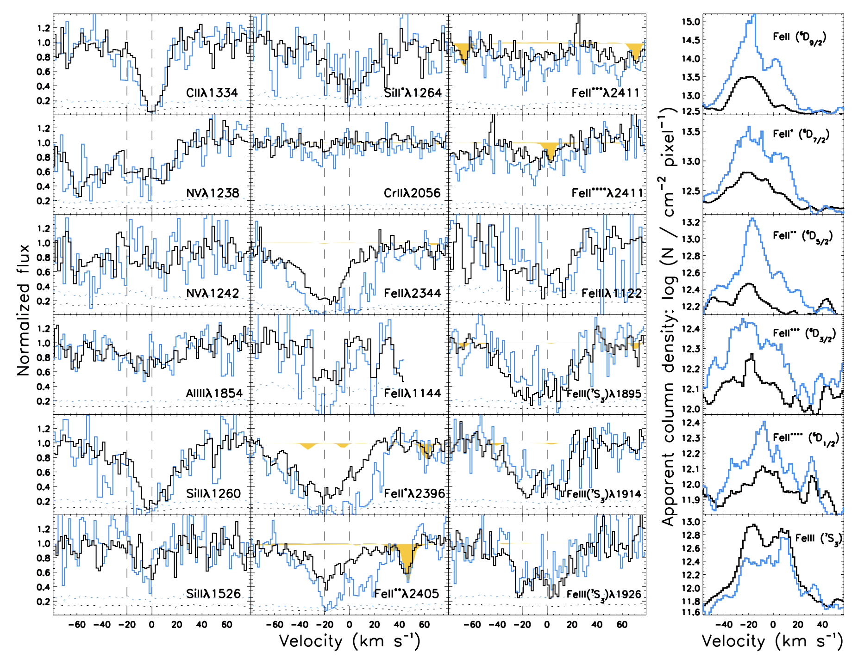
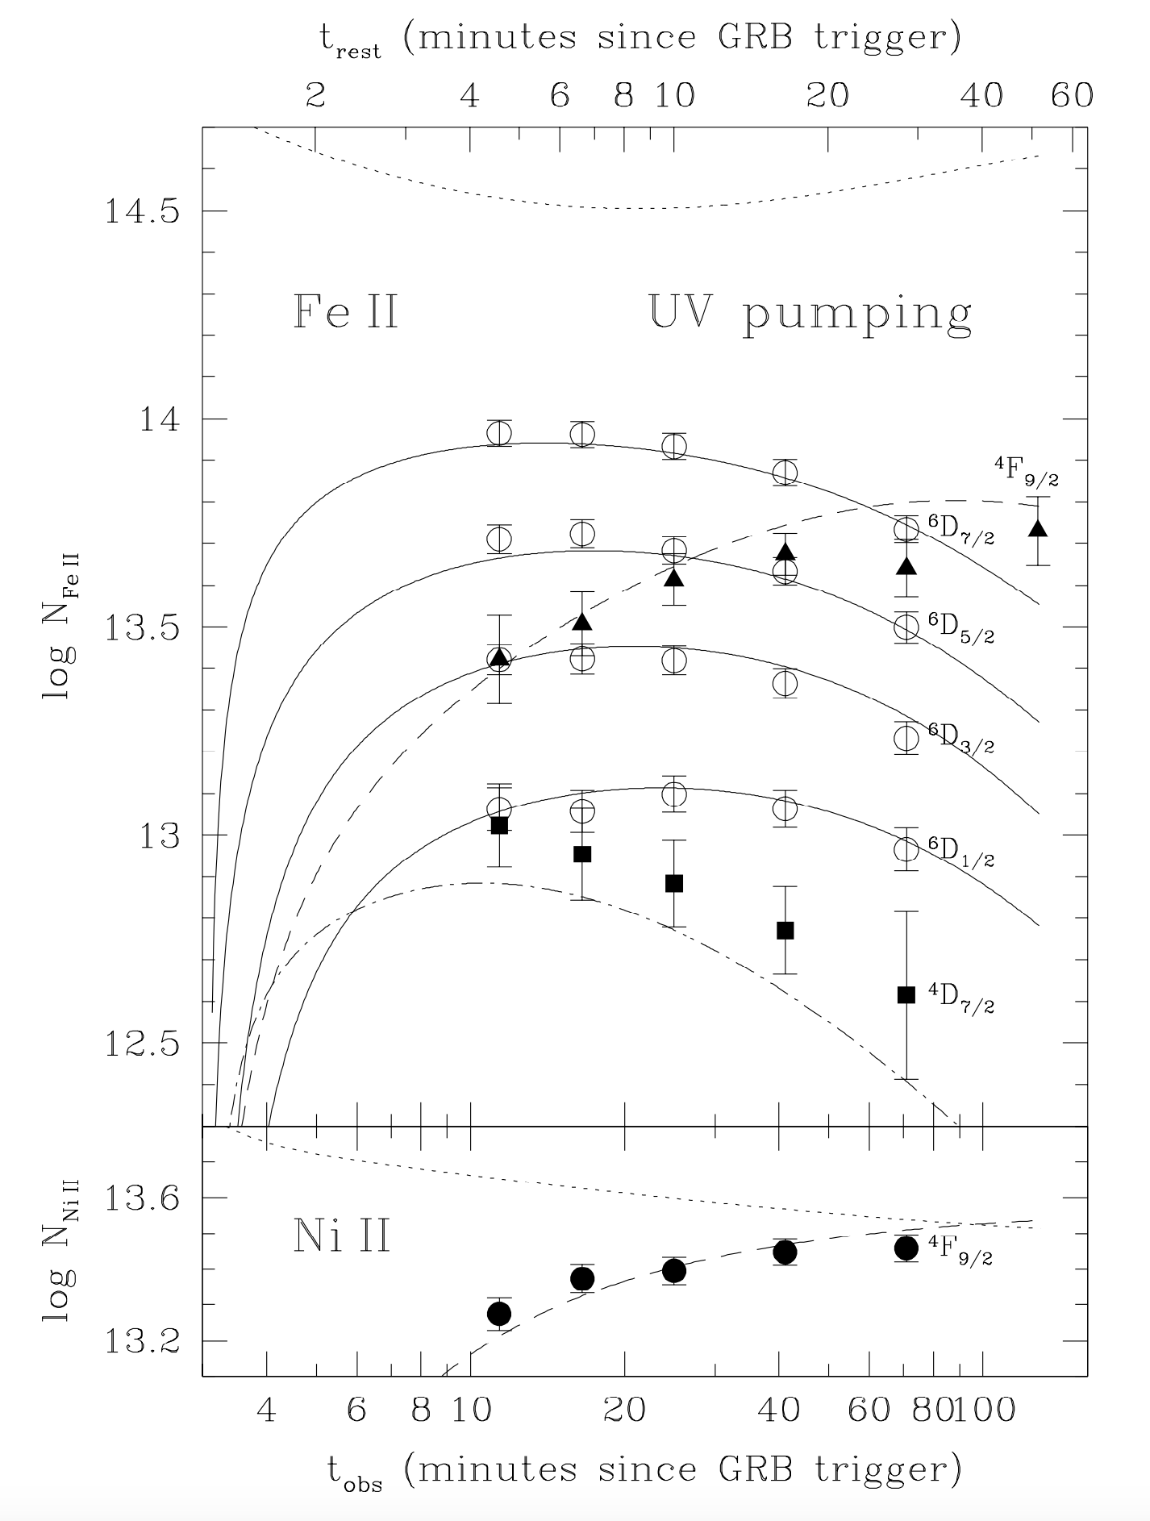
Tomography of gas
Time variability of fine structure lines due to UV pumping from GRB light provides distance to absorber from burst.
Vreeswijk et al. 2006
Possible at high redshift with ELT/ANDES.
De Cia et al. 2012

Slide 20
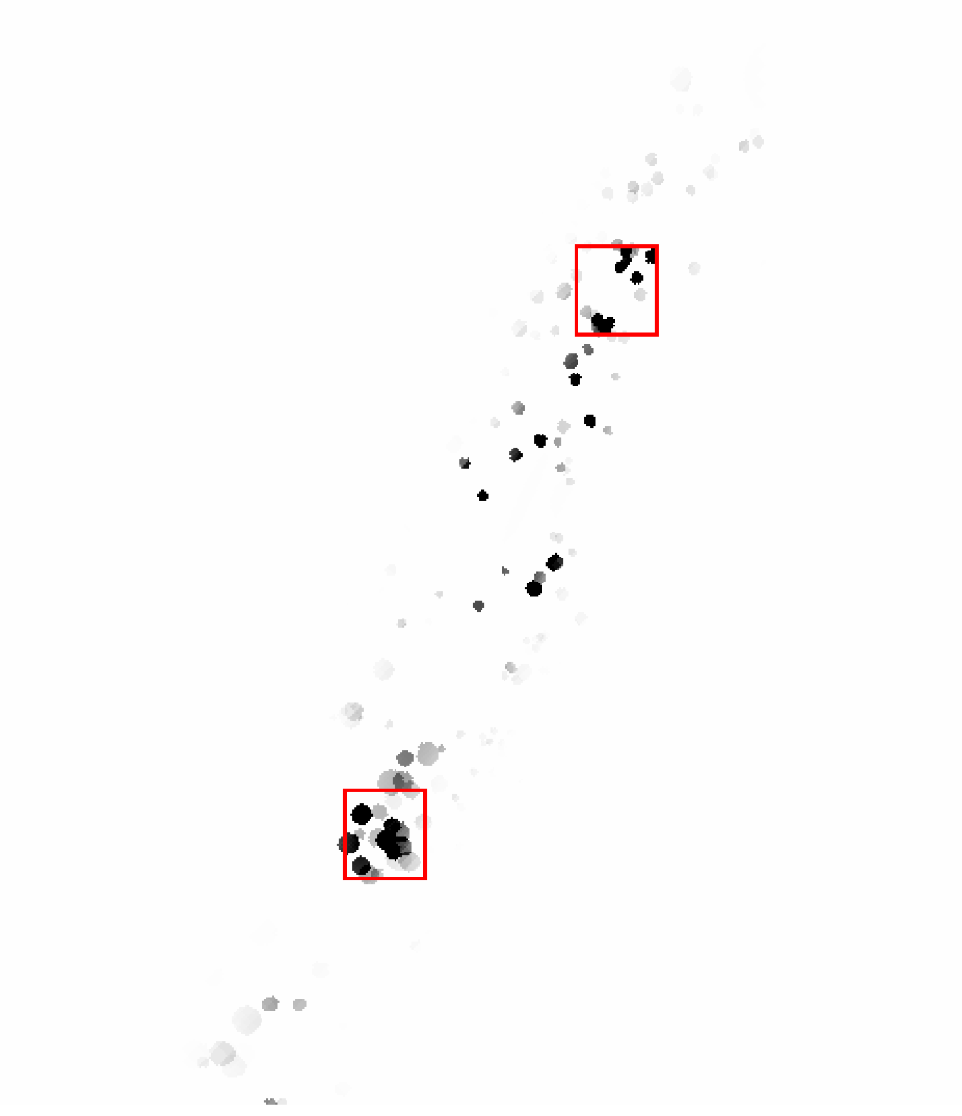
The Multi-Messenger Revolution
If Swift had been looking …

Slide 21
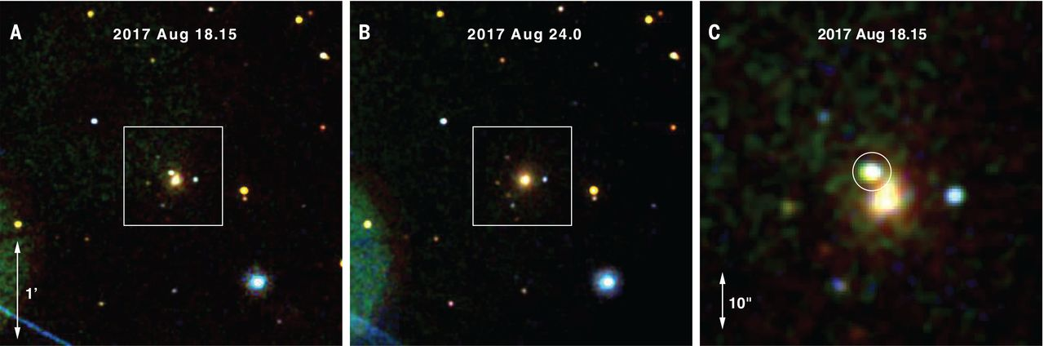
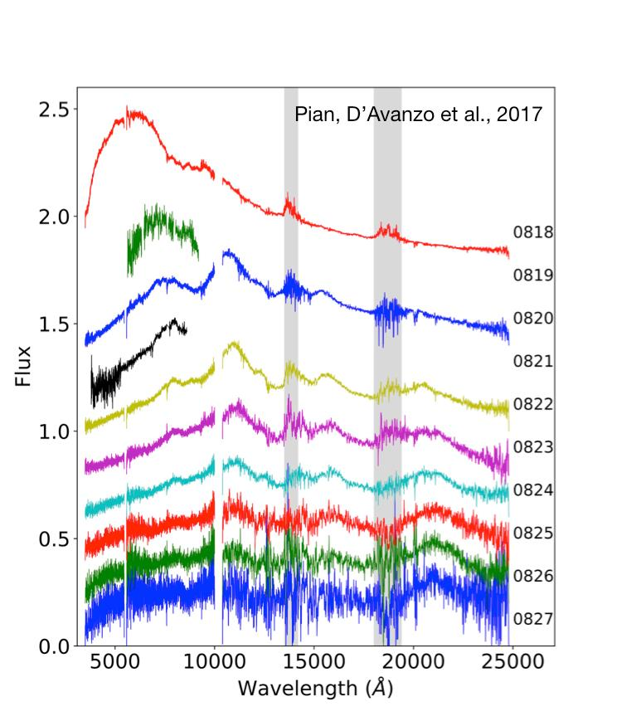
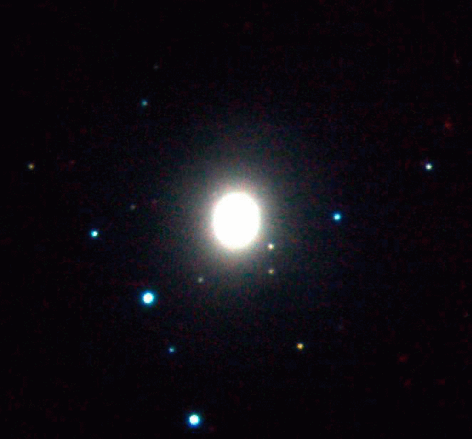
GW170817/AT2017gfo
Swift did provide essentially follow-up, supplementing the ground-based optical/nIR.
Evans et al. 2017
Pian et al. 2017
NT et al. 2017
VISTA

Slide 22
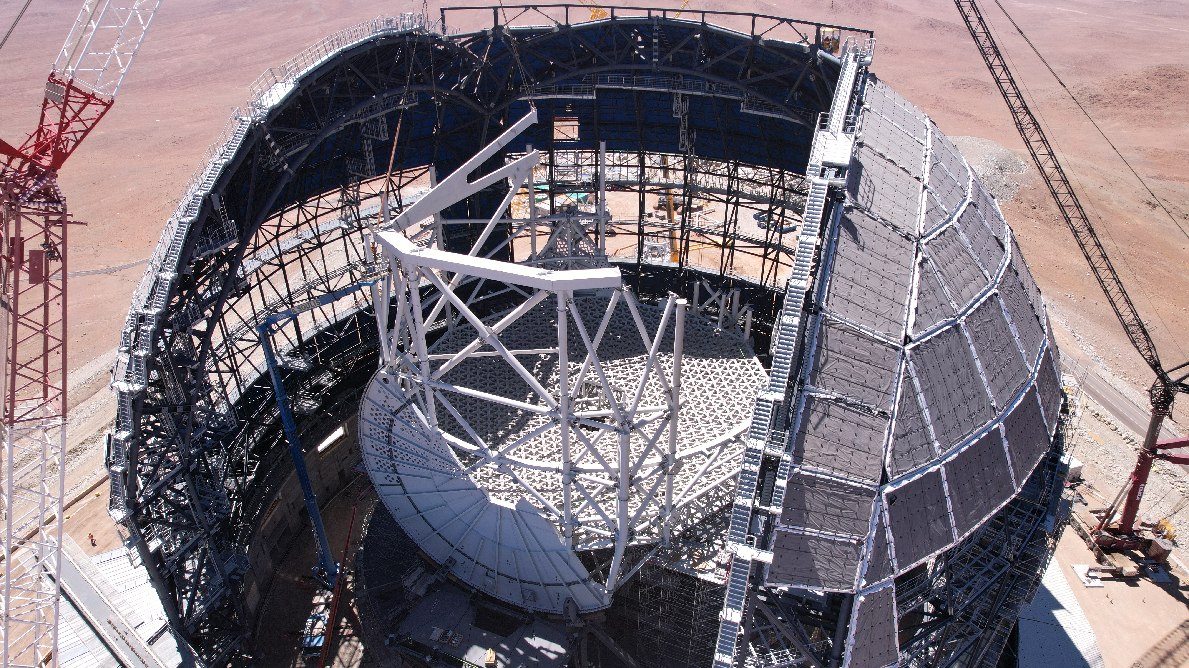
What’s next?
  The Extremely Large Telescope

Slide 23
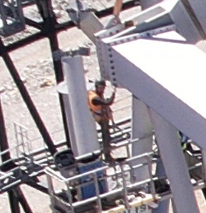
What’s next?
  The Extremely Large Telescope

Slide 24

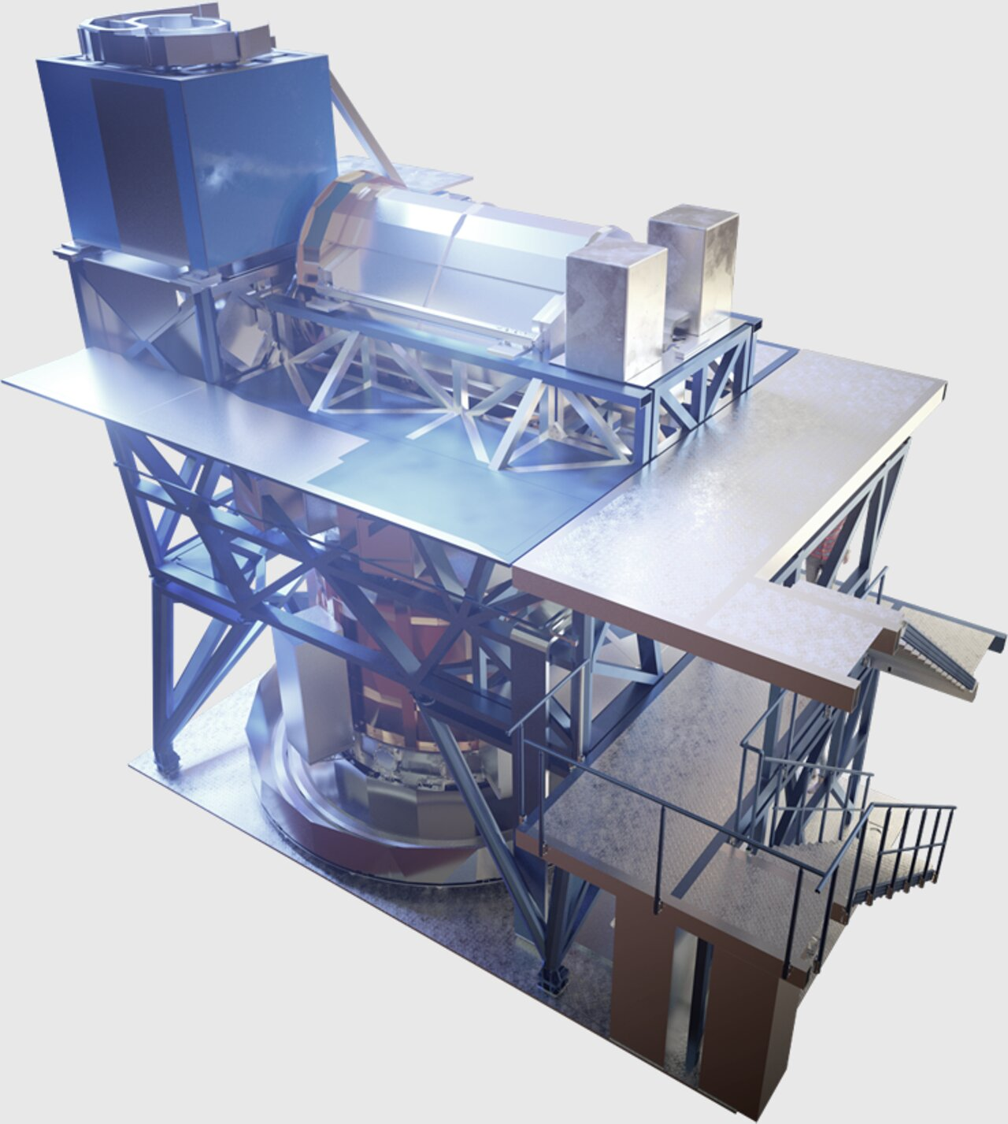
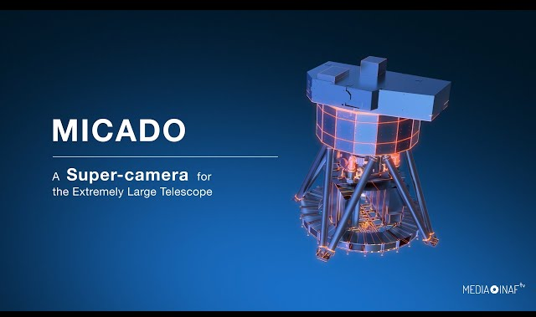
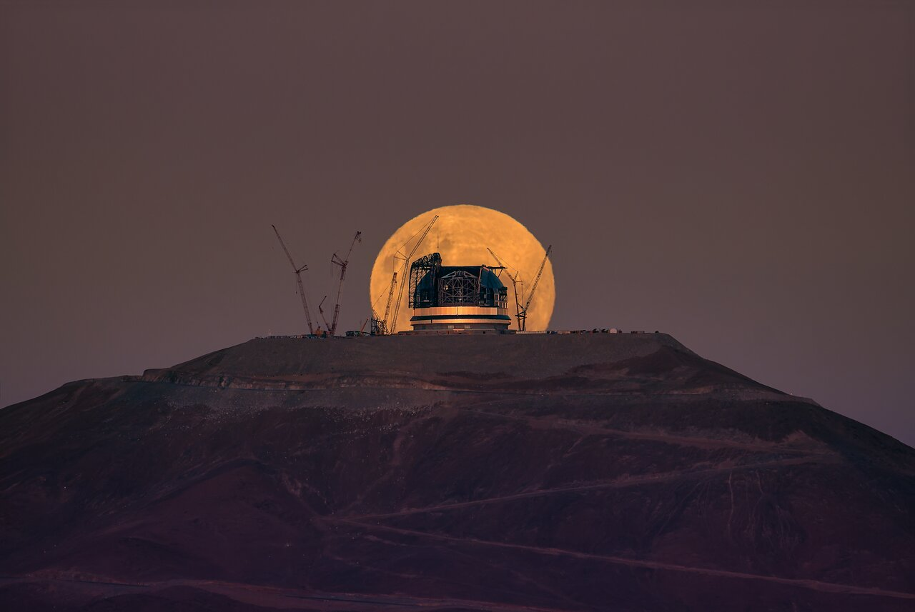

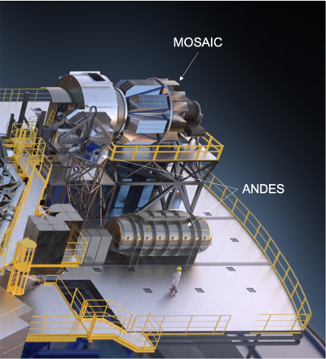
What’s next?
  First light by end of the decade

Slide 25
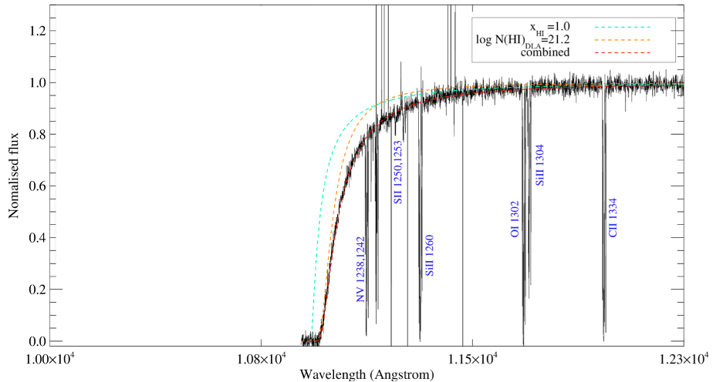
What’s next?
Simulated ELT spectrum of z = 8 afterglow
L. Christensen

Slide 26
Conclusions
  ESO and Swift have enjoyed a highly successful 20 years of scientific collaboration.
  The future in the 2030s is bright, providing that the high energy localisations continue to come!

