Slide 1
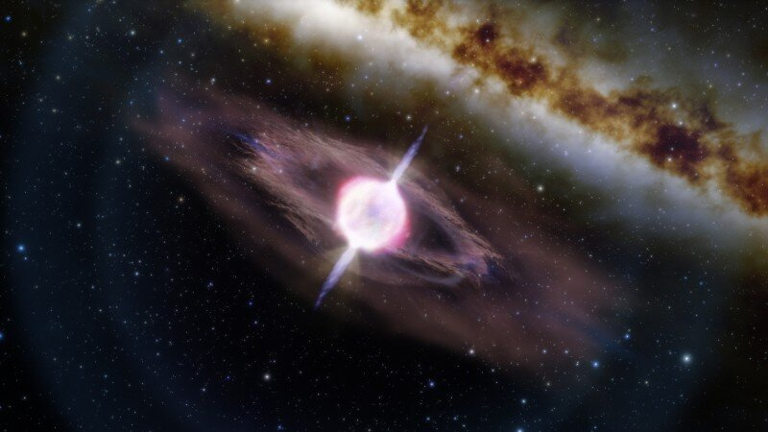
Swift 20 Conference
ORPHAN AFTERGLOWS – AT 2023SVA AND THE STATE OF THE FIELD
Image credit: International Gemini Observatory/NOIRLab/NSF/AURA/J. da Silva Image processing: M. Zamani (NSF's NOIRLab)
GOKUL SRINIVASARAGAVAN
4TH YEAR PHD CANDIDATE UMD COLLEGE PARK

Slide 2
What are orphan afterglows and their importance?
What is the state of the field?
What conclusions can be drawn from AT 2023sva?
2

Slide 3
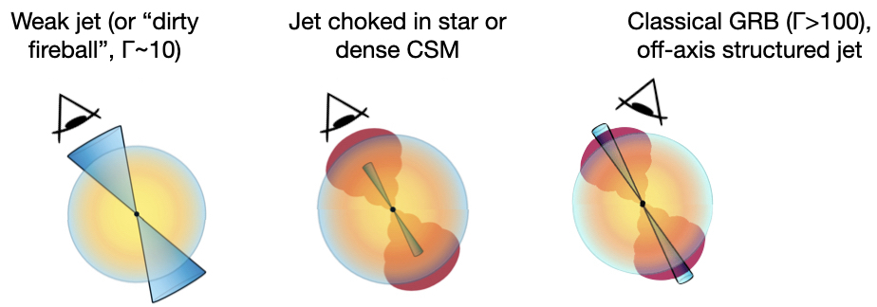
What are orphan afterglows and their importance?
Orphan Afterglows
Credit: Anna Ho
What are they?
  Discovered in UVOIR, no GRB found post-facto
  Off-axis GRB? Dirty fireball with low Lorentz Factor? Choked jet? Something else?
  Currently only optical discoveries – but future facilities will change this
Why are they important?
  Gamma-ray sky is not the only avenue for discovering relativistic transients
  Can help understand true angular rate/structure of LGRBs
  Can illuminate role of mass-loading and how important ultra-relativistic ejecta are for powering LGRBs
3

Slide 4
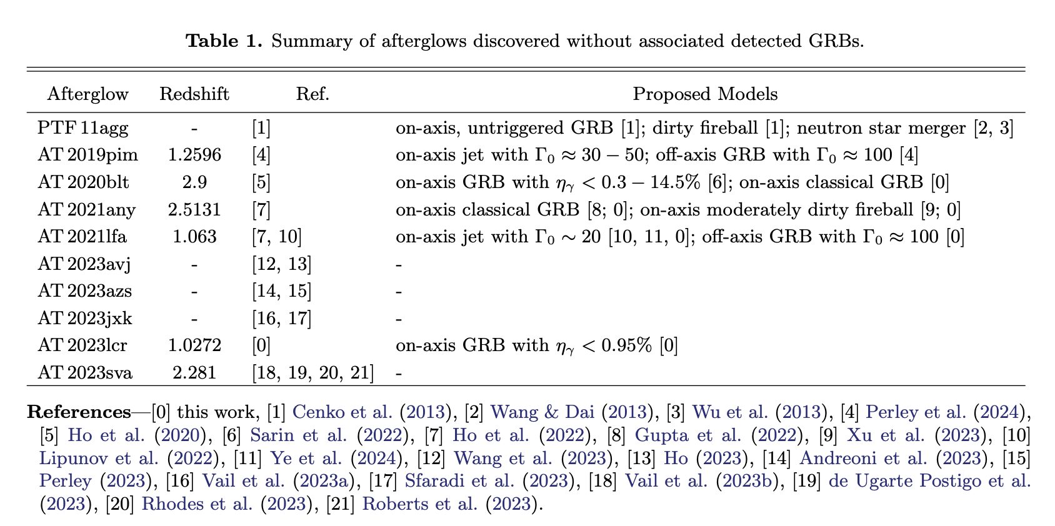
What is the state of the field?
State of the Field
Slightly off-axis structured jet with $Γ_{0}≈100$, on axis GRB with $η_{γ}<4 −11\%$, on axis jet with $Γ_{0}<100$
Credit: Li et al. (2024)
4

Slide 5
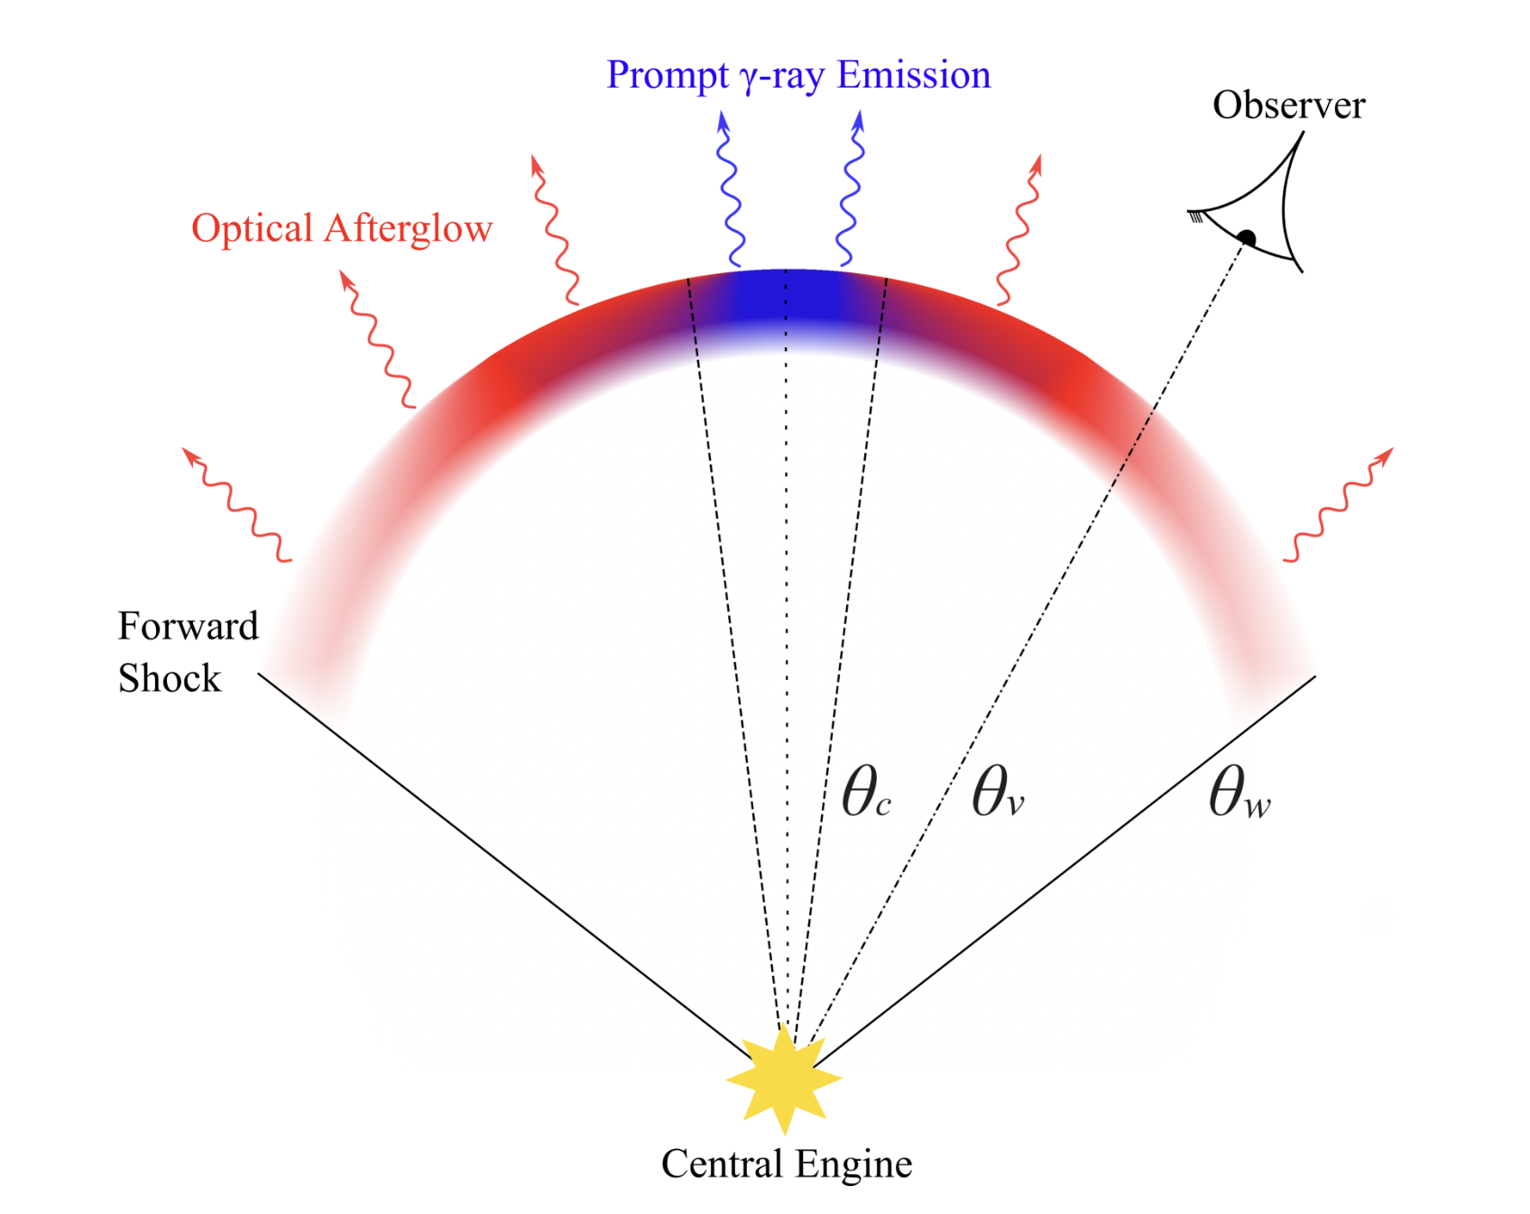
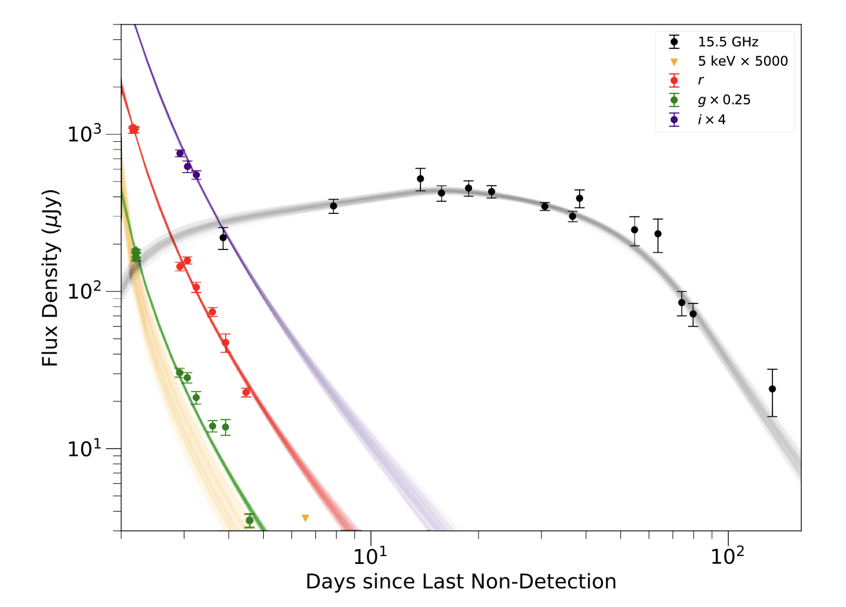


What conclusions can be drawn from AT 2023sva?
AT 2023sva’s Structured Jet
Swift Upper Limit
Credit: Freeburn et al. (2024)
Srinivasaragavan et al. (2025)
Structured jet model (O’Connor et al. 2023, Gill and Granot 2023, Rhodes et al. 2024, LHASSO Collaboration 2023) of GRB 221009A. Orphan afterglows are detected when $θ_{c}<$ $θ_{v}<θ_{w}$
The 90% credible interval of the predicted LCs from our posterior samples for the most favored power-law structured jet model. From the best-fit parameters, we constrain $Γ_{0}>9$.
5

Slide 6
What conclusions can be drawn from AT 2023sva?
Orphan Afterglow Source Sizes
Comparison of source size upper limits derived from interstellar scintillation analyses
7 classical GRBs, 5 orphan afterglows. Orphan afterglows have statistically smaller source size upper limits
What is the reason for this?
  Intrinsic lower Lorentz factors? Viewing orphan afterglows more off-axis? Variations in CSM density?
Srinivasaragavan et al. (2025)
6

Slide 7
What are orphan afterglows and their importance?
What is the state of the field?
What conclusions can be drawn from AT 2023sva?
7

Slide 8

THANK YOU!
Multi-Wavelength Analysis of AT 2023sva: a Luminous Orphan Afterglow With Evidence for a Structured Jet
Srinivasaragavan et al. (2025) MNRAS 538, 351
_{gsriniv2@umd.edu}
8

Slide 9
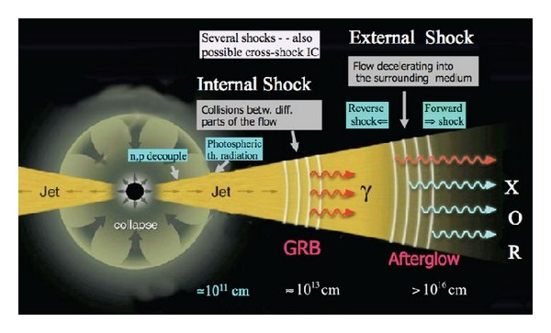
What are orphan afterglows and their importance?
Long Gamma-ray Burst Science
Swift-BAT, Fermi, etc.
Swift-XRT
Optical Telescopes
Radio Telescopes
Credit: Mészáros and Rees (2014)
9

Slide 10
AT 2023sva
Srinivasaragavan et al. (2025)
Srinivasaragavan et al. (2025)
Optical spectrum of AT 2023sva, obtained by the OSIRIS instrument. The Lyman-α absorption feature enables a redshift measurement at z = 2.28.
Optical LC of AT 2023sva in the g, r, and i bands, along with a best fit power-law decay model.
10

Slide 11

Radio Analysis
Srinivasaragavan et al. (2025)
Srinivasaragavan et al. (2025)
Radio SEDs over multiple epochs of AT 2023sva. Scintillation analysis constrains the Lorentz factor at explosion to $Γ$< 80.
Multi-frequency radio LC of AT 2023sva, fit power-laws fit to the 15.5 GHz data.
11

Slide 12

Multiwavelength Modeling
Srinivasaragavan et al. (2025)
Srinivasaragavan et al. (2025)
The 15.5 GHz radio observations of AT 2023sva and the X-ray upper limit, along with the best-fit power-law structured jet, tophat jet, and Gaussian structured jet fit to the observed LC.
The 90% credible interval of the predicted LCs from our posterior samples for the most favored power-law structured jet model. From the best-fit parameters, we constrain $Γ>9$.
12

Slide 13
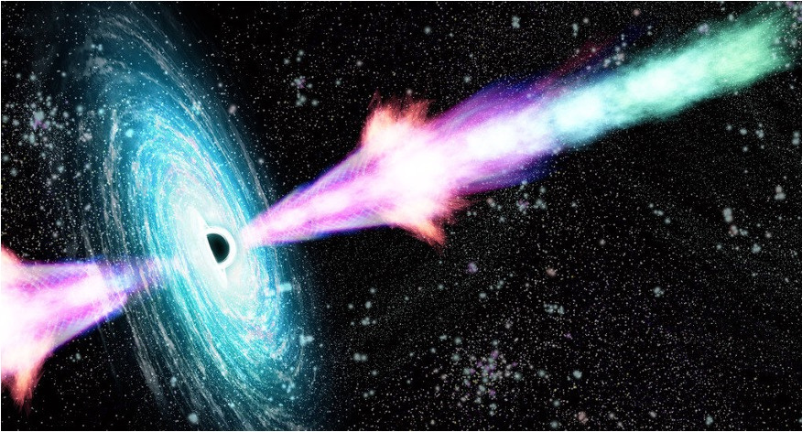
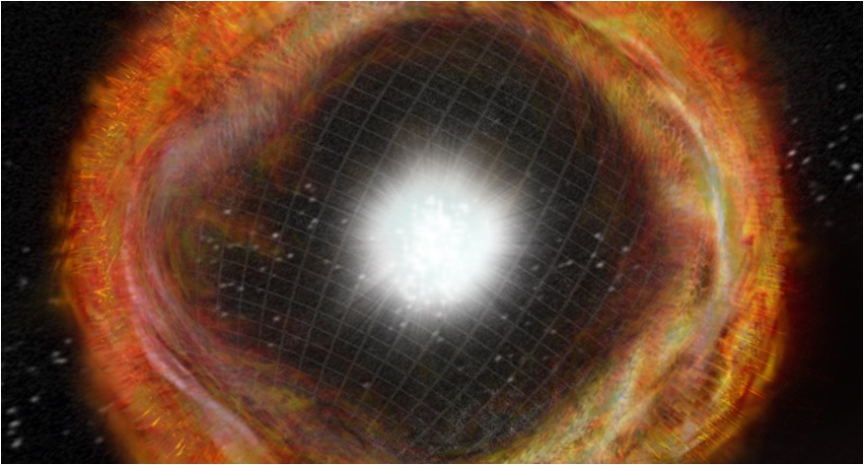
What are orphan afterglows and their importance?
High-Level Systems
Credit: SciTech Daily
Credit: NASA
Long Gamma-ray Bursts (LGRBs)
  Flashes of gamma-rays released from highly collimated, ultra-relativistic jets driven by compact remnants after CCSNe
  Most electromagnetically luminous explosions in Universe
Core-Collapse Supernovae (CCSNe)
  End of massive star’s (> 8 solar masses) life, resulting in formation of compact remnant
  Most powerful explosions in Universe
13

Slide 14
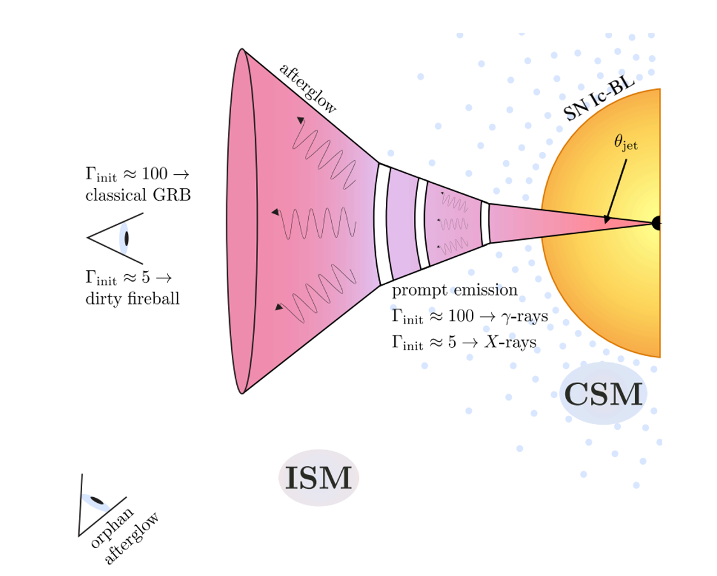
What are orphan afterglows and their importance?
GRB-SN Physical Picture
Artistic Depiction of a LGRB accompanying a broad-lined Ic SNe (SNe Ic-BL)
Illustration from Brittany Miller
14

Slide 15
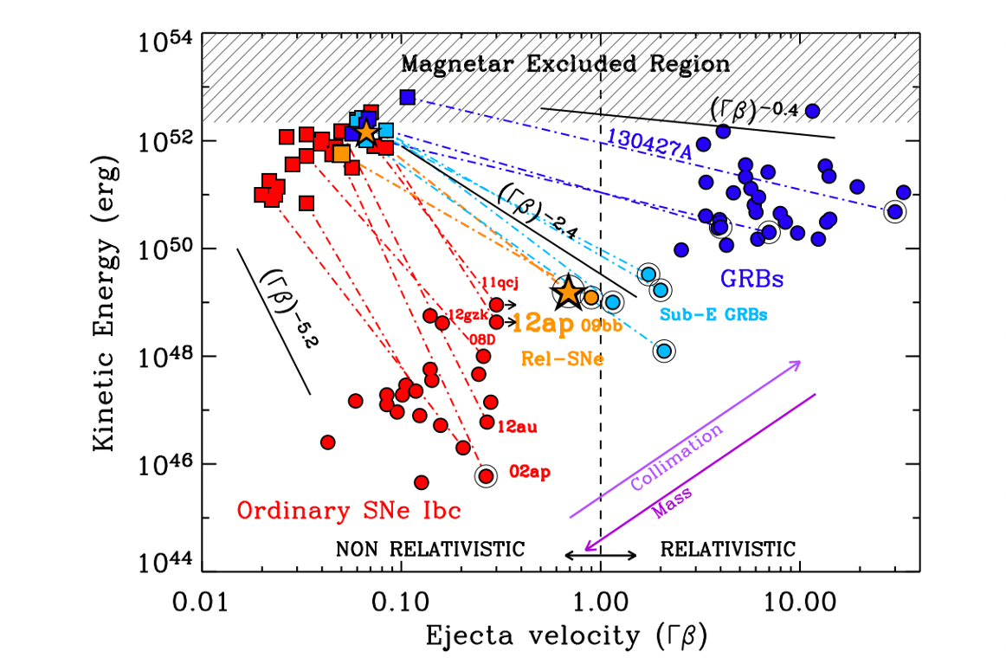
THE CONTINUUM OF RELATIVISTIC STELLAR EXPLOSIONS
  Kinetic energy profile of ejecta of normal stripped envelope SNe (red), relativistic SNe (orange), sub-energetic LGRBs (light blue), and LGRBs (blue) from Margutti et al. (2014).
  Circles represent fastest moving ejecta from radio observations, squares represent slowest moving ejecta from optical.
  Open circles have broad-lines in optical spectra.
Margutti et al. (2014)
15

Slide 16
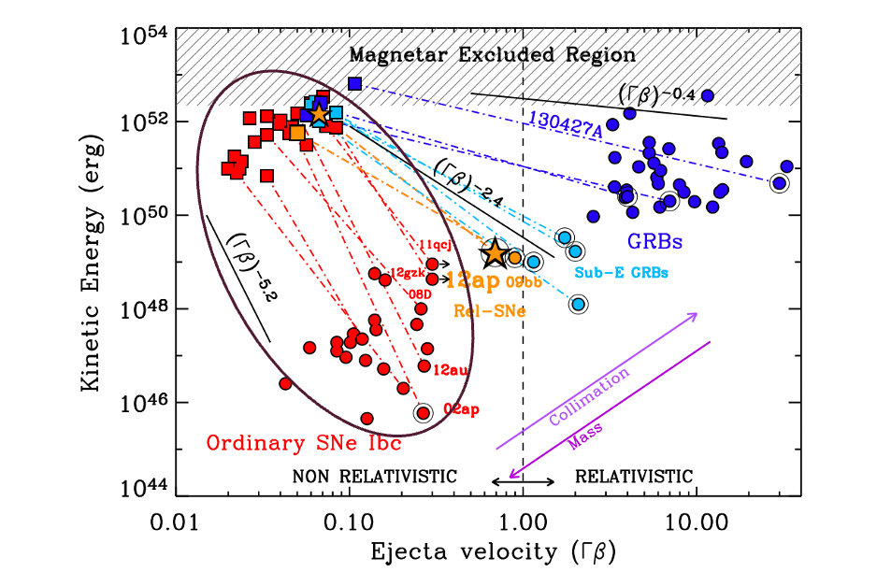
STUDYING BROAD-LINED TYPE IC SUPERNOVAE FROM THE ZWICKY TRANSIENT FACILITY
Srinivasaragavan et al. (2024b) ApJ 976, 71 and Mousa et al. in Prep
Why do only some massive stars produce GRBs?
How can observational studies of SNe uncover details about their progenitors?
16

Slide 17

Optical and Radio Analysis of Systematically Classified SNe Ic-BL from ZTF
Adequate LC coverage pre/post peak
SNe Sample Selection Criteria: 36 SNe Ic-BL From March 2018 to August 2021
13 Events followed up in radio using Very Large Array (Corsi et al. 2023) - 8 detections, 5 non-detections
Bright Transient Survey : All SNe < 18.5 mag
Spectroscopically classifed as SNe Ic-BL
Reference images uncontaminated by transient light, fields still visible one month after peak
Low Galactic Extinction (A_v < 1 mag)
17

Slide 18
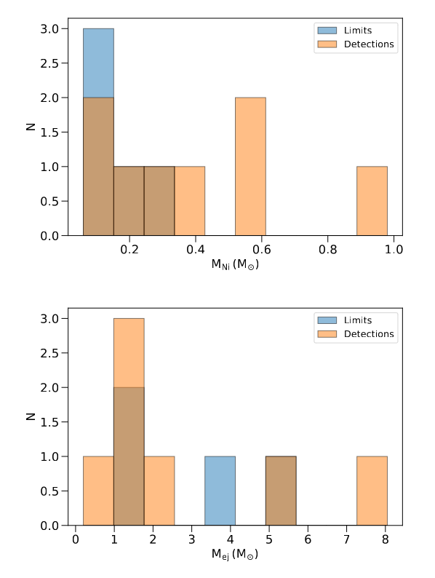
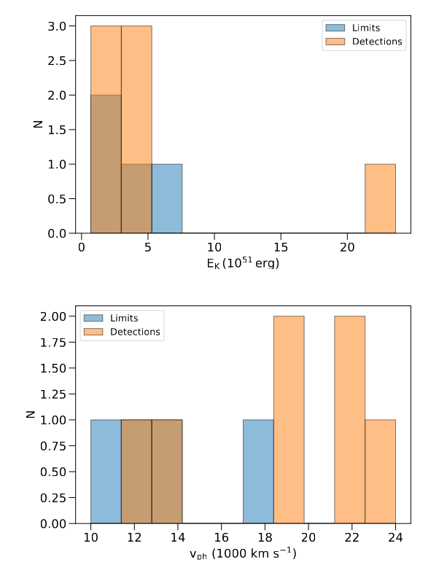
Radio Analysis
Srinivasaragavan et al. (2024b)
Srinivasaragavan et al. (2024b)
Histograms showing the distribution of optical properties for events with radio observations. We find no statistical differences between the populations for all four properties.
18

Slide 19
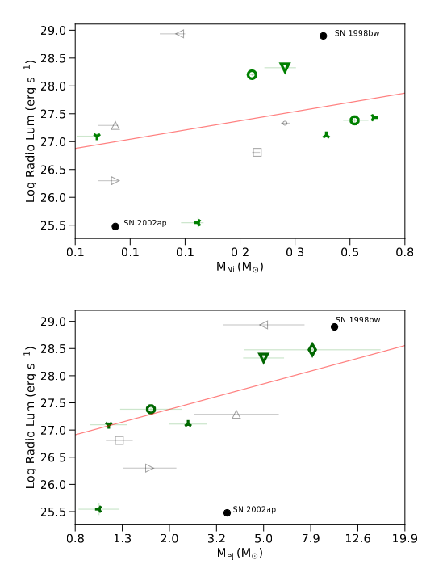
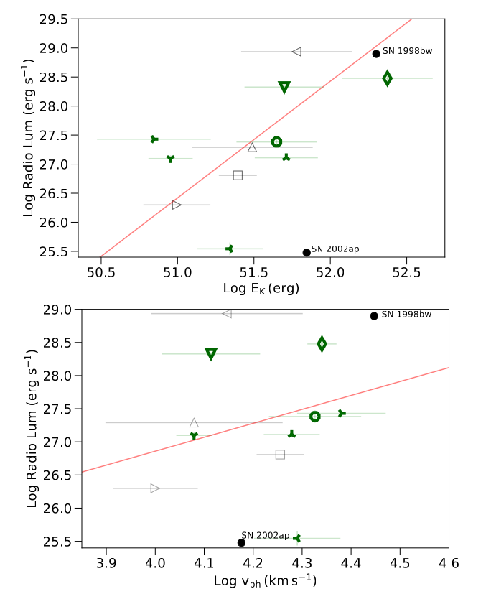
Srinivasaragavan et al. (2024b)
Srinivasaragavan et al. (2024b)
Best-fit Linmix linear regression model fitting between the peak radio luminosities and optical properties. Black points indicate limits while green points indicate detections. We find no statistically significant correlations present.
19

Slide 20

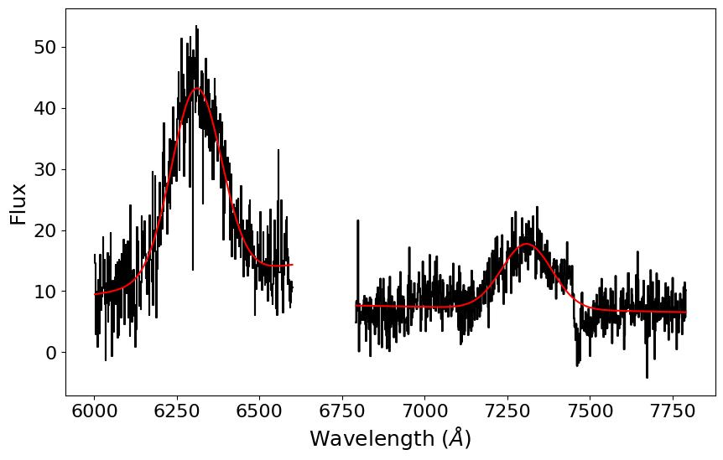
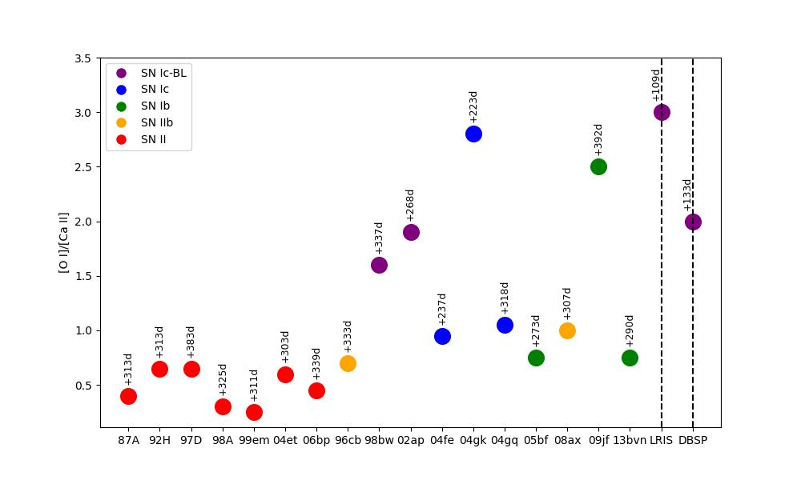
SN 2022crr: A Nearby SN Ic-BL
Muhammad Mousa, Senior at UVA
Mousa et al. in Prep.
Mousa et al. in Prep.
DBSP nebular spectrum isolated at the oxygen and calcium absorption features. Gaussian curve is fit to the absorption features. Integration of the curve is used to determine the line ratio of [O I]/[Ca II]
[O I]/[Ca II] line ratios of SN 2022crr (dashed lines) compared to other SNe. Initial plot produced by H. Kuncarayakti et al. (2015)
20

Slide 21
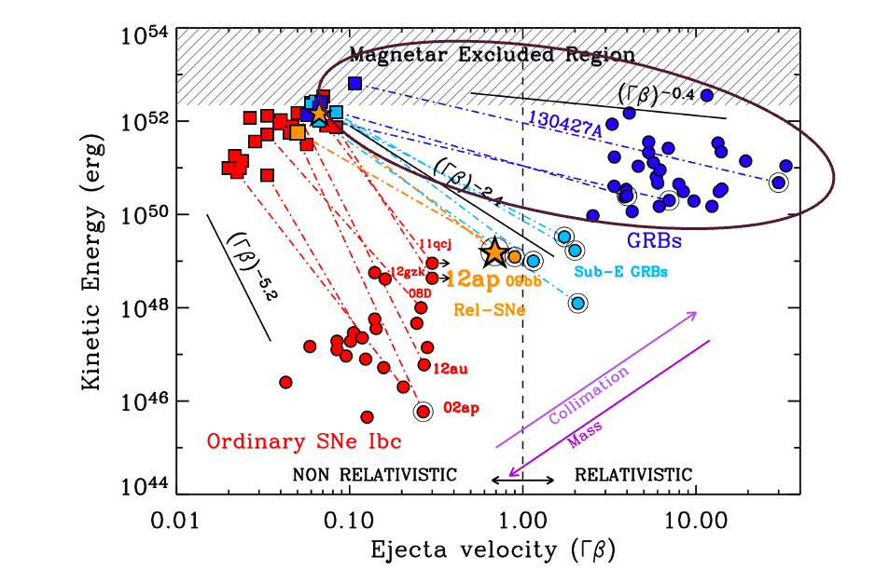
GRB 230812B/SN 2023PEL AND GRB 221009A/SN 2022XIW AND – TWO “ORDINARY” SNE ASSOCIATED WITH ENERGETIC GRBS
Srinivasaragavan et al. (2024a) ApJL 960 L18 and Srinivasaragavan et al. (2023) ApJL 949 L39
What is the relationship between SN emission and the central engine in GRB-SN systems?
21

Slide 22
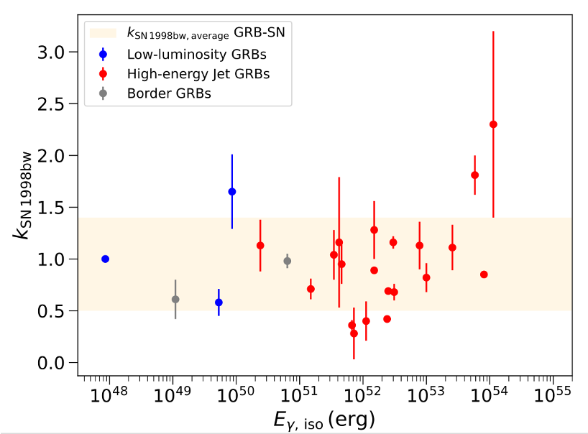
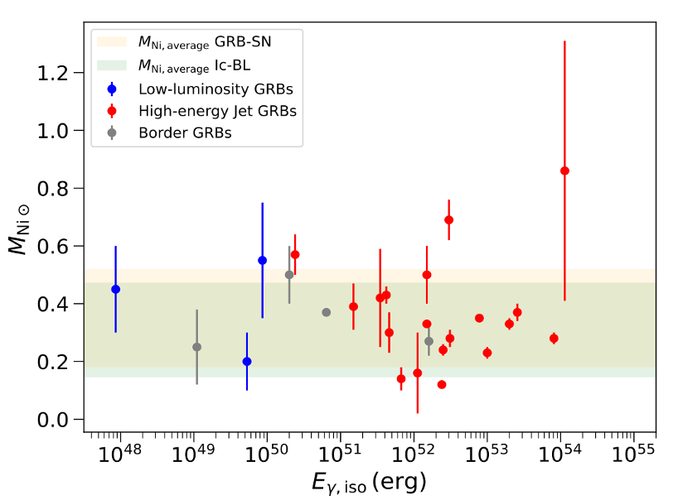
PROBING GRB-SN PROPERTIES
Srinivasaragavan et al. (2024a)
Srinivasaragavan et al. (2024a)
SN brightness versus gamma-ray isotropic equivalent energies of their associated GRBs’ prompt emission from literature
22

Slide 23
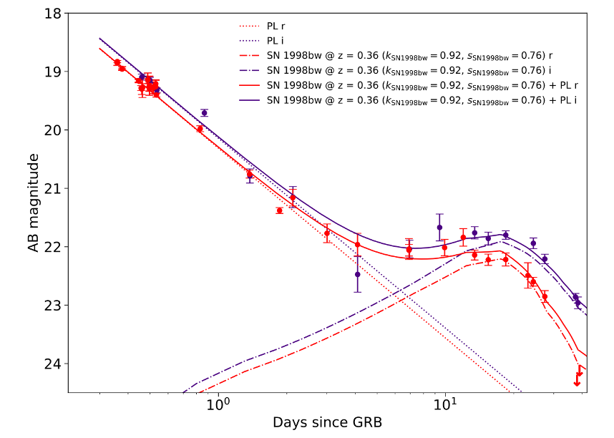
GRB 230812B/SN 20223pel
  Isotropic equivalent energy of 10⁵³ erg at z = 0.36
  Decay Index 1.31 ± 0.02
  E(B-V)_MW = 0.02 mag and E(B-V)_host < 0.07 mag
  SN 1998bw’s transformed LCs @ z=0.36
Srinivasaragavan et al. (2024a)
23

Slide 24
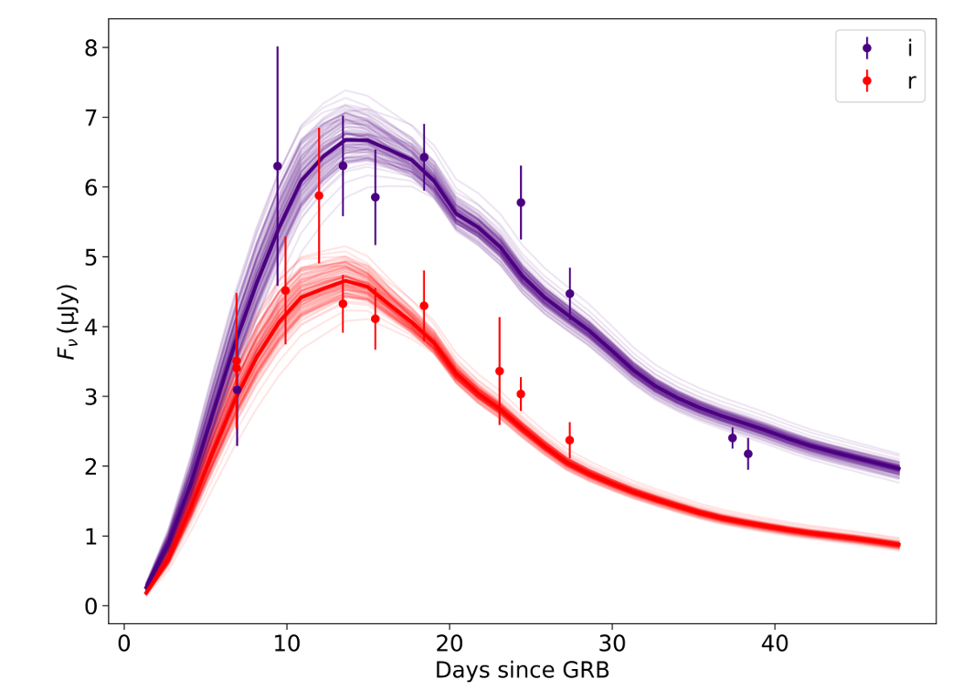
SN Analysis
  Isolated SN LC and Arnett (1982) Nickel-powered models,
  Peak M_{r} = -19.46 ± 0.18 mag
  Nickel Mass = 0.38 ± 0.01 solar masses
  Ejecta mass = 1.0 ± 0.6 solar masses
  Kinetic Energy ~ 10⁵¹ erg
Srinivasaragavan et al. (2024a)
24

Slide 25
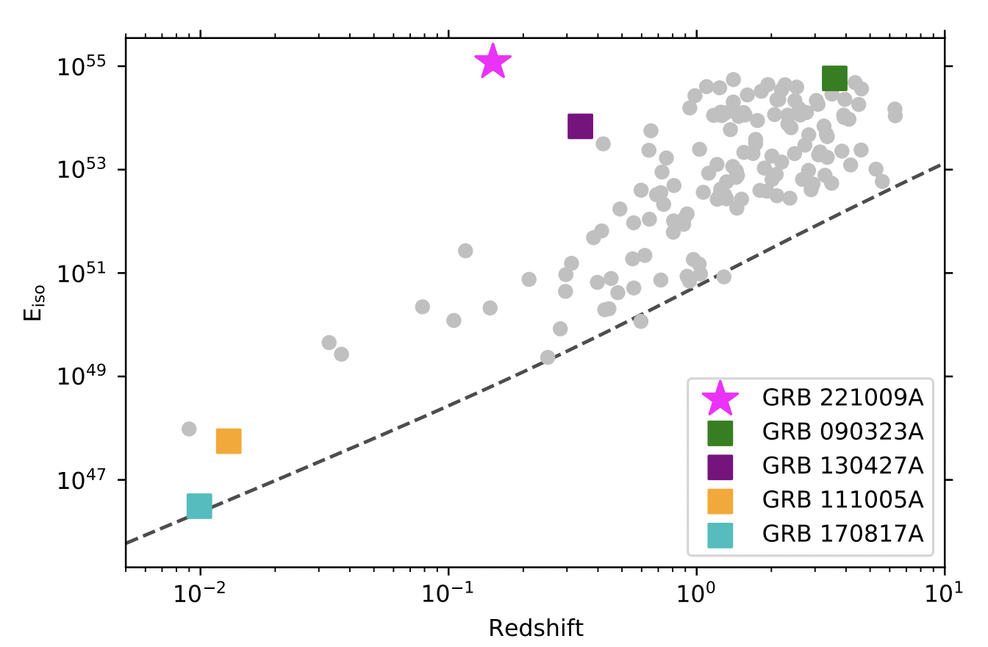
GRB 221009A in Context
Isotropic equivalent energy of 10⁵⁵ erg at z = 0.151 (Lesange et al. 2023)
Brightest GRB ever detected, once in a 10,000 year event (Burns et al. 2023)
Burns et al. (2023)
25

Slide 26
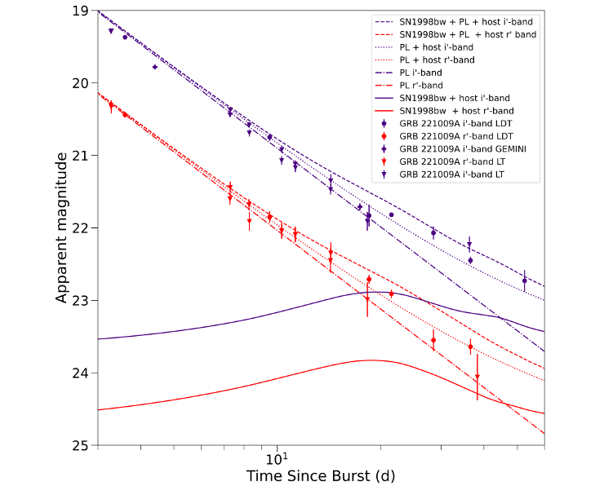
GRB 221009A/SN 2022xiw
  Decay Index 1.434 ± 0.004
  Host galaxy r ~24.9, i ~ 23.8 (Levan et al. 2023)
  E(B-V)_MW=1.3048 mag and E(B-V)_host=0.3 mag
  SN 1998bw’s transformed LCs @ z=0.151
Srinivasaragavan et al. (2023)
26

Slide 27
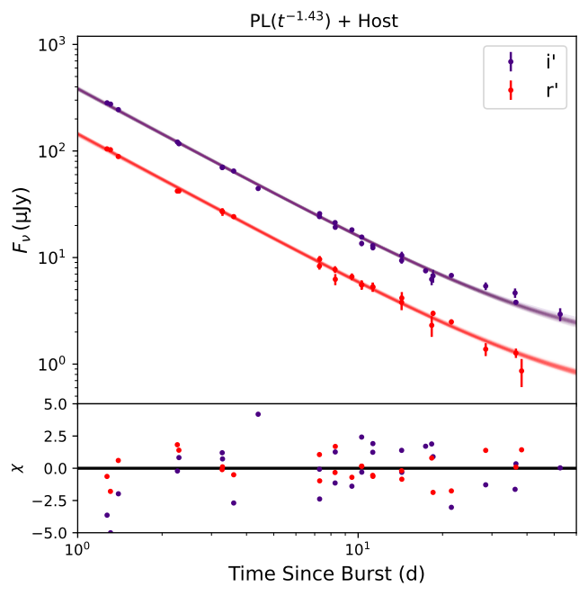
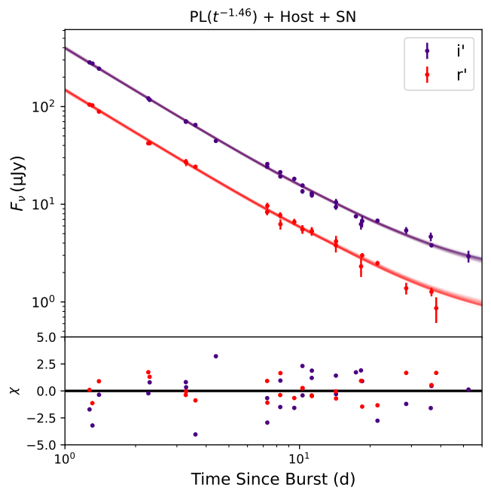
Afterglow model
Afterglow + SN Model
Srinivasaragavan et al. (2023)
Srinivasaragavan et al. (2023)
Afterglow + SN model favored with Log (K_Bayes) = 1.2, SN 2022xiw (Postigo et al. 2022) ~ 40% as bright as SN 1998bw
Consistent with JWST observations (Levan et al. 2023, Blanchard et al. 2024)
27

Slide 28
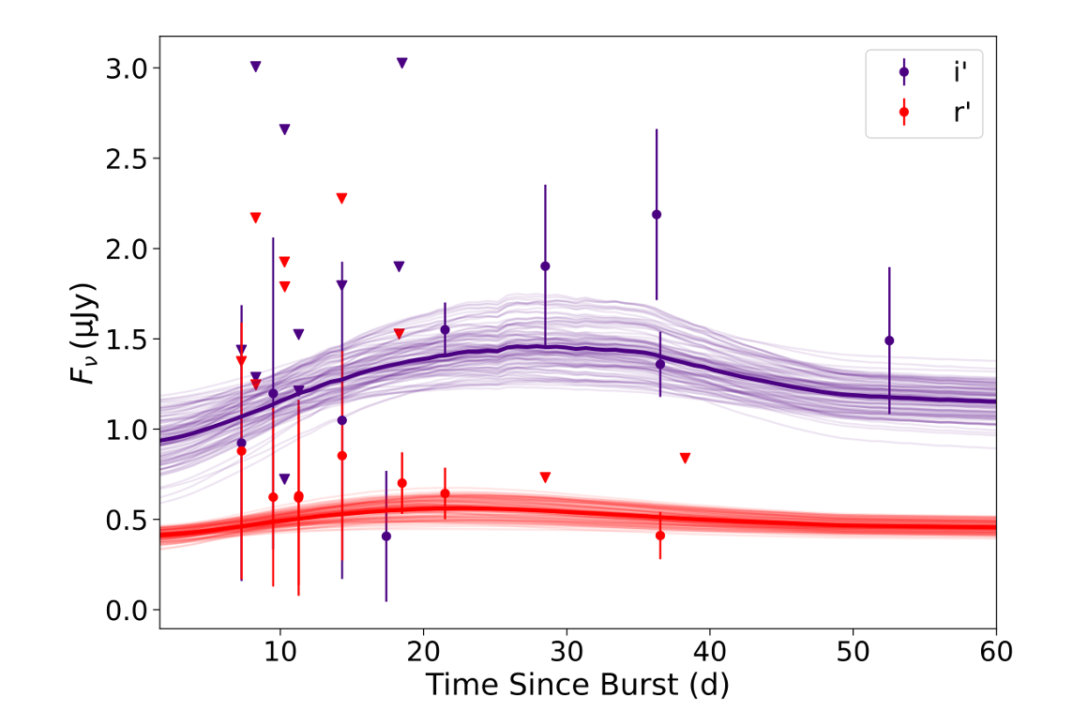
SN Analysis
  Isolated SN LC and Arnett (1982) Nickel-powered models
  Nickel mass ~ 0.05 - 0.25 solar masses, < 0.36 solar masses
  Ejecta mass ~ 3.5 -11.1 solar masses
  Kinetic energy ~ 1.6 - 5.2 × 10⁵² erg
Srinivasaragavan et al. (2023)
28

Slide 29
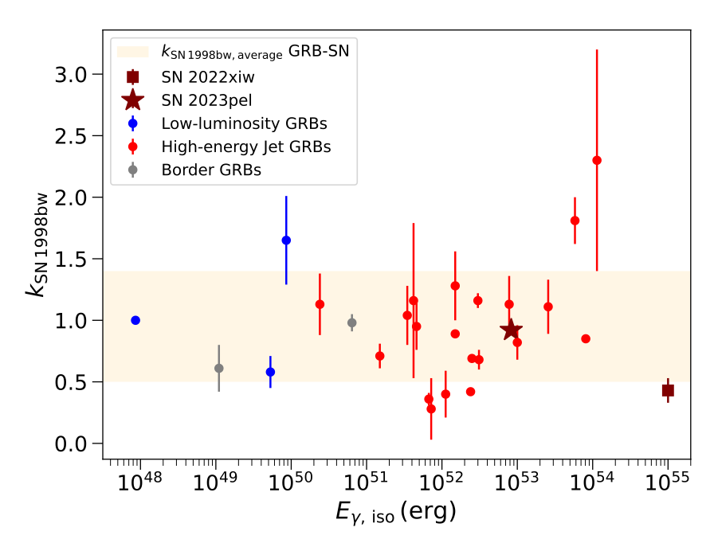
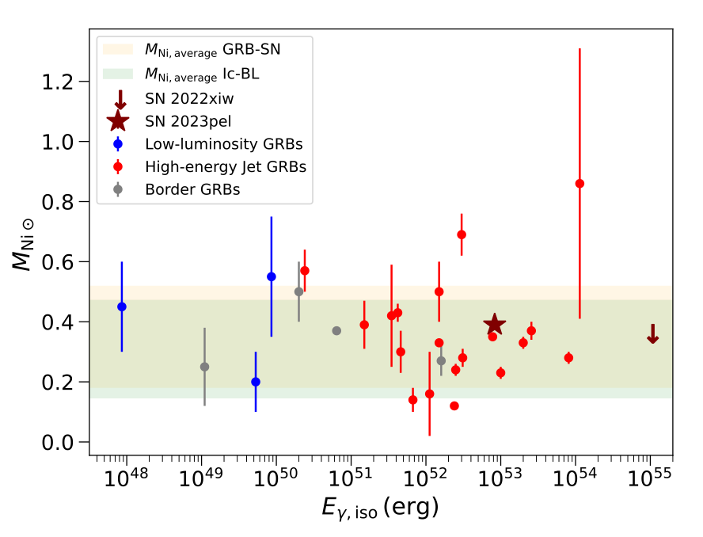
REVISITING GRB-SN PROPERTIES
SN emission appears to be largely decoupled from central engine activity in GRB-SN systems.
29

Slide 30
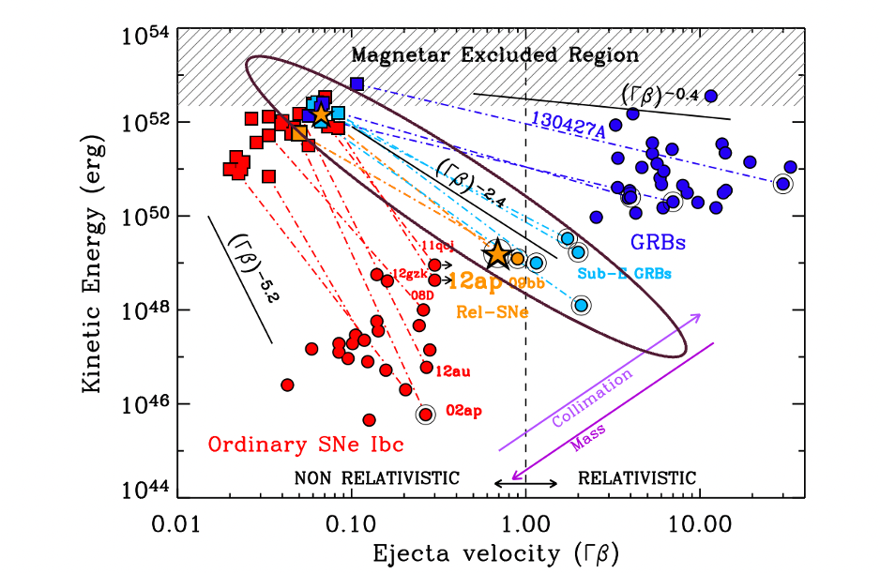
THE FUTURE: EXOTIC RELATIVISTIC TRANSIENTS (E.G., ORPHAN AFTERGLOWS, X-RAY FLASHES)
Srinivasaragavn et al. (2025) (on arXiv and in publication process to MNRAS) and Future Works
Why do some afterglows lack an associated GRB counterpart?
What physical systems create X-ray Flashes?
30

Slide 31
Credit: Anna Ho
Orphan Afterglows
  Discovered at UVOIR wavelengths, no GRB found post-facto
  Off-axis GRB? Dirty fireball with low Lorentz Factor? Something else?
  6 orphan afterglows with redshifts do not have a GRB-discovered post-facto (Srinivasaragavan et al. 2025 is 6th event)
X-ray Flashes
  Discovered in soft X-rays, peak energy < 30 keV
  Same physical mechanisms (maybe?) as orphan afterglows, or something else?
  7 XRFs with associated SNe thus far in literature
  Working on 8th (EP 241021a)
31

Slide 32
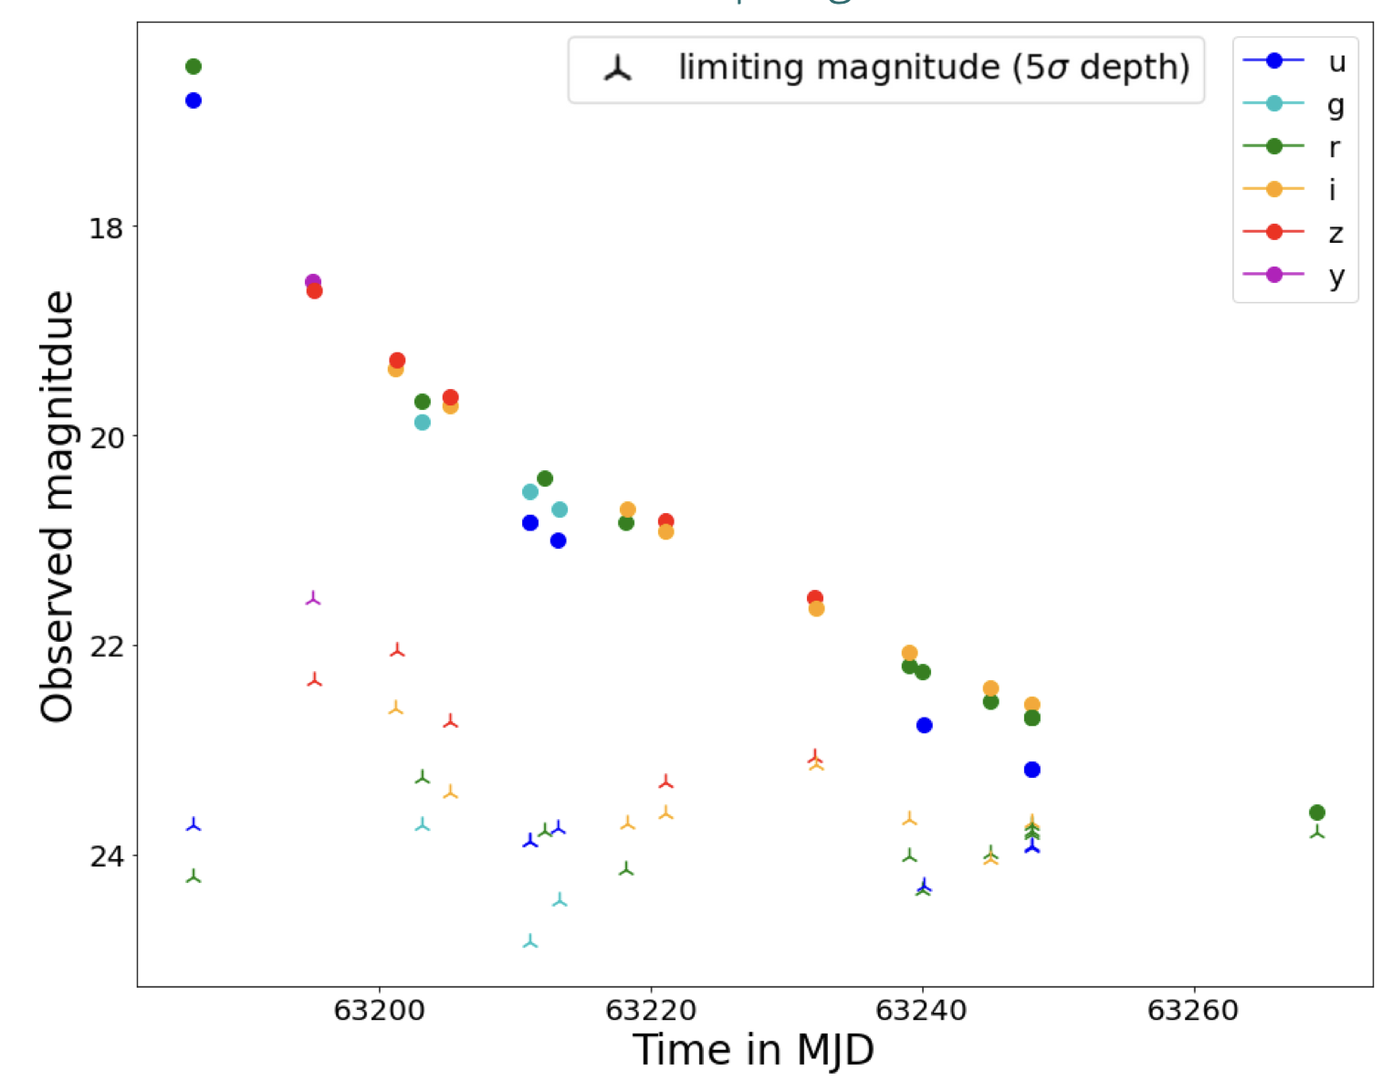
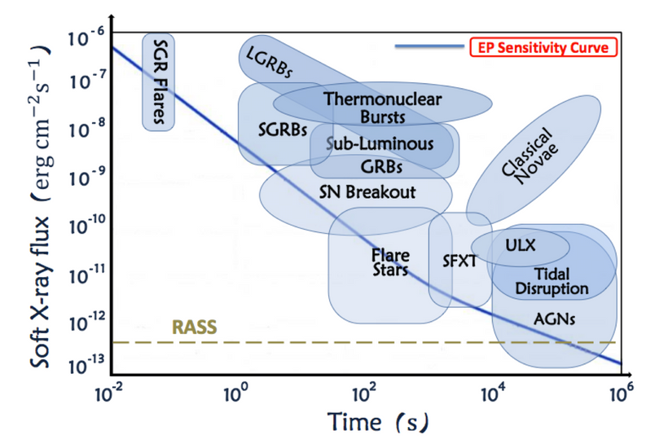
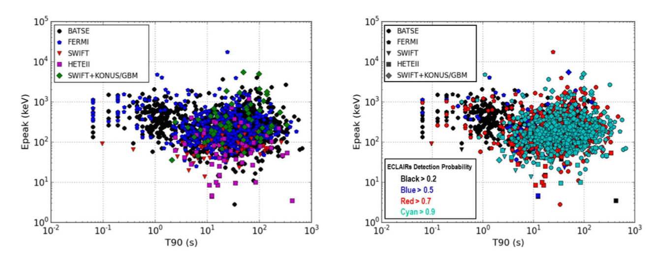
Next Generation Missions
LSST simulation of GRB afterglow (in presentation by Masson & Bregeon)
Einstein Probe (0.5 - 5 keV; in Presentation by Yuan)
SVOM (4 - 150 keV; Wei et al. 2016)
32

Slide 33
Observational studies of the continuum of relativistic stellar explosions are elucidating major open questions that affect our understanding of massive stellar evolution and the physics of relativistic jets.
33

Slide 34
THANK YOU!
34

Slide 35
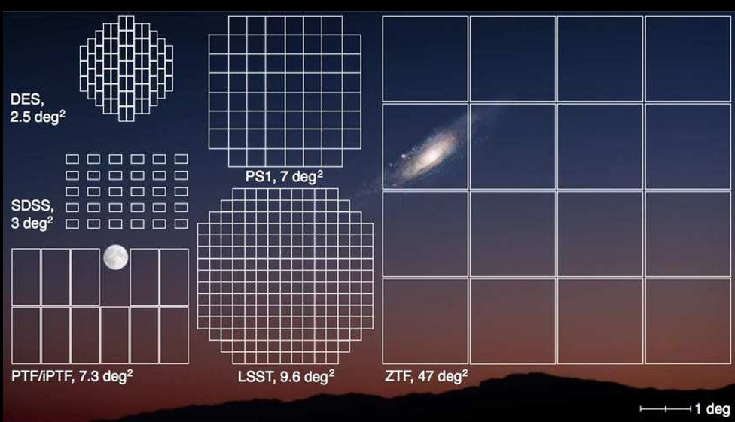
Zwicky Transient Facility
  A time-domain survey using the Palomar 48-inch Schmidt telescope
  Surveys entire Northern visible sky to Dec ~ –28°
  Fast cadence - surveys entire Northern sky every two - three nights in the g and r bands, with intermittent coverage in i band for select fields
  Single exposure depth (5σ): r ~ 20.5 mag.
  Large FOV, high cadence makes it extremely well-suited for transient science
From ZTF Website
35

Slide 36
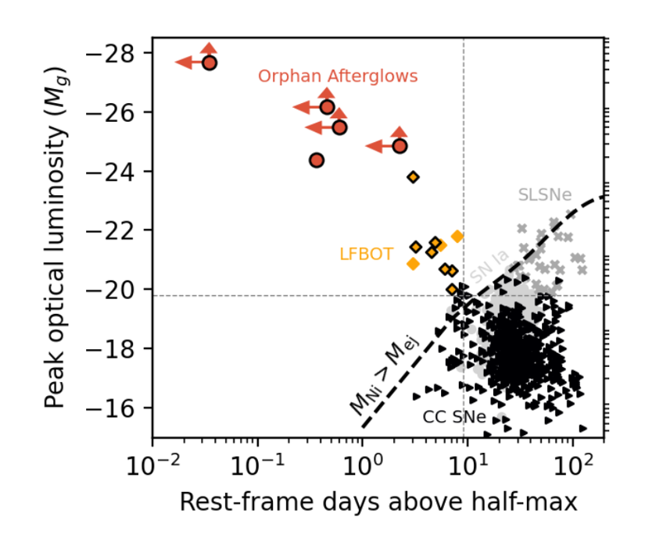
ZTF is well-equipped to discover these events (~6 optically-discovered afterglows, ~4 LFBOT candidates per year)
Credit: Anna Ho
Orphan Afterglows
  Only 6 orphan afterglows with redshifts do not have a GRB-discovered post-facto
  Off-axis GRB? Dirty fireball with low Lorentz Factor? Something else?
LFBOTs
  Rise times too quick, luminosities too large for solely Nickel powering
  Most found in star-forming galaxies
  Shock breakouts, failed SNe with relativistic ejecta, TDEs?
36

Slide 37
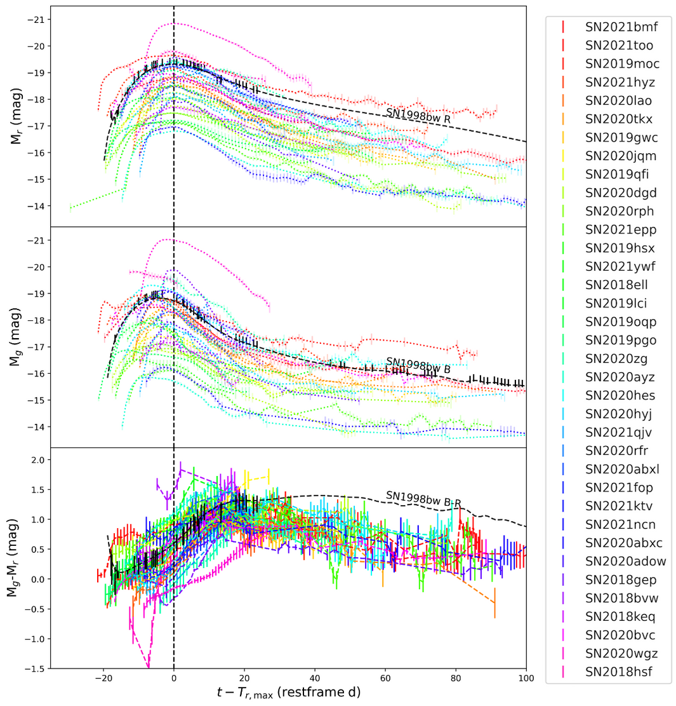
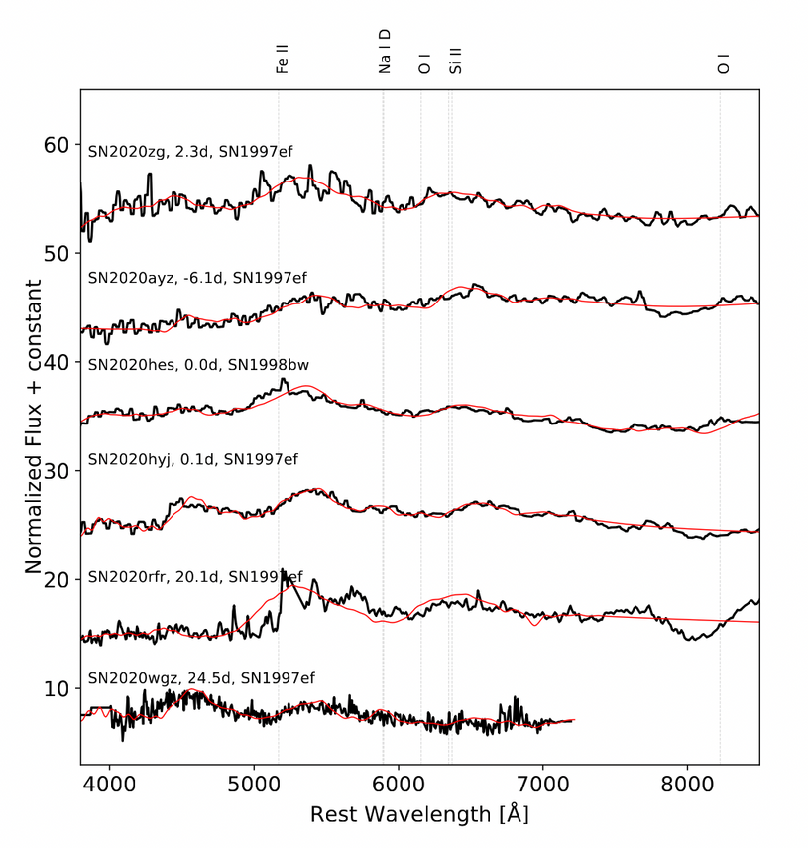
Optical Analysis
Srinivasaragavan et al. (2024b)
Srinivasaragavan et al. (2024b)
Supernova LCs and colors, with all magnitudes corrected for Galactic extinction.
Photospheric phase spectra and best fit SNID templates

Slide 38
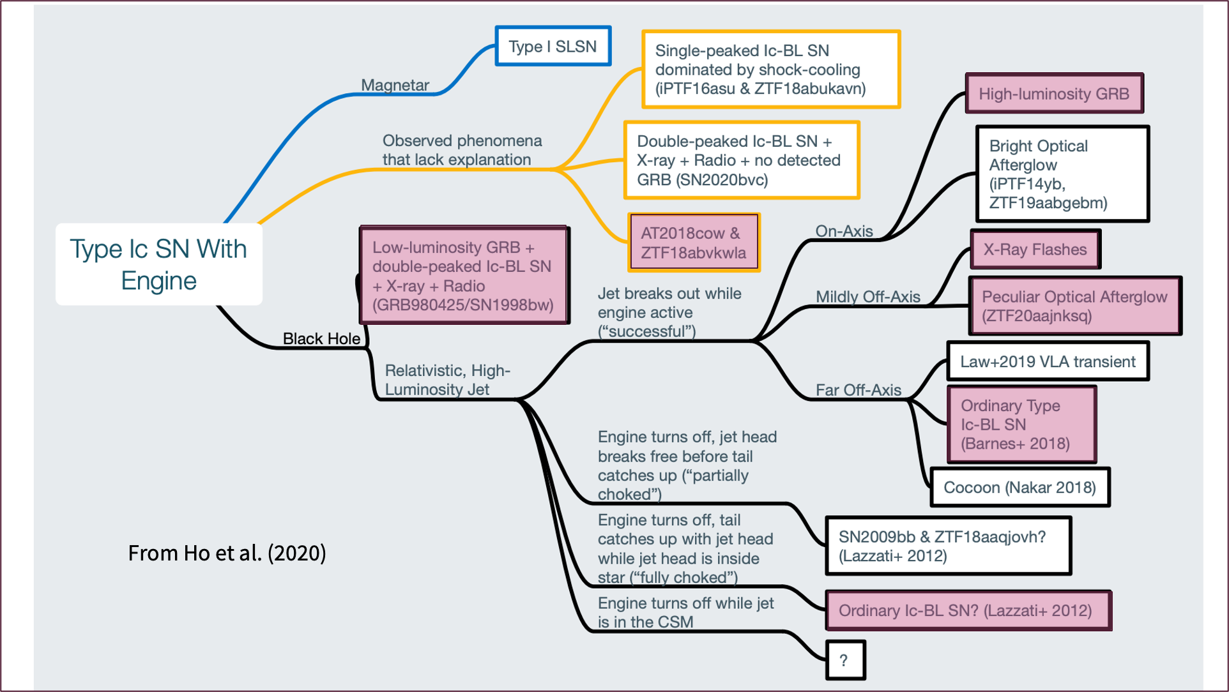
38

Slide 39
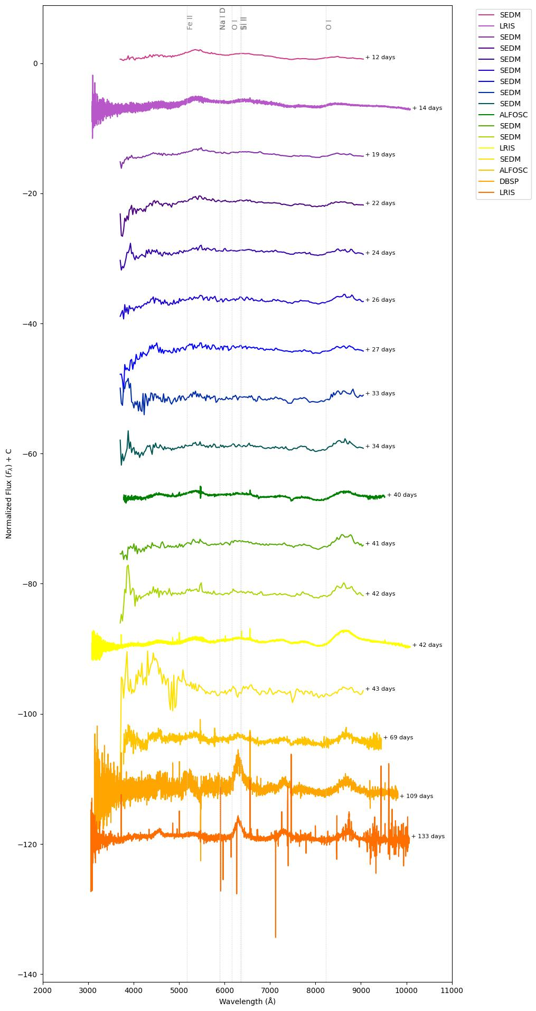
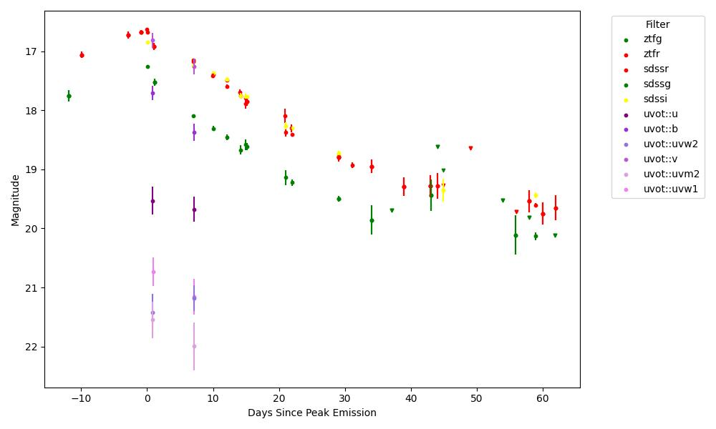

SN 2022crr: A Nearby SN Ic-BL
Mousa et al. in Prep.
Photometric light curve (left) and spectral evolution (right) of SN 2022crr. Photometric data comes from ZTF, SEDM, and Swift. Significant absorption features are shown in the spectra
39
Muhammad Mousa, Senior at UVA
Mousa et al. in Prep.

Slide 40
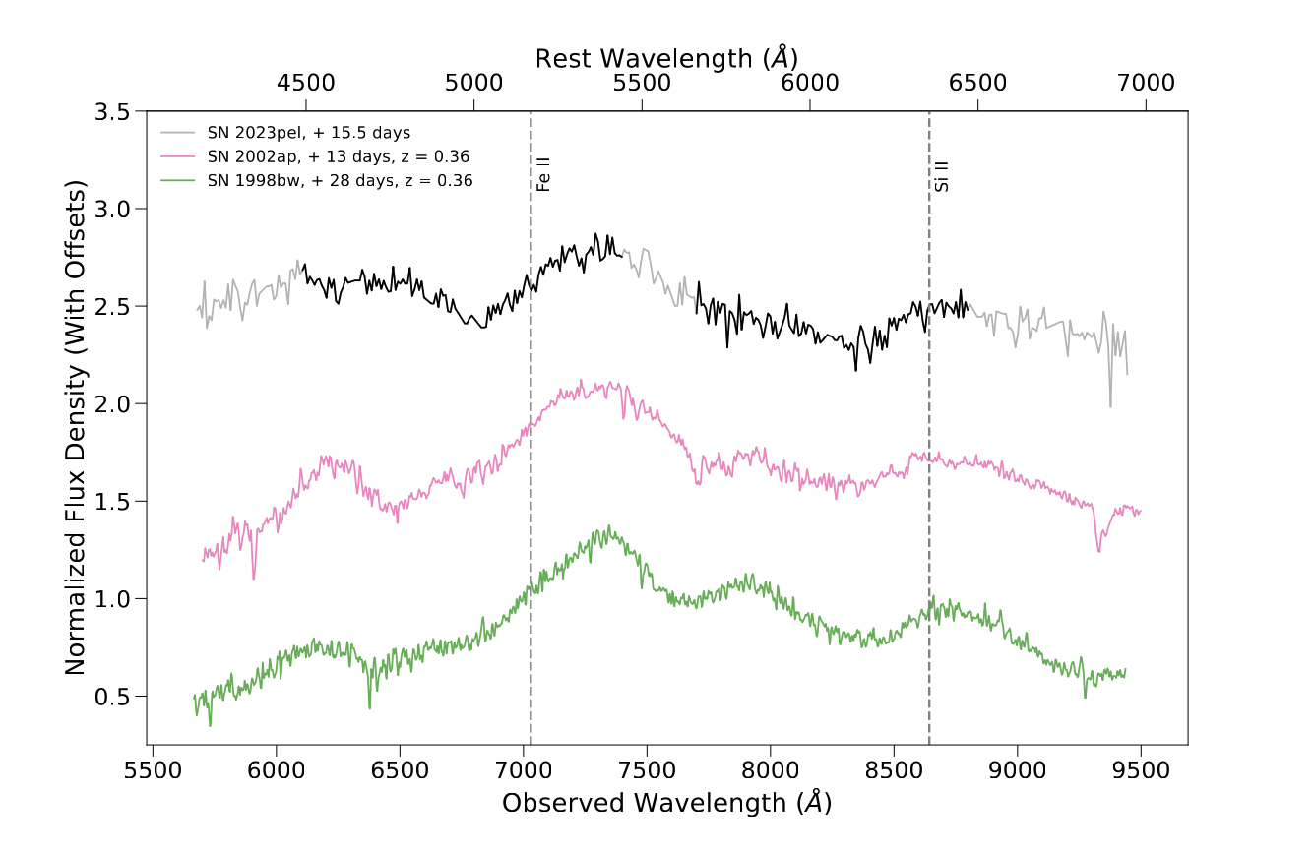
Spectrum Analysis
Srinivasaragavan et al. (2024)
Spectrum taken 27.4 days after GRB, 15.4 days after SN peak in r band
Photospheric expansion velocity of 11,300 ± 1,600 km/s
Ejecta mass = 1.0 ± 0.6 solar masses
Kinetic Energy ~ 10⁵¹ erg
40

Slide 41
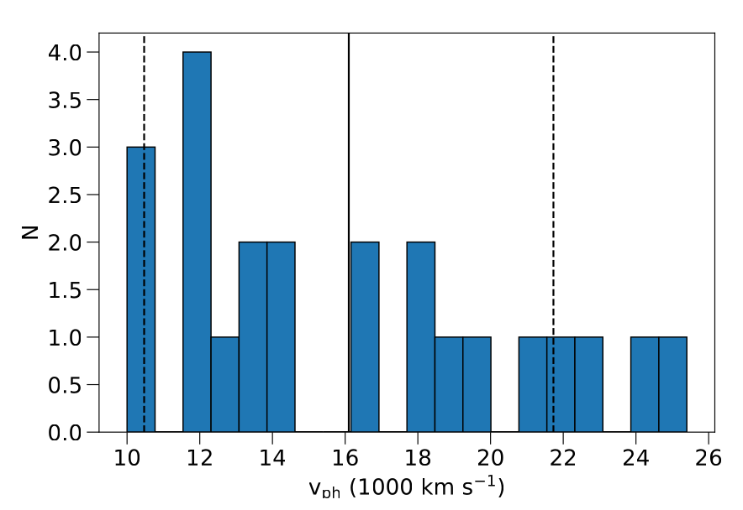
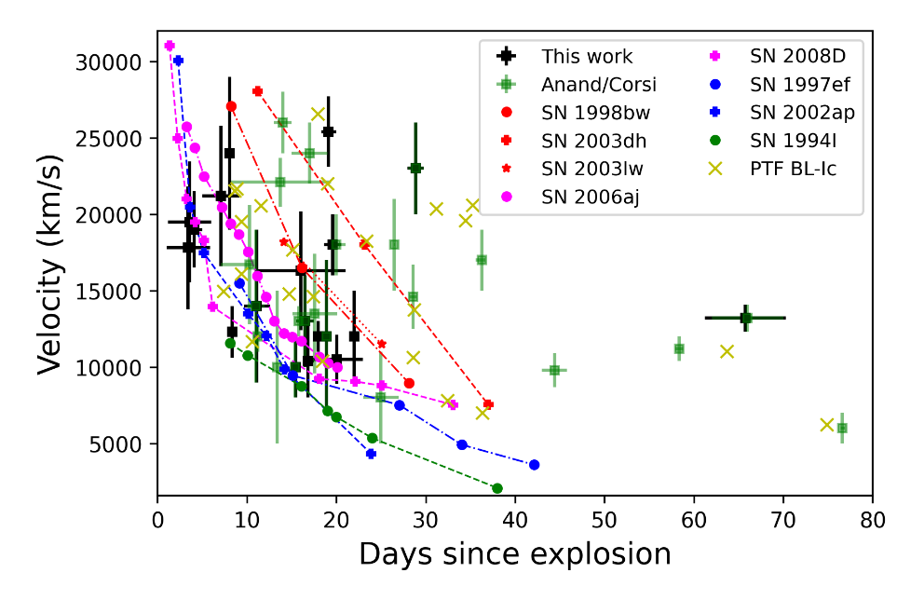
Srinivasaragavan et al. (2024b)
Srinivasaragavan et al. (2024b)
The peak photospheric velocities for the sample, with the mean velocity (16,100 km/s) and one sigma standard deviation (5,600 km/s) range shown.
SN velocities measured from the Fe II 5169 Angstrom line as a function of the spectroscopic phase, along with events from literature.
41

Slide 42
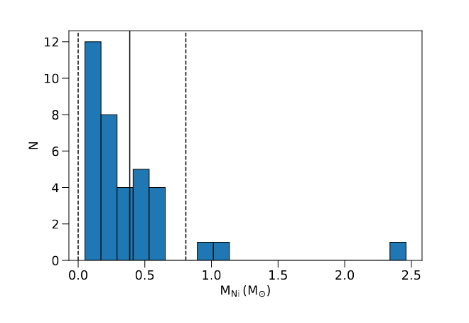
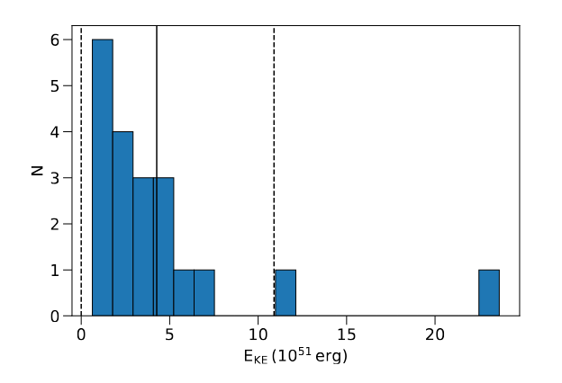
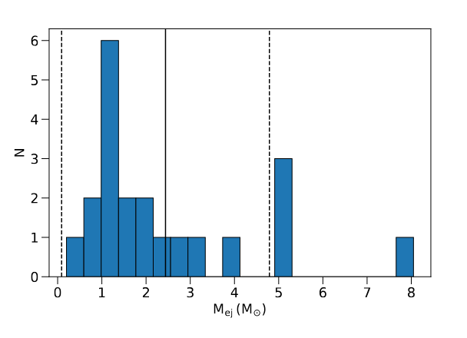
Explosion Parameters
Average Ni mass of 0.37 solar masses, one sigma standard deviation of 0.42 solar masses.
Average kinetic energy of 4.0e51 erg, one sigma standard deviation of 6.5e51 erg.
Average ejecta mass of 2.45 solar masses, one sigma standard deviation of 2.35 solar masses.
Srinivasaragavan et al. (2024b)
Srinivasaragavan et al. (2024b)
42
Srinivasaragavan et al. (2024b)

Slide 43
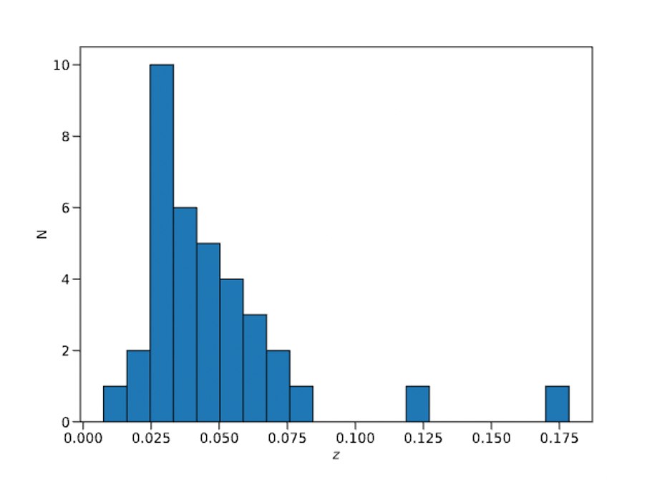
Redshift Distribution
Redshift distribution of sample, with range z = 0.017 to z = 0.1785. All events with exception of SN 2020wgz and SN 2018hsf have z < 0.082.
Srinivasaragavan et al. (2024b)
43

Slide 44
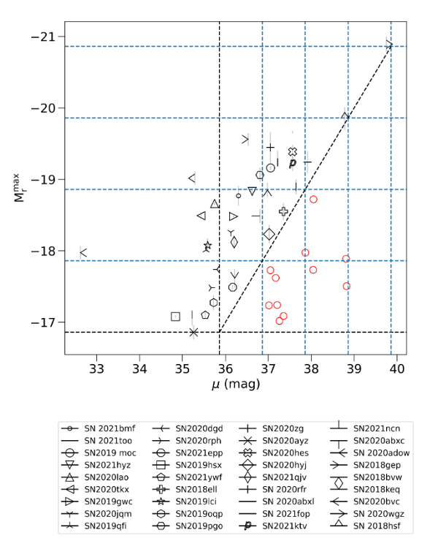
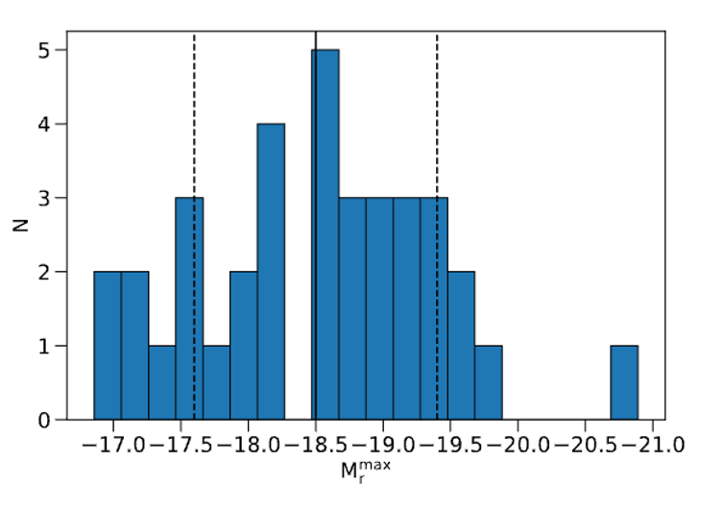
Photometric Analysis
Srinivasaragavan et al. (2024b)
Srinivasaragavan et al. (2024b)
Peak r band absolute magnitude distribution of the sample , with mean magnitude (-18.51 mag) and standard deviation (0.90 mag) range shown.
Investigation of the Malmquist bias on the sample. The overall effect is a 0.2 mag decrease in the overall average peak magnitude distribution.
44

Slide 45
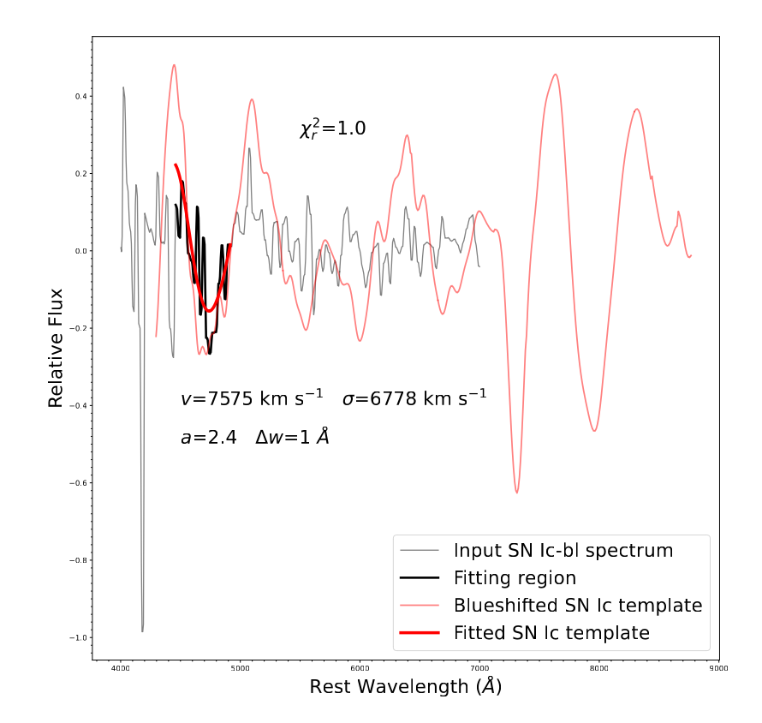
Spectroscopic Analysis
Srinivasaragavan et al. (2024b)
Srinivasaragavan et al. (2024b)
Photospheric phase spectra and best fit SNID templates
Example of velocity fitting procedure for SN 2018hsf, utilizing Modjaz et al. (2016)
45

Slide 46


Bolometric LC Analysis
Bolometric luminosity LCs for the Ic-BL sample, calculated using Lyman BC coefficients. The bolometric luminosity LC of SN 1998bw is also shown as comparison.
Blackbody temperature and radii evolution for the Ic-BL sample.

Slide 47


SN 2020wgz
Spectra of SN 2020wgz - a possible transition event from SLSN-I to Ic-BL
Srinivasaragavan et al. (2024b)
LC modeling of SN 2020wgz, utilizing a magnetar powered model with an additional Nickel-powered component (Omand and Sari 2023).
Srinivasaragavan et al. (2024b)
47

Slide 48


AT 2023sva (The Swan)
Srinivasaragavan et al. in Prep.
Srinivasaragavan et al. in Prep.
Radio luminosity of AT2023sva compared to GRB afterglows (Perley et al. 2014; Whitesides et al. 2017). We ruled out a gamma-ray counterpart to 2e52 erg.
ZTF LC of AT2023sva in the g, r, and i bands. The best-fit power-law decay index is 3.2 ± 0.3, charactersitic red colors and z = 2.28
48

Slide 49


Slide 50


Slide 51


Slide 52


Slide 53

Srinivasaragavan et al. (2024a)
Srinivasaragavan et al. (2024a)
Spectrum of afterglow taken 27.4 days after GRB, 15.4 days after SN peak in r band
Photospheric expansion velocity of 11,300 ± 1,600 km/s
Ejecta mass = 1.0 ± 0.6 solar masses
Kinetic Energy ~ 10⁵¹ erg
53

Slide 54
Data set used | SN model used | S-Correction Factor | Bayes Factor
Full | SN 1998bw | No | 10^4.0 SN model
Full | SN 1998bw | Yes (one for all telescopes) | 10^1.2 SN model
Full | SN 1998bw | Yes (different for each telescope) | 10^0.7 SN model
LDT only | SN 1998bw | No | 10^0.9 afterglow model with α=1.36
LT only | SN 1998bw | No | 10^0.0 indistinguis-hable
Full | SN 2013dx | Yes (one for all telescopes) | 10^0.7 SN model

Slide 55


Slide 56

Source Size Upper Limits
56

Slide 57


Slide 58


Slide 59
OUTLINE
Introduction and Motivation
Chapter 1: An Analysis of Type Ic-BL SNe from the Zwicky Transient Facility
Chapter 2: Characterizing SNe associated with LGRBs
Chapter 3: Orphan Afterglows and LFBOTs
Chapter 4: LGRB Afterglow Rates for ULTRASAT
Future Directions
59

