Slide 1
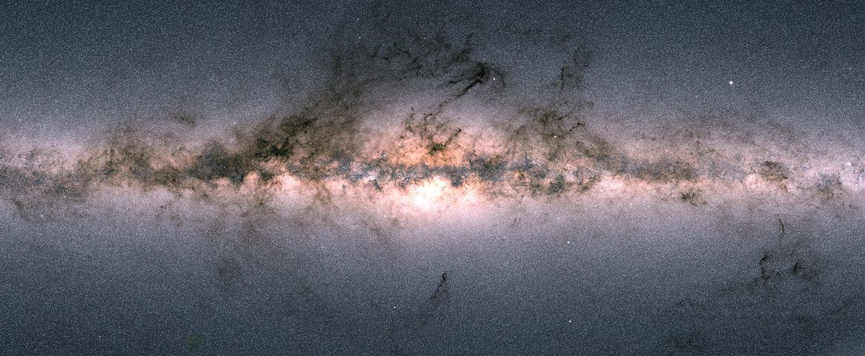
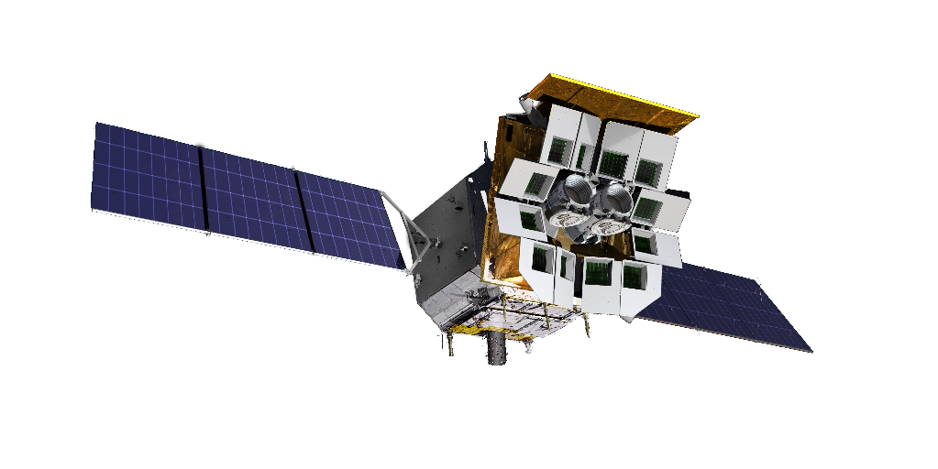

Soft X-ray prompt emission from the high-redshift GRB EP240315a
Y. Liu (NAOC), H. Sun (NAOC), D. Xu (NAOC), D. S. Svinkin (Ioffe), J. Delaunay (PSU), N. R. Tanvir (UL), H. Gao (BNU), C. Zhang (NAOC), Y. Chen (IHEP), X.-F. Wu (PMO), B. Zhang (UNLV), W. Yuan (NAOC) et al.
Nature Astronomy https://doi.org/10.1038/s41550-024-02449-8

Slide 2
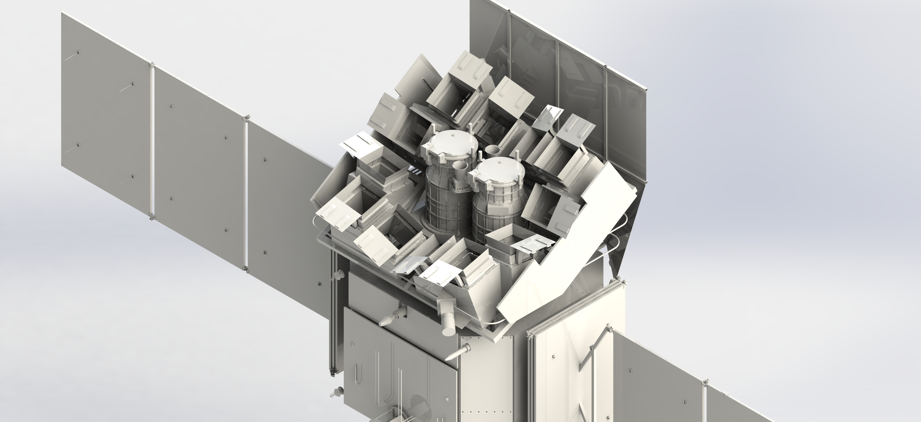

Einstein Probe
Spacecraft
On-board data processing
Quick slew & autonomous follow-up
Wide-field X-ray Telescope
WXT (12 modules)
Follow-up X-ray Telescope
FXT (2 units)
lobster-eye MPO
FoV: 3600 sq deg (1.1 sr)
band: 0.5 – 4 keV
spatial resolution: ~ 5’ (FWHM)
sensitivity: 10⁻¹¹ erg cm⁻² s⁻¹ (1 ks)
Wolter-1 optics
FoV: ~1 deg
band: 0.3-10 keV
effective area: 300 cm² @1 keV (1 unit)
spatial resolution: 30” (HPD on-axis)
Notes:
WXT can also process the data on-board in real time. If there is new transient, the spacecraft can perform quick slew and autonomous follow-up observations with FXT. Then we get precise localization down the arcsec level. There features are all optimized for fast X-ray transient.

Slide 3
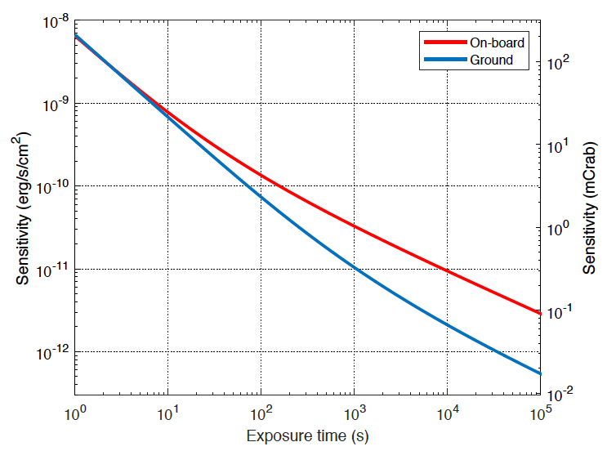
Simulated EP WXT sensitivity
central spot used only
Long GRB
photon limited
regime
Expect new phenomena or
New types of transients
0.3mCrab
5-sigma c.l.
power-law 𝛤=-2,N_{H}=3.e20cm⁻²
background limited
backgrounds : particles, diffuse background, with shielding
~ 1 survey snapshot
background 3.3 counts @ central spot
Notes:
we expect EP can detect some faint fast transients that we don’t know before.

Slide 4
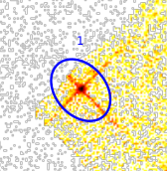
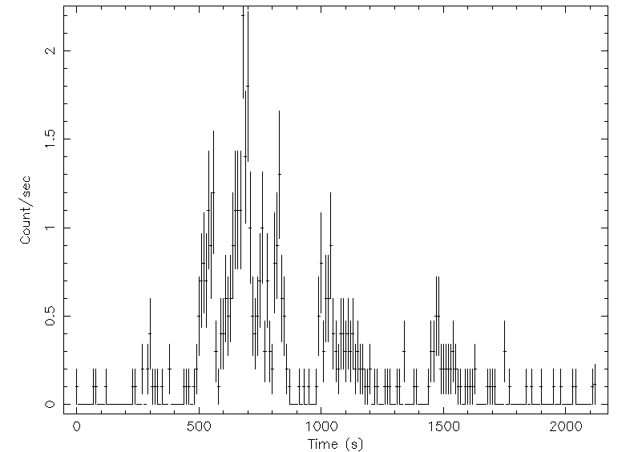
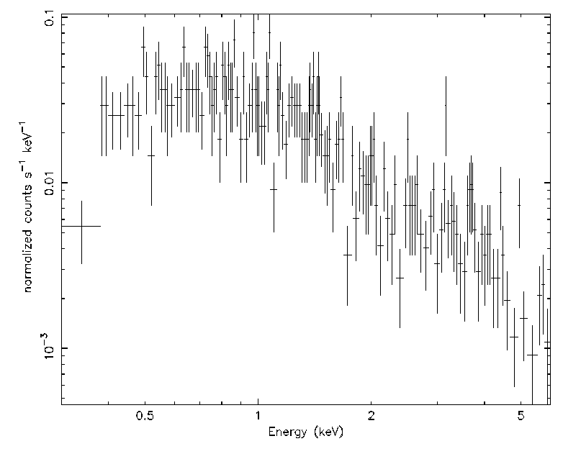
Timeline of EP240315a
2024-03-15T20:15:19 triggered on-board processing unit
20:15:30 EPSC received transient Alert
20:25:29 EPSC received VHF photon list
03-16T15:49:37 WXT detection GCN
03-17T01:02:52 VLT z~4.9
03-17T14:10:00 EP-FXT ToO follow-up obs
Image
Light curve
Spectrum
Notes:
10 days after the calibration; 2 weeks after the full operation of WXT; latency due to commissioning; after telemetry data

Slide 5
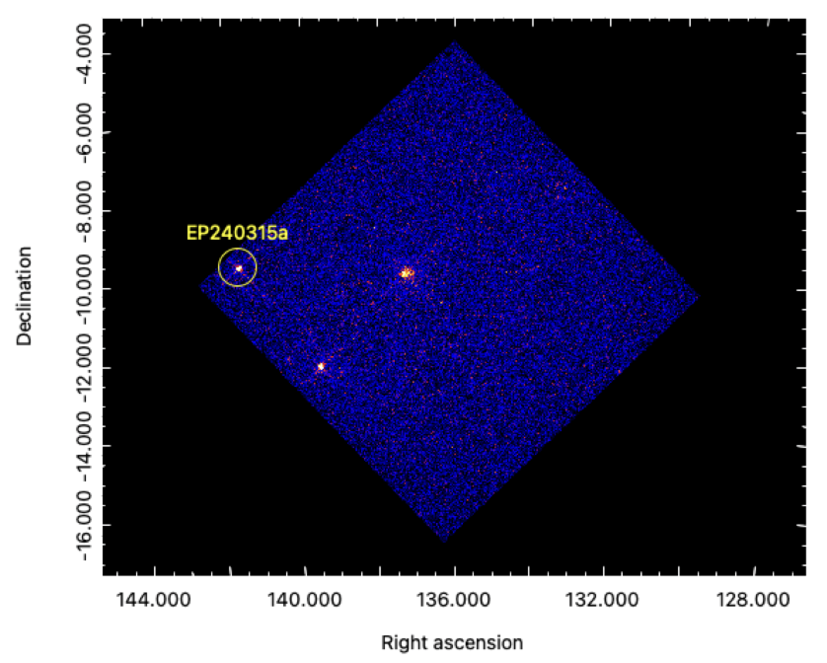
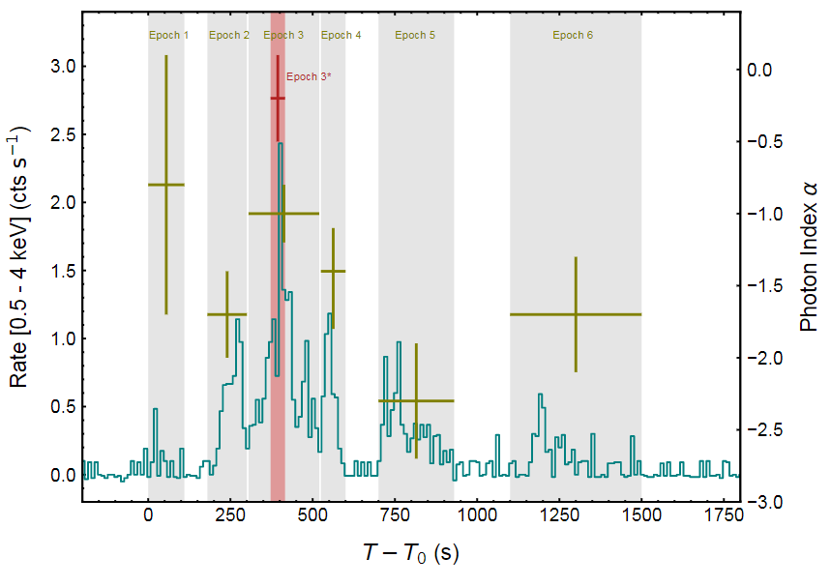

Imaging & Spectral evolution
A long calibration observation of Vela SNR (UTC 2024-03-15T18:00:22 to 2024-03-16T05:08:19)
Harder spectrum in the interval with γ-ray detection
Intense activity before γ-ray detection
T90 (WXT) = 1034±81 s
N_{H, z} = ${5.9}_{−4.6}^{+4.9}$×10²² cm⁻²
T0 = 2024-03-15T20:10:44
T90 (BAT) = 41.6±1.6 s; T90 (KW) = 38±3 s
Notes:
The WXT observation clearly shows that the central engine has already begun intense activity long before the detection of gamma-rays. The X-ray duration is longer than the gamma-rays one by a factor of 25.

Slide 6
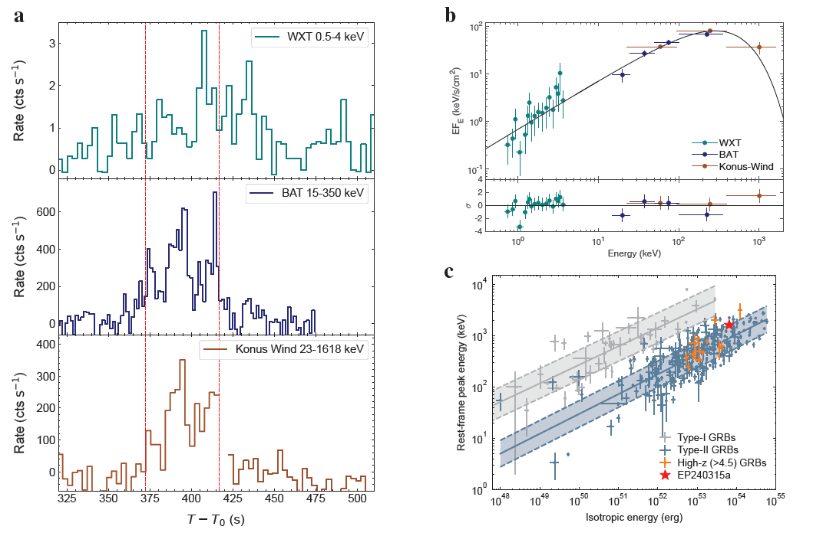

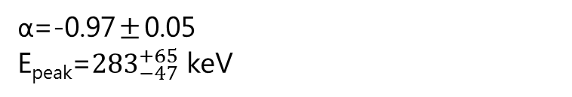
Broad band joint fitting
Common origin of X-ray and γ-ray
10⁻⁶ erg cm⁻²
α=-0.97±0.05
E_{peak}=${283}_{−47}^{+65}$ keV
Positive lag =10.7±1.1 s
E_{iso}=${6.4}_{−0.8}^{+0.4}$×10⁵³ erg/s
10⁻⁵ erg cm⁻²
Notes:
the X-ray is likely to have a common origin with the gamma-rays associated with the internal dissipation process.

Slide 7
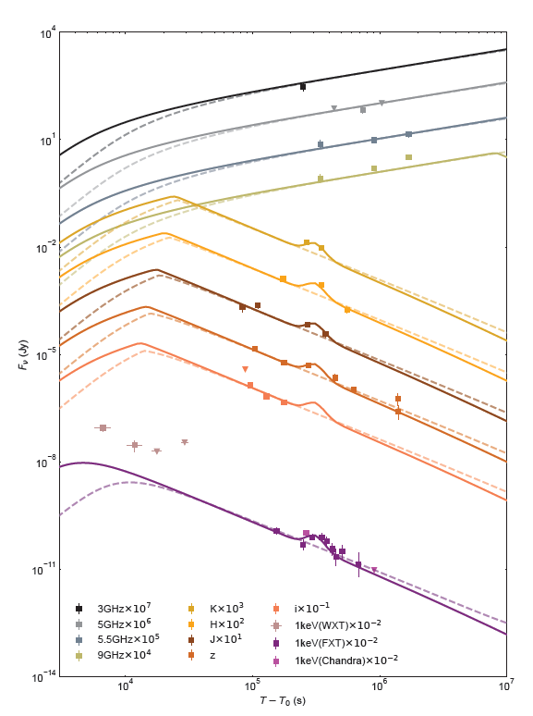
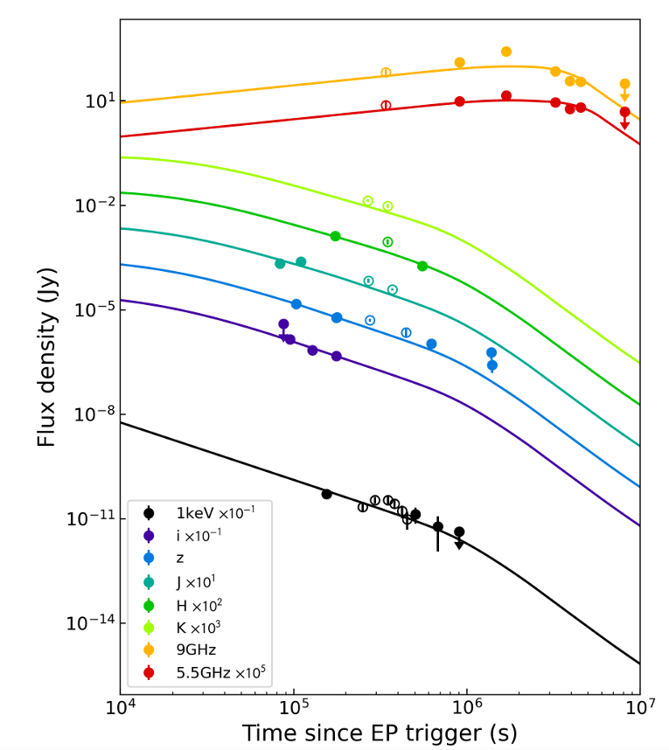
Multi-wavelength Afterglow
Well described by the forward shock model
No jet break
Loose constraints on params
WXT detections due to late central engine activity
A re-brightening signature at ~3.5 day (re-activation or complex jet structure)
Jet break detected in late radio obs (Ricci+2024)
Radio
Optical & IR
WXT
FXT
Notes:
Two additional WXT detections after the main prompt emission
10 EP-FXT follow-up observations ; re-activation of the central engine or to off-axis observations of complex jet
structures

Slide 8
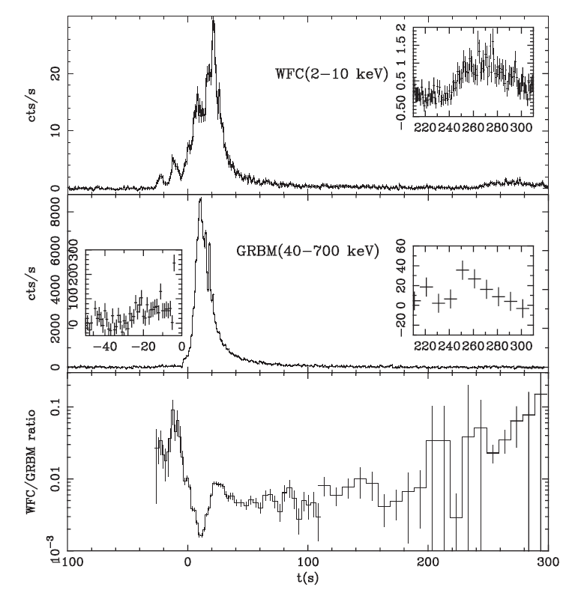
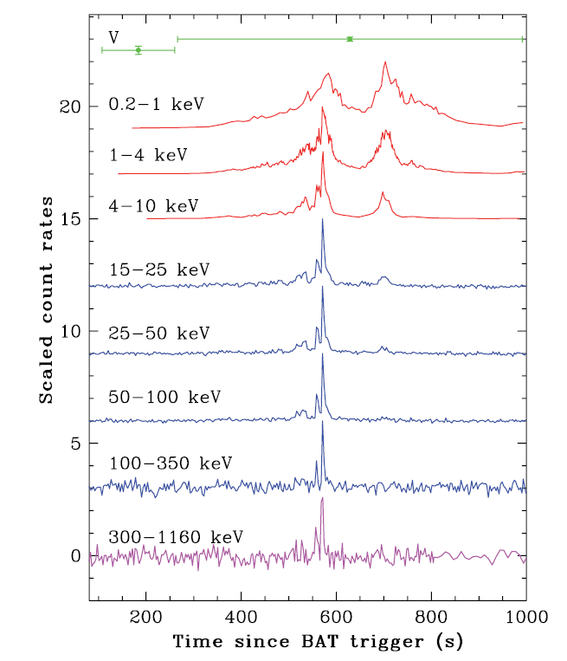
Prompt emission detected in X-ray
GRB 060124
XRT
GRB 011211
BAT
KW
Precursor
Piro+2005
Romano+2006
Notes:
Precursor 30 s before; not isolated from the main pulse; 300 s for 0315a

Slide 9
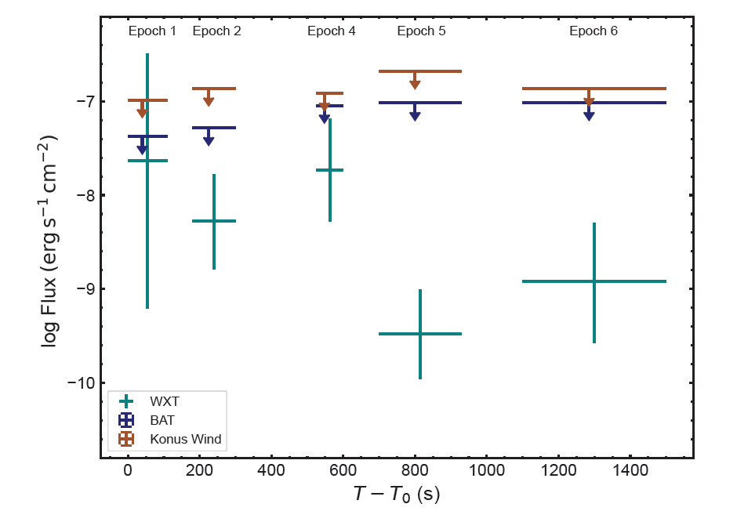
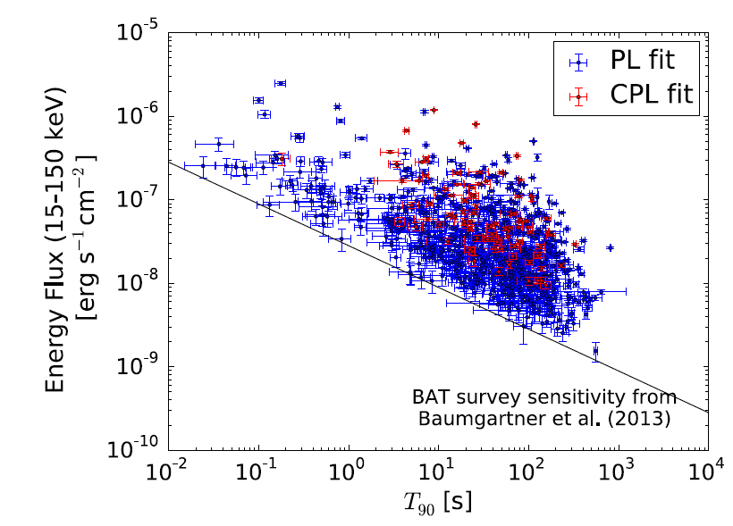
Detection prospect
EP240315a was out of the FoV of BAT
Extrapolated fluxes vs Upper limit
BAT normal sensitivity (100-200 s) 2-3×10⁻⁹ erg cm⁻² s⁻¹
WXT sensitivity (100-200 s; α=-2) 1-2×10⁻¹⁰ erg cm⁻² s⁻¹
BAT 3rd GRB catalog
Lien+2016
Notes:
we expect there will be more examples like 0315a that some pulses or the entire event cannot be detected in gamma-ray band

Slide 10
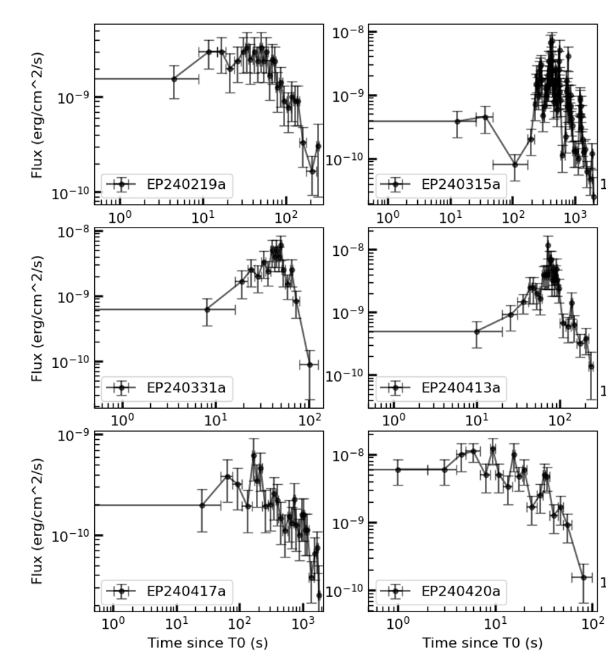
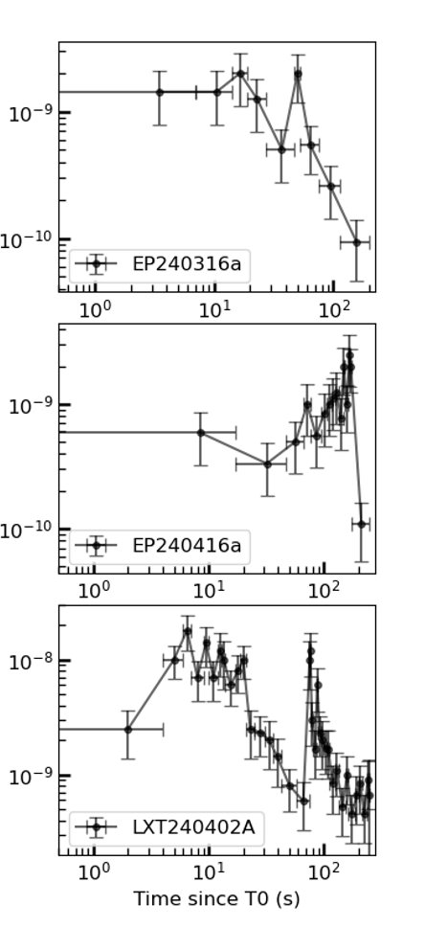
More fast X-ray transients
EP241026a
GRB 241026A
z=2.79
See more details in Qingyu’s talk
Notes:
吴沁宇 catalog 1026A

Slide 11
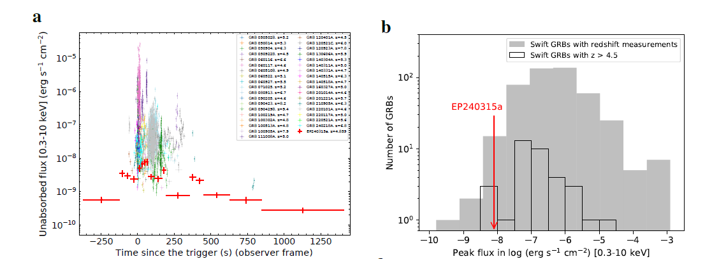
Comparison with high-z GRBs
At faint and long end in high-z GRBs

Slide 12
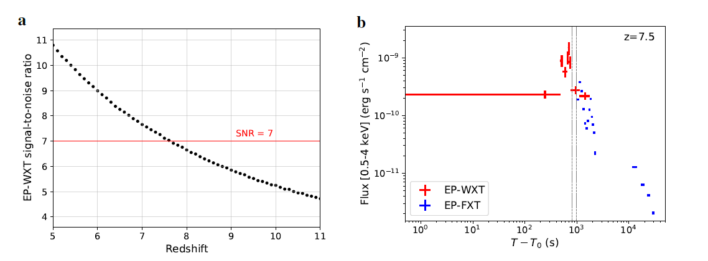
Expect more high-z GRBs
EP240315a can still be detected at z=7.5
Autonomous follow-up by FXT (precise localization ~10”)
Notes:
It will get the early emission phase of the source like 0315a. The positional error of FXT will be about 10 arcsec, which should increase the probability of redshift measurement.

Slide 13
Summary
EP-WXT captured the early engine activation and extended late engine activity through a continuous detection
Pose challenges to conventional definitions, e.g. T₉₀, T₀, and temporal slope
A peak X-ray flux at the faint end of previously known high-z GRBs
Great potential of EP to study the early universe via GRBs
Automated sending of WXT GCN Notice (5 min) and timely follow-up (https://gcn.nasa.gov/missions/einstein-probe)
~100 X-ray transients and expect more
Notes:
How to select T0

