Slide 1

Gamma-ray bursts progenitors revisited
Swift 20 years, Florence
Andrew Levan

Slide 2

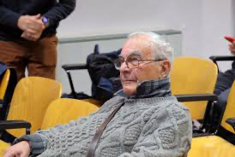
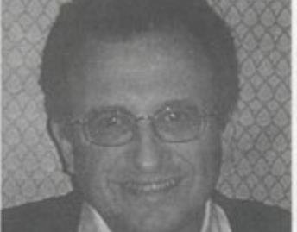
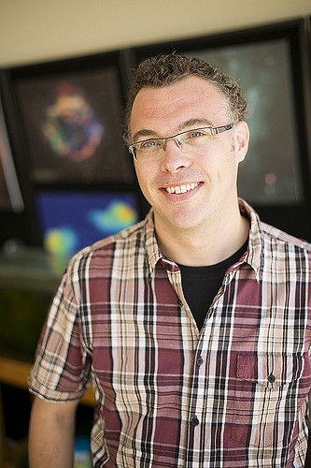

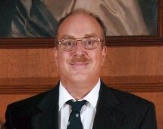
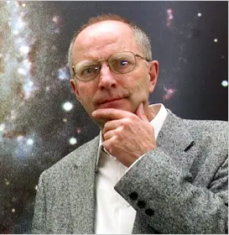
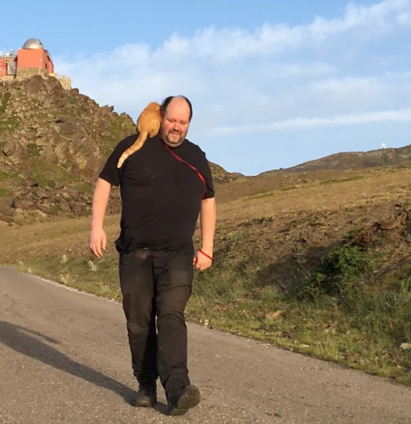
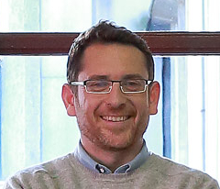
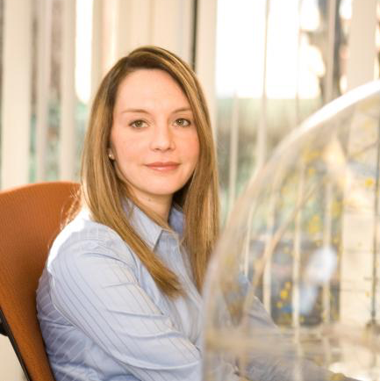
For those who cannot be here
Neil Gehrels
Guido Chincarini
David Band
Peter Curran
Kevin Hurley
John Cannizzo
Bodhan Paczynski
Alex Kann
Javier Gorosabel
Alicia Soderberg

Slide 3
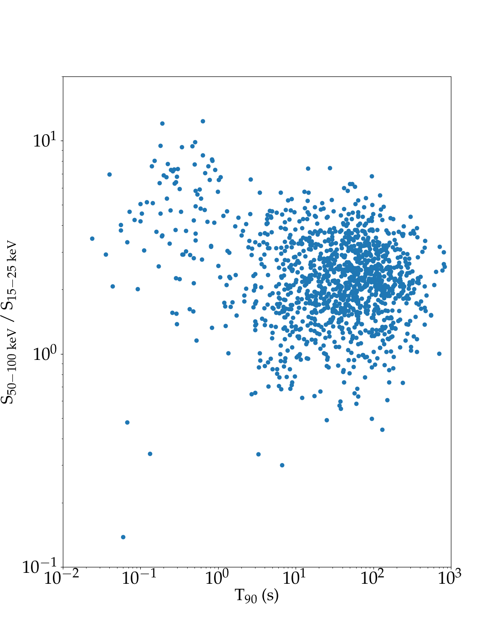
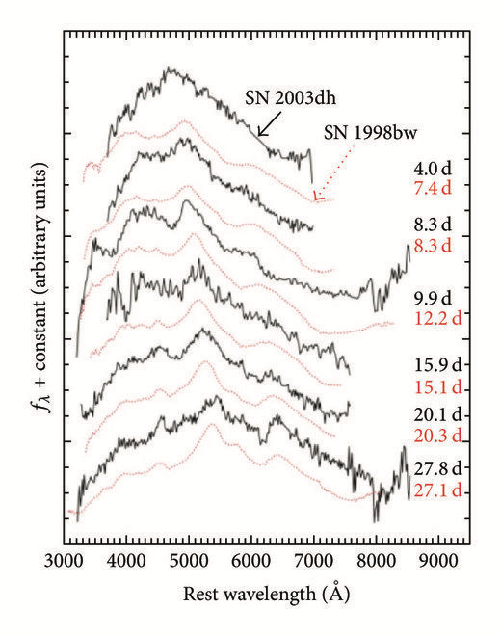
Where were we in 2004?
Long-GRBs:
securing the supernova connection
Short GRBs:
Who knows?
No localisations possible before Swift
Binary neutron stars suggested regularly, but only by exclusion
Mazets 1982, Kouveliotou 1993
Hjorth et al. 2003, Stanek et al. 2003

Slide 4
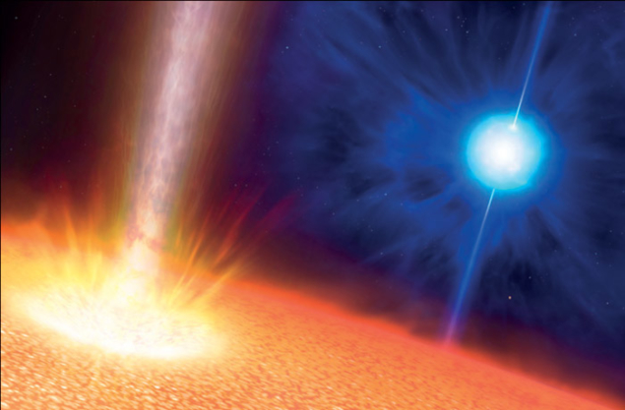
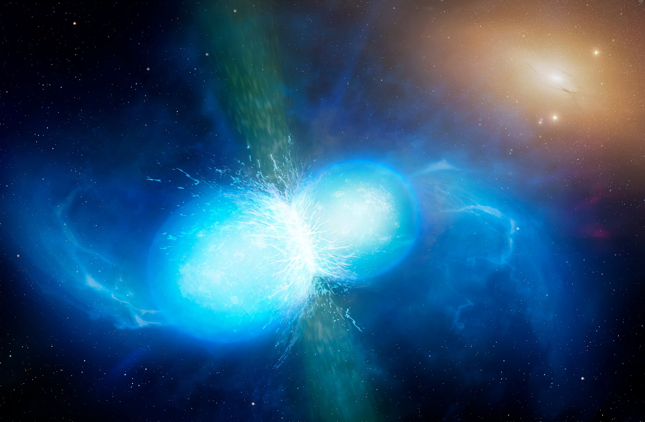
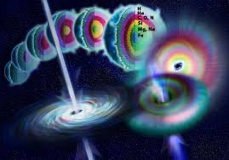
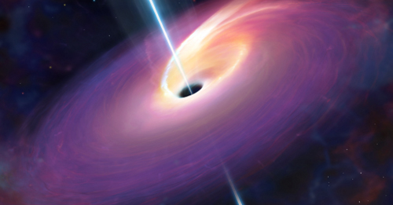
…to where we are today
Complicated, and maybe less wrong
Ultra-longs from
supergiants/envelopes/CSM
Simple, but wrong
Short
?
Substantial ignorance
Short, long, short-longs and long shorts (type I and type II?)
Long
Much of this work was enabled by Swift, and its now much emulated approach to get rapid accurate positions
Some “GRBs” are TDEs?

Slide 5
…to where we are today
Complicated, and maybe less wrong
Ultra-longs from
supergiants/envelopes/CSM
Simple, but wrong
Short
?
Substantial ignorance
Short, long, short-longs and long shorts (type I and type II?)
Long
The picture painted today is rich and varied allowing us to probe the most extreme ways stars end their lives:
How they die? What they did during their lives? What they leave behind? How they enrich the Universe?
+ their role as probes of cosmology and extreme physics.
Some “GRBs” are TDEs?

Slide 6
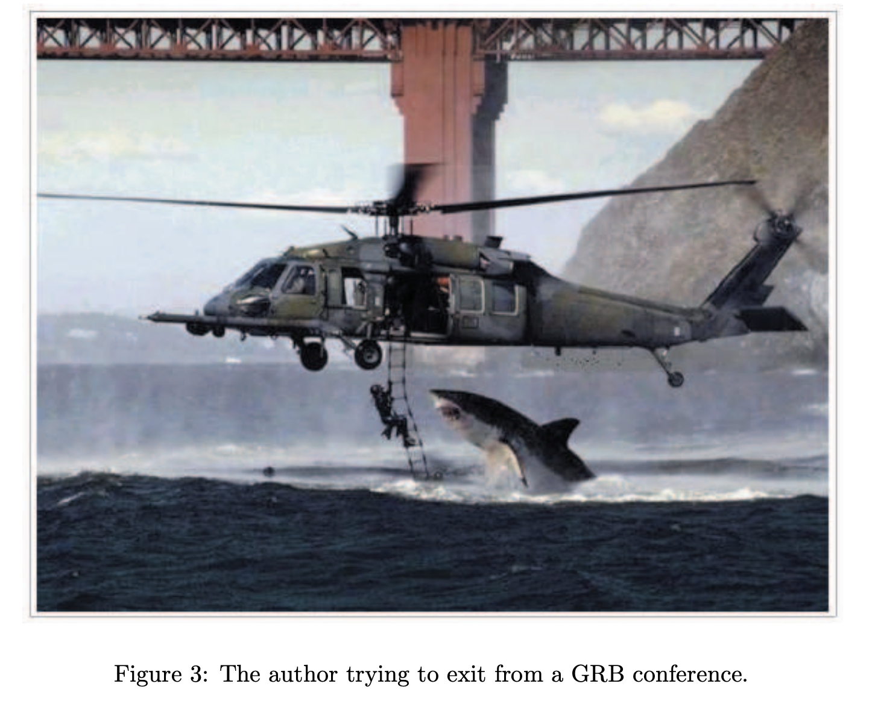
…to where we are today
GRB conference proceeding, early 2000’s

Slide 7
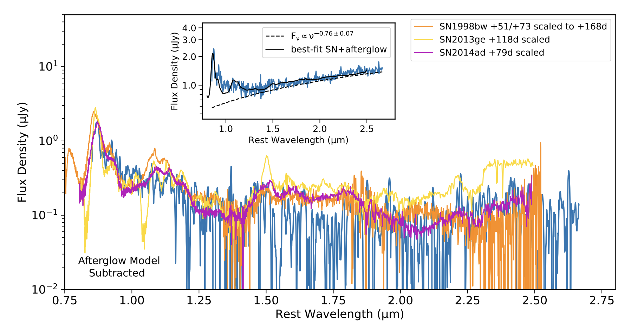
The GRB-supernova connection
Supernova detections across 7 orders of magnitude in isotropic equivalent energy, from GRB 980425 to GRB 221009A (the BOAT)
GRB980425/SN 1998bw
GRB 221009A (JWST)
Galama et al. 1998, Hjorth et al. 2003, Blanchard et al. 2024

Slide 8
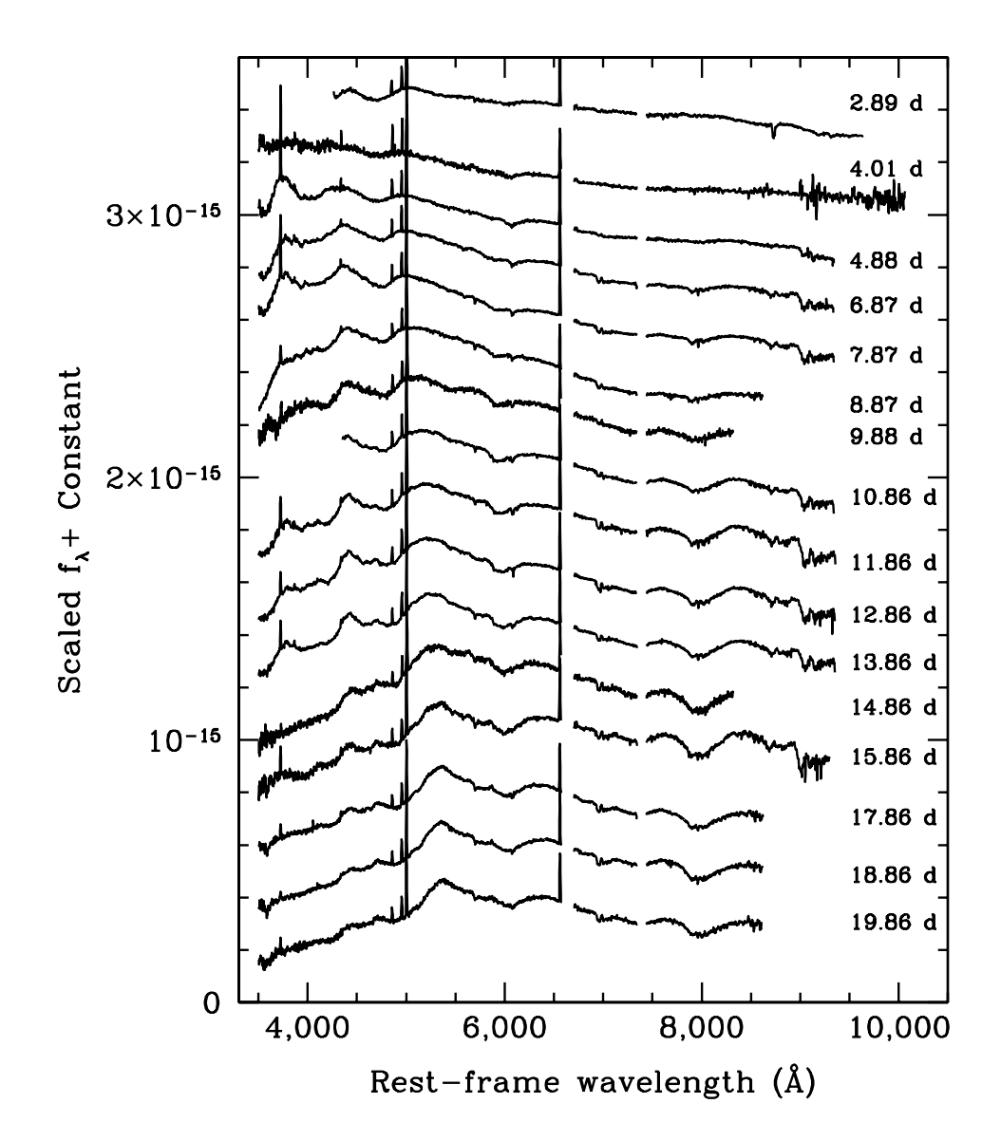
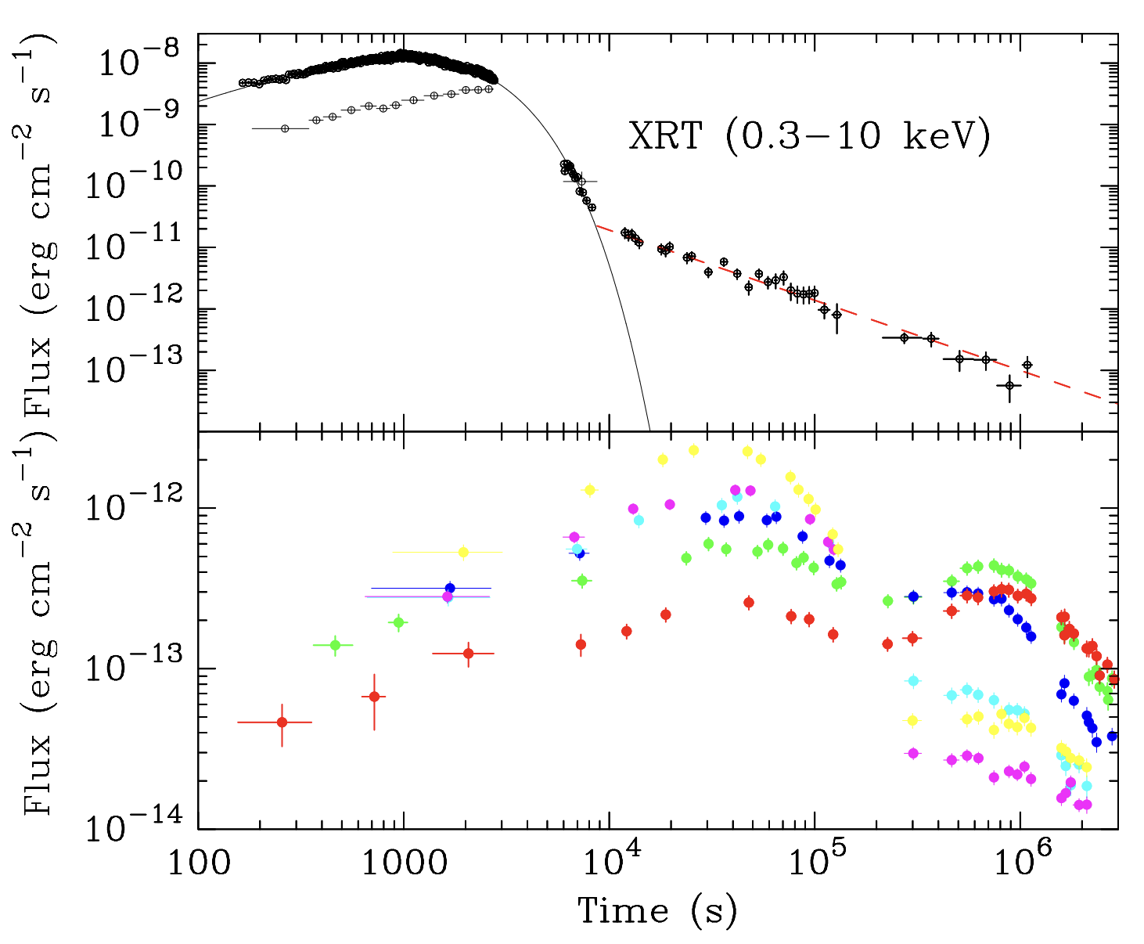
GRB/XRF/FXT supernovae
GRB980425/SN 1998bw
The implication of these observations is that the volumetric rate is dominated by these low luminosity events (see talk by Giancarlo Ghirlanda)
Campana et a. 2006, Pian et al. 2006, Soderberg et al. 2006

Slide 9
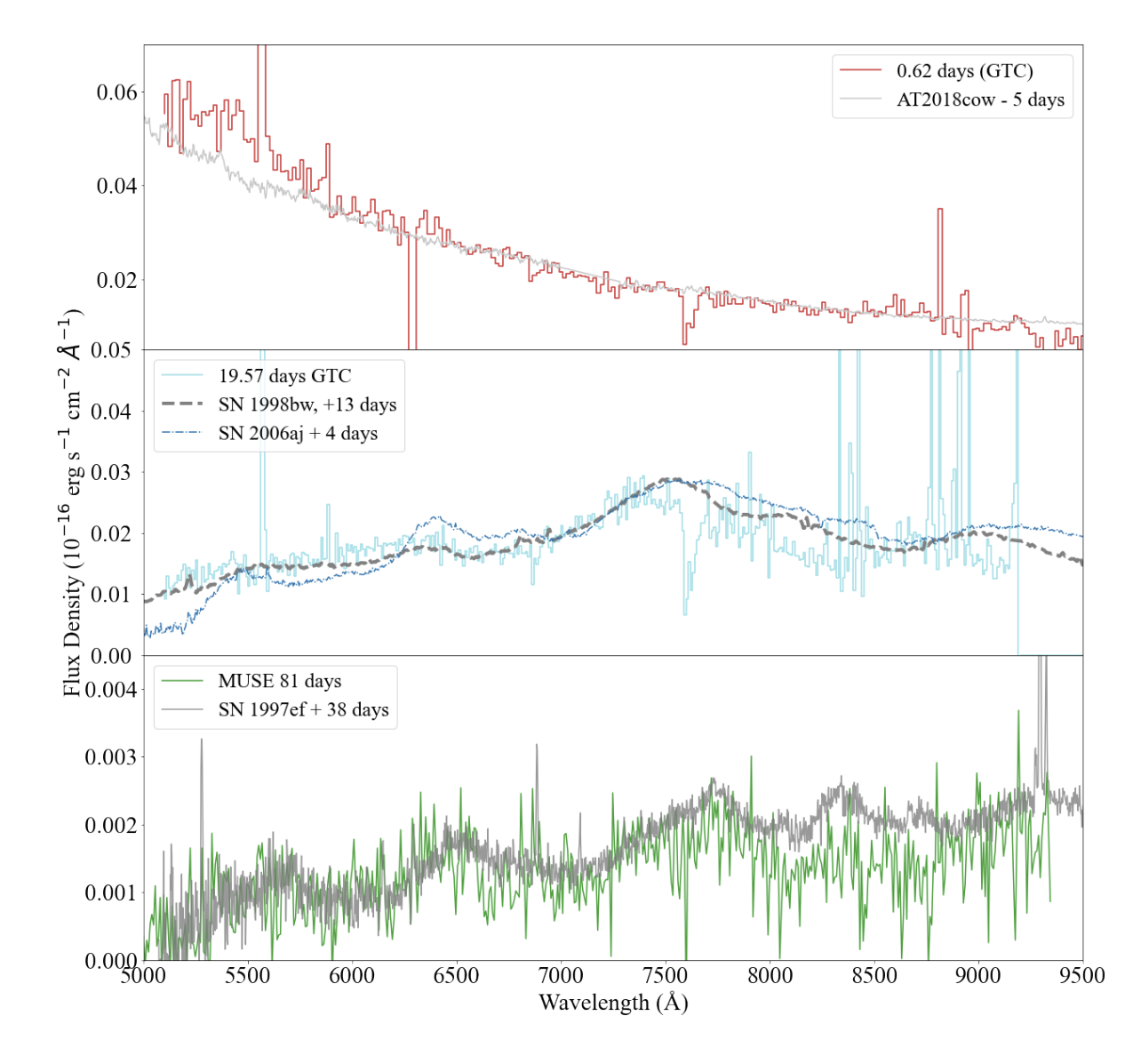
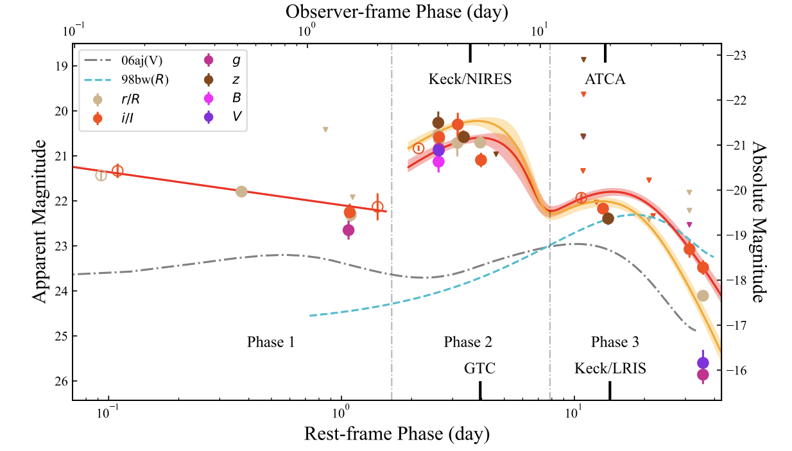
GRB/XRF/FXT
supernovae
GRB980425/SN 1998bw
Enter the Einstein Probe
EP240414a
Sun et al. 2024
van Dalen et al. 2024
See talks by Hui Sun, Weimin Yuan and Peter Jonker

Slide 10
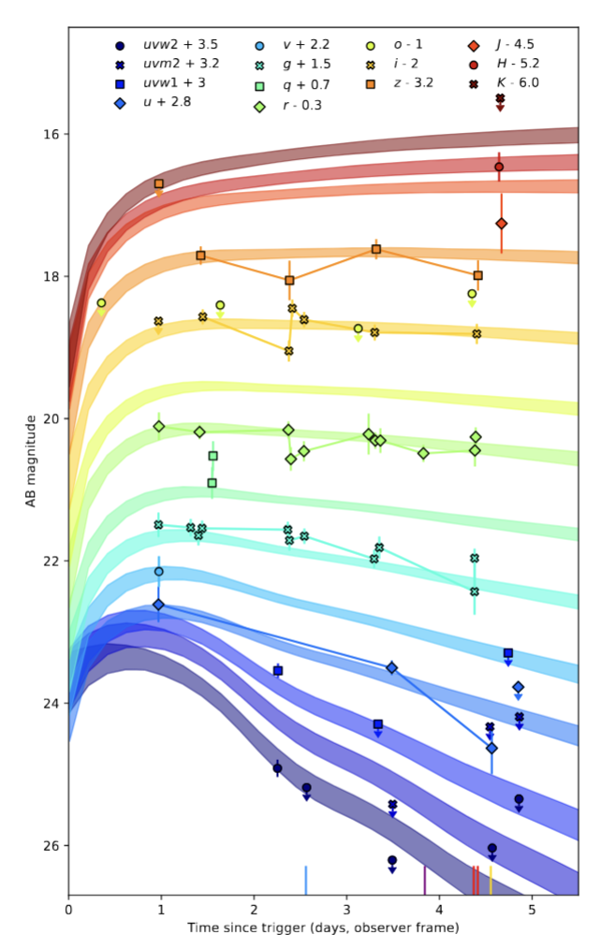
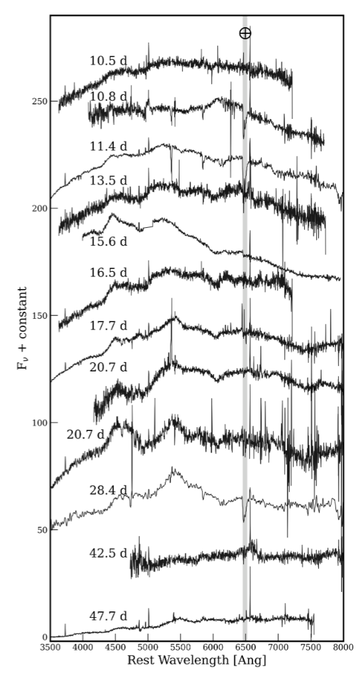
GRB/XRF/FXT
supernovae
GRB980425/SN 1998bw
Enter the Einstein Probe
EP250108a (z=0.17)
Eyles-Ferris et al. in prep, Rastinejad et al. in prep.

Slide 11
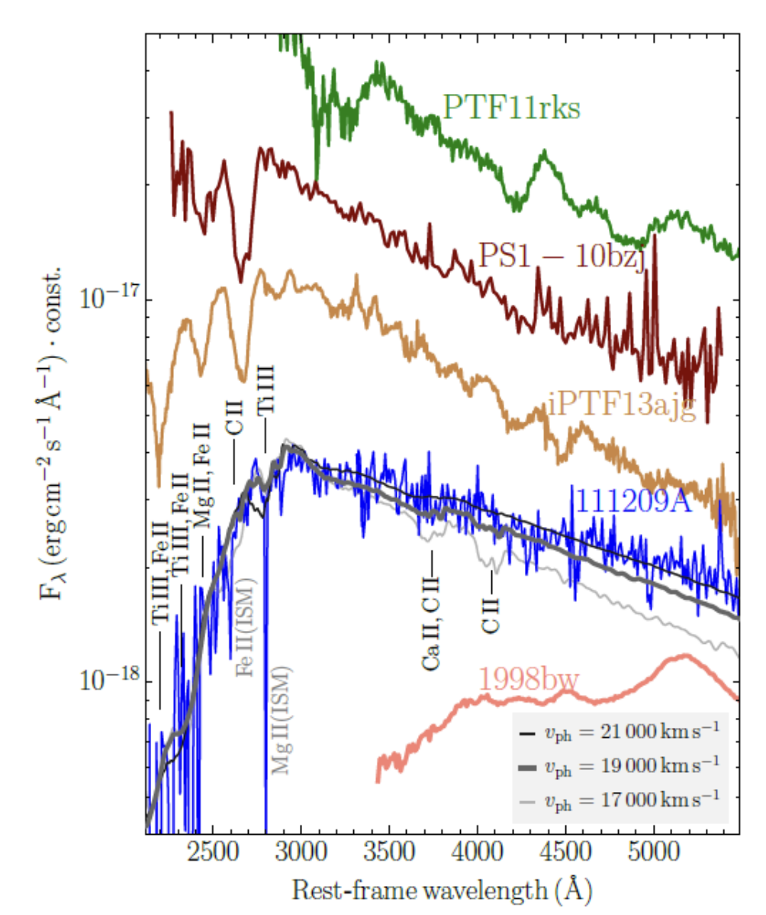
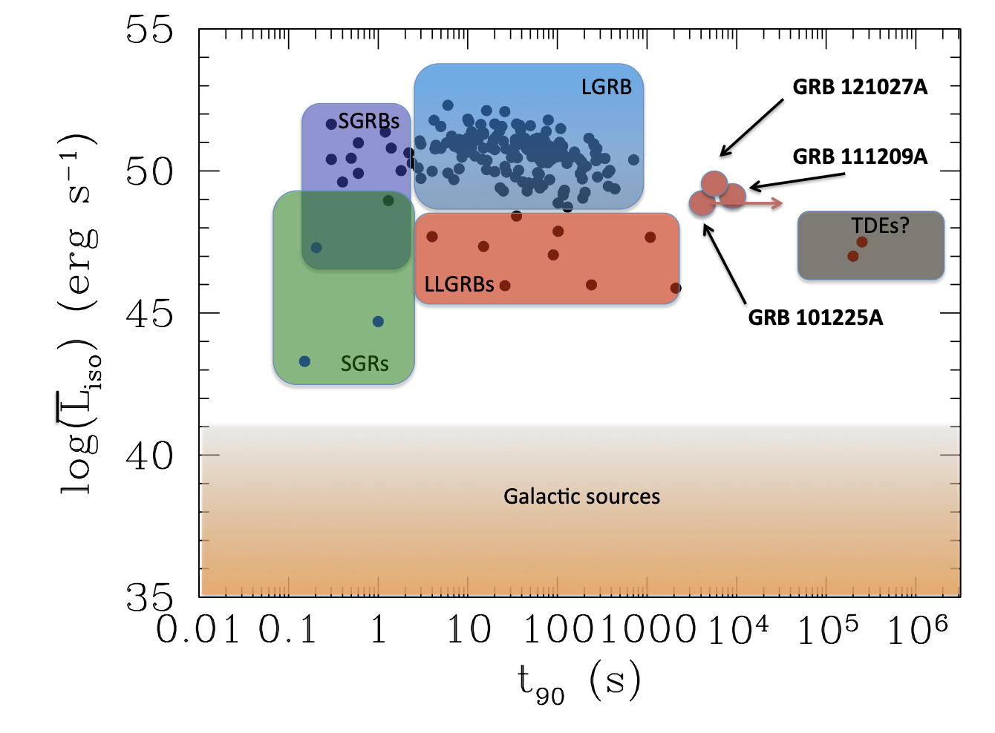
….but with some outliers: I: Ultra-long GRBs
Magnetars? (see also talks by Brian Metzger, Binbin Zhang)
Levan et al. 2014, Greiner et al. 2015

Slide 12
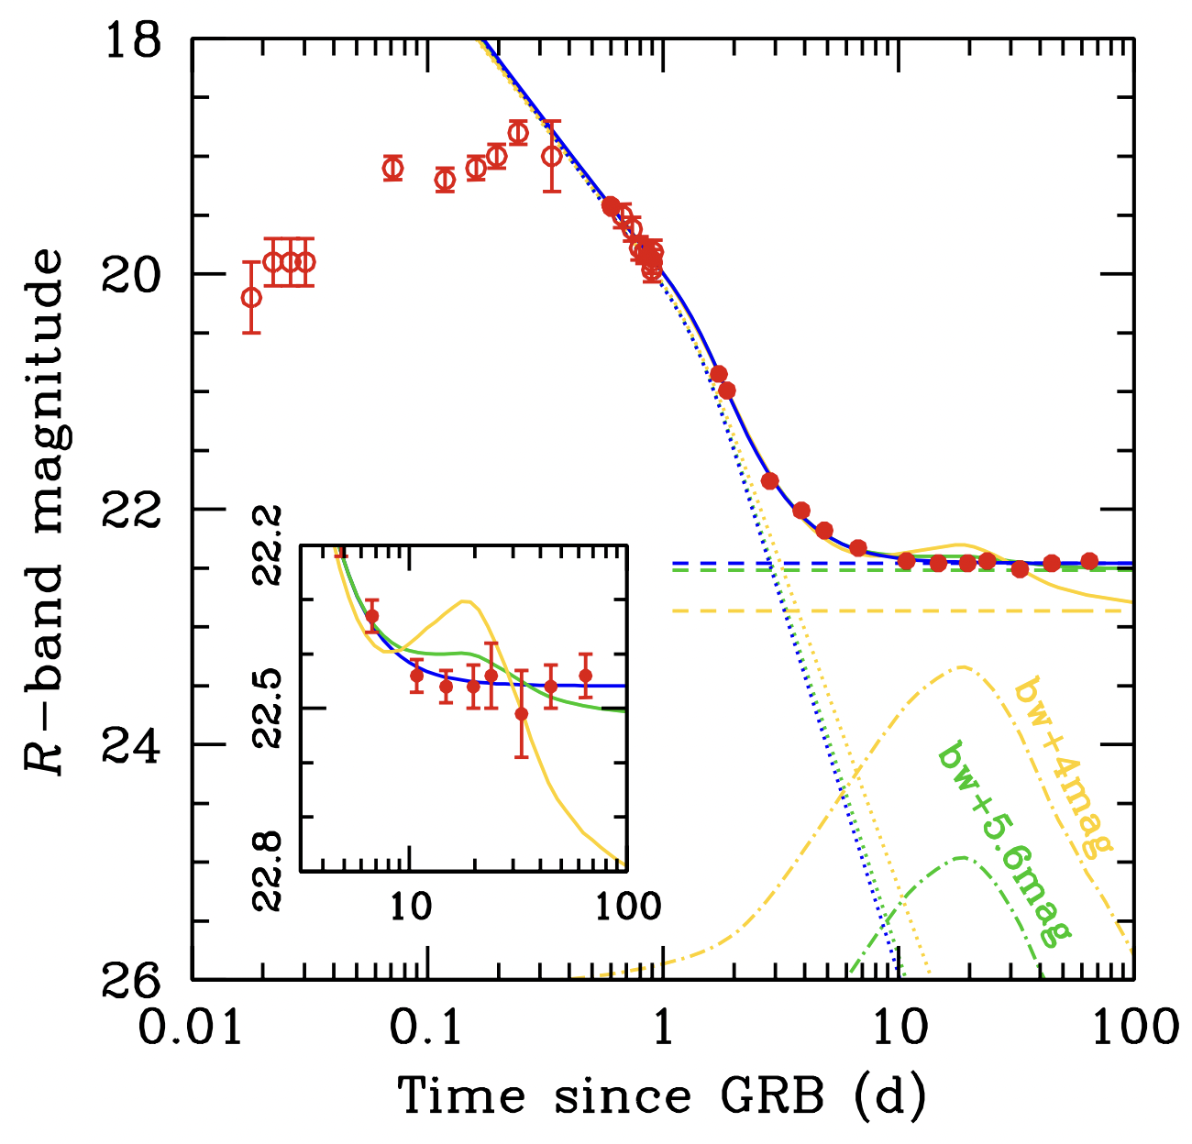
….but with some outliers: II: Supernova-less long GRBs
Fynbo et al. 2006, Gal-Yam et al. 2006, Della Valle et al. 2006, Gehrels et al. 2006

Slide 13
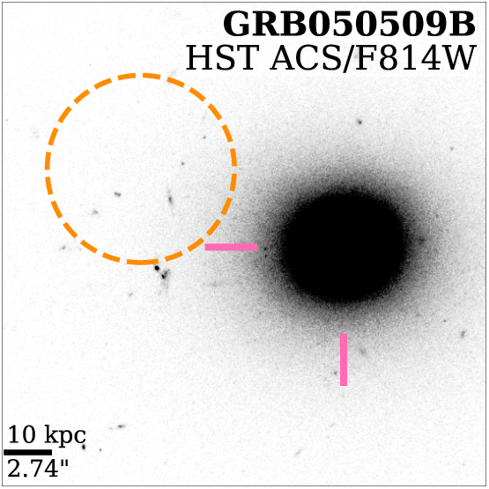
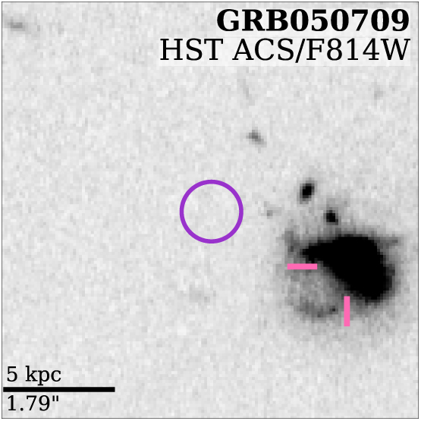
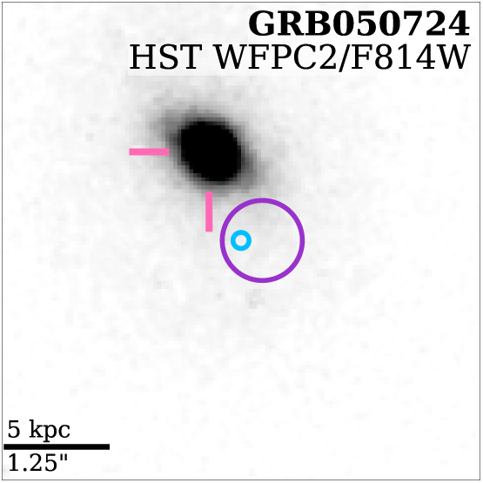
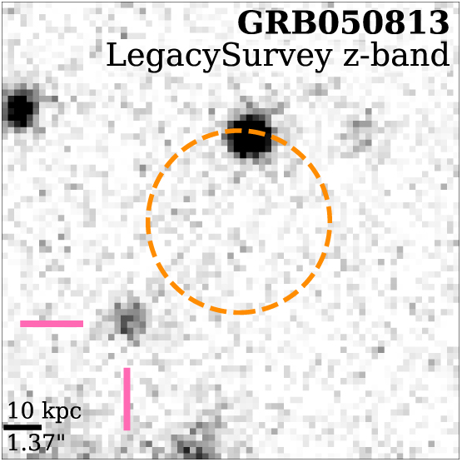
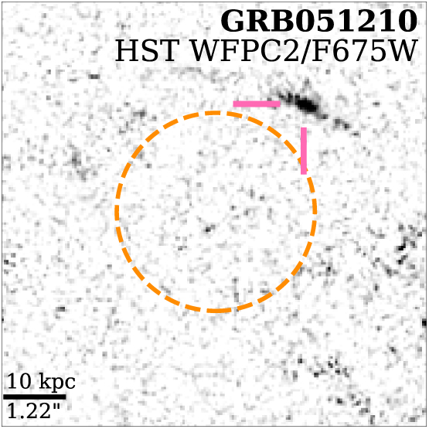
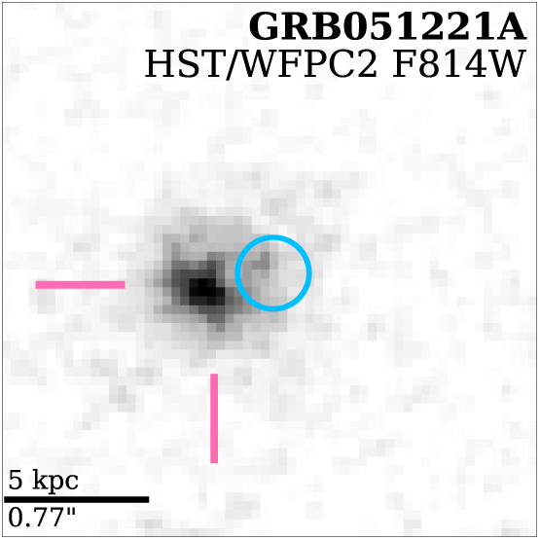
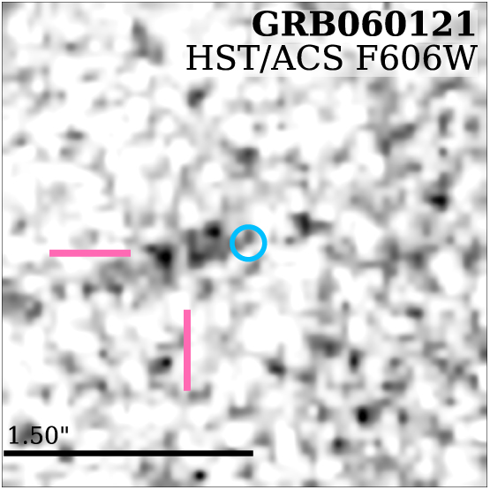
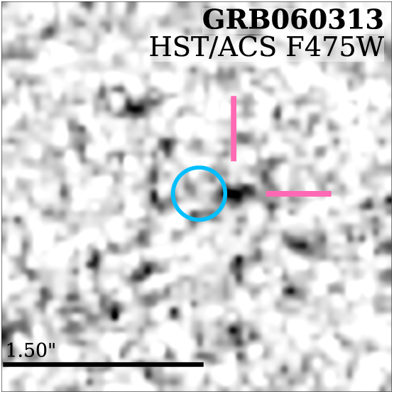
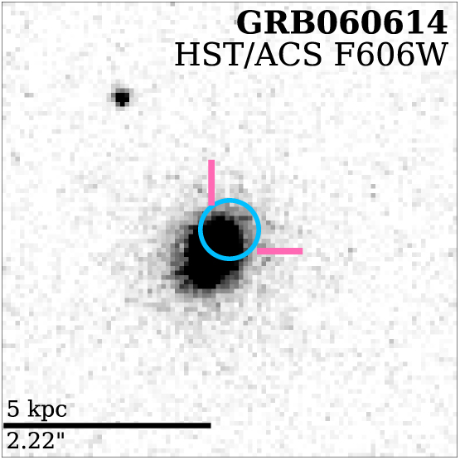
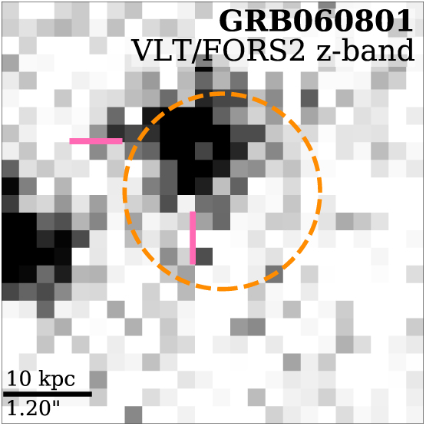
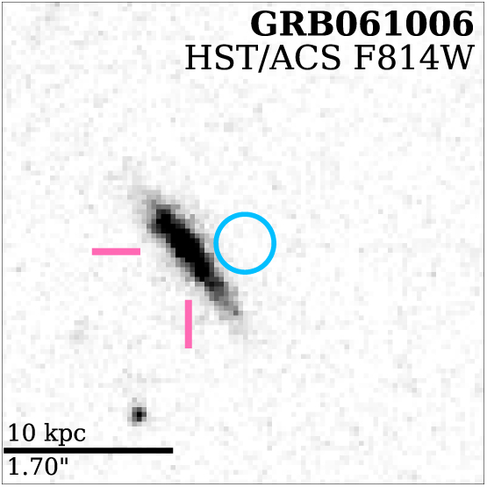
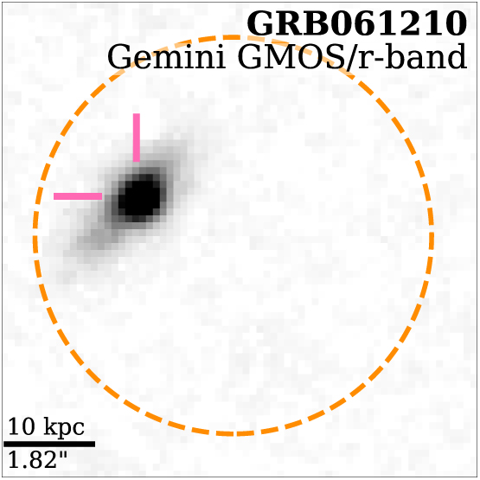
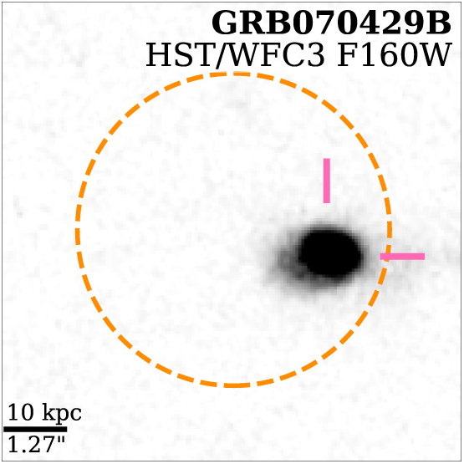
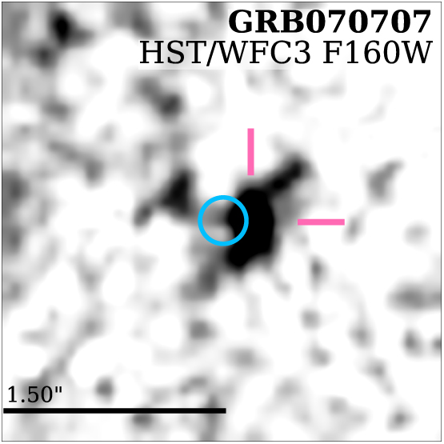
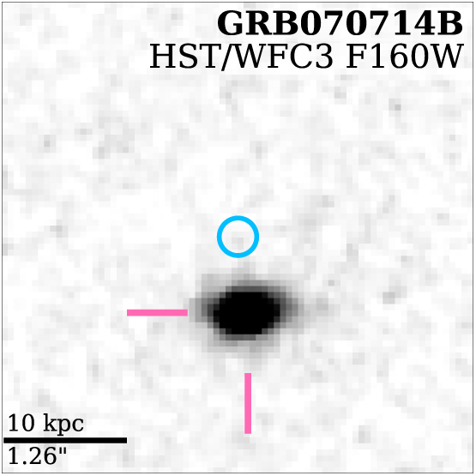
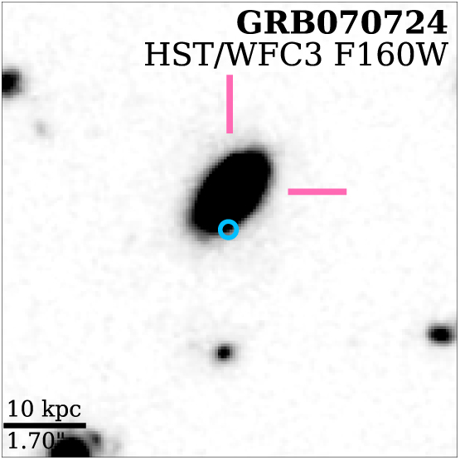
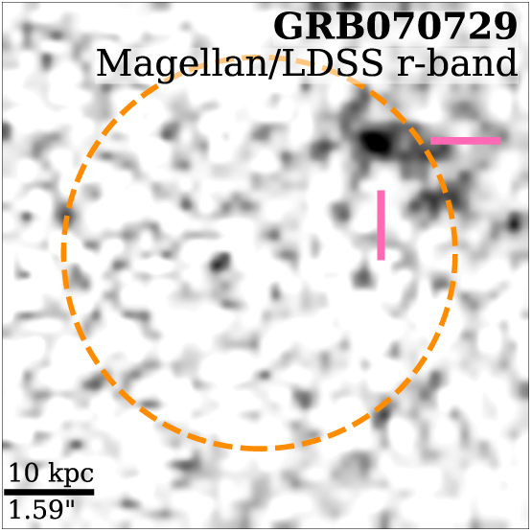
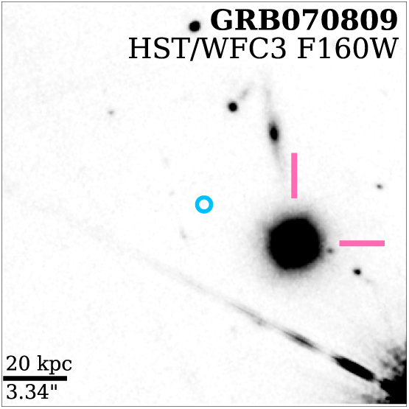
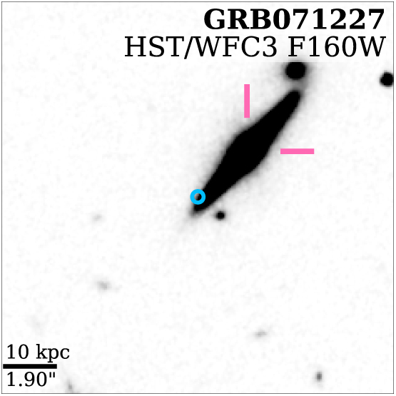
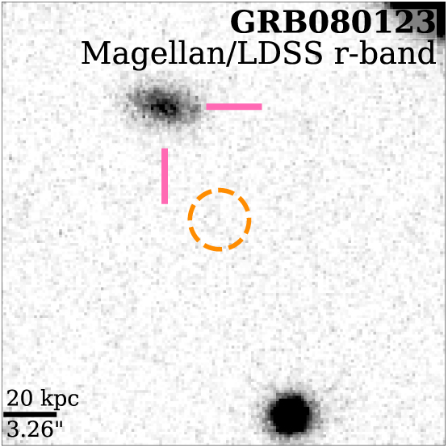
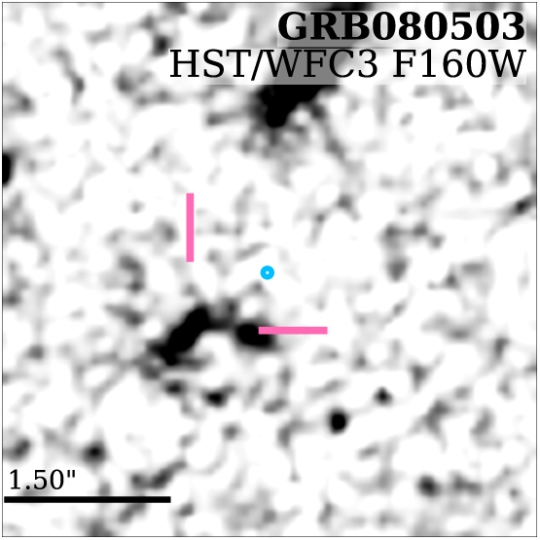
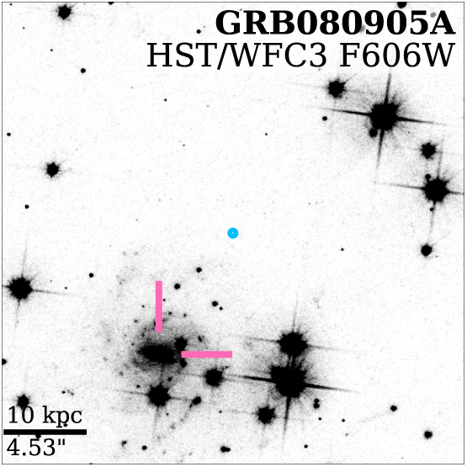
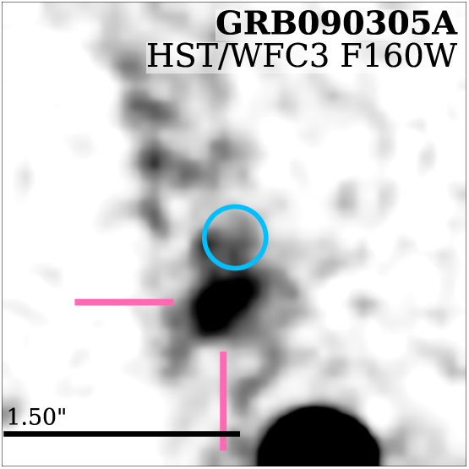
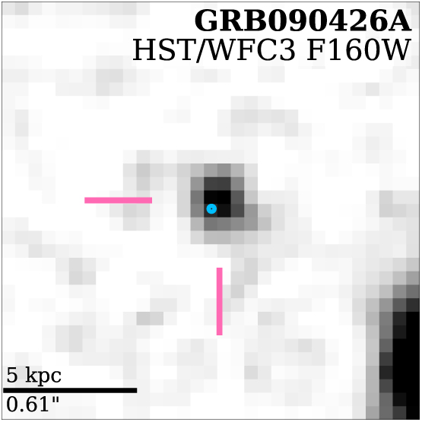
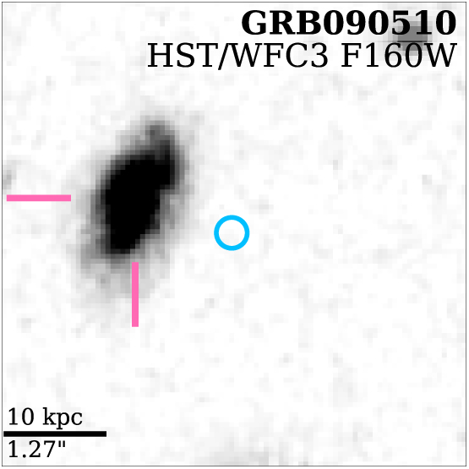

































































Short GRB progenitors – host galaxies and locations
Fong et al. 2022, Nugent et al. 2022
See also talks by Matteo Ferro and Anya Nugent

Slide 14


Short GRB progenitors – kilonovae
GRB 050509B
Li & Paczynski 1998, Bloom et al. 2005, Perley et al. 2008, Metzger & Berger 2012, Barnes & Kasen 2013

Slide 15
Short GRB progenitors – kilonovae
Tanvir et al. 2013, Berger et al. 2013

Slide 16

Short GRB progenitors – kilonovae
Tanvir et al. 2013, Berger et al. 2013

Slide 17


Short GRB progenitors secured
Levan et al. 2017, Tanvir et al. 2017
Abbott et al. 2017
See talks by Paolo D’Avanzo and Samuele Rochini

Slide 18
Short GRB progenitors secured
LVC et al. 2017 ApJL
See also:
Arcavi et al. 2017, Cowperthwaite et al. 2017, Chornock et al. 2017, Coulter et al. 2017, Drout et al. 2017 Nicholl et al. 2017, Haggard et al. 2017, Hallinan et al. 2017, Kasliwal et al. 2017, Levan et al. 2017, Lipunov et al. 2017, Margutti et al. 2017, Smartt et al. 2017, Soares-Santos et al. 2017, Tanvir et al. 2017, Troja et al. 2017, Valenti et al. 2017

Slide 19


The kilonova sample is dominated by gamma-ray bursts
Gravitational waves: 1
Wide field surveys: 0
Gamma-ray bursts: ~10
Rossi et al. 2020
Gompertz et al. 2018
See Jillian Rastinejad talk

Slide 20


The kilonova sample is dominated by gamma-ray bursts
Gravitational waves: 1
Wide field surveys: 0
Gamma-ray bursts: ~10
Ascenzi et al. 2019
Rastinejad et al. 2024
See Jillian Rastinejad talk

Slide 21


Right? Wrong? Something in between?
Short GRBs
Compact object mergers
Kilonovae
Long GRBs
Collapsing Massive stars
Supernovae

Slide 22


Short GRB progenitor outliers also exist
GRB 200826A
Zhang et al. 2021, Rossi et al. 2021

Slide 23


“Normal” long GRBs?
GRB 230307A
GRB 230307A
Rastinejad et al. 2022, Troja et al. 2022, Yang et al. 2022, Mei et al. 2022, Dicchiara et al. 2023, Levan et al. 2024 Yang et al. 2024, Sun et al. 2024, Gillanders et al. 2025

Slide 24


GRB 211211A
Long duration gamma-ray bursts can form kilonovae ➔ merging compact objects
Rastinejad et al. 2022, Troja et al. 2022, Yang et al. 2022

Slide 25


GRB 230307A
second brightest GRB of all time
Levan et al. 2024

Slide 26

GRB 230307A
Levan et al. 2024; Gillanders et al. 2025

Slide 27


GRB 19109A
(T₉₀ = 65s, no short spike, no supernova (<0.05 SN 1998bw)
Is GRB 191019A the first example of dynamical merger? Is it in an AGN disc?
Now with a kilonova detection, see Andrea Rossi talk
Levan et al. 2023,Lazzati et al. 2023, Stratta et al. 2024

Slide 28

A substantial fraction of the local Swift long-GRBs have little evidence for SNe.
How do we map the properties of a burst to the properties of a progenitor?
What does the dichotomy in duration actually tell us?
See Also Ashley Chrimes talk

Slide 29

What happens for very soft bursts, or very long bursts?

Slide 30
What drives the observed diversity we see in high energy transient properties?
Progenitors
Central Engines
Jets & angles
Environments
Can we ultimately track back from a given high energy transient to all of these properties? What do they tell us about stellar death?

